Slide 1
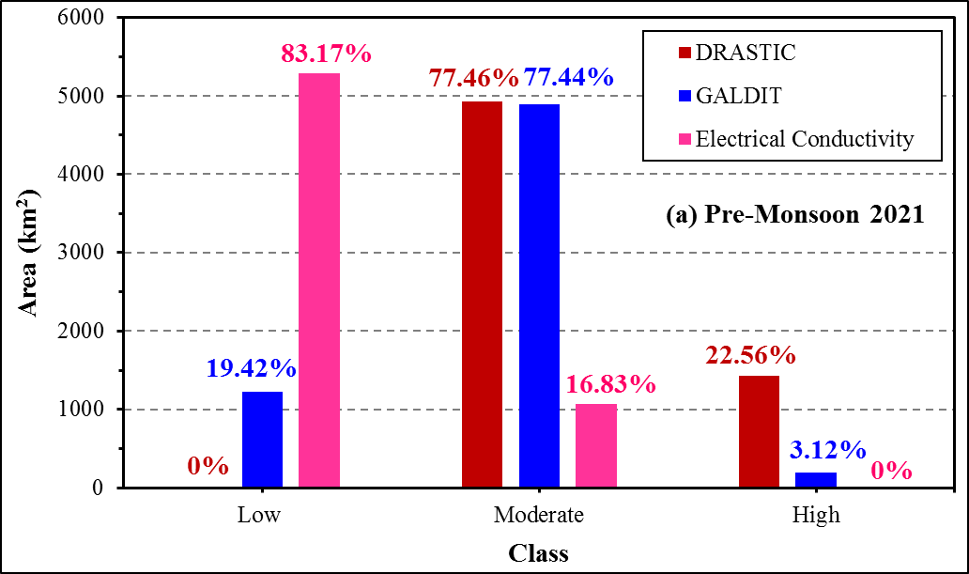
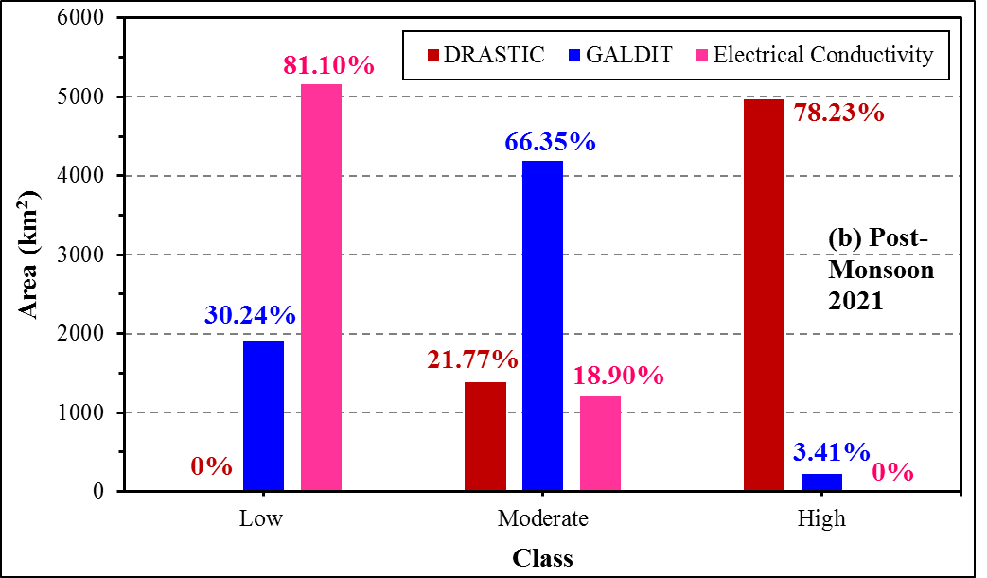
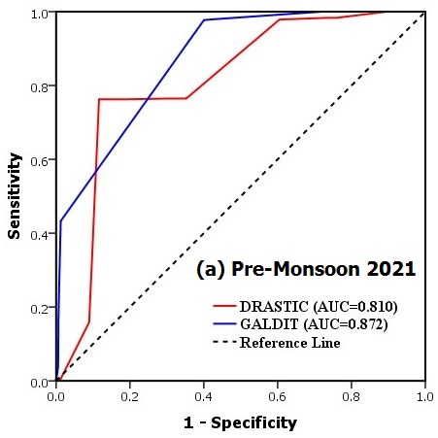
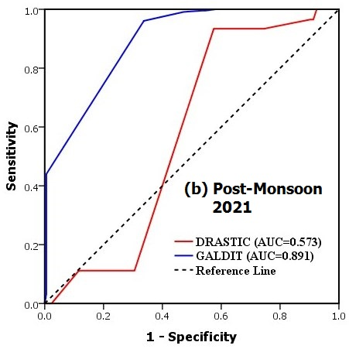
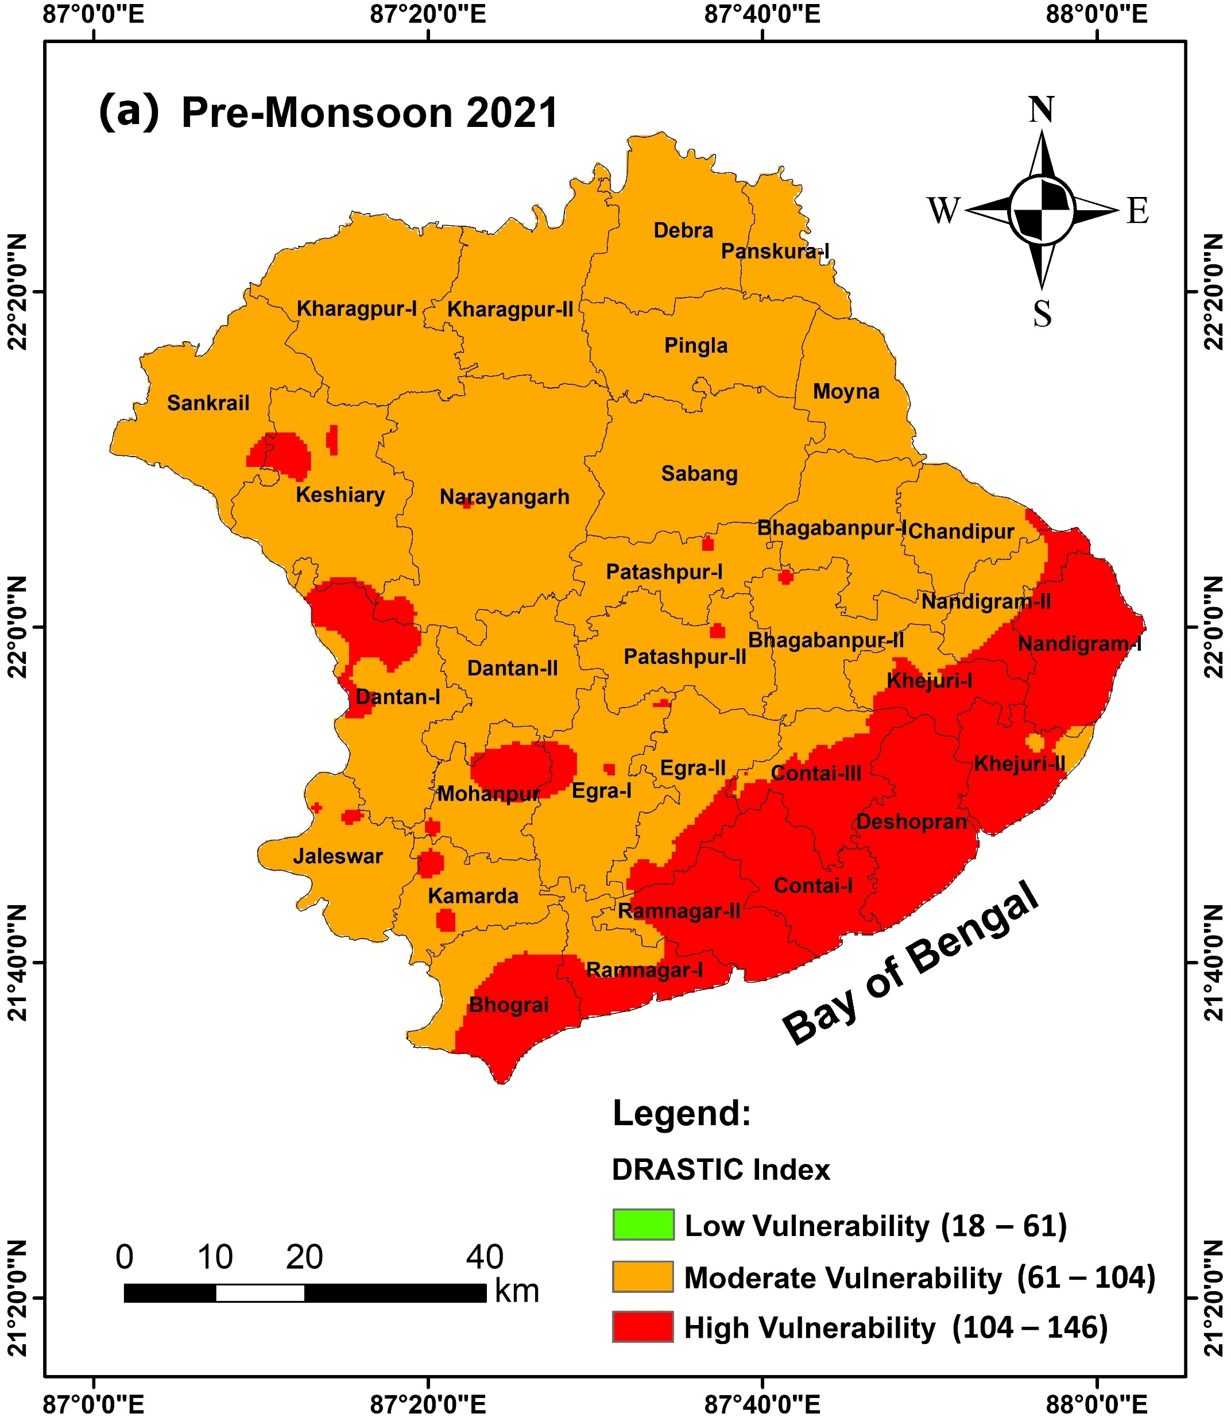
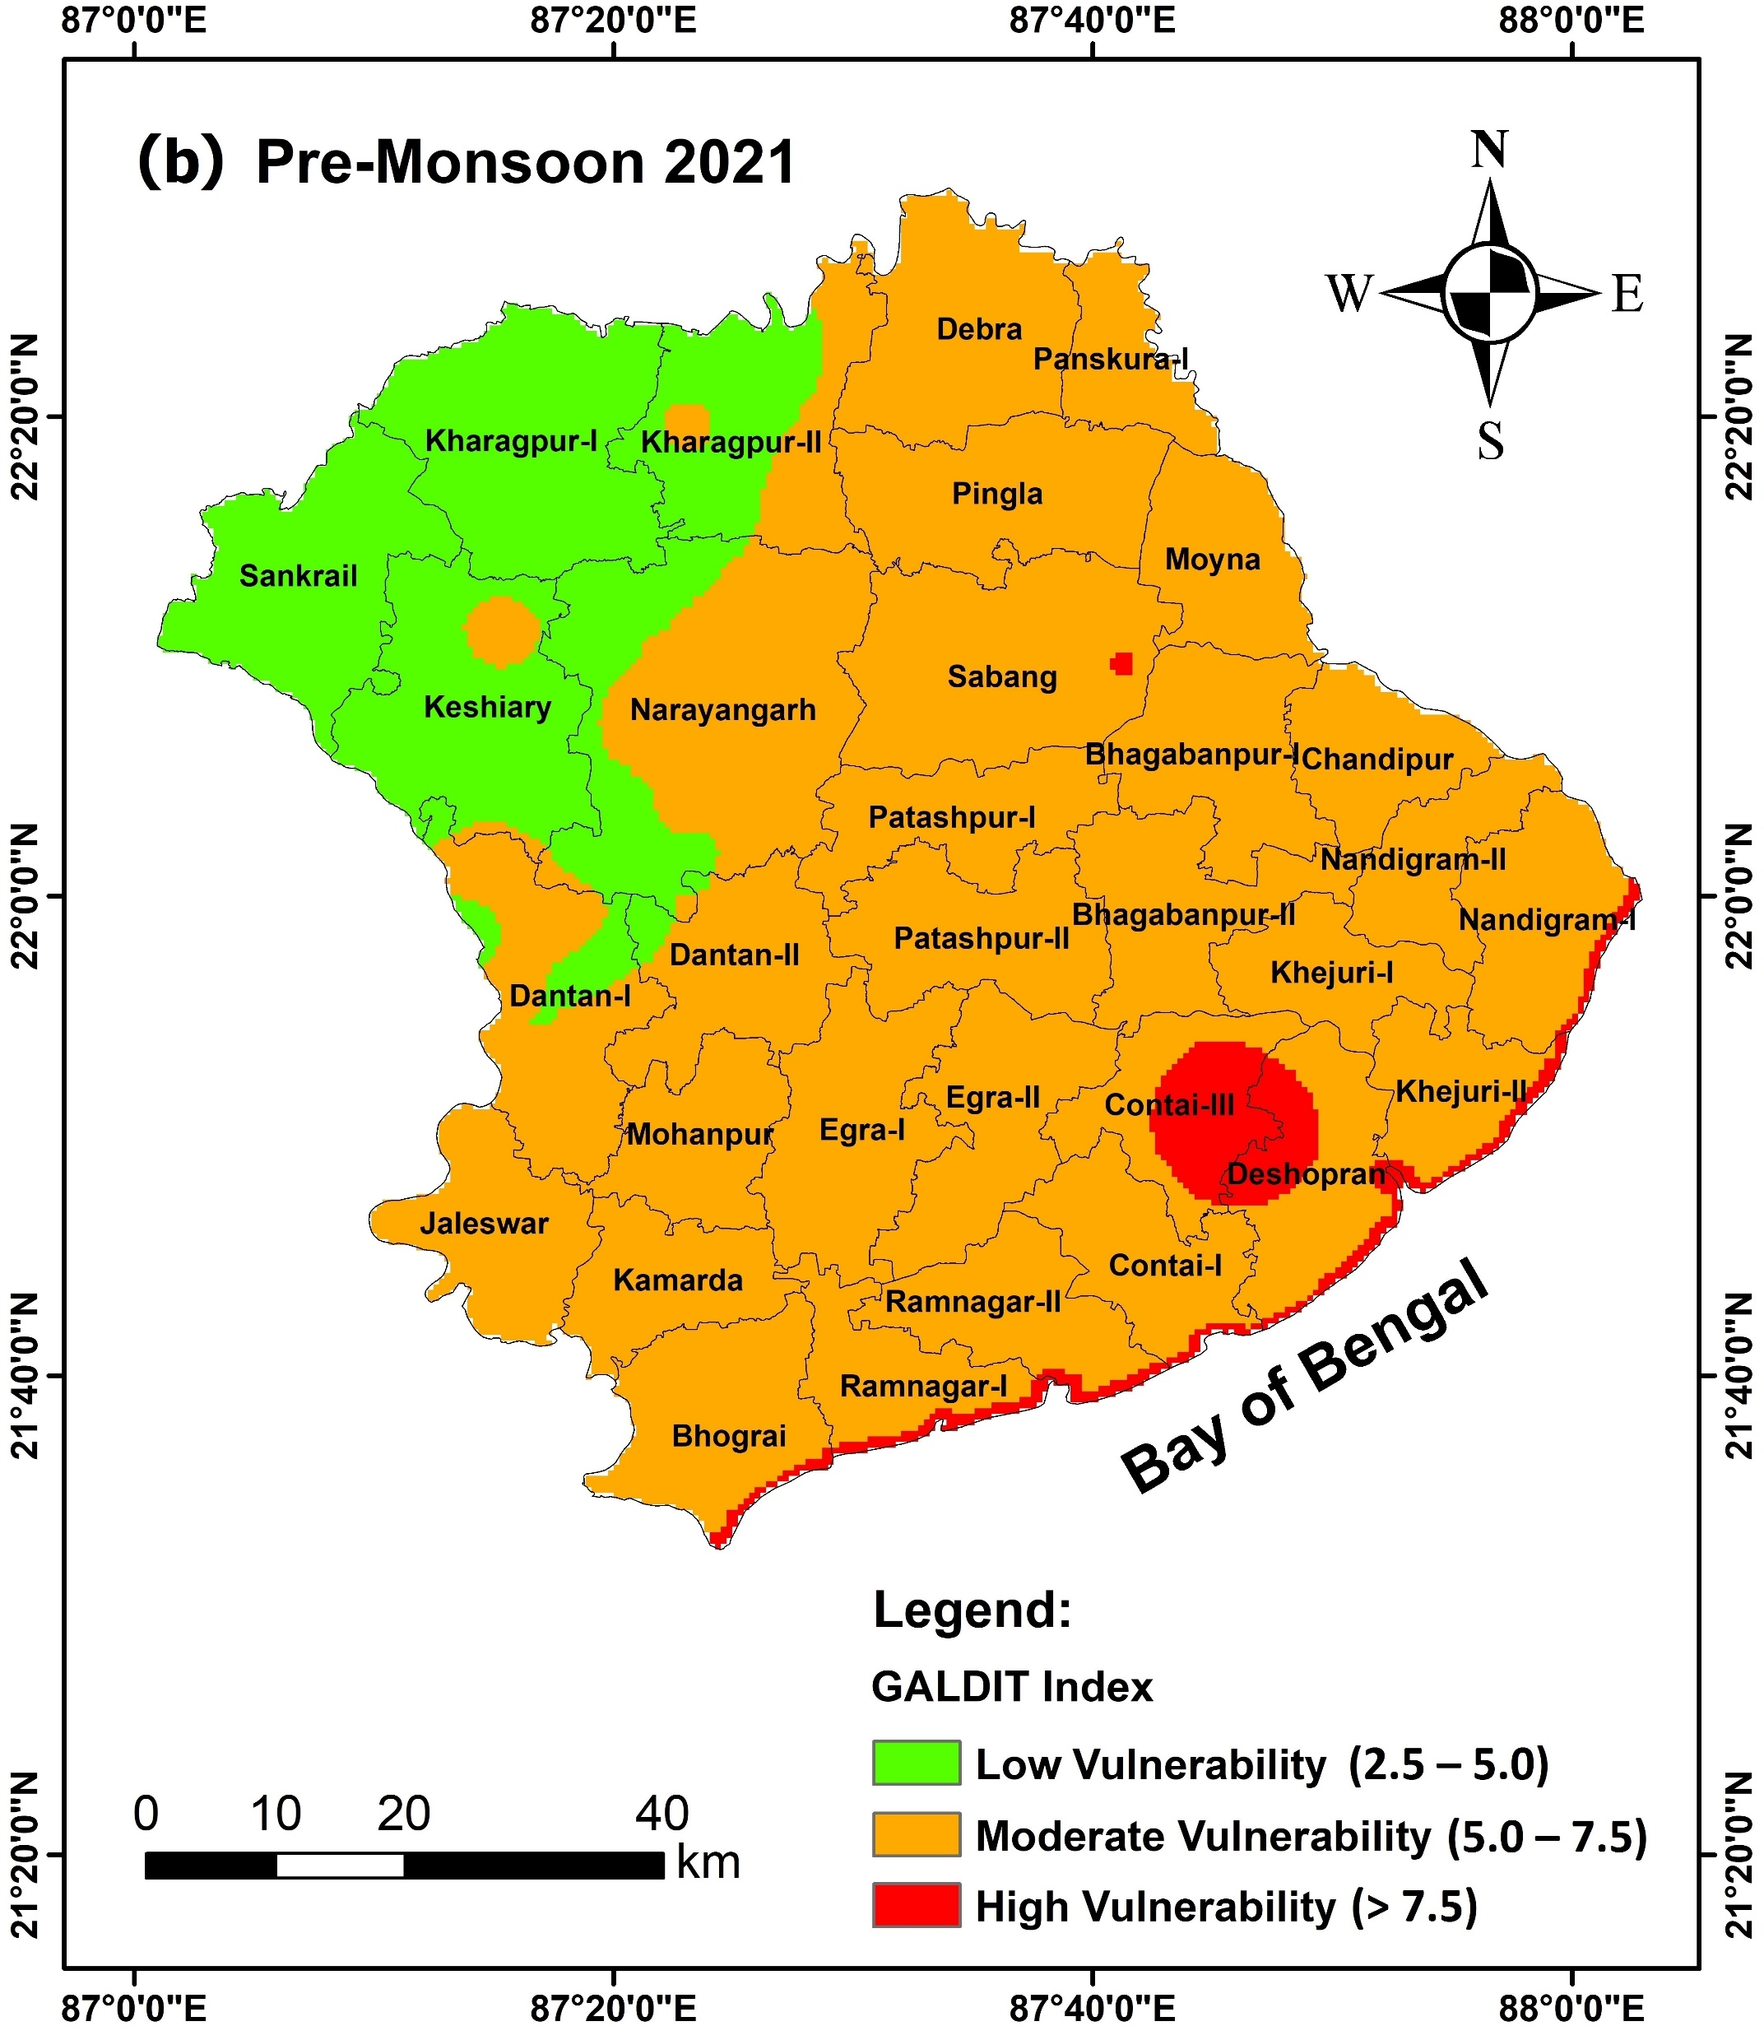
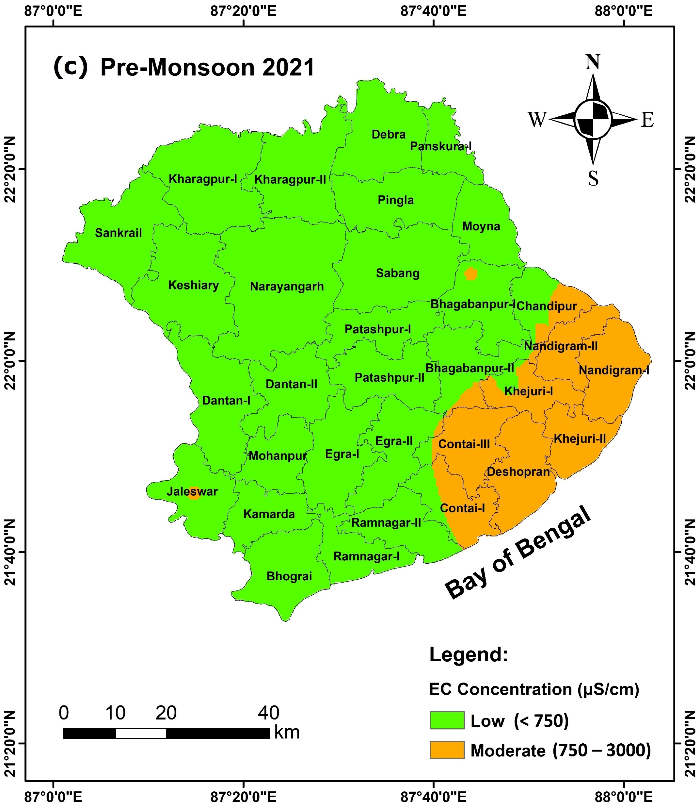
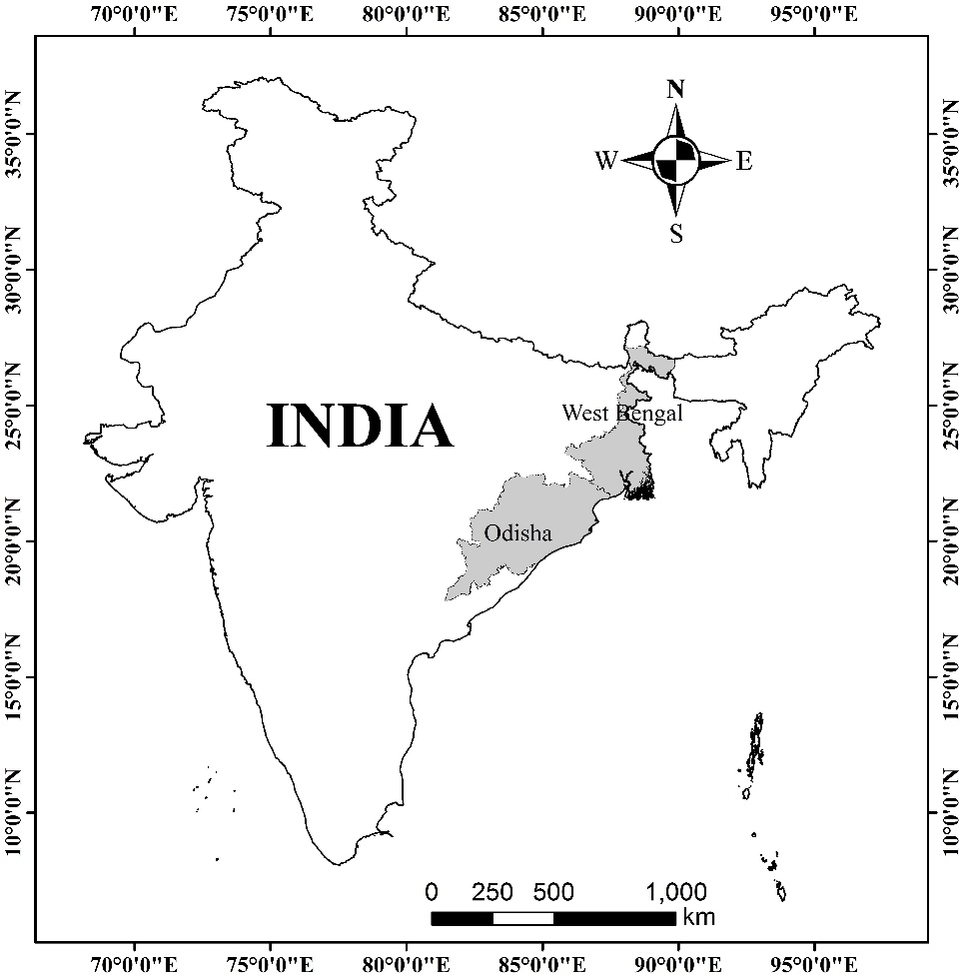
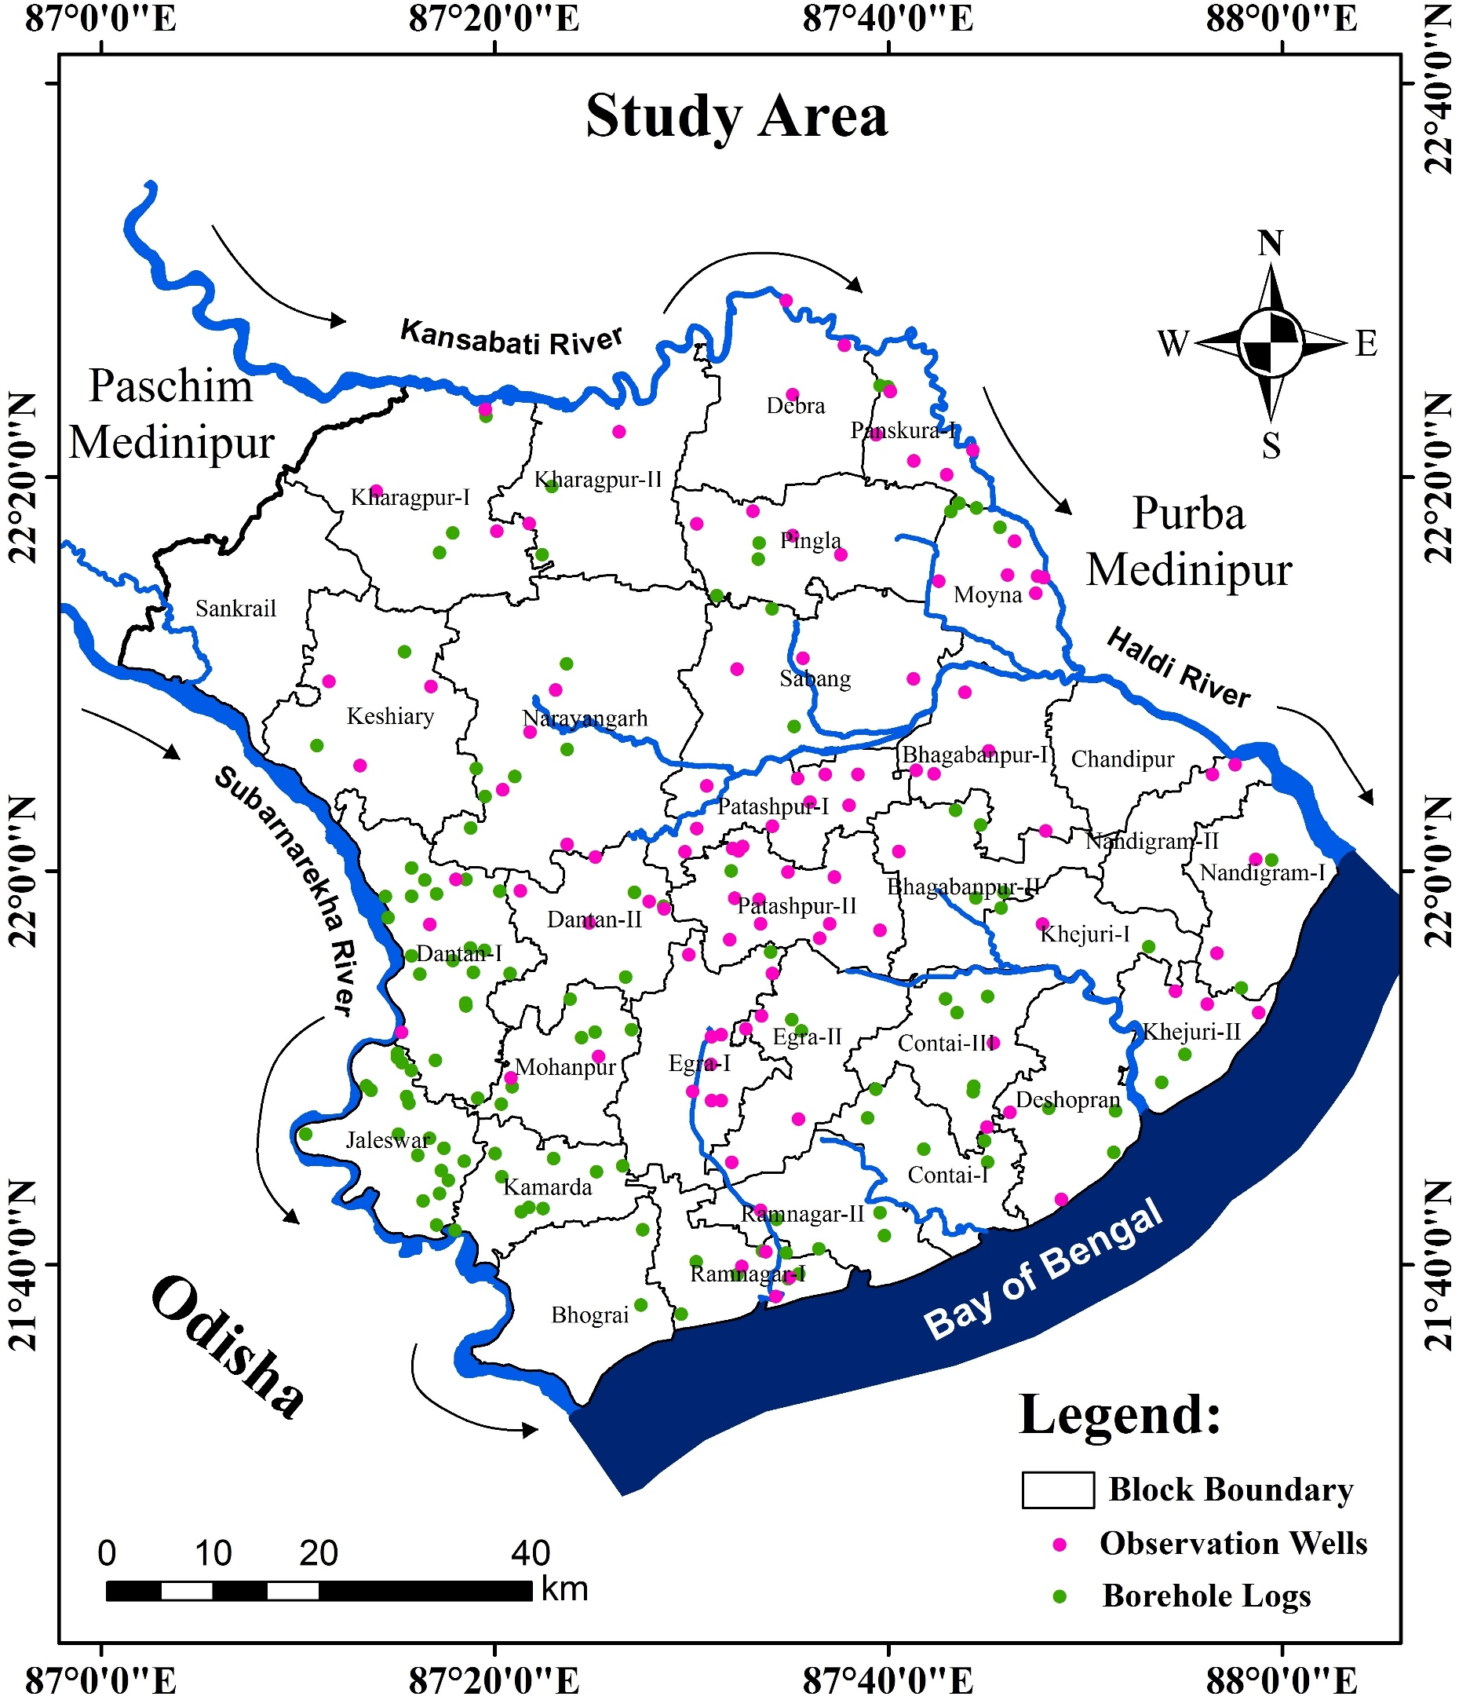
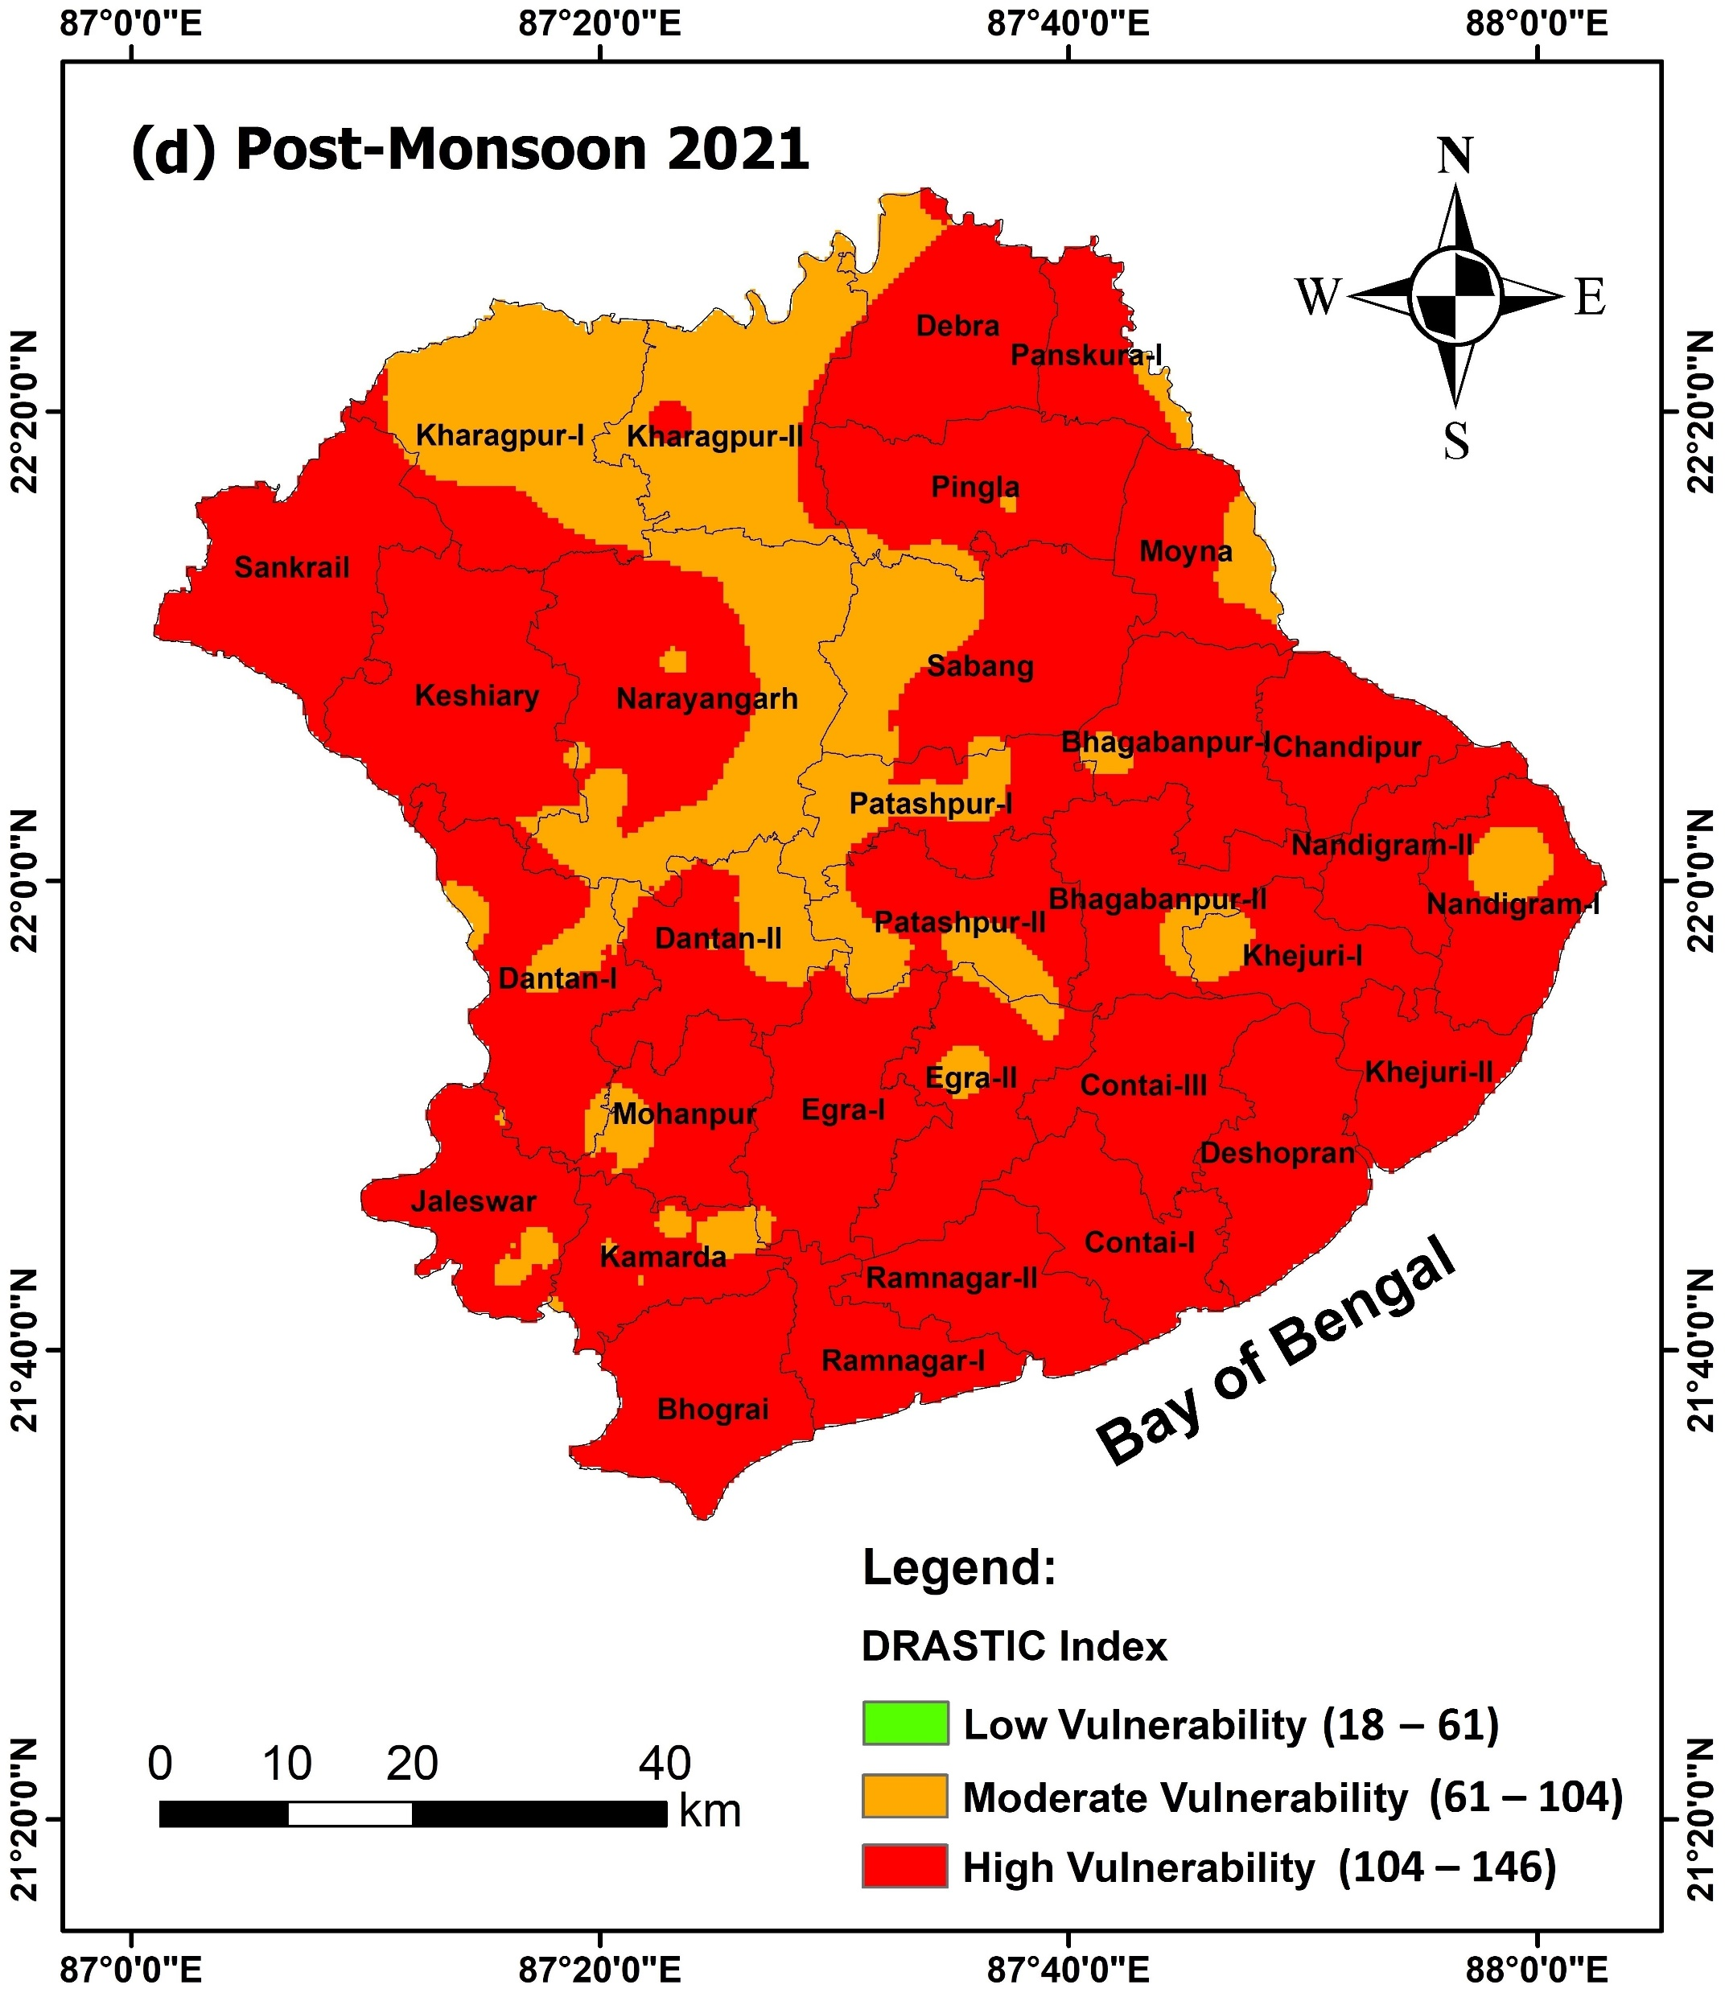
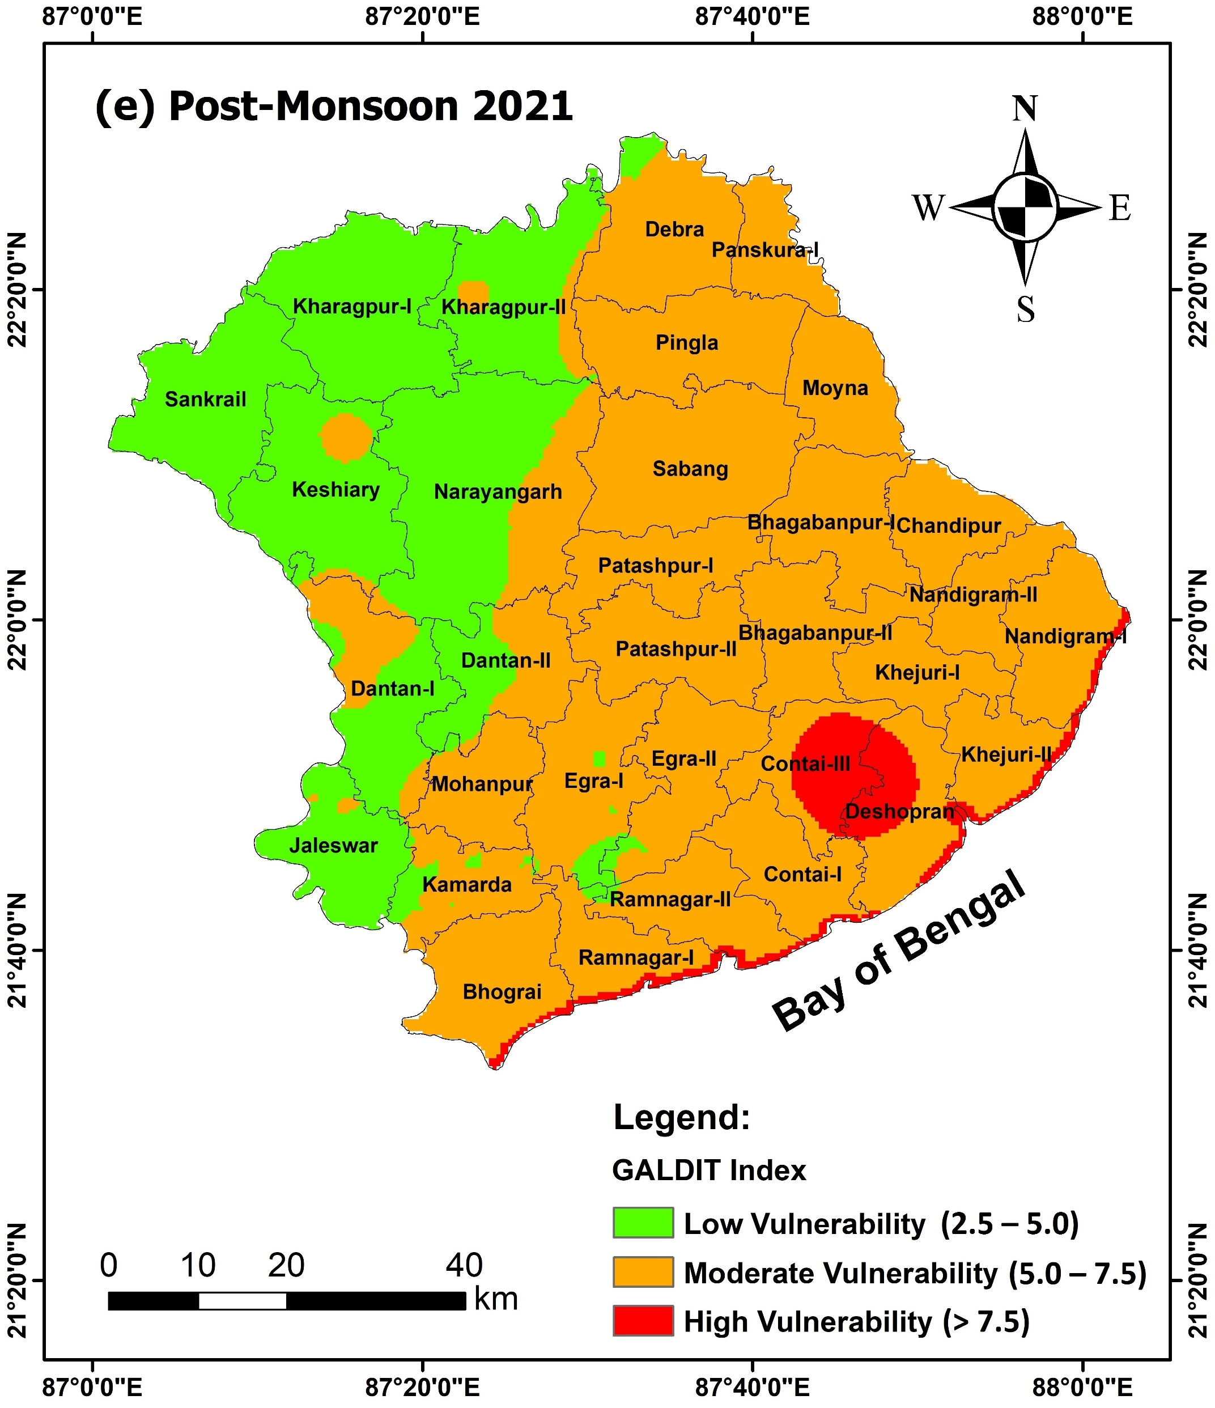
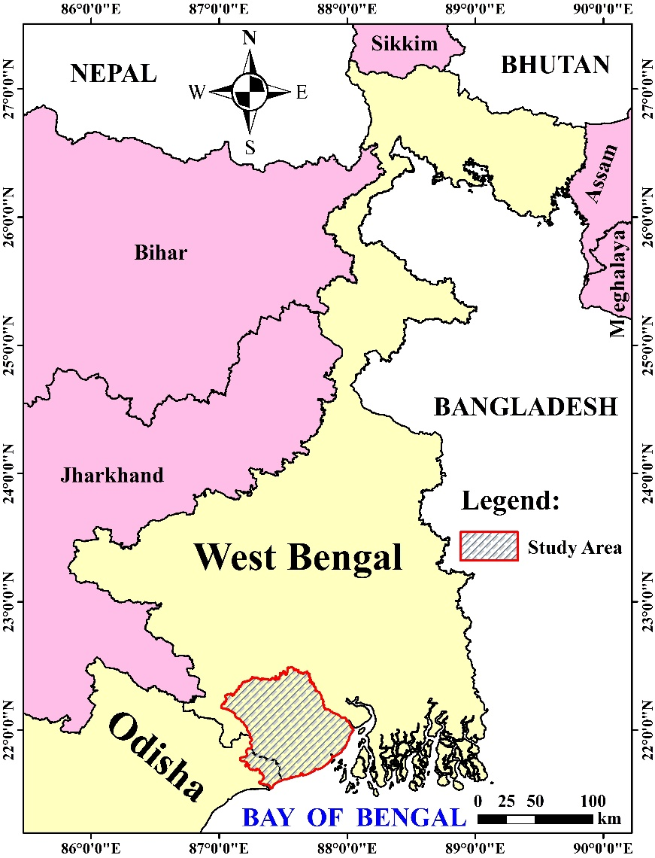
.
Evaluation of Index-Based Methods for Analyzing Seawater Intrusion Vulnerability in a Coastal Alluvial Aquifer of Eastern India
Subhankar Ghosh, Madan Kumar Jha and Vimlendra Mani Pandey
Agricultural and Food Engineering Department, Indian Institute of Technology Kharagpur, West Bengal–721302, India
Background and Motivation
DRASTIC Method
(Aller et al., 1985)
GALDIT Method
(Chachadi et al., 2003)
Table 1. Data used in this study
Groundwater contamination is becoming a major concern in the coastal regions worldwide, due to the threat of seawater intrusion; thus, necessitating proper assessment, suitable planning and management measures for mitigation.
Analyzing aquifer vulnerability to seawater intrusion using index-based techniques is an effective method for delineating and prioritizing zones vulnerable to contamination.
Depth to Groundwater Level (D)
Groundwater Occurrence (G)
Sl. No. | Data Type | Data Interval | Data Period / Sites / Resolution | Data Source
1 | Rainfall | Daily | 2021 (25 stations) | IMD
2 | Soil Texture | – | (1 km×1 km) | FAO (HWSD v2.0)
3 | SRTM Digital Elevation Model (DEM) Raster | – | 2014 (30m×30m) | https://earthexplorer.usgs.gov/
4 | Groundwater-Level Data of the ‘Leaky Confined Aquifer’ | April, November | 2021 (108 sites) | CGWB, GWS&I, WRIDD
5 | Groundwater-Quality Data (EC, Clˉ and HCO₃ˉ) of the ‘Leaky Confined Aquifer’
6 | Lithology Data (Borehole Logs) | – | 122 sites | CGWB, WRIDD, PHED
7 | Aquifer Hydraulic Conductivity | – | 13 sites | CGWB, WRIDD
Net Recharge (R)
Aquifer Hydraulic Conductivity (A)
Aquifer Media (A)
Groundwater Elevation (L)
Soil Media (S)
Distance from the Seashore (D)
Topography (T)
Impact of Existing Seawater Intrusion Status (I)
Impact of Vadose Zone (I)
Aquifer Thickness (T)
Aquifer Hydraulic Conductivity (C)
Figures 4(a,b). Areas predicted by the DRASTIC and GALDIT methods under different seawater intrusion vulnerability classes in the Pre-Monsoon and Post-Monsoon seasons of 2021.
Preparation of Thematic Layers in ArcGIS v10.8
Note – CGWB: Central Ground Water Board; FAO (HWSD v2.0): Food and Agriculture Organization (Harmonized World Soil Database v2.0); GWS&I: Ground Water Survey & Investigation; IMD: India Meteorological Department; PHED: Public Health Engineering Department; SRTM: Shuttle Radar Topography Mission; WRIDD: Water Resources Investigation & Development Department.
Assigning Weights and Ratings to the Themes and Their Feature Classes
Objectives
Integration of Rasters using ‘Weighted Overlay’ Tool in ArcGIS v10.8
Assessment of aquifer vulnerability to seawater intrusion using two GIS-based indexing techniques, viz., DRASTIC and GALDIT.
Performance evaluation of DRASTIC and GALDIT methods in delineating seawater intrusion vulnerable zones.
Preparation of Seasonal (Pre-Monsoon and Post-Monsoon, 2021) Seawater Intrusion Vulnerability Maps for the Leaky Confined Aquifer
Figure 2. Flowchart for implementing DRASTIC and GALDIT methods.
Validation of DRASTIC and GALDIT results with Electrical Conductivity, using Pearson’s Correlation and Area Under the ROC Curve (AUC)
Results and Discussion
Figures 5(a,b). Validation of DRASTIC and GALDIT methods using the Receiver Operating Characteristic (ROC) curves.
Materials and Methods
The study area is located in the inter-basin of Haldi-Kansabati-Subarnarekha rivers in the southern coastal region of West Bengal, eastern India, and has an area of 6358 km². It lies within 21˚32΄44˝N−22˚29΄32˝N and 87˚00΄57˝E−88˚02΄54˝E.
Conclusions
The GALDIT method demonstrated comparatively lesser discrepancies in the areas predicted under each vulnerability class than DRASTIC, when evaluated with Electrical Conductivity.
The GALDIT method (r=0.518-0.589; AUC=0.872-0.891) delineated seawater intrusion vulnerable zones much better than the DRASTIC method (r=0.118-0.442; AUC=0.573-0.810).
References
Aller, L., Lehr, J.H., Petty, R.J. and Bennett, T. (1985). DRASTIC: A Standardized System to Evaluate Ground Water Pollution Potential Using Hydrogeologic Settings. National Water Well Association, Bennett and Williams Inc., Ohio, USA, pp. 38–57.
Chachadi, A.G., Lobo-Ferreira, J.-P.C., Noronha, L. and Choudri, B.S. (2003). Assessing the impact of sea-level rise on salt water intrusion in coastal aquifers using GALDIT model. Proceedings of the Conference APRH/CEAS, Seminário Sobre Águas Subterrâneas, Volume: 1, 27–28 February 2003, Lisboa, Portugal, 13 p.
Acknowledgements
Figures 3(a–f). Seasonal seawater intrusion vulnerability maps by the DRASTIC and GALDIT methods and Electrical Conductivity for: (a–c) Pre-Monsoon, and (d–f) Post-Monsoon seasons.
Subhankar Ghosh is thankful to CGWB, GWS&I and WRIDD for data support, and Ministry of Education, Govt. of India for providing Doctoral Fellowship.
Figure 1. Location map of the study area.

