Slide 1
EGU25-3429
Machine Learning-Enhanced InSAR for Landslide Mapping: Differentiating Landslides from Ordinary Ground Movements
Ardy Arsyad
Hasanuddin University, Makassar, INDONESIA

Slide 2
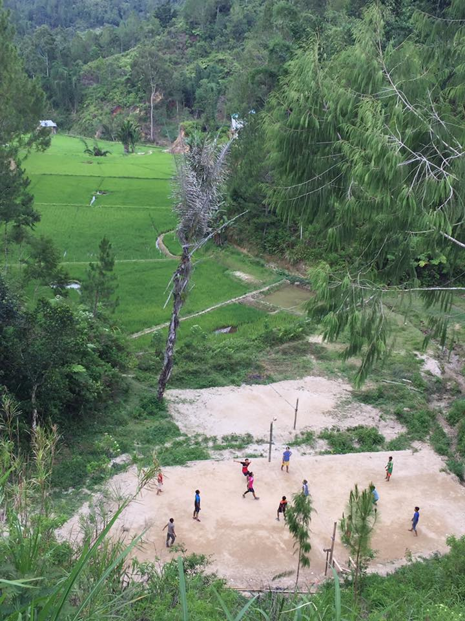
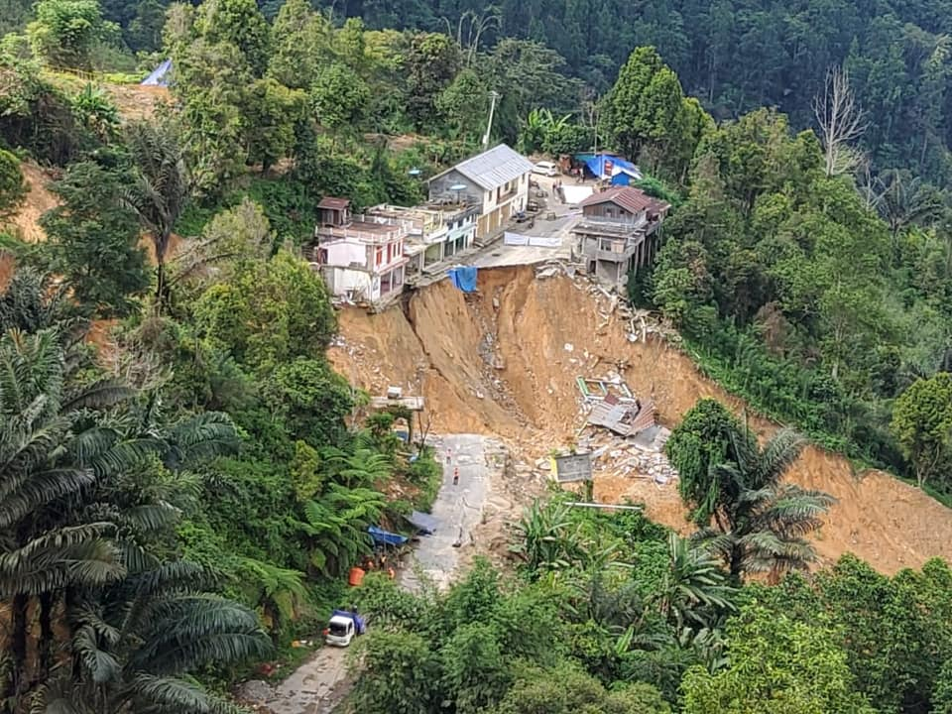
Landslide or Ordinary Ground Movement?

Slide 3
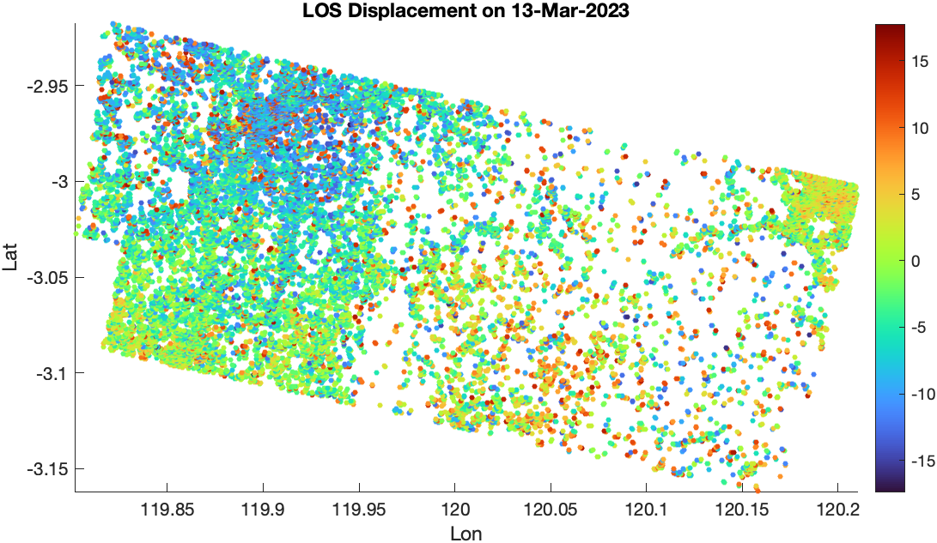
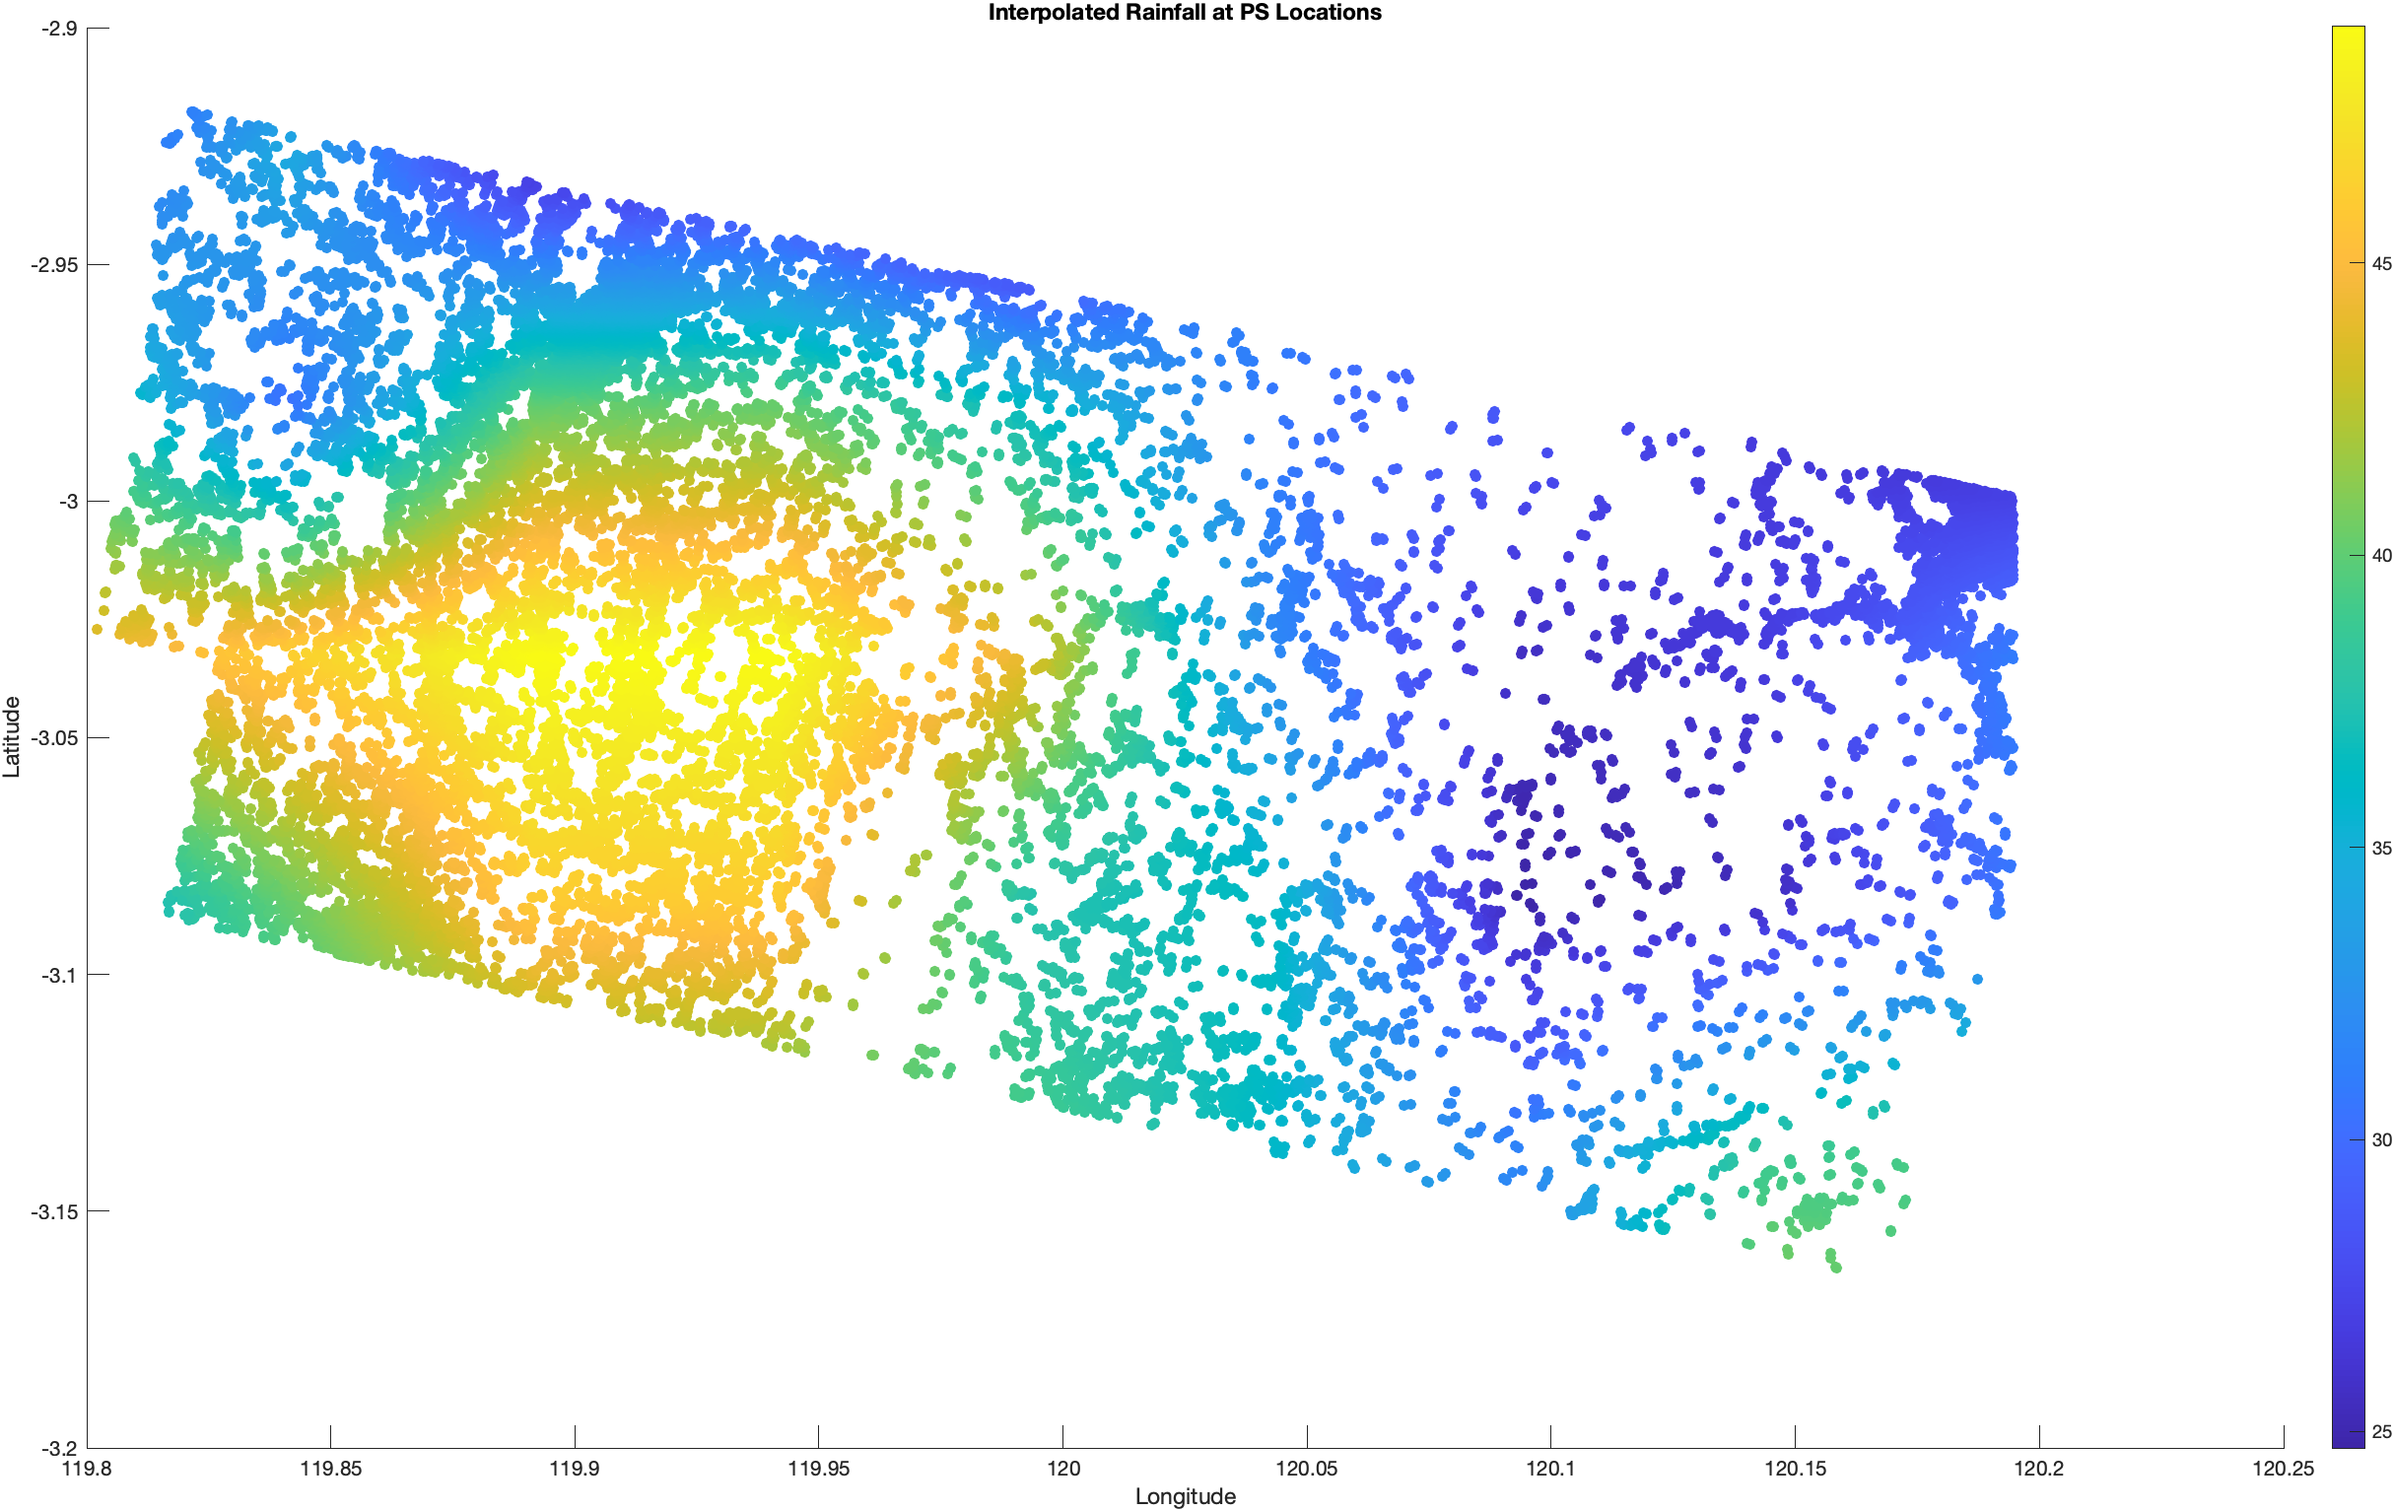
Ground displacement based PS-InSAR and Rainfall of CHIRPS

Slide 4
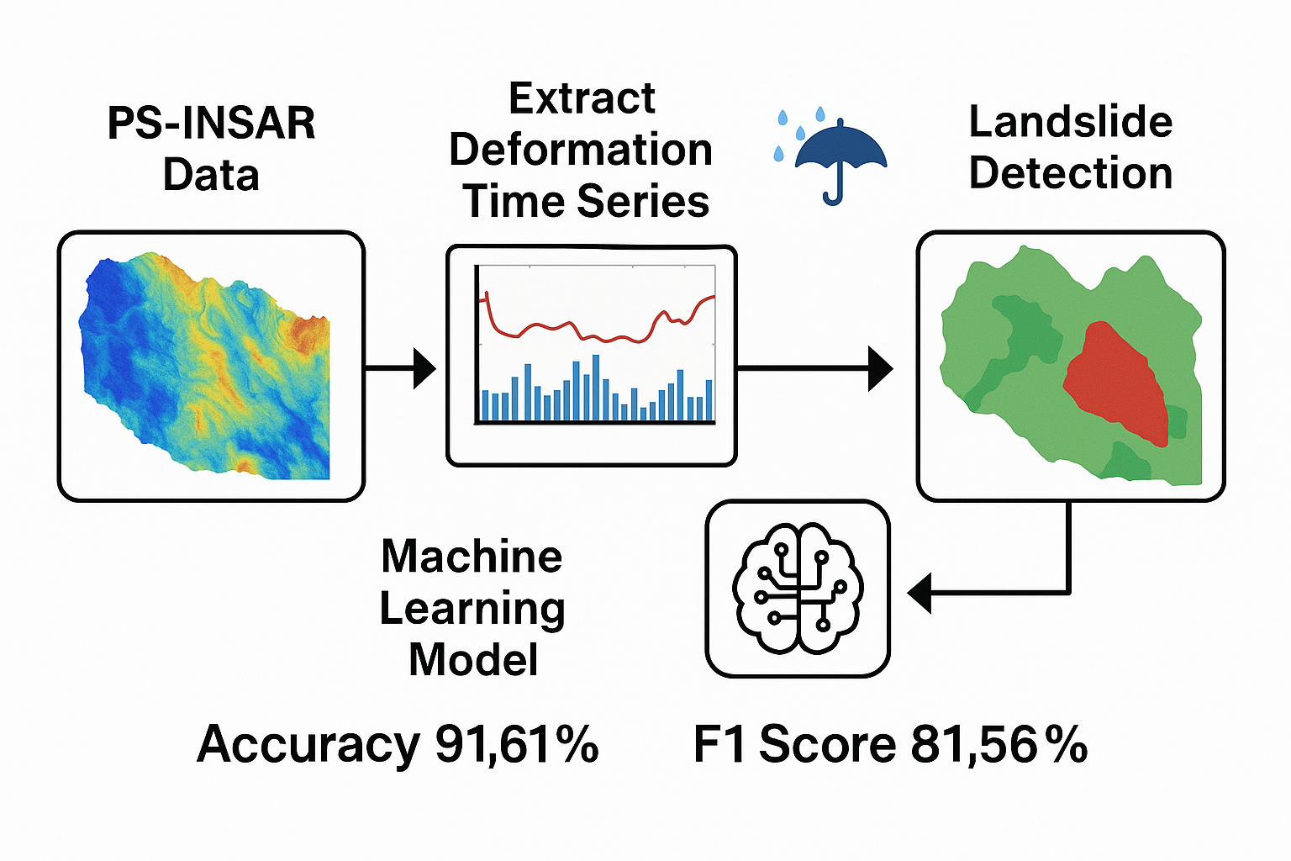

Slide 5
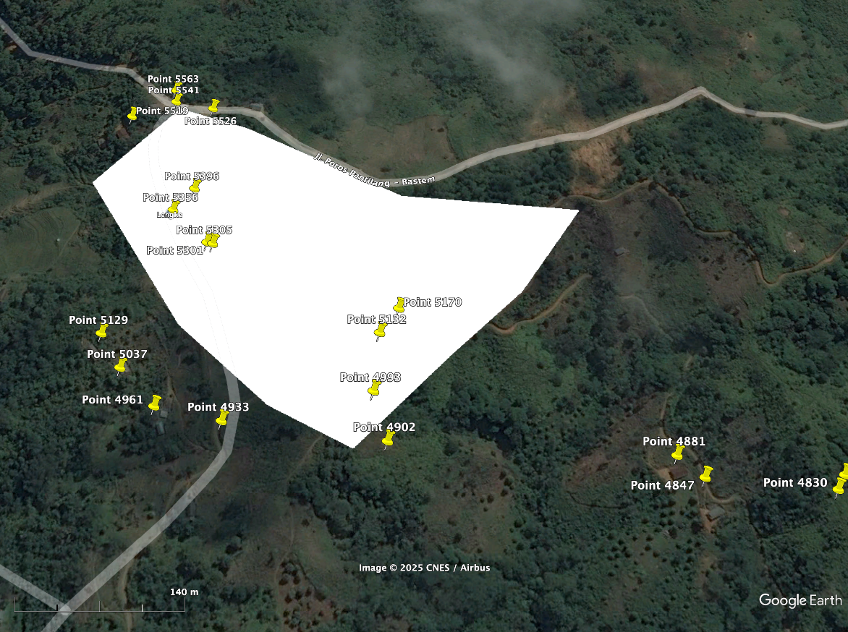

Slide 6
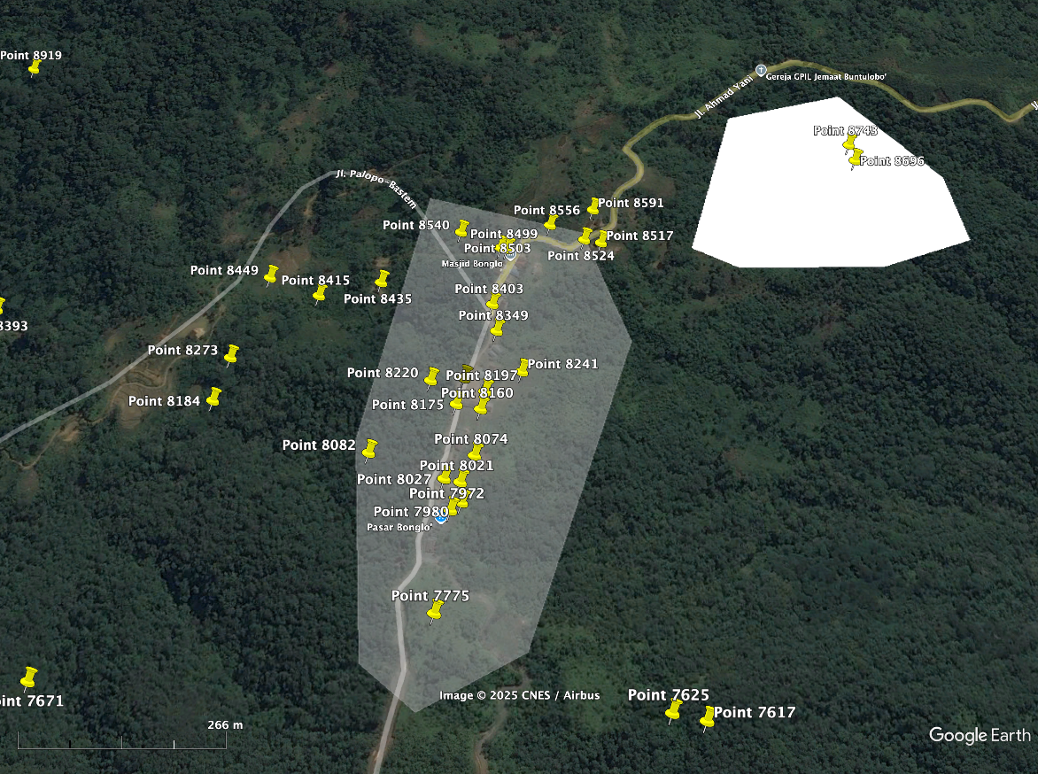

Slide 7
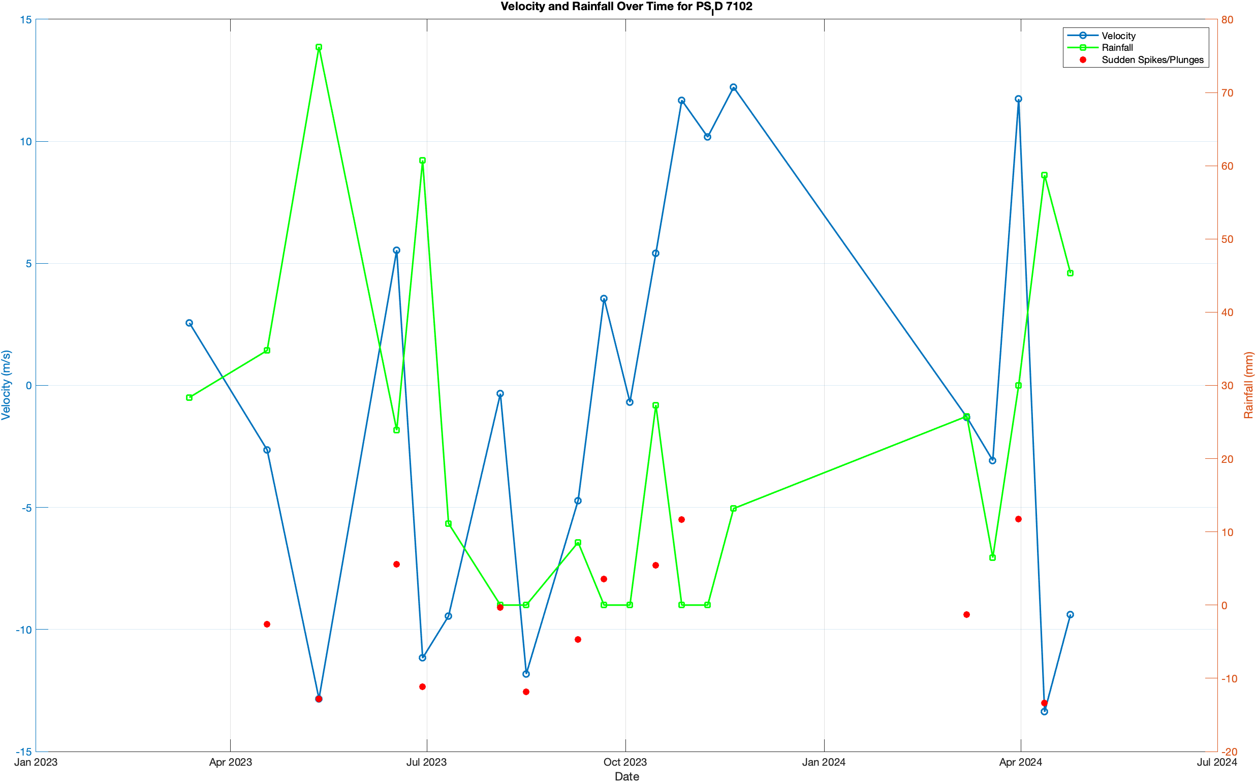

Slide 8
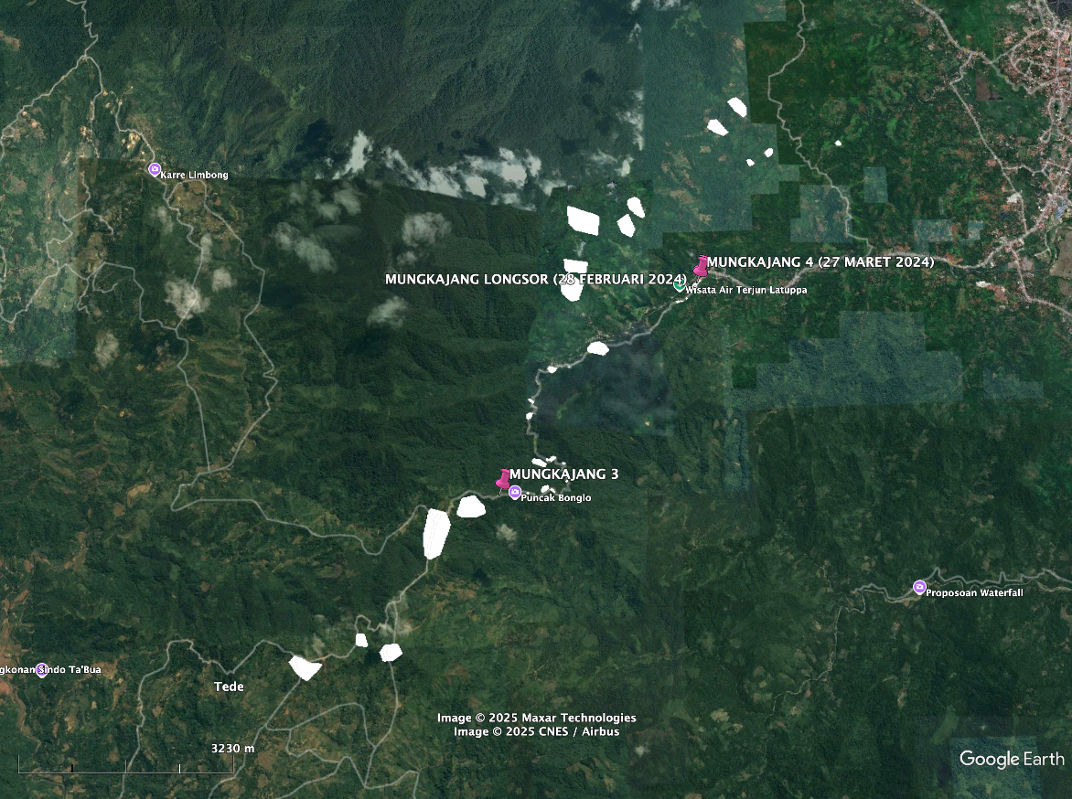

Slide 9
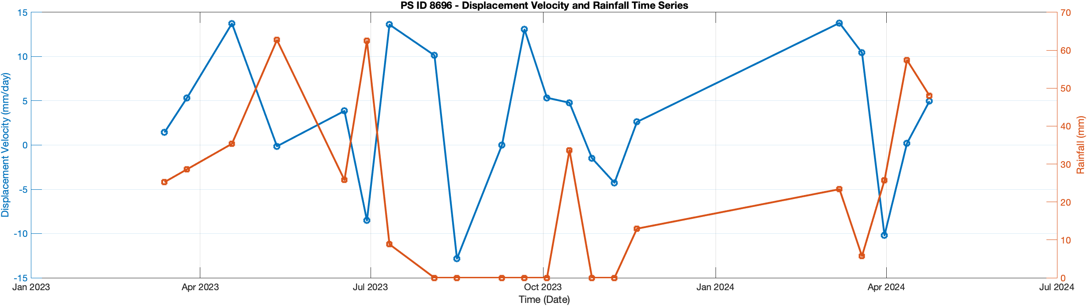
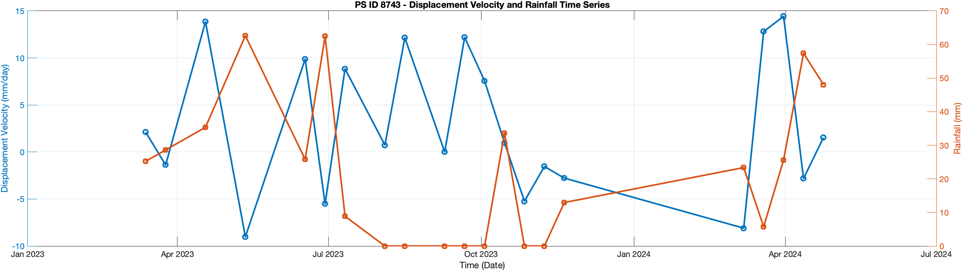

Slide 10
Method

Slide 11
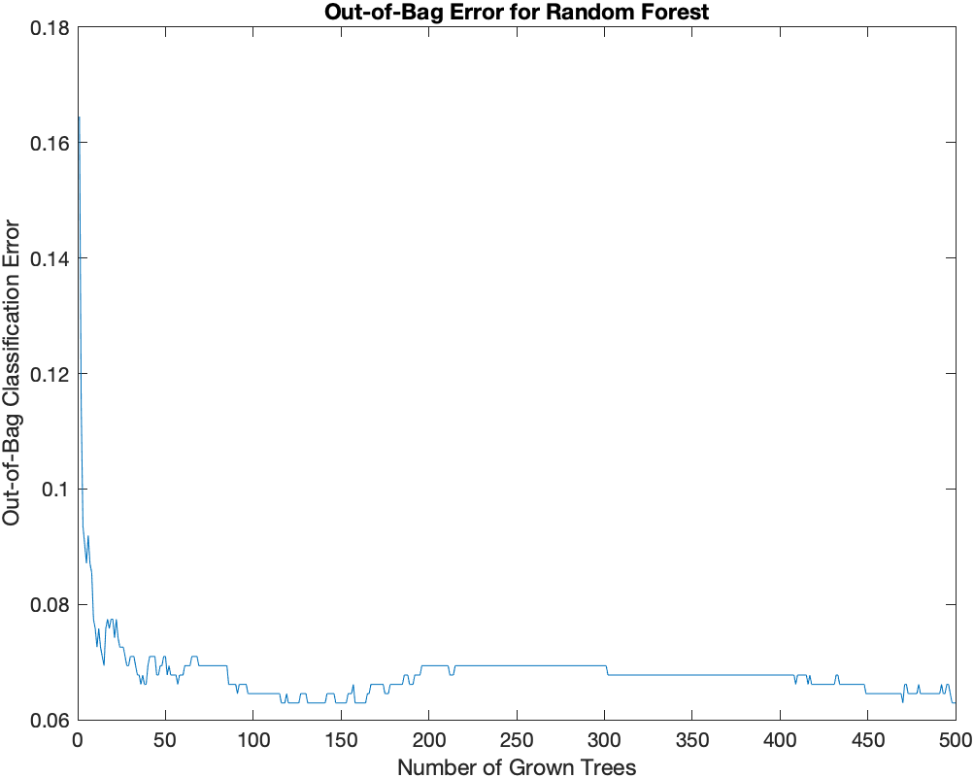

Slide 12
Cross validation
Accuracy, Sensitivity, and Precision
Training Accuracy: 0.98548
Test Accuracy: 0.91613
Confusion Matrix:
453 34
18 115
Accuracy: 0.91613
Sensitivity (Recall): 0.86466
Specificity: 0.93018
Precision: 0.77181
F1-Score: 0.8156
Mean Accuracy: 0.95806
Mean Sensitivity: 0.87652
Mean Specificity: 0.97035
Mean Precision: 0.81967
Mean F1 Score: 0.84328

Slide 13
This study proposes a machine learning framework for landslide detection using Persistent Scatterer Interferometric Synthetic Aperture Radar (PS-InSAR) time series data and rainfall information. Focusing on a case study in Indonesia, ground deformation patterns and rainfall variations were utilized as key features to classify landslide-prone areas. The developed model achieved a training accuracy of 98.55% and a test accuracy of 91.61%, with strong sensitivity (86.47%) and specificity (93.02%). The findings demonstrate that combining PS-InSAR and machine learning provides a powerful tool for early landslide detection and supports disaster risk mitigation strategies in vulnerable regions.

