Slide 1

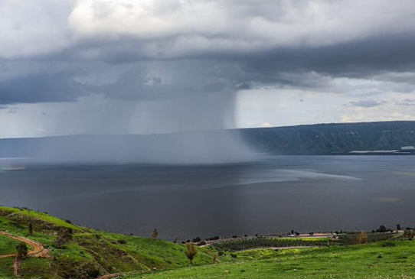
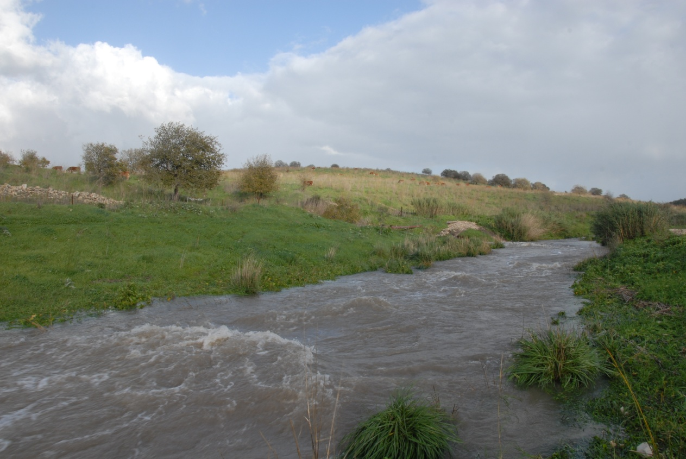




Shifting Flood Regimes Under Contradictory Precipitation Trends
in the Eastern Mediterranean
Efrat Morin, Yair Rinat, Moshe Armon, Yaniv Goldschmidt, Raz Nussbaum, Francesco Marra
Oshri Vizman
Contact: efrat.morin@mail.huji.ac.il

Slide 2
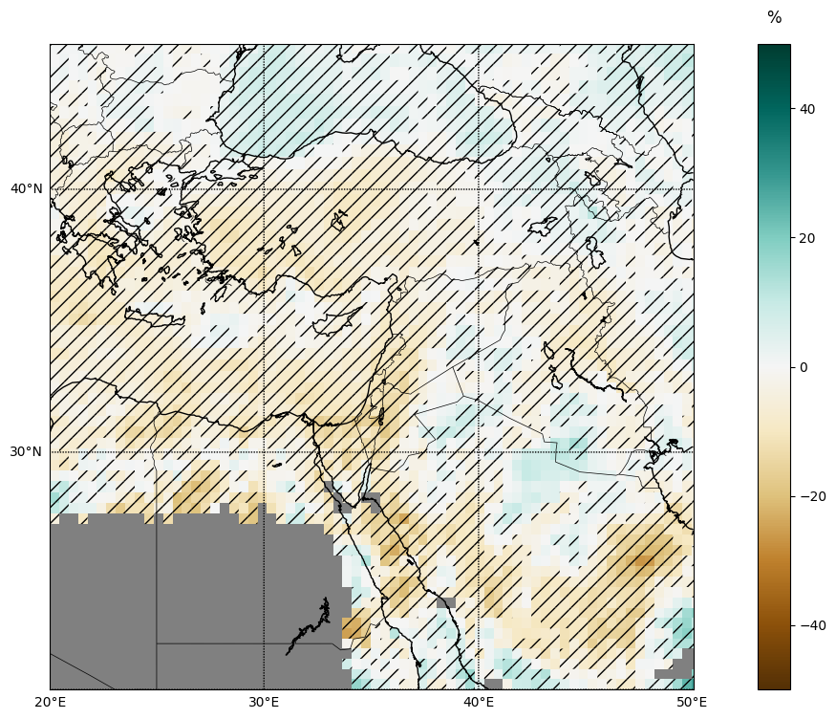
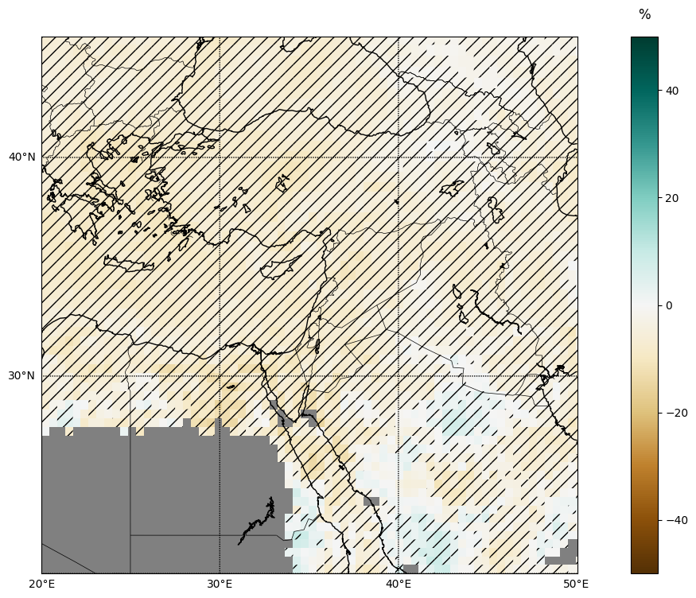
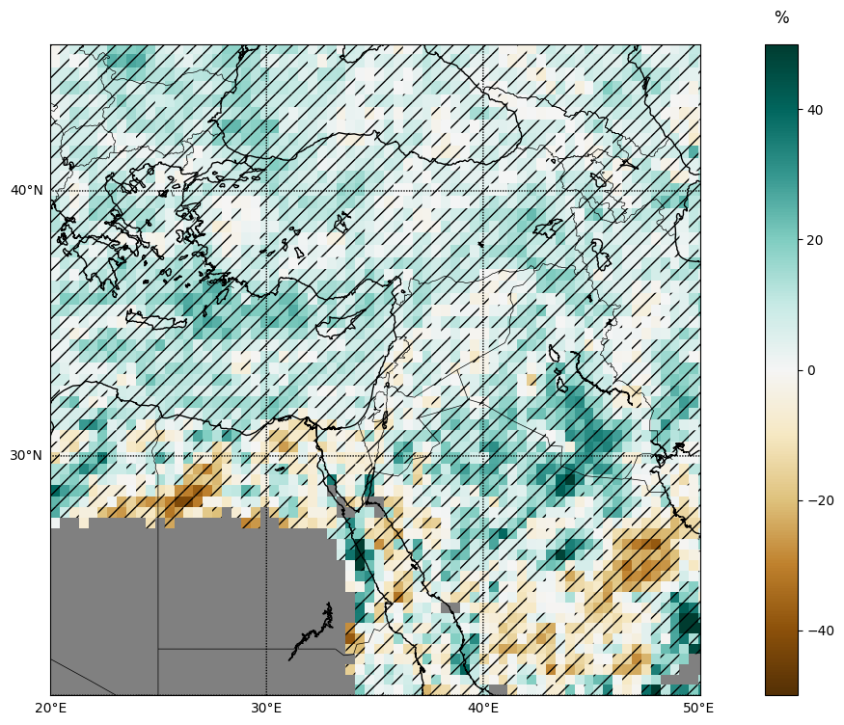
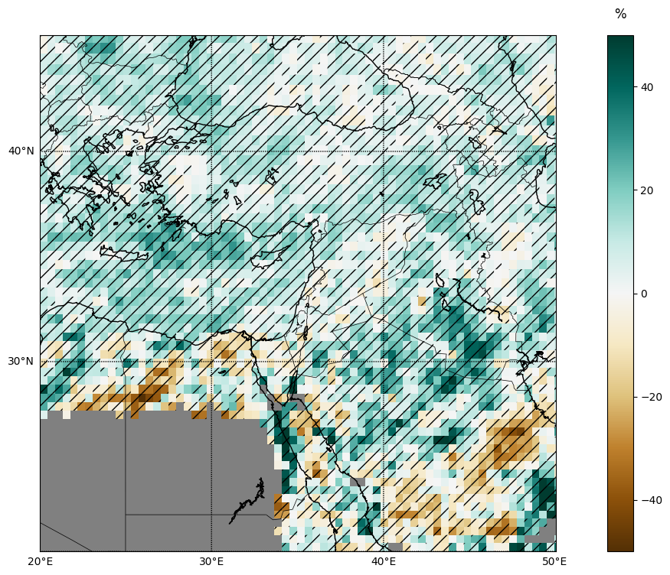
Contradictory precipitation trends in the Eastern Mediterranean
Mean annual precipitation
Number of wet days
Relative change:
Ensemble median of eight RCMs & high-resolution GCMs,
Mid 21st century vs. End 20th century, RCP8.5/SSP5-8.5.
Extreme daily precipitation 20-year
Extreme daily precipitation 100-year
Goldschmidt, Marra and Morin (to be submitted soon)
Session NH1.2, Room E2, Wed. 17:00

Slide 3
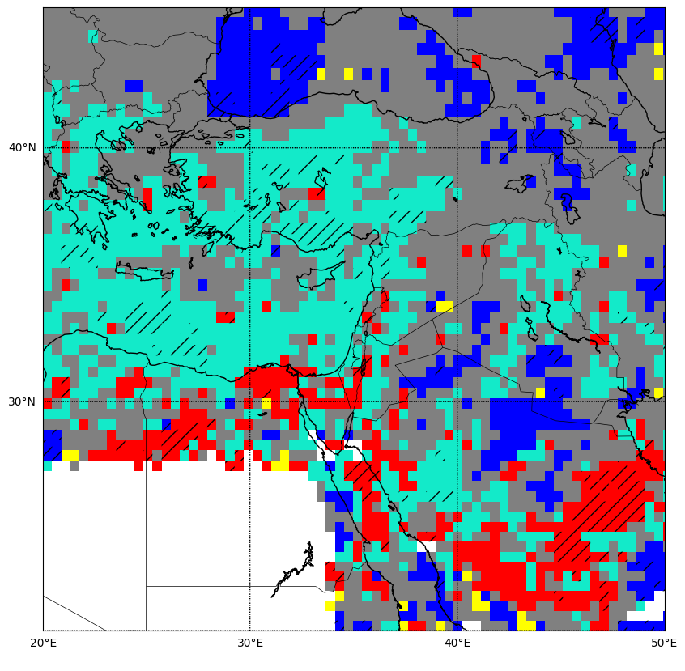
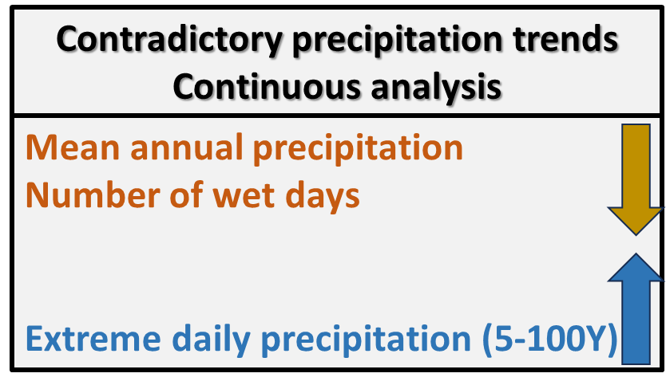

Contradictory precipitation trends in the Eastern Mediterranean
Mean annual precipitation
Ensemble median of eight RCMs & high-resolution GCMs, Mid 21st century vs. End 20th century, RCP8.5/SSP5-8.5.
Extreme daily precipitation 100-year
Goldschmidt, Marra and Morin (to be submitted soon)
Session NH1.2, Room E2, Wed. 17:00

Slide 4
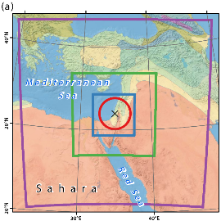
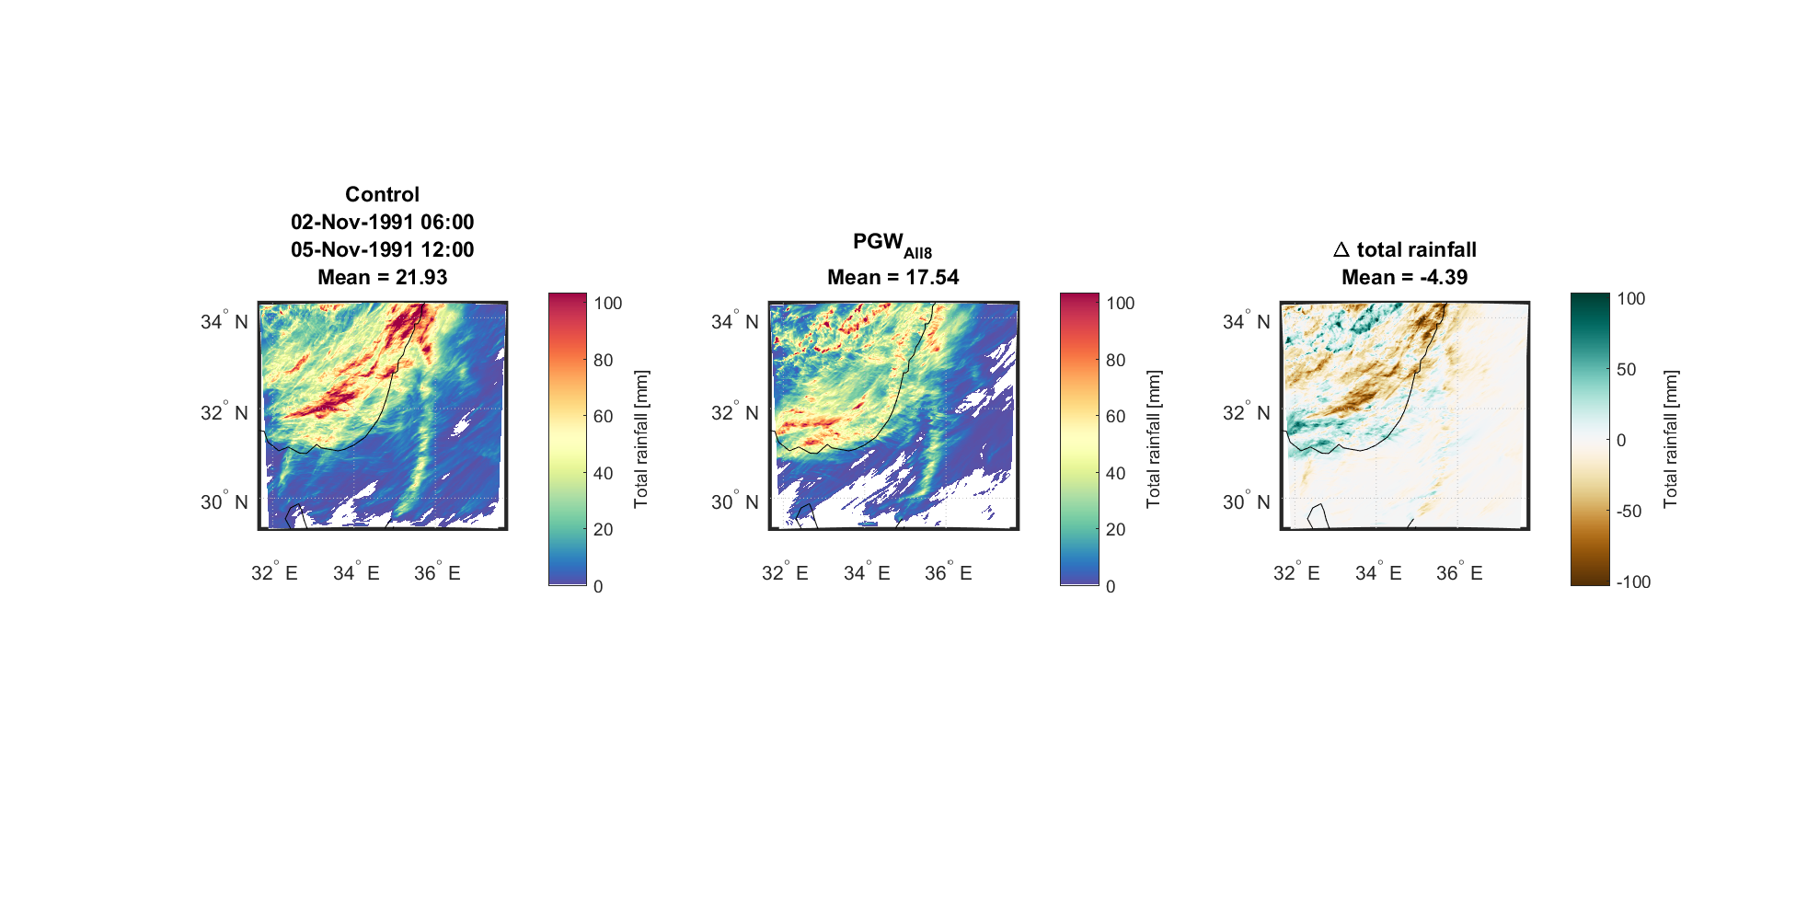

Contradictory precipitation trends in the Eastern Mediterranean
Reanalysis
Initial/boundary conditions
Pseudo global warming
Historical HPE
Future HPE
WRF model
41 heavy precipitation events (HPEs), high resolution simulations with WRF,
End 21st century vs. End 20th century, RCP8.5.
Historical – Future HPE pairs
with 1-km, 10-min resolution
Relative change in:
Rainfall accumulation
Wet area
Storm duration
Mean conditional rain rates
-30%
-40%
-9%
+15%
Armon et al. 2022, Earth’s Future

Slide 5
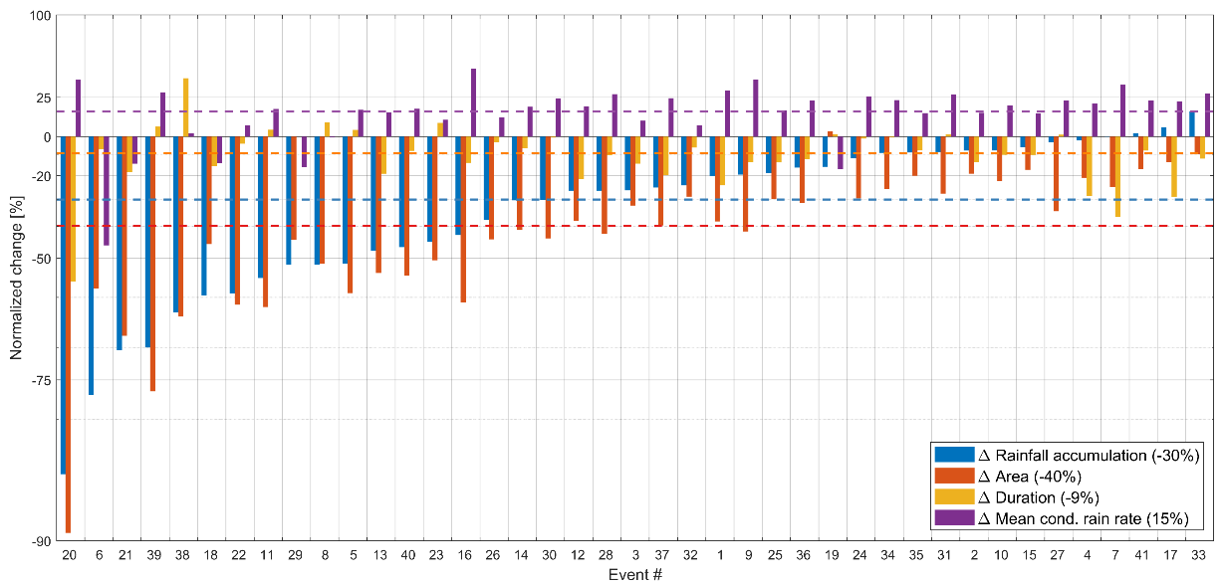
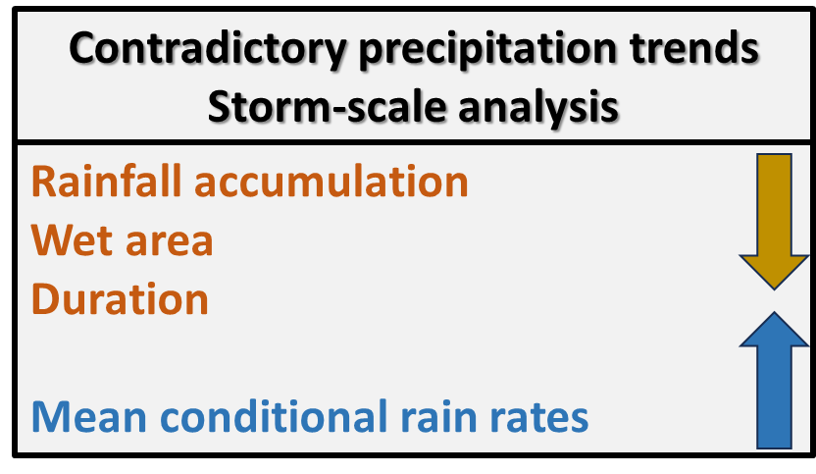
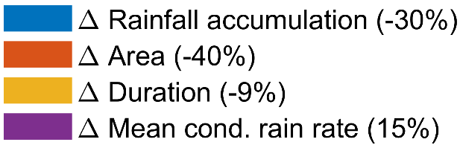
Contradictory precipitation trends in the Eastern Mediterranean
Relative change of 41 events
Relative change
41 analyzed storms
Armon et al. 2022, Earth’s Future

Slide 6
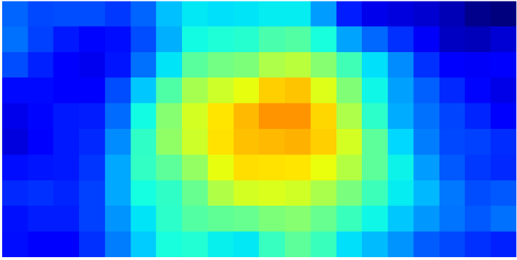
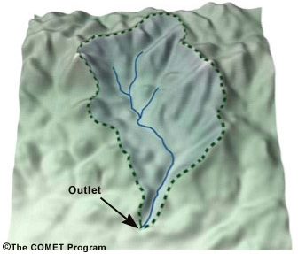
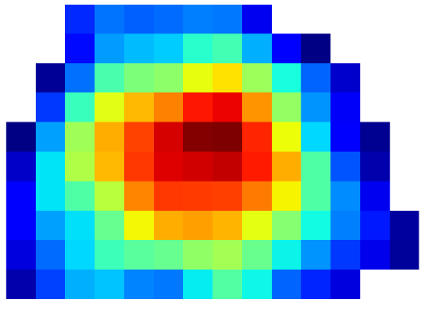
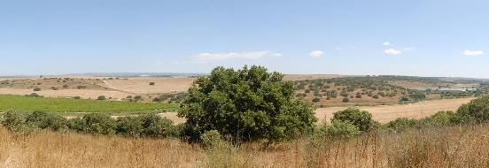
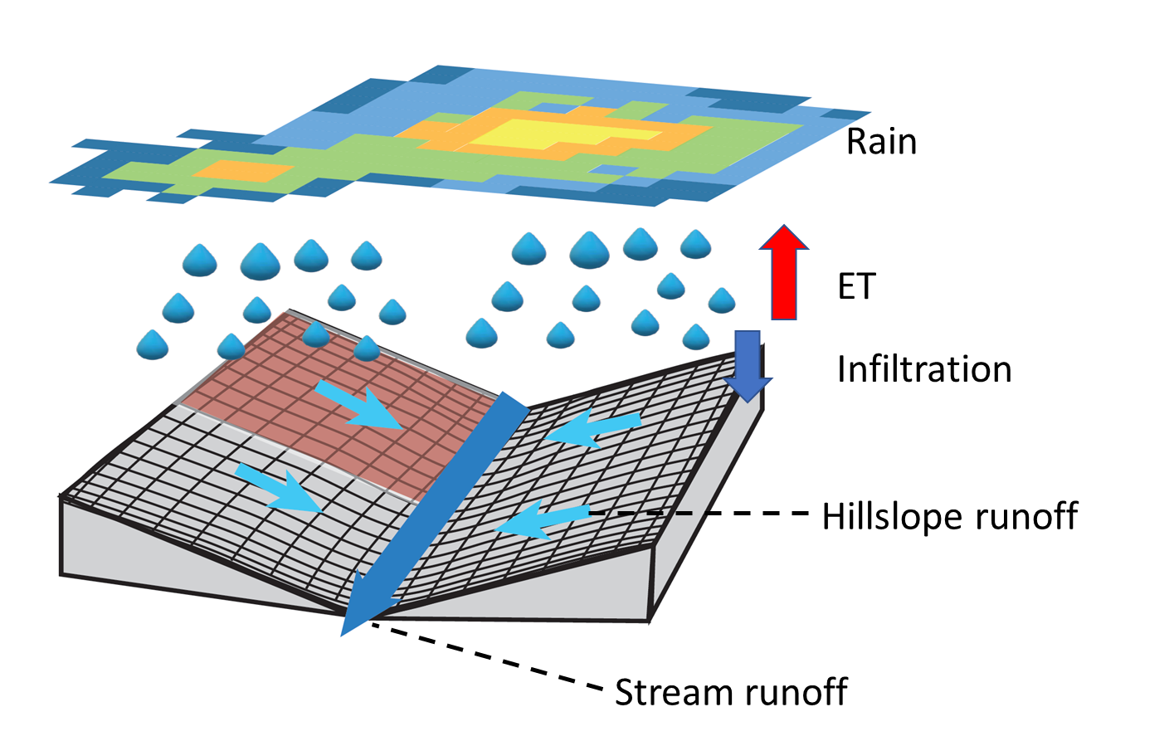
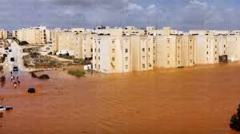
Historical
Future
What is the expected change in flood magnitude?
South-north storm translations
South-north storm translations
Historical – Future storm pairs
1-km, 10-min resolution
South-north storm translations
Input to hydrological models
Well-calibrated, high-resolution, process-based, hydrological models
Mostly agricultural basins
The GB-HYDRA model, Rinat et al., 2018
Urban basin
The SWMM urban runoff model

Slide 7
Flood regime shift in the Eastern Mediterranean
*
*
-33%
-24%
+3%
Ramot Menashe, Mostly agricultural basins, 18-70 km²
Rinat, Armon, Morin, (to be submitted soon)

Slide 8
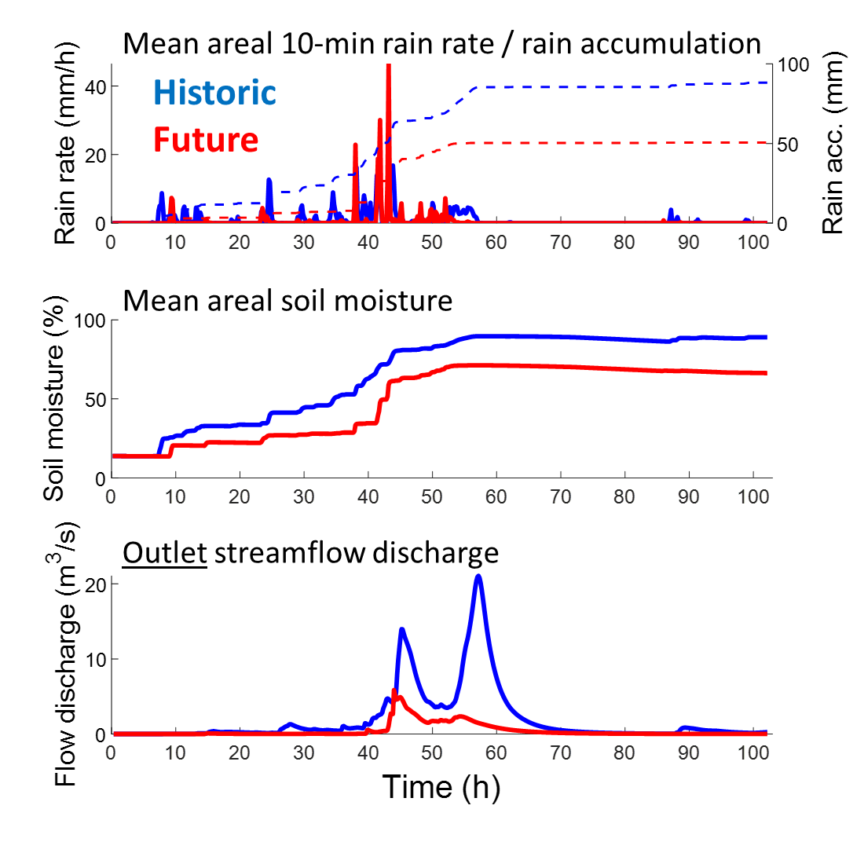
Flood regime shift in the Eastern Mediterranean
*
-9%
*
*
-21%
-30%
Ramot Menashe, Mostly agricultural basins, 18-70 km²
Rinat, Armon, Morin, (to be submitted soon)

Slide 9
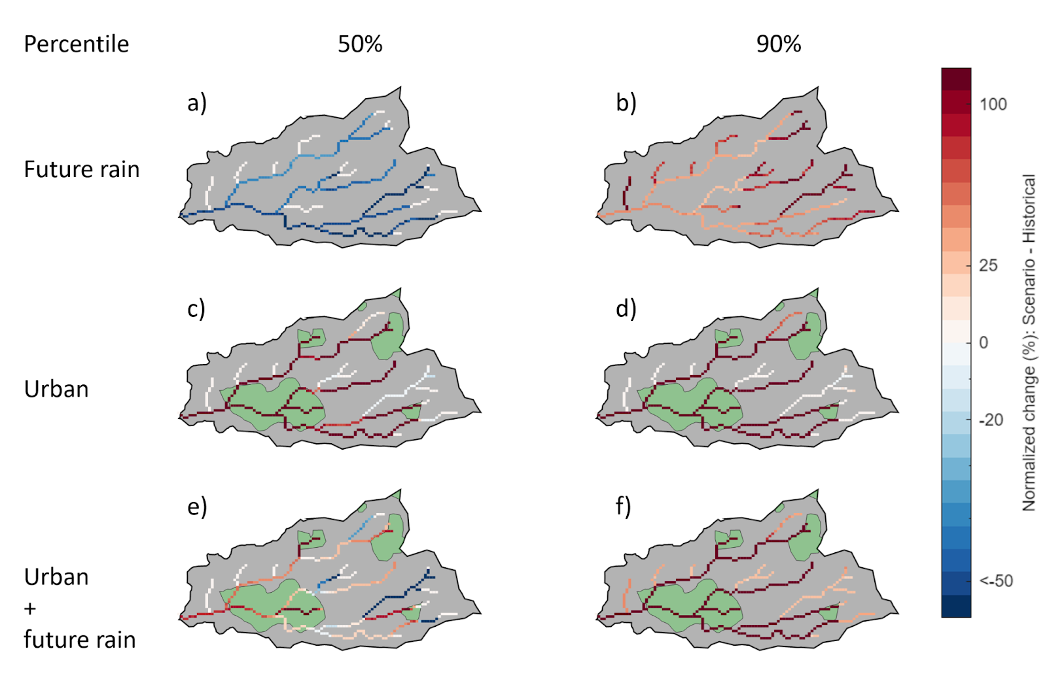
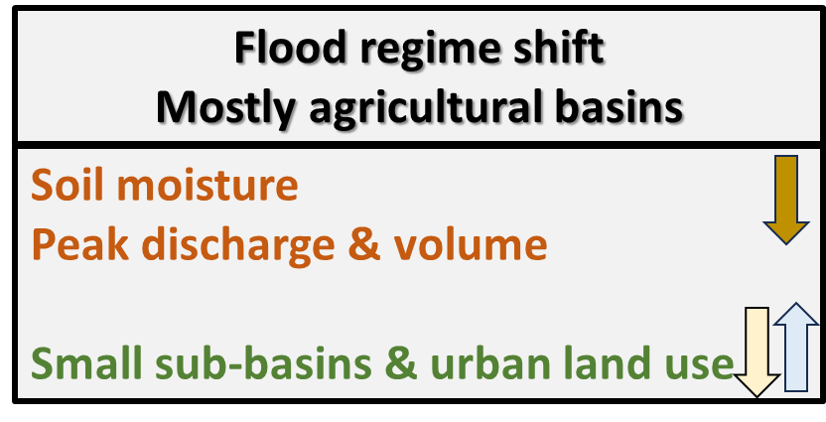
Flood regime shift in the Eastern Mediterranean
Spatial patterns of peak discharge change (relative change between random storm shifts for each HPE pair)
Future rain leads to more positive (or less negative) changes in first/second order streams compared to a higher order.
This behavior is attributed to the localized intense rain cells, characteristic of future rainfall.
Ramot Menashe, Mostly agricultural basins, 18-70 km²
Rinat, Armon, Morin, (to be submitted soon)

Slide 10
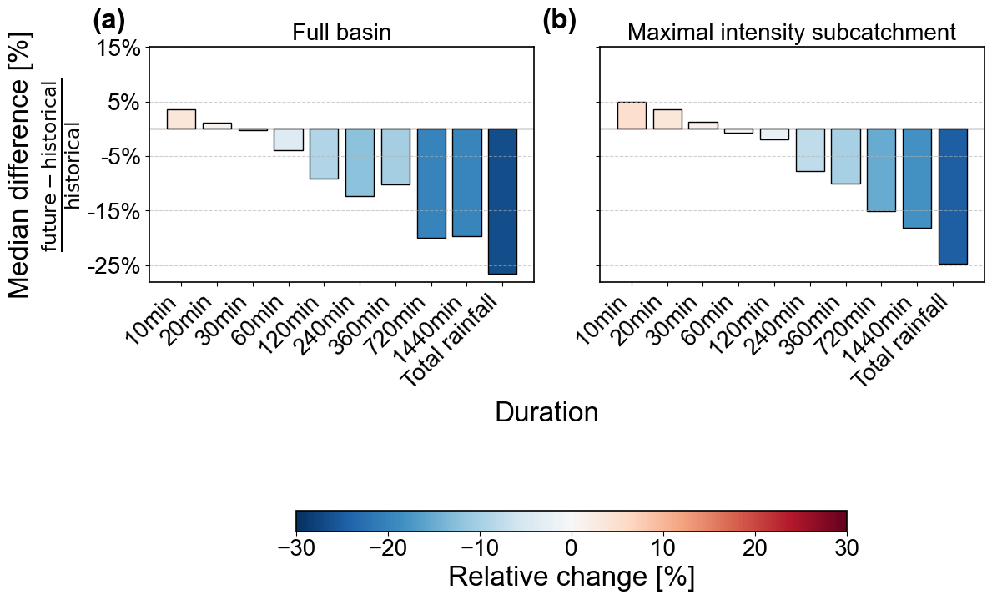
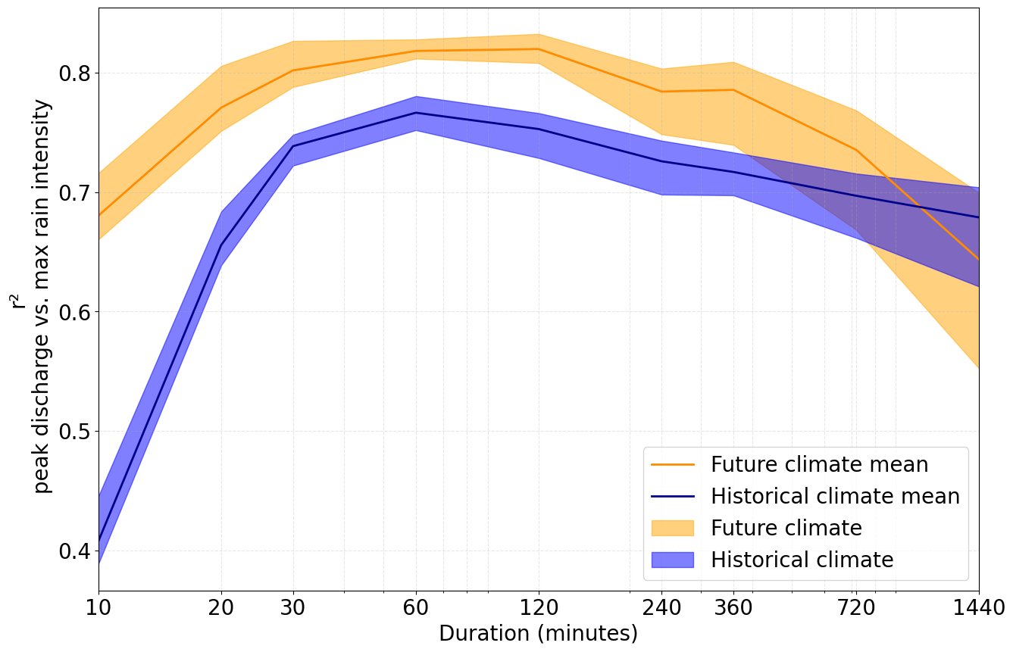
Flood regime shift in the Eastern Mediterranean
Correlation between maximal rainfall intensity and flow peak discharge
Maximum rainfall intensities increase for short durations and decrease for long durations and total rainfall.
Stronger impact of maximal rainfall intensities on runoff peak discharge in future climate, with the largest effect shown for the short-duration rainfall, which increases the most.
Urban basin, the Ra’anana city basin, 13 km²
Nussbaum, Armon, Morin (to be submitted soon)
Session HS7.2, Room 3.29/30, Mon. 14:10

Slide 11
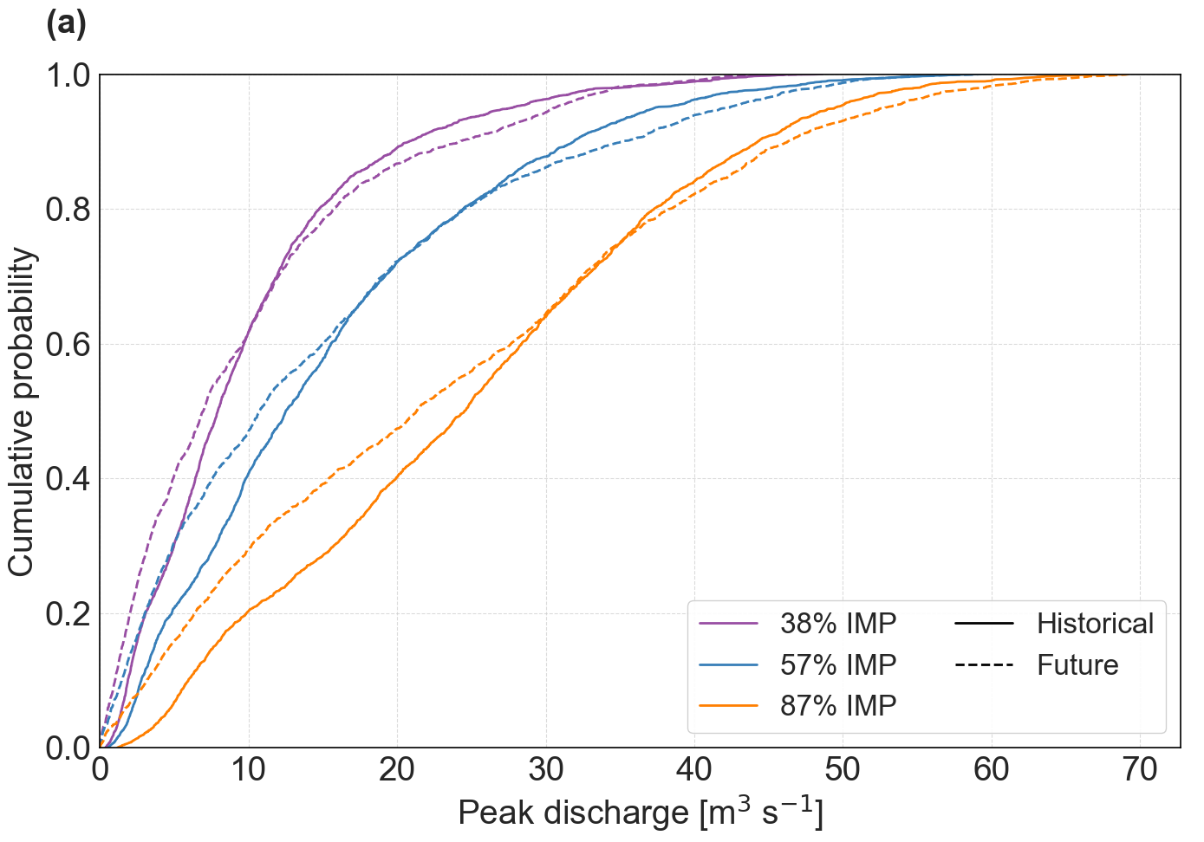
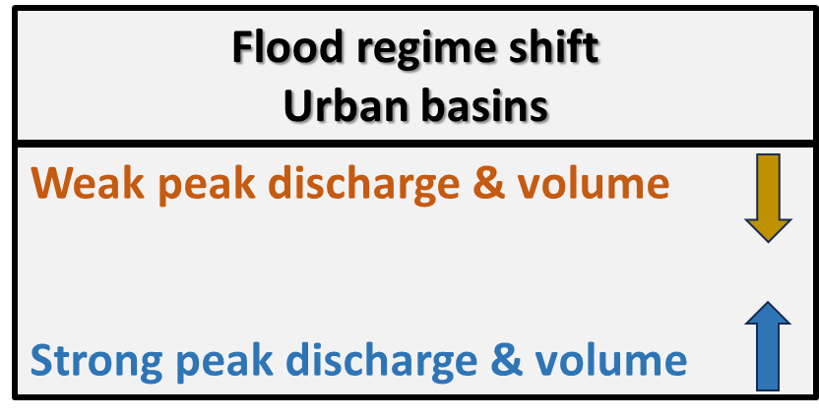
Flood regime shift in the Eastern Mediterranean
CDFs of flood peak discharge
Weak runoff flows become weaker and strong runoff flows become stronger,
across all three urbanization levels.
Urbanization
Urban basin, the Ra’anana city basin, 13 km²
Nussbaum, Armon, Morin (to be submitted soon)
Session HS7.2, Room 3.29/30, Mon. 14:10

Slide 12
Summary
Flood response under contradicting precipitation trends is complex.
Even if extreme precipitation increases, flood magnitude may decrease due to contradicting trends in other hydrologically-important precipitation properties (e.g., total depth, coverage area, resulted soil moisture).
In basins with little urbanization, flood magnitude is mostly decreasing. This effect is smaller for first order sub-basins (that can show some increase in magnitude).
Urban runoff becomes more sensitive to maximal rain intensities. In future climate, the weak runoff flows become weaker, but the strong become stronger and thus we expect higher extreme urban runoff events.

Slide 13
Publications & EGU presentations
Reduced rainfall in future heavy precipitation events related to contracted rain area despite increased rain rate, Armon, Marra, Enzel, Rostkier‐Edelstein, Garfinkel, Adam, Dayan, and Morin, Earth's Future, 2022.
Heterogeneous impact of climate change on daily extreme and average precipitation in the Middle East and North Africa (MENA) region, Goldschmidt, Marra and Morin, to be submitted soon. Session NH1.2, Room E2, Wed. 17:00
The complex effect of climate change and urbanization on flows in small–medium Mediterranean catchments, Rinat, Armon and Morin, to be submitted soon.
Urban runoff response to heavy precipitation driven by climate change and urbanization, Nussbaum, Armon and Morin, to be submitted soon. Session HS7.2, Room 3.29/30, Mon. 14:10

Slide 14
Shifting Flood Regimes Under Contradictory Precipitation Trends
in the Eastern Mediterranean

