Slide 1


Architecture Characteristics of Lake-Bottom Fan Sedimentary Reservoir: A Case Study of the PG2 Oil Reservoir
Li Xinkun , Zhang, X
Faculty of Earth Sciences and Technology

Slide 2
Outline
1、Introduction
2、 Method
3、Results and Discussion
4、Conclusions

Slide 3
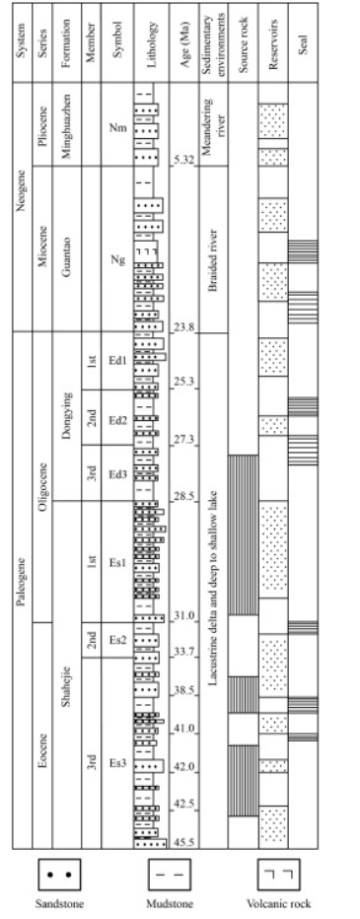
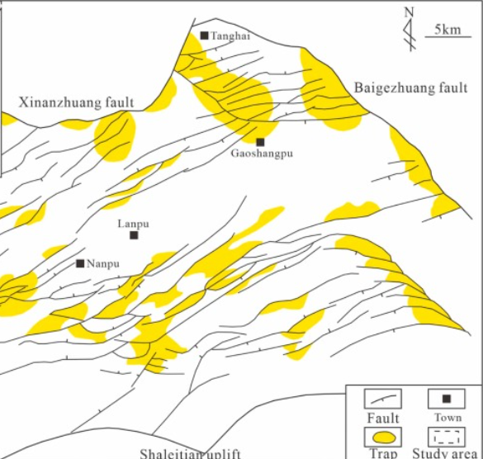
1、Introduction
1.1 Geological setting
PG2
provenance
From bottom to top, the Paleogene Shahejie Formation and Dongying Formation, the Neogene Guantao Formation and Minghuazhen Formation, and the Quaternary Pingyuan Formation developed successively. The burial depth of the middle sand section ranges from 4,200 to 4,600 meters, with a maximum burial depth reaching up to 5,200 meters. During the sedimentary period of the Shayi Member in the study area, it corresponded to the third stage of the Nanpu Depression's evolution. During this phase, the Nanpu Depression entered the strike-slip extensional stage. Under the influence of right-lateral strike-slip tectonic stress, the Nanpu No. 3 Fault exhibited intense activity. Simultaneously, due to the northwest-southeast tensional force, a series of northeast-oriented normal faults were formed, resulting in a topographic feature characterized by higher elevations in the south and lower elevations in the north within the Nanpu No. 3 structural zone. The PG2 2 Block is situated in the fault slope transition zone formed by the interaction of the Nanpu No. 3 Fault and secondary northeast-trending normal faults, transitioning from the Shalaitian Uplift to the Caofeidian Sub-depression. This region belongs to a deep lake to semi-deep lake sedimentary environment. The pre-accumulation and accumulation-type braided river delta sand bodies sourced from the southern Shalaitian Uplift provide abundant material for sandy gravity-driven flows in the study area.

Slide 4
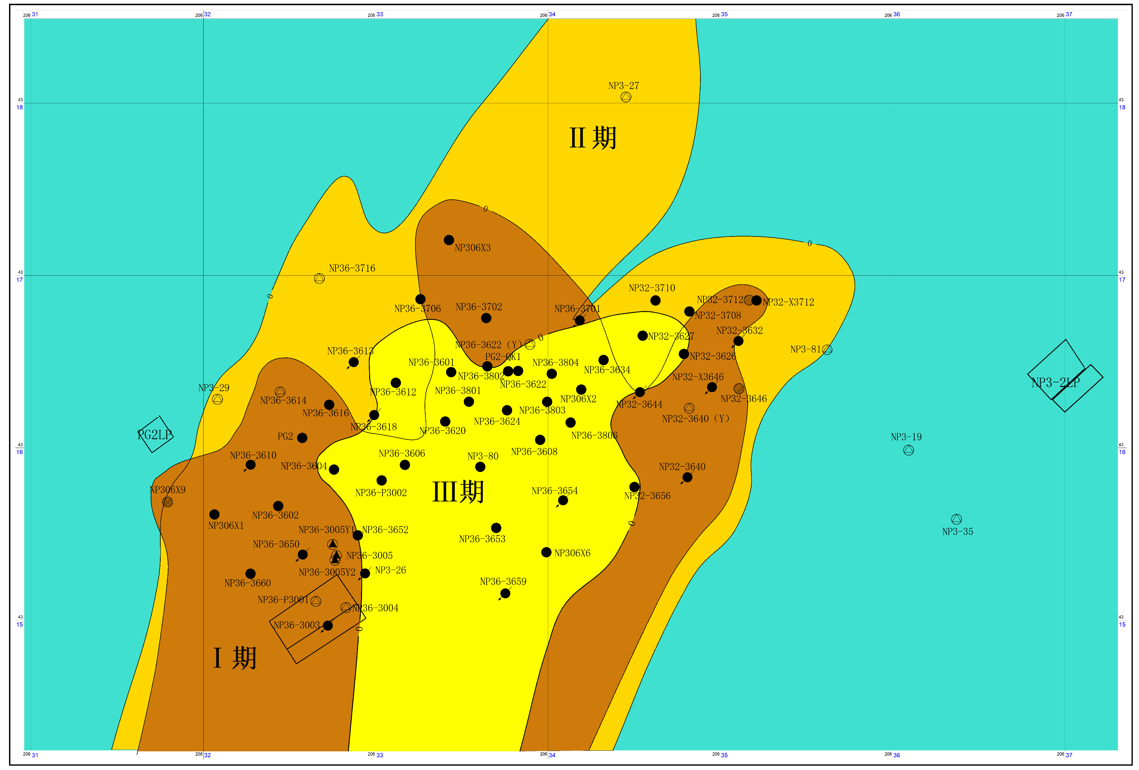
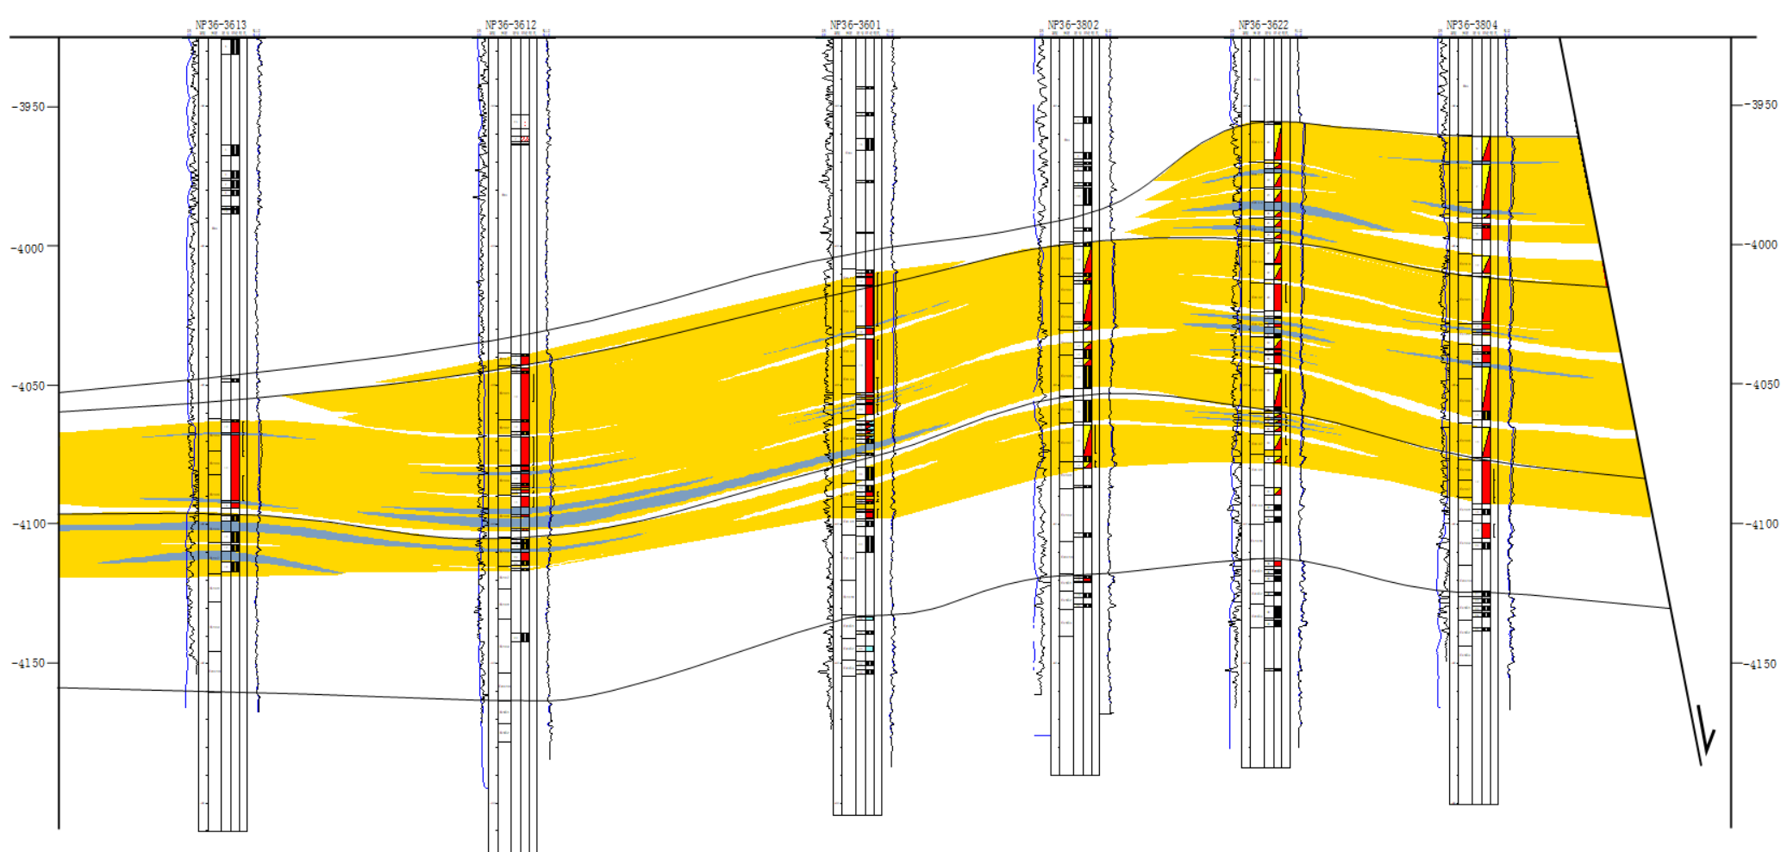
1、Introduction
1.2Challenges
The Es1 reservoir interval is characterized by sublacustrine fan deposits, which demonstrate multi-stage development. The reservoir exhibits strong internal heterogeneity with well-developed interlayers and baffles, resulting in complex seepage characteristics during subsequent gas storage conversion. Currently, there is insufficient understanding of the migration and distribution patterns of reservoir fluids.
Original understanding of Es1 sedimentary facies（2017）
Sand body Connection Diagram

Slide 5
Outline
1、Introduction
2、 Method
3、Results and Discussion
4、Conclusions

Slide 6
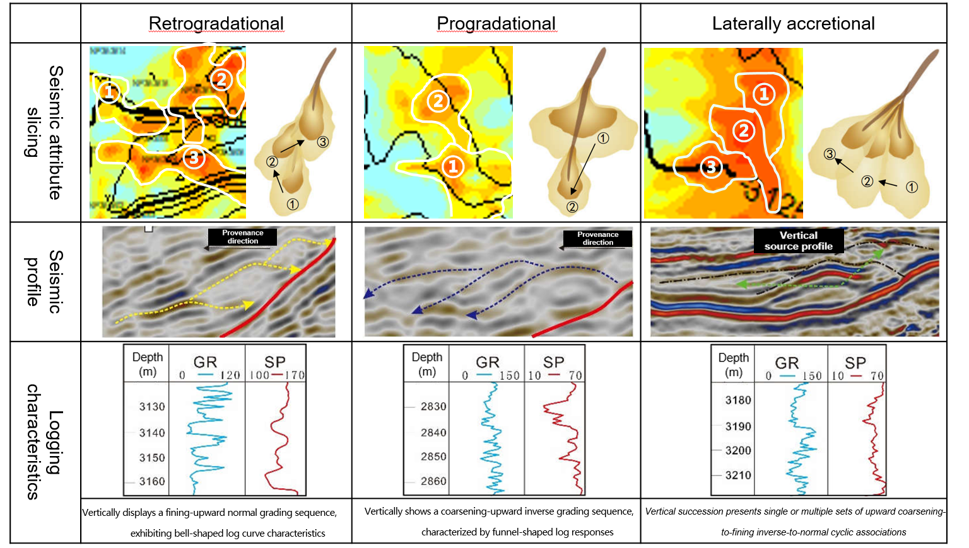
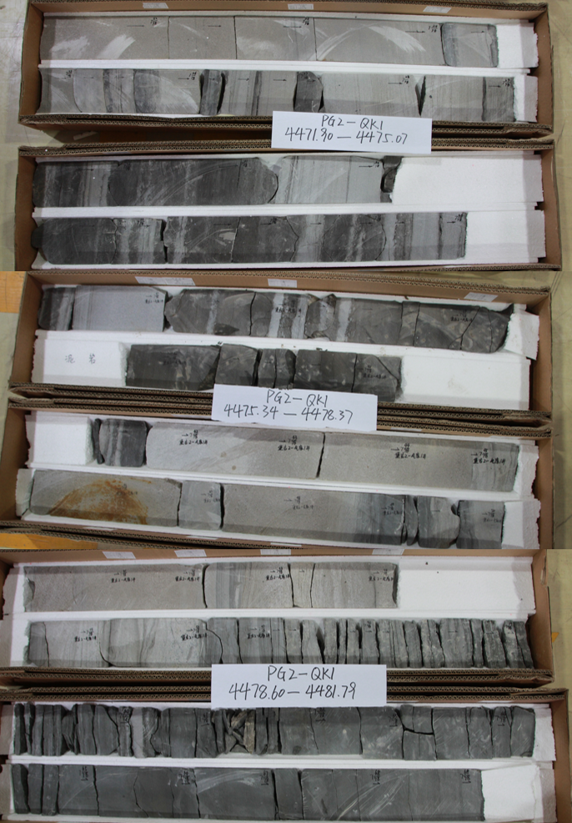
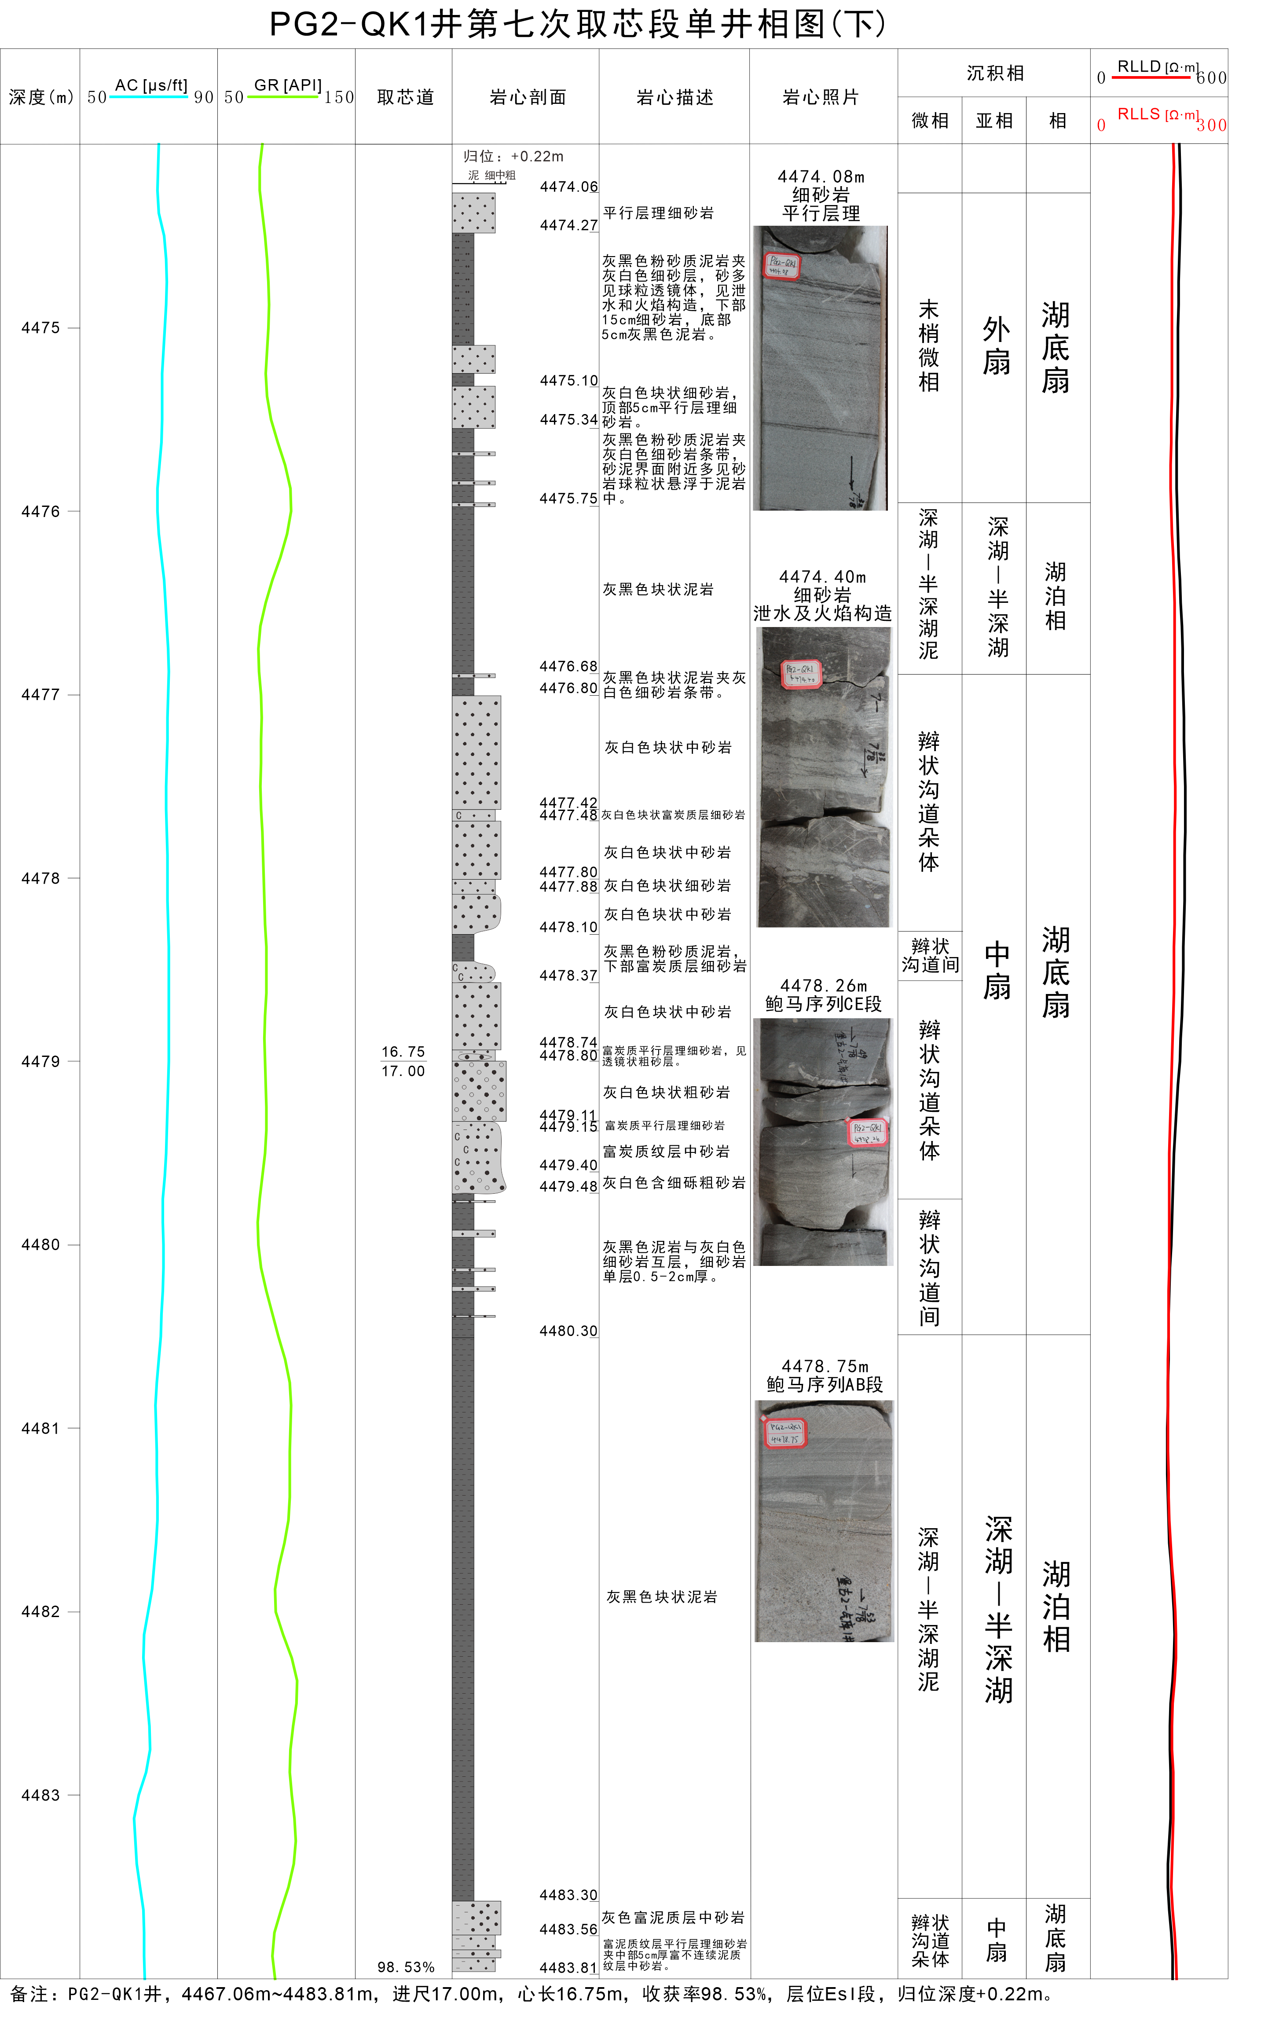
2、 Method
2.Architectural Classification Methods and Criteria
core data combined with logging data
Sedimentary facies
Stacking Patterns of Sandy Debris Flow Deposits in Subaqueous Fans
Deep lake
​Outer fan
​Inter-braided channel​
Braided channel lobe​
Fan thickness
（m）
Reservoir architecture classification
（m）
​​Channel thickness
Channel width
Fan width
（m）
（m）
Quantitative characterization of structural interfaces

Slide 7
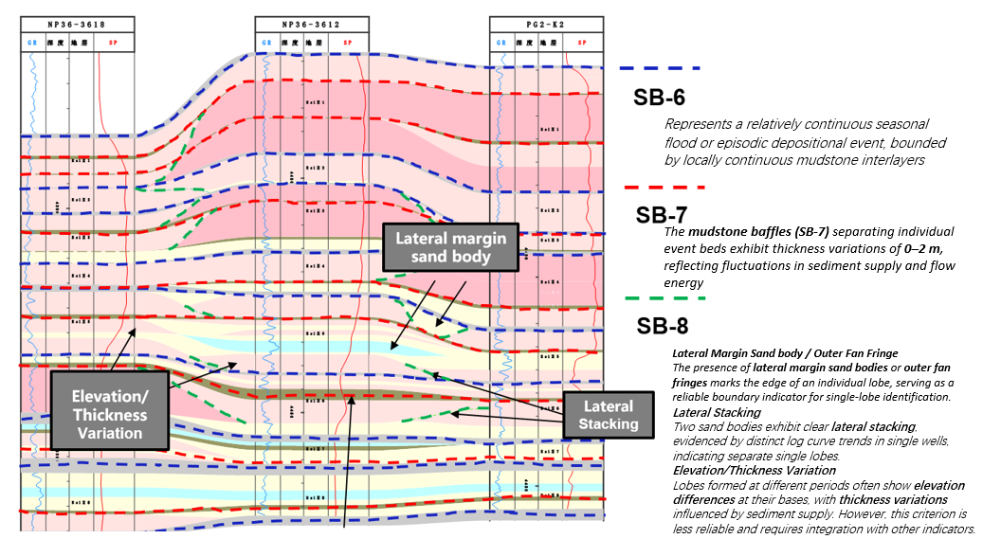
2、 Method
Vertical Compartmentalization & Architectural Surface Identification

Slide 8
Outline
1、Introduction
2、 Method
3、Results and Discussion
4、Conclusions

Slide 9
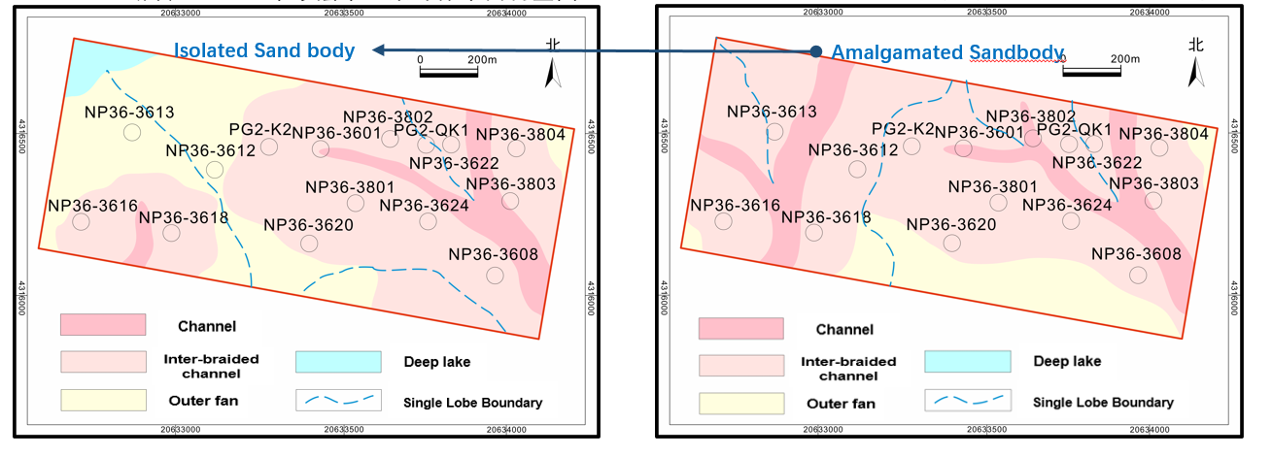
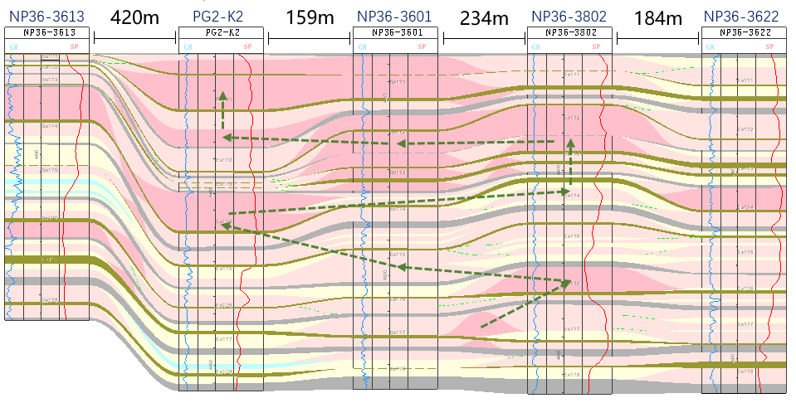
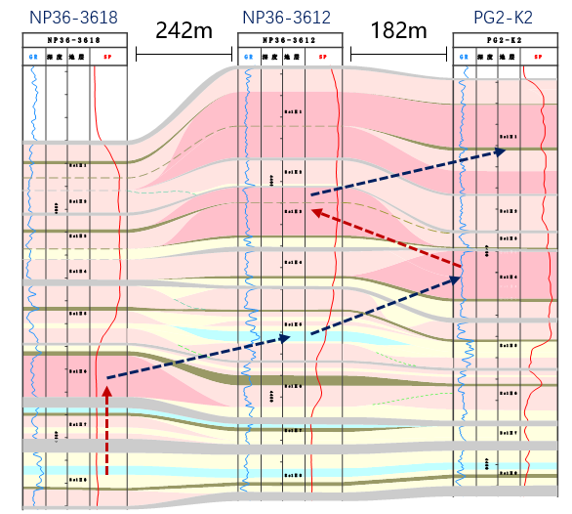
3、Results and Discussion
3.1Implementation：
Planar Architecture Characteristics of Single Lobe Complex (Case Study: X1 Fault Block)
Es2-1 Es2-2​
Architectural Study Using X1 Fault Block as an Example
Lateral Migration Pathways of Depositional Centers
Pro gradational Stacking
Retrogradational Stacking
Vertical Source-to-Sink Single Lobe Profile Characteristics
Downstream Longitudinal Profile of Single Lobe

Slide 10
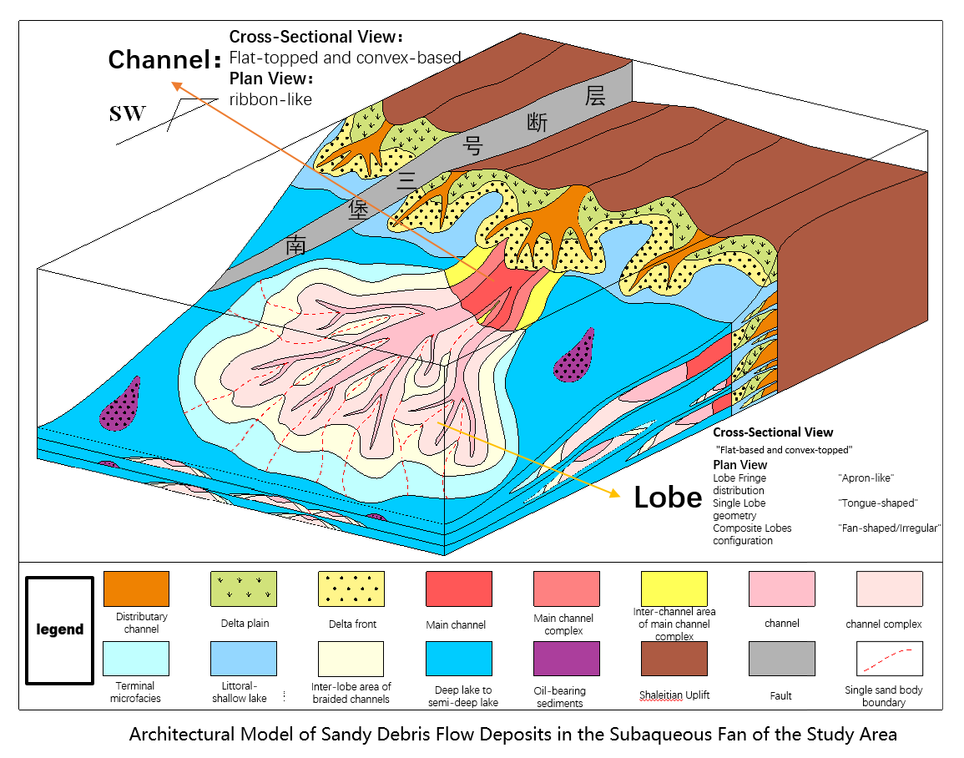
3、Results and Discussion
Channel:
1.Cross-Sectional View​​
​​Morphology​​: ​​"Flat-topped and convex-based"​​ geometry
Top Surface: Typically planar (erosional contact)
Base: Displays convex-downward curvature (scour morphology)
Geological Implication: Reflects turbulent flow erosion during high-energy transport
​​2. Plan View​​
​​Distribution Pattern​​: ​​Elongated "ribbon-like"​​ geometry
Length-to-Width Ratio: Typically >5:1
Boundary Definition: Sharp lateral contacts with lobe deposits
Seismic Expression: High-amplitude linear anomalies
Lobe:
1.Cross-Section​​:
Label convex tops with δ (delta) symbols
Mark flat bases with horizontal ruling lines
​​2.Plan View​​:
Use standardized color coding:
Lobe fringe: Light blue transparent overlay
Single lobe: Solid orange with flow-direction arrow
Composite lobes: Stippled pattern fill

Slide 11
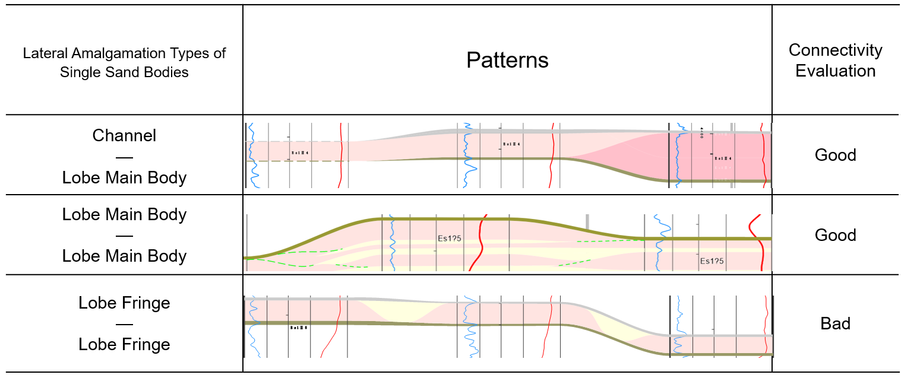
3、Results and Discussion
3.2Lateral juxtaposition characteristics between individual lobes
During the same depositional phase, multiple feeder channels may concurrently transport sediments into the lacustrine basin. The sediments carried by different feeder channels are deposited at their fronts, forming multiple lobes.
These individual lobes exhibit distinct lateral juxtaposition relationships in plan view.Three types of lateral amalgamation between single lobes were identified: (1) channel-to-lobe main body (CH-LMB), (2) lobe main body-to-lobe main body (LMB-LMB), and (3) lobe fringe-to-lobe fringe (LF-LF) contacts, with LMB-LMB being the dominant type.

Slide 12
Outline
1、Introduction
2、 Method
3、Results and Discussion
4、Conclusions

Slide 13
4、Conclusions
Architectural element types include six categories: main channel, distributary channel, lobe main body, lobe fringe, slump body, and inter-lobe/inter-channel deposits. The lobe main body constitutes the principal depositional component of subaqueous fans, exhibiting fan-shaped distribution. The internal architecture of subaqueous fans can be further subdivided from single fan complexes to individual lobe elements.
During short-term base-level lowstands, individual lobes demonstrate smaller length-to-width and width-to-thickness ratios, forming compensational stacked depositional patterns. Conversely, during short-term base-level highstands, individual lobes show larger length-to-width and width-to-thickness ratios, developing either isolated depositional bodies or partially laterally stacked deposits.
The established 3D architectural model of subaqueous fans reveals that channels serve as critical conduits for gravity flow sediment transport, with channel dimensions progressively decreasing toward the basin center before transitioning into lobes. Lobes can be subdivided into lobe main bodies and lobe fringes. This architectural model provides a conceptual framework for reservoir characterization in adjacent well areas and similar depositional systems.
Three types of lateral amalgamation between single lobes were identified: (1) channel-to-lobe main body (CH-LMB), (2) lobe main body-to-lobe main body (LMB-LMB), and (3) lobe fringe-to-lobe fringe (LF-LF) contacts, with LMB-LMB being the dominant type.

Slide 14
THANK YOU!
Question? Suggestion?

