Slide 1
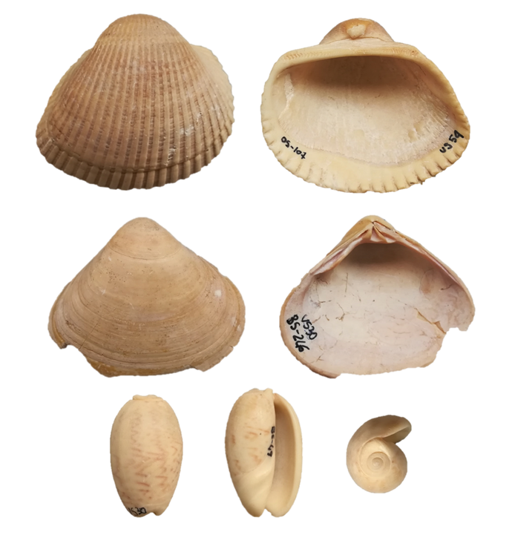
Investigating the shell microstructure and mineralogy of three Upper Holocene mollusc species from the Khor Rori Archaeological Park (Dhofar, Oman)
Andrea Chiari¹, Monica Dapiaggi¹ & Gaia Crippa¹
¹ Dipartimento di Scienze della Terra ‘A. Desio’, Università degli Studi di Milano, via Mangiagalli 34, 20133 Milano, Italy
Aim of the study
Characterising and illustrating for the first time the shell microstructure and mineralogy of specimens of the bivalves Anadara uropigimelana (Bory de Saint-Vincent, 1827) and Tivela stefaninii (Nardini, 1933), and of the gastropod Oliva bulbosa (Röding, 1798).
Providing useful characters for phylogenetic, evolutionary, crystallographic and palaeoenvironmental studies.
1 cm
Chiari et al. 2025

Slide 2
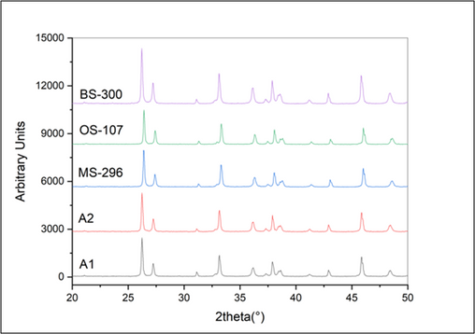
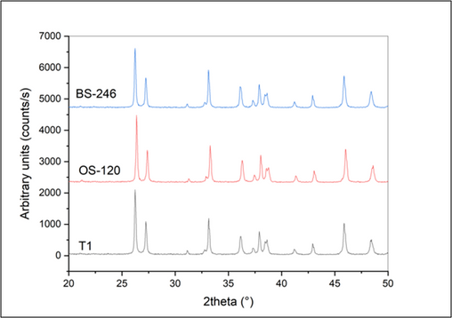
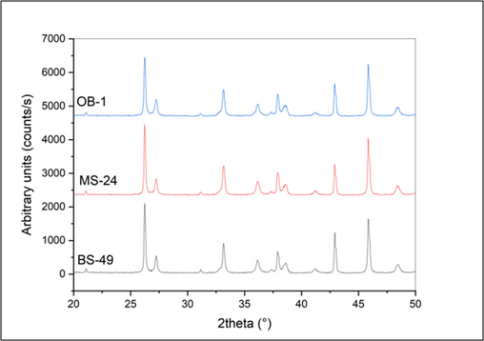
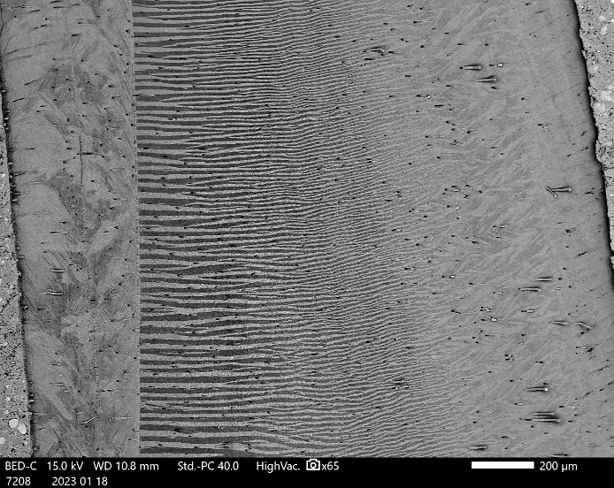
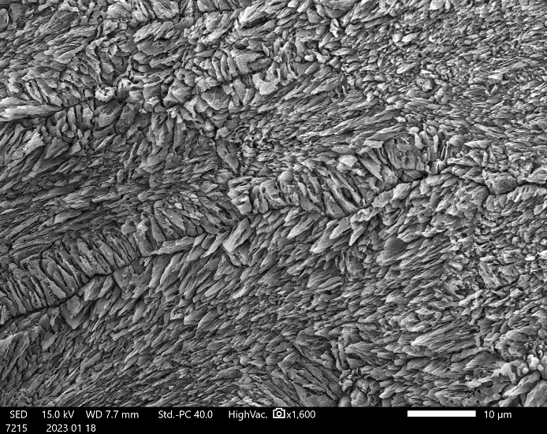
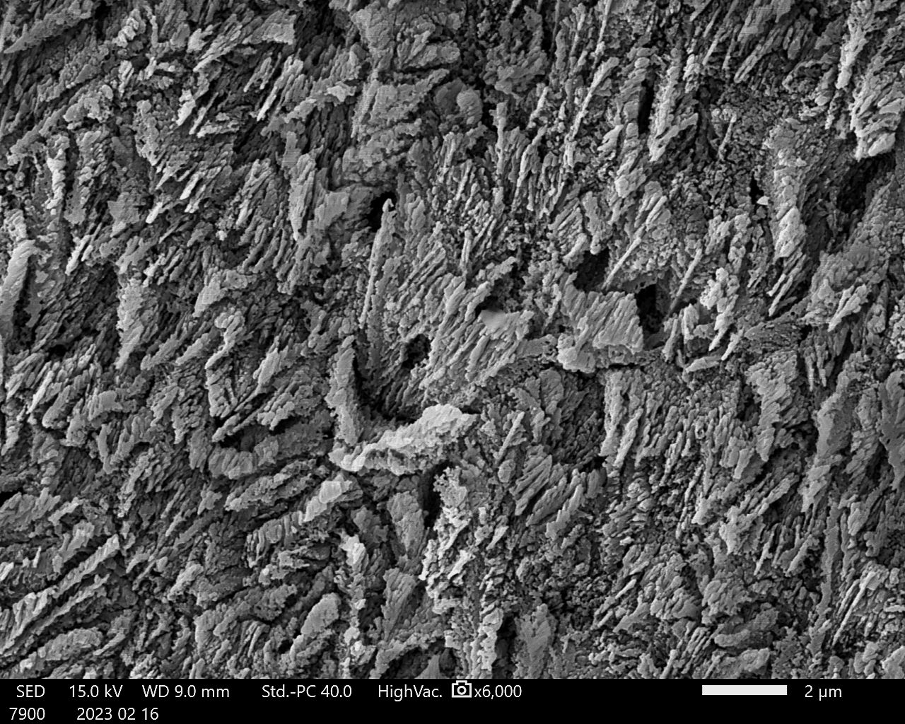
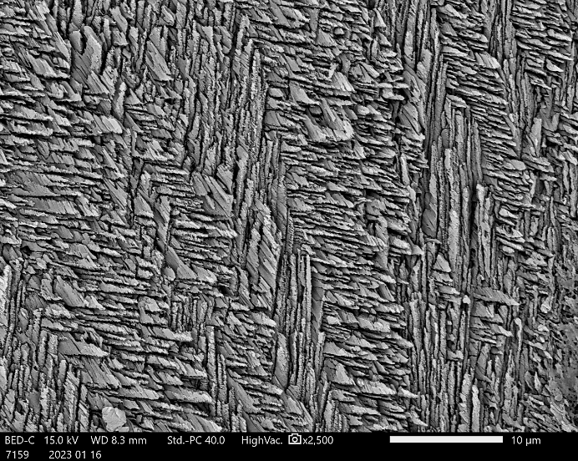
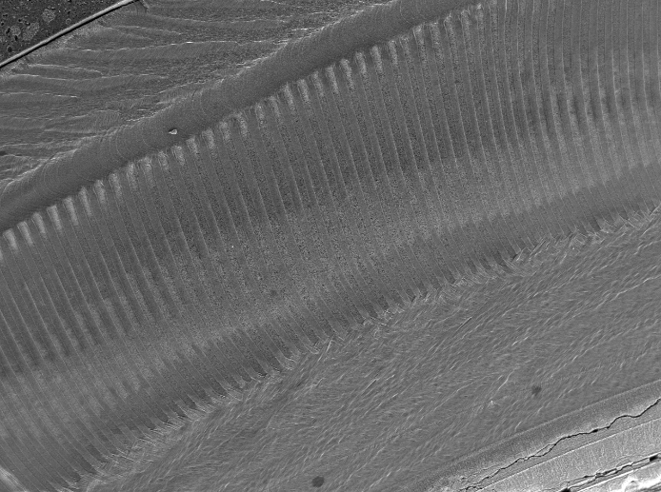
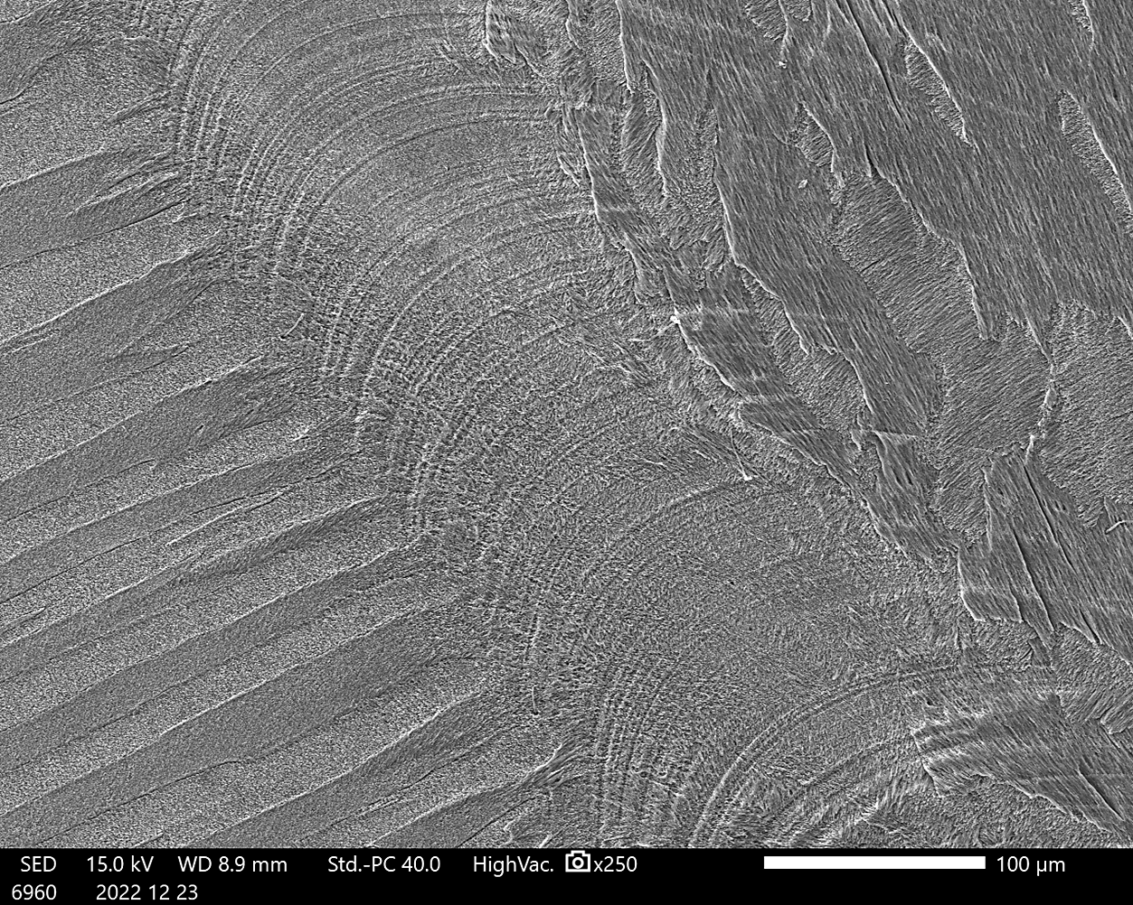
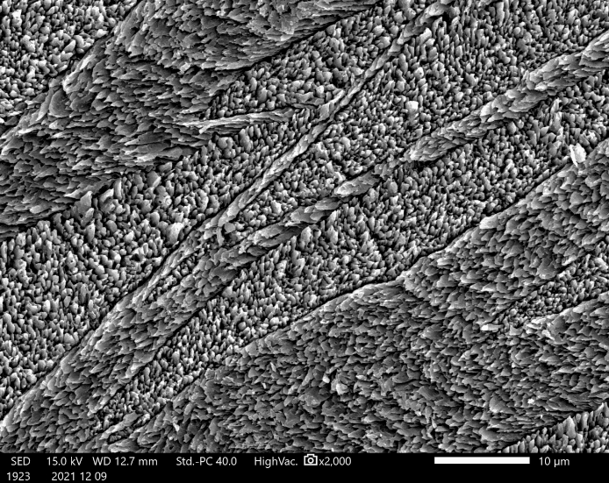
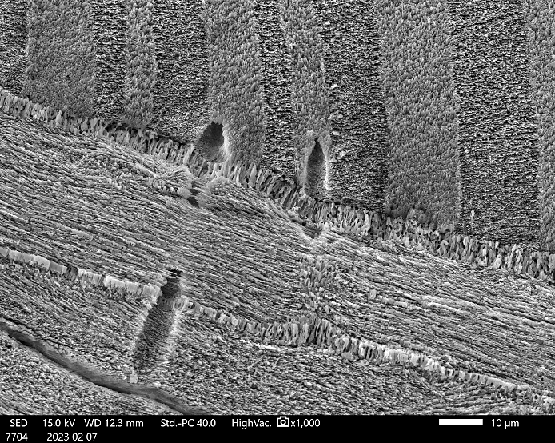
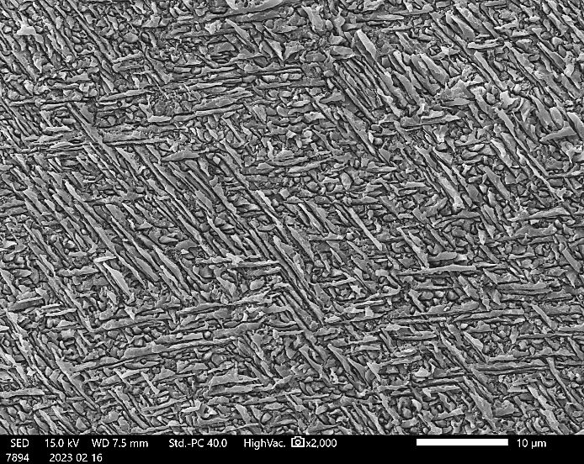
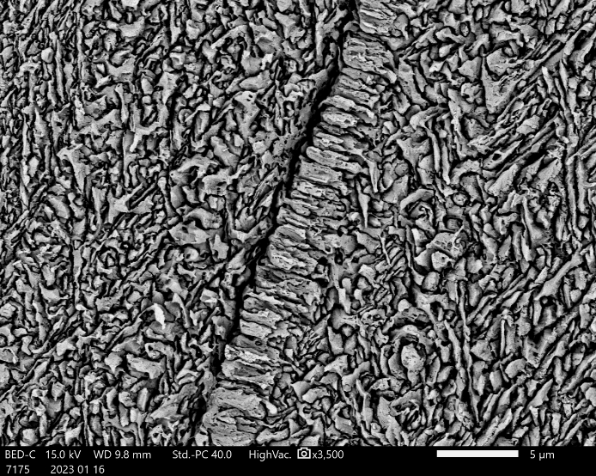
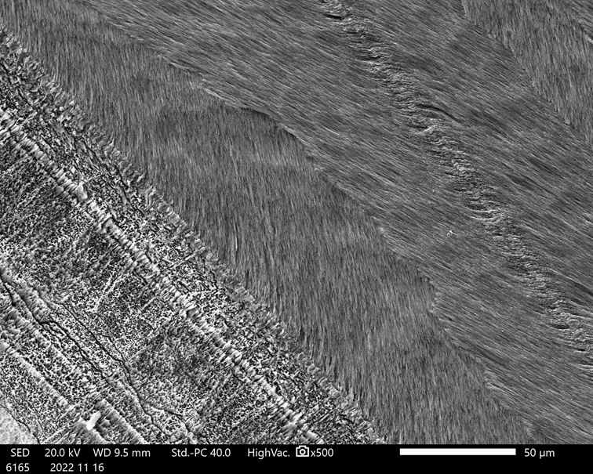
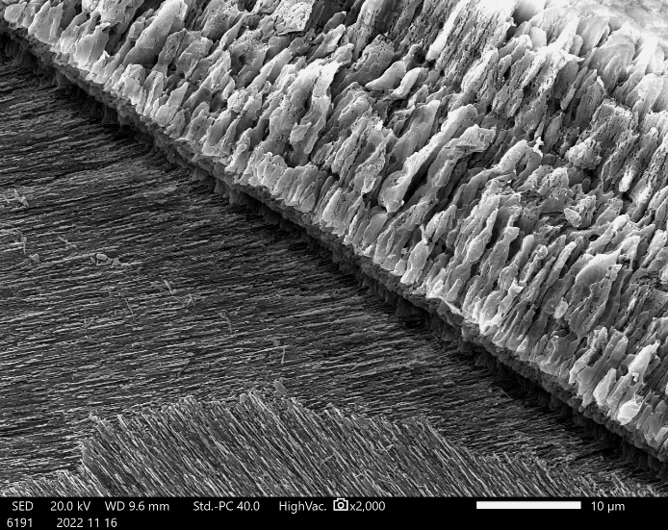
Anadara uropigimelana
Tivela stefaninii
Oliva bulbosa
1
OS
2
1
2
1
OL
2
TL
OL
M1
TL
IL
OL
M2
M1
200 µm
10 µm
2 µm
10 µm
200 µm
IL
100 µm
3
4
3
4
3
4
PM
OL
4
GL
GL
M2
OS
GL
PM
IL
IL
ML
GL
OL
10 µm
10 µm
10 µm
5 µm
50 µm
10 µm
Aragonitic shell: crossed lamellar OL, complex crossed lamellar IL, irregular simple prismatic PM, bands of dendritic nondenticular composite prisms.
  Aragonitic shell: outer composite prismatic layer, middle crossed lamellar layer, and inner complex crossed lamellar layer.
Aragonitic shell: alternation of several crossed lamellar layers + a transitional layer defined by several growth lines, a crossed lamellar callus and a myostracal layer.

Slide 3
Supplementary

Slide 4
Why this study?
The investigation of the shell microstructure and mineralogy is an important task:
It is a valuable tool to check fossil shell preservation before geochemical analyses.
It provides novel data on the shell fabric of poorly known mollusc species, increasing the availability of useful characters for phylogenetic, evolutionary, crystallographic and palaeoenvironmental studies.
Why these species?
Anadara uropigimelana, Tivela stefaninii and Oliva bulbosa frequently occur in archaeological shell assemblages of the Arabian region and are currently living in the Indo-Pacific region.
Their abundance in archaeological assemblages and the occurrence of clear growth lines and increments in their shells, makes them excellent tools to be used for high resolution palaeoclimatic and palaeoenvironmental studies. However, no data on their shell microstructure have been published.
1 cm
Chiari et al. 2025

Slide 5
Setting
(A) location of the HAS1 settlement (green star); (B) northern plateau of the Inqitat promontory; (C) eastern section of the midden; (D) HAS1 settlement showing the position of the circular structures (B5, B9).
11 mollusc specimens belonging to 3 different species were analysed: 2 bivalves, Anadara uropigimelana and Tivela stefaninii, and 1 gastropod, Oliva bulbosa.
The three species were collected from two stratigraphic units within two circular structures (US30 and US54) and from three stratigraphic units within a shell midden (US63, US70, US95).

Slide 6
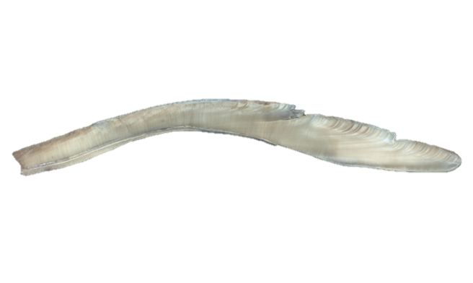
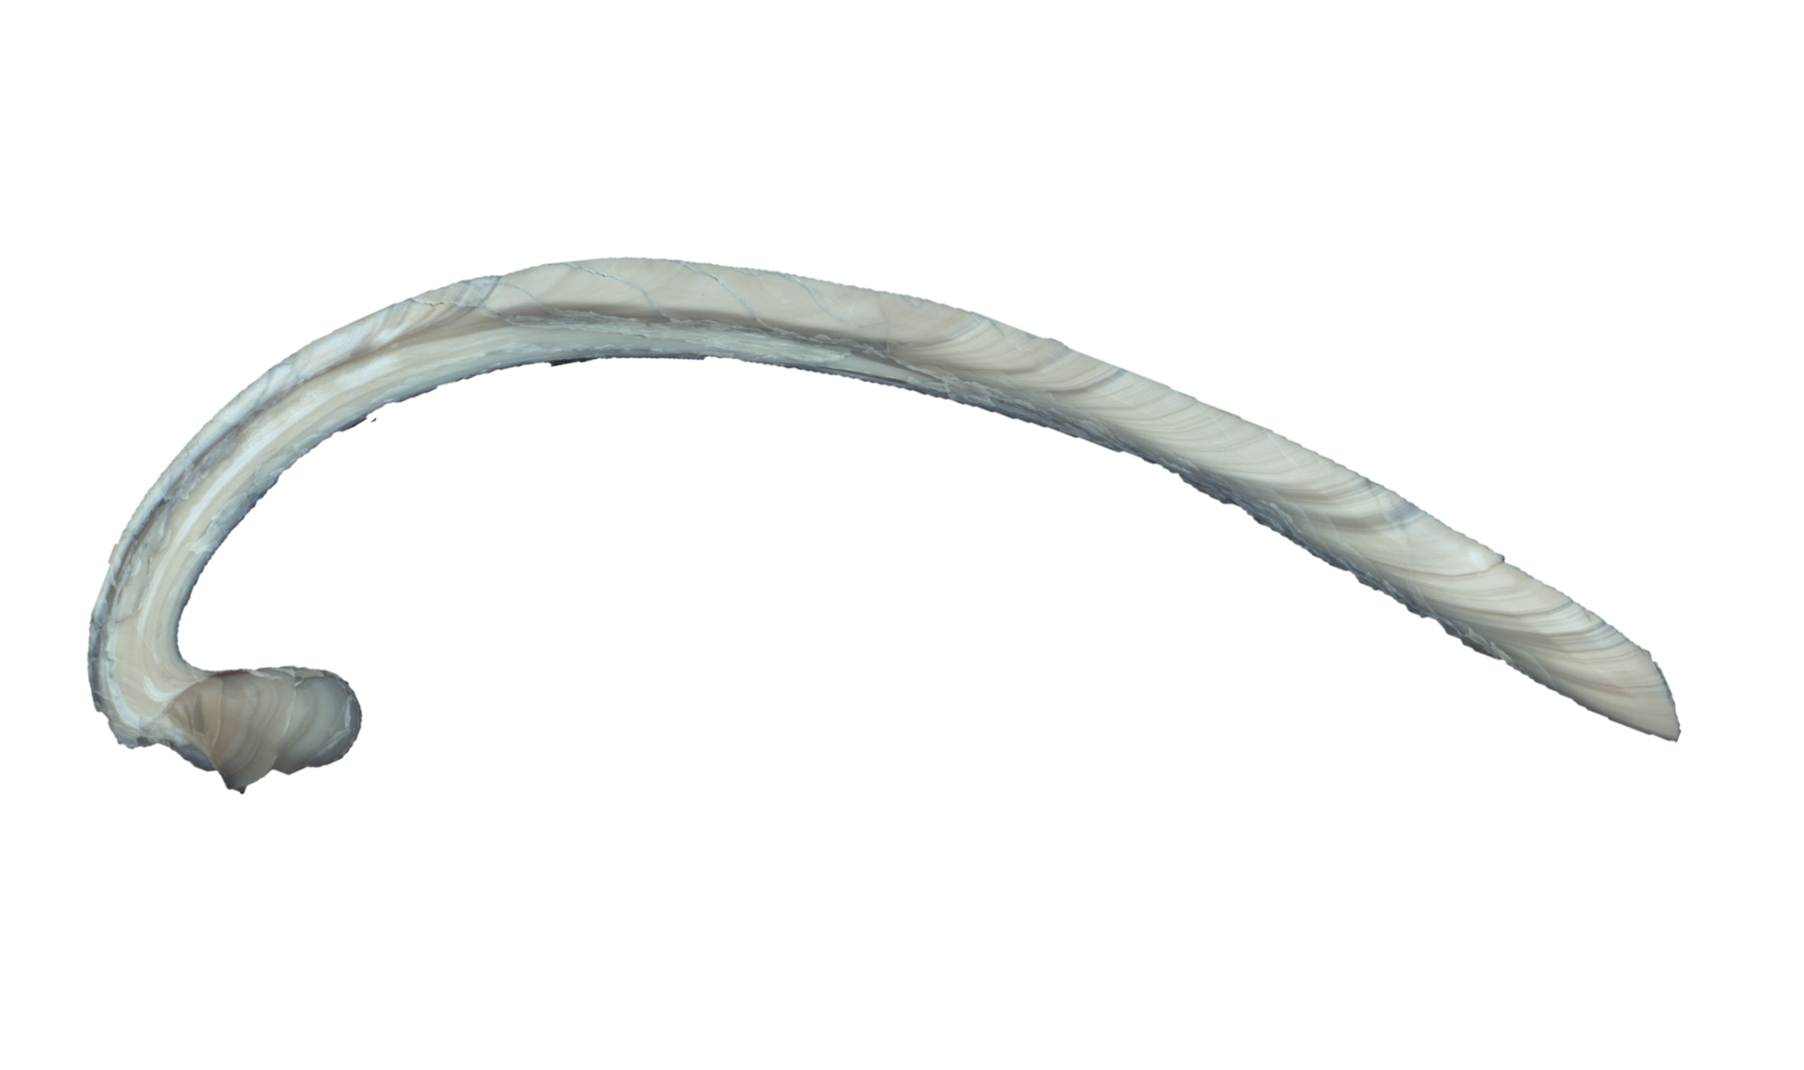
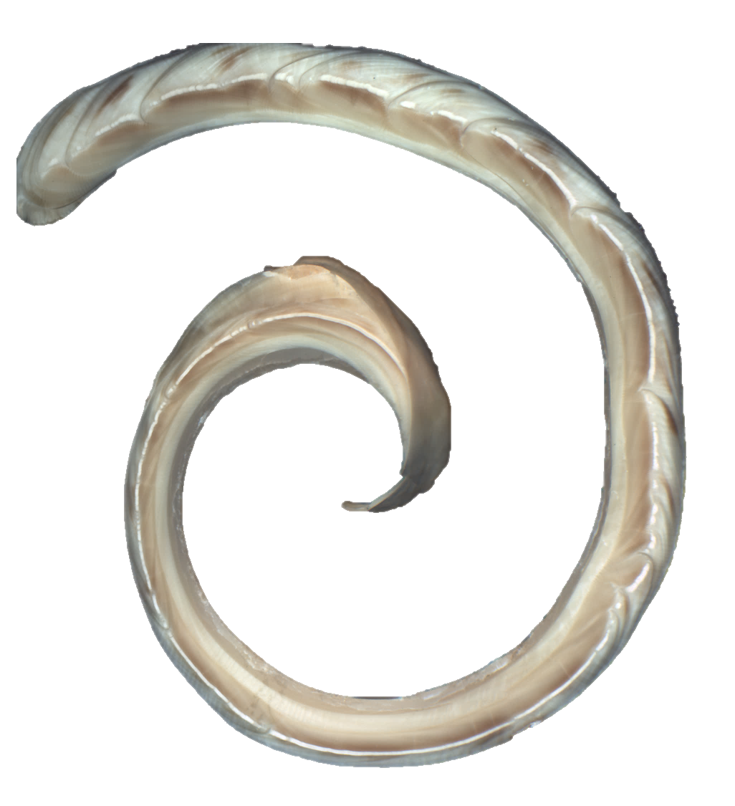
Materials and Methods
US | ID Number | Species
US30 | BS-300 (MPUM 12334) | Anadara uropigimelana
 | BS-246 (MPUM 12340) | Tivela stefaniniii
 | BS-39 (MPUM 12409) | Oliva bulbosa
US54 | OS-107 (MPUM 12335) | Anadara uropigimelana
 | OS-120 (MPUM 12341) | Tivela stefaniniii
US63 | MS-296 (MPUM 12336) | Anadara uropigimelana
 | MS-24 (MPUM 12411) | Oliva bulbosa
US70 | A2 (MPUM 12337) | Anadara uropigimelana
 | T1 (MPUM 12343) | Tivela stefaniniii
US95 | A1 (MPUM 12338) | Anadara uropigimelana
 | OB1 (MPUM 12413) | Oliva bulbosa
Bivalve specimens were cut in half longitudinally along the axis of maximum growth, gastropod specimens were cut transversely.
One half of each shell was cut again to obtain a slice about 1 cm-thick; the remaining part was crushed to a fine powder using an agate mortar and pestle and analysed by XRD to define the mineralogical composition and to verify the shell preservation.
Anadara uropigimelana, MS-296
1 cm
Oliva bulbosa, MS-24
Tivela stefaninii, BS-246
Each slice was glued on glass slides, ground smooth and etched with 5% hydrochloric acid (HCl) for 10 seconds to reveal the detail of the microstructure. After washing with demineralised water and drying, each section was coated with gold and observed using the SEM.
1 cm
1 cm

Slide 7
Shell mineralogy
The XRD analysis allows to differentiate between aragonite and calcite.
XRD analyses indicate that the three mollusc species (Anadara uropigimelana, Tivela stefaninii and Oliva bulbosa) have all an aragonitic shell.
The diffractograms of each specimen were compared with the characteristic spectra of calcite and aragonite, confirming aragonite as the major mineral component of the shell and the absence of a calcitic phase which would have indicated shell alteration.
Anadara uropigimelana
Tivela stefaninii
Oliva bulbosa

Slide 8
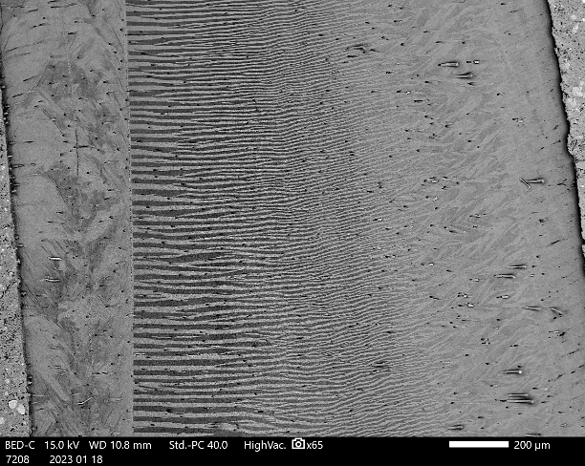
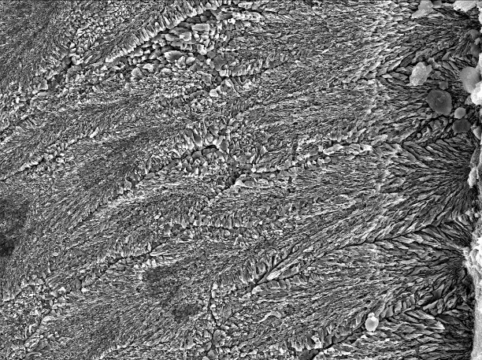
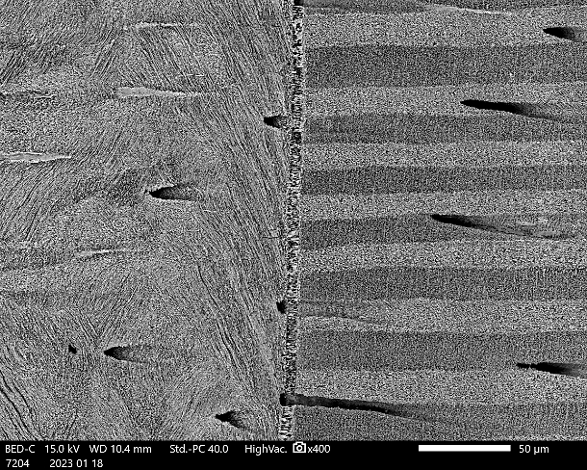
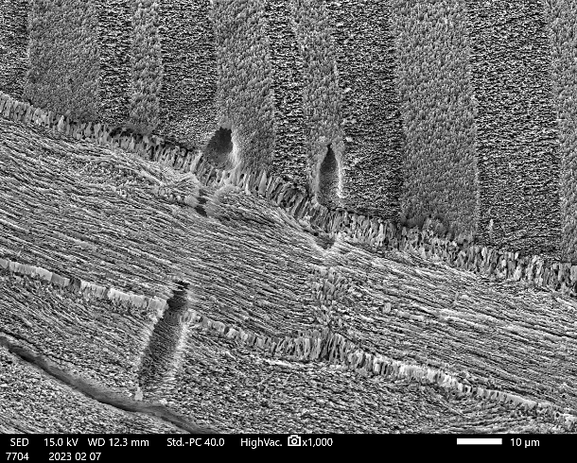
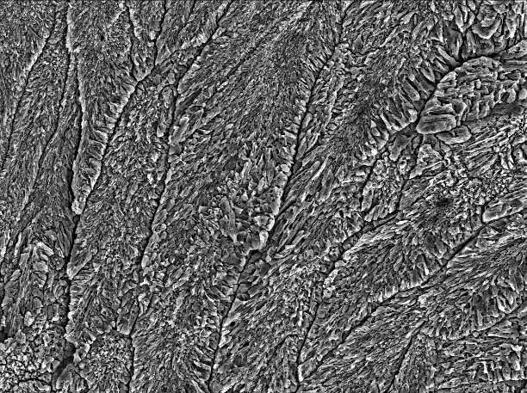

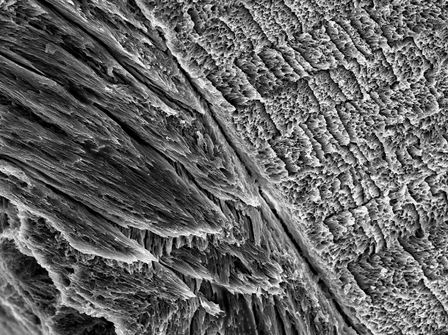
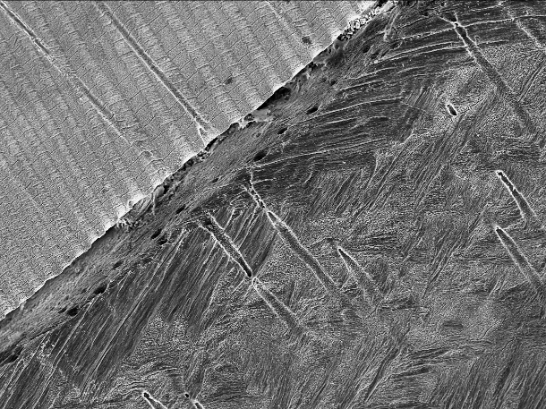
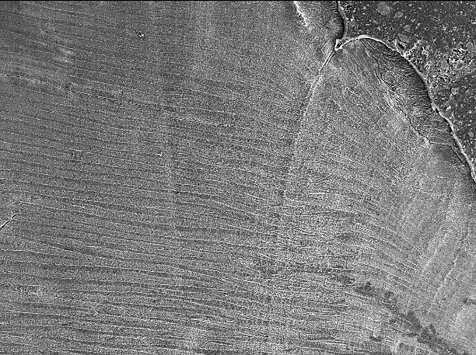

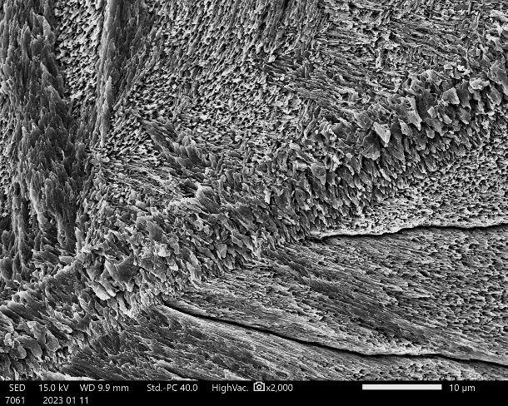
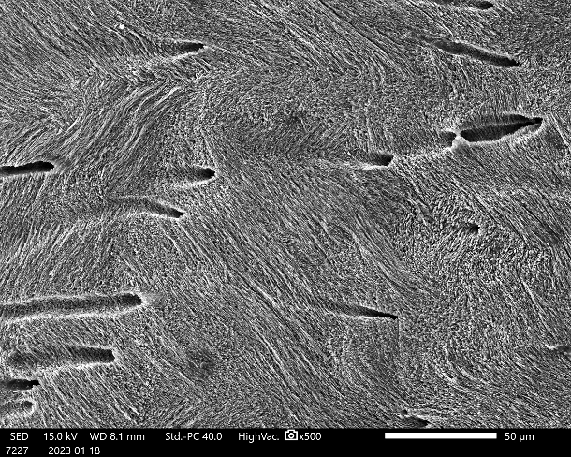
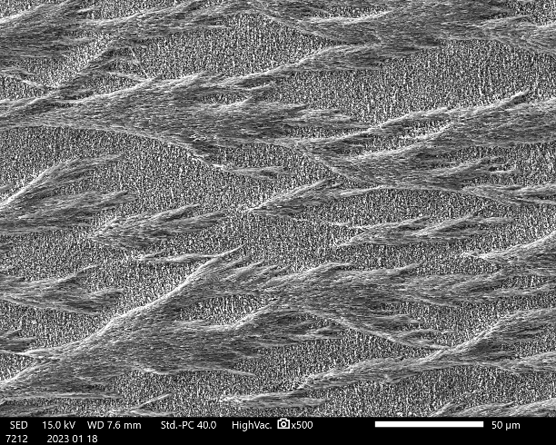
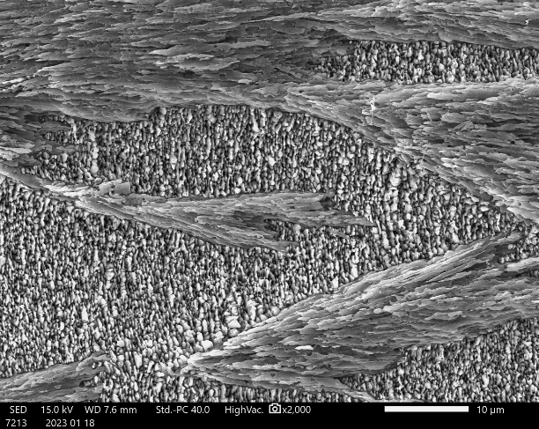
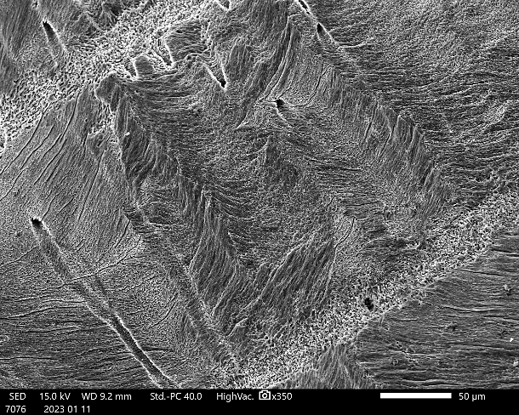
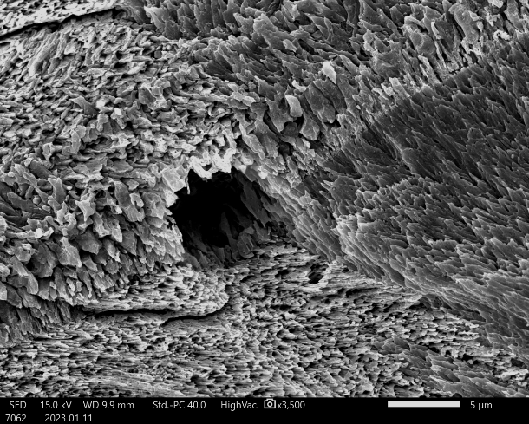
Shell microstructure: Anadara uropigimelana
Specimens of Anadara uropigimelana show an aragonitic shell with an outer crossed lamellar layer, an inner complex crossed lamellar layer and an irregular simple prismatic pallial myostracum; periodic bands of dendritic nondenticular composite prisms occur in the outer part of the outer layer. All the shell is crossed by growth lines and tubules.
1
2
1
2
Outer layer (OL)
It is composed of simple crossed lamellae that change from branching crossed lamellae in the outer part of the layer to linear crossed lamellae in the middle and inner part.
PM
OL
PM
IL
OL
IL
OL
IL
200 µm
20 µm
50 µm
10 µm
3
4
Inner layer (IL)
The inner layer is present only internally with respect to the pallial line and is absent in the hinge plate. It is composed of irregular complex crossed lamellae with irregularly shaped, laterally interdigitating first order lamellae.
3
4
OL
OL
IL
IL
20 µm
10 µm
Pallial myostracum (PM)
The outer and the inner layers are sharply separated by a pallial myostracum. It is composed of simple irregular prisms of aragonite.
10 µm
100 µm
5
6
5
6
CP
GL
Dendritic NDCP layer (CP)
In three specimens an additional layer is observed in the outer layer. The microstructure of this layer is dendritic nondenticular composite prismatic. This layer is not continuous but is locally present in nearly periodic bands in the outer part of the outer layer, interrupted and separated by major growth lines, where only the crossed lamellar microstructure occurs.
GL
100 µm
10 µm
10 µm
50 µm
7
8
7
8
GL
50 µm
10 µm
50 µm
5 µm

Slide 9
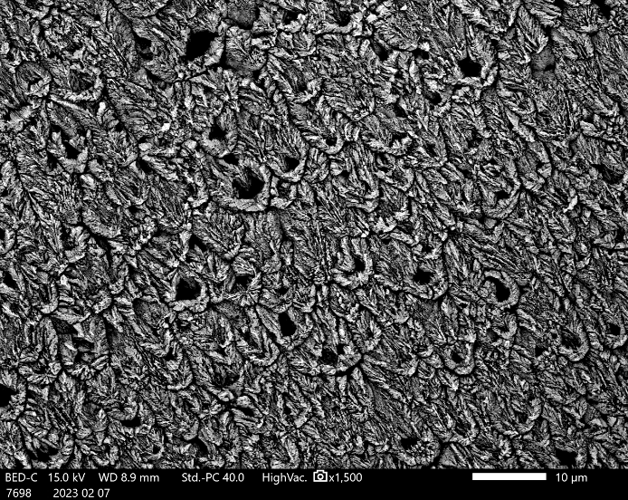
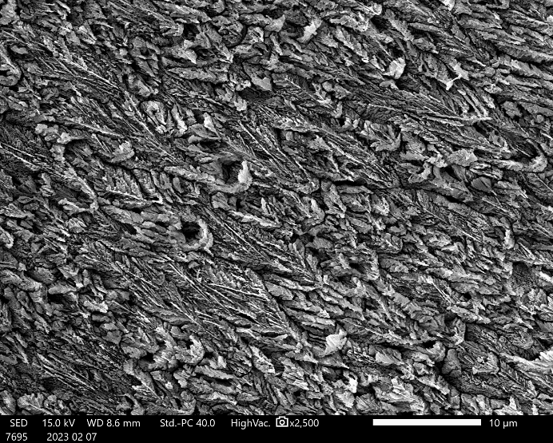
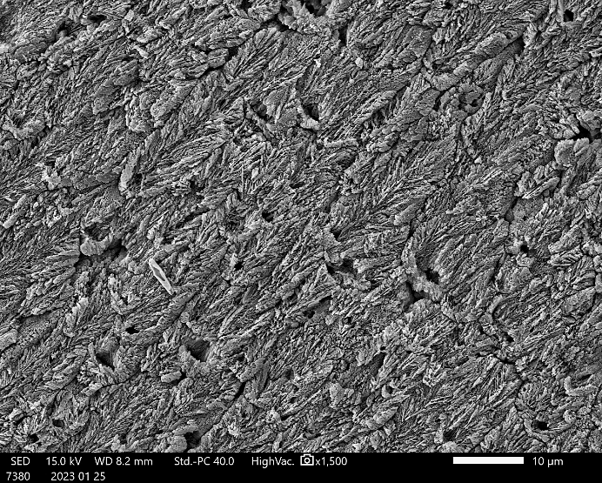
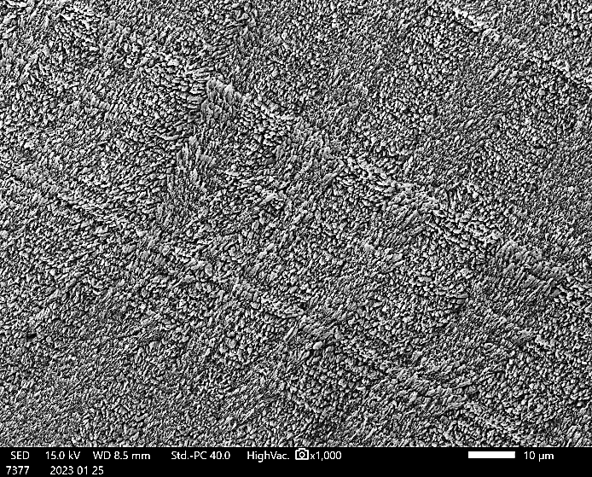
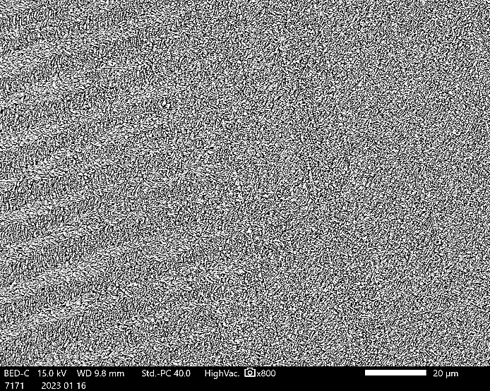
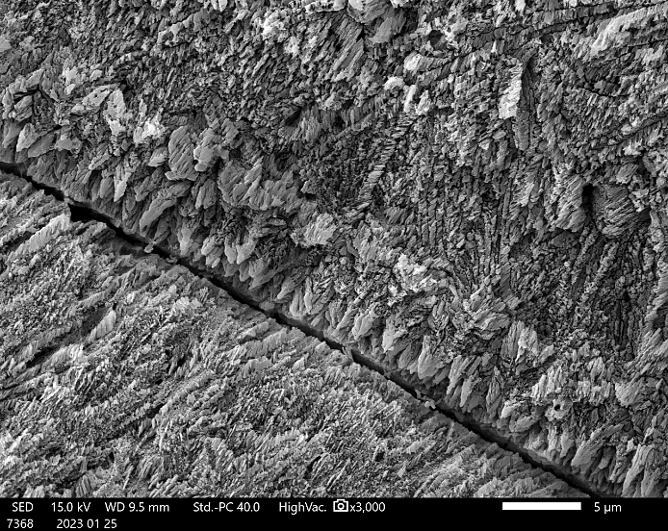
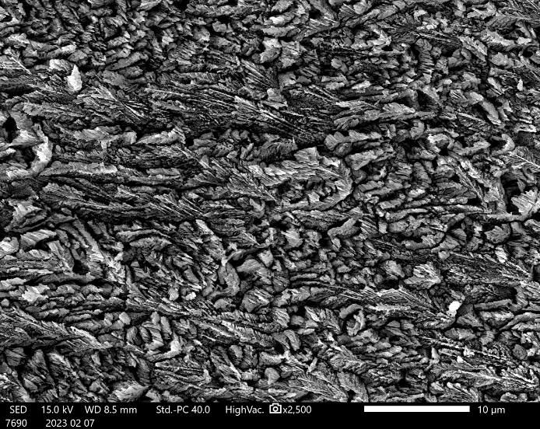
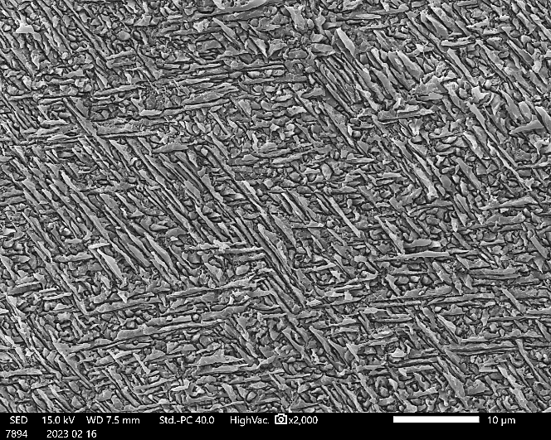

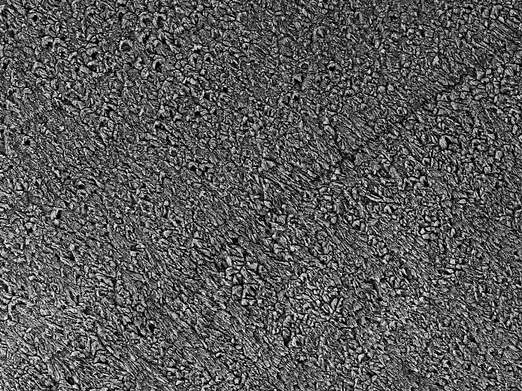

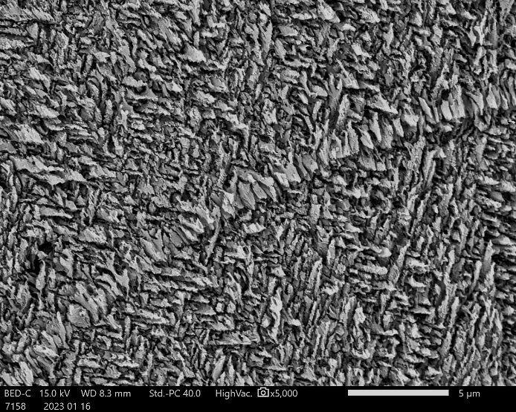
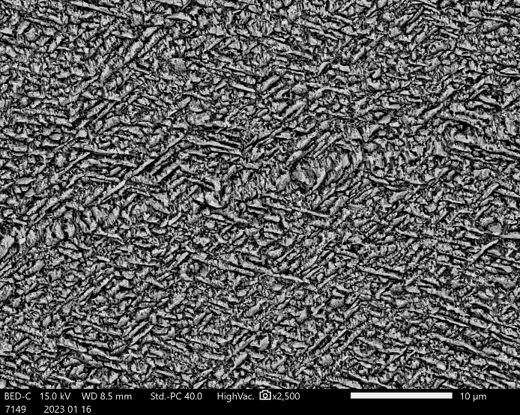
Shell microstructure: Tivela stefaninii
Specimens of Tivela stefaninii show an aragonitic shell with an outer composite prismatic layer, a middle crossed lamellar layer, and an inner complex crossed lamellar layer.
1
2
Outer layer (OL)
The outer layer is composed of first order prisms formed by second order fibrous prisms radiating from a spindle, toward the depositional surface; each second order fibrous prisms seem to be composed of lower order thin prisms radiating in a fan-like way from a central longitudinal axis. This microstructure is a composite prismatic seemingly with a spherulitic origin.
10 µm
10 µm
3
4
1
2
Middle layer (ML)
The middle layer is characterised by a simple crossed lamellar microstructure, with linear first order lamellae.
IL
ML
2 µm
10 µm
20 µm
Inner layer (IL)
The inner layer is composed of a distinct fine complex crossed lamellar microstructure, characterised by isolated and elongated structural units not arranged into first order or second order lamellae.
10 µm
5
6
3
4
GL
5 µm
10 µm
10 µm
5 µm
7
OL
8
5
6
GL
GL
GL
ML
20 µm
10 µm
5 µm
10 µm

Slide 10
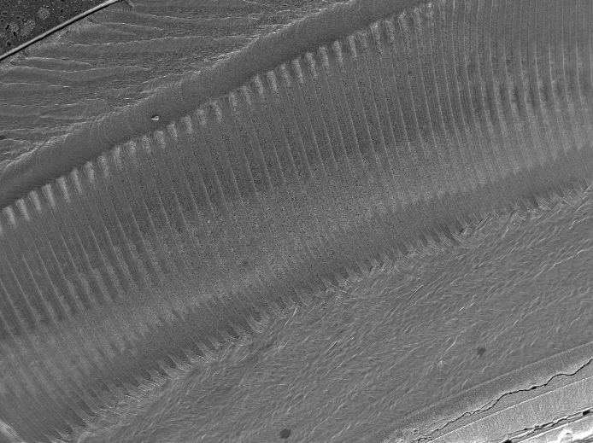
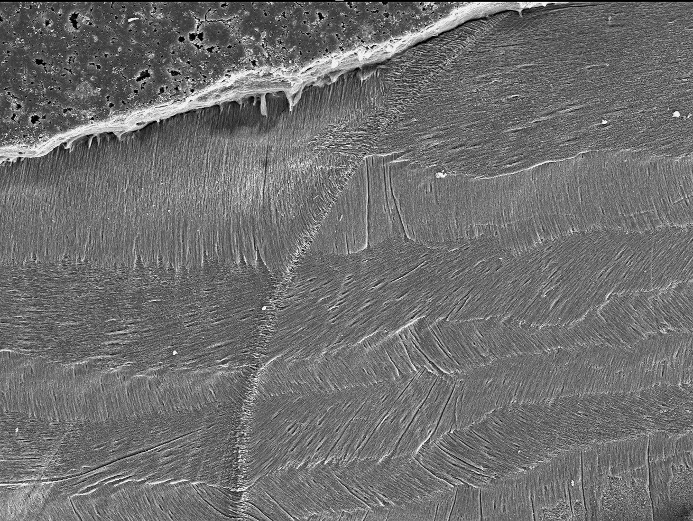
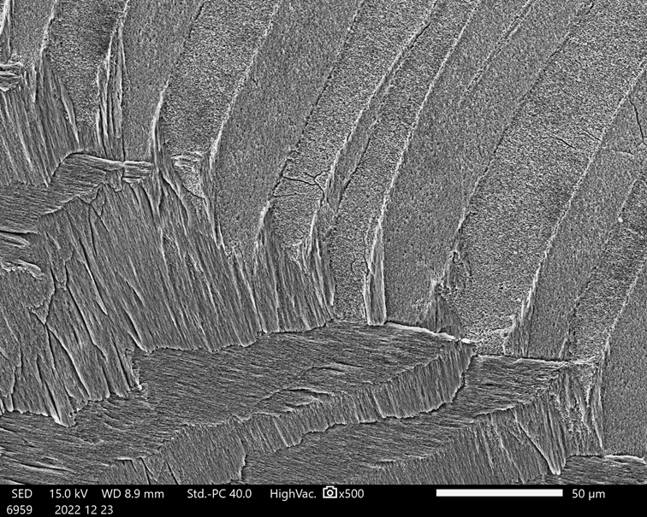
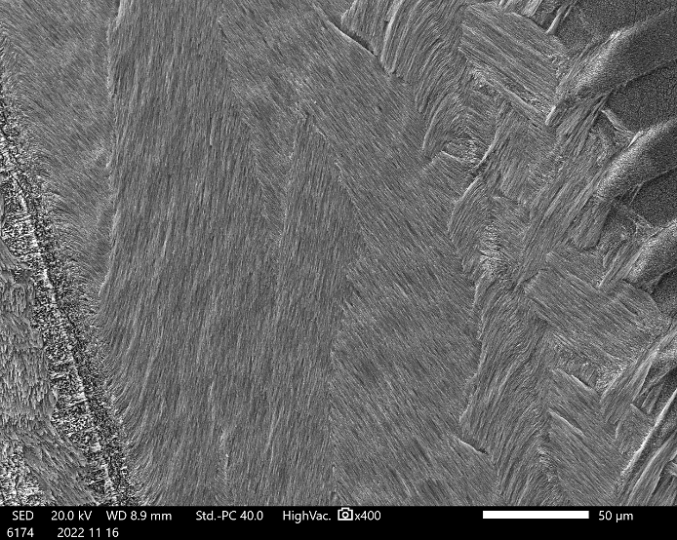
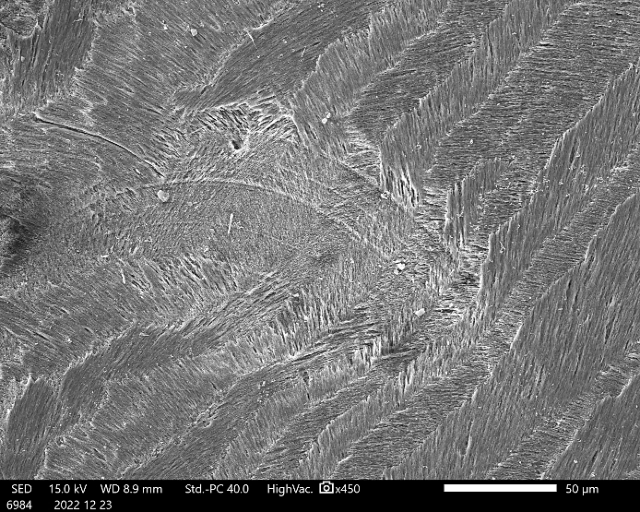
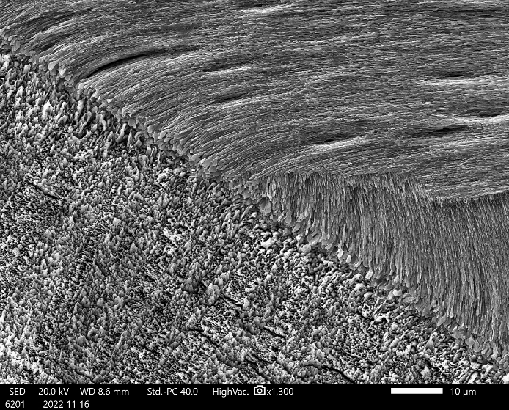








Shell microstructure: Oliva bulbosa
Specimens of Oliva bulbosa have an aragonitic shell characterised by an alternation of several layers with a crossed lamellar microstructure.
1
OL
2
Outer layer (OL)
It is composed of linear and slightly branching crossed lamellae and is separated from the M2 by a sharp limit or by the TL.
1
2
M1
TL
M1
M1
GL
GL
Transitional layer (TL)
It is characterised by numerous growth lines; sometimes it shows the branching crossed lamellar microstructure of the OL, other times the microstructure is not well defined and is masked by the numerous growth lines.
M2
M2
M2
200 µm
IL
50 µm
50 µm
IL
50 µm
3
4
3
4
OL
M2
Middle layer (M1 and M2)
It is composed of two sublayers showing the same linear crossed lamellar microstructure but with different orientation of the crossed lamellae. The boundary between these two layers is sharp.
M2
GL
PM
TL
TL
PM
M1
IL
GL
100 µm
50 µm
50 µm
IL
10 µm
5
6
Inner layer (IL)
It is constituted by a linear crossed lamellar microstructure. The boundary with the M2 is defined by a layer with an irregular simple prismatic microstructure.
5
6
PM
M2
OL
ML
Other layers (CL and ML)
CL occurs in the outer part of the inner whorls outside the OL and represents the callus. It has a linear crossed lamellar microstructure and is separated from OL by a stockade of irregular simple prisms.
ML is observed in the outer part of the columella and consists in a stockade of irregular simple prisms. It represents the attachment site of the columellar muscle.
10 µm
20 µm
IL
5 µm
10 µm
7
8
7
8
GL
10 µm
CL
GL
M2
M1
OL
OL
M2
M1
TL
10 µm
100 µm
50 µm
100 µm

