Slide 1
A framework for stabilizing deep-water oxygen under future climate change
Mahtab Yaghouti, Ana Isabel Ayala-Zamora, Jorrit Mesman, Don Pierson, Tom Shatwell, Lipa Gutani Terrence Nkwalale, Karsten Rinke, Eleanor Jennings, Peter Hunter, R. Iestyn Woolway, Ian D. Jones
This project has received funding from the European Union`s Horizon 2021 ​
research and innovation programme under the Marie Skłodowska-Curie grant agreement No 956623.​

Slide 2
Introduction
Worldwide hypolimnetic deoxygenation (Jane et al.,2022)
Negative consequences
Future climate change
Nutrient
GHG

Slide 3
Questions
How could climate change impact deepwater DO?
What is the main in-lake driver?
How much intervention is required to mitigate climate change?
DO model

Slide 4
Model structure
Stratified deepwater DO profile
Fully saturated onset
Depletion rates¹ modified by temperature
Mixing into and within the hypolimnion
Two parameters
1. Livingston & Imboden, 1996
Notes:
Two parameters need to be calibrated using oxygen profile values

Slide 5
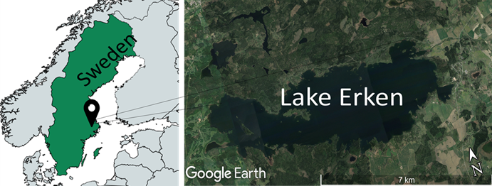
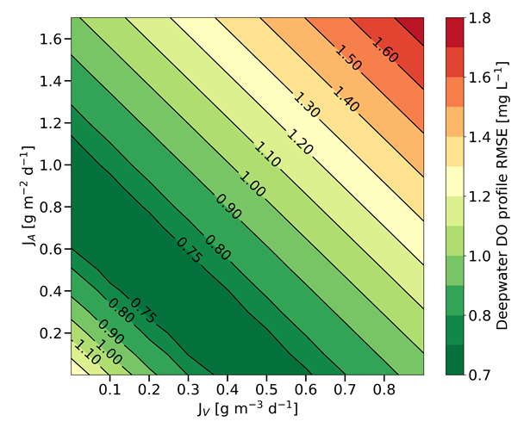
Case study
Dimictic, mesotrophic
Mean depth= 9 m
Deepwater: < -13.5m
Anoxia (< 0.5 mg/L) duration: 45d (2022)
Average volumetric hypolimnion oxygen depletion rate (VHOD)= 0.49 mg L⁻¹ d⁻¹
Sediment oxygen
depletion rate [g m⁻² d⁻¹]
Water-column depletion rate [g m⁻³ d⁻¹]

Slide 6
Model performance
The red shaded area denotes the 90% confidence interval of the model simulations (using 29 parameter sets), the dashed lines are centroid of the model estimations and the black dots are the observed values for the average deepwater DO value.

Slide 7
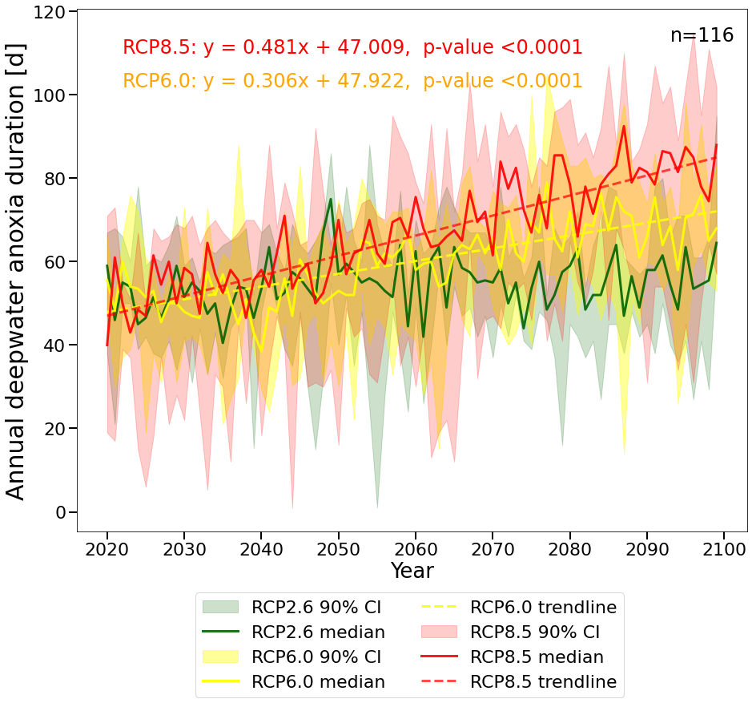
Future simulations
A hydrodynamic model (GOTM) (Ayala et al., 2020)
4 GCMs, 3 RCPs
1.5 to 1.8 times longer

Slide 8
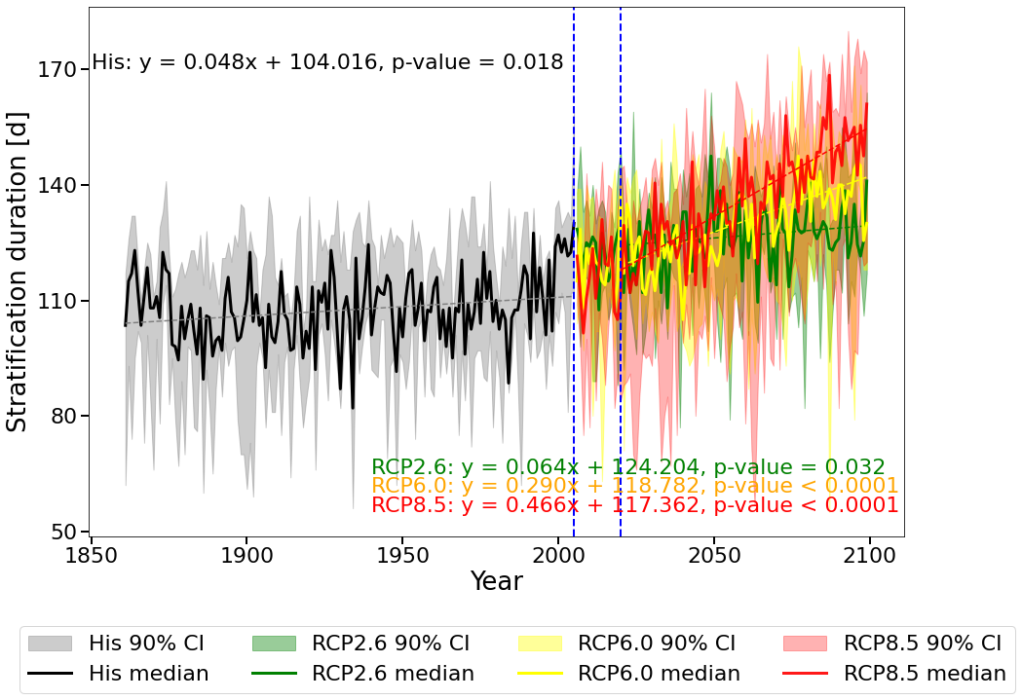
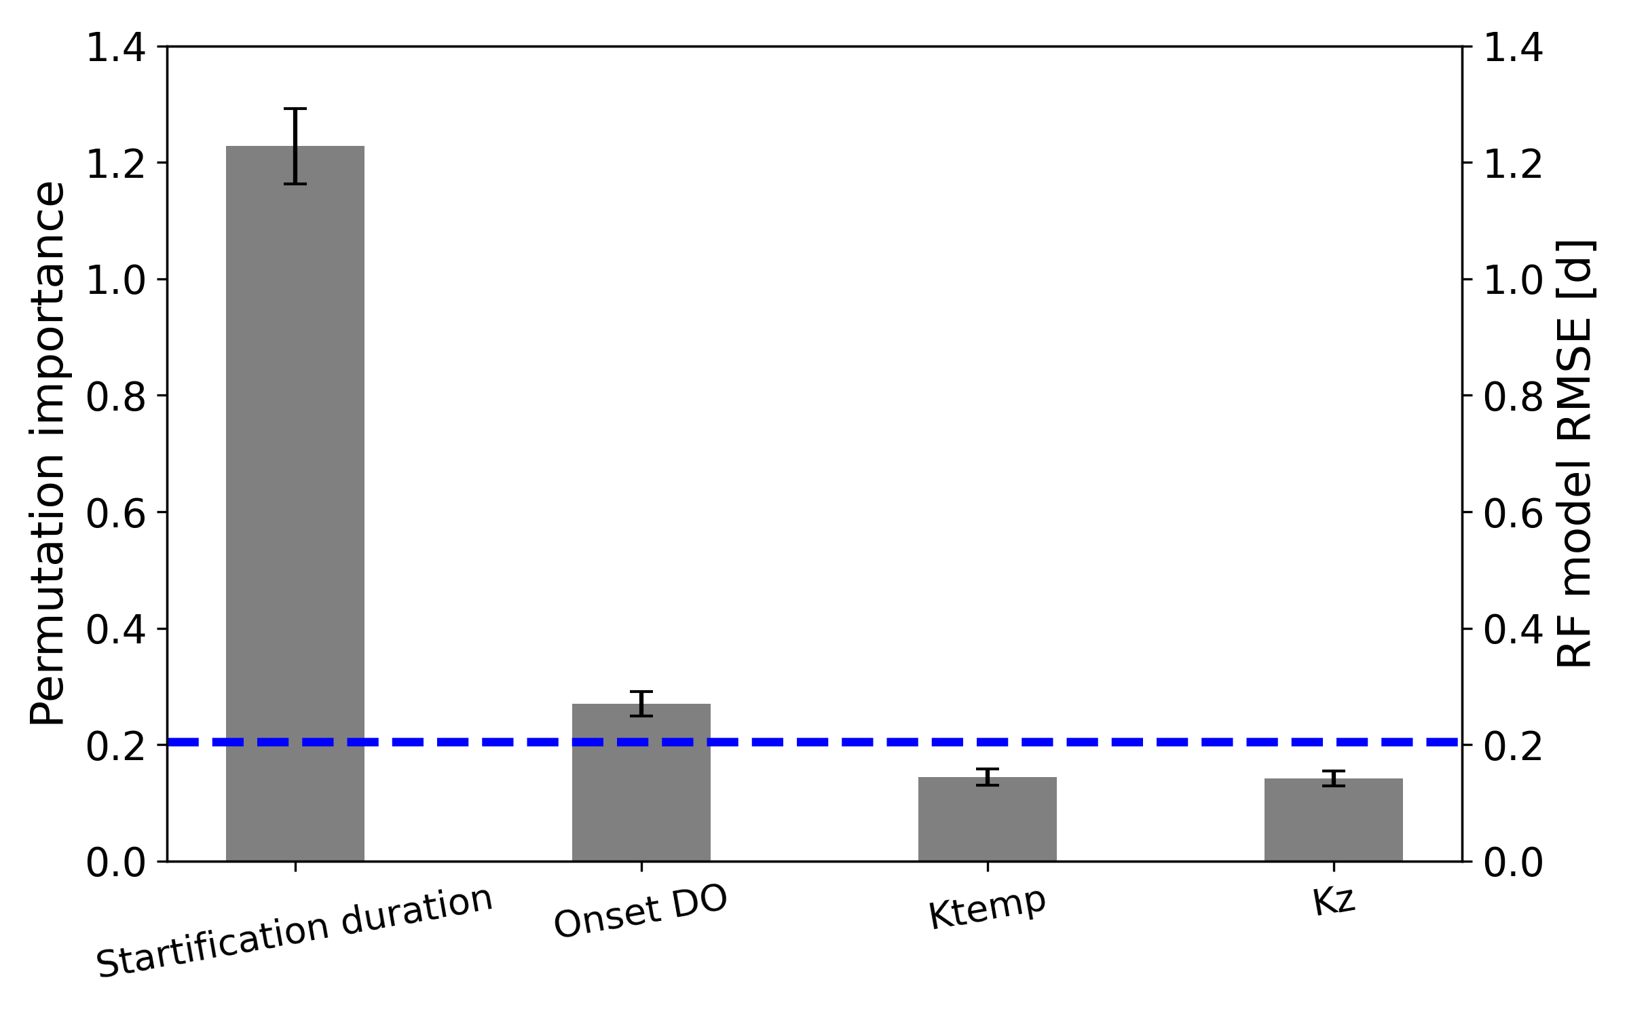
What is the main driver?
Changes of stratification
Importance of drivers in historical anoxia duration
(b)
[d]
(a)
Random Forest RMSE [d]
Temp. modifier
Stratification
Mixing coef.
Notes:
Historical years 1961-2005
RCPS from 2020 to 2100
From 120 days is going to be longer 160 (0.4 a year )
, 140 days

Slide 9
How can we achieve this in long term?
Notes:
Constant dash line

Slide 10
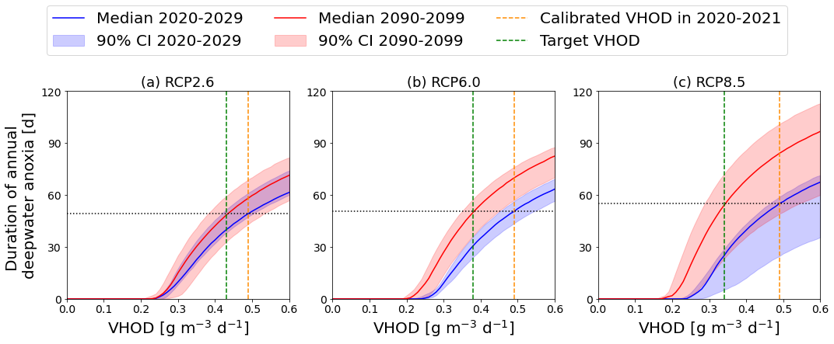
Required reduction in VHOD
12%
22%
31%

Slide 11
Lake restoration for VHOD reduction
Reducing external and internal nutrient inputs
Mixing and oxygenation (e.g., artificial aeration and destratification)
Biological management
DO

Slide 12
Summary
Simple model
Understand lake system
Supporting mitigation strategies
Data efficient: From local to global
D

Slide 13
This model is using to study
How could warming, wind stilling and brightening impact deep-water oxygen dynamics?
How could changes in light climate influence the deoxygenation patterns?
How could changes in lake morphometry impact the deep-water oxygen dynamics?

Slide 14
mahtab.yaghouti@stir.ac.uk
@mahtab_yaghouti
Scan for more:
DO model

