Slide 1
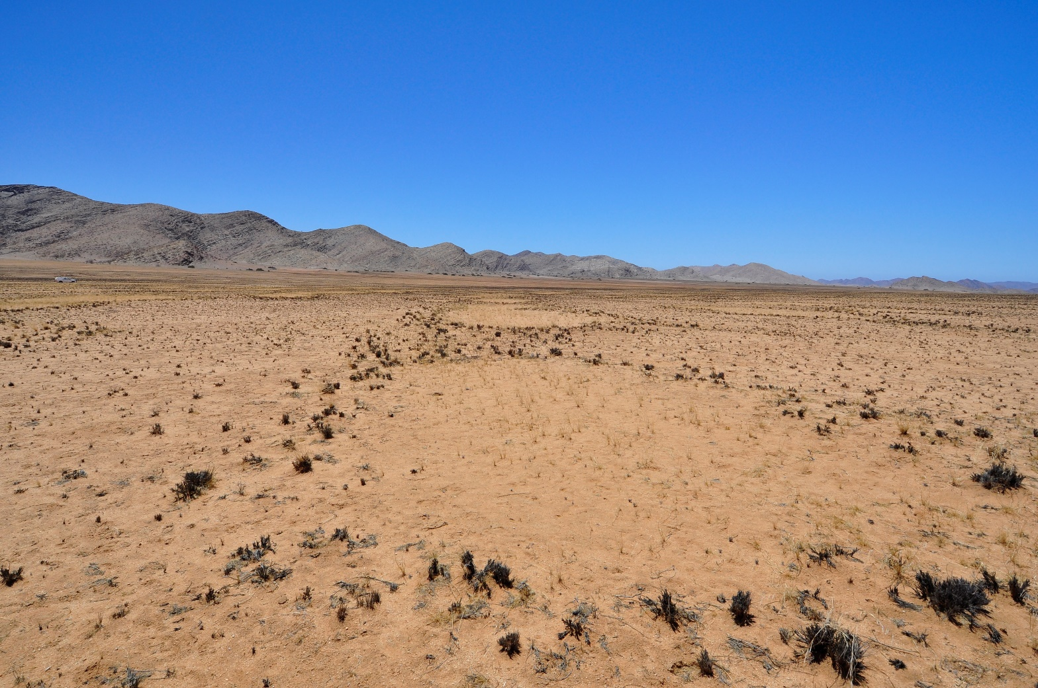
The origin of the elongated fairy circles in the Giribes Plains, northwest Namibia
Hezi Yizhaq, Stephan Getzin, Itzhak Katra, Nina Kamennaya, Yehuda Peled, and Ehud Meron
2nd International Fairy Circle Symposium
27 - 28 February 2025
Wolwedans Village, NamibRand Nature Reserve

Slide 2
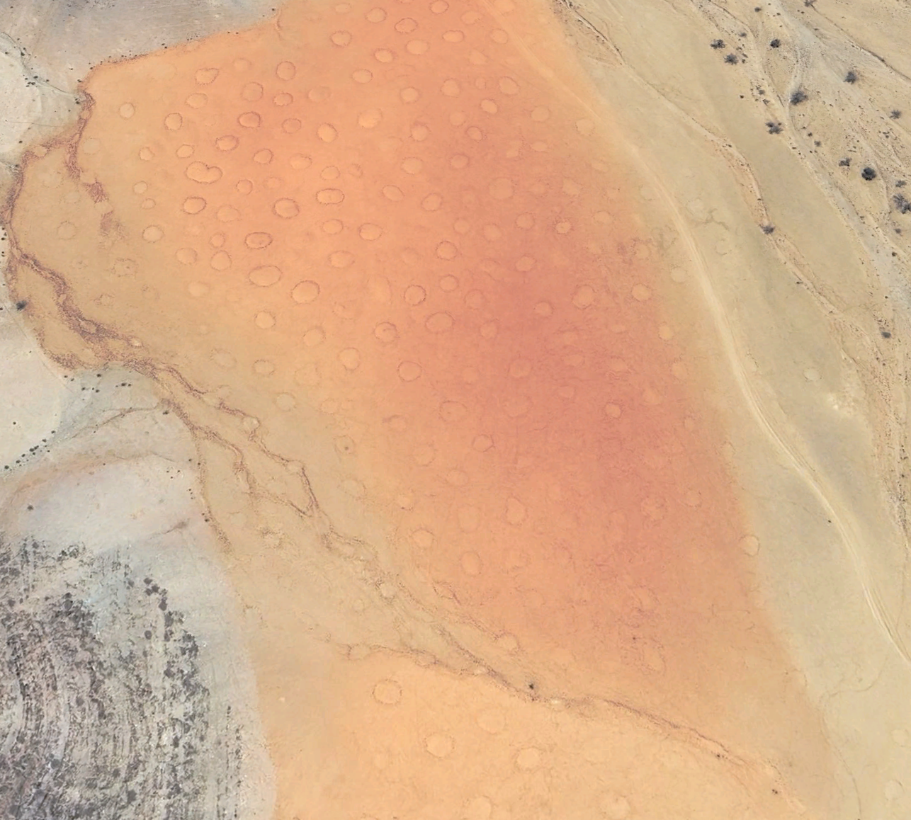
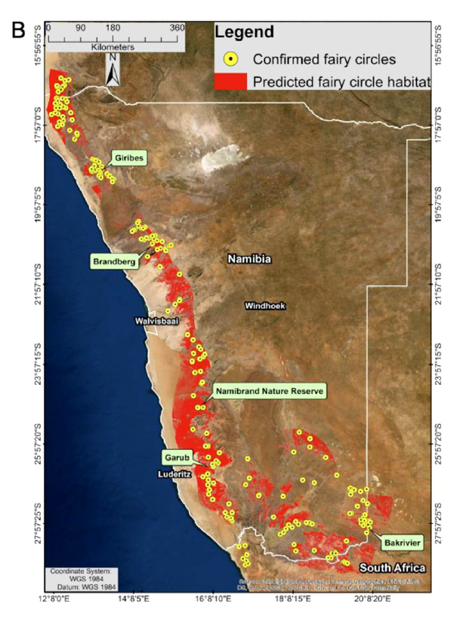
How can we explain the elongated shape of the fairy circles in the Giribes Plains?
Circular fairy circles
Mean annual precipitation 103 mm/y
Getzin et al., 2024
Elongated fairy circles
Meyer et al., 2021

Slide 3
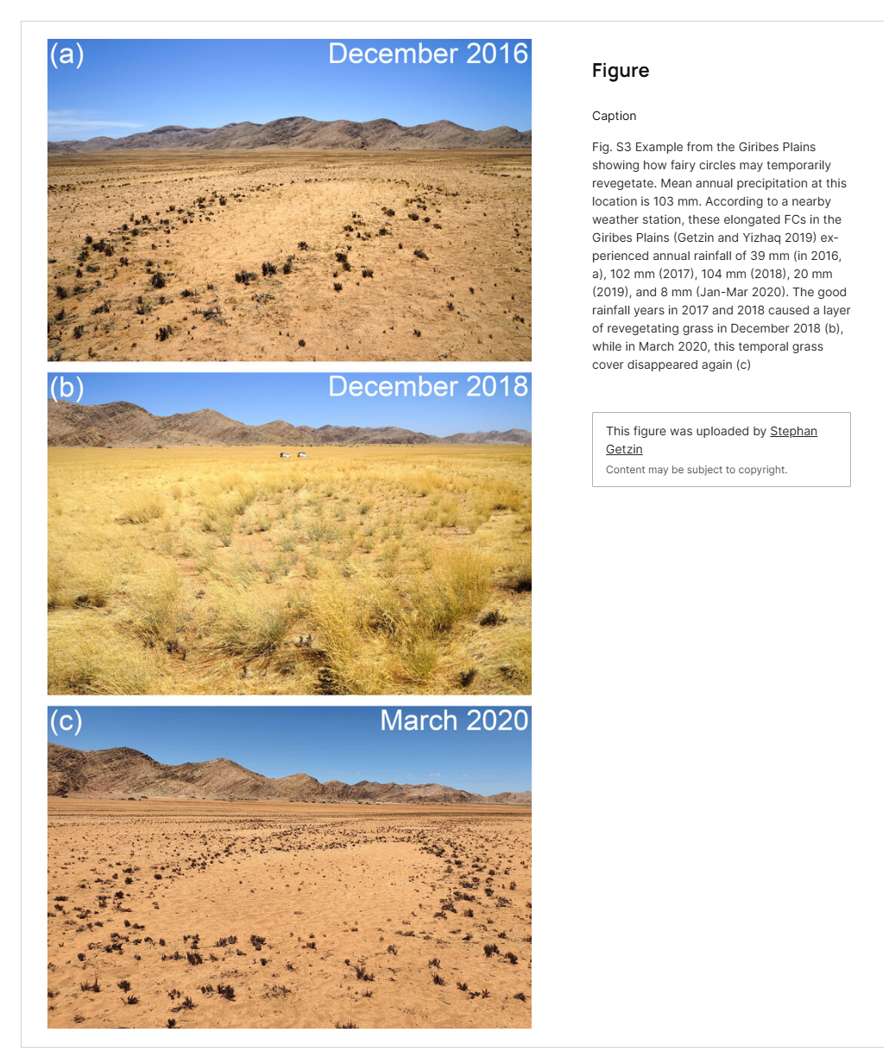
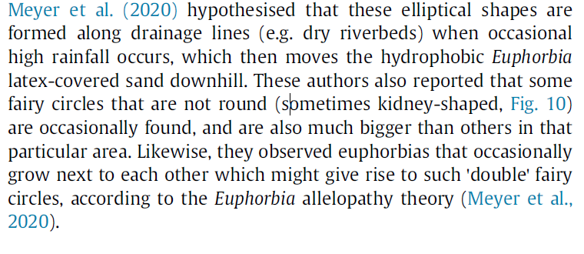
Hypothesis 1- Hydrophobic Euphorbia - Meyer 2020
Hypothesis 2- Anisotropic self organization along
Larger soil diffusion coefficient along dry riverbeds than in the area outside of these lines.
Getzin et al., 2024

Slide 4
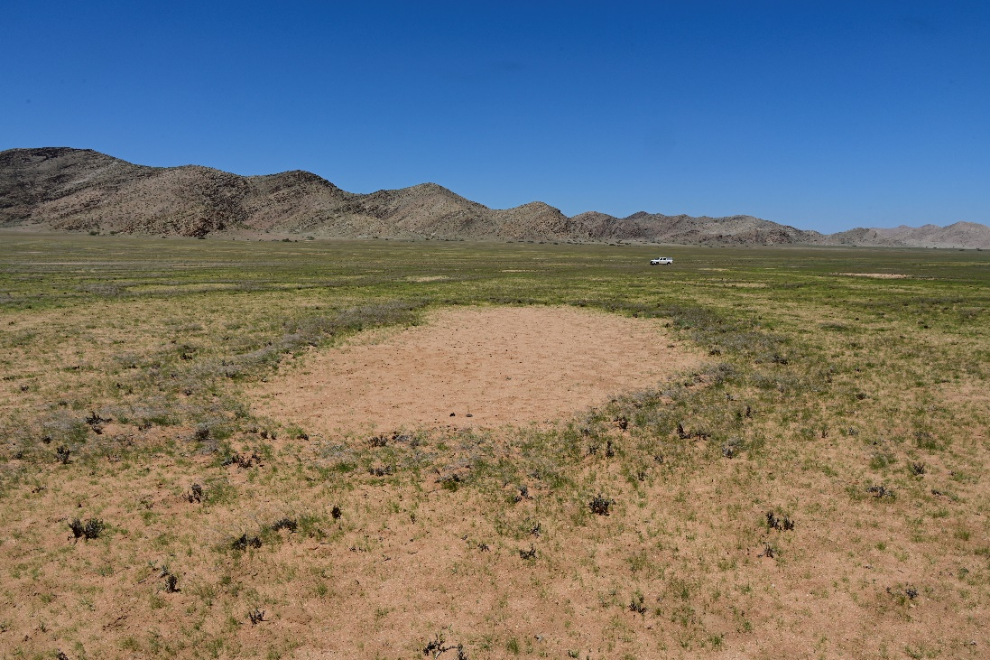
The elongated FC at the Giribes (Getzin and Yizhaq, 2019)

Slide 5
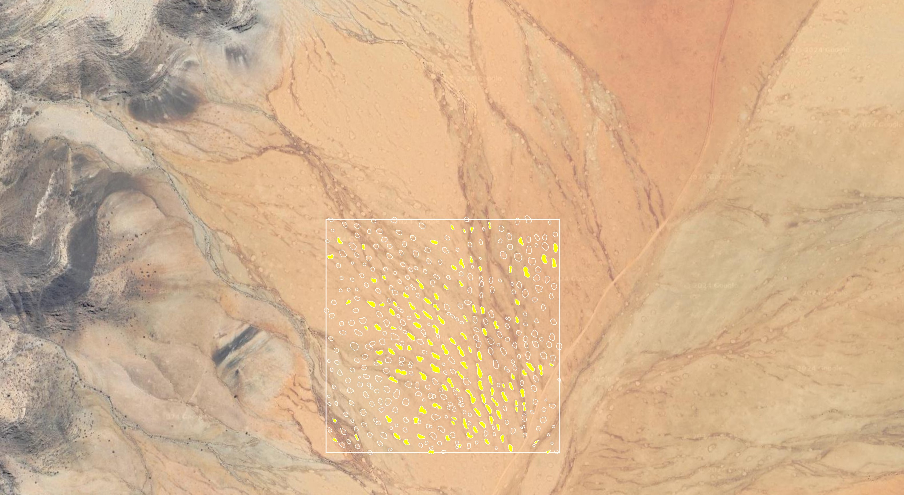

Slide 6
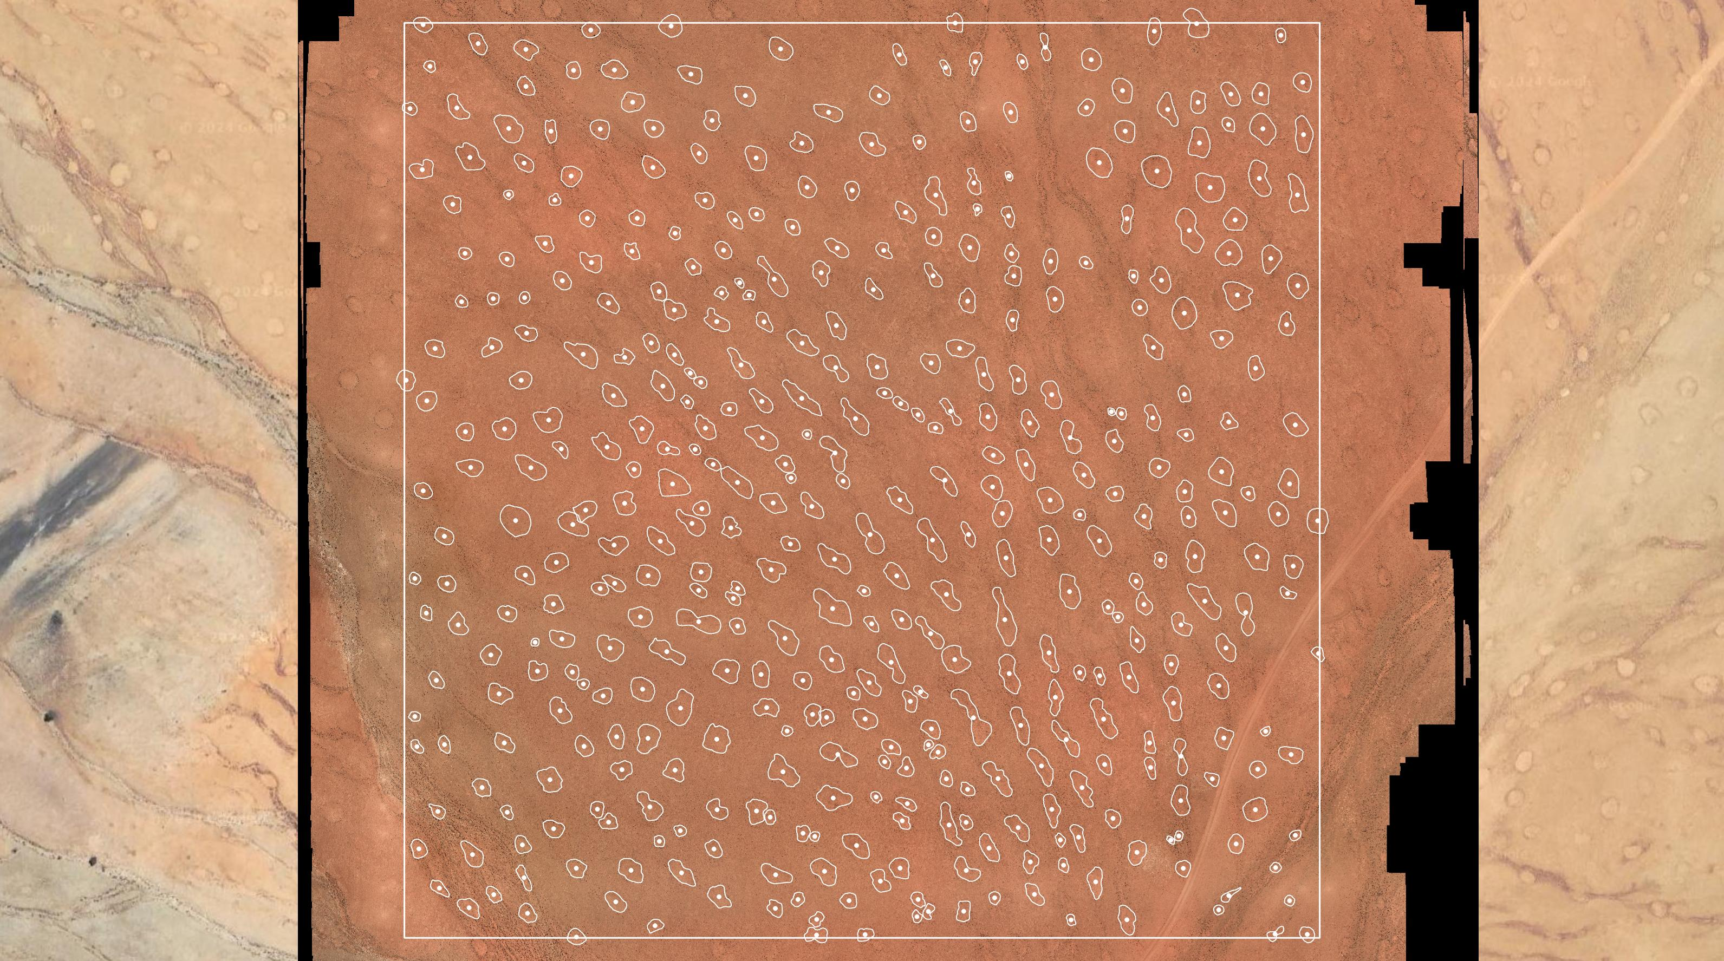
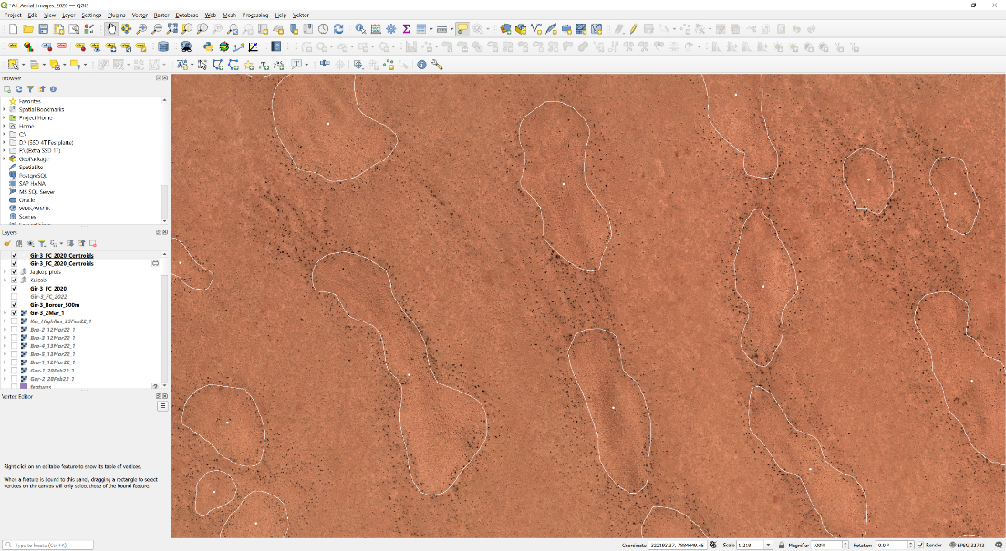
Remote sensing analysis – Stephan Getzin

Slide 7
Remote sensing analysis – Stephan Getzin

Slide 9
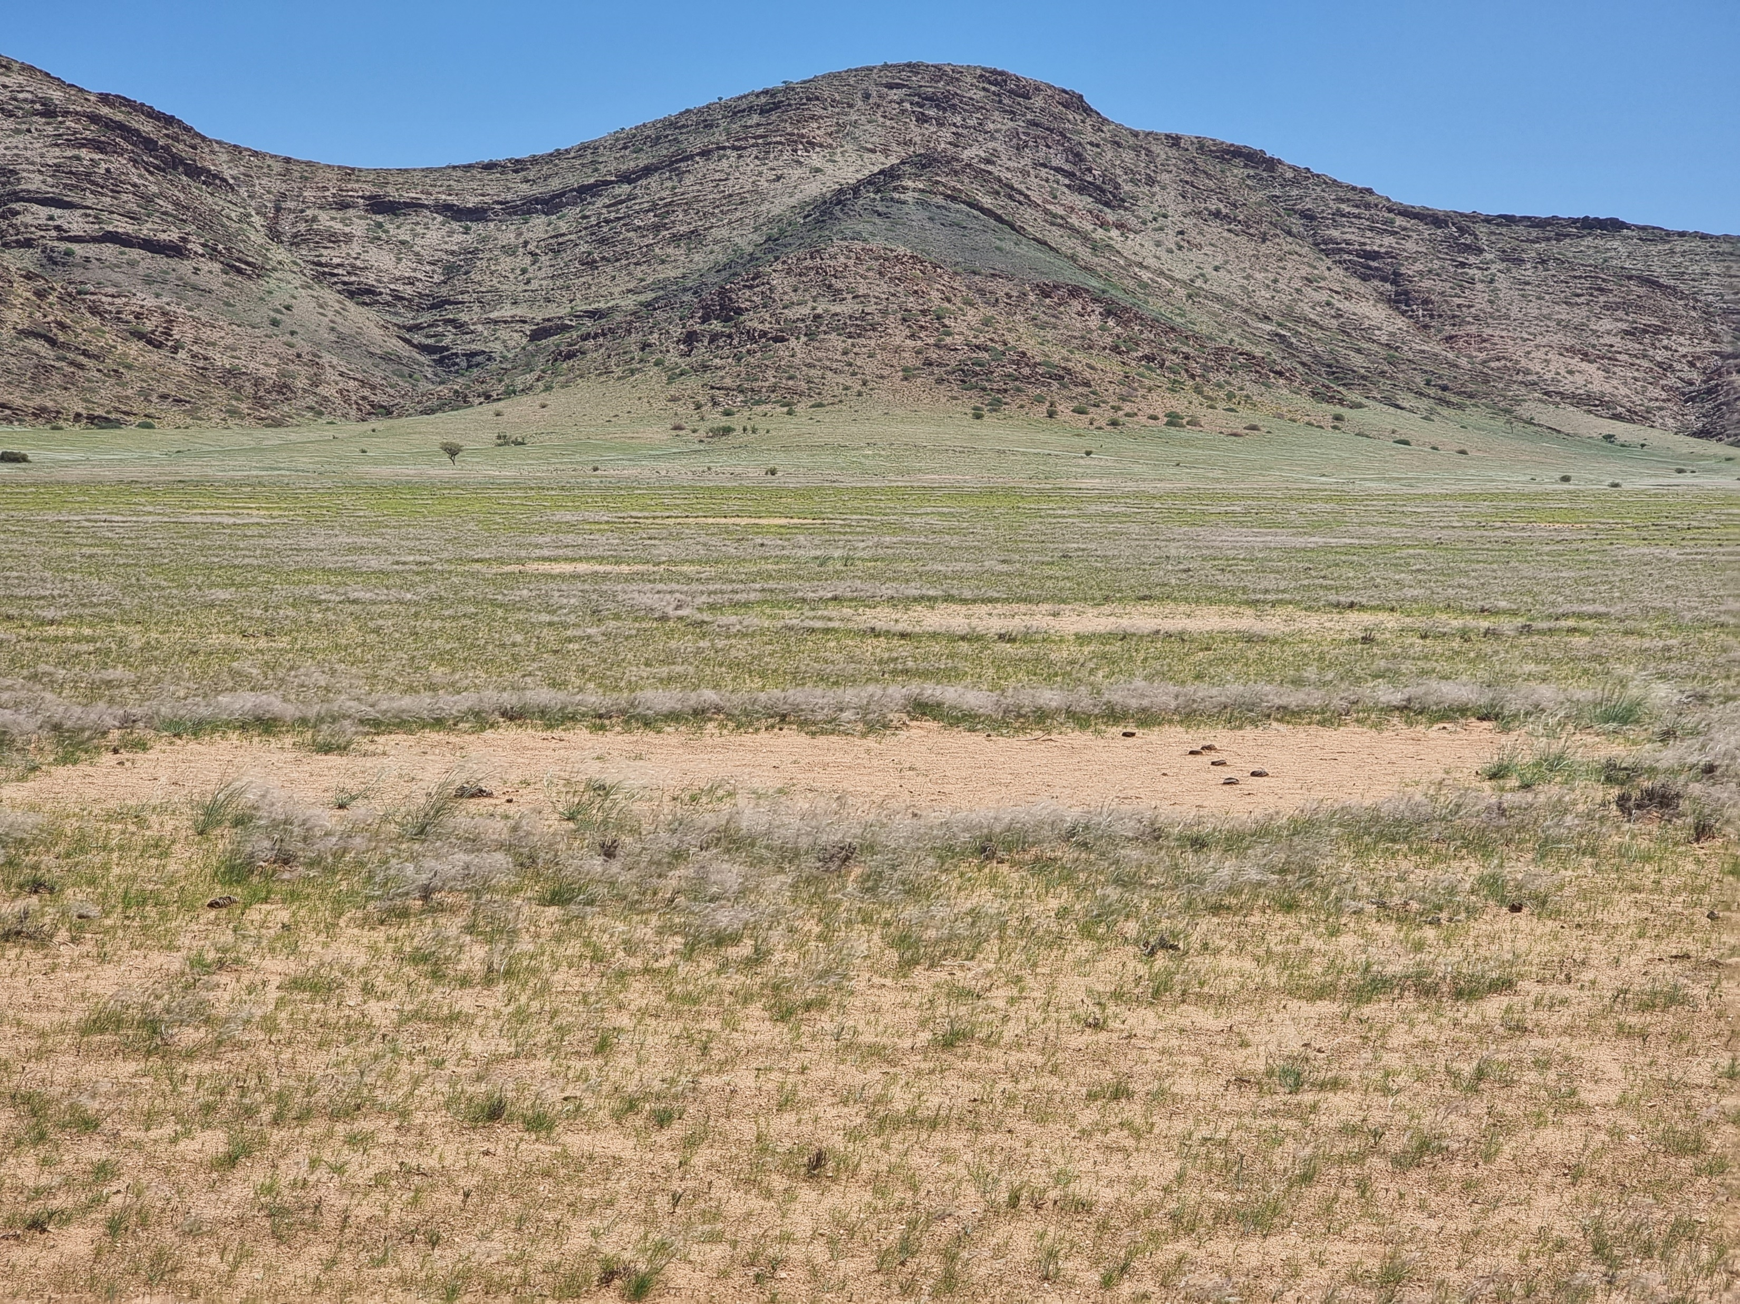

Slide 10
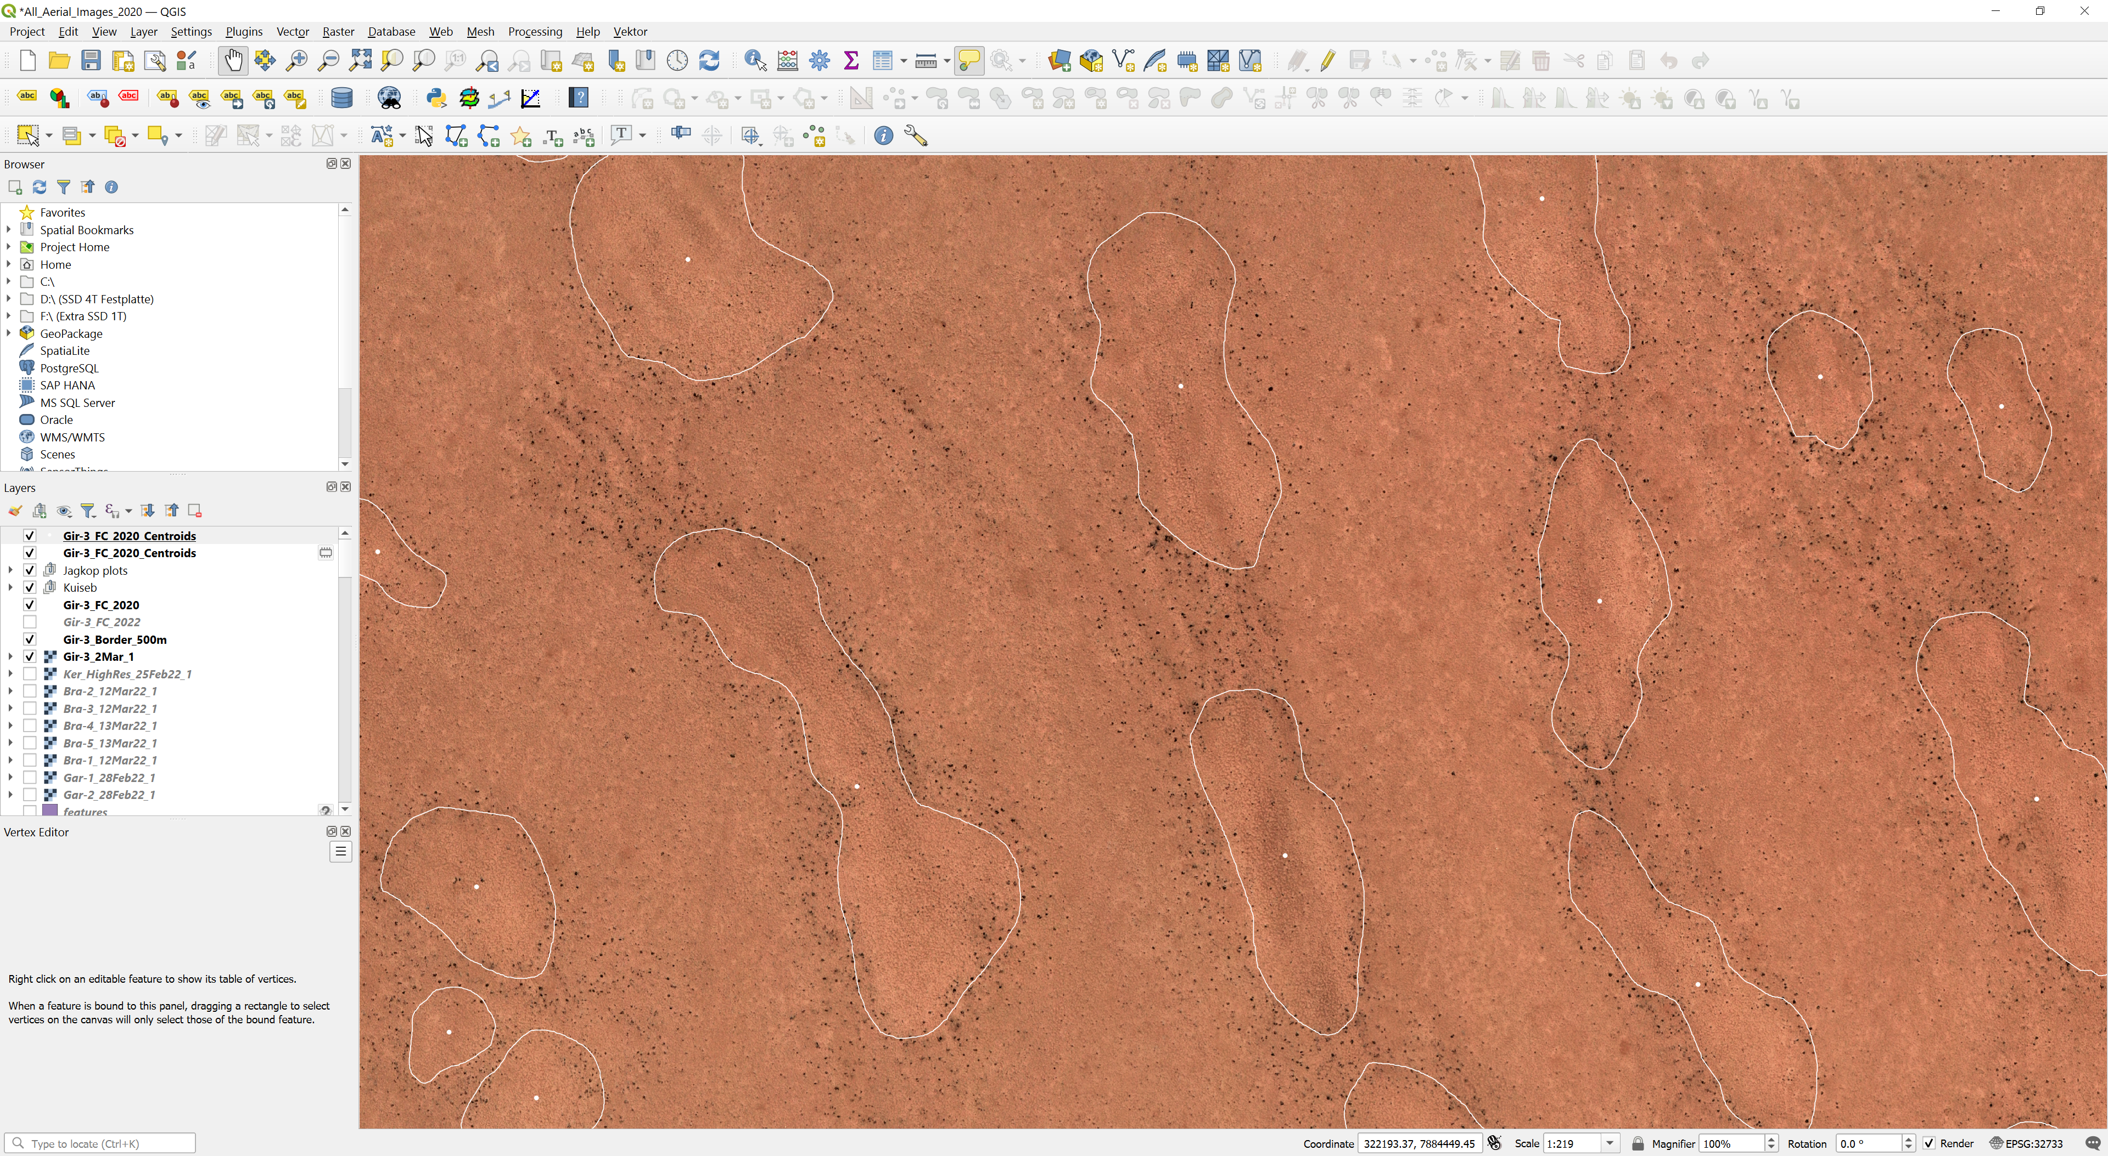

Slide 11
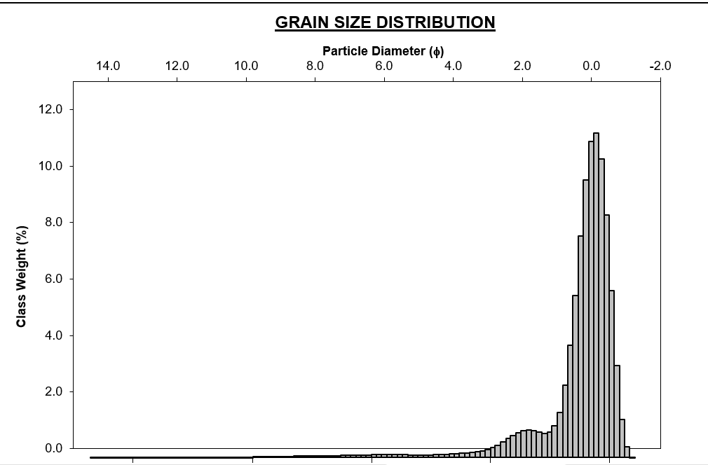
Grain size distribution
In the centre of the fairy circle

Slide 12
