Slide 2

T h a n k s a l o t f o r y o u r p a t i e n c e
Henricus de Alemania
14.Jh.

Slide 3
Sarnthein & Blaser, 2025, QSR
A G E C O N T R O L i s c r u c i a l
PEAKS help to constrain planktic ¹⁴C JUMPS
‘Raw’ planktic and benthic ¹⁴C dates vs depth
To derive ¹⁴C-based CAL. AGES
and MARINE RESERVOIR AGES (= Δ Ø¹⁴C ages)
the suite of planktic ¹⁴C plateaus is tuned
to a suite of
Atmospheric ¹⁴C plateaus of LAKE SUIGETSU
vs U/Th model ages (cal. ka)
(Bronk Ramsey et al., 2020)

Slide 4
Sarnthein & Blaser, 2025, QSR
A G E C O N T R O L
PEAKS help to constrain planktic ¹⁴C JUMPS
‘Raw’ planktic and benthic ¹⁴C dates
To derive of ¹⁴C-based CAL. AGES
and MARINE RESERVOIR AGES
planktic ¹⁴C plateaus are tuned
to a suite of
Atmospheric ¹⁴C plateaus of LAKE SUIGETSU dated by U/Th model ages
(Bronk Ramsey et al., 2020)

Slide 5
Sarnthein et al.
2023

Slide 6
Sarnthein et al.
2023

Slide 7
You, Stein, et al., 2024,
modified by Sarnthein
Eirik Drift off
the southern tip of Greenland
IntCal 20
¹⁴C PT

Slide 8
plankton
Sarnthein et al.
2002
*
18.4 cal. ka
HS -1 meltwaters diluted
the surface waters of
Irminger Current,
Source: South of Greenland
Elliot et al., 1998

Slide 9
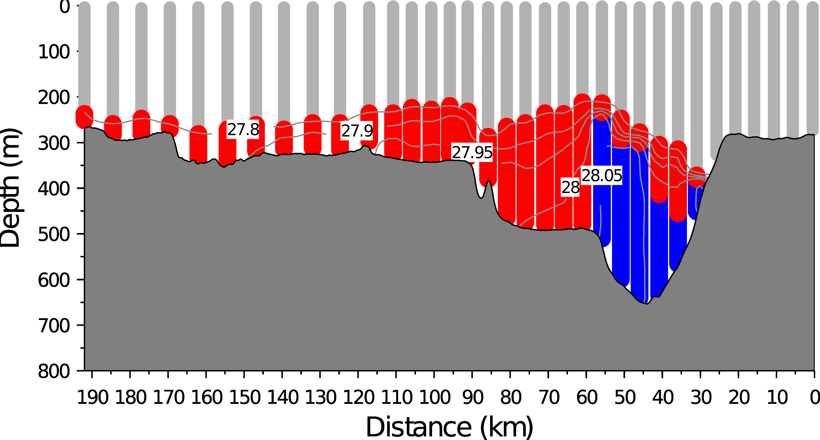
Differential origin of
DK Strait Overflow Waters
TODAY
Basaltic
sediments
modern
Greenland – transect – Iceland
Overflow formed by
ARCTIC DEEP WATERs overlain by modern
NORTH ICELAND JET (N I J) convected north of Iceland,
(Váge et al., 2011, QSR)
RED: N I J = sourced waters BLUE: Arctic bottom waters

Slide 10
Differential origin of
DK Strait Overflow Waters
HS-1
B a s a l t I c
sediments
modern
Greenland – transect – Iceland
x
Arctic deep waters were replaced by
NORTH ICELAND JET (N I J) plus ADMIXTURE of UPPER NAIW after having passed basaltic sediments
(based on radiogenic Nd and U/Th isotopes and various proxies)
x
RED: N I J = sourced waters BLUE: Arctic bottom waters

