Slide 3
METHODS
M1 – Indirect approach
Standard value
suggested by IPCC
M2 – Direct approach
IPCC using Biomass
Expansion Factor (BEF)
+
Field data
C = Biomass * %C
M4 – Hybrid approach
Allometric equation
(Forrester et al. 2017)
+
Indirect measurements
(dead:alive ratio, Global Soil Organic Carbon map)
M3 – Direct approach
IPCC using Biomass
Conversion Expansion Factor
(BCEF)
+
Field data
Sampling
design
RESULTS

Slide 4
SAMPLING DESIGN
METHODS
RESULTS

Slide 5
Aboveground
Belowground
RESULTS
Deadwood
Litter and soil

Slide 6
TOTAL
STOCK

Slide 8
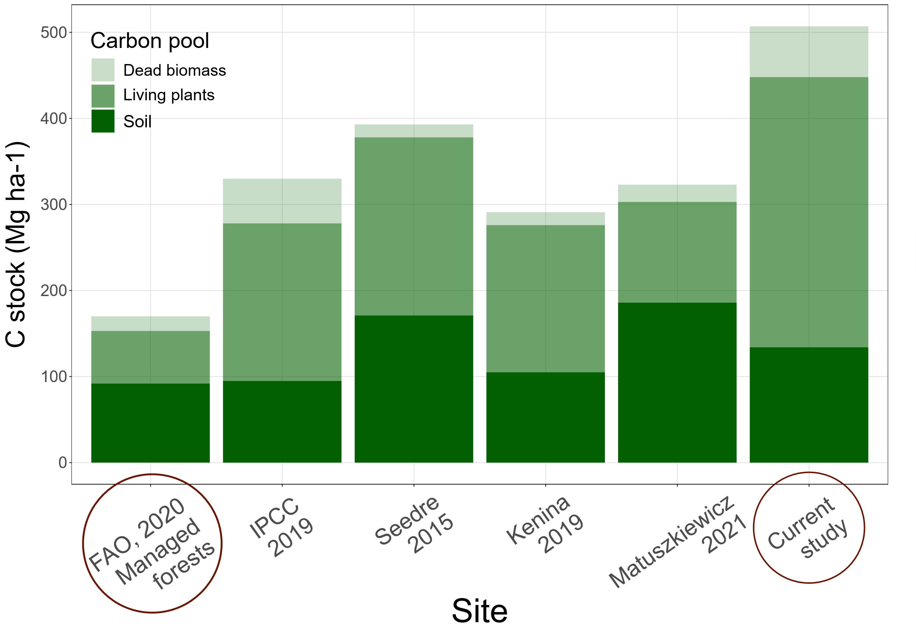
59
15
46
20
207
15
314
117
EUROPEAN
STOCK
158
171
17
61
92
95
171
105
186
134
M2

Slide 9
