Slide 1







Session: NH1.5 - Managing flood and drought risks across borders
Abstract ID: EGU25-3949
Spatial Drought Vulnerability Mapping for Regional Climate Resilience: A study over India's Northeast including Bangladesh
Ashesh Rudra Paul, Research Scholar
and
Rajib Maity, Professor
Department of Civil Engineering
Indian Institute of Technology Kharagpur
Kharagpur, India

Slide 2
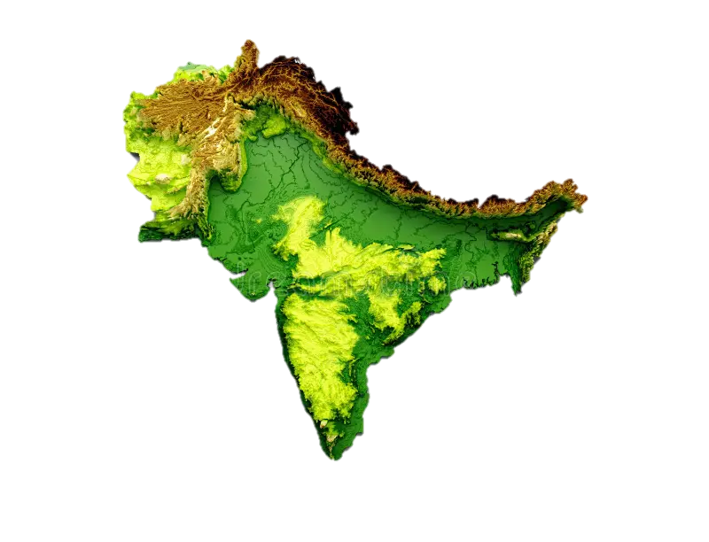



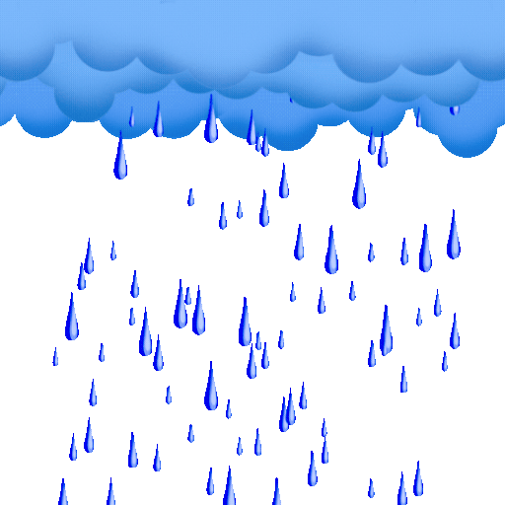
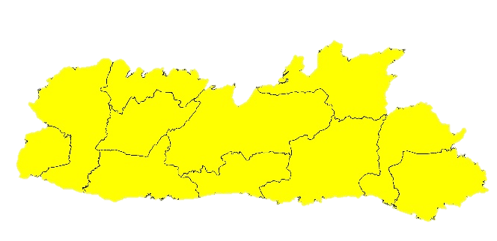
Rainfall in the region reducing?
M
AWSYNRAM IN MEGHALAYA, SITUATED ON A RIDGE IN THE KHASI HILLS, IS THE WETTEST PLACE ON THE EARTH AS PER THE GUINENESS WORLD RECORD IN 1985
90%
OF MAWSYNRAM’S RECORD BREAKING RAINFALL IS BETWEEN MAY AND OCTOBER
11,873 mm
Average Annual
Rainfall
The NEI has experienced a rapid decrease in summer monsoon rainfall (about 355 mm) in the last 36 years (1989–2024).
MEGHALAYA
Proper Drought Vulnerability Mapping is Required for
MAWSYNRAM
Cherrapunji
The wettest place on the earth, has seen a 10-20% rainfall decline since the late 20th century due to climate change and shifting monsoons.
Wettest Place on Earth Drying
NEI
The rains come in quick bursts and flood the region, followed by elongated dry periods that border on drought.
Challenges
Our Solution: (More Objective Approach)
✅ WASPAS + CRITIC
Holistic: Integrates 16 criteria across all 4 drought types.
Objective: Data-driven weights (CRITIC) eliminate bias.
Future-Ready: Projects vulnerability up to 2100.
Fragmented Approach:
  Isolated analysis of drought types (meteorological/agricultural/hydrological/socio-economic).
Subjective Weighting:
  Traditional MCDM (AHP/TOPSIS) relies on expert judgment, causing bias.
Short-Term Focus:
  Rarely incorporates future climate scenarios.

Slide 3
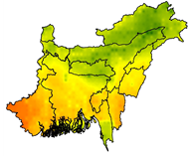
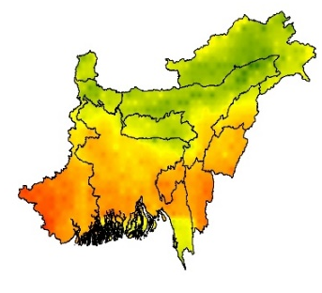
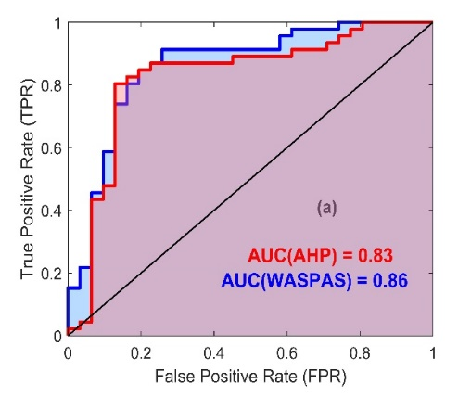
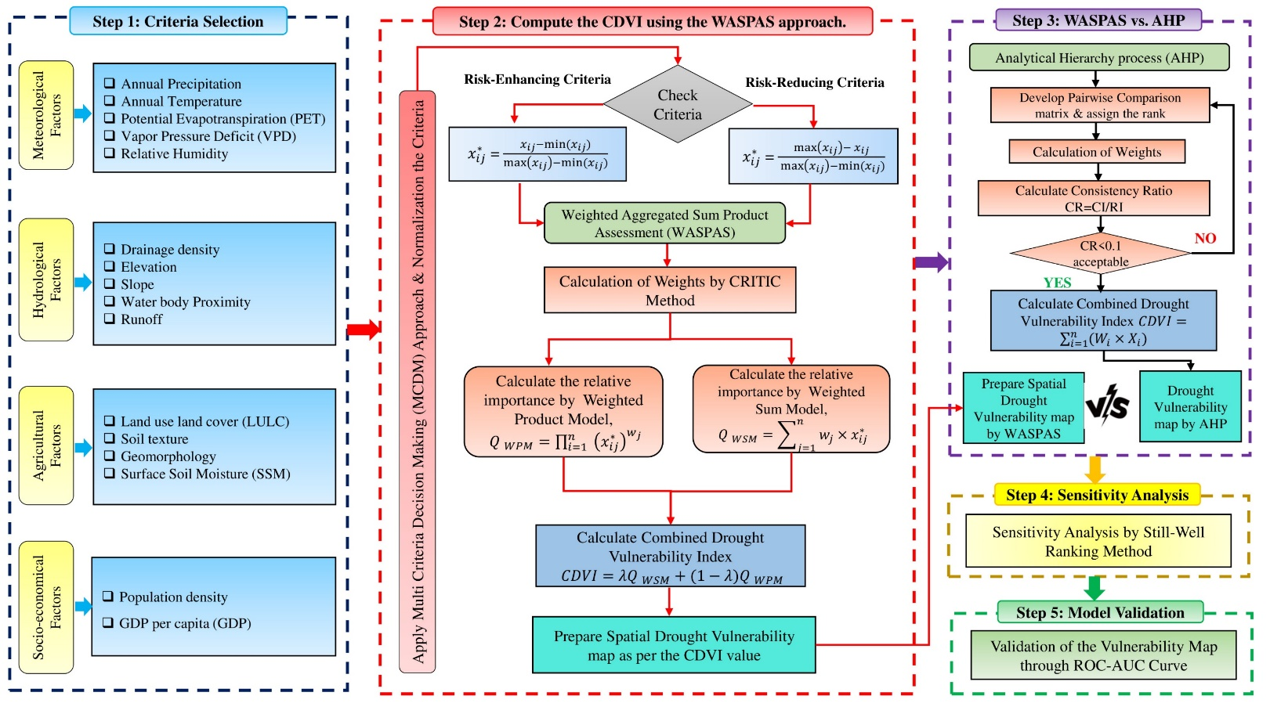

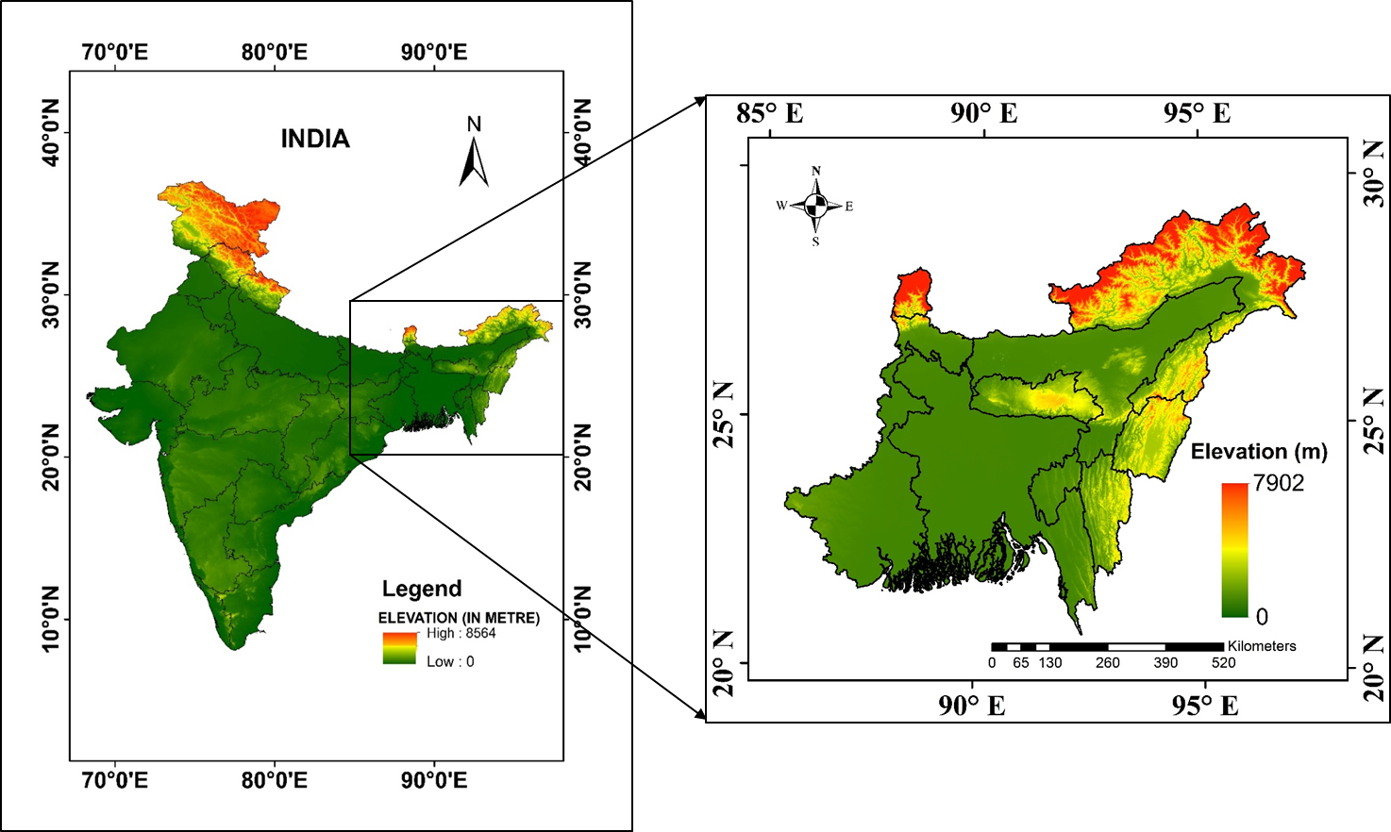
Methodological Flowchart:
1981-2014
2071-2100
ROC-AUC Curve
Major Findings:
WASPAS-based CDVI offers a scalable, accurate framework for global drought vulnerability mapping under climate change.
Current Vulnerability: Southern part of more vulnerable than northern side.
Future Projection (2100): 98% of NEIB faces moderate-to-high drought vulnerability.
Policy Implication: Proactive adaptation strategies needed for water & agriculture sectors.
Study Area & Objective
Develop a comprehensive Spatial Drought Vulnerability Mapping approach that integrates all type of droughts;
Implement the developed SDVM Approach to analyze the multi-faceted drought vulnerability status across NEIB
Northeast India including Bangladesh (NEIB)

Slide 4


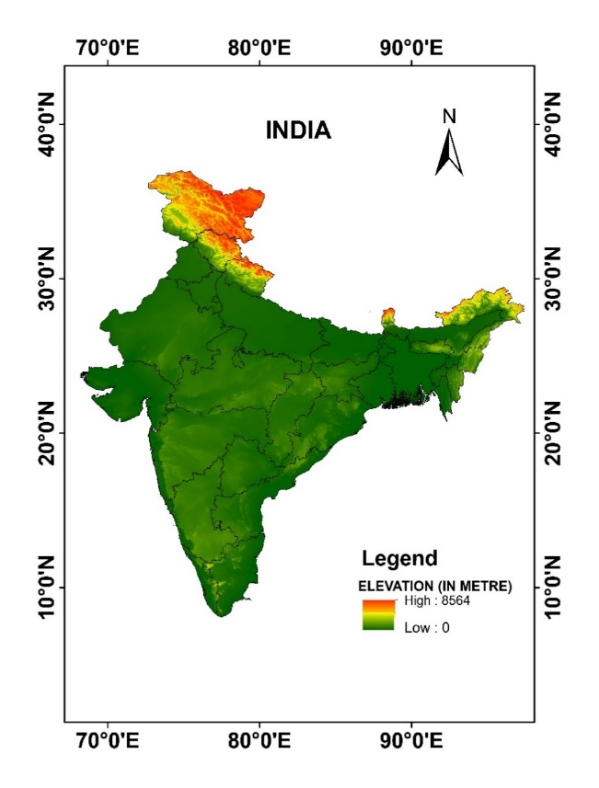

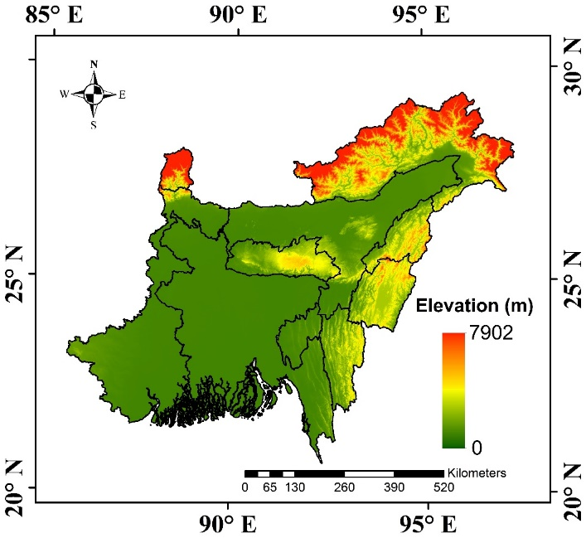


Study Area & Objective
Exploring Drought Vulnerability Across NEIB
Objective 1: Comprehensive Mapping Approach
Develop a comprehensive Spatial Drought Vulnerability Mapping (SDVM) approach that integrates meteorological, agricultural, hydrological, and socio-economic drought criteria, utilizing MCDM techniques
Objective 2: Analyzing Drought Vulnerability
Implement the developed SDVM Approach to analyze the multi-faceted drought vulnerability status across NEIB over the observed, as well as future period.
Northeast India including Bangladesh (NEIB)
Ashesh Rudra Paul, Department of Civil Engg., IITKGP
4

Slide 5


Methodological Flowchart
Spatial Drought Vulnerability Mapping Approach
Ashesh Rudra Paul, Department of Civil Engg., IITKGP
5

Slide 6
Different Data Sources for Drought Vulnerability Criteria
Criteria | Description | Source | Resolution/Scale | Data Type
Precipitation, Temperature & Humidity | NASA Earth Exchange Global Daily Downscaled Projections (NEX-GDDP-CMIP6) data from the year 1981-2100 | NASA Earth Exchange Global Daily Downscaled Projections (NEX-GDDP-CMIP6) Retrieved From: (https://www.nccs.nasa.gov/services/data-collections/land-based-products/nex-gddp-cmip6) | 0.25˚ X 0.25˚ | NetCDF
Elevation & Slope | Derived From ASTER DEM and prepare the thematic layer Using ArcGIS 10.4.1 | USGS Earth Explorer Retrieved From: (https://earthexplorer.usgs.gov/) | 30m×30m | Raster
LULC | Mapping the spatial heterogeneity of global land use and land cover from 2020 to 2100 at a 1 km resolution. | Zhang, T., Cheng, C., & Wu, X. (2023). Retrieved From: (https://doi.org/10.6084/m9.figshare.23542860) | 1 km ×1 km | Raster
PET | CMIP6 derived ensemble of global potential evapotranspiration from the year 1981-2100 | Bjarke, N., Barsugli, J., & Livneh, B. (2023). Retrieved From: (https://doi.org/10.5281/zenodo.7789759) | 0.25˚ × 0.25˚ | NetCDF
Soil texture | FAO-UNESCO Soil Map of the World, providing global soil data | FAO Soils Portal, Retrieved From: (https://www.fao.org/soils-portal/data-hub/soil-maps-and-databases/faounesco-soil-map-of-the-world/en/) | 1:50,00,000 | Vector
Population density | 1-km downscaled population projections compatible with SSPs from the year 2010-2100 | National Center for Atmospheric Research (NCAR), Global and Climate Dynamics, Retrieved From: (https://www.cgd.ucar.edu/sections/iam/modeling/spatial-population) | 1 km ×1 km | Raster
Geomorphology | Digital Geomorphological Map for India and Bangladesh | Bhukosh-Geological Survey of India (https://bhukosh.gsi.gov.in/)& United States Geological Survey(USGS) (https://www.sciencebase.gov/) | - | Vector
GDP per capita | Gridded GDP projections compatible with the five SSPs (shared socioeconomic pathways) for the year 2010 to 2100. | Murakami, D., Yoshida, T., & Yamagata, Y. (2021). Retrieved From: (https://doi.org/10.6084/m9.figshare.12016506.v1) | 1/12˚ × 1/12˚ | Raster
Runoff & Soil Moisture | ERA5 Monthly averaged Reanalysis data and World Climate Research Programme (WCRP) CMIP6 Gridded data | Copernicus Climate Data Store, Retrieved From (https://cds.climate.copernicus.eu/datasets) and CMIP6 Data Retrieved From: (https://esgf-node.ipsl.upmc.fr/search/cmip6-ipsl/) | 0.25˚ × 0.25˚ (After Bias Correction) | NetCDF
Ashesh Rudra Paul, Department of Civil Engg., IITKGP
6

Slide 7
Details of CMIP6 Climate Data
Data Source: NASA Earth Exchange Global Daily Downscaled Projections (NEX-GDDP)-CMIP6 dataset, which is a global downscaled climate scenario dataset generated as part of the CMIP6 initiative to support the Sixth Assessment Report of the Intergovernmental Panel on Climate Change (IPCC AR6)
Sl No | Name of the GCM | Modeling Center/Nation | Spatial Resolution | Temporal Resolution | Variant Label
1 | ACCESS-ESM1-5 | Commonwealth Scientific and Industrial Research Organization/Australia | 0.25˚ X 0.25˚ | DAILY | r1i1p1f1
2 | BCC-CSM2-MR | Beijing Climate Center China Meteorological Administration/China | 0.25˚ X 0.25˚ | DAILY | r1i1p1f1
3 | CanESM5 | Canadian Centre for Climate Modelling and Analysis/Canada | 0.25˚ X 0.25˚ | DAILY | r1i1p1f1
4 | CMCC-ESM2 | Centro Euro-Mediterraneo sui Cambiamenti Climatici, Lecce 73100, Italy | 0.25˚ X 0.25˚ | DAILY | r1i1p1f1
5 | EC-Earth3-Veg-LR | EC–EARTH consortium/Europe | 0.25˚ X 0.25˚ | DAILY | r1i1p1f1
6 | FGOALS-g3 | Chinese Academy of Sciences/China | 0.25˚ X 0.25˚ | DAILY | r3i1p1f1
7 | GFDL-ESM4 | NOAA Geophysical Fluid Dynamics Laboratory/USA | 0.25˚ X 0.25˚ | DAILY | r1i1p1f1
8 | INM-CM4-8 | Institute for Numerical Mathematics, Russian Academy of Science/Russia | 0.25˚ X 0.25˚ | DAILY | r1i1p1f1
9 | IPSL-CM6A-LR | L’Institute Pierre–Simon Laplace/France | 0.25˚ X 0.25˚ | DAILY | r1i1p1f1
10 | KACE-1-0-G | National Institute of Meteorological Sciences (NIMS) and Korea Meteorological Administration (KMA)/Korea. | 0.25˚ X 0.25˚ | DAILY | r1i1p1f1
11 | MIROC6 | Japan Agency for Marine–Earth Science and Technology, Atmosphere and Ocean Research Institute, The University of Tokyo, National Institute for Environmental Studies, and RIKEN Center for Computational Science/Japan | 0.25˚ X 0.25˚ | DAILY | r1i1p1f1
12 | MPI-ESM1-2-LR | Max Planck Institute for Meteorology/Germany | 0.25˚ X 0.25˚ | DAILY | r1i1p1f1
13 | NorESM2-MM | Norwegian Climate Centre/Norway | 0.25˚ X 0.25˚ | DAILY | r1i1p1f1
14 | UKESM1_0_LL | Met Office Hadley Centre/UK | 0.25˚ X 0.25˚ | DAILY | r1i1p1f2
Ashesh Rudra Paul, Department of Civil Engg., IITKGP
7

Slide 8

Selection of Risk Enhancing and Reducing Criteria
Influential Factors on Drought Vulnerability
Continuous 𝑐𝑟𝑖𝑡𝑒𝑟𝑖𝑎
𝐷𝑖𝑠𝑐𝑟𝑒𝑡𝑒 𝑐𝑟𝑖𝑡𝑒𝑟𝑖𝑎
01
𝑅𝑖𝑠𝑘 𝐸𝑛ℎ𝑎𝑛𝑐𝑖𝑛𝑔 𝐶𝑟𝑖𝑡𝑒𝑟𝑖𝑎 ∝ 𝐷𝑟𝑜𝑢𝑔ℎ𝑡 𝑉𝑢𝑙𝑛𝑒𝑟𝑎𝑣𝑖𝑙𝑖𝑡𝑦
01
Land use land cover (LULC)
Soil texture
Geomorphology
Slope
Elevation
Population density Index (PDI)
Annual Temperature
Water body Proximity
Potential Evapotranspiration (PET)
Vapor Pressure Deficit (VPD)
Alternative Ranking scheme based on the contribution to the Drought Vulnerability
( For Discrete criteria)
Discrete Criteria | Ranking based on Vulnerability
 | Very low (1) | Low (2) | Moderate (3) | High (4) | Very High (5)
Geomorphology | Snow Cover | Flood Plain | Coastal Plain | Alluvial Plain | Hills and Valleys/Plateau
Soil Texture | Clay-Loam/Clay | Loam | Silt-loam | Sandy-Clay-Loam | Sandy-Loam/Sandy-Clay
LULC | Water | Forest/Grassland | Urban | Barren | Cropland
02
𝑅𝑖𝑠𝑘 𝑅𝑒𝑑𝑢𝑐𝑖𝑛𝑔 𝐶𝑟𝑖𝑡𝑒𝑟𝑖𝑎 ∝ 1/ (𝐷𝑟𝑜𝑢𝑔ℎ𝑡 𝑉𝑢𝑙𝑛𝑒𝑟𝑎𝑣𝑖𝑙𝑖𝑡𝑦 )
Annual Precipitation
Relative Humidity
Drainage density
Runoff
GDP per capita
Surface Soil Moisture (SSM)
Ashesh Rudra Paul, Department of Civil Engg., IITKGP
8

Slide 9

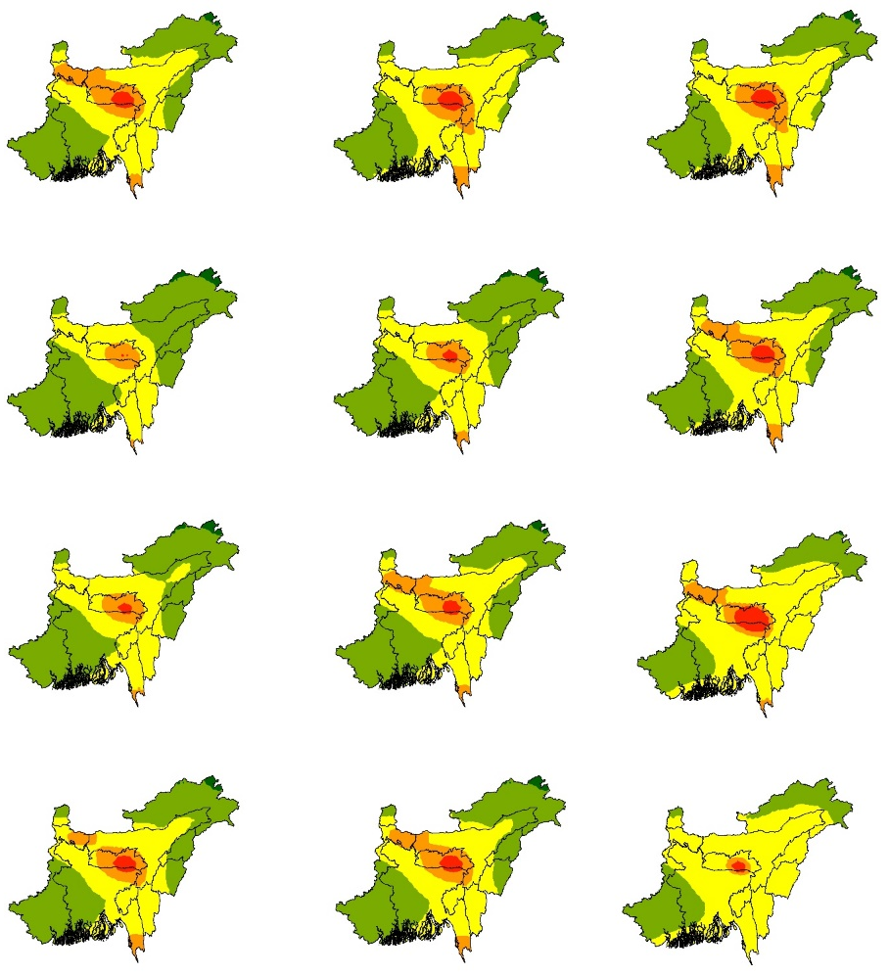
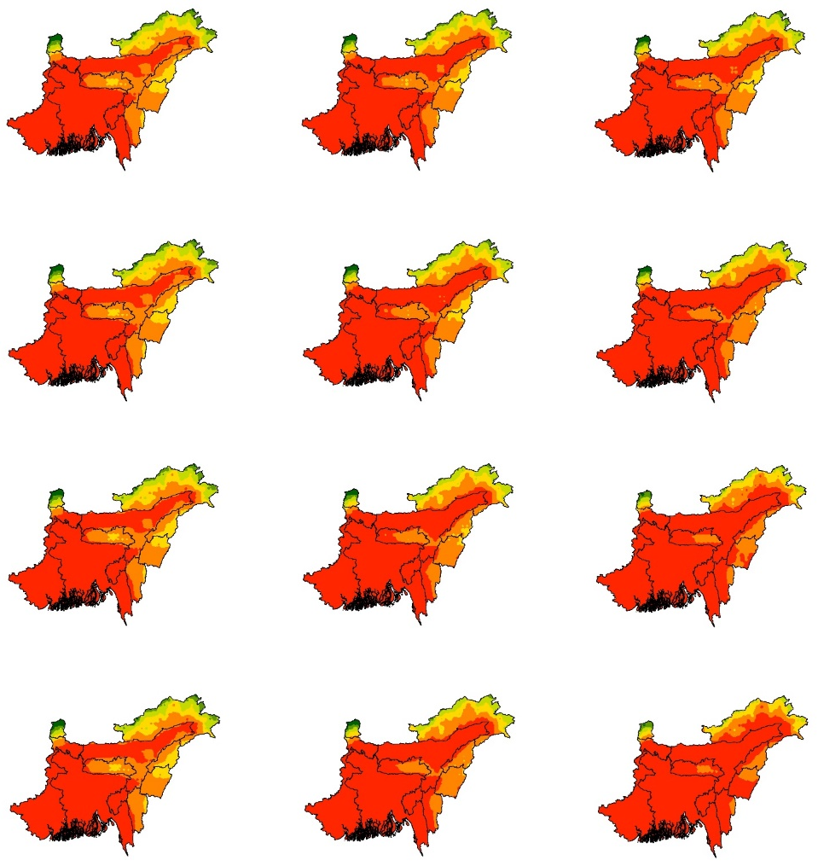
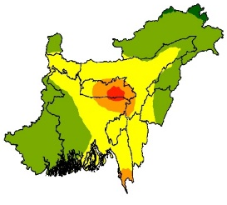

Meteorological Drought Vulnerability Criteria Layers
Reference Period (1981-2014) |  | Epoch 1 (2015-2040) | Epoch 2 (2041-2070) | Epoch 3 (2071-2100)
 | SSP126
 | SSP245
 | SSP370
 | SSP585
Reference Period (1981-2014) |  | Epoch 1 (2015-2040) | Epoch 2 (2041-2070) | Epoch 3 (2071-2100)
 | SSP126
 | SSP245
 | SSP370
 | SSP585
Precipitation
Temperature
5
10
30
1000
2000
3000
4000
15
20
25
Unit: Average Annual Precipitation in mm
Unit: Average Annual Temperature in °C
9

Slide 10
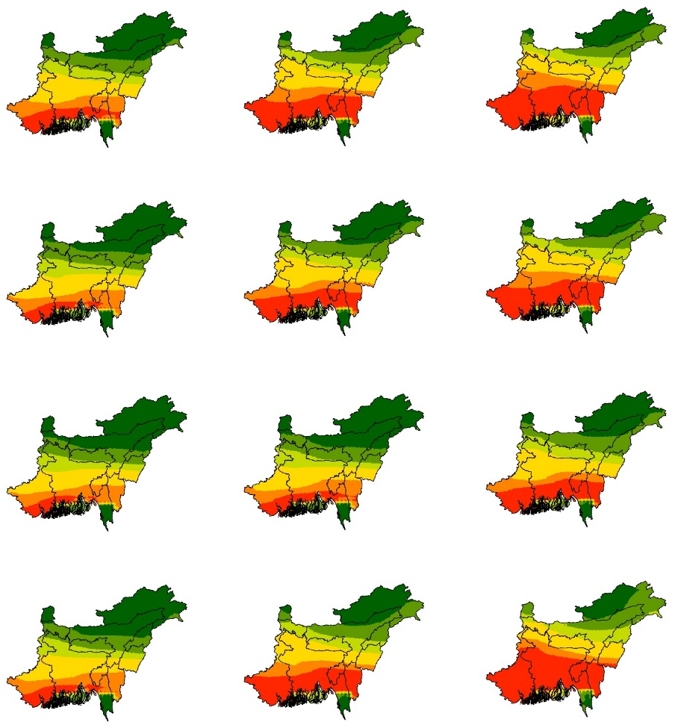
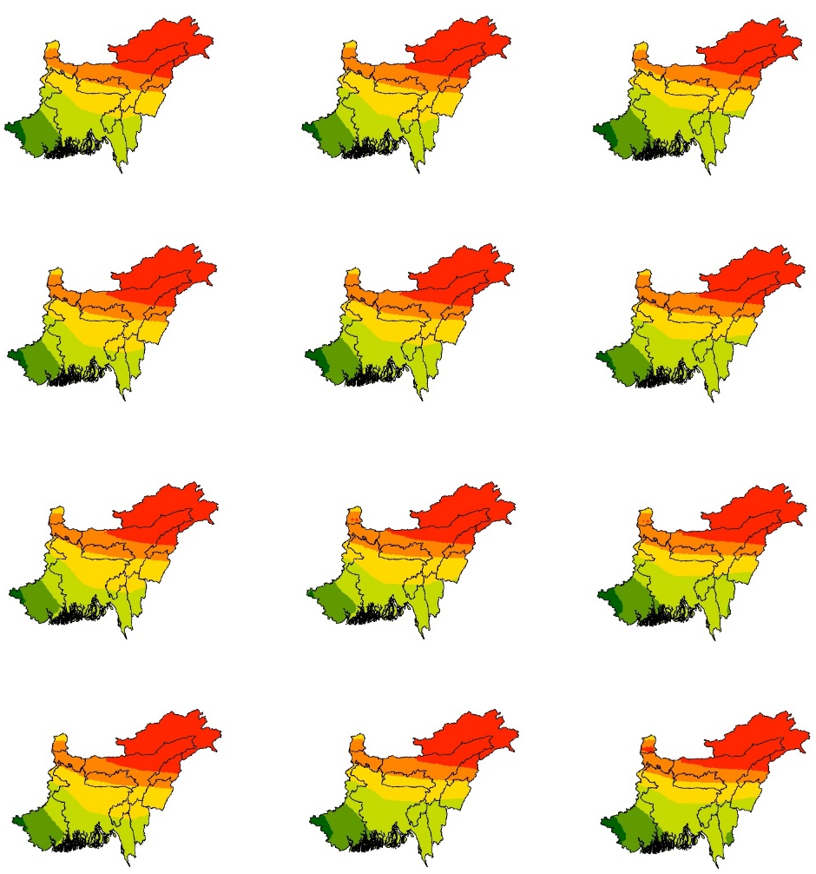


Meteorological Drought Vulnerability Criteria Layers
Reference Period (1981-2014) |  | Epoch 1 (2015-2040) | Epoch 2 (2041-2070) | Epoch 3 (2071-2100)
 | SSP126
 | SSP245
 | SSP370
 | SSP585
Reference Period (1981-2014) |  | Epoch 1 (2015-2040) | Epoch 2 (2041-2070) | Epoch 3 (2071-2100)
 | SSP126
 | SSP245
 | SSP370
 | SSP585
Relative
Humidity
PET
600
800
900
1000
1200
1300
1400
65
70
90
75
80
85
10
Unit: Average Annual PET in mm
Unit: Average Annual Relative Humidity (RH) in %

Slide 11
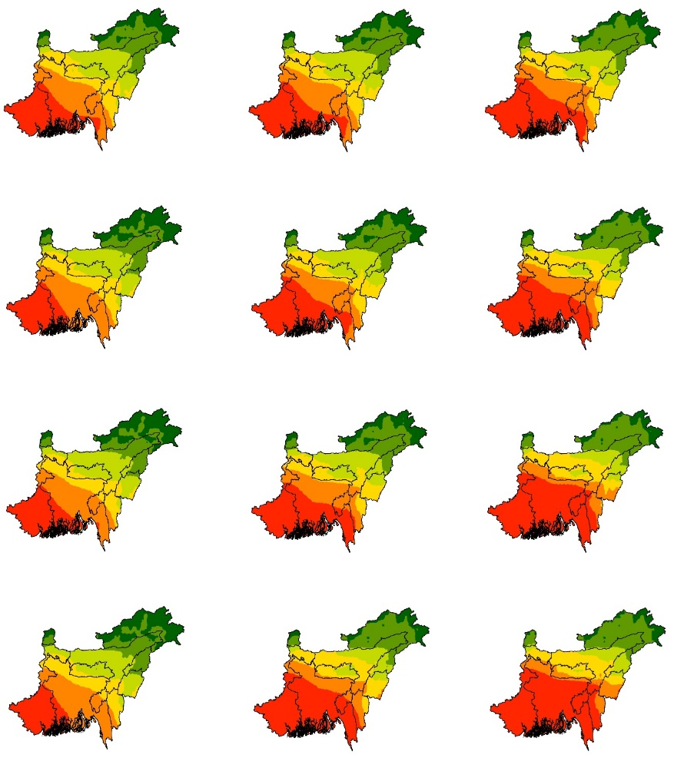


Meteorological Drought Vulnerability Criteria Layers
Reference Period (1981-2014) |  | Epoch 1 (2015-2040) | Epoch 2 (2041-2070) | Epoch 3 (2071-2100)
 | SSP126
 | SSP245
 | SSP370
 | SSP585
Calculation of Vapor Pressure Deficit
Vapor
Pressure
Deficit
Vapor Pressure Deficit = $e_{s}$‐$e_{a}$
= $e_{s}$‐$R_{h}$*$e_{s}$/100)
where, $e_{a}$ is the actual vapor pressure or vapor pressure at dew point temperature
$e_{s}$ is the saturation vapor pressure or vapor pressure at air temperature
$R_{h}$ is the relative humidity
$$e_{s}\text{=611 }×exp\left(\frac{17.27×T}{237.3+T}\right)$$
1000
2000
3000
4000
Unit: Average Annual Vapor Pressure Deficit in Pascal
11

Slide 12
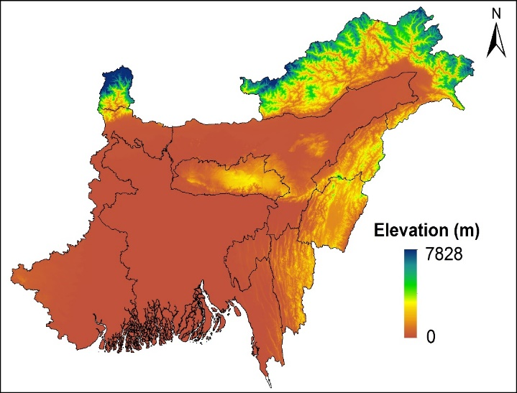
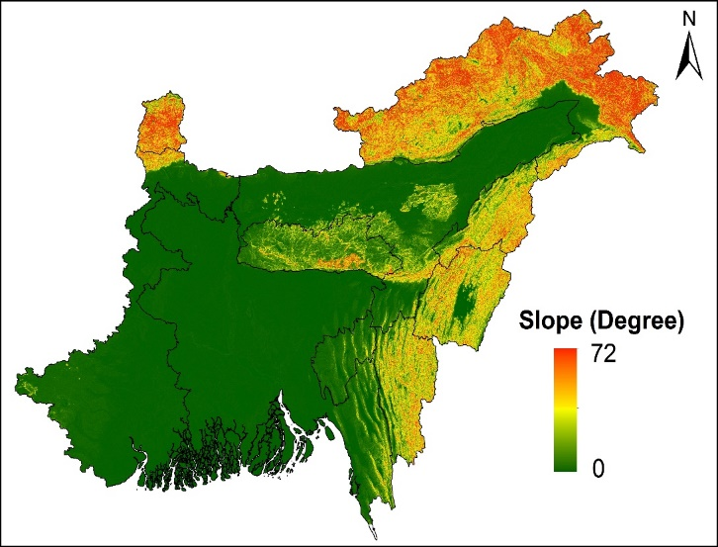
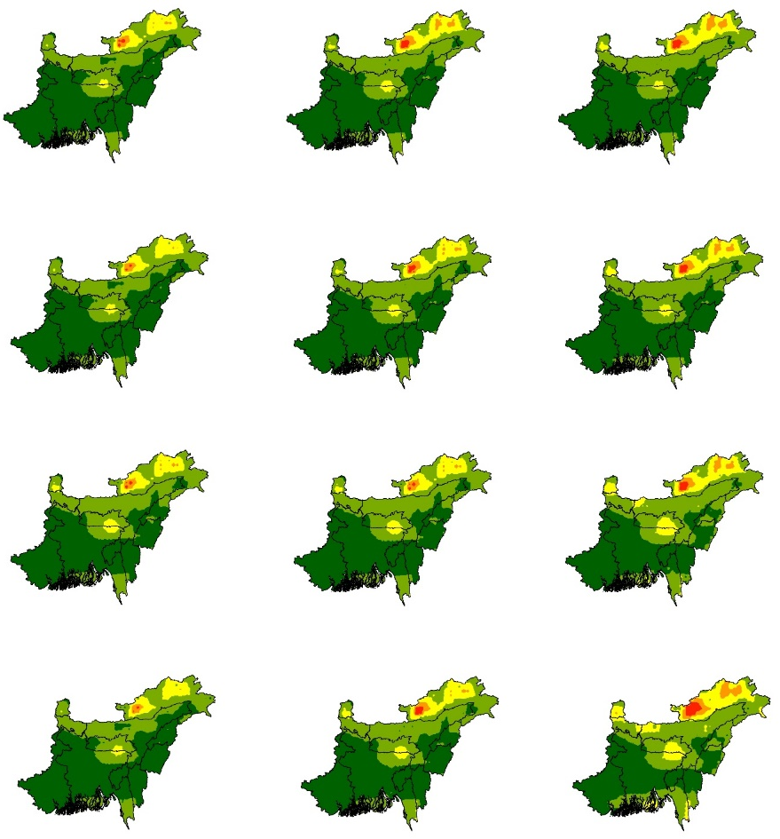

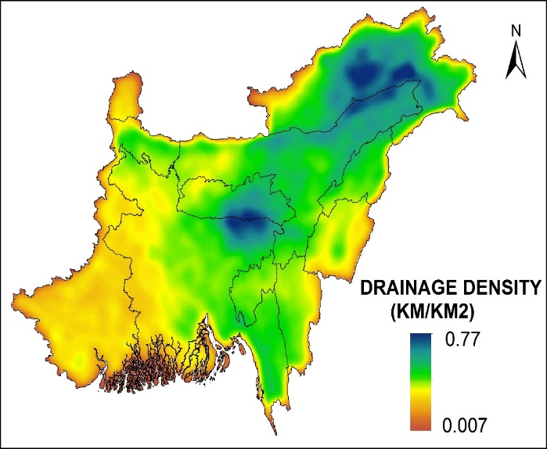
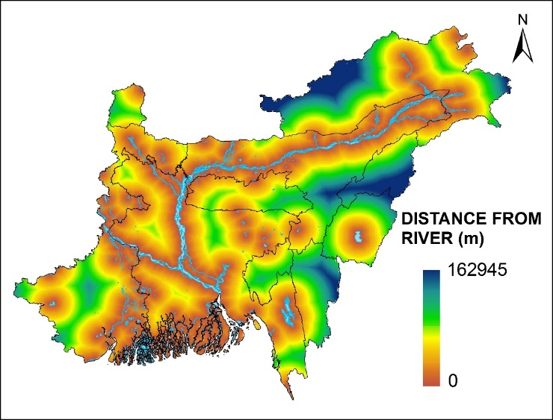
Hydrological Drought Vulnerability Criteria Layers
Reference Period (1981-2014) |  | Epoch 1 (2015-2040) | Epoch 2 (2041-2070) | Epoch 3 (2071-2100)
 | SSP126
 | SSP245
 | SSP370
 | SSP585
Runoff
1.1
1.15
1.2
1.25
12
Unit: Average Annual Runoff in m/year

Slide 13
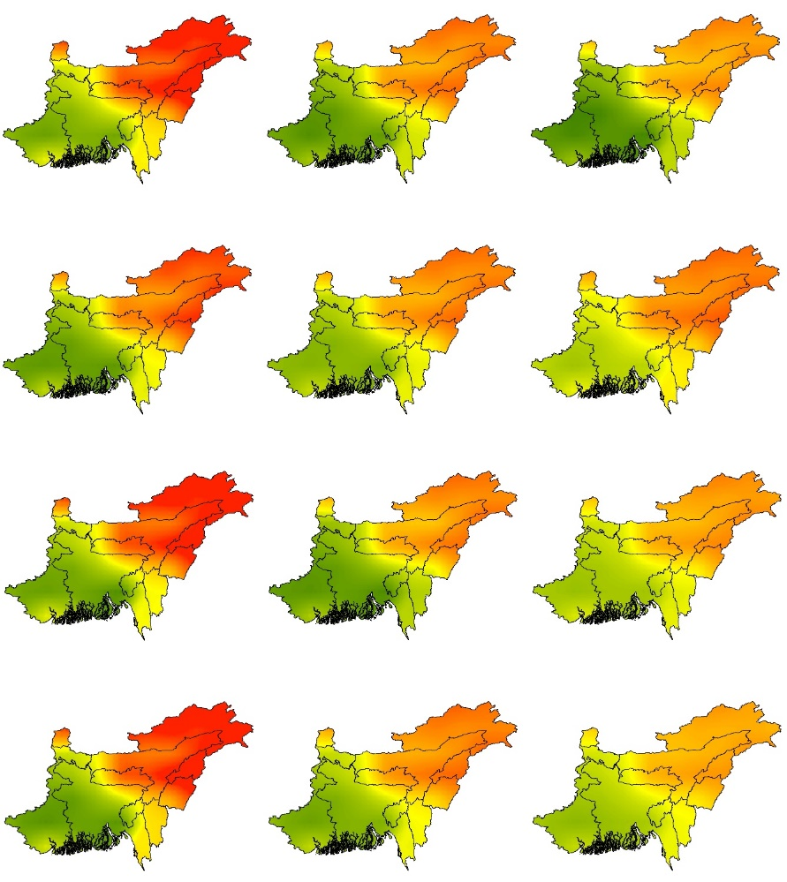
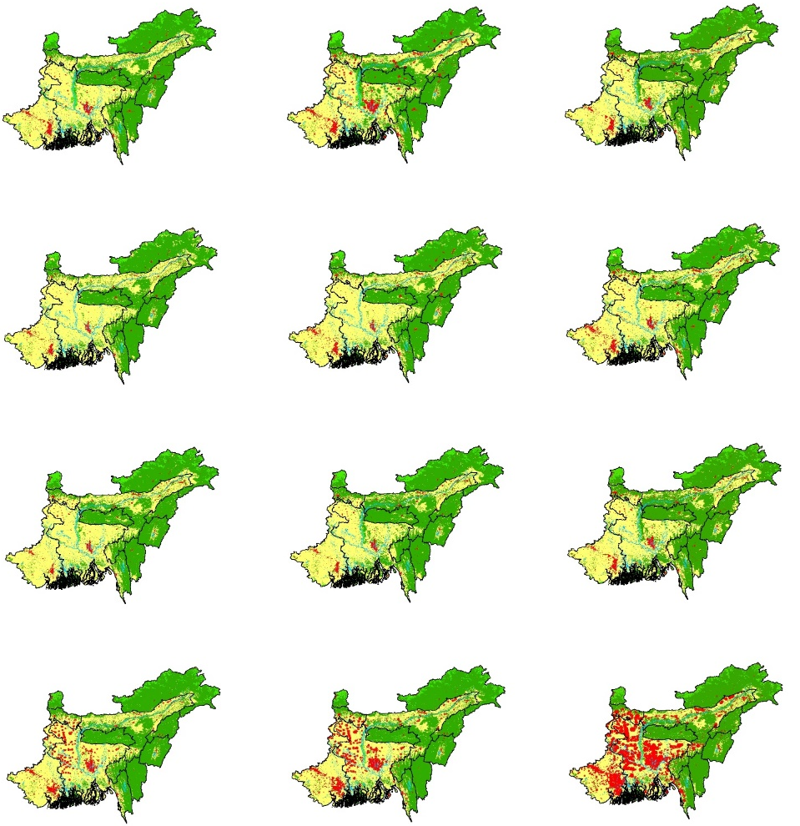

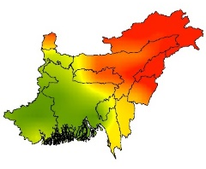
Agricultural Drought Vulnerability Criteria Layers
Reference Period (1981-2014) |  | Epoch 1 (2015-2040) | Epoch 2 (2041-2070) | Epoch 3 (2071-2100)
 | SSP126
 | SSP245
 | SSP370
 | SSP585
Reference Period (1981-2014) |  | Epoch 1 (2015-2040) | Epoch 2 (2041-2070) | Epoch 3 (2071-2100)
 | SSP126
 | SSP245
 | SSP370
 | SSP585
SSM
LULC
Cropland
Forest
Grassland
0.20
0.50
Urban
Barren
Water
13
Unit: Volumetric Surface Soil Moisture (SSM) m3/ m3

Slide 14
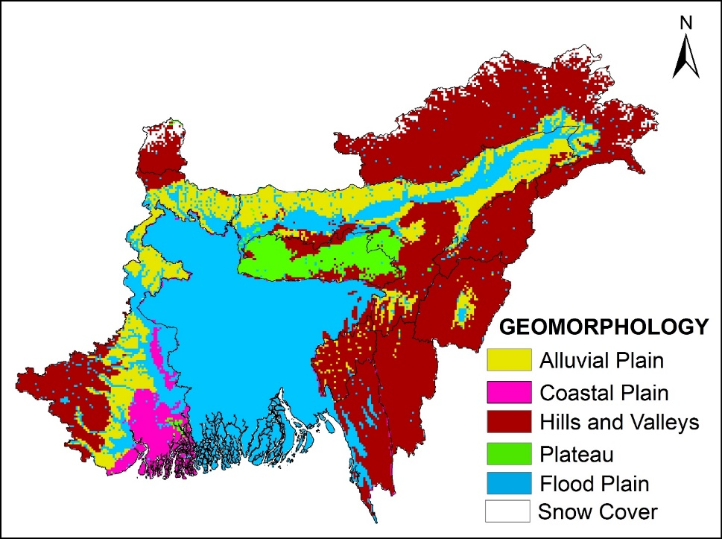

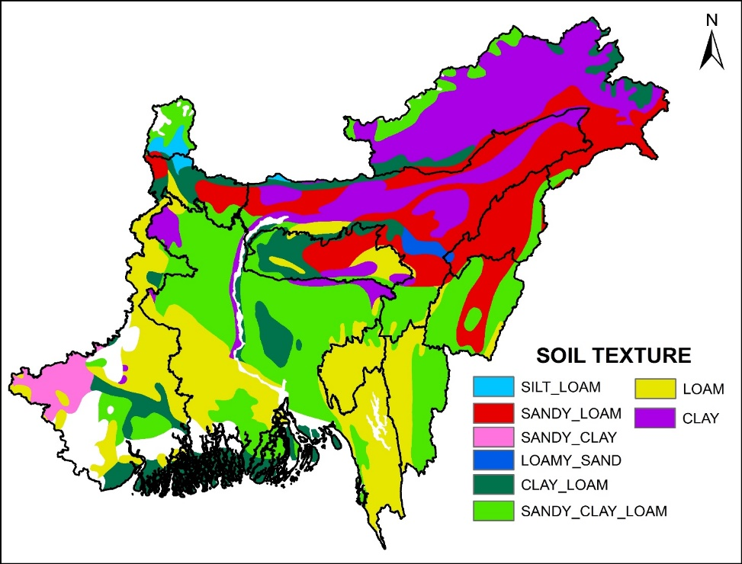
Geomorphology
Agricultural Drought Vulnerability Criteria Layers
Soil Texture
14

Slide 15
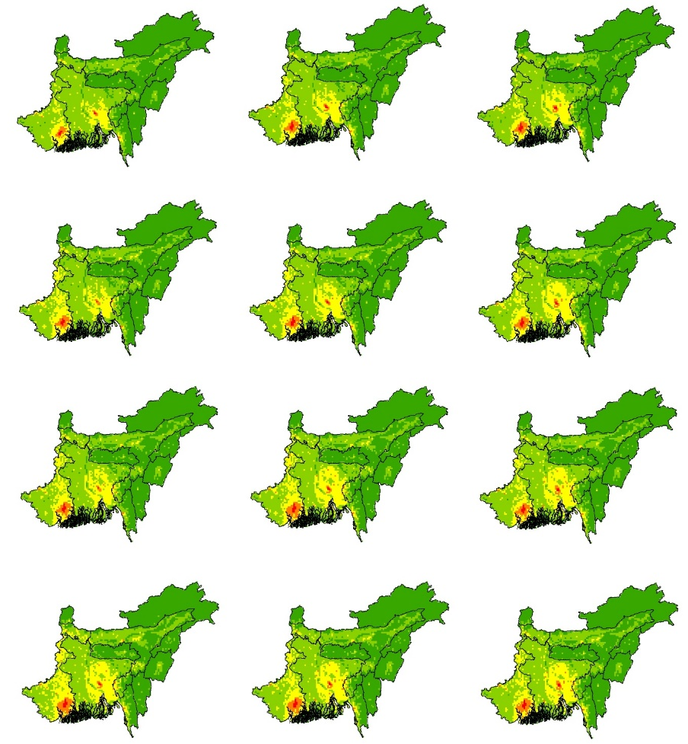
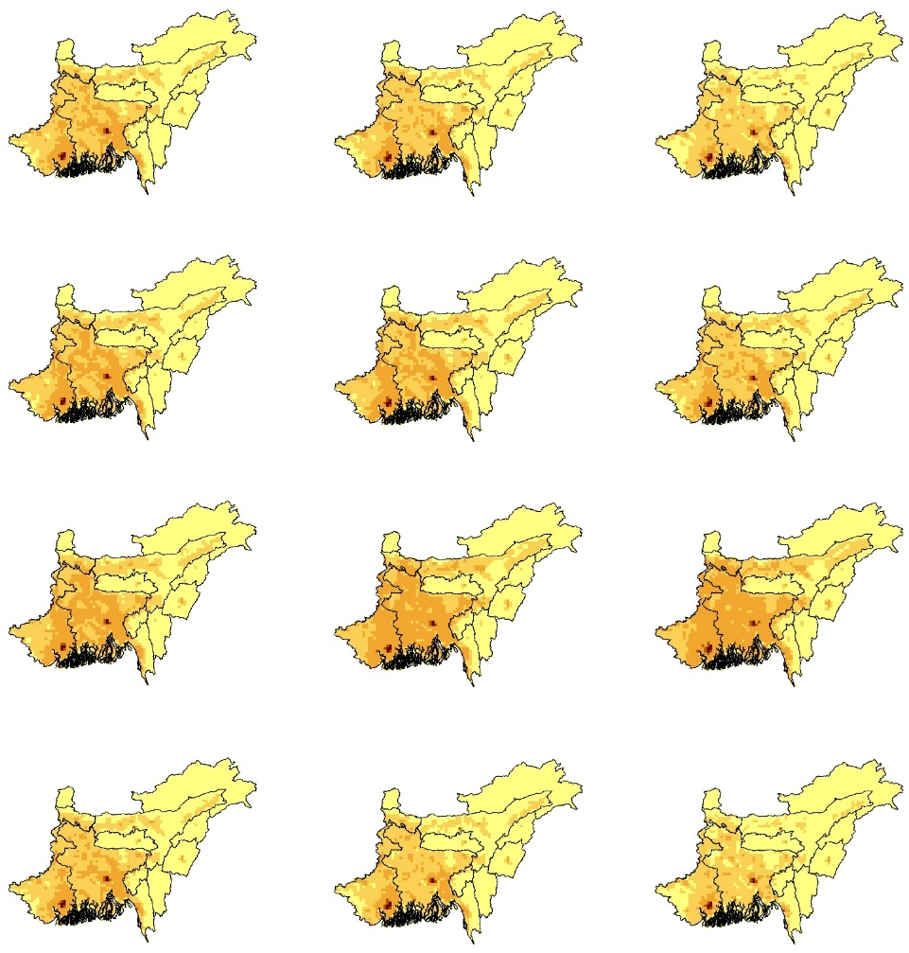


Socio-economic Drought Vulnerability Criteria layers
Reference Period (1981-2014) |  | Epoch 1 (2015-2040) | Epoch 2 (2041-2070) | Epoch 3 (2071-2100)
 | SSP126
 | SSP245
 | SSP370
 | SSP585
Reference Period (1981-2014) |  | Epoch 1 (2015-2040) | Epoch 2 (2041-2070) | Epoch 3 (2071-2100)
 | SSP126
 | SSP245
 | SSP370
 | SSP585
GDP
PDI
2800
8000
18000
42000
Low
Unit: Purchasing Power Parity (PPP)
Million USD in 2005 rate
High
PDI= Population Density Index
15

Slide 16








Weighted Aggregated Sum Product Assessment (WASPAS) Method Overview
Combining Weighted Sum Model and Weighted Product Method
Relative Importance Calculation by WSM
Relative Importance Calculation
By WPM
Decision Matrix Development
CDVI Determination
Create a structured matrix to evaluate multiple criteria based on alternatives.
Adjust the values in the matrix to a common scale to ensure comparability.
Determine the weight of each criterion to reflect its significance in the decision-making process.
Calculate the Composite Decision Value Index (CDVI) to rank the alternatives.
$$X={\left[x_{ij}\right]}_{m×n}=\left[\begin{matrix}x_{11} & x_{12} & … & x_{1n} \\ x_{21} & x_{22} & … & x_{2n} \\ ⋮ & ⋮ & ⋱ & ⋮ \\ x_{m1} & x_{m2} & … & x_{mn}\end{matrix}\right]$$
$$CDVI= λ{ Q }_{WSM}\text{+(1−} λ\text{)} {Q }_{WPM}$$
$$CDVI=λ\sum_{i=1}^{n}{ w_{j}×x_{ij}^{∗}}+\left(1−λ\right)\prod_{i=1}^{n}{ }{\left(x_{ij}^{∗}\right)}^{w_{j}}$$
$${ Q }_{WSM}=\sum_{i=1}^{n}{ w_{j}×x_{ij}^{∗}}$$
$${ Q }_{WPM}=\prod_{i=1}^{n}{ }{\left(x_{ij}^{∗}\right)}^{w_{j}}$$
16

Slide 17






Analytical Hierarchy Processes (AHP) Method Overview
Key Concepts and Processes
Definition of Pairwise Comparison Matrix (PCM)
Development of Combined Drought Vulnerability Index (CDVI)
PCM is a systematic method for comparing multiple criteria in decision-making.
Importance of Comparing Criteria
Each criterion is evaluated against others to determine its relative significance.
The CDVI is calculated using the following equation:
$$CDVI=\sum_{i=1}^{n=16}{(W_{i}×X_{i})}$$
where,
$W_{i}$denotes the weight assigned to the $i^{th }$criterion obtained from the AHP methodology.
$X_{i}$ represents the normalized value of the $i^{th }$ alternative.
Establishing Relative Importance
This process helps prioritize criteria based on their importance in the decision process.
Checking Consistency Ratio
The consistency ratio ensures the reliability of the weightages derived from comparisons.
Reliability of Weightages
A lower consistency ratio indicates a reliable and valid set of weightages for criteria.
17

Slide 18

Comparison of weightage using two different MCDM methods
A Systematic Approach to Mapping Drought Vulnerability
Criteria | WASPAS | AHP
Slope | 0.063 | 0.058
Elevation | 0.067 | 0.068
PDI | 0.059 | 0.061
Temperature | 0.088 | 0.092
Water body Proximity | 0.060 | 0.048
PET | 0.092 | 0.096
VPD | 0.075 | 0.081
Precipitation | 0.097 | 0.119
Relative Humidity | 0.062 | 0.068
Drainage Density | 0.022 | 0.029
Runoff | 0.050 | 0.047
GDP | 0.065 | 0.059
LULC | 0.060 | 0.051
Soil texture | 0.039 | 0.030
Geomorphology | 0.050 | 0.051
Surface Soil Moisture (SSM) | 0.051 | 0.042
TOTAL | 1.000 | 1.000
3
2
1
3
2
1
18

Slide 19

Combined Drought Vulnerability Index (CDVI) for NEIB using WASPAS
Reference Period (1981-2014) |  | Epoch 1 (2015-2040) | Epoch 2 (2041-2070) | Epoch 3 (2071-2100)
 | SSP126
 | SSP245
 | SSP370
 | SSP585
Reference Period (1981-2014) |  | Epoch 1 (2015-2040) | Epoch 2 (2041-2070) | Epoch 3 (2071-2100)
 | SSP126
 | SSP245
 | SSP370
 | SSP585
0-0.2 Extreme Low
0.2-0.4 Low
0.4-0.6 Moderate
0.6-0.8 High
0.8-1.0 Extreme High
0.70
Extreme Low
Low
Moderate
High
Extreme High
0.30
19

Slide 20
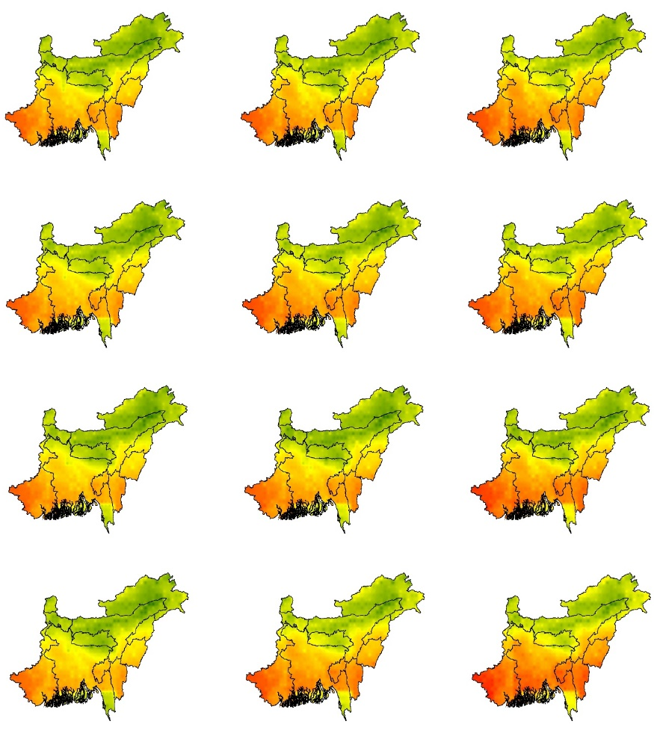
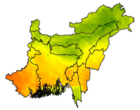
Combined Drought Vulnerability Index (CDVI) for NEIB using AHP
Reference Period (1981-2014) |  | Epoch 1 (2015-2040) | Epoch 2 (2041-2070) | Epoch 3 (2071-2100)
 | SSP126
 | SSP245
 | SSP370
 | SSP585
Reference Period (1981-2014) |  | Epoch 1 (2015-2040) | Epoch 2 (2041-2070) | Epoch 3 (2071-2100)
 | SSP126
 | SSP245
 | SSP370
 | SSP585
0-0.2 Extreme Low
0.2-0.4 Low
0.4-0.6 Moderate
0.6-0.8 High
0.8-1.0 Extreme High
0.70
Extreme Low
Low
Moderate
High
Extreme High
0.30
20

Slide 21
Region-wise Breakdown of Drought Categories in the NEIB: A Comprehensive Overview
21

Slide 22
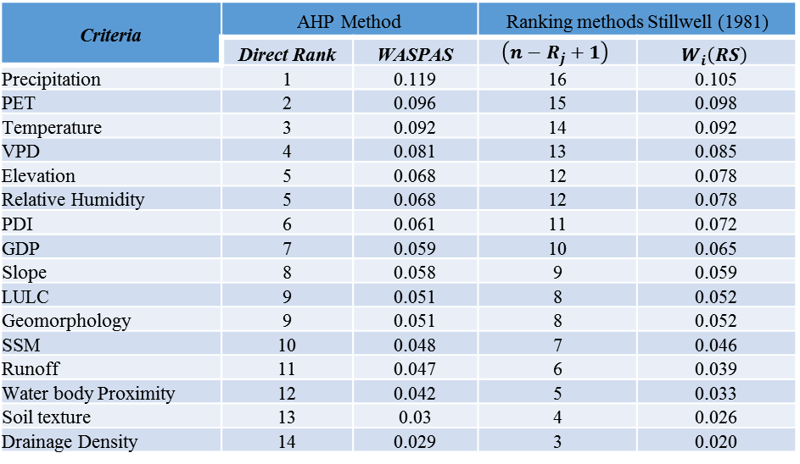
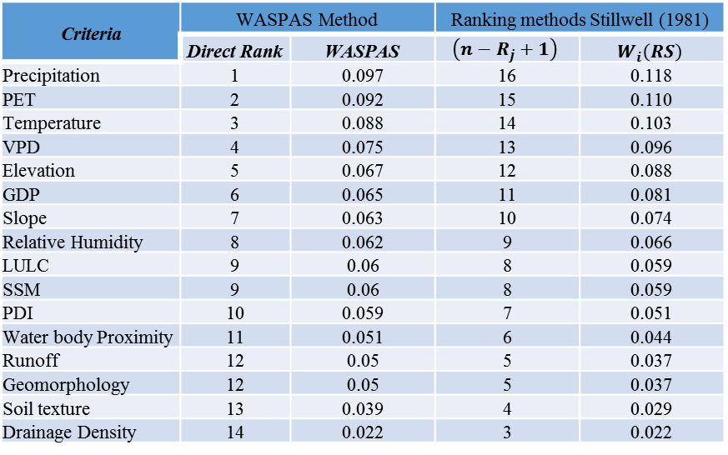
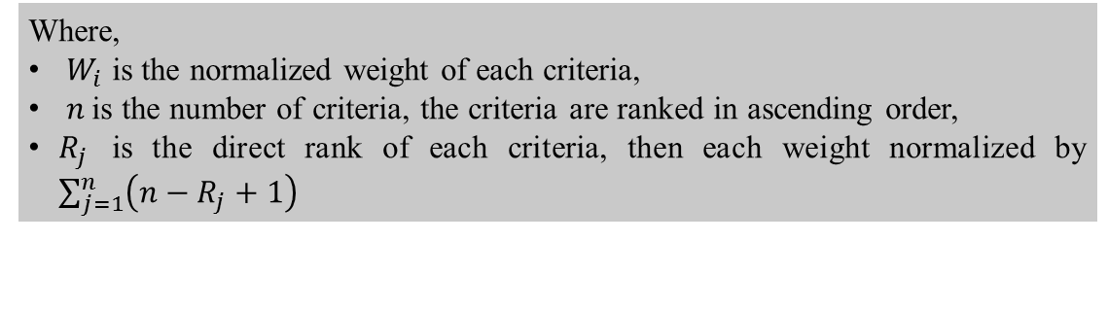
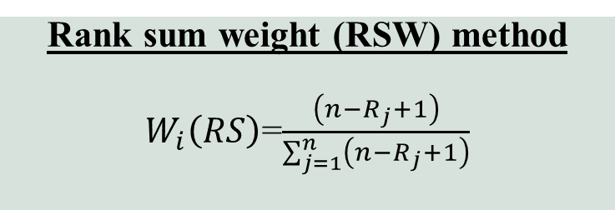
Verifying Consistency and Robustness
Verifying Consistency and Robustness
Rank sum weight (RSW) method
$W_{i}\left(RS\right)$=$\frac{\left(n−R_{j}+1\right)}{\sum_{j=1}^{n}{\left(n−R_{j}+1\right)}}$
Where,
$W_{i}$ is the normalized weight of each criteria,
$n$is the number of criteria, the criteria are ranked in ascending order,
$R_{j}$ is the direct rank of each criteria, then each weight normalized by $\sum_{j=1}^{n}{\left(n−R_{j}+1\right)}$
Criteria | WASPAS Method |  | Ranking methods Stillwell (1981)
 | Direct Rank | WASPAS | $$\left(n−R_{j}+1\right)$$ | $$W_{i}\left(RS\right)$$
Precipitation | 1 | 0.097 | 16 | 0.118
PET | 2 | 0.092 | 15 | 0.110
Temperature | 3 | 0.088 | 14 | 0.103
VPD | 4 | 0.075 | 13 | 0.096
Elevation | 5 | 0.067 | 12 | 0.088
GDP | 6 | 0.065 | 11 | 0.081
Slope | 7 | 0.063 | 10 | 0.074
Relative Humidity | 8 | 0.062 | 9 | 0.066
LULC | 9 | 0.06 | 8 | 0.059
SSM | 9 | 0.06 | 8 | 0.059
PDI | 10 | 0.059 | 7 | 0.051
Water body Proximity | 11 | 0.051 | 6 | 0.044
Runoff | 12 | 0.05 | 5 | 0.037
Geomorphology | 12 | 0.05 | 5 | 0.037
Soil texture | 13 | 0.039 | 4 | 0.029
Drainage Density | 14 | 0.022 | 3 | 0.022
Criteria | AHP Method |  | Ranking methods Stillwell (1981)
 | Direct Rank | WASPAS | $$\left(n−R_{j}+1\right)$$ | $$W_{i}\left(RS\right)$$
Precipitation | 1 | 0.119 | 16 | 0.105
PET | 2 | 0.096 | 15 | 0.098
Temperature | 3 | 0.092 | 14 | 0.092
VPD | 4 | 0.081 | 13 | 0.085
Elevation | 5 | 0.068 | 12 | 0.078
Relative Humidity | 5 | 0.068 | 12 | 0.078
PDI | 6 | 0.061 | 11 | 0.072
GDP | 7 | 0.059 | 10 | 0.065
Slope | 8 | 0.058 | 9 | 0.059
LULC | 9 | 0.051 | 8 | 0.052
Geomorphology | 9 | 0.051 | 8 | 0.052
SSM | 10 | 0.048 | 7 | 0.046
Runoff | 11 | 0.047 | 6 | 0.039
Water body Proximity | 12 | 0.042 | 5 | 0.033
Soil texture | 13 | 0.03 | 4 | 0.026
Drainage Density | 14 | 0.029 | 3 | 0.020
22

Slide 23
Comparative Evaluation of WASPAS/AHP and Rank Sum Weight Methods
WASPAS
AHP
RSW
23

Slide 24
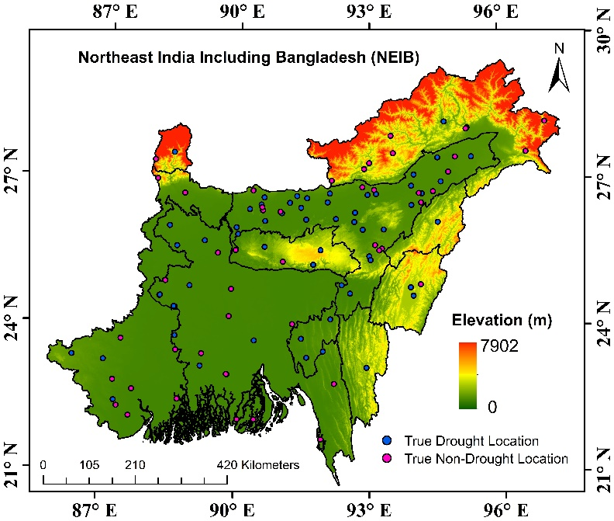

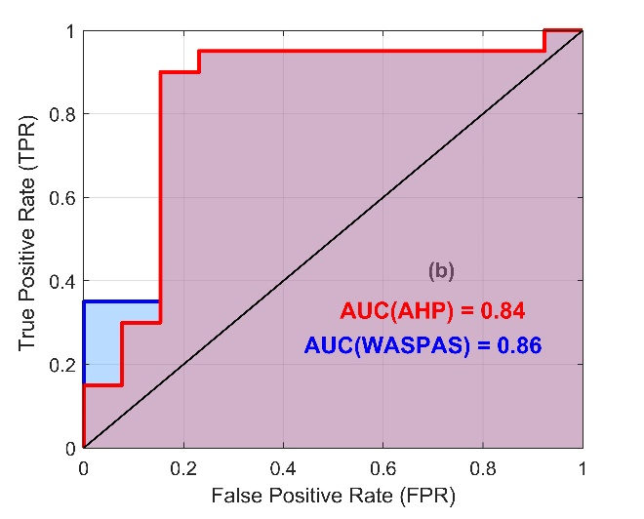


Model validation
Receiver Operating Characteristic (ROC) curves and Area under the Curve (AUC) values
Success rate ROC curve
Prediction rate ROC curve.
$$TPR=\frac{TP}{TP+FN}$$
$$FPR=\frac{FP}{FP+TN}$$
True Positive (TP) represents correctly mapped observed drought locations.
True Negative (TN) denotes correctly mapped non-drought locations.
False Positive (FP) refers to drought locations that were incorrectly mapped as non-drought.
False Negative (FN) represents non-drought locations that were incorrectly classified as drought-affected.
24

Slide 25








Conclusions
Overview of MCDM Applications for prepare drought vulnerability mapping
Successful Application of SDVM in NEIB
Most Influential Parameter
Performance of MCDM Methods
SDVM approach was successfully applied to the NEIB region, showcasing its ability to identify drought-vulnerable areas
Precipitation, Potential Evapotranspiration (PET), and Temperature emerged as the most critical factors.
The WASPAS method performed slightly better than the AHP method
Increasing Drought Vulnerability
High-Risk
Regions
Community-Centric Policies & Early Warning Systems
Tripura, Mizoram, and West Bengal, underscoring the urgent need for resilience-building and adaptation strategies.
Strengthening local participation, integrating indigenous knowledge, and improving drought forecasting
70-73% of NEIB experiencing moderate vulnerability and 25-28% facing high vulnerability.
Ashesh Rudra Paul, Department of Civil Engg., IITKGP
26

Slide 26
Selected References
Alharbi, R. S., Nath, S., Faizan, O. M., Hasan, M. S. U., Alam, S., Khan, M. A., Bakshi, S., Sahana, M., & Saif, M. M. (2022). Assessment of Drought vulnerability through an integrated approach using AHP and Geoinformatics in the Kangsabati River Basin. Journal of King Saud University - Science, 34(8). https://doi.org/10.1016/j.jksus.2022.102332
de Araújo, M. D., Maia Araújo de Brito, Y., & de Oliveira, R. (2022). Spatial multi-criteria approach to water scarcity vulnerability and analysis of criteria weighting techniques: a case study in São Francisco River, Brazil. GeoJournal, 87, 951–972. https://doi.org/10.1007/s10708-022-10676-7
Eini, M., Kaboli, H. S., Rashidian, M., & Hedayat, H. (2020). Hazard and vulnerability in urban flood risk mapping: Machine learning techniques and considering the role of urban districts. International Journal of Disaster Risk Reduction, 50(March). https://doi.org/10.1016/j.ijdrr.2020.101687
Guo, H., Chen, J., & Pan, C. (2021). Assessment on agricultural drought vulnerability and spatial heterogeneity study in china. International Journal of Environmental Research and Public Health, 18(9). https://doi.org/10.3390/ijerph18094449
Heydari Alamdarloo, E., Khosravi, H., Nasabpour, S., & Gholami, A. (2020). Assessment of drought hazard, vulnerability and risk in Iran using GIS techniques. Journal of Arid Land, 12(6), 984–1000. https://doi.org/10.1007/s40333-020-0096-4
Hoque, M. Z., Haque, M. E., & Islam, M. S. (2022). Mapping integrated vulnerability of coastal agricultural livelihood to climate change in Bangladesh: Implications for spatial adaptation planning. Physics and Chemistry of the Earth, 125(November 2020). https://doi.org/10.1016/j.pce.2021.103080
Kulkarni, S. S., Wardlow, B. D., Bayissa, Y. A., Tadesse, T., Svoboda, M. D., & Gedam, S. S. (2020). Developing a remote sensing-based combined drought indicator approach for agricultural drought monitoring over Marathwada, India. Remote Sensing, 12(13). https://doi.org/10.3390/rs12132091
Mokarram, M., Pourghasemi, H. R., Hu, M., & Zhang, H. (2021). Determining and forecasting drought susceptibility in southwestern Iran using multi-criteria decision-making (MCDM) coupled with CA-Markov model. Science of the Total Environment, 781. https://doi.org/10.1016/j.scitotenv.2021.146703
Saaty, T. L. (1990). An Exposition of the AHP in Reply to the Paper “Remarks on the Analytic Hierarchy Process.” Management Science, 36(3), 259–268. https://doi.org/10.1287/mnsc.36.3.259
Sivakumar, V. L., Radha Krishnappa, R., & Nallanathel, M. (2020). Drought vulnerability assessment and mapping using Multi-Criteria decision making (MCDM) and application of Analytic Hierarchy process (AHP) for Namakkal District, Tamilnadu, India. Materials Today: Proceedings, 43, 1592–1599. https://doi.org/10.1016/j.matpr.2020.09.657
Zavadskas, E. K., Turskis, Z., Antucheviciene, J., & Zakarevicius, A. (2012). Optimization of weighted aggregated sum product assessment. Elektronika Ir Elektrotechnika, 122(6), 3–6. https://doi.org/10.5755/j01.eee.122.6.1810
Ashesh Rudra Paul, Department of Civil Engg., IITKGP
27

Slide 27


Thank You
Ashesh Rudra Paul, Department of Civil Engg., IITKGP
28

