Slide 1


Concentration characteristics and emission estimates of major HCFCs and HFCs
at three typical fluorochemical plants in China
based on a Gaussian diffusion model
Jing Wu*, Zehua Liu, Tengfei Ma, Minde An, Tong Ye, Xingchen Zhao, Mingzhu Li, Fan Wang, Mao Yuan, Dongmei Hu, Lin Peng*
EGU Vienna. April 2025

Slide 2
Outline
1 Introduction
2 Method
3 Results and Discussion

Slide 3
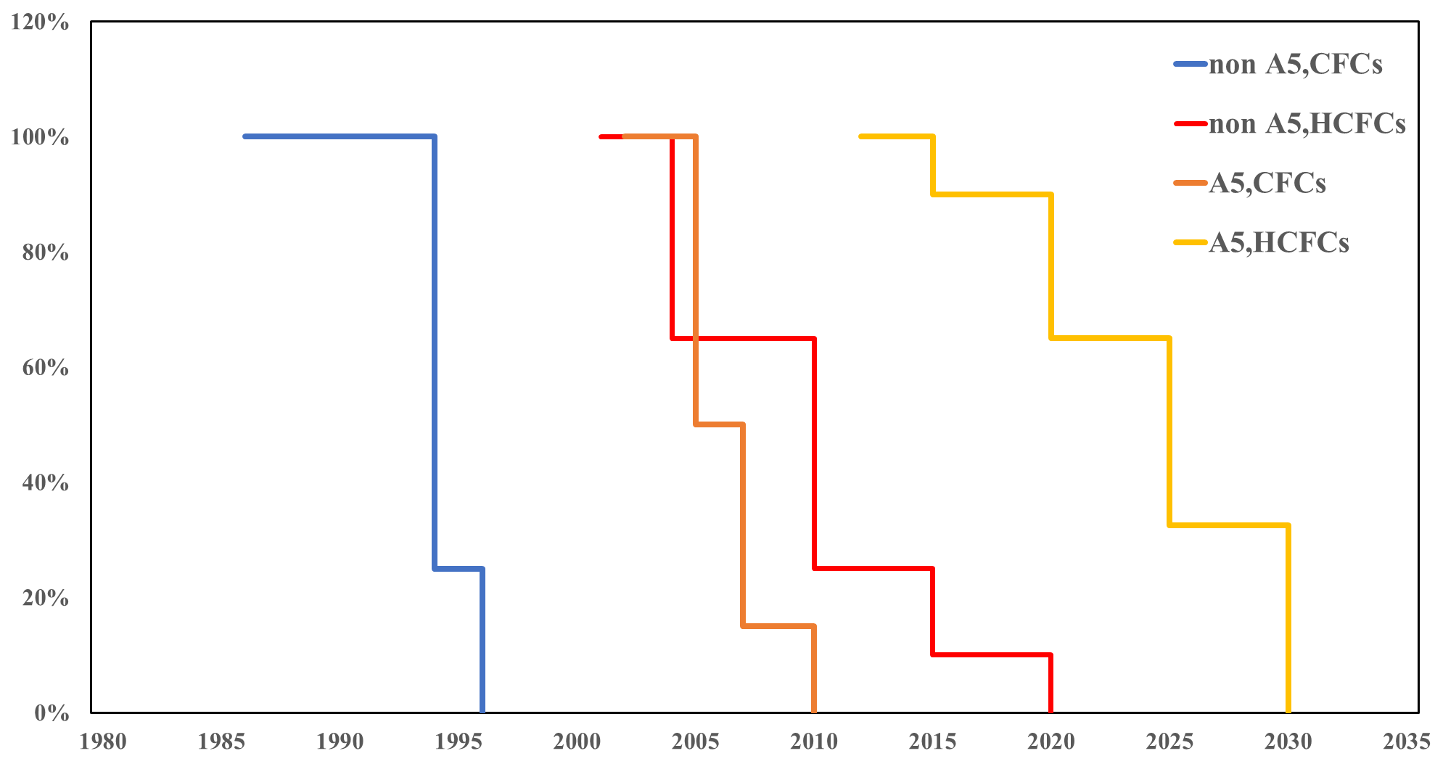
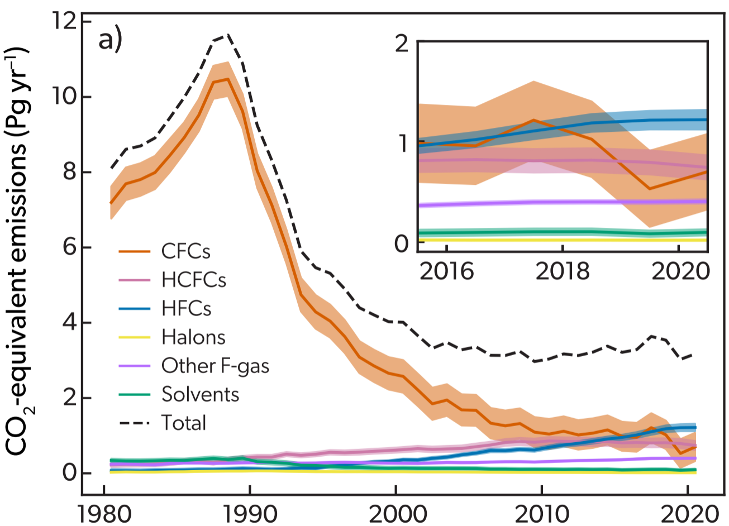
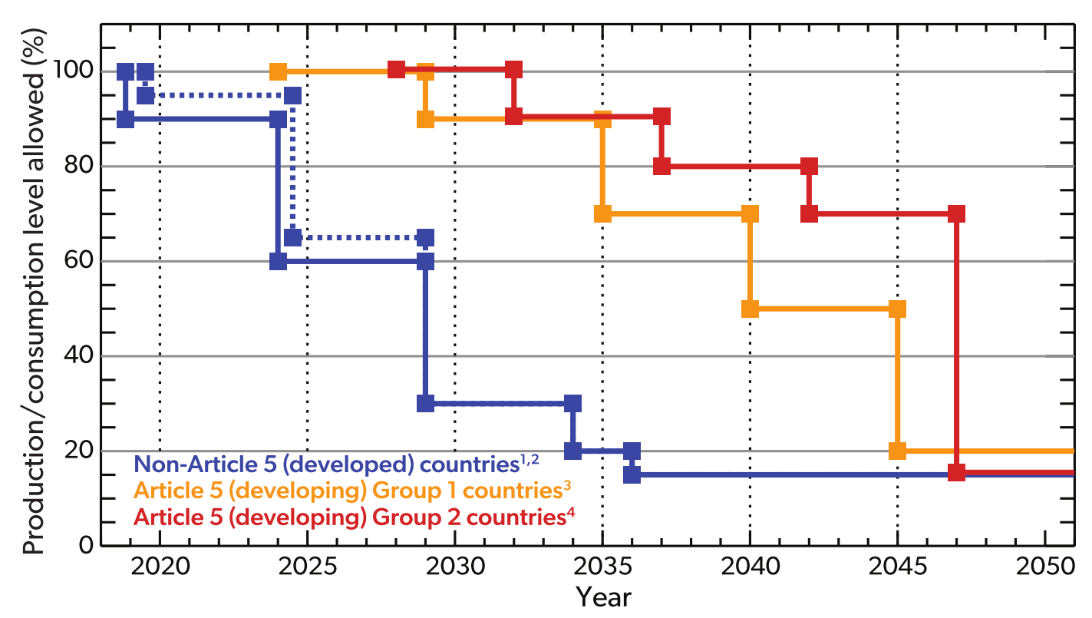

1、Introduction
CFCs and HCFCs
CFCs: Phased out end of 2010
HCFCs: non-A5 (Phased out end of 2020); A5 (Phased out end of 2030)
HFCs: non-A5 (85% reduction by 2036); A5 Group 1 (80% reduction by 2045); A5 Group 2 (85% reduction by 2047)
HFCs
GHG emissions(CO₂-eq)
(UNEP,2022)
With the global emissions of HFCs increasing year by year, it is therefore necessary to study HFC emissions.
"Montreal Protocol" control measures
Notes:
Hydrochlorofluorocarbons (HCFCs) and hydrofluorocarbons (HFCs) are controlled substances under the Montreal Protocol. HCFCs are widely used in refrigeration, air-conditioning, foam, and other sectors
(UNEP, 2011; Wan et al., 2009). Owing to their long atmospheric lifetime (1.3 to over 10 years) and the ability to release free chlorine atoms into the stratosphere and absorb infrared irradiation (thermal radiation), HCFCs are both ozone-depleting substances (ODSs) and potent greenhouse gases (GHGs). HFCs contain no chlorine or bromine and do not deplete the ozone layer. Therefore, HFCs are used to substitute HCFCs, and are mainly used in the refrigeration, air-conditioning, foam, and firefighting sectors(UNEP, 2016), and a small amount is used in the aerosol, solvent, and other sectors(UNEP, 2019; Velders et al., 2012). However, they are potent GHGs with the atmospheric lifetime ranging from hundreds to thousands of years, and global warming potential (GWP) from tens to tens of thousands. They are not only controlled by the Montreal Protocol but also one of the seven controlled substances listed in the United Nations Framework Convention on Climate Change (UNEP, 2008). An accurate estimation of HCFC and HFC emissions is essential for assessing ozone depletion and climate change

Slide 4
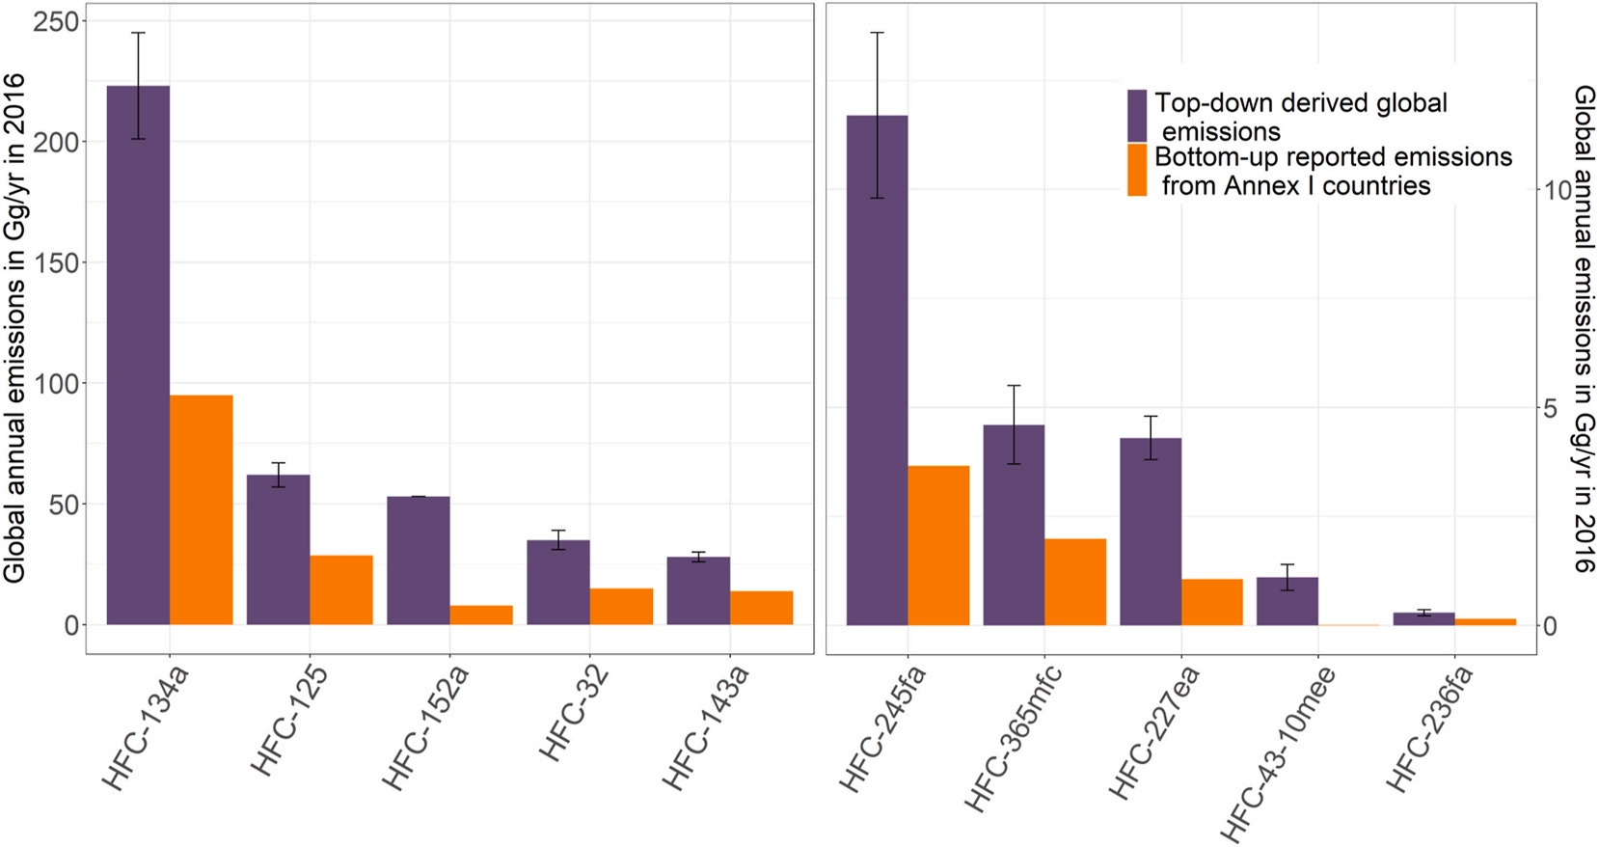
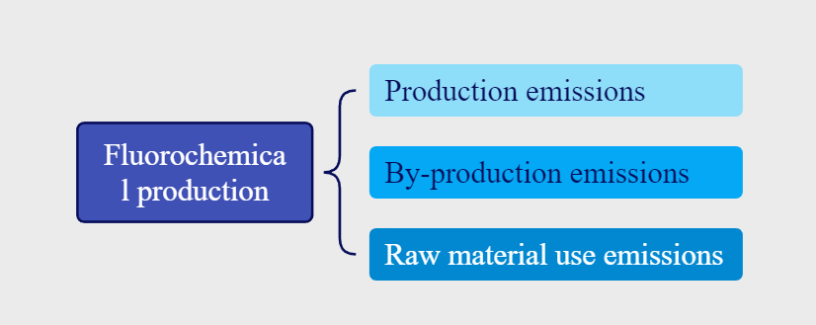
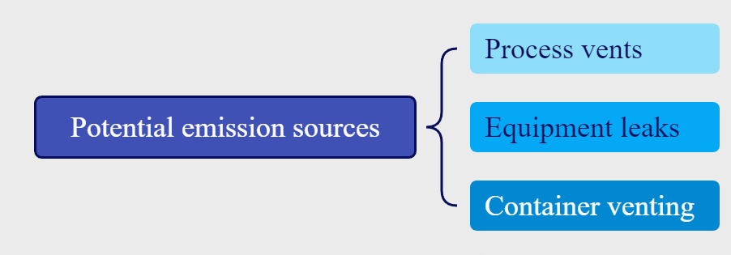
1、Introduction
One major emission process
(Montzka et al., 2018)
(IPCC,2019)
HCFCs and HFCs: Differences between
top-down emissions and bottom-up emissions
Major emission processes
Notes:
字体小+大小写
There were differences between top-down emissions (based on observation data) and bottom-up emissions (based on production and consumption data) for HCFCs and HFCs.
As one of the major emission processes, the fluorochemical production process includes product emissions, by-product emissions, and raw material use emissions (IPCC, 2019). Potential emission sources include process vents, equipment leaks, and container venting (IPCC,2019).

Slide 5
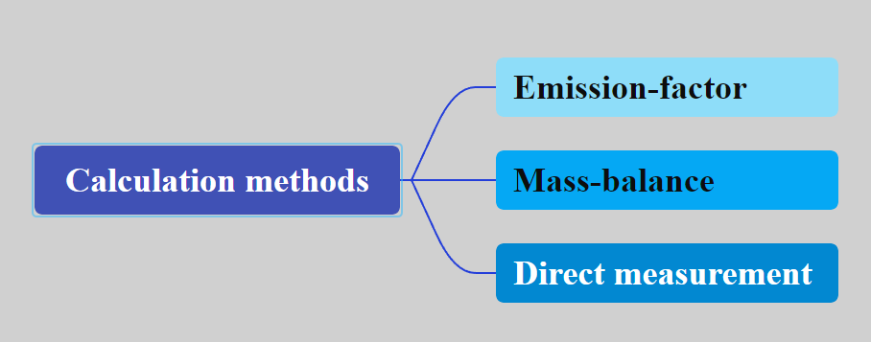

1、Introduction
Emission-factor : The factors have a big gap and a large range of uncertainty.（IPCC2006 : 0%-1% IPCC2019 : 0.1%-20%）
Mass-balance : The industrial material data is difficult to obtain.
Direct measurement : Little research about HFCs and HCFCs.
Existing research on production emissions based on the direct measurement method
Time | Place | Model | References
1992-2014 | China | ISCST-3 | Bai et al.,2019
2014 | Lanzhou | Aermod | Duan, 2017
2020 | Xian | Aermod | Lu et al., 2023
2014 | Northern China | ISCST-3 | Lv et al., 2015
2021 | Qingdao | FTIR | Wang et al., 2020
2014 | Northern China | ISCST-3 | Wei et al., 2016
2017 | Northern China | ISCST-3 | Wei et al., 2018
2017 | China | FTIR | Zou et al., 2017
Notes:
The calculation methods mainly involve emission-factor approach, mass-balance approach and direct measurement method. There is a big gap between different emission factors (like ipcc 2006 and 2009),with the latter having a larger range of uncertainty.The mass-balance approach is to calculate the emission by multiplying the mass of flue gas by the mass concentration of pollutants in the flue gas .It is highly dependent on the industrial material data, which is difficult to obtain. The direct measurement method is usually based on the observation data around the plant and mainly uses the Gaussian plume diffusion model to establish the source–receptor relationship to estimate emissions. This method can avoid not only the shortcomings of the default emission factor from the IPCC guidelines, but also the difficulty in the mass-balance approach to obtain industrial material data. At present, some studies have carried out VOC sampling around plants to estimate VOC emission based on the Gaussian diffusion virtual point source postposition method combined with remote sensing FTIR (Fourier Transform Infrared Spectroscopy) or least square method, and based on the ISC3 (Industrial Source Complex 3) model, ISCST-3 (Industrial Source Complex Short Term-3) model or AERMOD (AMS/EPA Regulatory Model) in the steady-state Gaussian plume diffusion model. However, no research has been conducted on the HCFC and HFC emissions from fluorochemical plants based on observation data and diffusion model.
At present, most studies (Li et al., 2016; Wu et al., 2022) directly use the emission-factor approach to estimate the emissions of HCFCs and HFCs during the production process based on the emission factors recommended by the Intergovernmental Panel on Climate Change (IPCC).
In addition to the emission-factor approach, the calculation methods for production process emissions include the mass-balance approach andthe direct measurement method (IPCC, 2006). The mass-balance approach is to calculate the emission by multiplying the mass of flue gas by the mass concentration of pollutants in the flue gas (IPCC, 2019). It is highly dependent on the industrial material data, which is difficult to obtain. The direct measurement method is usually based on the observation data around the plant (IPCC, 2006) and mainly uses the Gaussian plume diffusion model to establish the source–receptor relationship to estimate emissions. This method can avoid not only the shortcomings of the default emission factor from the IPCC guidelines, which cannot accurately reflect the actual situation of countries, regions, and plants, but also the difficulty in the mass-balance approach to obtain industrial material data. At present, some studies (Bai et al., 2019; Duan, 2017; Lu et al., 2023; Lv et al., 2015; Wang et al., 2020; Wei et al., 2016; Wei et al., 2018; Zou et al., 2017) have carried out VOC sampling around plants to estimate VOC emission based on the Gaussian diffusion virtual point source postposition method combined with remote sensing FTIR (Fourier Transform Infrared Spectroscopy) or least
square method, and based on the ISC3 (Industrial Source Complex 3) model, ISCST-3 (Industrial Source Complex Short Term-3) model or AERMOD (AMS/EPA Regulatory Model) in the steady-state Gaussian plume diffusion model. However, no research has been conducted on the HCFC and HFC emissions from fluorochemical plants based on observation data and diffusion model.

Slide 6
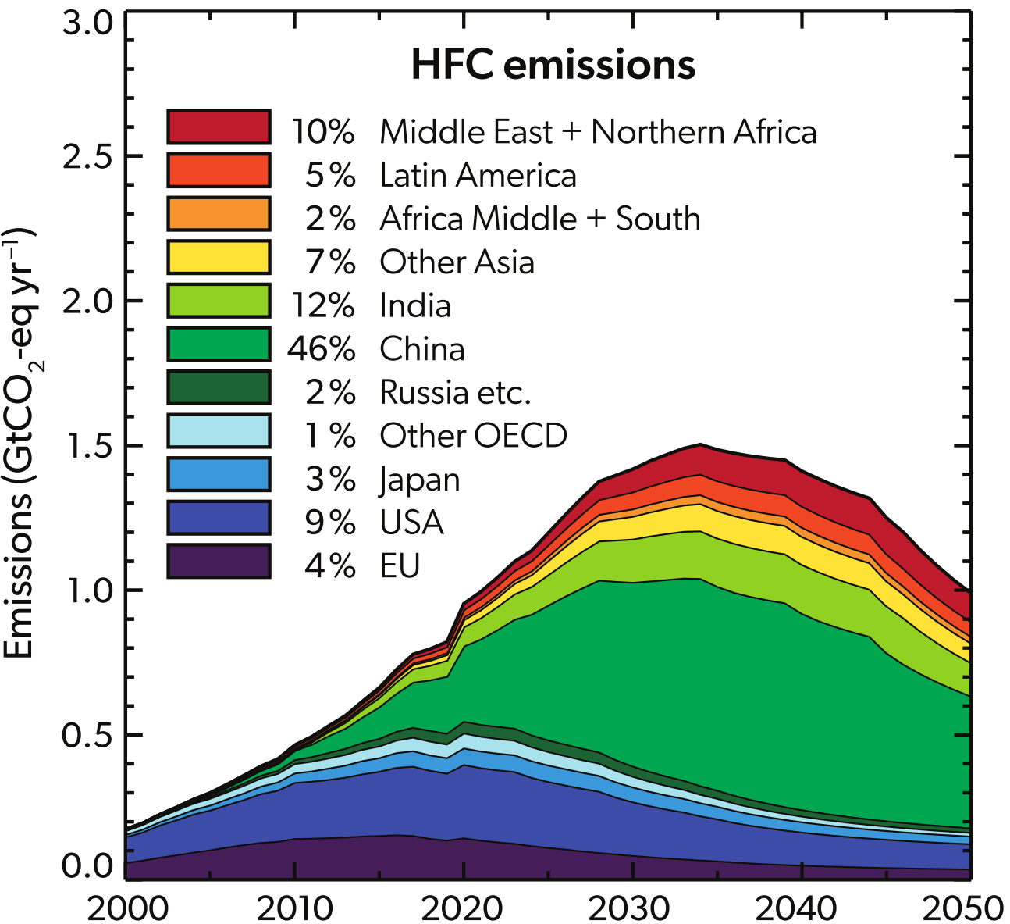
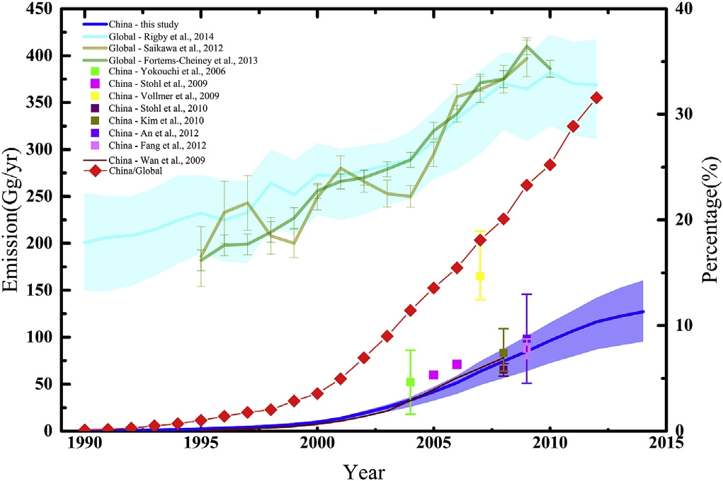
1、Introduction
China is the largest producer, consumer, and emitter of HCFCs and HFCs worldwide.
The relative contributions of emission
(UNEP, 2022)
Notes:
China is the largest producer, consumer, and emitter of HCFCs and HFCs worldwide(Bie et al., 2017).

Slide 7
1、Introduction
What we have done:
Air samples around the fluorochemical plants were collected and the mixing ratio characteristics of atmospheric concentration of HCFCs and HFCs were analyzed.
The emission rates and annual emissions of six major HFCs and two major HCFCs in three plants were estimated based on the Gaussian diffusion virtual point source postposition method in modified Gaussian diffusion models.
The total HCFC and HFC emissions from the three plants were compared with their national bottom-up emissions in China and the applicability of emission factors from IPCC 2006; 2019 in China were further discussed.
Notes:
The total HCFC and HFC emissions from the three plants were compared with their national bottom-up emissions in China and the applicability of emission factors from IPCC 2006; 2019 in China were further discussed. This study firstly evaluated the emissions of fluorochemical plants based on observation data around fluorochemical plants, which provided scientific support for accurately estimating the HCFCs and HFCs emissions of the production process.

Slide 8
Outline
1 Introduction
2 Method
3 Results and Discussion

Slide 9
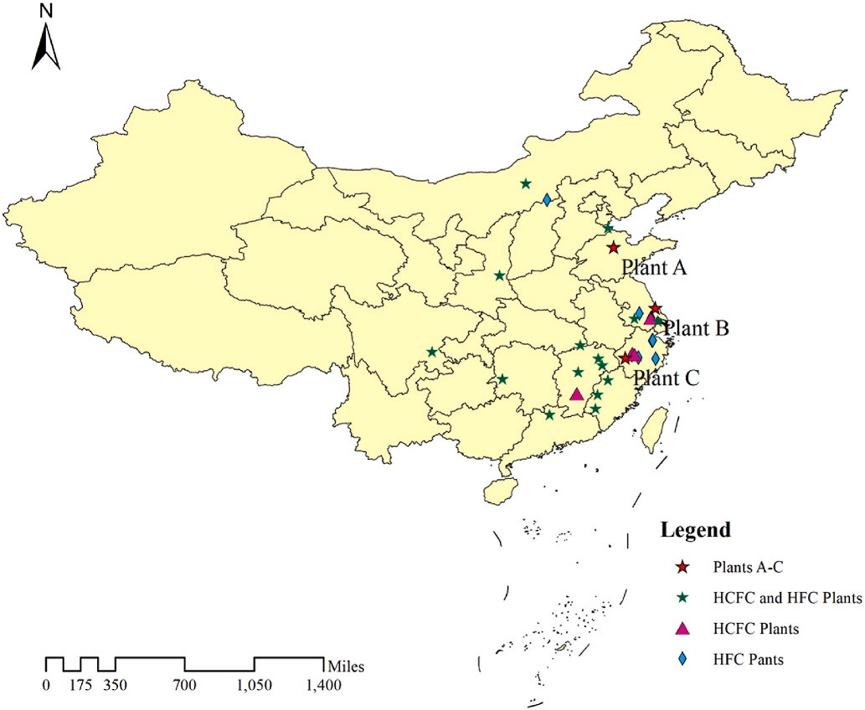
2、Method
HCFC and HFC sampling and analysis
We selected fluorochemical plants A, B, and C to carry out atmospheric observations . Collected a total of 104 atmospheric samples based on 52 sampling times.
Plant A : Shandong
Plant B : Jiangsu
Plant C : Zhejiang
In this study, the terrain around the three plants was open and flat. There are no other emission sources within 2 km of the plants. These conditions are suitable for application to a Gaussian diffusion model.
Notes:
We selected fluorochemical plants A, B, and C to carry out atmospheric observations in November 2021 and May 2022. The three plants are located in Shandong, Jiangsu, and Zhejiang Provinces, which are the
main distribution provinces of HCFC and HFC plants. Fig. 1 illustrates the three chosen typical plants. In this study, the terrain around the three plants was open and flat. There are no other emission sources
within 2 km of the plants. These conditions are suitable for application to a Gaussian diffusion model

Slide 10


2、Method
Estimation of HFC-134a national inventory
The formula for calculating the Gaussian diffusion virtual point source postposition method is as follows:
National emission estimation
The estimation can be briefly described by the following formula:
Notes:
Multiple emission sources are distributed inside the plant, which can be regarded as an area source. The Gaussian model is the most widely used in industry and has been verified by a large number of experiments (Wang et al., 2020), which includes two common calculation methods of area source model, namely ATDL model and virtual point source postposition method (Zou et al., 2017). The latter is more suitable for industrial area sources (Lu et al., 2023; Wang et al., 2020; Wu and Ding, 2007; Zou et al., 2017), and thus was selected to simulate the emission rates of HCFCs and HFCs in three plants. First, it is assumed that all emission sources in the fluorochemical plant are concentrated in the center of the area source block (on the diagonal intersection of the area source block), forming an "equivalent point source". The source–receptor relationship of the target compounds is then established using the point source formula. However, if the scattered emission sources are concentrated at one point, an unreasonably high concentration is obtained near the equivalent point source. To overcome this disadvantage, the location of the equivalent point source can be moved to a location in the upwind direction, so that the area source of this plant will be equivalent to a virtual point source in the upwind direction (Gu et al., 2001). Although the virtual point source postposition method has large uncertainty for the calculation of near distance pollution concentration (Liu et al., 2009), we can get a rough estimate based on this method. Briefly, based on meteorological parameters, the emission rate of pollutants could be roughly estimated by using Gaussian diffusion model and virtual point source postposition method.

Slide 11
Outline
1 Introduction
2 Method
3 Results and Discussion

Slide 12
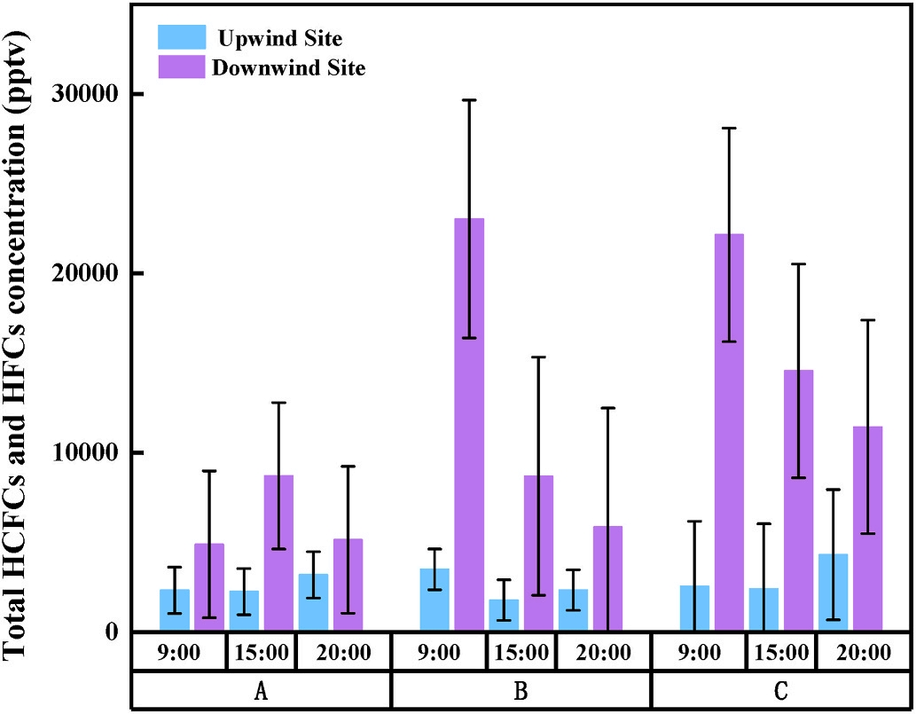
3、Results and Discussion
1) Concentration differences between the downwind and upwind sites
The differences in the total concentrations of HCFCs and HFCs in the three plants during the daytime between the downwind and upwind sites were significantly higher (p < 0.05) than those
during nighttime :
9:00 16723-19583 pptv
15:00 6452-12145 pptv
20:00 1954-7124 pptv
The Gaussian diffusion virtual point source postposition method is unsuitable for diffusion analysis of nighttime concentrations in this study.
Notes:
By comparing the wind speed, we found that the average wind speed during the daytime (2.5m/s) was significantly higher than at night (1.5 m/s). Lower wind speeds can slow down horizontal and vertical diffusion, so it was not favorable for the transportation of the HCFCs and HFCs from the plants to sampling sites. In addition, under low wind speed conditions, local turbulence had a greater impact on pollutant concentrations, which would
increase the uncertainty of the model (Li et al., 2023)

Slide 13
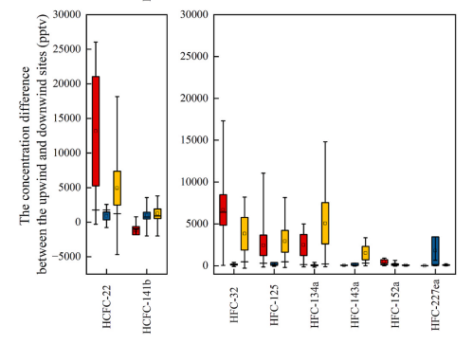
3、Results and Discussion
1. Concentration differences between the downwind and upwind sites
The species with the largest down-up differences:
Plant A : HCFC-22(13157pptv), HFC-32(8604pptv)
Plant B : HFC-227ea(1802pptv), HCFC-141b(971pptv)
Plant C : HFC-134a(5070pptv), HFC-22(4923pptv)
The proportion of HFCs to the total down-up differences:
Plant A : 51.7%
Plant B : 57.9%
Plant C : 69.1%
In the substitution process of HCFC products, the HFC production in these major fluorochemical plants in China may have catched up with the HCFC production and become more and more important.
Notes:
For Plant A, the concentration difference between the downwind and upwind sites (from now on referred to as down-up difference) in terms of the total concentrations of HCFCs and HFCs was 27,230 pptv. Among all substances, HCFC-22, HFC-32 had the largest down-up differences, with 13,157 pptv and 8604 pptv, respectively. The down-up difference of Plant B is about 4482 pptv, with HFC-227ea and HCFC-141b having the largest values of 1802 pptv and 971 pptv, respectively. For Plant C, the down-up difference of HCFCs and HFCs was 19,918 pptv. Among all substances, down-up differences of HFC-134a and HFC-22 were the highest, which were 5070 pptv and 4923 pptv, respectively. In three plants, the down-up differences of HFCs accounts for more than 50% of the total down-up differences, which were 51.7%, 57.9% and 69.1%, respectively. It indicated that in the substitution process of HCFC products, the HFC production in these major fluorochemical plants in China may have catched up with the HCFC production and become more and more important.

Slide 14
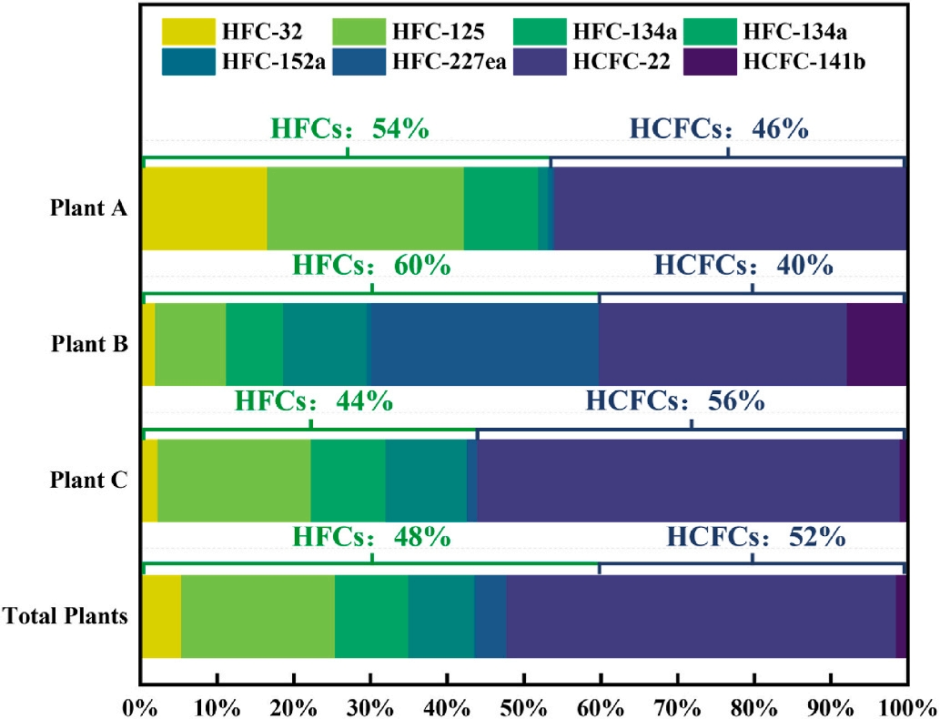
3、Results and Discussion
2. Emissions from fluorochemical plant
Plant A:
The sum of HCFC-22 (5.62 Mt) , HFC-125 (3.13 Mt) ,
HFC-32 (2.03Mt) emissions exceeded 85% of the total emissions.
Plant B:
The total emissions of HCFC-22 (1.87Mt) , HFC-227ea (1.72Mt)
HFC-143a (0.63Mt) , HFC-125(0.54Mt) and
HCFC-141b (0.46Mt)exceeded 80% of the total emissions.
Plant C:
The sum of HCFC-22 (21.24Mt) , HFC-125 (7.69Mt) ,
HFC-143a (4.10Mt) emissions exceeded 85.6% of the
total emissions.
The HFC production of the three plants had reached a very large scale with the phaseout of ODSs.
Notes:
The emissions of three plants were estimated by Gaussian diffusion model, and each substance in our study was known greenhouse gases. Therefore, The GWP was used to normalize the emissions of each substance (Fig. 5). The total emissions of all substance from the three plants were 56.62(34.73–81.15) Mt CO2-equiv yr− 1. The emissions of HCFCs and HFCs in three plants reached about 29.57(18.02–41.89) and 27.05 (16.70–39.26) Mt CO2-equiv yr− 1 (see in Figs. 5 and 6), respectively. For Plant A, HCFC-22, HFC-125, and HFC-32 had the highest emissions among all HCFCs and HFCs. The sum of their emissions exceeded 85% of the total emissions, which were about 5.62(4.57–6.78) Mt CO2-equiv yr− 1 (45.9%), 3.13(1.70–4.67) Mt CO2-equiv yr− 1 (25.6%), and 2.03 (1.44–2.75) Mt CO2-equiv yr− 1 (16.6%), respectively. The ranking results of the emissions were the same as those of down-up differences. For Plant B, the total emissions of HCFC-22, HFC-227ea, HFC-143a, HFC- 125, and HCFC-141b exceeded 80% of the total emissions in Plant B, which were 1.87(1.37–2.39) Mt CO2-equiv yr− 1 (32.3%), 1.72 (1.40–2.07) Mt CO2-equiv yr− 1 (29.7%), 0.63(0.50–0.77) Mt CO2-equiv yr− 1 (10.9%), 0.54(0.32–0.76) Mt CO2-equiv yr− 1 (9.2%), and 0.46(0.34–0.59) Mt CO2-equiv yr− 1 (7.9%), respectively. In Plant C, the emissions of HCFC-22, HFC-125, and HFC-143a were the highest among all the HCFCs and HFCs, which were 21.24(11.49–31.64) Mt CO2-equivyr− 1 (55.1%),7.69(4.37–11.37) Mt CO2-equiv yr− 1 (19.9%), and 4.10 (2.61–0.92) Mt CO2-equiv yr− 1 (10.6%), respectively. Among different substances, HCFC-22 emissions (28.75(17.42–40.81) Mt CO2-equiv yr− 1, 50.7%) were significantly higher than the other substances. The total emissions of six HFCs were 27.05(16.70–39.26) Mt CO2-equiv yr− 1 ,accounting for 47.8% of the three plants, suggesting that the HFC production of the three plants had reached a very large scale with the phaseout of ODSs. In addition, comparing the ranks of the down-up differences and emissions, each plant did not show consistency. For example,for Plant C, the down-up difference of HFC-32 ranked second, but its emission ranked fifth. One possible reason was that the molar mass and GWP of HFC-32 (55.02 g mol− 1; 675 CO2-equiv) was lower than other substances.

Slide 15
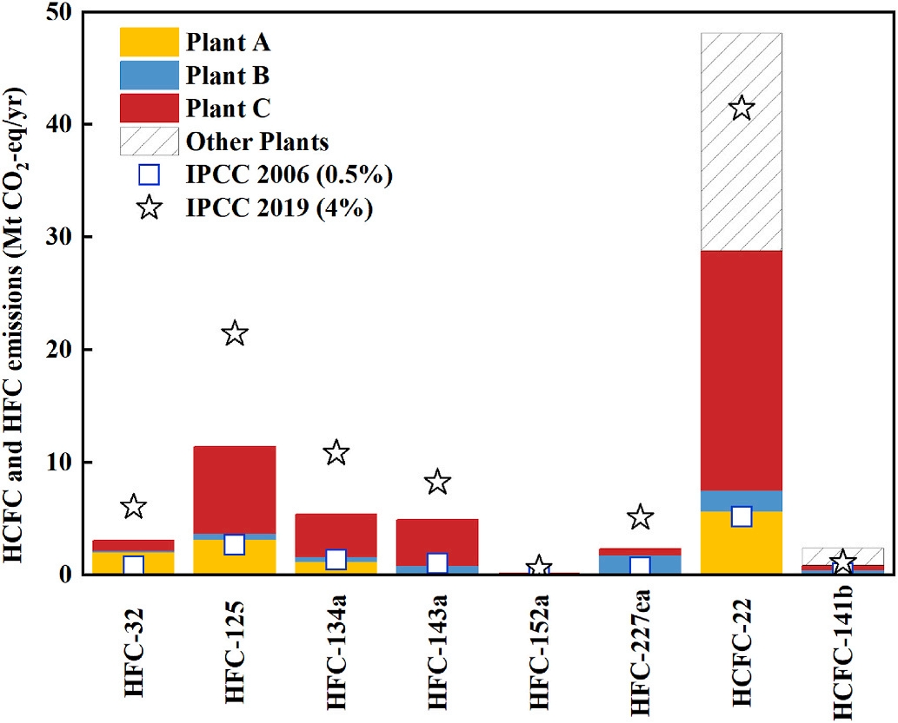
3、Results and Discussion
3. Implication for emission factor from fluorochemical plants
Method | Objection | Emission
Direct Measurement | HCFC-22 | 28.74Mt
 | HFC-32 | 3.05Mt
 | HFC-134a | 5.38Mt
 | HFC-125 | 11.36Mt
Emission-factor(2006) | HCFC-22 | 5.18Mt
 | HFC-32 | 0.75Mt
 | HFC-134a | 1.35Mt
 | HFC-125 | 2.68Mt
Emission-factor(2019) | HCFC-22 | 41.41Mt
Compared with the IPCC 2019 national emissions:
HCFC-22: 69%
HFC-32, HFC-134a: 50%
Compared with the IPCC 2006 national emissions:
HCFC-22: approximately six times
HFC-32, HFC-134a, and HFC-125: approximately four times
Using factor in IPCC 2006 to estimate the emissions from the fluorochemical production process may lead to an underestimation of the bottom-up emissions in China.
The emission factor in IPCC 2019 seems more suitable for Chinese plants to calculate their HCFCs and HFCs emissions.
Notes:
It is easy to see from the above chart that there is a gap among the emissions from different methods . The total emissions of HCFC-22 accountin for 69% of the IPCC 2019 national emissions. The emissions of HFC-32, HFC-134a, HFC-125 account for approximately 50% of the IPCC 2019 national emissions of the corresponding substances. The emissions of HCFC-22 were approximately six times of its IPCC 2006 national emissions .The emissions of HFC-32, HFC-134a, and HFC-125 were approximately four times of their IPCC 2006 national emissions. It indicated that using factor in IPCC 2006 to estimate the emissions from the fluorochemical production process may lead to an underestimation of the bottom-up emissions in China. The emission factor in IPCC 2019 seems more suitable for Chinese plants to calculate their HCFCs and HFCs emissions.
The total emissions of HCFCs and HFCs in China were 11.83 (0–23.66) Mt CO2-equiv yr− 1 using the emission factors recommended by IPCC 2006 and 94.65 (2.37–473.16) Mt CO2-equiv yr− 1 using the emission factors recommended by IPCC 2019, respectively. We compared the emissions of all substances from all three fluorochemical plants derived by the Gaussian diffusion model, to the national emissions estimated based on the emission factors recommended by IPCC 2019 (from now on referred to as IPCC, 2019 national emissions). The comparison showed that the total emissions for each HCFC and HFC were within the uncertainty range of the IPCC 2019 national emission of the corresponding substance (see Supplementary Table S5), and emissions of most substances this study are consisted with the results by using the bottom-up method, with the accounting for a range of 20%–76% of the best estimate of IPCC 2019 national emission of each substance. The total emissions of HCFC-22 from the three plants were about 28.74 (17.70–40.51) Mt CO2-equiv yr− 1 , accounting for 69% of the IPCC 2019 national emissions of HCFC-22 (41.41 (1.04–207.03) Mt CO2-equiv yr− 1). The emissions of HFC-32, HFC-134a, HFC-125 from the three plants were about 3.05 (2.11–4.18) Mt CO2-equiv yr− 1 , 5.38 (3.19–7.97) Mt CO2-equiv yr− 1, and 11.36 (6.39–17.16) Mt CO2-equiv yr− 1 , accounting for approximately 50% of the IPCC 2019 national emissions of the corresponding substances. The emissions of HFC-227ea from the three plants were 0.83 (0.63–1.06) Mt CO2-equiv yr− 1, accounting for approximately 44% of the IPCC 2019 national emissions of HFC-227ea (5.10 (0.13–25.50) MtCO2-equiv yr− 1 ). For HFC-152a, its emissions reached about 0.12 (0.07–0.18) Mt CO2-equiv yr− 1 , accounted for only 20% of IPCC 2019 national emissions. The difference may be because our results do not include emissions from some other plants using HFC-152a as chemical synthesis intermediates. Considering that only three typical fluorochemical plants in China were selected in this study and other plants should also contribute to national HFC and HCFC emissions, the phenomenon that emissions of HFCs and HCFCs in this study are lower than the IPCC 2019 national emissions is reasonable. On the other hand, the lack of production data from the three plants during the sampling period and the lack of observational study in other plants limit more quantificational estimates of the actual emission factors and total emissions from China’s fluorochemical plants.
However, the actual emission factors from China’s fluorochemical plants should be much larger than the recommended value from IPCC2006, according to the comparison between the emissions of all substances from the three fluorochemical plants and the national emissions estimated based on the emission factors recommended by IPCC 2006 (referred to as IPCC, 2006 national emissions). The total emission from all three plants for each substance ranged 2–6 times of the IPCC 2006 national emission of the corresponding substance (11.83 (0–23.66) Mt CO2-equiv yr− 1 ). The emissions of HCFC-22 from the plant were
approximately six times of its IPCC 2006 national emissions (5.18 (0–10.35) Mt CO2-equiv yr− 1). The emissions of HFC-32, HFC-134a, and HFC-125 were approximately four times of their IPCC 2006 national
emissions (0.75 (0–1.51) Mt CO2-equiv yr− 1 , 1.35 (0–2.70) Mt CO2-equiv yr− 1, and 2.68 (0–5.35) Mt CO2-equiv yr− 1, respectively. Considering that the three plants only represent part of China’s production
capacity, the default emission factor of 0.5% (0%–1%) recommended by the IPCC 2006 may be underestimated, which makes it difficult to reflect the actual leakage of HCFCs and HFCs in China’s fluorochemical production process. Using this value to estimate the emissions from the fluorochemical production process may lead to an underestimation of the bottom-up emissions in China. The emission factor in IPCC 2019
seems more suitable for Chinese plants to calculate their HCFCs and HFCs emissions

Slide 16
Conclusions
The substances with the highest down-up atmospheric concentration difference among the three plants are all HCFCs. It indicated that in the substitution process of HCFC products, the HFC production in these major fluorochemical plants in China may have catched up with the HCFC production and become more and more important .
01
The emissions from three plants were significantly higher than national emissions (contained 17 fluorochemical plants) in China estimated by using the emission factor of IPCC 2006. This revealed that using the emission factors recommended by IPCC 2006 to estimate the emissions of HCFCs and HFCs from the fluorochemical plants in China may lead to underestimation.
02
Notes:
In our study, 52 atmospheric observations were conducted in three typical Chinese fluorochemical plants. The results showed that the substances with the highest down-up atmospheric concentration difference among the three plants are all HCFCs (Plant A: HCFC-22; Plant B: HFC-227ea; Plant C: HFC-134a). The total HFC down-up difference (10,143 pptv; 58%) of the three plants is higher than that of HCFCs. The rough emission estimation results showed that the total emissions of HCFCs and HFCs during the production process from the three plants reached 56.62 (36.91–83.69) Mt CO2-equiv yr− 1 . The HCFC and HFC emissions were about 27.05(16.70–39.26) and 29.57(18.02–41.89) Mt CO2-equiv yr− 1 , respectively. It indicated that in the substitution process of HCFC products, the HFC production in these major fluorochemical plants in China may have catched up with the HCFC production and become more and more important. The national emissions were estimated by production data and emission factors from IPCC 2019 or 2006. The estimated emissions from all of three fluorochemical plants for each substance was within the uncertainty range of the IPCC 2019 national emission of the corresponding substance and national production data, accounting for a range of 20%–76% of the best estimate of IPCC 2019
national emission, indicating that the emission factor in IPCC 2019 was more suitable to estimate China’s fluorochemical emissions from production. However, the emissions from three plants were significantly higher than national emissions (contained 17 fluorochemical plants) in China estimated by using the emission factor of IPCC 2006. This revealed that using the emission factors recommended by IPCC 2006 to estimate the emissions of HCFCs and HFCs from the fluorochemical plants in China may lead to underestimation.

Slide 17
Limitations and prospects
Our study only selected three typical fluorochemical plants in China to carry out observations and emission estimations . The production data from each plant during the sampling period could not be obtained, making the quantification of emission factors of each substance impractical.
01
Additionally, our study is limited by the uncertainty of the inversion method. These may limit further exploration of emission factors and total emissions during the production process from the fluorochemical plants in China.
02
As the production equipment, process flow, and control measures of different fluorochemical plants vary, more field observations around plants should be conducted and the production information during the sampling period should be synchronously collected to further quantify the actual emission factor and emissions from the fluorochemical plants in China.
03

Slide 18

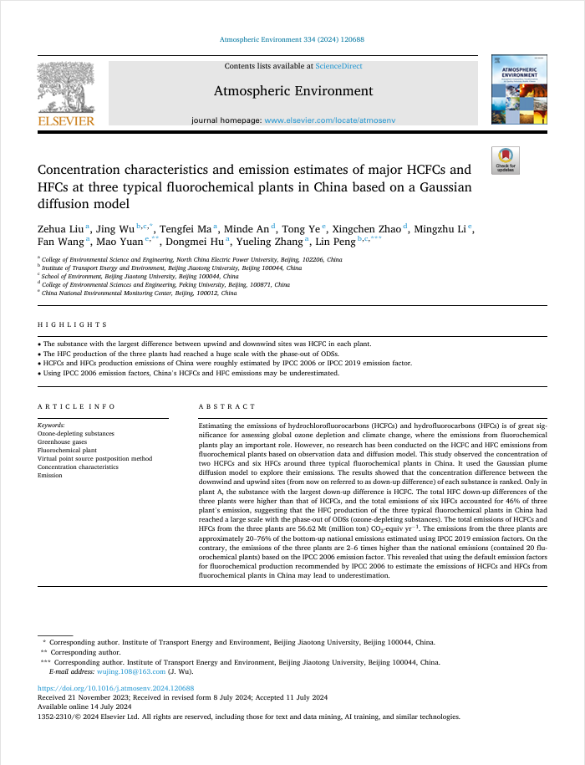

Thank you ！
Prof. Jing Wu
E-mail: wujing.108@163.com
Tel: +86 13811231816
Work unit: School of Environment, Beijing Jiaotong University
Notes:
The work above has been accepted in the Atmospheric Environment on the 11th July 2024 (Concentration characteristics and emission estimates of major HCFCs and HFCs at three typical fluorochemical plants in China based on a Gaussian diffusion model. Atmospheric Environment 2024, 334 ,https://doi.org/10.1016/j.atmosenv.2024.120688).

