Slide 1
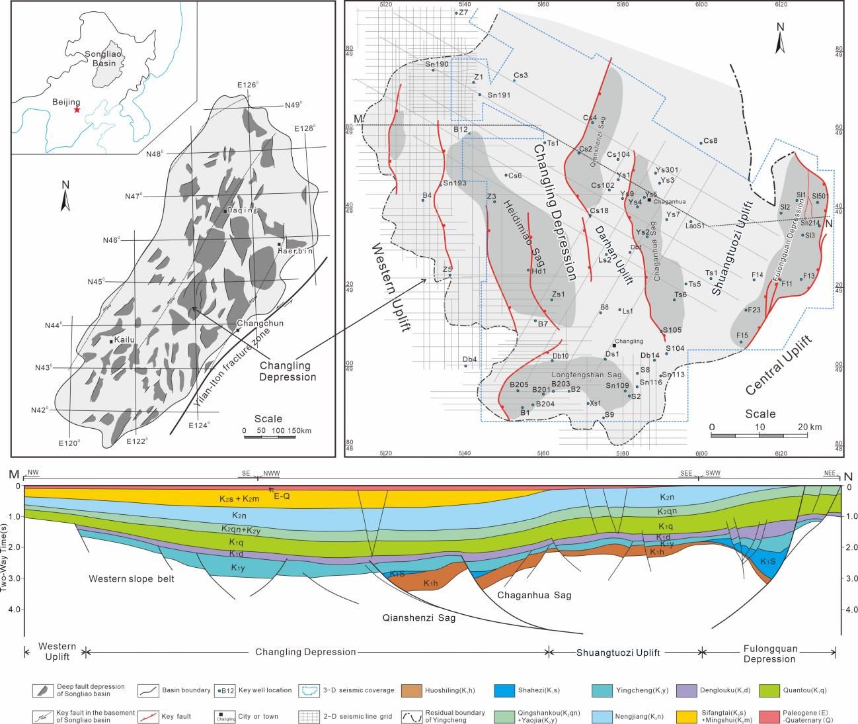
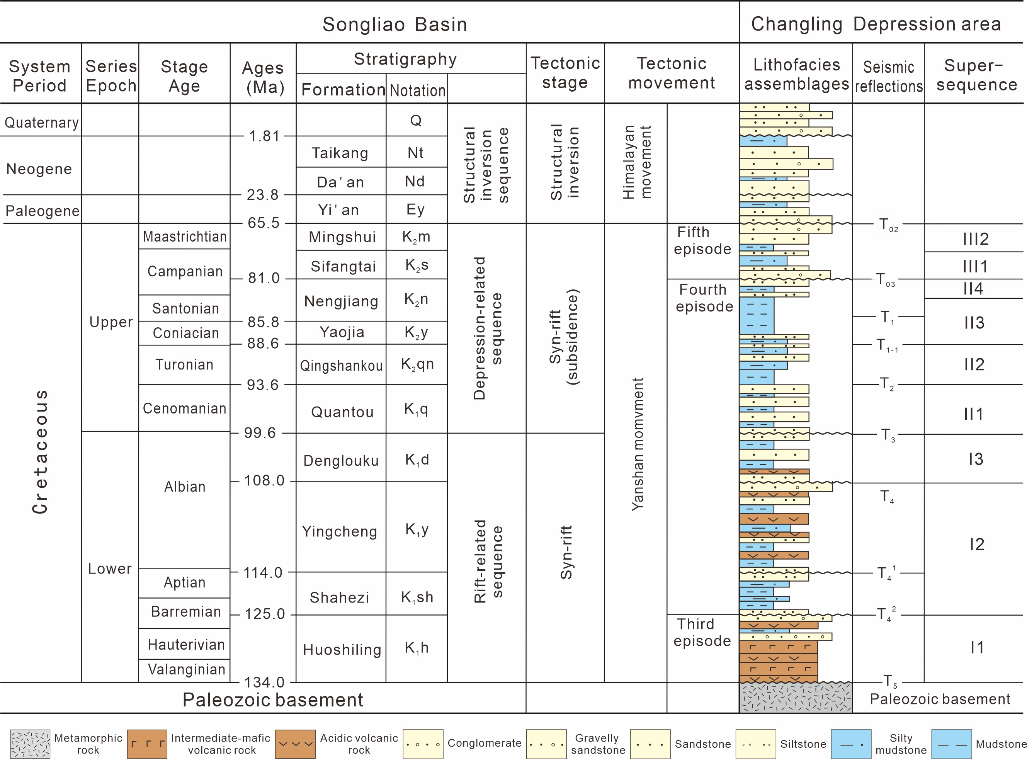
Influence of volcanic eruptions on the sedimentary filling of a continental rift basin
—— A case study of the Yingcheng Formation in the Changling faulted depression in the Songliao Basin, China
Hongyu Wang, Haoyu Zhang, Ao Liu China University of Geosciences, Beijing 100083, China
Geological Setting
Study region
The Songliao Basin: a large continental rift basin in Northeast China
The Changling faulted depression is a graben located in the central region of the basin(8,000 km²)
Stratigraphic lithology
The lower Cretaceous Yingcheng Formation contains several cycles composed of volcanic and sedimentary rocks.
Data
Methods
The seismic data, covering most of the study area.
150 exploration wells with gamma ray (GR), acoustic (AC), deep lateral resistivity (LLD) and shallow lateral resistivity (LLS) logging data and cutting logging data.
50 wells have core data
10 wells have volcanic rock age data
Establishing the stratigraphic framework is realized via sequence stratigraphic analysis
Interpretation of volcanic rocks through the cutting logging data, core data and seismic facies analysis
The reconstruction of tectonic paleogeomorphology
Interpretation of sedimentary filling characteristics
Correspionding Author: wanghy@cugb.edu.cn

Slide 2
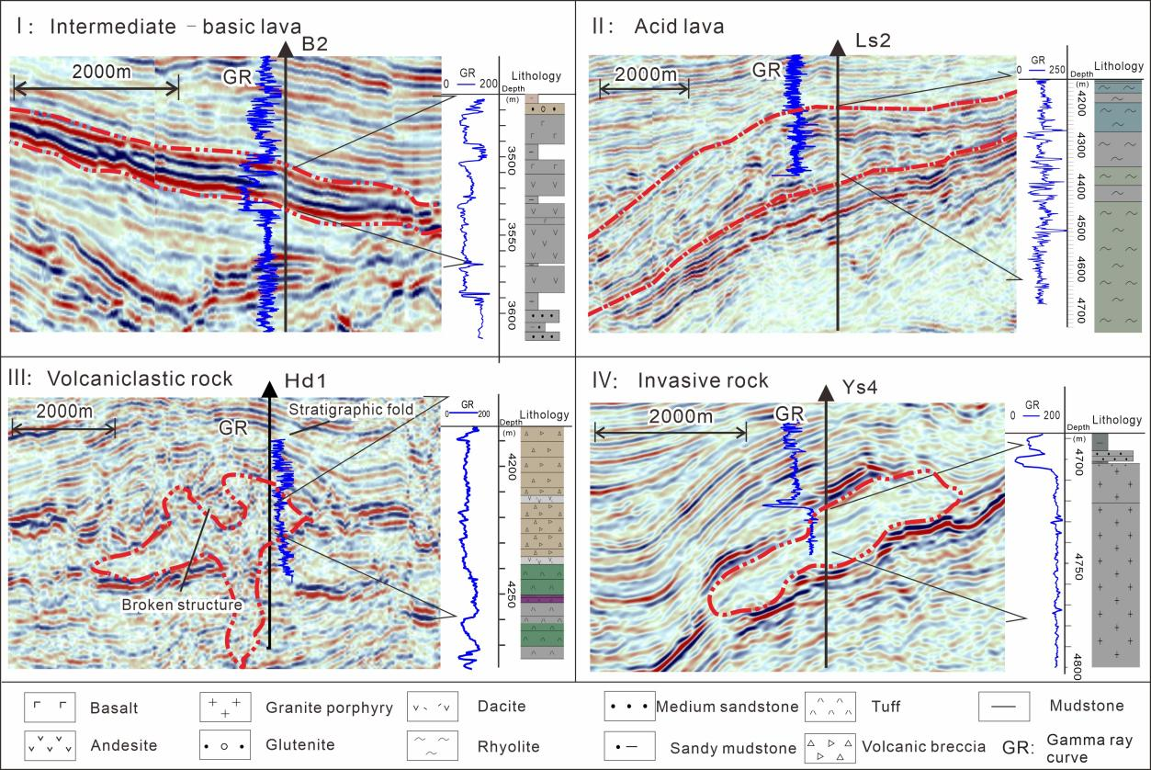
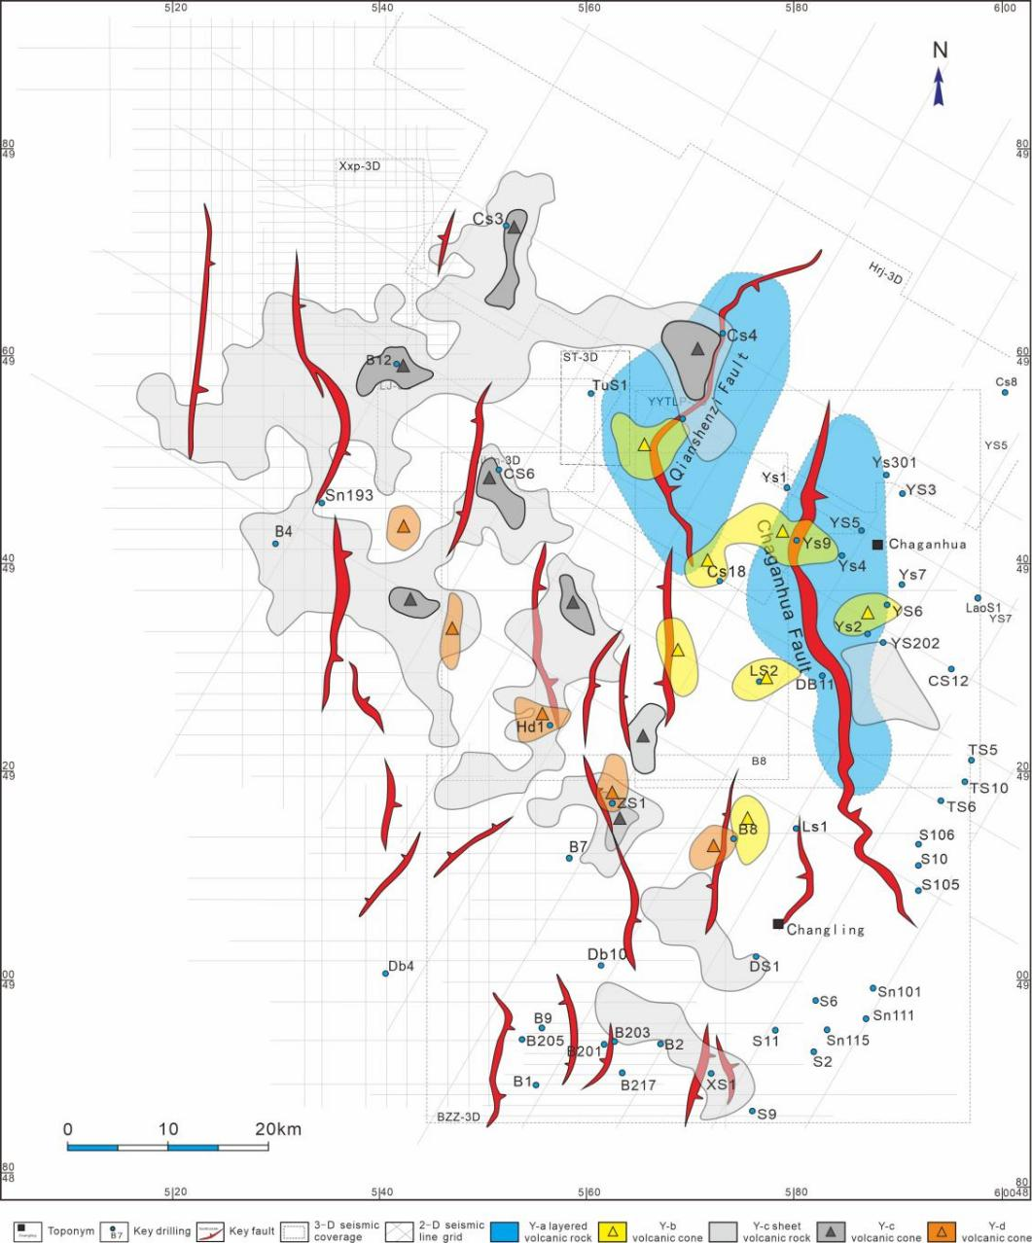
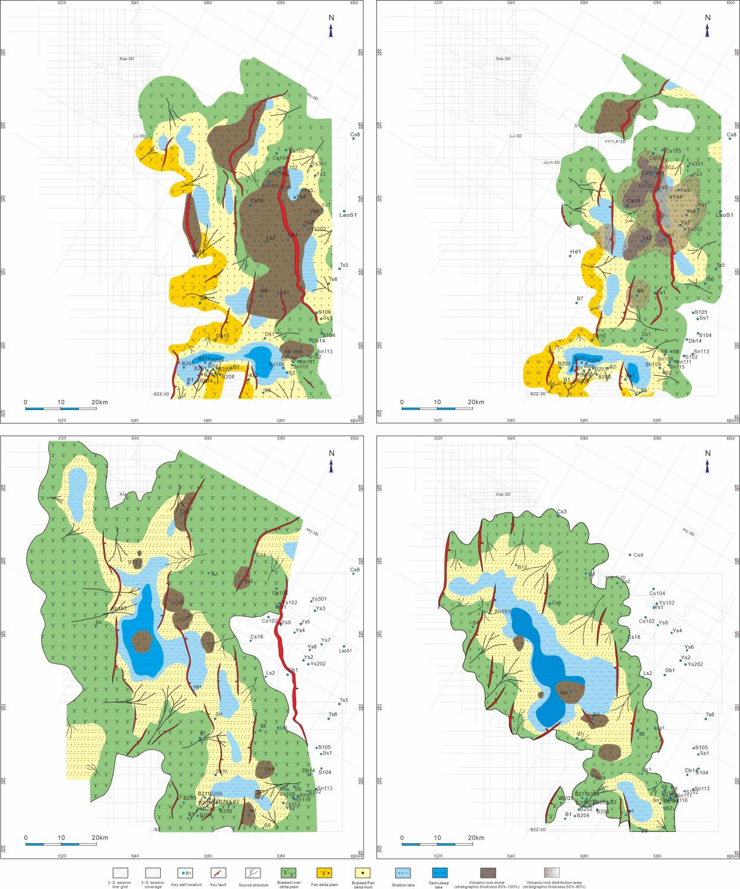
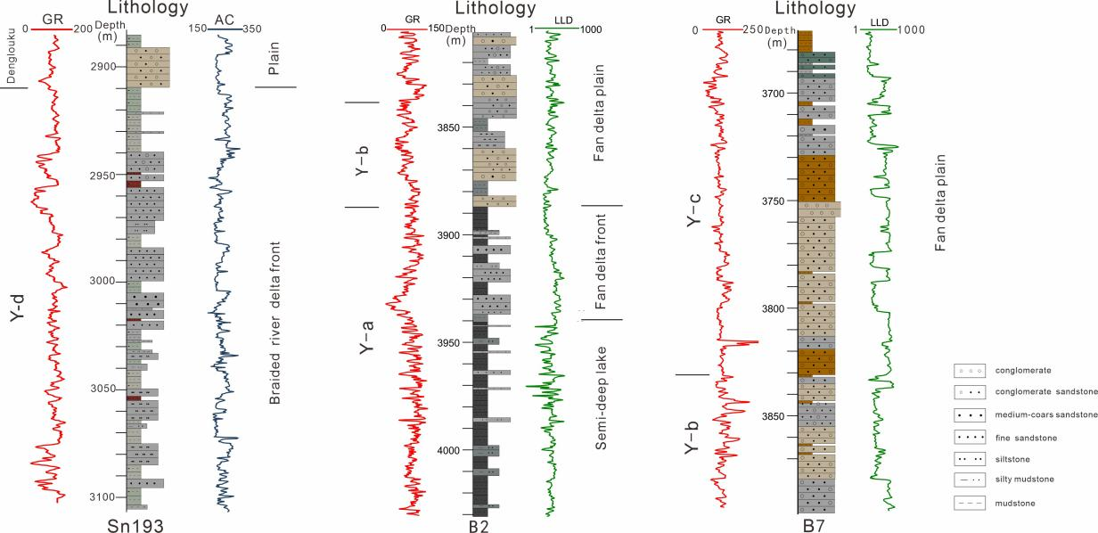
Results
The study region experienced four stages of volcanic activity during the depositional period of the Yingcheng Formation in the Cretaceous. The lithofacies and distribution of volcanic rocks are closely related to the activity and distribution of the major faults that cut the basement.
Fan deltas, braided river deltas and lakes constituted the main depositional systems in the study area. The lake basin that was composed of several grabens and half-grabens gradually developed into a unified saucer-shaped lake basin. During this process, the proportion of the braided river delta depositional system in the lake basin gradually increased, and the distribution area of volcanic uplift gradually decreased.
Volcanic rock types and their corresponding seismic facies and logging facies
Shape and distribution of volcanic vents in each member of the Yingcheng Formation
Sedimentary facies distribution in each member in the Yingcheng Formation
The main sedimentary facies types and their lithofacies and logging facies characteristics

Slide 3
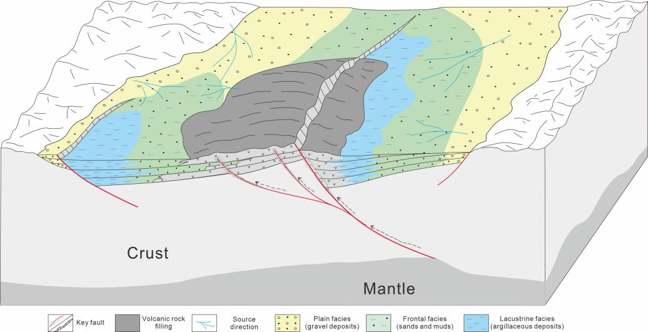
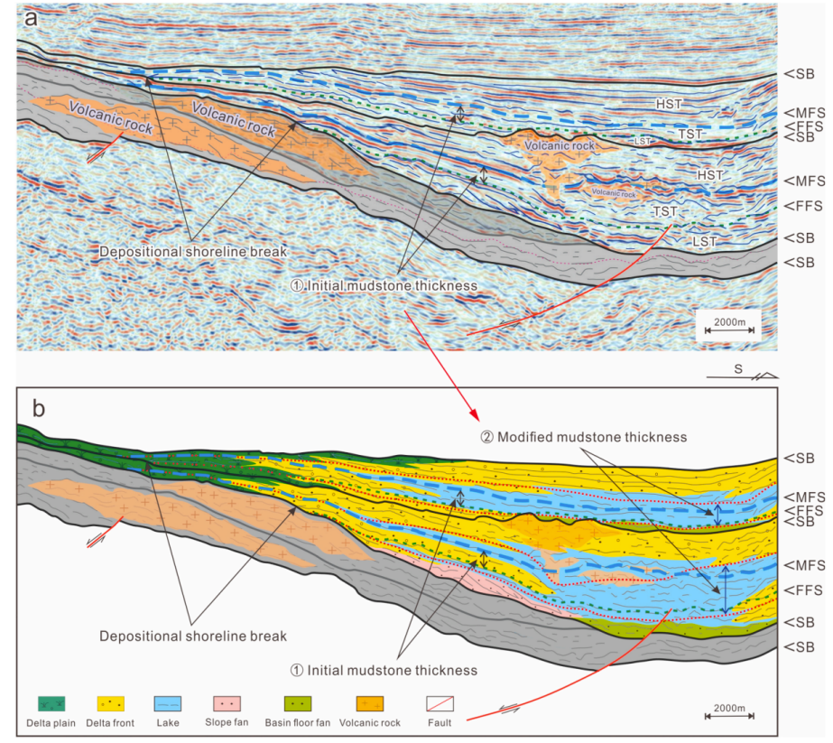
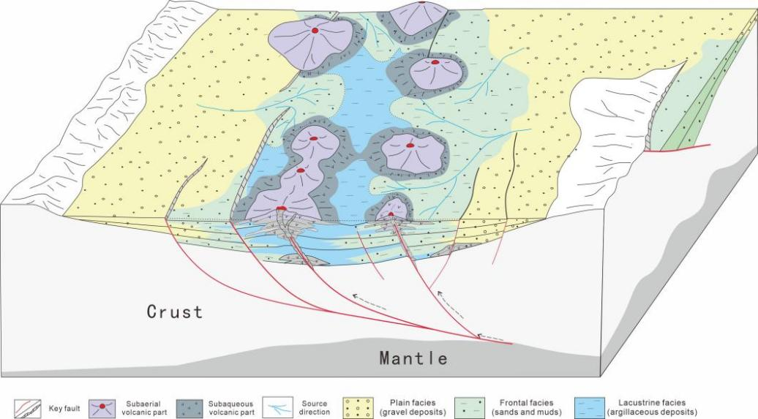
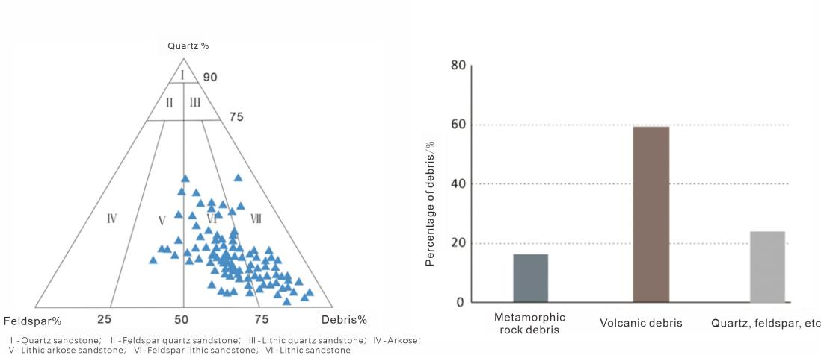
Discussion: The influence of volcanism on basin sedimentary filling
1) Causes of the difference between the subsidence center and sedimentary center
2) Causes of changes in paleogeomorphology and sedimentary patterns
Patterns of volcanic eruption and sedimentary filling. Note the difference in the locations of the depositional centers of the two secondary depressions when there is and is no volcanic uplift.
Changes in the sequence stratigraphic structure of slopes with and without volcanoes
Multiple barrier lakes and restricted depositional centers caused by volcanic cones in the HDM sag area
3) Causes of changes in sediment composition and rock types
They changed the structural style and paleogeomorphic features of the basin and affected the type and spatial distribution of the depositional systems. The influences of different types of volcanic rock masses also differed. The early large-scale volcanic uplift in Yingcheng directly affected the structural style of the fault depression and the sequence stratigraphic style of the sag. The late multipoint distribution of volcanic cones had a greater influence on the paleogeomorphology and the shape and distribution extent of the sedimentary system.
Volcanic eruptions provided different sources of detrital materials for continental lake basins. One was contemporaneous pyroclastics and volcanic ash. The other was associated with volcanic rock uplift that provided coarse-grained clastic material after long-term erosion and flowing-water transport. The spatial distribution difference and the supply mode difference of volcanic materials complicate the rock structure and reservoir characteristics of sandstones and enhance the difficulty of sandstone reservoir evaluation in this continental lake basin.
Sandstone particle composition in the Longfengshan sag in the Changling fault depression (a. particle composition, b. debris composition)

