Slide 1



Climate mosaic: inspiring conversations about data through art
Poppy Townsend (she/her)
Senior Data Scientist – user centred design
Centre for Environmental Data Analysis (CEDA)
Special thanks to my colleagues: Molly MacRae, Vicky Hall, Ag Stephens, Adrian Debski, Ed Hawkins

Slide 2


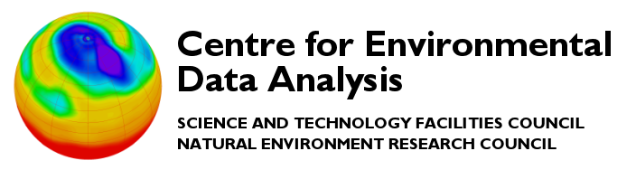


Why do I want to talk about data?
British Oceanographic Data Centre
Discipline: Marine
Centre for Environmental Data Analysis
Discipline: Atmospheric, Earth Observation, and Solar and space physics
Environmental Information Data Centre
Discipline: Terrestrial and freshwater
National Geoscience Data Centre
Discipline: Geoscience
UK Polar Data Centre
Discipline: Polar and cryosphere

Slide 3
Word association…
Data = boring, dry, complicated, technical
Climate change = depressing, demotivating, negative, challenging
Notes:
… but understanding climate impacts and data and digital skills are essential to our every day life.
Communicating about climate change can be - challenging and complex, demotivating and negative
What does good science communication mean to me? - storytelling, relatable, creative and interesting, hopeful

Slide 4
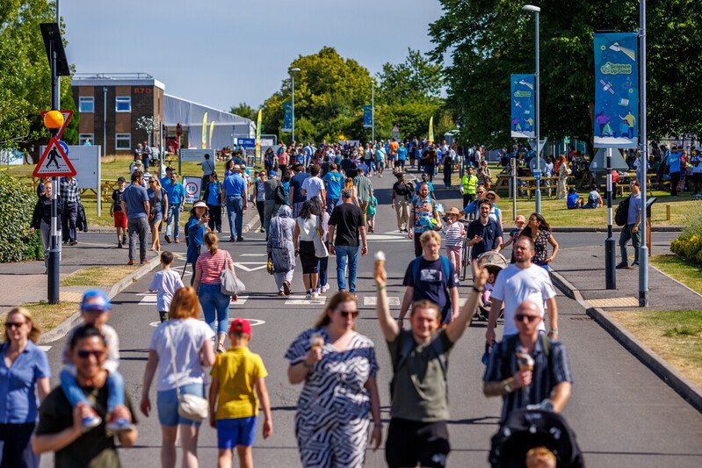
Designing the (not boring or depressing) activity
Where: Harwell Open week - up to 11,000 people
Who: all ages – next generation and their influencers
Why: to inspire transparent, relatable and motivating conversations about climate change, extreme weather events, data and digital skills

Slide 5
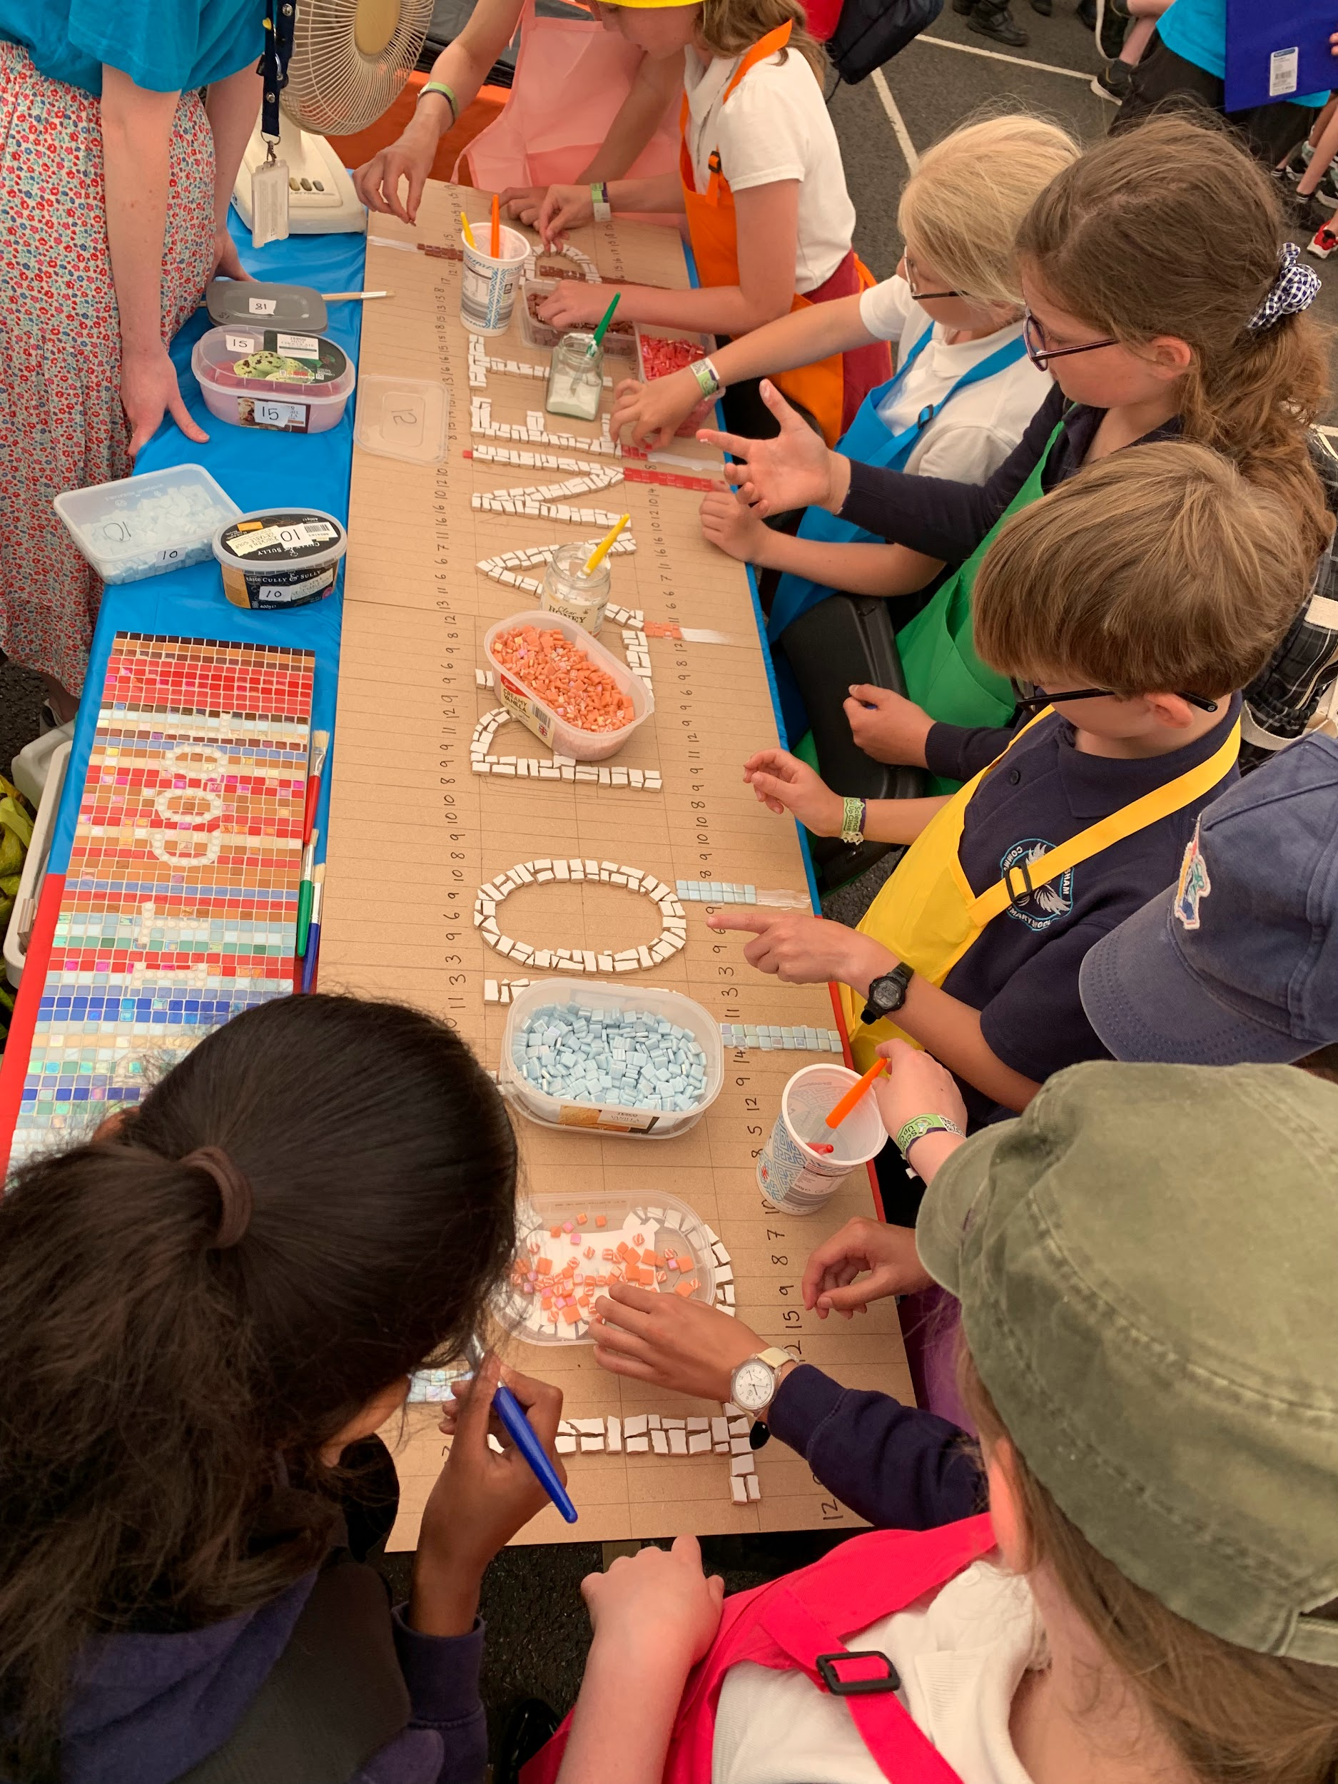
Designing the (not boring or depressing) activity
How:
Interactive, hands on
Fun and engaging
Hopeful not scary
Relatable and local
Inspired by https://showyourstripes.info/ (Ed Hawkins, Reading/NCAS)
What:
Art - mosaic
Local climate data
Visual, engaging, creative

Slide 6
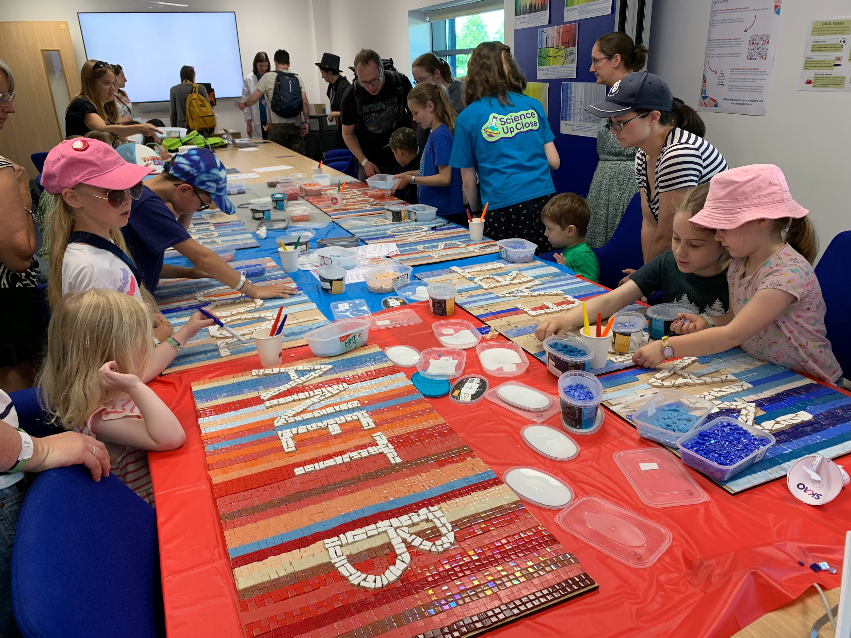
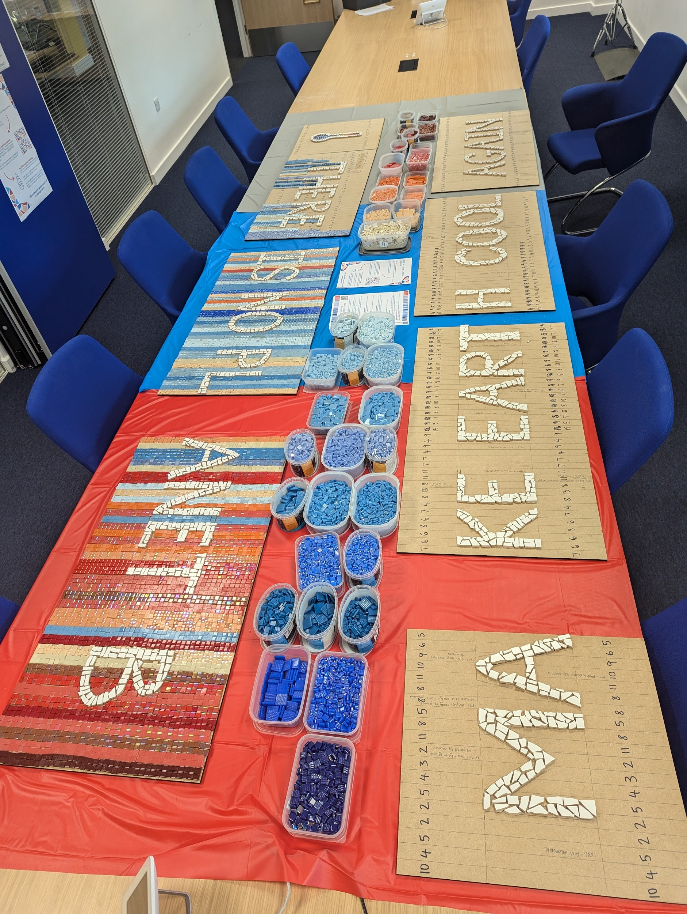
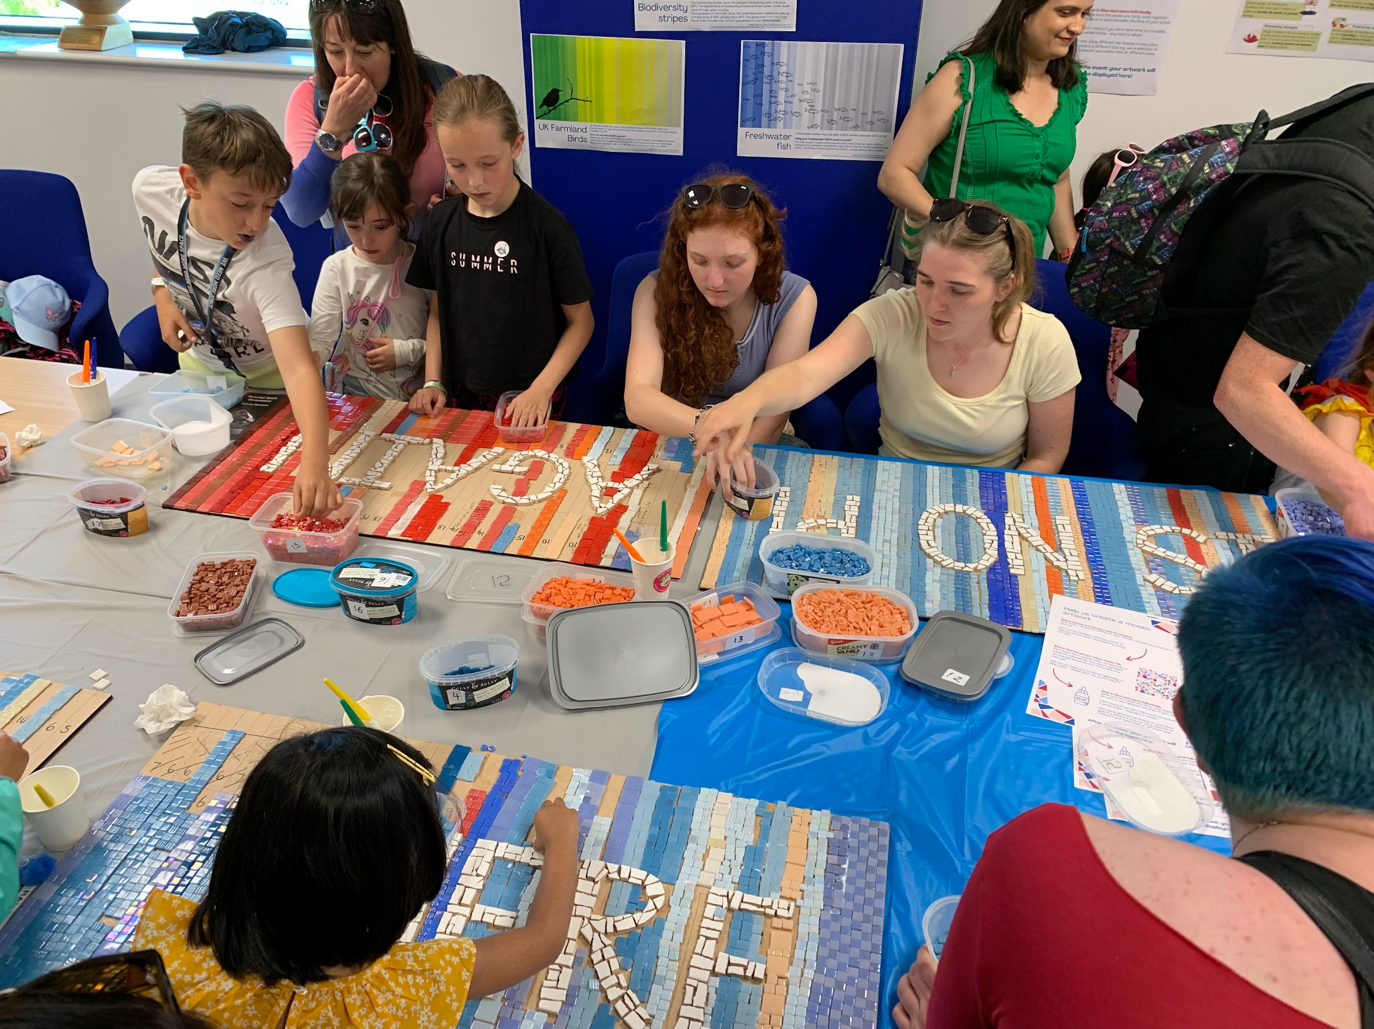
Climate mosaic
100’s of people creating art to represent the warming climate at Harwell, Oxfordshire

Slide 7
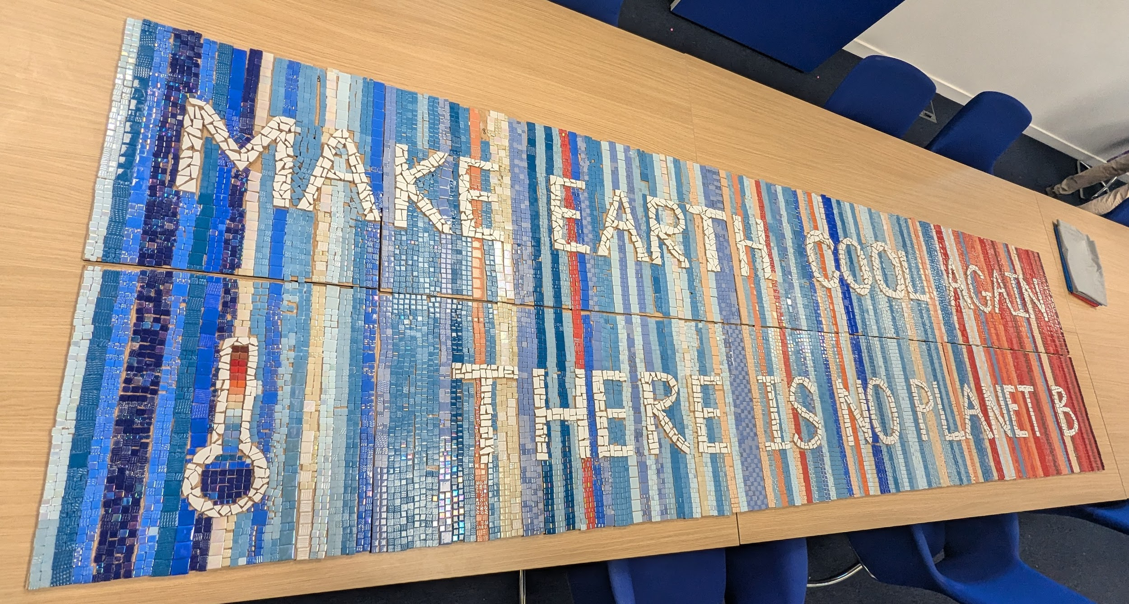
Grandma
Mum
Me
~120 years = 3-4 generations

Slide 8
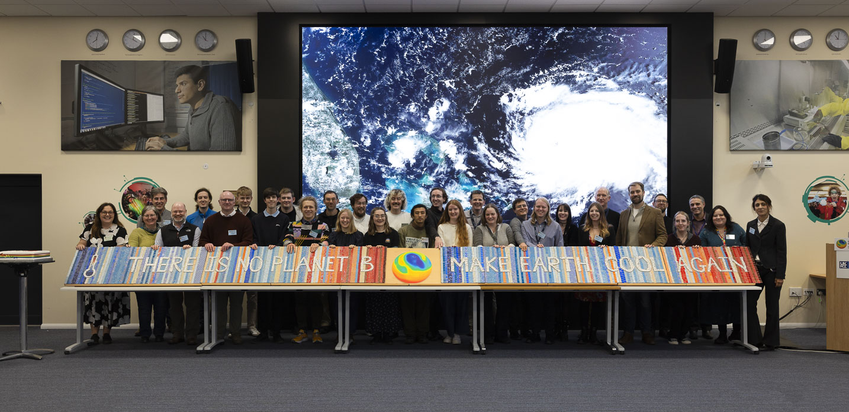

Slide 9
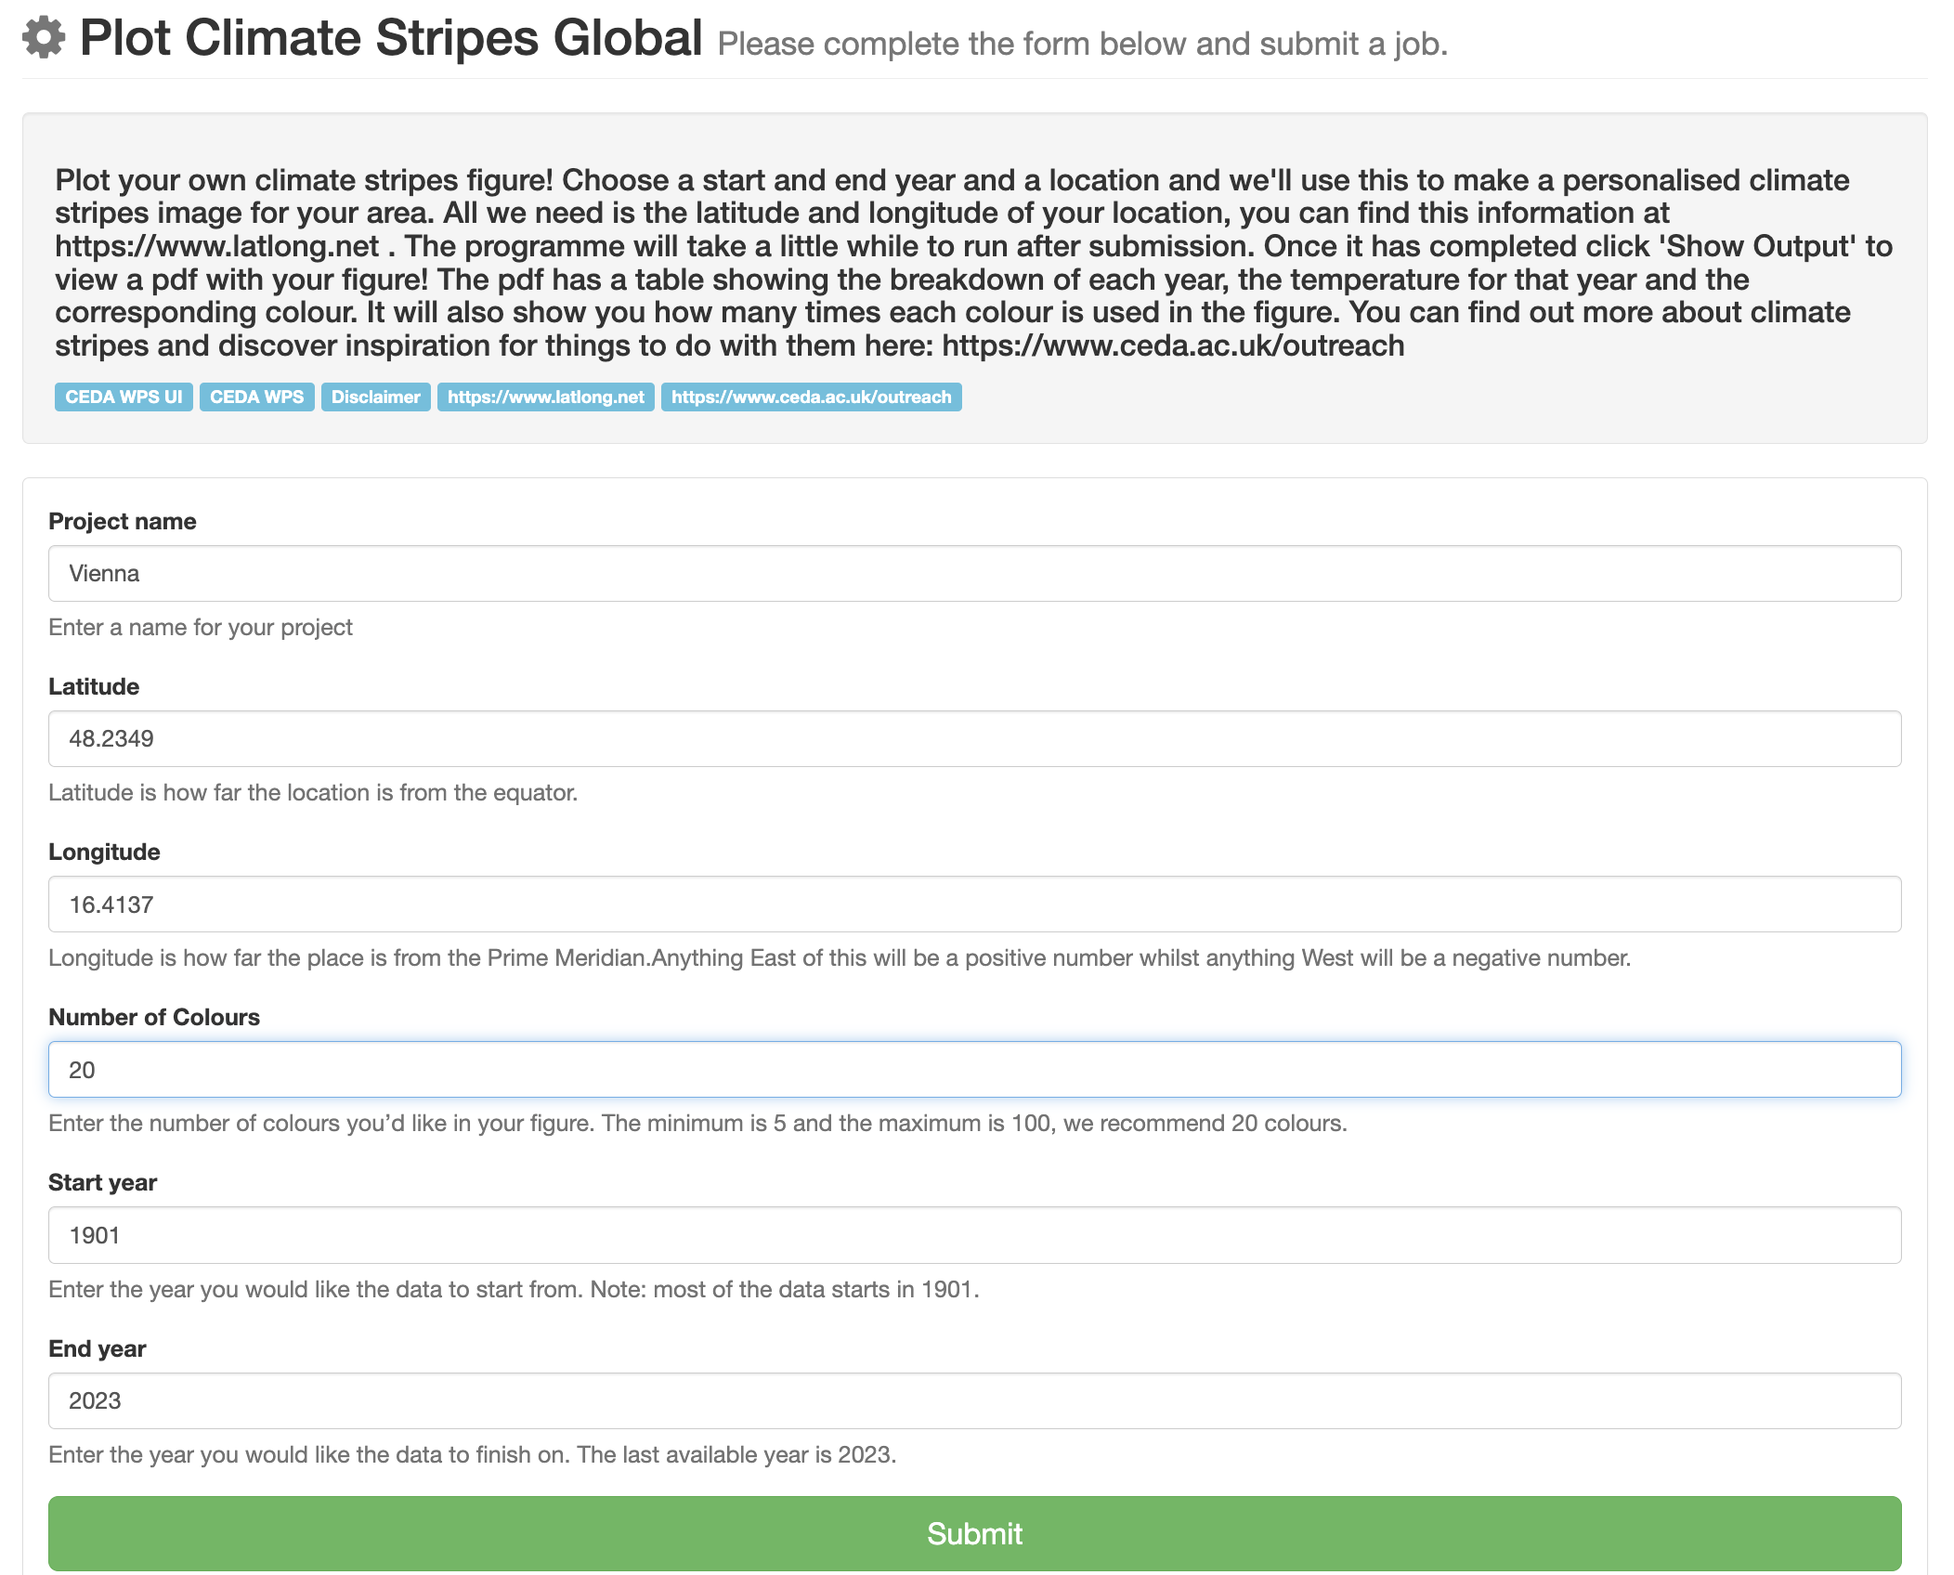

Accessing the data
www.ceda.ac.uk/outreach/

Slide 10

Tool output
1. Image file (PNG) of your personalised stripe
Vienna - Latitude: 48.2349°, Longitude: 16.4137°
Time period: (1901, 2023)
Using: 20 colours
Data used by global tool - University of East Anglia Climatic Research Unit; Harris, I.C.; Jones, P.D.; Osborn, T. (2024): CRU TS4.08: Climatic Research Unit (CRU) Time-Series (TS) version 4.08 of high-resolution gridded data of month-by-month variation in climate (Jan. 1901- Dec. 2023). NERC EDS Centre for Environmental Data Analysis, 28/04/2025. https://catalogue.ceda.ac.uk/uuid/715abce1604a42f396f81db83aeb2a4b/.

Slide 11
Tool output
2. Table with metadata about the data behind each colour
Year
Data
Colour codes
Colour number
Example colour
Find out more: www.ceda.ac.uk/outreach/

Slide 12
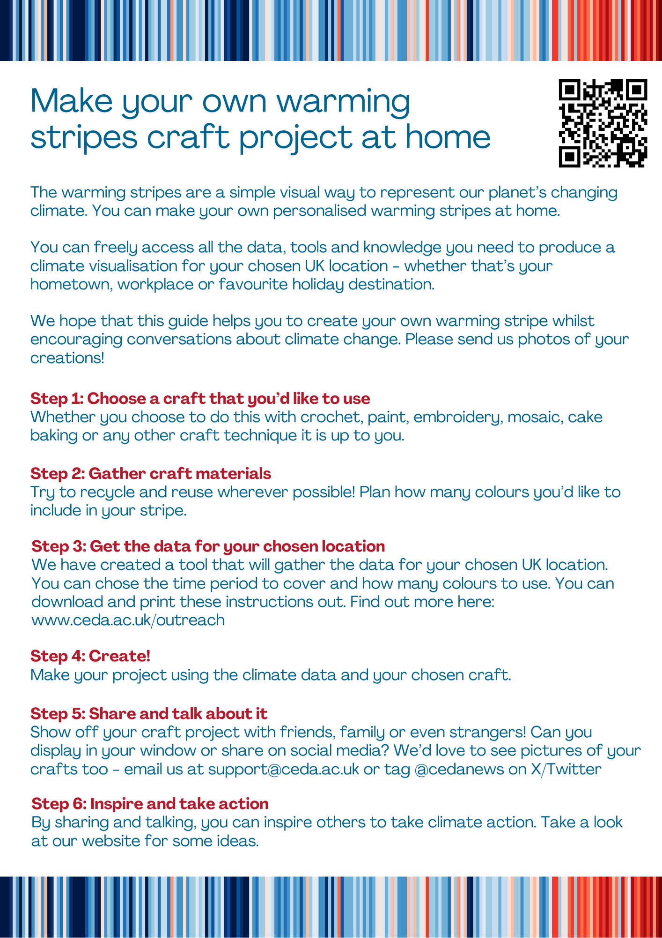
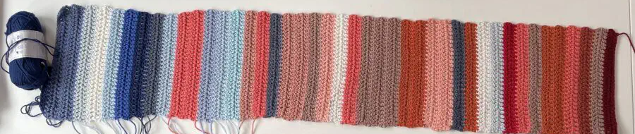
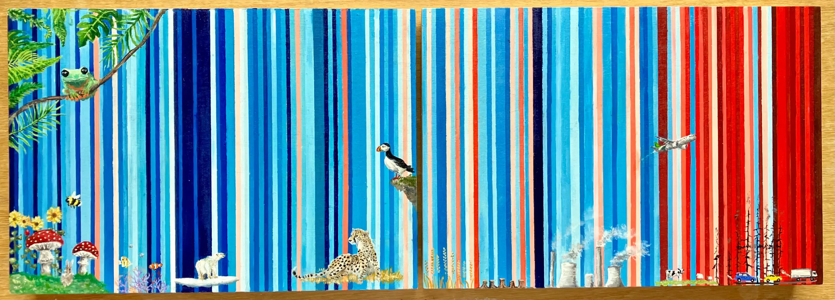
Create your own artwork
Crochet, Scotland, UK
Painting, Oxford, UK
Townsend, P. (2024). Create a warming stripes artwork - Home activity. Zenodo. https://doi.org/10.5281/zenodo.12168556

Slide 13
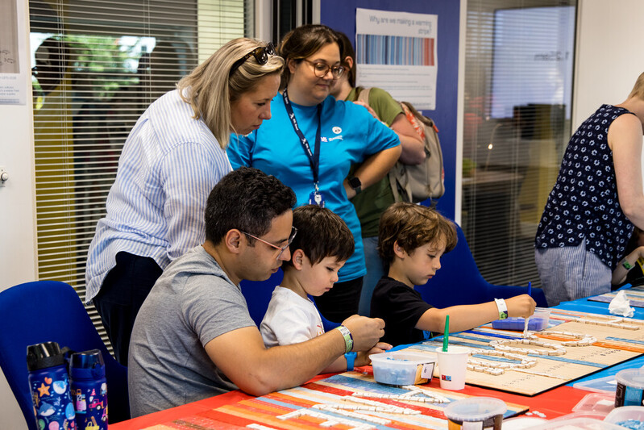
What we learnt
Teenagers loved it (and teachers)
In depth conversations with influencers
People love having conversations with ‘experts’
Personalising it to the local area made it relatable
A calm space

Slide 14
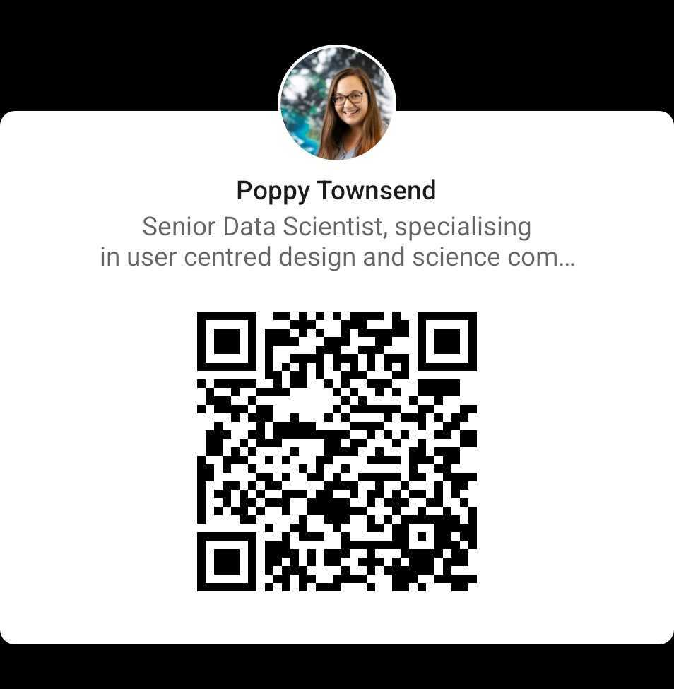
Take home messages
LinkedIn:
1 Using art inspires engaging personal conversations
2 Communicating about environmental science, data and digital skills can be hopeful and interesting
3 There are resources you can reuse/build upon – ask me about them!
Email: poppy.townsend@stfc.ac.uk
Website: www.ceda.ac.uk/outreach/

Slide 15
Questions?
Email: poppy.townsend@stfc.ac.uk
Website: www.ceda.ac.uk/outreach/

Slide 16

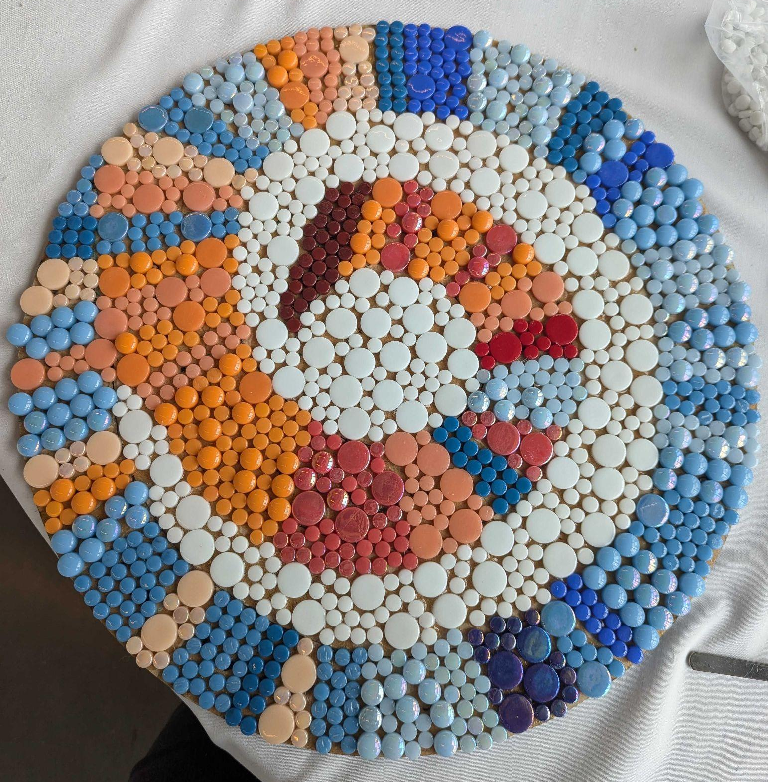
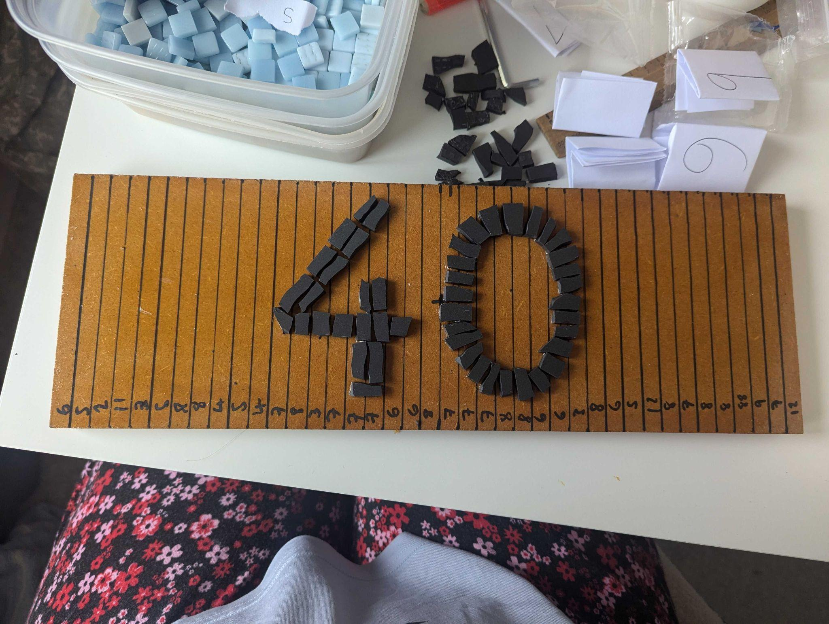
Other examples
A work in progress for my allotment plot
Trying different shapes and styles

Slide 17
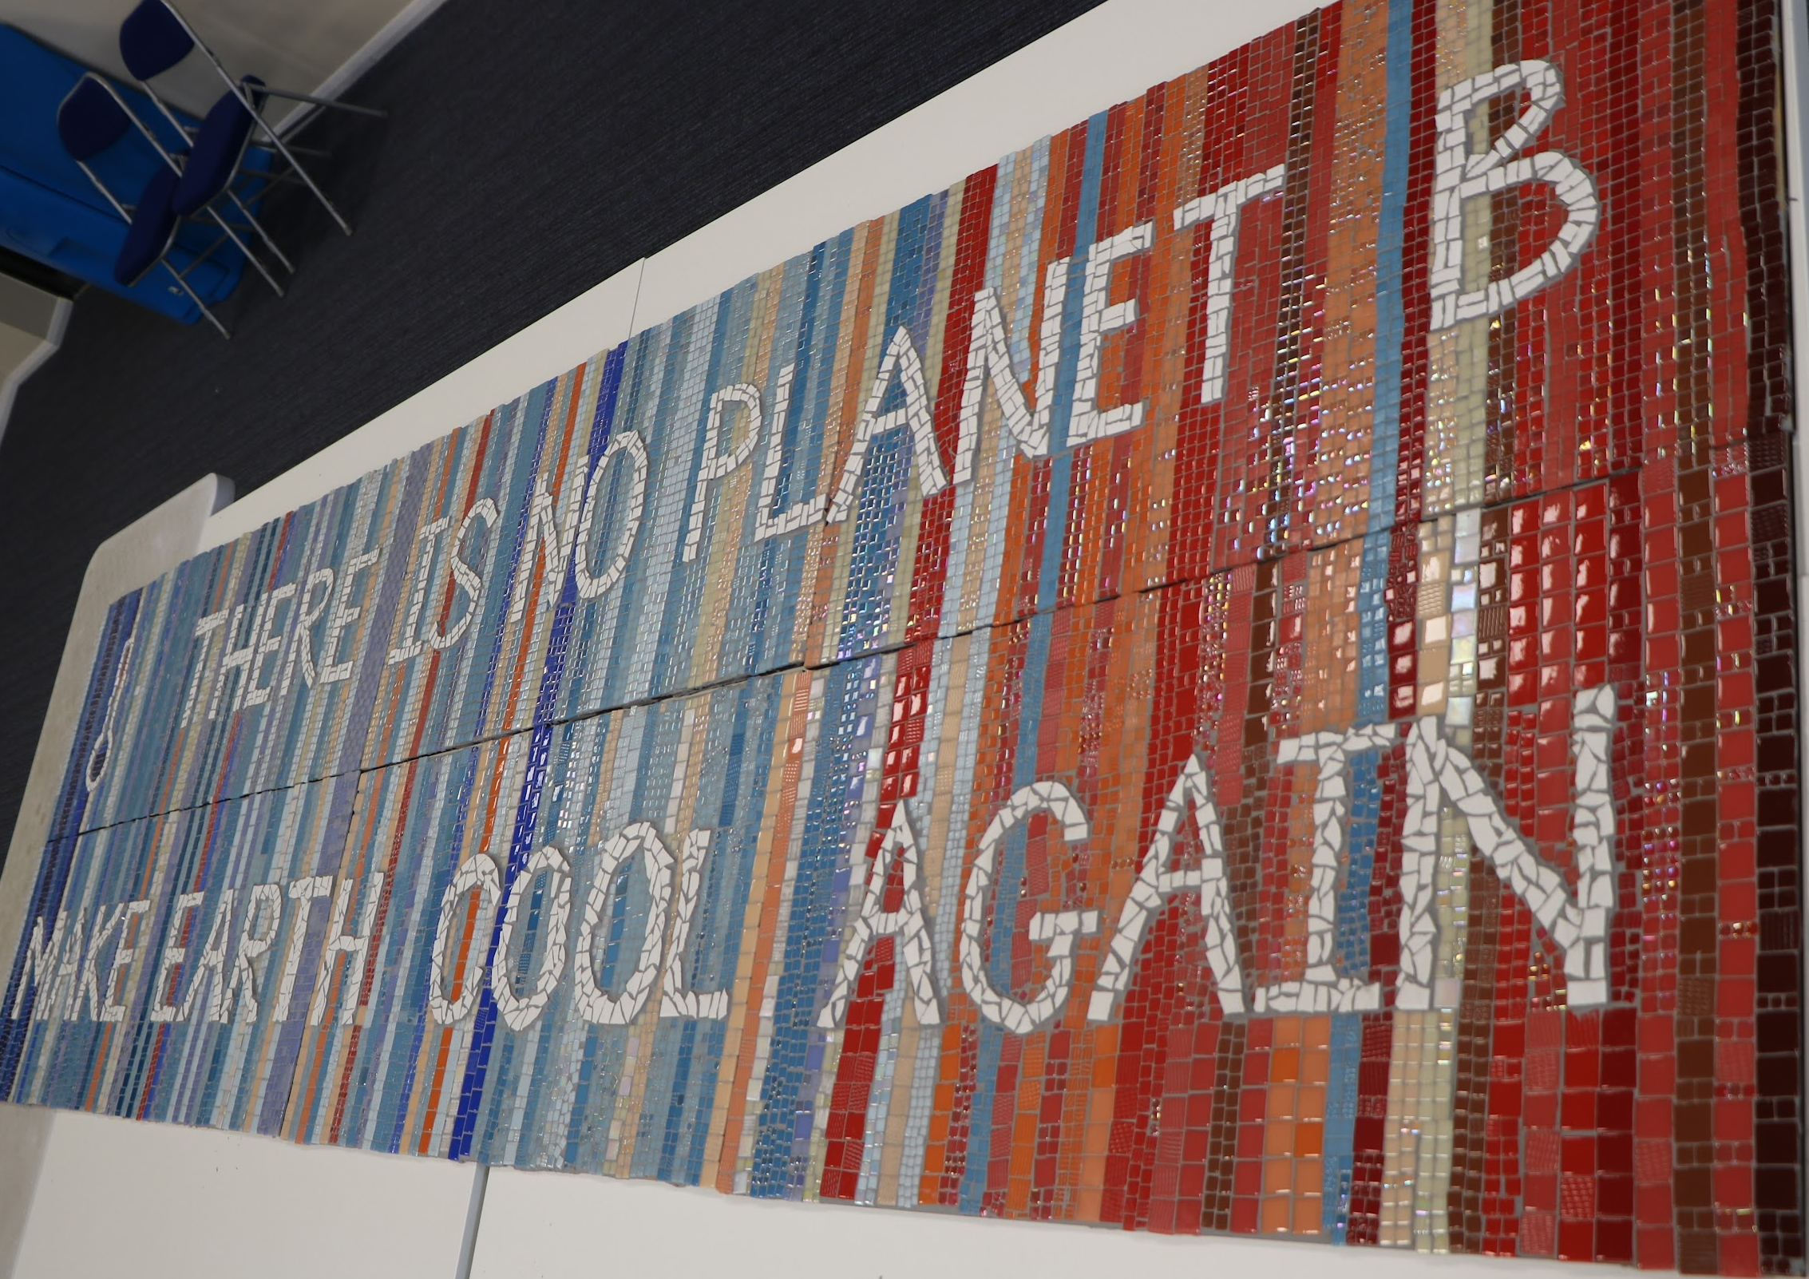

Slide 18
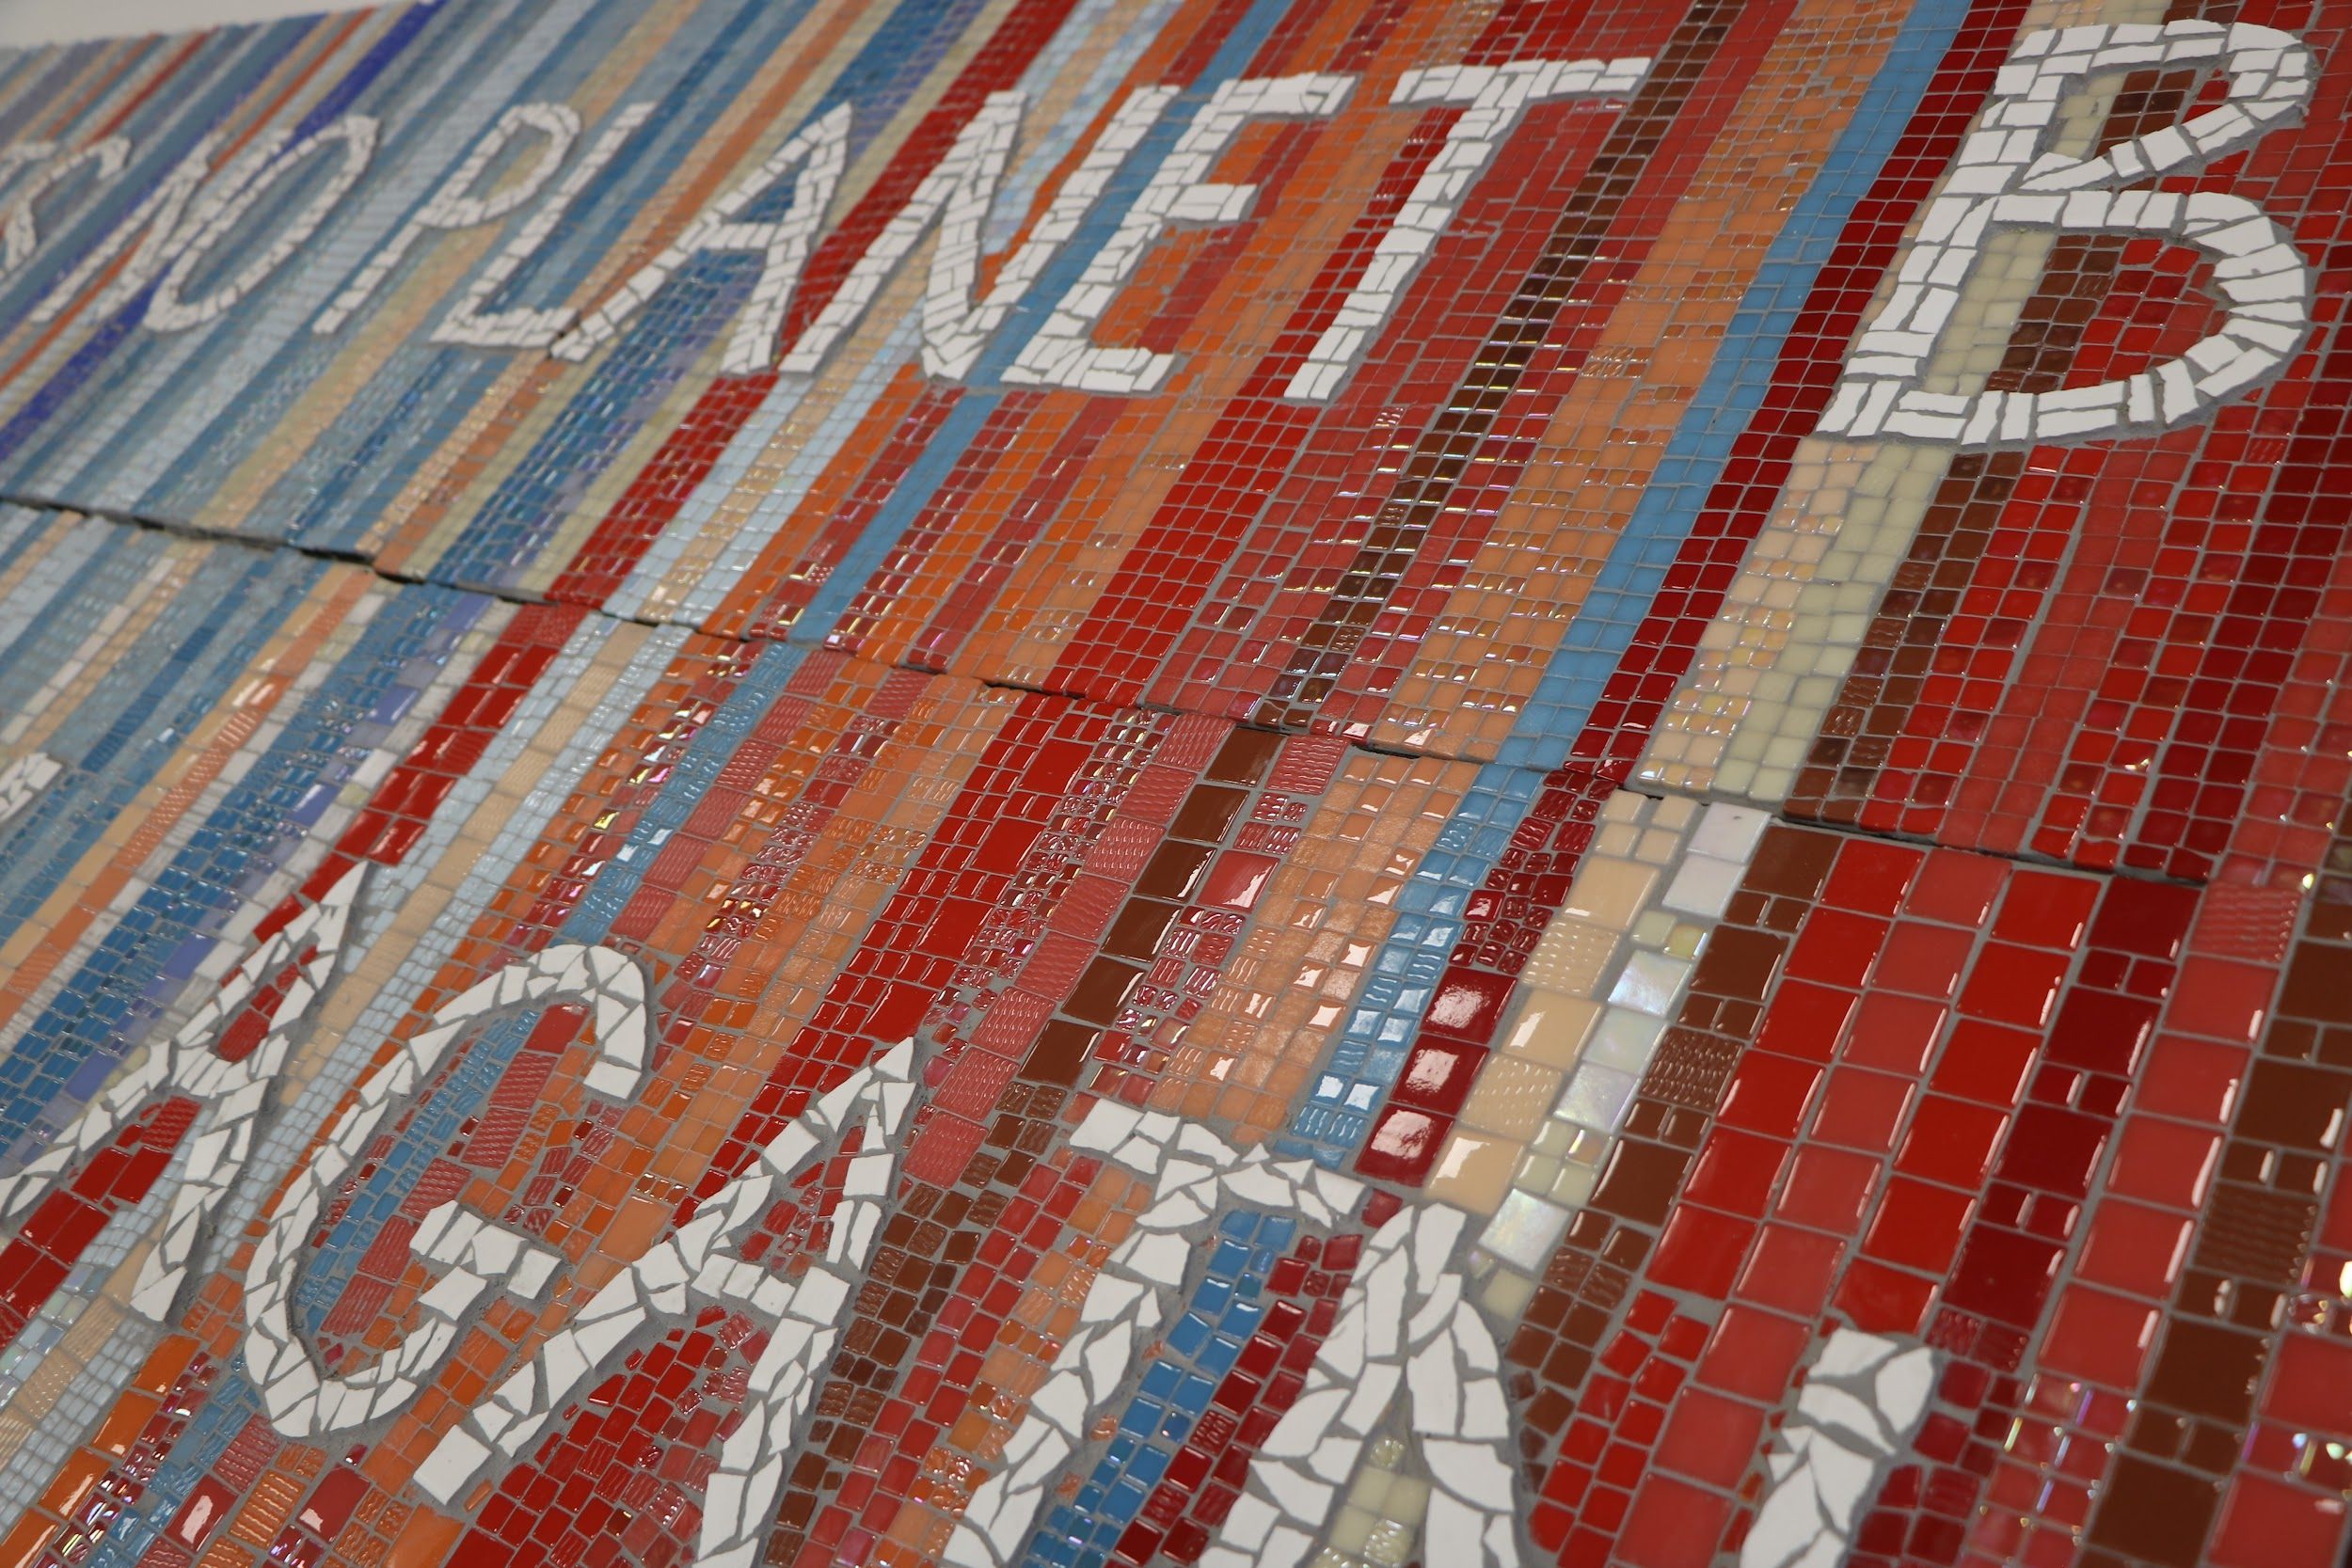

Slide 19
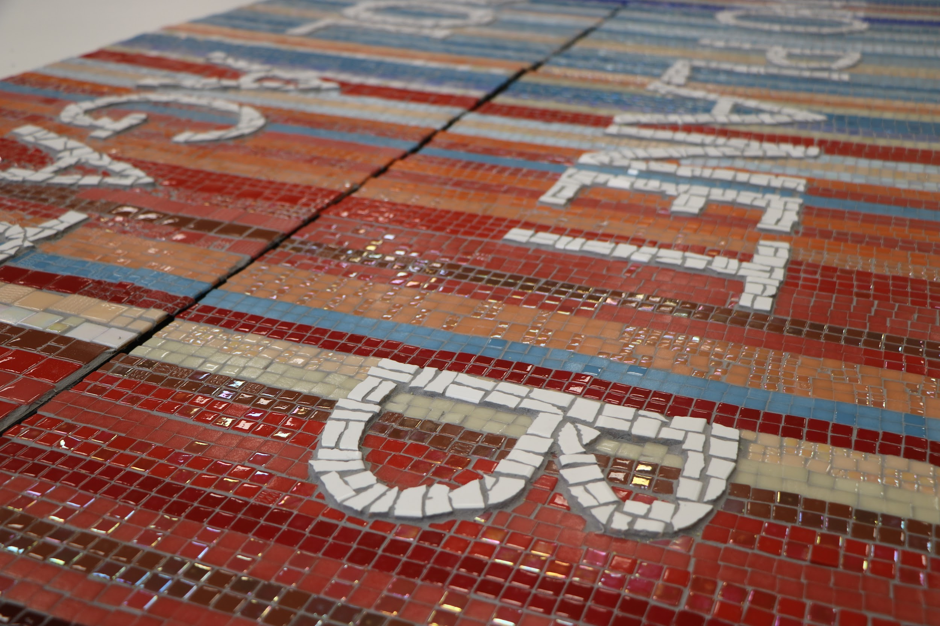

Slide 20
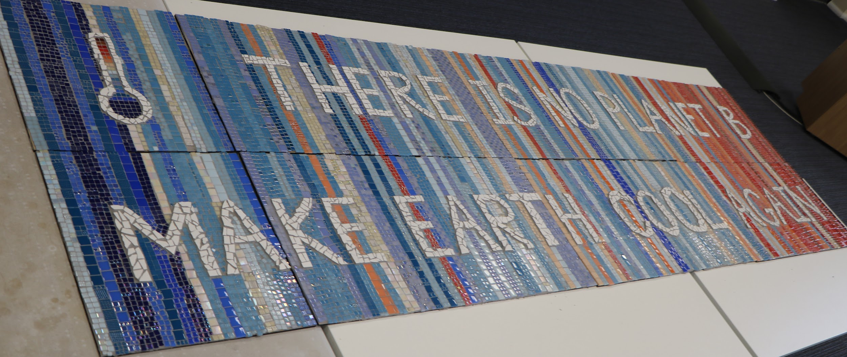

Slide 21
