Slide 1
The health effects of plastic burning particulate matter - the role of metals, Polycyclic aromatic hydrocarbons, environmentally persistent free radicals, reactive oxygen and chlorine species in inducing oxidative stress in human body
Salim, R^{.1,2,3}, Kapur, S.³ , Schervish, M.³ , Edwards, K.³ , Gerritz, L.³ , Raghunathan, R.¹ , A. Nizkorodov, S.³ , S. Gunthe, S.^{1,2} , and Shiraiwa, M³
¹Centre for Atmospheric and Climate Sciences (CACS), IIT Madras, Chennai
²Environmental Engineering division, Department of Civil Engineering, IIT Madras, Chennai
³Department of Chemistry, University of California, Irvine
Notes:
1

Slide 2
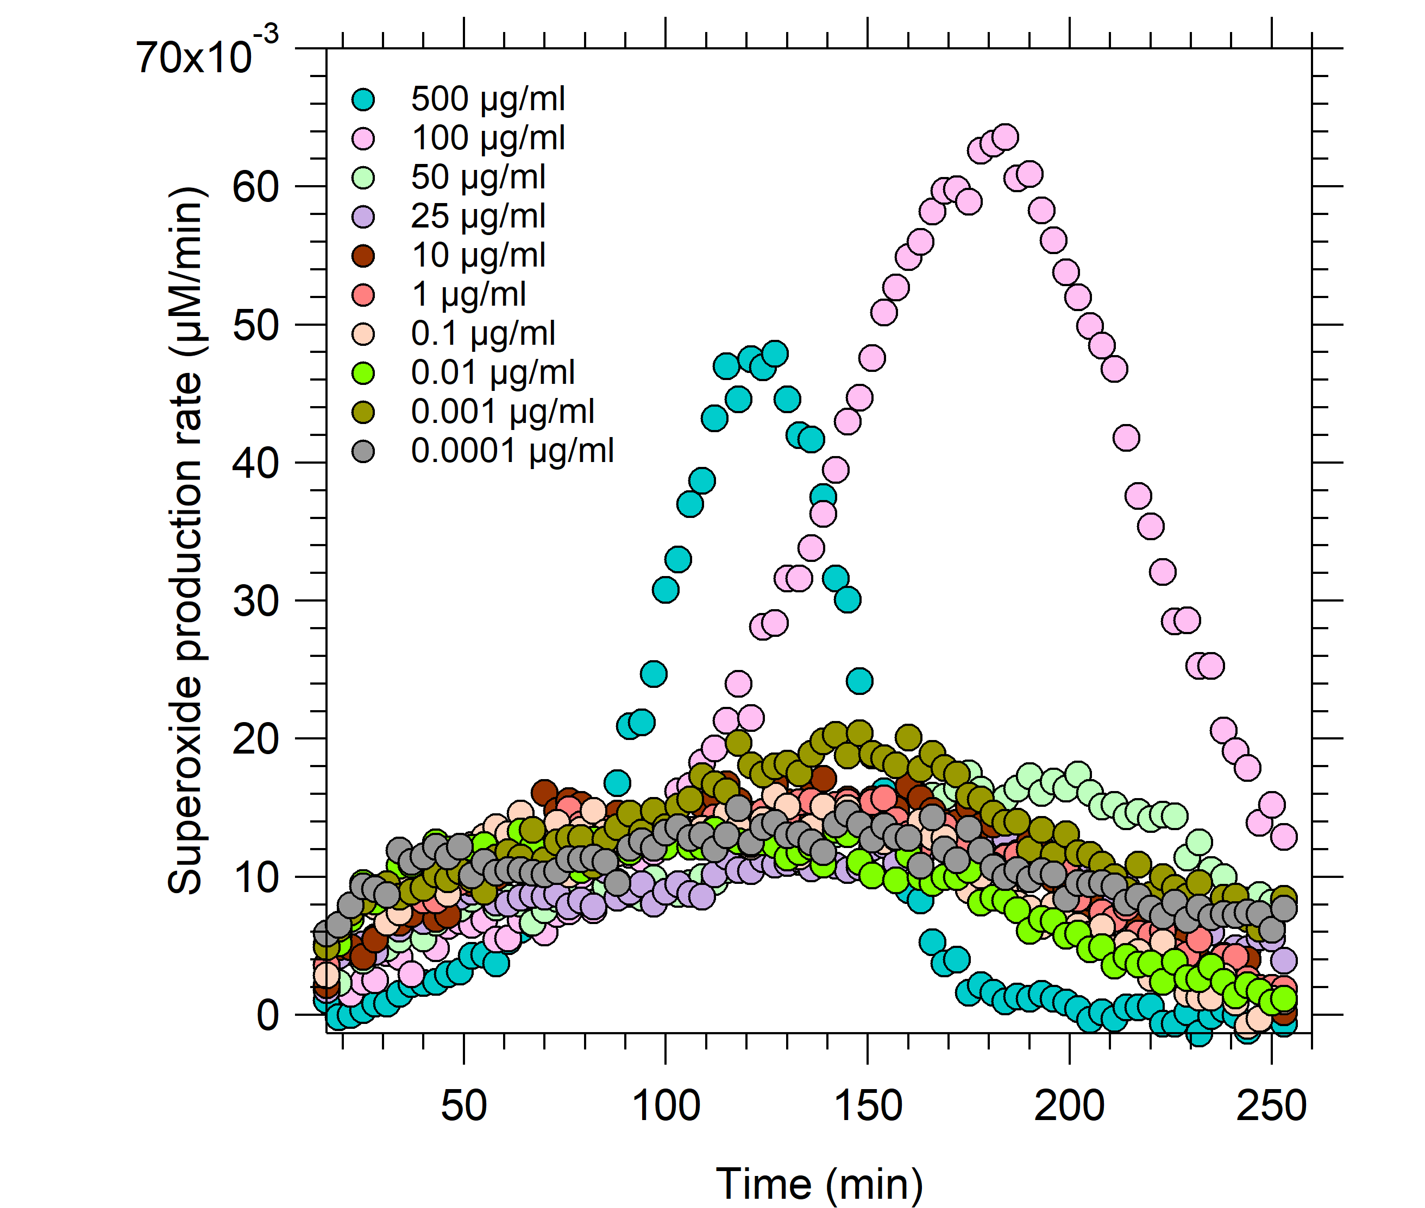
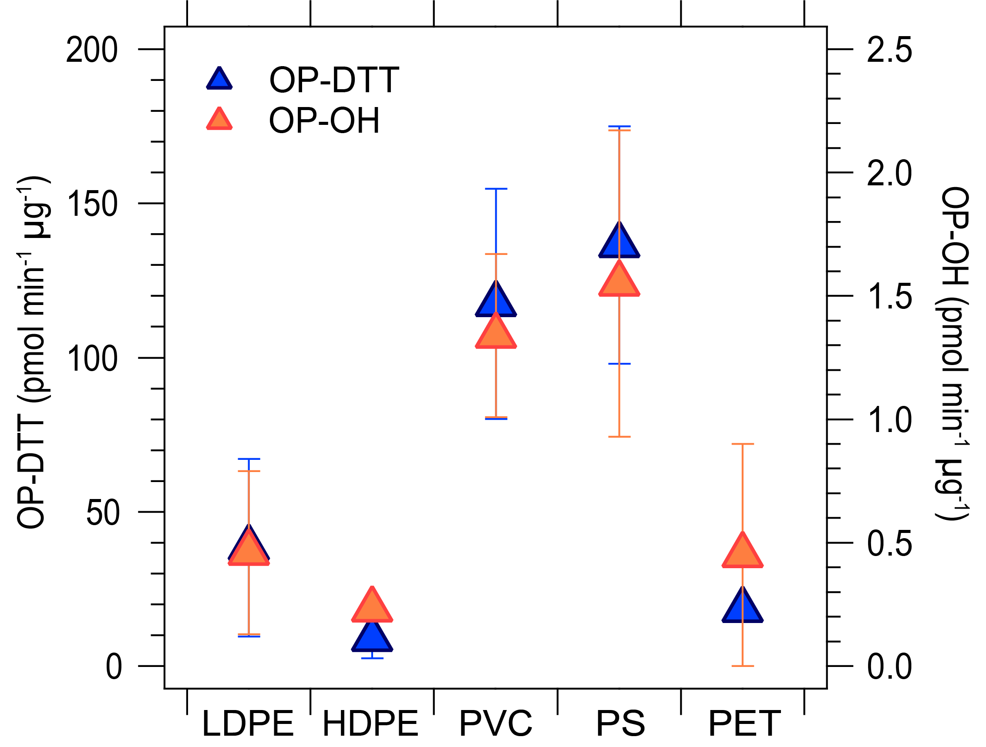
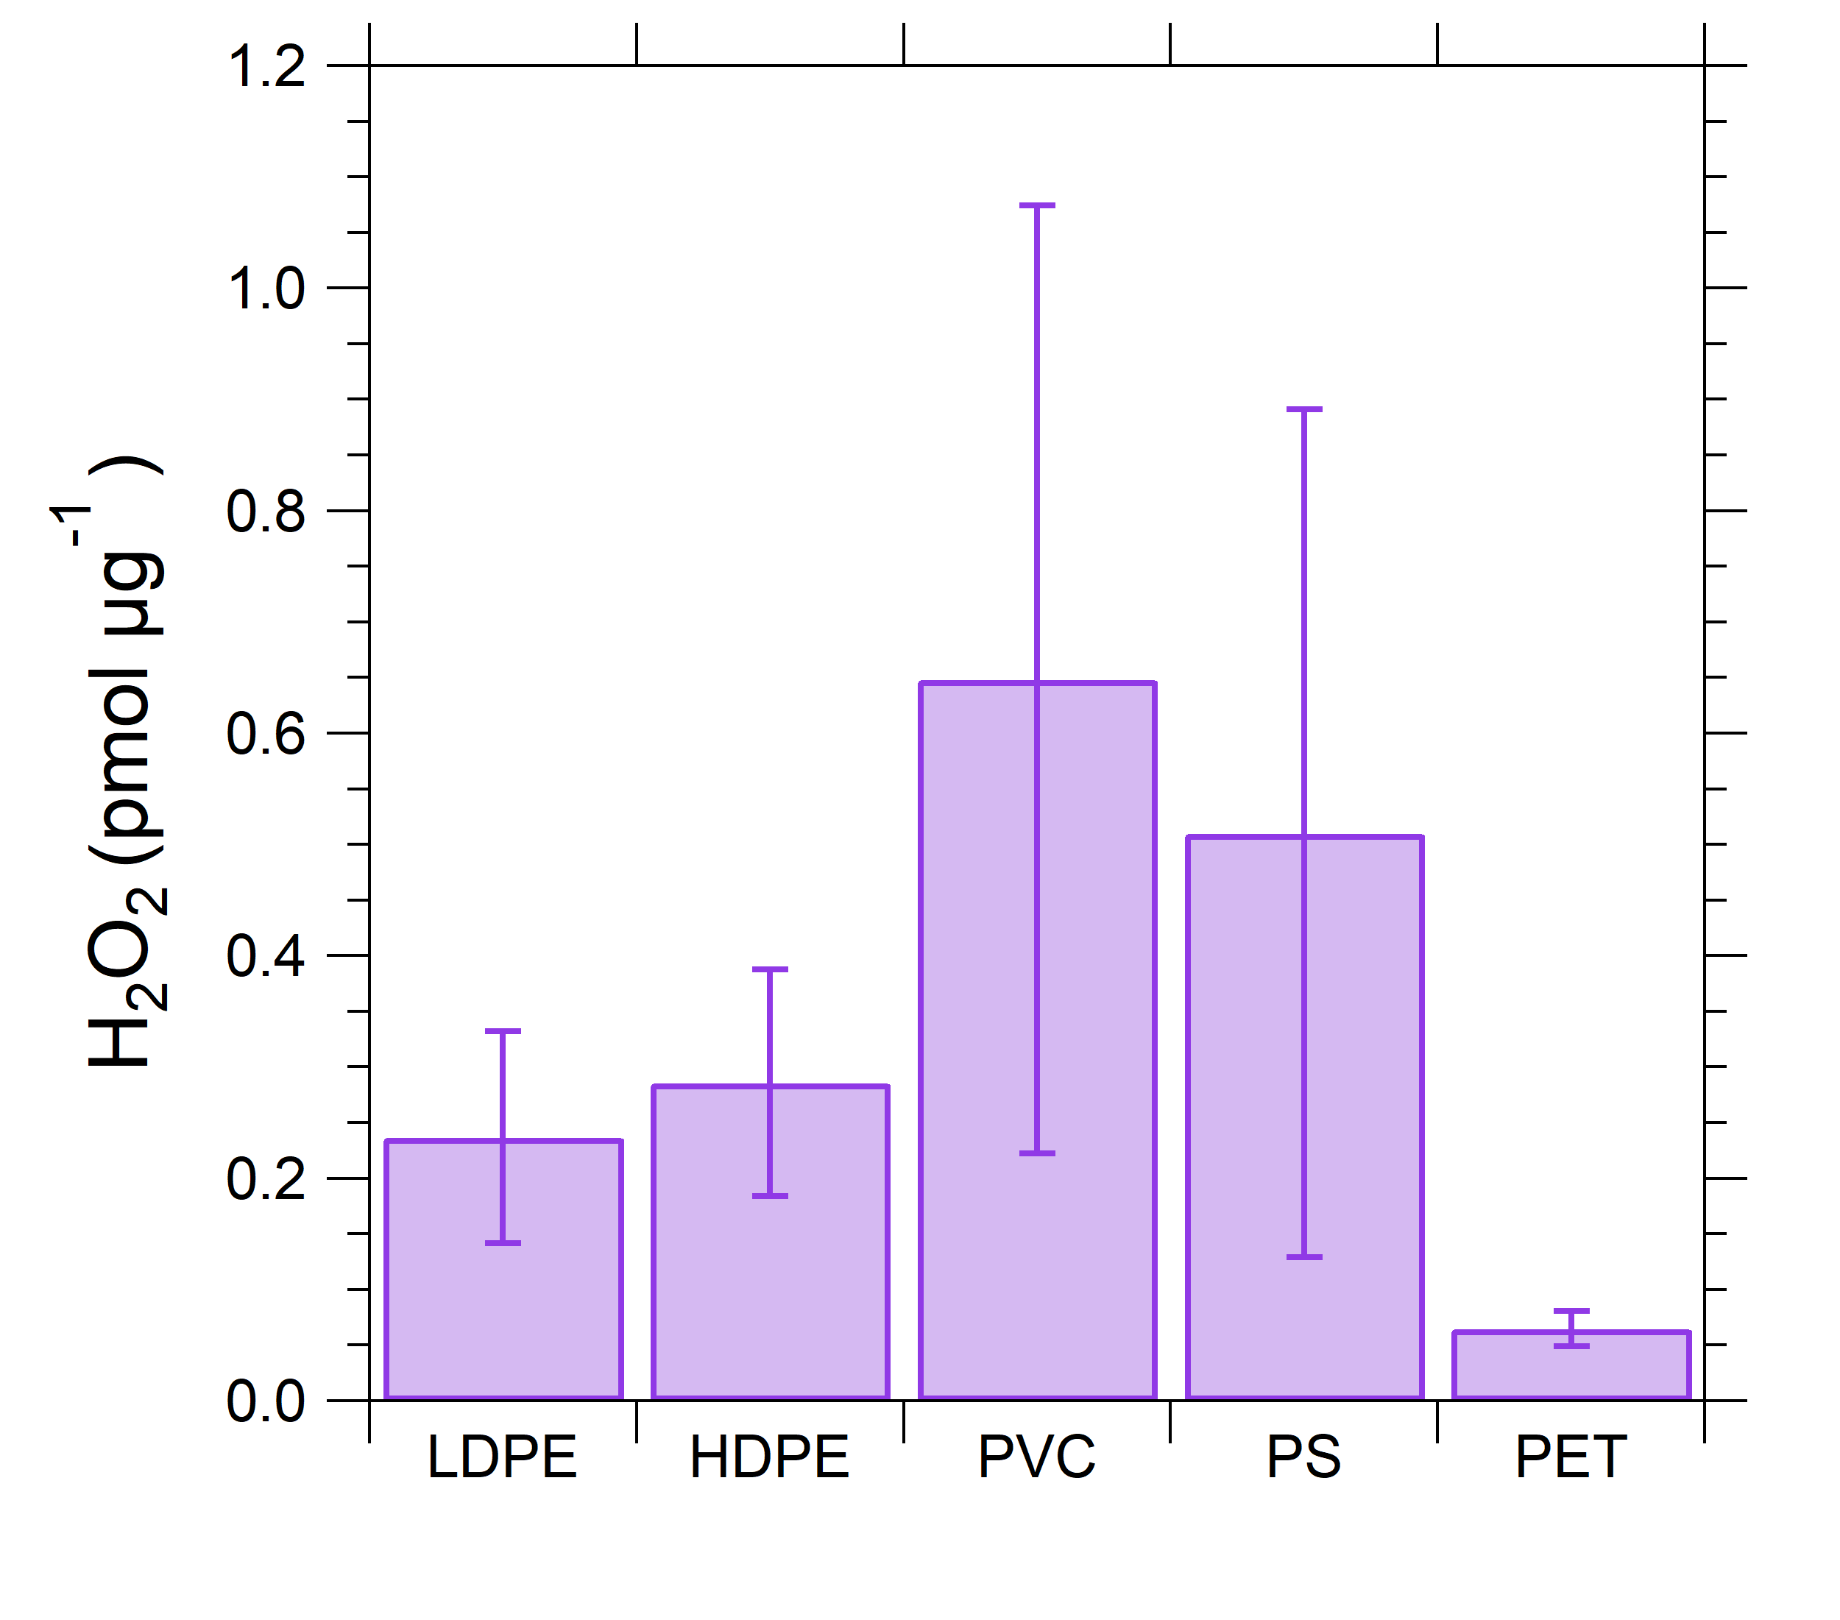
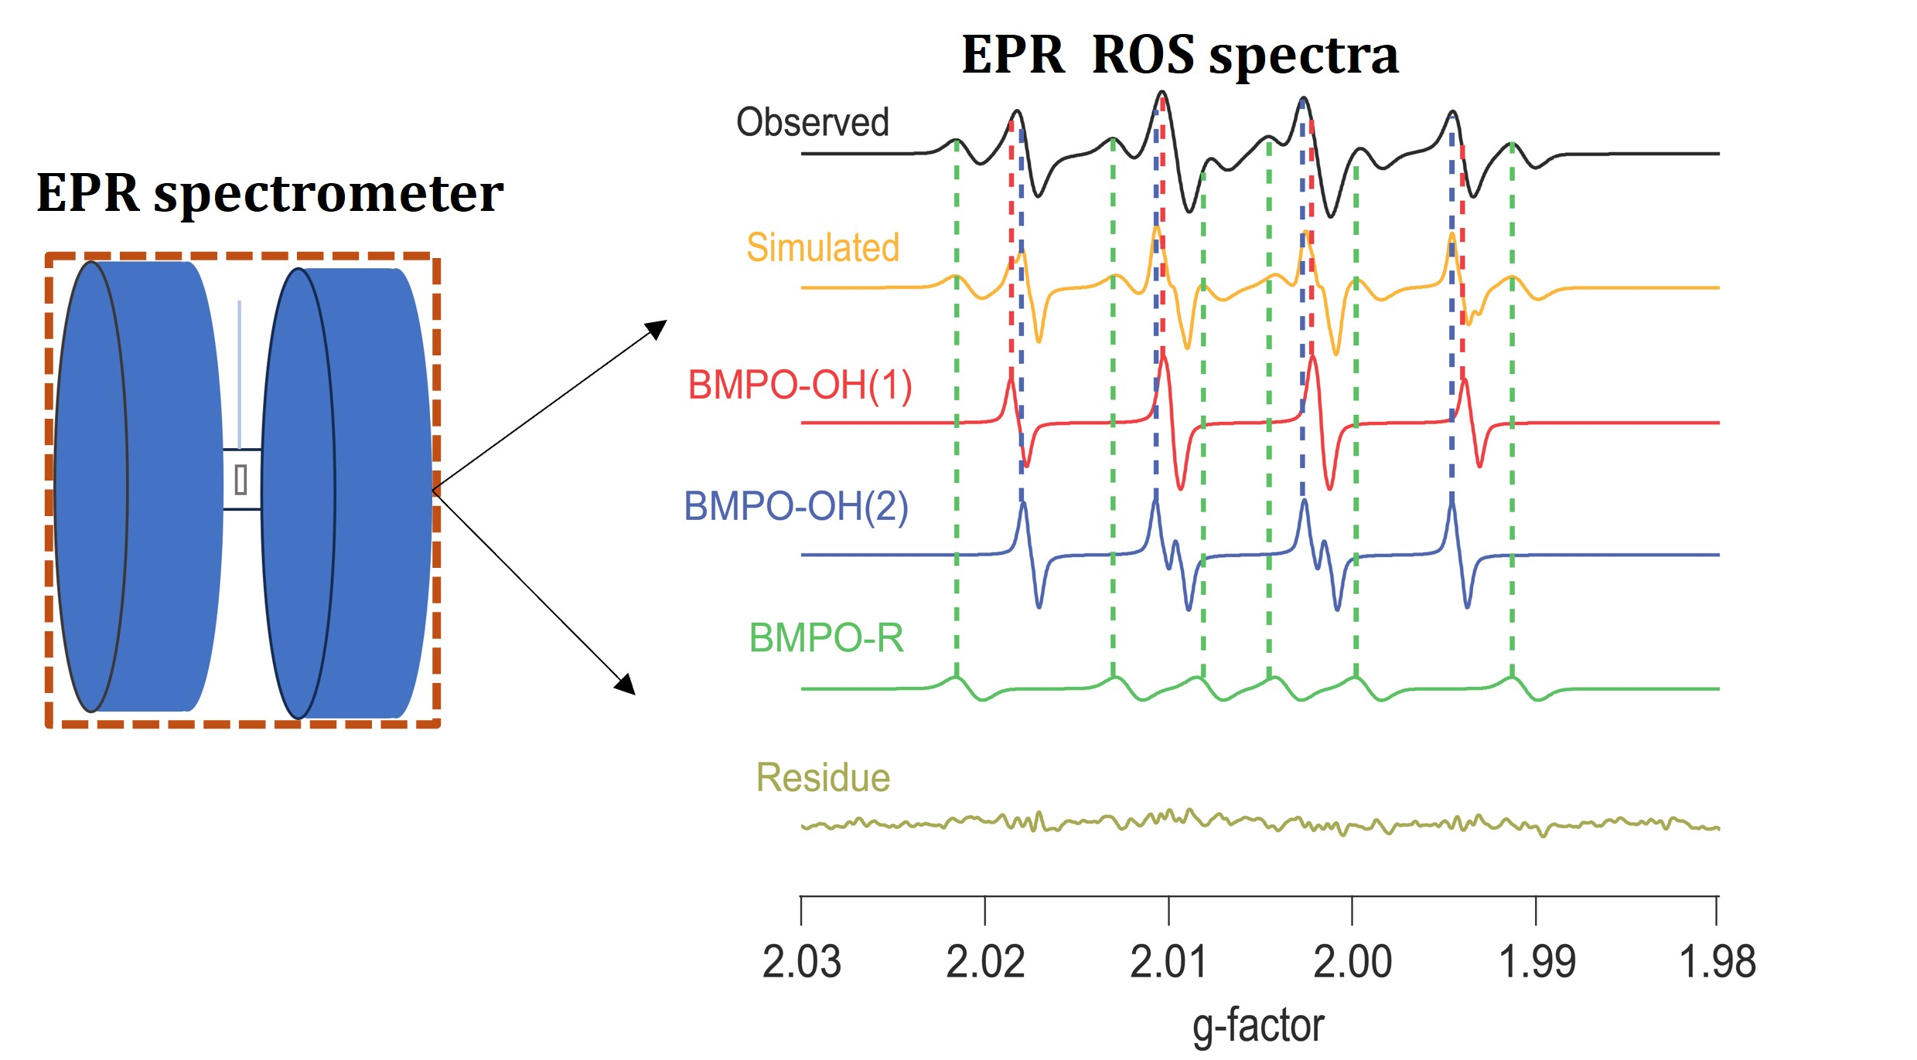
Plastic burning PM affecting human health
PET
Oxidative potential: an important property of PM, related to the redox activity and the formation of ROS
Cellular assays: macrophage-based assay
Iodometric spectrophotometry and Fluorimetric methods
Electron paramagnetic resonance spectrometry
Acellular assays:
Dithiothreitol (DTT) , OH assay, AA (ascorbic acid) assay

Slide 3
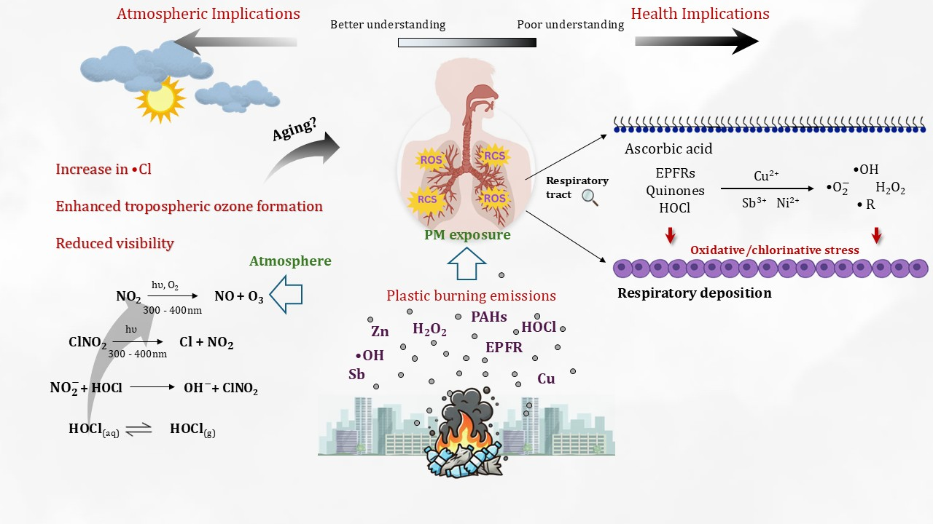
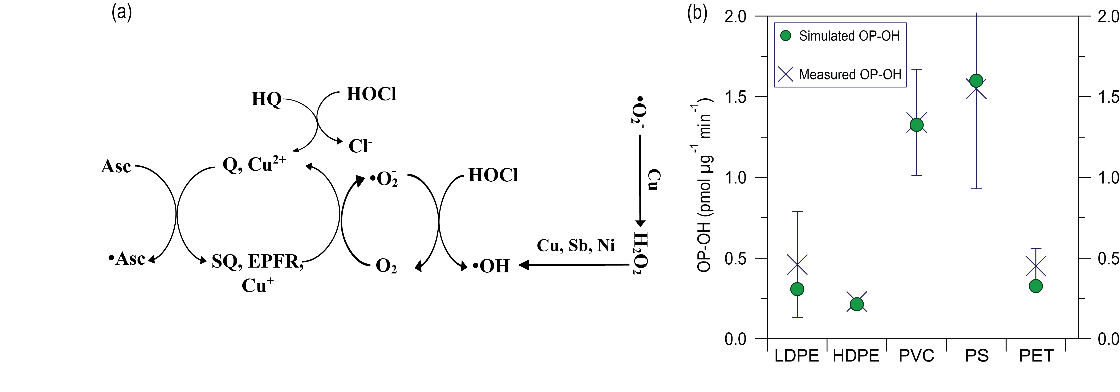
How plastic burning PM generates ROS; oxidative stress

Slide 4
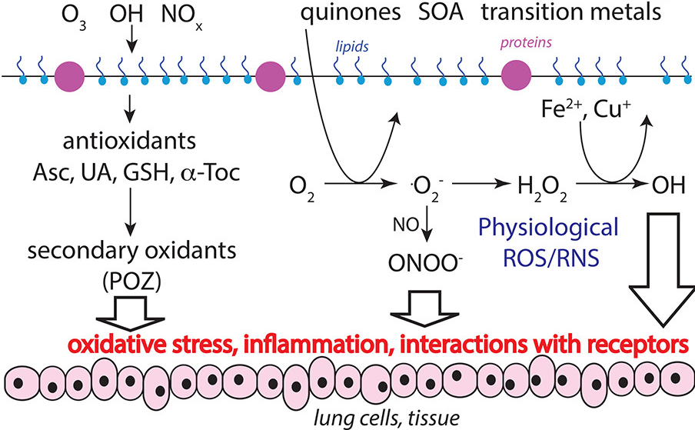
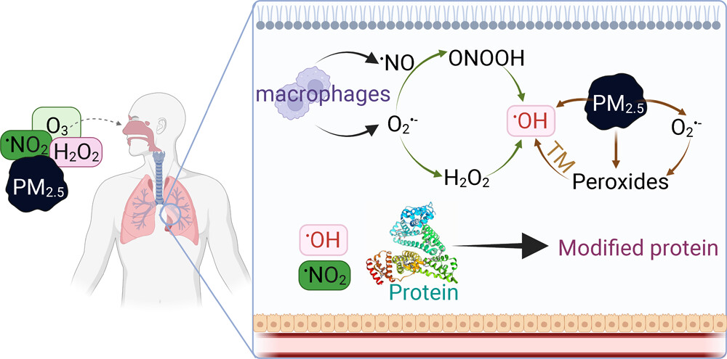
Importance for Public Health: Reactive Oxygen Species
Generated via photo-chemistry and gas-phase, heterogeneous and multiphase reactions involving atmospheric oxidants and aerosol particles
Redox-active compounds in aerosols like transition metals, quinones promote ROS formation
Causes oxidative stress, biological aging, cell death and disease
OH .O₂⁻ H₂O₂ .ROO, O₃
Extremely reactive, have a short lifespan, damages the tissues, generate new ROS by chain reactions
Mechanism of inducing oxidative stress
Mishra et al., 2023
Shiraiwa et al., 2017
Nearly 4.3 million people die of air pollution in a year!

Slide 5
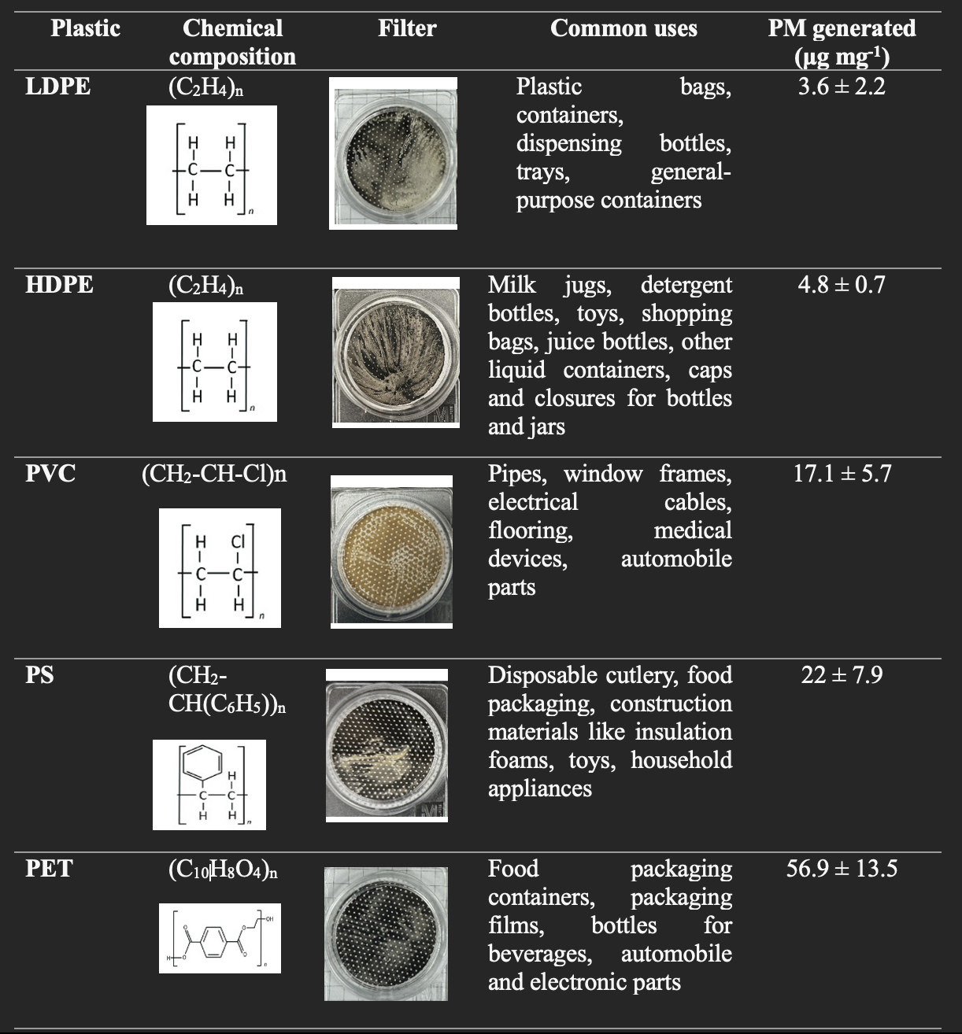
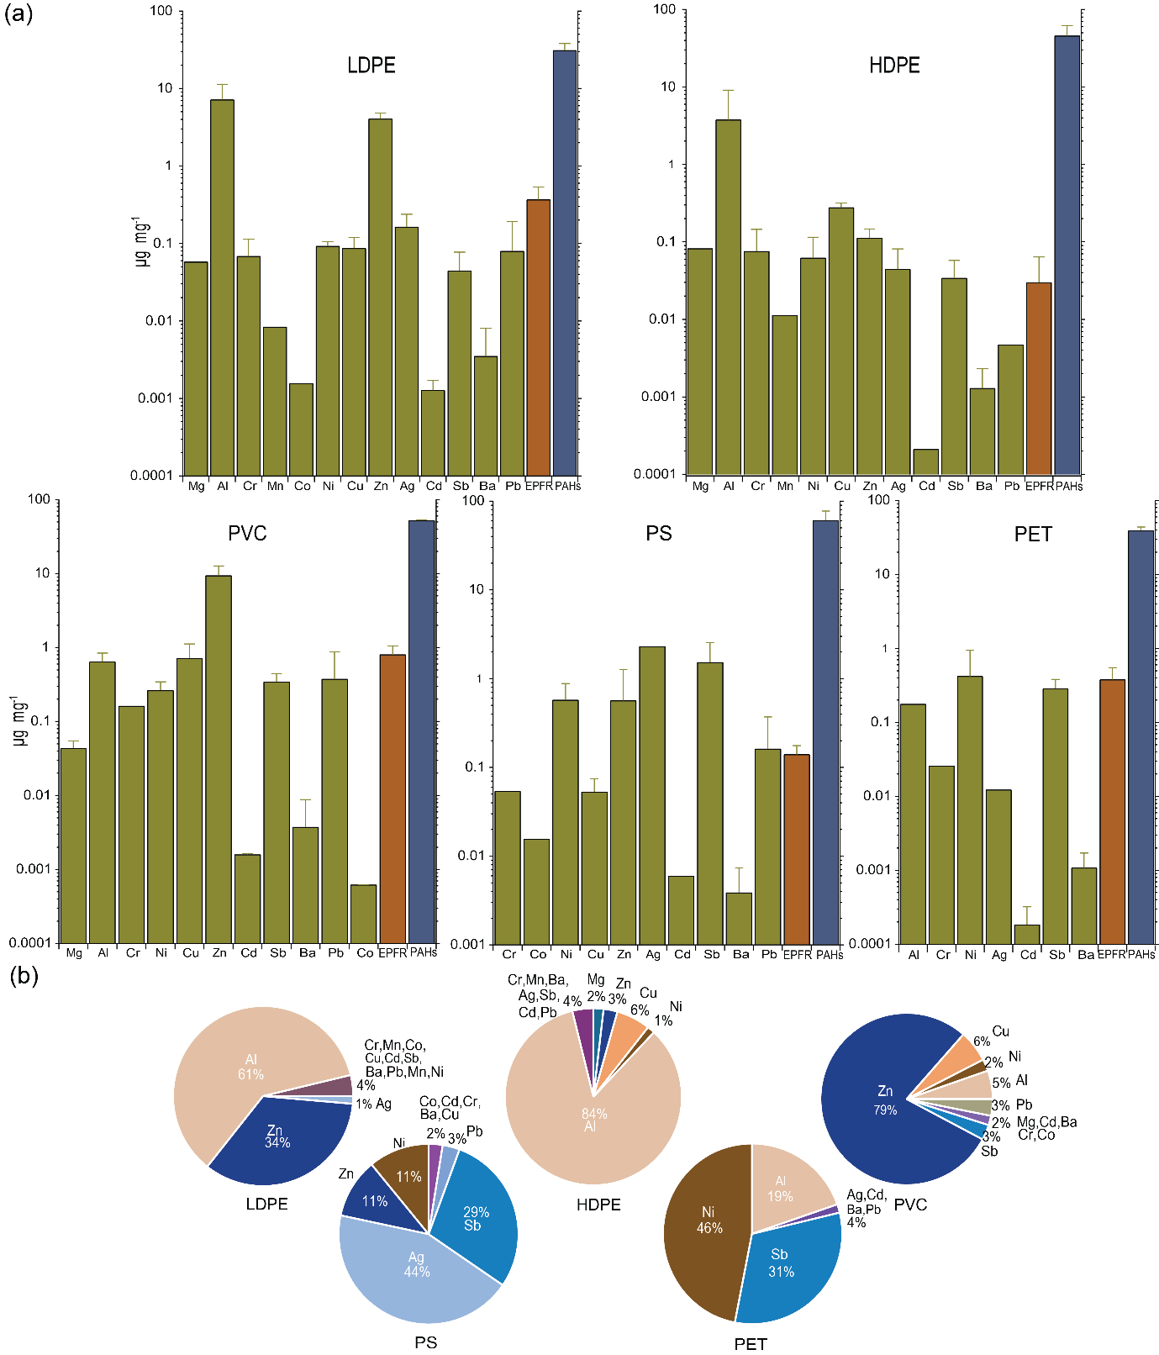
Chemical characterisation of the PM
EPFRs are potentially stabilised on metal oxide surfaces
zinc oxides may contribute to the formation and stabilization of EPFRs in plastic burning PM

Slide 6
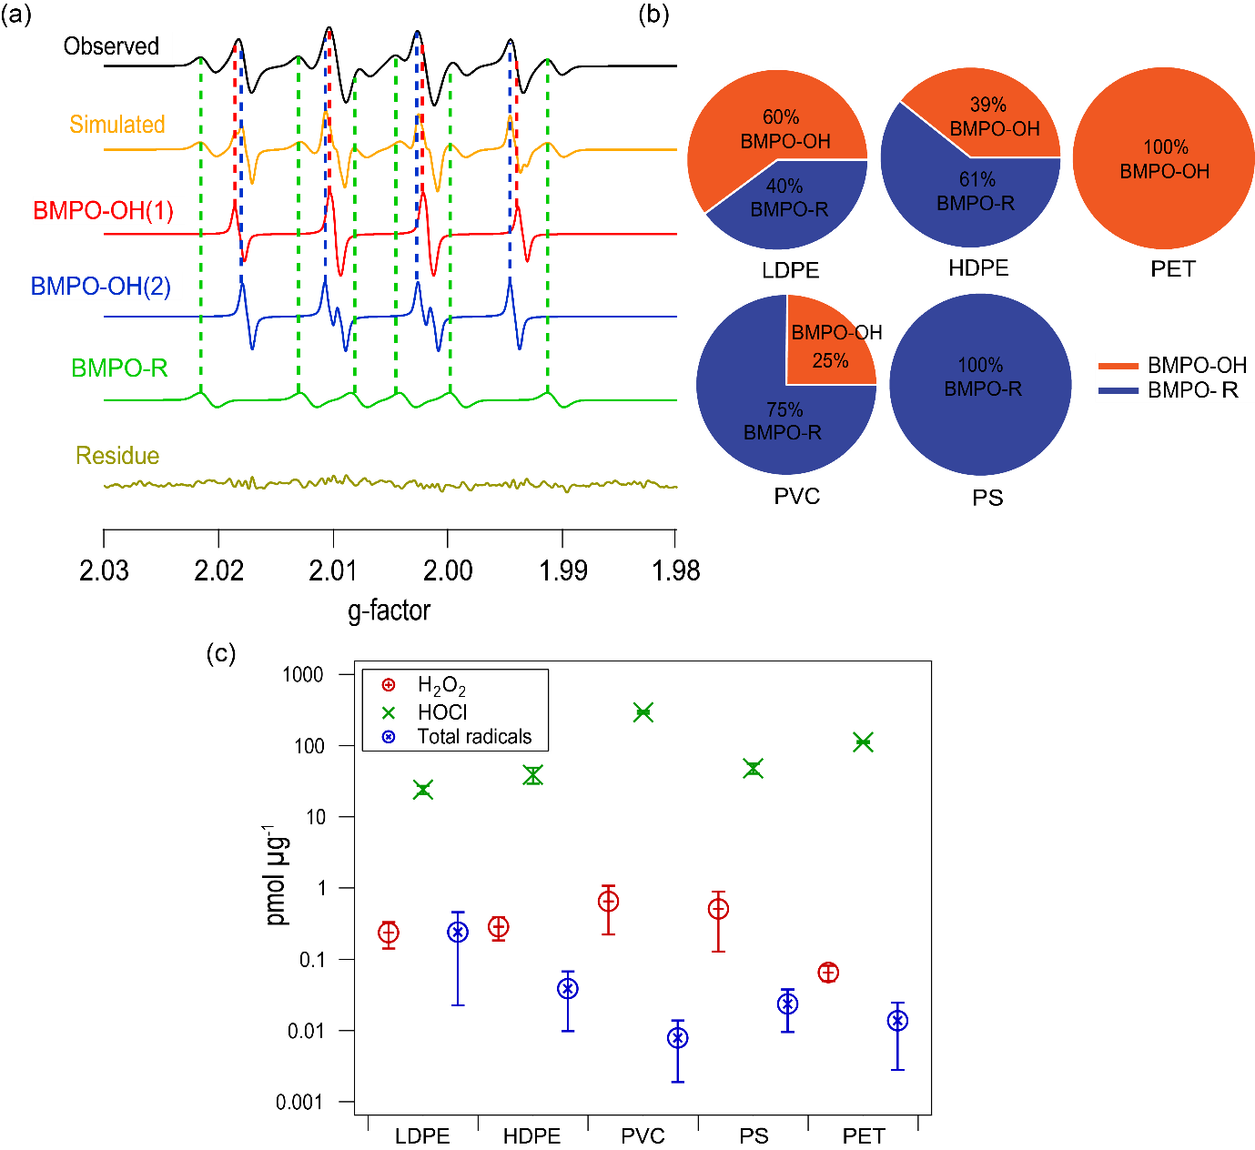
Reactive oxygen and chlorine species
Radical formation is a consequence of complex chemistry of chemical compounds- depends on burning materials and combustion conditions
H₂O₂ triggered by redox reactions of transition metals and quinones and other organic substances
H₂O₂ yield is higher than radicals- H₂O₂ has longer lifetime as it is less reactive compared to radicals
The highest HOCl yield was observed for PVC

Slide 7
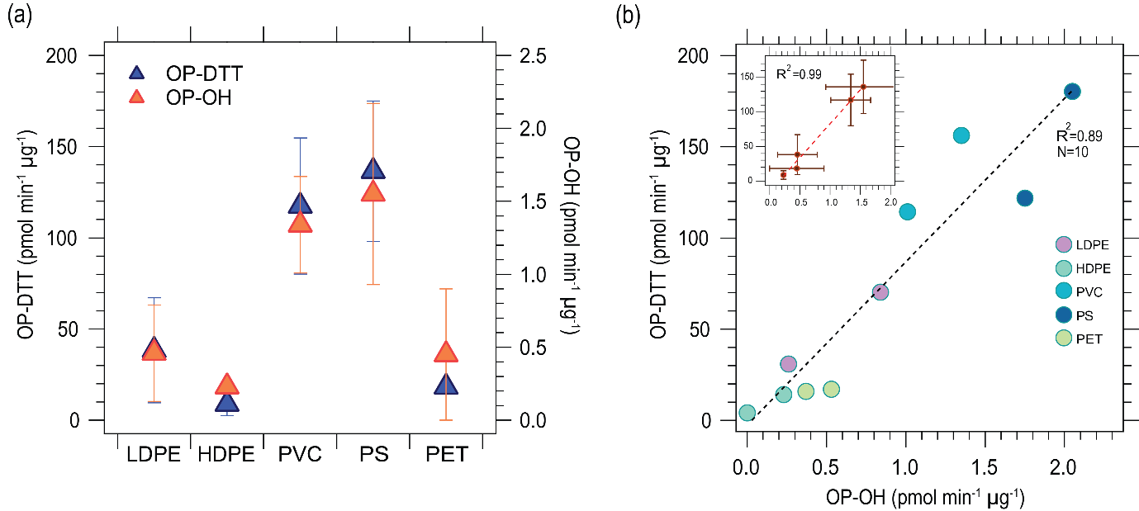
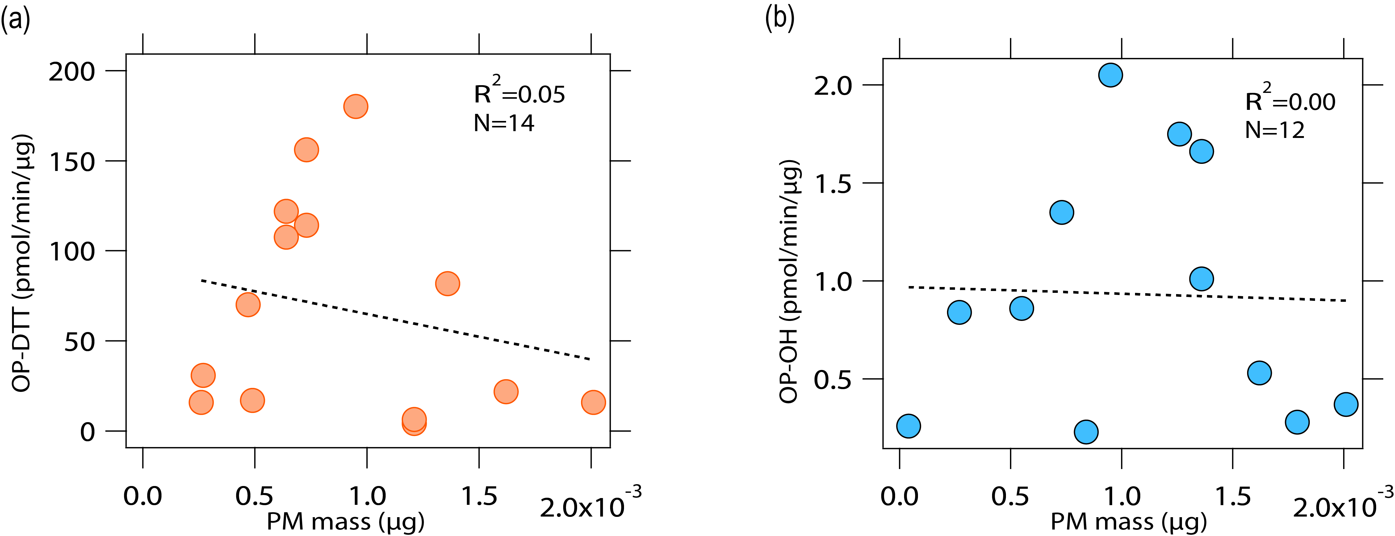
Oxidative potential- DTT and OH assays
High OP-DTT and OP-OH observed for PVC and PS type plastics
OP-DTT and OP-OH exhibit a strong correlation with R² = 0.89. This reflects that both assays are sensitive to similar but not exactly same compounds
The DTT assay- sensitive to organic species such as redox-active quinones, HULIS and water-soluble metals including Cu but not with Fe, while the OP-OH assay is sensitive to Fe
Both OP-DTT and OP-OH exhibit no significant correlations with PM mass- PM oxidative potential is driven by chemical composition

Slide 8
Kinetic modeling
Developed a kinetic box model to simulate •OH radical formation in surrogate lung fluid (OP-OH)
The model treats redox cycling of redox-active components including quinones, EPFRs, and transition metal ions (Cu, Zn, Ni, Sb), ROS cycling, Fenton-like chemistry, and chlorine chemistry
Reproduced OP-OH reasonably within one standard deviation

Slide 9
Conclusions
Plastic-burning particulate matter contains high levels of environmentally persistent free radicals (EPFRs), polycyclic aromatic hydrocarbons (PAHs), and redox-active metals—all of which contribute to the in vivo generation of reactive oxygen species (ROS) and can trigger oxidative stress in the respiratory system
In aqueous extracts, these pollutants also form reactive chlorine species (RCS) - HOCl/OCl⁻, leading to combined oxidative and chlorinative stress in the respiratory tract
Oxidative potential, an important indicator of PM toxicity, was observed to be significantly elevated in plastic-derived PM, especially from polystyrene (PS) and polyvinyl chloride (PVC), as measured using OP-OH and OP-DTT assays
Kinetic modeling of OH radical formation in surrogate lung fluid (SLF) closely matched experimental results, supporting the mechanistic pathways of ROS formation
Redox cycling of EPFRs and quinones, fenton-like reactions with transition metals (Cu, Zn, Ni, Sb) and additional chlorine chemistry interactions contributing to further radical formation

Slide 10
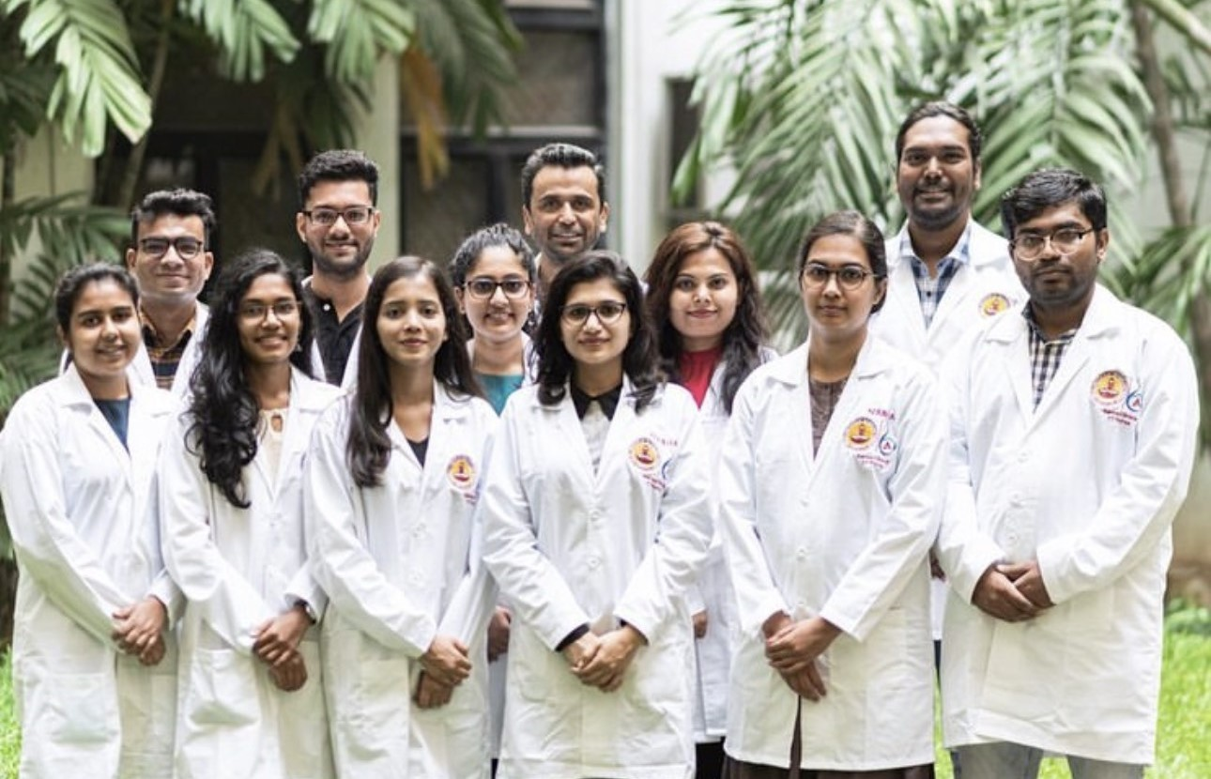
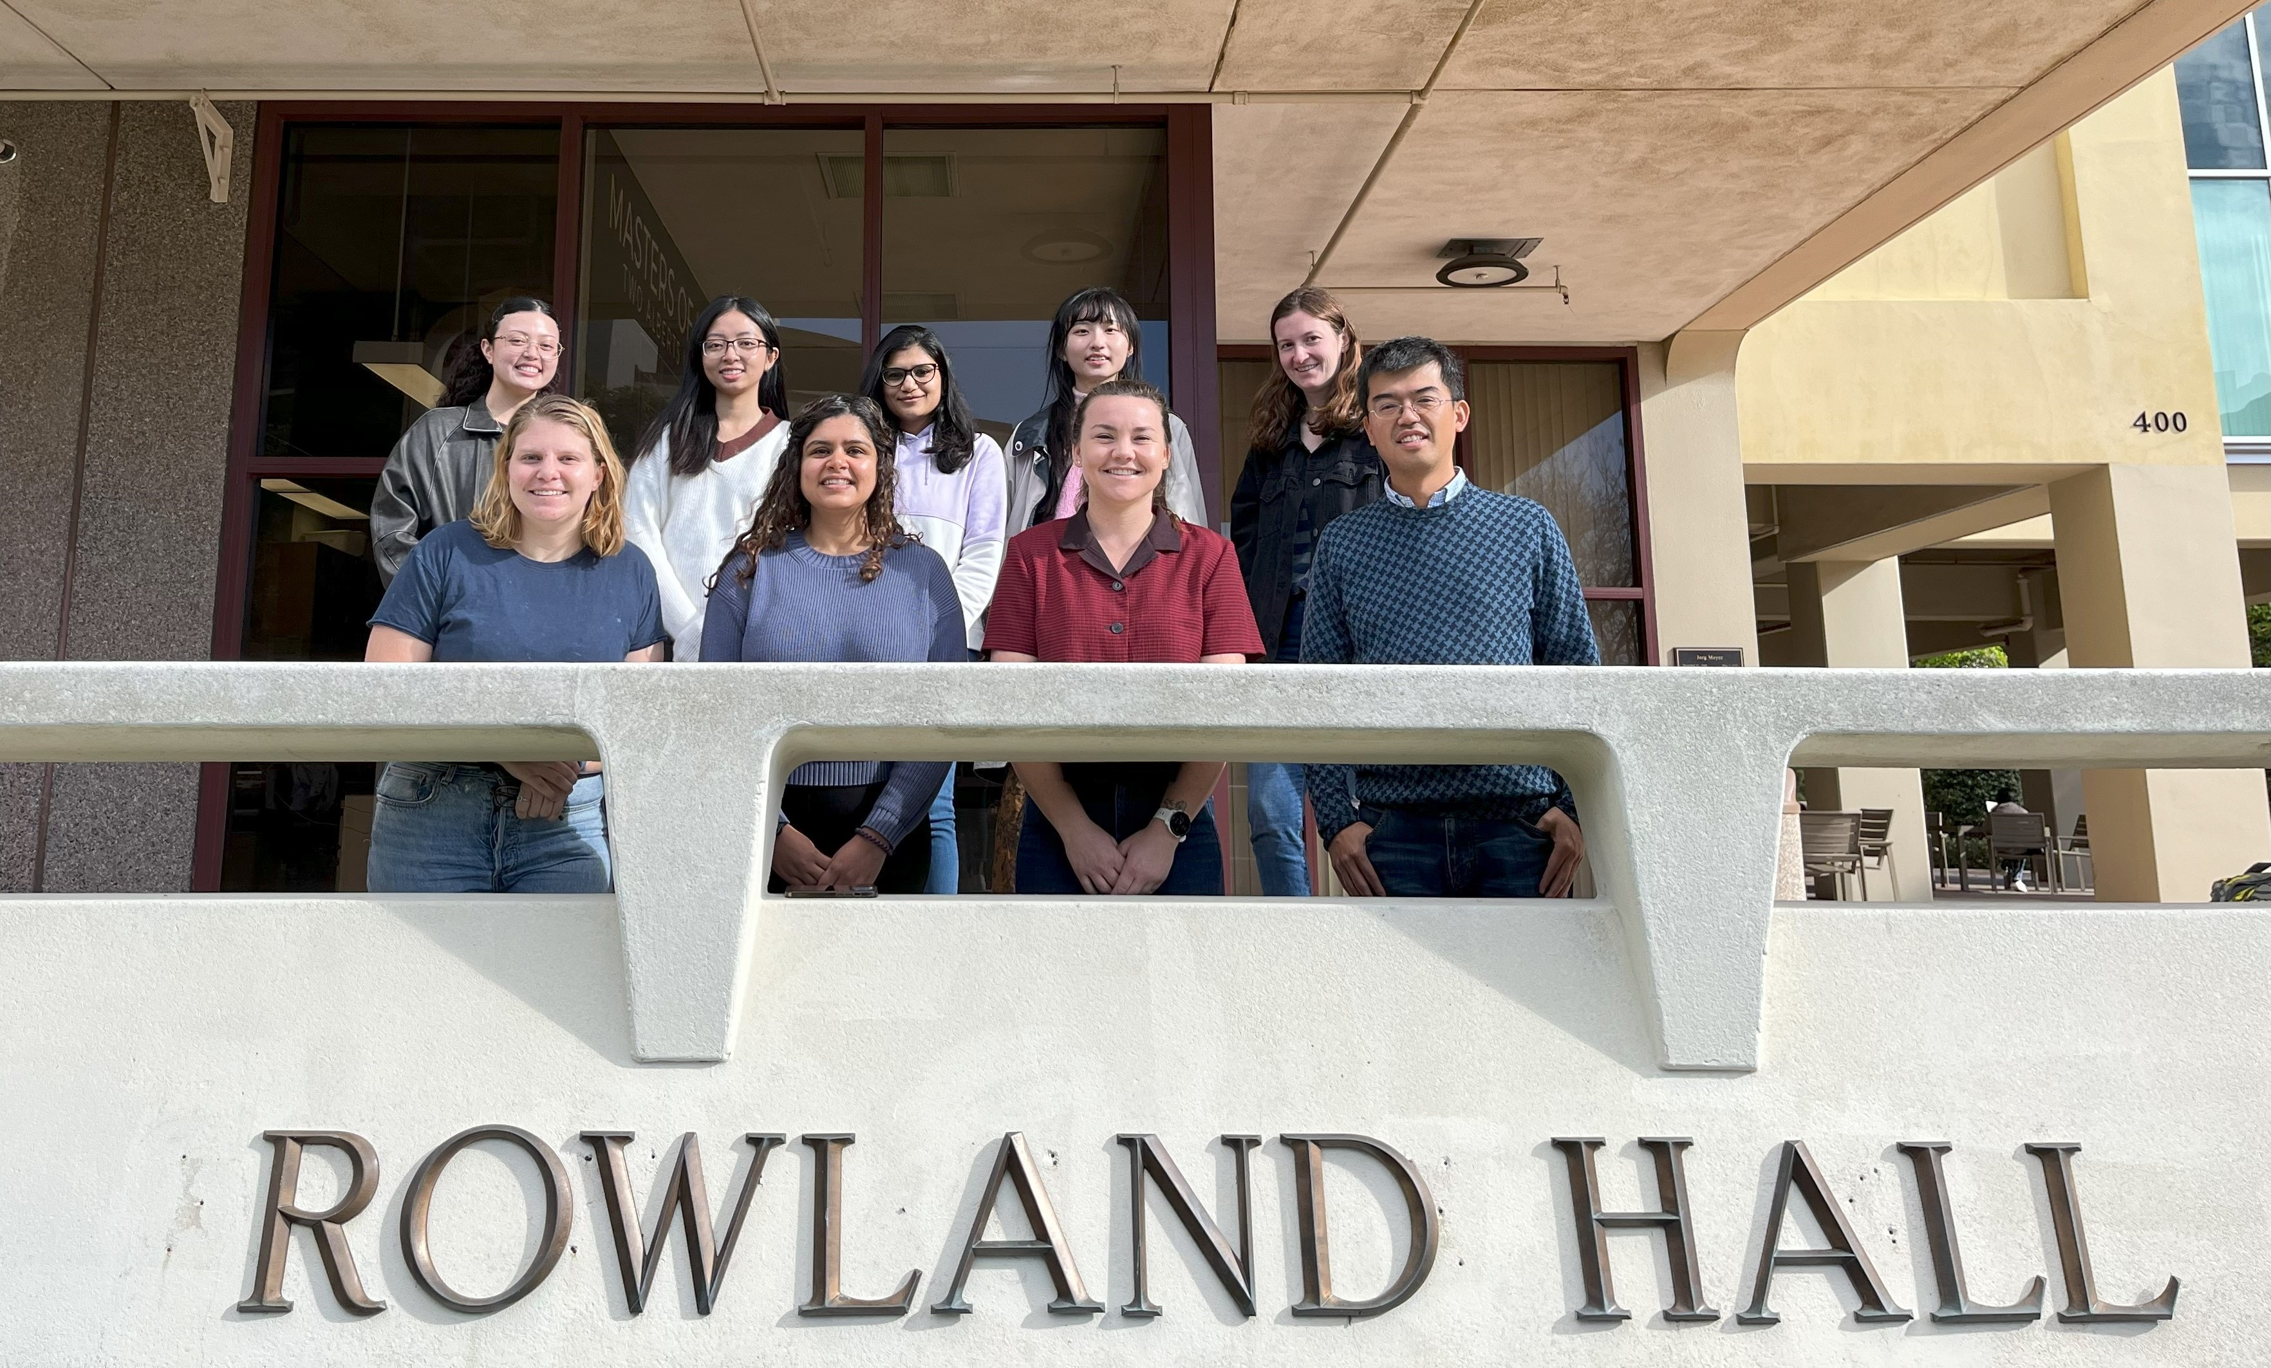
Acknowledgments

Slide 11
Reaction | Rate Constant (cm⁻³ s⁻¹ for bimolecular reactions and s⁻¹ for unimolecular reactions | Reference
HQ+Q->2SQ+2H⁺ | 9.63 x 10⁻²⁰ | ³
2SQ+2H->HQ+Q | 1.33 x 10⁻¹³
HQ+OH->HQOH | 1.99 x 10⁻¹¹
Q+OH->QOH | 1.1 x 10⁻¹¹
HOCl+O₂⁻->OH+O₂+Cl⁻ | 1.25 x 10⁻¹⁴
HOCl+HQ->Q+Cl⁻ | 3.6 x 10⁻²⁰
HOCl+SQ->Q+HOCl⁻ | 3.6 x 10⁻²⁰
HOCl⁻->OH+Cl⁻ | 1.01 x 10⁻¹¹
OH+Cl⁻->HOCl | 7.14 x 10⁻¹²
O2⁻+O2⁻->H₂O₂+O₂ | 2.66 x 10⁻¹² | ⁴
HO₂->O₂⁻+H⁺ | 226000 s⁻¹
O2⁻+OH->O₂+OH⁻ | 1.3 x 10⁻¹¹
HQ+O₂->O2⁻+SQ | 1.66 x 10⁻²⁸
O₂⁻+SQ+2H⁺->HQ+O₂ | 1.66 x 10⁻¹⁴
H₂O₂+OH->H₂O+HO₂ | 5.48 x 10⁻¹⁴
OH+OH->H₂O₂ | 8.64 x 10⁻¹²
OH+HO₂->H₂O+O₂ | 1.18 x 10⁻¹¹
HO₂+HO₂->H₂O₂+O₂ | 1.38 x 10⁻¹⁵
H₂O₂+HO₂->H₂O+O₂+OH | 5 x 10⁻²¹
H⁺+O₂⁻->HO₂ | 1 x 10⁻¹¹
HO₂+O2⁻->H₂O₂+OH⁻+O₂ | 1.7 x 10⁻¹³
SQ+O₂->Q+O₂⁻ | 4.63 x 10⁻¹³
SQ+O₂⁻->Q+H₂O₂ | 3.28 x 10⁻¹²
Cu⁺+H₂O₂->Cu³⁺+2OH⁻ | 4.95 x 10⁻¹⁹
Cu⁺+O₂->O₂⁻+Cu²⁺ | 6.89 x 10⁻²⁰
Cu⁺+O₂⁻->Cu²⁺+H₂O₂ | 5.79 x 10⁻¹⁵
Cu⁺+H₂O₂->Cu³⁺+OH⁻+OH | 2.39 x 10⁻²⁰
Cu²⁺+H₂O₂->Cu⁺+2OH | 2.39 x 10⁻²⁰
Cu⁺+Cu³⁺->2Cu²⁺ | 5.81 x 10⁻¹²
Cu²⁺+H₂O₂->Cu⁺+O₂⁻+2H⁺ | 3.8 x 10⁻²⁴
Cu²⁺+O2⁻->Cu⁺+O₂ | 8.32 x 10⁻¹²
HO₂+Cu²⁺->H⁺+Cu⁺+O₂ | 1.55 x 10⁻¹¹
HO₂+Cu⁺->H₂O₂+Cu²⁺+OH⁻ | 2.27 x 10⁻¹²
Cu¹⁺+O₂->Cu₂+O₂⁻ | 6.9 x 10⁻²⁰
Sb³⁺+H₂O₂->Sb⁵⁺+OH+OH⁻ | 2.5 x 10⁻²⁰ | ⁵
Sb³⁺+OH->Sb⁴⁺+OH⁻ | 1.4 x 10⁻¹¹
Ni²⁺+H₂O₂->Ni³⁺+OH+OH⁻ | 2.39 x 10⁻²⁰
AscH+O₂⁻ +H⁺->Asc⁻+H₂O₂ | 5.13 x 10⁻¹⁷ | ⁴
Asc⁻+Asc⁻+H⁺->AscH | 5 x 10⁻¹⁶
OH+AscH->H₂O + Asc⁻ | 1.8 x 10⁻¹¹
Q+AscH->SQ+Asc⁻ | 1.21 x 10⁻²⁰
HQ+Asc->SQ+Asc | 9.63 x 10⁻¹⁹
Asc+Cu²⁺->Cu⁺+Asc+AscD | 1.37 x 10⁻¹⁸
UA+OH->Product | 1.2 x 10⁻¹¹ | ⁶
GSH+OH->Product | 1.7 x 10⁻¹¹
AscH+GS->GSH+Asc⁻ | 1 x 10⁻¹²
AscH+UA->UAH+Asc⁻ | 1.7 x 10⁻¹⁵
UAH⁻+GS->GSH+UA | 5 x 10⁻¹⁴
Organic+OH->Prod | 1.15 x 10⁻¹² | ^{4,6}
OH+TPT->2-OHTA | 6.21 x 10⁻¹² | ^{3,4}

