Slide 1
EGU25-4173
Fieldwork education and the use of Virtual Geological Tours
Thu 1 May 2025 3:46pm – 3:48pm (CAT)
PICO PRESENTATION: Jan van Bever Donker, Charl Cilliers, and Matthew Huber

Slide 2
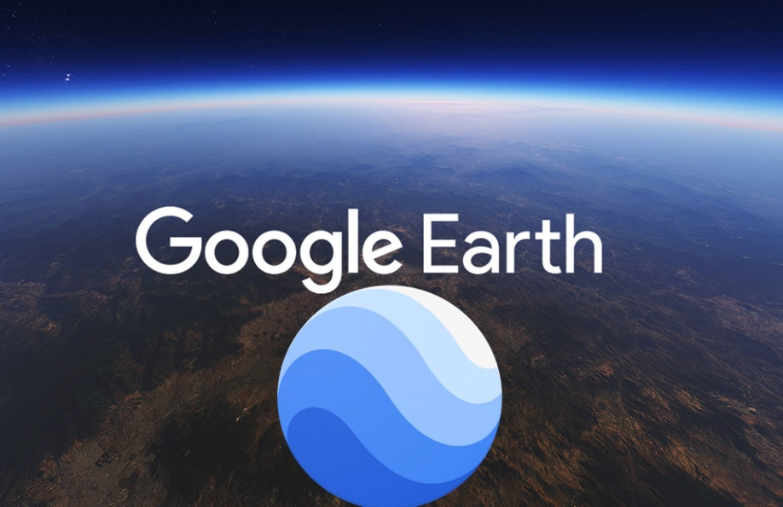
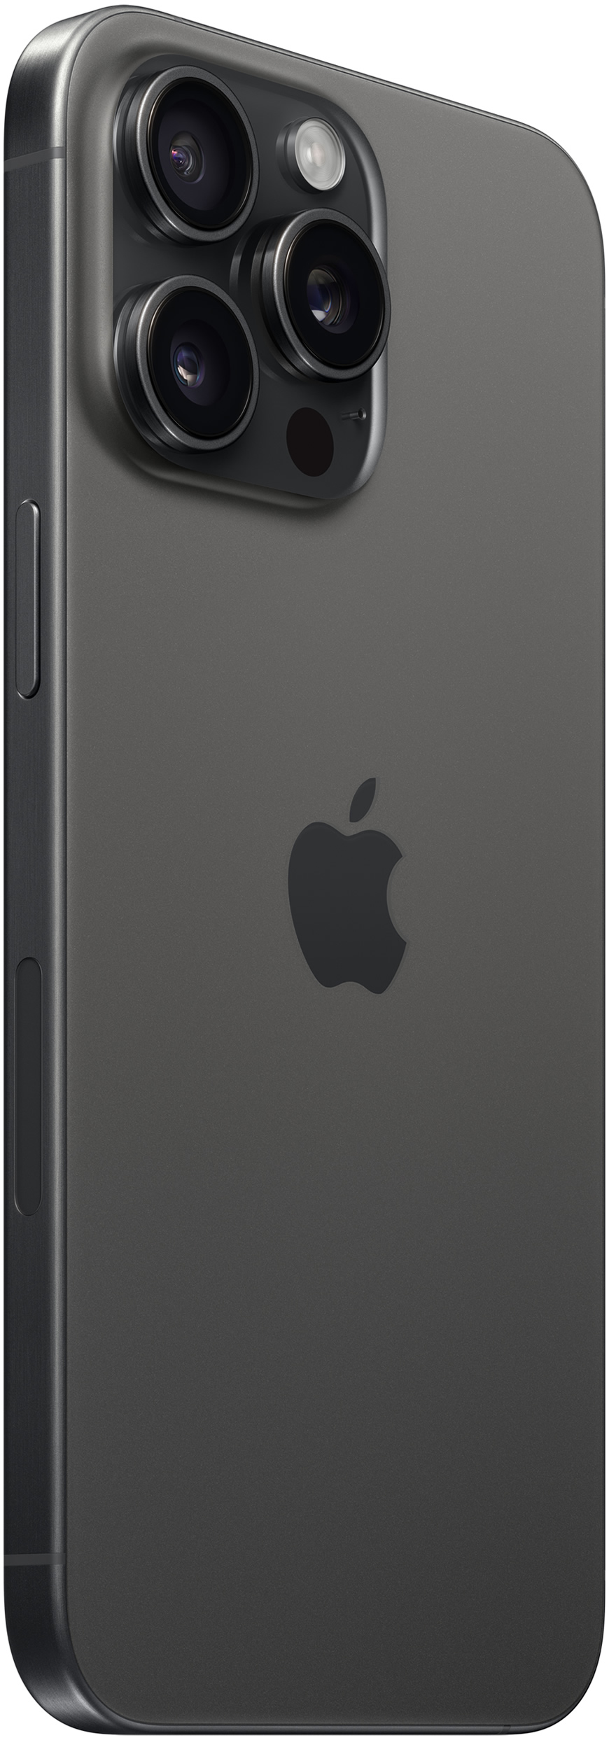
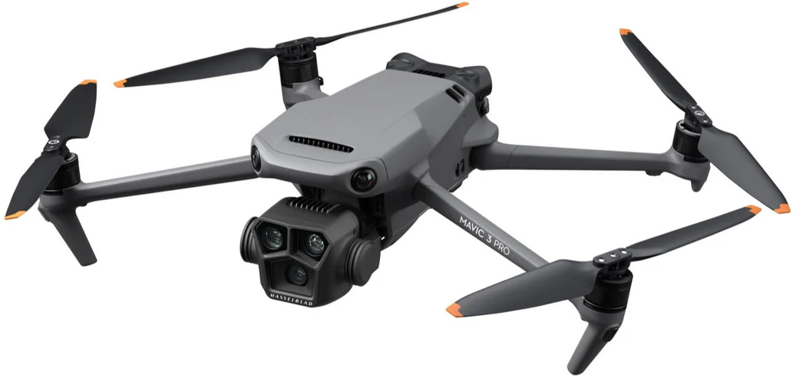
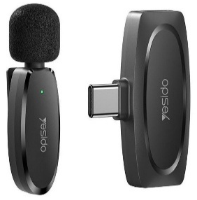
METHODS

Slide 3
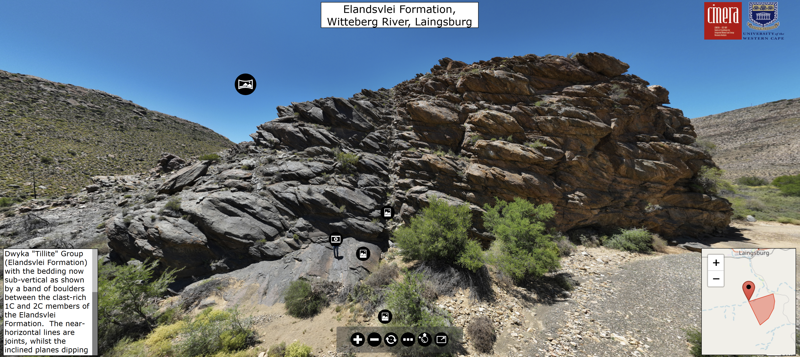
Virtual geological tours
CAPE AND KAROO SUPERGROUPS

Slide 4
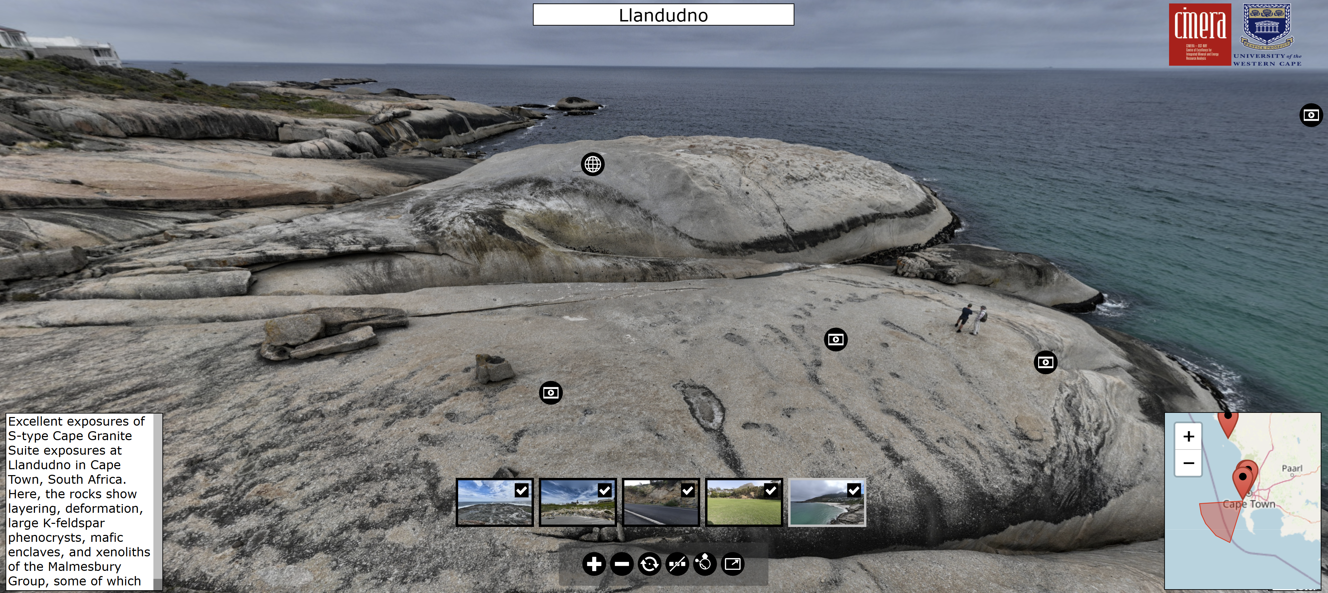
Virtual geological tours
CAPE GRANITE SUITE

Slide 5
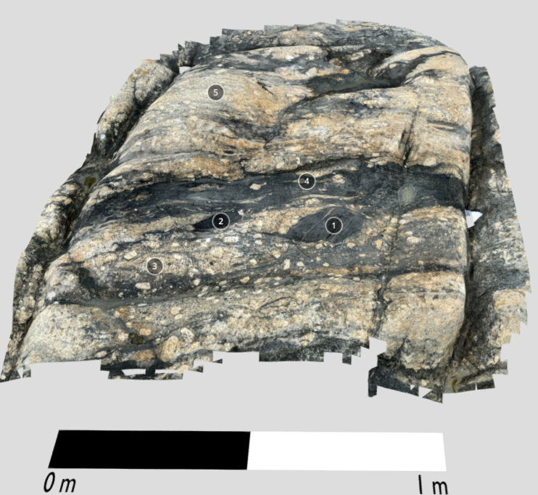
other applications
GEOTOURISM/GEOHERITAGE
PUBLICATIONS

Slide 6
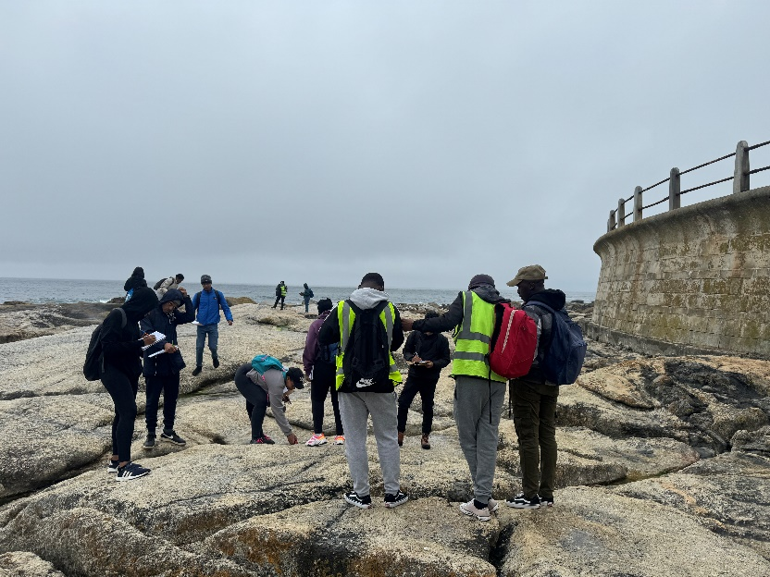
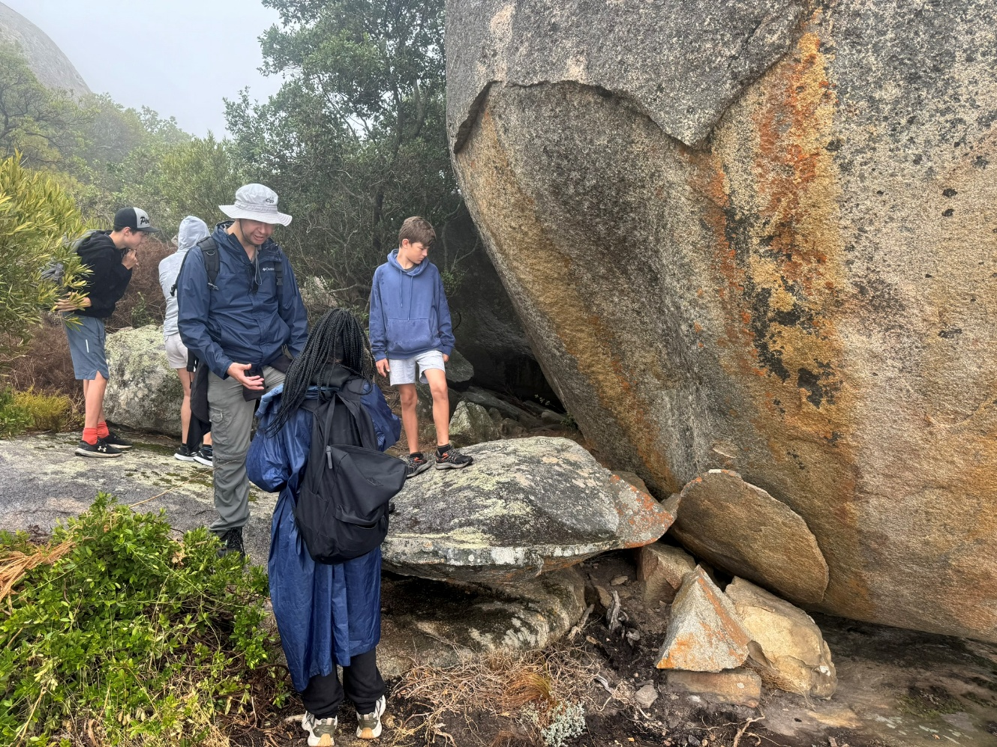
DO vtS WORK in geo-cognition?

Slide 7
EGU25-4173
Fieldwork education and the use of Virtual Geological Tours
Thu 1 May 2025 3:50pm – 5pm (CAT)
ORAL PRESENTATION: Jan van Bever Donker, Charl Cilliers, and Matthew Huber

Slide 8
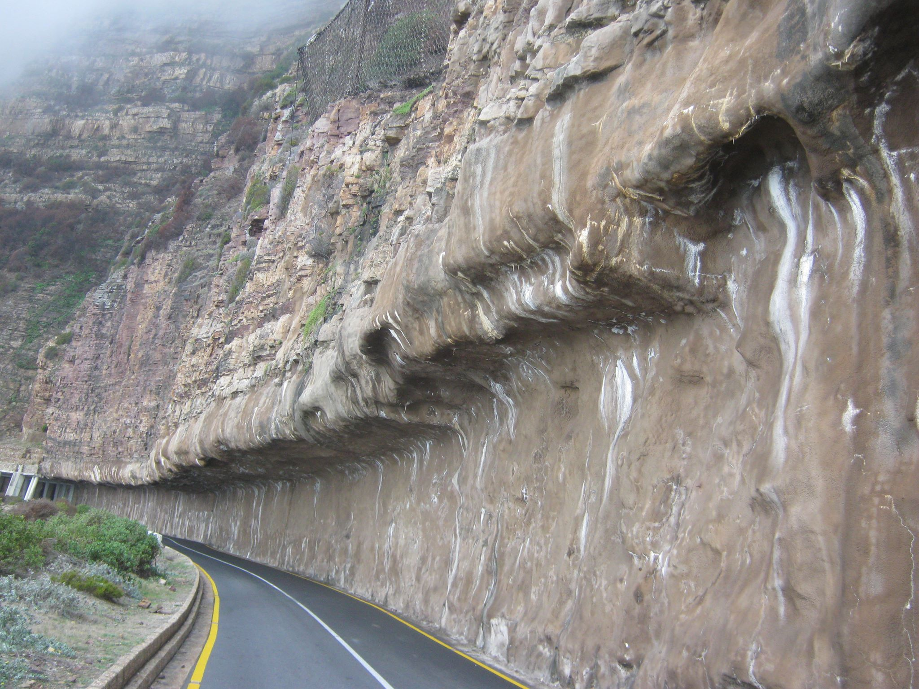
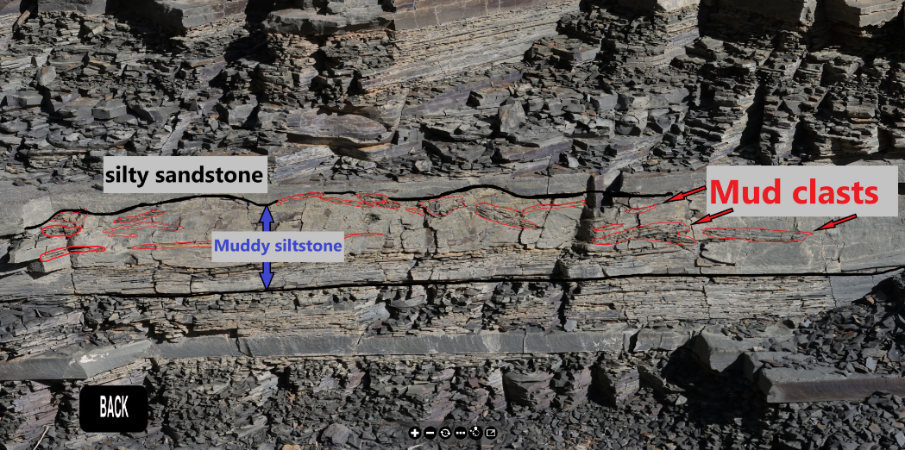
WHY?
GEO-HERITAGE
GEO-cognition
GEO-TOURISM
SHOTCRETE AT CHAPMAN’S PK.
IMAGE: Melis & Du Plessis Consulting’s Facebook Page
SEDIMENTARY FEATURES IN TURBIDITE

Slide 9
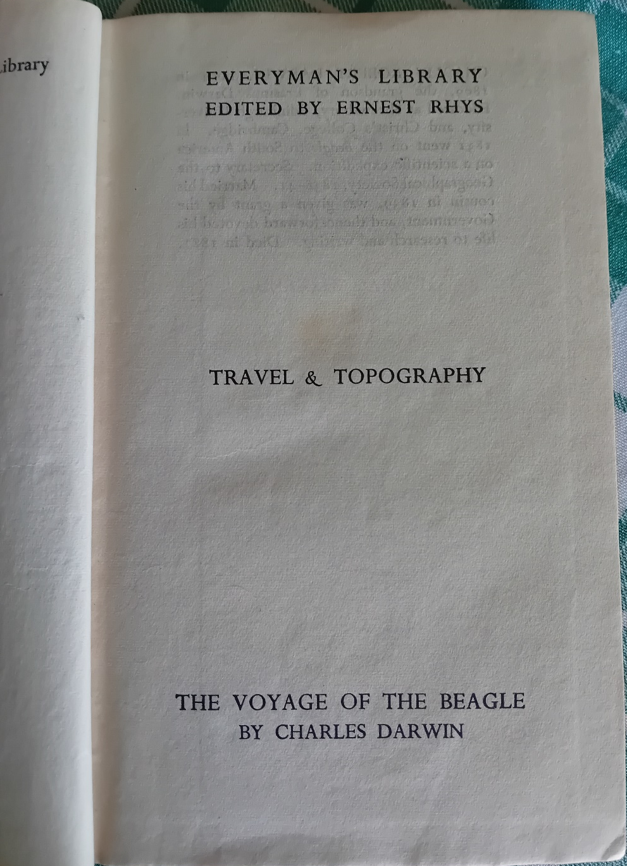
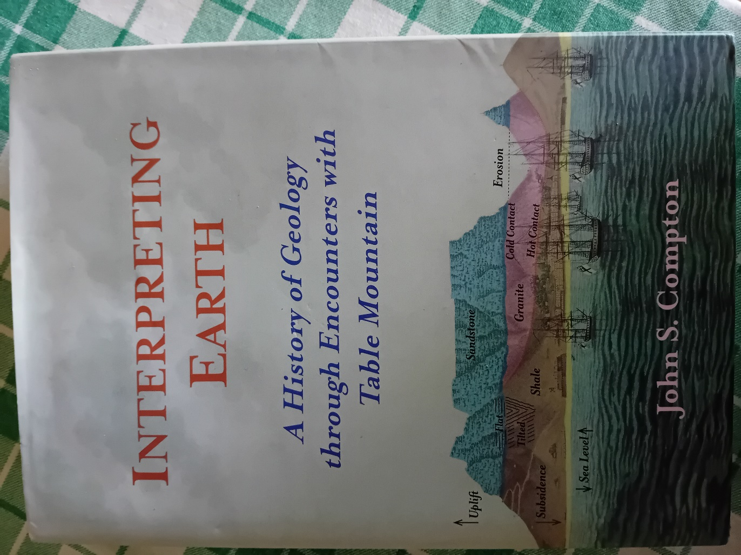
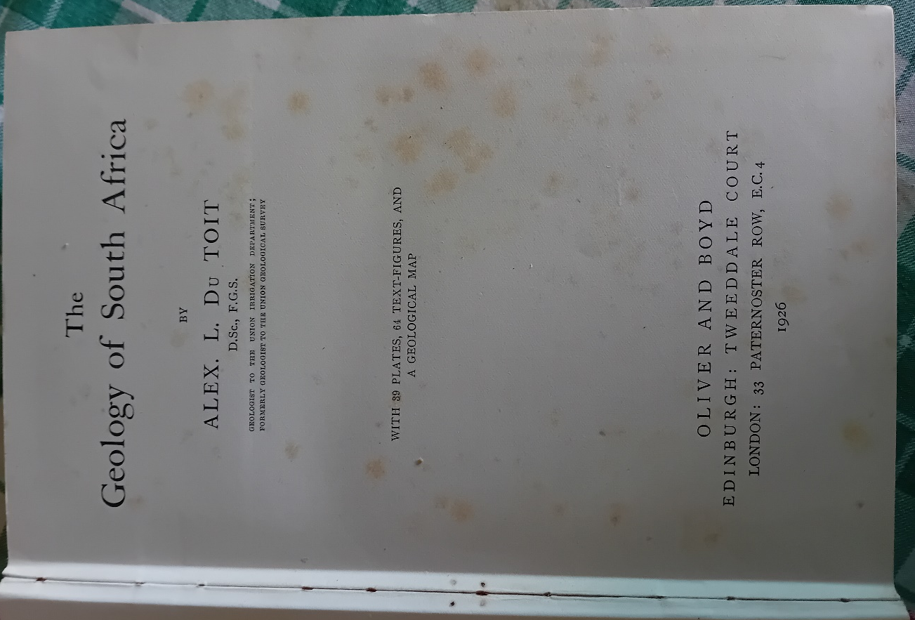
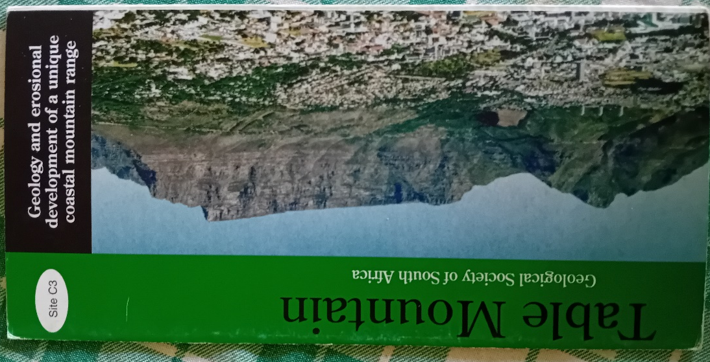

Slide 10
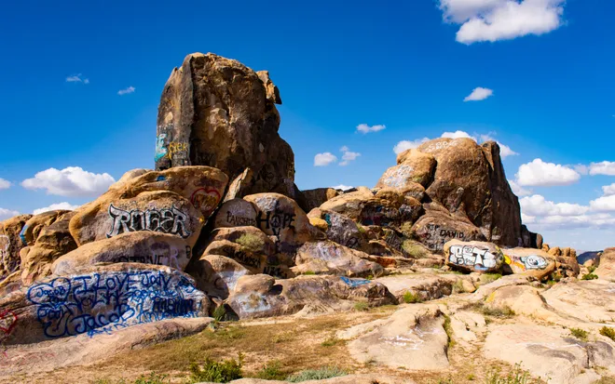
GRAFFITI AT SEA POINT CONTACT
VANDALISED ROCKS IN MOJAVE DESERT, CALIFORNIA
IMAGE: https://www.desertsun.com/story/life/2020/05/02/graffiti-a-problem-for-mojave-desert-public-lands-amid-coronavirus/3030746001/

Slide 11
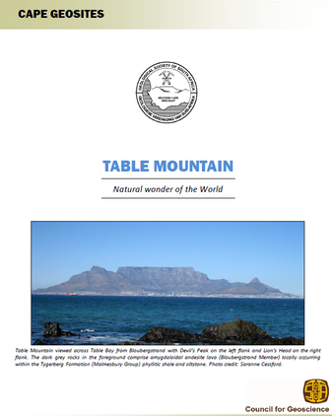
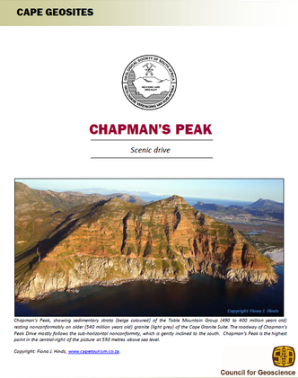
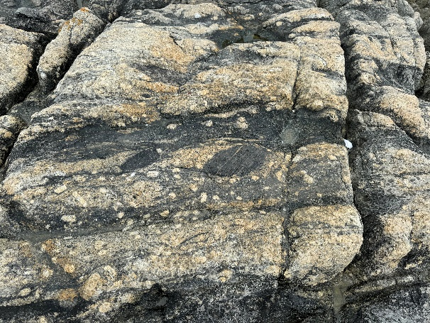
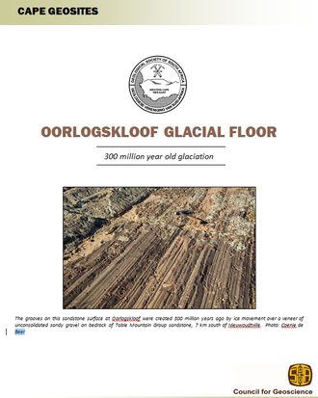
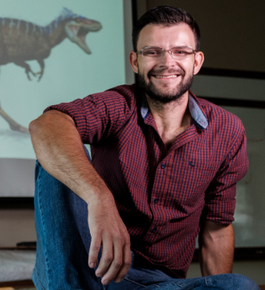
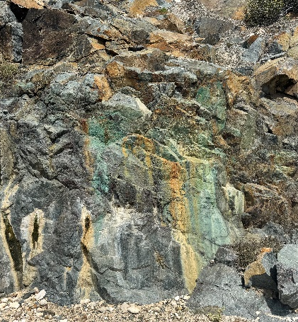
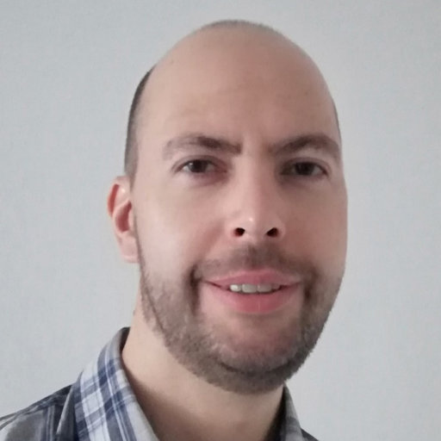
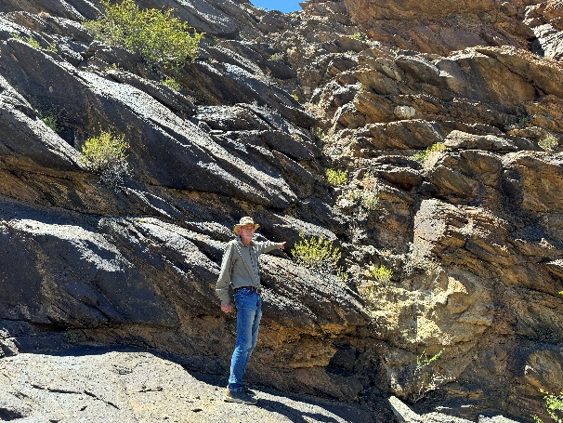
HOW?
1. CHOOSE A SITE
2. I.D THE EXPERT
3. KEY FEATURES
4. IN-FIELD DATA
5. BUILD THE vft
6. PUBLISH/HOST

Slide 12
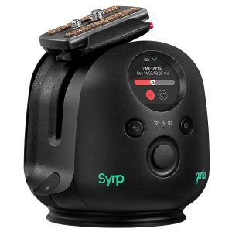
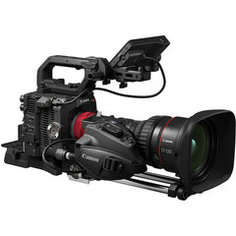
IN-FIELD DATA
SYRP GENIE II PAN TILT
INSTA 360
APPLE iPHONE 15 PRO MAX & YESiDO KR 11 LAVALIER MIC
CANON XA 40 VC
CANON EOS R5
DJI MAVIC 3 PRO CINE DRONE

Slide 13
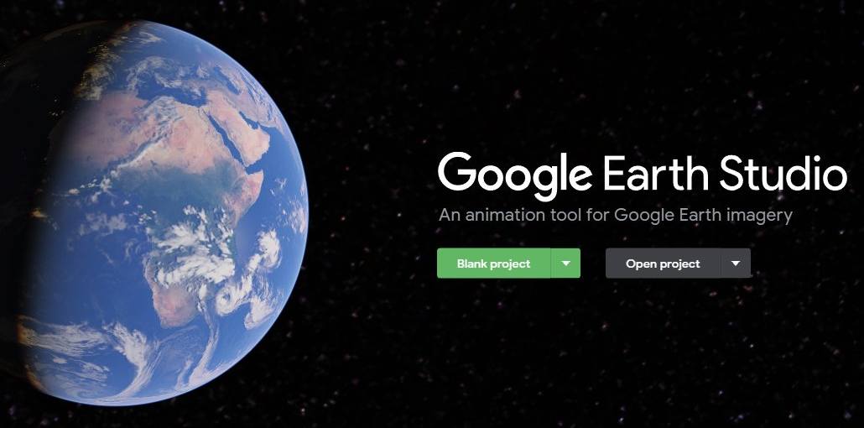
Build the vT
“FLY IN” & 360˚ OVERVIEW
ALIGN AND STITCH PHOTOS TO CREATE PANORAMAS
PUT TOGETHER, EDIT, ANNOTATE VIDEOS
EDIT 3D LIDAR SCANS AND DRONE-MODELS
BUILD INTERACTIVE 360˚ IMAGES WITH HOTSPOTS

Slide 14
PLATFORMS
INTERACTIVE 360˚ IMAGES
WITH IMBEDDED EXPLANATORY
VIDEOS, 3D SKETCHFAB MODELS
AND HD PHOTOS
TOUR ON EARTH.GOOGLE.COM/WEB
LINKS TO EXPLANATORY VIDEOS
LINKS TO 3D MODELS

Slide 15
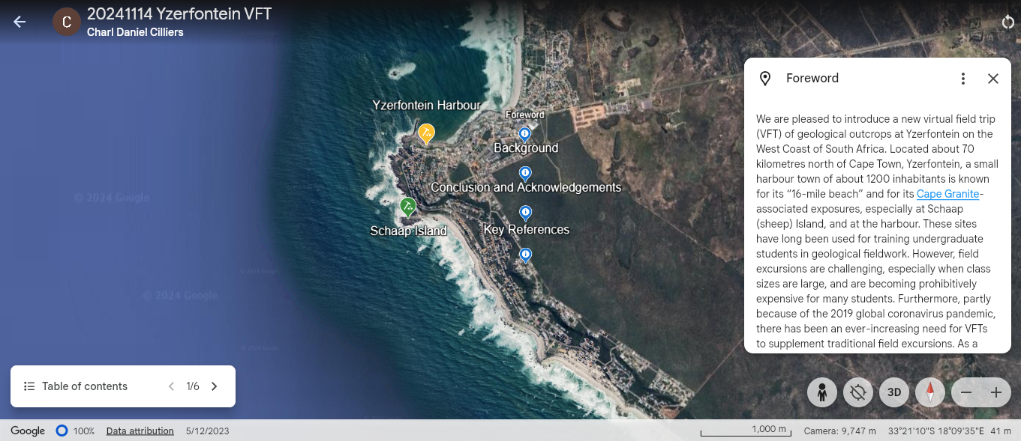
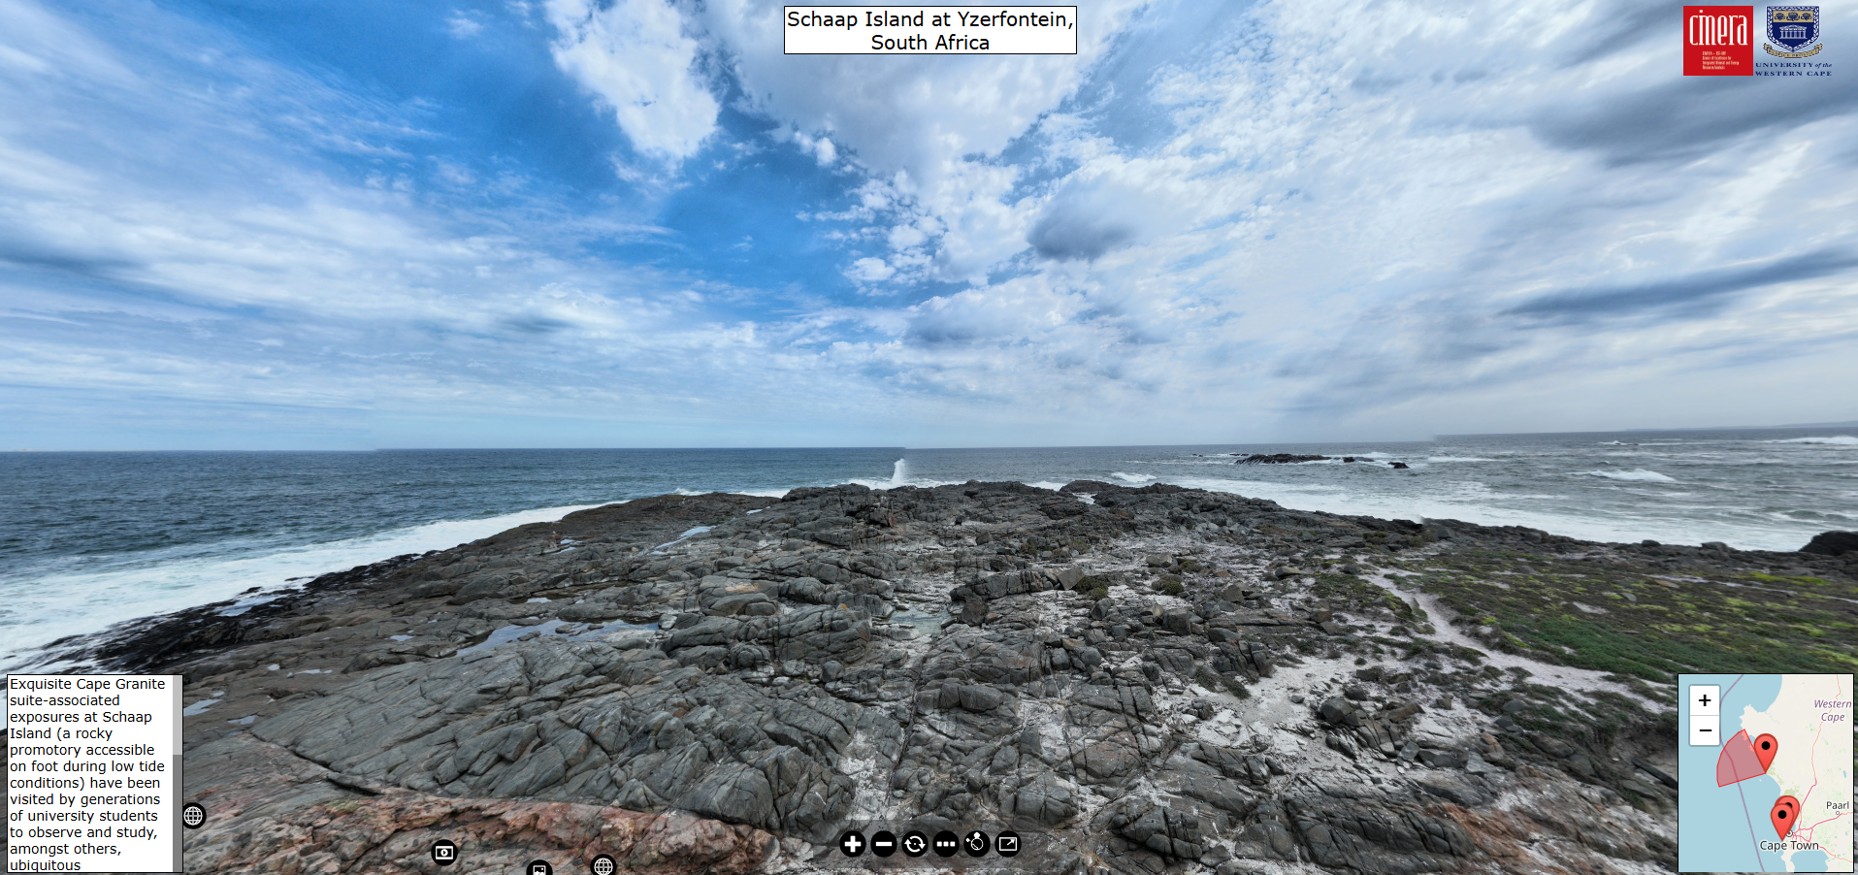
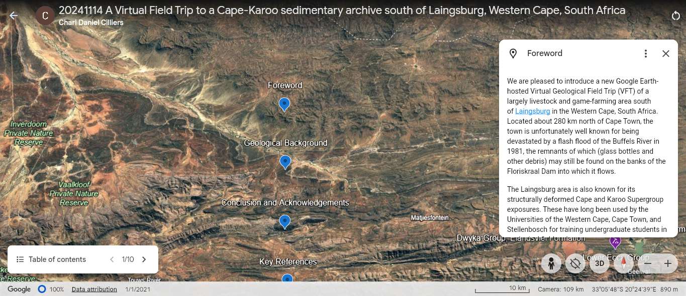
NEW VIRTUAL TOURS
CAPE AND KAROO SUPERGROUPS, CAPE GRANITE SUITE

Slide 16
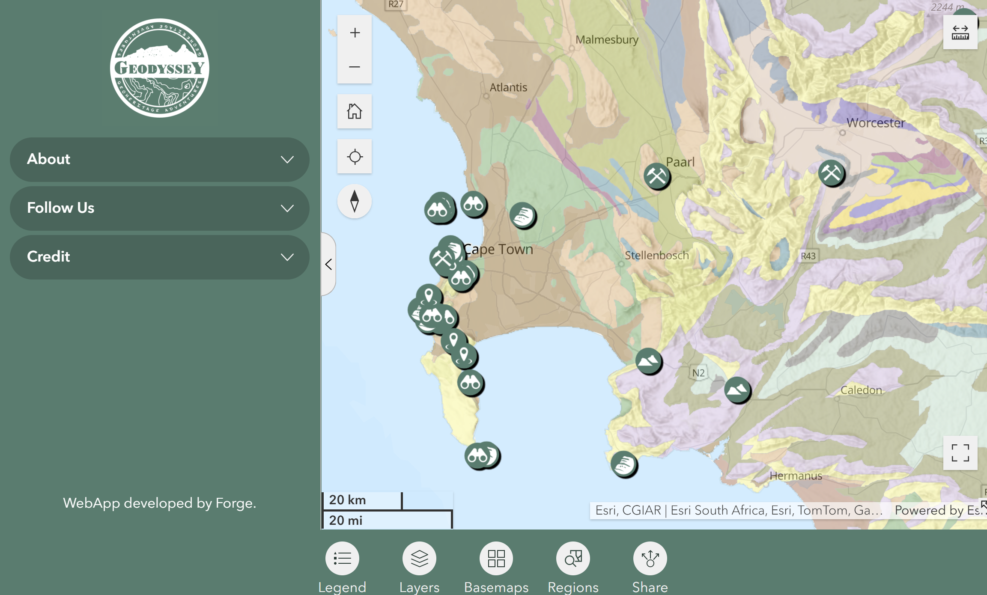
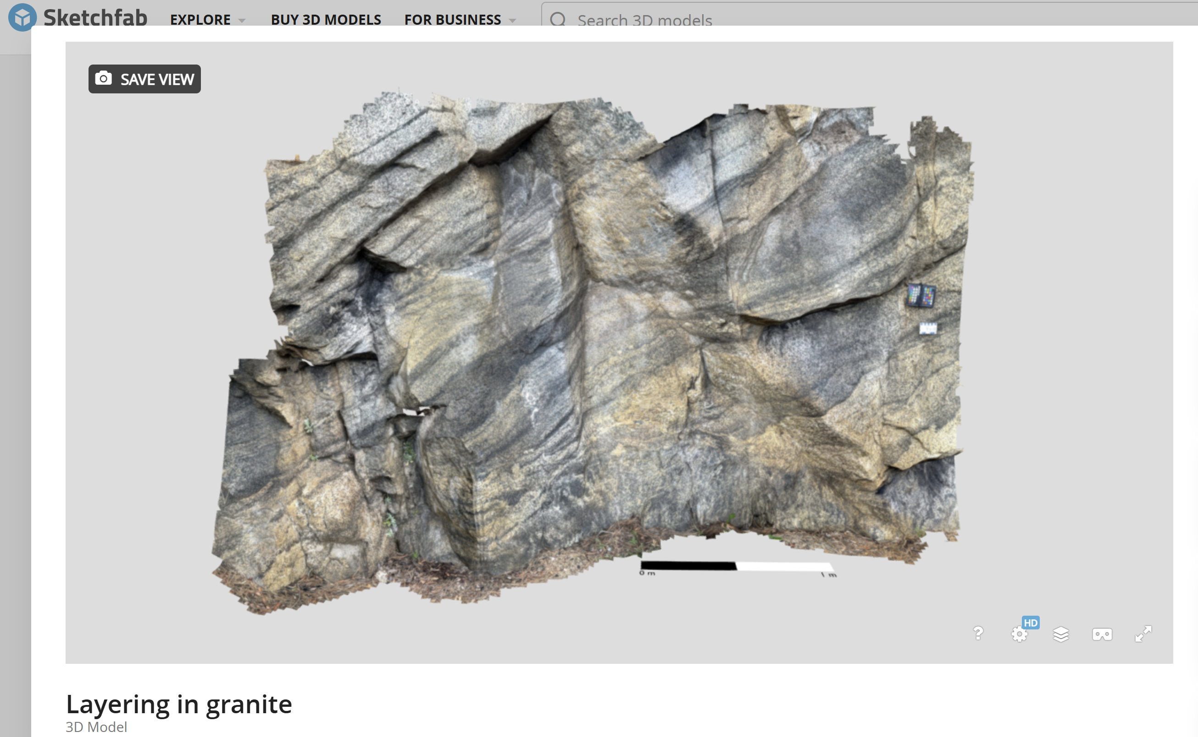
other applications
GEOTOURISM/GEOHERITAGE
PUBLICATIONS – SUPPLEMENTARY MATERIAL

Slide 17
DO vtS WORK in geo-cognition?
BASELINE TEST
PRESENT VFT
TEST AGAIN
UNDERGRADUATE MARKS 10 – 30%
POSTGRADUATE MARKS: 30 – 50%
WORKING GRADUATES’ MARKS > 50%
# THESE RESULTS ARE BEING UPDATED AS WE SPEAK!!!

Slide 18
ACKNOWLEDGEMENTS
Prof Russell Bailie (UWC)
Rudy Maart (UWC)
Dewan Isaacs (UWC)
Dr Chris Lambert (Tect Geol. Consult.)
Dr Gerrie van Aswegen (OGG)
Yaseen Hendricks (UWC)
Dr Ryan Tucker (US)
Prof John Rogers (UCT – retired)
Dr Cameron Penn-Clarke (WITS)
Dr Wendy Taylor (ASU / UCT)
Leonard Gardner (GSSA)
Dr Petré Prins (Prins & Prins diamonds)

Slide 19
Join me for a taste of some of our tours
PLEASE PLAY THE SUPPLEMENTARY MP4 FILE!

Slide 20
In summary
Initial analysis suggests that there is a distinct learning gain from working with these tours
The higher the level of education, the more pronounced the learning gain: +10% at first year level to +50% at postgrad level!
It can even be used to replace field trips when the classes are too big (>300 in first year!)
With the right equipment (iPhone Pro and drone) it is easy to record HiRes video and stills as well as LiDAR scans for 3D representations
Software and some of the hardware are expensive – freeware options
We are increasing our testing database

