Slide 1
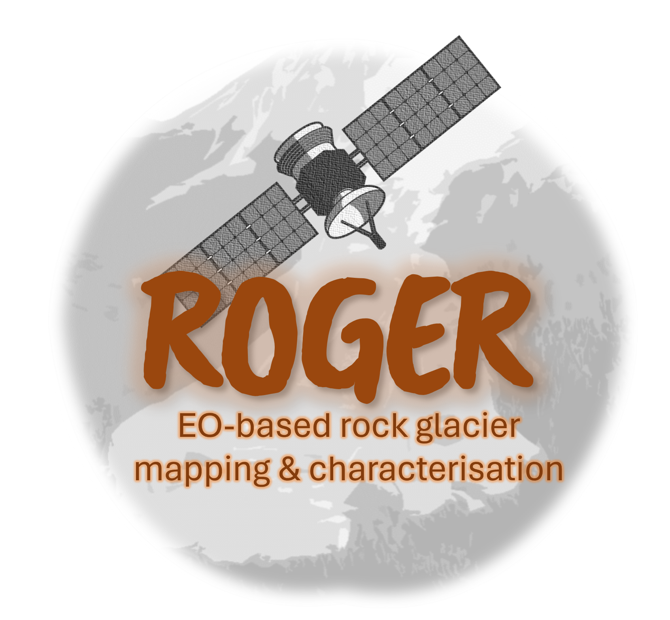
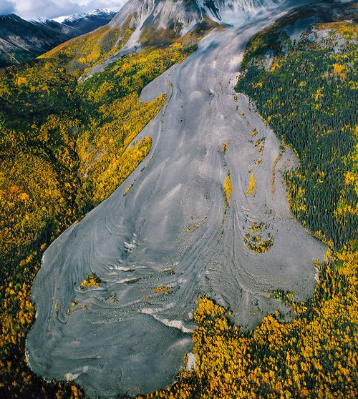
Deep learning-based rock glacier mapping using Earth observation data
Streifeneder Vanessa 1, Robson Benjamin Aubrey 3, Hölbling Daniel 1, Nafieva Elena 1, Dabiri Zahra 1;2, Hauglin Emma 3, Abad Lorena 1
1 University of Salzburg, Department of Geoinformatics – ZGIS
2 University of Salzburg, Artificially Intelligence and Human Interfaces
3 University of Bergen, Department of Earth Science
@franslnating

Slide 2
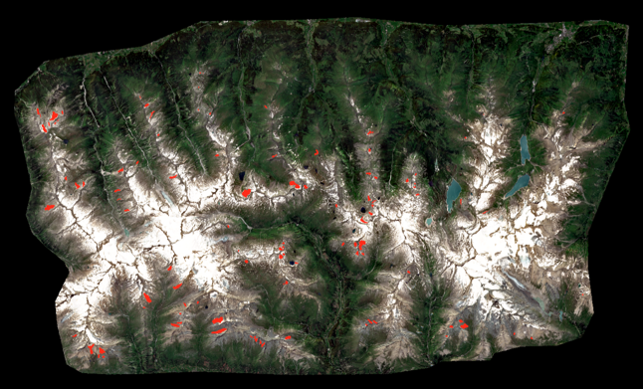
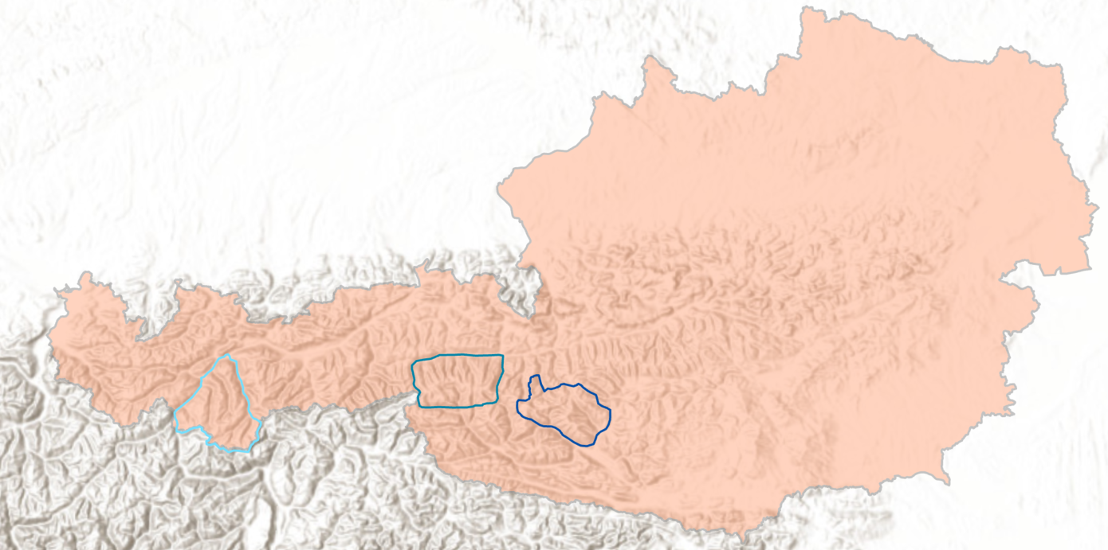
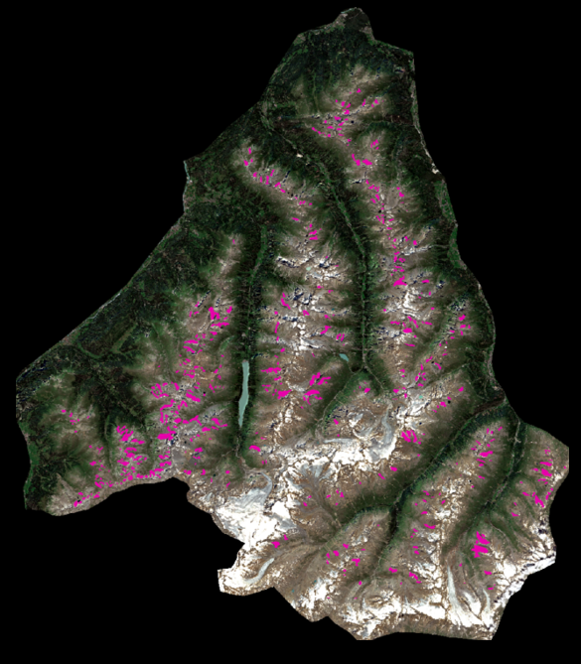
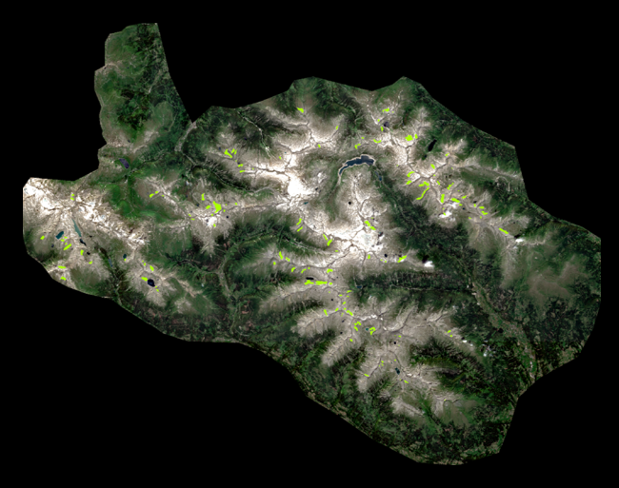
Study Area: Austrian Alps
Study Area
DeepLab V3+
Results
Outlook
Test site: Großglockner – Großvenediger (109 active rock glaciers)
Training site: Ötztal (556 active rock glaciers)
Training site: Ankogel (149 active rock glaciers)
Wagner, T., Pleschberger, R., Kainz, S., Ribis, M., Kellerer-Pirklbazer, A., Krainer, K., Philippitsch, R., Winkler, G. (2020): The first consistent inventory of rock glaciers and their hydrological catchments of the Austrian Alps. Austrian Journal of Earth Science, 113/1, p. 1-23

Slide 3
Rock Glaciers
Study Area
DeepLab V3+
Results
Outlook
Tongue-shaped bodies of frozen debris that insulate an ice-core or ice-debris mixture. They exist in all major mountain ranges where permafrost occurs (Janke & Bolch, 2013).
Challenges
Sufficient number and quality of training samples
Complex geomorphological structure can also be hard for non-experts to identify
Is the resolution of Sentinel-2 (10m) imagery suitable?
@franslnating
Ranke, J.R. and Bolch, T, (2022): 4.06 Rock Glaciers. Treatise on Geomorphology (Second Edition), Academic Press, p. 75-118.

Slide 4
The Model: DeeplLab V3+ with adaptation
Study Area
DeepLab V3+
Results
Outlook
Input:
We tested different patch sizes: 256*256; 320*320; 400*400
Image augmentation
Different input layers:
RGB (Sentinel -2)
RGB + Slope
RGB + Hillshade
RGB+ Hillshade + Slope
TBC
Model adjustments:
Backbone: Xception
Sample weights: 32* foreground
Loss-function: Combination of Focal and Tversky Loss
Learning rate: Exponential Decay
Adjust to N channel input: 3* Con2D layers + DeeplLab V3+
Model code based on: DeepLabV3-Segmentation/src/model.py at main · mukund-ks/DeepLabV3-Segmentation · GitHub
Sun, Z., Hu, Y., Racoviteanu, A., Liu, L., Harrison, S., Wang, X., Cai, J., Cguo, X., He, Y., Yuan, H. (2024): TPRoGI: a comprehensive rock glacier inventory for the Tibetan Plateau using deep learning. Earth Syst. Sci. Data, 5703-5721.

Slide 5
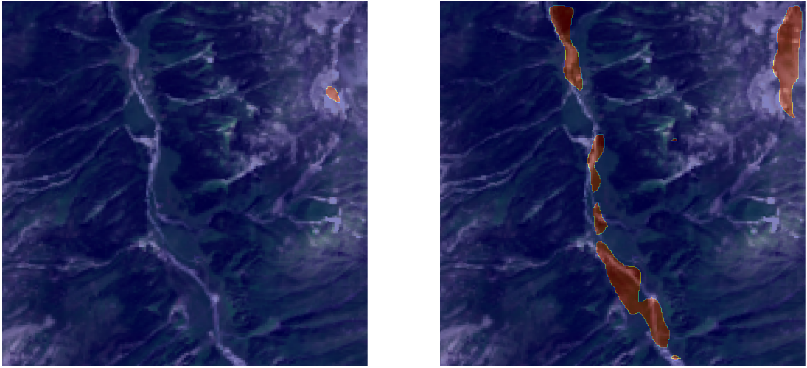
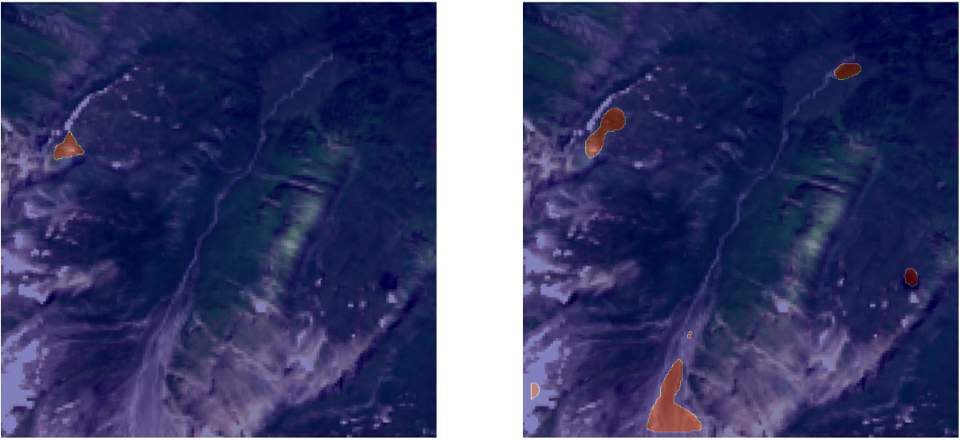
Results (Sentinel 2)
Study Area
DeepLab V3+
Results
Outlook
Model performance for different patch sizes (RGB+Hillshade+Slope)
Reference data
Predicted
Patch size | Binary accuracy | Mean IoU | Precision | Recall | F1-Score
256*256 | 97.83% | 49.83% | 0.43 | 0.28 | 0.34
320*320 | 99.45% | 55.40% | 0.64 | 0.36 | 0.46
400*400 | 99.63% | 49.58% | 0.49 | 0.3 | 0.37
Confusion Matrix 320*320 (RGB + Hillshade + Slope)
Class Value | Background | Rock Glacier | Total (Pixels) | User Accuracy | Kappa
Background | 392 | 8 | 400 | 51.17% | --
Rock Glacier | 374 | 26 | 400 | 76.47% | --
Producer Accuracy | 98% | 6.5% | 800 | 52.25% | --
Kappa | -- | -- |  | -- | 0.045

Slide 6
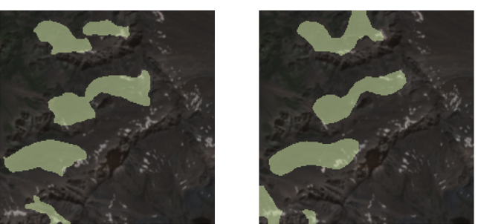
Results (ArcGIS Pro)
Study Area
DeepLab V3+
Results
Outlook
Model:
WorldView image (Patch size 400 *400)
DeeplabV3 + Resnet 34 Backbone
Model:
Sentinel-2 image (Patch size 400 *400)
DeeplabV3 + Resnet 34 Backbone
Class Value | Producer Accuracy | User Accuracy
Background | 91.6% | 92.4%
Rock Glacier | 79.2% | 77.3%
Class Value | Producer Accuracy | User Accuracy
Background | 98.99% | 98.81%
Rock Glacier | 74.91% | 78.03%
Reference Data
Predicted
Reference Data
Predicted

Slide 7
Discussion & Outlook
Study Area
DeepLab V3+
Results
Outlook
Ongoing challenge for ML to be used as a reliable detection method for rock glaciers:
Number of training samples
Complex structure and surface morphology
Delineation and classification is challenging, even for experts
Higher resolution provides a better performance, as well as the introduction of additional classes identifying other landscape features
Rock glacier detection in Norway
Further exploitation of DEM derivates

Slide 8
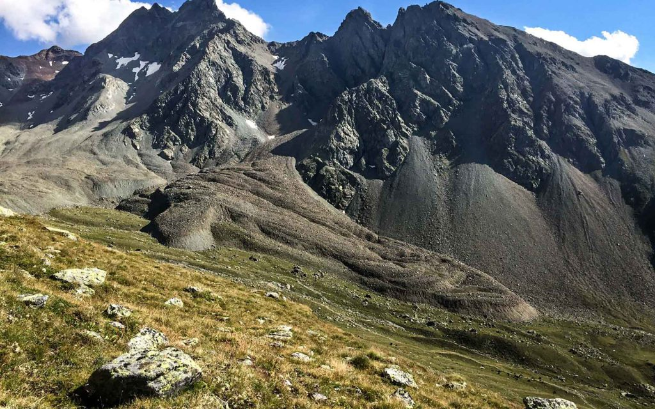
Thank you for your attention!
Study Area
DeepLab V3+
Results
Outlook
Contact:
Vanessa Streifeneder, Benjamin Aubrey Robson, Daniel Hölbling, Elena Nafieva, Emma Hauglin, Lorena Abad
vanessa.streifeneder1@plus.ac.at
Benjamin.Robson@uib.no
daniel.hoelbling@plus.ac.at
elena.nafieva@plus.ac.at
emma.hauglin@uib.no
lorena.abad@plus.ac.at
Risk, Hazard & Climate Lab
Department of Geoinformatics – Z_GIS
University of Salzburg
Schillerstrasse 30, 5020 Salzburg
https://plus.ac.at/risk-hazard-climate
Risk, Hazard & Climate Lab
@riskhazclimlab.bsky.social
@ iugs-geoheritage.org
Acknowledgement
This research has been supported by the Austrian Research Promotion Agency (FFG) through the project ROGER (EO-based rock glacier mapping and characterisation; project no. FO999911924).

