Slide 1
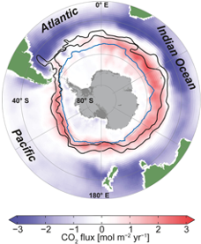
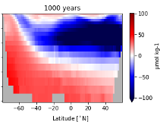
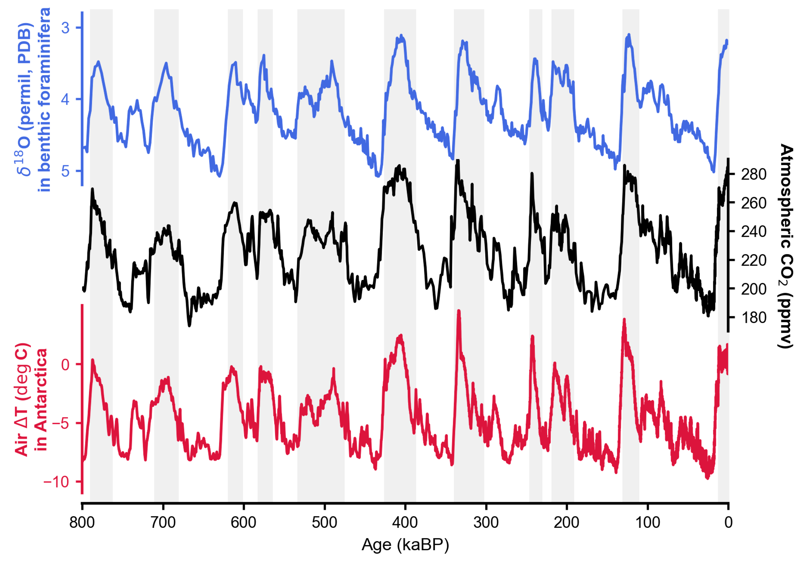
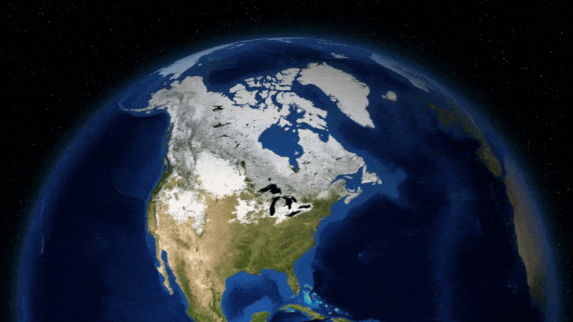
Southern Ocean mechanisms of glacial CO₂ drawdown and their links to global climate
Maddie Shankle¹, Post-Doctoral Researcher
Graeme MacGilchrist¹, Andrea Burke¹, James Rae¹
28 April 2025
EGU25
Present-day outgassing
Glacial PCO₂ Anomaly (Pacific Zonal Average)
Glacial Cycles
Sci Tech Daily; Based on Coulson et al. (2021, GRL)
1) School of Earth and Environmental Sciences, University St Andrews, UK. mgs23@st-andrews.ac.uk
Notes:
Thanks very much – this has been a great session so far, and what I’d now like to contribute are some exciting stories and highlights from a paleo perspective.
Now studying past climate states, helps ground-truth our understanding, of how the Southern Ocean impacts climate and CO2. And today I will present you with the ice ages as especially good case-studies for this.
So by the end of this talk, I hope you’ll know more about the Southern Ocean’s behavior under glacial periods… and how these changes helped drive atmospheric CO2 drawdown.
[37 sec]

Slide 2
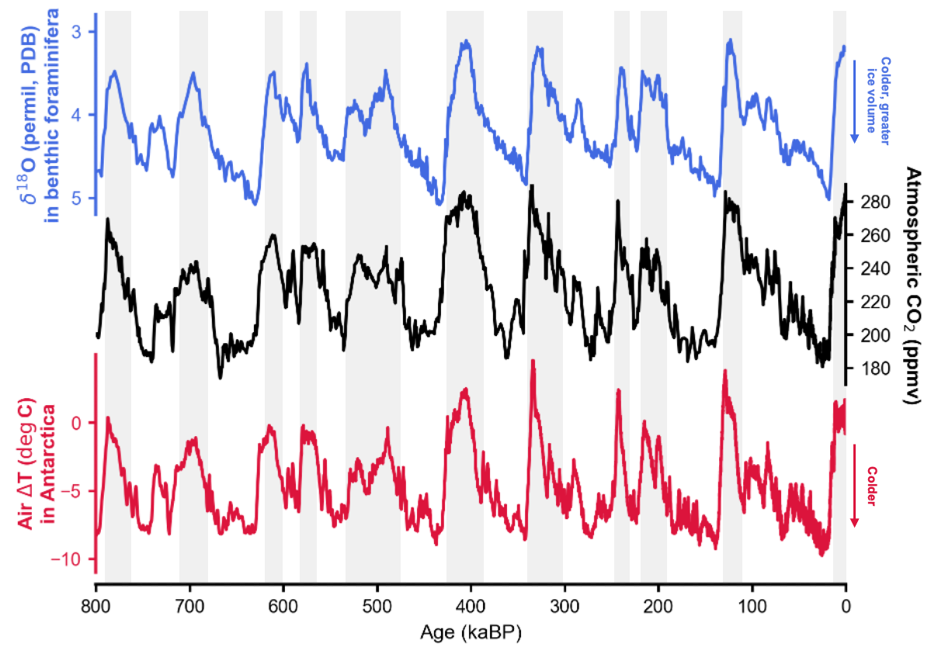
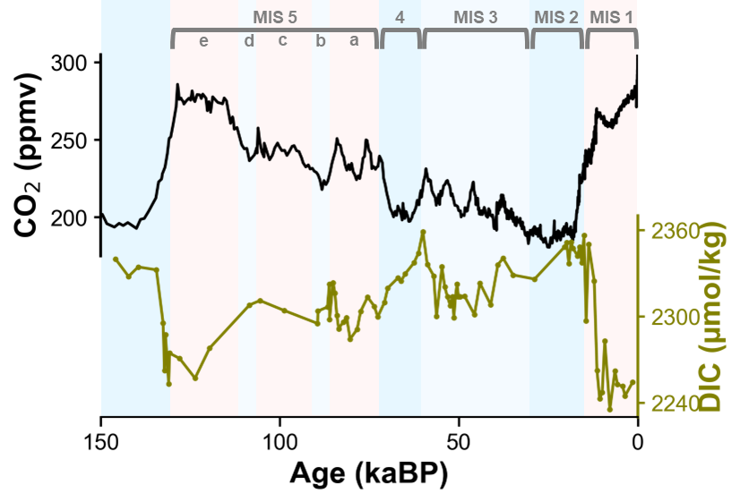
Glacial Cycles: Ice Volume, Temperature, and CO₂
Most recent episodes of major climate change, occurring every 40-100 thousand years, over the last ~2 million years
Offer a window into processes that drive CO₂ in and out of the atmosphere (and ocean)
Sci Tech Daily; Based on Coulson et al. (2021, GRL)
~ -6ºC, global average
(Tierney et al., 2020)
Where did the carbon go?
Lithosphere (geological weathering ~millions of years)
Terrestrial Biosphere
Deep Ocean
CO₂
~ 80-100 ppm
(Bereiter et al., 2015)
Deep-ocean carbon! Stay tuned…
Southern Ocean key to glacial CO₂ drawdown:
a conduit to the deep ocean (a large reservoir of carbon, with appropriate residence times to explain glacial cycles)
800,000 years of proxy data
Notes:
Now the ice ages represent, the most recent episodes of major climate change available for us to look at. [CLICK] They emerged and have been a feature of Earth’s climate since about 2 million years ago, and they are characterized by major swings in global temperature, ice sheet volume, and of course, CO2.
But the reason I find the ice ages SO fascinating is that they offer us a window specifically into processes that drive CO2 in and out of the atmosphere.
So we can think about, what specifically in the Earth system could be taking up all this carbon, this 80-100 ppm change. Well, we can rule out geological weathering, as this is much too slow a process to explain these cycles.
As for the terrestrial biosphere, well a large portion of this got bulldozed by the growing ice sheets, so we actually lose an important reservoir for carbon there.
[CLICK!] And finally, by this chain of logic, but now also increasingly being supported by proxy data, we believe that all atmospheric carbon largely went into the deep ocean.
Now, as is the theme of this session, the, Southern Ocean is particularly important in this, for it being a conduit between the surface and the deep. So you can imagine how changes in regional processes here can modulate the storage or release of carbon from the deep ocean.
Alright, that was the ice ages done in a single slide. To move on to the outline of my talk today…
[2:18]
TEXT GRAVEYARD
Southern Ocean key to glacial CO₂ drawdown:
a conduit to the deep ocean with S.O. processes modulating the storage and release of carbon

Slide 3
Outline: S.O.’s role in glacial CO₂ change
Document and quantify deep ocean carbon
(1) New proxy record: tight coupling between atmospheric and deep-ocean carbon
Understand driving processes behind it
Northern-Southern Hemisphere connections: remote regions influencing S.O. processes.
(2) N. Pacific ventilation (glacial proxy data) → reduces carbon load of upwelling S.O. waters, reducing outgassing (intermediate-complexity Earth system models)
(3) N. Atlantic cooling → glacial-like changes in S.O., atms. CO₂ (idealized model)
Notes:
… To, understand the Southern Ocean’s role in CO2 change, there are really two goals, which is also how I’ve structured the talk.
First, one can work to, document and quantify this deep-ocean carbon storage. And second, work can be done to pick apart the processes, driving it. So the new results I’ll present today are three-fold. I’ll first briefly present a new proxy record that documents this deep-ocean carbon storage, and shows it clearly varying with atmospheric CO2.
And I’ll then present a novel perspective on the second point, by discussing remote regions that may themselves have influence on Southern Ocean processes.
So in this vein, I’ll show how a well-ventilated glacial North Pacific, which we have proxy data of, impacts Southern Ocean biogeochemistry and reduces outgassing. Next, I’ll show how cooling the North Atlantic alone – and no where else – is actually sufficient to induce many glacial-like changes in the Southern Ocean, and impact CO2
[3:30]

Slide 4
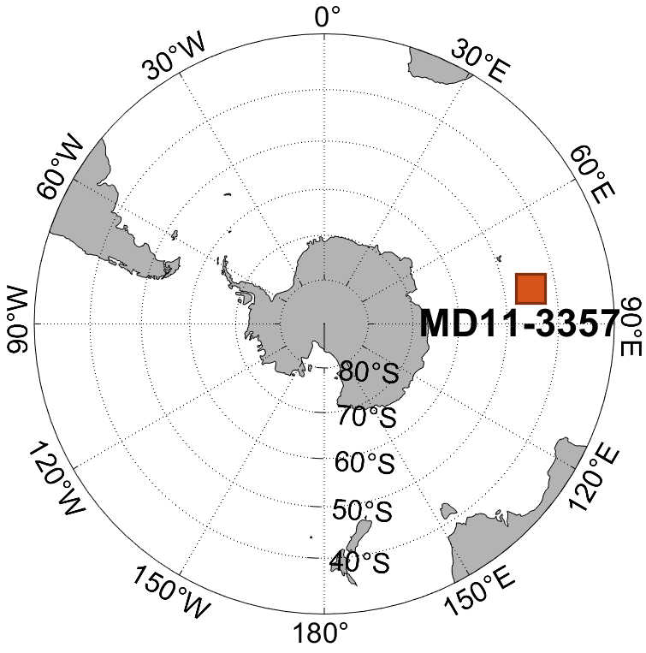
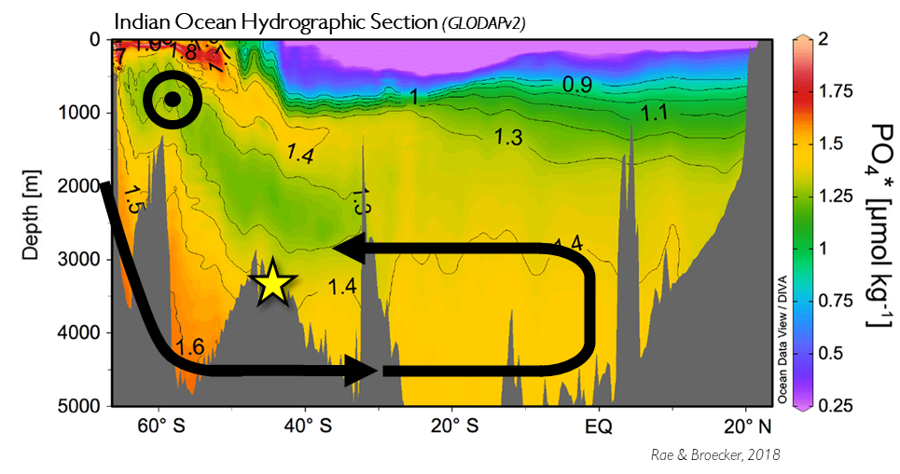
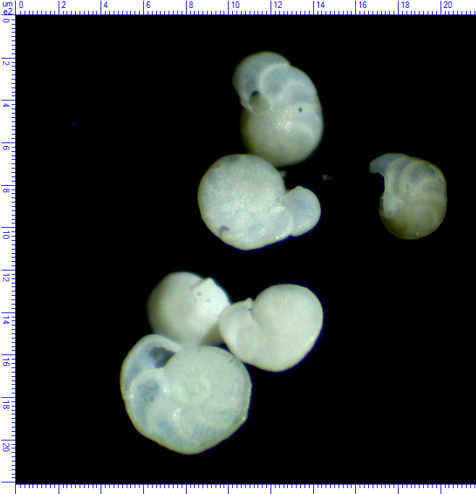
New proxy record documents unprecedented covariation between atmospheric and oceanic carbon
Last Glacial Cycle: 120ka - present
Sediment core site MD11-3357
Indian-sector Subantarctic Zone (~45°S), ~3300 m depth
Conservative water mass tracer PO₄³⁻* (“phosphate-star”)
PO₄* at γ_{n} = 28.0 (averages ~2500m in basins)
Benthic foraminifera B/Ca data
Rae & Broecker, 2018
Shankle et al., in prep
Benthic foraminifera: C. wuellerstorfi (M. Shankle)
Proxy data: deep-ocean C N. Pacific ventilation N. Atlantic cooling Slide 4/18 mgs23@st-andrews.ac.uk
Notes:
Alright, so you’ll be able to follow that outline along the bottom here, and starting with the proxy record. We have a new record that beautifully documents this covariation between atmospheric and oceanic carbon content. [3:45] [now start MD11 timing]
And, here it is. So we’re looking at just the Last Glacial Cycle here, which commenced about 120 thousand years ago with CO2 reaching its minimum about 20 thousand years ago, before coming back up to modern levels. So we have the ice-core CO2 record on top, and on the bottom is my data, documenting the DIC or carbon concentration of deep waters from a Southern Ocean site over this time.
So we see this clear correlation where, as CO2 declines out of the atmosphere – it’s gradually accumulating in these deep waters. And this is a pattern we see not only over the whole of the glacial cycle, but we even see peaks in carbon storage in response to shorter-lived periods of low or declining CO2, such as Marine Isotope Stages 2, 4, and 5 b, and d.
Now let me situate this site and what it represents a little bit better. Here is a modern map of the phosphate star water mass tracer at the depth of our site, and here is a depth section of it up the Indian basin.
So we can see that our site is not quite sitting in these red, high-PO4 star, Antarctic-sourced bottom waters. Instead, it’s sitting in these more yellow-y, intermediate-valued waters which are just the result of some mixing with lower-PO4* Atlantic waters.
But the significant thing here, is these yellow-ish waters that our site sits in characterize a majority of the Indo-Pacific basin, both in area and depth space. So we’re really lucky to have been able to reconstruct the carbon content of these waters, thanks to this site, because we can now scale that up… So by roughly estimating the volume, filled by waters of such carbon content, we can make an estimate of the total mass of carbon stored in the basin.
Now today, we know that such waters fill up to about 1000m depth. But, this is harder to say back in the ice ages, so what we do is account for a range of depth scenarios. Did these waters only fill up to 3000m depth or 2000. And this of course gives different potential volumes filled by such waters.
So what I’ll show next, is…

Slide 5
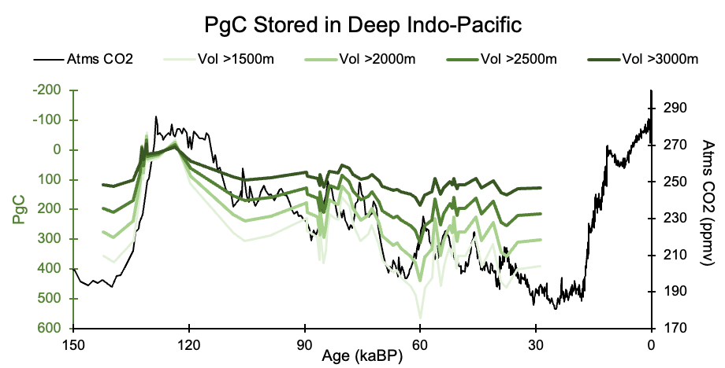
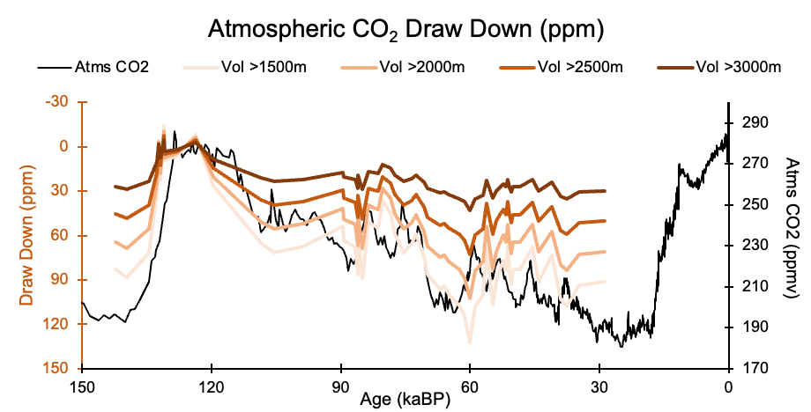
Total Carbon (PgC and ppm equivalent)
Depending on volume…
Anywhere from ~100-300 PgC stored in Indo-Pacific basin
(Pre-industrial atmosphere: ~600 PgC)
Rae & Broecker, 2018
+
Or, ~30-60ppm drawdown
(Actual glacial atmospheric CO₂ draw down: ~80-100 ppm)
Shankle et al., in prep
Proxy data: deep-ocean C N. Pacific ventilation N. Atlantic cooling Slide 5/18 mgs23@st-andrews.ac.uk
Notes:
… the total mass of carbon over time, coming out of multiplying this concentration by the different volume scenarios [2:47] [6:23 total]
So, I’ve inverted this green y-axis here, and you can see, by the deepest point of the ice age, we could've reached anywhere from 100-300 PgC being stored in these waters.
And, if I convert that mass into an equivalent change in the atmosphere, we’re looking at a drawdown of 30-60 ppm, which is a large portion of the actual drawdown.
So, that wraps up this section, definitely a rough and ready estimate, sweeping a range of scenarios, but we're gonna work on refining this, and what this data does show is first, this very clear uptake of carbon by the deep ocean, and second, it demonstrates the Indo-Pacific was an substantial reservoir for this carbon.
[3:40] (intro and md11 = 3:45 + 3:40 == 7:25) [7:14 total]

Slide 6
Outline: S.O.’s role in glacial CO₂ change
Document and quantify deep ocean carbon
(1) New proxy record: tight coupling between atmospheric and deep-ocean carbon
Understand driving processes behind it
Northern-Southern Hemisphere connections: remote regions influencing S.O. processes.
(2) N. Pacific ventilation (glacial proxy data) → reduces carbon load of upwelling S.O. waters, reducing outgassing (intermediate-complexity Earth system models)
(3) N. Atlantic cooling → glacial-like changes in S.O., atms. CO₂ (idealized model)
Proxy data: deep-ocean C N. Pacific ventilation N. Atlantic cooling Slide 6/18 mgs23@st-andrews.ac.uk
Notes:
So moving on to the next section, …

Slide 7
Outline: S.O.’s role in glacial CO₂ change
Document and quantify deep ocean carbon
(1) New proxy record: tight coupling between atmospheric and deep-ocean carbon
Understand driving processes behind it
Northern-Southern Hemisphere connections: remote regions influencing S.O. processes.
(2) N. Pacific ventilation (glacial proxy data) → reduces carbon load of upwelling S.O. waters, reducing outgassing (intermediate-complexity Earth system models)
(3) N. Atlantic cooling → glacial-like changes in S.O., atms. CO₂ (idealized model)
Proxy data: deep-ocean C N. Pacific ventilation N. Atlantic cooling Slide 7/18 mgs23@st-andrews.ac.uk
Notes:
So moving on to the next section, … I’ll now discuss PROCESSES driving CO2 change,
again actually focusing on remote regions that influence southern ocean conditions.
So we’re gonna talk first about
- the North Pacific,
- how it was better ventilated in glacial times,
- and what this did to S.O. outgassing. [0:21] + 7:25 == 7:46
[7:37 total]

Slide 8
(Today) Poorly-ventilated N. Pacific dominates carbon supply to Southern Ocean outgassing
Modern-day global ocean carbon content
PCO₂ = “potential pCO₂” (corrects for compressive effects with depth)
Δ = in excess of a 400 μatm atmosphere
== Outgassing potential at surface
Present-day outgassing
Ice ages…
A net source of natural/oceanic carbon to the atmosphere!
(Is a net sink for anthropogenic carbon, but irrelevant to ice ages)
Reduced physical delivery to surface?
Outgassing
(+) Carbon
Reduced carbon content?
IPDW
NADW
Chen et al., 2022
BGC Argo float data
Well-ventilated; relatively young; low carbon
Poorly-ventilated; old; carbon-rich
Chen et al., 2022
GLODAPv2
See also Prend et al., 2022
Proxy data: deep-ocean C N. Pacific ventilation N. Atlantic cooling Slide 8/18 mgs23@st-andrews.ac.uk
Notes:
[0:00] So let’s start in the present-day.
[click] Today, the Southern Ocean represents a leak, of carbon to the atmosphere from, upwelling deep waters. !! And note that I am neglecting anthropogenic carbon here, which the Southern Ocean is a net sink of, but that’s of course not relevant to the ice ages.
So, what we also know is that the carbon supplying this outgassing mainly comes from the Indo and especially Pacific basins. !! So this figure is now showing PCO2, expressed in terms of an EXCESS, beyond a 400 ppm atmosphere.
~~~So this shows the outgassing potential of various waters, should they come in contact with the surface. !!
And we can see, these Indo-Pacific waters feeding the Southern Ocean supply a lot more carbon than the Atlantic waters.
Now, this difference in carbon is largely a factor of circulation. The Atlantic is very well-ventilated, with deep water formation and overturning, pumping down and filling the basin with carbon-poor, subtropical surface waters.
~~~And in contrast, the North Pacific is isolated from the surface by a strong halocline, and these waters mainly form by slow, interior diffusive processes.
~~~So much more carbon has accumulated here, which crucially largely escapes through the Southern Ocean.
Now in terms of the ice ages, a lot of work has been done on how to STEM this leak, and this is something evidenced by proxy data – a reduced C load in the Southern Ocean surface.
But, thus far, most explanations have relied on physical processes, citing either reduced upwelling or enhanced surface stratification, to reduce that carbon outgassing. But another possibility, that hasn’t been considered, is what if the carbon content of the upwelling water itself was reduced. This is the idea I’ll explore here.
[2:10]xxx
[9:46] total

Slide 9
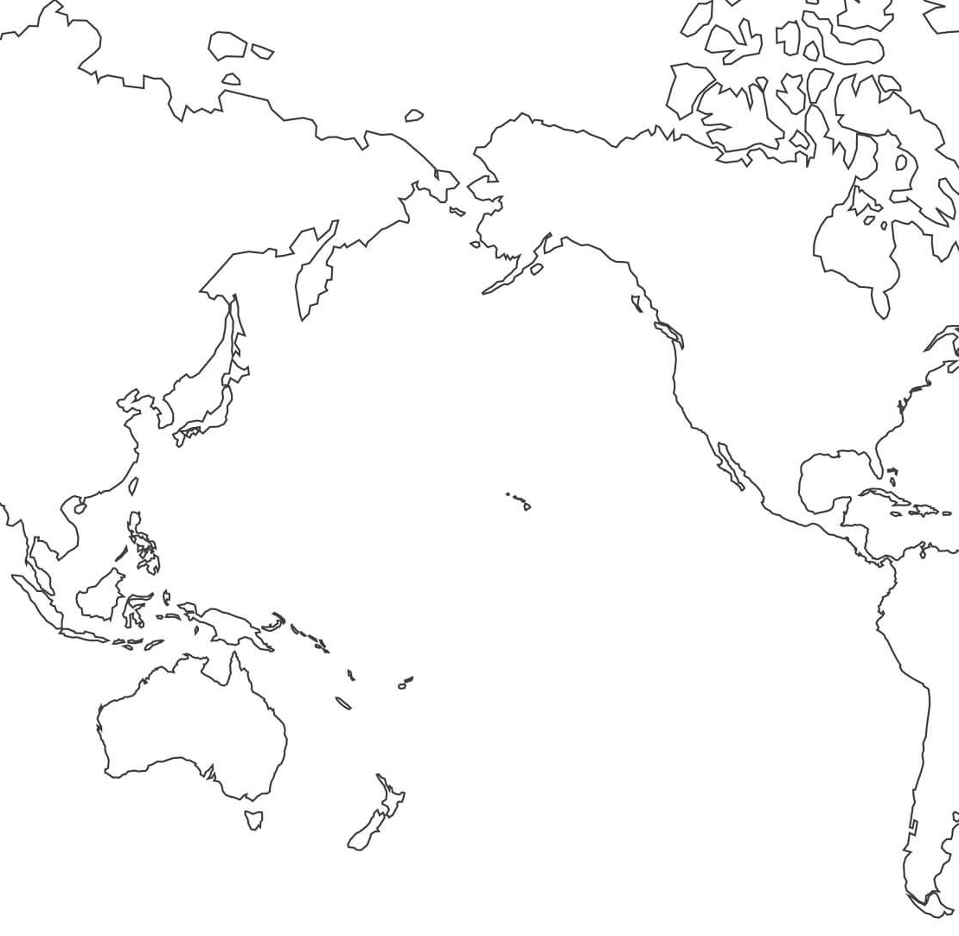
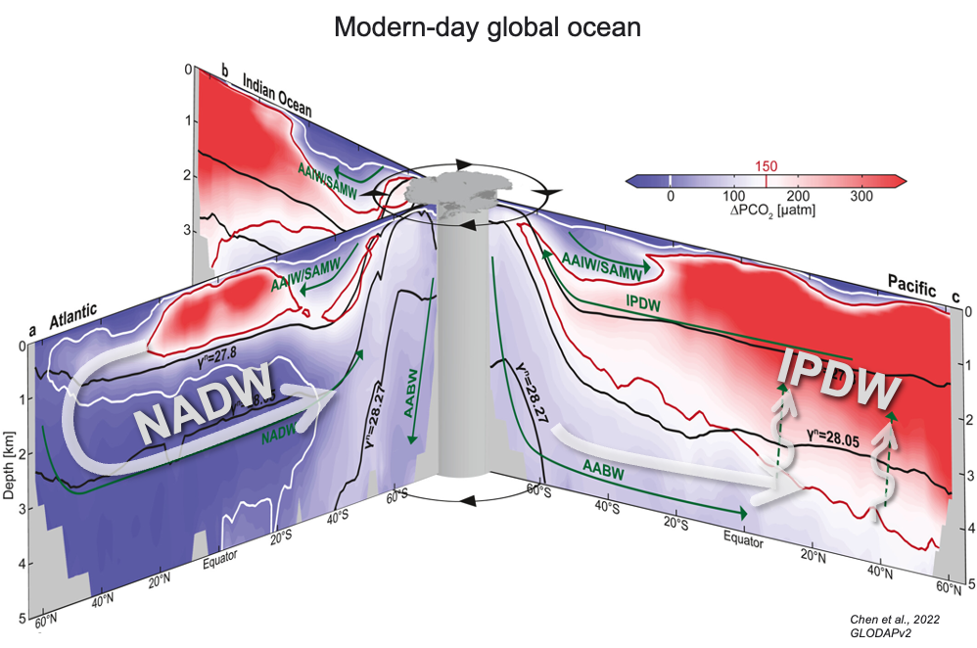
A better-ventilated N. Pacific at Last Glacial Maximum
(“LGM”, 19-23 kyr ago)
Modern-day
(depicting all sediment core sites north of 20°N)
Atlantic:
Ventilated
Carbon-poor
Pacific:
Poorly-ventilated
Carbon-rich – reduced in ice ages?
Better ventilated glacial waters…
…also carbon-poor?
(relative to modern)
Rae et al., 2020
Proxy data: deep-ocean C N. Pacific ventilation N. Atlantic cooling Slide 9/18 mgs23@st-andrews.ac.uk
Notes:
So with that in mind, lets now look at the GLACIAL North Pacific.
Well, in contrast to today, proxy data indicates the North Pacific was BETTER ventilated during glacial periods.
So this figure ~~~compiles data from all available sediment cores north of 20 degrees, and it’s also compiling three different proxies of ventilation.
And what ~~~emerges, is this clear signal of better ventilation in glacial times both across the basin, and down to about 2000 m depth.
~~~ So with this better ventilation, it begs the question – are we looking at, in the ice age, a more, Atlantic-like regime [CLICK] with well-ventilated and carbon-poor waters coming down and filling the basin? And furthermore, what downstream impacts would that have on the Southern Ocean?
So this prompted us to look at, glacial-like model simulations that ~have a well-ventilated North Pacific. [1:08 this slide] [3:16]
[10:57] total

Slide 10
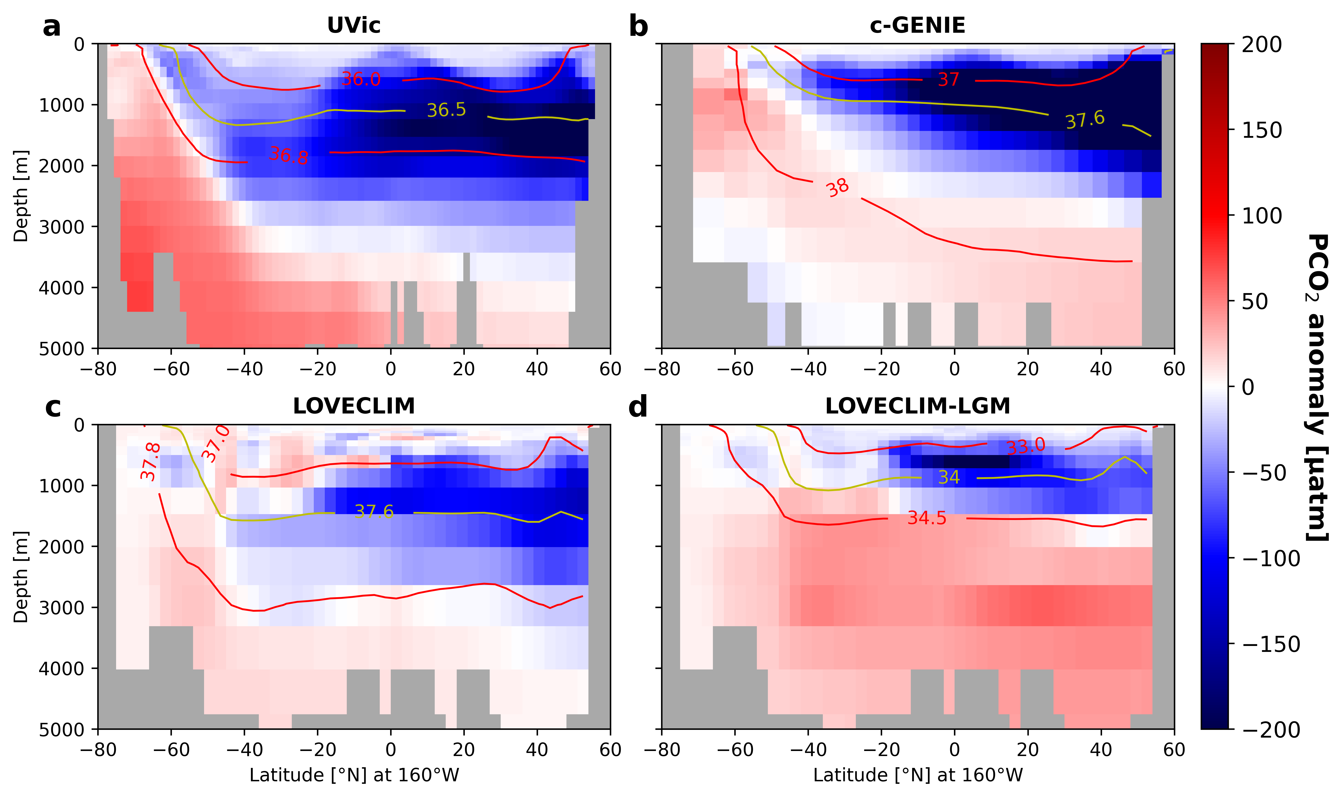
Glacial-like Earth System Model Simulations with a Well-Ventilated N. Pacific
Various intermediate-complexity ESMs
Glacial-like boundary conditions
Either with (ventilated) or without (control) North Pacific ventilation
Perturbed freshwater forcing degrades N. Pacific halocline, initiates convection and overturning (proxy data supports)
Anomaly: Ventilated – Control
Carbon (PCO₂) Anomaly
UVic
C-GENIE
E.g. Pacific Meridional Overturning Stream Function
LOVECLIM
LOVECLIM LGM-OT
UVic, LOVECLIM: ~12-15 Sv
c-GENIE: ~12 Sv
LOVECLIM-LGM: ~5 Sv
(Menviel et al., 2014; Rae et al., 2020; Menviel et al., 2017)
Proxy data: deep-ocean C N. Pacific ventilation N. Atlantic cooling Slide 10/18 mgs23@st-andrews.ac.uk
Notes:
So I've compiled a few different models here,
and ~~the consistent signal we get is that – if you simply compare two, glacial-like simulations, either WITH or WITHOUT North Pacific ventilation imposed –
we see that such ventilation majorly reduces the carbon content of these mid-depth waters. So these are depth transects up and down the Pacific, with each panel depicting a different model.
Now I chose these simulations because they all trigger ventilation the same way[click]— they all essentially break down the North Pacific halocline through freshwater forcing, which leads to convection and overturning, as shown here.
~~So we can see that ventilation is very effective at reducing the carbon content of these waters, again, replacing those previously old, diffusively-formed waters with now younger, carbon-poor water from the surface.
~~ Now what’s exciting is that this signal makes its way south, mainly diffusively along these isopycnals, and upwells in the Southern Ocean, where it impacts outgassing.
[12:15] total
XXXX
x x x - Alright, so we can see that this is a really effective way of reducing the carbon content of these waters. And what happens is, we have initial, transient response of that North Pacific carbon being first ventilated to the atmosphere, but within a few centuries we have this new regime where the basin is now being filled…
there is an initial transient response where the C we previously had is lost to the atms, but what happens after 1000 years...
just to confirm this (for later slide) leads to net ingassing/reduced outgassing

Slide 11
The effect of N. Pacific ventilation on Southern Ocean
Ice ages…
Outgassing
(+) Carbon
IPDW
NADW
~51% reduction in net S.O. outgassing relative to control
Proxy data: deep-ocean C N. Pacific ventilation N. Atlantic cooling Slide 11/18 mgs23@st-andrews.ac.uk
Notes:
So we can see here, that yes, this negative carbon anomaly outcrops very strongly in the Southern Ocean and drives major reductions in outgassing.
- Alright so that was another, whistle-stop tour of an entire chapter of my thesis,
- but the summary is, we’ve shown how this LEAK of carbon to the atmosphere could’ve been mitigated by ventilation of the North Pacific which reduces the carbon content of the supplying mid-depth waters.
Now, moving on to our final section [5:04]
[12:50] total (<5 min for final section)
TEXT GRAVEYARD
Now I’ll just end on a note here, I’m not showing global maps, but while there are evidently some compensating changes in outgassing elsewhere, in the global integral they ARE outpaced by these Southern Ocean reductions. However, for details that I won’t go into, we can’t easily interpret Atlantic changes in this set of simulations, so we limit our interpretation to just the Pacific and Southern Ocean sectors. [0:38 with opening line]
So we see this negative carbon anomaly outcropping very strongly in the Southern Ocean surface, resulting in major reductions in outgassing.
And I'll also point out, in these simulations, there is no reduction in upwelling or enhanced stratification, reducing the physical delivery of water up from depth. This surface anomaly is completely coming from the reduced carbon content of the supplying waters, due to ventilation.
So in a global integral, shown here as a function of latitude, we can see that outgassing rates are REDUCED in the ventilated simulation (in the orange line) in key regions of outgassing like the Southern Ocean and Equatorial latitudes, and regions of ingassing, given by negative values on this graph, are strengthened. So even in a global sense it's a net reduction.
X X X
maybe now include "in a global context" (tho cautious not to over interpret b/c lots of things going on in these simulations)
latitudinal flux, in global sense, (not just offset by changes else, global signal of reduced outgassing in the net)

Slide 12
Outline: S.O.’s role in glacial CO₂ change
Document and quantify deep ocean carbon
(1) New proxy record: tight coupling between atmospheric and deep-ocean carbon
Understand driving processes behind it
Northern-Southern Hemisphere connections: remote regions influencing S.O. processes.
(2) N. Pacific ventilation (glacial proxy data) → reduces carbon load of upwelling S.O. waters, reducing outgassing (intermediate-complexity Earth system models)
(3) N. Atlantic cooling → glacial-like changes in S.O., atms. CO₂ (idealized model)
Proxy data: deep-ocean C N. Pacific ventilation N. Atlantic cooling Slide 12/18 mgs23@st-andrews.ac.uk
Notes:
Now, moving on to our final section [12:50] total (<5 min for final section)

Slide 13
Outline: S.O.’s role in glacial CO₂ change
Document and quantify deep ocean carbon
(1) New proxy record: tight coupling between atmospheric and deep-ocean carbon
Understand driving processes behind it
Northern-Southern Hemisphere connections: remote regions influencing S.O. processes.
(2) N. Pacific ventilation (glacial proxy data) → reduces carbon load of upwelling S.O. waters, reducing outgassing (intermediate-complexity Earth system models)
(3) N. Atlantic cooling → glacial-like changes in S.O., atms. CO₂ (idealized model)
Proxy data: deep-ocean C N. Pacific ventilation N. Atlantic cooling Slide 13/18 mgs23@st-andrews.ac.uk
Notes:
Now, moving on to our final section [12:50] total (<5 min for final section)
I’ll demonstrate the importance of the North Atlantic, showing how cooling in this region, can, on its own kick off Southern Ocean processes impacting CO2
[13:01] total

Slide 14
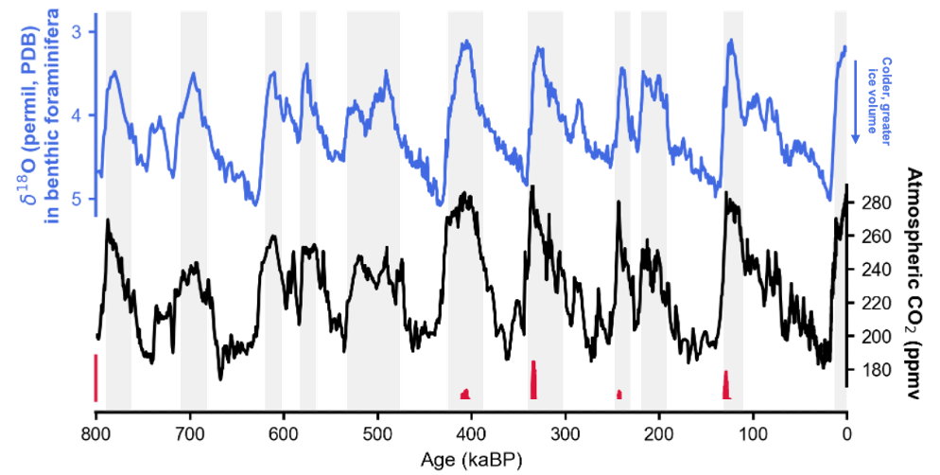
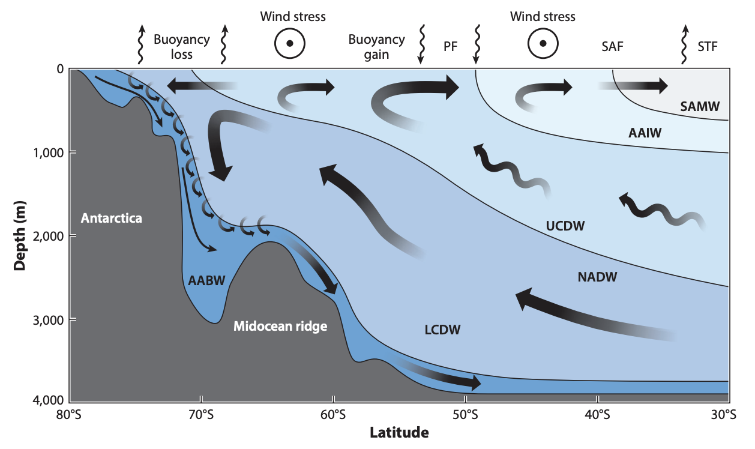
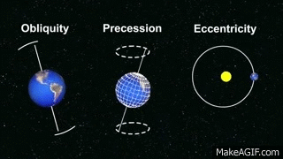
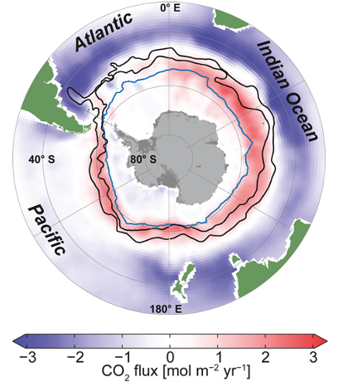
N. Hemisphere pacing… S. Hemisphere carbon cycling?
Northern Hemisphere ice sheets…
à la Gildor & Tziperman, 2001 (6-box ocean + atmos + ice sheets + sea ice)
Brine rejection, altering S.O. circulation, deep ocean stratification
CO₂ capping .
Sci Tech Daily; Based on Coulson et al. (2021, GRL)
…Southern Hemisphere carbon cycling?
Orbital “Milankovitch” Cycles
Total incoming insolation (W/m²) negligibly affected
Rather impact latitudinal distribution & seasonality of the incoming energy (cooler Northern summers == ice sheets don’t melt back, can grow very large)
youtube.com/watch?v=OWXoRSIxyIU
~41,000 yr
~21,000 yr
~125,000 & 400,000 yr
Gent, 2016
Chen et al., 2022
Proxy data: deep-ocean C N. Pacific ventilation N. Atlantic cooling Slide 14/18 mgs23@st-andrews.ac.uk
Notes:
Now, one thing I skipped in my Intro slide, is that the timing of the ice ages - each decline down into glacial conditions – paced by these regular variations in Earth’s orbit known as Milankovitch cycles.
But rather than altering the total solar insolation received by the planet; they more impact the latitudinal distribution and seasonality of that incoming energy. And as a result, they are primarily important for initiating the growth of Northern Hemisphere ice sheets.
But an ice sheet on its own doesn’t draw down CO2. Instead, many of the processes understood to drive glacial carbon cycling are hosted in the far-flung SOuthern Ocean, as we’ve discussed. So the question is, what is the link? What about the growth and decay Northern Hemisphere ice sheets, would kick into gear the Southern Ocean changes and processes important to carbon? [1:03 this slide so far]
Well, one hypothesis is that the growth of an ice sheet, kicked off by orbital forcing, would cool the water around it, and in particular North Atlantic Deep Water formed here and making its way to the Southern Ocean. And this anomalously cold water in turn would promote sea ice growth, with knock-on effects on outgassing, Southern Ocean circulation, and deep ocean stratification.
Now Gildor and Tziperman originally demonstrated this working in a coupled box model, but I’ve now revisited this idea in a set of idealized model simulations.
[1:40] this slide

Slide 15
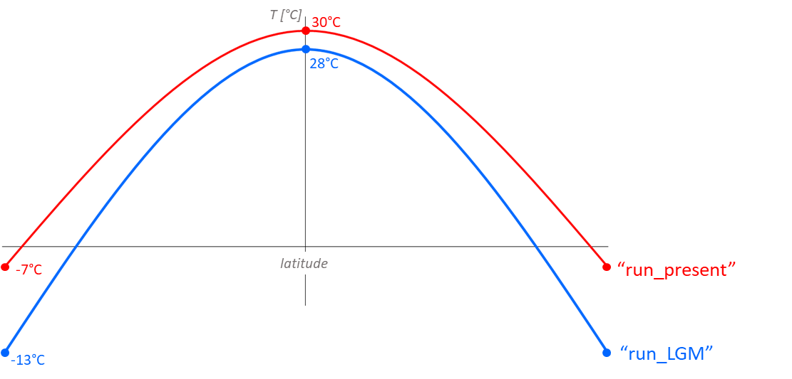
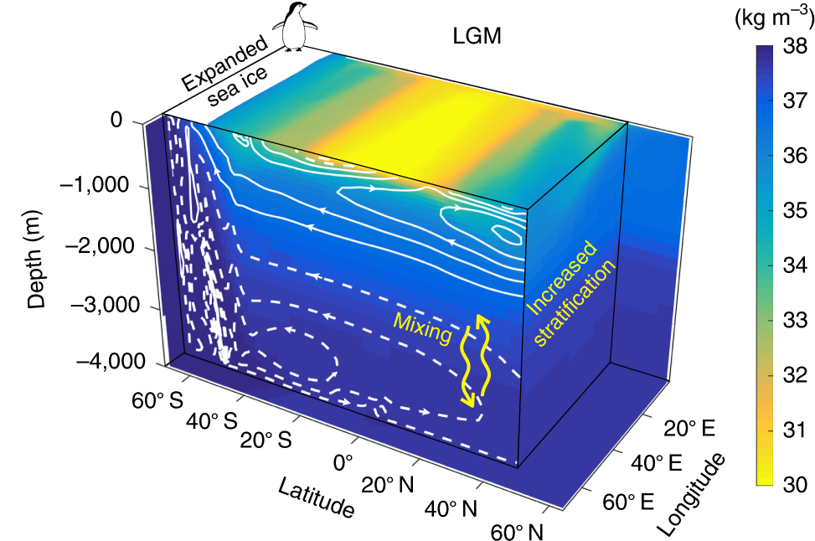
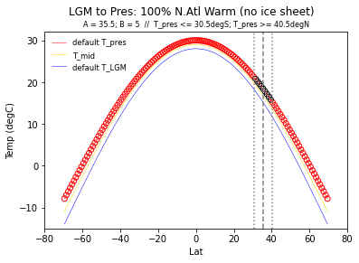
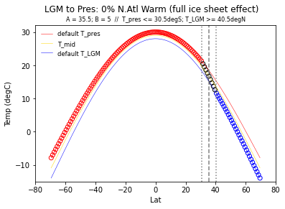
Study design: idealized simulations of N. Atl. cooling
∆ – 2°C
MITgcm (Marzocchi & Jansen, 2019)
Single basin, southern re-entrant channel
1º x 1º resolution, 29 depth levels
Coupled ocean, sea ice, biogeochemistry (+ well-mixed atmospheric box)
Forcing: 2m air temperature
Glacial- and interglacial-like latitudinal profiles →
∆ – 6°C
Example: equilibrated glacial-like state
Interglacial (Reference)
Cool North Lats (Experiment)
Potential density (color); overturning (contours)
Shallower AMOC, stratified AABW cell.
Marzocchi & Jansen (2019)
Proxy data: deep-ocean C N. Pacific ventilation N. Atlantic cooling Slide 15/18 mgs23@st-andrews.ac.uk
Notes:
So here I’m using an idealized configuration of the MITgcm model, which was originally used by Marzocchi and Jansen 2019. And what this study found was that a, simple, cooling of global air temperatures, was on its own able to recreate many important features of glacial ocean circulation, such as a shallower AMOC and more isolated stratified AABW cell (talk C if have time, 0:28)
So we then took this model and said, well what if we only cool, the northern latitudes? How many of those glacial-like changes would emerge from that?
[click] So rather than simulate the ice sheet ITSELF - which would also impact winds and albedo and other parts of the climate - we're actually able to test the Gildor and Tziperman hypothesis, very specifically here, as we're isolating and only simulating the cooling effect an ice sheet would have on this region of north Atlantic deep water formation.
So I ran the model under these two forcings, and will now compare their equilibrated states, and see whether this northern cooling impacts Southern Ocean and deep ocean circulation.
[1:20]
TEXT GRAVEYARD
Also winds, radiation, precipitation, etc. (all kept at interglacial)
... this does make a good simple test of the Gildor and Tziperman hypothesis, by specifically testing that cooling effect.
...we ARE simulating
So note that there’s no ice sheet as part of this model, but we can still test our question by saying, ok, well what if we only cool the northern latitudes? How many of those glacial-like changes would emerge from that?
can re-create many of the major features of glacial ocean circulation and particularly, features typically associated with CO2 drawdown. So these include a shallower AMOC and more isolated Antarctic Bottom Water through both enhanced stratification and reduced air-sea gas exchange, both of which were notably associated with enhanced sea ice formation).
And then finally, in their 2019 study, Alice and Malte coupled this physical model to a biogeochemical model and found these changes resulting in substantially increased DIC concentrations in the deep ocean as well as a lowering atmospheric CO2 by about 40 ppm.

Slide 16
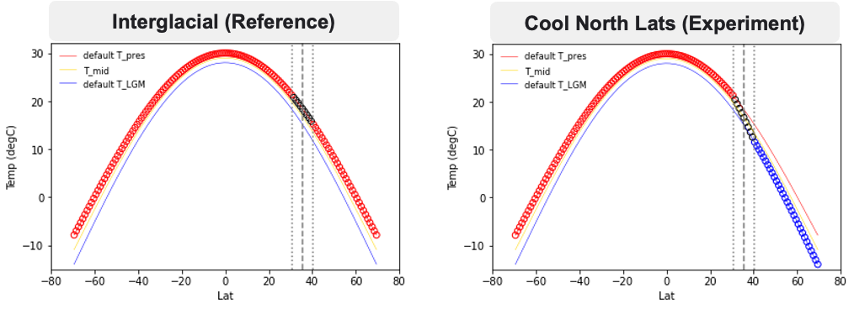
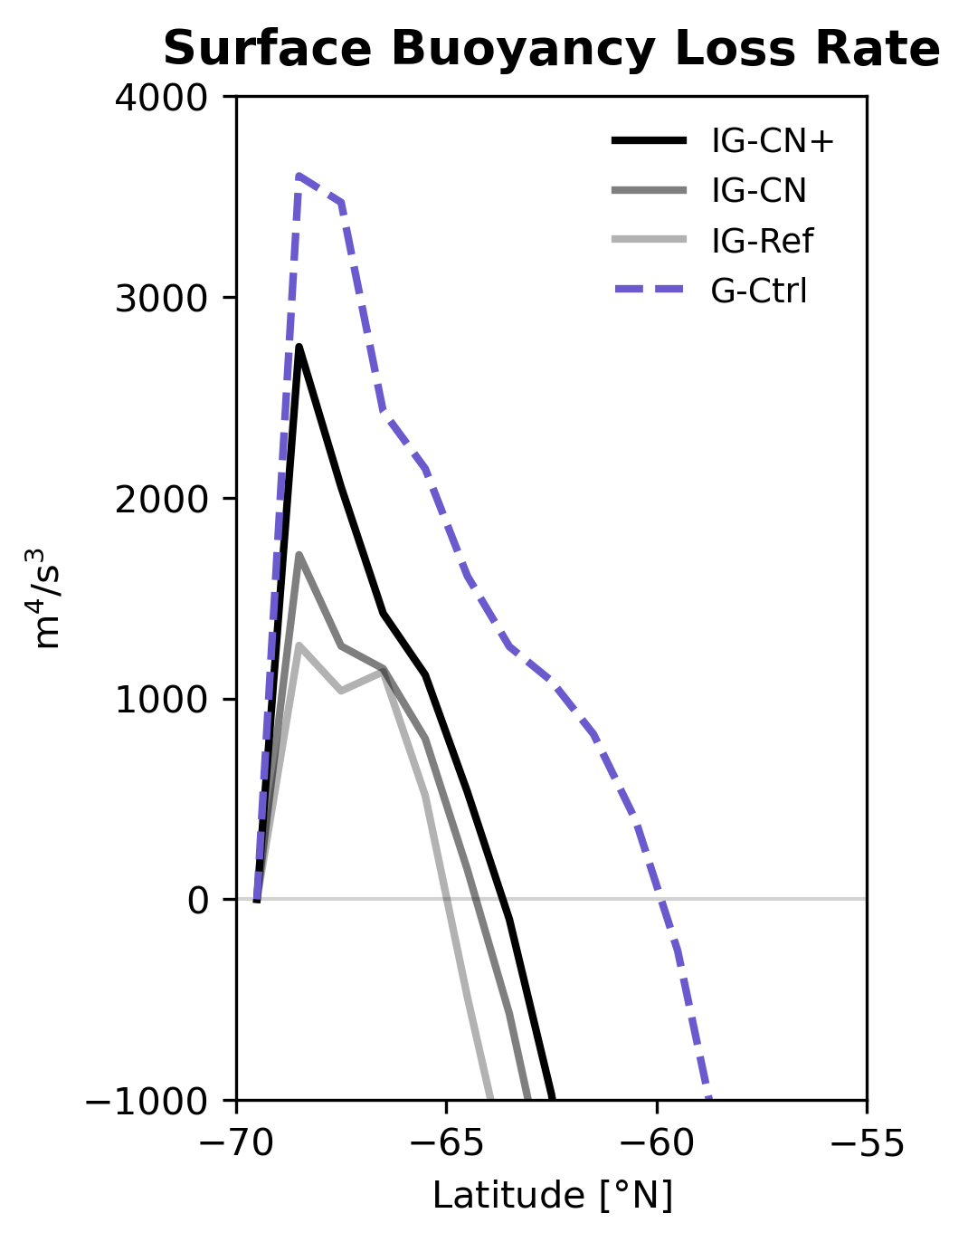
Glacial-like changes in re: Northern cooling
Temperature Anomaly:
Cool-North – Reference
Surface Buoyancy Flux
(+ == denser)
Sea Ice Load (kg/m²) (zonal-mean)
Glacial simulation
Brine rejection, etc.
Effect of increasingly cooling the N latitudes
Zonal-average, after 10,000 years simulation time
Proxy data: deep-ocean C N. Pacific ventilation N. Atlantic cooling Slide 16/18 mgs23@st-andrews.ac.uk
Notes:
Now, there’s loads of results I could show, but I’ll stick with the highlights. So starting with ocean temperature,
We find that cooling air temperature at ~only these high latitudes, is actually very effective at cooling the global ocean. So that cold signal translates into the ocean very well at these high latitudes, and is then taken up by North Atlantic Deep Water which you can see here, with downstream effects on the rest of the basin.
You can also see this cold anomaly coming up in the Southern Ocean, so the question is, does this promote sea ice growth? Well yes it does. We can see that it increases the mass of sea ice in the Southern Ocean, back towards glacial-like levels. And there is associated brine rejection and freshwater export that contribute to surface buoyancy transformations, which will impact both Southern Ocean circulation and downstream bottom waters. [1:00]
Now these circulation changes and others I’m not showing are important because they promote the storage of carbon in the ocean...
[1:11] this slide
TEXT GRAVEYARD
This is this zonally-averaged temperature anomaly up and down our basin
So the zonally-averaged temperature anomalies shows major cooling in response to these cooled northern latitudes.

Slide 17
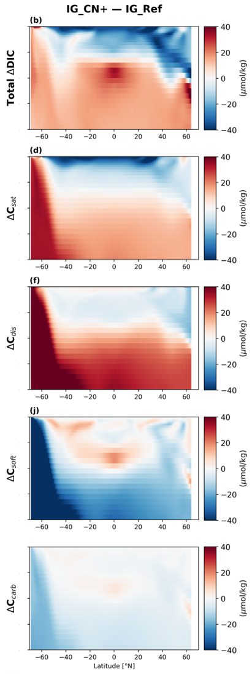
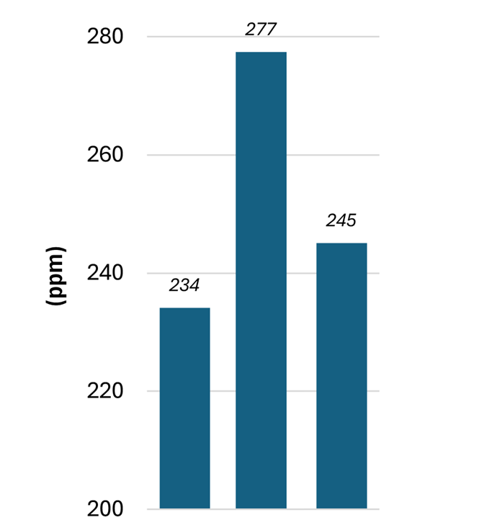
Glacial-like changes in re: Northern cooling
DIC Anomaly
∆DIC (total)
Equilibrated Atms. CO₂ Levels
These circulation changes induced by cool northern latitudes promotes accumulation of carbon in the deep ocean
Mainly achieved through solubility and disequilibrium effects
Cooler bottom waters, increased CO₂ solubility
Sea ice capping promoting disequilibrium
Cooling northern latitudes achieves nearly same CO₂ drawdown (-32 ppm) as full glacial cooling (-43 ppm)
Interglacial simulation
∆ saturated carbon
Simulation only cooling N. lats!
∆ diseqb. carbon
Full glacial simulation
∆ soft-tissue carbon
∆ hard-tissue carbon
Proxy data: deep-ocean C N. Pacific ventilation N. Atlantic cooling Slide 17/18 mgs23@st-andrews.ac.uk
Notes:
(Now these circulation changes and others I’m not showing are important because they promote the storage of carbon in the ocean... ).
Deep waters store much more carbon, is mainly achieved through a combination of solubility and disequilibrium effects, being only ~slightly offset by changes in biological carbon. But overall, this increases the ocean’s net carbon content, meaning it has absorbed significant amount of carbon from the atmosphere. And indeed, So the big result of this study here is that, cooling northern latitudes alone achieves nearly the same magnitude of CO2 drawdown as a full glacial simulation, run under glacial temperatures everywhere.
So you can see, with cool temperatures applied everywhere, atmospheric CO2 drops by about 40 ppm, and, our simulation where we’ve only cooled the North, gets a large part of the way there. So in my mind, this demonstrates the validity of the Gildor and Tziperman hypothesis and the large role, cooling northern waters may have on canonical Southern Ocean glacial changes.
…So with that, I’ll leave you with my summary slide and thank you for listening and for your questions.
[1:10+?]
TEXT GRAVEYARD
So you can see these deep waters holding much more carbon, and this is mainly achieved through a combination of solubility and disequilibrium effects, with only slight in biological carbon. But in the net, the total mass of carbon held in the ocean is increased, which means it has taken up significant amounts of carbon from the atmosphere. The key finding here is that cooling just the northern latitudes can draw down nearly as much CO2 as a full glacial simulation, run under glacial temperatures everywhere.
So more carbon is stored in the ocean…
But of course, what's especially significant about this process is its impact on atmospheric CO₂ — as more carbon gets stored in the ocean, less remains in the atmosphere
And of course, with more carbon being held in the ocean, this means it must have drawn it down from the atmosphere, and the big result of this study here is that, cooling northern latitudes alone achieves nearly the same magnitude of CO2 drawdown as a full glacial simulation, run under glacial temperatures everywhere.

Slide 18
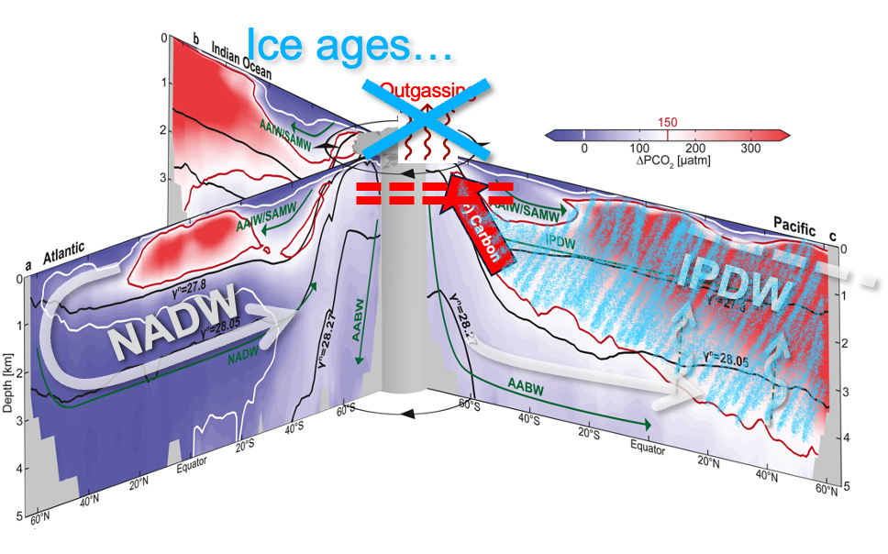
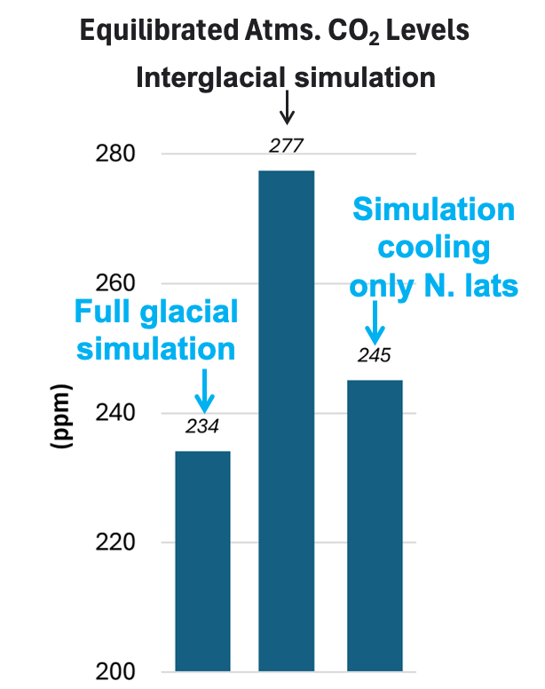
(2) A well-ventilated glacial North Pacific reduces S.O. outgassing
(1) Documenting deep-ocean carbon storage
(3) Cool N. Atlantic impacts S.O., reduces atms. CO₂
Rae & Broecker, 2018
mgs23@st-andrews.ac.uk

