Slide 1




Theoretical-Deductive Content Analysis of Text as Data in Environmental Research
A research Paradigm
Vienna, 27 April–2 May 2025
Andreas Niekler, Taís Maria Nunes Carvalho, and Mariana Madruga de Brito

Slide 2


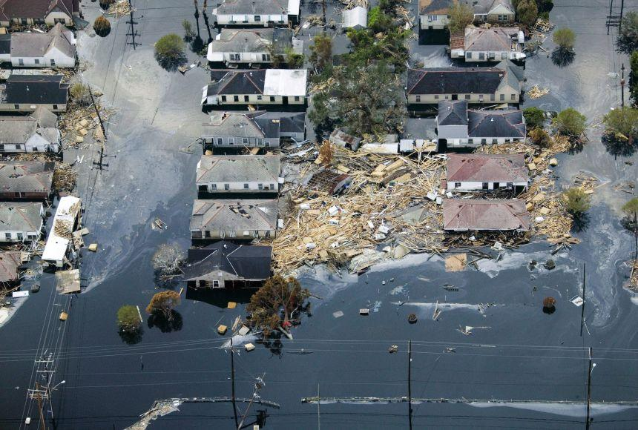
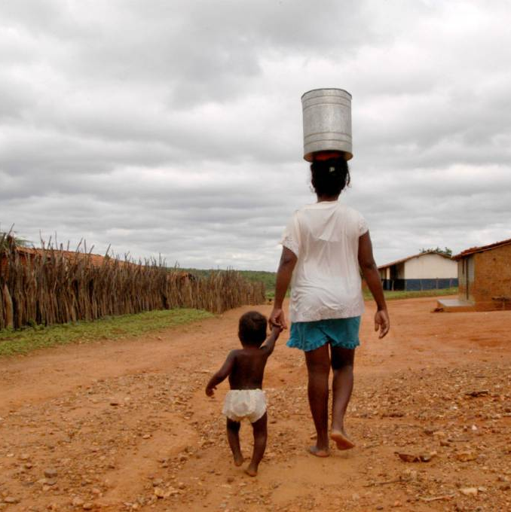
SUMMARY
Natural Language Processing (NLP) and Text Mining (TM) have undergone dramatic transformations.
We've witnessed a shift from reliance on experts and complex processes rooted in statistical feature-based Machine Learning Approaches to the utilization and ecosystem of Large Language Models.
Application of Text Mining is no longer limited to absolute experts; rather, highly accessible interfaces have opened its doors to scholars in various fields.
Notes:
The field of Natural Language Processing and Text Mining has transformed dramatically with the rise of Large Language Models,
moving from expert-only statistical methods to highly accessible interfaces.
This shift makes "Text as Data" increasingly vital for expanding evidence horizons, enabling big data pattern recognition, and facilitating the use of diverse textual sources (like reports and local media) to address global research bias and gain holistic understanding,
particularly for complex topics like climate extremes.
Latest research has shown that text sources like scientific publications have biases that can only be mitigated including other resorucres
This also have their own biases
Seeing all those developments and o´bersavions from other fields like computational social science or Digital Humanities
It is importent to put relevance to establised research paradigms in empirical research using text as data
In my talk i will present current understanding of theoretically driven deductive appraoches using automatted NLP methods, securing tranparency, intersubjectivity and validity of research
Aiming towards a practical understanding which will produce credible and trusful research using text as data
However, this increased accessibility underscores the critical need for maintaining scientific correctness, transparency, and ethical rigor when utilizing text as evidence.

Slide 3
OBJECTIVES AND CoNtribution
Objectives:
Raise awareness for scientific standards in text analysis using text as data.
Present established approaches for content & discourse analysis of heterogeneous text sources.
Contribution:
Emphasizing "Text as Data" for expanding empirical evidence.
Show reasons for scientific rigor, transparency, and ethics in text analysis.
Providing guidance on navigating text analysis operationalization.

