Slide 1
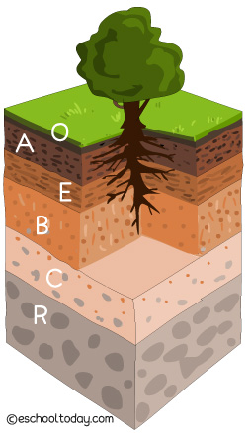
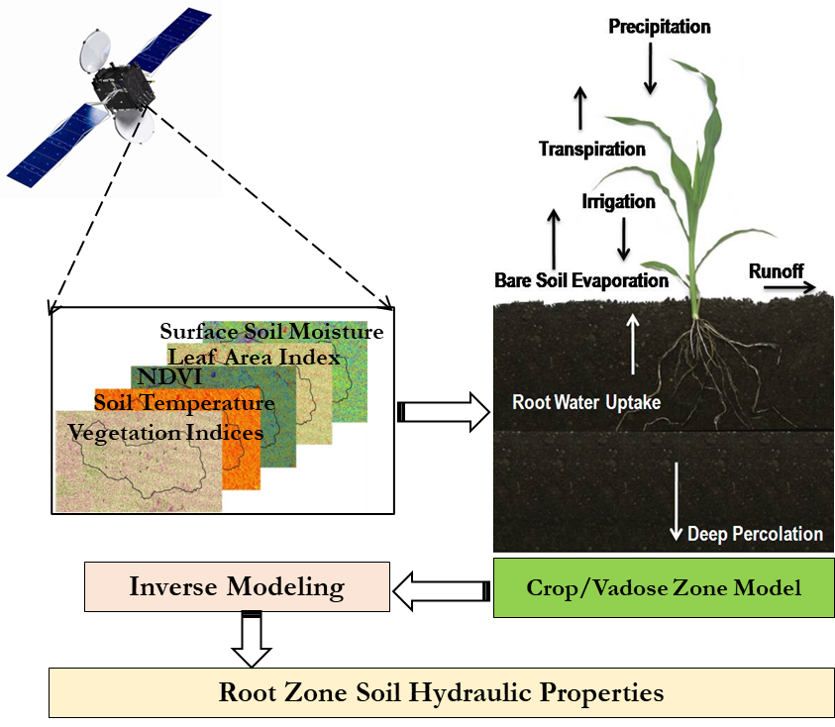
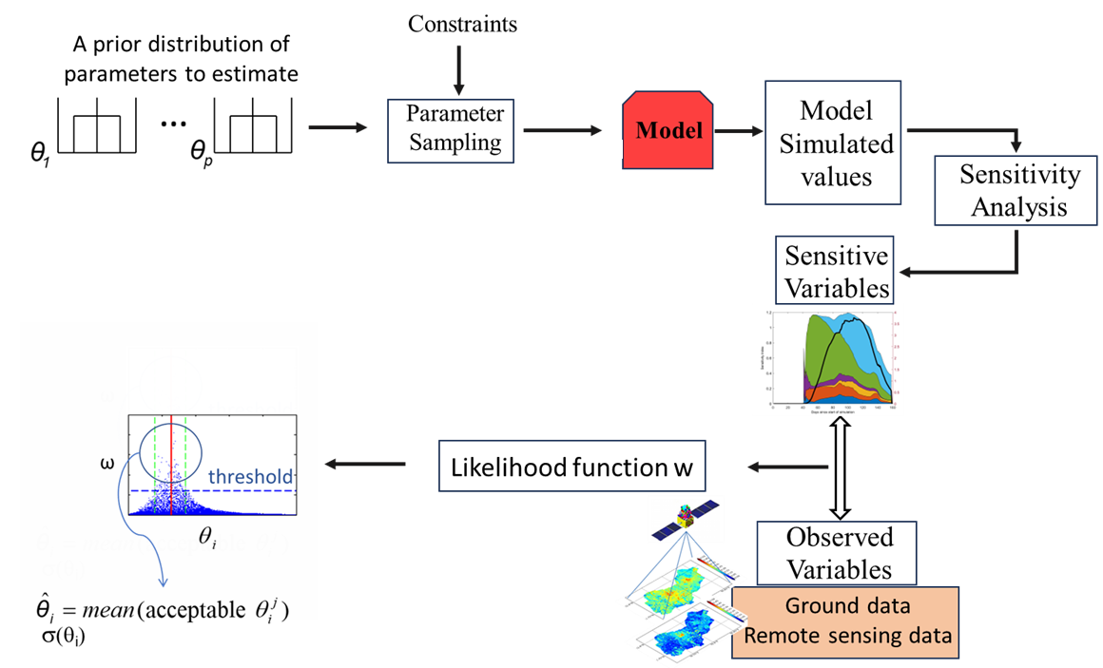
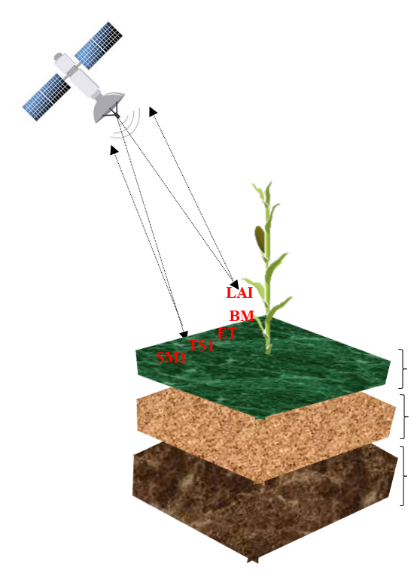
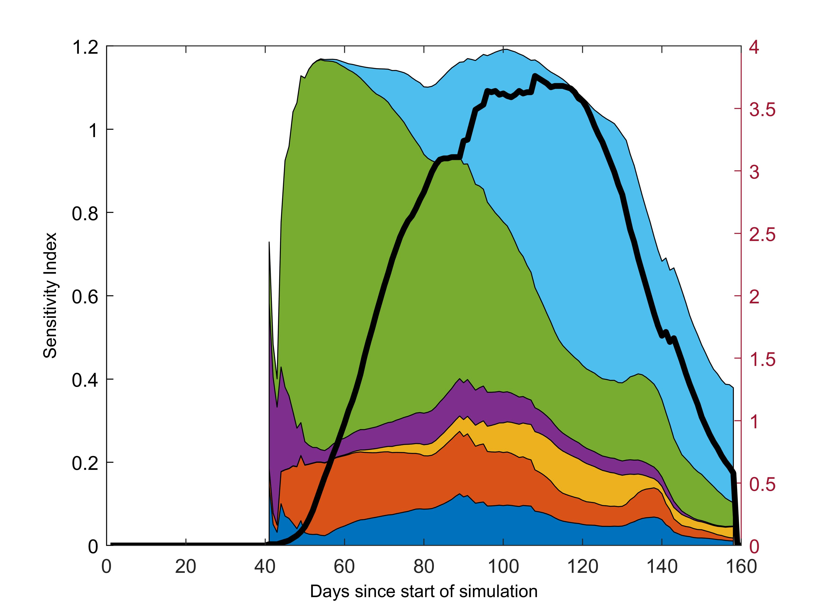
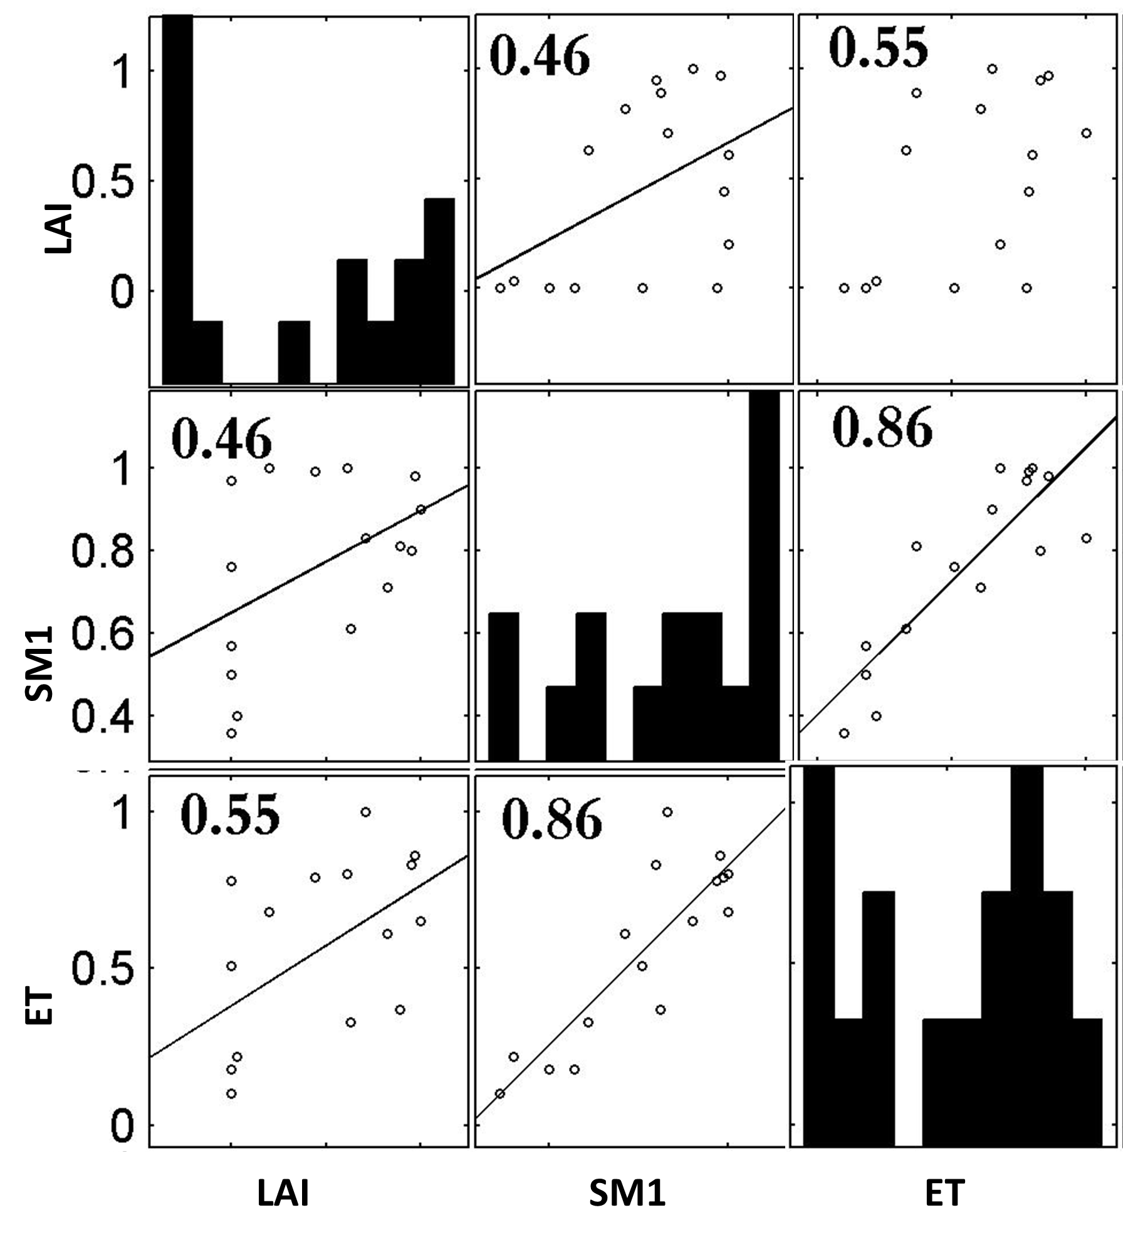
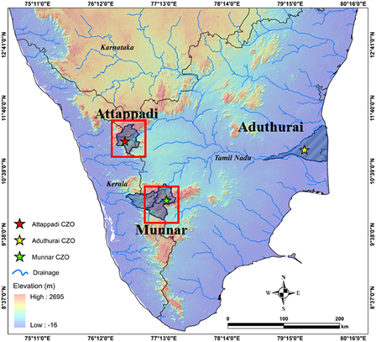
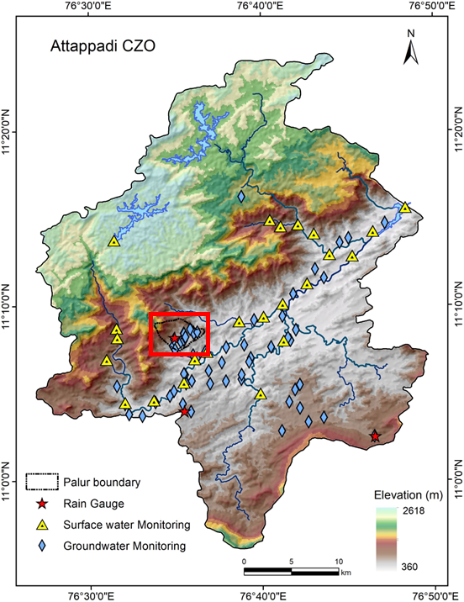
Vegetation as proxies for improving the estimation of soil water fluxes
Aswathi V K^{1,2} and Sreelash Krishnan¹
¹National Centre for Earth Science Studies, Akkulam, Thiruvananthapuram.
²School of Environmental Studies, Cochin University of Science and Technology, (CUSAT), Kochi, Kerala.
Poster No: EGU25-446
1. Introduction
5. Methodology
Soil water fluxes (soil moisture, soil water storage, and recharge flux) play a critical role in energy exchange at the earth’s surface and are of primary interest in the modeling of land surface processes.
Estimating multilayer soil hydraulic properties (SHPs) is essential for modeling soil water fluxes.
However, a feasible and reliable approach for spatial-scale estimation of sub-surface SHPs is still lacking.
Inverse Modeling – Soil Hydraulic Parameter Estimation
Experiment I: Estimation of SHPs using soil moisture and canopy observations
Soil Layer 1: (a) CL1: SM1; (b) CL2 : TS1
Soil Layer 2: (a) CL3: SM1 + LAI (b) CL4 : SM1 + ET (c )CL5 : ET + LAI
Soil Layer 3: (a) CL6: ET + LAI + SM1
2. Significance of Study
CL: Combined Likelihood
Plants are a primary conduit for returning terrestrial water to the atmosphere, thereby exerting a strong effect on hydrologic fluxes of the terrestrial-atmospheric system.
The dynamics of vegetation’s response to environmental conditions (particularly crop water stress) provide an opportunity to understand soil water storage in vegetated areas and thereby give information on sub-surface SHPs.
Experiment II: Effect of the type of soil on the estimation
Different weighted combinations are made with cases of Experiment I, and the best-suited combinations are determined for different soil layers
Experiment III: Effect of water stress condition on estimation
Soil Layer 1: CL: $1.0 {\overline{RSAE}}_{SM1}^{k}$
Soil Layer 2: CL: $0.1 {\overline{RSAE}}_{ET}^{k}+ 0.9 {\overline{RSAE}}_{LAI}^{k}$
Soil Layer 3: CL: $0.2 {\overline{RSAE}}_{ET}^{k}+ 0.6 {\overline{RSAE}}_{LAI}^{k}+ 0.2 {\overline{RSAE}}_{SM1}^{k}$
Crop Type: Maize
Wet Period: May to October (573.5mm rainfall)
Dry Period: August to February (197mm rainfall)
Growth Duration: 90 days
10 cm
SM1 – Soil Moisture of layer 1
TS1 – Soil Temperature layer 2
LAI – Leaf Area Index
ET - Evapotranspiration
40 cm
3. Objective
50 cm
RSAE: Rescaled Sum of Absolute Error
To estimate SHPs for multi-layered soils, specifically field capacity and wilting point, in vegetated regions.
To test the effect of the type of soil and water stress condition on the estimatibility of SHPs
6. Results
7. Conclusion
FC: Field capacity
WP: Wilting point
Sensitivity analysis revealed that surface and canopy variables can serve as proxies for estimating SHPs.
Improved estimates of SHP for the first layer can be achieved by inverting the Agro hydrological model with SM1 alone, while the deeper layer requires LAI, ET, and SM1.
The result shows better estimates for all types of soil; however, the uncertainty in the estimation is relatively higher for sandy and clayey soils.
Water stress was found to have a significant impact on the estimability of SHPs of the deeper layer.
4. Study Area
Sensitivity Index
LAI
8. Summary
Weighted combinations of LAI, SM1, and ET can effectively improve SHP estimates, thus providing an opportunity for using remote sensing data for generating spatial maps of multi-layer SHPs
Physics-informed machine learning offers a promising approach for obtaining multilayered SHPs at spatial scales, which is currently being developed and tested.
Attappadi Critical Zone Observatory, Palakkad, Kerala, India
Sensitivity graph of LAI with SHPs
Correlation between LAI, SM1, and ET
TERRAIn (Tropical Ecosystem Research ObservatoRies in PeninsulAr India) network of observatories initiated and set up by the National Centre for Earth Science Studies (NCESS), Akkulam, Thiruvananthapuram.
SM1 and ET show sensitivity towards SHPs of the first layer, whereas LAI and ET show sensitivity towards the sub-surface soil layers, which indicates that these variables can be considered for the estimation of the properties of multilayer soils.
Acknowledgment: (1) University Grants Commission, India for support through Junior Research Fellowship, (2) Kerala State Council for Science, Technology and Environment for financial support through the KSCSTE –SRS project

