Slide 1
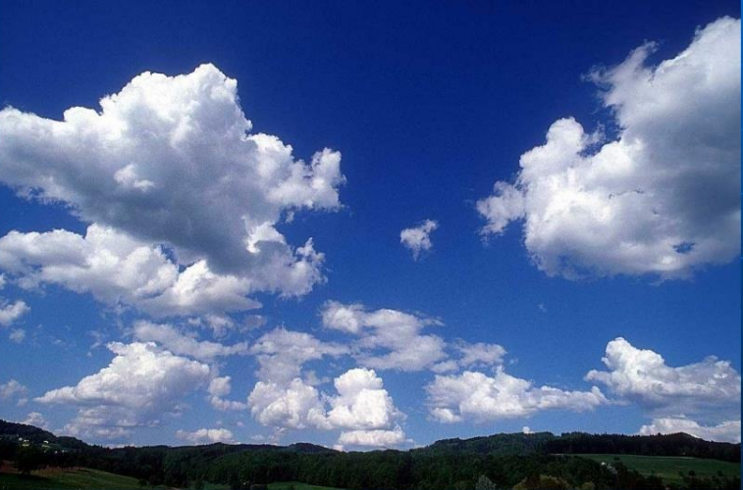




TRACING MOISTURE FLOW FROM THE BAY OF BENGAL AND ARABIAN SEA WITH ITS IMPACT ON GANGA BASIN DURING MONSOONAL EXTREMES
Authors
Ranjan Kumar & Dr. Amey Pathak
at Vienna, Austria & Online | 27 April–2 May 2025
Presenting Author: Ranjan Kumar
Agricultural and Food Engineering Department
Indian Institute of Technology Kharagpur
Kharagpur – 721 302

Slide 2
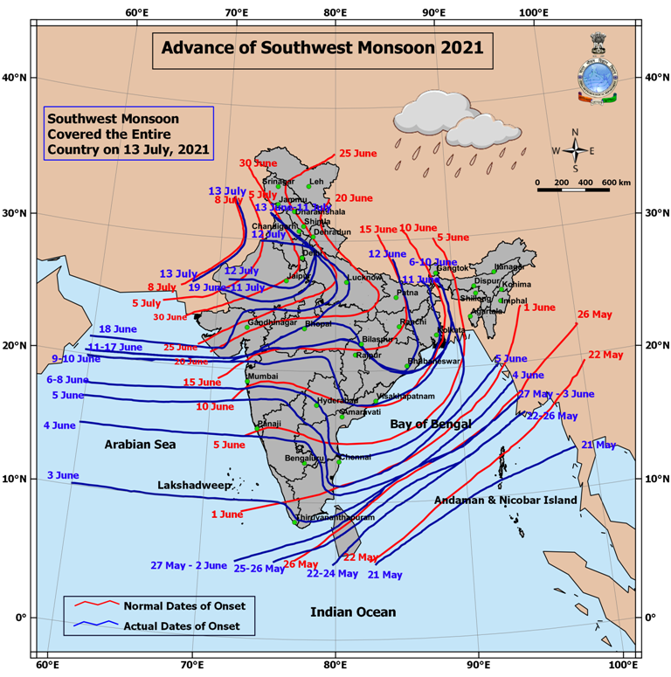
MOTIVATION & INTRODUCTION
Source: Koster et. al., 2004
Source: IMD
The Indian Summer Monsoon (ISM) is a key driver of South Asian climate, bringing essential rainfall for agriculture and water resources.
The Bay of Bengal (BoB) and Arabian Sea (AS) act as primary moisture sources, supplying vast amounts of atmospheric water through monsoonal winds.
The BoB, in particular, is responsible for deep convection and heavy rainfall over the eastern and northern parts of India, while the AS contributes moisture to western India.
variability and transport of moisture from source regions is crucial for predicting extreme rainfall events, floods, and droughtsa highly populated and agriculturally critical region.

Slide 3
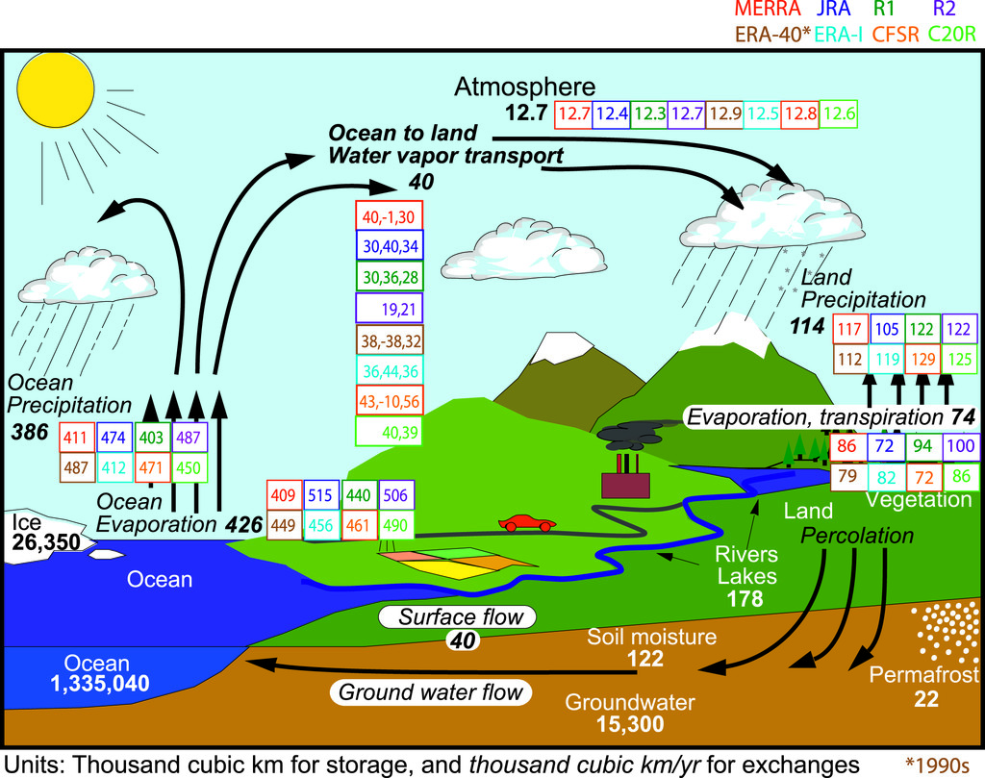
Motivation and Research Questions
How dominant is local moisture recycling within the Ganga Basin during extreme monsoonal events?
What role does the Bay of Bengal play in supplying moisture during intense rainfall episodes?
To what extent does the Arabian Sea contribute to moisture transport during extreme rainfall in the Ganga Basin?
How do the spatial and seasonal variations in moisture source contributions influence extreme rainfall patterns in JJAS?
What are the implications of varying moisture source contributions for land–atmosphere interactions in the Ganga Basin?
Can 3D Lagrangian moisture tracking models effectively identify the origins and pathways of moisture leading to extreme rainfall events?
https://journals.ametsoc.org/view/journals/clim/24/18/2011jcli4171.1.xml
Source: Trenberth et al., (2011)

Slide 4
OBJECTIVES
To quantify and analyze the relative contributions of moisture from the Bay of Bengal, and Arabian Sea, to the Ganga Basin during monsoonal extreme events.
To quantify and analyze the relative contributions of moisture Ganga Basin as local recycling to the Ganga Basin during monsoonal extreme

Slide 5
STUDY AREA

Slide 6
Data and Methodology
Data Source | Variable Name | Data Type- Global Reanalysis | Data Period | Spatial and Temporal Resolution
ECMWF ERA5-Interim (Gridded Data) | Specific Humidity (Q) | Gridded (Pressure level 1000hPa to 50hPa) | 1990–2023 | 0.25°×0.25° resolution hourly
 | Zonal wind (U) | Gridded (Pressure level 1000hPa to 50hPa) | 1990–2023 | 0.25°×0.25° resolution hourly
 | Meridional Wind (V) | Gridded (Pressure level 1000hPa to 50hPa) | 1990–2023 | 0.25°×0.25° resolution hourly
 | Precipitation | Gridded Single Level | 1990–2023 | 0.25°×0.25° resolution hourly
 | Evaporation | Gridded Single Level | 1990–2023 | 0.25°×0.25° resolution hourly
 | VIEWVF | Gridded Single Level | 1990–2023 | 0.25°×0.25° resolution hourly
 | VINWVF | Gridded Single Level | 1990–2023 | 0.25°×0.25° resolution hourly
 | TCW | Gridded Single Level | 1990–2023 | 0.25°×0.25° resolution hourly
 | Temperature | Gridded (Pressure level 1000hPa to 50hPa) | 1990–2023 | 0.25°×0.25° resolution hourly
 | Vertical wind velocity (w) | Gridded (Pressure level 1000hPa to 50hPa) | 1990–2023 | 0.25°×0.25° resolution hourly

Slide 7
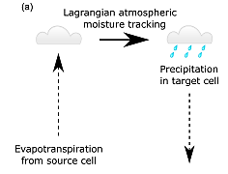
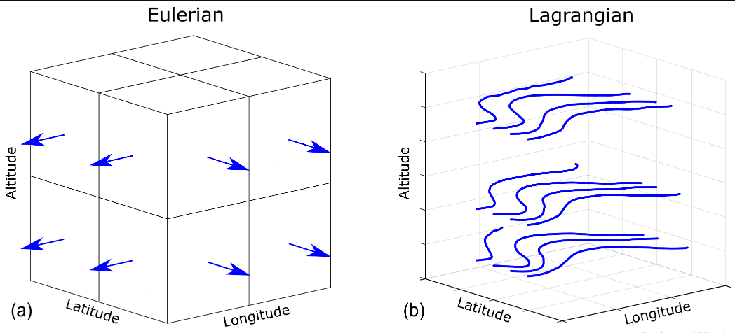
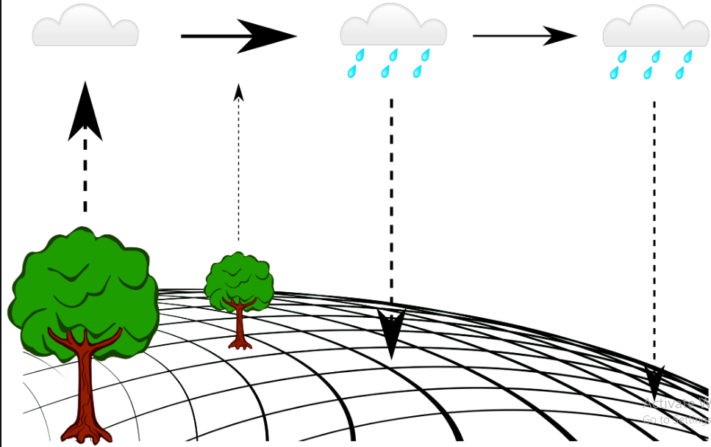
Methodology
UTrack Moisture Model: Overview & Application
UTrack is a Lagrangian moisture tracking model that simulates the movement of atmospheric moisture from evaporation source regions to precipitation sinks.
It uses reanalysis data to track parcels of water vapor in 3D space and attributes rainfall to its source.
How it works
  It works in three steps mainly (a) Parcel Release, (b) Trajectory Simulation and (c) Moisture Allocation to Rainfall
  Moisture from evaporation is split into parcels (e.g., 100 per mm of E), At least one parcel is released per hour at each grid cell.
  Parcels are tracked forward in time in 3D using interpolated wind data (u, v, omega over 25 pressure levels).
  Trajectories updated every 0.1 hours.
  At each time step, a fraction of parcel moisture is rained out.
UTrack model [Tuinenburg and Staal (2020)]

Slide 8
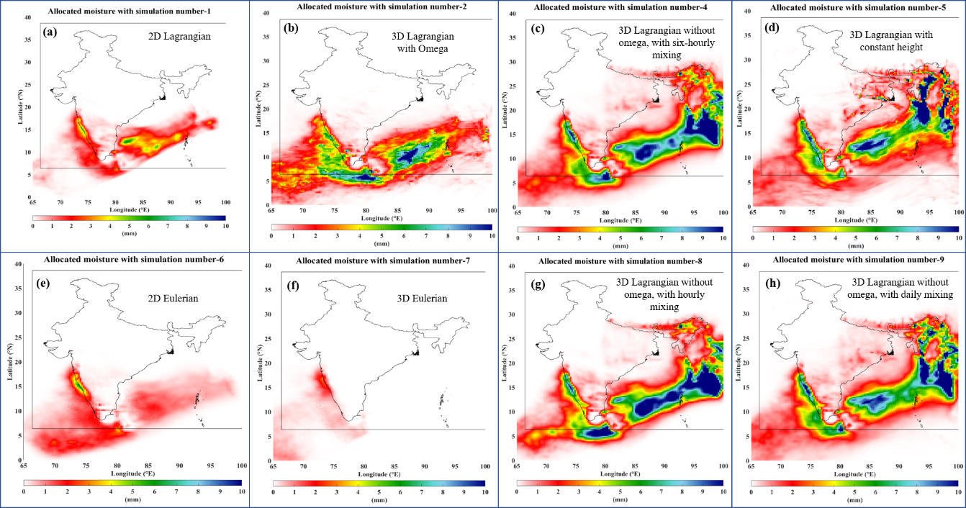
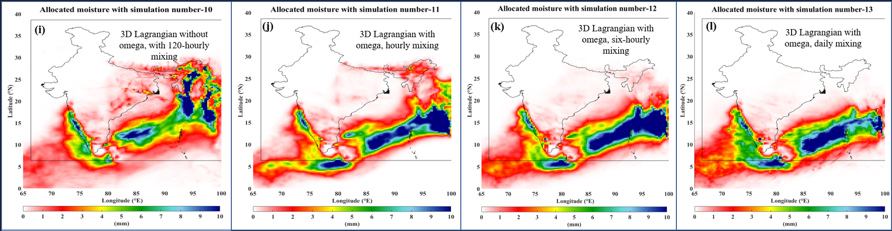
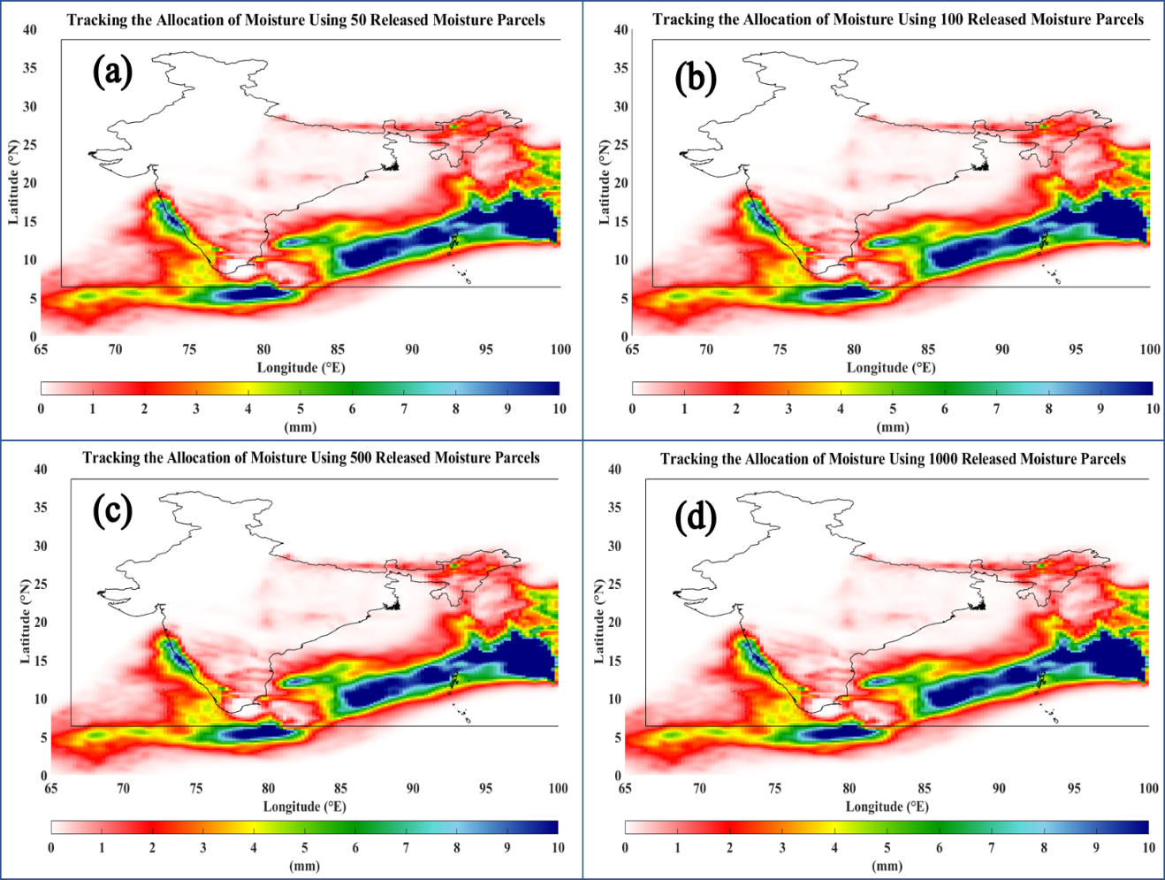
Results and Discussion
Simulation Configurations Tested
Compared 12 simulations varying:
    2D vs 3D
    With/without omega (vertical motion)
    Mixing frequency: hourly, 6-hourly, daily, 120-hourly
Found Simulation no. 11 (3D + omega + hourly mixing) most accurate and realistic.
Parcel Count Sensitivity
Tested simulations with 50, 100, 500, 1000 parcels. And observed 100 parcels was optimal: balanced spatial coverage and computing efficiency, as:
    50 parcels missed key dynamics.
    500–1000 parcels were more precise but computationally heavy.
Selected set up of model
    Simulations 11 + 100 parcels best balances accuracy, realism, and computational cost.
    Captures precipitation source regions for India’s monsoon months effectively.

Slide 9
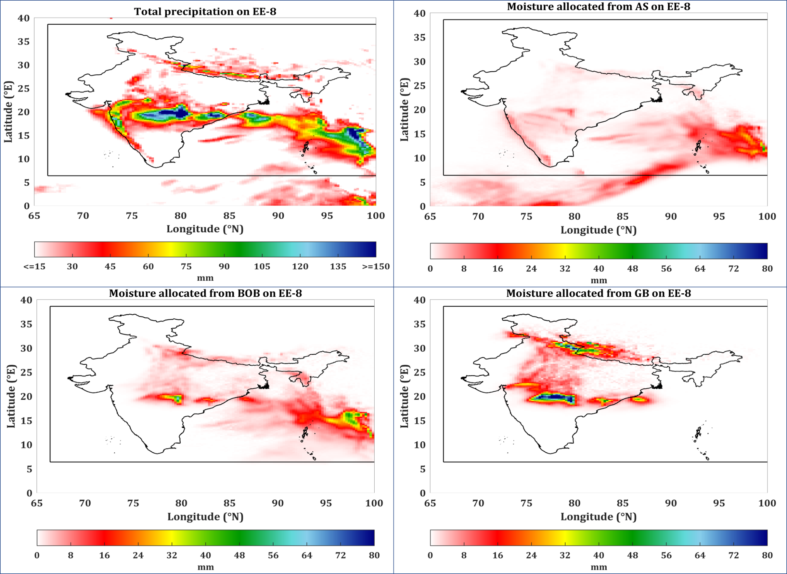
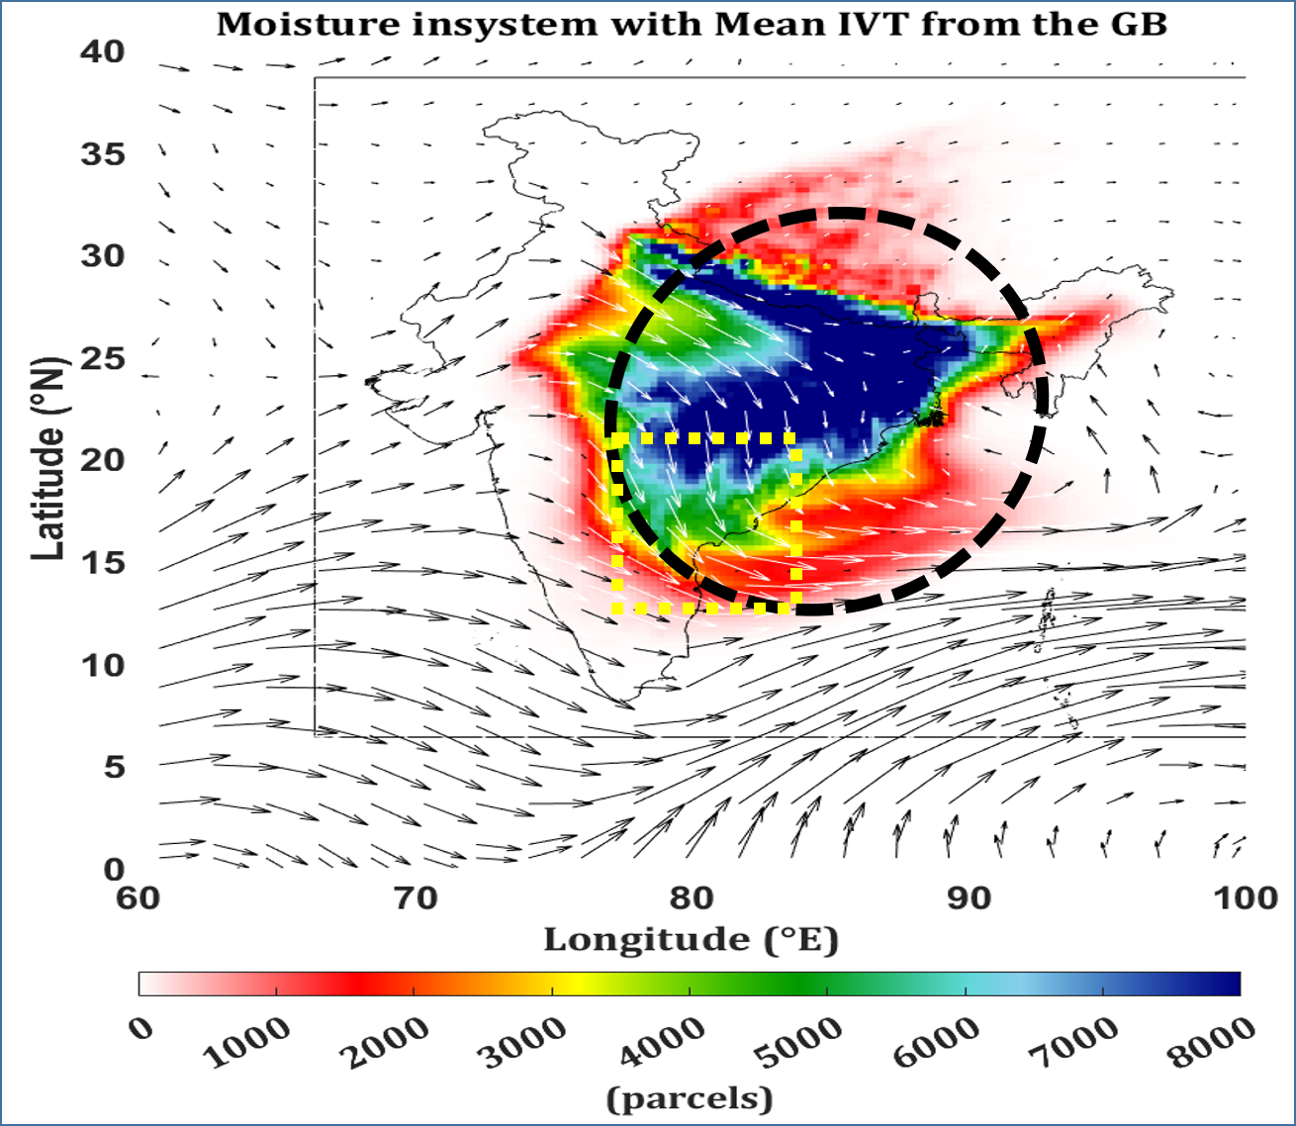

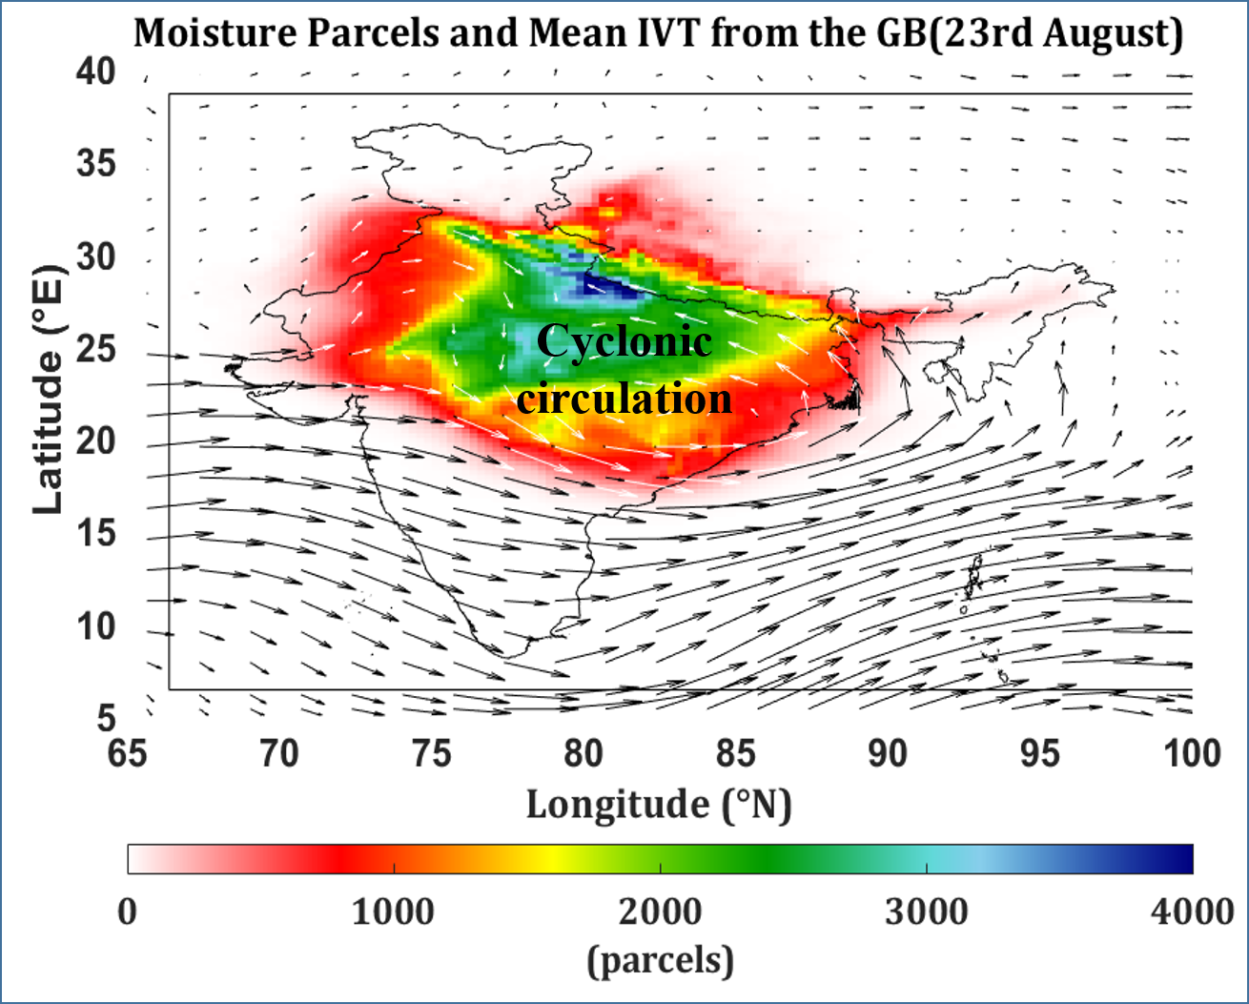
Results and Discussion

Slide 10
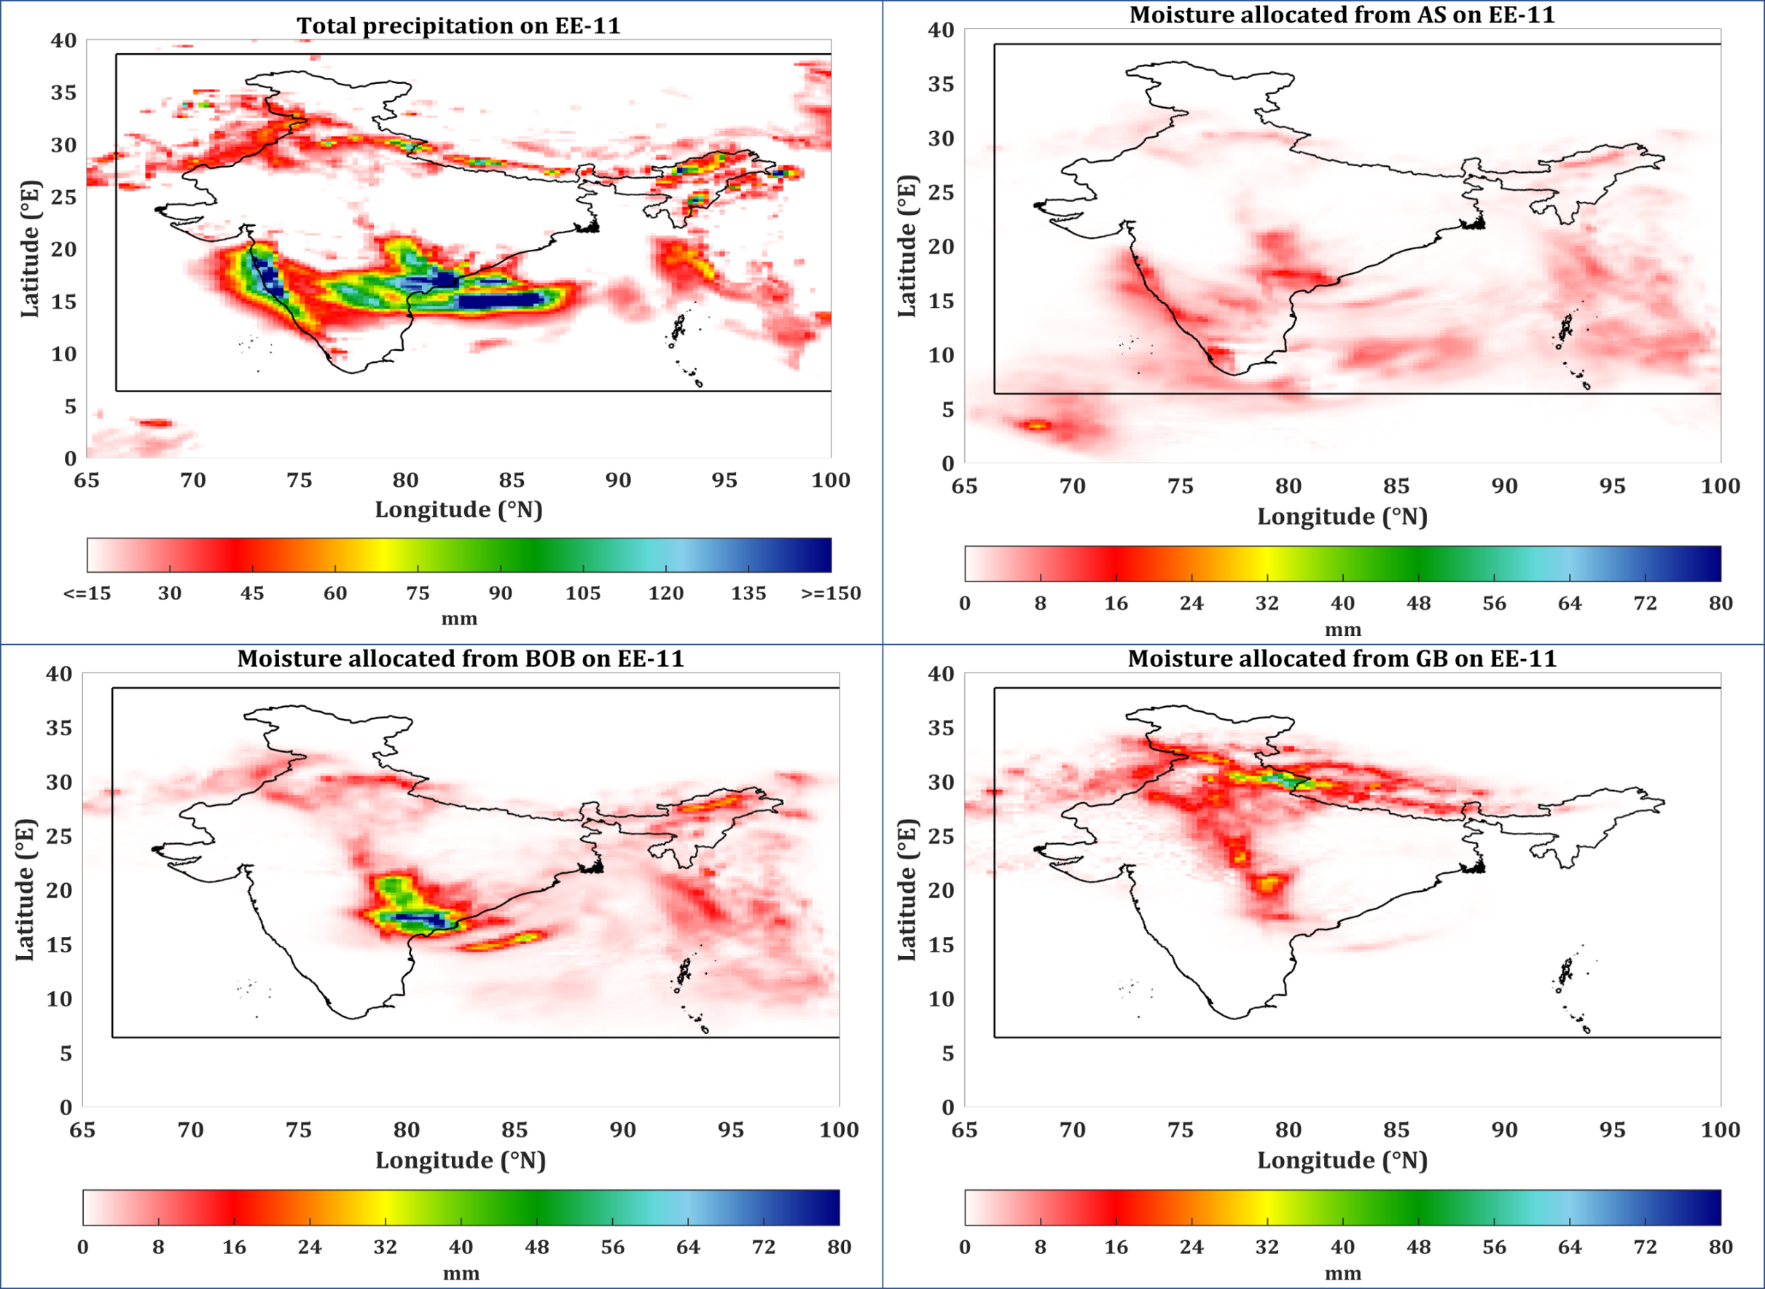
Results and Discussion

Slide 11
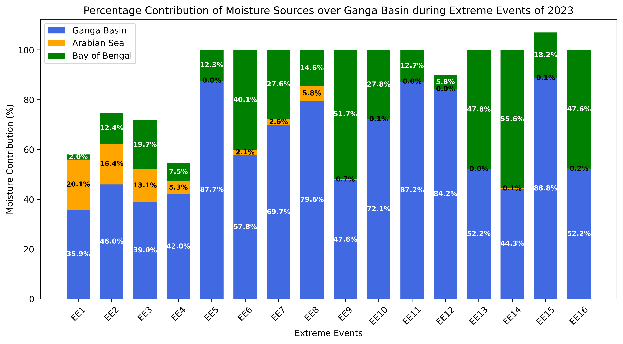
Results and Discussion
JUNE
JULY
AUGUST
SEPTEMBER

Slide 12
Conclusions
Ganga Basin (GB) contribution: 35.9% to 88.8%, shows dominance during extreme events (EEs) which indicates strong local moisture recycling, suggests significant precipitation feedback loops within the basin.
Bay of Bengal (BOB) contribution: 2% to 55.6% shows high variability suggests significant BOB role during some monsoon surges. A notable observation we found in the analayis as BOB contribution increases during active monsoon phases.
Arabian Sea (AS) contribution: generally varies from 0.7% to 20.1 % manly during the starting of monsoon season in the month of June its overall influence is minimal among the three. It mainly Indicates westerly moisture transport.
Overall conclusive statement can be shaped as : During JJAS Extreme Events over India the GB plays major role as enhancing the extreme events with surplus rainfall due to Local recycling dominates with BOB contributes variably but AS plays a minor role.
Kumar, R., & Pathak, A. On Origins and Sustenance of Monsoon Extreme Rainfall During the Year 2023 Over India. Available at SSRN 4976231. Under Review. Atmospheric Research, Elsevier.

Slide 13
References
Koster, R. D., Dirmeyer, P. A., Guo, Z., Bonan, G., Chan, E., Cox, P., ... & Yamada, T. (2004). Regions of strong coupling between soil moisture and precipitation. Science, 305(5687), 1138-1140.
Trenberth, K. E., Fasullo, J. T., & Mackaro, J. (2011). Atmospheric moisture transports from ocean to land and global energy flows in reanalyses. Journal of climate, 24(18), 4907-4924.
Gimeno, L., Dominguez, F., Nieto, R., Trigo, R., Drumond, A., Reason, C. J., ... & Marengo, J. (2016). Major mechanisms of atmospheric moisture transport and their role in extreme precipitation events. Annual Review of Environment and Resources, 41, 117-141.
Suthinkumar, P. S., Varikoden, H., & Babu, C. A. (2023). Changes in extreme rainfall events in the recent decades and their linkage with atmospheric moisture transport. Global and Planetary Change, 221, 104047.
Tuinenburg, O. A., & Staal, A. (2020). Tracking the global flows of atmospheric moisture and associated uncertainties. Hydrology and Earth System Sciences, 24(5), 2419-2435.
Tuinenburg, O. A., Theeuwen, J. J., & Staal, A. (2020). High-resolution global atmospheric moisture connections from evaporation to precipitation. Earth System Science Data, 12(4), 3177-3188

Slide 14
Acknowledgement
The authors acknowledge the computational resources provided by Meghmala (the IIT Kharagpur Cloud), and High Performance Computing (HPC) facility-Param Shakti of IIT Kharagpur. We also gratefully acknowledge the support from the Science and Engineering Research Board (Anusandhan National Research Foundation (ANRF), Department of Science and Technology, Government of India) under the Core Research Grant for Earth and Atmospheric Sciences (CRG/2022/004423).

Slide 15

Thank You
Questions and
Suggestions?

Slide 16
Supportive slides
Questions and
Suggestions?

Slide 17
About IIT and AGFE Department
Indian Institute of Technology Kharagpur (IIT KGP)
Established in 1951 — the first IIT in India; declared an Institute of National Importance in 1956. Set in a 2100-acre green campus with over 15,000 residents.
Motto: “योगः कर्मसु कौशलम्” — "Excellence in action is Yoga".
Originated in the Hijli Detention Camp, linking its roots to India’s freedom movement. A pioneer in technical education, research, innovation, and entrepreneurship with global impact.
🌾 Agricultural and Food Engineering Department (AGFE), IIT KGP
Established in 1952 (renamed in 1994), unique among all IITs. It Comprises of 6 major disciplines: Farm Machinery & Power, Land & Water Resources, Food Process Engineering, Agricultural Biotechnology, Aquacultural Engineering and Agricultural Systems & Management.
Hosts national-level hubs like:
Centre of Excellence in Precision Agriculture
Agri-Business Incubation Foundation
Strong focus on cutting-edge R&D: Precision farming, Climate-resilient agriculture, AI/ML in water & food systems, Hydroponics, Packaging tech, and more.
Faculty Achievements:
2200+ publications, h-index: 60
64 patents, 34 books, international awards
Vision aligned with Atma nirbhar Bharat for a self-reliant, sustainable future.
“Everything else can wait, agriculture can't.” – Norman Borlaug

