Slide 1
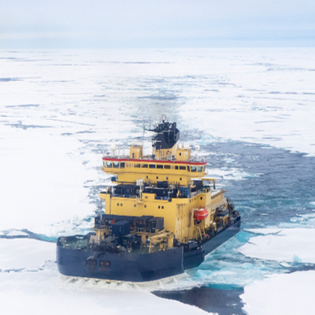
Using Noble Gases to Constrain Parameterizations of Arctic Air-Sea-Ice Gas Exchange Processes
Chiara-Marlen Hubner* (chiara.hubner@awi.de), Stanley Scott, Yannis Arck, and Werner Aeschbach
Institute of Environmental Physics, Heidelberg University, Heidelberg, Germany * now at: Alfred-Wegener-Institute, Helmholtz Center for Polar and Marine Research, Bremerhaven, Germany and University of Bremen, Bremen, Germany
Vienna,
30th April 2025,
EGU25-4579,
OS1.1
https://doi.org/10.5194/egusphere-egu25-4579

Slide 2
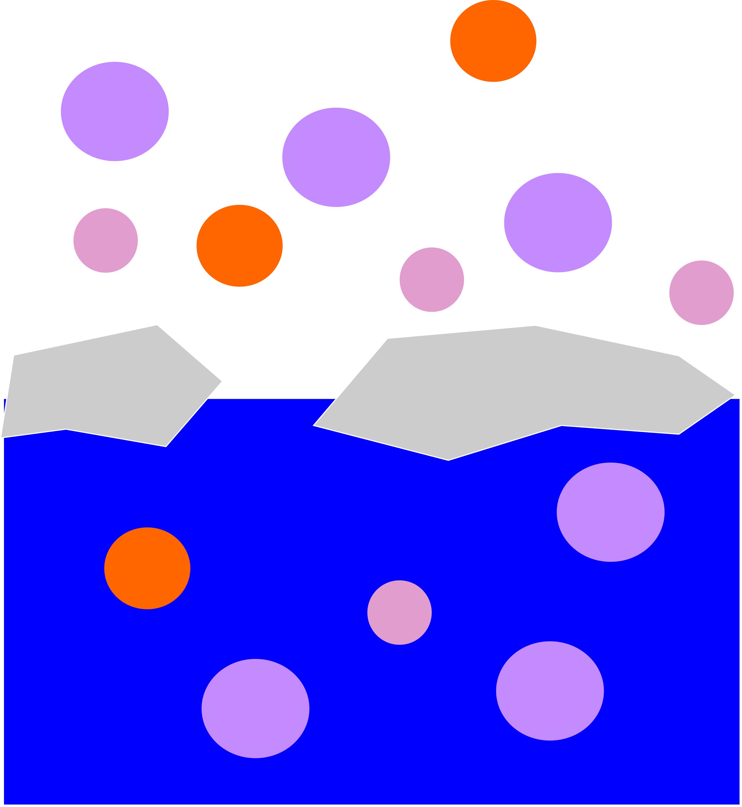
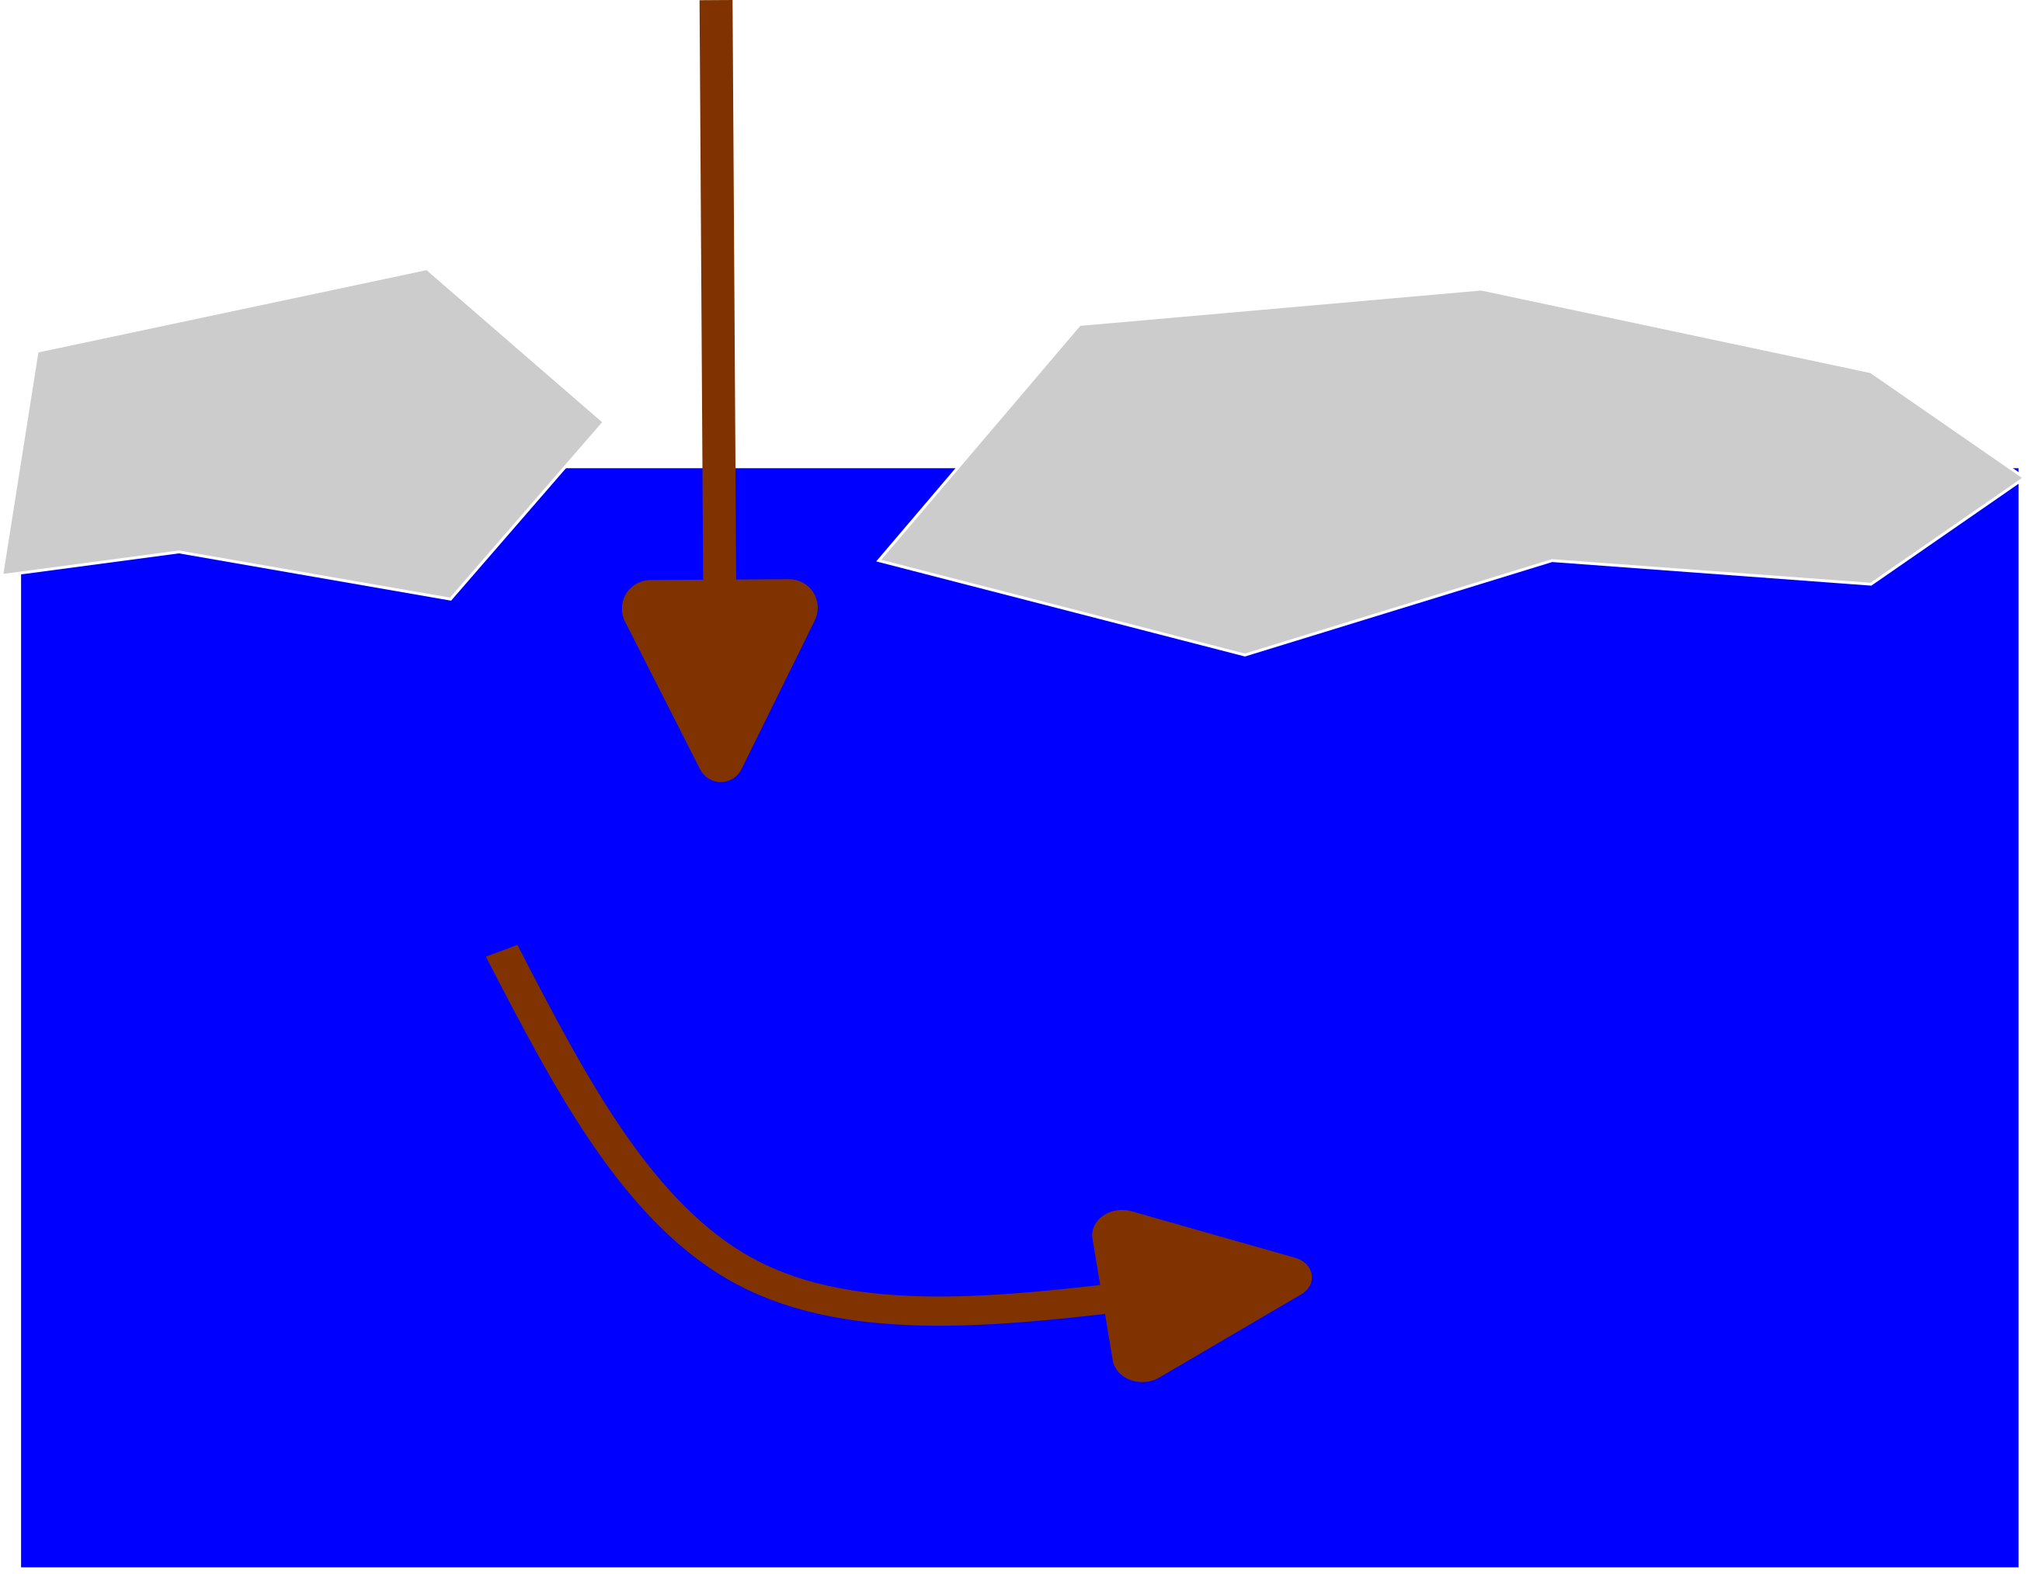
Motivation
EGU25-4579/OS1.1/Using Noble Gases to Constrain Parameterizations of Arctic Air-Sea-Ice Gas Exchange Processes
Arctic Ocean is major reservoir of anthropogenic carbon (Tanhua et al. 2009)
Sparse data, surface saturations?
Noble gases 1. Constant atmospheric abundance
2. Inert
Improved ventilation estimates (transient tracers)
Improvements on carbon inventory estimates
(Seltzer et al. 2023, Aeschbach 2016)

Slide 3
Main Research Questions
EGU25-4579/OS1.1/Using Noble Gases to Constrain Parameterizations of Arctic Air-Sea-Ice Gas Exchange Processes
SAS-Oden 2021/VACAO
What is the tracer potential of noble gases in the Arctic Ocean?
What are the dominating air-sea-ice gas exchange processes?
Can we model the air-sea-ice gas exchange?
What predictions for transient tracers (SF₆ & CFC-12) can be made?
→ Age and ventilation estimates
Hubner et al. in prep.
(Snoeijs-Leijonmalm and the SAS-Oden 2021 Scientific Party, 2022)

Slide 4
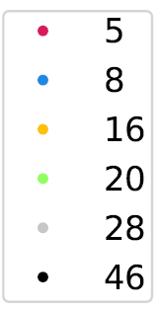
EGU25-4579/OS1.1/Using Noble Gases to Constrain Parameterizations of Arctic Air-Sea-Ice Gas Exchange Processes
Data Set
First application of full set of five stable noble gases to the Arctic Ocean
Hubner et al. in prep.

Slide 5
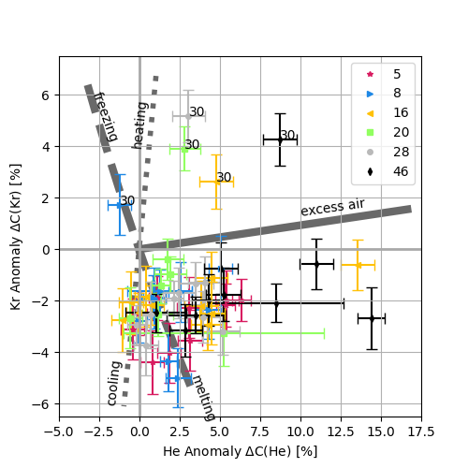
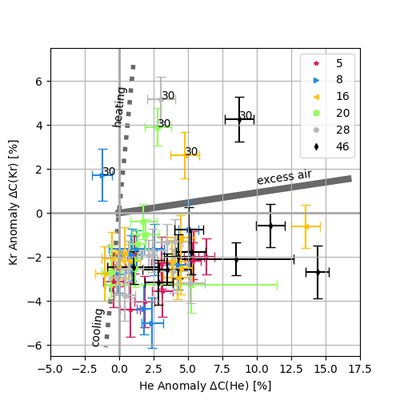
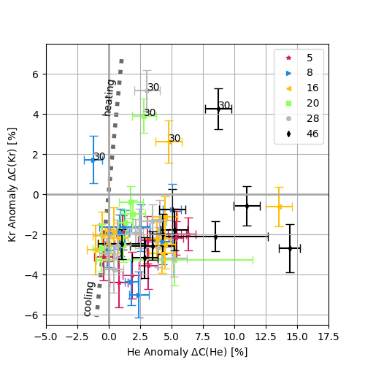
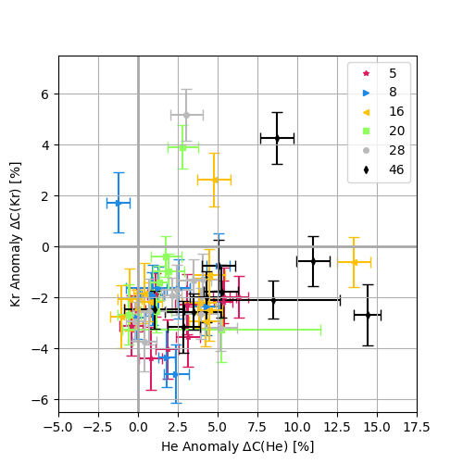
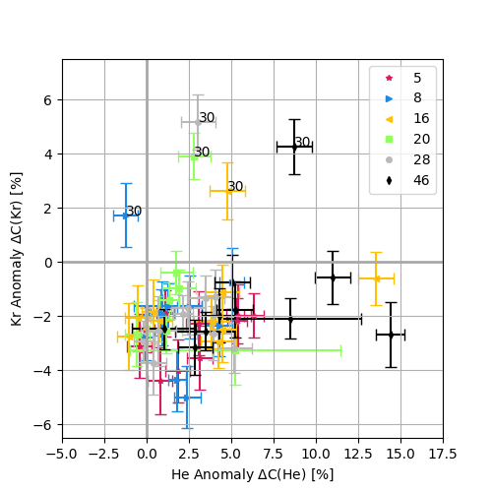
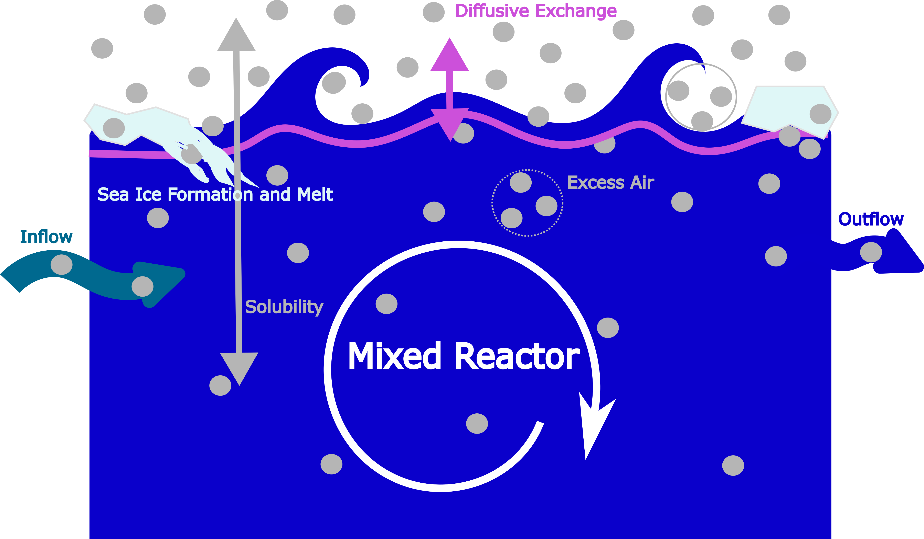
Methods
EGU25-4579/OS1.1/Using Noble Gases to Constrain Parameterizations of Arctic Air-Sea-Ice Gas Exchange Processes
Qualitative Data Analysis:
Saturation Anomaly
Model Developments:
A) Static single water mass models B) Dynamic box models (dC/dt =…)

Slide 6
Parameterizations
EGU25-4579/OS1.1/Using Noble Gases to Constrain Parameterizations of Arctic Air-Sea-Ice Gas Exchange Processes
A) Static single water mass models
B) Dynamic box models
fractionation coefficient
atmospheric abundance
Extension of “unfractionated air” (Jung and Aeschbach 2018, Kluge et al. 2014)
melt
remaining ice fraction
recharge temperature
excess air
inflow temperature
net freeze-flush ratio
(Inspired by Loose et al. 2023, Hamme et al. 2017)
quasi-steady-state
excess air
inflow rate

Slide 7
Implementation
EGU25-4579/OS1.1/Using Noble Gases to Constrain Parameterizations of Arctic Air-Sea-Ice Gas Exchange Processes
Session HS3.8
Scott et al. 2025

Slide 8
Results
EGU25-4579/OS1.1/Using Noble Gases to Constrain Parameterizations of Arctic Air-Sea-Ice Gas Exchange Processes
measured ( ) vs. modelled ( )
Parameterizations represent measurements accurately and precisely, e.g. quasi-steady-state solution
Model intercomparison: concentrations and saturation anomalies agree within uncertainties
Forward model SF₆ and CFC-12 saturations: relative oversaturation of SF₆ to CFC-12 by (6$±$2)% (compatible with Gerke et al. 2024)

Slide 9
Conclusion
EGU25-4579/OS1.1/Using Noble Gases to Constrain Parameterizations of Arctic Air-Sea-Ice Gas Exchange Processes
Successful analysis of noble gas concentrations in the Arctic Ocean
Good tracers for Arctic air-sea-ice gas exchange → Dominating: cooling, excess air, sea ice formation
Two well-performing static models
Two well-performing dynamic models
Predictions for transient tracers: relative oversaturation of SF₆ to CFC-12
Outlook: Application to age and ventilation estimates
Thank you!
Contact: chiara.hubner@awi.de and stanley.scott@iup.uni-heidelberg.de

Slide 10
References
EGU25-4579/OS1.1/Using Noble Gases to Constrain Parameterizations of Arctic Air-Sea-Ice Gas Exchange Processes
T. Tanhua, E. P. Jones, E. Jeansson, S. Jutterström, W. M. Smethie Jr., D.W. R. Wallace and L. G. Anderson, “Ventilation of the Arctic Ocean: Mean Ages and Inventories of Anthropogenic CO2 and CFC-11”, Journal of Geophysical Research: Oceans, 114 (C1), 2009, doi: https://doi.org/10.1029/2008JC004868.
A. M. Seltzer, D. P. Nicholson, W. M. Smethie, R. L. Tyne, E. Le Roy, R. H. R. Stanley, M. Stute, P. H. Barry, K. McPaul, P. W. Davidson, B. X. Chang, P. A. Rafter, P. Lethaby, R. J. Johnson, S. Khatiwala, W. J. Jenkins, “Dissolved gases in the deep North Atlantic track ocean ventilation processes”, Proceedings of the National Academy of Sciences U.S.A. , 120 (11), 2023, doi: https://doi.org/10.1073/pnas.2217946120.
W. Aeschbach, “New Perspectives for Noble Gases in Oceanography”, Journal of Geophysical Research: Oceans, 121 (8), 6550-6554, 2016, doi: https://doi.org/10.1002/2016JC012133.
C.-M. Hubner, S. Scott, Y. Arck, W. Aeschbach, “New Noble Gas-Derived Parameterizations of Arctic Air-Sea-Ice Gas Exchange Processes” (Manuscript in preparation), Institute of Environmental Physics, Heidelberg University, 2025
P. Snoeijs-Leijonmalm and the SAS-Oden 2021 Scientific Party, Expedition Report Swedarctic Synoptic Arctic Survey 2021 with Icebreaker Oden. Swedish Polar Research Secretariat, 300pp., 2022, url: https://www.diva-portal.org/smash/get/diva2:1729240/FULLTEXT01.pdf.
M. Jung and W. Aeschbach, “A New Software Tool for the Analysis of Noble Gas Data Sets from (Ground)water,” Environmental Modelling & Software, vol. 103, pp. 120–130, 2018, doi: https://doi.org/10.1016/j.envsoft.2018.02.004.
T. Kluge, T. Marx, W. Aeschbach-Hertig, C. Spötl and D. K. Richter, “Noble Gas Concentrations in Fluid Inclusions as Tracer for the Origin of Coarse Crystalline Cryogenic Cave Carbonates”, Chemical Geology, 368, 54-62, 2014, doi: https://doi.org/10.1016/j.chemgeo.2014.01.006.
B. Loose, S. Stammerjohn, P. N. Sedwick, and S. F. Ackley, “Sea ice formation, glacial melt and the solubility pump boundary conditions in the Ross Sea,” Journal Of Geophysical Research: Oceans, 2023, doi: https://doi.org/10.1029/2022jc019322.
R. C. Hamme, S. R. Emerson, J. P. Severinghaus, M. C. Long, and I. Yashayaev, “Using Noble Gas Measurements to Derive Air-Sea Process Information and Predict Physical Gas Saturations”, Geophysical Research Letters, 44, 9901–9909 pp., 2017, doi: https://doi.org/10.1002/2017GL075123.
S. Scott, C. Hubner, Y. Arck, and W. Aeschbach: “PAGOS: A New Python Library for Fast Implementation of (Tracer-Based) Hydrological Models”, EGU General Assembly 2025, Vienna, Austria, 27 Apr–2 May 2025, EGU25-7347, 2025, doi: https://doi.org/10.5194/egusphere-egu25-7347.
L. Gerke, Y. Arck and T. Tanhua, “Temporal Variability of Ventilation in the Eurasian Arctic Ocean”, Journal of Geophysical Research: Oceans, 129 (7), 2024, doi: https://doi.org/10.1029/2023JC020608.

Slide 11
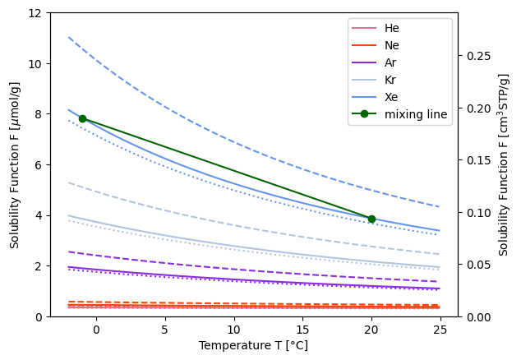
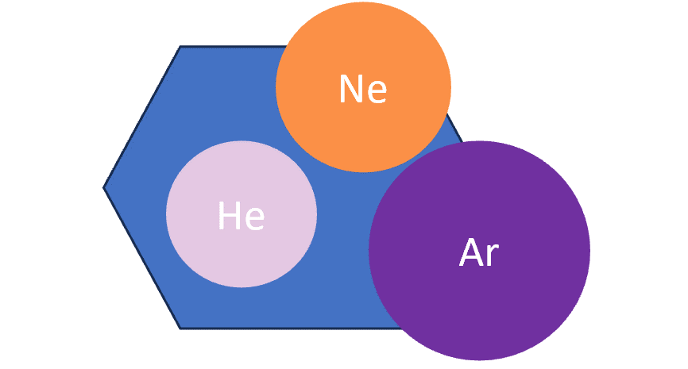
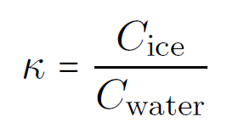
Solubility, Excess Air and Sea Ice
EGU25-4579/OS1.1/Using Noble Gases to Constrain Parameterizations of Arctic Air-Sea-Ice Gas Exchange Processes
Hamme and Severinghaus 2007

Slide 12
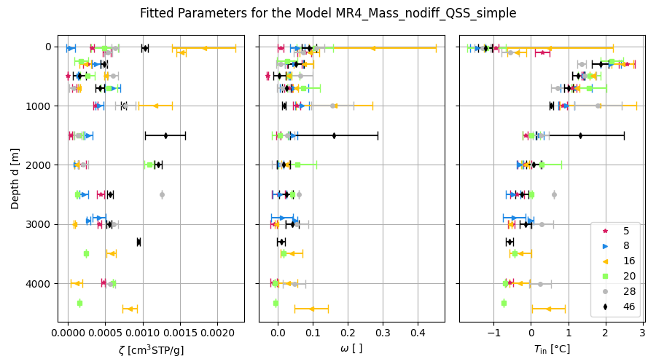
Dynamic Model, QSS
EGU25-4579/OS1.1/Using Noble Gases to Constrain Parameterizations of Arctic Air-Sea-Ice Gas Exchange Processes

Slide 13
Dynamic Model, QSS
EGU25-4579/OS1.1/Using Noble Gases to Constrain Parameterizations of Arctic Air-Sea-Ice Gas Exchange Processes

Slide 14
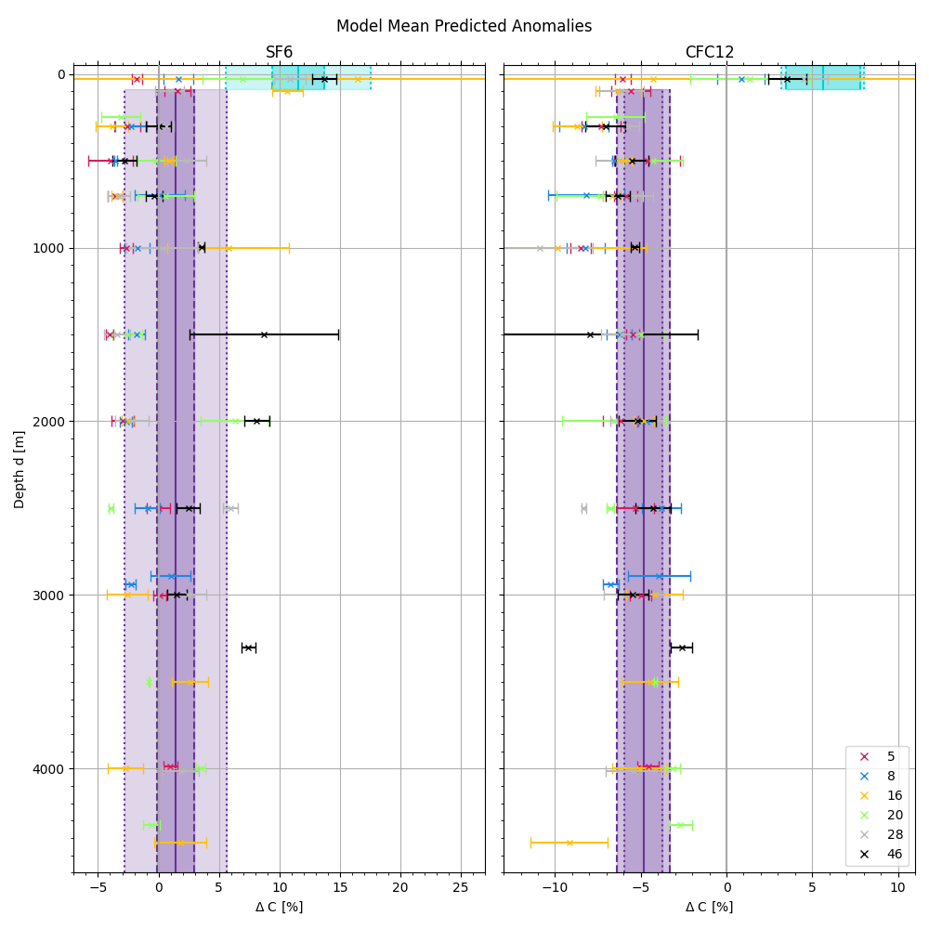
Predictions
EGU25-4579/OS1.1/Using Noble Gases to Constrain Parameterizations of Arctic Air-Sea-Ice Gas Exchange Processes

