Slide 1

Study on sedimentary evolution characteristics and sand body distribution law of regressive fan delta
Yifang Yang, Tianhui Wei
China University of Petroleum (East China)
UPC

Slide 2
Table of Contents
Sedimentary Facies Identification
Microfacies Identification
Reservoir Quality Evaluation

Slide 3
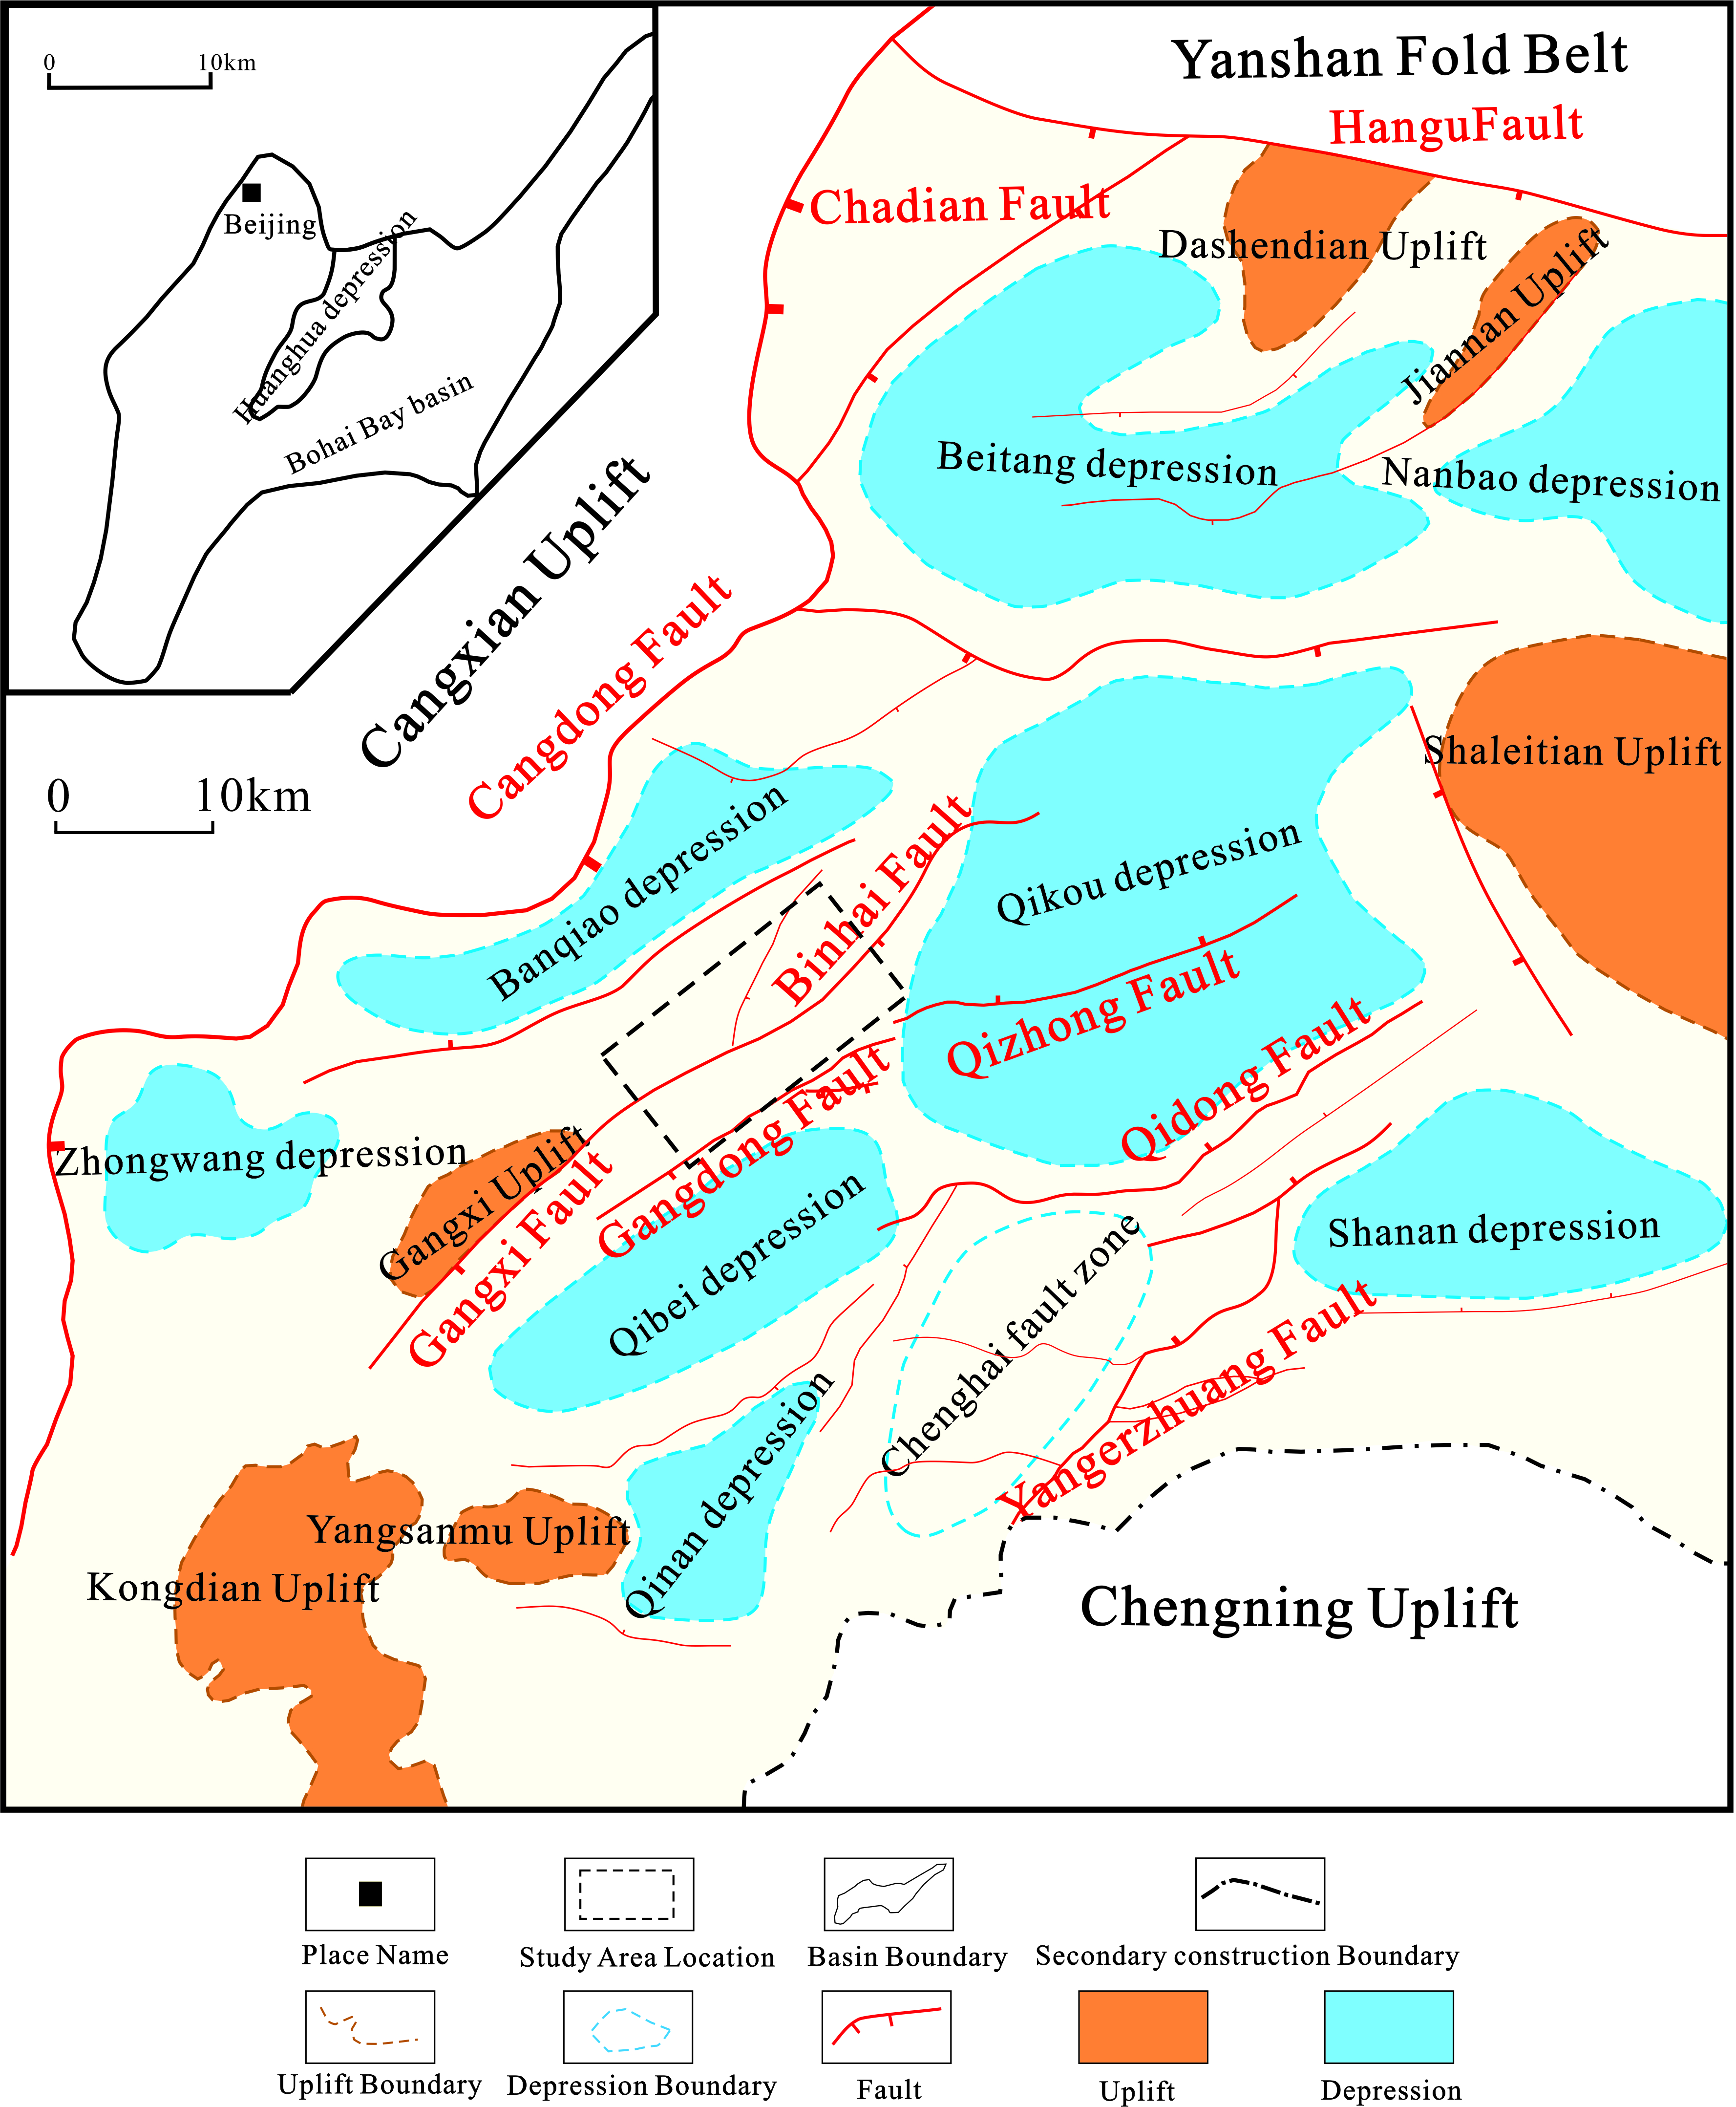
The study area is mainly a shallow water delta sedimentary environment
Qikou depression is located in the southern part of the Bohai Bay Basin
Gangzhong oil field is located in the west of Qikou depression
It developed Lacustrine - fan delta depositional system in the strata

Slide 4
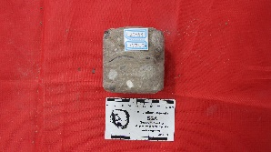





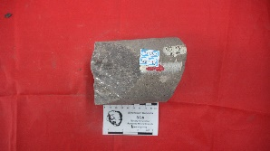

Sedimentary Facies Identification
Core data reveals eight lithofacies types, indicating varying hydrodynamic energy intensities during different depositional periods in the study area.
high-energy hydrodynamic environment
low-energy hydrodynamic conditions
Massive-bedded conglomeratic sandstone facies (Ss)
Massive-bedded sandstone facies (Sm)
Horizontally-laminated siltstone facies (Fh)
Lenticular-bedded siltstone facies (Se)
Parallel-laminated sandstone facies (Sh)
Ripple cross-laminated sandstone facies (Sr)
Massive argillaceous siltstone facies (Fsc)
Massive mudstone facies (Mm)

Slide 5
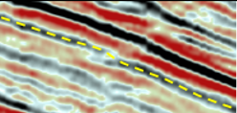
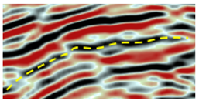
Microfacies Identification
Based on integrated analysis of core, well logging, and seismic data, a fan-delta front subfacies has been identified in the study area, which can be further subdivided into four microfacies types.
Subaqueous distributary channel microfacies
Mouth bar microfacies
Moderate to strong amplitude reflection
Moderate to low frequency
Moderate to low continuity
Divergent fill-type emission structure
Moderate to weak amplitude reflection
Moderate to high frequency
Moderate to low continuity
Sheet-like subparallel emission structure

Slide 6
Microfacies Identification
Based on integrated analysis of core, well logging, and seismic data, a fan-delta front subfacies has been identified in the study area, which can be further subdivided into four microfacies types.
Interdistributary channel microfacies
Sheet sand microfacies
Weak amplitude reflection
Low frequency
Moderate to high continuity
Sheet-like subparallel emission structure
Moderate to weak amplitude reflection
Low frequency
Moderate to low continuity
Sheet-like subparallel emission structure

Slide 7
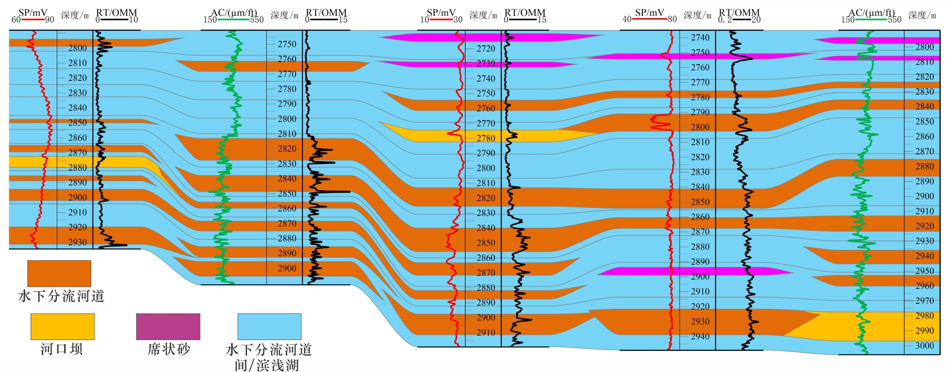
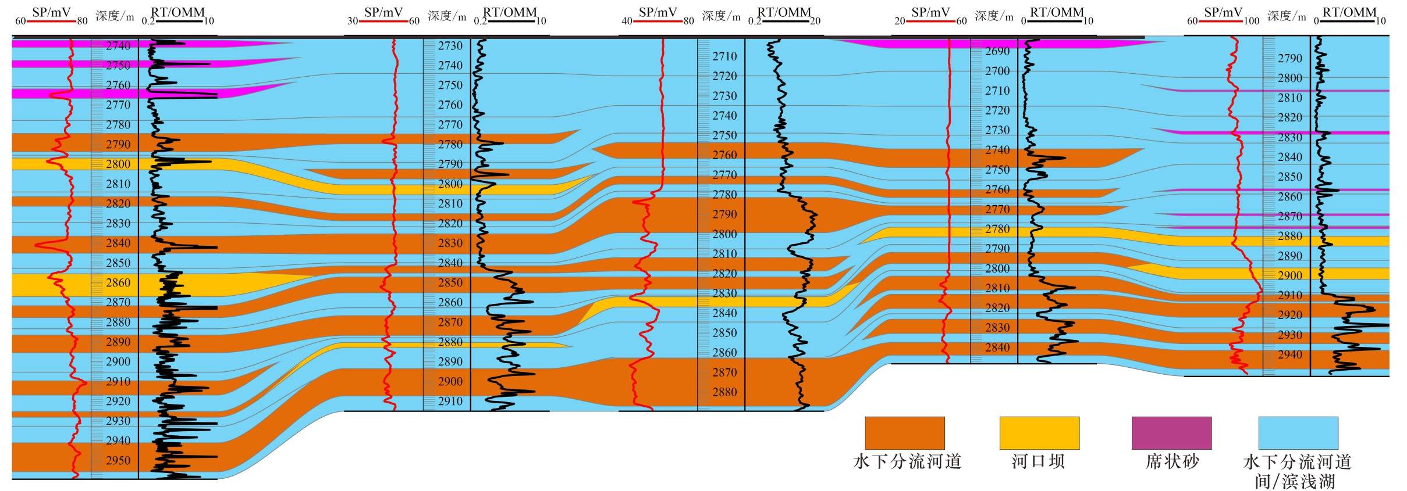
Microfacies Identification
Interwell correlation profiles indicate that the sedimentary microfacies in the study area exhibit retrogradation dip direction of provenance while showing lateral migration strike direction of provenance.
dip direction of provenance
migration strike direction of provenance
The subaqueous distributary channel microfacies exhibit poor lateral continuity, while the reservoir top adjacent to the flooding surface is composed of sheet sands and thin subaqueous distributary channel microfacies, indicating lateral migration of the fan system during deposition.
The early stage was characterized by well-developed subaqueous distributary channel and mouth bar microfacies in the fan delta front, exhibiting greater sandbody thickness and extended channel continuity. In contrast, the late stage featured sporadically distributed small-scale distributary channels and sheet sand microfacies, demonstrating a retrogradational fan evolution process.

Slide 8
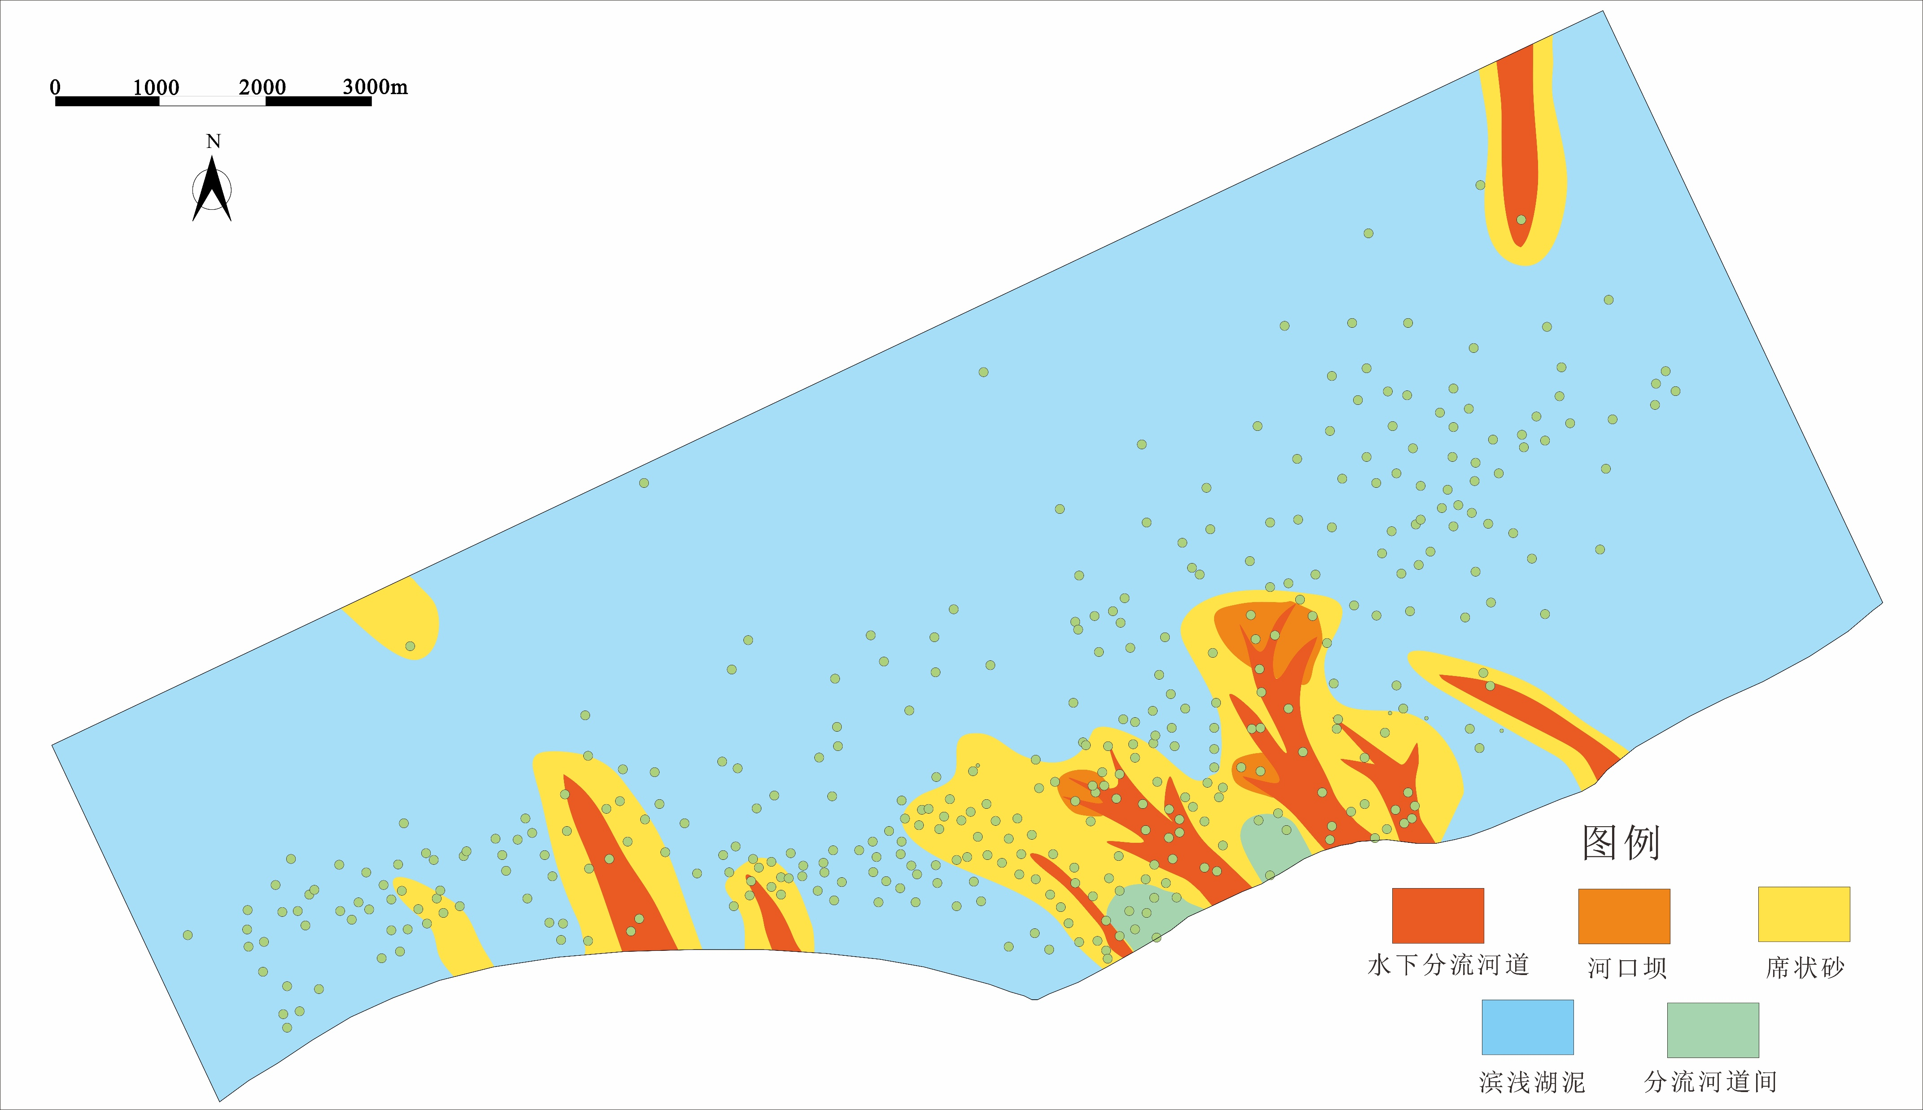
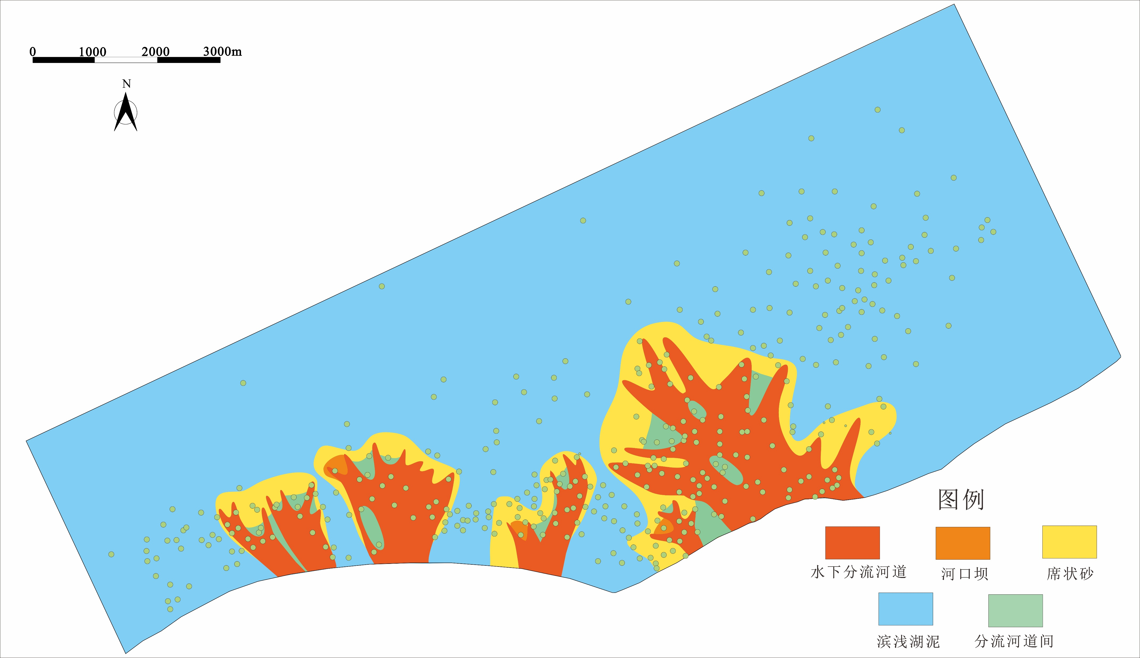
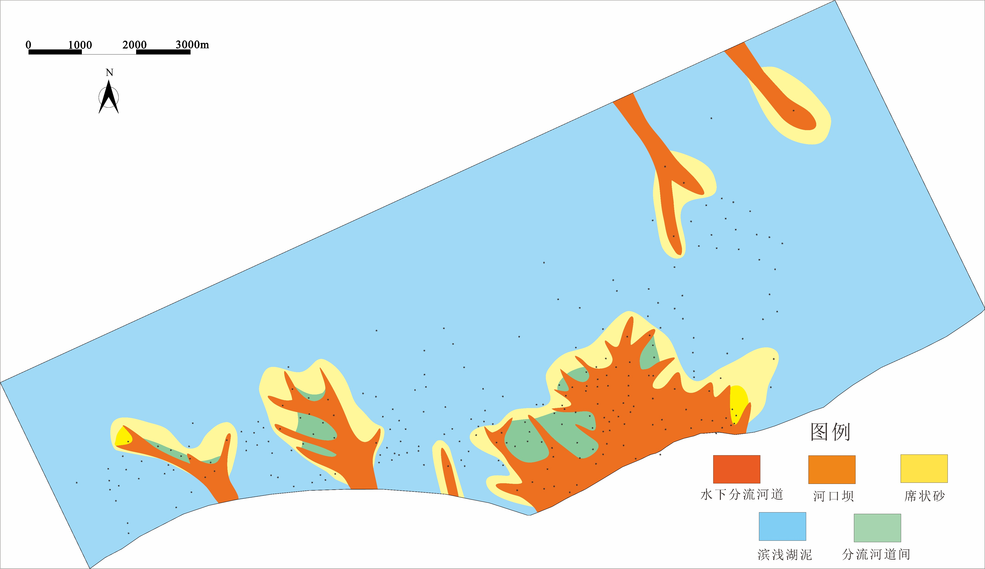
Microfacies Identification
From a planar perspective, the sedimentary pattern of sand bodies in the study area exhibits retrogradation accompanied by lateral migration, consistent with the well-tie cross-section.

Slide 9
Reservoir Quality Evaluation
The difference of reservoir quality is characterized by comprehensive utilization of logging and analysis test data. The study shows that there are five reservoir types in the retrograde fan delta facies, and the difference of reservoir quality is closely related to the type of sedimentary microfacies. There are also significant differences in reservoir quality within the same microfacies.
0.8~1.0
Non-productive
Sand bodies exhibit strong heterogeneity and poor connectivity.
0.6~0.8
Marginal
Reservoir type
0.4~0.6
Average
0.2~0.4
Favorable
Sand bodies exhibit weak heterogeneity and good connectivity.
0~0.2
High-quality

Slide 10

Thank you for your listening！
Yifang Yang
Email: 2799974568@qq.com

