Slide 1
Modeling the Atmosphere of 55 Cancri e with a Non-grey General Circulation Model
Ruizhi Zhan and Daniel D.B. Koll
Department of Atmospheric and Oceanic Sciences
Peking University
ruizhi.zhan@stu.pku.edu.cn
ruizhizhan.github.io

Slide 2
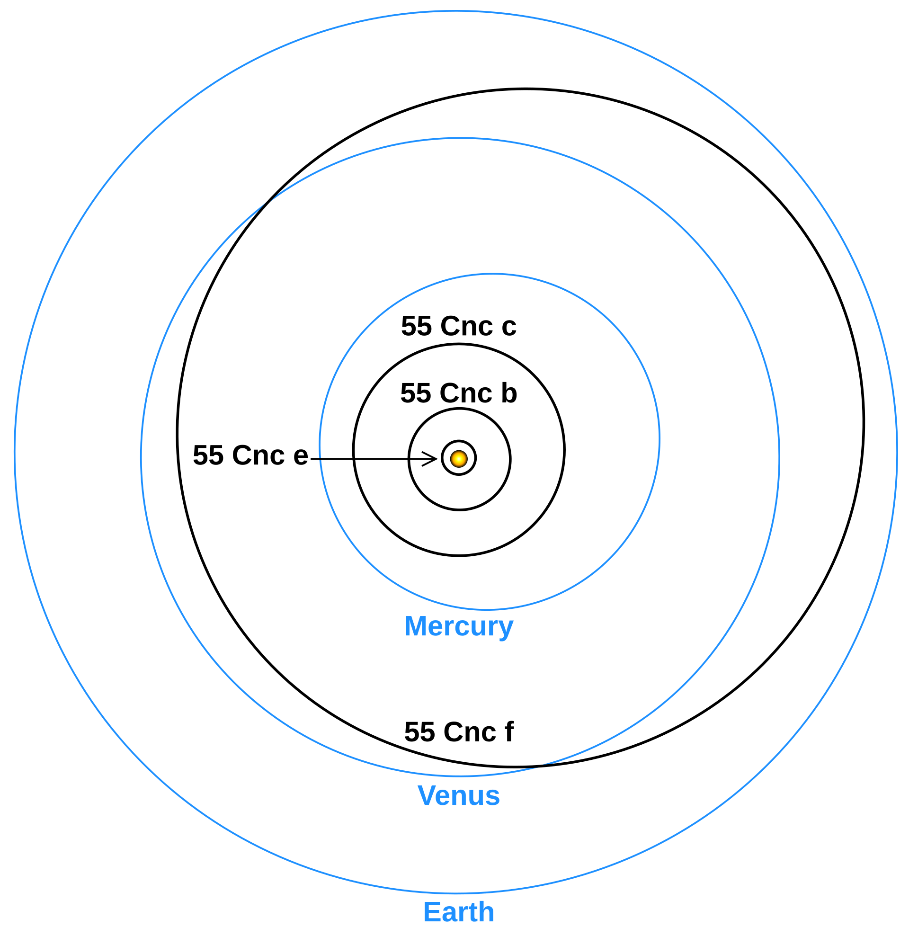
55 Cancri e is an ideal target to study planet in extreme environment
55 Cnc e
55 Cnc A system vs Solar System
M. V ́azquez, The Earth as a Distant Planet, p.380

Slide 3
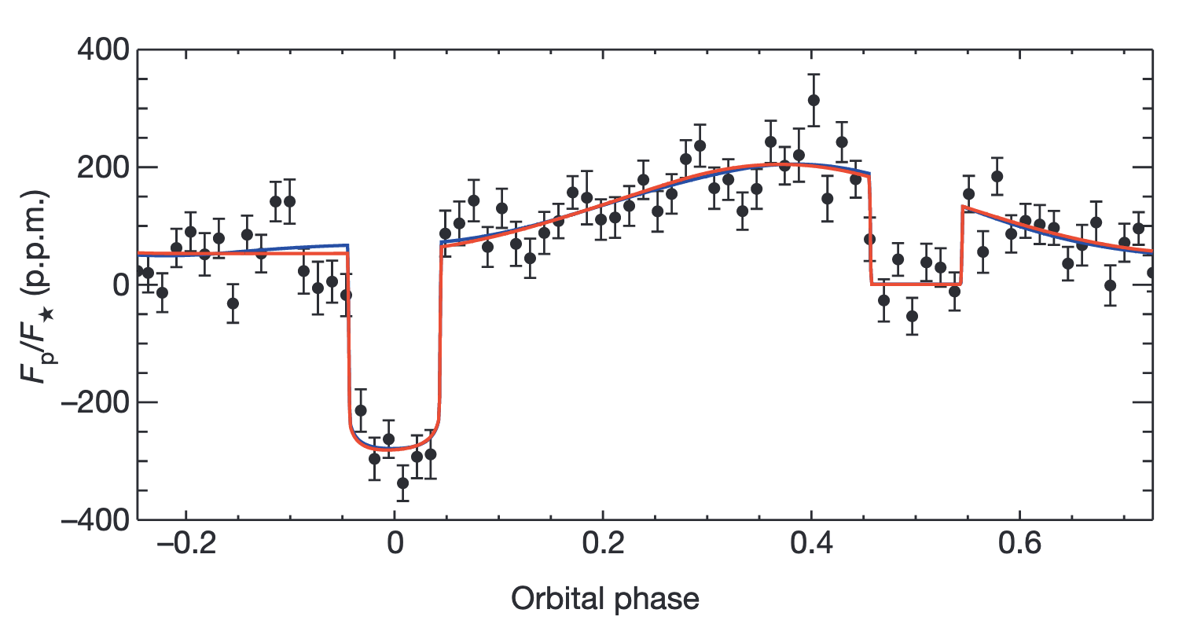
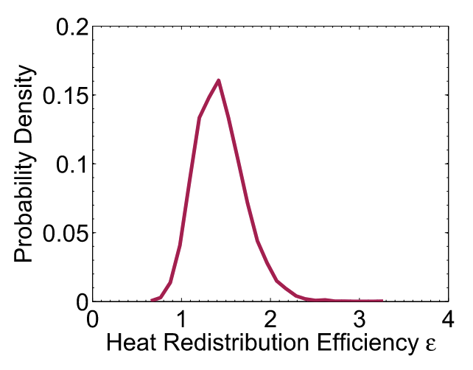
55 Cancri e is likely to have an atmosphere.
Effective heat redistribution
There might be an atmosphere
Spitzer IRAC, thermal phase curve
Demory et al. (2016a); Angelo & Hu (2017)

Slide 4
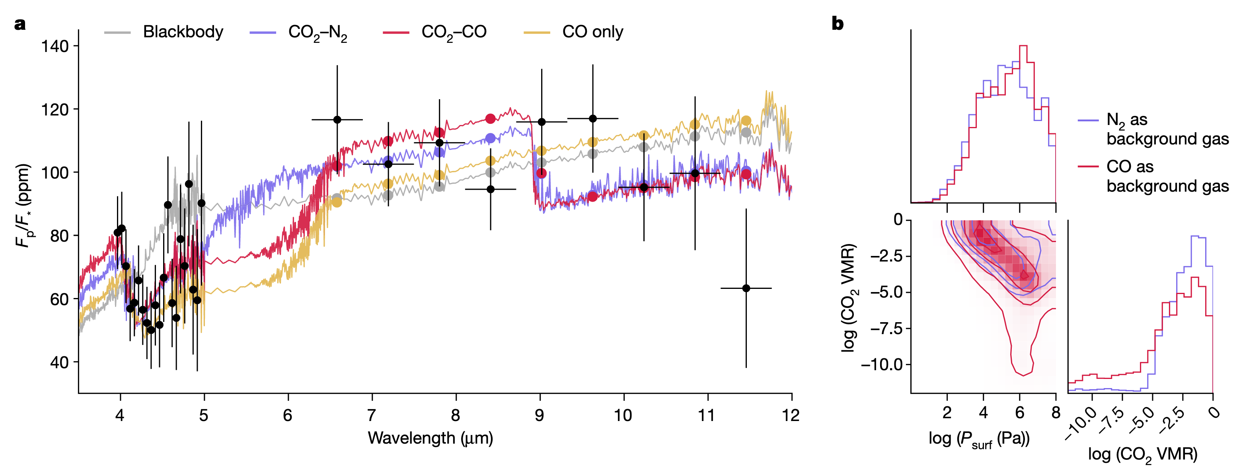
55 Cancri e is likely to have a secondary atmosphere.
JWST MIRI/NIRCam, emission spectrum
Posterior distributions
Thickness and composition are still weakly constrained
Hu et al. 2024

Slide 5
By now, few 3D model with realistic radiative transfer has been employed for 55 Cancri e.

Slide 6
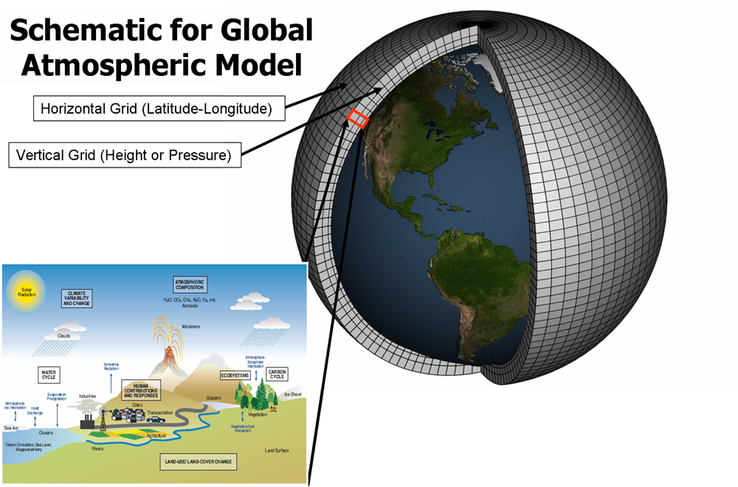
3D General Circulation Models (GCMs) can simulate
atmospheric dynamics, self-consistent heat redistribution
credit: NCAR

Slide 7
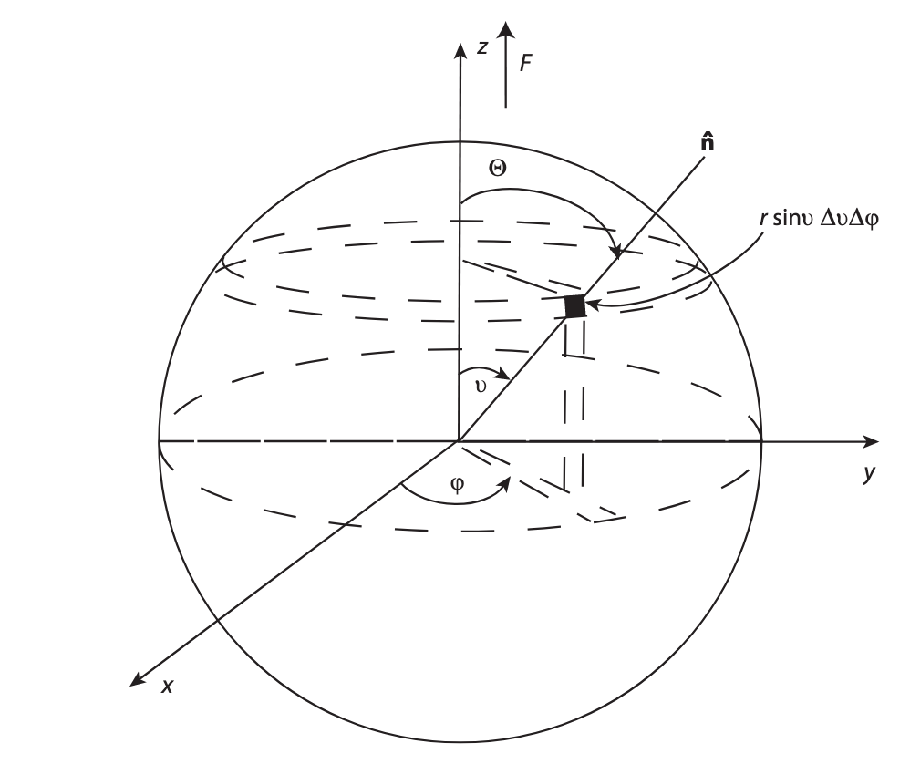
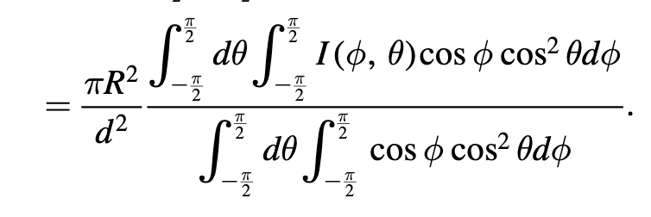
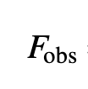
3D GCMs can simulate more realistic planet emission than 1D models
I
observer-projected flux
Planet
Seager 2010
Koll & Abbot 2015
Zhan et al. 2024
Observer

Slide 8
Can standard GCM radiative transfer codes be applied to 55 Cancri e?
Standard GCM radiative transfer codes for Earth
?
Hot planet
55 Cancri e ($T_{eq}$~2000K)

Slide 9
Can standard GCM radiative transfer codes be applied to 55 Cancri e?
No
Standard GCM radiative transfer codes for Earth
Hot planets
55 Cancri e ($T_{eq}$~2000K)
lack of absorption lines
line profile changes with temperature
$$T$$
$$P$$
$$T$$

Slide 10
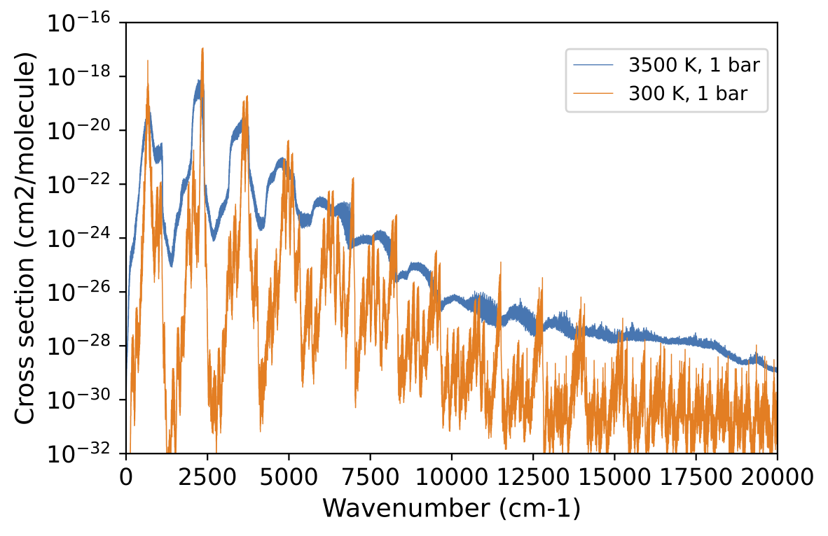
We develop custom correlated-k coefficients
and run a GCM with non-grey radiative transfer
CO₂ absorption cross section
line lists parameters for line profiles
ExoCross
Cross section
at high temperature
www.exomol.com
Absorption lines from
Yurchenko et al. 2020
Notes:
The difference between orange line and blue line is obviously significant.

Slide 11
We develop custom correlated-k coefficients
and run a GCM with non-grey radiative transfer
absorption lines
and parameters for line profiles
ExoCross
Cross section
at high temperature
ExoMol
UV absorption
Compute
correlated-k
SOCRATES
Suite Of Community RAdiative Transfer codes based on Edwards and Slingo
CIA
Collision induced absorption
HITRAN

Slide 12
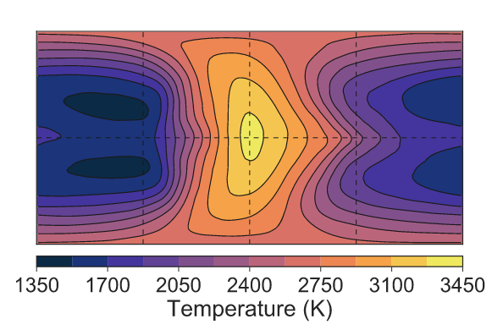
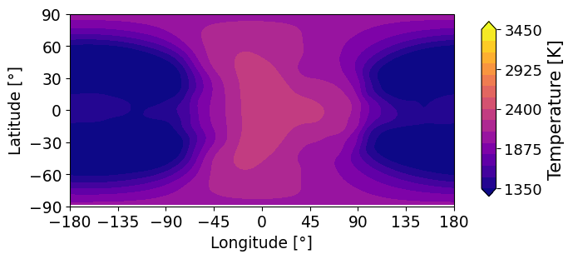
Result I: Atmospheric dynamics on 55 Cancri e
Half-surface-pressure air temperature (10-day average)
Grey model:
Non-grey model:
Hammond & Pierrehumbert 2017
this work (n2 with 1% CO2)
$μ=28$ g/mol, $p_{s}=10$ bar
$μ=28.16$ g/mol, $p_{s}=10$ bar
Stationary Rossby waves and Kelvin waves

Slide 13
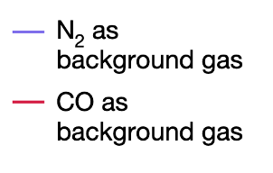
Result II: JWST MIRI/NIRCam Data favors
thick and CO₂ rich atmosphere
1D retrieval models cannot constrain the thickness and composition well
Hu et al. 2024

Slide 14
Result II: JWST MIRI/NIRCam Data favors
thick and CO₂ rich atmosphere
3D GCMs, this work
this work

Slide 15
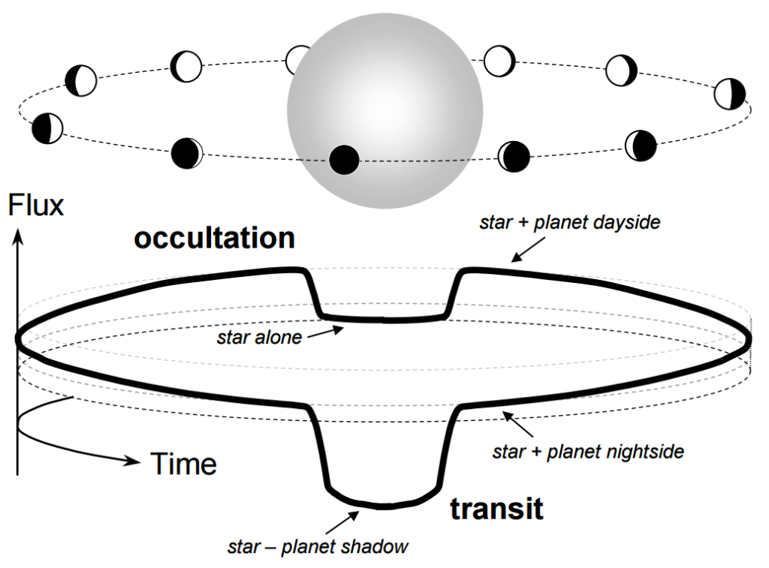
Observations indicate large time variability of the infrared eclipse depth.
eclipse
credit: Winn 2010

Slide 16
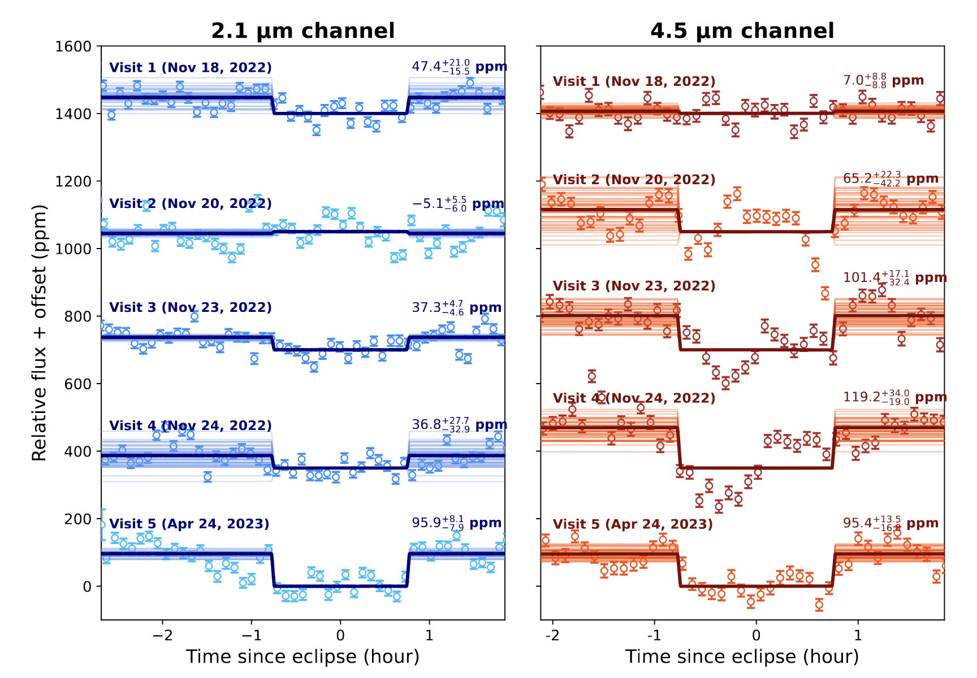
Observations indicate large time variability of the infrared eclipse depth.
The explanation remains inclusive,
e.g., surface outgas
circumstellar torus
clouds
tidal heating
...
JWST NIRCam observed the variability
Patel et al. 2024

Slide 17
Result III: Time variability due to large-scale atmospheric dynamics
Air temperature and horizontal wind at half pressure level

Slide 18
Result III: Time variability due to large-scale atmospheric dynamics
variability $∝$ surface pressure
$$T_{b}(t)$$

Slide 19
Result III: Time variability due to large-scale atmospheric dynamics
variability $∝$ surface pressure
$$T_{b}(t)$$
$$σ_{T_{b}}$$
$$σ_{T_{air}},σ_{\sqrt{u^{2}+v^{2}}}$$
at $p=\frac{1}{2} p_{s}$

Slide 20
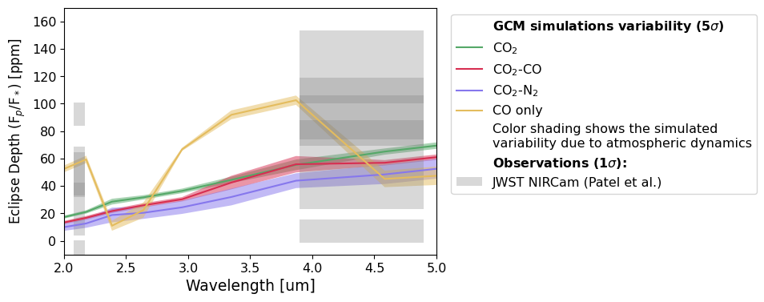
Result III: Time variability due to large-scale atmospheric dynamics is much weaker than observations

Slide 21
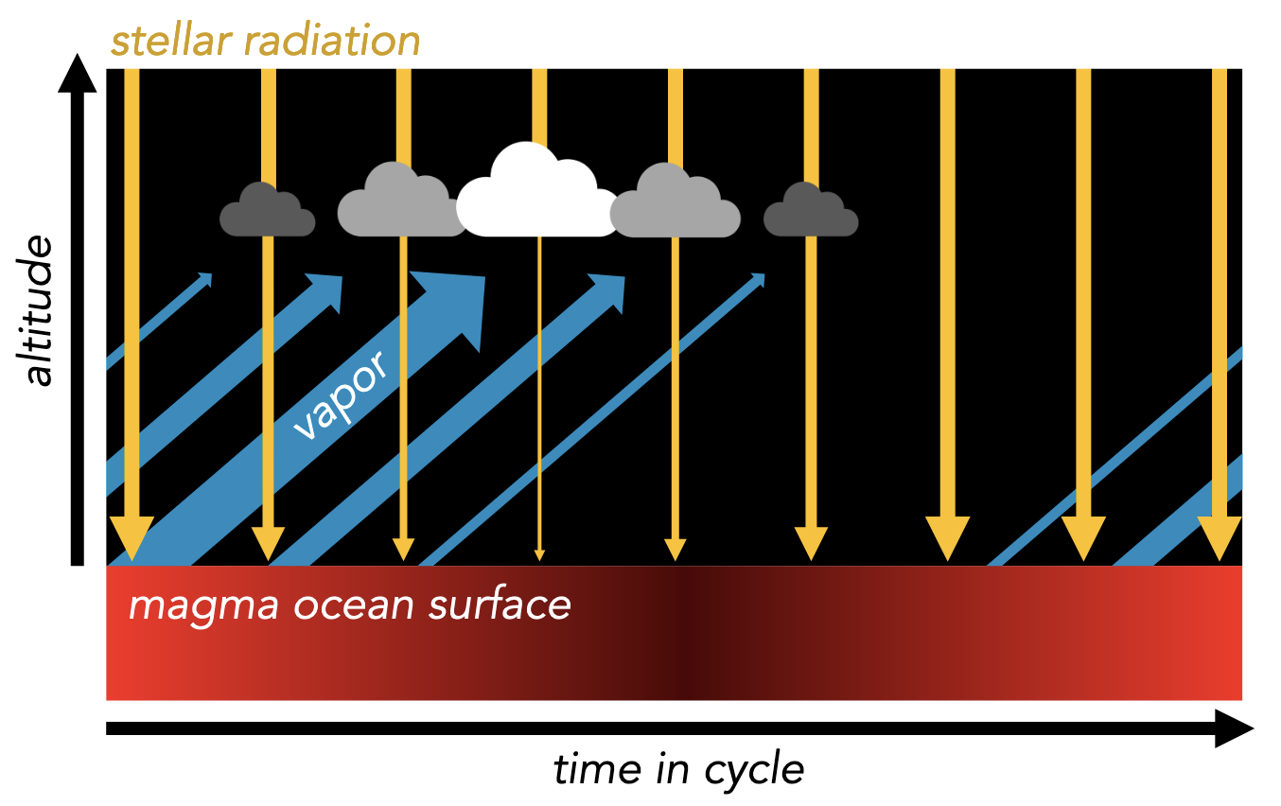
Next Step: Cloud Variability?
cloud shortwave feedback.
Loftus et al. 2024

Slide 22
Take home message
We develop custom correlated-k coefficients and run a 3D GCM with non-grey radiative transfer.
JWST MIRI and NIRCam Data favors thick and CO₂ rich atmosphere. Our 3D model has predictions differ from 1D model.
Time variability due to large-scale atmospheric dynamics is much weaker than that detected by telescopes.
Contact: ruizhi.zhan@stu.pku.edu.cn
Personal website: ruizhizhan.github.io
Notes:
sound speed vs escape velocity

Slide 23
Result I: Atmospheric dynamics on 55 Cancri e
Zonal mean zonal wind
Non-grey model:
this work (n2 with 1% CO2)

Slide 24
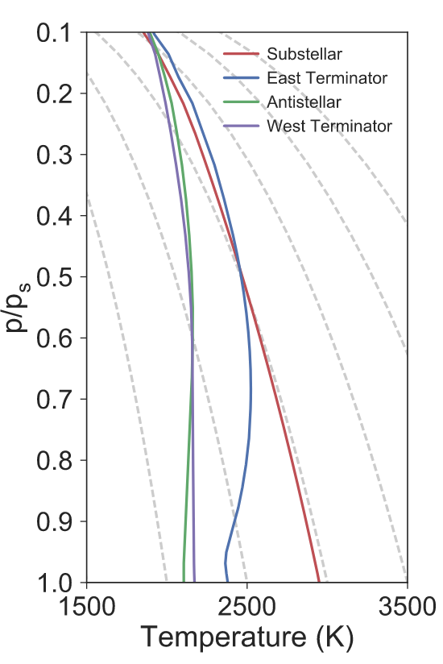
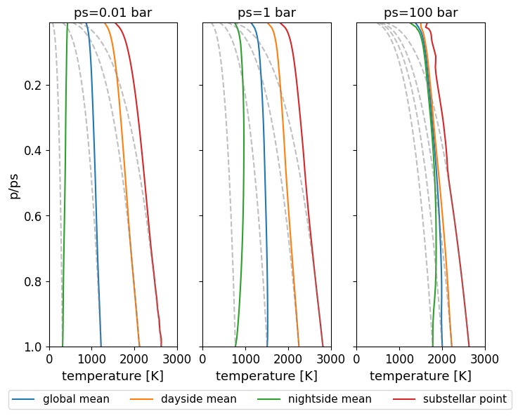
Result I: Atmospheric dynamics on 55 Cancri e
Temperature-pressure profiles:
Grey model:
Non-grey model:
Hammond & Pierrehumbert 2017
this work
Notes:
Grey model: The T(p) profiles follow the dry adiabat on the lower atmosphere of the day-side, but tend toward isothermal elsewhere.
Similar to grey model result but convection layer is thinner.

Slide 25
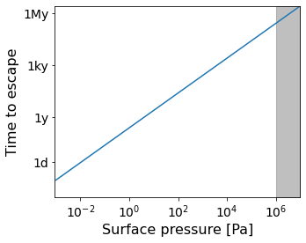
Discussion I: The escape of thick atmosphere cannot explain the observed variability
Thick atmosphere
suggested by JWST MIRI
Energy-limited mass flux of atmospheric escape:
Heng 2023
Observed variability timescale

Slide 26
Despite extensive observation, the nature of 55 Cancri e is still poorly understood.
Does 55 Cancri e has an atmosphere?
Why is the time variability of the infrared eclipse depth so large?
Probably yes, a secondary atmosphere.
Explanation remains inclusive
Surface outgas
reflective grains/dust Rappaport et al. 2012, 2014; Tamburo et al. 2018; Meier et al. 2023
transient outgas/escape Heng 2023;
Circumstellar torus
Demory et al. 2016;
Clouds
Loftus et al. 2024;
...

Slide 27
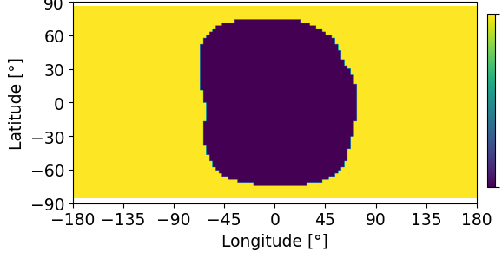
Discussion II: Cloud variability?
If there is no transport, dayside of the planet might be cloud free.
cloudy
no cloud
Notes:
here we use temperature field

Slide 28
Despite extensive observation, the nature of 55 Cancri e is still poorly understood.
Does 55 Cancri e has an atmosphere?
Probably yes, a secondary atmosphere.
The heat redistribution is more effective than lava ocean.
Infrared thermal phase curve
Demory et al. (2016a); Angelo & Hu (2017)
The atmosphere is more likely to be secondary with high mean molecular weight.
Transit spectroscopy
Jindal et al. (2020); Deibert et al. (2021); Zhang et al. (2021)
The secondary atmosphere is probably rich in CO₂ or CO.
Infrared thermal emission spectra
Hu et al. (2024)
Notes:
xxx observations suggests xxx

Slide 29
Despite extensive observation, the nature of 55 Cancri e is still poorly understood.
Does 55 Cancri e has an atmosphere?
Why is the time variability of the infrared eclipse depth so large?
Probably yes, a secondary atmosphere.
Explanation remains inclusive
Surface outgas
reflective grains/dust Rappaport et al. 2012, 2014; Tamburo et al. 2018; Meier et al. 2023
transient outgas/escape Heng 2023;
Circumstellar torus
Demory et al. 2016;
Clouds
Loftus et al. 2024;
...
Notes:
Another interesting fact of this planet is the
There are some hypothesis

