Slide 1
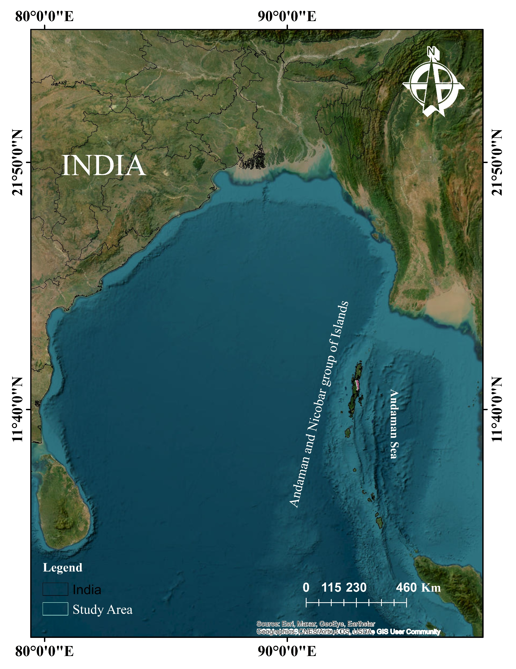
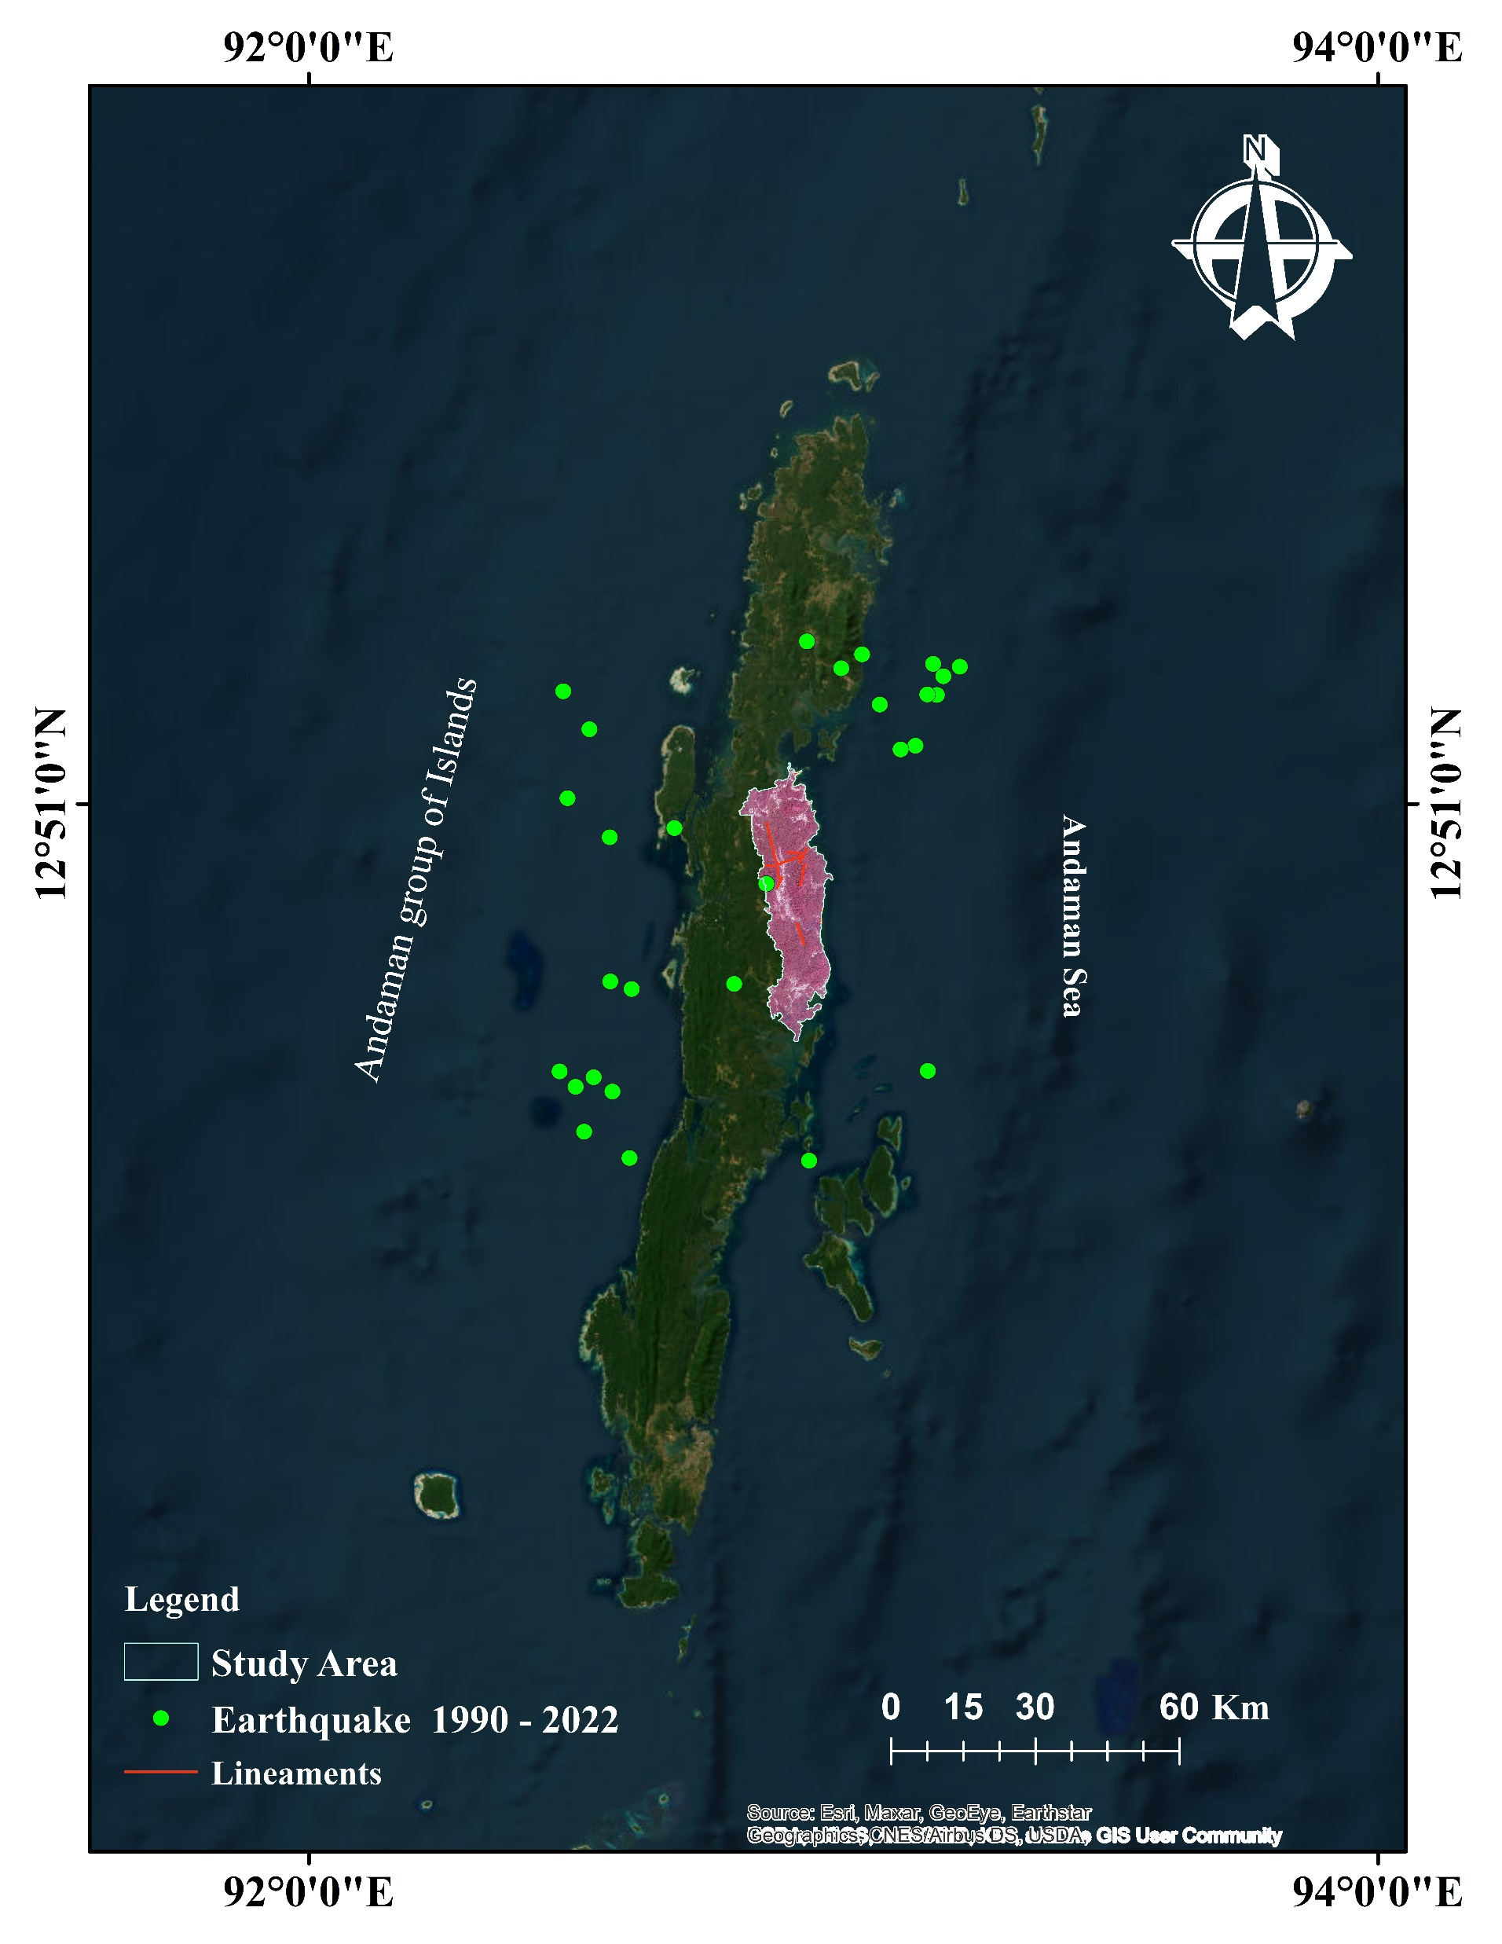
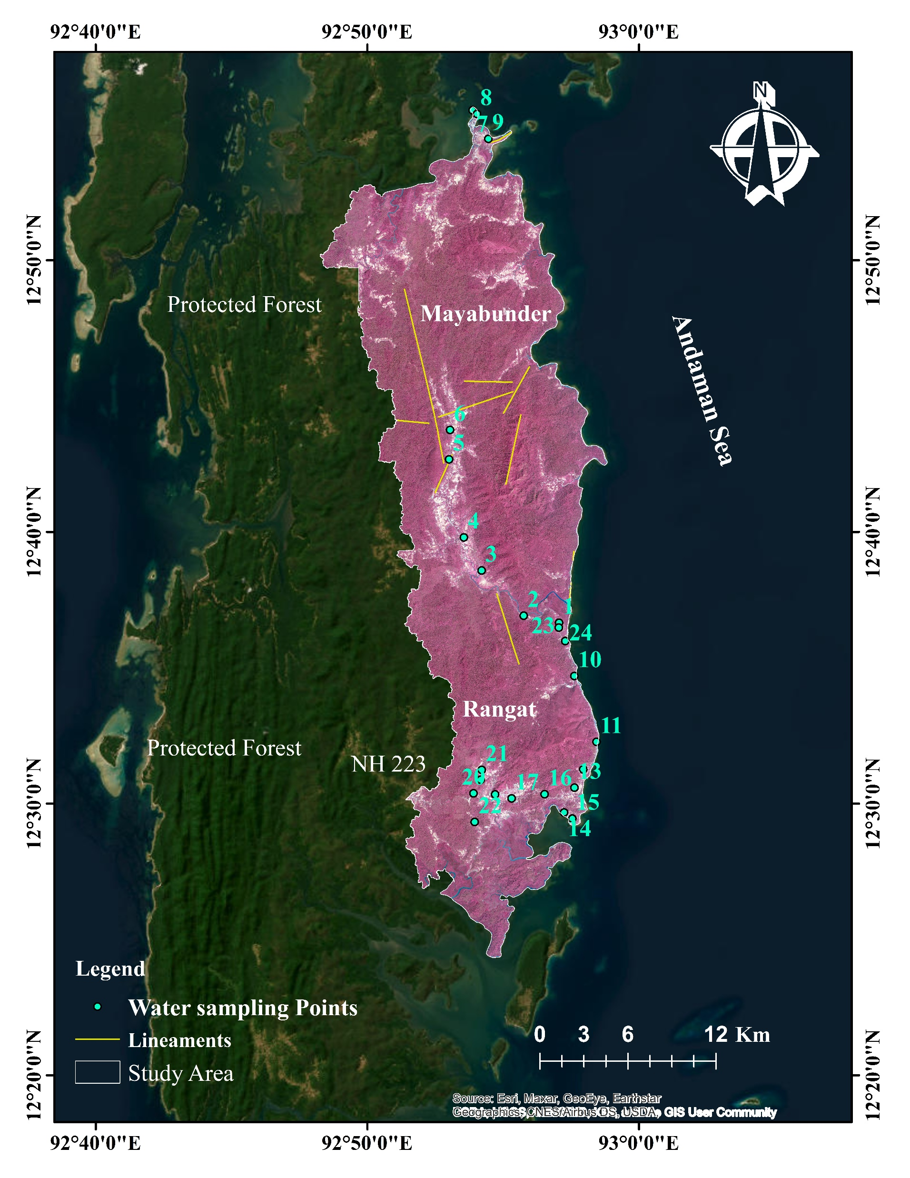

Slide 2
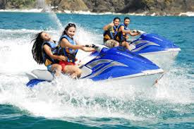
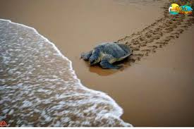
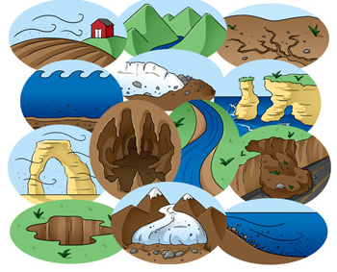
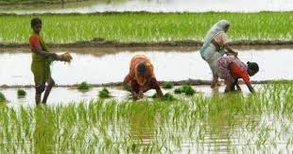
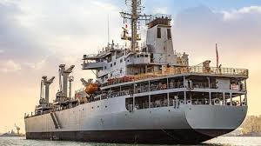
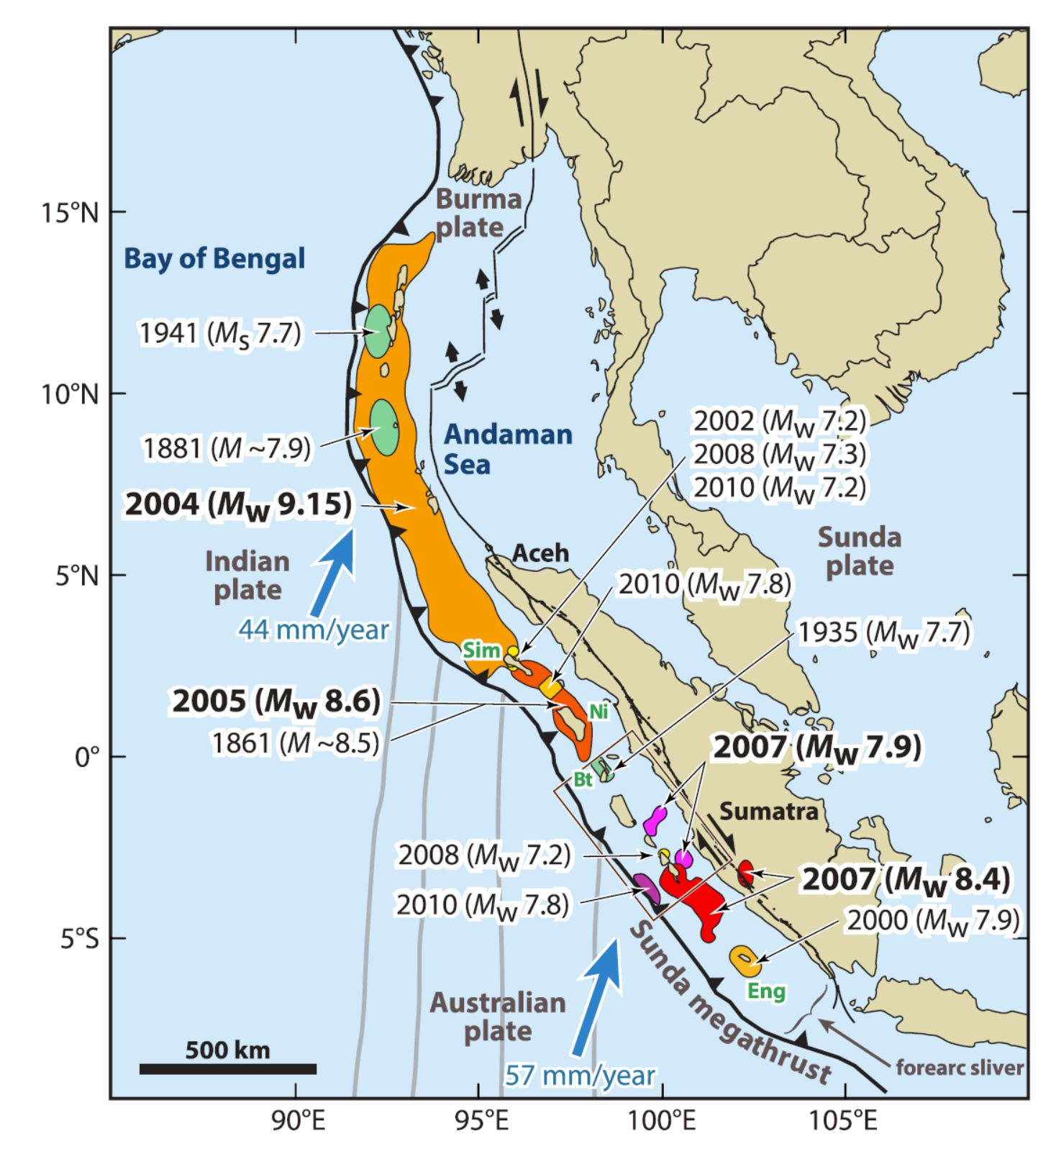
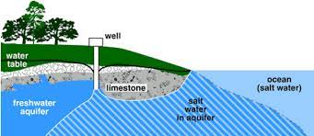
Precipitation and Evaporation
pH, EC, TDS, CO₃, and Mg.
Enrichment of NO₃, PO₄, and As.
Human activities -Tourism and Irrigation
Weathering and Erosion
Limestone dissolution/ reverse ion exchange process (enrichment of Na, K, Ca, Cl, and F)
Limestone cave damage/ enrichment of Na, Ca, HCO₃ Cl, and F
Earthquakes and lineaments
Seawater intrusion
Weathering of rocks across lineaments (enrichment of heavy metals and rainwater percolation (HCO₃)
Hydrogeochemical processes in middle Andaman

