Slide 1
The potential impacts of environmental factors change on evapotranspiration in the Gaoping River Basin, Taiwan: A sensitivity analysis using Artificial Neural Networks (ANN)
Authors: Shin-En Chen¹, Shiu-Hao Yeh², Chi-Cheng Chiu², Tsung-Yu Lee³
Affiliation of authors: National Taiwan Normal University

Slide 2
Introductory Presentation
2 min

Slide 3
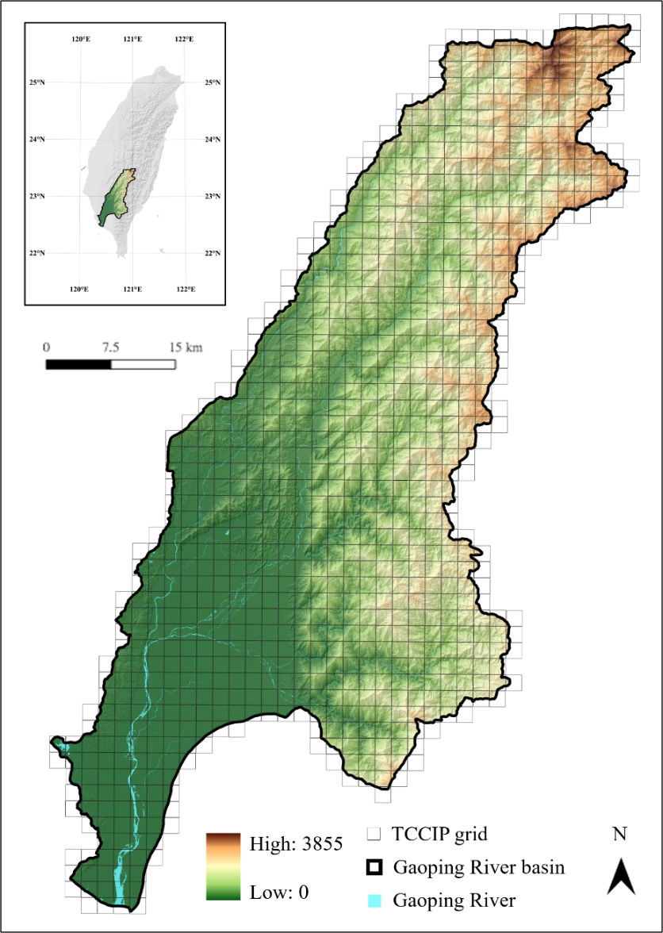
ANN model (1980-2021)
SR
ET
T
VPD
Input layer
Hidden layer
Output layer
Notes:
The relationship between ET and environmental factors has long been discussed. However, less attention has been given to the variability of these relationships under different environmental conditions.
Our study focuses on the Gaoping River Basin, using gridded data from 1980 to 2021 to train an ANN model that predicts ET based on solar radiation, temperature, and vapor pressure deficit.

Slide 4
100 Bins
All data
100
SR percentiles
……
10
10
……
100
VPD percentiles
Notes:
To simulate different environmental conditions, we divide the data into 10x10 bins based on the percentiles of vapor pressure deficit and solar radiation.

Slide 5
Formula 1
$$s{ensitivity}_{IV}=\frac{\frac{{ET}_{\left(adjusted\right)}−{ET}_{\left(original\right)}}{{ET}_{\left(original\right)}}\%}{IV change rate(i.e.,+1\% or −1\%)}×100\%$$
100
Adjusted VPD by a small percentage (e.g., ±1%) and predicted how sap flow would respond.
Result: the rate of ET change relative to the rate of change in the VPD (ET sensitivity to VPD).
Positive value: ET increase when VPD increase
Negative value: ET decrease when VPD increase
Example
SR percentiles
……
10
10
……
100
VPD percentiles
Notes:
The sensitivity of ET to each environmental factor was calculated within each bin using Equation 1, with the result representing the percentage change in ET when the environmental factor changes by 1%.

Slide 6
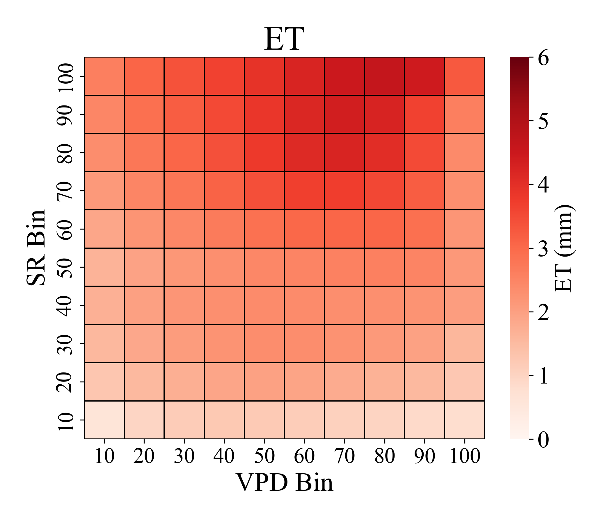
Peak ET
Notes:
The first key finding of our research is that the peak ET does not occur in the bins with the highest VPD percentiles. This suggests that under excessive environmental stress, plant transpiration tends to slow down.

Slide 7
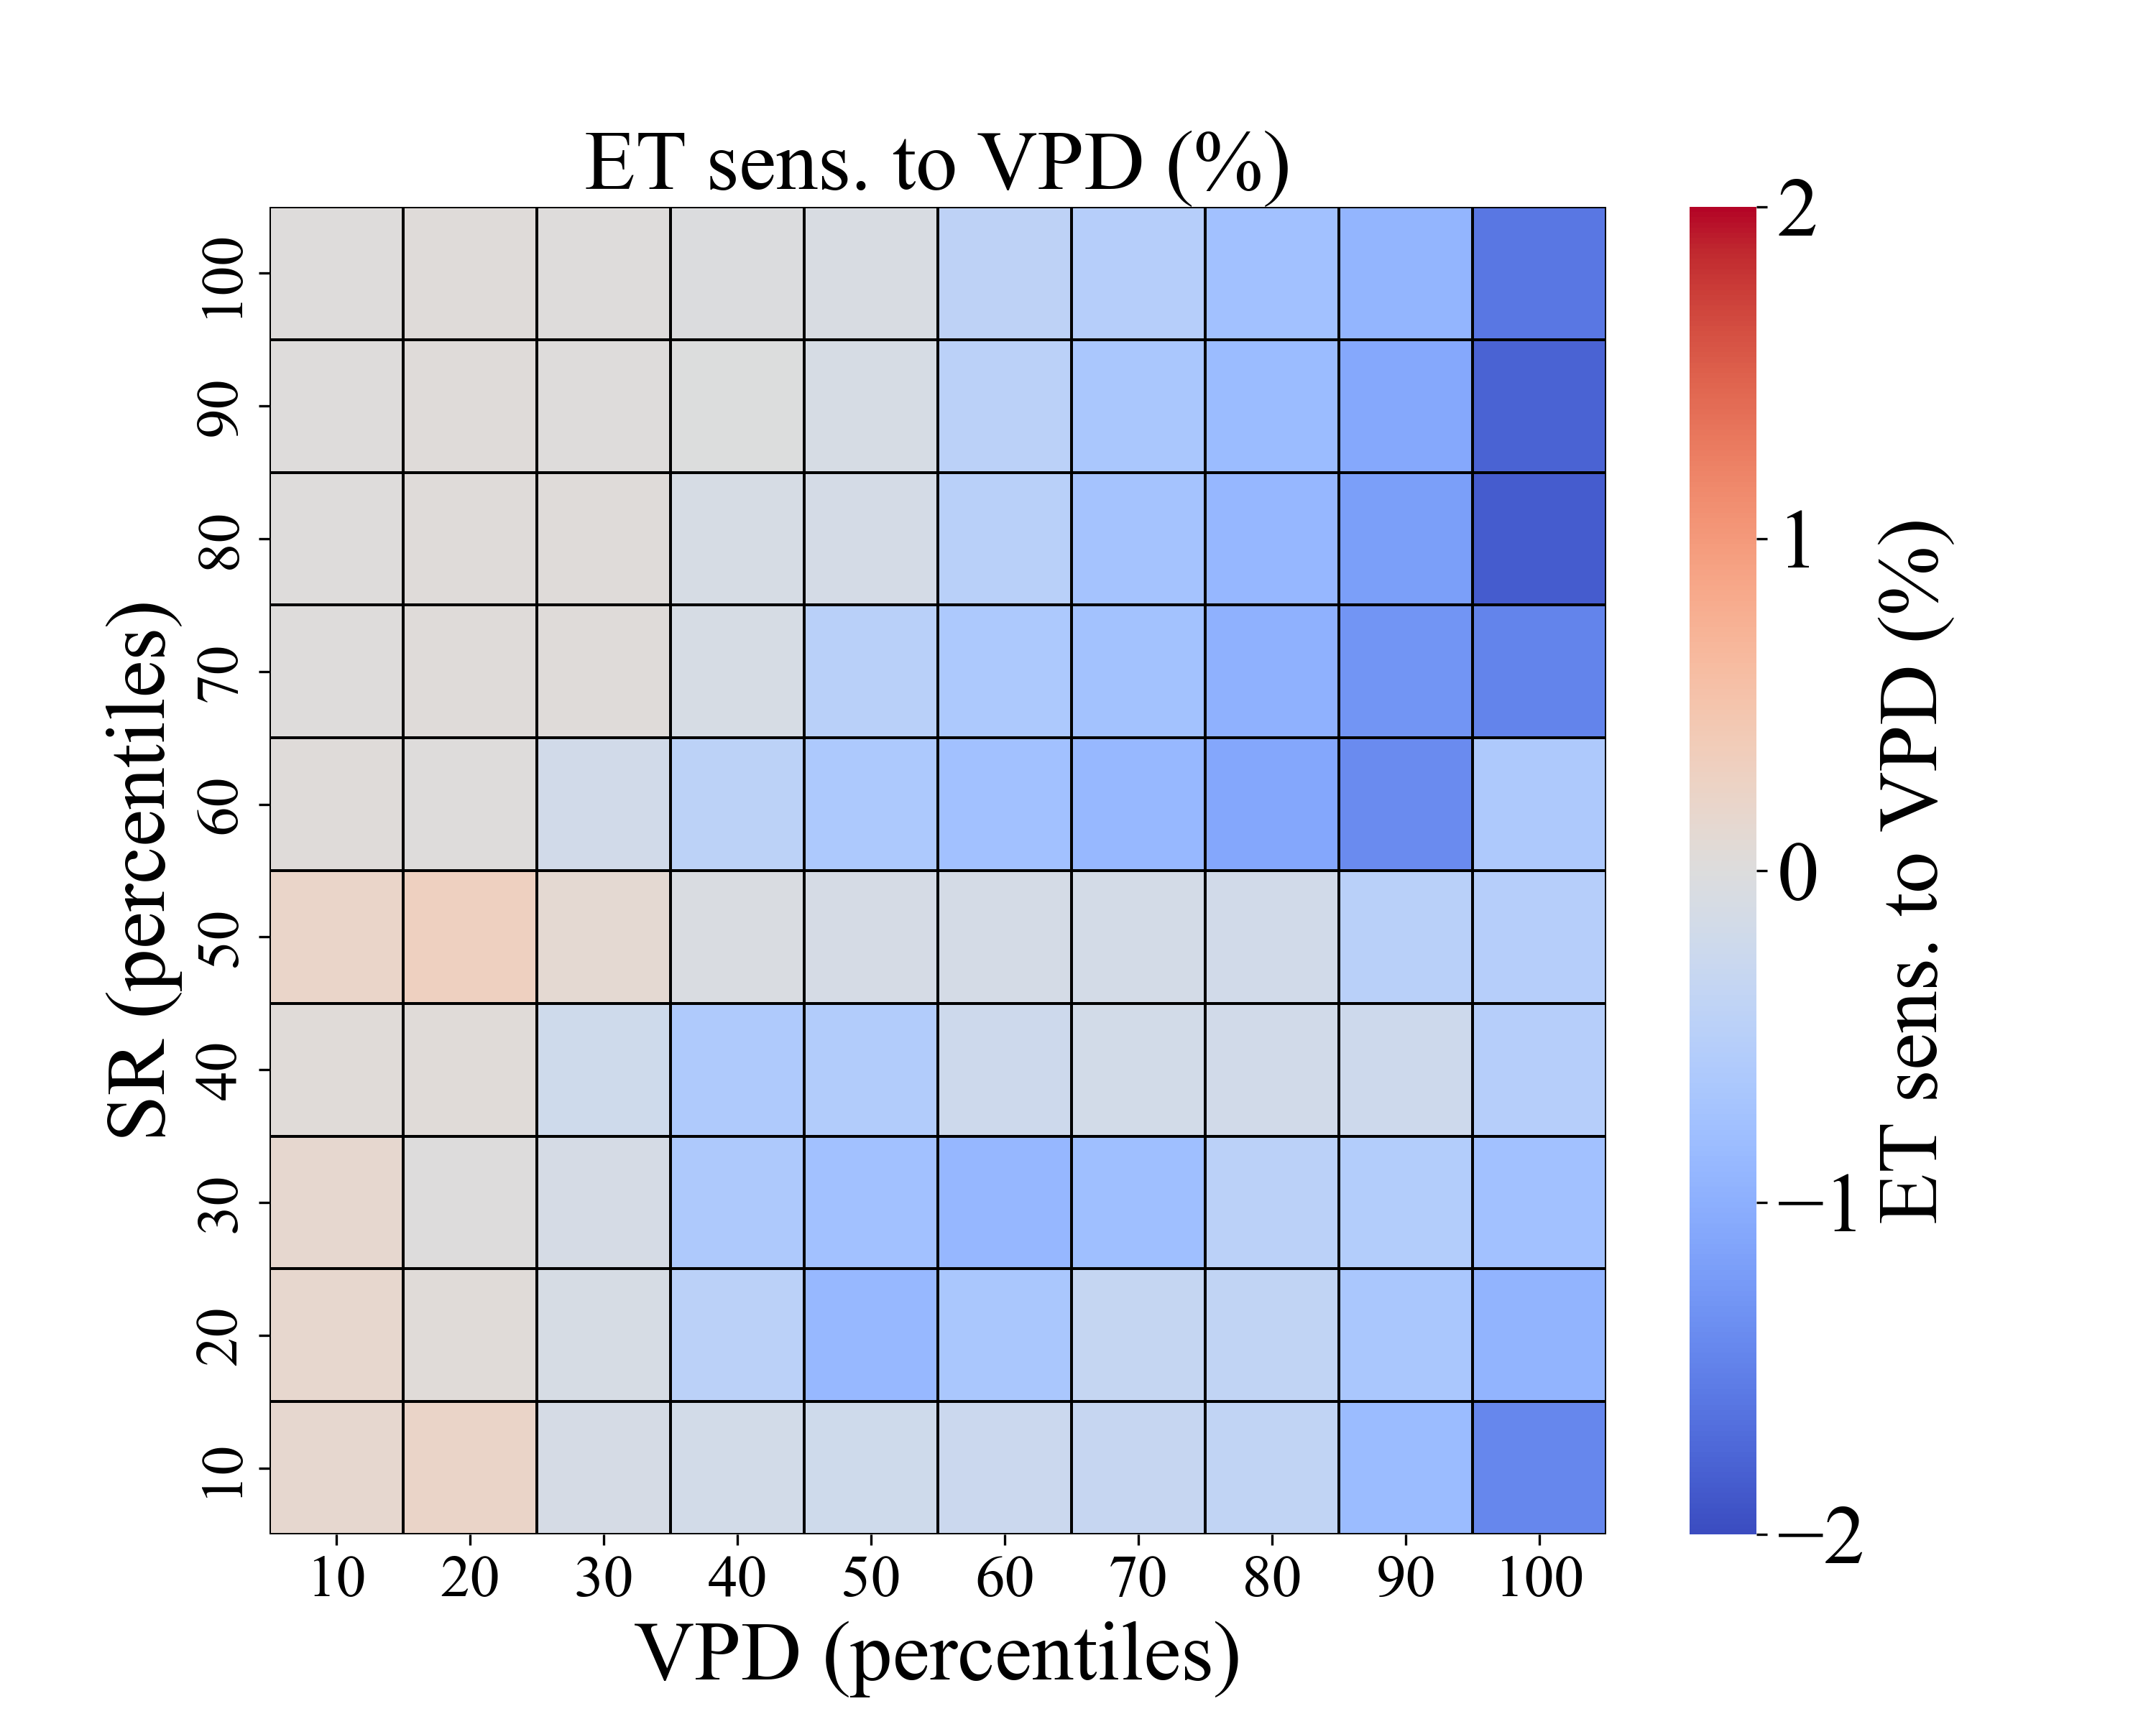
Negative
sensitivity
VPD ≈ 0.4
Notes:
In terms of the sensitivity analysis, we found that after VPD surpasses 0.35 kilopascals (kPa), ET shows negative sensitivity to VPD, with the magnitude of this negative response becoming stronger under higher VPD and SR conditions. This indicates that in relatively drier environments, if the air gets even drier, evapotranspiration might stop rising — or even start to decrease.
Evapotranspiration has been increasing under climate change, as shown in both global and Taiwan-based studies. However, under environmental pressure, transpiration could be limited by plant regulation. If the research findings hold true, the increase in evapotranspiration under climate change may not be unlimited but constrained by plant regulation.

Slide 8
Interactive Discussion Phase

Slide 9
Introduction
Driven by rising temperature and evaporative demand, previous studies indicate an increasing trend in evapotranspiration (ET) across Taiwan under climate change (Lee et al., 2023; Li et al., 2009; Yu et al., 2002), aligning with global trends (Yang et al., 2023).
1

Slide 10
Introduction
However, Yuan et al. (2019) highlighted that the rising vapor pressure deficit (VPD) globally since the 1990s have had negative impact on vegetation growth.
Similarly, by segmenting the data into multiple bins and applying machine learning along with sensitivity analysis, Fu et al. (2022) demonstrated that the sensitivity of canopy conductance (Gc) to environmental factors could vary under different environmental conditions.
Both studies suggest that plants may engage in self-regulation to reduce transpiration when facing environmental stress.
2

Slide 11
Introduction
Assessing how ET responds to environmental factors under varying conditions in the context of climate change is crucial for understanding its implications on the hydrological budget.
3

Slide 12
Introduction
Our study focus on the Gaoping River Basin located in southern Taiwan, using the 2-kilometer gridded ET and meteorological data, including temperature (T), solar radiation (SR) and vapor pressure deficit (VPD) from 1980 to 2021 produced by Taiwan Climate Change Projection Information and Adaption knowledge Platform (TCCIP), combined with an Artificial Neural Network (ANN) to develop the model. We divide the data into bins based on the percentiles of environmental factors to represent various environmental conditions, the sensitivity of ET to changes in environmental factors was calculated in each bin.
4

Slide 13
Introduction
The objectives of this study include (1) Identifying the dominant drivers of ET within Gaoping River Basin; (2) Examining whether the sensitivity of ET to environmental factors exhibits seasonal variation; and (3) Assessing the potential impacts of changes in environmental factors on ET under climate change.
5

Slide 14
Methodologies
Study area
Data
ANN modeling
Sensitivity analysis
Gaoping River Basin is in southern Taiwan, the elevation is high in the northeast and low in the southwest. the dry season occurs from November to April (Water Resources Agency, 2021).
 | Mountainous regions | Lowlands
Climate | temperate climate | tropical climate
Precipitation | 2,900 mm | 2,000 mm
6

Slide 15
Methodologies
Study area
Data
ANN modeling
Sensitivity analysis
TCCIP
Taiwan Climate Change Projection Information and Adaption Knowledge Platform
TReAD (Taiwan ReAnalysis Downscaling data) is a long-term, high-resolution historical climate dataset for Taiwan, generated using the WRF (Weather Research and Forecasting) model.
It is produced by performing dynamical downscaling on the ERA5 reanalysis data from the European Centre for Medium-Range Weather Forecasts (ECMWF, 2017). The grided dataset covers the period from 1980 to 2021, with plans for future extensions both forward and backward in time.
7

Slide 16
Methodologies
Study area
Data
ANN modeling
Sensitivity analysis
Grid resolution | 2 km × 2 km
Number of grids | 893 grids covering the Gaoping River Basin
Data Categories | SR (MJ/m²), T (°C), RH (%), ET (mm) VPD (kPa) is calculated by T and RH
Temporal resolution | Daily data
Diagram of Data Downscaling: https://tccip.ncdr.nat.gov.tw/km_newsletter_one.aspx?nid=20210323110413
8

Slide 17
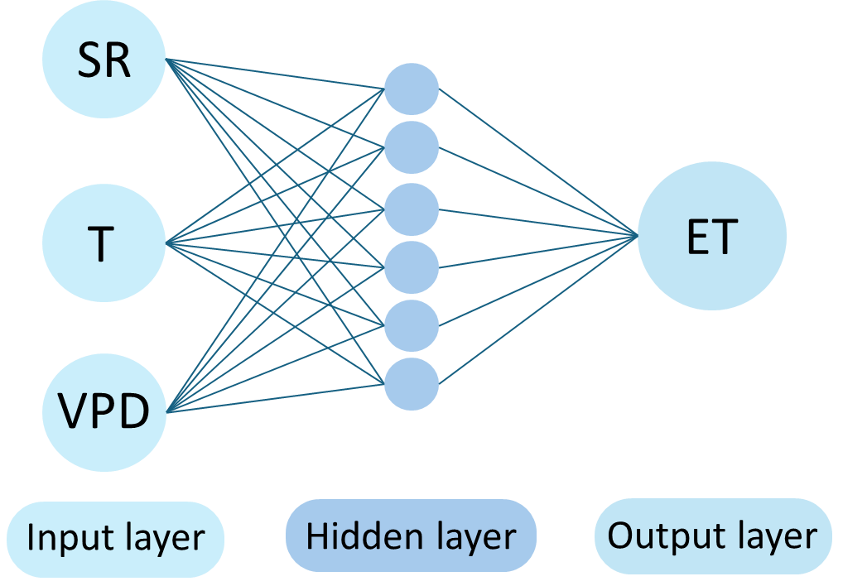
Methodologies
Study area
Data
ANN modeling
Sensitivity analysis
Backpropagation (BP) algorithm to train a Feed-forward Artificial Neural Network (FFNN)
Includes a single hidden layer with 10 nodes.
Independent variables: VPD, SR, and T
Response variable: ET
All data are normalized to a 0 - 1 scale prior to analysis.
The dataset is divided into training (60%), validation (20%), and testing (20%) sets. Model performance is evaluated using the Pearson correlation coefficient (R value). To ensure model stability, the process is repeated 10 times, and the median results from these iterations are presented.
9

Slide 18
Methodologies
Study area
Data
ANN modeling
Sensitivity analysis
Modeling approaches
Basin-based model
Grid-based models
Basin-based models: trained on data from all grid cells across the basin, reflecting the overall influence of environmental factors on ET across the basin. This model was also applied separately under wet and dry seasonal conditions to capture seasonal variations.
Grid-based models: trained separately for each grid cell, capturing the spatial variability in sensitivity
10

Slide 19
Methodologies
Study area
Data
ANN modeling
Sensitivity analysis
For sensitivity analysis, we divided entire dataset (from all grids) into 10×10 bins based on the percentiles of VPD and SR. This binning scheme was then applied to guide the sensitivity calculations in both modeling approaches.
100
All data
SR percentiles
……
10
10
……
100
VPD percentiles
11

Slide 20
Methodologies
Study area
Data
ANN modeling
Sensitivity analysis
The sensitivity of ET to environmental factors was calculated in each bin by formula 1 to understand how changes in environmental factors affect ET.
$$s{ensitivity}_{IV}=\frac{\frac{{ET}_{\left(adjusted\right)}−{ET}_{\left(original\right)}}{{ET}_{\left(original\right)}}\%}{IV change rate(i.e.,+1\% or −1\%)}×100\%$$
Formula 1
100
Adjusted VPD by a small percentage (e.g., ±1%) and predicted how ET would respond.
Result: the rate of ET change relative to the rate of change in the VPD (ET sensitivity to VPD).
Positive value: ET increase when VPD increase
Negative value: ET decrease when VPD increase
Example
SR percentiles
……
10
10
……
100
VPD percentiles
12

Slide 21
Methodologies
Study area
Data
ANN modeling
Sensitivity analysis
The following figure provides a summary of the data analysis process.
Modeling approaches
Global model for whole basin
Individual models for each grids
Sensitivity analysis
All data
Wet season
Dry season
Sensitivity analysis
All data
13

Slide 22
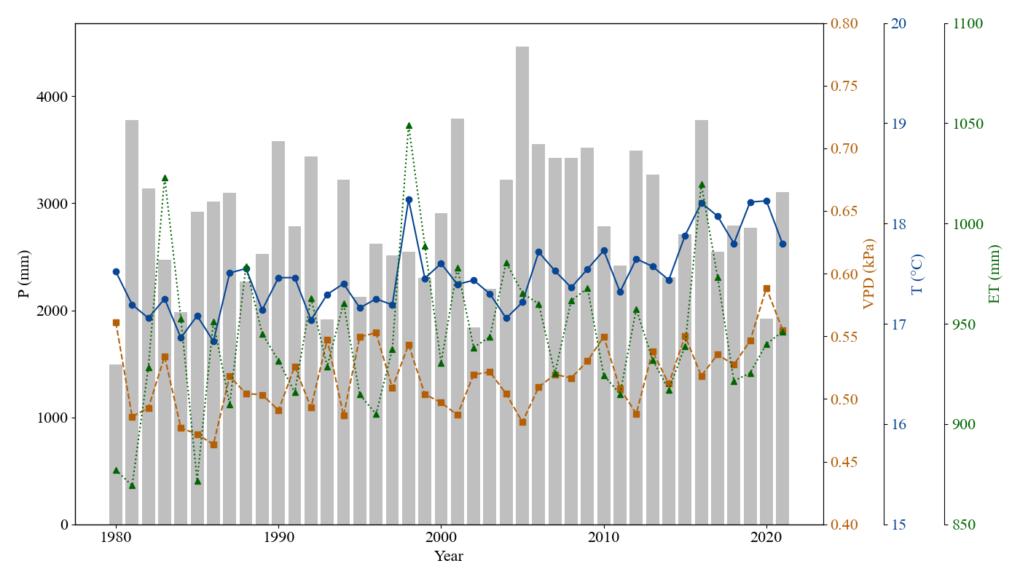
Results and Discussion
ET & Environmental condition
The annual mean VPD and T, along with the annual total ET and precipitation (P) distribution in the Gaoping River Basin from 1980 to 2021, are shown in the figure. It can be noticed that VPD, T and ET all exhibit an increasing trend.
14

Slide 23
Results and Discussion
ET & Environmental condition
The result is consistent with the long-term warming patterns reported in the “Climate Change in Taiwan: National Scientific Report 2024” and previous studies (Lee et al., 2023; Li et al., 2009; Yu et al., 2002). These trends indicate that climate change has already altered the hydrological budget.
15

Slide 24
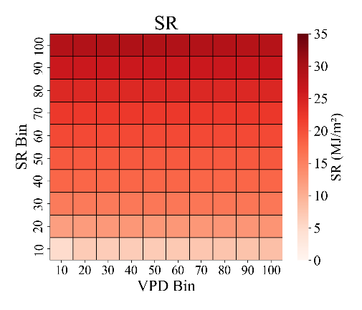
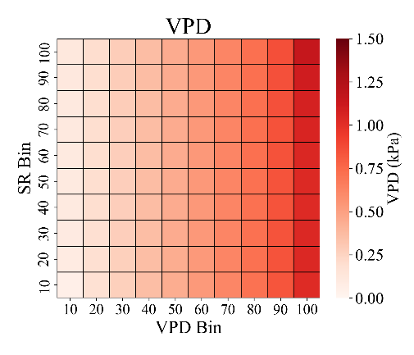
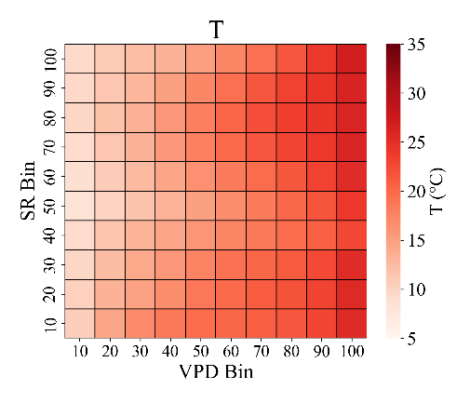
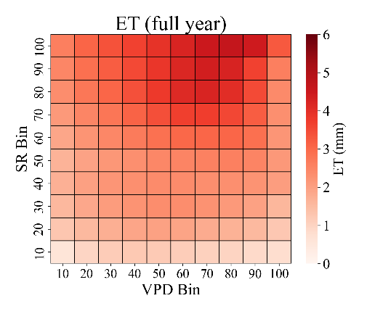
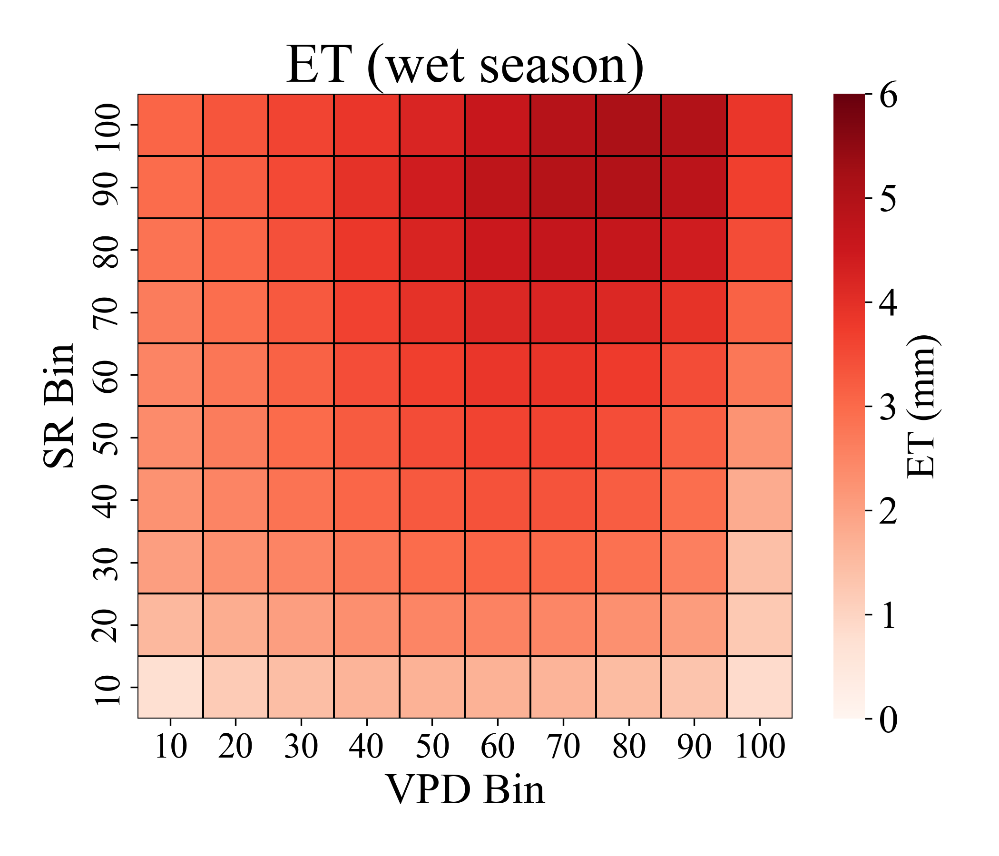
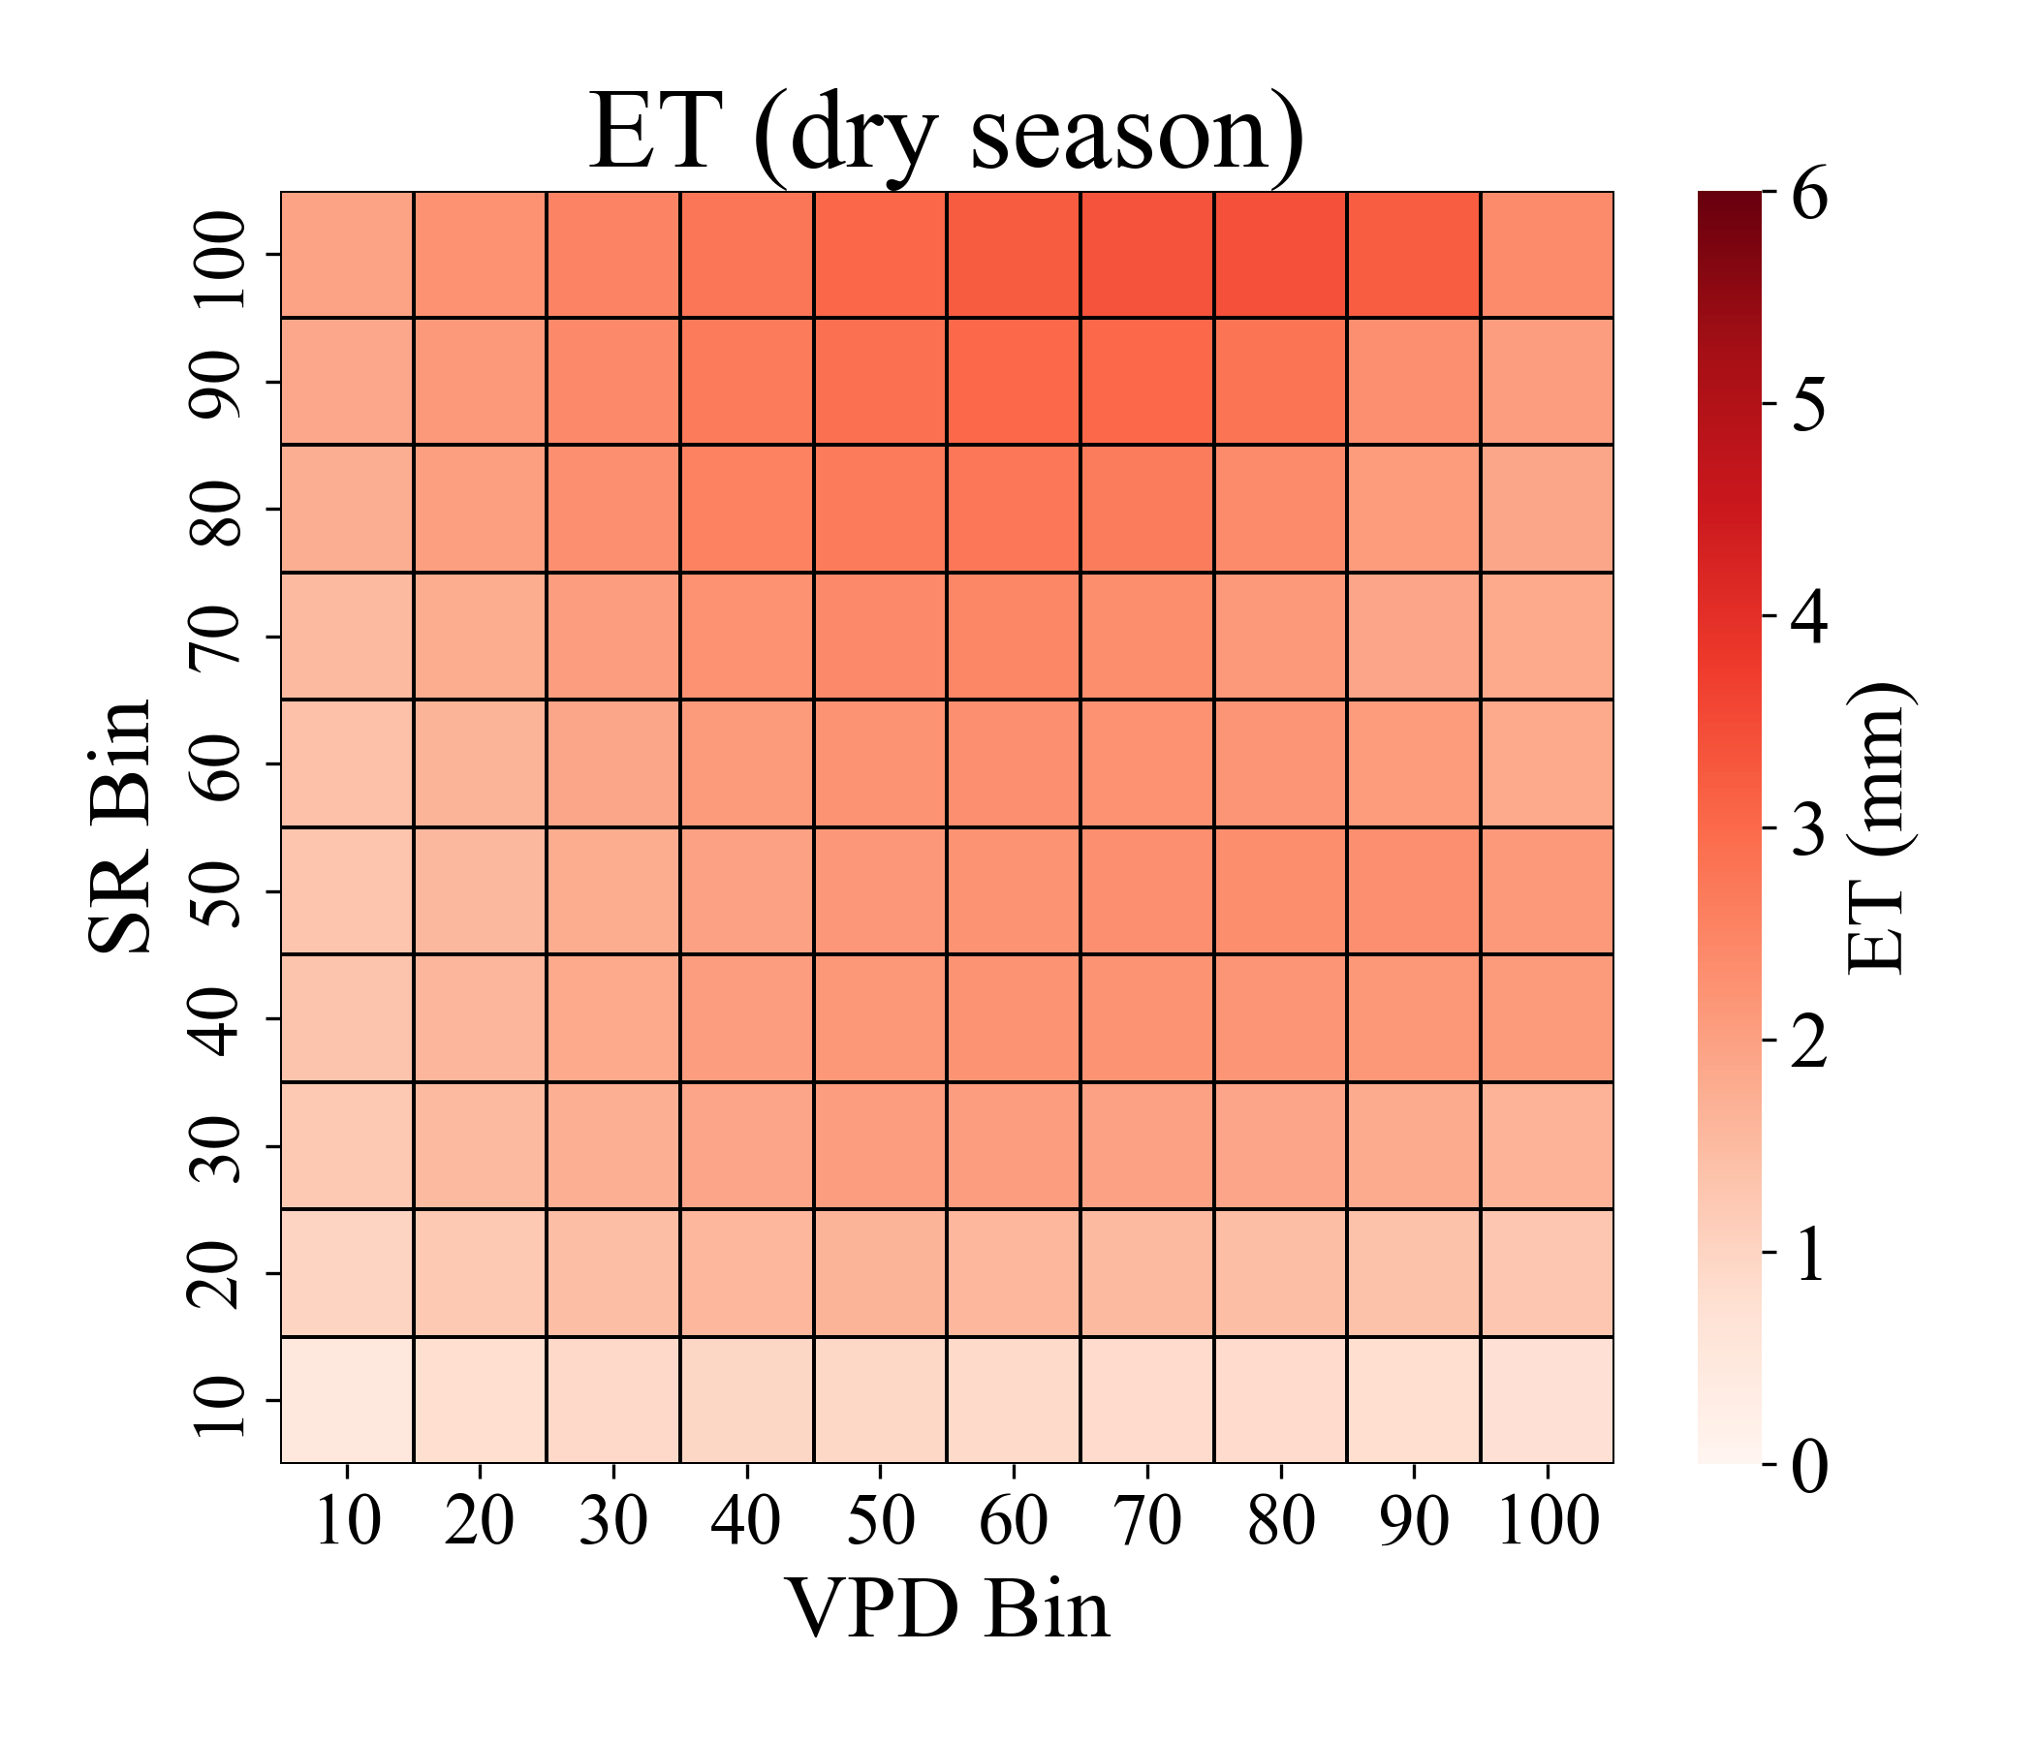
Results and Discussion
ET & Environmental condition
16

Slide 25
Results and Discussion
ET & Environmental condition
It can be noticed that highest ET is observed in bins with VPD percentiles of 70–90% and SR percentiles of 90–100%, rather than in the highest VPD range, indicating that the relationship between VPD and ET are nonlinear, and excessive environmental pressure could suppress ET, as reported by Massmann et al. (2019) and Liu et al. (2024).
17

Slide 26
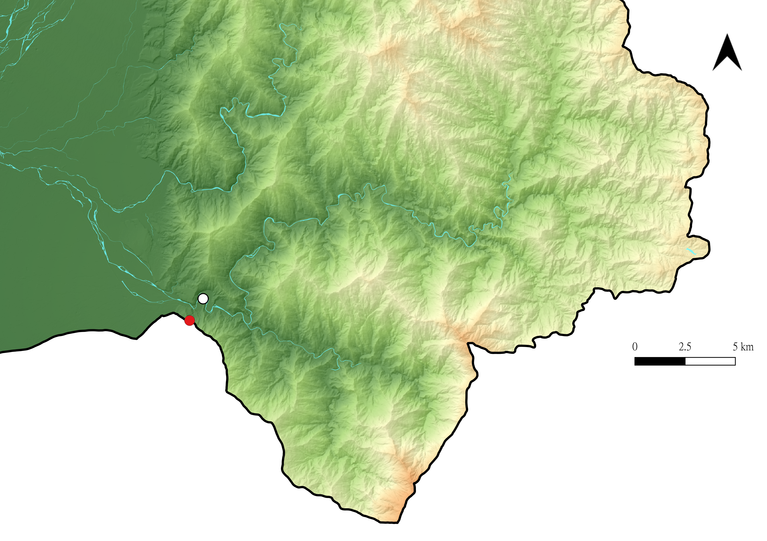
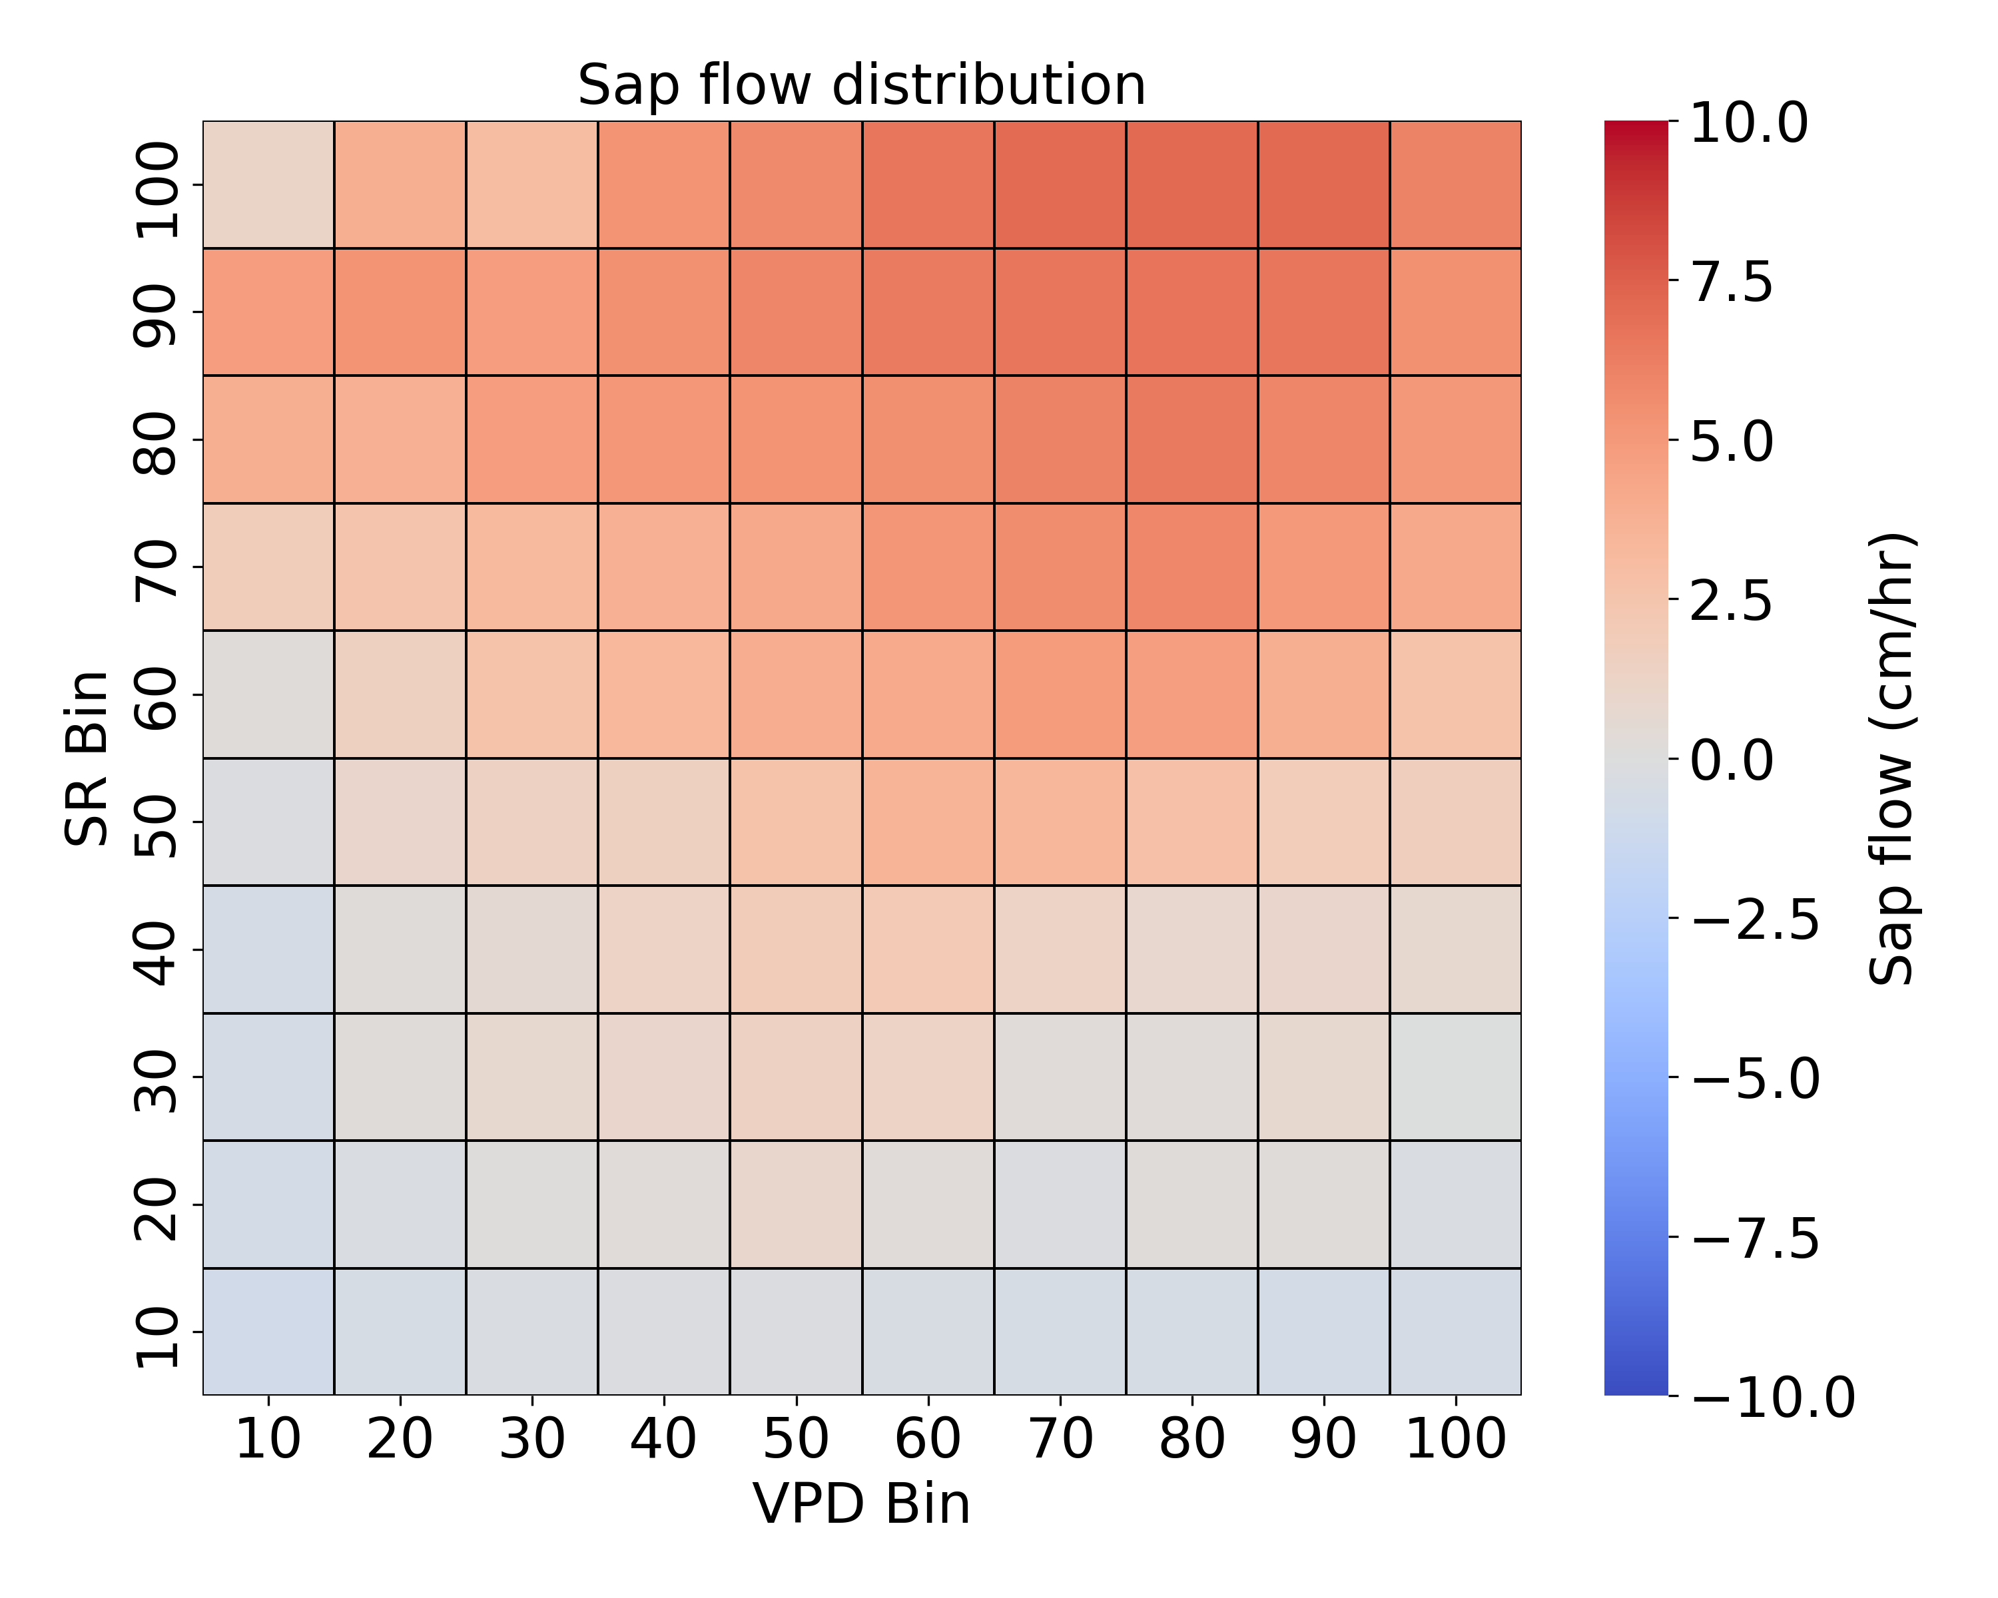
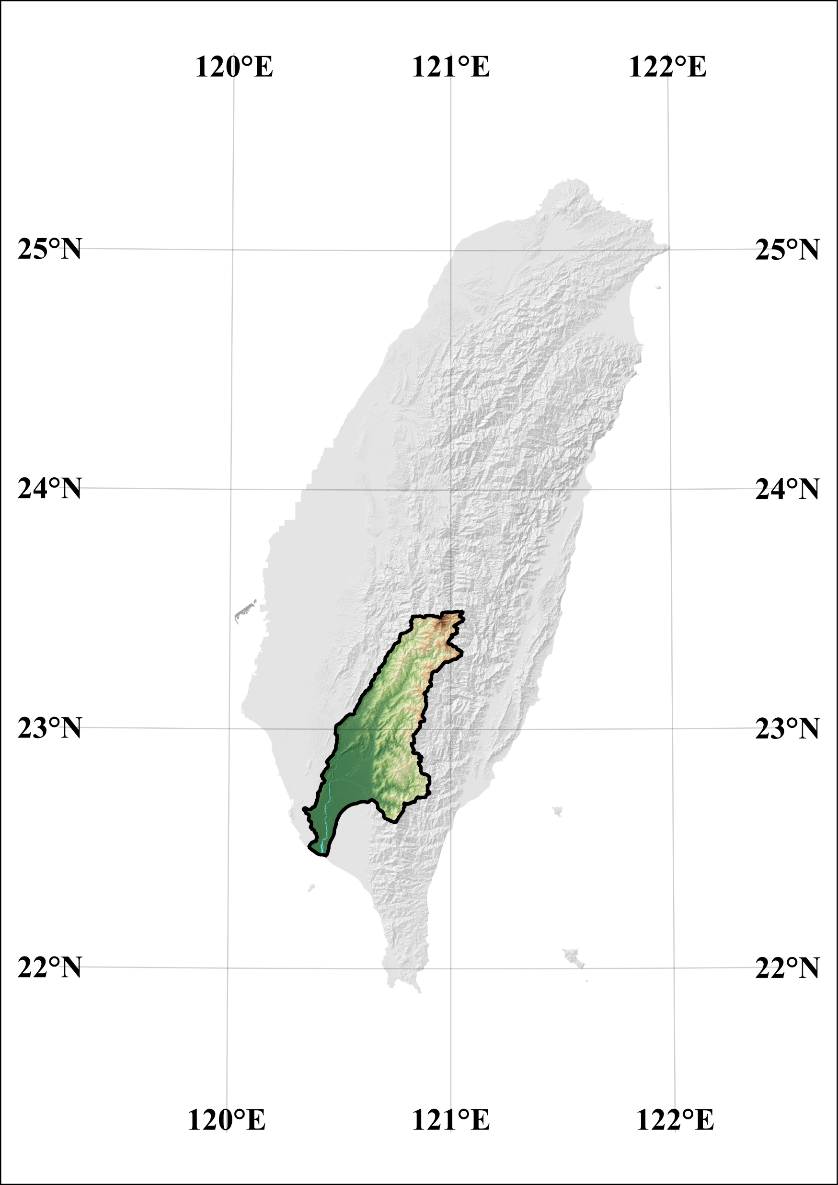
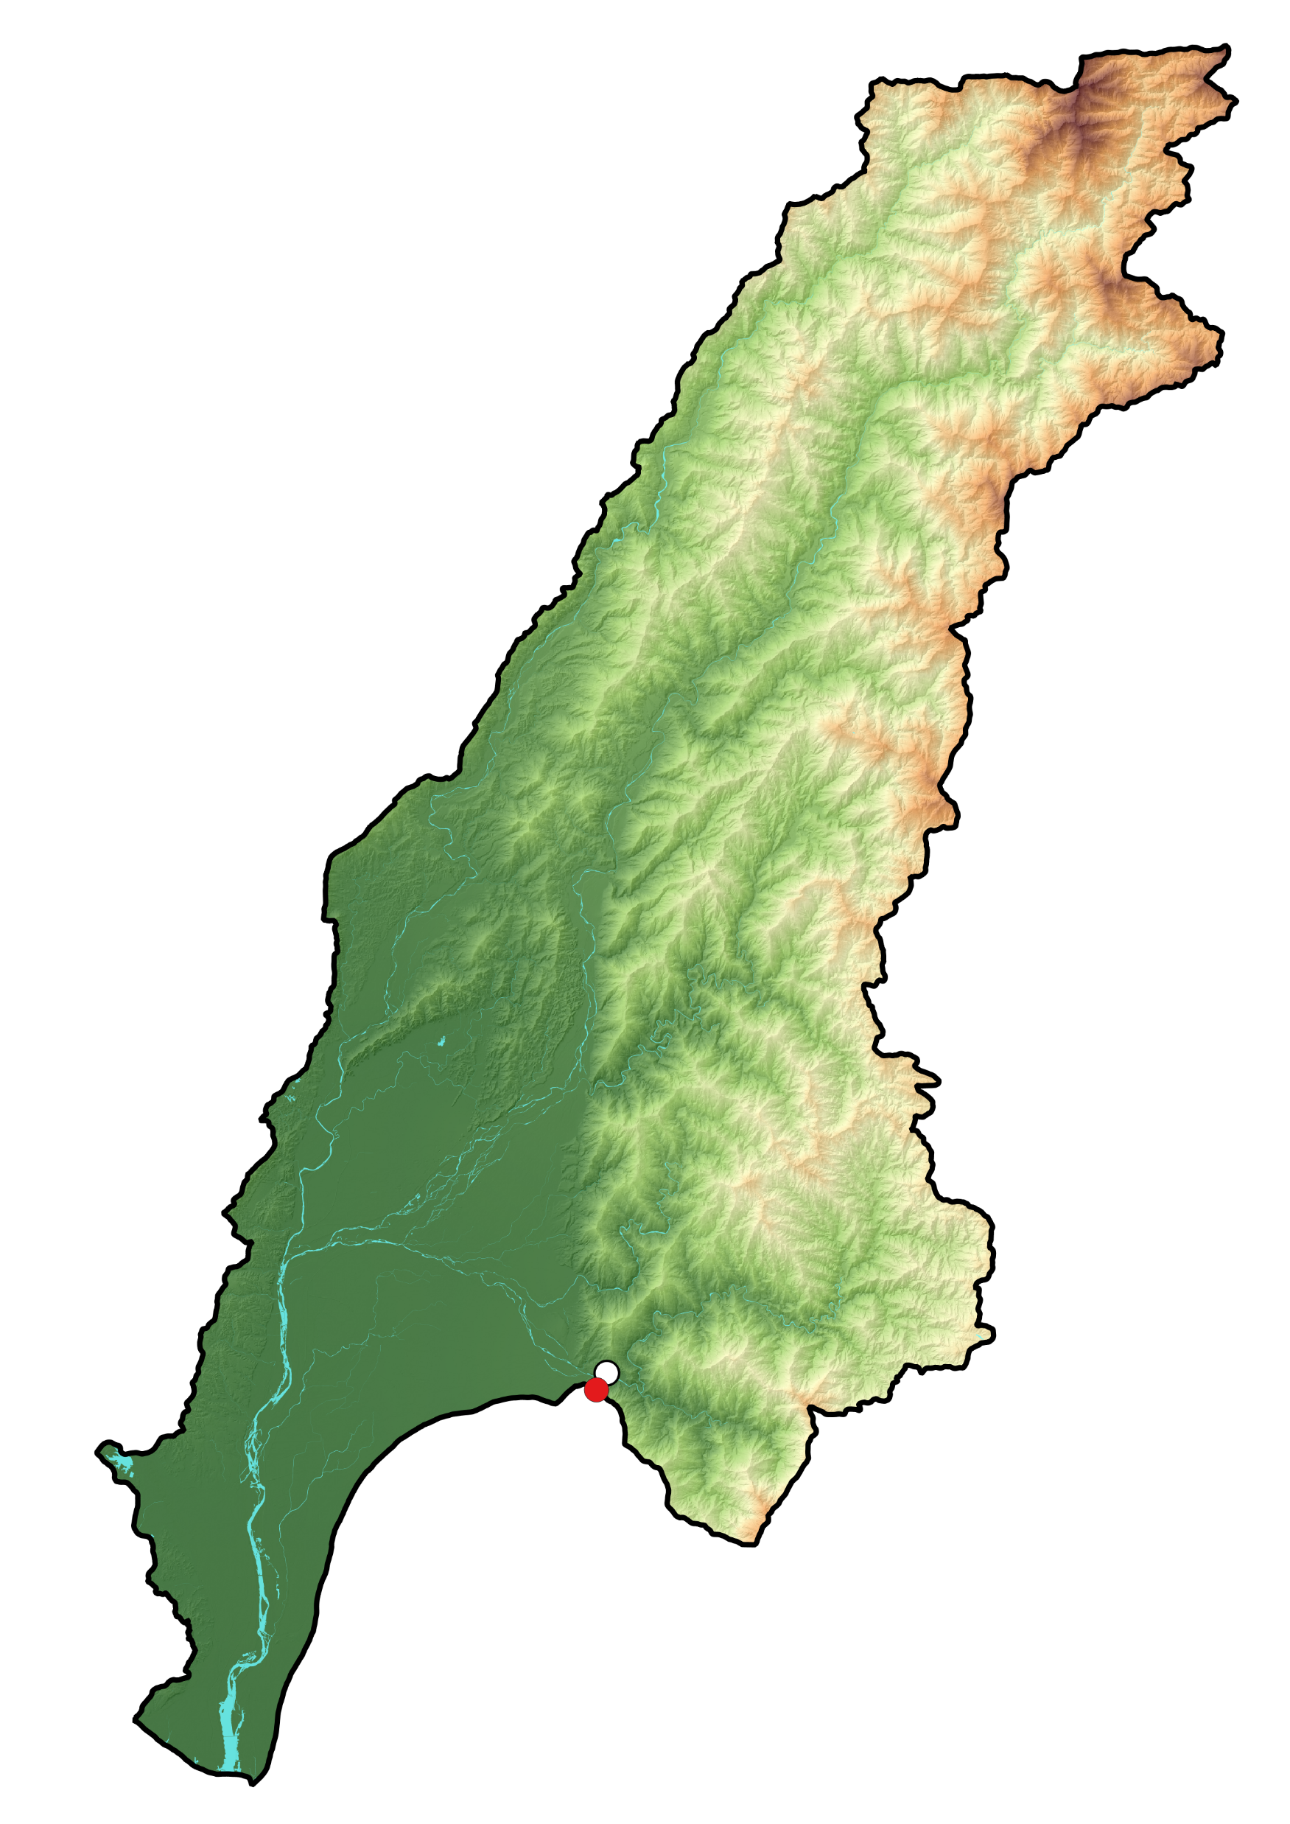
Results and Discussion
ET & Environmental condition
N
Grided
ET data
Gaoping River
Observed sap flow
Gaoping River Basin
Weather station
High: 3855
Sap flow meter
low: 0
18

Slide 27
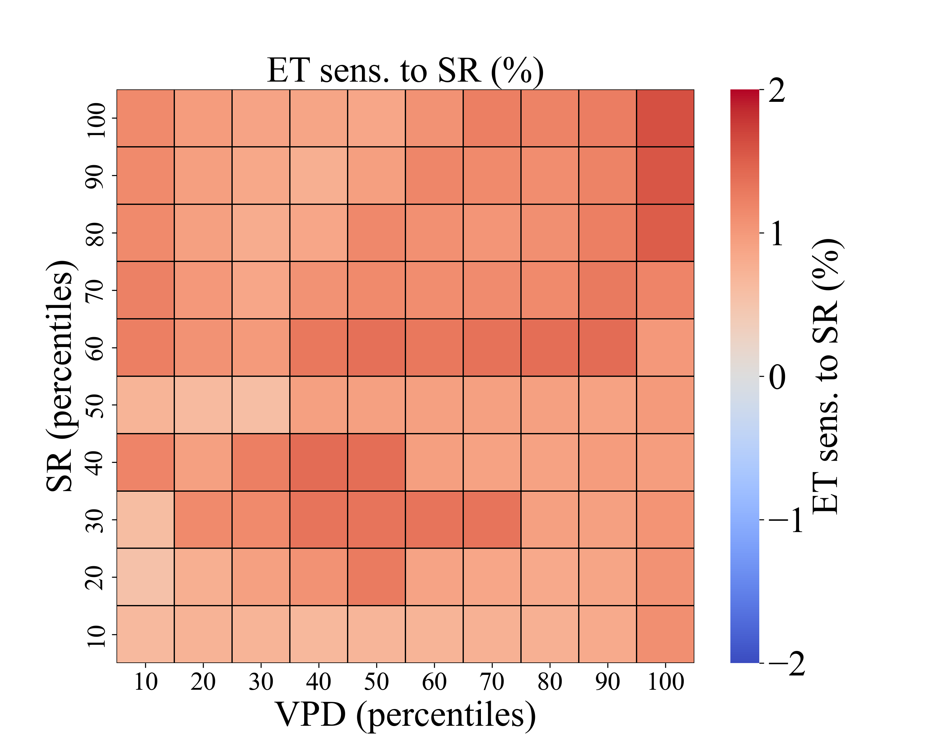
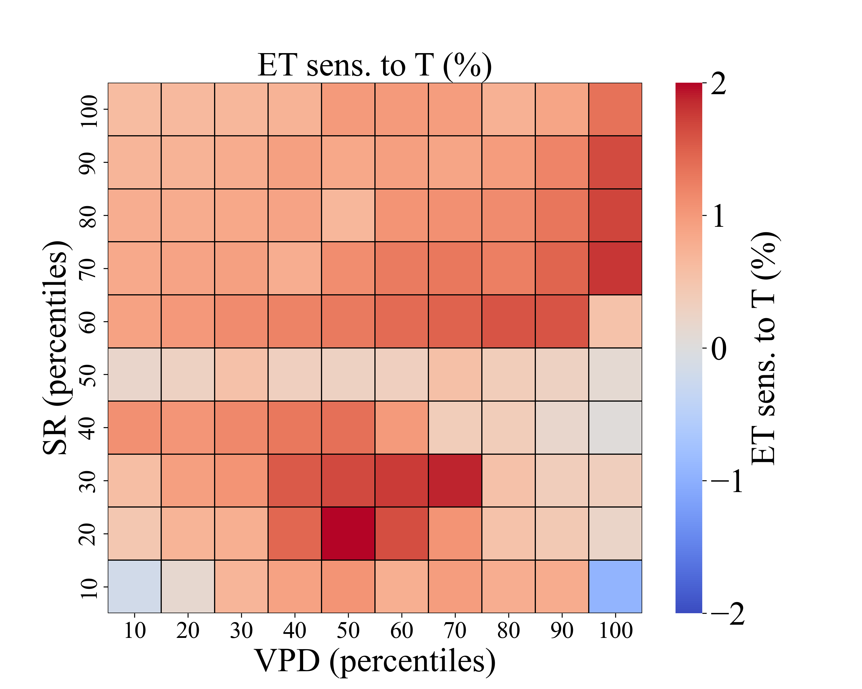
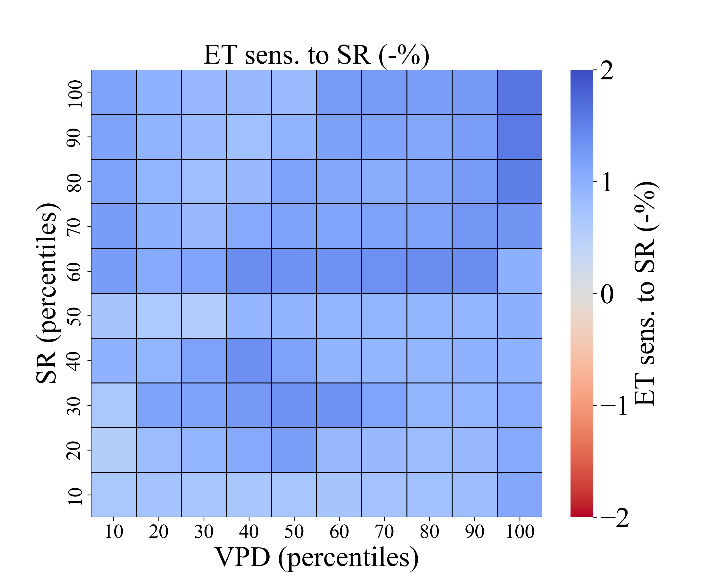
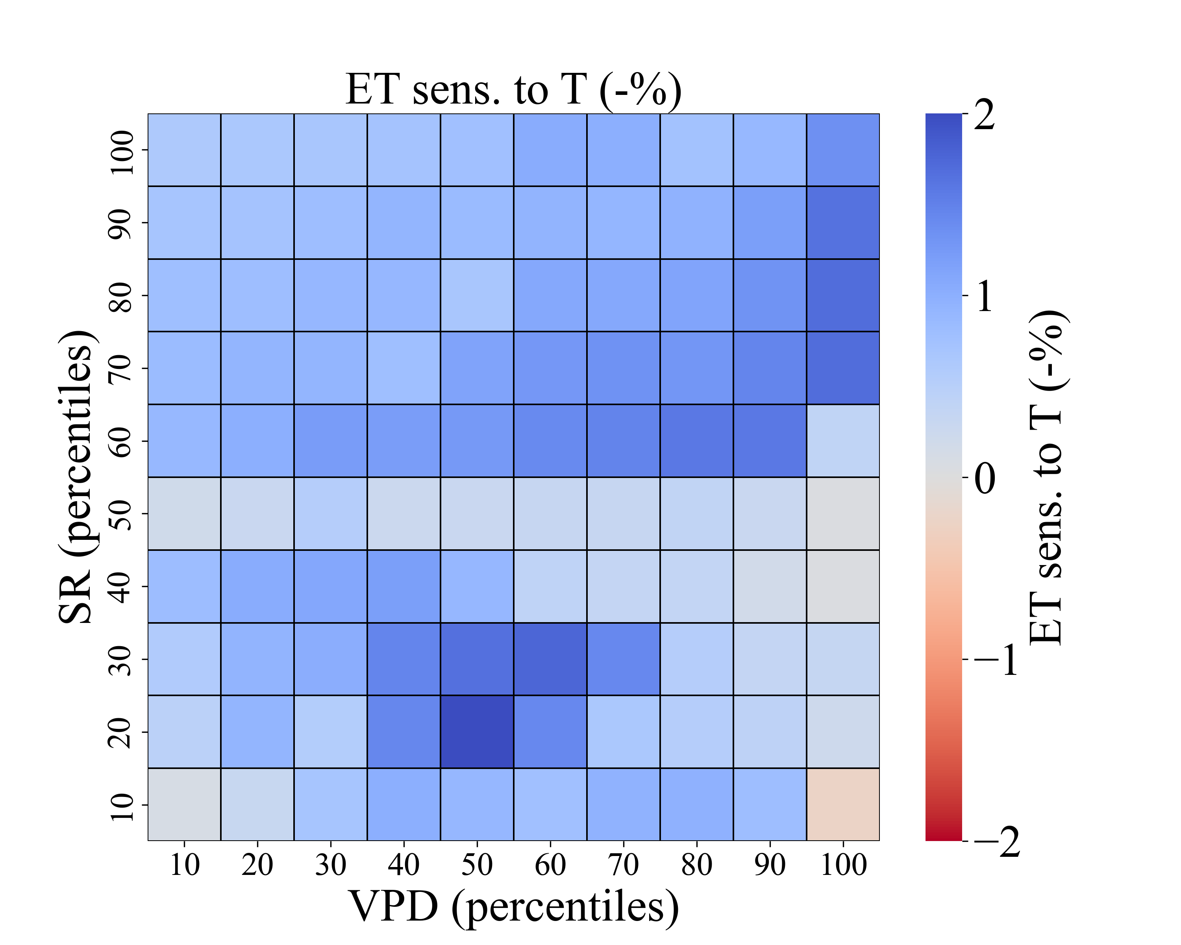
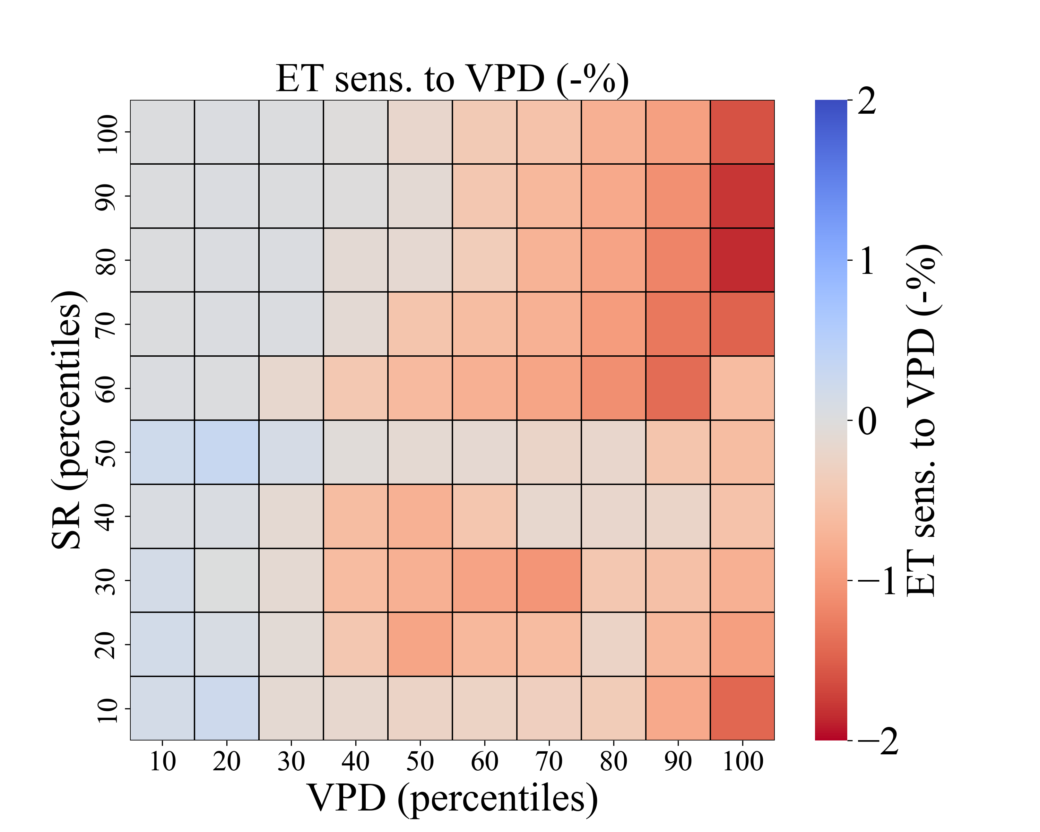
Results and Discussion
Basin-based sensitivity analysis
All-data analysis: All available data were used, regardless of season.
+1 %
-1 %
19

Slide 28
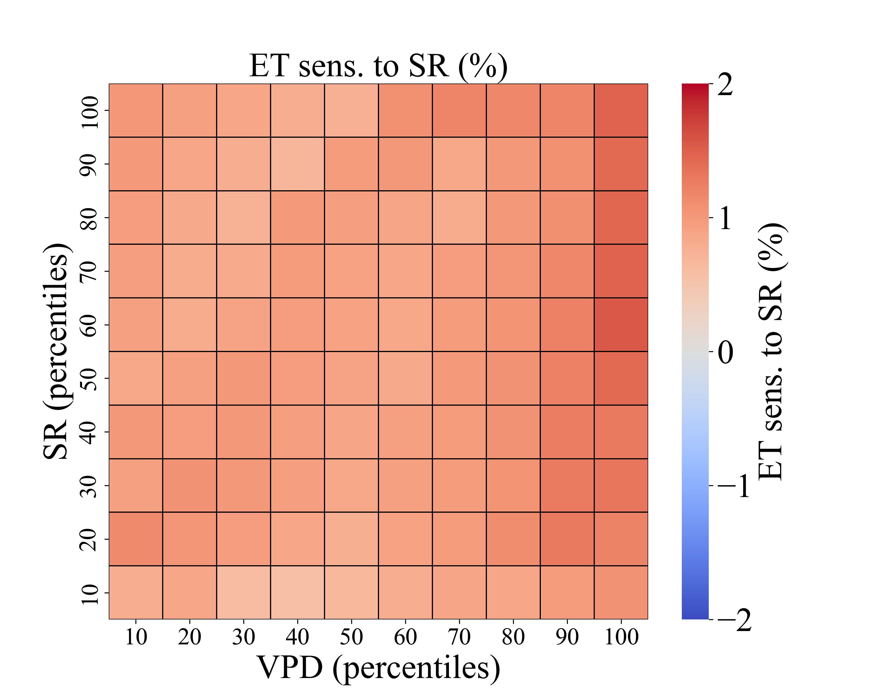
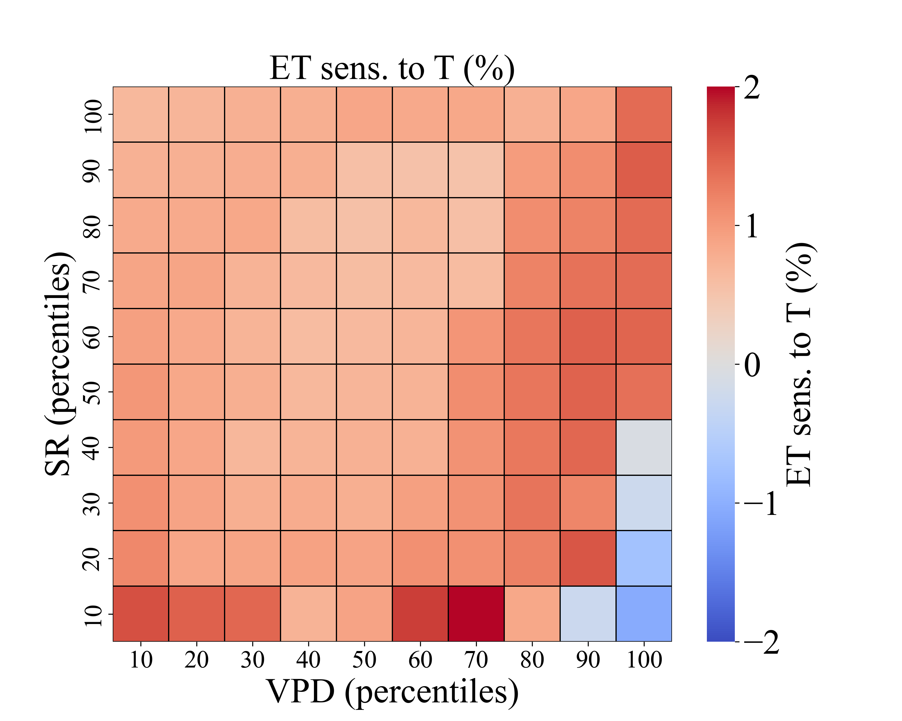
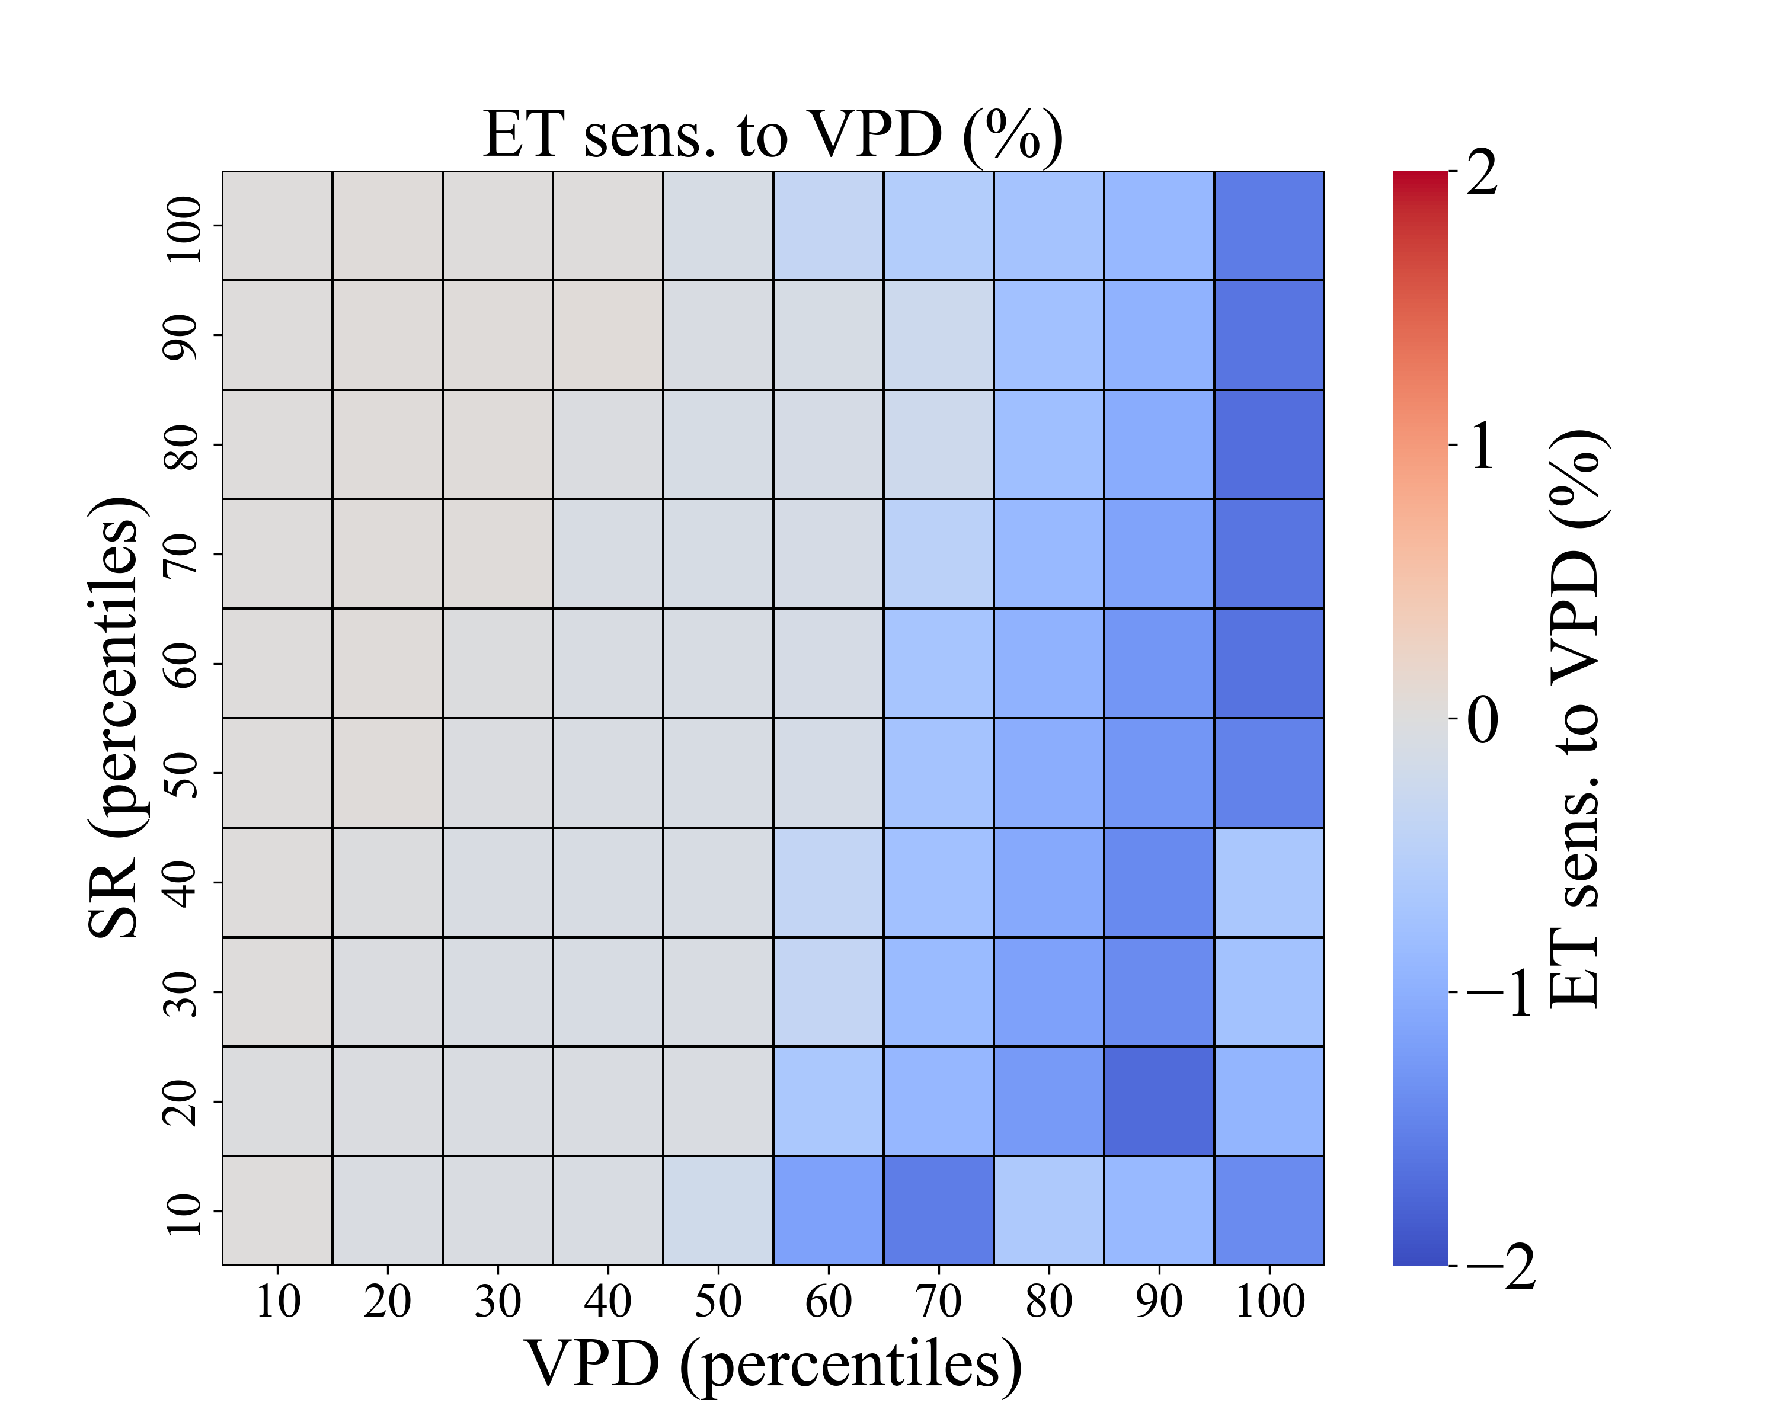
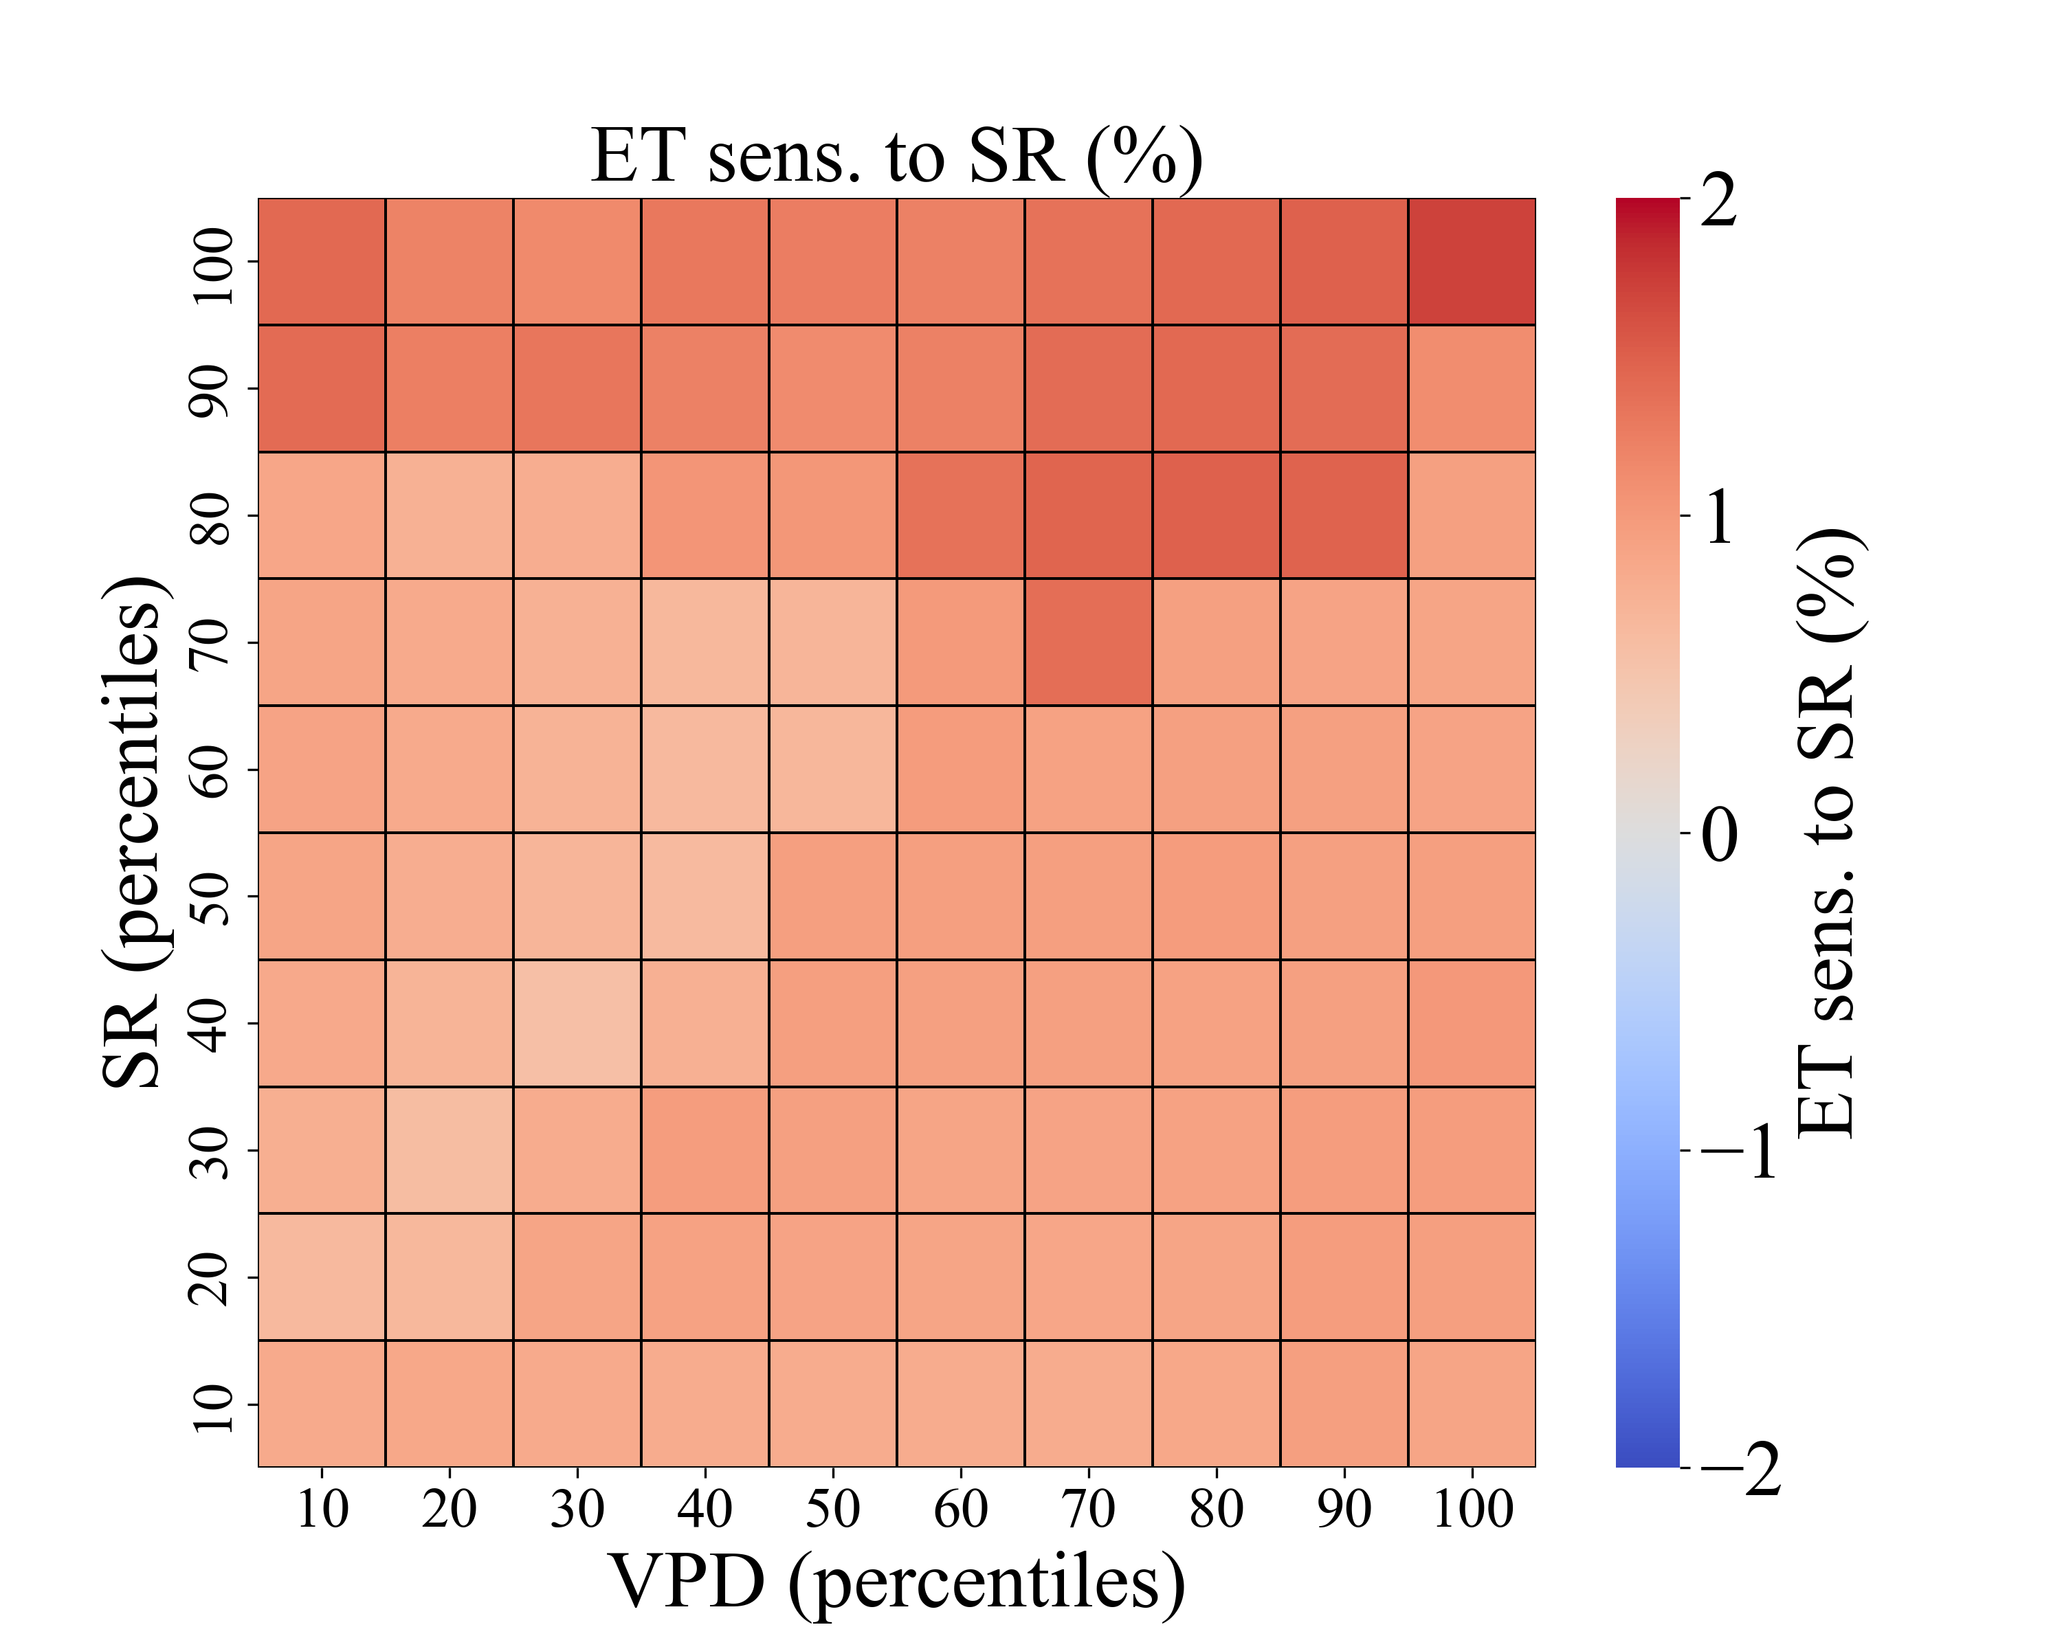
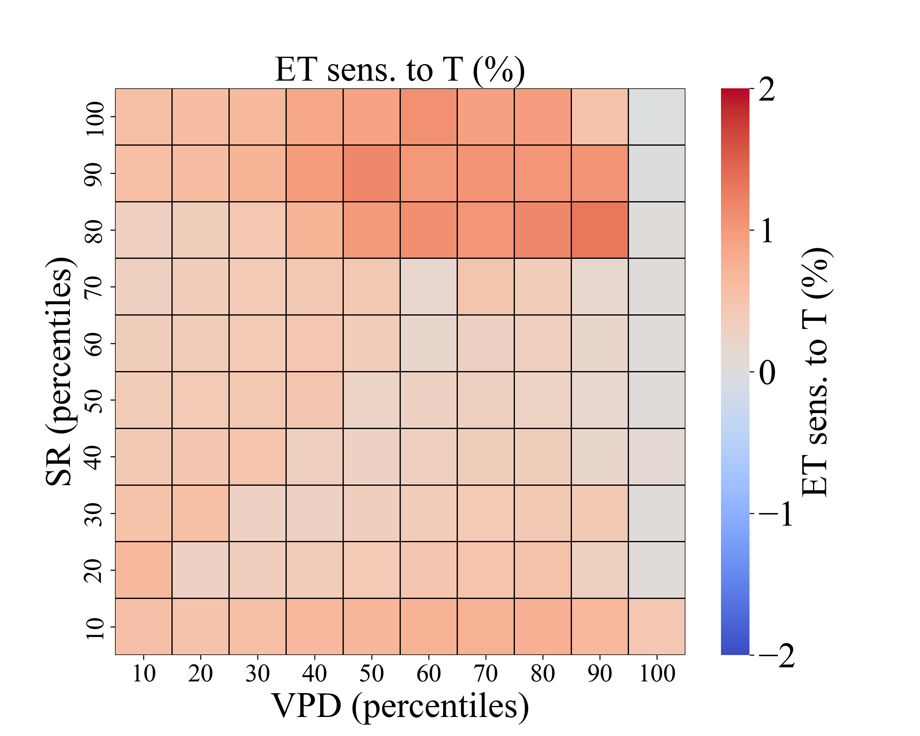
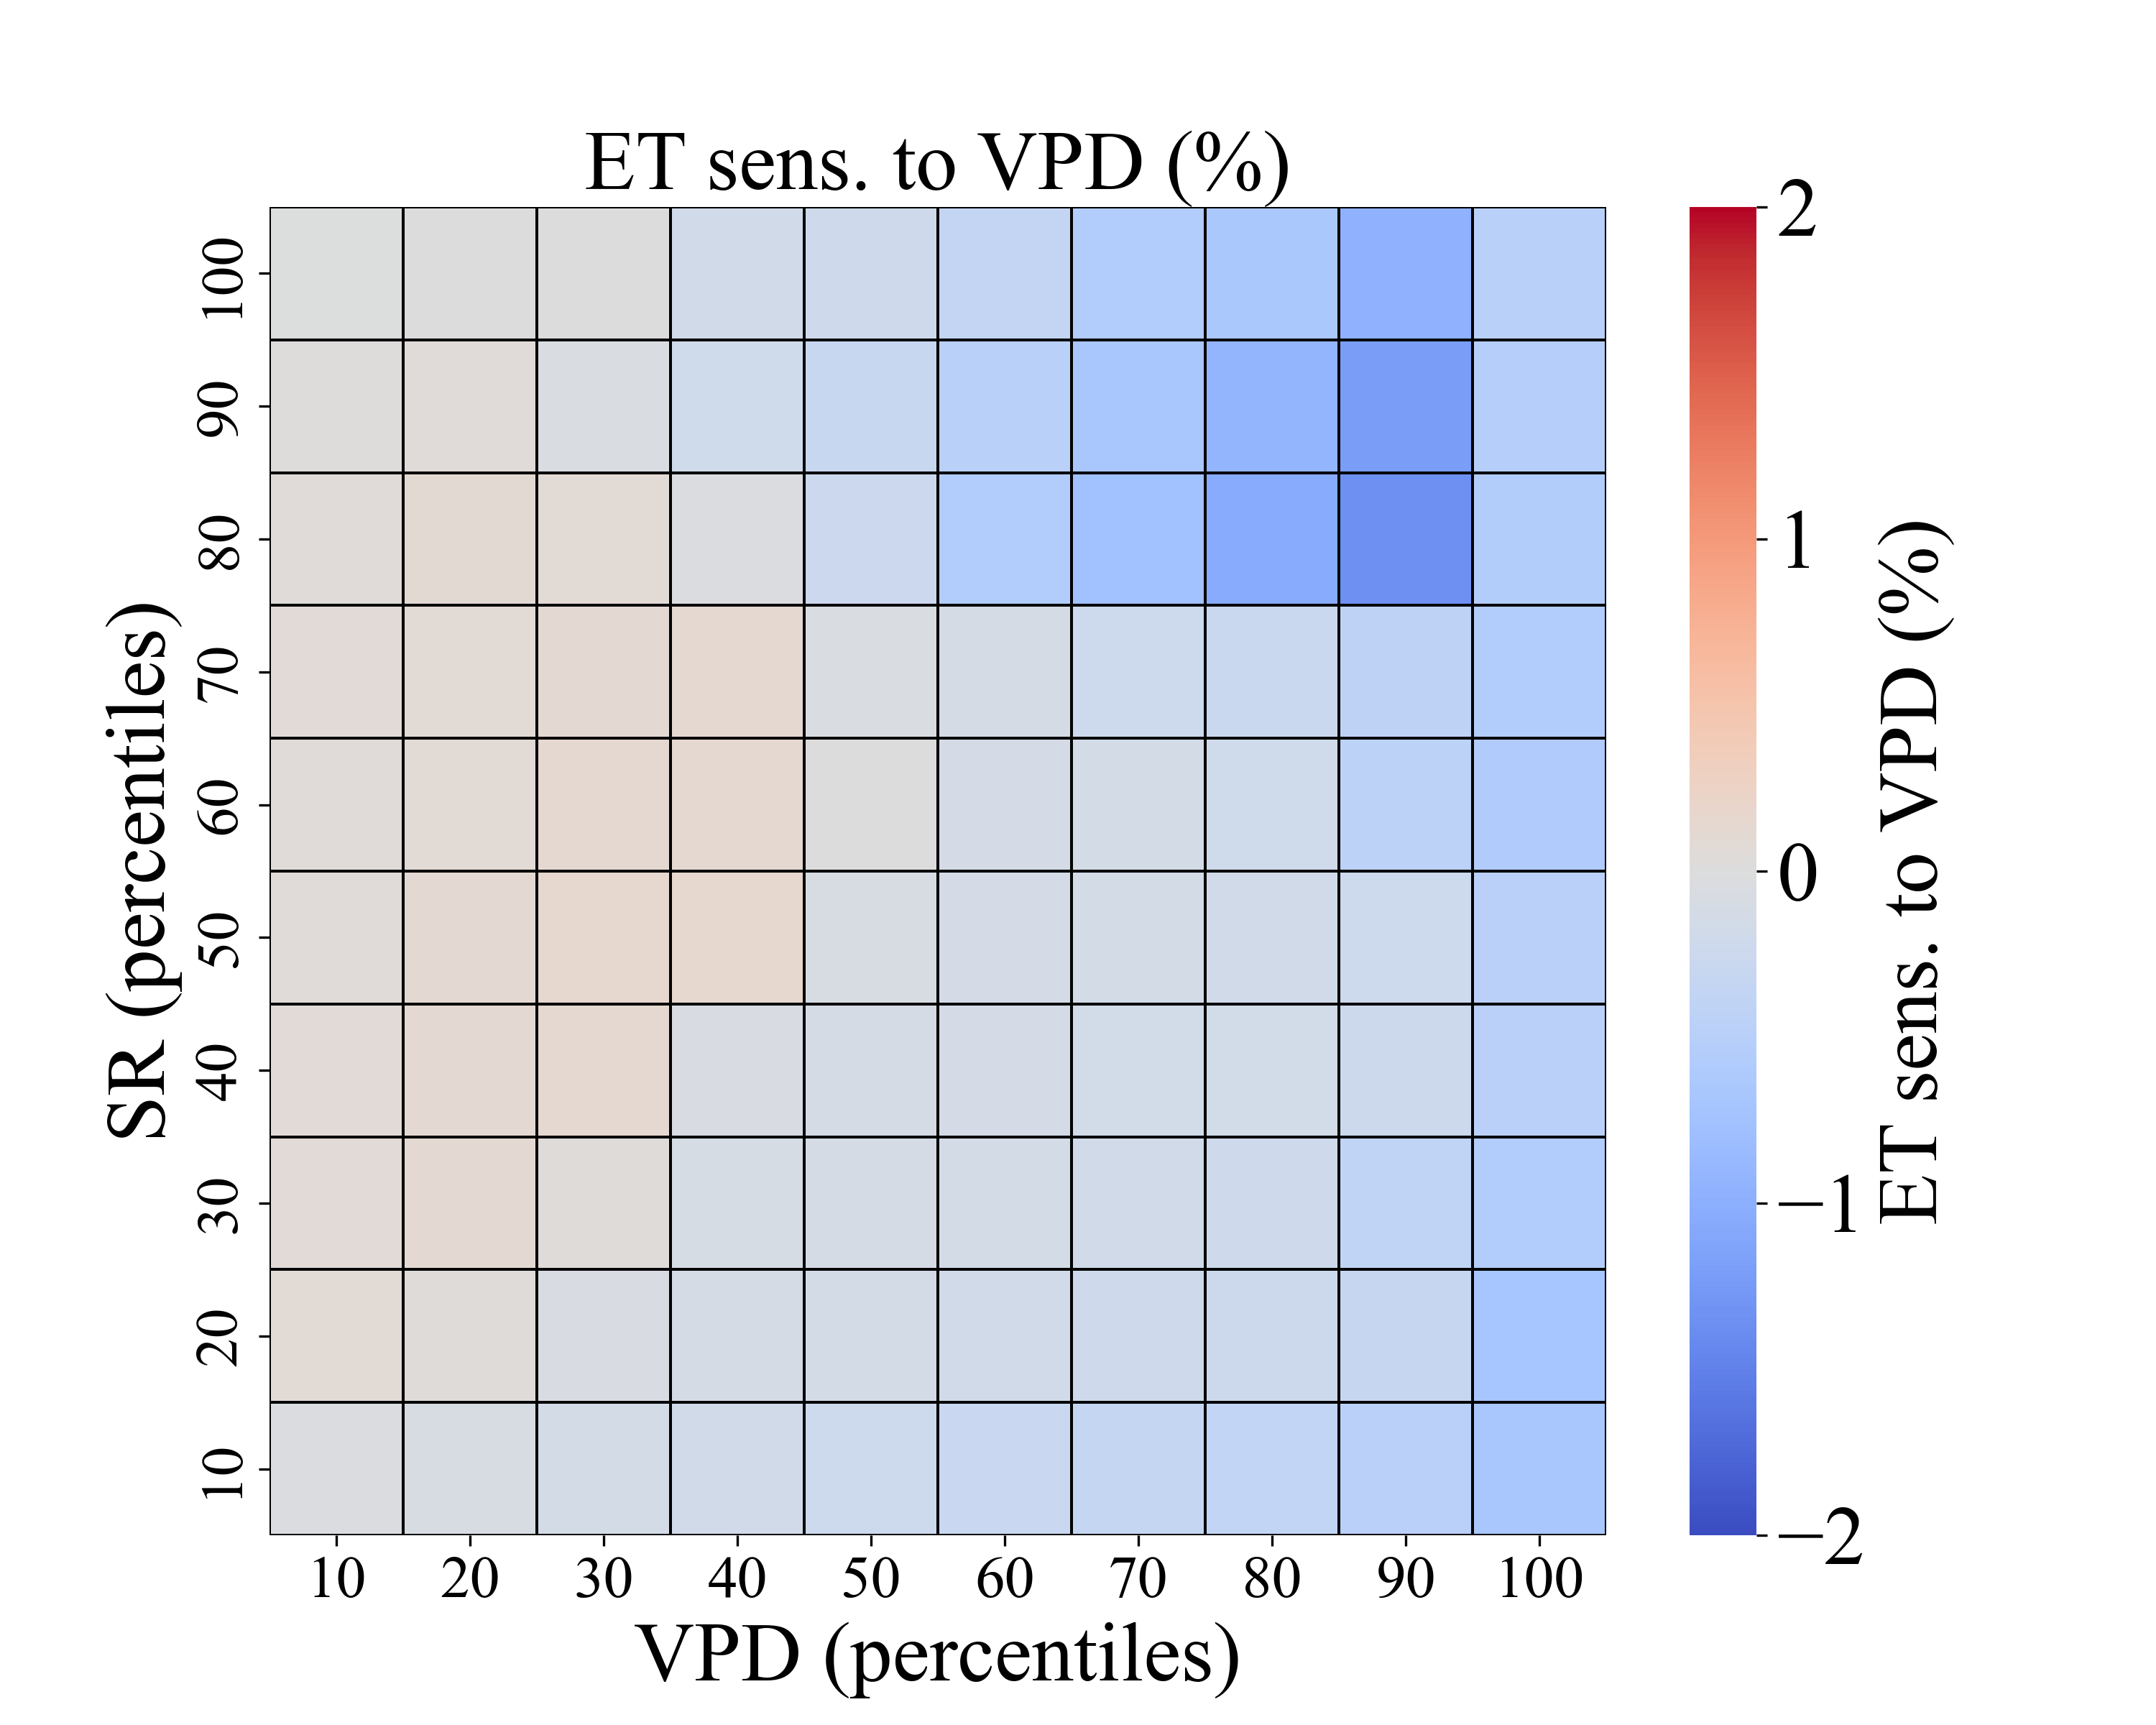
Results and Discussion
Basin-based sensitivity analysis
Wet
Season
+1 %
Dry
Season
+1 %
20

Slide 29
Results and Discussion
Basin-based sensitivity analysis
All-data analysis: All available data were used, regardless of season.
21

Slide 30
Results and Discussion
Basin-based sensitivity analysis
All-data analysis: All available data were used, regardless of season.
According to past research, the threshold of VPD to decreasing transpiration is about 1.5 - 2 kPa. (Bovard et al., 2005; Chen et al., 2014; Ma et al, 2017; O ‘BRIEN et al.,2004; Tie et al., 2017)
We found that ET began to show negative sensitivity values in some bins once the VPD percentile exceeded 30, which is around 0.4 kPa.
Negative
sensitivity
VPD ≈ 0.4
22

Slide 31
Results and Discussion
Basin-based sensitivity analysis
Compared to the sensitivities of ET to SR and T, VPD clearly shows the strongest negative impact on plant transpiration.
However, It’s important to note that in real-world conditions, these environmental factors often interrelated.
Our analysis does not yet account for the combined effects of multiple changing variables. Further studies are needed to explore these interactions and their joint impact on ET.
23

Slide 32
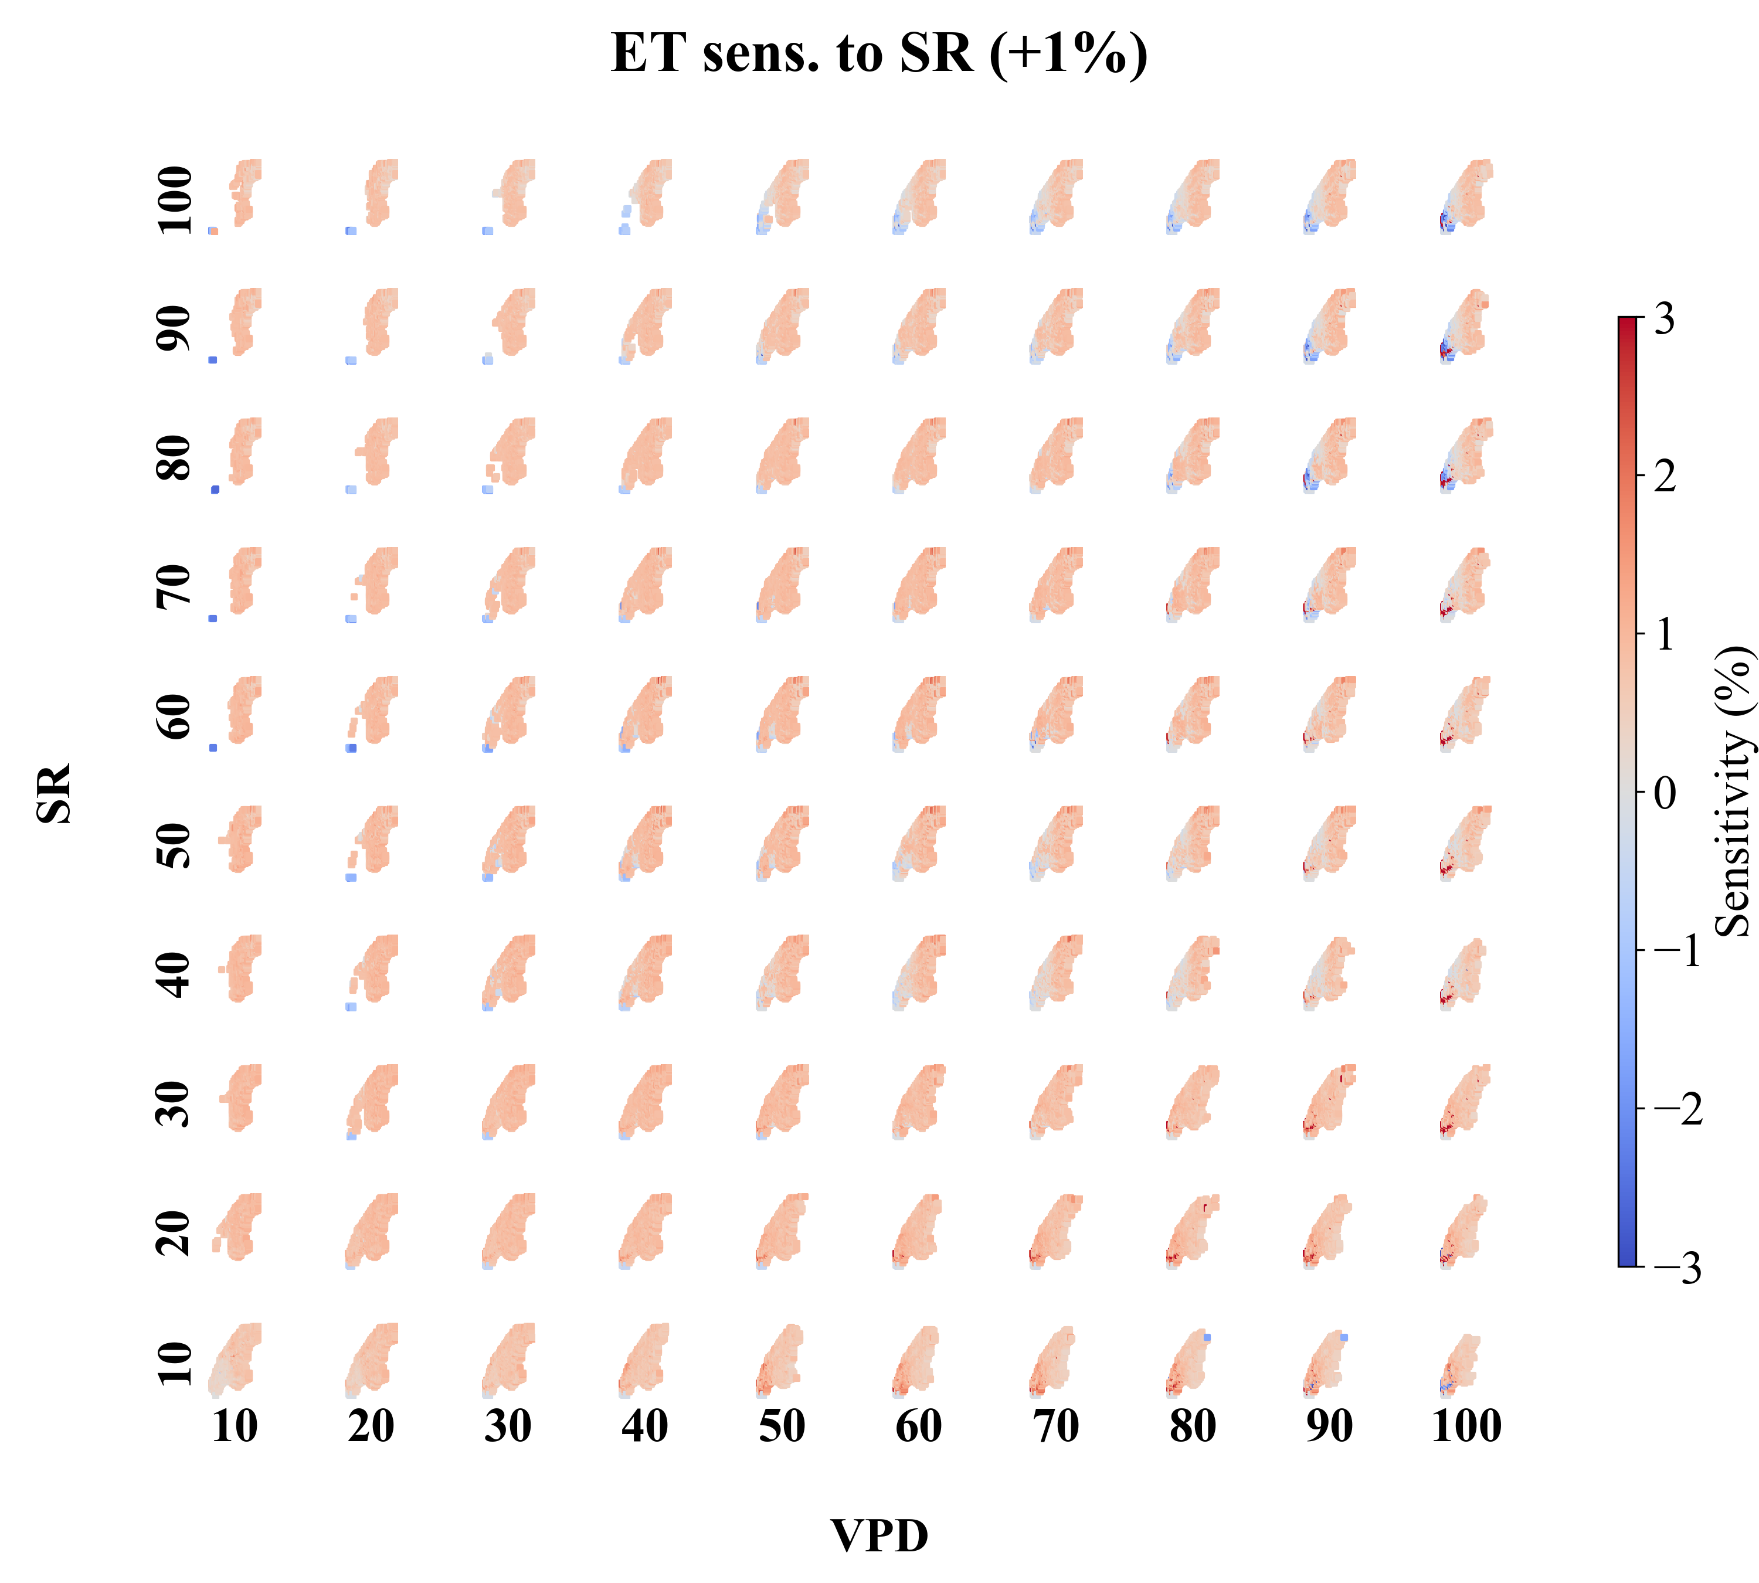
Results and Discussion
Grid-based sensitivity analysis
24

Slide 33
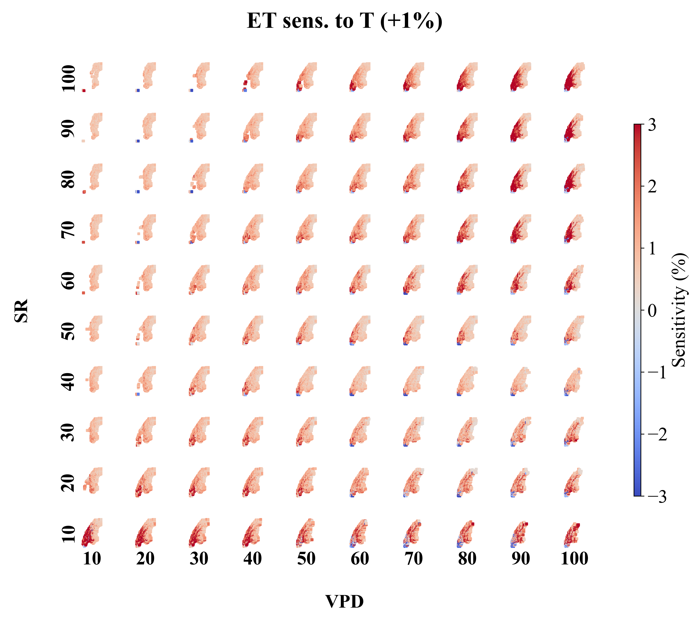
Results and Discussion
Grid-based sensitivity analysis
25

Slide 34
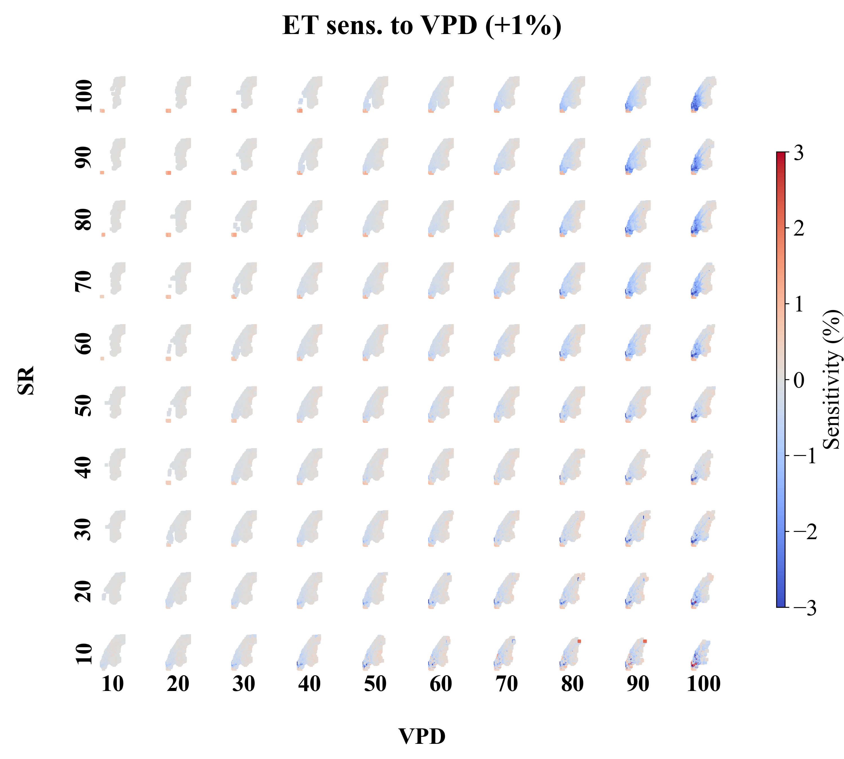
Results and Discussion
Grid-based sensitivity analysis
26

Slide 35
Results and Discussion
Grid-based sensitivity analysis
Overall, ET in the lowland regions shows greater sensitivity (absolute value) to SR, T, and VPD compared to the mountainous areas, and this sensitivity generally increases in bins with higher VPD and SR.
In these high VPD and high SR bins, the sensitivity of ET to VPD and SR in lowland areas tends to be negative, suggesting that excessive environmental stress may suppress evapotranspiration.
As for temperature, the sensitivity of ET to T is generally positive in both lowland and mountainous regions.
27

Slide 36
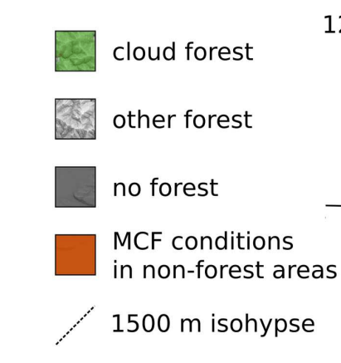
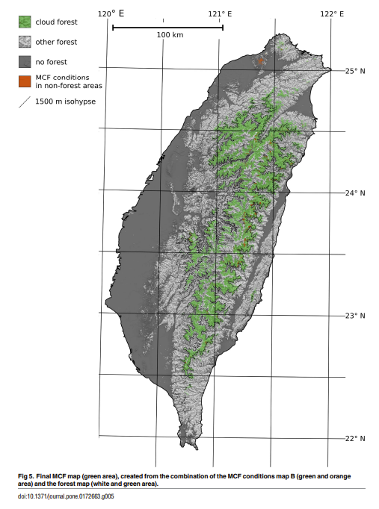
Results and Discussion
Grid-based sensitivity analysis
Mountain cloud forests are characterized by their unique microclimatic conditions. According to Chu et al. (2014), these forests are frequently shrouded in clouds, resulting in reduced solar radiation and lower vapor pressure deficit (VPD). Such microclimatic features not only decrease atmospheric evaporative demand (PET) but also alleviate plant water stress.
Schulz et al., 2017
28

Slide 37
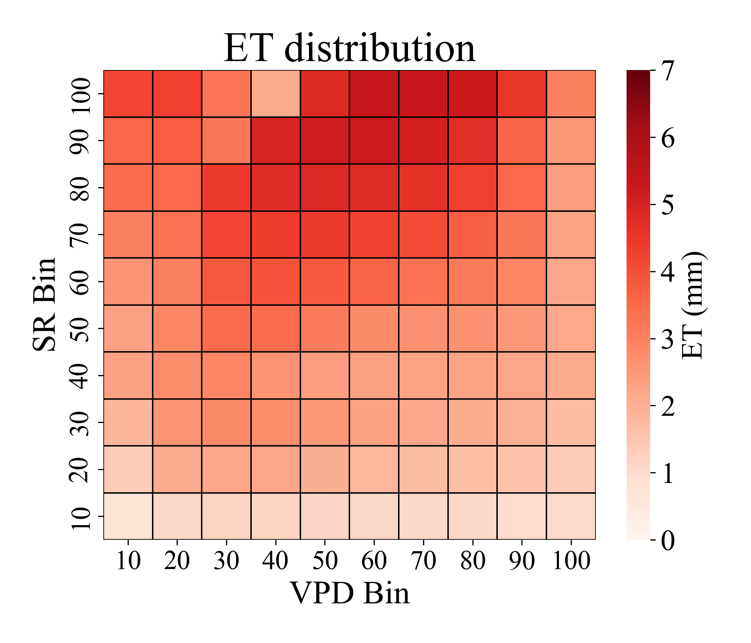
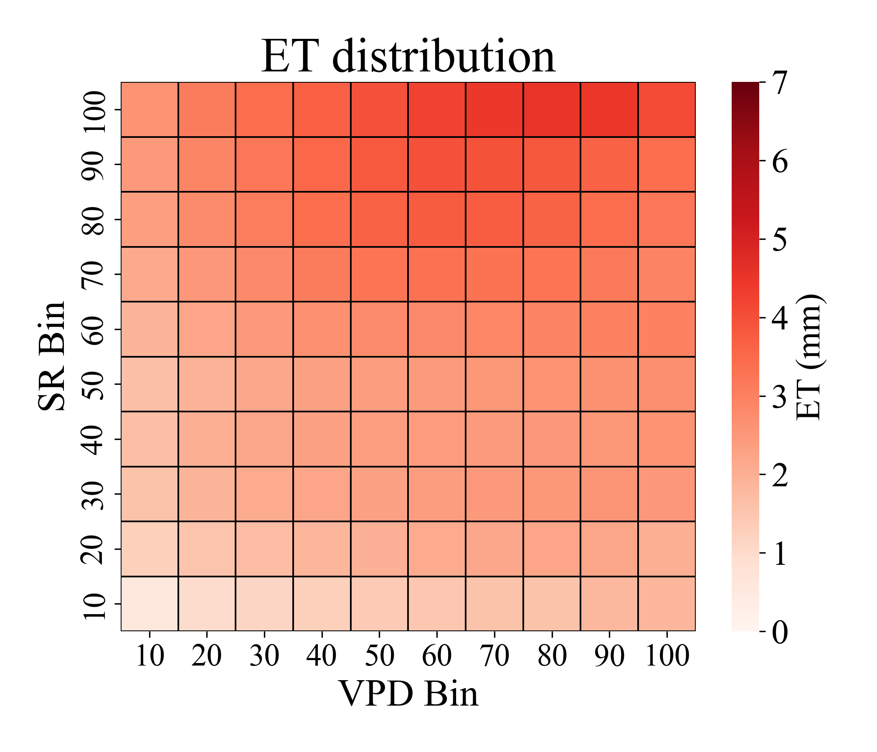
Results and Discussion
Grid-based sensitivity analysis
Lowlands
Mountainous area
Under similar VPD and SR conditions, the lowlands tend to have higher evapotranspiration rates compared to the mountains.
29

Slide 38
Results and Discussion
Grid-based sensitivity analysis
Yang et al. (2019) also found that the sensitivity of Potential Evapotranspiration (PET) to environmental factors varied between mountainous regions and lowlands, with PET exhibiting higher sensitivity to SR, and T in lowlands compared to mountainous regions.
In the mountainous regions of the Gaoping River Basin, ET shows overall lower sensitivity to environmental factors, and negative sensitivities are less frequently observed. This pattern may be attributed to the microclimatic differences between mountainous and lowland areas.
32

Slide 39
Conclusion
The "evapotranspiration" in a watershed's hydrological budget consists of "evaporation" and "transpiration."
Under environmental stress, if water within the watershed is sufficient, evaporation may continue to increase. However, transpiration might be constrained due to plant regulation (Massmann et al., 2019). Previous studies have found that increasingly drying environment under climate change have negatively impacted plants, triggering self-protective mechanisms (Fu et al., 2022; Yuan et al., 2019). The findings of this study also exhibit similar phenomena.
33

Slide 40
Conclusion
Findings:
The sensitivity of ET to SR and T is generally positive, with greater sensitivity observed in regions with higher SR and VPD.
After VPD surpasses 0.4 kilopascals (kPa), ET shows negative sensitivity to VPD, with the magnitude of this negative response becoming stronger under higher VPD and SR conditions. This indicates that in relatively drier environments, if the air gets even drier, evapotranspiration might stop rising, or even start to decrease.
34

Slide 41
Conclusion
The overall patterns of sensitivity analysis show seasonal differences, suggesting that additional environmental controls are influencing ET during different seasons.
The sensitivity of evapotranspiration (ET) to environmental factors varies spatially, and this pattern may be attributed to the microclimatic differences between mountainous and lowland areas.
35

Slide 42
Conclusion
If the research findings hold true, the increasing trend of evapotranspiration in watersheds under climate change may not be unlimited but could be constrained by plant regulation.
Future studies could extend the analysis to climate change projection data from General Circulation Models (GCMs) to explore the mechanisms driving changes in watershed evapotranspiration under climate change.
36

Slide 43
References
Bovard, B. D., Curtis, P. S., Vogel, C. S., Su, H. B., & Schmid, H. P. (2005). Environmental controls on sap flow in a northern hardwood forest. Tree physiology, 25(1), 31-38.
Chen, D., Wang, Y., Liu, S., Wei, X., & Wang, X. (2014). Response of relative sap flow to meteorological factors under different soil moisture conditions in rainfed jujube (Ziziphus jujuba Mill.) plantations in semiarid Northwest China. Agricultural Water Management, 136, 23-33.
Fu, Z., Ciais, P., Prentice, I. C., Gentine, P., Makowski, D., Bastos, A., ... & Hajima, T. (2022). Atmospheric dryness reduces photosynthesis along a large range of soil water deficits. Nature communications, 13(1), 989.
Lee, T. Y., Chiu, C. C., Chen, C. J., Lin, C. Y., & Shiah, F. K. (2023). Assessing future availability of water resources in Taiwan based on the Budyko framework. Ecological Indicators, 146, 109808.
Li, M. H., Tien, W., & Tung, C. P. (2009). Assessing the impact of climate change on the land hydrology in Taiwan. Paddy and Water Environment, 7, 283-292.
Liu, M., Yang, G., Yuan, W., Li, Z., Gao, M., Yang, Y., ... & Yuan, Z. (2024). Overridingly increasing vegetation sensitivity to vapor pressure deficit over the recent two decades in china. Ecological Indicators, 161, 111977.
Massmann, A., Gentine, P., & Lin, C. (2019). When does vapor pressure deficit drive or reduce evapotranspiration? Journal of Advances in Modeling Earth Systems, 11(10), 3305-3320.
Ma, C., Luo, Y., Shao, M., Li, X., Sun, L., & Jia, X. (2017). Environmental controls on sap flow in black locust forest in Loess Plateau, China. Scientific Reports, 7(1), 13160.
National Science and Technology Council (NSTC) and the Ministry of Environment, 2024: Climate Change in Taiwan: National Scientific Report 2024, Taiwan Climate Change Projection Information and Adaption knowledge Platform, National Science and Technology Council and Ministry of Environment, Taiwan.

Slide 44
References
O'BRIEN, J. J., Oberbauer, S. F., & Clark, D. B. (2004). Whole tree xylem sap flow responses to multiple environmental variables in a wet tropical forest. Plant, Cell & Environment, 27(5), 551-567.
Schulz, H. M., Li, C. F., Thies, B., Chang, S. C., & Bendix, J. (2017). Mapping the montane cloud forest of Taiwan using 12 year MODIS-derived ground fog frequency data. PLoS One, 12(2), e0172663.
Tie, Q., Hu, H., Tian, F., Guan, H., & Lin, H. (2017). Environmental and physiological controls on sap flow in a subhumid mountainous catchment in North China. Agricultural and Forest Meteorology, 240, 46-57.
Water Resource Agency (WRA), 2021: Hydrological Yearbook of Taiwan Republic of China 2021, Water Resource Agency, Ministry of Economic Affairs, Taiwan.
Yang, Y., Chen, R., Song, Y., Han, C., Liu, J., & Liu, Z. (2019). Sensitivity of potential evapotranspiration to meteorological factors and their elevational gradients in the Qilian Mountains, northwestern China. Journal of Hydrology, 568, 147-159.
Yang, Y., Roderick, M. L., Guo, H., Miralles, D. G., Zhang, L., Fatichi, S., ... & Yang, D. (2023). Evapotranspiration on a greening Earth. Nature Reviews Earth & Environment, 4(9), 626-641.
Yu, P. S., Yang, T. C., & Chou, C. C. (2002). Effects of climate change on evapotranspiration from paddy fields in southern Taiwan. Climatic change, 54(1), 165-179.
Yuan, W., Zheng, Y., Piao, S., Ciais, P., Lombardozzi, D., Wang, Y., ... & Yang, S. (2019). Increased atmospheric vapor pressure deficit reduces global vegetation growth. Science advances, 5(8), eaax1396.

