Slide 1
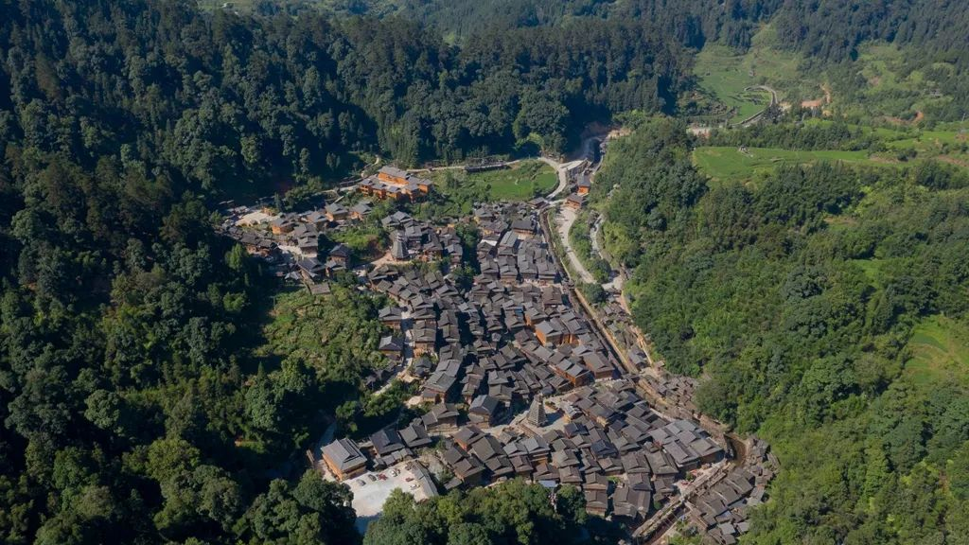
Integrating Bio-Cultural Diversity for Sustainable Conservation in Karst Landscapes:
Insights from the Miaoling Mountainous Region
Authors: Xiaoqi Li, Qichi Yang, and Paolo Tarolli
Presenter: Xiaoqi Li (Ph.D. Candidate, Huazhong Agricultural University; Joint Ph.D. Student, University of Padova)
Notes:
Good morning everyone!I’m Xiaoqi Li, a Ph.D. candidate at Huazhong Agricultural University and joint Ph.D. student at the University of Padova. I’m honored to share our work, co-authored with Dr. Qichi Yang and Prof. Paolo Tarolli, titled:“Integrating Bio-Cultural Diversity for Sustainable Conservation in Karst Landscapes: Insights from the Miaoling Mountainous Region.”

Slide 2
CONTENTS
1. Introduction
2. Study area and methods
3. Results
4. Conclusion

Slide 3
01
Introduction
Notes:
Let’s begin

Slide 4
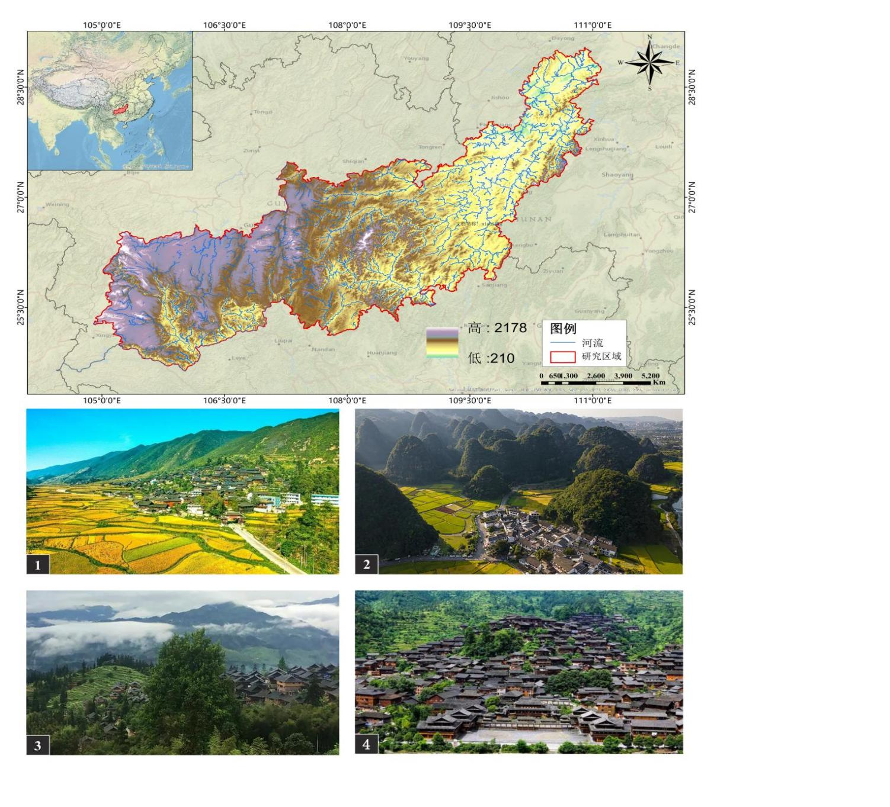
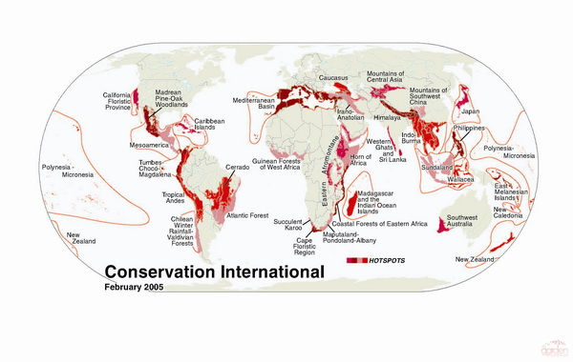
Introduction
Karst landscapes are not only ecological hotspots but also cultural strongholds. However, they face severe pressures—ecological degradation, rocky desertification, and cultural homogenization.
Notes:
Karst landscapes are not only ecological hotspots but also cultural strongholds. However, they face severe pressures—ecological degradation, rocky desertification, and cultural homogenization.

Slide 5
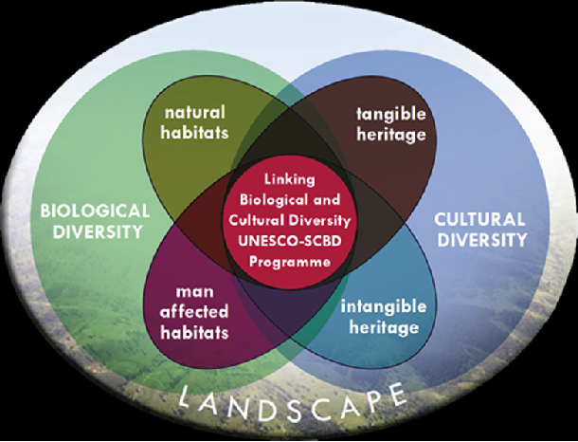
Introduction
Current conservation strategies often treat ecology and culture as separate issues, leading to fragmented outcomes.
Our goal is to bridge this gap by proposing an integrated framework for bio-cultural diversity conservation.
The "bio-cultural diversity" (BCD) emphasizes the interdependence between biological and cultural diversity, highlighting the role of traditional knowledge and practices in sustainable resource management and conservation .
Notes:
Current conservation strategies often treat ecology and culture as separate issues, leading to fragmented outcomes. Our goal is to bridges this gap by proposing an integrated framework for bio-cultural diversity conservation.

Slide 6
02
Study area and methods

Slide 7
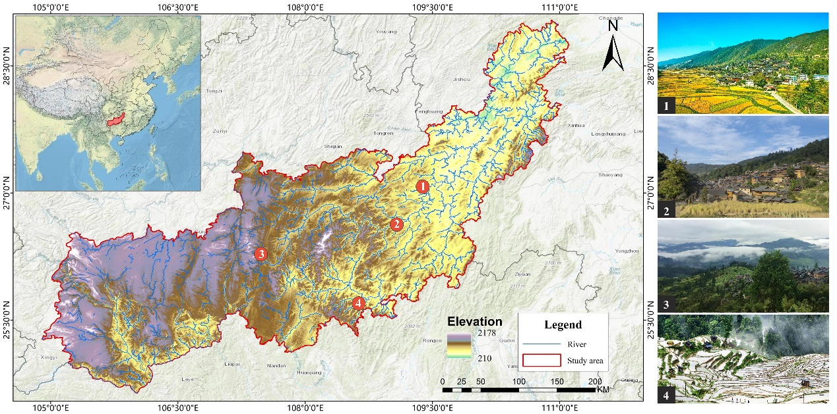
Study Area
We focus on the Miaoling mountainous region in Southwest China—a typical karst area rich in endemic species and ethnic cultures.
Notes:
We focus on the Miaoling mountainous region in Southwest China—a typical karst area rich in endemic species and ethnic cultures.
Our objectives are:
To assess bio-cultural diversity spatially;
Identify priority conservation areas;
Design a connected network to guide sustainable conservation.

Slide 8
Methodology
We followed a three-step approach:
First, we developed a bio-cultural diversity assessment system.
Second, we used the Zonation model to identify priority conservation areas.
Finally, we constructed a 'source - corridor - network' strategy to enhance connectivity and resilience.
Notes:
We followed a three-step approach:

Slide 9
1. Construction of the bio-cultural diversity assessment system
First, we developed a bio-cultural diversity assessment system.
Biodiversity metrics included karst geology, habitats of key species , and ecosystem services like carbon storage and soil retention.
Cultural diversity included the distribution of traditional villages, agricultural heritage, minority communities, and intangible cultural elements.
Table. Weight values of biological and cultural feature factors.
Types | Evaluation factor | Weight
S1 Biodiversity assessment indicators（0.63） | B1 Degree of karst lithology development | 0.07
 | B2 Distribution of endangered species | 0.22
 | B3 Distribution of rare species | 0.18
 | B4 Ecosystem services: carbon storage, soil conservation, habitat quality, water conservation | 0.16
S2 Evaluation indicators of cultural diversity（0.37） | B5 Traditional villages | 0.08
 | B6 Historical relics | 0.05
 | B7 Agricultural cultural heritage | 0.1
 | B8 Intangible cultural heritage | 0.09
 | B9 Ethnic minority population | 0.05
Notes:
First, we developed a bio-cultural diversity assessment system. Biodiversity metrics included karst geology, habitats of key species (e.g., Andrias davidianus, Abies fanjingshanensis), and ecosystem services like carbon storage and soil retention.Cultural diversity included the distribution of traditional villages, agricultural heritage, minority communities, and intangible cultural elements.

Slide 11
Table 1(b): Information of selected rare species in the Miaoling mountainous area.
Number | Latin name of species | Order | Family | Genera
21 | Carpodacus erythrinus | Passeriformes | Fringillidae | Carpodacus
22 | Delichon urbicum | Passeriformes | Hirundinidae | Delichon
23 | Locustella mandelli | Passeriformes | Locustellidae | Locustella
24 | Anthus pratensis | Passeriformes | Motacillidae | Anthus
25 | Alcippe morrisonia | Passeriformes | Muscicapidae | Alcippe
26 | Enicurus scouleri | Passeriformes | Muscicapidae | Enicurus
27 | Heterophasia melanoleuca desgodinsi | Passeriformes | Muscicapidae | Heterophasia
28 | Muscicapa dauurica | Passeriformes | Muscicapidae | Muscicapa
39 | Myophonus caeruleus | Passeriformes | Muscicapidae | Myophonus
30 | Turdus merula | Passeriformes | Muscicapidae | Turdus
31 | Oriolus chinensis | Passeriformes | Oriolidae | Oriolus
32 | Sylviparus modestus | Passeriformes | Paridae | Sylviparus
33 | Ixos mcclellandii | Passeriformes | Pycnonotidae | Ixos
34 | Spodiopsar cineraceus | Passeriformes | Sturnidae | Spodiopsar
35 | Suthora fulvifrons | Passeriformes | Sylviidae | Suthora
36 | Zosterops japonicus | Passeriformes | Zosteropidae | Zosterops
37 | Blythipicus rubiginosus | Piciformes | Picidae | Blythipicus
38 | Tachybaptus ruficollis | Podicipediformes | Podicipedidae | Tachybaptus
39 | Liquidambar styraciflua | Saxifragales | Altingiaceae | Liquidambar
40 | Glaucidium brodiei | Strigiformes | Strigidae | Glaucidium

Slide 12
Table 1(a): Information of selected rare species in the Miaoling mountainous area.
Number | Latin name of species | Order | Family | Genera
1 | Aquila chrysaetos | Accipitriformes | Accipitridae | Aquila
2 | Aviceda subcristata | Accipitriformes | Accipitridae | Aviceda
3 | Pernis ptilorhynchus | Accipitriformes | Accipitridae | Pernis
4 | Aix galericulata | Anseriformes | Anatidae | Aix
5 | Cosmos bipinnatus | Asterales | Asteraceae | Cosmos
6 | Persicaria hydropiper | Caryophyllales | Polygonaceae | Persicaria
7 | Ardea cinerea | Ciconiiformes | Ardeidae | Ardea
8 | Egretta alba | Ciconiiformes | Ardeidae | Egretta
9 | Streptopelia orientalis | Columbiformes | Columbidae | Streptopelia
10 | Vaccinium corymbosum | Ericales | Ericaceae | Vaccinium
11 | Trifolium repens | Fabales | Fabaceae | Trifolium
12 | Tragopan temminckii | Galliformes | Phasianidae | Tragopan
13 | Amaurornis phoenicurus | Gruiformes | Rallidae | Amaurornis
14 | Gallinula chloropus | Gruiformes | Rallidae | Gallinula
15 | Veronica persica | Lamiales | Plantaginaceae | Veronica
16 | Oenothera biennis | Myrtales | Onagraceae | Oenothera
17 | Aegithalos caudatus | Passeriformes | Aegithalidae | Aegithalos
18 | Abroscopus albogularis | Passeriformes | Cisticolidae | Abroscopus
19 | Corvus corax | Passeriformes | Corvidae | Corvus
20 | Emberiza citrinella | Passeriformes | Emberizidae | Emberiza

Slide 13
Table 2: Information of selected endangered species in the Miaoling mountainous area.
Number | Latin name of bird species | Order | Family | Genera | Endangered level
1 | Andrias davidianus | Caudata | Cryptobranchidae | Andrias | CR
2 | Rhinopithecus brelichi | Primates | Cercopithecidae | Rhinopithecus | EN
3 | Trachypithecus francoisi | Primates | Cercopithecidae | Trachypithecus | EN
4 | Vibrissaphora boringii | Anura | Megophryidae | Vibrissaphora | EN
5 | Pseudohynobius kuankuoshuiensis | Caudata | Hynobiidae | Pseudohynobius | CR
6 | Abies fanjingshanensis | Pinales | Pinaceae | Abies | CR
7 | Carya kweichowensis | Juglandales | Juglandaceae | Carya | EN
8 | Handeliodendron bodinieri | Sapindales | Sapindaceae | Handeliodendron | EN
9 | Ormosia saxatilis | Fabales | Fabaceae | Ormosia | EN
10 | Cathaya argyrophylla | Pinales | Pinaceae | Cathaya | EN
11 | Altingia multinervis | Saxifragales | Altingiaceae | Altingia | CR

Slide 14
2. Identification of priority areas for protection patterns
Next, the Zonation model identified priority conservation zones , focusing on the top 15% of the region.
Notes:
Next, the Zonation model identified priority conservation zones , focusing on the top 15% of the region.

Slide 15
3. Identification of priority areas for protection patterns
Finally, circuit theory helped design corridors and nodes to connect fragmented hotspots, forming a ‘source-corridor-network’ framework.
Notes:
Finally, circuit theory helped design corridors and nodes to connect fragmented hotspots, forming a ‘source-corridor-network’ framework.

Slide 16
03
Results
Notes:
Now, let’s see what this approach revealed about the Miaoling region.

Slide 17
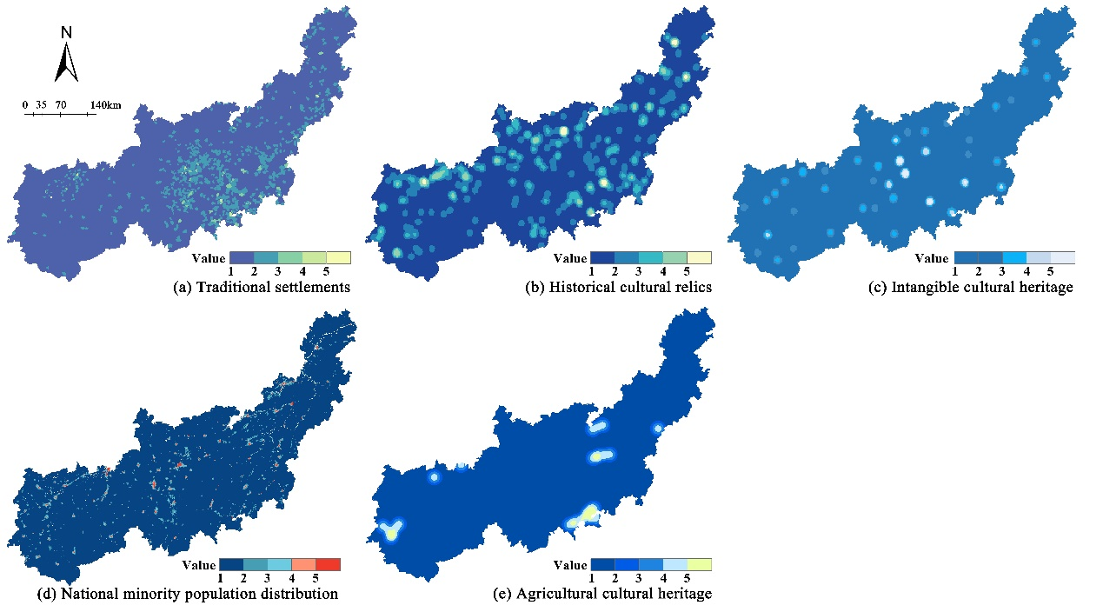
Results
1. Spatial analysis of bio-cultural diversity factors in Miaoling mountainous region
Results show that central and western Miaoling—especially the Beipan River basin—host high biodiversity, supported by intact karst habitats and key species.
Traditional villages, mainly of Miao, Dong, and Bouyei ethnic groups, cluster at 600–800 meters elevation with gentle slopes, closely aligned with favorable karst conditions.
Notes:
Our results show that central and western Miaoling—especially the Beipan River basin—host high biodiversity, supported by intact karst habitats and key species.
Traditional villages, mainly of Miao, Dong, and Bouyei ethnic groups, cluster at 600–800 meters elevation with gentle slopes, closely aligned with favorable karst conditions.

Slide 18
Despite these overlaps, nearly half of the region exhibits limited coordination between biological and cultural diversity, with an average coupling coordination degree of 0.611.
Notes:
We found that nearly half of the region —particularly western and eastern mountains—shows low coordination.

Slide 19
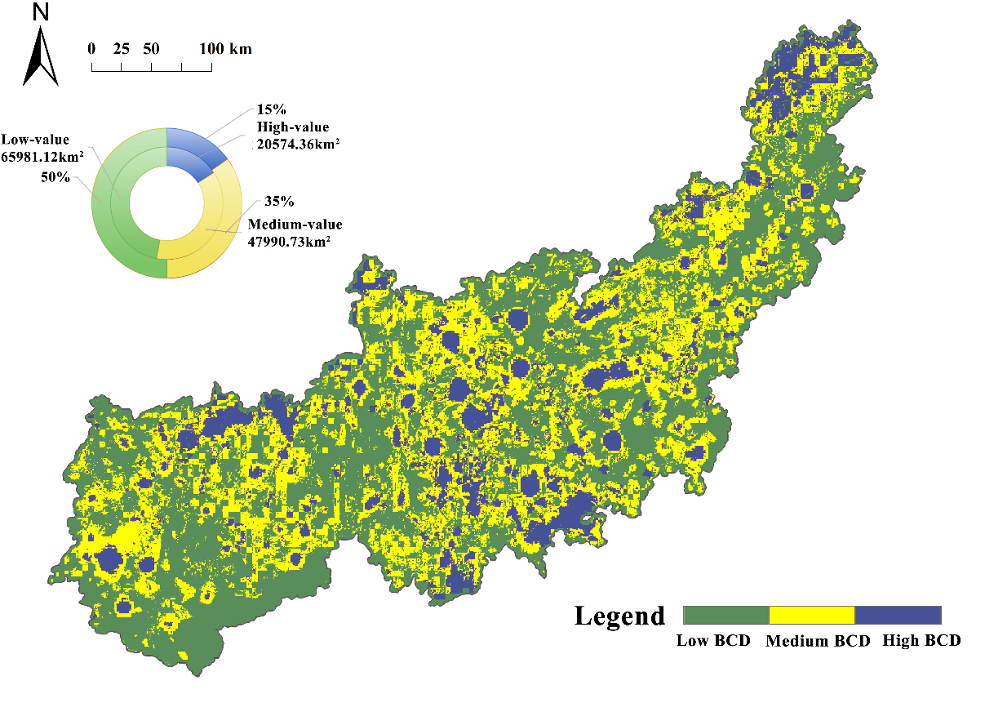
2. Identification of priority areas for bio-cultural diversity conservation
Priority conservation zones, covering 2,286.76 km², are primarily located in small watersheds and agroforestry systems, revealing a fragmented spatial distribution.
Notes:
Priority conservation zones, covering 2,286.76 km², are primarily located in small watersheds and agroforestry systems, revealing a fragmented spatial distribution.

Slide 20
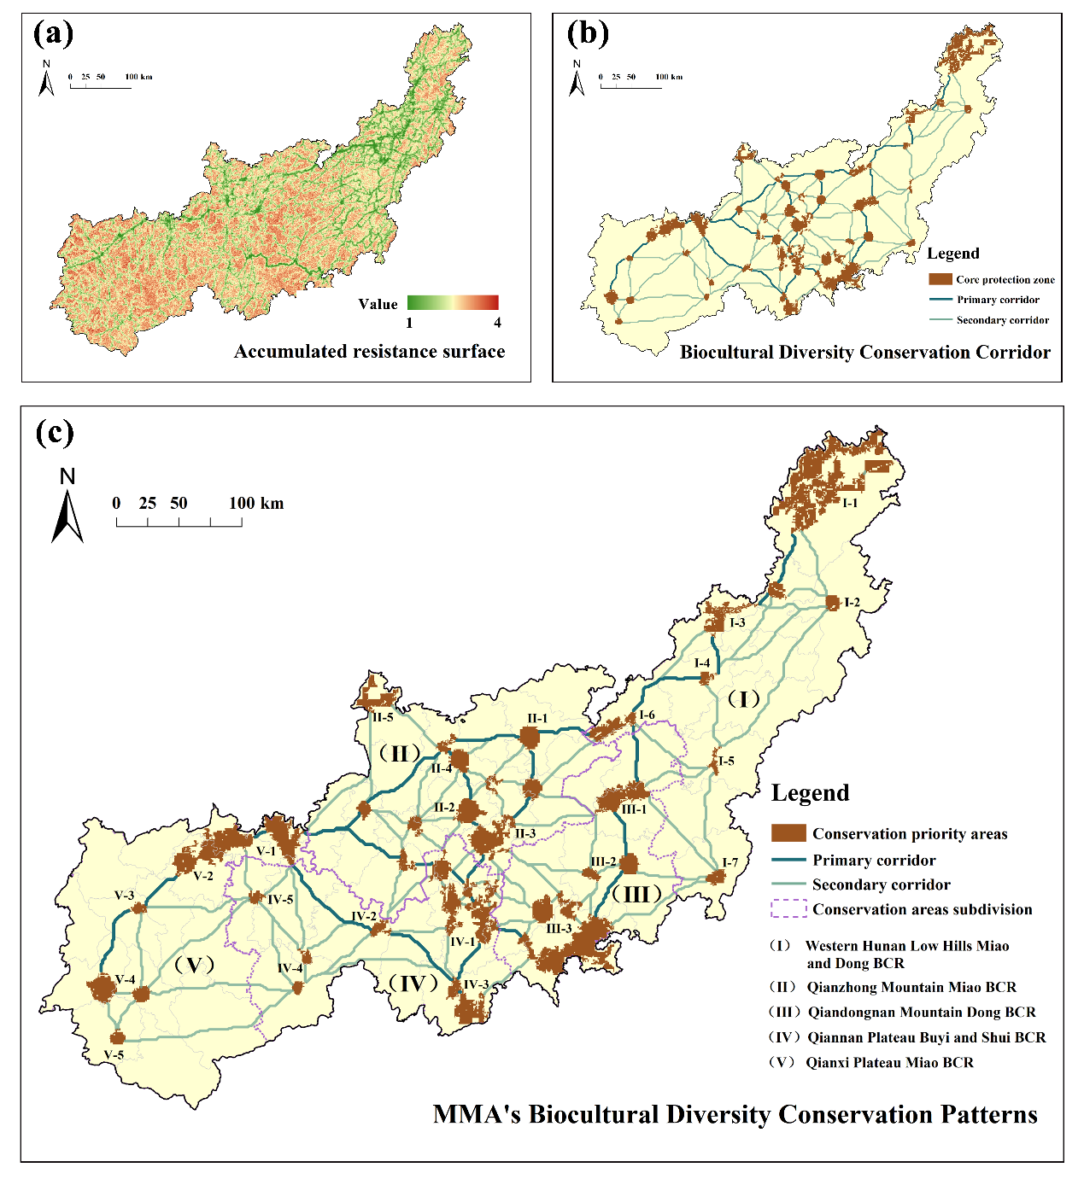
3.3 Construction of biodiversity conservation network in Miaoling mountain area
To address these challenges, a “source-corridor-network” conservation strategy was proposed, consisting of 29 primary corridors, 76 secondary corridors, and 25 key nodes to enhance connectivity and resilience.
Notes:
To address these challenges, a “source-corridor-network” conservation strategy was proposed, consisting of 29 primary corridors, 76 secondary corridors, and 25 key nodes to enhance connectivity and resilience.

Slide 21
Management Framework
Based on the results of the Miaoling Bio-cultural Diversity Conservation Priority Areas and corridor network, the conservation planning area was further generalized into a planning layout of "one core, two axes, five zones and many nodes".
Notes:
Based on the results of the Miaoling Bio-cultural Diversity Conservation Priority Areas and corridor network, combined with in-depth fieldwork and participatory mapping by stakeholders, the conservation planning area was further generalized into a planning layout of "one core, two axes, five zones and many nodes".

Slide 22
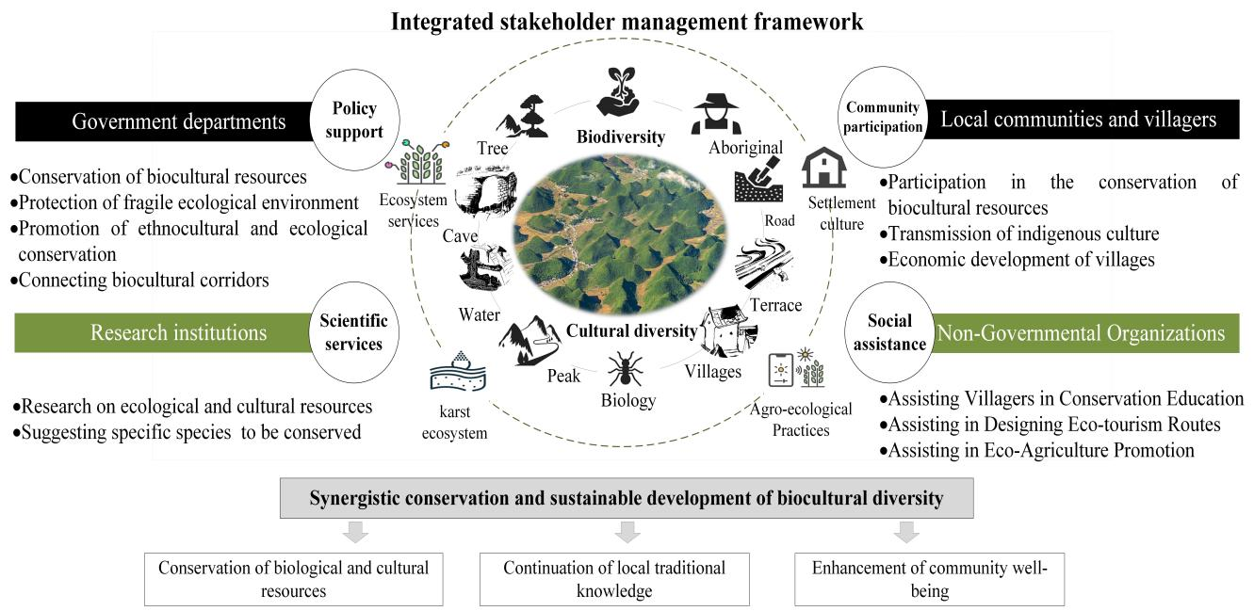
Furthermore, we proposed a multi-stakeholder adaptive management framework. This framework emphasizes policy and financial support, community participation, and collaboration to integrate ecological protection with sustainable development.
Notes:
Furthermore, we proposed a multi-stakeholder adaptive management framework. This framework emphasizes policy and financial support, community participation, and collaboration to integrate ecological protection with sustainable development.

Slide 23
04
Conclusion

Slide 24
Conclusion
1.This study demonstrates that integrating bio-cultural diversity provides a robust pathway for enhancing conservation effectiveness in karst mountain systems, where ecological functions and cultural heritage are deeply intertwined.
2.Our framework contributes to advancing interdisciplinary conservation approaches, offering spatially explicit strategies that support both landscape resilience and cultural continuity.
Notes:
This study demonstrates that integrating bio-cultural diversity provides a robust pathway for enhancing conservation effectiveness in karst mountain systems, where ecological functions and cultural heritage are deeply intertwined.Our framework contributes to advancing interdisciplinary conservation approaches, offering spatially explicit strategies that support both landscape resilience and cultural continuity in Southwest China's karst regions and beyond.

Slide 25
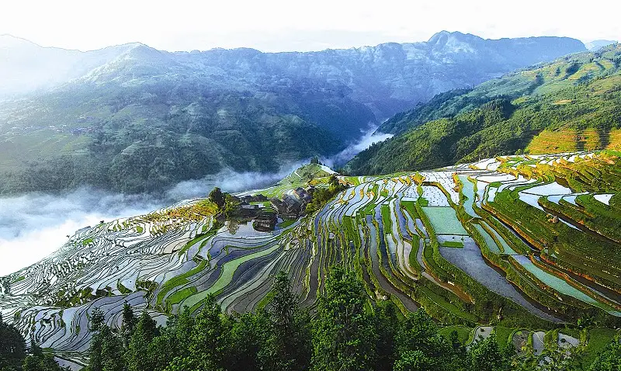
THANKS
Notes:
Thank you for your attention! I look forward to your questions and discussion.

