Slide 1
Modeling Seismic Hazard and Landslide Occurrence Probabilities in Northwestern Yunnan, China: Exploring Complex Fault Systems with multi-segment rupturing in a Block Rotational Tectonic Zone
Jia Cheng, Chong Xu, Xiwei Xu
China University of Geosciences, Beijing
Vienna, 2025-04-28

Slide 2
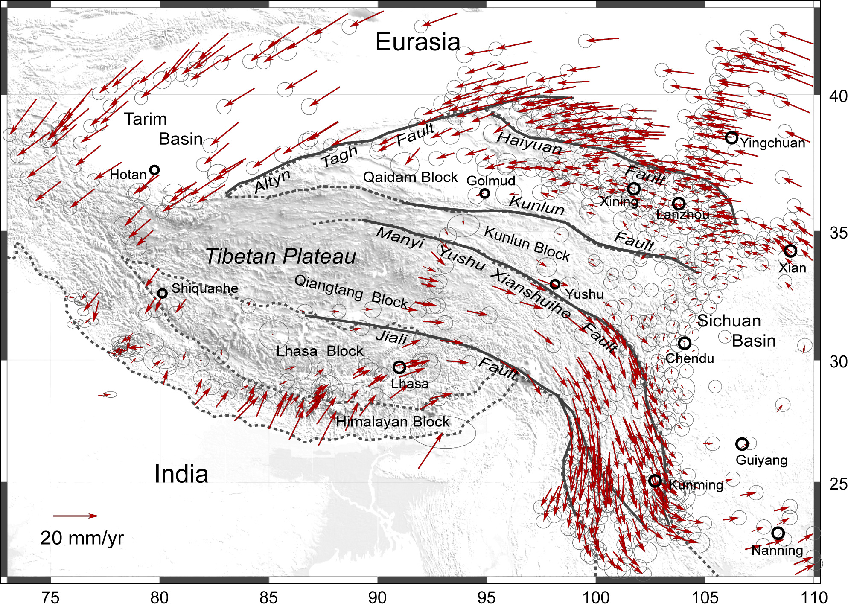
Introduction
The Northwestern Yunnan Region, is characterized by a combination of low-crustal flow and gravitational collapse, giving rise to a complex network of active faults.
Clockwise rotation and SE extrusion of the crust
NE- and SW- trending faults coexist
NE-trending faults
SW-trending faults
Gan et al., 2007

Slide 3
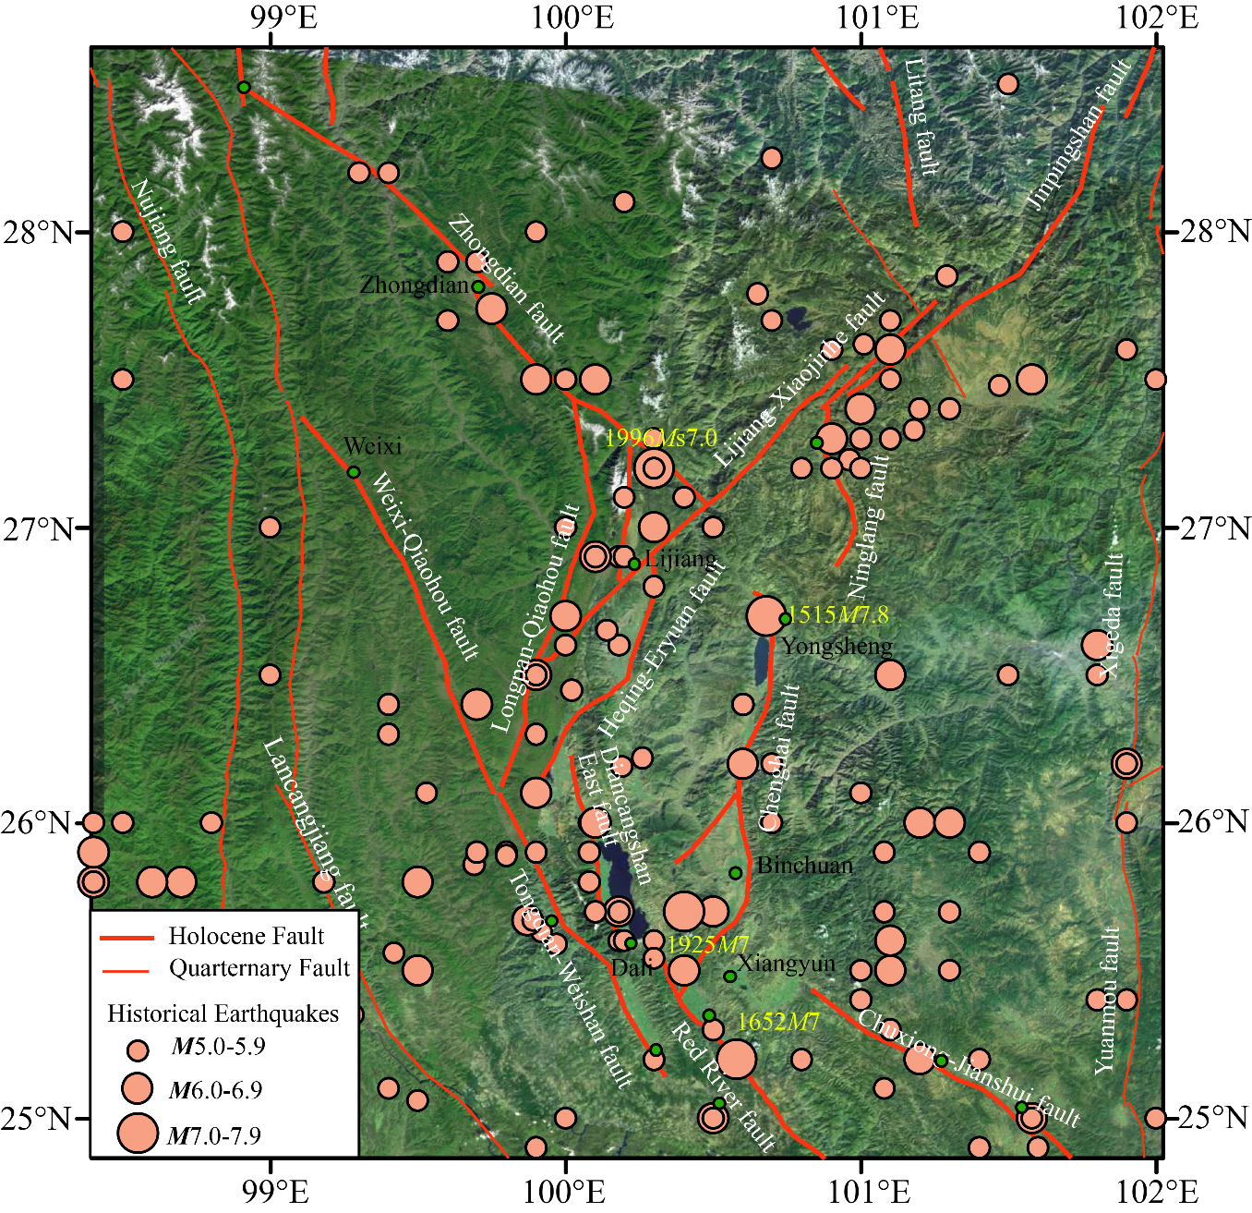
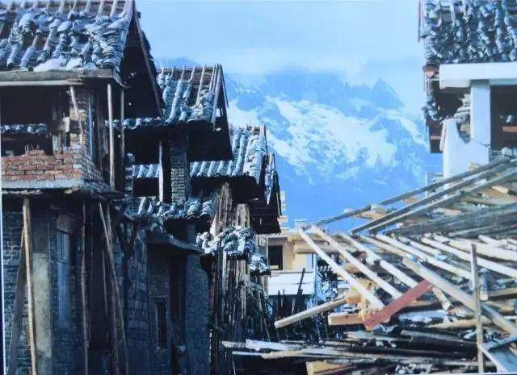
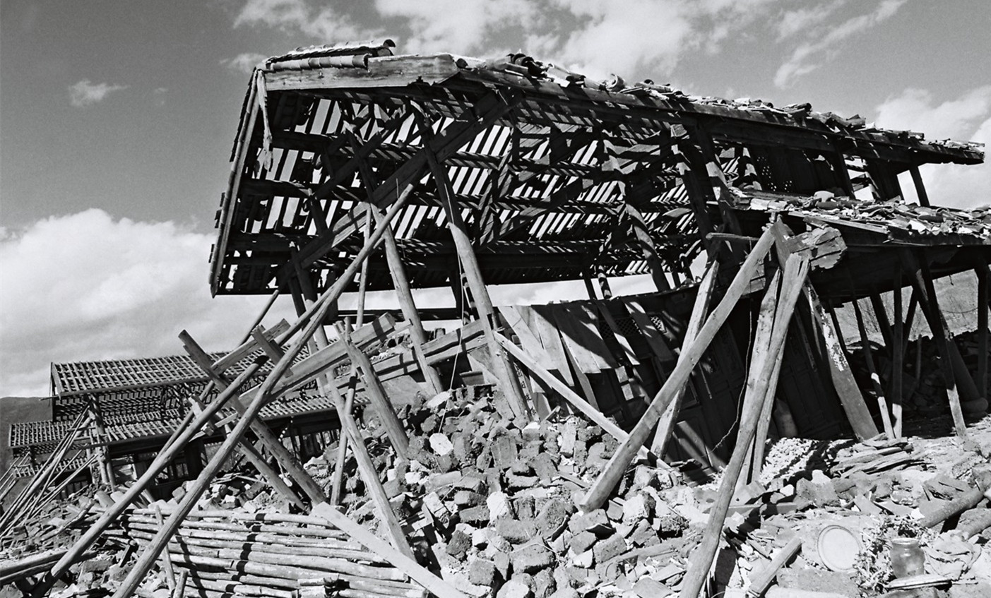
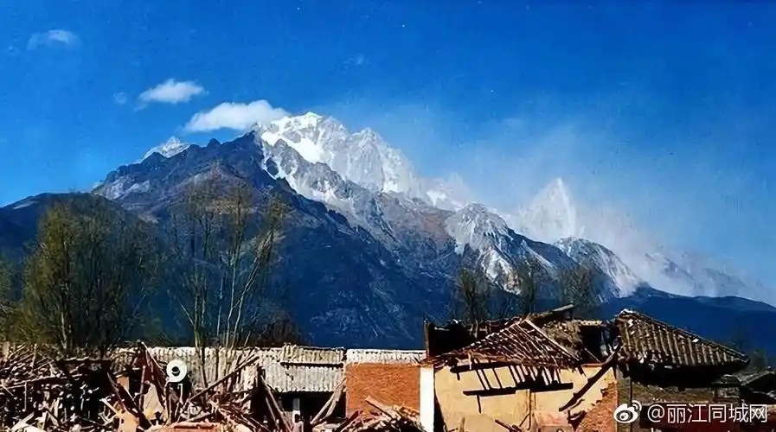
Introduction
Strong Historical earthquakes frequently ruptured in this region.
1996-02-03 Ms7.0 Earthquake occurred near Lijiang Area

Slide 4
Introduction
Seismic landslide hazard:
Landslide accomplice with the seismogenic fault of the 1515 Yongsheng M7.8 EQ
This area also has frequent landslides, with high mountains, steep slopes, abundant water and loose soil.
Active crustal movement
Unique monsoon climate with heavy rainfall
Complex geological structure
fragile ecological environment
diverse local climate background
Huang et al., 2021, Earth Science Frontiers

Slide 5
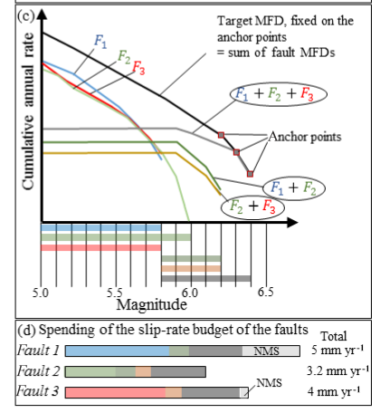
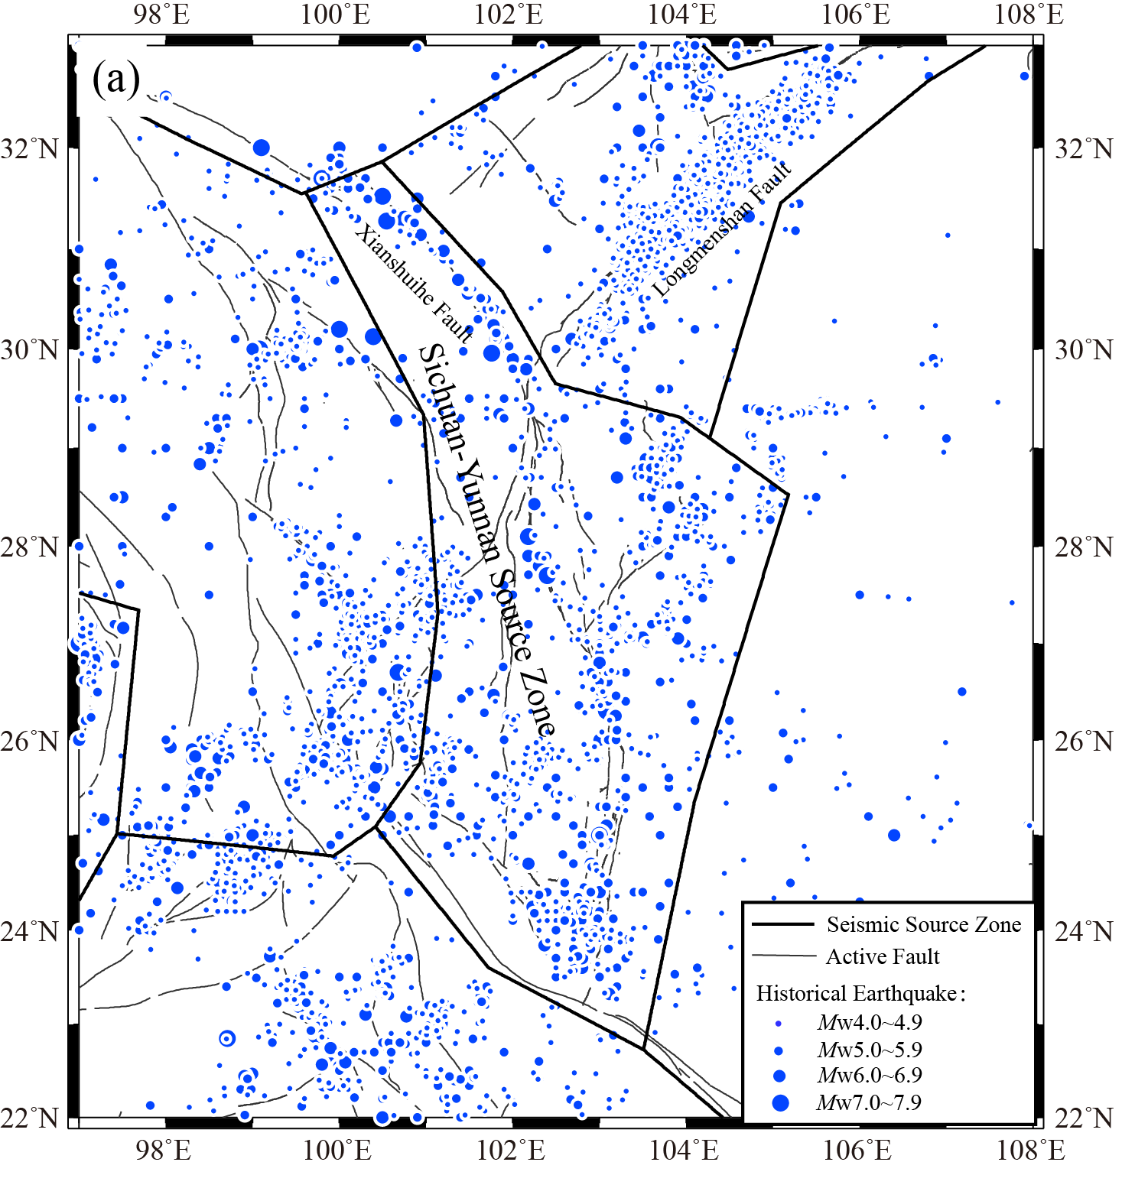
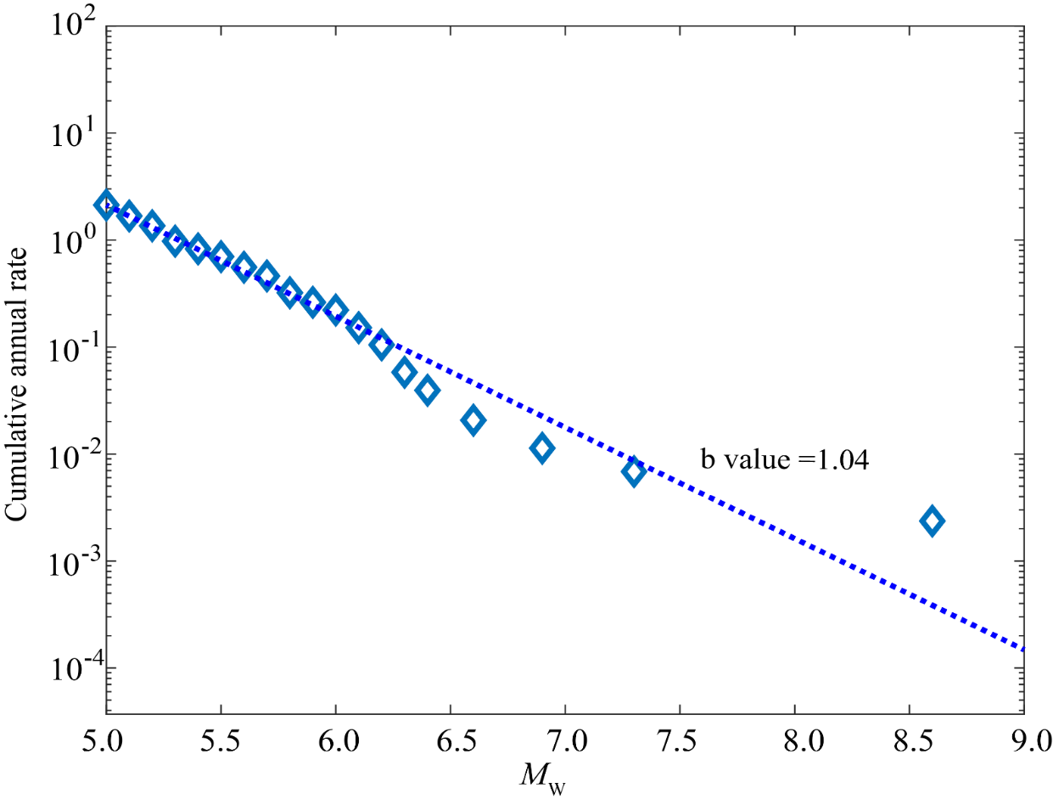
Multi-segment Seismic Hazard Modeling
Seismic Source Model: we applied the method of SHERIFs (Chartier et al. 2017) to simulate the occurrence rate of multi-segment rupturing, align with the fault slip rate, fault segmentation, historical earthquake occurrence rates, and the recurrence intervals of historical and paleo-earthquake events.
SW Yunnan Region
Chartier et al., 2017,NHESS
Cheng et al., 2017, BSSA

Slide 6
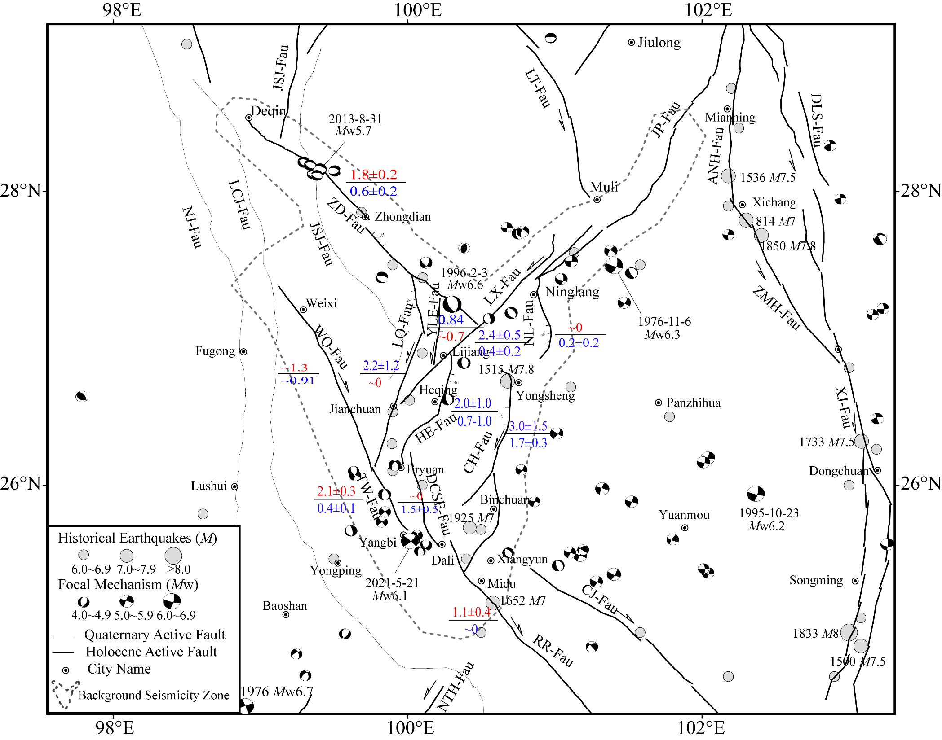
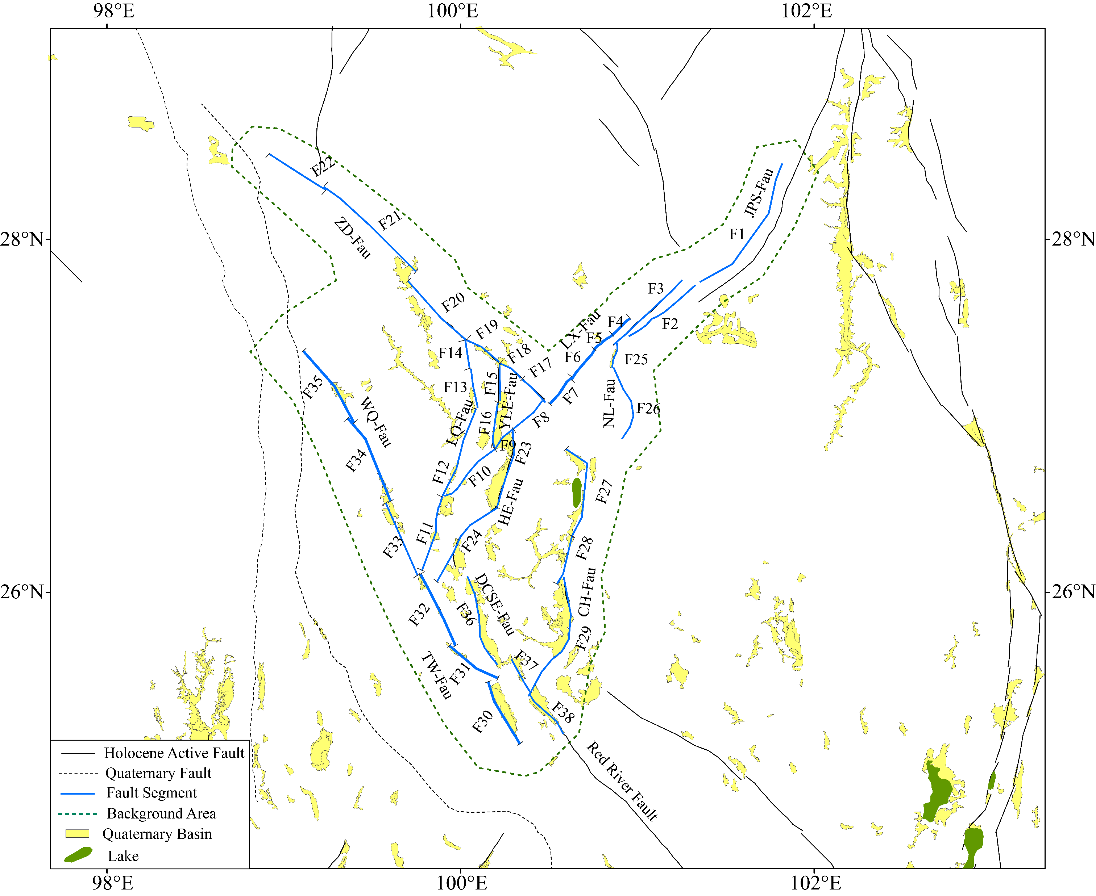
Introduction
A fault segmentation and rupture combination model to characterize seismic sources.
Geological data and Slip rates
Rupture combination considering Quaternary Basins

Slide 7
Multi-segment Seismic Hazard Modeling
Two factors can stop the rupture to be a multi-segment event.
Numerical simulations: A 5+ km width step-over could stop rupture process
Strike-difference of > 30° can stop the multi-segment rupture.
historical rupture data: >30° can stop the rupture
Biasi and Wesnousky, 2017
Stress field study : similar results, but should also consider the background stress field
Harris and Day, 1993
Harris and Day, 1999
Mignan et al., 2015

Slide 8
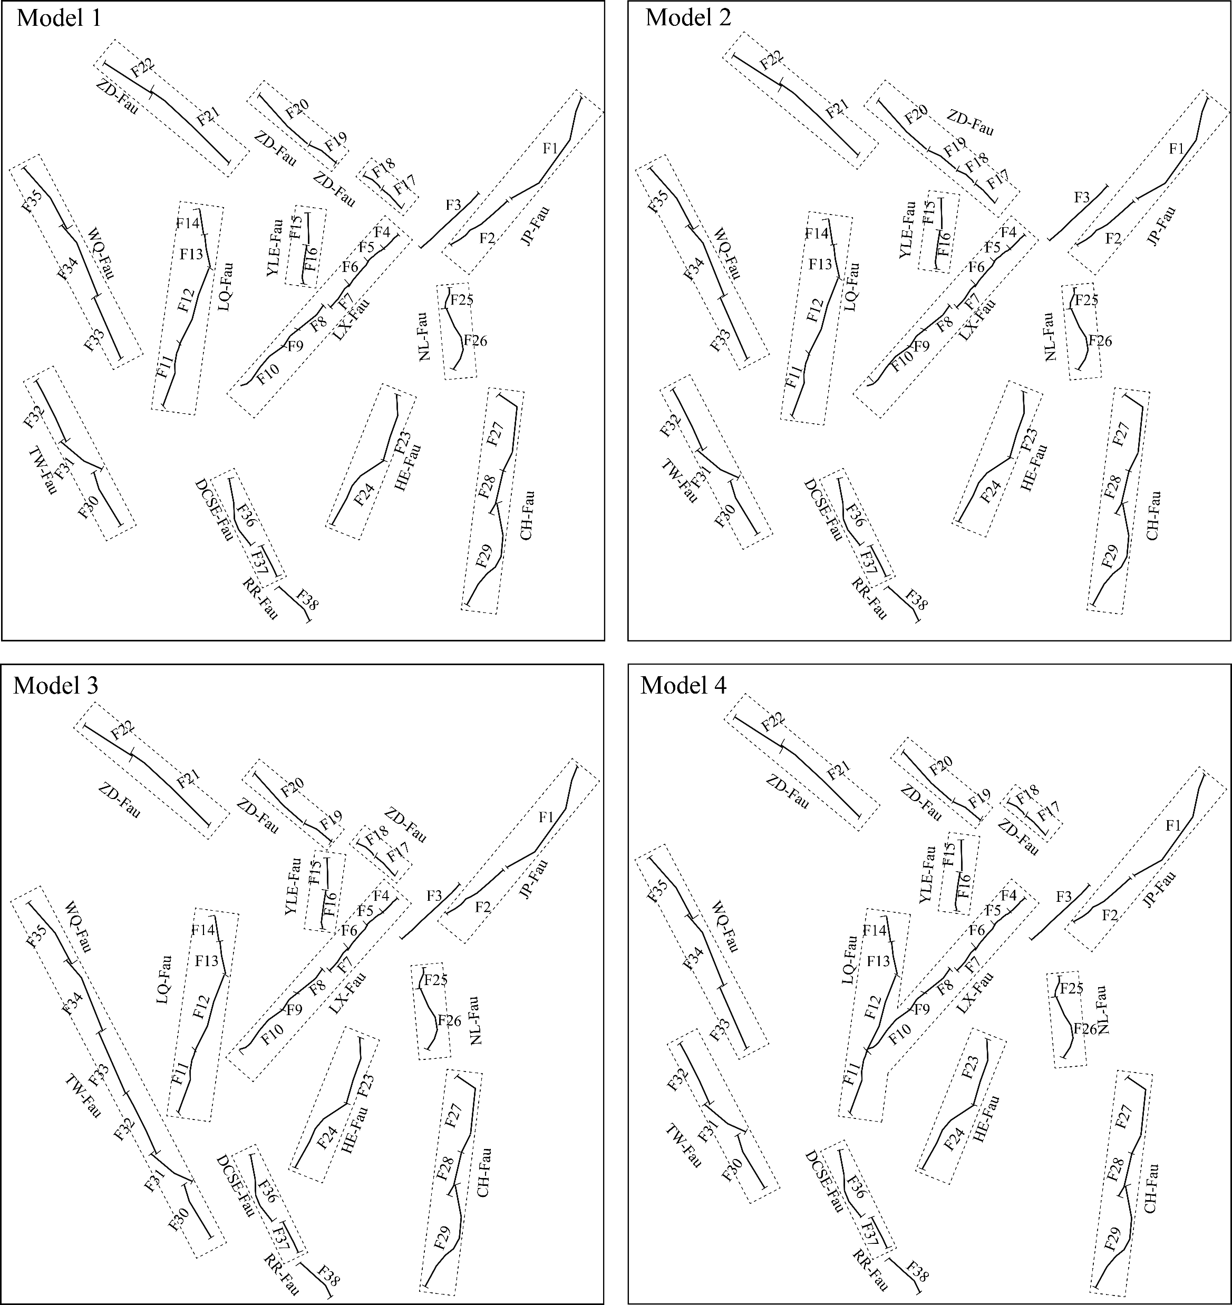
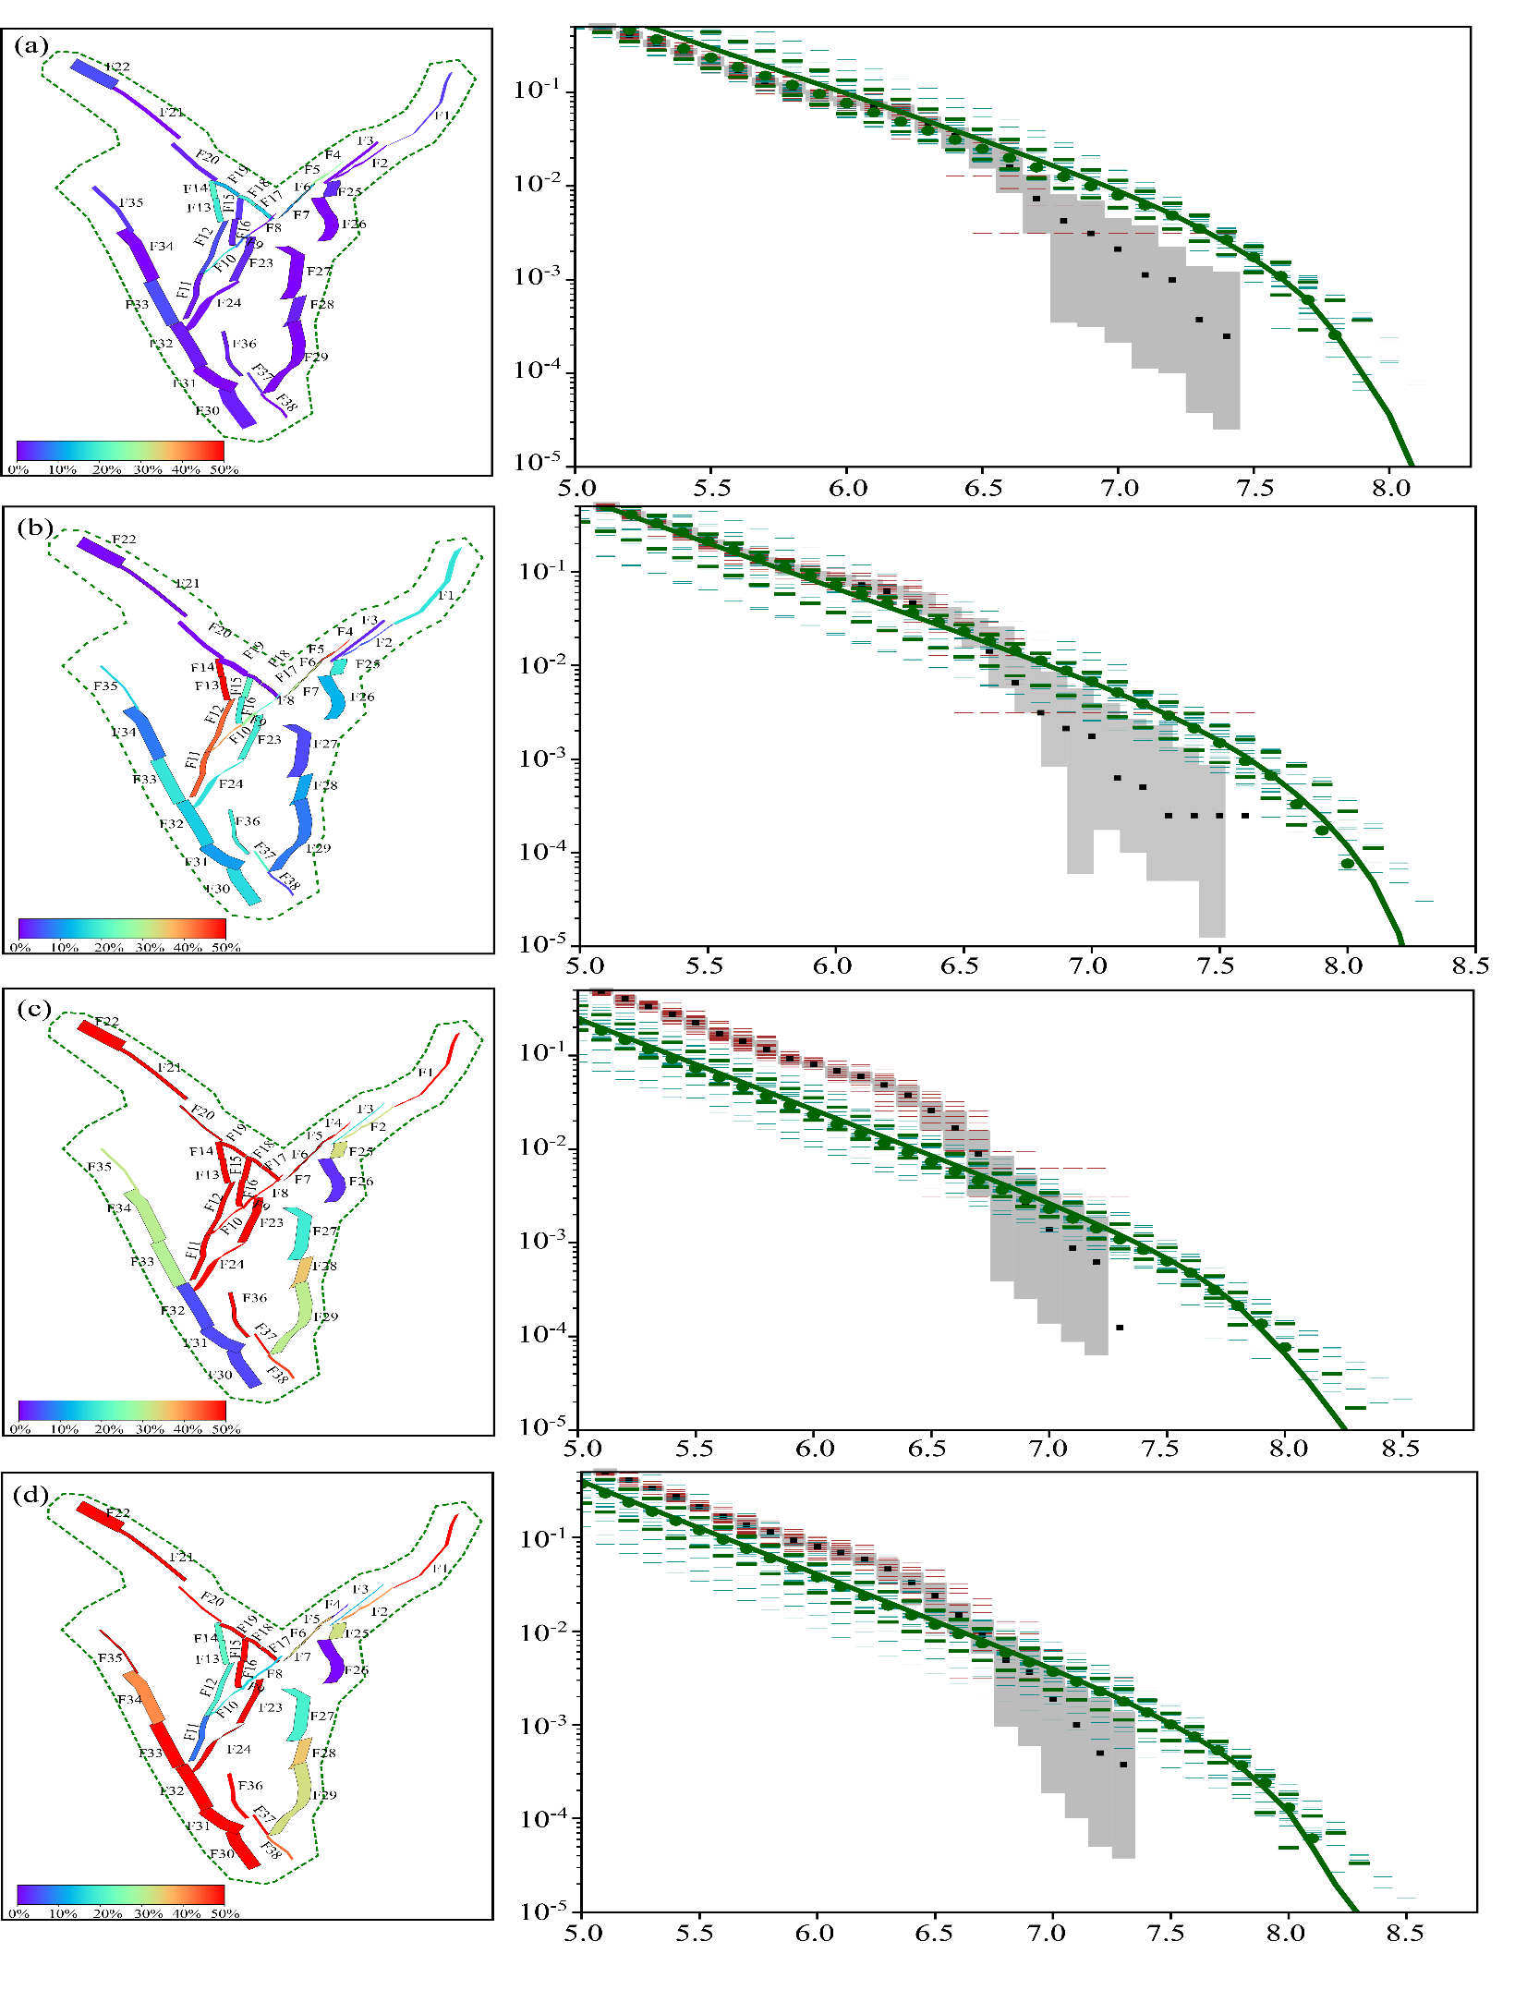
Multi-segment Seismic Hazard Modeling
Simulation of the seismicity rates
Four multi-segment rupture combination model
Comparison of modeled and historical seismicity rates
Multi-segment in individual fault
Normal slip of the YLF
(F15-F16)
NMS (non-mainshock slip) ratio ≤30–40%
was used for judging the reasonableness of the rupture combination models
F30-F35, the strike-slip of LQ-Fault
F4-F10 with F11-F14
(2023 M7.8 Turkey EQ)
Chartier et al., 2019

Slide 9
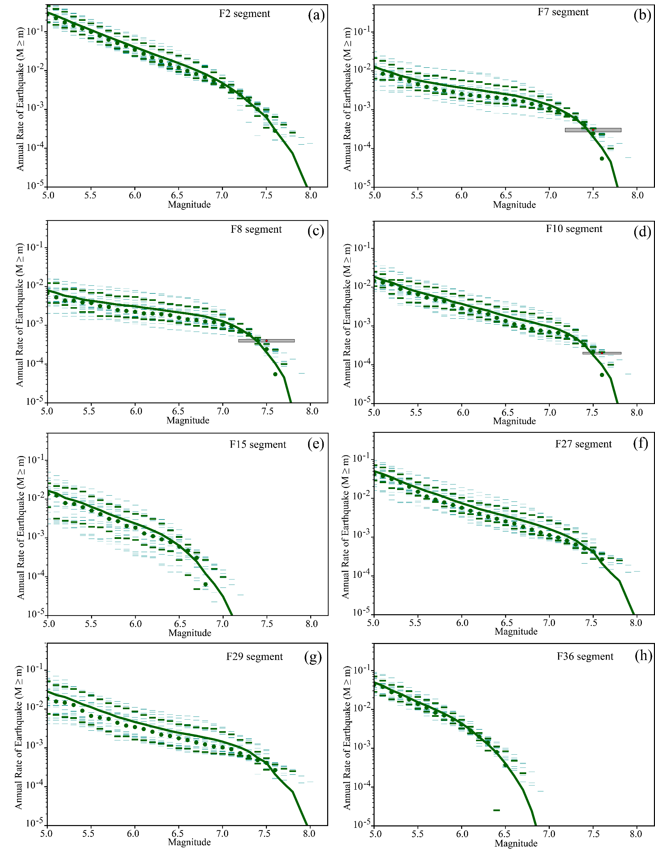
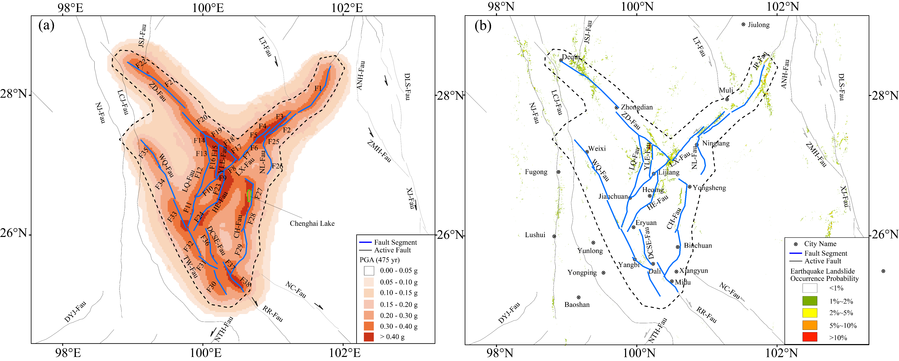
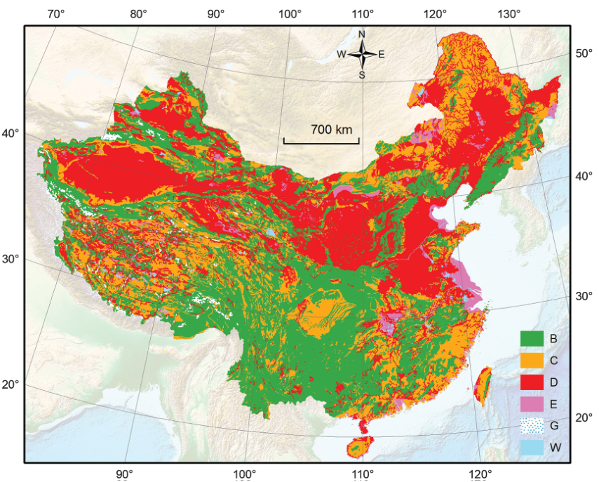
Multi-segment Seismic Hazard Modeling
Calculation of the PGA values, considering the amplification effect of site conditions.
PGA distribution with selected GMPEs
(10% PE in 50 yr)
Site amplification of rock types
Chen et al., 2021

Slide 10
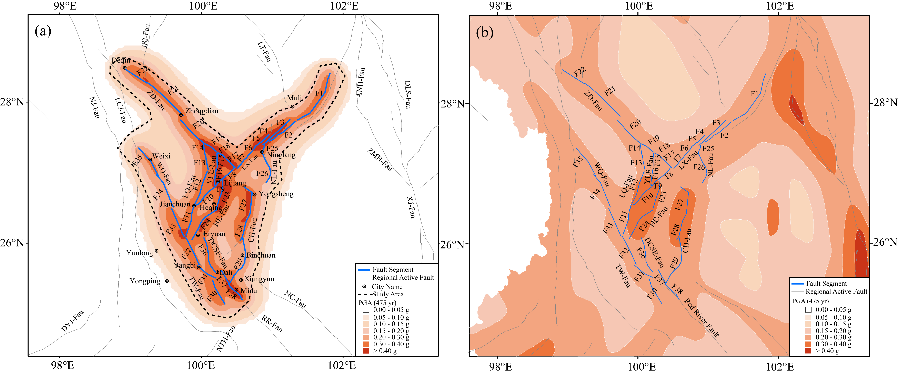
Multi-segment Seismic Hazard Modeling
Comparison with our PGA distribution of Nation Seismic Hazard Map
(10% probability of exceedance in 50 years)
Our results
National Seismic Hazard Map of China

Slide 11
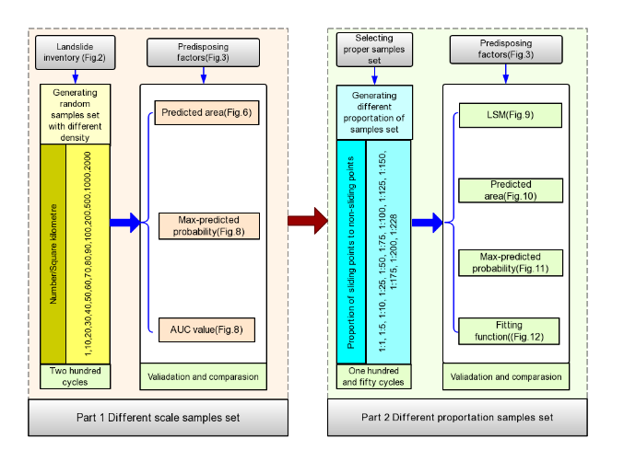
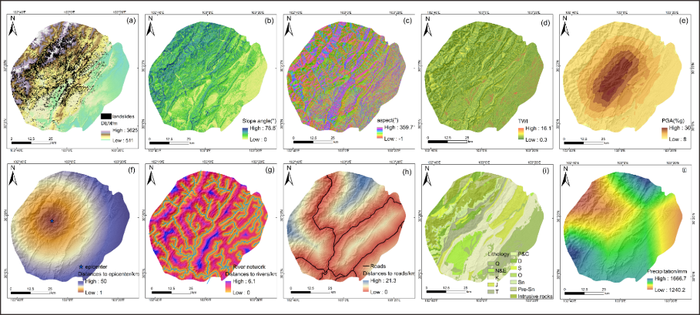
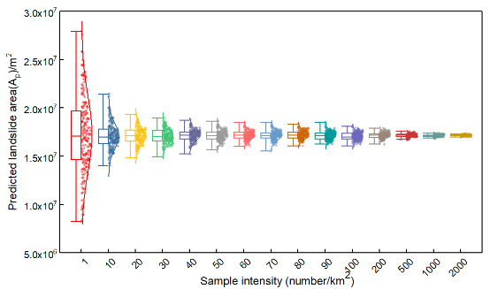
历史
历史
Probabilistic Seismic Landslide Hazard Assessment
Machine Learning - Logistic Regression
Landslides
Slope angle
Slope aspect
TWI
PGA
Epicenter
River Network
Road
Lithology
Precipitation
The 15 types of sample densities are randomly selected in the study area, and each repeated calculation 200 times to ensure that there is no abnormal impact of sample selection.
Xu et al., 2012
11
Notes:
We use Machine learning – logistic regression to do probabilistic seismic landslide hazard assessment. The parameters includes topography, geology ,earthquake, hydrology and other factors.

Slide 12
Probabilistic Seismic Landslide Hazard Assessment
Landslide occurrence probabilities under PGA distribution.
PGA distribution
Landslide Occurrence Probabilities

Slide 13
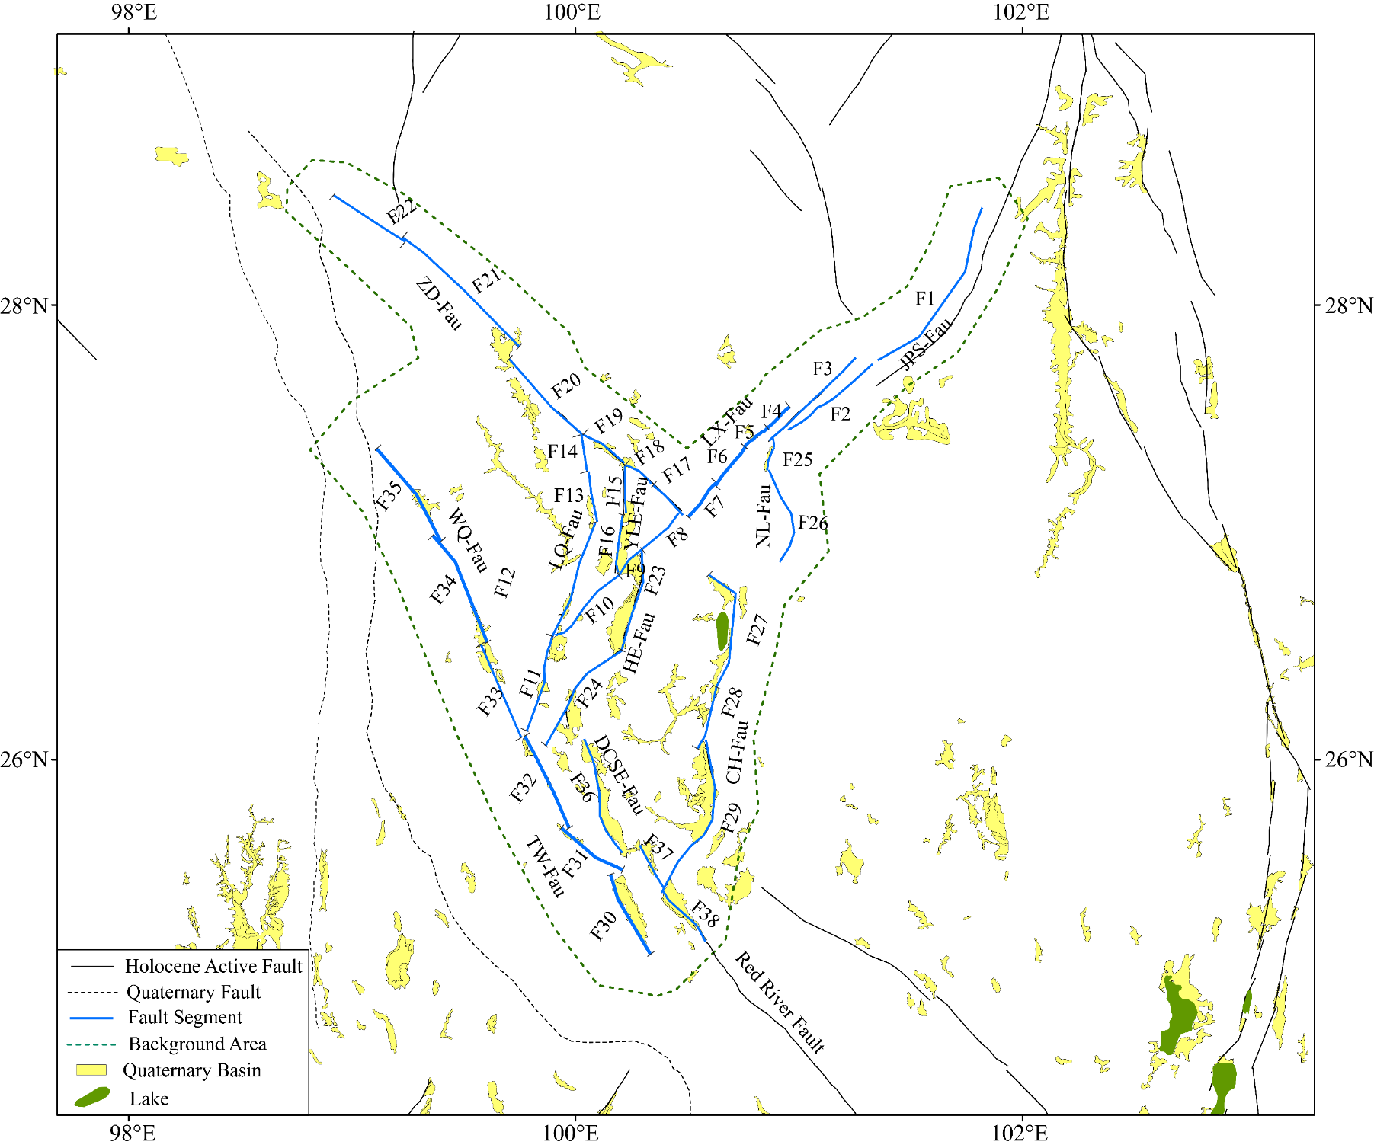
Conclusion
Our multi-segment rupture source model is consistent with the microplate rotational model.
Multi-segment rupture combination
Microplate rotational model
Tectonic and strata
data
Wang et al., 1998,
GSA Special Paper

Slide 14
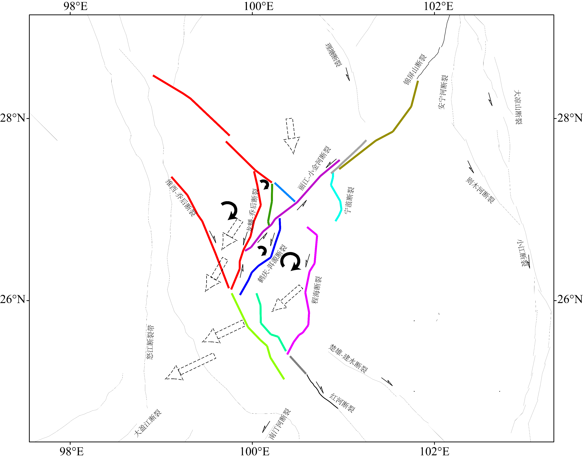
Conclusion
This Micro-plate rotation is driven by the gravitational collapse, causing the upper crust to move westward faster than the lower crust.
Micro-plate rotation model
Dynamic sources
Rangin et al., 2013, JAES

Slide 15
Conclusion
We used the simulation method in the SHERIFS code to calculate seismicity rates for both single-segment and multi-segment ruptures. Our results show that multi-segment ruptures occur only within individual faults in the NW Yunnan Region.
We also provided valuable insights into the seismic hazards present in the NWYR, and generated a more comprehensive assessment of seismic hazards and landslide probabilities, considering both the fault slip behavior and site condition map.
Our multi-segment rupture source model aligns with the rotational motion of regional micro-blocks, driven by lower crustal flow and gravitational collapse along the southeastern margin of the Tibetan Plateau, reflecting both tectonic implications and fault activities.

Slide 16
Reference：
Cheng et al. 2025. Modeling seismic hazard and landslide occurrence probabilities in northwestern Yunnan,
China: exploring complex fault systems with multi-segment rupturing in a block rotational tectonic
zone. Natural Hazards and Earth System Sciences, 25, 857-877, doi:10.5194/nhess-25-857-2025.
Cheng et al. 2023. From Active Fault Segmentation to Risks of Earthquake Hazards and Property and Life
Losses – A Case Study from the Xianshuihe-Xiaojiang Fault Zone. Science China Earth Sciences,
66(6): 1345-1364.
Cheng and Chartier, et al. 2021. Multisegment Rupture Hazard Modeling along the Xianshuihe Fault Zone,
Southeastern Tibetan Plateau. Seismological Research Letters, 92(2A), 951-964.
Cheng et al. 2021. Probabilistic multi-segment rupture seismic hazard along the Xiaojiang fault zone,
southeastern Tibetan Plateau. Journal of Asian Earth Sciences, 221, doi: 10.1016/j.jseaes.2021.104940.
Chartier T, Scotti O, Lyon-Caen H, Boiselet A. 2017. Methodology for earthquake rupture rate estimates of
fault networks: example for the western Corinth rift, Greece. Nat Hazards Earth Syst Sci, 17:1857-1869.
Chartier T, Scotti O, Lyon-Caen H. 2019. SHERIFS: Open-Source code for computing earthquake rates in
fault systems and constructing hazard models. Seismol Res Lett, 90:1678-1688.

Slide 17
Thanks for your attention!

Slide 18
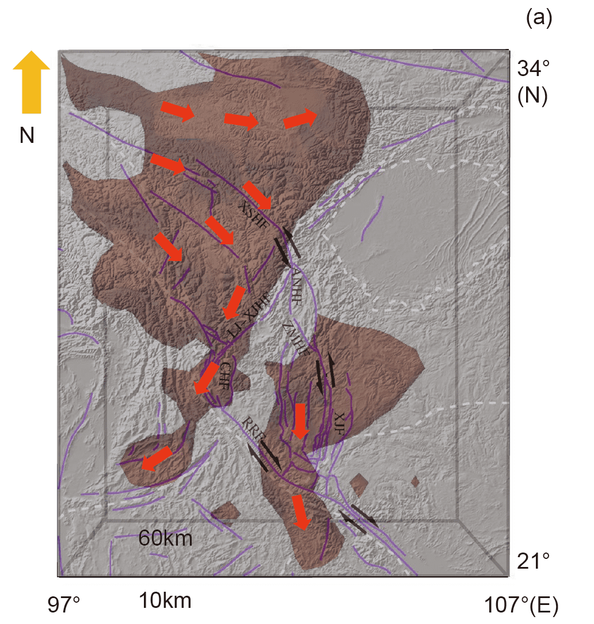
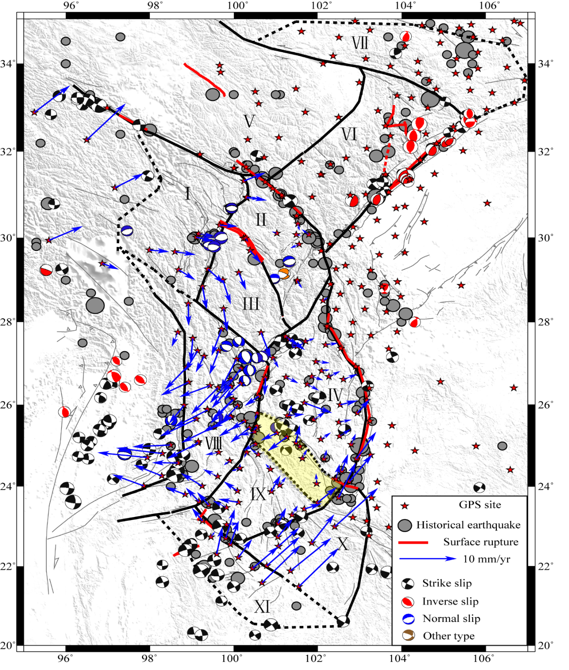
Introduction
GPS velocity observations and S-wave velocity imaging both indicate that this region may be a lower crustal flow channel.
GPS velocity field after removing overall (block) motion
Vs velocity field
Extensional
Crustal
deformation
Low
Crustal
flow
Cheng et al., 2012, Chinese J. Geophys
Zhang et al., 2021, Science China

Slide 19
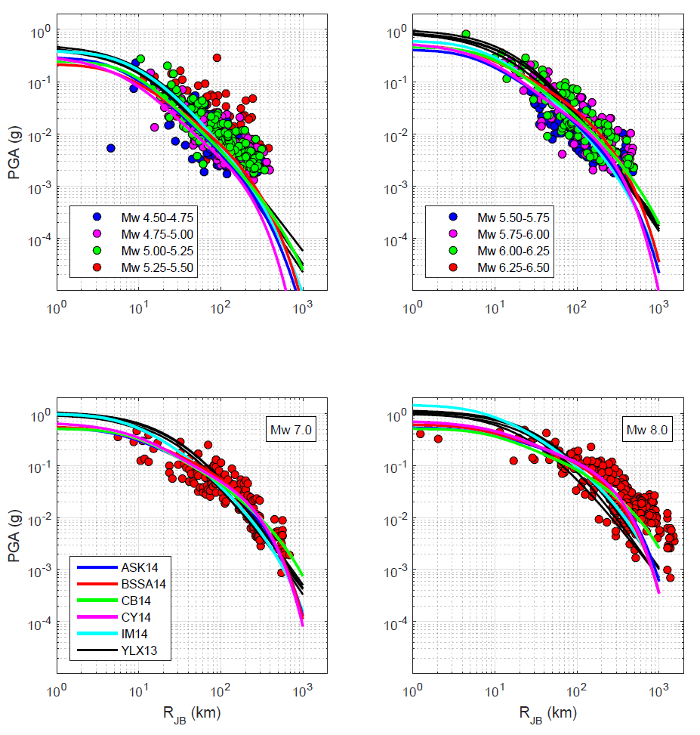
Multi-segment Seismic Hazard Modeling
GMPEs的选取
PGA calculation with GMPEs
We used logic Tree model of 4 branches.
Abrahamson, Silva, and Kamai (2014)
Chiou and Youngs (2014)
Campbell and Bozorgnia (2014)
Boore et al. (2014) branches.
Each branch was assigned the same weight of 0.25
Dangkua, et al., 2017, BSSA

