Slide 1
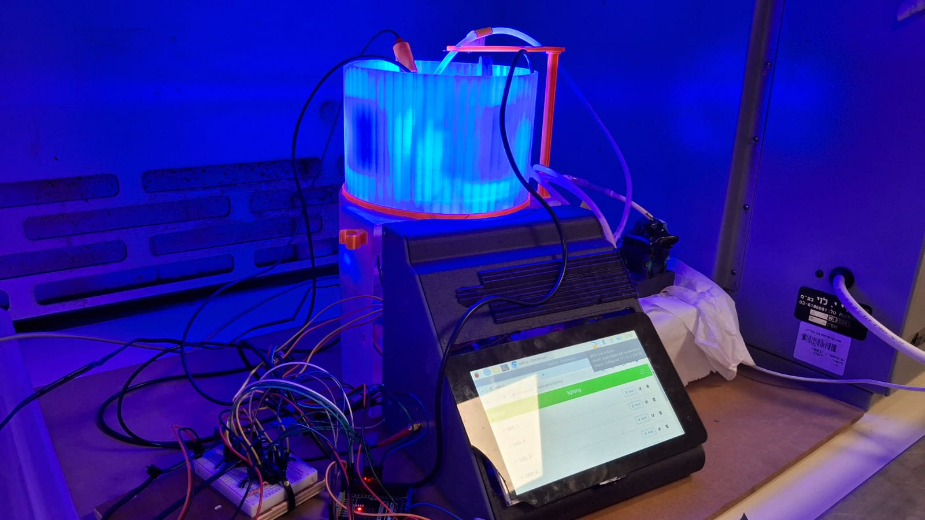
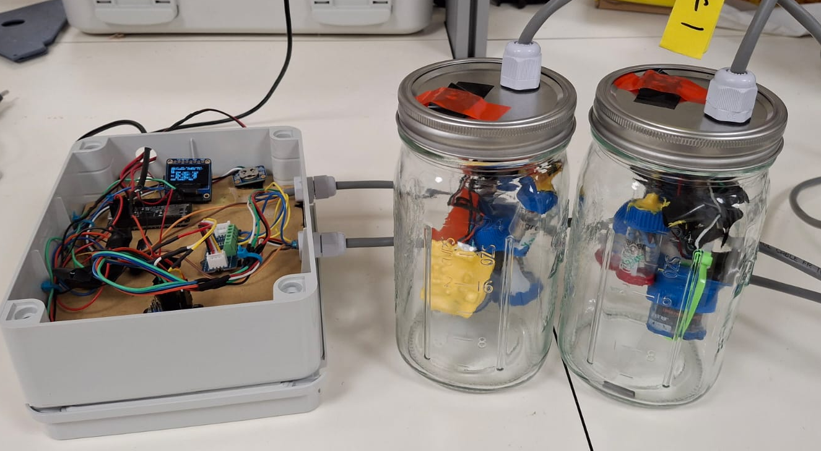
Connect with us!
EGU25-5229
New open-source, self-assembly tools to study microbial activity and water treatment applications
Devi Orozco^{a*}, Thomas Cadenbach^{b}, Elad Levintalª
ª The Zuckerberg Institute for Water Research, The Jacob Blaustein Institutes for Desert Research, Ben-Gurion University of the Negev, Israel
^{b} Universidad San Francisco de Quito, Ecuador
High Resolution
Real-Time Monitoring
Low-cost
System 1
Hydrological Monitoring Systems: Current Challenges
Solution
Open-Source Sensors
System 2
Notes:
Good morning dear audience, monitoring systems are essential to explore and understand the world that surround us. As hydrologysts, we are in constant seek of portable, economically acessible systems that provide us high spatiotemporal resolution meassurements in real-time. Can we achieve these aims? The answer is Yes! By using Open-Source Sensors. I will briefly show you two of our systems.

Slide 2
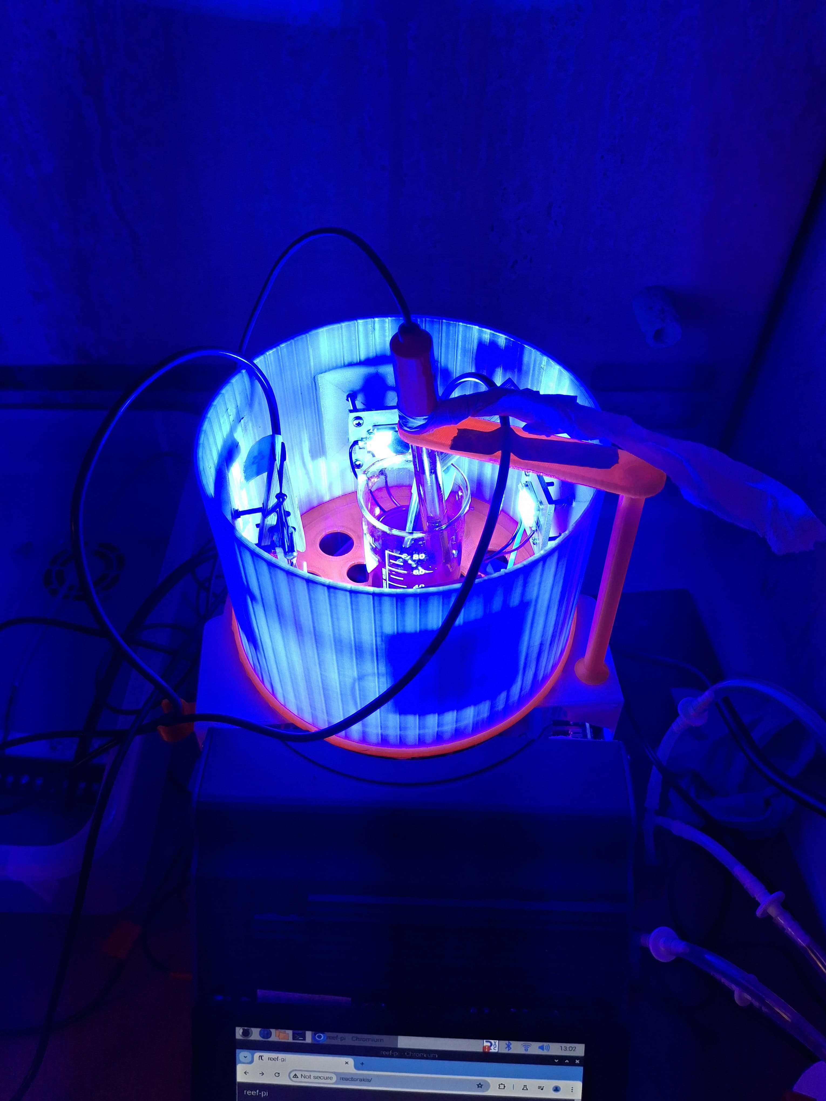
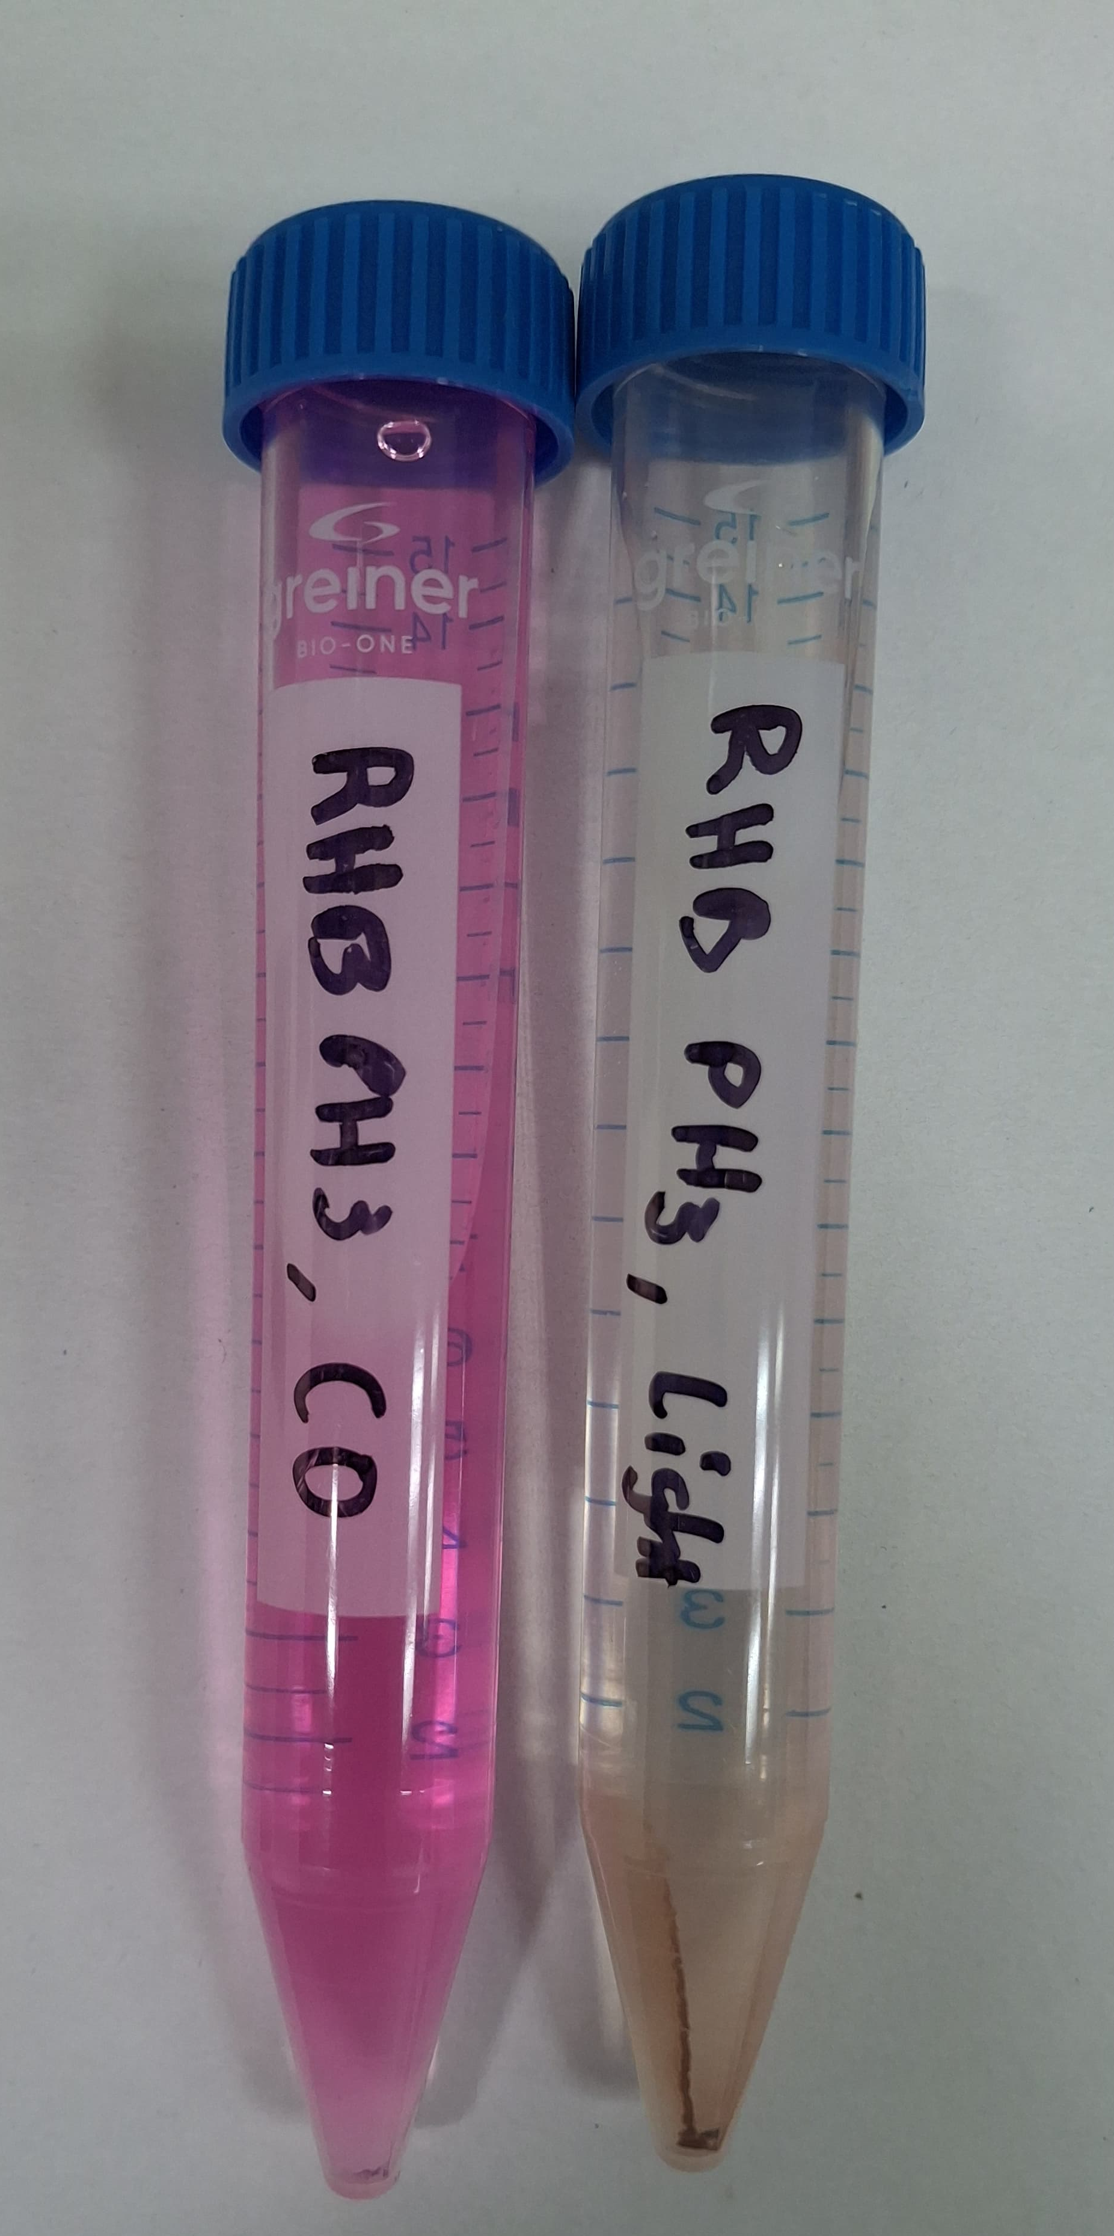
Connect with us!
EGU25-5229
System 1
Photoreactor-spectrophotometer
Photocatalytic degradation of Rhodamine B (RhB): 5mg/L, pH 3
Before
After
67% deg. after 3 h
Notes:
Our first system, a portable, lab-scale photoreactor spectroohotometer for water treatment applications, completely modular and open source. This system allow us to perform photocatalysis reactions, while doing symultaneous sampling and meassurements of the pollutant concentration in real time. We tested this system for the photocatalysis degradation of Rhodamine B in acid conditions, showing significant degradation of the dye after 4 hours of continous operation.

Slide 3
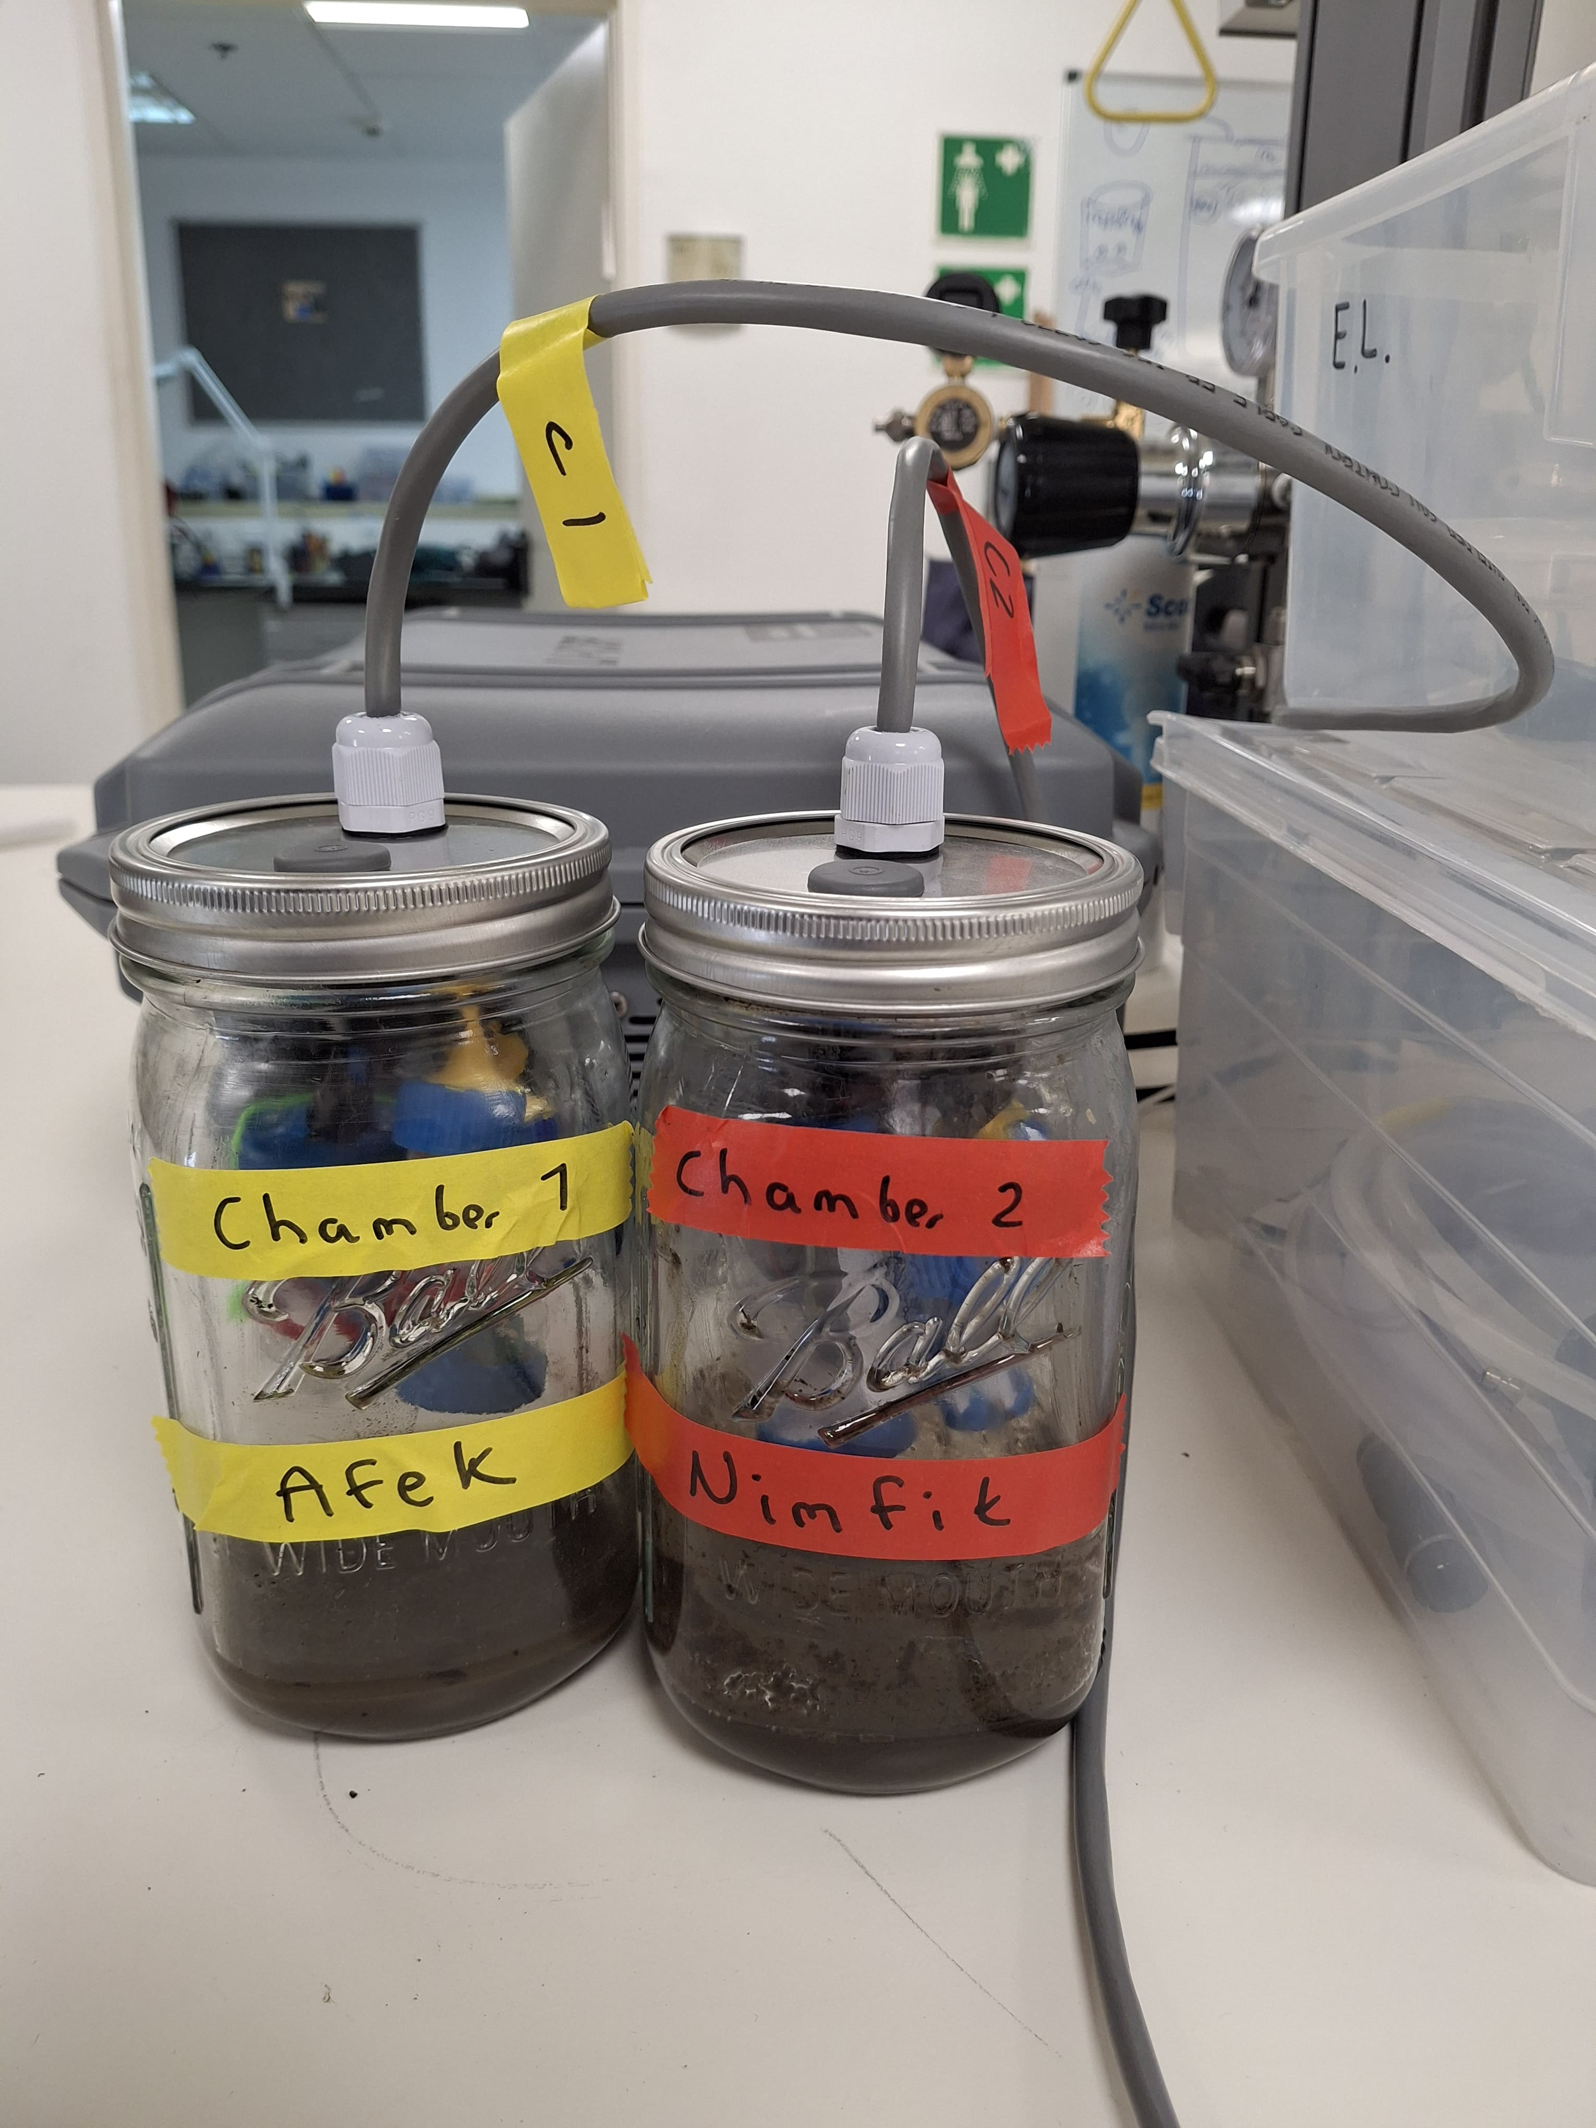
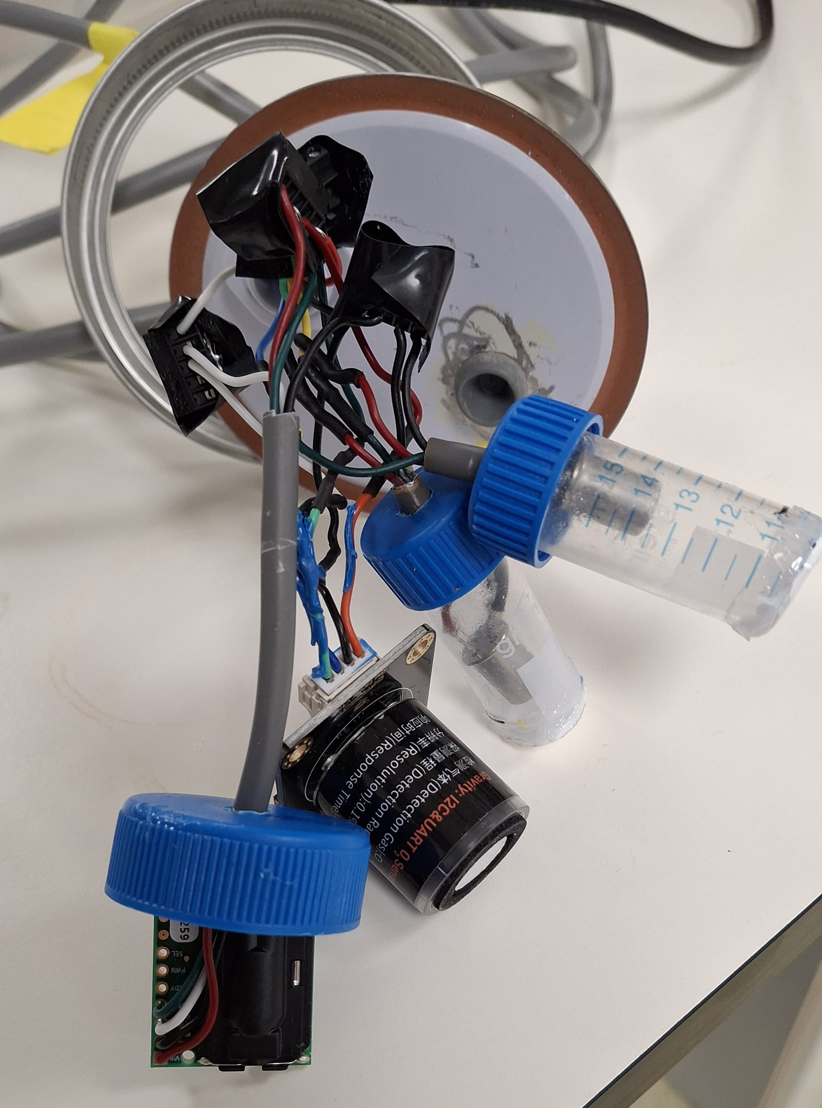
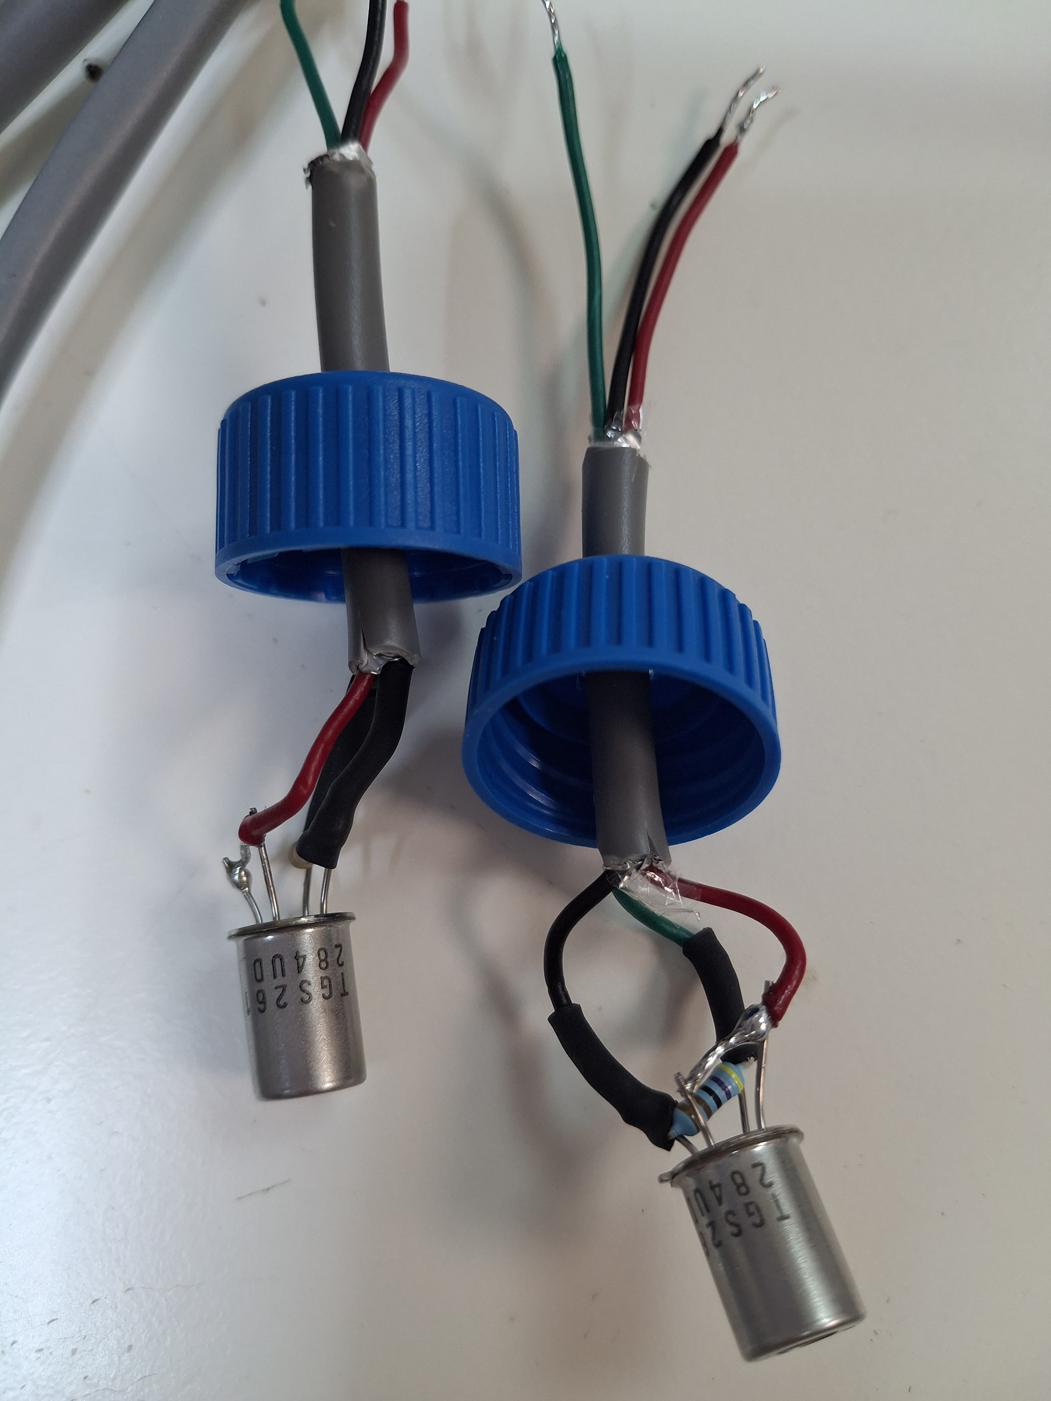
Connect with us!
EGU25-5229
System 2
DIY Incubation chambers
Methane emission incubation experiment: Site 1, 72 h
Site 1
Site 2
Sensors
O₂
CO₂
Ein Afek
CH₄
Significant increase of CH₄ concentration after 48 h
Notes:
Our second system consists in two incubation chambers, with sensors for carbon dioxide, oxygen and methane detection. These system was tested with wetland sludge to evaluate the capacity of detection of methane under anoxic conditions. Results show a significant increase of methane in the chamber, being a baseline for further analysis.
If you want to hear more, you are welcome to connect with us and help us with your valuable insights.
Thank you.

Slide 4
New open-source, self-assembly tools to study microbial activity and water treatment applications
Connect with us!
EGU25-5229
Devi Orozco^{a*}, Thomas Cadenbach^{b}, Elad Levintalª
ª The Zuckerberg Institute for Water Research, The Jacob Blaustein Institutes for Desert Research, Ben-Gurion University of the Negev, Israel
^{b} Universidad San Francisco de Quito, Ecuador
EGU General Assembly 2025
Session HS1.2.1. PICO A.10
May 1st, 2025

Slide 5
EGU25-5229
Photoreactor-Spectrophotometer
➤ Background
➤ Photoreactor modules
➤ Spectral Module: Heat Test
➤ Spectrophotometer & Sampling
➤ Test: Acid Conditions
Incubation Chambers
➤ Background
➤ Modules
➤ Calibration of Methane Sensors
➤ Leakage Tests
➤ Initial Findings
System 1
System 2

Slide 6
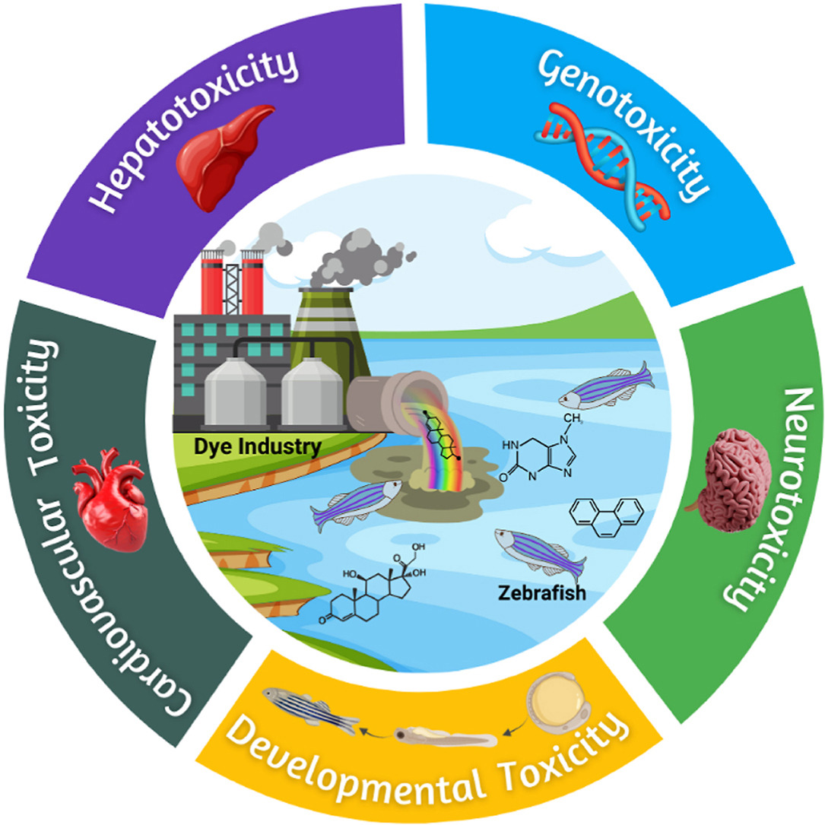
Background
EGU25-5229
Persistent Organic Pollutants (POPs):
Long-lasting in nature.
Highly resistant to conventional physicochemical methods.
Harm to aquatic organisms and public health concerns (e.g., Dyes)
Impact of dyes on aquatic ecosystems.
Source: Khandelwal et al. 2024. DOI: 10.1016/j.envres.2024.119684

Slide 7
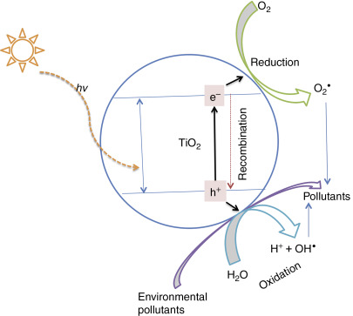
Background
EGU25-5229
Advanced oxidation processes (AOP):
Optimal method for degrading POPs.
Production of hydroxyl radicals to degrade organic matter.
Easy operation, cost-effective, low sludge production.
The schematic diagram for the advanced oxidation process using TiO2 catalyst in the presence of light and an environmental pollutant.
Source: Kumar, R. & Chandra, M. 2016. DOI: :10.1016/B978-0-12-804609-8.00003-0

Slide 8
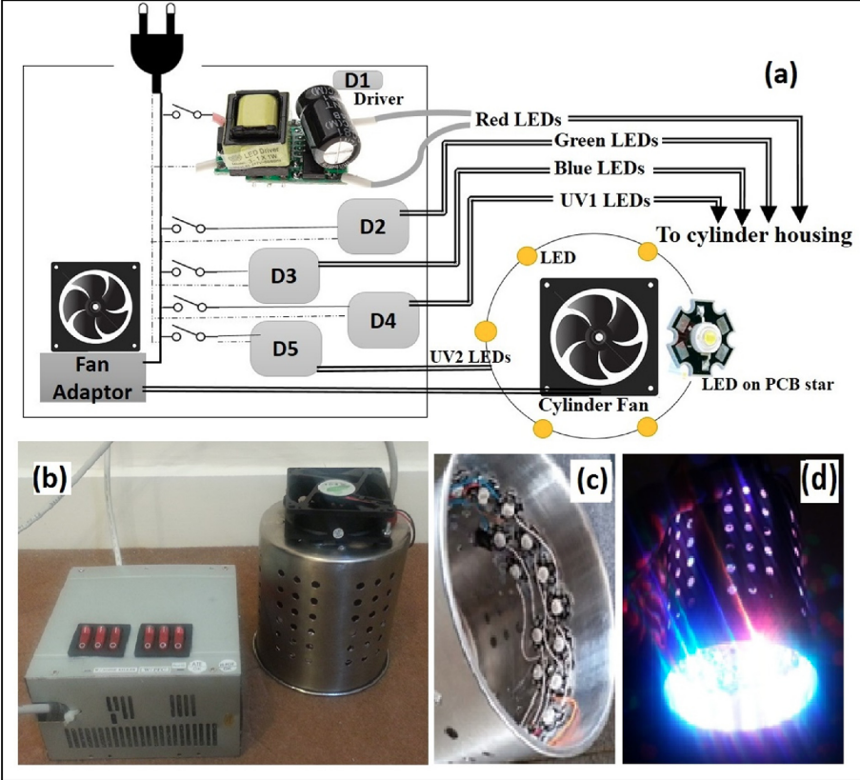
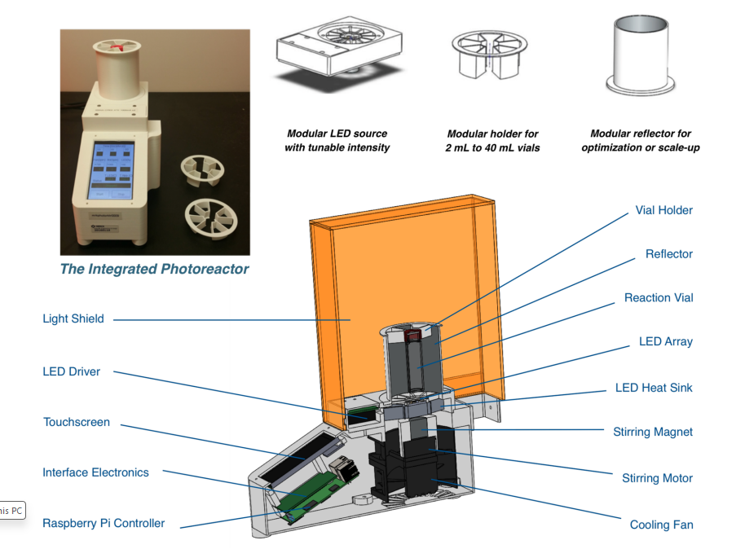
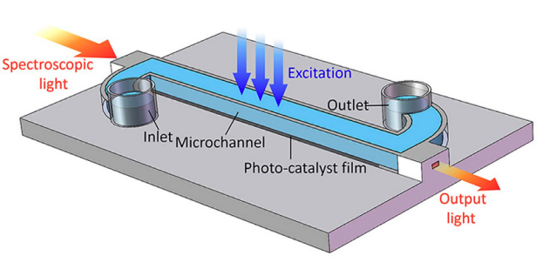
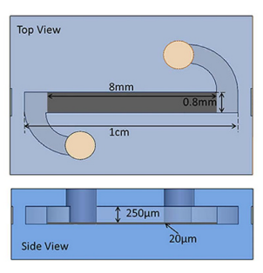
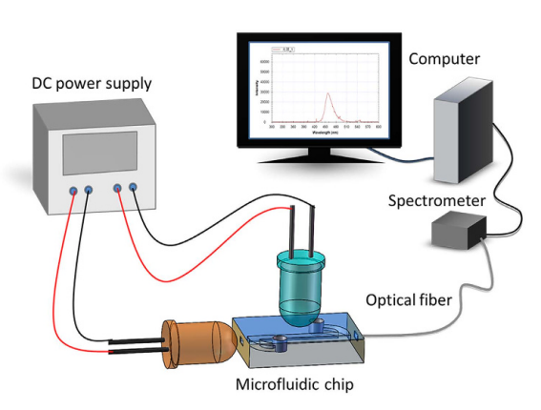
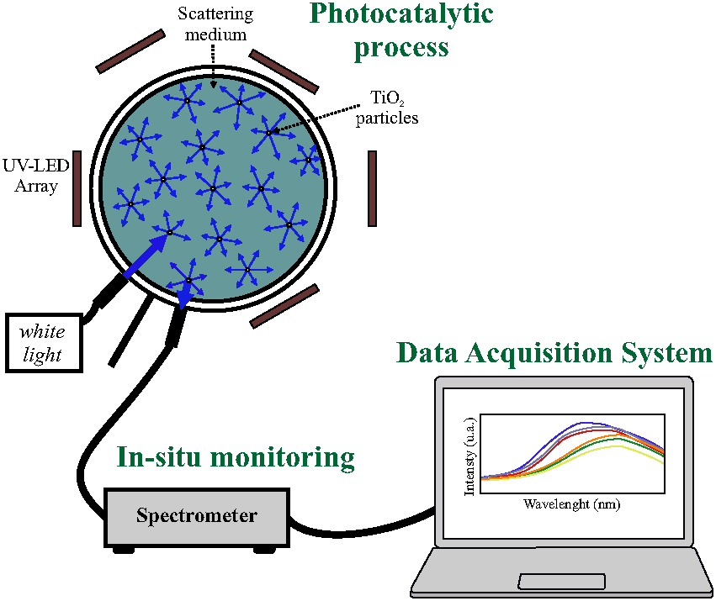
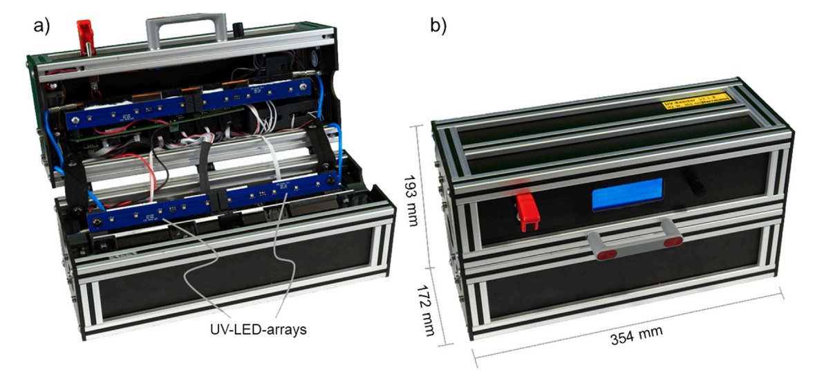
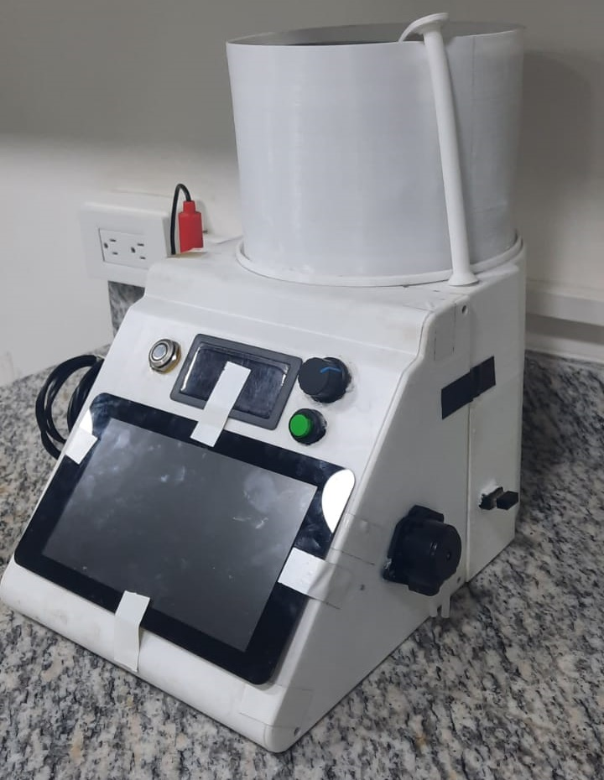
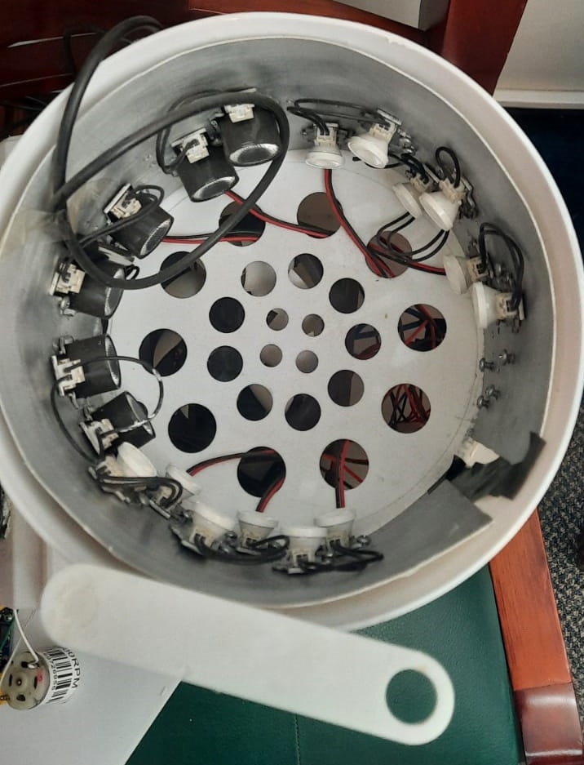
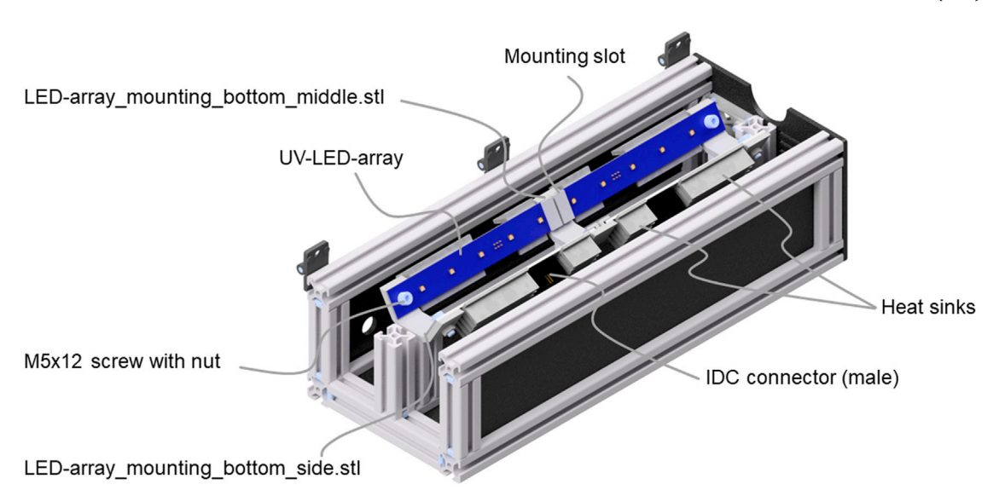
Limitations
High complexity and acquisition costs
2. No complete technical guidelines
3. Lack of continuous real-time monitoring
(Khademalrasool. et al, 2016) | (Le et al., 2016) | (Li et al., 2016)
(Tapia-Tlatelpa et al., 2019) | (Herrman et al., 2024) | (Rojas et. Cadenbach, 2019)

Slide 9
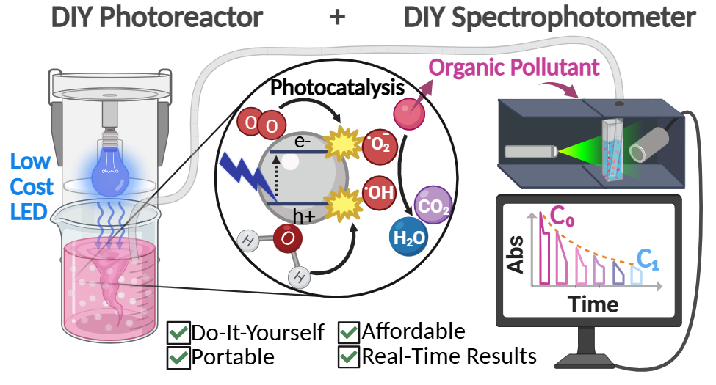
Objectives
EGU25-5229
Develop a portable, affordable, easy-to-use system for POP degradation and real-time monitoring.
Validate the system using dye degradation in water as a case study.
Provide a complete self-assembly guide to facilitate the replication of the system and research on photocatalytic processes.
Photoreactor-Spectrophotometer general scheme.
Created in Bio Render.

Slide 10
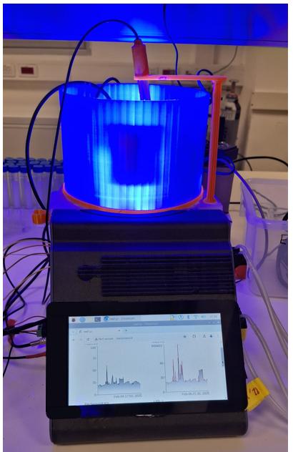
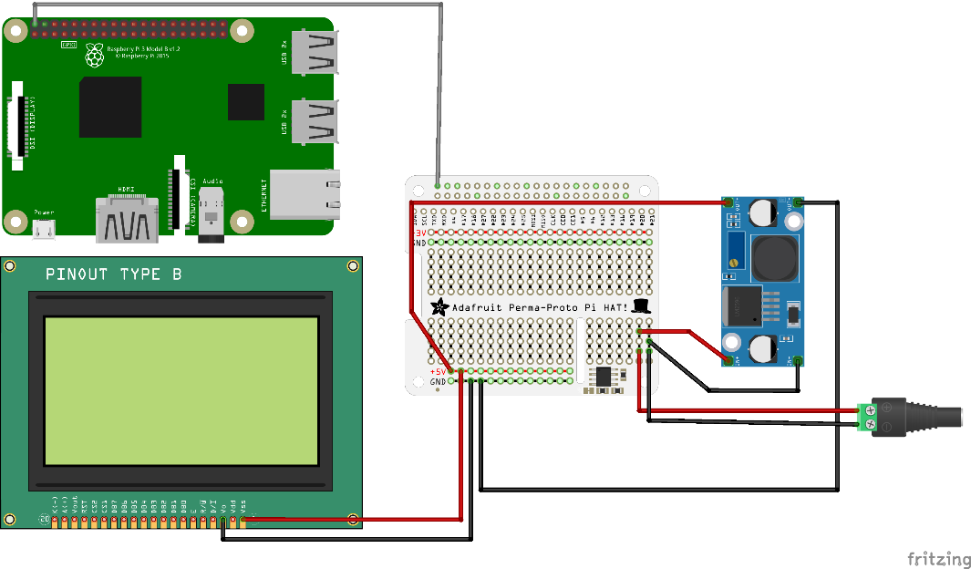
Photoreactor Modules
EGU25-5229
1. Control System: Raspberry Pi OS (Legacy, 32-BIT) and Reef-Pi Software Installation (V 6.0, Ranjib Dey).
Raspberry Pi 3B
Pi HAT
LM2596
Connector
Pi Screen
Circuit Diagram of the Control System.
Notes:
Polycarbonate bending temperature: 30 or 160 centigrade degrees.

Slide 11
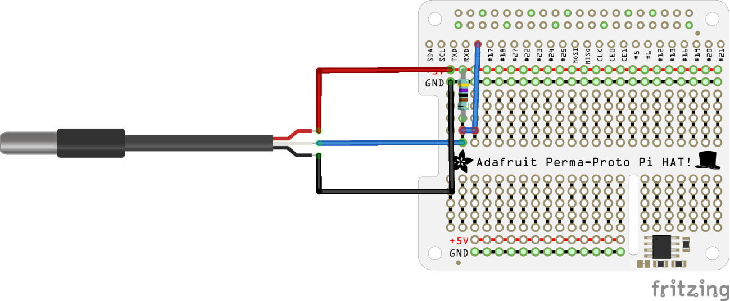
Photoreactor Modules
EGU25-5229
2. Temperature control: DS18B20 (DF Robot), calibrations using WTW probe as reference.
4.7 kΩ resistor
Pi HAT
DS18B20 probe
Circuit Diagram of the Temperature Control Module.

Slide 12
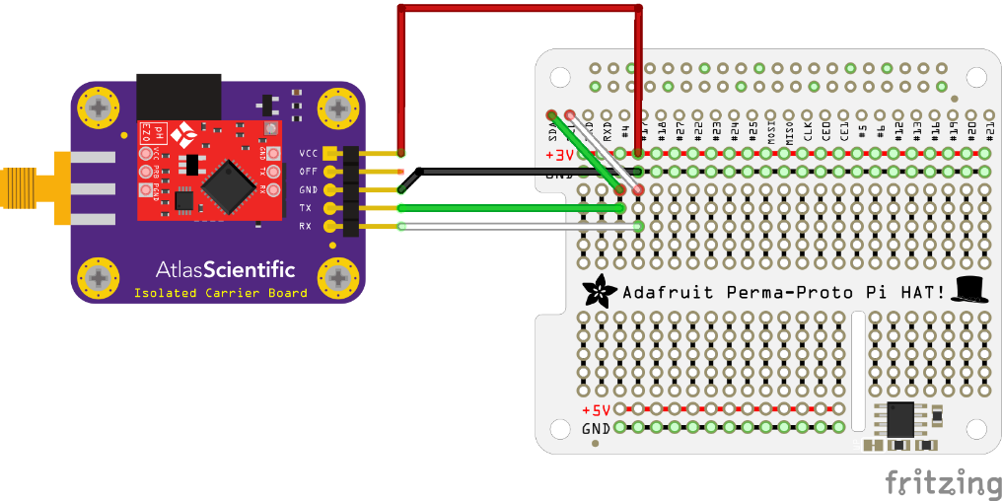
Photoreactor Modules
EGU25-5229
3. pH module: pH probe and EZO board (Atlas Scientific).
Pi HAT
pH EZO board
Circuit Diagram of the pH module.

Slide 13
Photoreactor Modules
EGU25-5229
3. pH module: pH probe and EZO board (Atlas Scientific).
Pi HAT
pH EZO board
Circuit Diagram of the pH module.

Slide 14
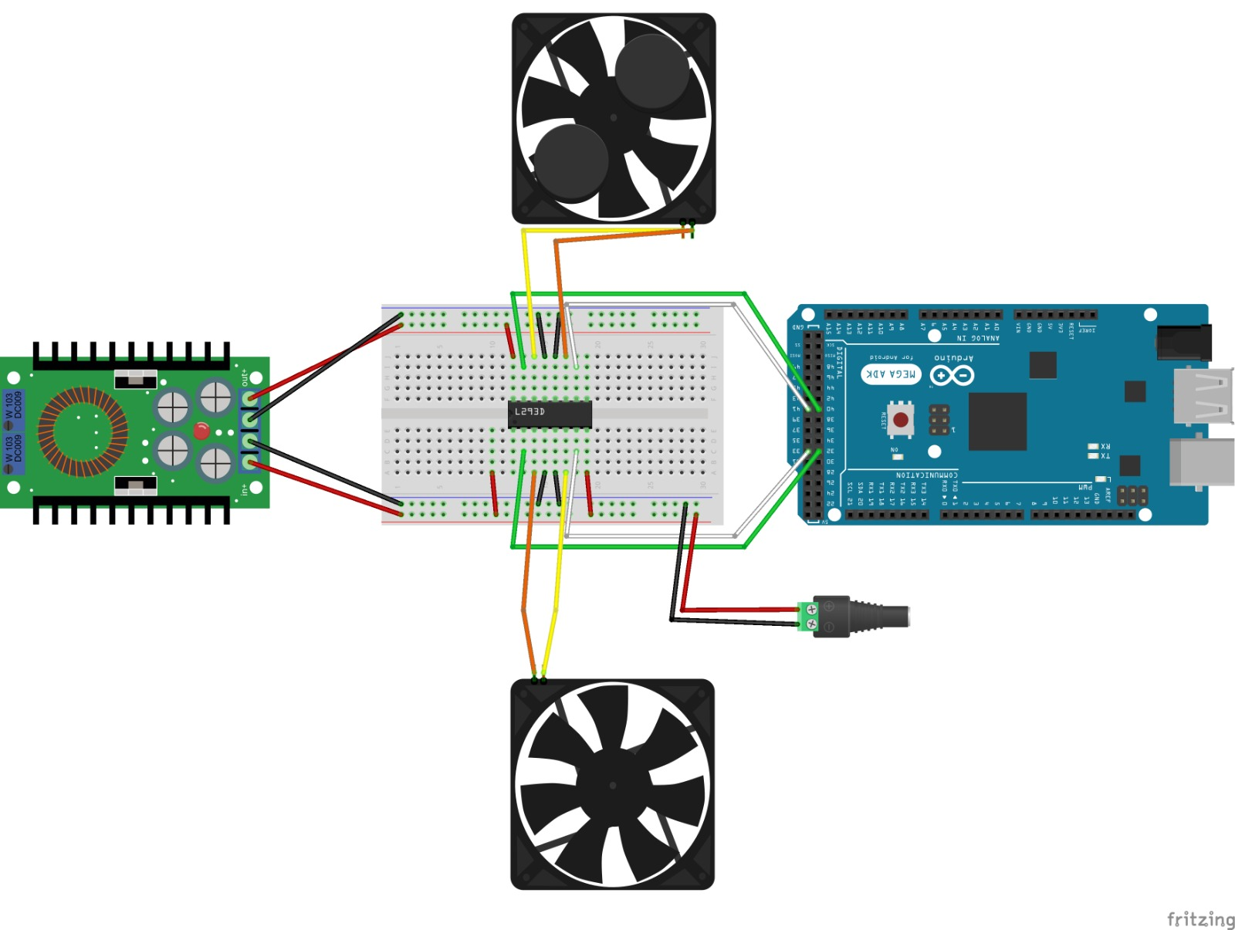
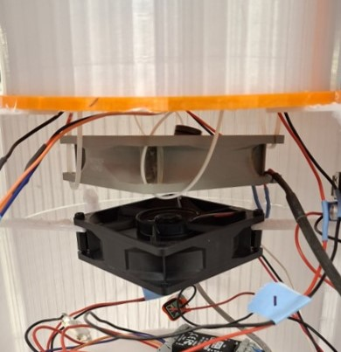
Photoreactor Modules
EGU25-5229
4. Ventilation and stirring module: Arctic Fans, L293D motor drivers, Neodymium magnets.
Arctic Fan
Nd Magnets
Motor Driver
Arduino Mega
Power modulator (12V to 5V)
Fan set-up in the photoreactor chamber.
Circuit Diagram of the ventilation and stirring module.

Slide 15
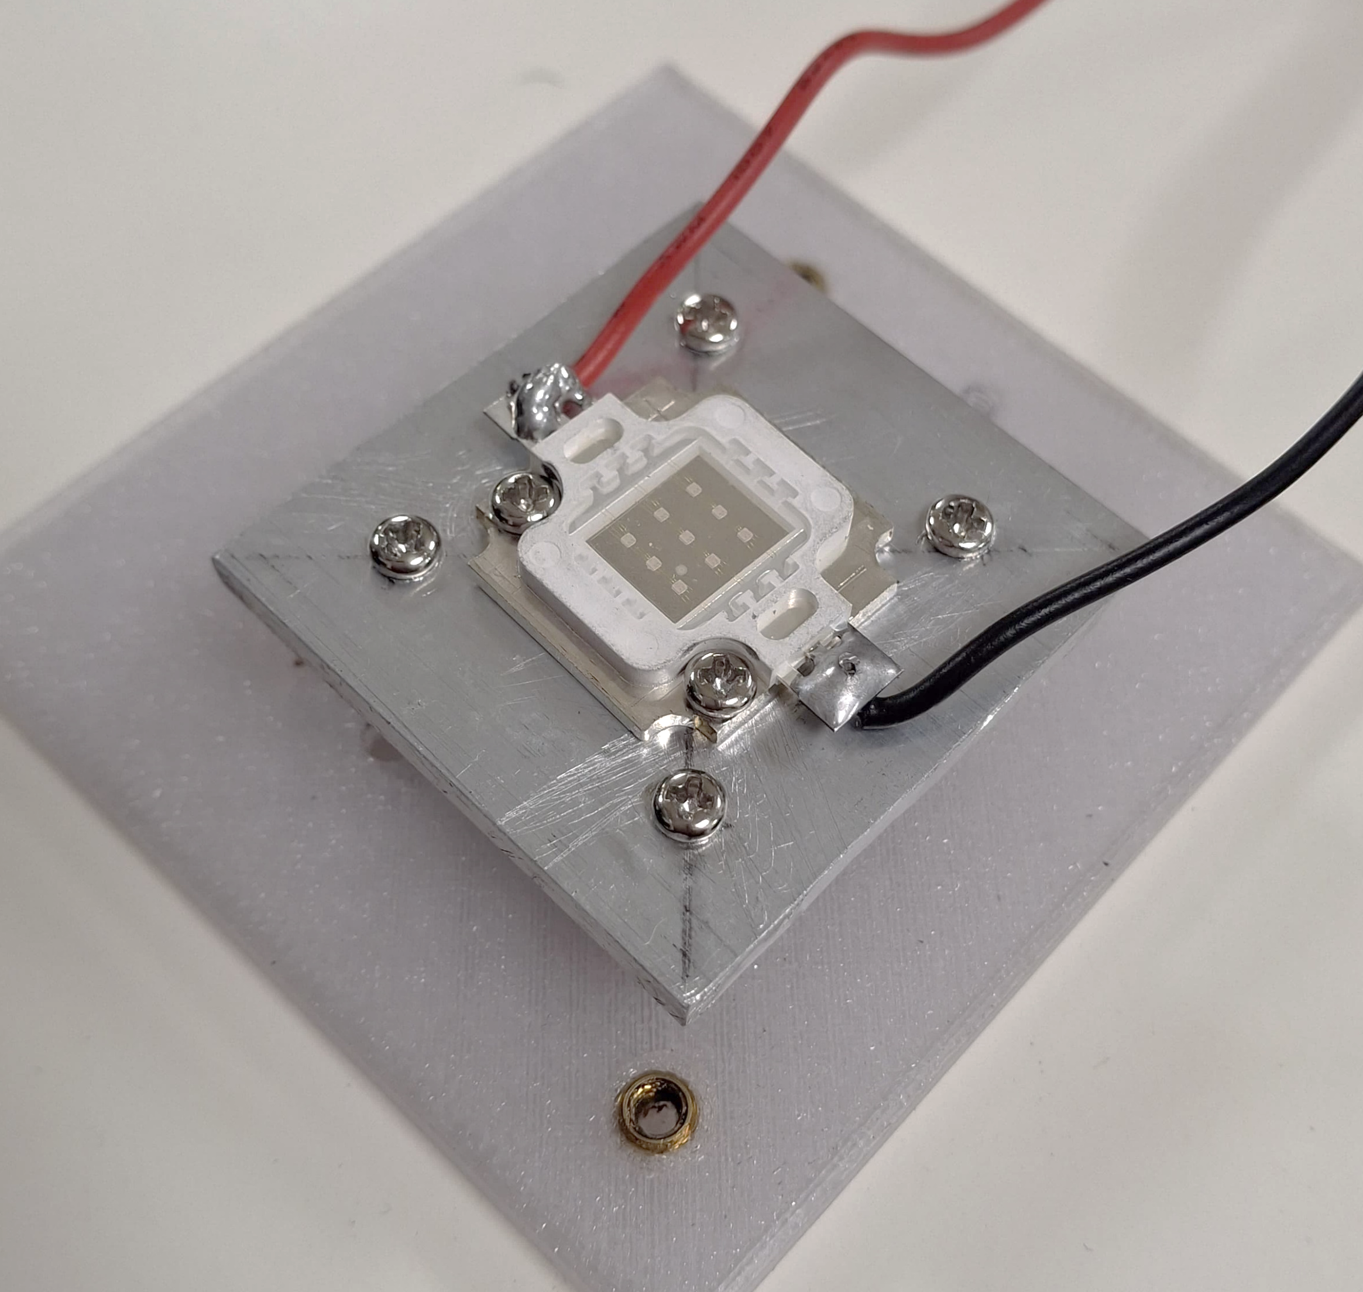
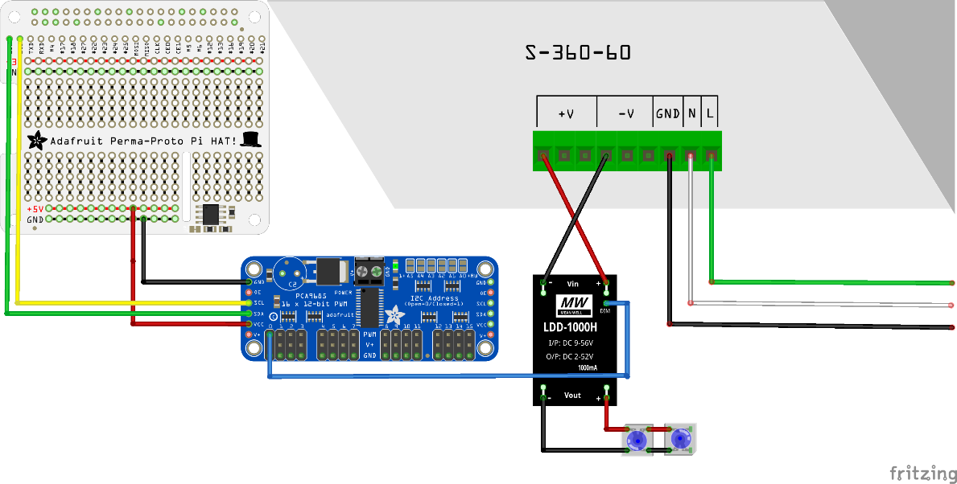
Photoreactor Modules
EGU25-5229
5. Spectral module: 4 Royal Blue LEDs (10W, 450-465 nm), Mean Well driver board.
Pi HAT
48 V power source
PWM Driver
10 W LED
Spectral Module Circuit Diagram.

Slide 16
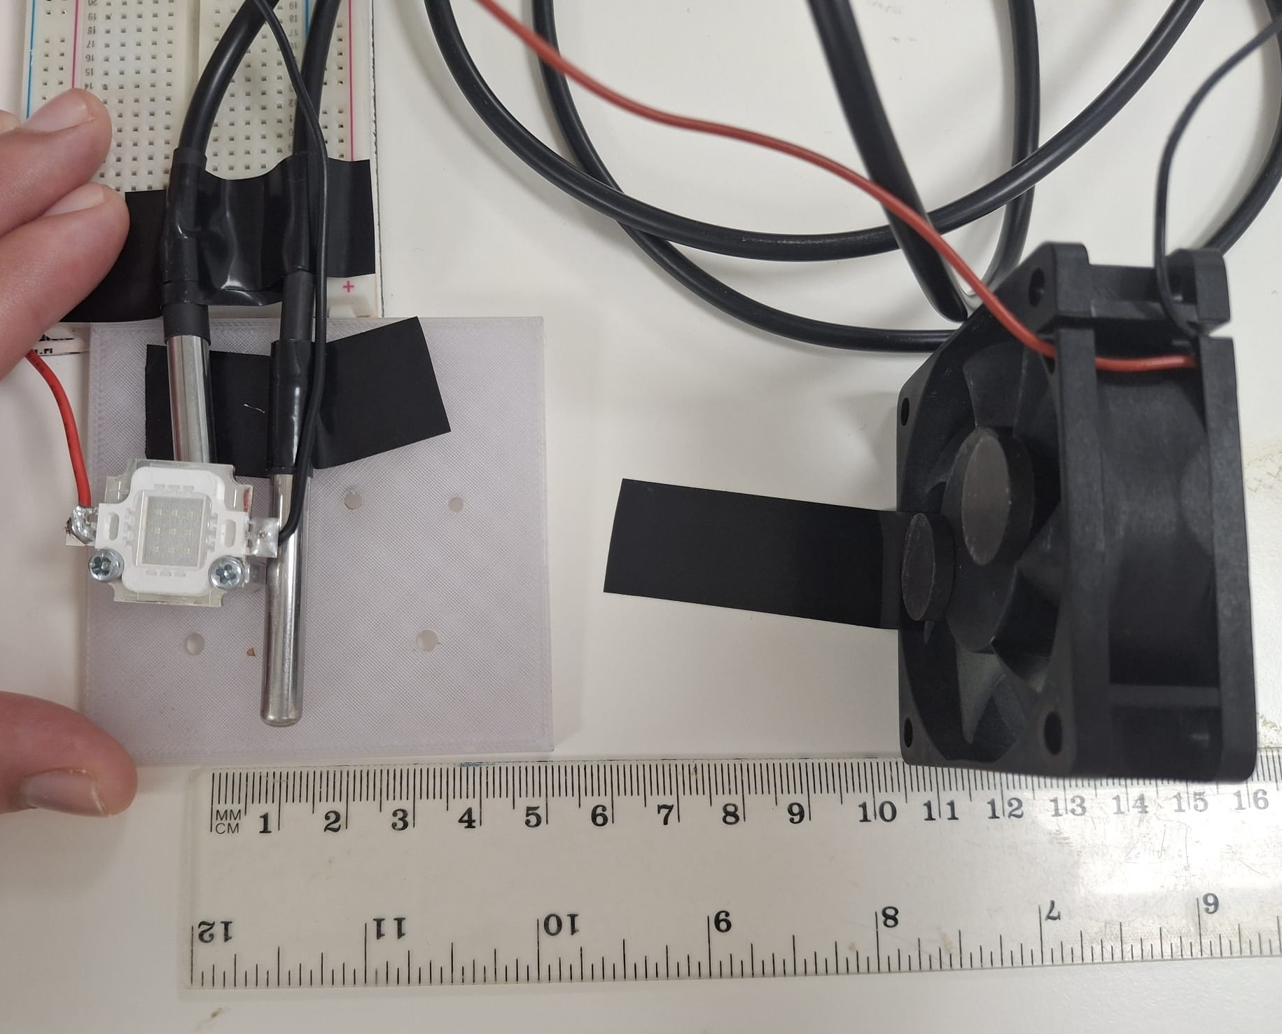
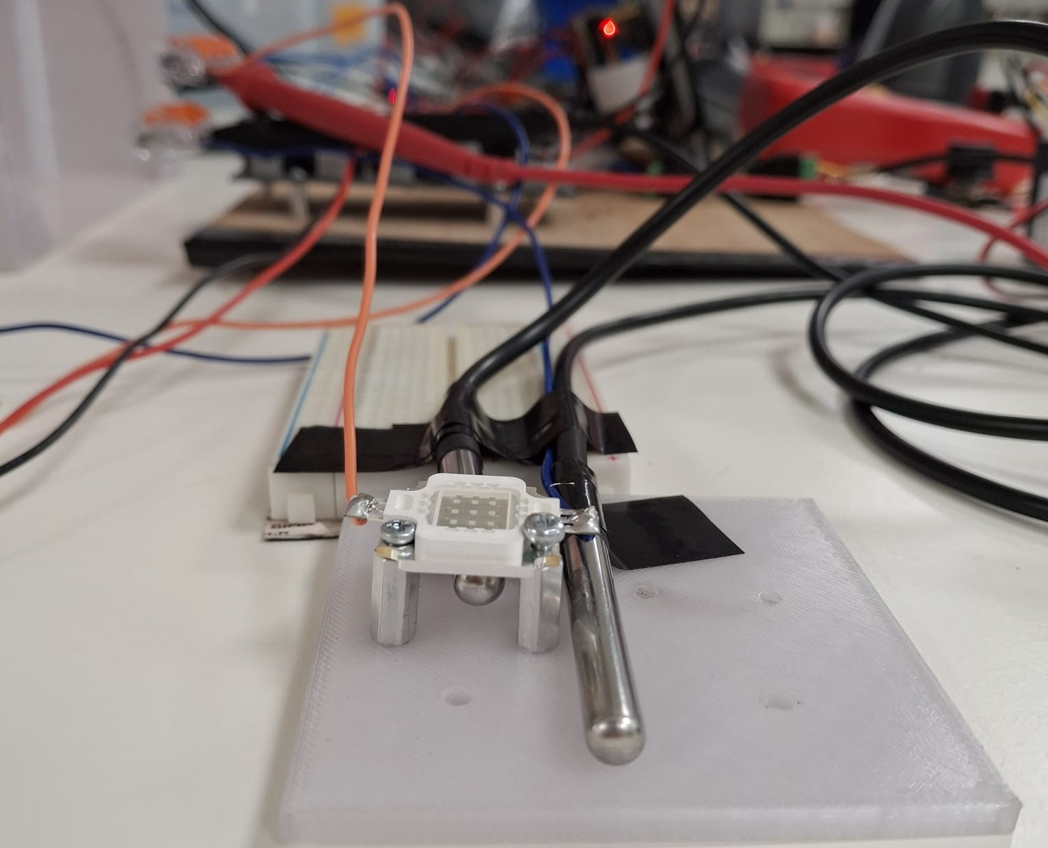
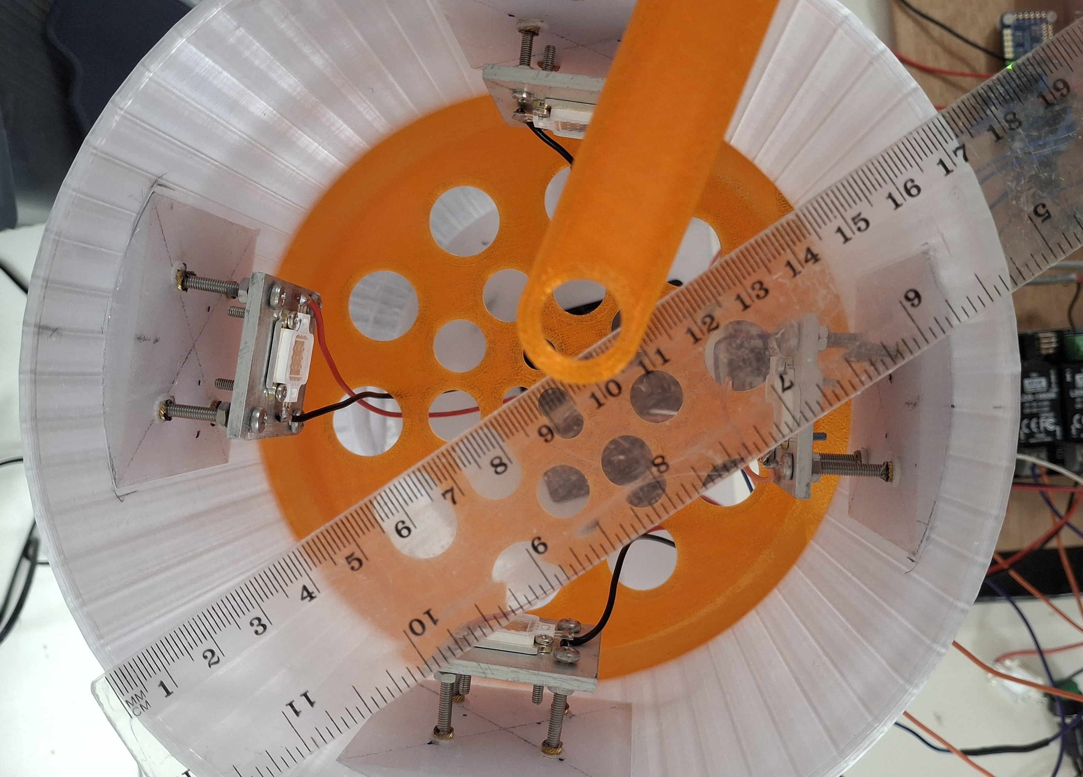
Spectral Module: Heat Resistance Tests
EGU25-5229
Case 1: Spacers (1.5 cm from PC)
Case 2: Spacers + Fan
Case 3: Spacers + Al + Fan
T1
Fan
T2
Spacer
T2
T1
Burned at 90% intensity
T2 = 88 °C
T1 max = 40 °C
Burned at 100% intensity
T2 = 63 °C
T1 max = 34 °C

Slide 17
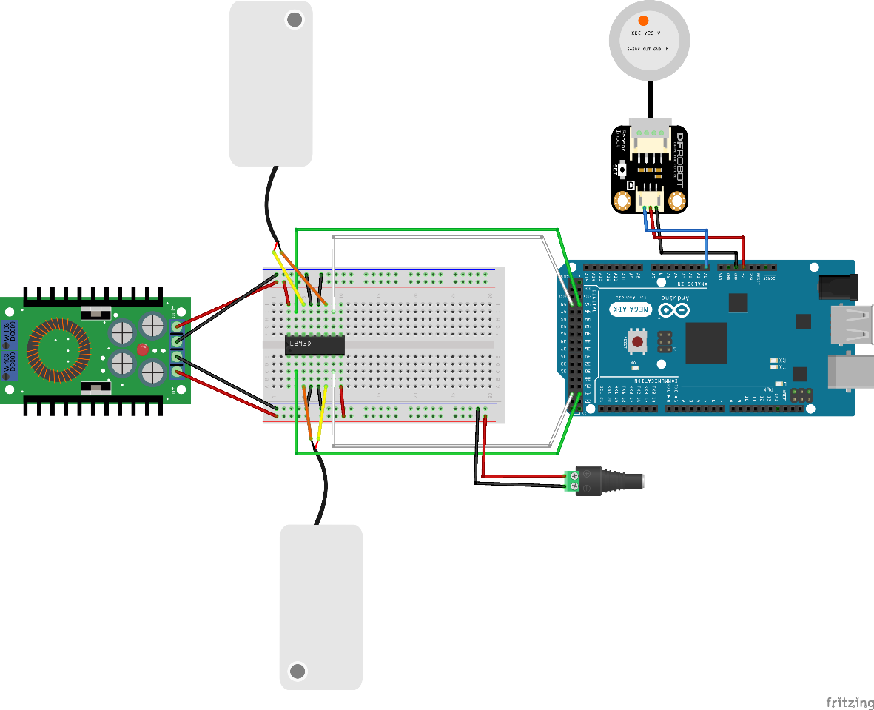
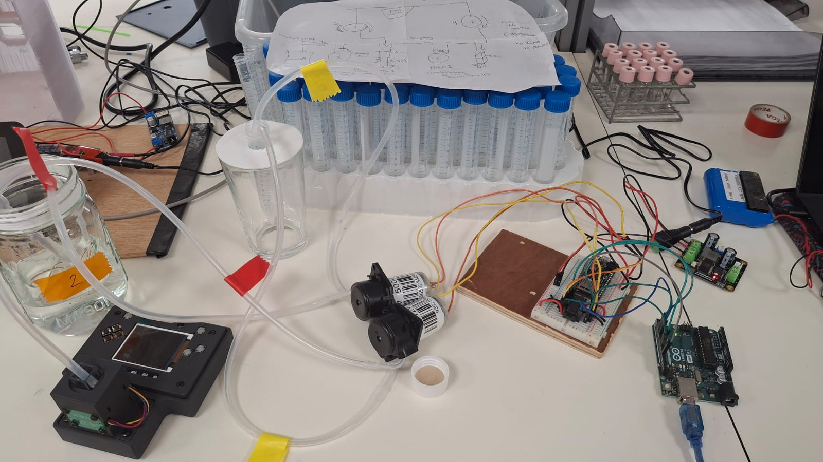
Spectrophotometer: Sampling unit
EGU25-5229
Peristaltic pumps, DIY Spectrophotometer (IO Rodeo), non-contact water level sensor (SEN0370 DF Robot), silicone tubes with capillary ends.
Flask 2
Peristaltic Pumps
Arduino microcontroller
Flask 1
DIY Spectrophotometer
Power modulator (12V to 5V)
Arduino Mega
Cuvette
Spectrophotometer System.
Data is retrieved every second from the Serial Port of the computer via USB
ABS
Dosing Module Circuit Diagram.
Time
Notes:
Problem: Distortion of measurement due to the plastic water tube in the cell (4 mm diameter).
Solution: Using a capillary tube (e.g., from a perfume bottle), clamp it to the edge of the cell (<1.5 mm diameter).

Slide 18
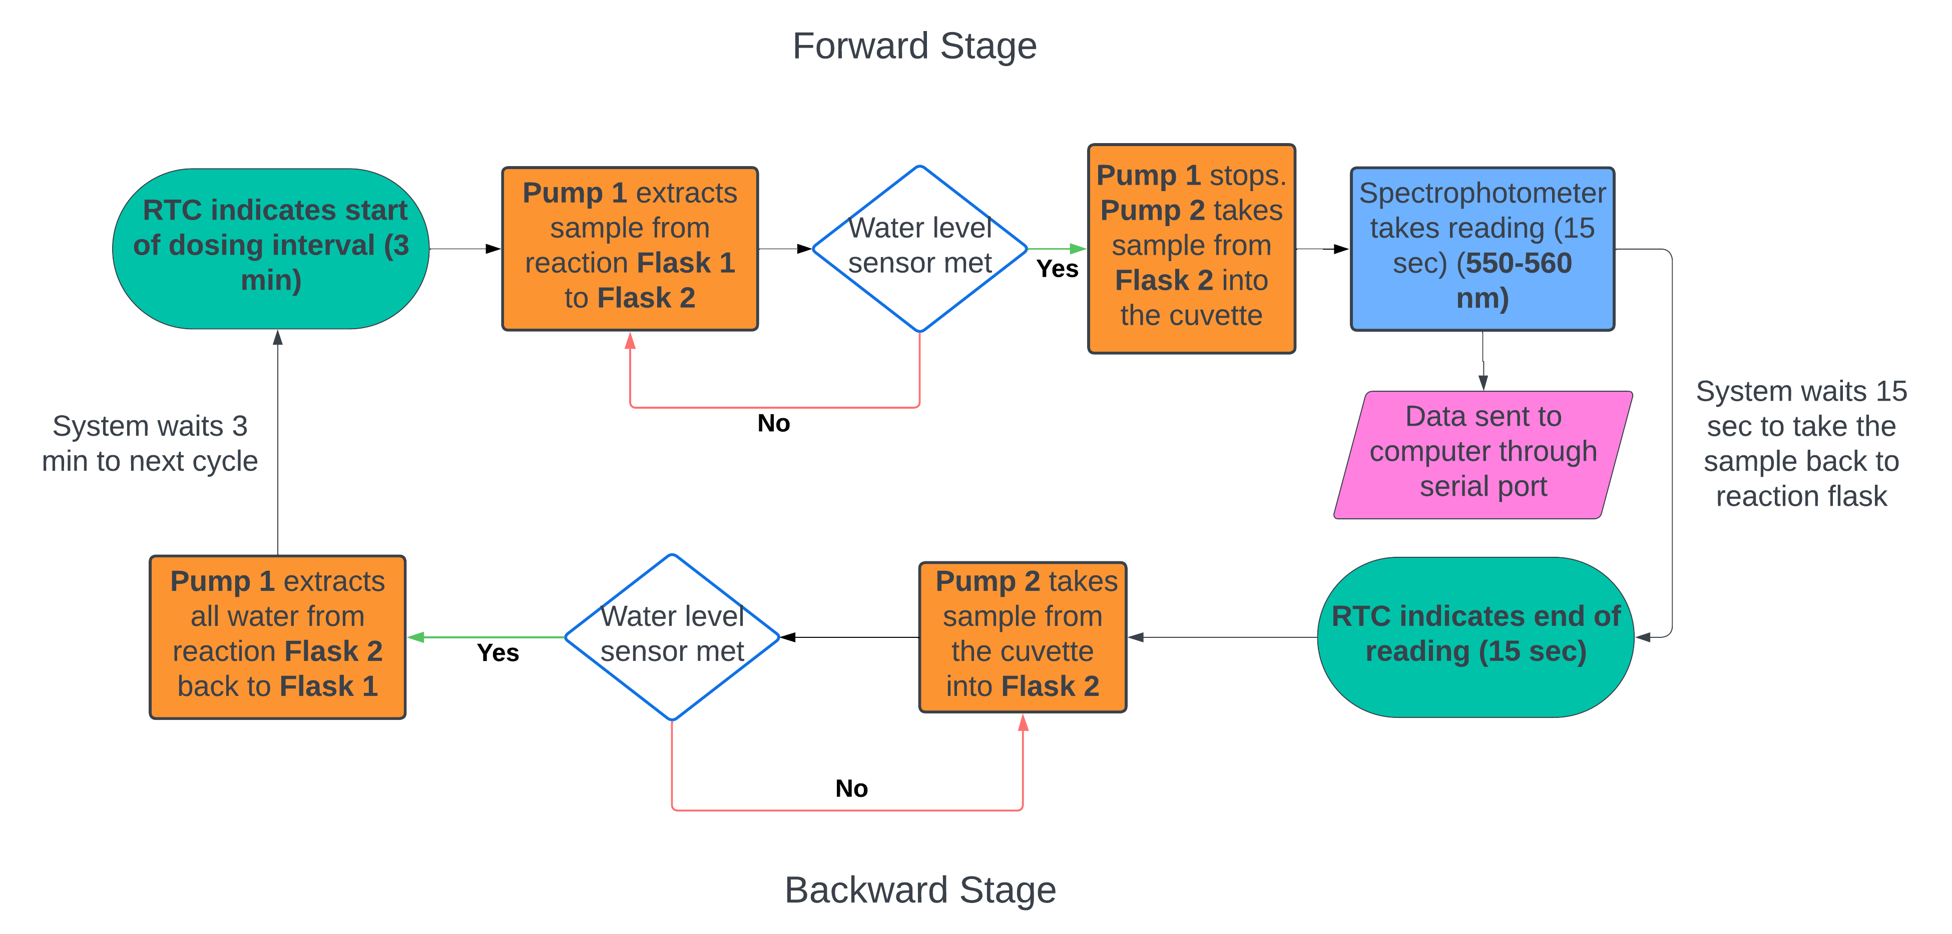
Spectrophotometer: Sampling unit
EGU25-5229
Spectrophotometer System Flow Chart

Slide 19
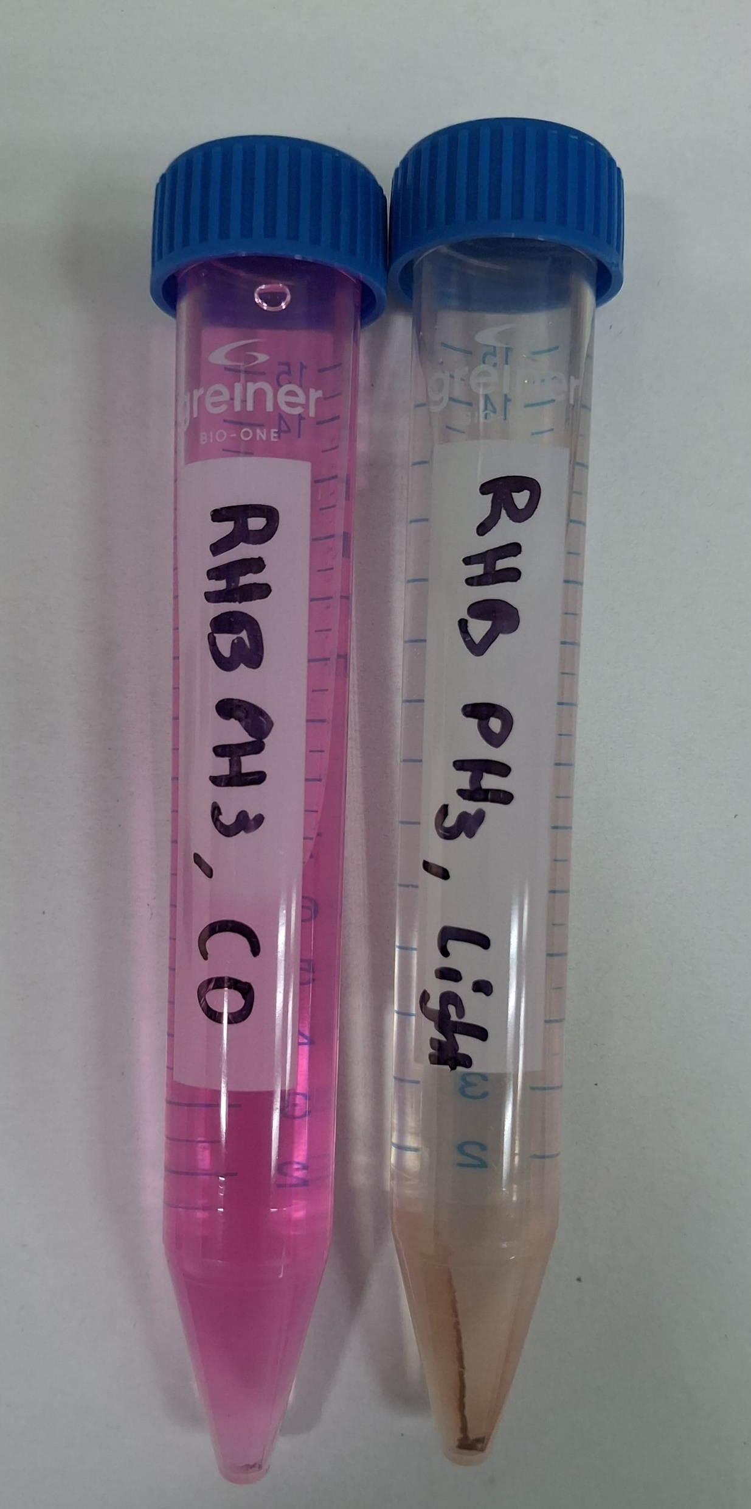
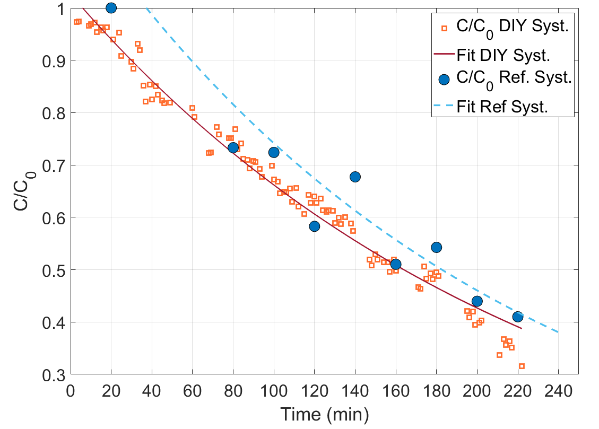
Test: Acid Conditions
EGU25-5229
Photoreactor-spectrophotometer
Photocatalytic degradation of Rhodamine B (RhB): 5mg/L, pH 3
Before
After
y = 1.194 e^{-0.005 t} R² = 0.91
y = 1.1262x^{-0.004} R² = 0.68
67% deg. after 3 h

Slide 20
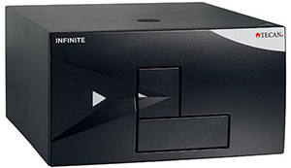
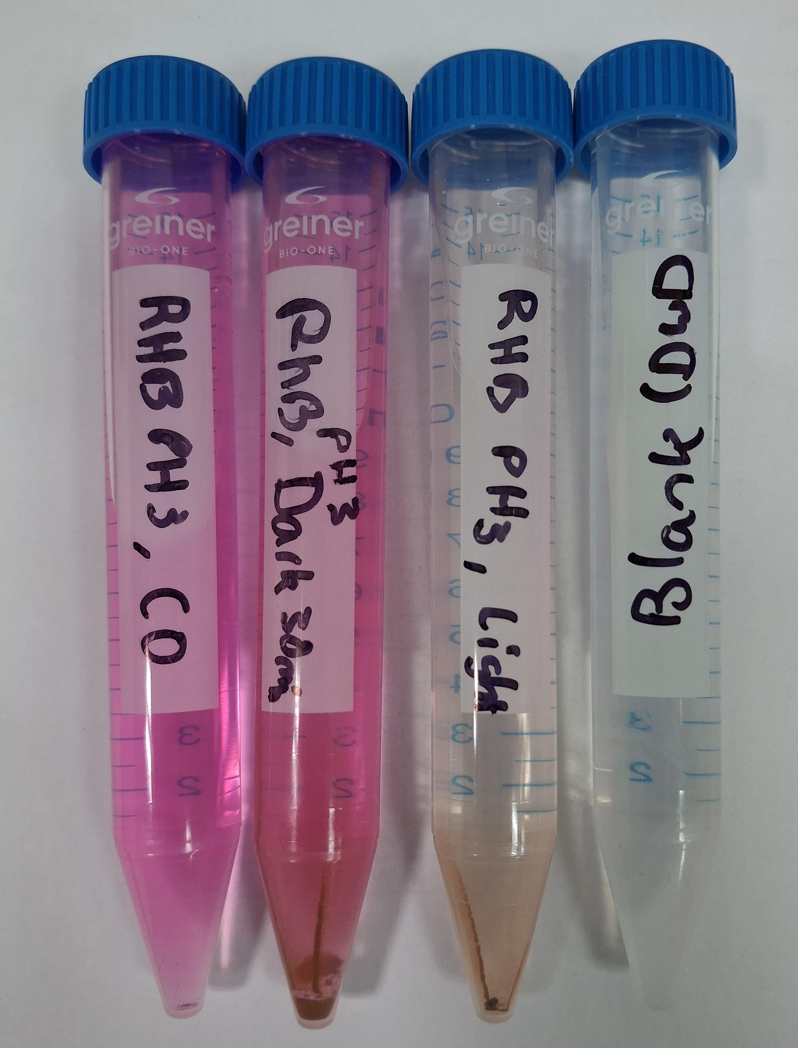
Test: Acid Conditions
EGU25-5229
Reference Instrument: TECAN Infinite 200 PRO plate reader.
Source: https://lifesciences.tecan.com
Absorption Spectra Rhodamine B (RhB): 5mg/L, pH 3, TECAN
1
2
3
4
15 ml samples
1. Before photocatalysis
2. 30 min in the dark
3. After photocatalysis
4. Blank
70% deg. after 3 h
Centrifuge and visible spectra analysis in the reference instrument

Slide 21
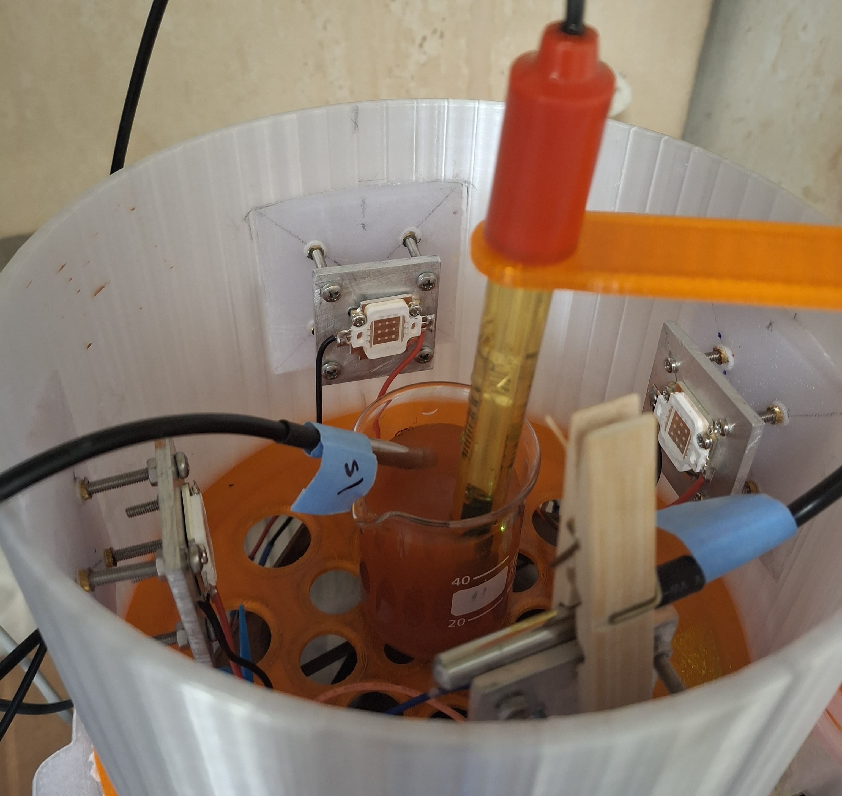
Test: Acid Conditions
EGU25-5229
Temperature and pH control with low-cost sensors: RhB 5mg/L, pH 3
pH probe
T1: Sample
T2: Light board
System chamber with sample and low-cost sensors

Slide 22
EGU25-5229
Photoreactor-Spectrophotometer
➤ Background
➤ Photoreactor modules
➤ Spectral Module: Heat Test
➤ Spectrophotometer & Sampling
➤ Test: Acid Conditions
Incubation Chambers
➤ Background
➤ Modules
➤ Calibration of Methane Sensors
➤ Leakage Tests
➤ Initial Findings
System 1
System 2

Slide 23
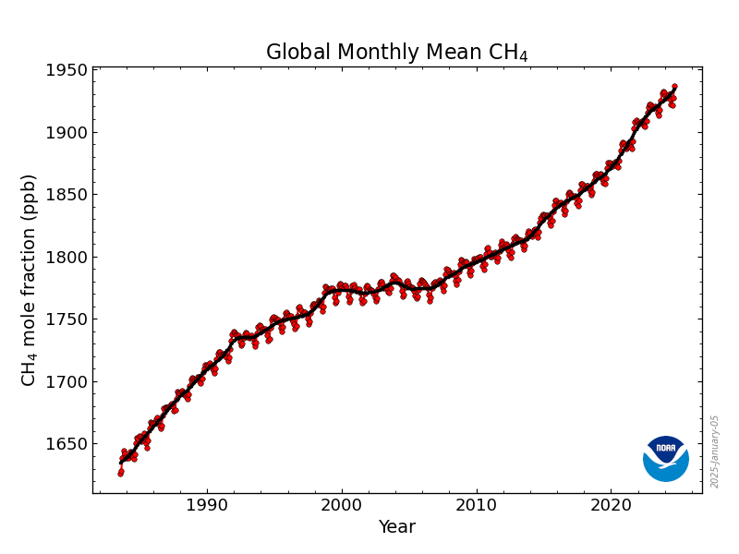
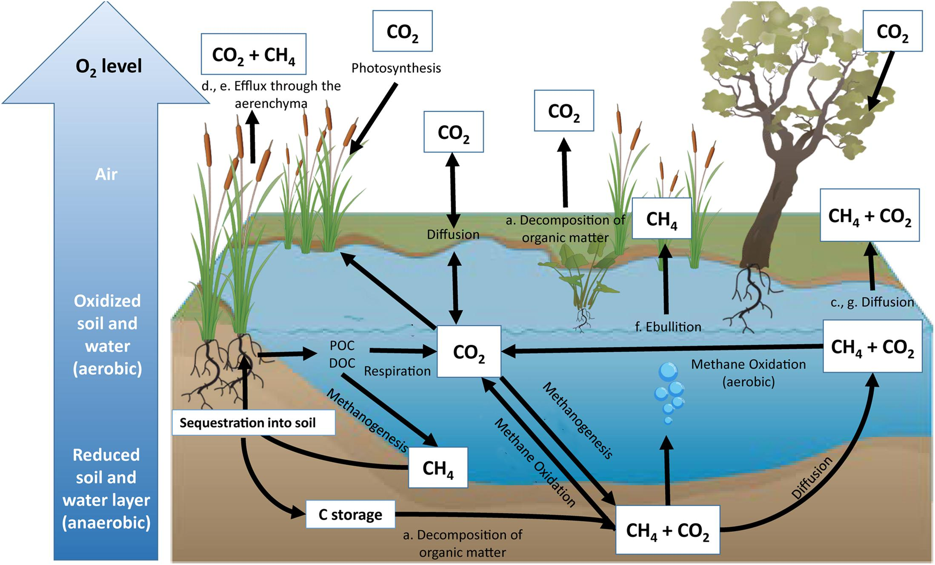
Background
EGU25-5229
Methane (CH₄): The Second most important GHG.
Shorter lifetime but greater GWP, 28 times greater than CO₂.
Main natural sources: Wetlands, landfills, rice paddies
About 3rd of the total methane emissions come from wetlands.
Global Monthly CH₄ levels in the atmosphere.
Source: NOAA Global Monitoring Laboratory, 2022, www.noaa.gov
Methane emissions from wetlands for years 1980 - 2021.
Source: SubbaRao, Gaeta and Ott., 2022, https://svs.gsfc.nasa.gov/5054
Inland wetland carbon cycle.
Source: Limpert et al., 2020, DOI: 10.3389/fenvs.2020.00008

Slide 24
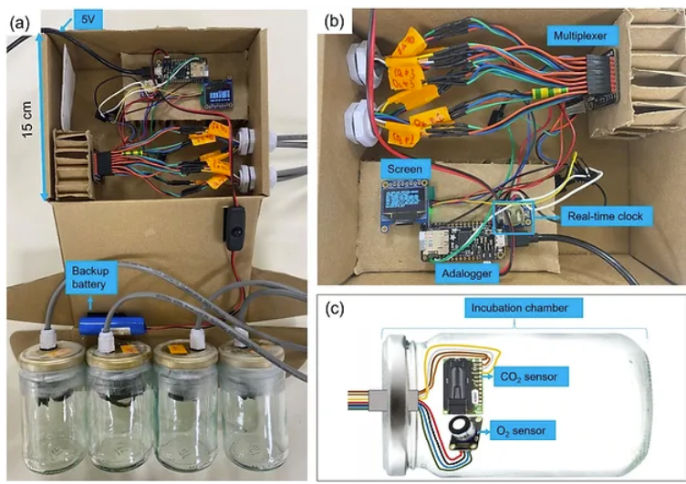
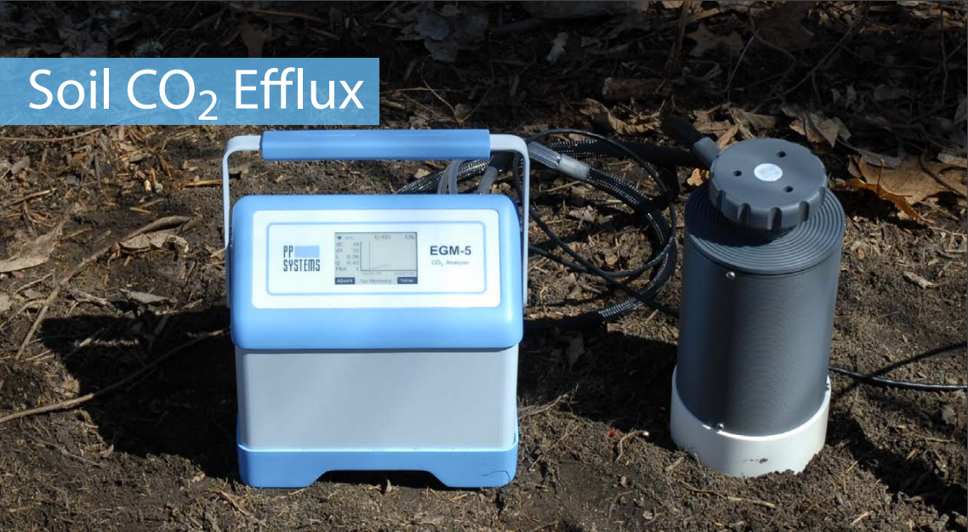
Preliminary System
Limitations
1. No quantification of Methane
2. Not suitable for wet samples
3. Not suitable for anoxic conditions
Low-cost incubation chamber for real-time characterization of soil respiration and microbial activity (aerobic).
Real-time tracking of CO₂ and O₂ concentration changes.
Low-cost (~700 USD/1637 NIS).
Open source: Replication and customization.
Figure 22: Experimental setting CO₂ soil chambers: a) Complete system, b) Core unit, c) CO2/O2 sensing unit.
O₂
Source: Levintal Lab., 2023, Greenhouse gas emissions from soils. Real time soil incubator chamber.
https://github.com/OpenDigiEnvLab/Incubation-chamber
COST: 3 786 USD/13 587 NIS
Figure 21: SRC-2 Soil Respiration Chamber.
Source: https://ppsystems.com/soil-and-canopy-flux/

Slide 25
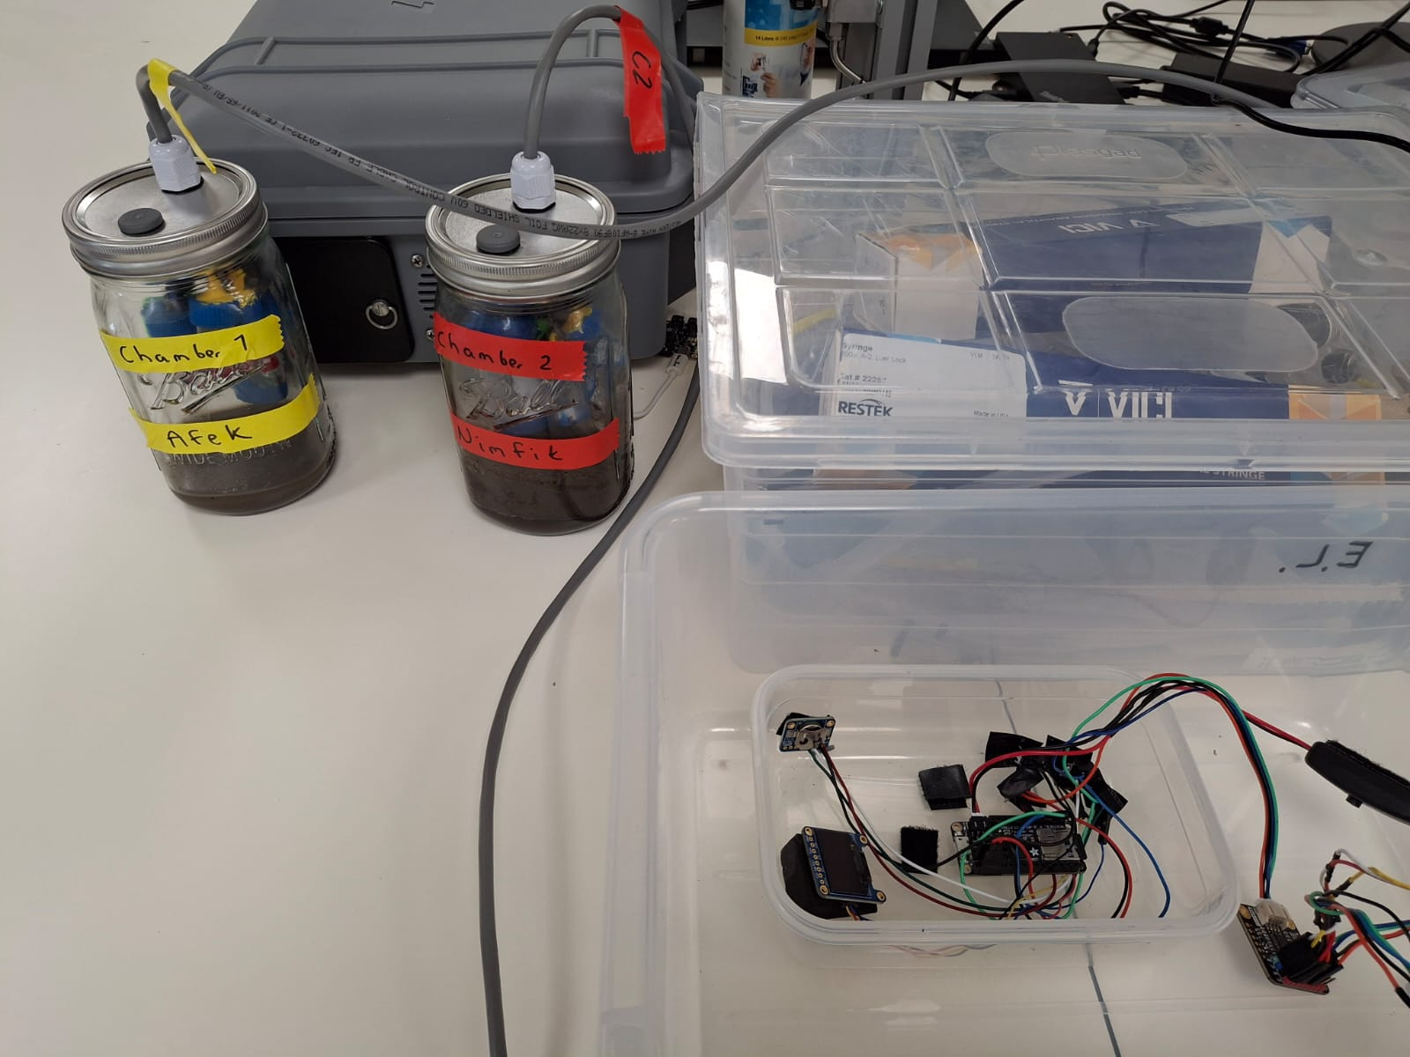
Objective
EGU25-5229
Develop a portable, affordable, easy-to-use system for real-time monitoring of greenhouse gases in wetland samples.
Validate the system using wetland samples from two sites as case studies.
Provide a complete self-assembly guide to facilitate the replication of the system and research on microbial activity.
Incubation Chambers Prototype for wetland samples monitoring.

Slide 26
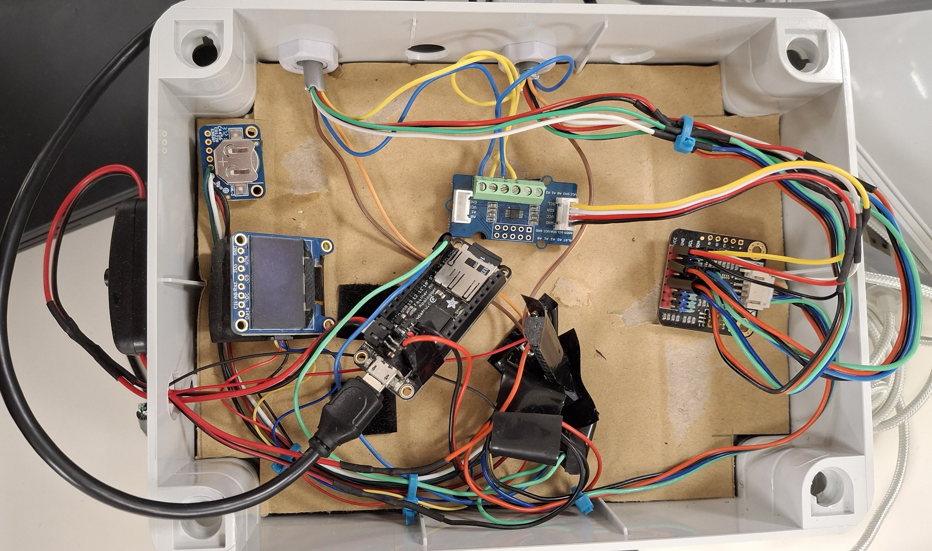
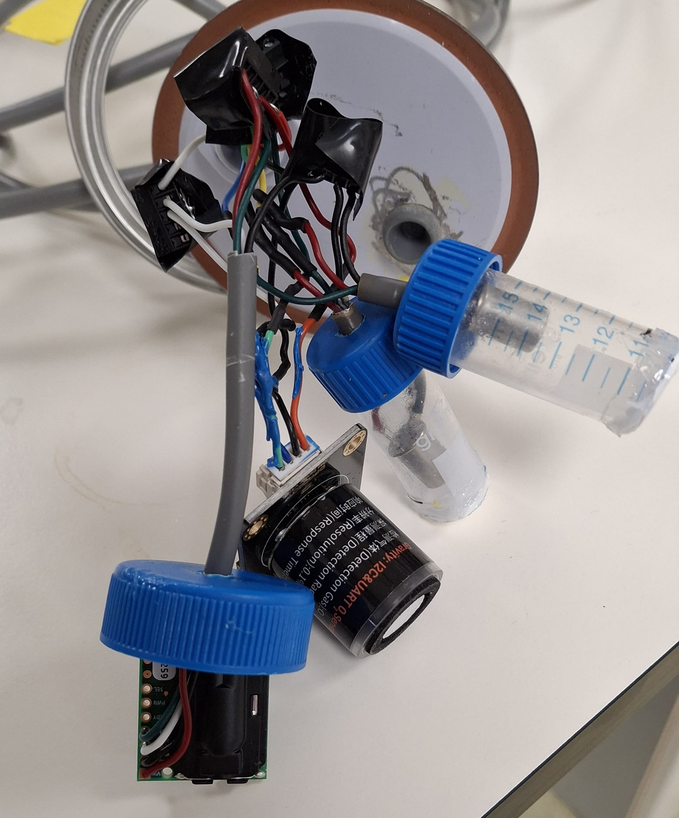
EGU25-5229
Modules
6
Feather M0 Adalogger.
Oxygen Sensor: SEN 0465 DF Robot.
SCD30: CO₂, T, RH (digital sensor, 3V)
4Figaro 2611: CH₄ (analog sensor), 5V
Additional components:
5. OLED
6. RTC
7. Analog2digital converter.
8. Multiplexer
7
1
8
5
4
3
2
Incubation chamber components.

Slide 27
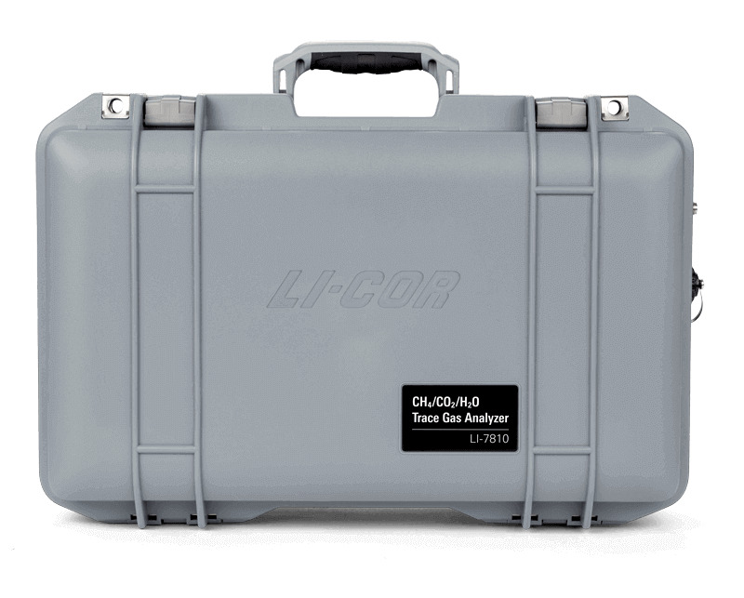
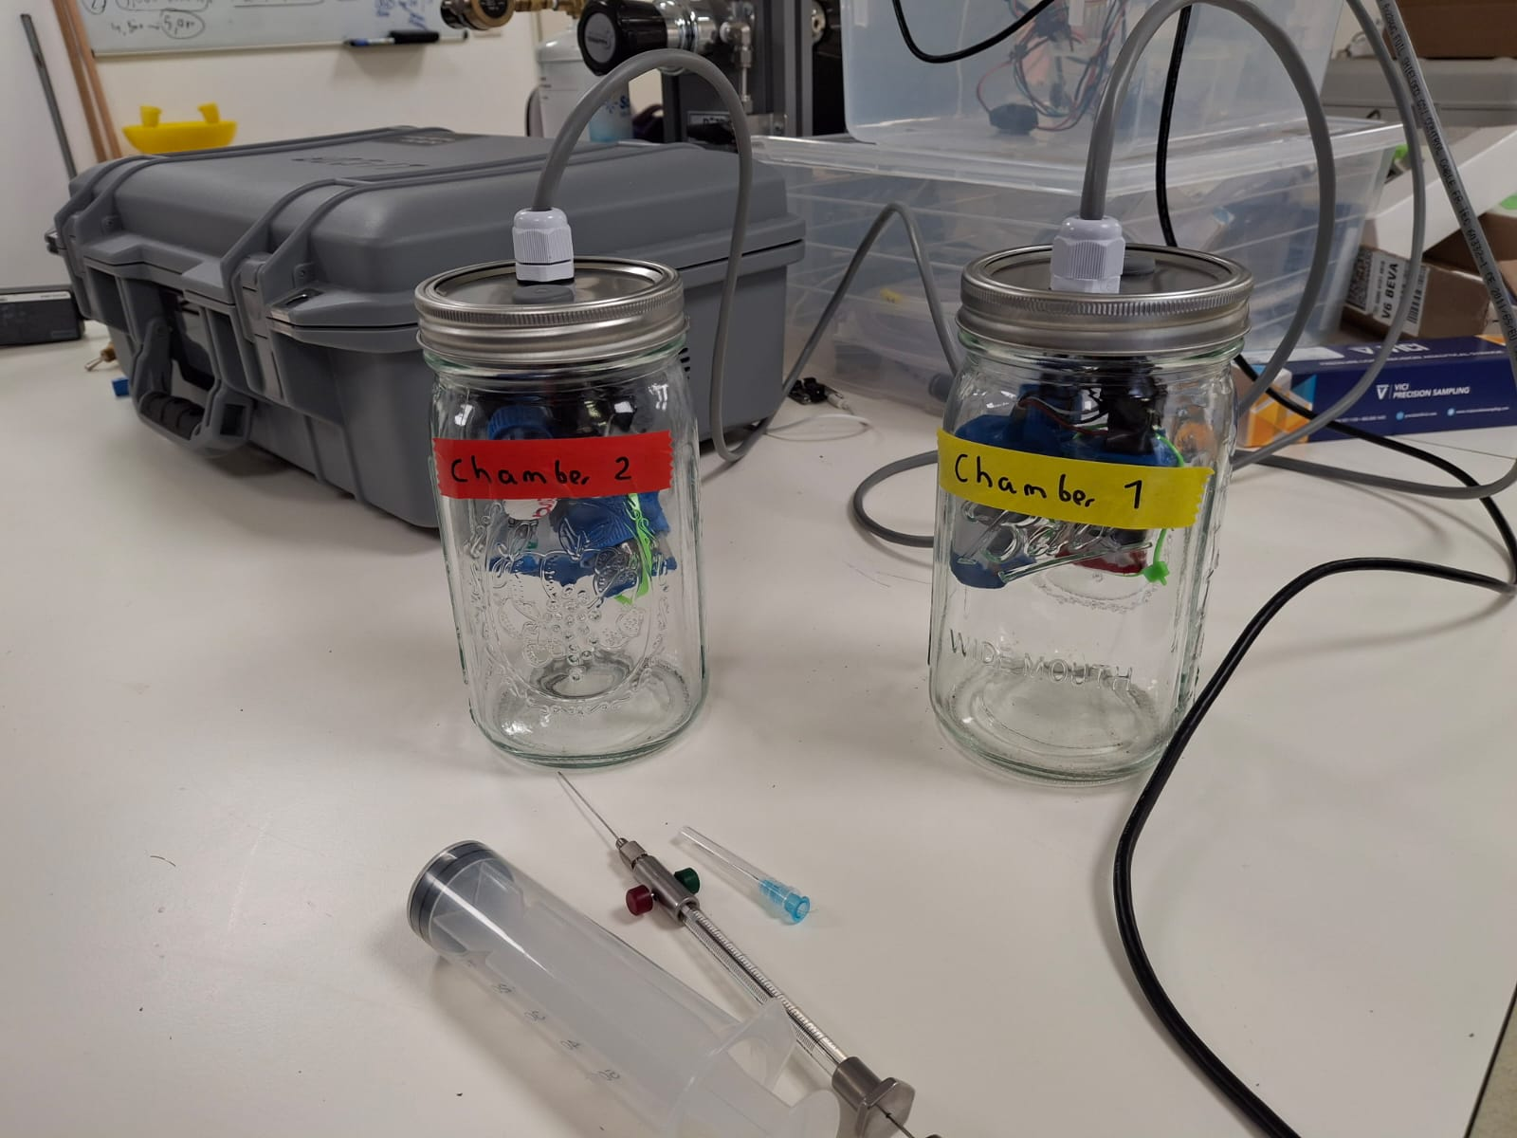
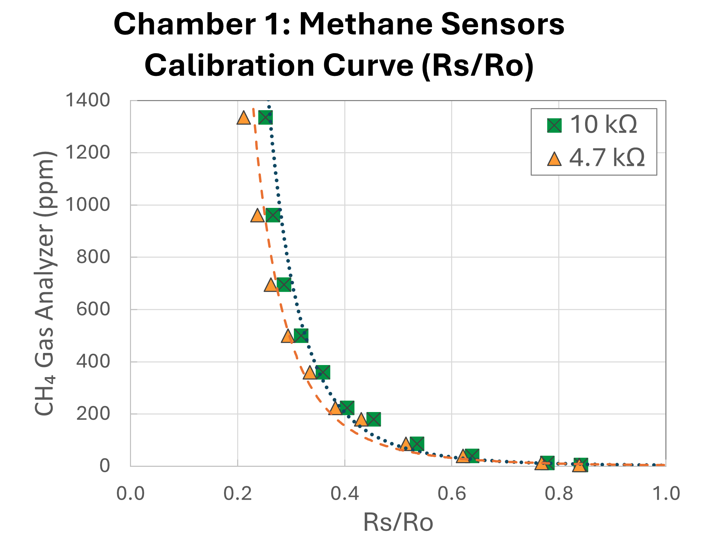
Calibration of methane sensors
EGU25-5229
Reference Instrument: LI-COR 7810 Trace Gas Analyzer.
LI-7810 Trace Gas Analyzer.
Source: https://www.licor.com
y = 3.776x^{-4.363} R² = 0.99
y = 4.318 x^{-3.909} R² = 0.98
Figaro 2611 sensors Calibration with Gas Analyzer
Incubation chambers calibration results.
Notes:
After calibration and testing of the system, it was taken to the field, close to Mitzpe Ramon, 4 chambers where set in the soil and data was taken every 30 minutes during one month (May and the first week of June 2023). As expected, results evidenced a clear crorrelation between the CO2 concentration from the soil to the air and the daily temperature. A decrease of both temperature and CO2 was observed due to precipitation. Precipitation increases the soil moisture content, decreasing soil temperature which decreases the microbial respiration rate/activity and therefore lower levels of CO2 are expected. Precipitation also washes out CO2 from the soil to carbonic acid. The Buckinham flux comes from a theorem which relates independent variables to dependent variables to predict the flow into or out to a system, one of the variables that plays an important role into this theorem is water content temperature and viscosity in the soil media. We need water for CO2 diffusion.

Slide 28
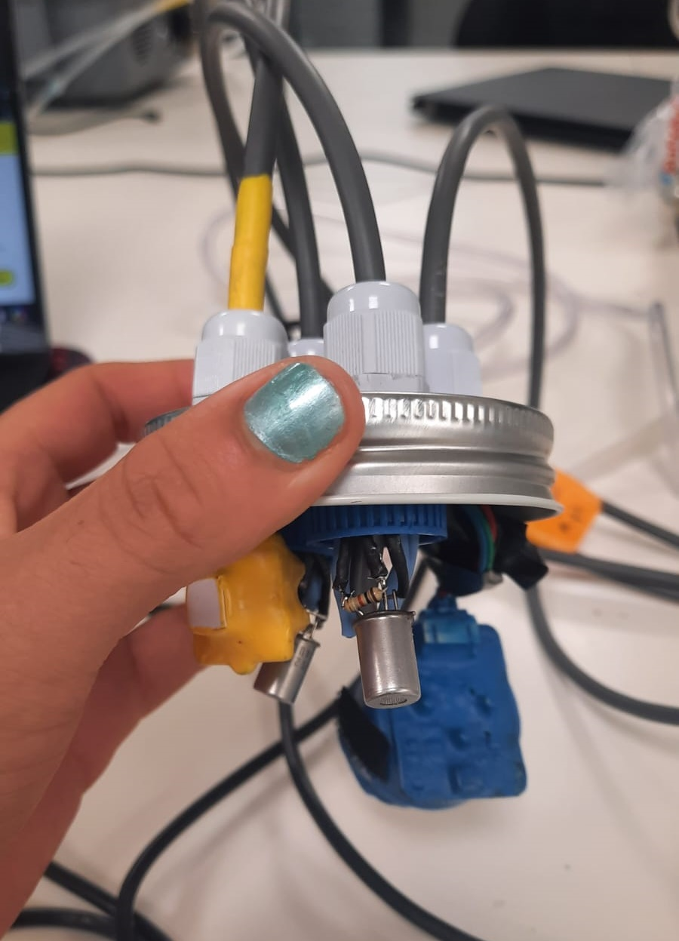
Leakage Tests
EGU25-5229
Oxygen and CO2 Leakage Tests:
3 Different Chambers: 1 L Chamber with two holes in the lid, minimum leakage.
3.52 ppm/min
9 ppm/min
0.03 - 0.04 ppm/min

Slide 29
Initial Findings
EGU25-5229
Methane emission incubation experiment: Site 1, 72 h
Site 1
Site 2
Sensors
Ein Afek
CH₄

Slide 30
Initial Findings
EGU25-5229
Methane emission incubation experiment: Site 2, 72 h
In the first test with the wetland matrix, Corrosion, all digital sensors stopped working.
Coating the sensors with Plasti Dip.
Site 1
Site 2
Sensors
Incubation chambers validation test.
Results incubation experiment chamber 2

Slide 31
References
EGU25-5229
Herrman et al. (2024) Lab-scale tubular LED UV reactor for continuous photocatalysis. Hardware X. DOI: 10.1016/j.ohx.2023.e00506
Khademalrasool. et al (2016) The improvement of photocatalytic processes: Design of a photoreactor using high-power LEDs. Advanced Materials and Devices. DOI: 10.1016/j.jsamd.2016.06.012
Lampkin et al. (2021) Versatile Open-Source Photoreactor Architecture for Photocatalysis Across the Visible Spectrum. ACS Org. Lett. DOI: 10.1021/acs.orglett.1c01910
Le et al. (2016) A General Small-Scale Reactor To Enable Standardization and Acceleration of Photocatalytic Reactions. ACS Cent. Sci. DOI: 10.102/acscentrsci.7b00159
Li et al. (2016). Real-time spectroscopic monitoring of photocatalytic activity promoted by graphene in a microfluidic reactor. Nature Scientific Reports. DOI: 10.1038/srep28803
Tapia-Tlatelpa et al. (2019) In situ Decolorization Monitoring of Textile Dyes for an Optimized UV-LED/TiO2 Reactor. Catalyst. DOI: 10.3390/catal9080669
Complete Resources List:

Slide 32
Acknowledgements & Contact
Connect with us!
EGU25-5229
Do you want to check more open-source projects?
Devi Sarai Orozco
Dr. Thomas Cadenbach
Dr. Elad Levintal

