Slide 1
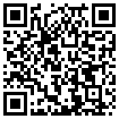
Geological map level of detail and its impact on our perception of dominant streamflow processes in large-sample hydrological studies
Thiago M. do Nascimento
Julia Rudlang, Sebastian Gnann, Jan Seibert, Markus Hrachowitz and Fabrizio Fenicia
Navigation
Back here
For(back)wards
?
Go to content

Slide 2
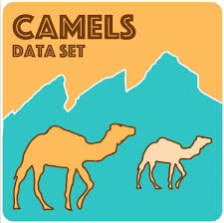
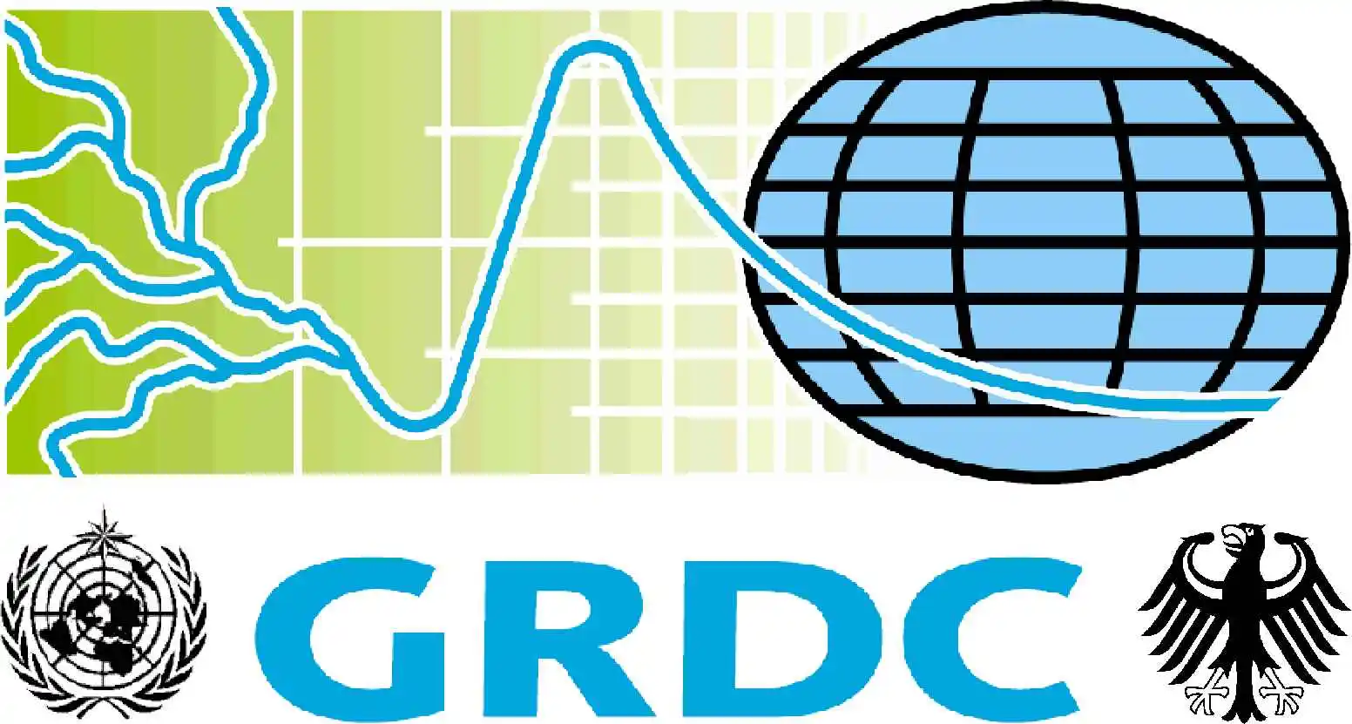
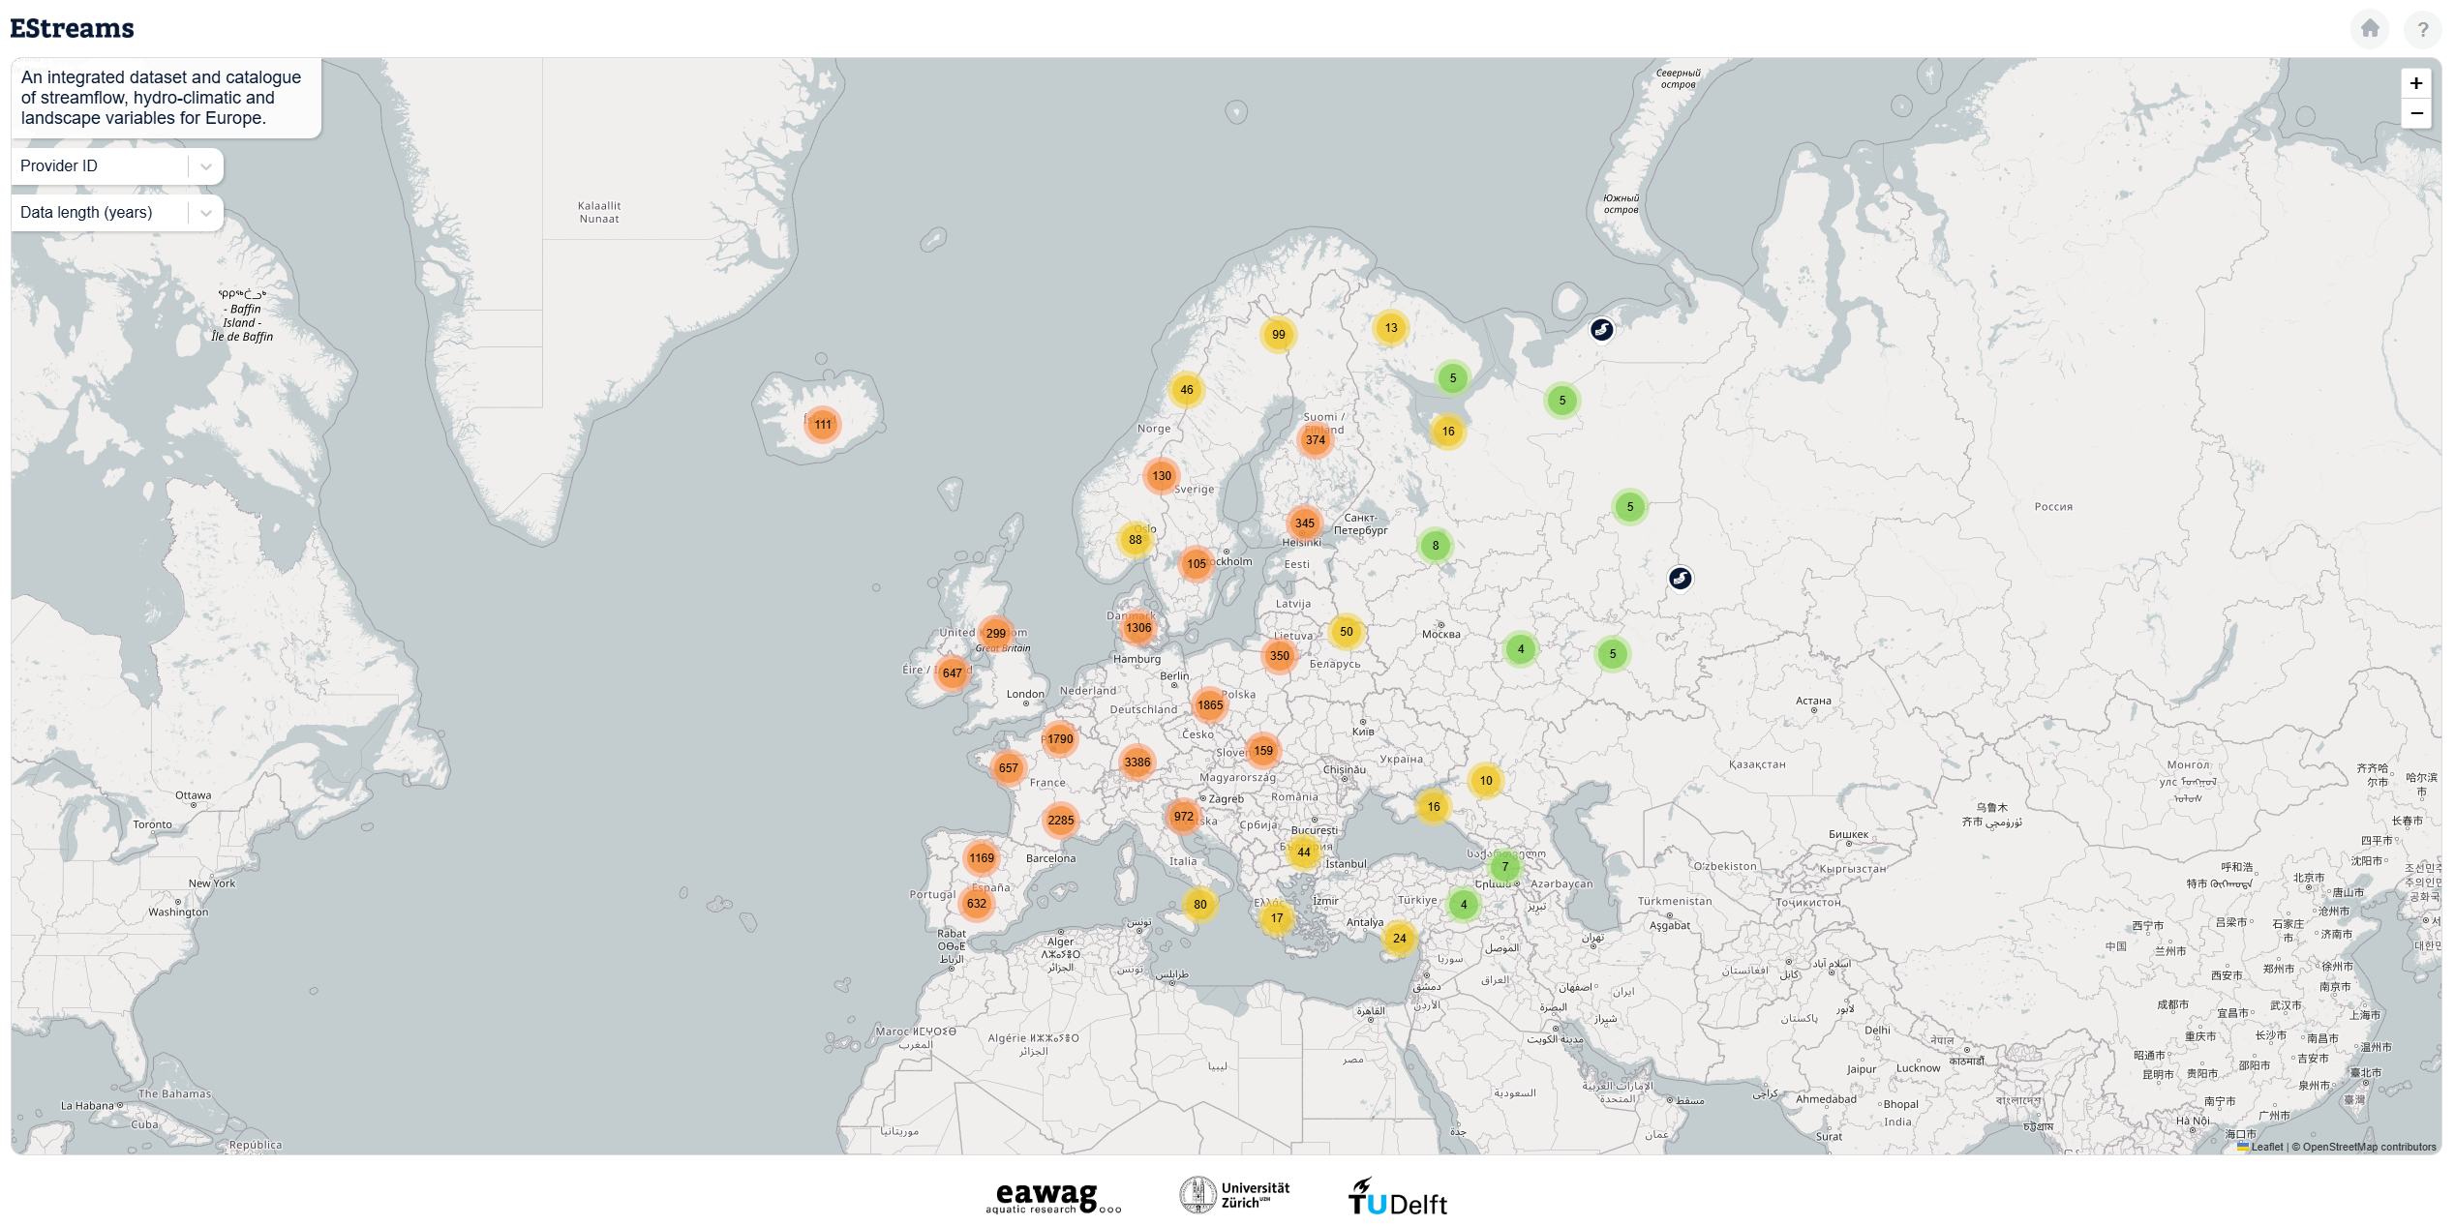
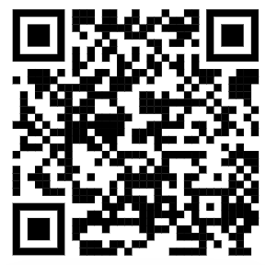
Background information
Recently many large-sample hydrology datasets have been available worldwide
This enabled several studies exploring the drivers of streamflow generation at large scales.
Most of them found that streamflow is more correlated with climate than with landscape.
This has often been attributed to the limited level of detail in available landscape datasets.
www.estreams.eawag.ch
?

Slide 3
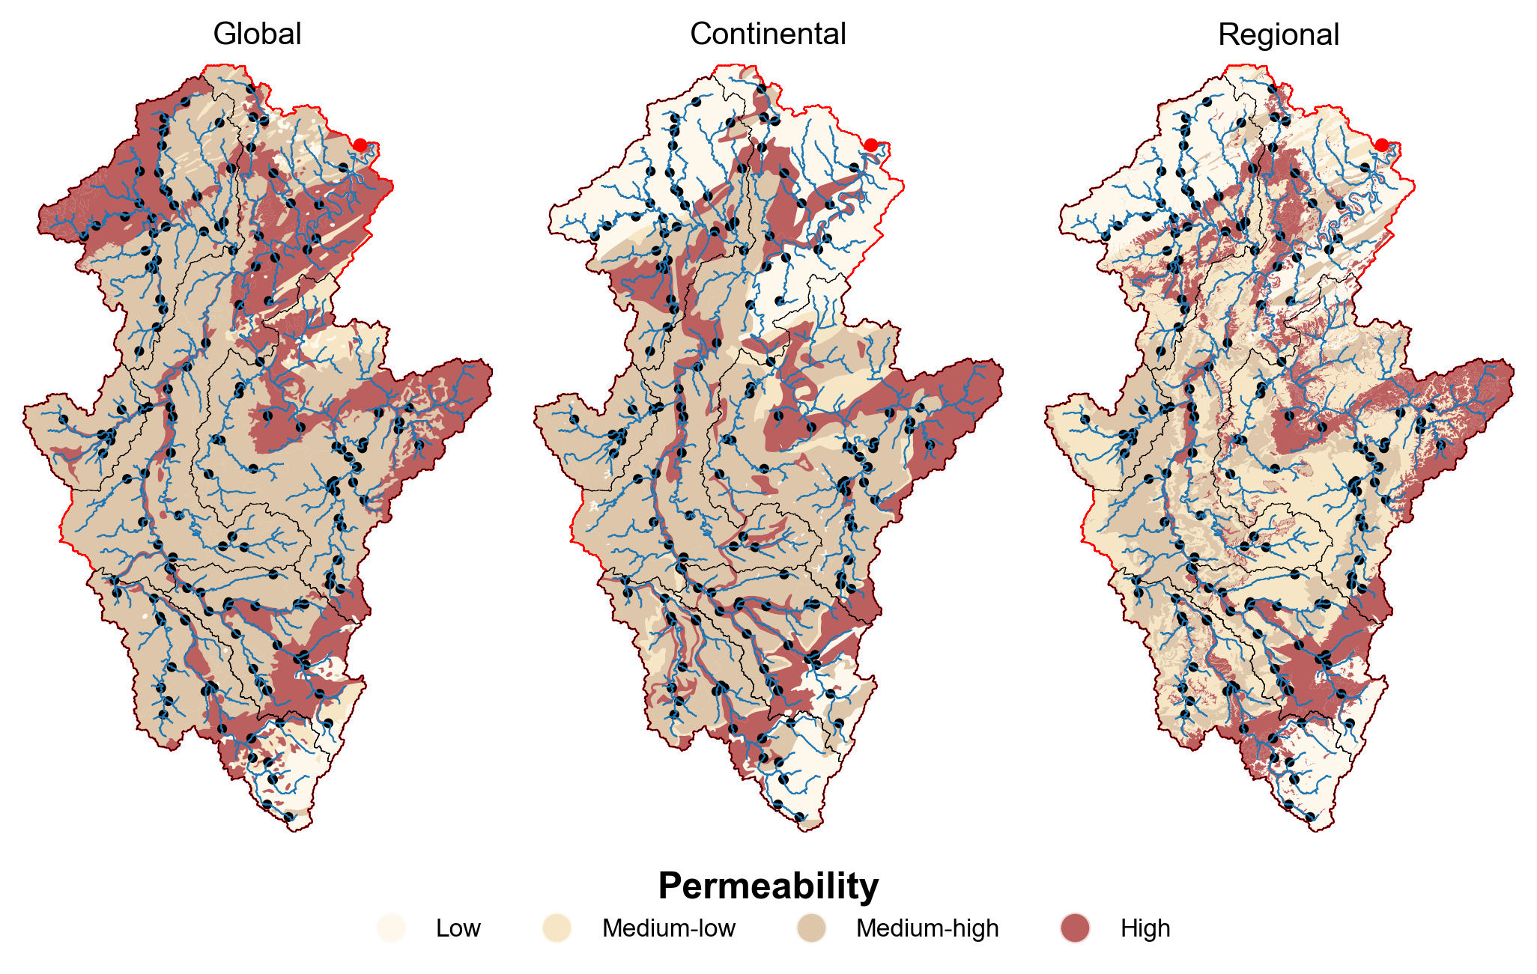
Geological map detail
Global
Continental
Regional
Global
Continental
Regional
Q
FDC Slope
BFI
Spearman correlation [-]
HFD
Q5
Q95
Map level of detail
Signatures correlation value
?

Slide 4
Geological map detail
Global
Continental
Regional
Global
Continental
Regional
Is this the whole picture?
Q
!!
?!
FDC Slope
BFI
Spearman correlation [-]
HFD
Q5
Q95
Map level of detail
Signatures correlation value
Camels’ image created using ChatGPT.
?

Slide 5
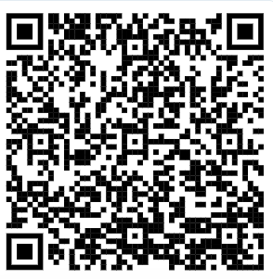
Content
Background information
Study area and data
Methodology
Results
Large scale
Intermediate scale
Small scale
Geology outlook
Final remarks
Contact information
Global
Continental
Regional
Manuscript in review
?

Slide 6
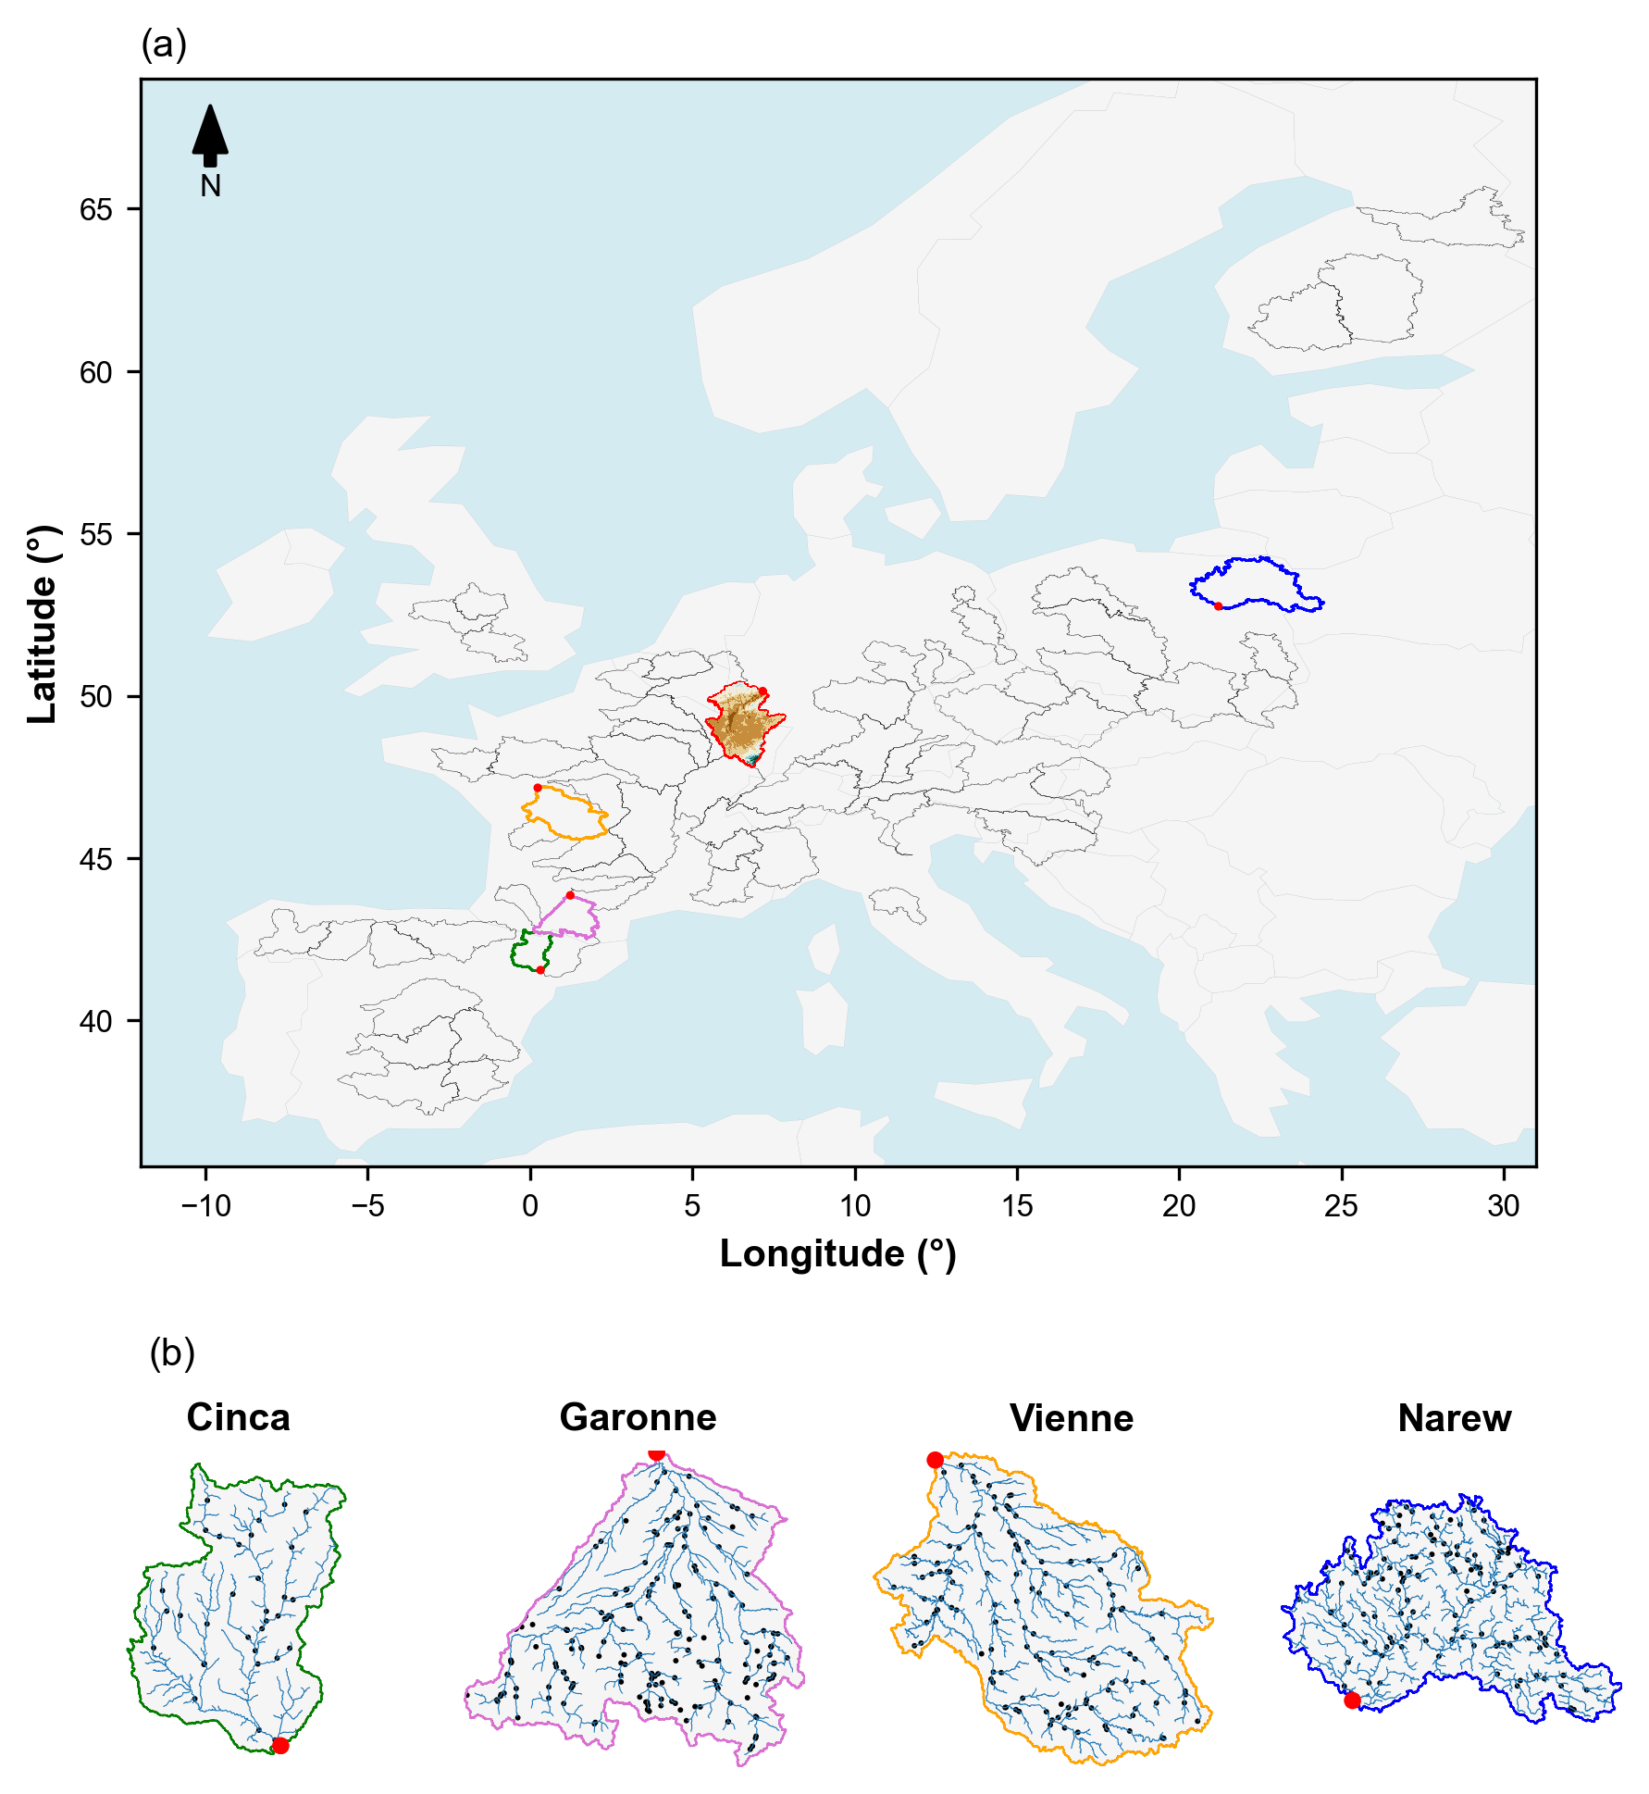
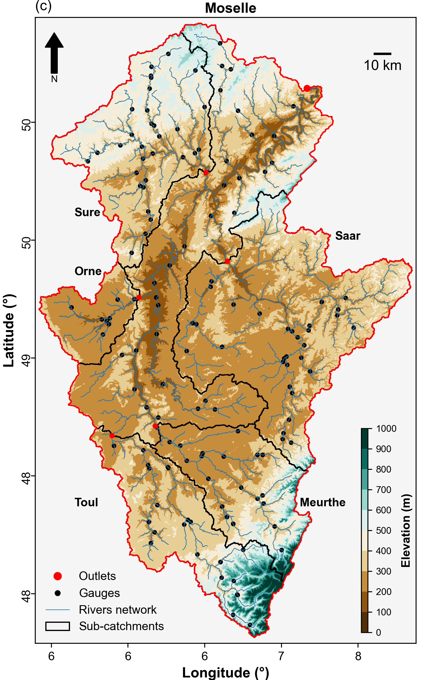
Study area
A
C
Three analysis of progressively smaller scales (from breadth to depth)
Large-scale: 63 river basins
Intermediate-scale: Moselle river basin
Small-scale: 5 nested catchments within the Moselle
B
?

Slide 7
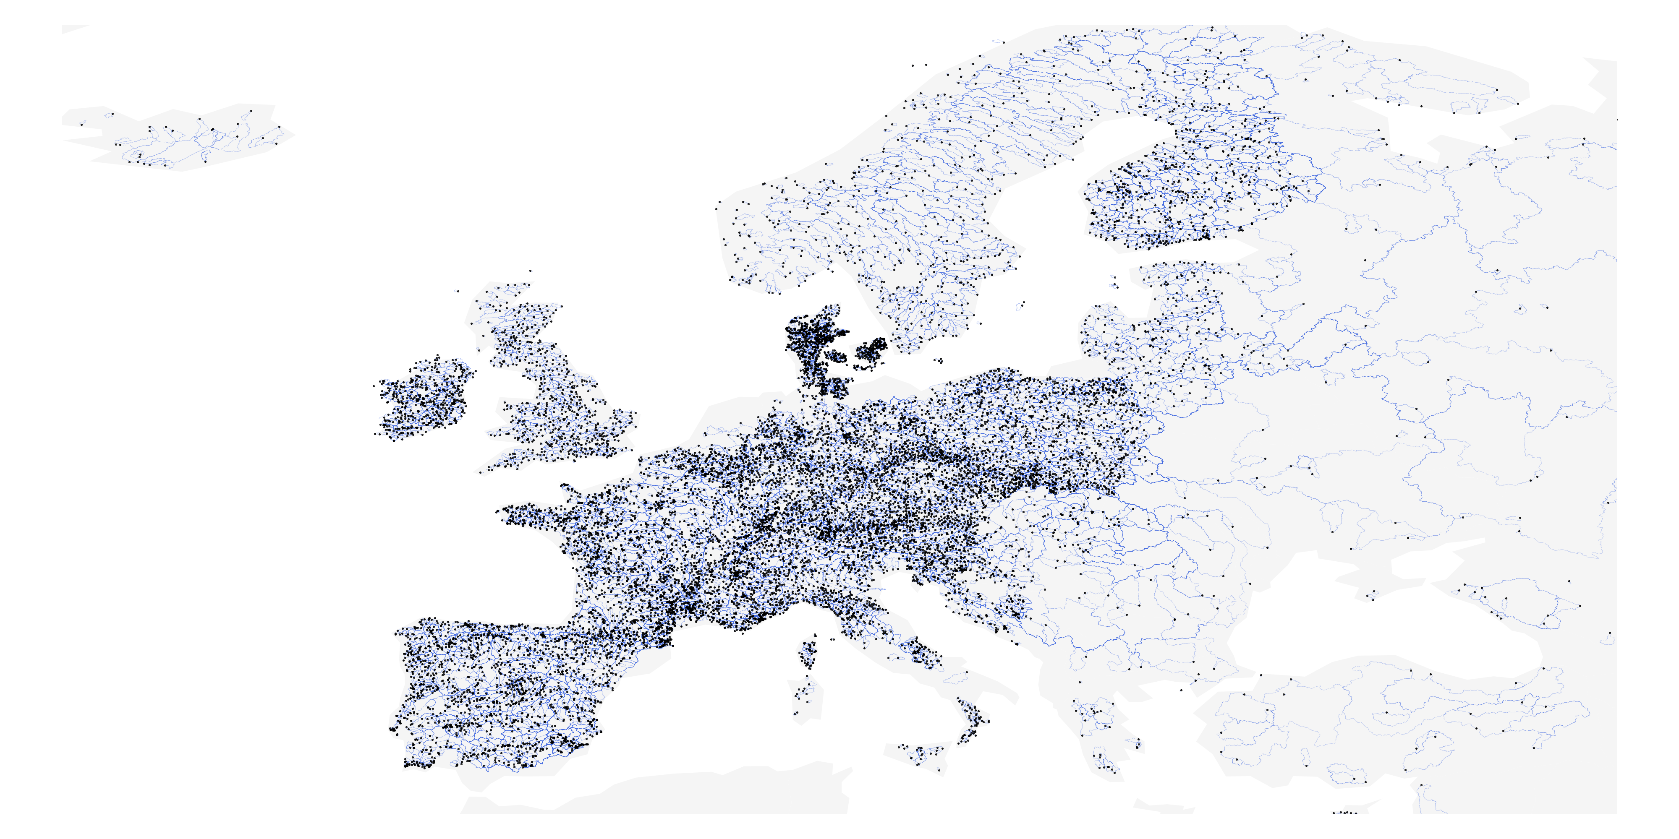
Data
EStreams dataset
Streamflow signatures
Q mean, FDC slope, BFI, HFD, Q5 and Q95
Climatic indices
Landscape attributes
Topography, Soils, Geology and Land use
Distribution of the catchments (blue) included in EStreams with their respective streamflow gauges (black) location.
www.estreams.eawag.ch
?

Slide 8
Data
EStreams geological maps
Global: GLiM
Continental: IHME 1500, level 3
Additional geological map
Regional: France, Germany, Belgium and Luxembourg.
Global
Continental
Regional
Example of the three geological map types for the Moselle basin. The maps show their original geological classes.
?

Slide 9
Data
Reclassification of the geological maps
Here we reclassified the different geological classes into 4 permeabilties.
We explored the methodology used by previous work.
e.g., unconsolidated sediments were categorized as “high permeability”.
Global
Continental
Regional
Example of the three geological map types for the Moselle basin. The maps show their original geological classes.
?

Slide 10
Data
Reclassification of the geological maps
Here we reclassified the different geological classes into 4 permeabilties.
We explored the methodology used by previous work.
e.g., unconsolidated sediments were categorized as “high permeability”.
Global
Continental
Regional
?

Slide 11
Methodology
Main hypothesis
Increased correlation with higher map detail.
Consistency of correlations with physical understanding.
Overall procedure
We computed the Spearman correlation (rs) between attributes and signatures.
We then grouped the maximum rs per group: climate, topography, soils, land use and geology: global, continental and regional.
Exploratory statistical analysis
6 x 47 x 63 = 20,727 correlation values.
6 x 7 x 63 = 2,646 correlation values.
?

Slide 12
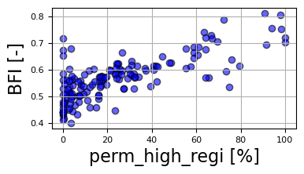
Methodology
For example…
Main hypothesis
Increased correlation with higher map detail.
Consistency of correlations with physical understanding.
Overall procedure
We computed the Spearman correlation (rs) between attributes and signatures.
56 gauges = 56 BFI values
rs = 0.72
Stored at the group of geology regional
We then grouped the maximum rs per group: climate, topography, soils, land use and geology: global, continental and regional.
Exploratory statistical analysis
6 x 47 x 63 = 17,766 correlation values.
6 x 7 x 63 = 2,646 correlation values.
?

Slide 13
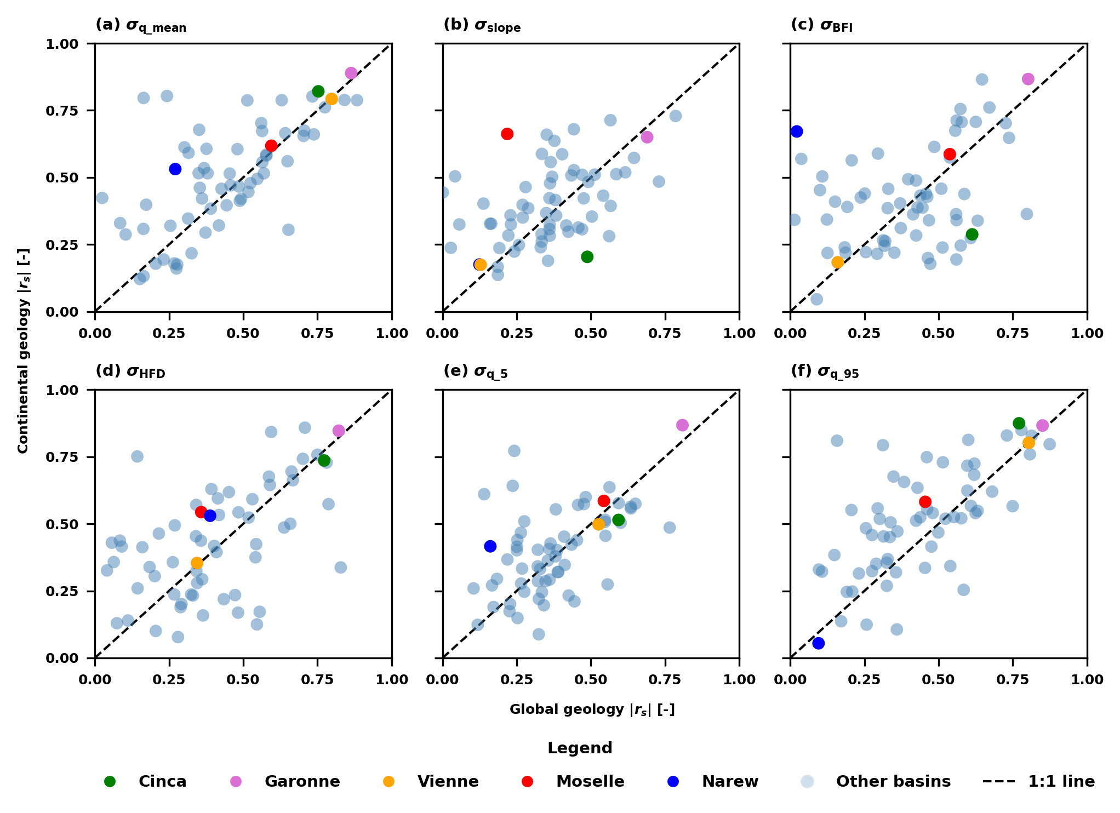
Results
Signatures correlation between two geological maps
Most of basins above the diagonal line.
Q mean (85%), Q95 (81%) and BFI (59%).
Mean rs from Moselle increased from 0.45 to 0.60.
Scatter plot of the |rs| derived from the global geology map, versus the |rs| from the continental geology map for the streamflow signatures. Each light blue circle represents one of the 63 river basins.
?

Slide 14
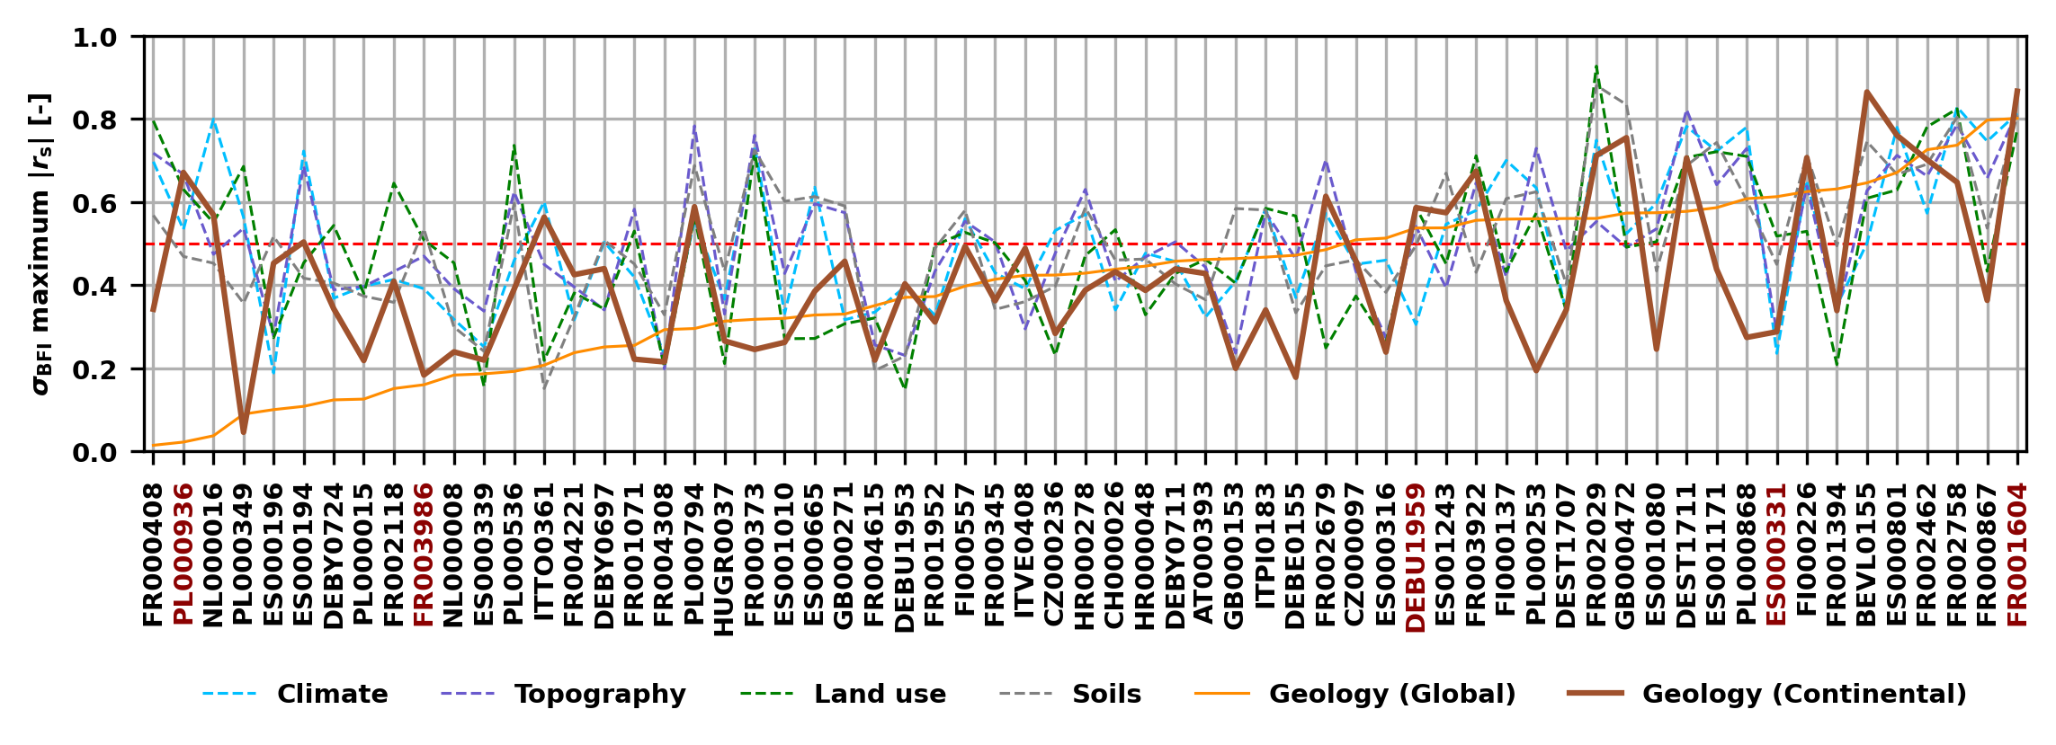
Results
Correlation dynamics for the baseflow index
Most basins have at least one attribute with rs.> 0.50
The group with the highest rs varied: land use most often.
Basins were more often correlated to landscape than to climatic attributes.
Maximums |rs| for each catchment attribute group for each of the 63 river basins used in the large-scale analysis. Each color represents the respective maximums |rs| for a specific catchment attribute group (e.g., climate is shown in blue).
?

Slide 15
Results
Correlation dynamics for the baseflow index
A
B
?

Slide 16
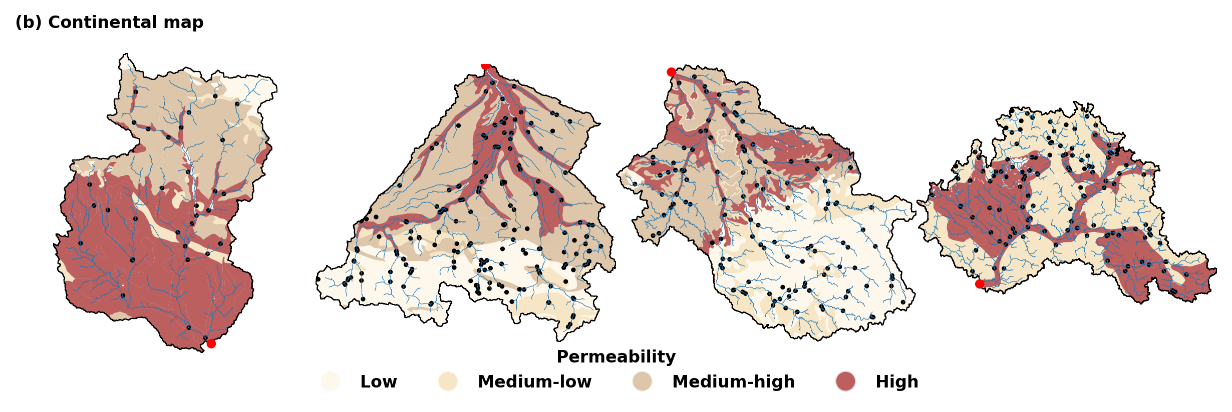
Results
Global maps
Cinca
Garonne
Viene
Narew
Further exploration of representative basins
Cinca: continental map presents finer details and higher rs.
Garonne and Viene: both maps present similar pattern and rs.
Narew: continental map presents more heterogeneity and higher rs.
Continental maps
Spatial distribution of the permeability categories across four selected basins for the global and continental geology maps.
?

Slide 17
Results
Heatmap of maximum |rs| for the set of streamflow signatures in relation to the seven attribute groups used in this work. Notice that the |rs| values are in absolute terms.
Moselle basin
Consistent increase in |rs| values from global to regional maps.
Geology became the group with the highest correlation in four signatures.
FDC slope |rs| increased from 0.22 to 0.70.
Q
FDC Slope
BFI
HFD
Q5
Q95
?

Slide 18
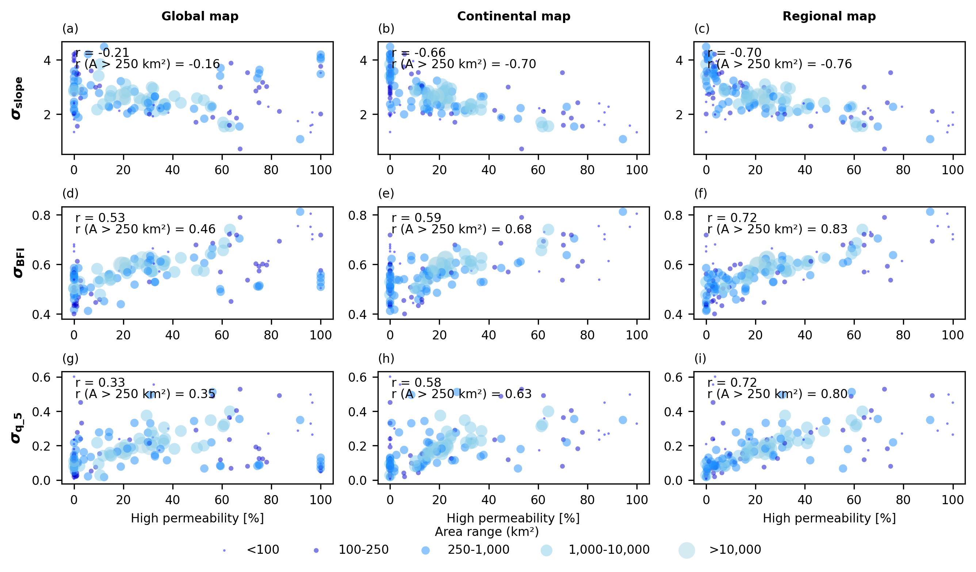
Results
Moselle basin: Signatures versus high permeability
Global map performs poorly mainly in smaller catchments.
Many catchments covering a single geology class in the global map.
This suggests that its lower correlations stem from its less heterogeneity.
Scatter plots showing the correlation between the high-permeability percentages of area in each Moselle sub-catchment versus selected streamflow signatures. The colours of the circles and their respective sizes represent their area range.
?

Slide 19
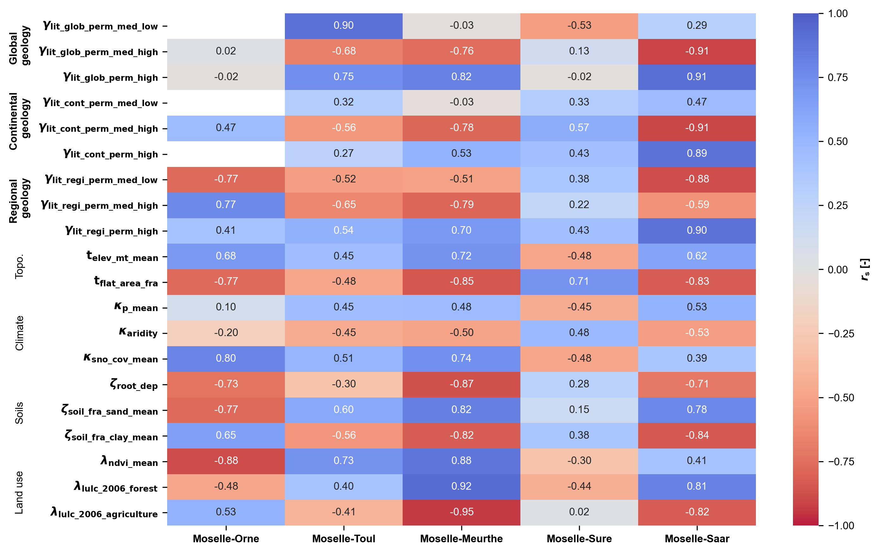
Results
Small-scale analysis: Moselle sub-catchments
No single attribute presented rs > 0.50 for BFI across all 5 catchments.
Regional map was the only one that provided a more consistent pattern (high permeability attribute).
?

Slide 20
Geological maps outlook
Enough geological heterogeneity.
Fine resolution.
Regional
Limited geological heterogeneity (classes).
Fine resolution.
Geological maps
Enough geological heterogeneity.
Limited fine resolution.
Often heterogeneity is more important for correlations.
Global
Continental
Finding the right balance between geological heterogeneity and fine detail resolution
?

Slide 21
Final remarks
Generally correlations increased from global to continental to regional
At local and large scale: no consistent correlation emerged between baseflow and landscape attributes, though landscape effects outweighed climate influences.
At the intermediate scale: geology attributes transitioned from being low-to-high correlated to streamflow signatures as map detail increased.
Our findings have implications for hydrological regionalization and the prediction of streamflow in ungauged catchments.
More information?
do Nascimento et al. (2025) (in review)
?

Slide 22
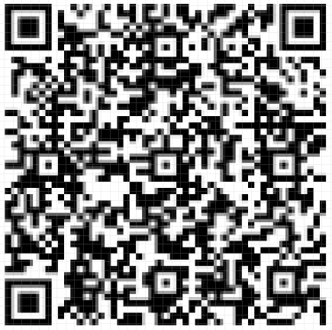
Contact information
Thiago Nascimento
E-mail: thiago.nascimento@eawag.ch
GitHub: thiagovmdon
Projects
Development of large-sample hydrology datasets
Improving our understanding of dominant landscape and climatic drivers in streamflow processes
Main publications
do Nascimento, T.V.M. et al. EStreams: An integrated dataset and catalogue of streamflow, hydro-climatic and landscape variables for Europe. Nature Scientific Data 11, 879 (2024). https://doi.org/10.1038/s41597-024-03706-1
do Nascimento, T. V. M. et al. Impacts of large-scale irrigation and climate change on groundwater quality and the hydrological cycle: A case study of the Alqueva irrigation scheme and the Gabros de Beja aquifer system. Sci. Total Environ. 907, 168151.(2023). https://doi.org/10.1016/j.scitotenv.2023.168151
do Nascimento, T.V.M. et al. Monthly Streamflow Modeling Based on Self-Organizing Maps and Satellite-Estimated Rainfall Data. Water Resour Manage 36, 2359–2377 (2022). https://doi.org/10.1007/s11269-022-03147-8
EStreams website
?

