Slide 1
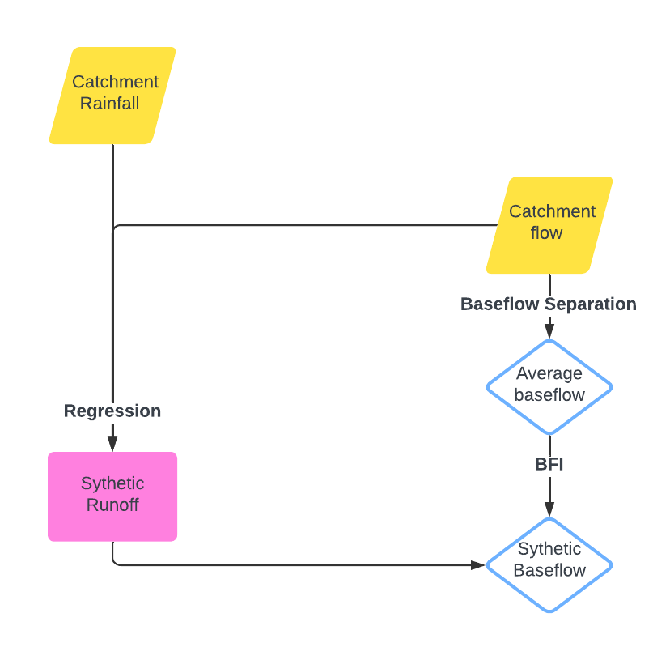
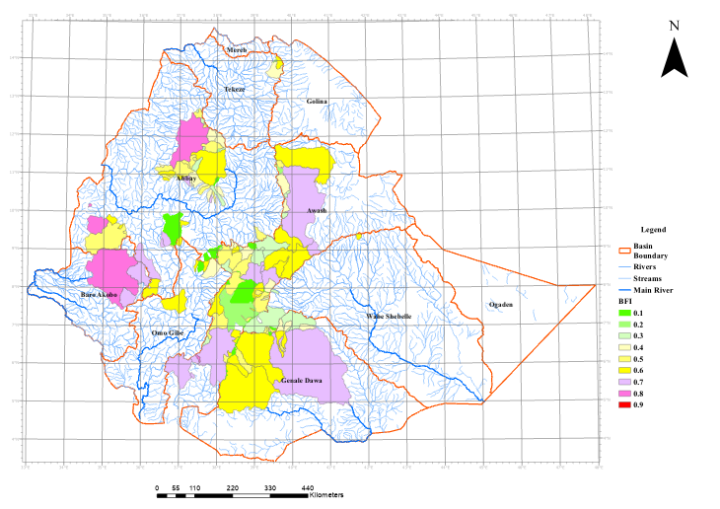
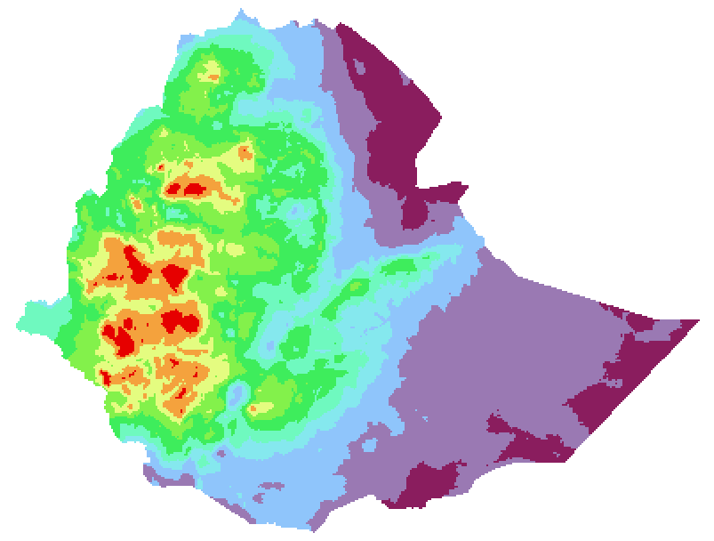
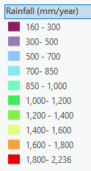
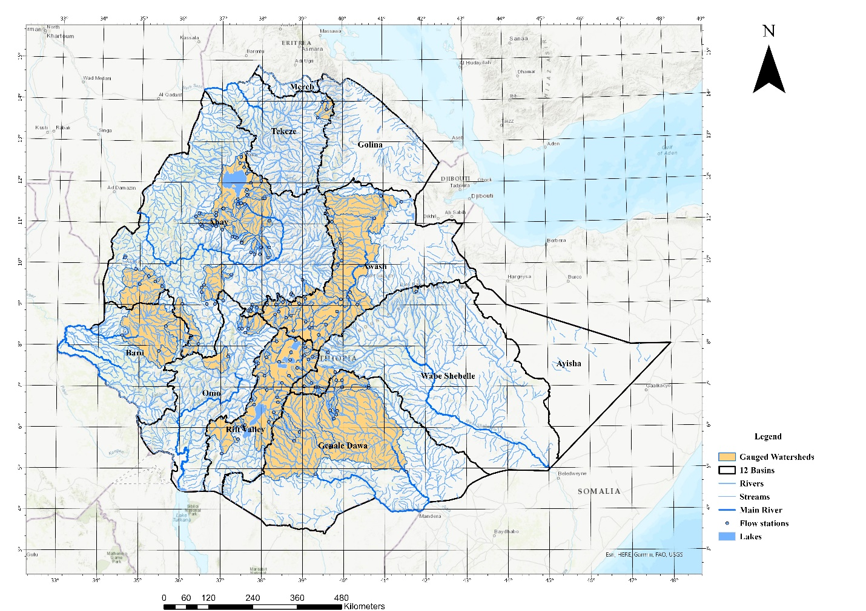
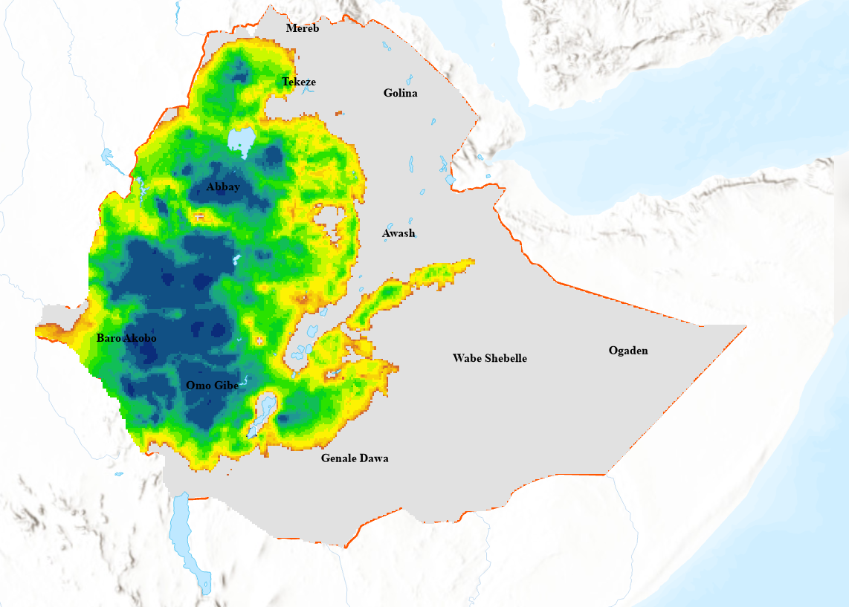
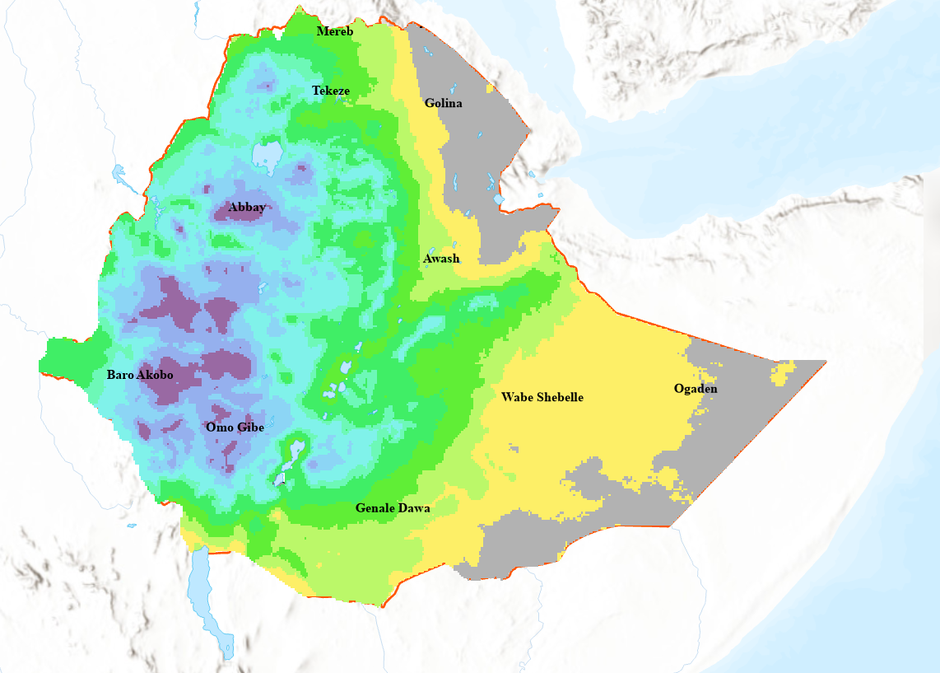
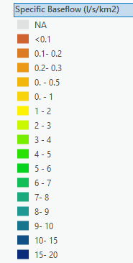
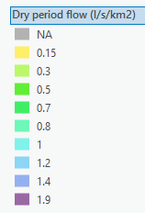
Estimation of Spatial Distribution of Long-term Groundwater Recharge Variability over Ethiopia Mekuanent Muluneh Finsa^{1,2}* and Jiří Bruthans¹ 1 Institute of Hydrogeology, Engineering Geology and Applied Geophysics, Charles University, 128 44 Prague, Czech Republic 2 Water Resource Research Center, Arba Minch University, Arba Minch P.O. Box 21, Ethiopia
Data scarcity is a major challenge in water resource management in Ethiopia
Baseflow, which is sustained throughout the year, and rainfall estimations are better represented in the study area.
Significant correlation exists between the long-term mean precipitation and the long-term mean stream runoff/ baseflow per unit of area
Summary
Introduction
The analysis demonstrates a strong correlation between precipitation and baseflow in favorable regions, highlighting precipitation as the primary driver of recharge, modulated by local geological and hydrological conditions. These findings underscore the importance of tailored, localized water management strategies for Ethiopia’s diverse hydrological conditions. They provide critical insights for improving water security, supporting sustainable groundwater utilization, and enhancing resilience in climate variability, particularly for the country’s rain-fed agricultural systems.
Results
The relationship between mean precipitation data in the grid and specific total runoff
Recharge Estimation
Methodology
Rainfall Data (1990-2010)
$$SRo=\frac{Q}{A}$$
$$BFI=\frac{\sum{BF}}{\sum{Q}}$$
$$SBf=BFI×SRo$$
$$SRo=f(P)$$
Flow analysis
High precipitation and permeable geological formations exhibit high baseflow contributions.
Arid areas with impermeable substrates show weaker recharge and lower baseflow.
Daily flow data from 139 gauging stations (1990–2010)
Dry period SBf (1.9 to 0.15 l/s/km2)
Average SBf (0.1 to 20 l/s/km2)
P= Precipitation (mm), Q= Flow (l/s), A=Area (km²), BF= Baseflow (l/s), BFI= Baseflow index (-), SRo= Specific runoff (l/s/km²), SBf= Specific Baseflow (l/s/km²)
This elaboration was processed as a part of the project by the Czech Geological Survey No. ET-2023-006-RO-43040 (to K. Verner) entitled "Improving the quality of life by ensuring availability and sustainable management of water resources in Sidama Region and Gamo and Gofa Zones (Ethiopia)" financed by the Czech Republic through the Czech Development Agency.

