Slide 1
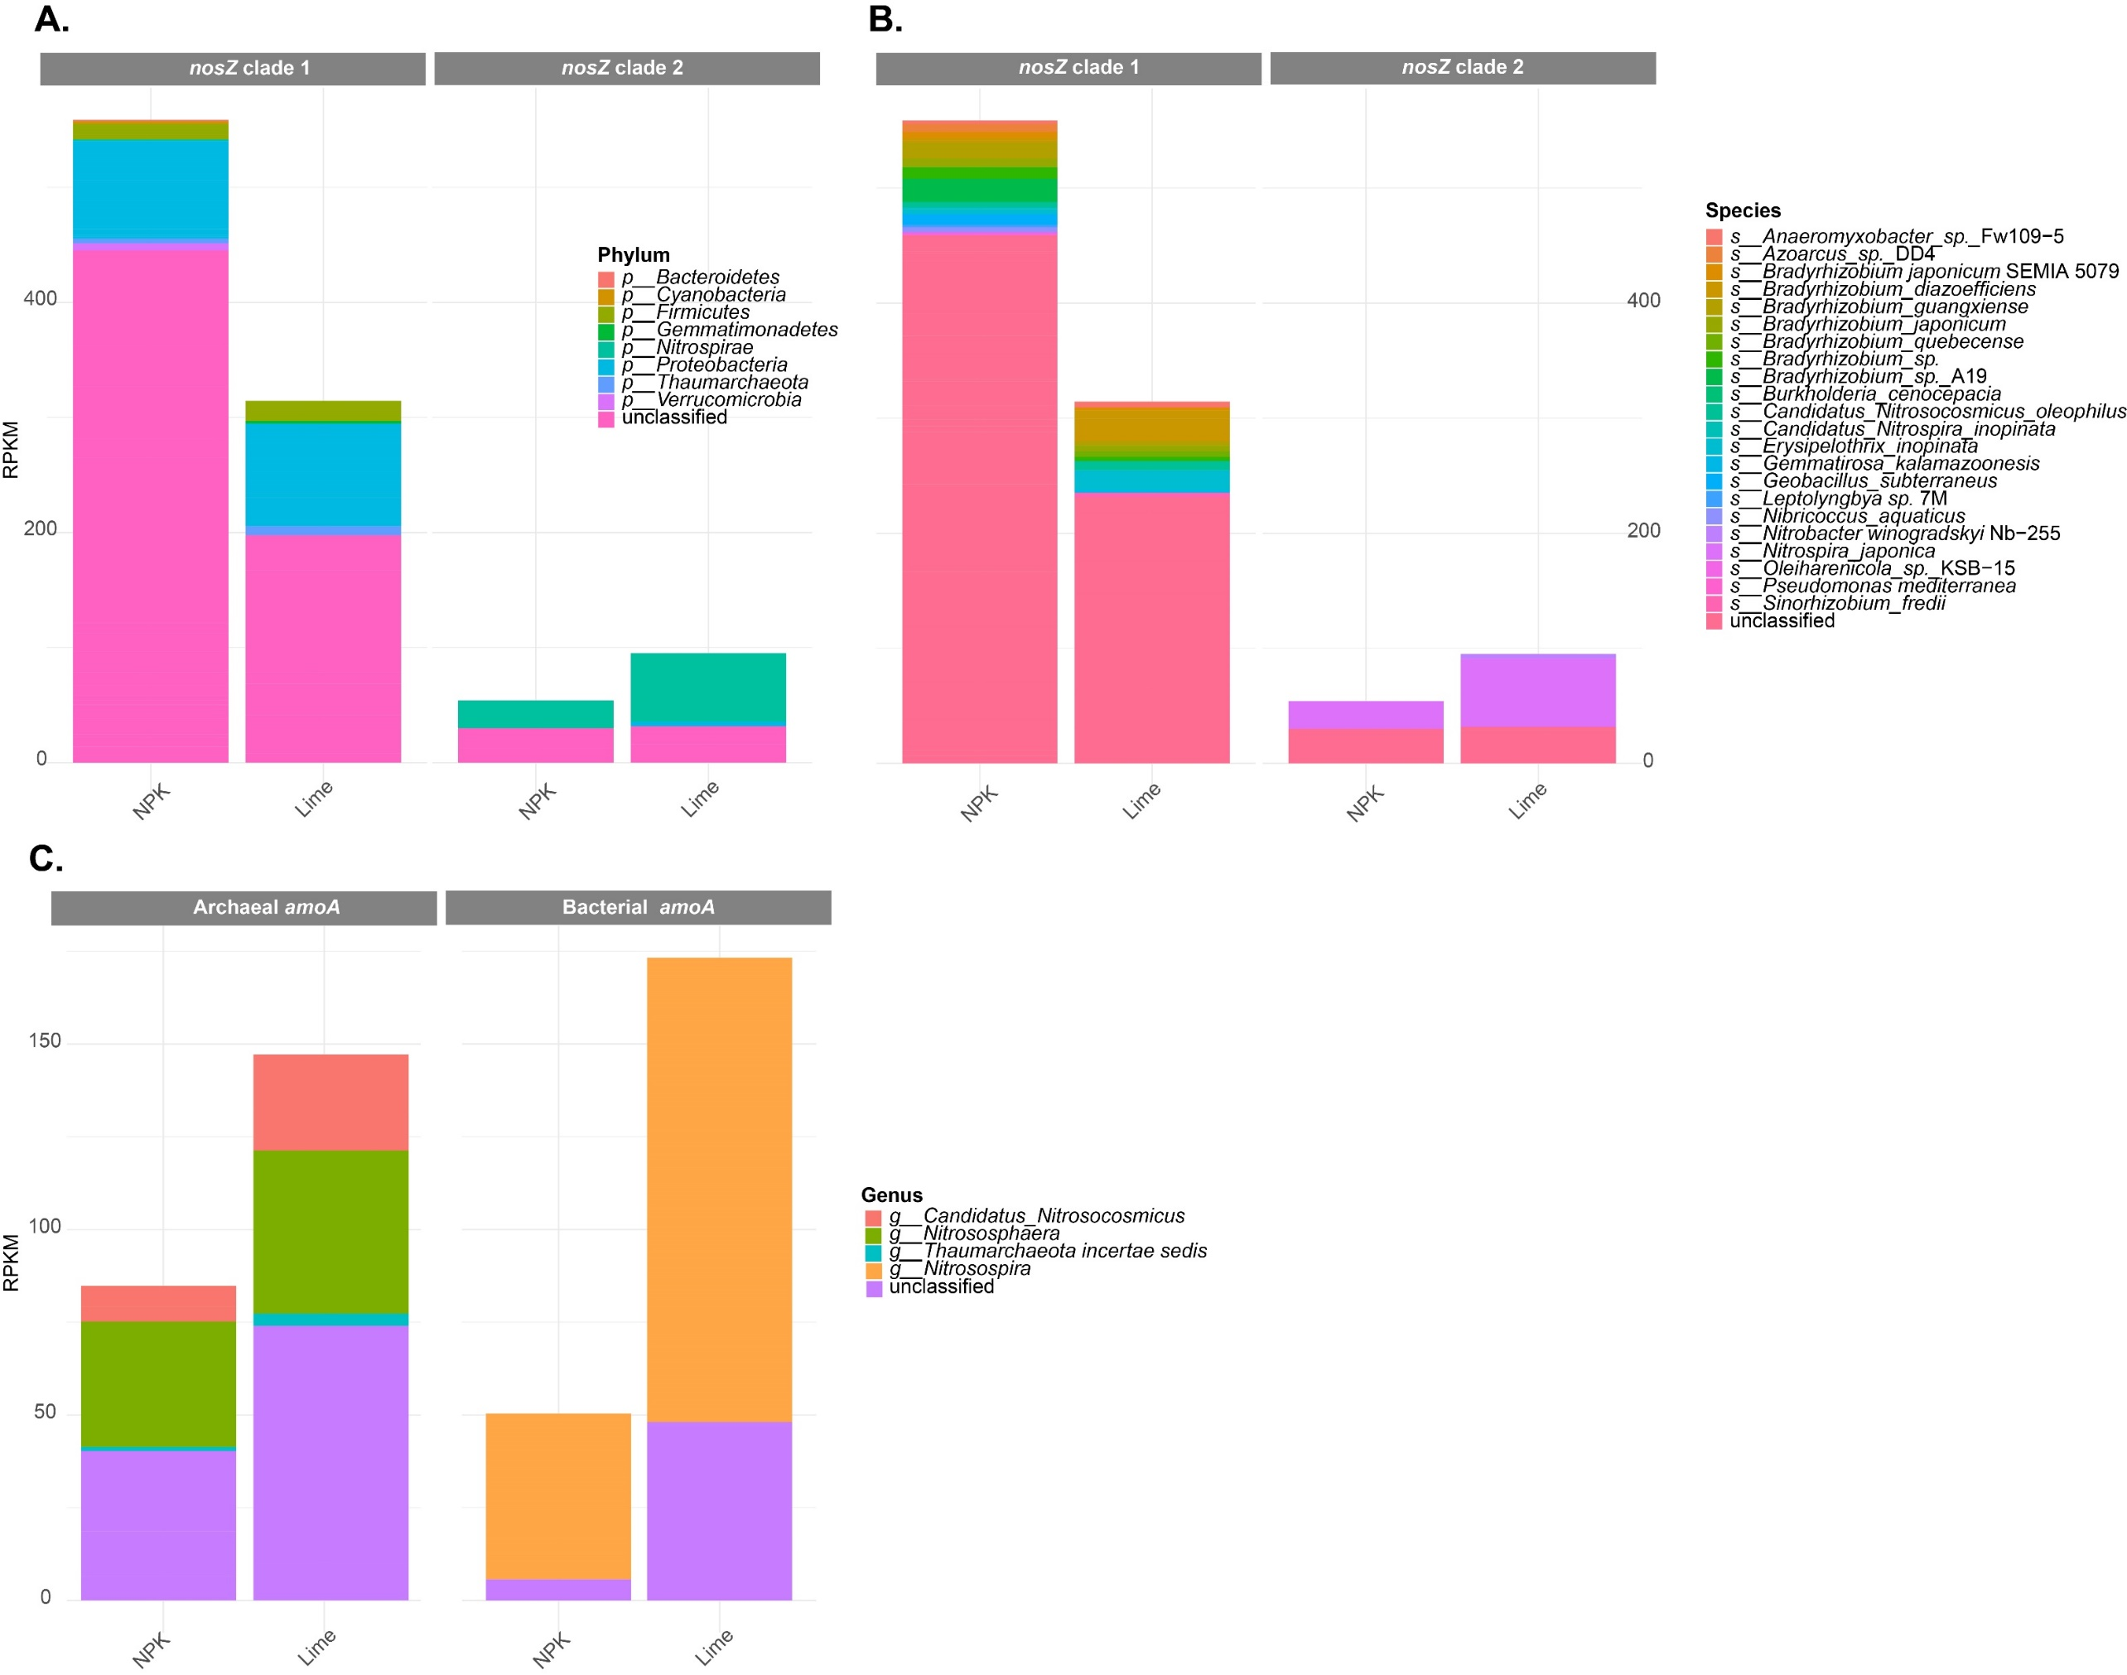
06
Supplementary

Slide 2
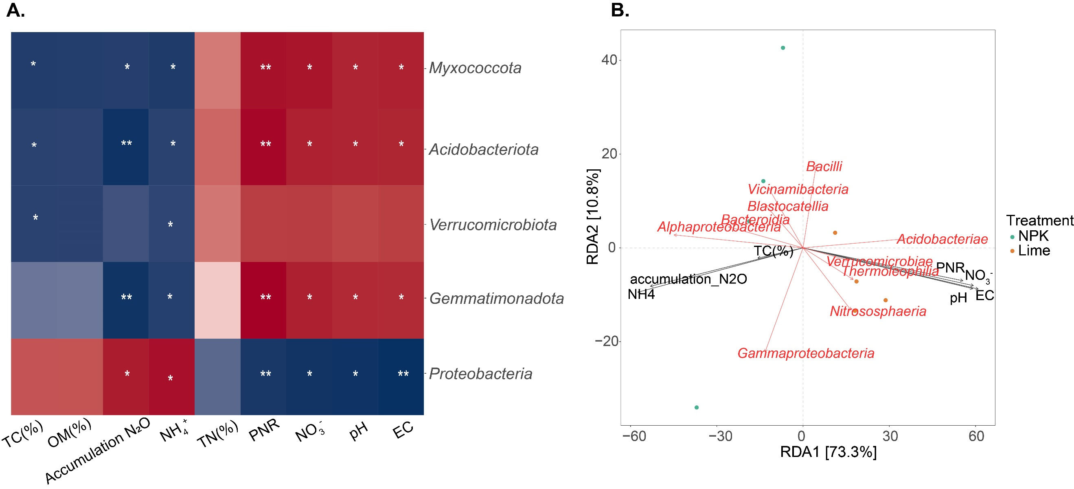
06
Supplementary

Slide 3
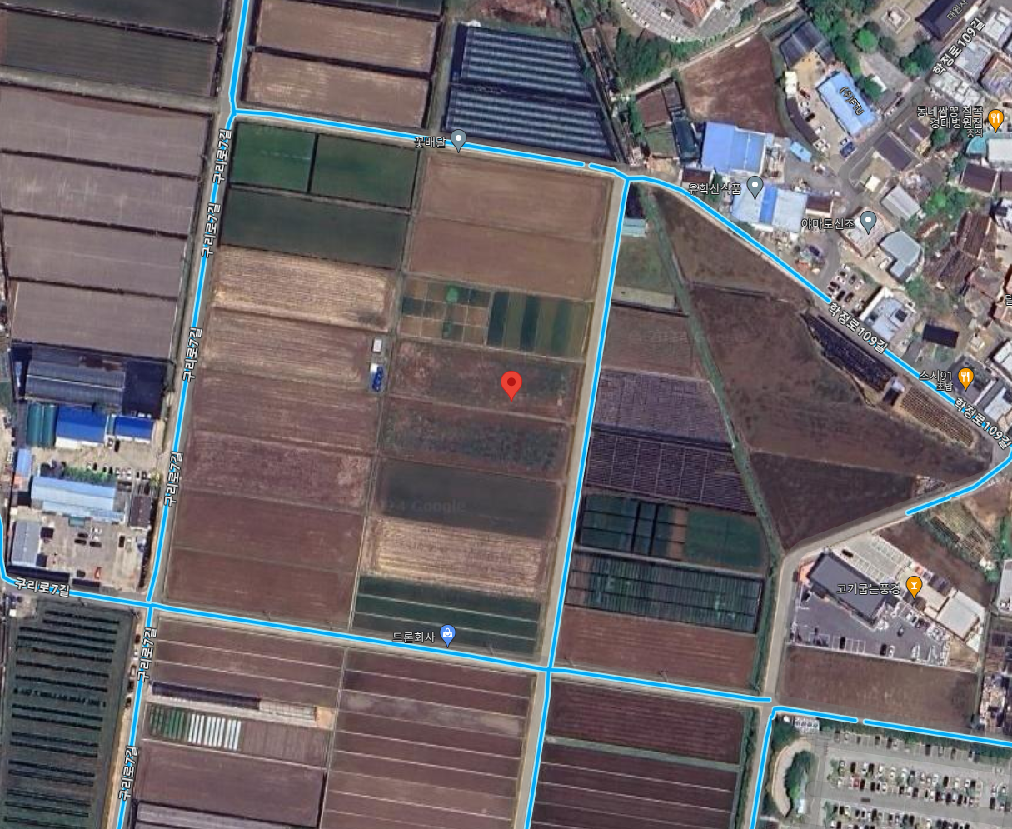
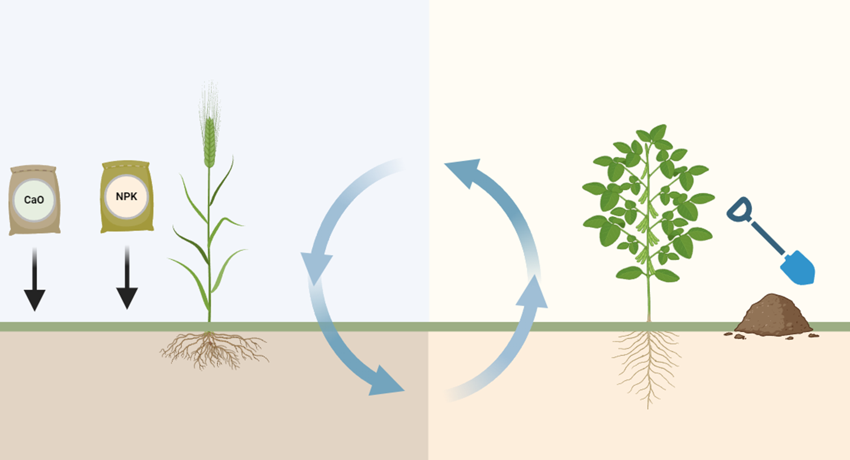
02
Material and Methods
1) Experimental site
Site information
Period: 1975 – 2022 (48years)
Site: Gyeongsangbuk-do Agricultural Research
Winter season
Crop: Barley (Hordeum vulgare L.)
Sowing date: Early September
Harvesting: Late May
Main treatment: NPK(control) & Lime (NPK+Lime)
(35.9528°N, 128.5622°E)
Fertilizer application amount
(N,P, K: kg ha⁻¹, Ca(OH)₂ : Mg ha⁻¹)
Fertilizer | Pre-fertilization | Sowing | 1st Additional | 2nd Additional | Total
N | - | 48 (40%) | 36 (30%) | 36 (30%) | 120
P | - | 80 (100%) | - | - | 80
K | - | 60 (100%) | - | - | 60
Ca(OH)₂ | 1.5 (100%) | - | - | - | 1.5
3

Slide 4
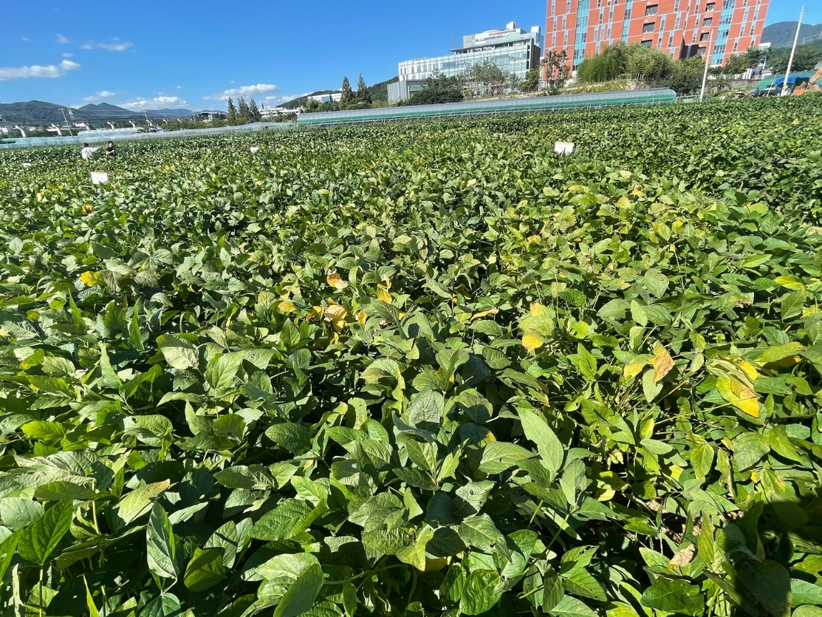
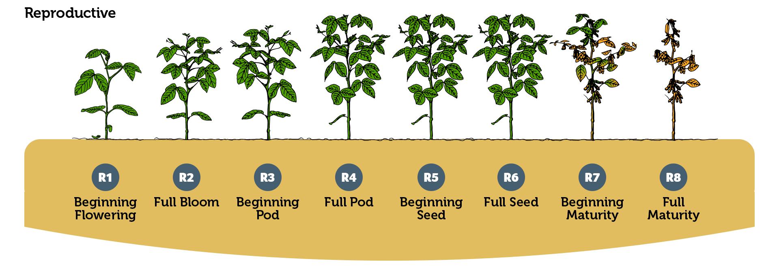
02
Material and Methods
1) Experimental site
Summer season
Main treatment: NPK(control) & Lime
Crop: Soybean (Glycine max L.)
Sowing date: Early June
Sampling : 2022. 09. 21 (R6 stage)
Harvesting: Late October
출처 : https://nutrien-ekonomics.com (Soybean grows stages)
4

Slide 5
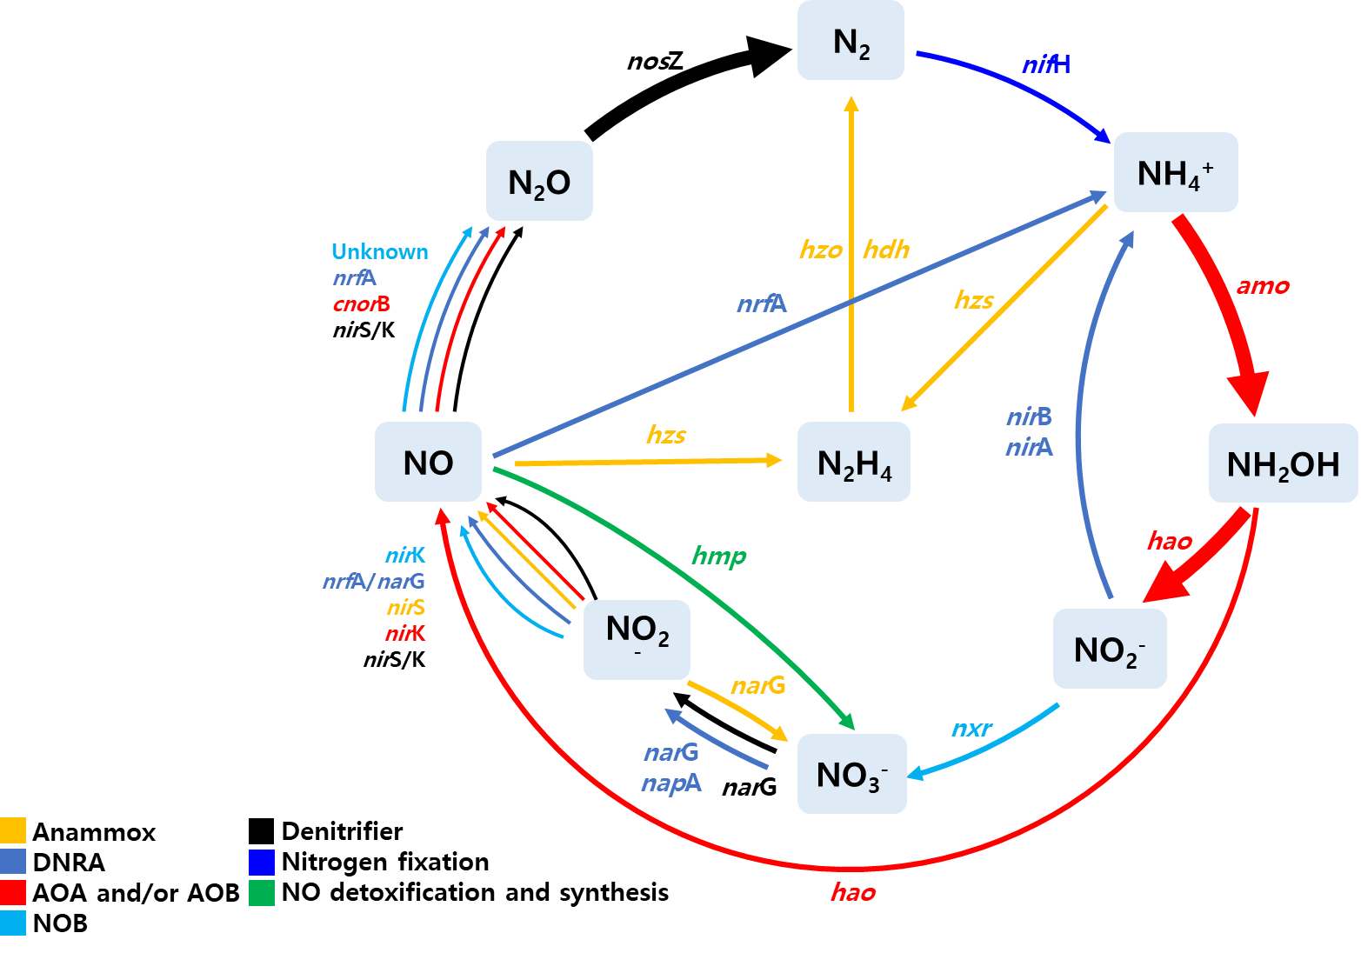
02
Material and Methods
2) Incubation test for comparison N₂O emission
Preincubation
Nitrous oxide
reduction
Soil: 20g of dried weight
Moisture content: 60% of WFPS
Temperature: 25 °C
Period: One week
Incubation
Substrate: 1mM KNO₃ solution (N source)
N₂O emission flux
+ sampling point: 3, 6, 12, 24, 48, 72, 96, 120,
144, 168, 312 and 480 (hours)
+ sampling time: 10:00 – 10:30 A.M (30 min intervals)
<Analysis: Gas chromatography (GC-2010 plus: Shimadzu)>
Condition |  | N₂O
Column |  | Micro-packed column
Detector |  | Electron capture detector
Gas | Burning | Hydrogen (H₂)
 | Carrier | Helium (He)
5

Slide 6
02
Material and Methods
3) Determination Potential nitrification rate
KClO₃ inhibition method
Nitrification
Preincubation
Soil: 5g of dried weight
Temperature: 25 °C
Period: One week
Solution : 17.5ml of 1mM PBS
Incubation test
Substrate: 2.5ml PBS containing 1 mM of (NH₄)₂SO₄ (N source)
Inhibitor : KClO₃ (final concentration 10 mg l⁻¹)
Time : 24hours in dark condition
Determine nitrite concentration
Extraction NO₂⁻ : 5 ml of 2 M KCl was added to the tubes after incubation.
Colorimetric : Griess-Ilosavay reagent (sulfanilamide and N-napthylethyldiamine)
Measuring method : measuring with a spectrophotometer at 520nm
6

Slide 7
02
Material and Methods
3) Determination Potential nitrification rate
KClO₃ inhibition method
NH₄⁺
Preincubation
Soil: 5g of dried weight
Temperature: 25 °C
Period: One week
Solution : 17.5ml of 1mM PBS
Nitritation AOB, AOA
NO₂⁻
Incubation test
Nitratation Nitrite-oxidizing bacteria (NOB)
Substrate: 2.5ml PBS containing 1 mM of (NH₄)₂SO₄ (N source)
Inhibitor : KClO₃ (final concentration 10 mg l⁻¹)
Time : 24hours in dark condition
KClO₃
NO₃⁻
Determine nitrite concentration
Extraction NO₂⁻ : 5 ml of 2 M KCl was added to the tubes after incubation.
Colorimetric : Griess-Ilosavay reagent (sulfanilamide and N-napthylethyldiamine)
Measuring method : measuring with a spectrophotometer at 520nm
7

Slide 8
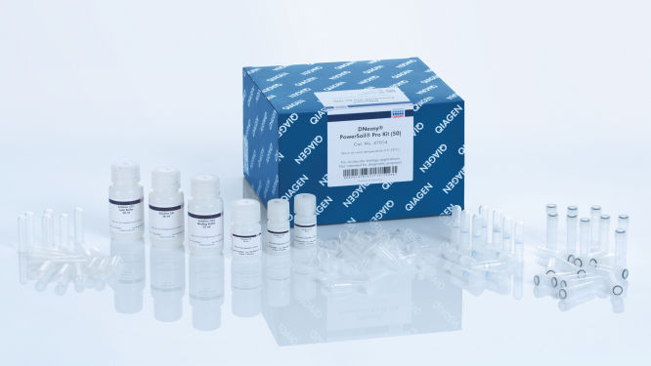
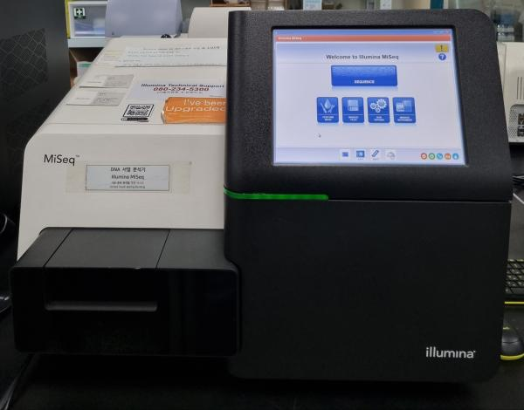
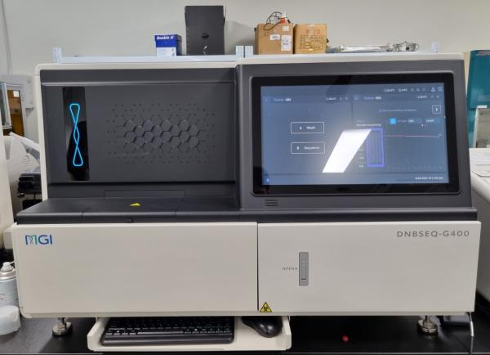
02
Material and Methods
3) DNA extraction and sequencing
DNA extraction
Microbial DNA was extracted from each sample with the DNeasy PowerSoil Pro DNA Kit (Qiagen, Germany)
Microbial DNA Sequencing
https://www.qiagen.com/ko-us/products/discovery-and-translational-research/dna-rna-purification/dna-purification/microbial-dna/dneasy-powersoil-pro-kit
16S rRNA Amplicon sequencing
The verified DNA was subjected to Amplicon sequencing using a MiSeq (Illumina, USA) sequencing apparatus.
Shotgun metagenome sequencing
Preparation using a DNBSEQ-G400RS high-throughput sequencing kit (MGI Tech, China).
Sequencing was performed using the DNBSEQ-G400RS platform (MGI Tech, China) at KNU NGS Core Facility (Daegu, Korea).
8

Slide 9
02
Material and Methods
4) Sequence data analysis and Statistical analysis
Amplicon sequencing data
Metagenome sequencing data
Data trimming with Trimmomatic using the follow option; Single End, SLIDINGWINDOW:4:30 MINLEN:36
Co-assemble with Megahit using the follow option; --k-min 21 --k-step 10 --k-max 17
Prediction gene with Prodigal
Annotation function gene with diamond using blastP mode on Ncyc database and CAZy database
Statistical analysis
For comparison of the two groups, Wilcox-test and T-test were conducted
Permutational multivariate analysis of variance (PERMANOVA) was used for comparison Bray-Curtis dissimilarity
9

Slide 10
06
Supplementary
Method of analysis of soil chemical properties
OM: Chromic acid titration method
P2O5: Molybdenum blue phosphorus method
T-N, T-C: Elemental Analyzer(EA)
NH4-N, NO3-N : Ion-chromatography
Cell Synthesis Reaction Equation of Nitrosomonas and Nitrobacter
NH₄⁺​+HCO₃⁻​+4CO₂​+H_{2​}O→C₅​H₇​O₂​N+5O₂​
NH₄+​+1.83O₂​+1.98HCO₃⁻​ → 0.021C₅​H₇​O₂​N+0.98NO₃⁻​+1.041H₂​O+1.88H₂​CO₃
C₅​H₇​O₂​N :​ Ethyl cyanoacetate

Slide 11
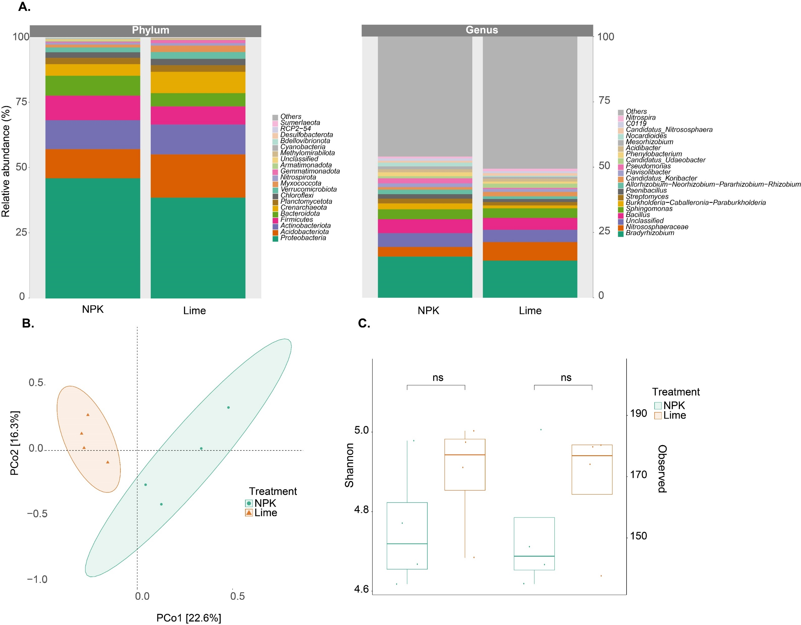
03
Results and Discussion
1) Taxa composition and diversity analysis
11

Slide 12
03
Results and Discussion
1) Taxa composition and diversity analysis
12

Slide 13
03
Results and Discussion
1) Taxa composition and diversity analysis
13

Slide 14
03
Results and Discussion
1) Taxa composition and diversity analysis
[PERMANOVA]
F-value: 1.5895
R-squared: 0.20944
p-value: 0.023
14

Slide 15
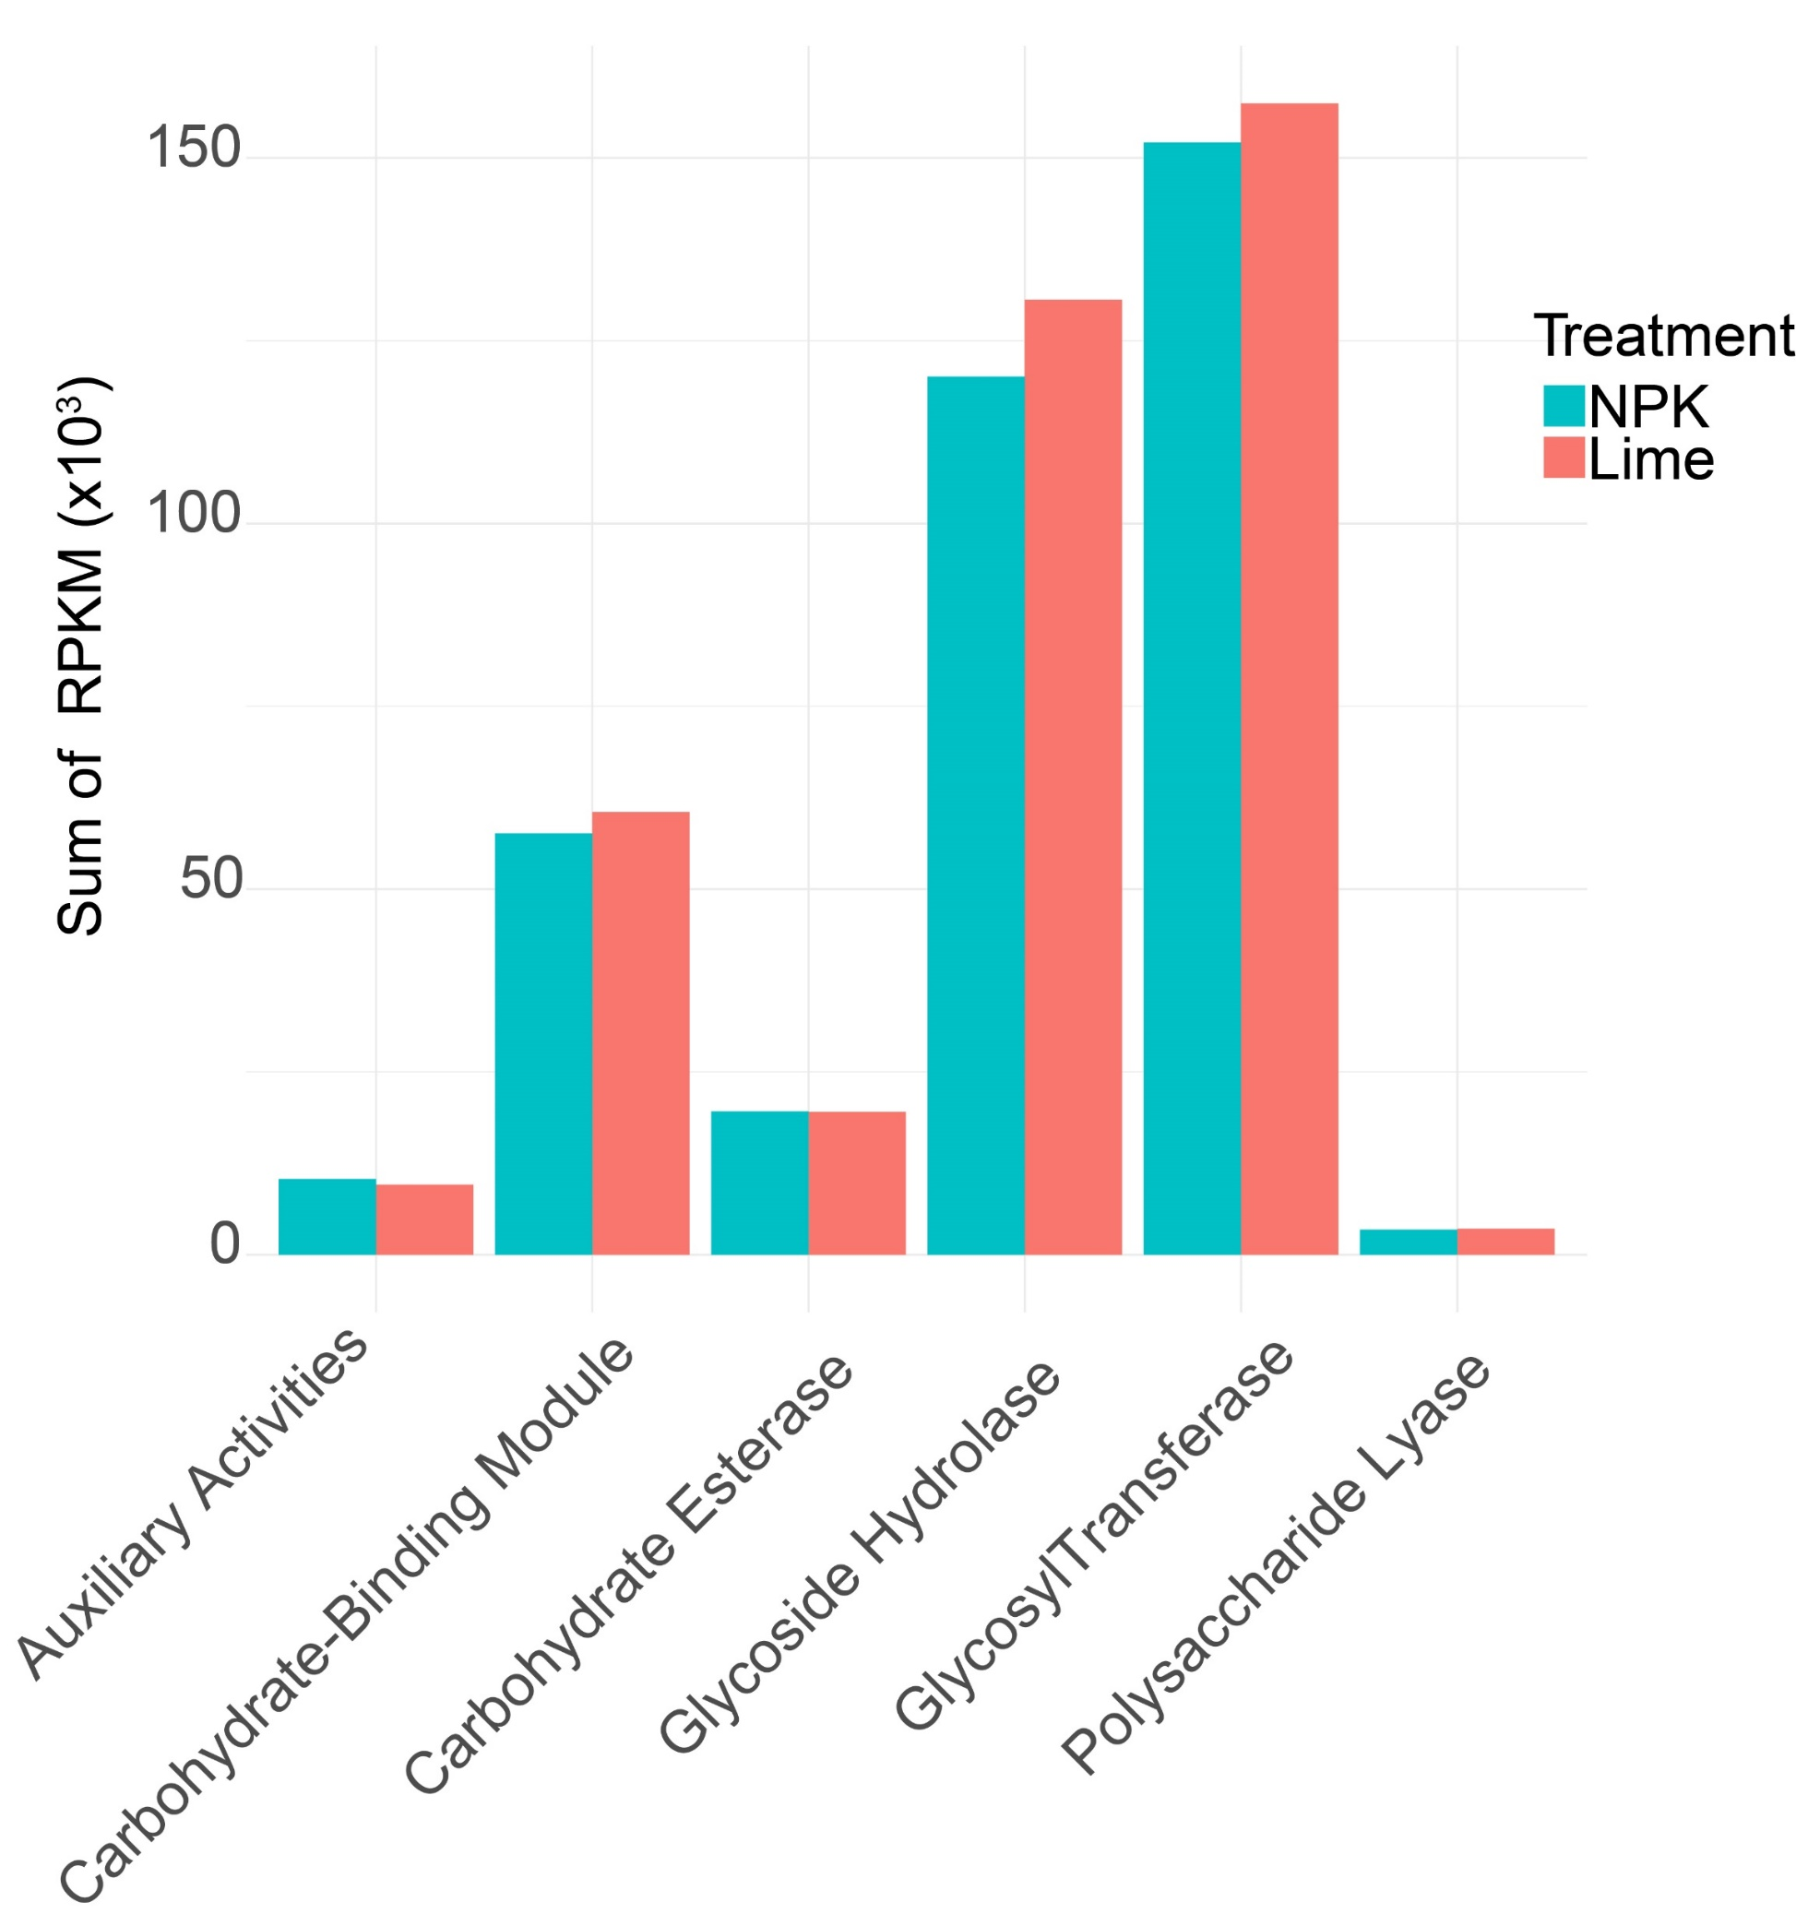
03
Results and Discussion
4) Carbon pathway analysis with CAZyme database
A
Notes:
This has implications for microbes: stimulation of nitrogen metabolism for energy can lead to increased carbon metabolism to feed microbial biomass demands, leading to a priming effect in which microbes obtain carbon by decomposing soil organic matter, thereby posing a risk of soil carbon depletion.

