Slide 1
Significant crust remelting and accompanied continental uplift during amalgamation of world's largest Phanerozoic accretionary orogeny (Altaids) with North China Craton
Speaker: Hai Zhou¹
Cooperaters: Qiqi Zhang¹, Guochun Zhao^{2,3}, Yigui Han³, and Yanrong Wu¹
1 School of Earth Science and Resources, Chang'an University, China
2 Department of Earth Sciences, University of Hong Kong, Hong Kong, China
3 State Key Laboratory of Continental Dynamics, Department of Geology, Northwest University, Xi'an, 710069, China
Email: zhouhai@chd.edu.cn
2025.4.29

Slide 2
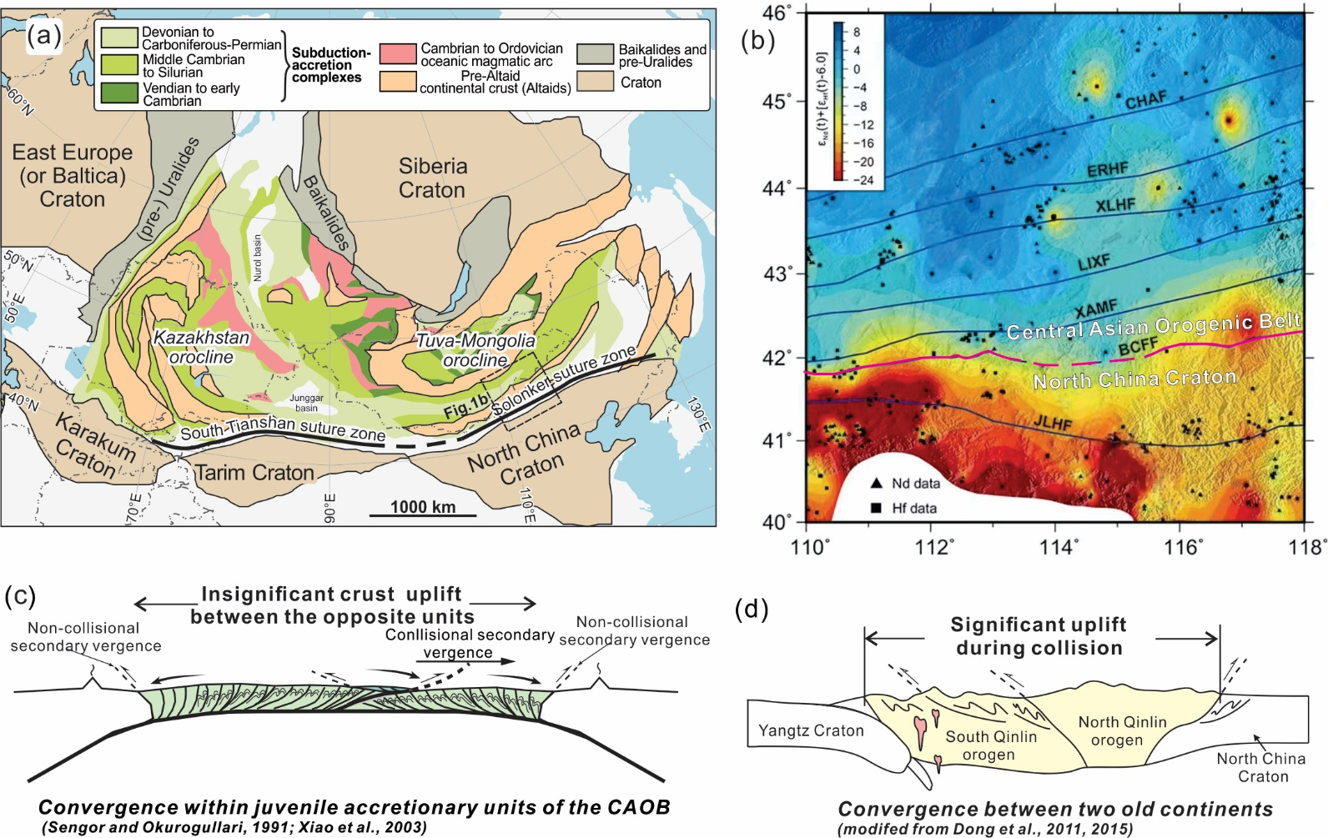
Tectonic Puzzle of late-stage evolution of the Altaids (also termed as Central Asian Orogenic Belt, CAOB)
Different crust architecture and tectonic processes (figs. a-b) .
CAOB accretionary zone:
Juvenile and collaged crusts.
North China Craton (NCC) : ancient and stable crusts.
Key question: Did significant crustal contraction occur during the amalgamation of CAOB with the NCC?
Xiao et al., 2015
Wang et al., 2023
Schematic comparing of collision processes between CAOB accretionary zone (fig. c) and typical continent-continental collisional orogeny (fig. d)

Slide 3
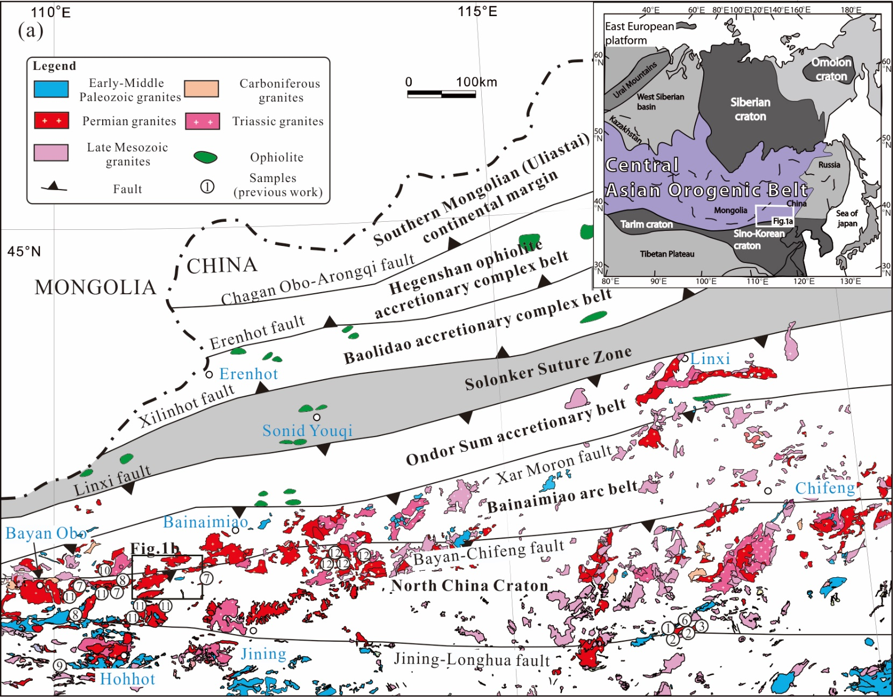
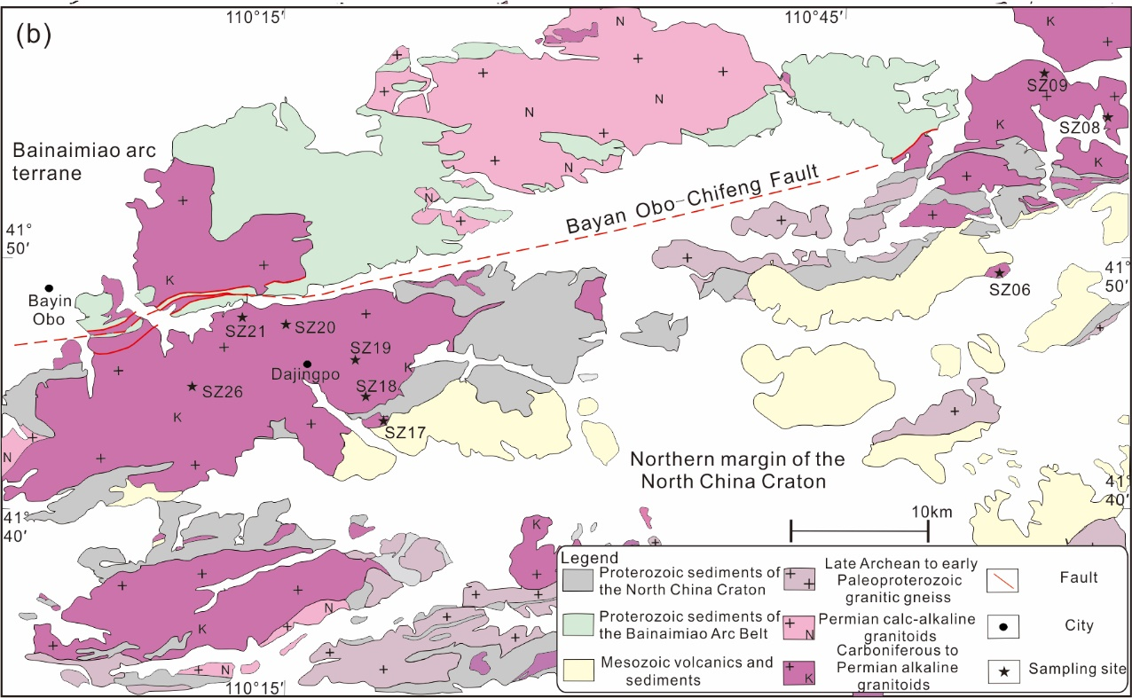
Tectonic Framework of the Study Area
​Central Asian Orogenic Belt (CAOB)
Largest Phanerozoic accretionary orogen
Final closure of PAO at ~250-270 Ma (Solonker suture)
​North China Craton (NCC)
Ancient craton with Archean basement and Proterozoic-Paleozoic sediments intruded by Permian-Triassic magmatism along northern margin
Modified from Wu et al., 2021
Modified from 1:250000 Geological map of Siziwanqi area
Study Area: Siziwangqi, Inner Mongolia
A key area to test CAOB-NCC interaction located at the junction of Bainaimiao arc belt and NCC active margin

Slide 4
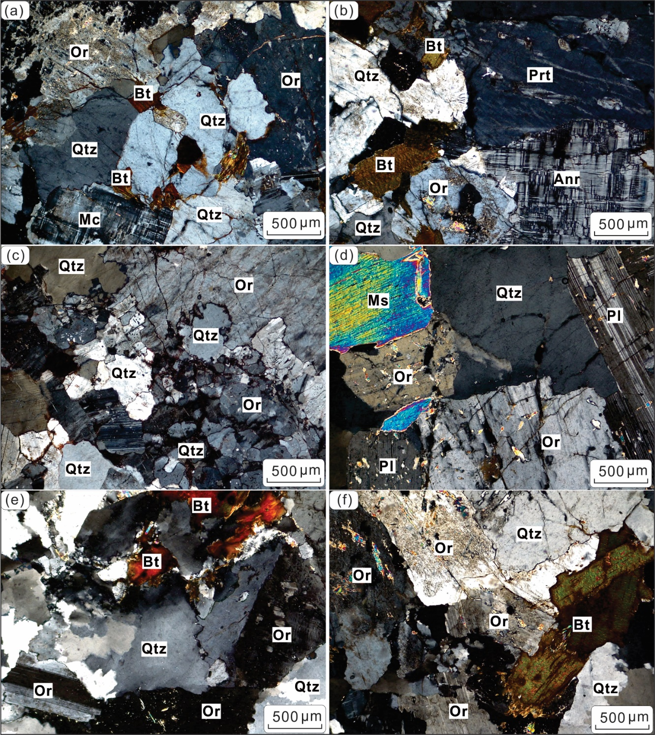

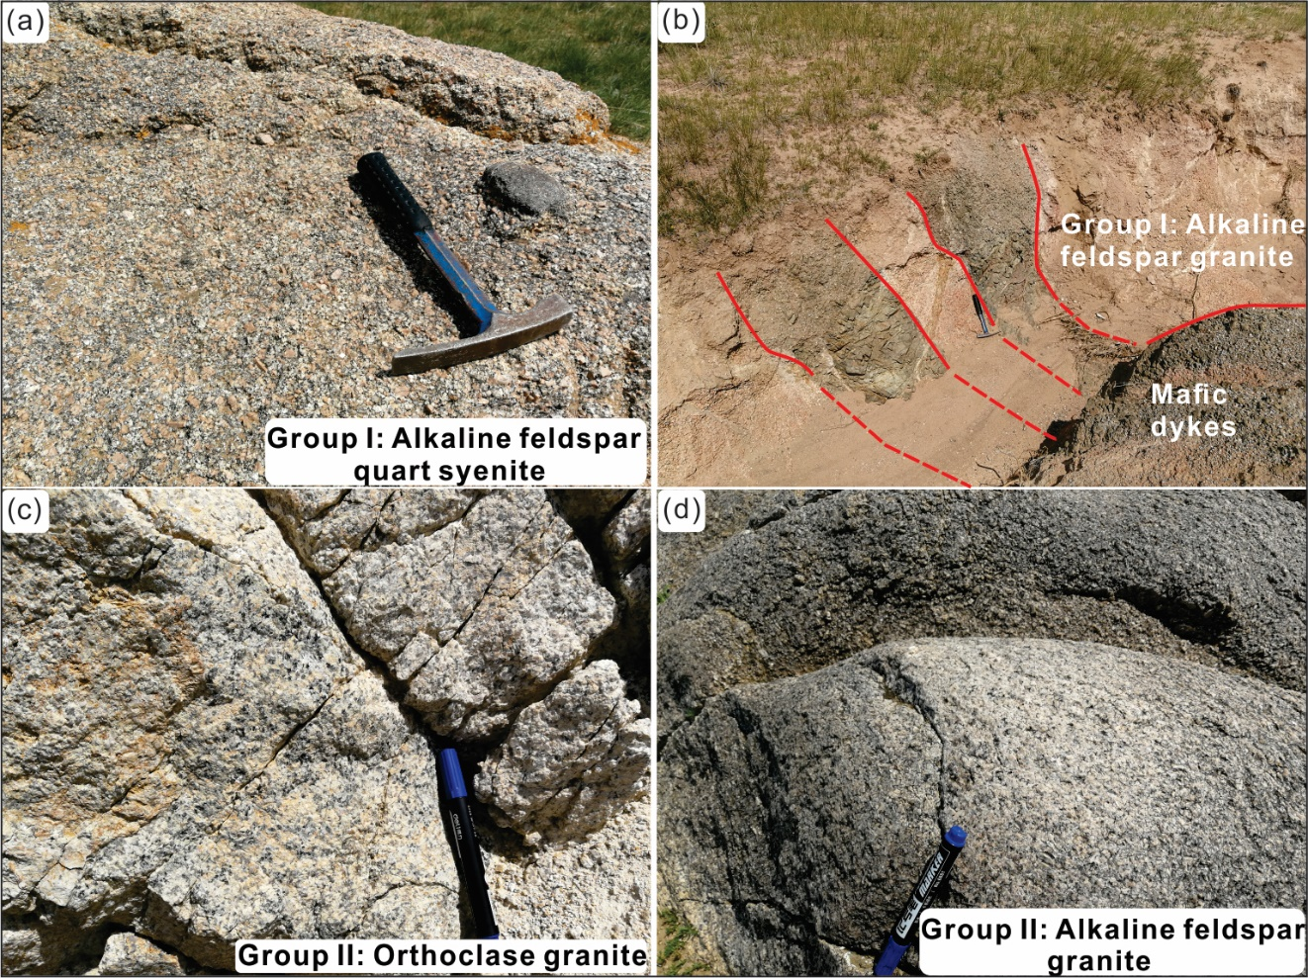
Field investigation and samplings
Group I
SZ18
Group I
SZ20
Group II
Group I
Group I
SZ26
Group II
SZ06
Group I: Batholith granite, alkaline feldspar granite (samples SZ17-7, 17-8 and that collected from SZ18, 19, and 20 (sampling sites)), and alkaline feldspar quartz syenite (samples from SZ21, and 26);
Group II: stock granite, syenogranite (samples from SZ06, 08 and 09) with minor alkaline feldspar granite (samples SZ17-1, 17-3, 17-4).
Group II
SZ08
Group II
SZ17-1

Slide 5
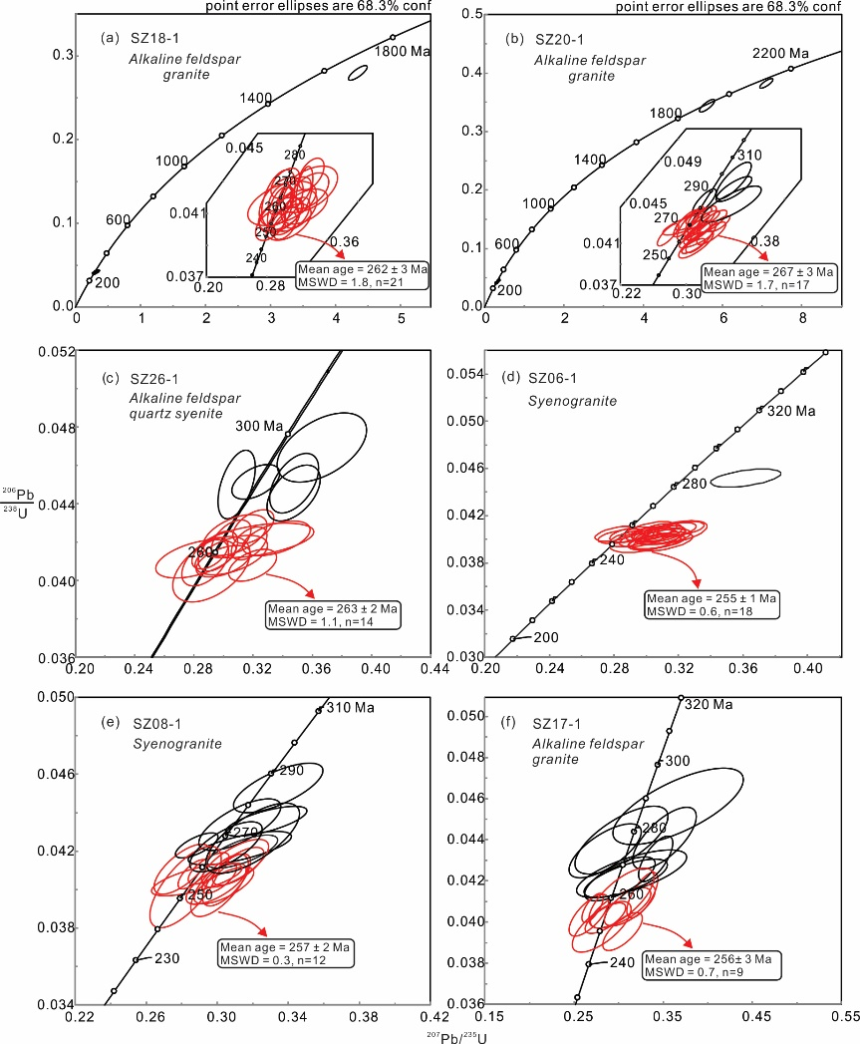
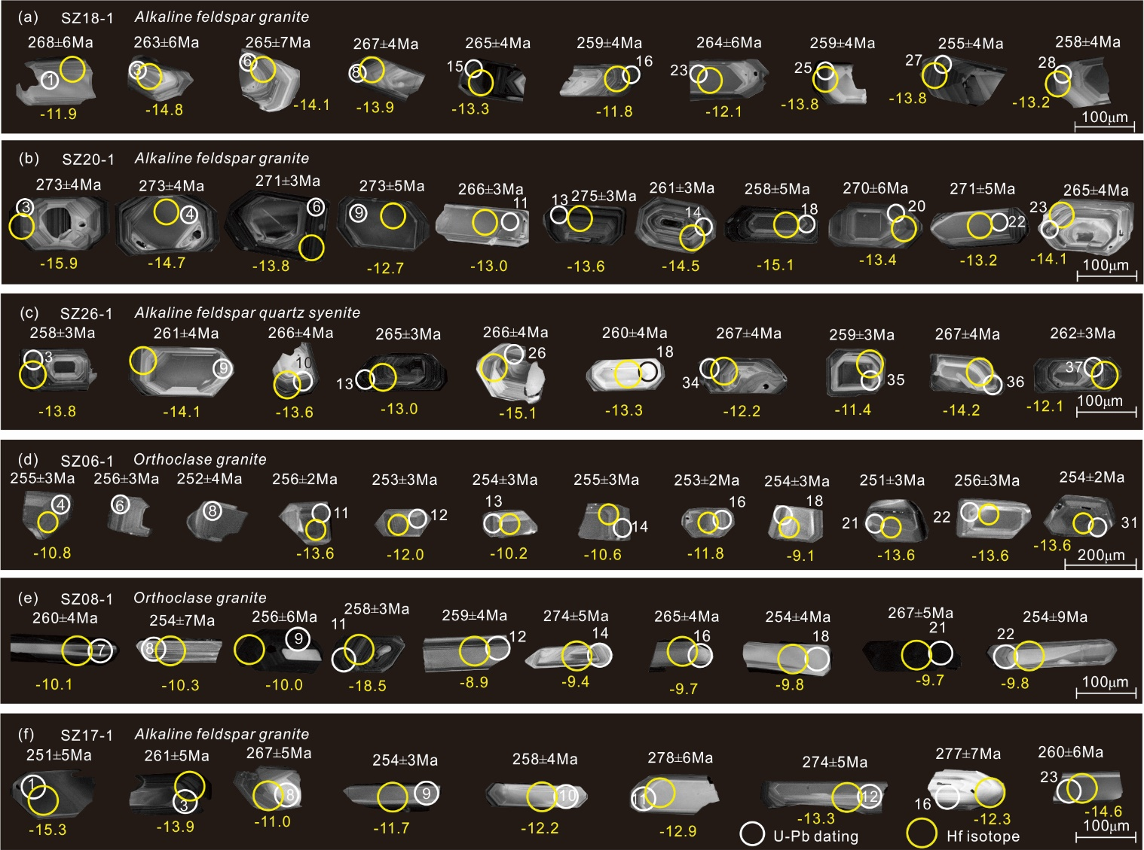
Temporal Framework of Granitic Magmatism
Group I
Group I 262 Ma
Group I 267 Ma
Group II
Group I 263 Ma
Group II 255 Ma
Batholith granites: 262-267 Ma
​Inherited zircons: Paleo-Mesoproterozoic cores (~1.8-2.2 Ga)
Stock granites: 255-257 Ma
Group II 257 Ma
Group II 256 Ma

Slide 6
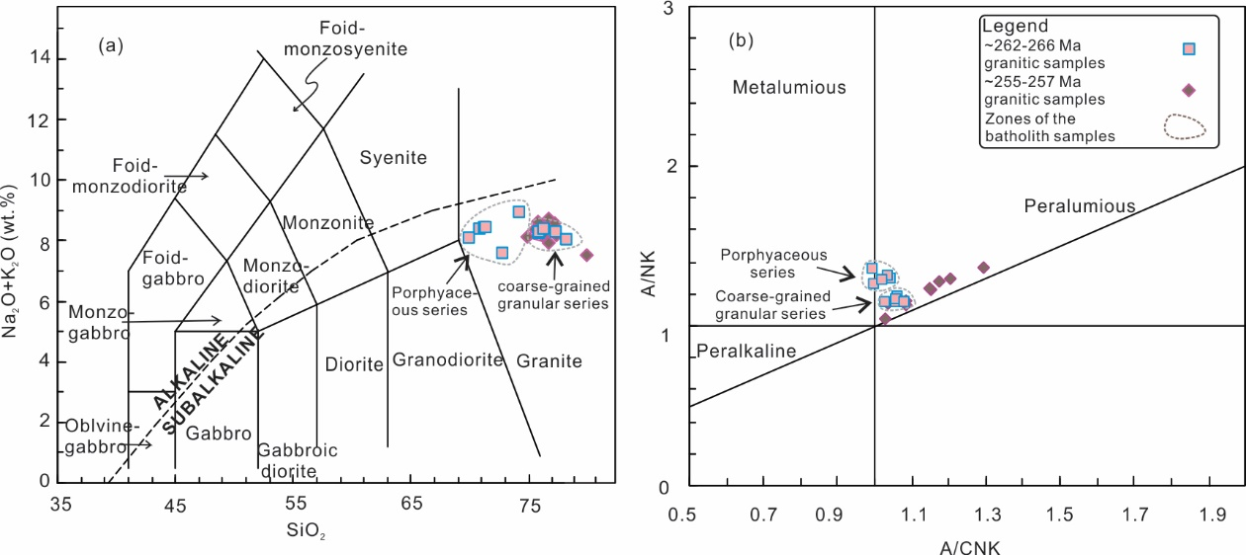
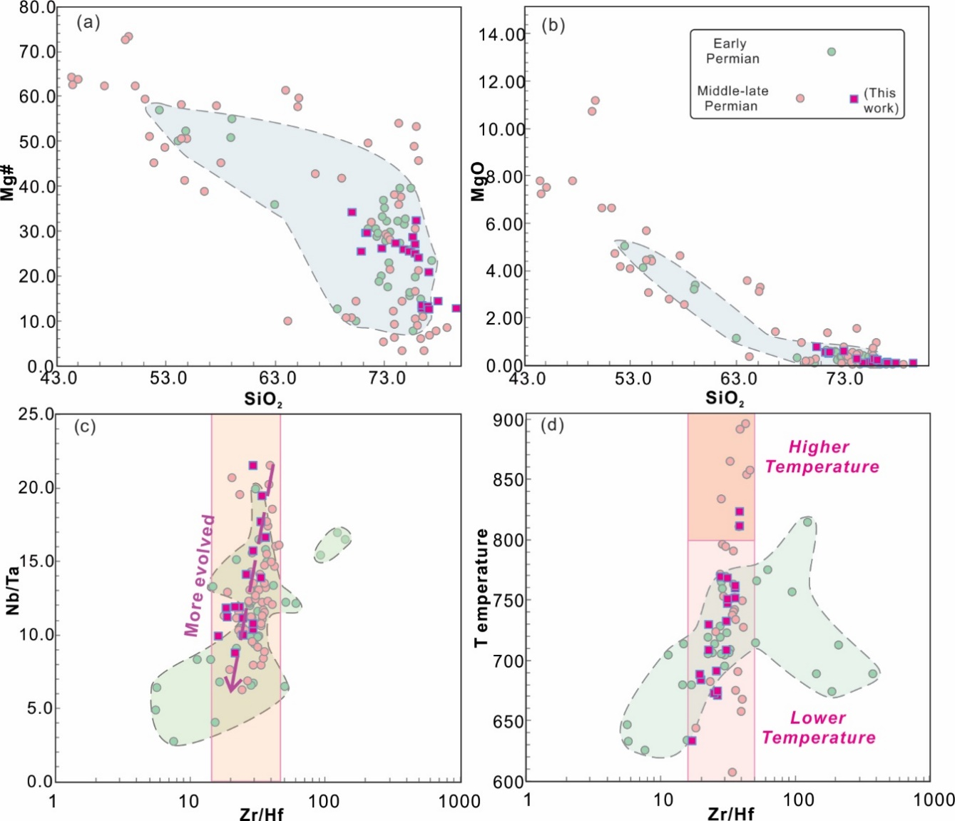
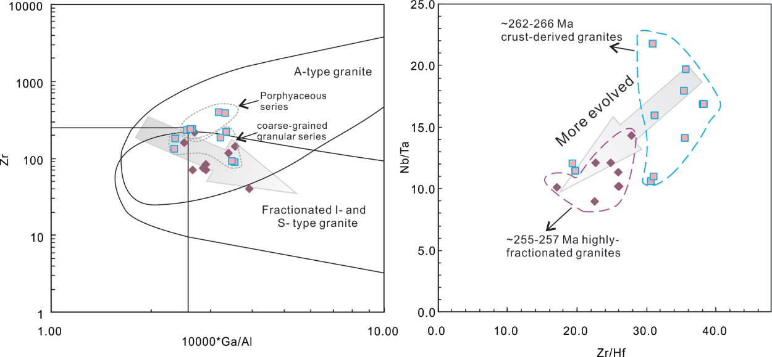
Petrogenesis & Geochemistry: High evolved features
Geochemical Features:
High evolved geochemistry enhanced with time: SiO₂ (>70 wt.%), low MgO (<0.5 wt.%).

Slide 7
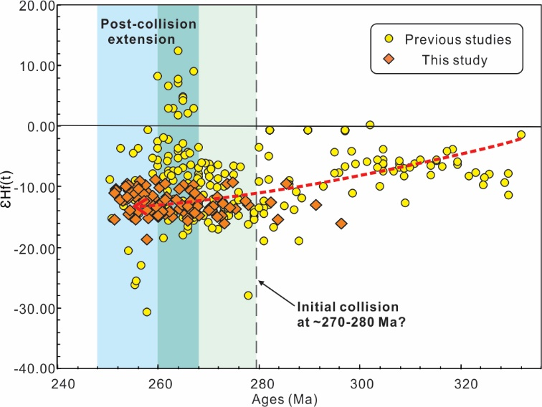
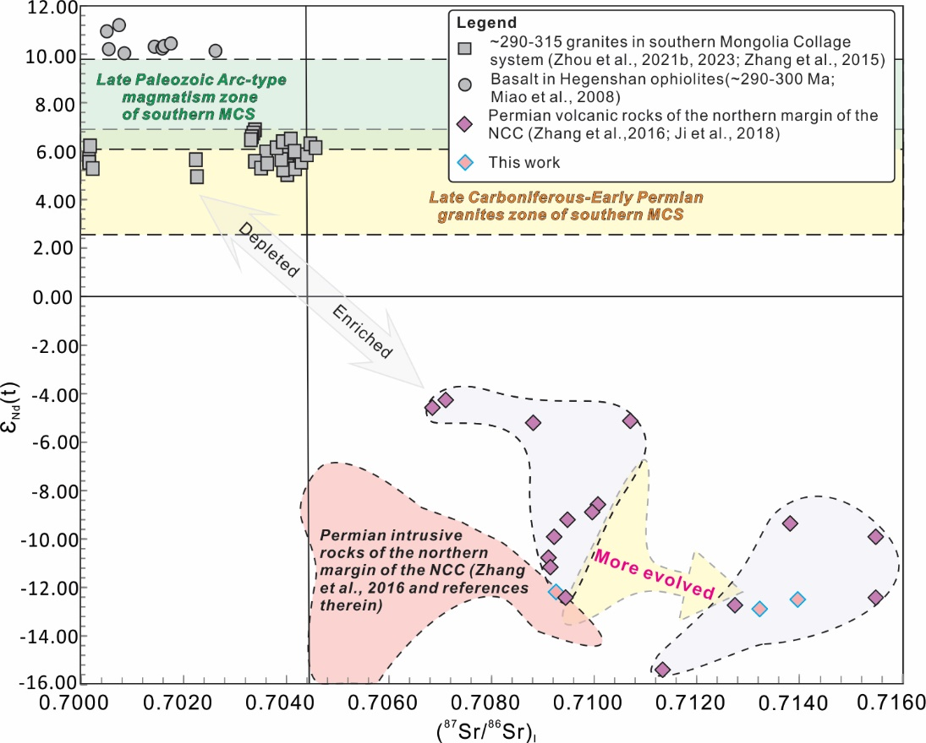
Petrogenesis & Geochemistry: Crust-Dominated Magma Sources
Geochemical Features:
Enriched Sr-Nd-Hf isotopes (ε_{Nd}(t)=-11.2~-13.8; ε_{Hf}(t)=-11.4~-15.9)

Slide 8
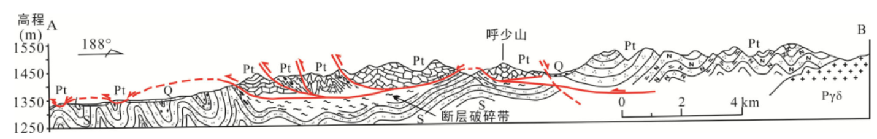
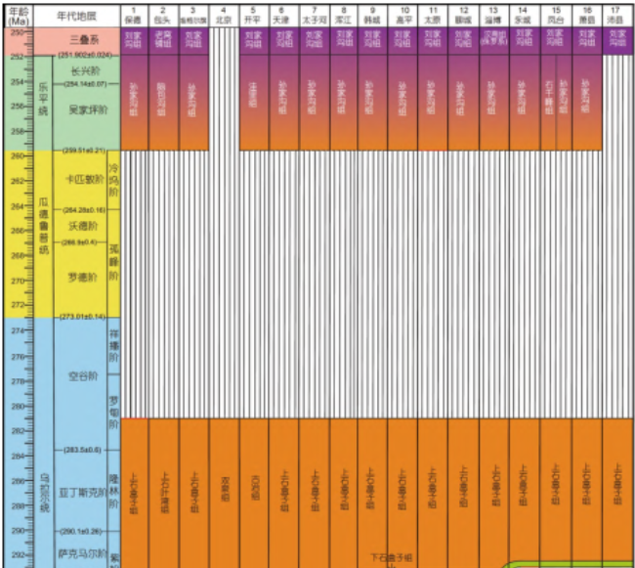
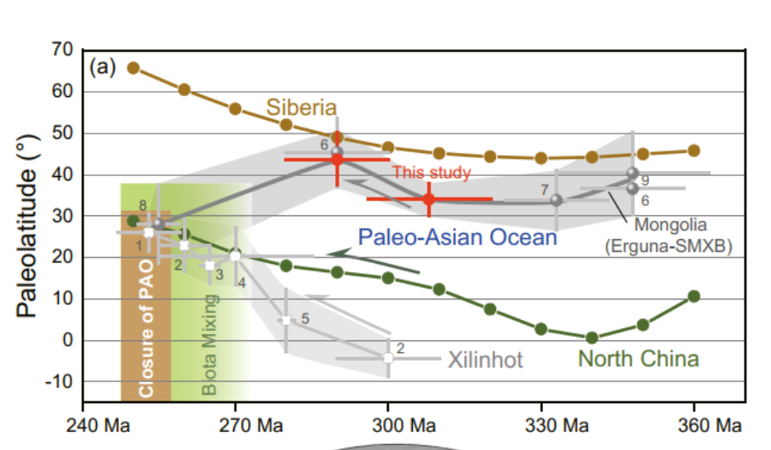
Tectonic Implications: Crustal Shortening During PAO Closure
Bainaimiao arc belt
North China Craton
NCC Proterozoic cover overthrusted onto Bainaimiao arc belt in Middle-late Permian, Zhou et al., 2018
260 Ma
？
280 Ma
Closer Paleolatitudes between NCC and CAOB, Zhang et al., 2021
Key Evidence:
1 Widespread Permian crustal reworking in NCC margin (This work)；
2 Coeval compressional structures (e.g., Bainaimiao thrust nappe)； 3 Closer Paleolatitudes between NCC and CAOB ；4, Stratigraphic shift with marine strata vanish post-260 Ma; 5 Marine Fauna mixing.
Sedimentary hiatus, Shen et al., 2022

Slide 9
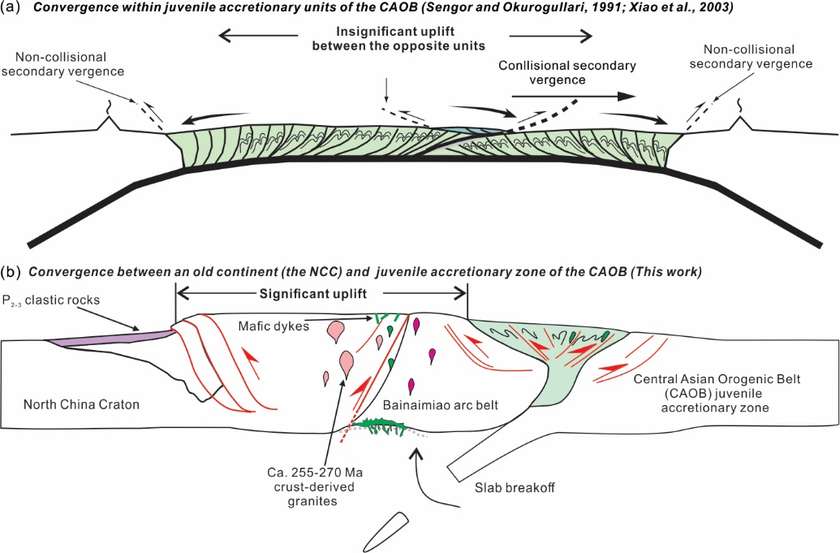
Differential Tectonic Styles: CAOB accretionary zone vs NCC margin
​CAOB Accretionary Zone:
Limited crustal shortening and thickening
Preserved pre-Carboniferous sequences
NCC Margin:
Intensive crustal contraction and uplift
Extensive middle-late Permian crust-derived magmatism

Slide 10
Summary
Key Results:
Widespread Middle-Late Permian crustal reworking occurred along the northern margin of the NCC;
PAO closure and related collision process are primary driver of this crustal shortening;
Different tectonic responses between CAOB accretionary zone and NCC margin.
In addition, we thank all our collaborators for supporting this research, and EGU for giving us this opportunity to show our work.

Slide 11
Thanks very much

