Slide 1


Prioritization and Interconnectivity Analysis of Critical Facilities for Volcanic Ash Risk Management in South Korea: An ANP Approach
29 March 2025
Yoo Jung Kim¹, Sungsu Lee², Byung Cheol Park¹, and Sanghoon Yoon¹
¹National Disaster Management Research Institute, South Korea
²Chungbuk National University, South Korea

Slide 2


Ⅰ
Introduction

Slide 3
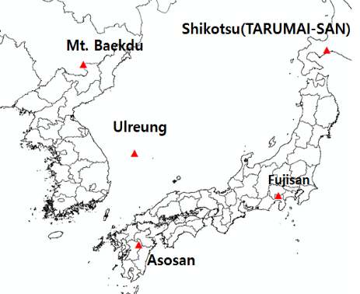
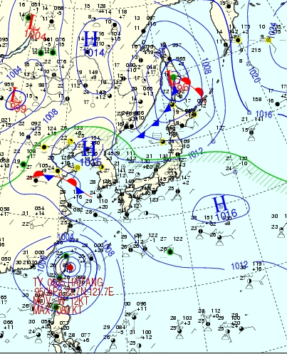
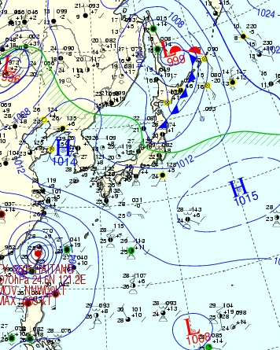
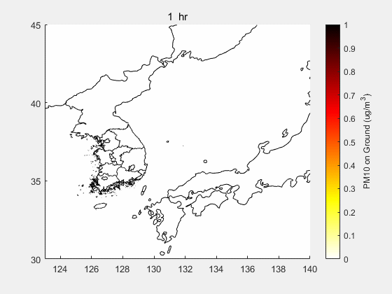

Background
Geographical environment
Volcanic Disaster Response Strategy
Volcanic eruptions can lead to complex, widespread disasters due to ash dispersion
South Korea faces potential impacts from remote volcanic eruptions due to geographical proximity to active volcanoes
Korea's volcanic disaster response system and policy are focused on mitigating volcanic ash damage
  Established volcanic disaster countermeasures by law
Improving strategies for potential volcanic ash hazards
Mt. Baekdu volcanic ash
2009.07.03
VEI=7 : 14.5% Chance of PM₁₀ (24hr) > 100ug/m³
Max PM10 (24hr mean) inside South Korea
2009.7.3 00:00
2009.7.3 12:00
Notes:
South Korea faces potential impacts from remote volcanic eruptions due to geographical proximity to active volcanoes
The Korean Peninsula has active volcanoes such as Mount Baekdu
the surrounding countries have hundreds of active volcanoes
VEI of 4 or higher, a total of 29 volcanoes, including Mount Baekdu, were estimated to pose a significant risk of causing widespread volcanicdisasters in the Korean Peninsula should an explosive eruption occu

Slide 4
Object and Content of Study
Object
Content of Study
The main goal is to analyze the importance and interconnectivity of various facility sectors affected by volcanic ash, utilizing the Analytic Network Process (ANP)
  To effectively mitigate the damage caused by volcanic ash, specific risk assessment by area must be carried out
  However, volcanic ash risk studies that reflect domestic realities are not sufficient for facilities, including infrastructure facilities
  To advance systematic volcanic ash risk research, an assessment of the importance and interconnectivity by area is warranted
Research Method
  Investigation of Cases of Volcanic Ash Damage
  The Process for ANP analysis
Facilities with Volcanic Ash Disaster Risk
  Analysis of Cases of Volcanic Ash Damage
  Areas of Facilities with Volcanic Ash Disaster Risk
Importance and Interconnectivity of the Areas of Facilities with Volcanic Ash Disaster Risk
  Building an ANP Analysis Network
  Expert survey
  Results of Importance and Interconnectivity Analysis
Conclusions & Future works

Slide 5
II
Research Method

Slide 6
Research Method
Investigation of Cases of Volcanic Ash Damage
Analytic Network Process (ANP)
Data Collection and Selection
  Data Sources : vHub database and Smithsonian GVP
  Investigated volcanic eruptions from 1900 to 2022
  Focused on events with VEI ≥ 3 causing significant ash fallout
Damage Classification
  Out of 3,727 eruption cases, 53.8% involved volcanic ash damage.
  1,652 cases were grouped damage into human, facility, and industrial categories
  Human damage was the largest in number
  Limited to facility damages to maintain focus on sectors critical for immediate disaster management
Overview of ANP
  ANP is a sophisticated network analysis tool to capture interdependencies among multiple factors.
  Developed by Thomas Saaty as an extension of AHP to model decision problems
  ANP captures feedback and mutual influence among decision elements, making it suitable for complex, interconnected systems like disaster management.
Application to This Study
  Enabled modeling of cascading effects between facility sectors under volcanic ash scenarios.
  Allowed prioritization of facility sectors based on their importance and degree of influence.

Slide 7
Research Method
The Process for Analyzing the Importance and Interconnectivity
① The correlations between the areas are examined
Considering that correlation review is a qualitative method
② A correlation-based analytical network was constructed
A network structure model was designed based on the correlations between areas
The questionnaire was structured to identify the importance and influence relationships between the areas for ANP analysis
④ Survey results were entered, and the importance and influence relationships were analyzed
The correlations between the areas were examined through a survey of experts on volcanic disasters
Using SuperDecisions v.3.2
③ A questionnaire for importance analysis was created and a survey was conducted

Slide 8
III
Facilities with Volcanic Ash Disaster Risk

Slide 9
Analysis of Cases of Volcanic Ash Damage
Cases of Volcanic Ash Damage
Large categories | Medium categories | Small categories | Frequency | Frequency(%)
Facility | Transportation | Roads | 20 | 8.2
 |  | Railways | 9 | 3.7
 |  | Ships | 1 | 0.4
 |  | Aviation | 124 | 50.8
 |  | Terminal | 0 | 0.0
 |  | Overall | 155 | 63.5
 | Infrastructure | Water Supply | 2 | 0.8
 |  | Electricity | 5 | 2.0
 |  | Gas | 0 | 0.0
 |  | Heat | 0 | 0.0
 |  | Broadcasting | 1 | 0.4
 |  | Oil | 0 | 0.0
 |  | Sewage | 3 | 1.2
 |  | Waste | 0 | 0.0
 |  | Water pollution | 7 | 2.9
 |  | Overall | 18 | 7.4
 | Public Facilities | Schools | 13 | 5.3
 |  | Public service building | 1 | 0.4
 |  | Cultural facilities | 6 | 2.5
 |  | Sports facilities | 0 | 0.0
 |  | Medical facilities | 2 | 0.8
 |  | Unclassified | 4 | 1.6
 |  | Overall | 26 | 10.2
 | Private facility | house | 45 | 18.4
 |  | Hotel | 0 | 0.0
 |  | Overall | 45 | 18.4
Overall |  |  | 243 | 100.0
Review of Historical Damage Cases
  Thorough review of global eruption records focusing on ash-related impacts
  Data filtered for relevance and intensity of impact
High-Frequency Damage Areas
  Aviation sectors showed the most frequent disruptions
  Significant damage also observed in housing infrastructure and road networks
Refinement of Categories
  Consolidated similar sectors to enhance analysis clarity
  Ensured sufficient data representation across categories for robust ANP application

Slide 10
Areas of Facilities with Volcanic Ash Disaster Risk
Large categories | Medium categories | Small categories | Frequency | Frequency(%)
Facility | Transportation | Roads | 20 | 8.2
 |  | Railways | 9 | 3.7
 |  | Ships | 1 | 0.4
 |  | Aviation | 124 | 50.8
 |  | Terminal | 0 | 0.0
 |  | Overall | 155 | 63.5
 | Infrastructure | Water Supply | 2 | 0.8
 |  | Electricity | 5 | 2.0
 |  | Gas | 0 | 0.0
 |  | Heat | 0 | 0.0
 |  | Broadcasting | 1 | 0.4
 |  | Oil | 0 | 0.0
 |  | Sewage | 3 | 1.2
 |  | Waste | 0 | 0.0
 |  | Water pollution | 7 | 2.9
 |  | Overall | 18 | 7.4
 | Public Facilities | Schools | 13 | 5.3
 |  | Public service building | 1 | 0.4
 |  | Cultural facilities | 6 | 2.5
 |  | Sports facilities | 0 | 0.0
 |  | Medical facilities | 2 | 0.8
 |  | Unclassified | 4 | 1.6
 |  | Overall | 26 | 10.2
 | Private facility | house | 45 | 18.4
 |  | Hotel | 0 | 0.0
 |  | Overall | 45 | 18.4
Overall |  |  | 243 | 100.0
Large categories | Medium categories | Small categories
Facility | Transportation | Roads
 |  | Railways
 |  | Ships and Ports
 |  | Aviation
 |  | Terminal
 | Infrastructure | Water Supply
 |  | Electricity
 |  | Gas
 |  | Heat
 |  | Broadcasting and Communication
 |  | Oil
 |  | Sewage
 |  | Waste
 |  | Water pollution
 | Public Facilities | Schools and educational establishment
 |  | Public service building
 |  | Cultural and sports facilities
 |  | Medical facilities
 | Private facility | House
 |  | Hotel

Slide 11
IV
Importance and Interconnectivity of the Areas of Facilities with Volcanic Ash Disaster Risk

Slide 12
Building an ANP Analysis Network
Identification of Key Interconnections
21 significant influence relationships were identified among the 12 facility sectors
  Moderate or strong influence (scoring 2.0 or above) for inclusion in the ANP analysis
  Relationships validated through pre-screening expert survey
The elements on the left side of the matrix influence the elements at the top.
The degree of influence is indicated as 3 (strong influence), 2 (moderate influence), 1 (weak influence), or 0 (no influence).
Notes:
Identified transportation (aviation, ships/ports), infrastructure (electricity), and public facilities (broadcasting/ communication, medical) as the highest-risk areas, with aviation ranked most critical due to its sensitivity to airborne ash.
Analysis revealed strong interdependencies: electricity failures significantly impact broadcasting, medical, and railway services; medical facilities are highly vulnerable to disruptions in roads, water, and electricity.
도로(5) : 철도, 선박 및 항만, 항공, 공공청사, 의료시설
철도(1) : 선박 및 항만
상수도(2) : 공공청사, 의료시설
전기(11) : 도로, 철도, 선박 및 항만, 항공, 상수도, 방송 및 통신, 하수도, 학교 및 교육시설, 공공청사, 문화 및 체육시설, 의료시설
방송 및 통신(2) : 항공, 공공청사

Slide 13
Building an ANP Analysis Network
Network Construction
Created a comprehensive network model to capture sectoral interdependencies for the ANP analysis
  3 medium categories and 12 small categories
A network syntax was created reflecting these influence relationships for ANP analysis
  ex. electricity had a strong ripple effect, influencing all other sectors
  A network syntax was built using SuperDecisions v.3.2
< Network syntax for ANP analysis of volcanic ash risk to facilities >
Notes:
In the form of a square matrix, the elements on the left side of the matrix influence the elements at the top.
If a 'number' is displayed in a cell, it indicates the degree to which the element on the left of the cell affects the element at the top of the cell.
The degree of influence is indicated as 3 (strong influence), 2 (moderate influence), 1 (weak influence), or 0 (no influence).

Slide 14
Expert survey
Survey Content
  Assessed both importance and influence between facility sectors
  Scenario: South Korea is affected by volcanic ash that is emitted into the atmosphere and deposited on the ground in quantities of several centimeters resulting from VEI 4 or higher eruptions
Survey Respondent Profile
  8 experts from universities, national research institutes, and private engineering firms
Data Reliability Validation
  Consistency Ratio (CR) for all surveys below 0.1
  Ensured high-quality, reliable prioritization data
Notes:
In the form of a square matrix, the elements on the left side of the matrix influence the elements at the top.
If a 'number' is displayed in a cell, it indicates the degree to which the element on the left of the cell affects the element at the top of the cell.
The degree of influence is indicated as 3 (strong influence), 2 (moderate influence), 1 (weak influence), or 0 (no influence).
Scenario: South Korea is affected by volcanic ash that is emitted into the atmosphere and deposited on the ground in quantities of several centimeters or more as a result of massive eruptions (VEI 4 or higher) from volcanoes on the Korean Peninsula and its surrounding regions.

Slide 15
Results of Importance and Interconnectivity Analysis
Results of Importance Analysis
Medium Category Rankings
  Transportation facilities scored highest in importance (0.509), Infrastructure (0.354) followed by Public Facilities (0.137)
Small Category Insights
  Aviation within transportation was the highest individual priority (0.246)
  Electricity (0.117) and Broadcasting & Communication (0.110) were critical among infrastructure

Slide 16
Results of Importance and Interconnectivity Analysis
Results of Interconnectivity Analysis
Broad Ripple Effects of electricity
  All other sectors, especially broadcasting, medical, and railway sectors
Medical Facility Vulnerability
  Highly sensitive to disruptions in road access, water supply, and electricity
Disaster Management Implications
  Necessity of integrated, cross-sectoral disaster response plans
  Special focus on safeguarding electricity and medical services to maintain societal functions

Slide 17
Ⅴ
Conclusions & Future works

Slide 18
Conclusions & Future works
Conclusions
Critical sectors: Aviation, Electricity, Broadcasting & Communication, Medical Facilities
Aviation most vulnerable due to atmospheric ash dispersion
  the sensitivity of flight operations to even small amounts of atmospheric ash
Electricity damage leads to cascading failures
  ripple effects across multiple facility types, illustrating its foundational role in maintaining sector-wide functionality
Medical facilities were highly vulnerable to cascading impacts from other sectors
Future works
Improvement of national strategies and countermeasures for volcanic ash damage mitigation, including updates to disaster response manuals
Enhancement of preparedness and response capabilities in the electricity and broadcasting/communication sectors
  relatively overlooked in existing disaster management systems

Slide 19
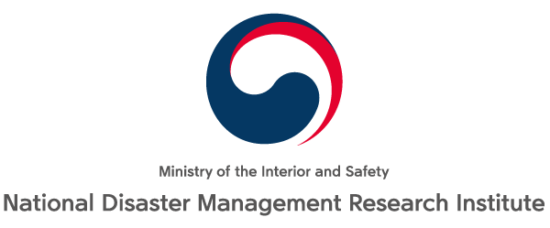
Thank you for your attention

