Slide 1
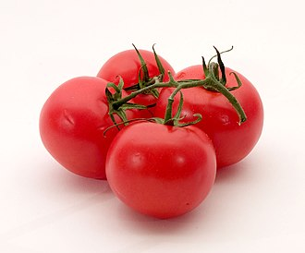
Quantifying Climate Impact on Tomato Production in Central India: A Process-Based Yield Simulation for Near and Mid-Future Scenarios
Pashupati Nath Singh and Prashant K Srivastava
Remote Sensing Laboratory, Institute of Environment and Sustainable Development, Banaras Hindu University, Varanasi, Uttar Pradesh, India
Email: pashupati1110@bhu.ac.in; Mob No: +919984805858
Supplementary Materials
User ID 778438

Slide 2
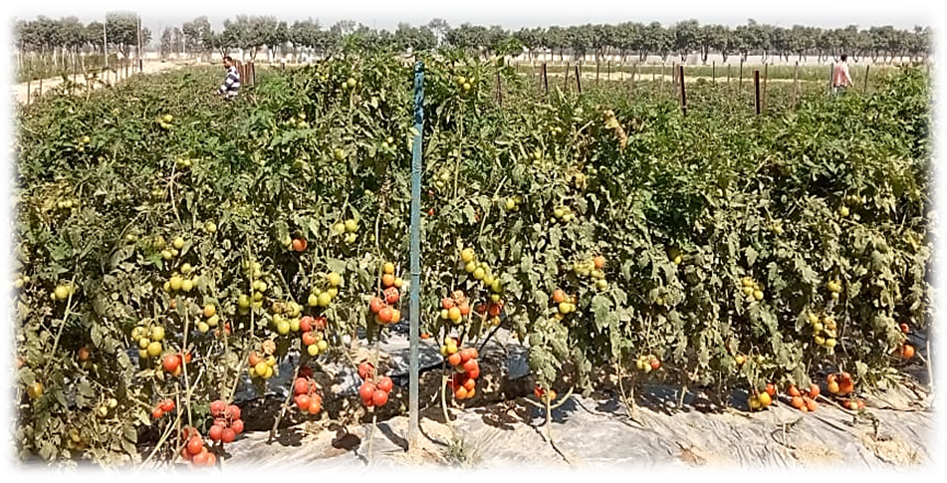
Tomato genotype NDT-4 (Narendra Tomato-4) has been used in this study, and the variety was developed at Narendra Dev Agricultural University, Narendra Nagar, Faizabad (Ayodhya), Uttar Pradesh.
Temperatures ranging from 21 to 24°C produce the finest fruit colour and quality.
Irrigation intervals depends upon soil type and rainfall, irrigation occurs every 7-8 days and more frequent in case of drip irrigation system.
Figure S1- Overview of Tomato field, staking is done by laying overhead wires to which individual plant is tied.
Harvesting depends on the variety, fruits become ready for first picking in about 60-70 days after transplanting.

Slide 3
Table T1: Genetic Coefficients for CROPGRO-Tomato Model Before and After Calibration (Tomato NDT-4 Variety)
Parameter | Symbol | Before Calibration (Default or Literature Value) | After Calibration (Optimized for NDT-4, Central India) | Description
Thermal time from emergence to end of juvenile phase (°C days) | P1 | 210 | 180 | Controls duration of vegetative growth
Photoperiod sensitivity (h) | P2 | 0.50 | 0.20 | Sensitivity to day length; low for tomato
Thermal time from flowering to maturity (°C days) | P5 | 600 | 550 | Duration between flowering and fruit maturity
Maximum photosynthesis rate (µmol CO₂/m²/s) | G1 | 45 | 40 | Max leaf photosynthesis under optimal conditions
Potential fruit number per unit leaf area (fruits/cm²) | G2 | 2500 | 2000 | Number of fruits per leaf area unit
Maximum individual fruit weight (g) | G3 | 100 | 90 | Potential size of mature fruit
Phyllochron interval (°C days/leaf) | PHINT | 50 | 45 | Thermal time between appearance of successive leaves
The calibrated model showed improved agreement with observed flowering dates and yields (~5–10% error).
Slightly reduced P1 and P5 helped capture the faster crop development observed under warm Rabi season conditions.
Adjusted G2 and G3 values better represented local fruit size and fruit count.

Slide 4
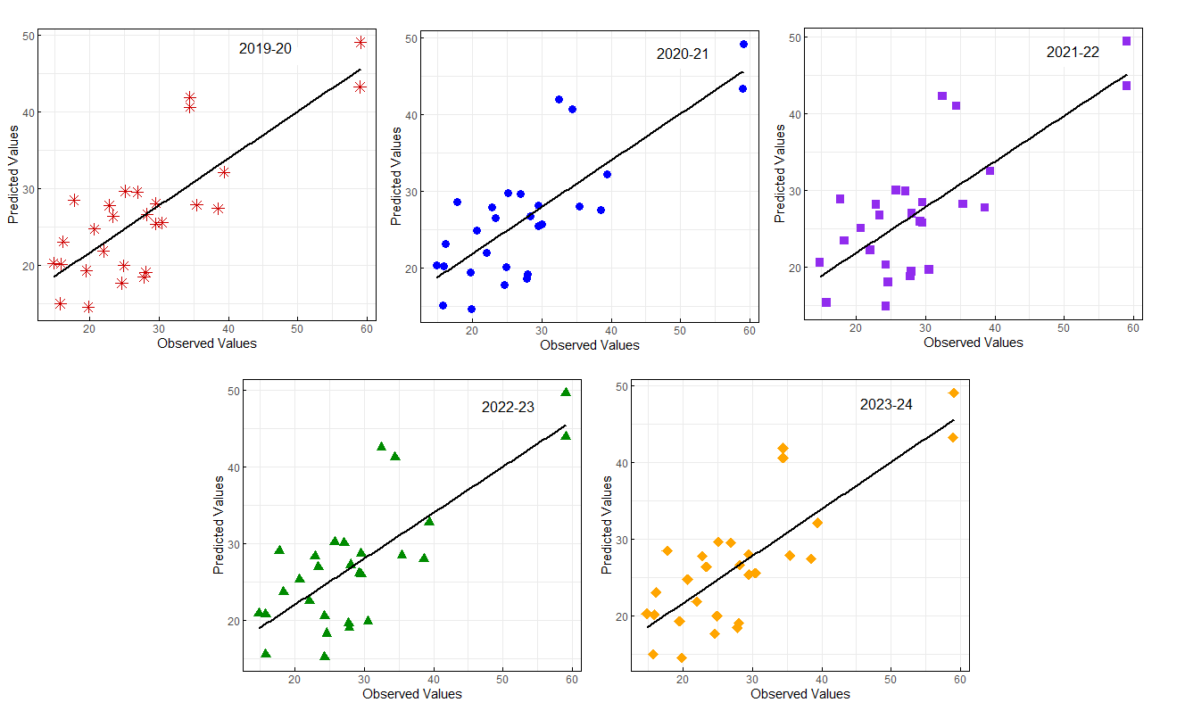
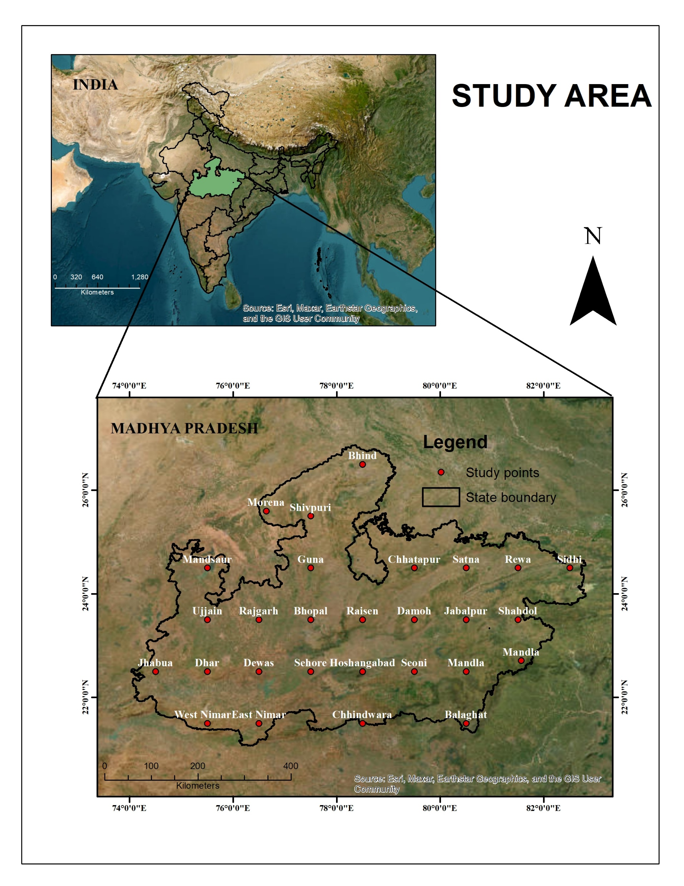
STUDY AREA
Figure S2 - Model performance Matrix for observed yield data (2019-20 to 2023-24).
The study area of research includes the entire Madhya Pradesh (MP) state, located between 74.03°E, 82.81°E longitudes and 26.86°N, 21.07°N latitudes.
Figure S3 - Location map of the study area

Slide 5
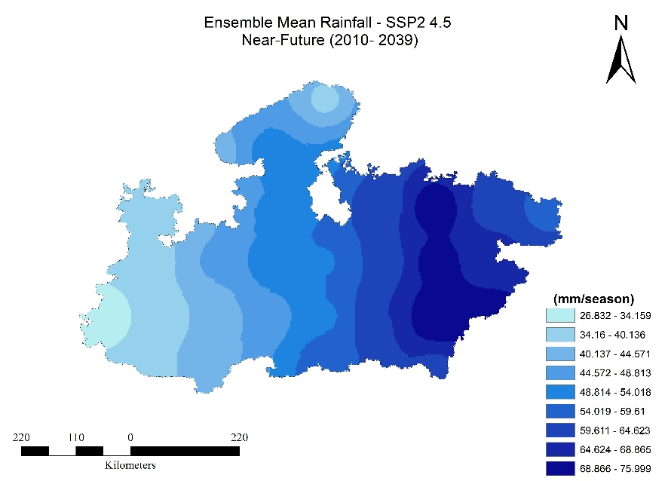
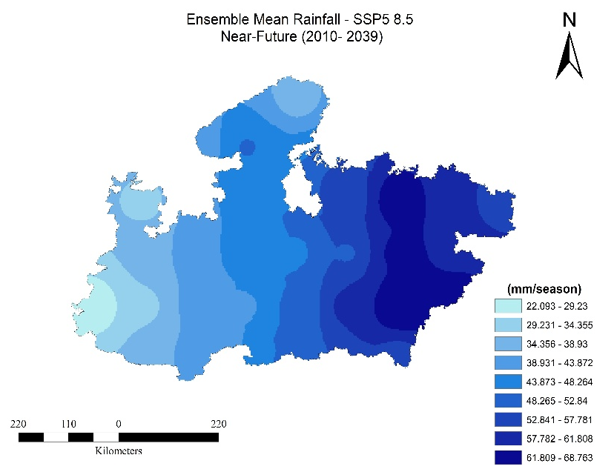
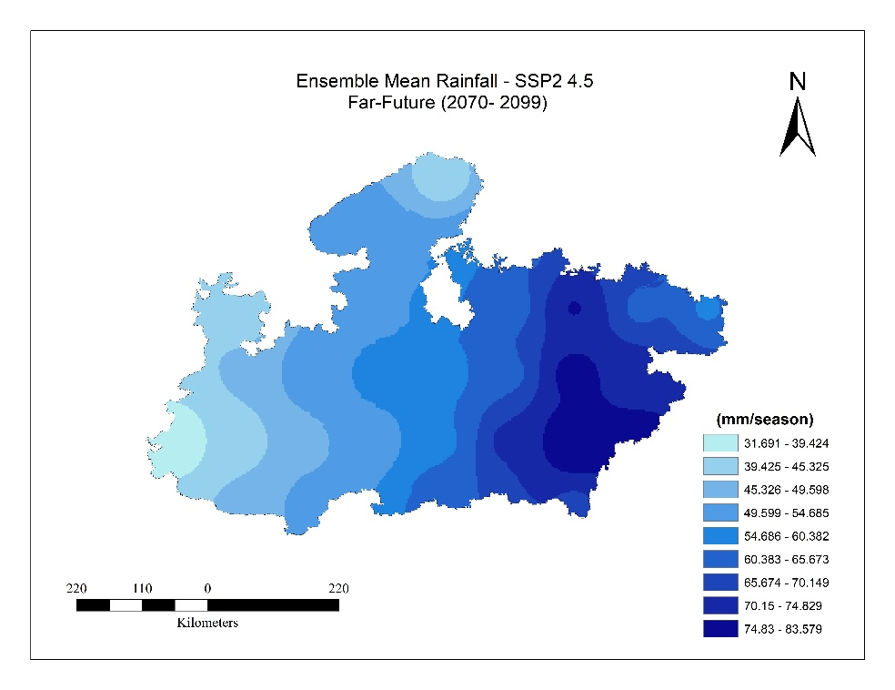
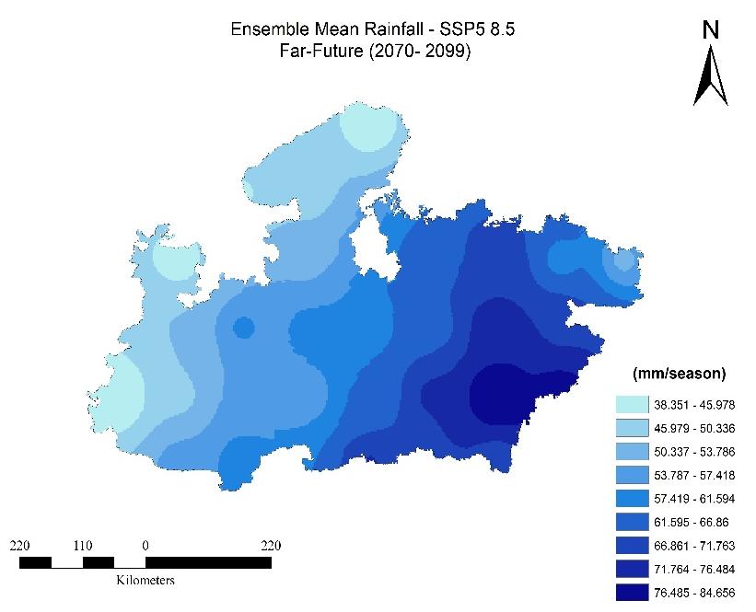
Variation in Mean Rainfall

Slide 6
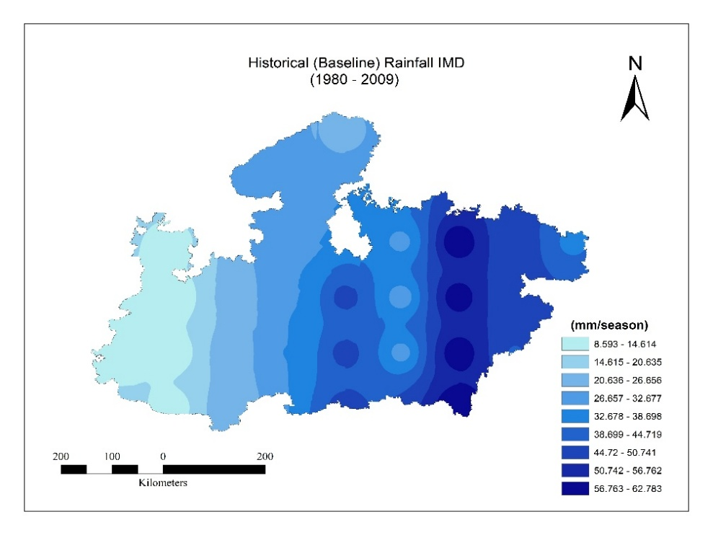
Figure S4- Spatial distribution of historical (1980–2009) and projected rainfall (mm/season) under SSP2-4.5 and SSP5-8.5 scenarios for near future (2010–2039) and mid future (2040–2069).
Variability in mid-season rainfall affects fruit-setting processes. Increased rainfall during this phase may reduce fruit quality due to excessive vegetative biomass allocation at the expense of reproductive growth. Drier mid-season conditions may accelerate fruit ripening but reduce fruit size and marketable yield.

Slide 7
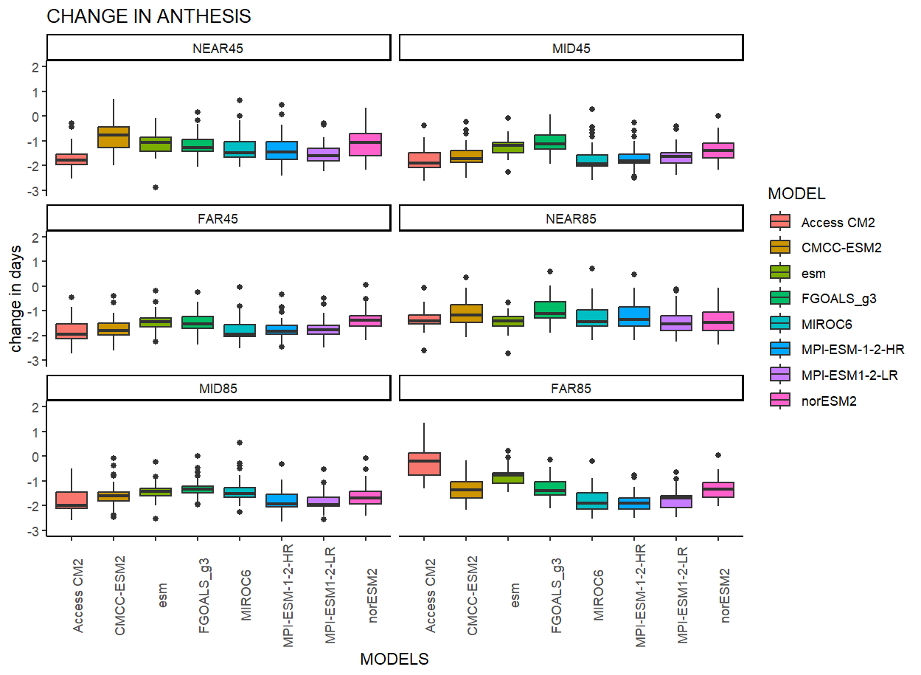
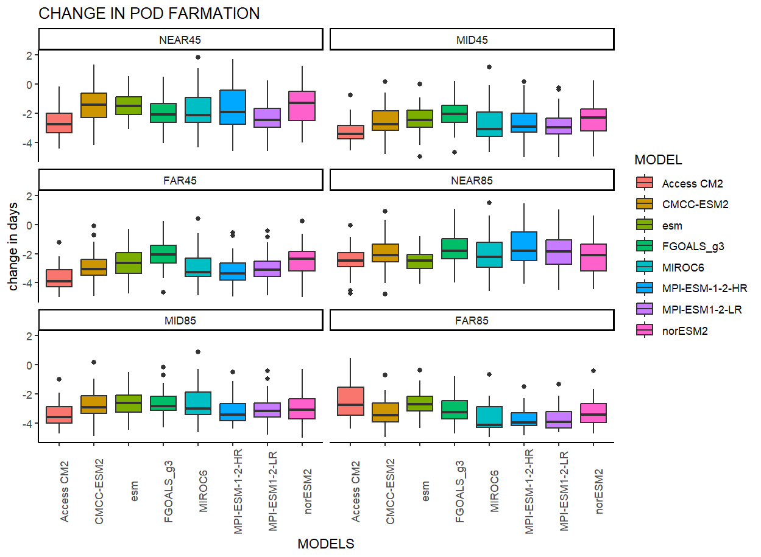
Change in days of Anthesis and Pod (Fruits) formation
(a)
(b)
Figure S5 - Simulated change in phenological stages (a) change in days of Anthesis (b) change in Pod (fruit) formation compared with baseline 1980–2009 in 2010–2039 (near-future) and mid-future (2040–2069) under SSP2 4.5 and SSP5 8.5 using different climate models for MP, India.

Slide 8
Acknowledgement
The first author gratefully acknowledges the Council of Scientific and Industrial Research (CSIR), Government of India, for providing Senior Research Fellowship (SRF) support. The authors also expresses sincere thanks to the Institute of Environment and Sustainable Development (IESD), Banaras Hindu University (BHU), Varanasi, for the research facilities and academic guidance. This work is presented at the European Geosciences Union (EGU) General Assembly 2025.

