Slide 1
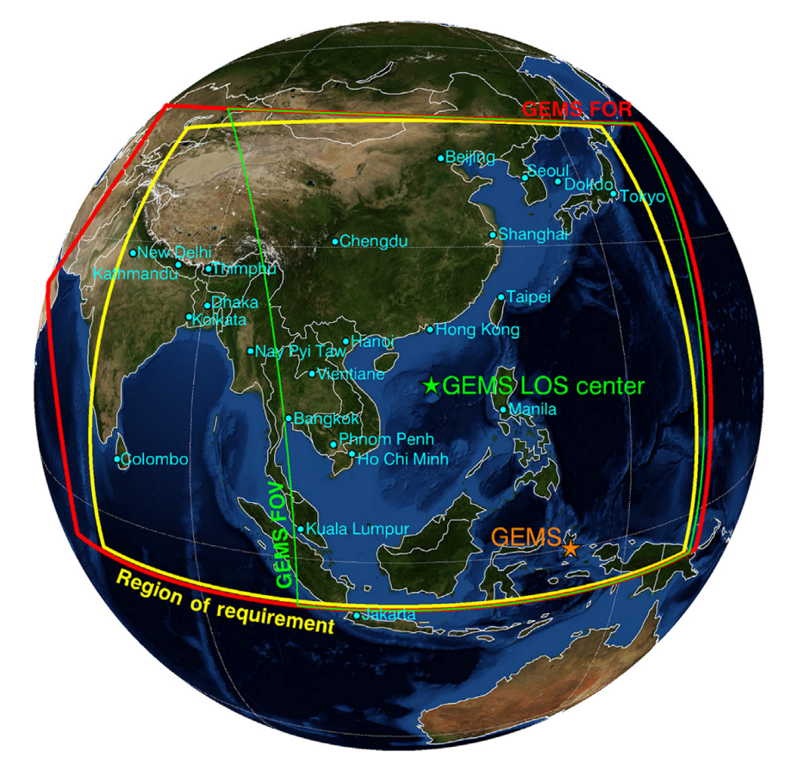
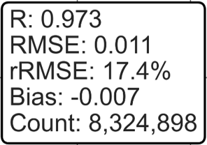
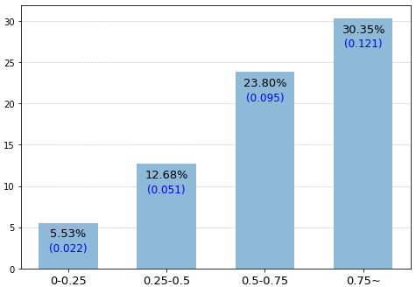
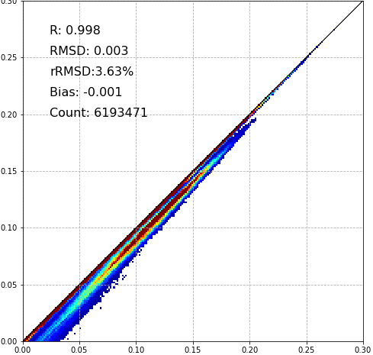
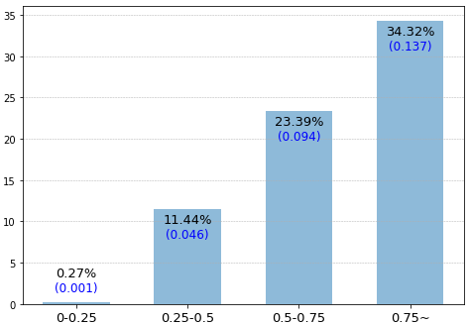
Evaluation of the Impact of NO₂ in Atmospheric Correction for Surface Reflectance Estimation
[ Seungwon Kim¹ • Kyung-soo Han^{1, †} ]
¹ Division of Earth Environmental Science (Major of Spatial Information Engineering), Pukyong National University, Busan, Republic of Korea
† Professor, Division of Earth Environmental Science (Major of Spatial Information Engineering), Pukyong National University, Busan, Republic of Korea
Introduction
Study area & Materials
Surface reflectance is the intrinsic reflectance of the Earth’s surface, derived by considering atmospheric scattering and absorption from Top-Of-Atmosphere (TOA) radiance using a Radiative Transfer Model (RTM). It plays a vital role in satellite-based environmental monitoring, supporting applications such as land surface analysis and atmospheric product generation. Traditionally, atmospheric correction algorithms have focused on aerosol effects and geometry, often overlooking the impact of trace gases like nitrogen dioxide (NO₂) due to the assumption that their influence is negligible.
However, recent studies challenge this notion. NO₂ exhibits strong absorption in the visible spectrum, and its spatio-temporal variability is especially significant in urban and industrial areas. As demand for accurate surface reflectance grows, incorporating NO₂ into atmospheric correction has drawn increasing interest.
In this study, we investigate the impact of NO₂ on surface reflectance retrieval using data from the GK-2B Geo-stationary Environment Monitoring Spectrometer (GEMS). Atmospheric correction was performed using VLIDORT, a vector radiative transfer model, and lookup tables (LUTs) were generated with and without NO₂ absorption.
The findings of this study may contribute to enhancing the accuracy of surface reflectance retrieval, which in turn can improve the quality of satellite-derived products such as Aerosol Optical Depth (AOD). This improvement could play a meaningful role in advancing air quality assessments and fine particulate matter (PM10, PM2.5) monitoring, particularly in urban and industrial regions.
Study Area : GEMS Field Of Requirement (yellow box)
Study Period : 2024.09.15 – 2024.09.30
Input data
GEMS L1C Radiance data (440nm)
TSIS-1 HSRS (Hybrid Solar Reference Spectrum) Irradiance Data
GEMS L1C Geometric angle data (SZA, SSA, VZA, VAA)
GEMS L1C Terrain height data (DEM), Land Sea mask
GEMS AOD (Aerosol Optical Depth), SSA (Single Scattering Albedo) data (550 nm)
GEMS Aerosol Type data
GEMS ECF (Effective Cloud Fraction) data
ECF ≥ 0.2 → masked as cloud / ECF < 0.2 → masked as clear
GEMS O3T (Total Column Ozone) data
GEMS NO₂ VCD data
< Region of requirement (yellow box) for the
GEMS Source : Choi et al., 2019 >
Methodology & Result
Comparative Analysis – With vs. Without NO₂
TOC reflectance was retrieved using two LUTs : with and without NO₂ consideration
The resulting ΔTOC was analyzed to assess NO₂ sensitivity, and the scatter plot showed correlation coefficient(R=0.998), RMSD(0.003), rRMSD(3.63%), and Bias(-0.001).
The difference map (upper-right) demonstrates spatial variations in TOC reflectance, showing notable increases (red) over regions with high NO₂ concentration like Eastern China, and slight decreases (blue) in other areas, implying the impact of NO₂ on atmospheric correction.
Bu using the transformation function proposed by Li et al. (2012), AOD percentage error was calculated to demonstrate how incorporating NO₂ in atmospheric correction can lead to changes in satellite derived products like AOD.
The results indicate that considering NO₂ during atmospheric correction affects TOC reflectance retrieval, particularly in regions with high NO₂ levels, although its incorporation does not necessarily guarantee the improvement in accuracy.
Atmospheric Correction Coefficients calculation (LUT creation using VLIDORT)
VLIDORT (Vector Linearized Discrete Ordinate Radiative Transfer Model) was used to simulate Top-Of-Atmosphere (TOA) radiance and to generate lookup tables (LUTs).
Three aerosol type modes were used : HAF(High Absorbing Fine) / Dust / NA(Non-Absorbing)
The LUTs were created by varying 8 key parameters : SZA, RAA, VZA, O₃, AOD, DEM + SSA, NO₂
Due to the characteristics of LUT, discontinuity occurs depending on the interval.
→ The coefficients were interpolated based on 8-d interpolation method.
LUT construction using VLIDORT
(SZA, RAA, VZA, O₃, DEM, AOD + SSA, NO₂)
Comparison of results with/without NO₂
Difference map (TOC reflectance with NO₂ vs. without NO₂)
< Workflow of atmospheric correction considering NO₂ >
TOC Reflectance retrieval
Using the VLIDORT generated LUTs, TOC reflectance was calculated.
An 8D interpolation scheme was applied to reflect full angular and trace gas variability.
AOD percentage error (AOD = 0.4)
Original TOC reflectance
$$Surface reflectance=\frac{xap×TOA reflectance−xb}{1+xc×(xa×TOA reflectance−xb)}$$
※ $xa$, $xb$, $xc$ are the coefficients for atmospheric correction
NO₂ VCD (DU)
NO₂ applied TOC reflectance
NO₂ Concentration during study period
Acknowledgment
※ This research was supported by Particulate Matter Management Specialized Graduate Program through the Korea Environmental Industry & Technology Institute(KEITI) funded by the Ministry of Environment(MOE).
[European Geosciences Union General Assembly 2025, Vienna, Austria & Online, 27 April – 2 May 2025]

