Slide 1




Application of Radon-Deficit Technique for Site Characterization and Machine Learning Integration: Case Studies and Emerging Insights
Fernando Barrio-Parra*, David Lorenzo Fernández, Alessandra Cecconi, Humberto Serrano-García, Miguel Izquierdo-Díaz and Eduardo De Miguel
* fernando.barrio@upm.es
Acknowledgements:
This study was funded through the CARESOIL–CM [TEC-2024/ECO-69] and the agreement-subvention for the encouragement and promotion of research and technology transfer at the Universidad Politécnica de Madrid, in Line A, Emerging Doctors ML-TRACER [DOCTORES-EMERGENTES-24-FL6X] funded by the Regional Government of Madrid (Comunidad de Madrid).

Slide 2
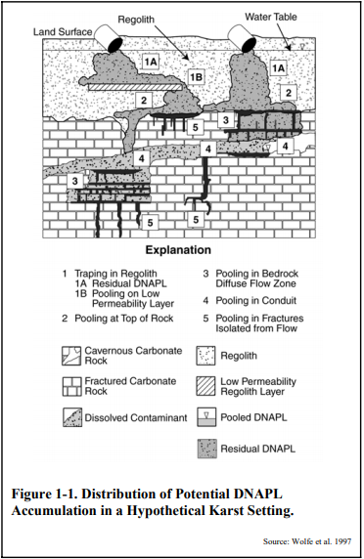
Introduction
Site characterization is the basis for all decisions on the environmental status of a potentially contaminated site.
Uncertainties could raise the cost of monitoring and remediation programs.
Screening methods could be very useful tools in order to locate pollution hotspots and optimize intrusive sampling campaigns.
USEPA 2004. Site Characterization Technologies for DNAPL investigations.
https://doi.org/10.5194/egusphere-egu25-5524

Slide 3
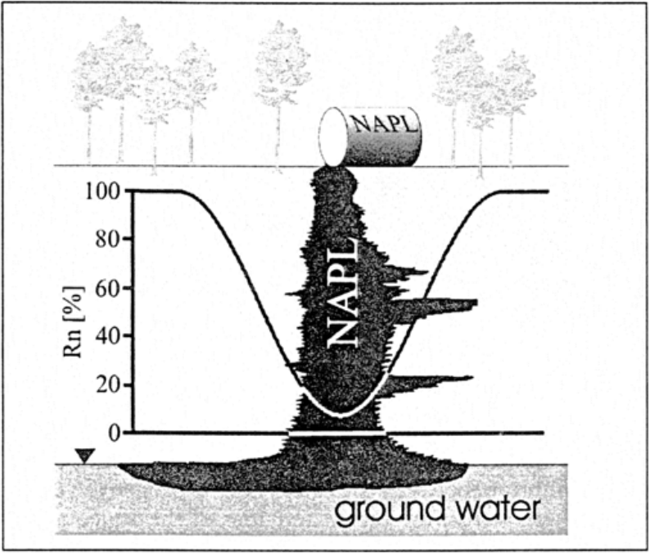
The ²²²Rn Deficit technique (RDT)
²²²Rn omnipresent in soil and groundwater.
Easily detectable in situ.
Preferential partitioning with organic phases.
Spatial representation of vadose zone ²²²Rn activity → location of pollution hotspots.
Schubert et al. 2001.
Journal of Soils and Sediments
García-Gonzalez et al. 2008. Applied Geochemistry

Slide 4
Objectives:
Temporal variability of background Rn signal
Influence of environmental parameters
Field validation as a screening method
Applicability of radon deficit Technique

Slide 5

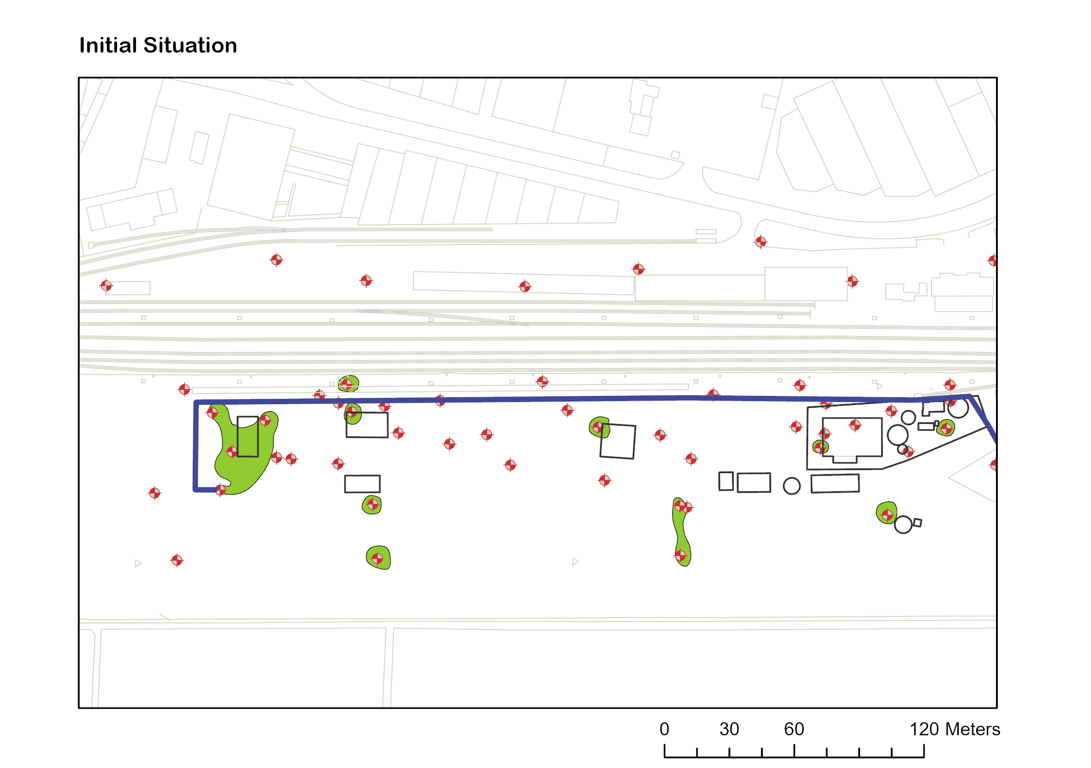
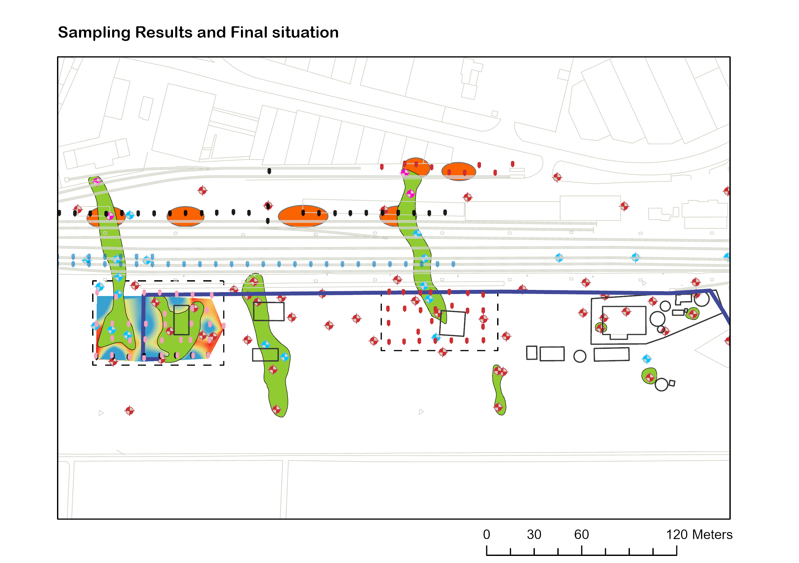
Field results: Case Study#1
New boreholes had been installed after identifying potential hotspots of DNAPL with RDT
The method made it possible to identify migration routes to an industrial area that was not initially considered.

Slide 6
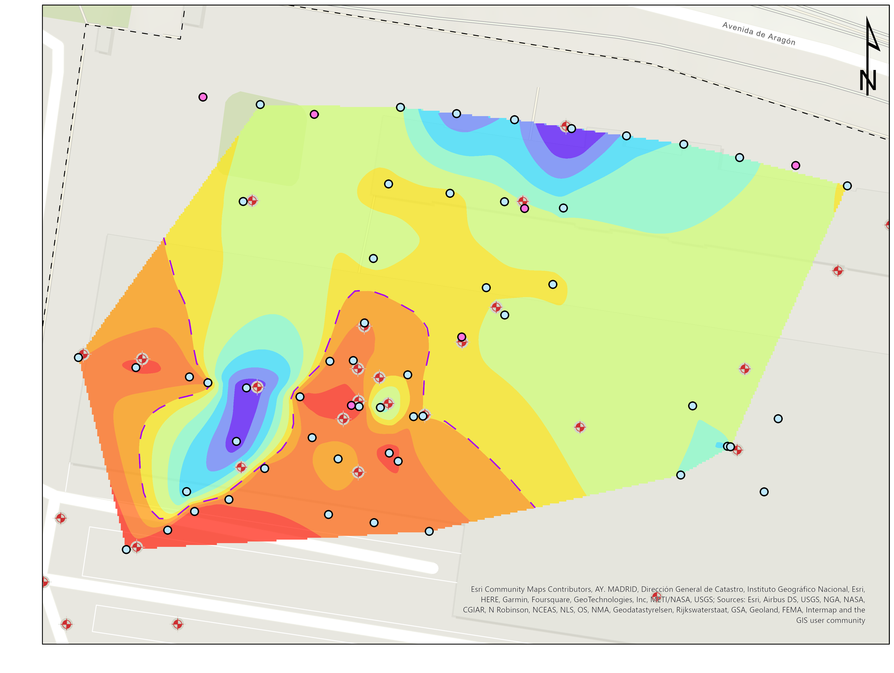
Field results: Case Study#2
(1) New boreholes had been installed after identifying potential hotspots of LNAPL with RDT.
(2) Plume extension have been confirmed (high Rn activities match with the absence of LNAPL)
2
1

Slide 7
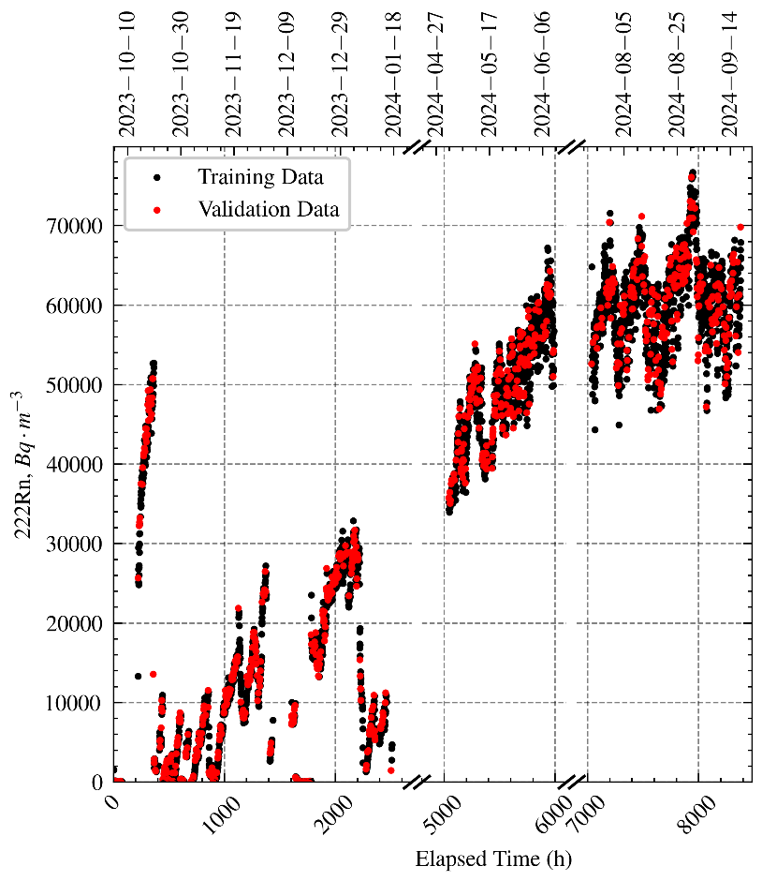
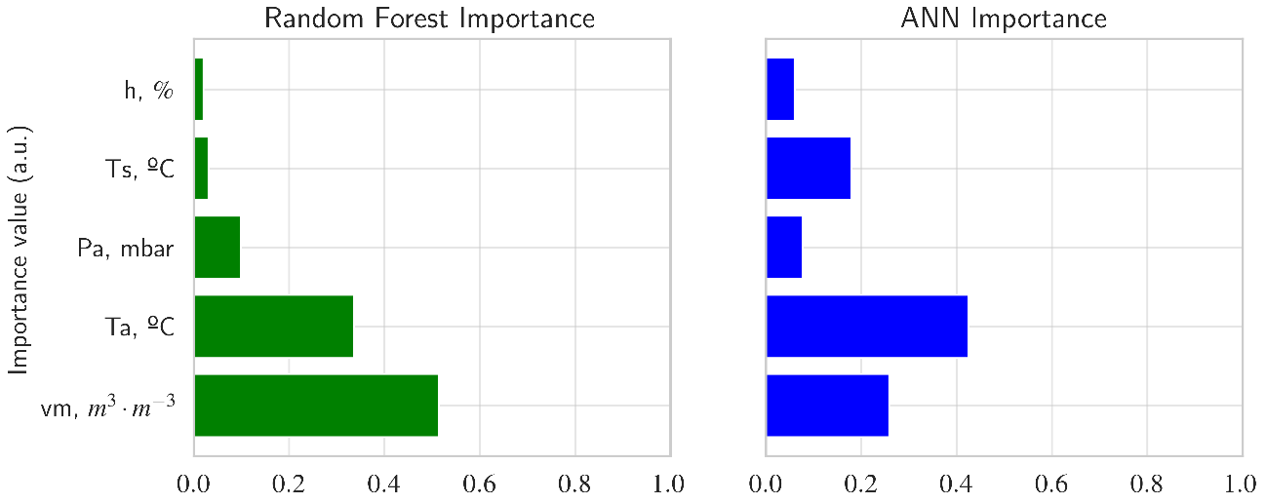
Temporal variability of ²²²Rn Background activity and influence of environmental conditions
²²²Rn activity data were collected at a site unaffected by NAPL for one year, monitoring atmospheric and soil parameters.
Machine Learning methods allowed the prediction of ²²²Rn activity, identifying atmospheric temperature and soil moisture as the most important parameters in its variability.

Slide 8
Emerging Insights:
The radon deficit technique has been tested in various sites with different contaminants, including DNAPLs and LNAPLs.
The method has successfully identified contamination hotspots and aided in delineating contaminant plumes.
It has proven useful for optimising intrusive sampling strategies.
Machine learning techniques applied to time series data have identified the key environmental variables influencing signal variability.
The technique is now ready for the development of methodological guidelines for its implementation in contaminated land consultancy procedures.
As a screening tool, it can enhance both site characterisation and remediation monitoring processes.
Acknowledgements:
This study was funded through the CARESOIL–CM [TEC-2024/ECO-69] and the agreement-subvention for the encouragement and promotion of research and technology transfer at the Universidad Politécnica de Madrid, in Line A, Emerging Doctors ML-TRACER [DOCTORES-EMERGENTES-24-FL6X] funded by the Regional Government of Madrid (Comunidad de Madrid).

Slide 9
Some Related works:
Barrio-Parra, F., Hidalgo, A., Izquierdo-Díaz, M., Arévalo-Lomas, L., De Miguel, E. (2022). 1D_RnDPM: A freely available 222Rn production, diffusion, and partition model to evaluate confounding factors in the radon-deficit technique. Sci. Total Environ. 807, 150815. https://doi.org/10.1016/j.scitotenv.2021.150815
Barrio-Parra, F., Izquierdo-Díaz, M., Díaz-Curiel, J., De Miguel, E. (2021). Field performance of the radon-deficit technique to detect and delineate a complex DNAPL accumulation in a multi-layer soil profile. Environ. Pollut. 269, 116200. https://doi.org/10.1016/j.envpol.2020.116200
Cecconi, A., Verginelli, I., Baciocchi, R. (2024). Assessing Light Non-Aqueous Phase Liquids in the Subsurface Using the Soil Gas Rn Deficit Technique: A Literature Overview of Field Studies. Sustainability 16(8), 3317. https://doi.org/10.3390/su16083317
Cecconi, A., Verginelli, I., Barrio-Parra, F., De Miguel, E., Baciocchi, R. (2023). Influence of advection on the soil gas radon deficit technique for the quantification of LNAPL. Sci. Total Environ. 875, 162619. https://doi.org/10.1016/j.scitotenv.2023.162619
De Miguel, E., Barrio-Parra, F., Izquierdo-Díaz, M., Fernández, J., García-González, J.E., Álvarez, R. (2020). Applicability and limitations of the radon-deficit technique for the preliminary assessment of sites contaminated with complex mixtures of organic chemicals: A blind field-test. Environ. Int. 138, 105591. https://doi.org/10.1016/j.envint.2020.105591

