Slide 1

Landslide topography interpretation technology using deep learning research on improvement
Prior studies for the 2025 EGU publication
Presentation materials for my doctoral thesis.
The repository for the thesis can be accessed using the QR code below.
Hirokazu FURUKI
Research & Development Center NIPPON KOEI CO.,LTD

Slide 2
Chapter1
Conception, first try, and verification

Slide 3
Introduction to AI (deep learning)
■Types of machine learning
◆Use supervised learning*
*In this presentation, supervised deep learning will be referred to as "AI"
type | Data | method | Advantages/disadvantages
Supervised learning | With Label (with correct answer) | ◆Automatically analyze data with correct answers to the machine ◆Learning the relationship between the features captured by the machine and the features of the correct data | ◆Efficient for classification problems. ◆It takes time to prepare a huge amount of labeled data
Unsupervised learning | No label | ◆ Automatically analyze a huge amount of data ◆ Since there is no correct answer, we derive structures, laws, trends, classifications, definitions, etc. from the calculated features. | ◆ Since the machine itself discovers characteristics and definitions, if there is a huge amount of data, there is no need or effort to prepare labeled data.
Reinforcement learning | none※ | updates its own actions and evaluations ◆ Maximizes the results and value of a continuous series of actions | * There is no correct answer, but it is necessary to set rewards (points and wins). "Examples: Go, Shogi, Autonomous Driving"

Slide 4
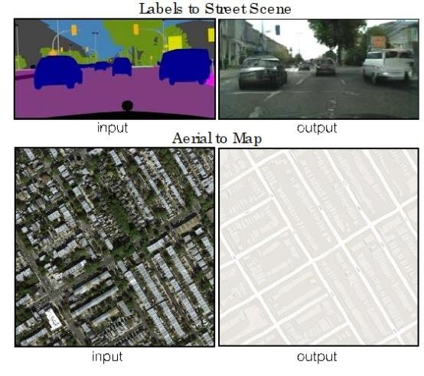
Idea of ​​applying AI (deep learning) to interpretation technology
■What I want AI to remember
⇒Learn the tacit knowledge of civil engineers
*Using deep learning to learn how to diagnose and interpret intuitively by looking at “photos” and “diagrams”
Ex. “pix2pix” *
◆Input as an image ⇒ Output as an image ⇒ Intuitive to use
◆You can learn the results that technicians are seeing and diagnosing
Frameworks required for deep learning
Use freely available libraries (programs) (from the perspective of versatility)
Generate photos from mosaics with Pix2pix
■Machine learning environment (implemented on a general PC)
Framework: Tensorflow (google)*
OS: Windows10
GPU: NVIDIA RTX2080
Generate maps from aerial photos
※Isola, P., Zhu, JT., Zhou, T. and Efros, AA. （2017）： Image-To-Image Translation With Conditional Adversarial Networks, Proceedings of the IEEE conference on computer vision and pattern recognition. pp. 5967-5976.

Slide 5
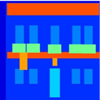
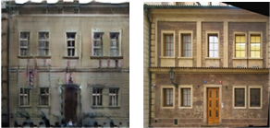
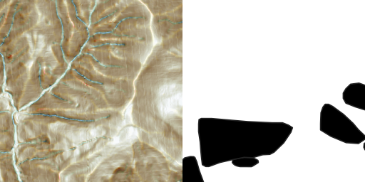
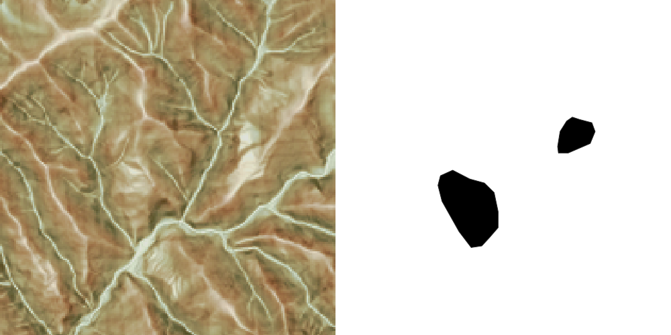

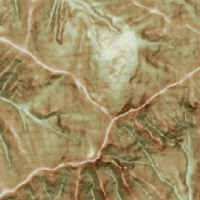
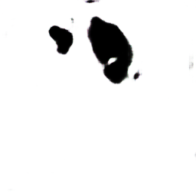

Flow of applying terrain interpretation to deep learning
■Generate photos from mosaic images with pix2pix ⇒ Application to landslide topography interpretation
The idea of applying AI for image generation to decipherment
Flow of research in this thesis
Application example for general images
Input
Output
Correct image
Train Data
3D topographic information(DEM)
Test Data
Terrain information
(color tone/pattern)
Unidentified
Data Input
mosaic image
AI generated image
real photo
CS 3D map etc.
application
Example of application to landslide topography interpretation
Deep learning
Inference
Generate (convert) images
Expert decipherment
(tacit knowledge)
Test and Evaluation
Landslide predicted by AI
topographic map
Landslide topographic image generation using AI = Interpretation map
Landslide topography interpretation map
Advantages of AI: Output is several tens of seconds - minutes

Slide 6
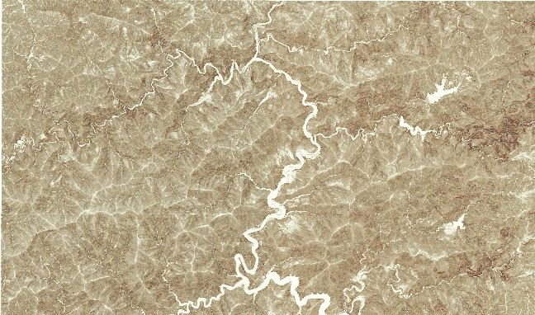
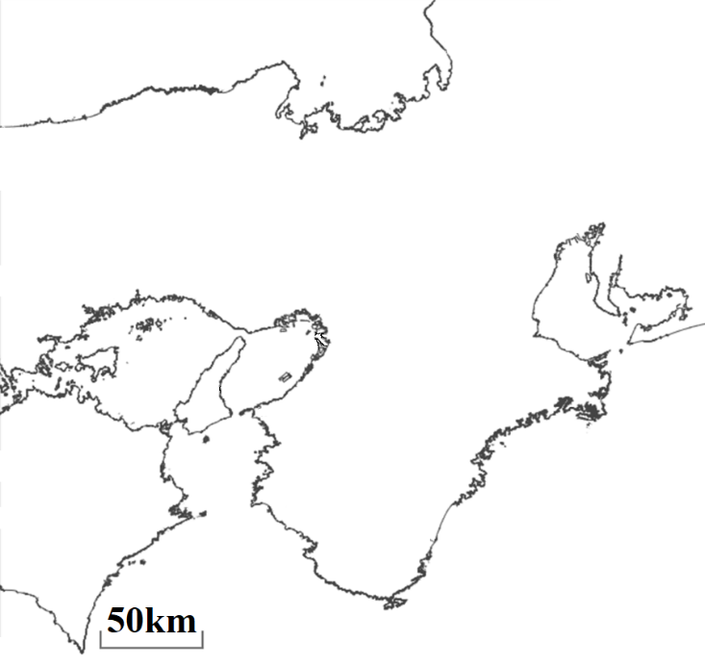

Survey location and creation of CS map
◆Uses the digital elevation model (5m mesh) of Geospatial Information Authority of Japan basic map information
◆Created with GIS software plug-in
◆The coloring has been changed to a color tone that is easier to see in three dimensions from the reader's perspective
1km
Test data area
3/4 Off Set
Train data area
37km
Nara Pref.
Study area
5km
23km

Slide 7
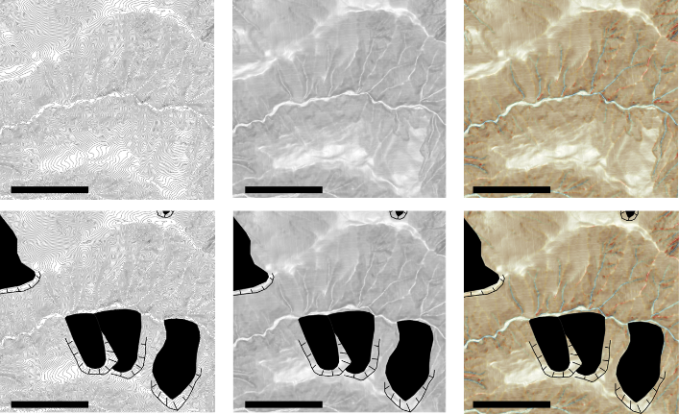
Creation of multiple types of topographic representation maps
◆Differences in the amount of information and landslide representation for each topographic map
(Top: topographic map, bottom: image with landslide topographic distribution map superimposed on the topographic map)
◆The more color information there is, the easier it is for readers to read (Is AI learning the same or different?)
Contour map
Inclination map
CS 3D map
※Scale Bar = 500ｍ
Amount of color
information
1bit
8bit
24bit
Legibility
△
○
◎

Slide 8
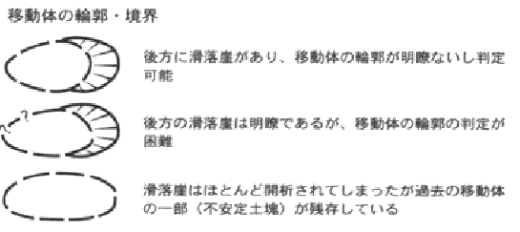
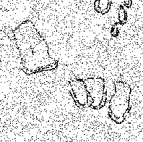
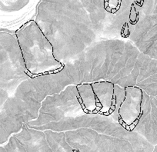
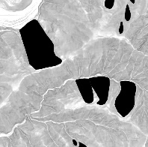
Incorporating engineer knowledge into Train data
Focusing on the clarity of the contours and boundaries of moving objects
There is a sliding cliff at the back, and the outline of the moving object is clear and can be judged
The sliding cliff behind is clear, but it is difficult to determine the outline of the moving object
Most of the cliffs have been opened, but some of the moving bodies of the past remain
NIED(Japan) 1:50,000 Partial addition to landslide topographic distribution map legend
Landslide topographic distribution map
GIS polygons
Landslide topographic distribution map
Train data
Moving only
As notation
It was used as training data

Slide 9
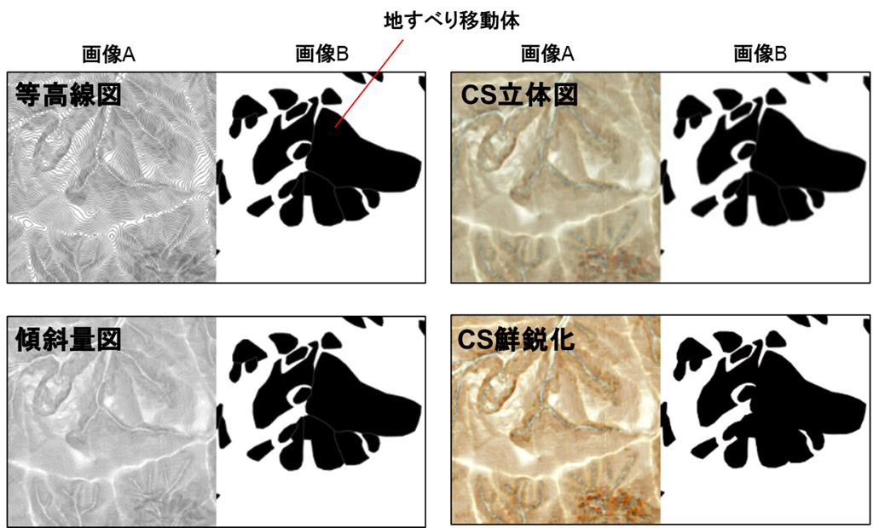
Creation of multiple types of topographic representation maps
originality
◆Differences in the amount of information and landslide representation for each topographic map
(Top: topographic map, bottom: image with landslide topographic distribution map superimposed on the topographic map)
◆The more color information there is, the easier it is for readers to read (Is AI learning the same or different?)
Train・Correct data image example
Contour Map
Inclination Map
CS 3D Map
Landslide moving body
Image A
Image B
Image A
Image B
Contour map
CS 3D map
500ｍ
500ｍ
500ｍ
Contour map
CS Sharpening
500ｍ
500ｍ
500ｍ
color’s information | 1bit | 2bit | 24bit
legibility | △ | ○ | ◎

Slide 10
Data used for learning
Train data and number of verification data
◆Engineers look at the images to be trained and select only the necessary images.
★The “feature acquisition” mentioned in the AI ​​overview is from “a large amount of messy data”
★Deep learning is possible with "quality over quantity" for targets where the amount of data is limited, such as disaster phenomena.
topographic map | Train Data |  |  |  | Test Data
 | original | data expansion | After expansion | Number of data after sorting
Contour Map | 600 | slides | 2000 | 1000 | 80
Inclination Map
CS 3D Map
CS Sharpening

Slide 11
Chapter2
Evaluation of landslide topography interpretation AI

Slide 12
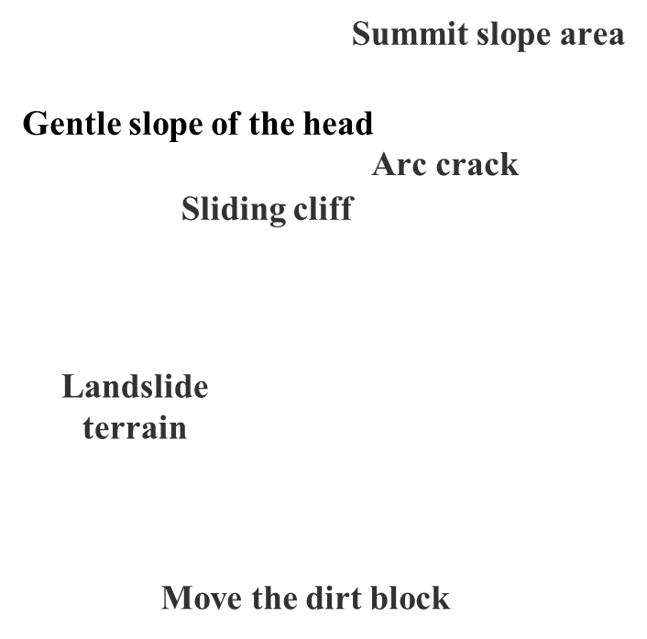
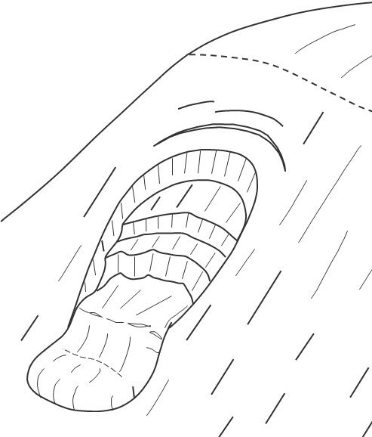
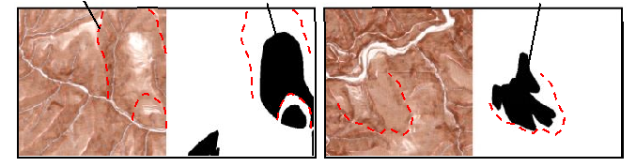
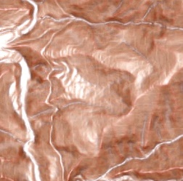
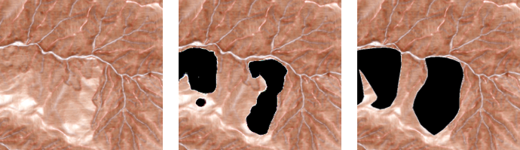
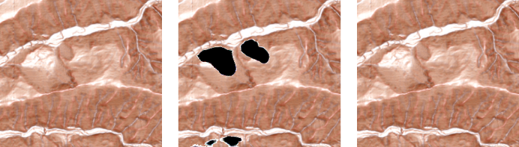
Key points of the results of landslide topography interpretation using AI
originality
■Learn landslide topography displayed in color. Expert knowledge required.
1. No Train data selection, no image processing
2. Train data selection/image sharpening
input
output
target
Landslide area is out of frame
Image does not contain landslides
Topography to focus on when sorting
DELETE
Sliding Cliff
Landslide moving body
Landslide moving body
Head gentle slope
Sliding Cliff
3. Train data selection and sharpening processing
input
output
target
Landslide Body
[Number of teacher data]
◆Before sorting: Approx. 2300*1
◆After sorting: Approximately 1000
Improved accuracy even with less data
⇒ Expert knowledge is required to create Train data
Example of landslide topography on CS3Dmap
input
output
target
[When writing the paper in *1]
Hirokazu Furuki, Yutaka Inagaki, Masayuki Hitoto, Dai Fujihira, Tomomi Sakuramoto: Automatic extraction of landslide topography using deep learning - Relationship between accuracy and training data, Journal of the Japanese Society of Geotechnical Engineering, Vol. 67, No. 6, p. 20-23, 2019
Output is several tens of seconds to several minutes

Slide 13
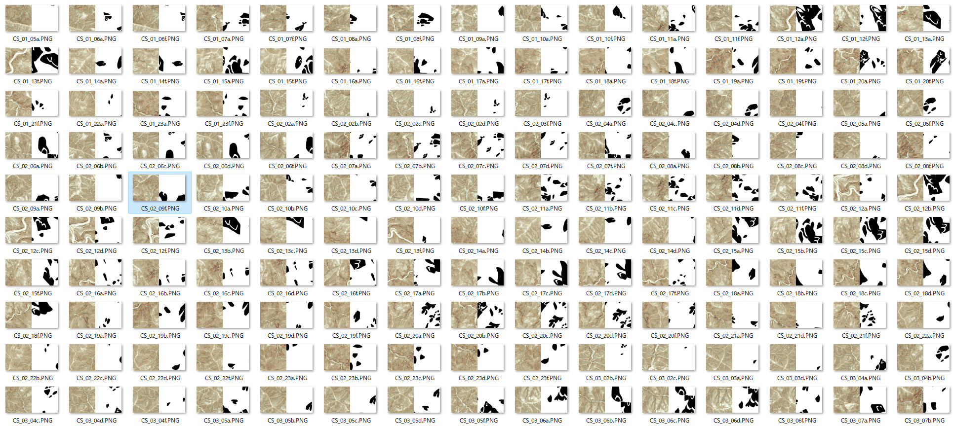
Sorting Train data (before sorting)
■Before sorting: 150 out of about 2000. There are many blank areas in image B. Images deleted during sorting

Slide 14

AI generate Landslide areas movie

Slide 15
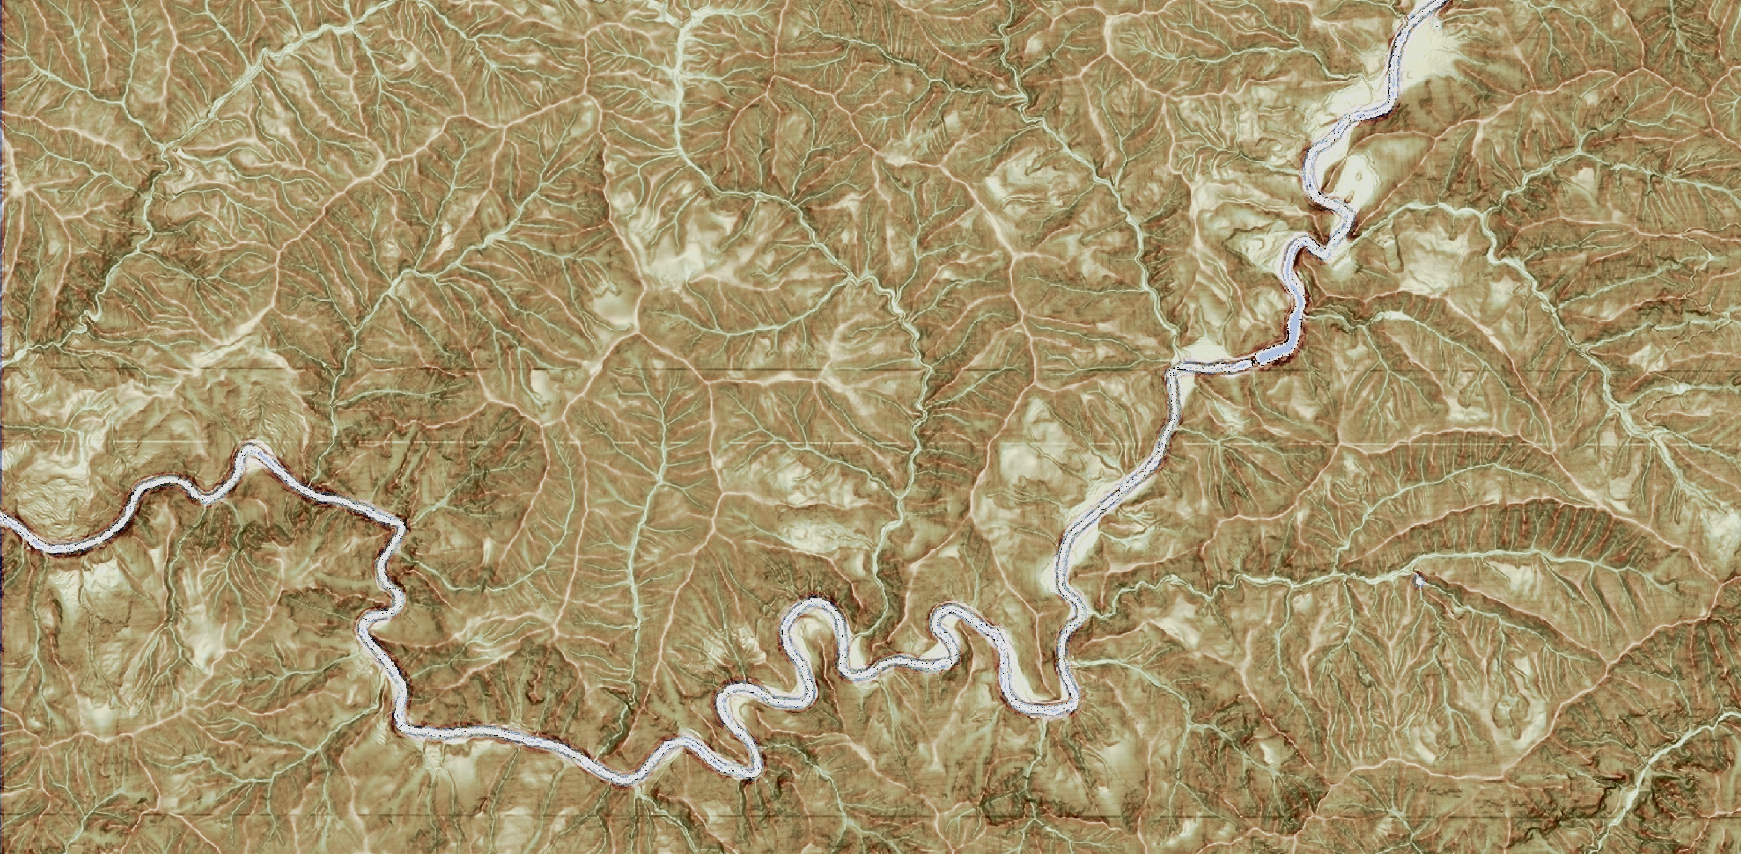
[Implementation results] Input image
1km

Slide 16
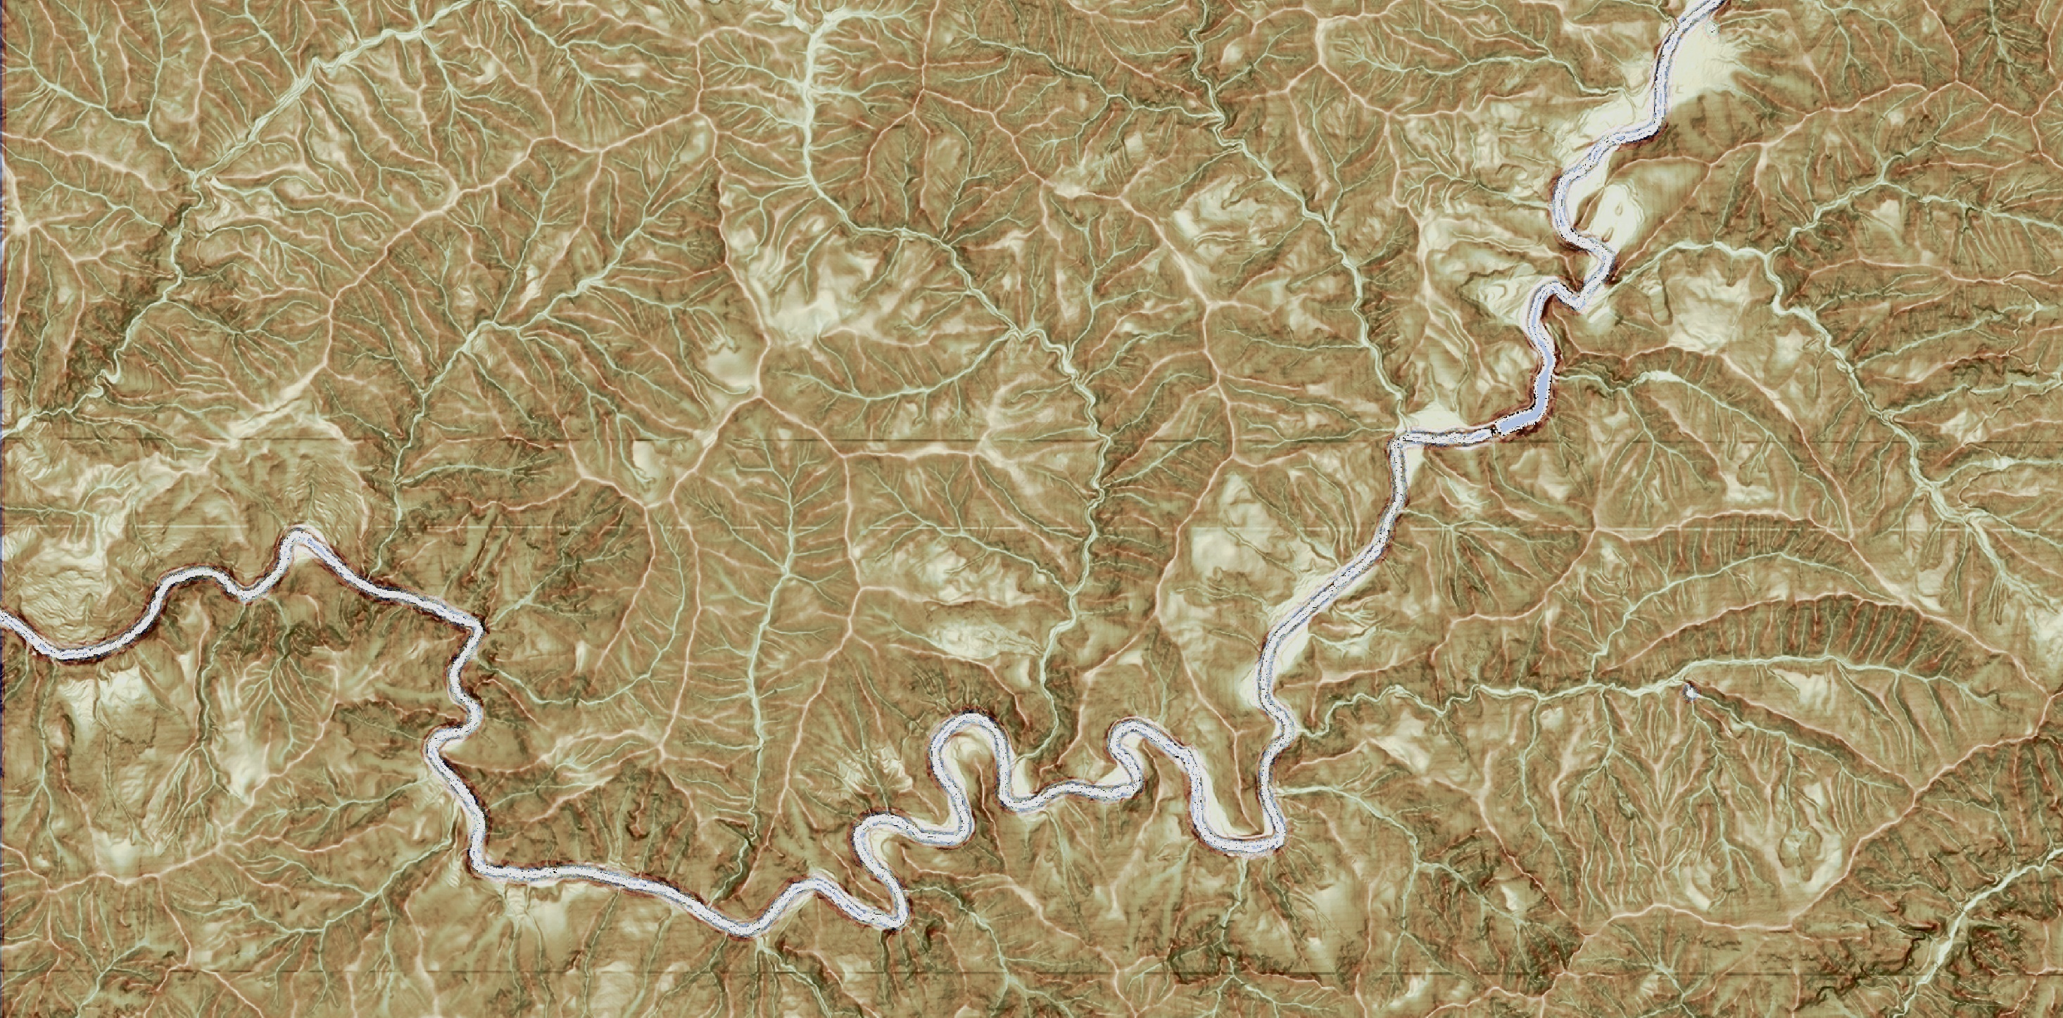

[Implementation results] Correct answer example - Landslide topography distribution map
1km

Slide 17
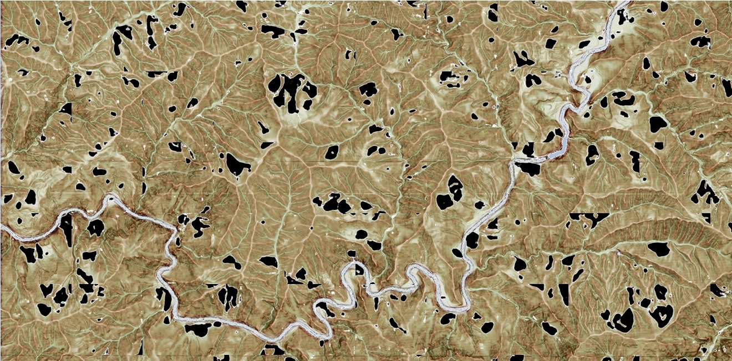
[Implementation results] AI interpretation diagram
It takes about 5 minutes to output and synthesize
It would take an engineer about 1 to 2 hours to decipher this area.
Inference
Size of one image
1km

Slide 18
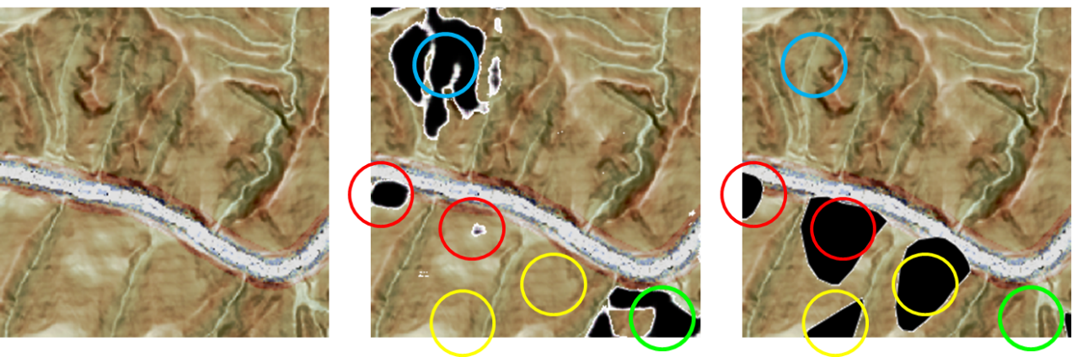
Evaluation indicators for implementation results
Recall rate = matched area / (matched area + unreadable area)……(1)
Precision rate = matching area / (matching area + misinterpretation area)…………(2)
Match
Match
Recall Rate =
Precision rate=
Match
Leak
Excess
Match
◆How well does the AI ​​extract (match) the correct answers without omission?
◆The higher the value (closer to 1), the less leakage.
◆How much does AI overreact to correct answers?
◆The higher the value (closer to 1), the less excessive image generation occurs.
Landslide topographic distribution map
(Correct answer data)
Input
AI generated image
matching part
Parts that AI overlooks
Parts that AI extracts excessively

Slide 19
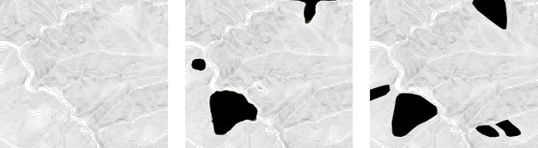
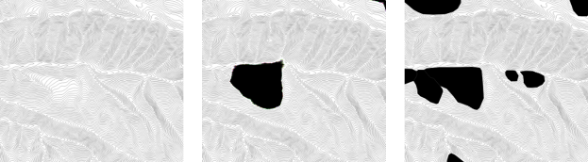
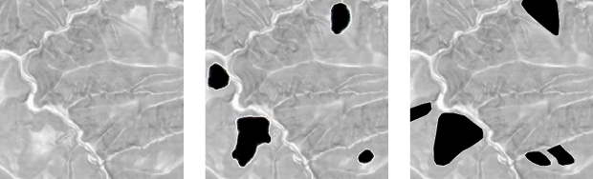
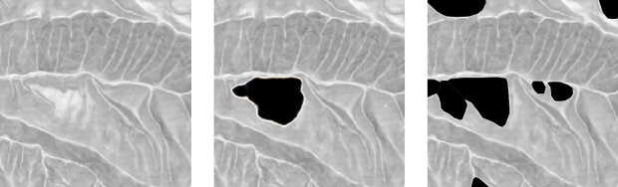
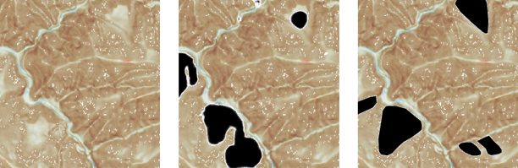
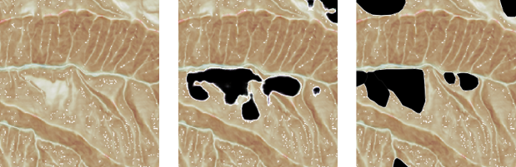
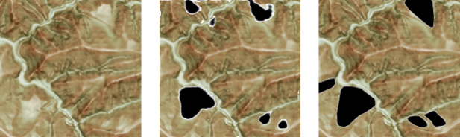
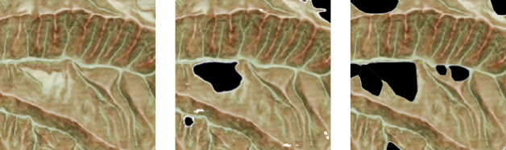
Examination result example 1
Example of an image with a high extraction rate of landslide moving objects (1)
Example of an image with a high extraction rate of landslide moving objects (2)
Landslide topographic distribution map
(Correct answer data)
Landslide topographic distribution map
(Correct answer data)
AI generated image
AI generated image
Input
Input
Contour Map
Contour Map
Inclination Map
Inclination Map
CS 3D Map
CS 3D Map
CS Sharpening
CS Sharpening

Slide 20

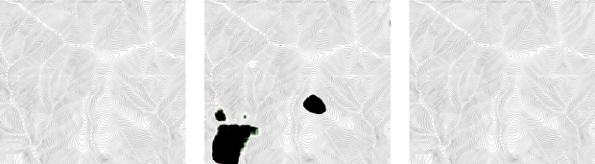
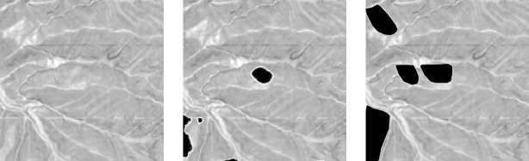
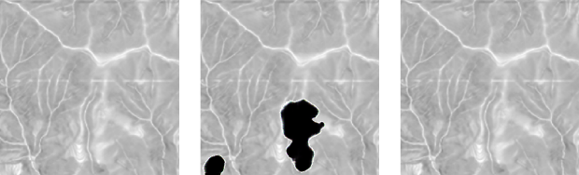
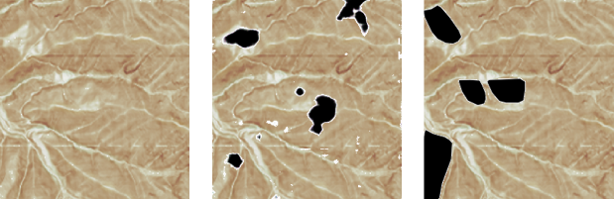
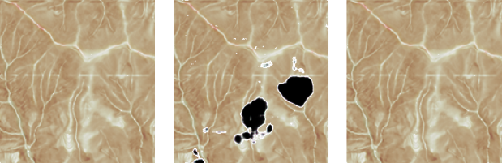
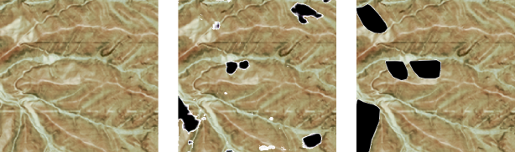
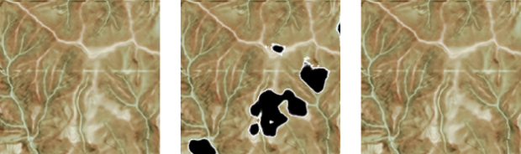
Examination result example 2
Example of an image with a low extraction rate (Landslide terrain included in the correct answer)
Example of an image with a low extraction rate (no landslide image in the correct answer)
Landslide topographic distribution map
(Correct answer data)
Landslide topographic distribution map
(Correct answer data)
AI generated image
Input
AI generated image
Input
Contour Map
Contour Map
Inclination Map
Inclination Map
CS 3D Map
CS 3D Map
CS Sharpening
CS Sharpening

Slide 21
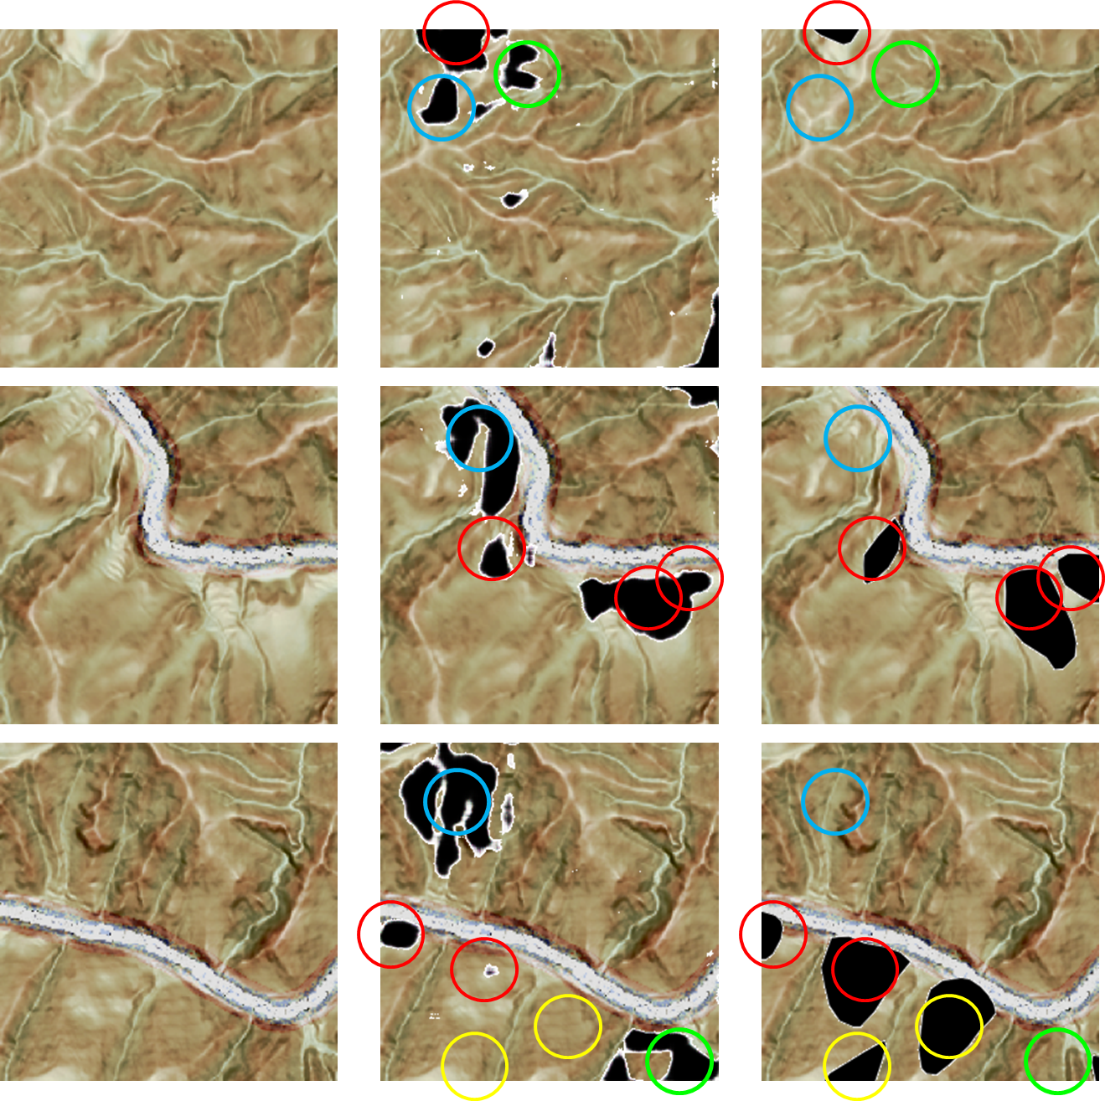
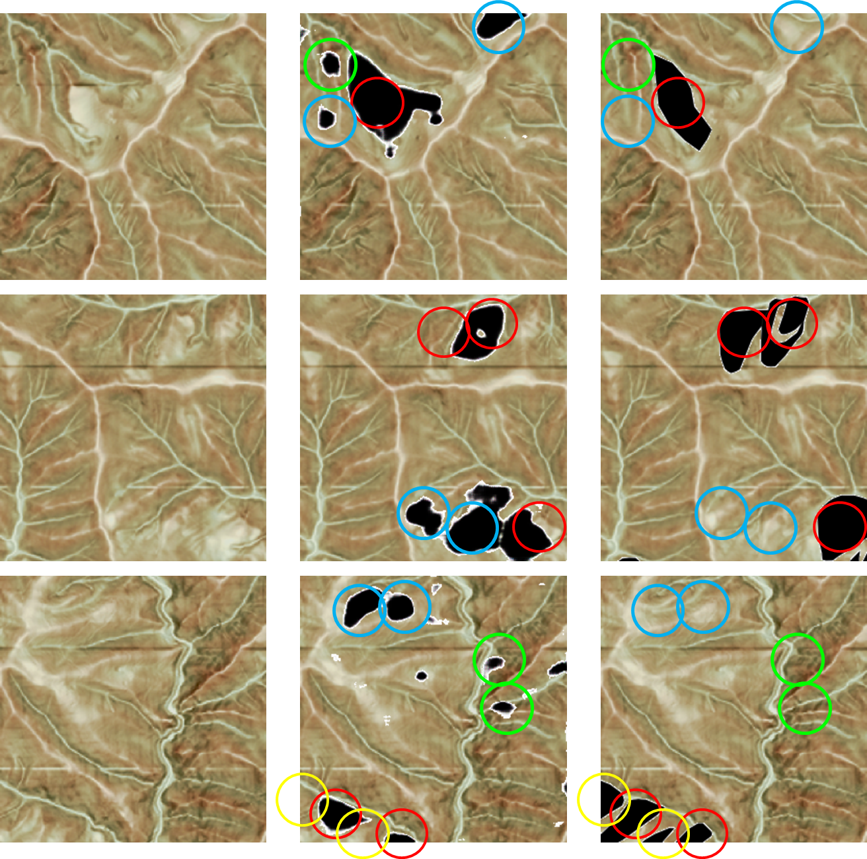
Example of matching correct data and AI extracted image for evaluation
Input
AI generated image
Landslide topographic distribution map (correct data)
Input
AI generated image
Landslide topographic distribution map (correct data)

Slide 22
Verification result list ~ Performance of landslide topography interpretation AI
■What you want is the location of the landslide
◆Pixel-by-pixel evaluation → No need to reproduce the shape
◆Evaluate by location → know the general landslide area
⇒70-80% of the locations identified by AI are landslide terrain
Match, recall, and precision calculated per pixel
Type of topographic map | Match rate | Recall rate | Precision rate
contour map | 0.08 | 0.11 | 0.24
Inclination map | 0.19 | 0.26 | 0.43
CS map | 0.15 | 0.27 | 0.22
Sharpening CS map | 0.20 | 0.33 | 0.26
AI landslide extraction rate calculated on a part-by-point basis
Type of topographic map | Matches the engineer's prior interpretation of the location |  |  | AI over-detected |  | AI Landslide Number of extracted area (2)＋(3) | Total number of AI extraction area (2)＋(3)＋(4) | Probability that the AI extraction site is a landslide ((2)＋(3)) / ((2)＋(3)＋(4))
 | (1)Total number of landslides | (2)Number of matches between engineer's decipherment and AI extraction | Extraction rate（％） | (3)Polygons that engineers can determine to be landslides | (4)Determined not to be a landslide
contour map | 228 | 98 | 43.0% | 40 | 56 | 138 | 194 | 71.1%
Inclination map | 228 | 94 | 41.2% | 47 | 34 | 141 | 175 | 80.6%
CS map | 228 | 119 | 52.2% | 77 | 87 | 196 | 283 | 69.3%
Sharpening CS map | 228 | 125 | 54.8% | 84 | 51 | 209 | 260 | 80.4%

Slide 23
Chapter3
Recommendations regarding landslide topograpic interpretation AI
◆Landslide moving object extraction using deep learning using 3D topographic information
Journal of the Japan Landslide Society (2021), Volume 58, Issue 2, p. 65-72.
◆Automatic extraction of landslide topography using deep learning - Relationship between accuracy and training data
Journal of Japan Geotechnical Engineering Society (2019), 67(6), pp.20-23.
◆Examination of annotation methods targeting a small number of phenomena in deep learning
Japan Society of Civil Engineers, Proceedings of AI and Data Science (2021), Volume 2, No. J2, pp.856-862.
◆Deep generation of landslide moving bodies by normalization processing regarding spatial heterogeneity and continuity
Japan Photogrammetry Society (2022), Vol. 61, No. 1, pp. 14-31.
◆Proposal of uncertainty evaluation and performance improvement method for image generation of landslide moving objects using deep learning model
Japan Photogrammetry Society (2022), Vol. 61, No. 6, pp. 368-386.

Slide 24
Interpretation of matching results
◆Extraction rate improves in the order of contour line → slope map → CS 3D map
◆In other words, it is easy to read ⇒ Engineers and AI are the same in terms of being able to read accurately
◆The probability that the location extracted by AI is landslide terrain is approximately 80%
AI Landslide Number of extracted area (2) + (3)
Probability that the AI extraction site is a landslide ((2) + (3)) ／ ((2) + (3) + (4))
(2)Number of matches between engineer’s decipherment and AI extraction

Slide 25
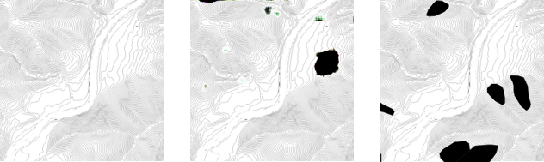
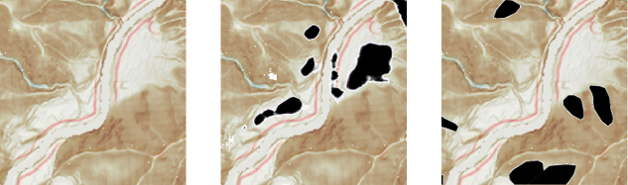
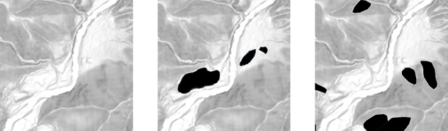
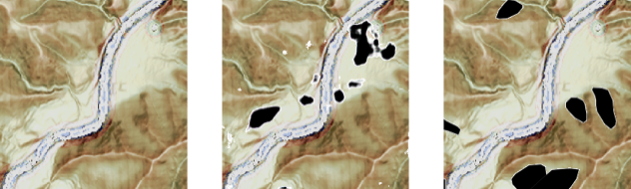
Characteristics of misinterpreted images - problem extraction
[★Misinterpretation points]... Locations where the positional relationship and color tone of the top of an alluvial fan, a meandering river, and a slope between a sliding cliff and a gentle slope in a landslide topography are similar, such as the surface of a terrace.
[▲Characteristics of poorly readable areas]...Topography that even engineers are confused about ⇒Landslide topography that is unclear in the legend of the landslide topography distribution map
Example: A falling cliff is clear, but a gentle slope, slope line, slope line is not clear, etc.
Landslide topographic distribution map
(Correct answer data)
▲：Missing part of reading
★：Misreading part
Contour Map
CS 3D Map
Input
AI generated image
Inclination Map
CS Sharpening

Slide 26
Proposed measures to solve problems
■Solutions to reduce misinterpretation
(1) Expand the variety of interpretation data
◆The topographical patterns to be interpreted tend to have similar morphological characteristics depending on the region and geology.
◆If we can accumulate and learn from the knowledge of civil engineering engineers who make a living by interpreting, it is possible to improve accuracy and reduce misinterpretation.
(2) Let AI learn the features of the terrain that were misinterpreted
◆Let AI learn terrain that is not landslide terrain
◆However, future verification is required in order to apply it to regions and topographical elements where it is difficult to determine the true correct answer due to natural phenomena.
(3) Use detailed topographical information
◆Use more detailed terrain information. It is necessary to specify the landslide range more clearly.
◆Example of high-resolution topographic data: 0.5-1m mesh topographic data is released by local governments.
The Geospatial Information Authority of Japan also announced that it will release 1m mesh resolution topographical data nationwide on October 28, 2020.
(4) Add processing such as emphasizing the features (color tone) that engineers focus on

Slide 27
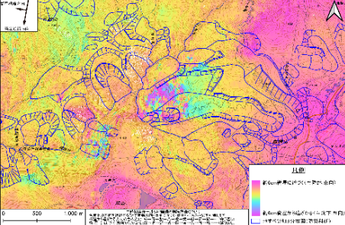
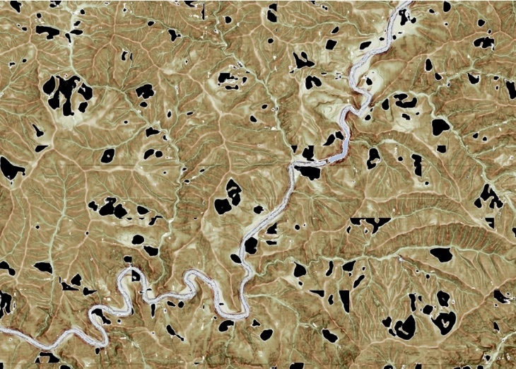
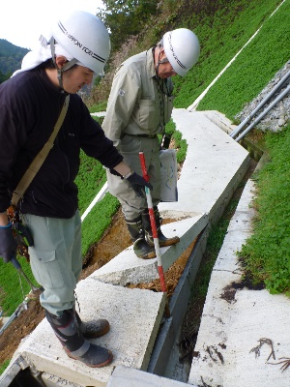







Improving terrain interpretation technology through deep learning: Improving efficiency, awareness, and passing on technology
Terrain interpretation AI + α
Judgment assistance in combination with monitoring technology
Wide area and high precision
Interpretation work possible
Ex. : satellite information
◆Application to other regions
◆Feedback to teacher data/topographic interpretation AI
technical
results
Information acquired by sensors (SAR, etc.)
Contents of interpretation technology
improved by AI
◆Speed ​​up
◆Reducing risks such as individuality and
human error
◆Supports high-resolution terrain data
◆Flexibility in updating terrain/teacher data
◆Versatility to other regions
◆Explanability by visualizing tacit knowledge
◆Use as a technology inheritance tool
Terrain interpretation AI
Area monitoring
wide area terrain
Interpretation diagram completed
High Quality Train Data
Check by technician
(On The Desk/Field)
Preliminary learning
Automatic reading
◆Improving the efficiency of interpretation
◆Preventing oversight
◆Engineer's awareness
Teaching materials for technology inheritance
Terrain interpretation AI construction
Completed topographical interpretation map
Acquisition of terrain data
Conventional method
Field survey
Interpretation engineers spend several months interpreting and plotting
Creating and checking topographical
interpretation maps
period

Slide 28







Example of deployment of terrain interpretation AI
Combining traditional Japanese technology (interpretation) with AI technology to pass on technology
Examples of overseas expansion
in El Salvador
June 2023
Seminar on terrain interpretation technology and terrain interpretation AI overseas
in Ecuador
June 2022-June 2023

Slide 29







Recommendations regarding landslide topography interpretation AI
■Improve excellent conventional interpretation techniques with deep learning
◆Use of open source
◆Extract macro-scale “locations” of landslide terrain risk areas
◆pix2pix: Intuitive and versatile AI algorithm
◆Expert knowledge (tacit knowledge) can be deep learned
◆Technical knowledge is essential for teacher data
◆Landslide location extraction rate in target area: approximately 80%
◆Improvement in interpretation technology brought about by AI
Previously
Not 100%, but highly accurate
It takes about 10 days to interpret 100m²
Higher terrain resolution requires more time
Depends on each individual's ability, there is a risk of oversight, and updates require a lot of effort
1．Speed ​​up
2．Reduce risks such as individuality and human error
3．Supports high-resolution topographic data
4．Flexibility in updating terrain/teacher data
5．Versatility to other regions
6．Explainability by visualizing tacit knowledge
7．Utilization as a technology inheritance tool
interpretation expertise
Landslide topography interpretation AI
objectivity
Reduces misreading
Regional versatility
(Customization required)
Checked and added by someone
Focus on risk assessment
Can be output in a short time
Supports various terrain resolutions

Slide 30


Recommendations regarding landslide topography interpretation AI
■Points to keep in mind and issues in utilizing AI
◆ This study utilizes the data accumulated so far and integrates the advantages of AI
◆AI is a tool and will always give an answer if data is input.
⇒Check function is required
◆ Sometimes there is no absolute right answer in Geoscience. ⇒Only experts can do it.
◆ Even so, the results predicted by AI are appealing (e.g., Risk assessment of ground interior).
◆Time saved by deep learning
Shouldn't the time saved by deep learning be used for further discussion?
【Assignment】
◆Weaknesses of deep learning: black box remains ⇒ Control by quality of training data
◆ Verification of stability of inference accuracy and generalization performance
Combined use of sensor technology (e.g., satellites)
existing methods
Desk Research
Result
Field
Analysis/Tes
What kind of output method?
What kind oあf data?
What about the procedures and format?

