Slide 1

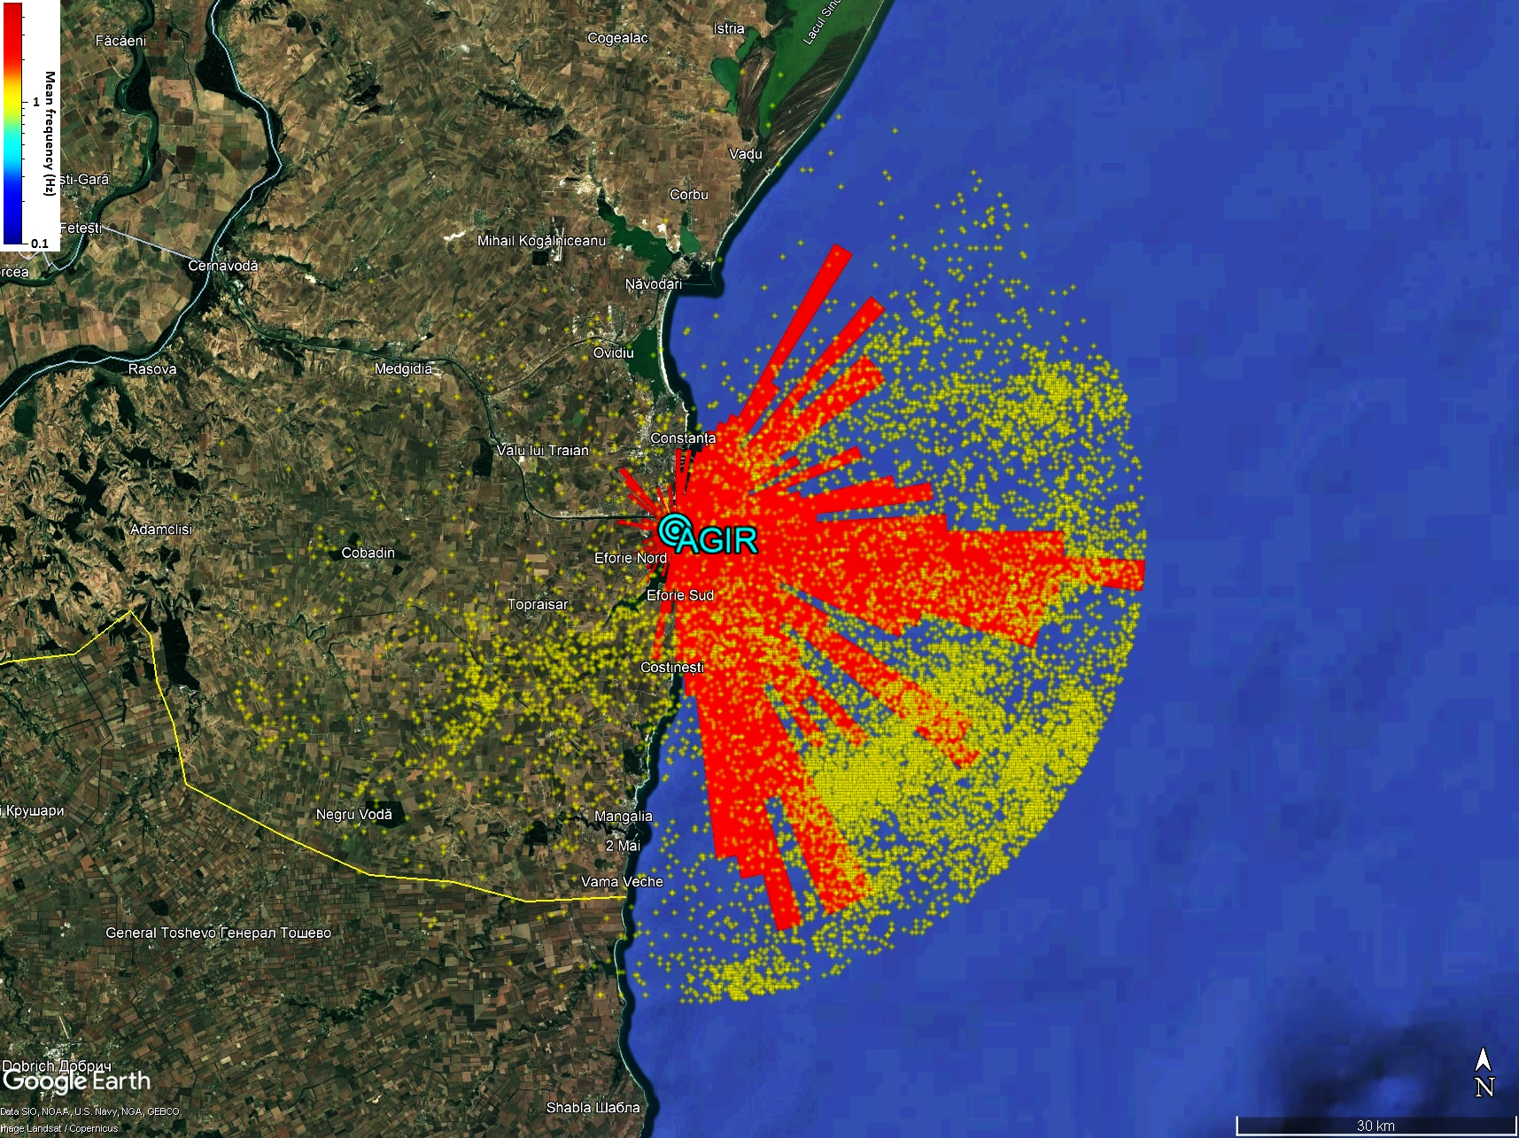
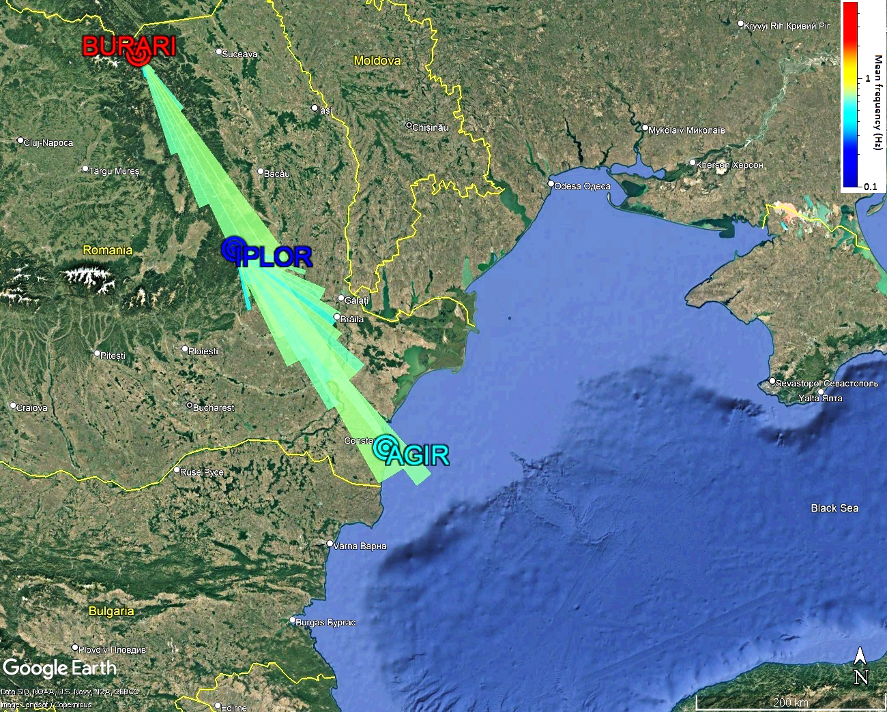
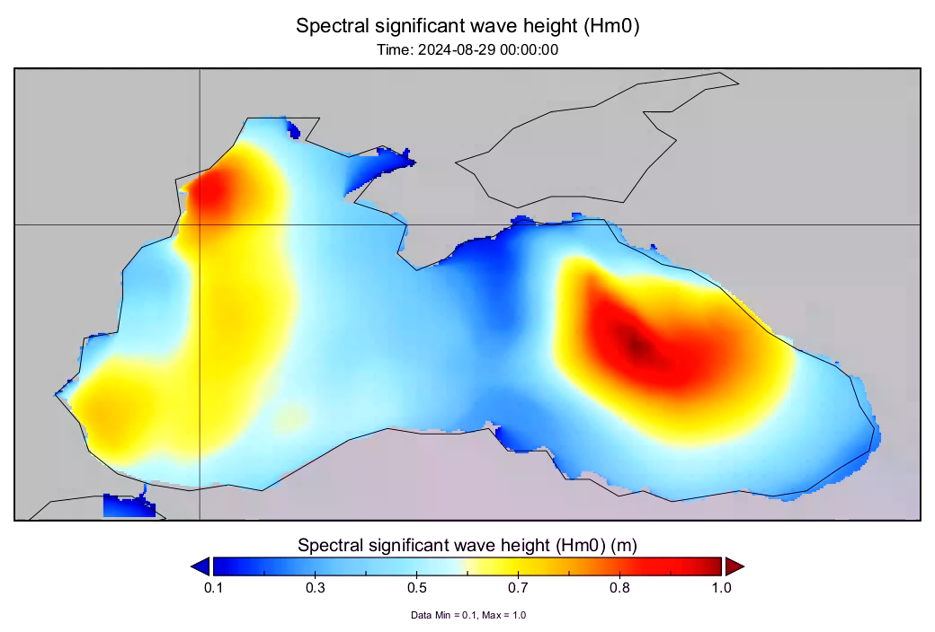
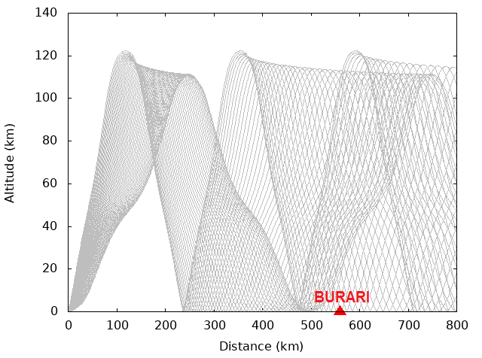
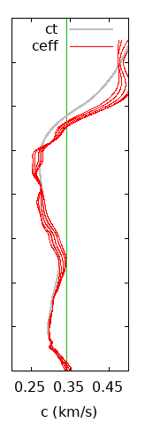
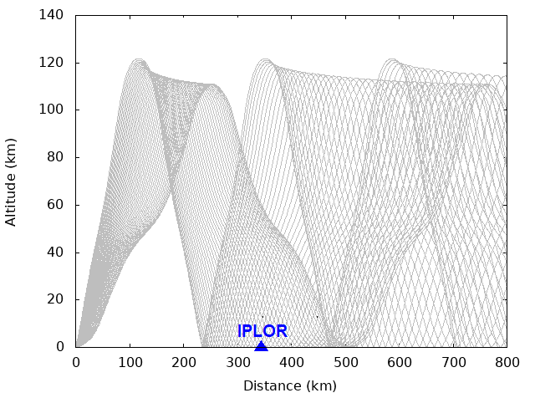
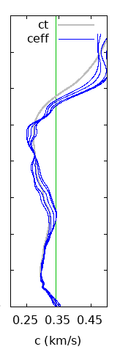
Using Romanian infrasound observations to analyze thunderstorms generated by extratropical cyclones over the Black Sea
Daniela Ghica, Bogdan Antonescu, Dragoș Ene
From August and September 2024, several strong thunderstorms that crossed Romania’s Black Sea coast could be correlated to cyclones moving over the Black Sea and greatly affecting Romania's regional climate in 2024. Between 29 and 31 August 2024, a severe rainfall event crossed Romania’s Black Sea coast, resulting from the development of an extratropical cyclone in the western Black Sea basin
Data from NIEP's infrasound network – BURARI, IPLOR and AGIR stations – were examined in order to study the possibilities of infrasound-based monitoring of extratropical cyclones over the Black Sea; lightning flashes detected by MTG Lightning Imager within 50 km from the AGIR infrasound station was investigated, assuming direct wave propagation path
Polar histogram plot of AGIR detections and MTG lightning locations displayed with Google Earth
Polar histogram plot of BURARI&IPLOR detections displayed with Google Earth
  Local wind was averaged for the BURARI&IPLOR locations using local weather measurements, NRL-G2S wind fields (at station altitude) and meteorological reanalysis data, i.e., ERA5-Land dataset
BURARI
IPLOR
  Thermospheric infrasonic phases are identified to be observed at BURARI and IPLOR station by applying infraGA 2D ray tracer through NRL-G2S atmospheric model
Infrasound detections associated with MTG lightning flashes and microbaroms

