Slide 1

European Geoscience Union
General Assembly 2025
Vienna | Austria | 28 April 2025
RER2023: a freely accessible landslide inventory from the May 2023 Emilia-Romagna event
Matteo Berti - Università di Bologna

Slide 2
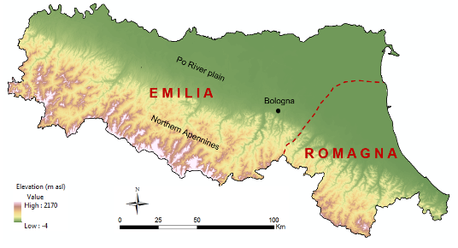

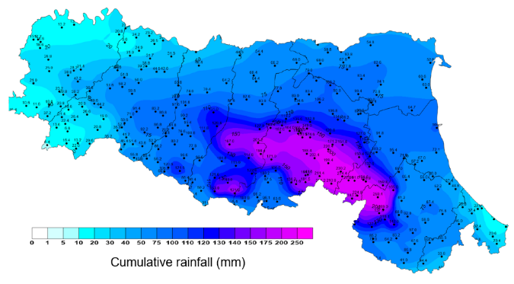
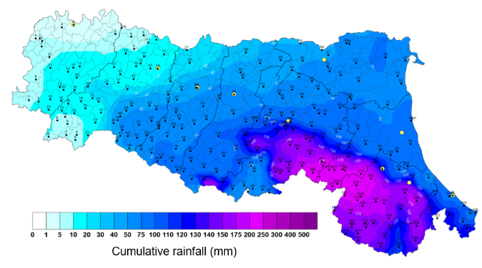
The rainfall events
First rainfall event (1-3 May 2023)
Second rainfall event (16-17 May 2023)
Cumulative rainfall: ≈ 200 mm in 48 hours
Cumulative rainfall: ≈ 300 mm in 48 hours
Return period: more than 100 years
Return period: more than 300 years

Slide 3
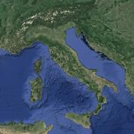
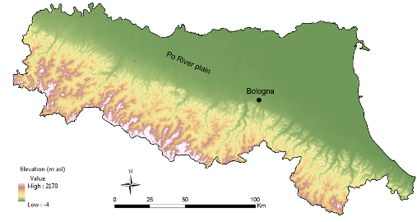
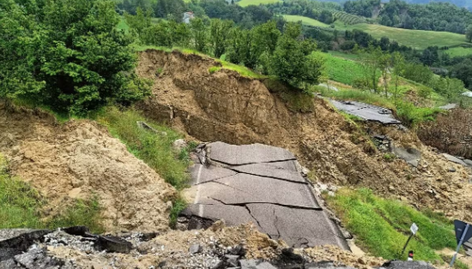
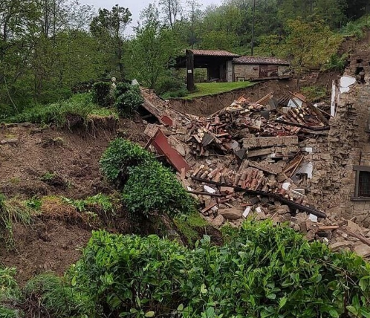
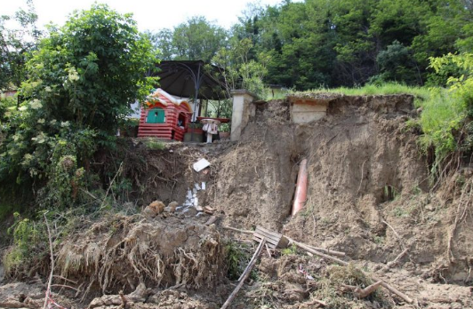
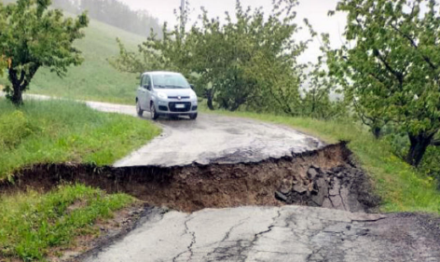
The numbers of the disaster
over 80.000 landslides
800 km² severily affected
more than 1000 roads interrupted
hundreds of houses damaged
10.200 landslides larger than 1000 m²

Slide 4
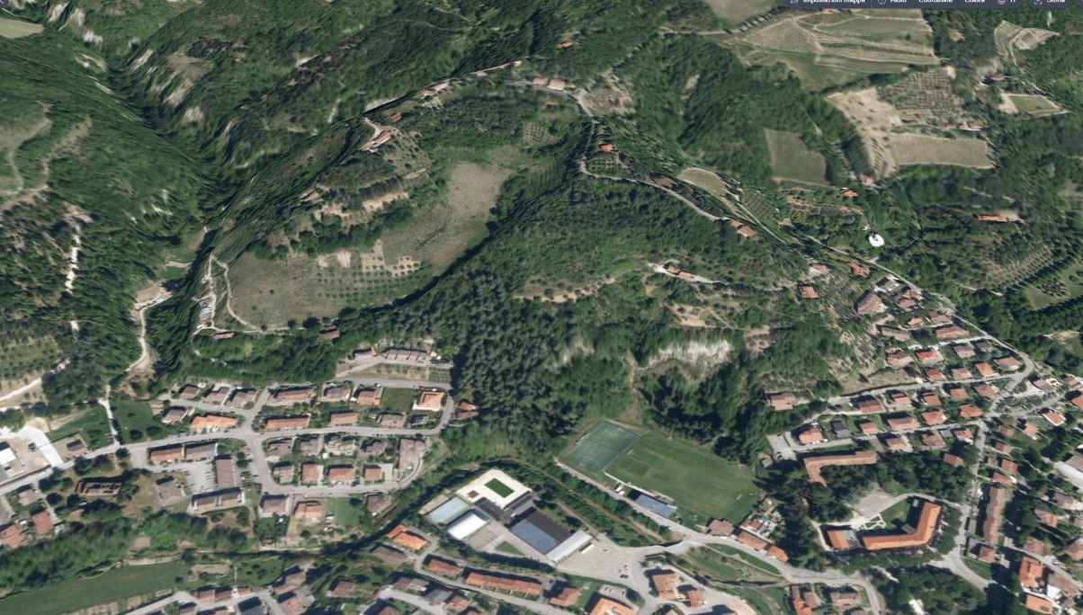
The Romagna disaster
Before the event ( AGEA 2020 aerial photos –0.2 m resolution)
Modigliana
Notes:
The other unit prone to landslide is the clay unit. It consists of … In these units, landslide deposits cover more than 25% of the area.

Slide 5
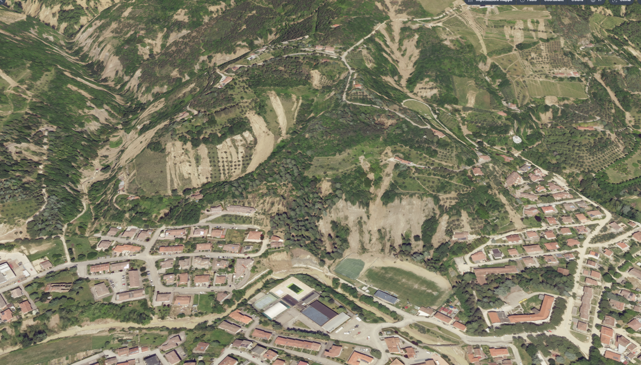
The Romagna disaster
After the event (CGR aerial photos 23 May 2023 – 0.2 m resolution)
Modigliana
Notes:
The other unit prone to landslide is the clay unit. It consists of … In these units, landslide deposits cover more than 25% of the area.

Slide 6
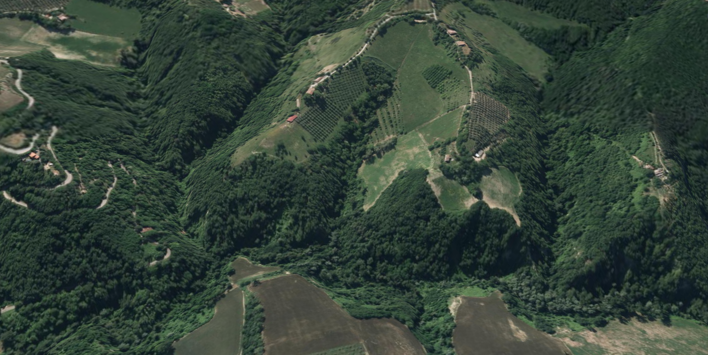
The Romagna disaster
Before the event ( AGEA 2020 aerial photos –0.2 m resolution)
Predappio
Notes:
The other unit prone to landslide is the clay unit. It consists of … In these units, landslide deposits cover more than 25% of the area.

Slide 7
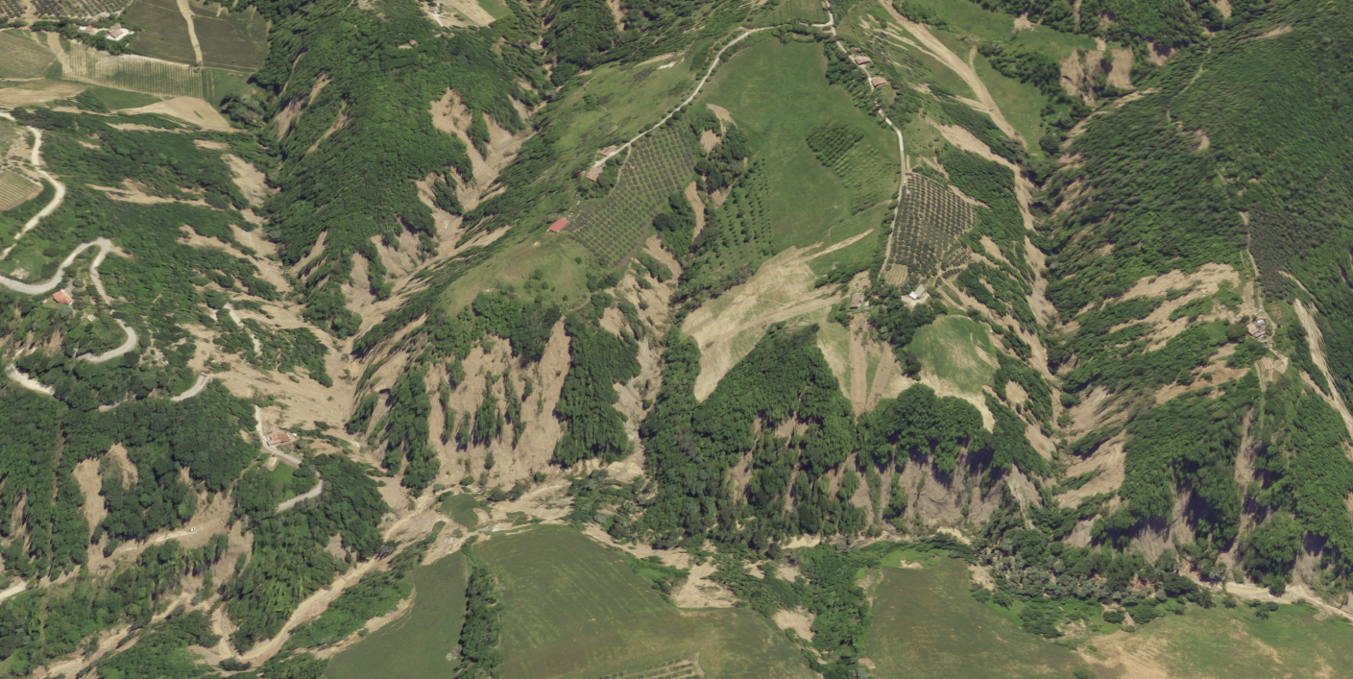
The Romagna disaster
After the event (CGR aerial photos 23 May 2023 – 0.2 m resolution)
Predappio
Notes:
The other unit prone to landslide is the clay unit. It consists of … In these units, landslide deposits cover more than 25% of the area.

Slide 8
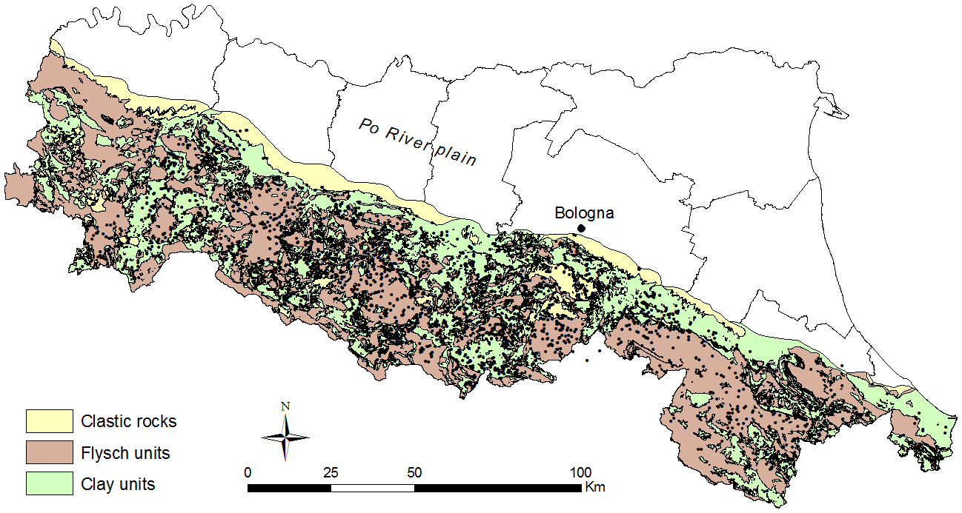
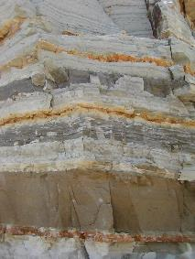
Geological setting of the Emilia-Romagna region
Notes:
The other unit prone to landslide is the clay unit. It consists of … In these units, landslide deposits cover more than 25% of the area.

Slide 9
Typical slope morphology
Bedding planes dipping
against slope
Weathering mantle (soil)
Bedding planes dipping
with slope
30°-50°
river
10°-20°
river
Much of the area consists of a stratified rock formation, composed of alternating layers of sandstone and marl (Marnoso-Arenacea Formation)
Slopes are distinctly asymmetrical. The inclination of the slope is governed by bedding attitude: gentle slopes where beds align with the slope, steep slopes where bedding contrasts with the slope.
The thickness of the weathering mantle is variable, but generally modest
Notes:
The other unit prone to landslide is the clay unit. It consists of … In these units, landslide deposits cover more than 25% of the area.

Slide 10
Landslide types
Bedding planes dipping
against slope
Bedding planes dipping
with slope
DS) Debris slides
RS) Rock-block slides
DF) Debris flows
Notes:
The other unit prone to landslide is the clay unit. It consists of … In these units, landslide deposits cover more than 25% of the area.

Slide 11
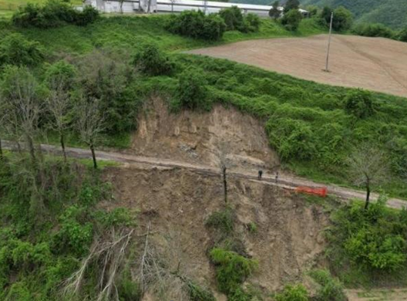
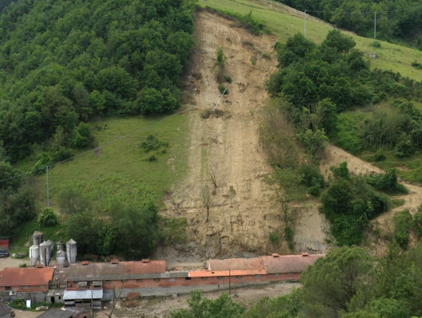
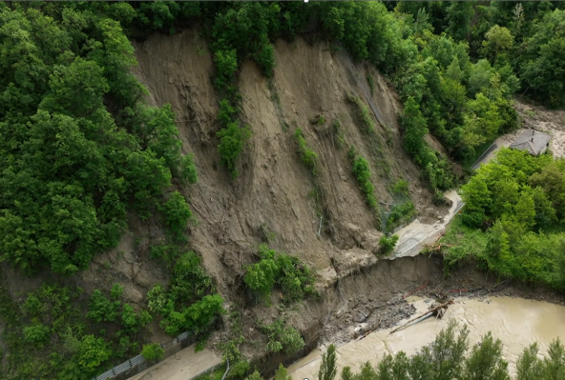
DS) Debris slides
Debris slides
took place on steep slopes (≈30°)
shallow or very shallow (less than 2 m)
typically very small (area<1000 m²)
primarily affecting densely vegetated slopes
Notes:
The other unit prone to landslide is the clay unit. It consists of … In these units, landslide deposits cover more than 25% of the area.

Slide 12
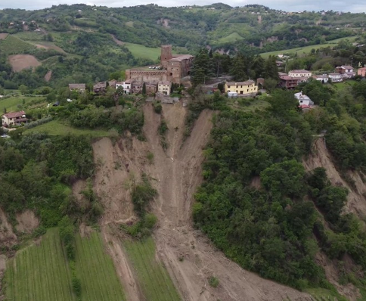
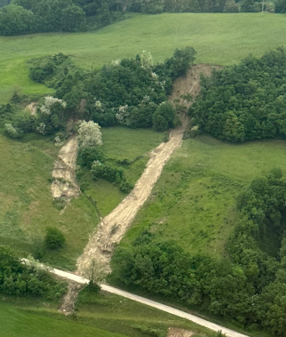
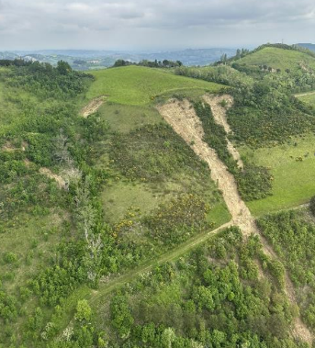
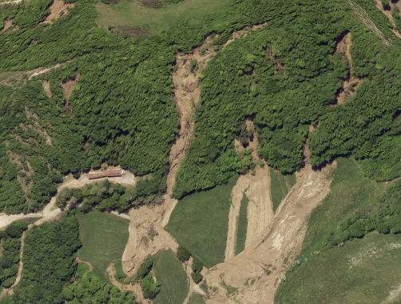
DF) Debris flows
Debris flows:
started as Type A slides on a steep slope
propagated for long distances
exhibited channelized or unchannelized behavior
typically small (area<4000 m²)
relatively low destructive power
Type A ?
Notes:
The other unit prone to landslide is the clay unit. It consists of … In these units, landslide deposits cover more than 25% of the area.

Slide 13
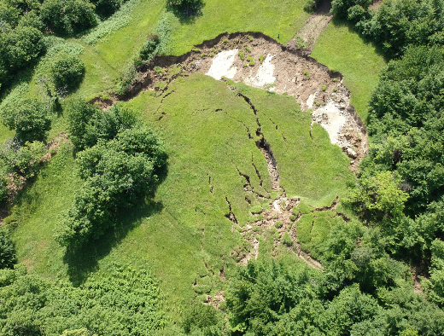
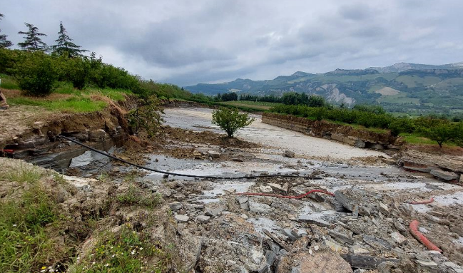
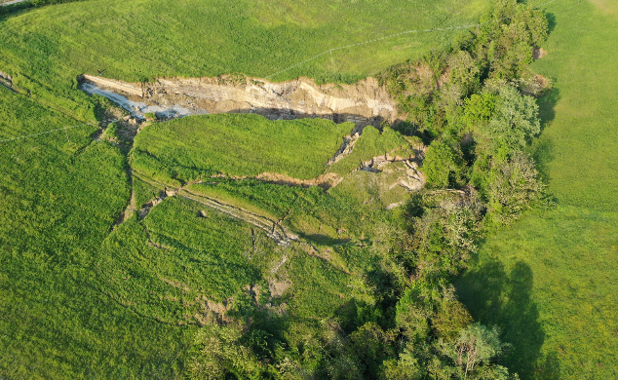
RS) Rock-block slides
Rock-block slides:
Occurred in areas where bedding planes aligned parallel to the slope
average slope of 10°-15°
thickness ranging from 2 to 30 m
mainly moved as coherent blocks, but capable of transforming into a flow
high destructive potential
Type A ?
Notes:
The other unit prone to landslide is the clay unit. It consists of … In these units, landslide deposits cover more than 25% of the area.

Slide 14
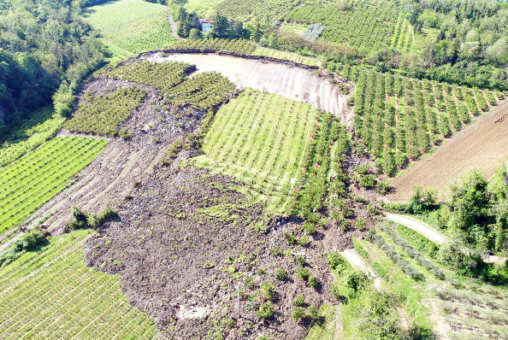
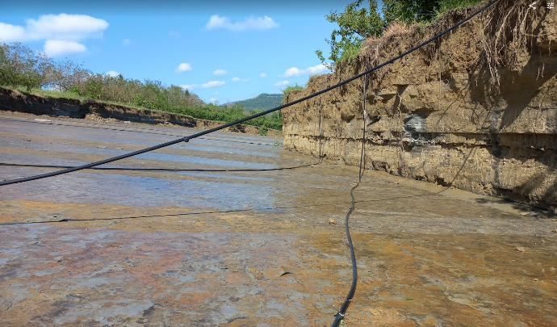
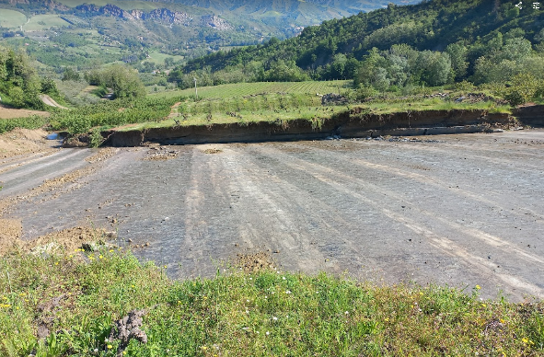
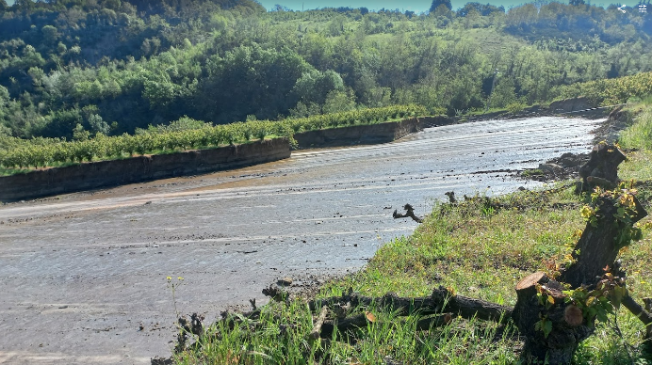
RS) Rock-block slides
Siepi San Giovanni
3 m
50 m
Notes:
The other unit prone to landslide is the clay unit. It consists of … In these units, landslide deposits cover more than 25% of the area.

Slide 15
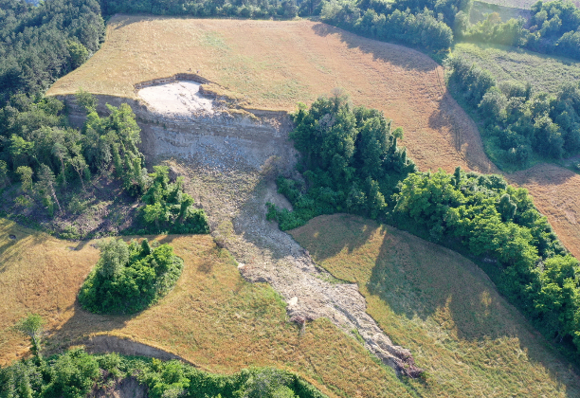
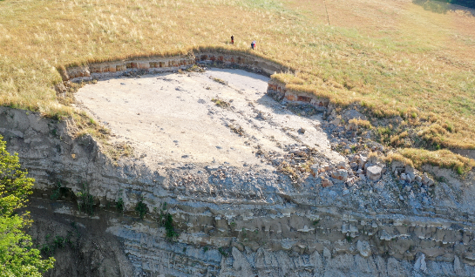
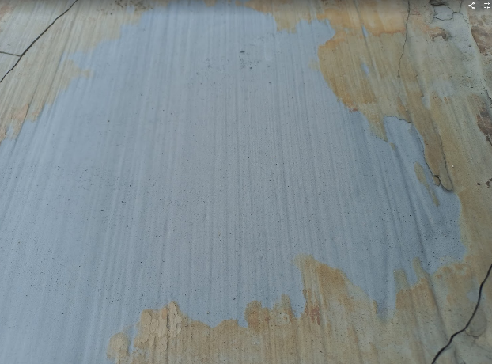
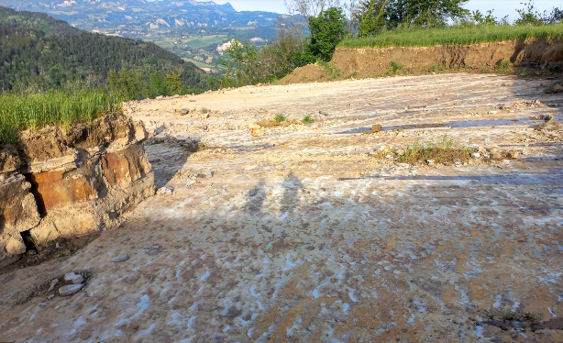
RS) Rock-block slides
Montefortino
2.5 m
Notes:
The other unit prone to landslide is the clay unit. It consists of … In these units, landslide deposits cover more than 25% of the area.

Slide 16
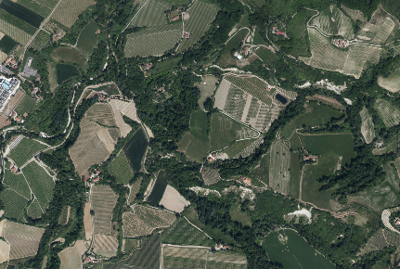
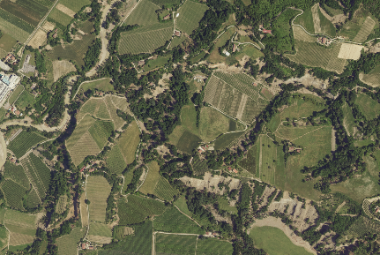
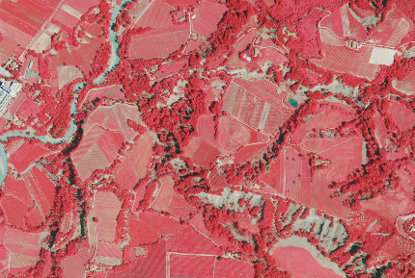
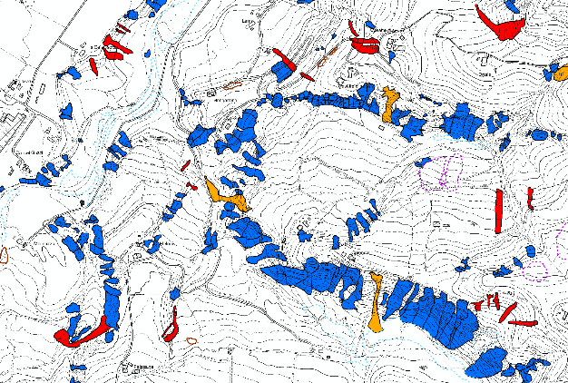
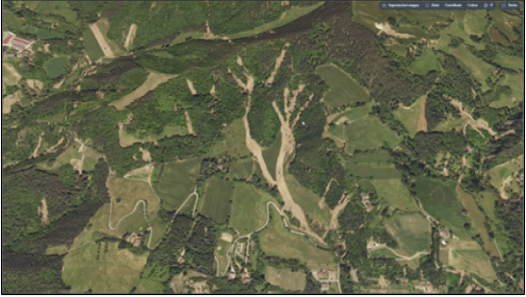
Manual mapping
Pre-Event RGB (AGEA 2020, 0.2 m)
Post-Event RGB (CGR, 0.2 m)
Post-Event NIR (CGR, 0.2 m)
Landslide map
3D viewer
Notes:
The other unit prone to landslide is the clay unit. It consists of … In these units, landslide deposits cover more than 25% of the area.

Slide 17
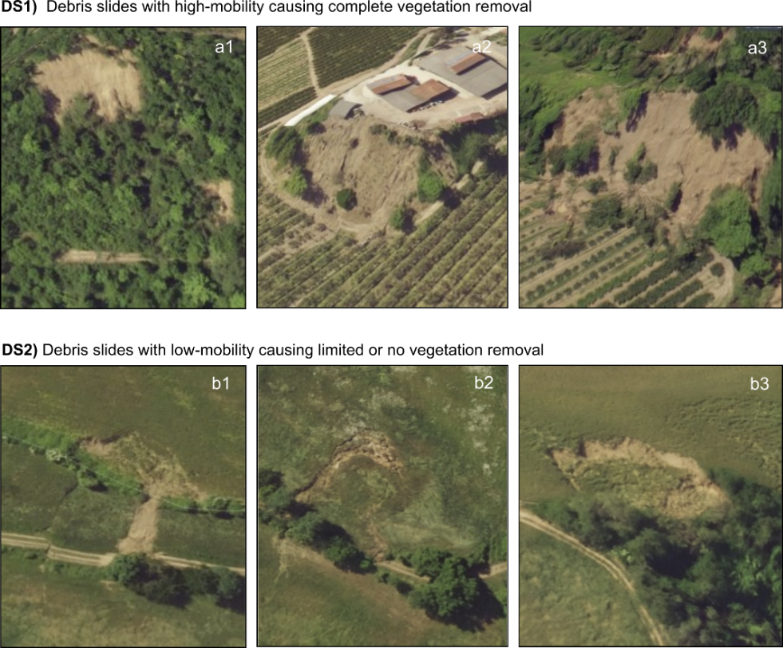
Distinct types of debris slides (DS1 – DS2)
Notes:
The other unit prone to landslide is the clay unit. It consists of … In these units, landslide deposits cover more than 25% of the area.

Slide 18
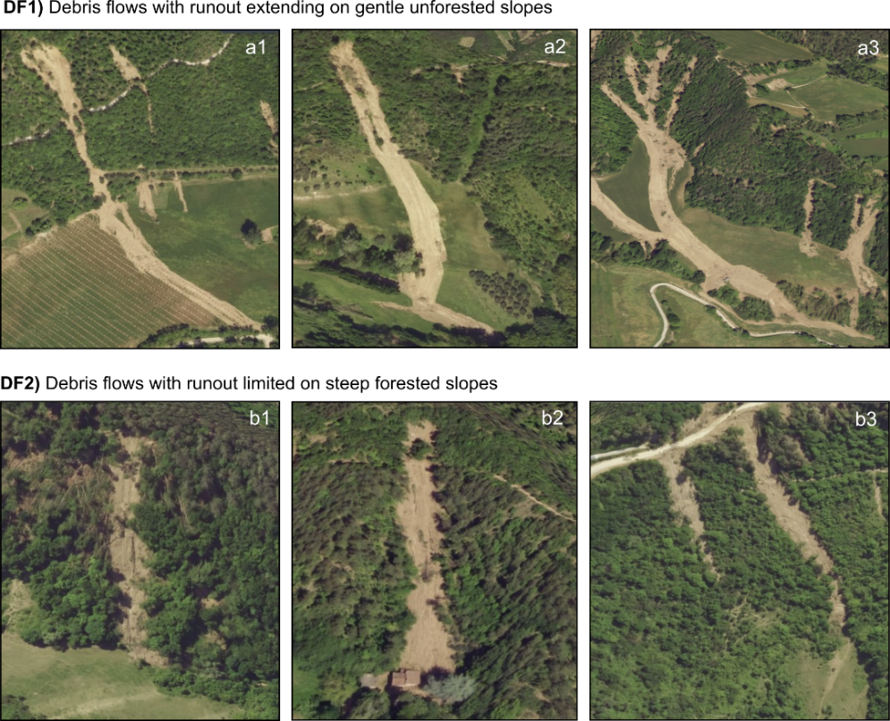
Distinct types of debris flows (DF1 – DF2)
Notes:
The other unit prone to landslide is the clay unit. It consists of … In these units, landslide deposits cover more than 25% of the area.

Slide 19
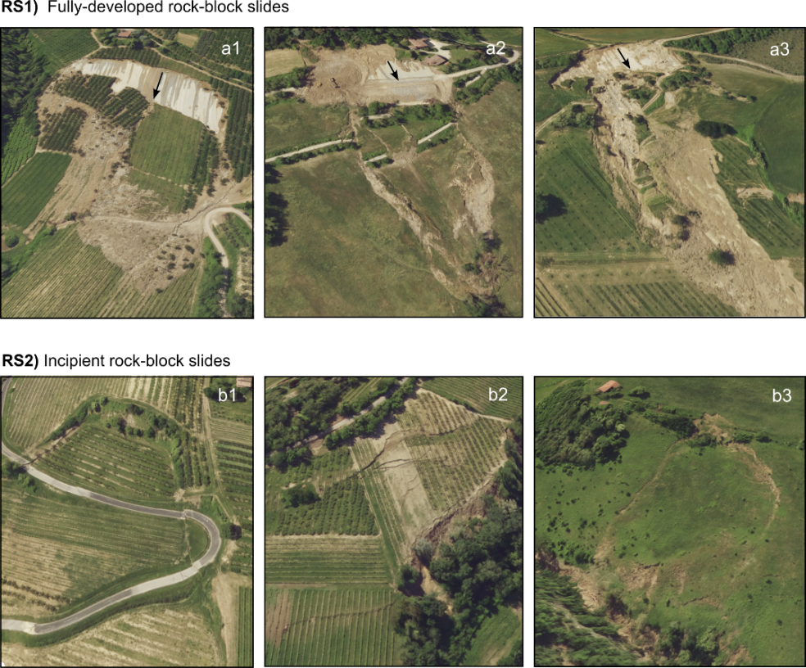
Distinct types of rock-block slides (RS1 – RS2)
Notes:
The other unit prone to landslide is the clay unit. It consists of … In these units, landslide deposits cover more than 25% of the area.

Slide 20
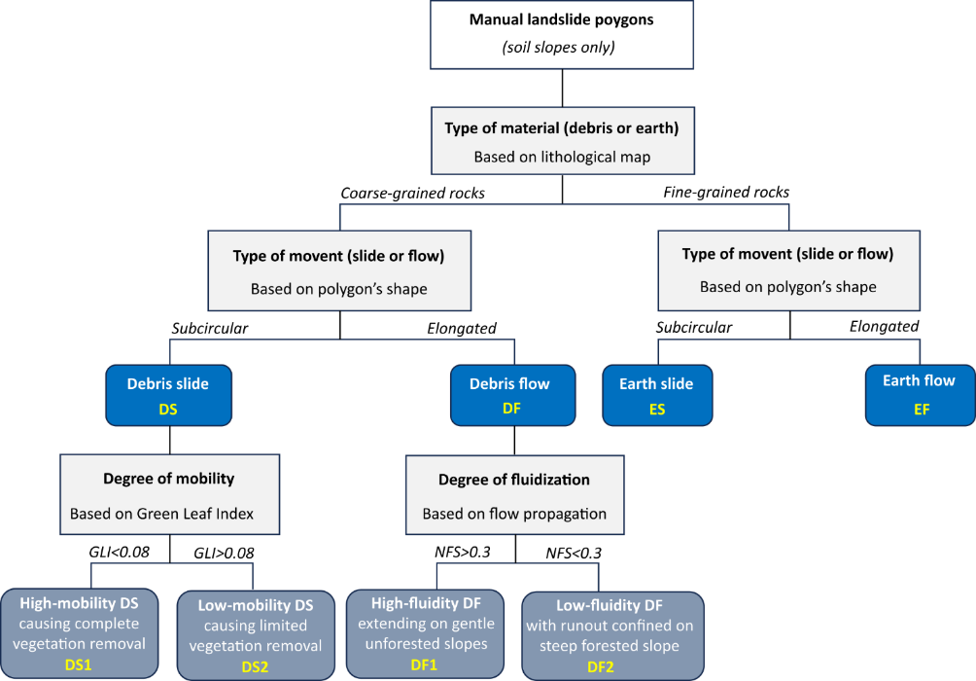
Data harmonization
Flowchart showing the process used to standardize the landslide classification
Notes:
The other unit prone to landslide is the clay unit. It consists of … In these units, landslide deposits cover more than 25% of the area.

Slide 21
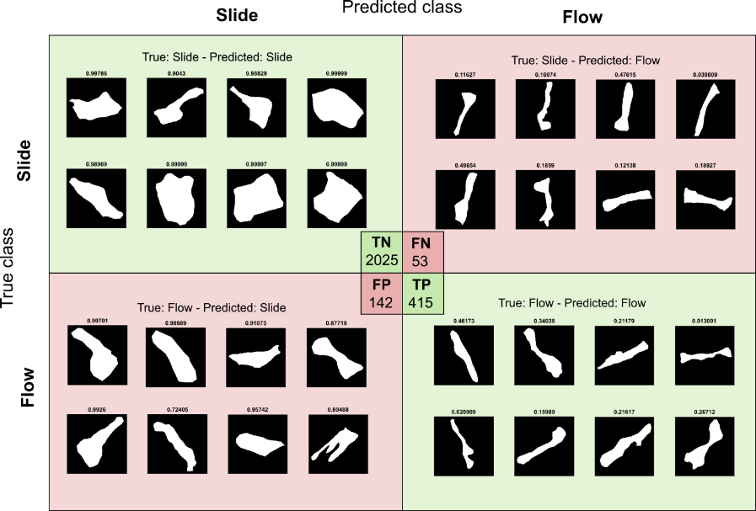
Data harmonization
Outcomes from the Convolutional Neural Network model applied to differentiate slides from flows using the shape of the polygons. The figure displays the confusion matrix for the testing dataset, which includes 50% of the landslides manually mapped in the Casola Valsenio municipality: TN=True Negative; FN=False Negative; FP=False Positive; TP=True Positive
Notes:
The other unit prone to landslide is the clay unit. It consists of … In these units, landslide deposits cover more than 25% of the area.

Slide 22
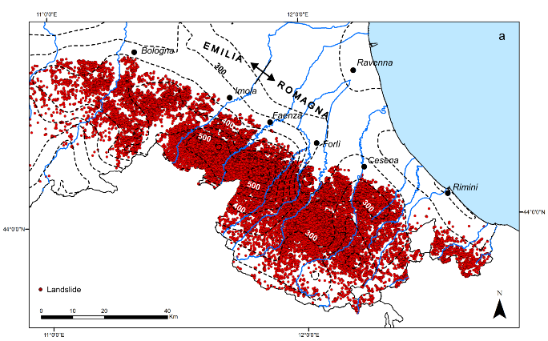
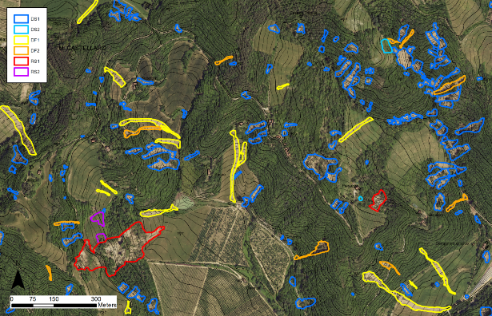
The landslide inventory
80997 landslide polygons
Total area ≈1000 km²
Classification:
Debris slide
Debris flow
Rock-block slide
Earth slide
Earth flow
Data download (Zenodo):
https://doi.org/10.5281/zenodo.13742643
Data description (Earth System Science Data):
https://doi.org/10.5194/essd-17-1055-2025
Notes:
The other unit prone to landslide is the clay unit. It consists of … In these units, landslide deposits cover more than 25% of the area.

Slide 23
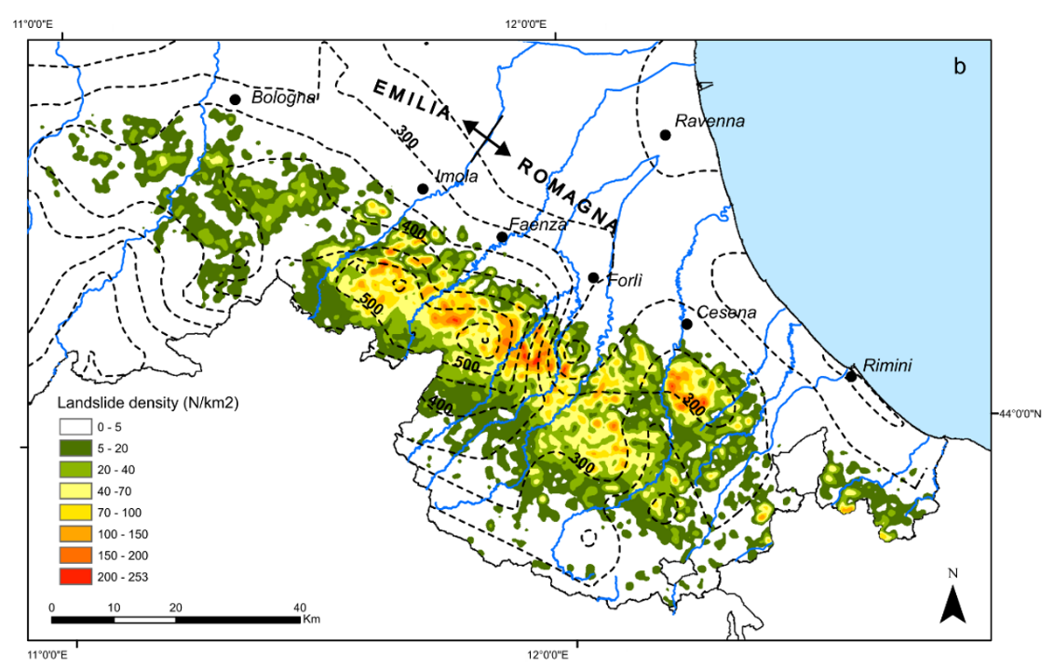
Landslide density
Density map calculated as the number of landslides per 1 km² cell
Notes:
The other unit prone to landslide is the clay unit. It consists of … In these units, landslide deposits cover more than 25% of the area.

Slide 24
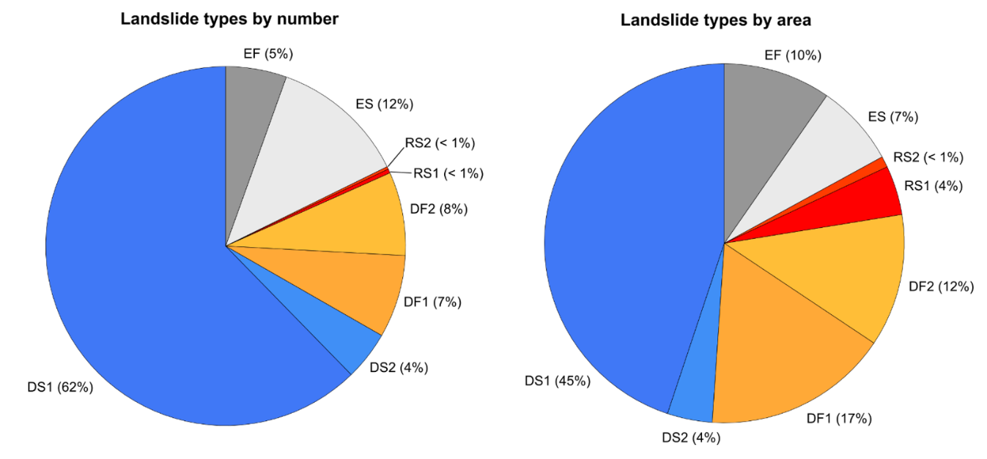
Landslide types
Notes:
The other unit prone to landslide is the clay unit. It consists of … In these units, landslide deposits cover more than 25% of the area.

Slide 25
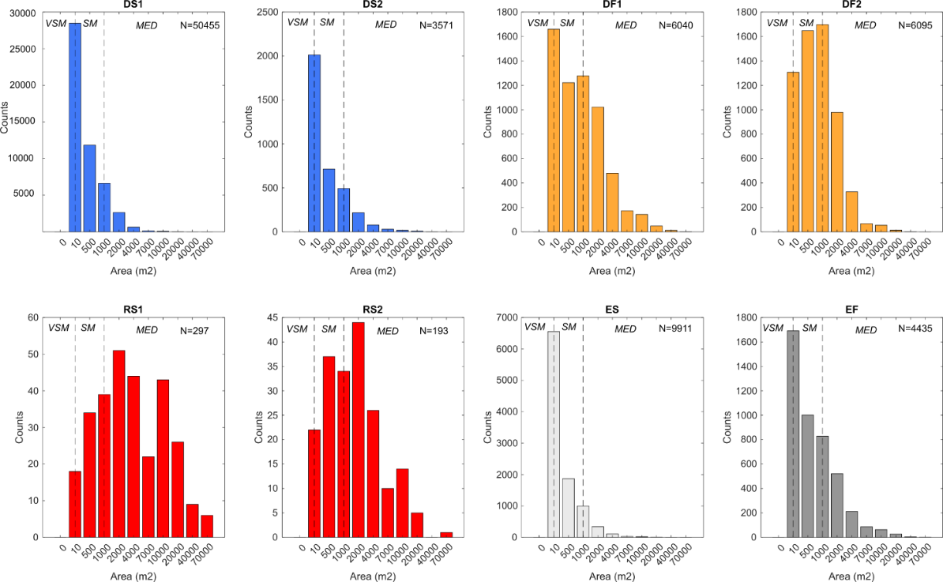
Landslide size
Frequency histograms ol landslidesize.
VSM=very small; SM=small; MED=medium (McColl and Cook, 2024)
Notes:
The other unit prone to landslide is the clay unit. It consists of … In these units, landslide deposits cover more than 25% of the area.

Slide 26
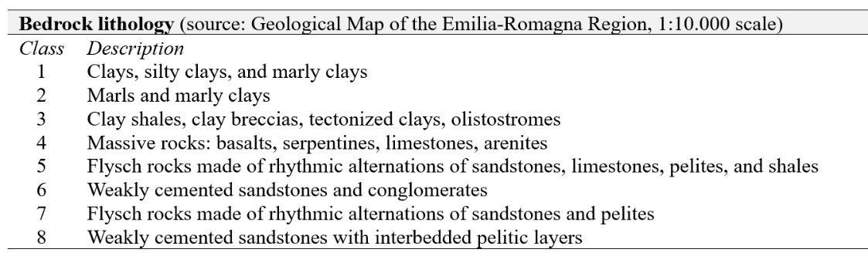
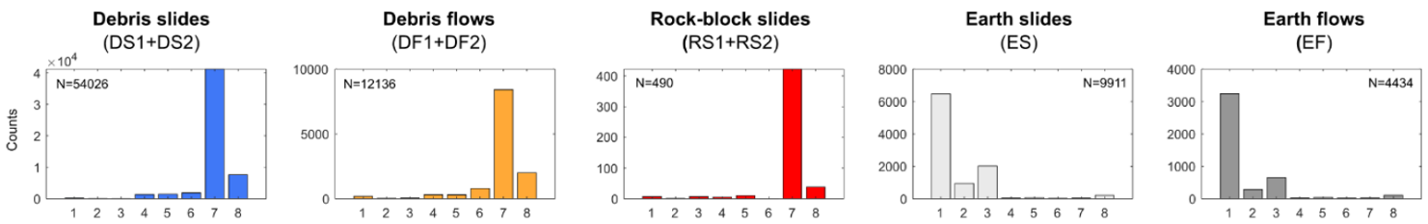
Landslide influential factors
Notes:
The other unit prone to landslide is the clay unit. It consists of … In these units, landslide deposits cover more than 25% of the area.

Slide 27


Landslide influential factors
Notes:
The other unit prone to landslide is the clay unit. It consists of … In these units, landslide deposits cover more than 25% of the area.

Slide 28


Landslide influential factors
Notes:
The other unit prone to landslide is the clay unit. It consists of … In these units, landslide deposits cover more than 25% of the area.

Slide 29


Landslide influential factors
Notes:
The other unit prone to landslide is the clay unit. It consists of … In these units, landslide deposits cover more than 25% of the area.

Slide 30


Download the dataset!
Test your susceptibilty method!!
Validate your algorithm for rapid mapping!!
Train your AI model!!
Use the dataset in your classroom!
Data download (Zenodo):
https://doi.org/10.5281/zenodo.13742643
Contact us:
Data description (Earth System Science Data):
Matteo Berti
Università di Bologna
matteo.berti@unibo.t
https://doi.org/10.5194/essd-17-1055-2025
Notes:
The other unit prone to landslide is the clay unit. It consists of … In these units, landslide deposits cover more than 25% of the area.

