Slide 1
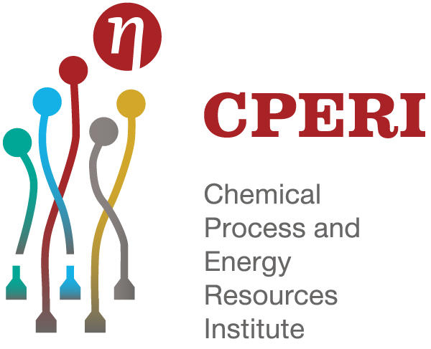
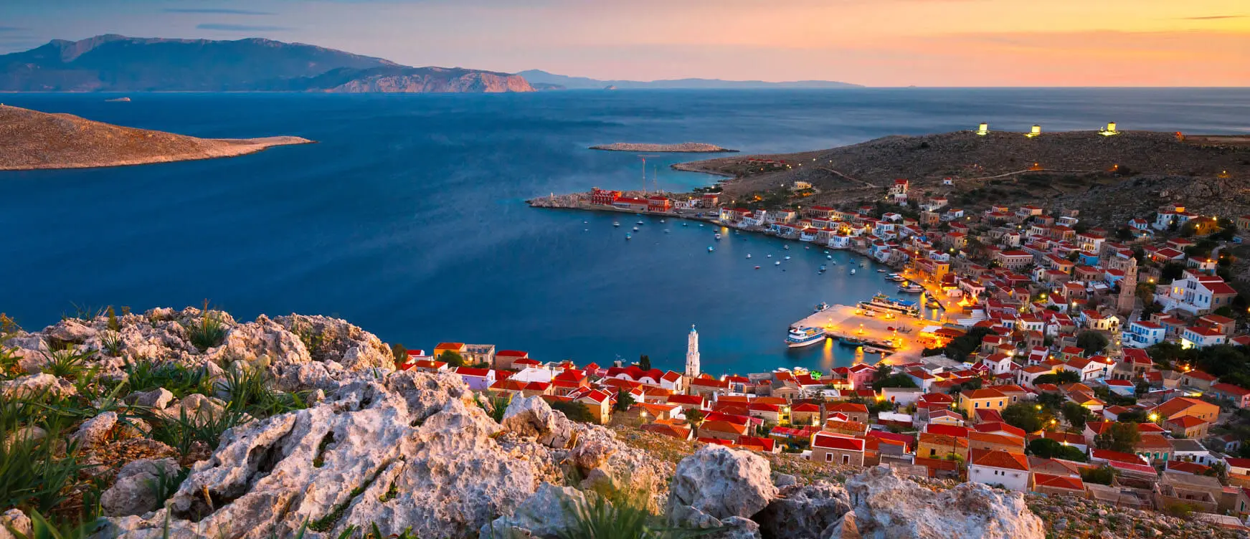
“NHSOS” Project
Vienna, Austria
27 April - 2 May 2025
EGU General Assembly 2025
Sustainable Waste Management, Air Pollution and Carbon Footprint Calculations over
Chalki Island in southeastern Mediterranean
CERTH/ CPERI Team:
I. Logothetis*, D. Kourkoumpas, A. Kerchoulas, G. Giakoumakis, A. Mitsotakis and P. Grammelis *Correspondence: logothetis@certh.gr

Slide 2
Outline
Introducing CERTH/ CPERI
A short introduction regarding the “NHSOS” Project
The contribution of CPERI in Project:
Life Cycle Assessment Methodology
Air Quality in Chalki Island
Carbon Emission Sources - Chalki

Slide 3
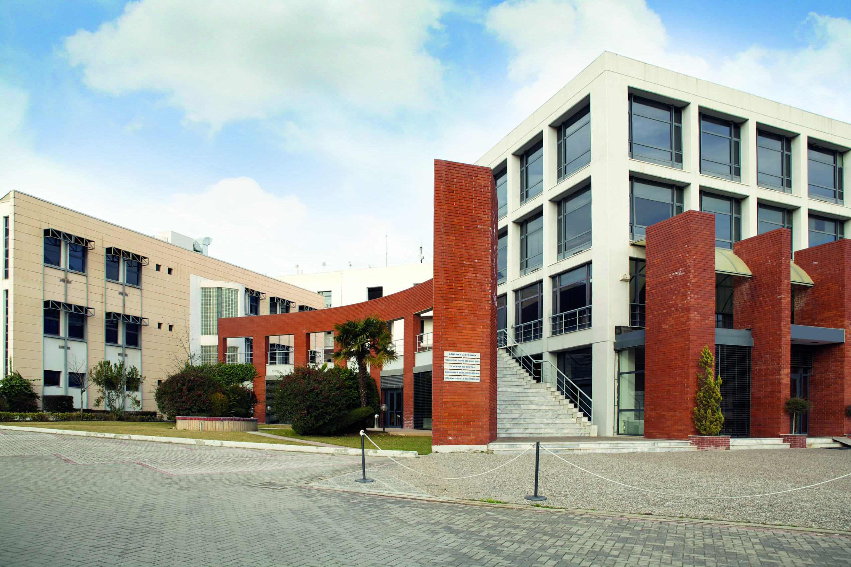
The Centre for Research and Technology Hellas (CERTH) is a legal entity governed by private law with non-profit status, supervised by the General Secretariat for Research and Innovation (GSRI) of the Greek Ministry of Development. CERTH suggests one of the most important Research Centers in Greece with a main mission: The promotion of innovative research for the benefit of society. Dedicated to this purpose, CERTH lies at the forefront of basic, applied and technological research to provide solutions to society’s modern challenges. Clean energy, low/zero CO2 emission technologies, clean vehicle technologies, green hydrogen, climate change, artificial intelligence, advanced robotic systems, the internet of things, Industry 4.0, smart home infrastructure for the future, precision medicine, holistic health nutrition, holistic health-nutrition approach, autonomous vehicles, driving simulators, traffic control hubs, smart cities, precision agriculture, agro-robotics and circular economy, are the primal fields around which CERTH’s five (5) institutes are organized. Chemical Process & Energy Resources Institute - CPERI, Information Technologies Institute - ITI, Hellenic Institute of Transport - HIT, Institute of Applied Biosciences - INAB, and Bio-economy and Agro-Technology Institute - IBO, bring together more than 1600 people (engineers and scientists in their majority), in 7 regions and 9 cities of Greece.
The main scientific direction of CERTH/ CPERI:
Energy - green energy, RES, promotion of RES in buildings, clean carbon technologies, hydrogen applications, transition to the post lignite era,
Smart systems - smart technologies) and
Environment - environmental technologies, circular economy based on Life Cycle thinking approach, waste management, air quality, air pollution, pollution monitoring, alternative fuels

Slide 4
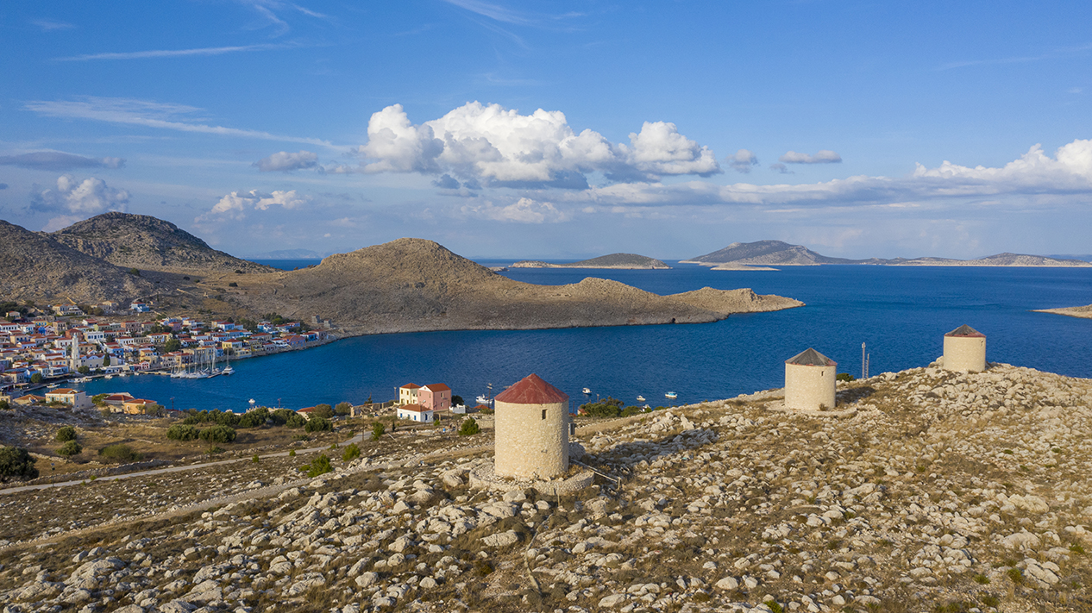
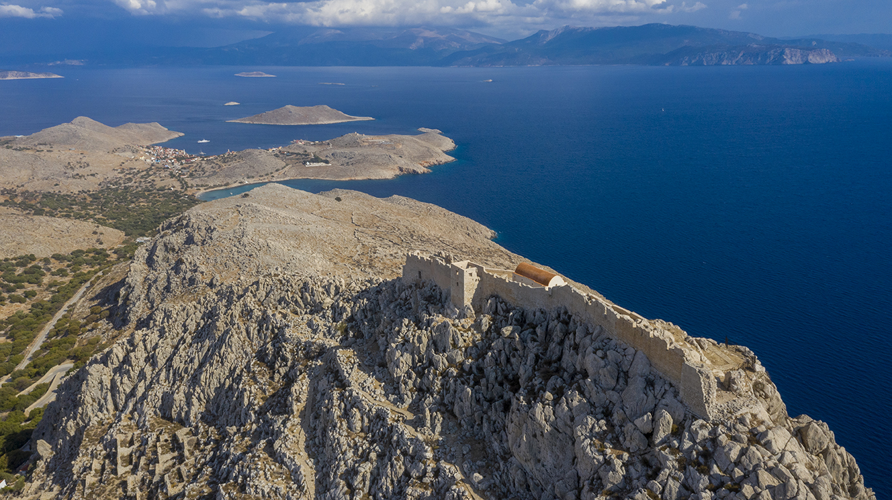
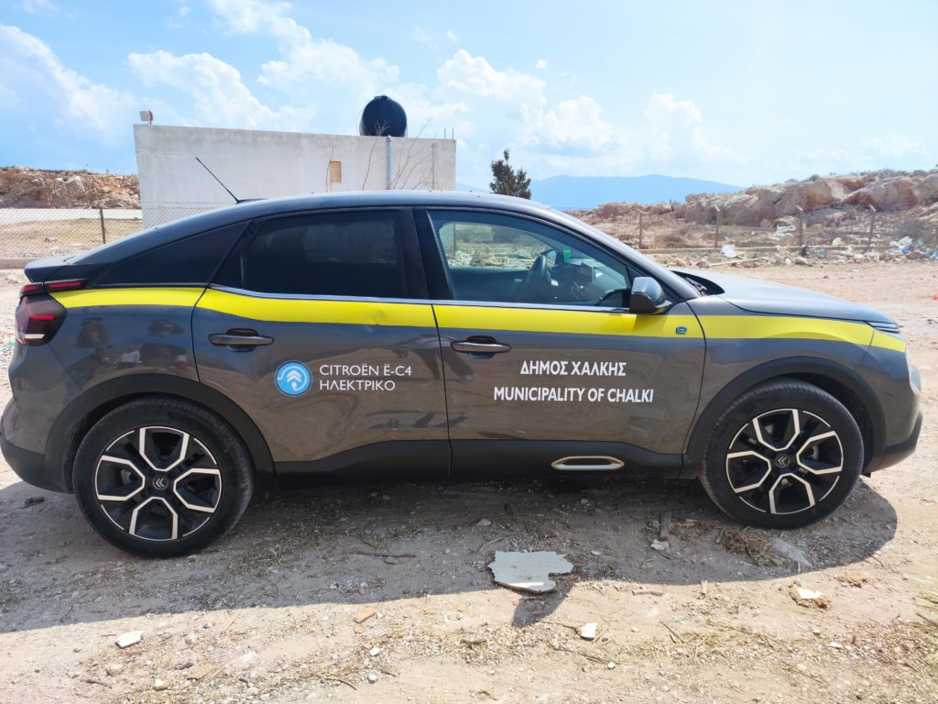
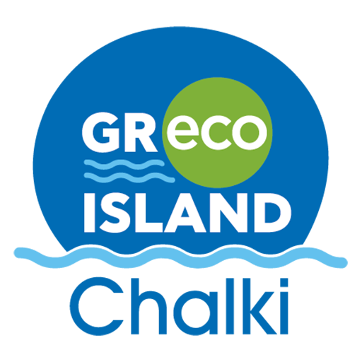
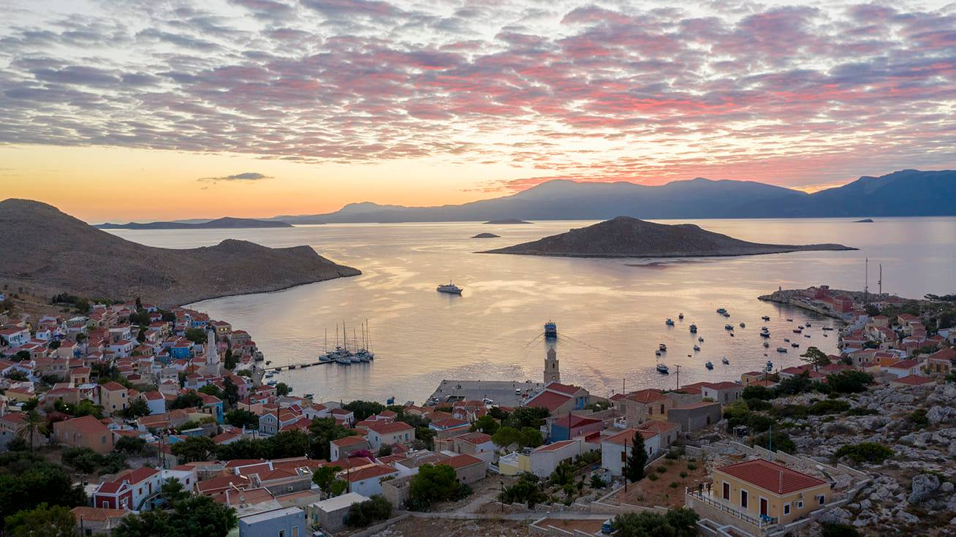
“NHSOS” Project aims to provide a sustainable and holistic vision for Chalki Island adopting practices and actions that can be expanded in other Islandic ecosystems.
“NHSOS” actions include:
Renewable systems (a small number of high efficiency PV panels will be installed in Island),
Smart systems for high Energy efficiency (connected to the local Energy network),
Smart energy network (an energy demand management center will upgrade the energy efficiency for the Island),
Chargers for electro-mobility (electric vehicles, bikes and scooters),
Pilot studies for the installation of wave energy machines (mapping up to 100m),
Waste management (promoting the principles of circular economy),
Air Quality studies (mapping the level and variation of air pollution in areas of interest i.e. Chalki’s port),
Smart tourist card to promote “green” tourism
In the context of “NHSOS” project, a pilot “Green Park” where visitors would be familiarized with sustainable practices and “green” technologies

Slide 5
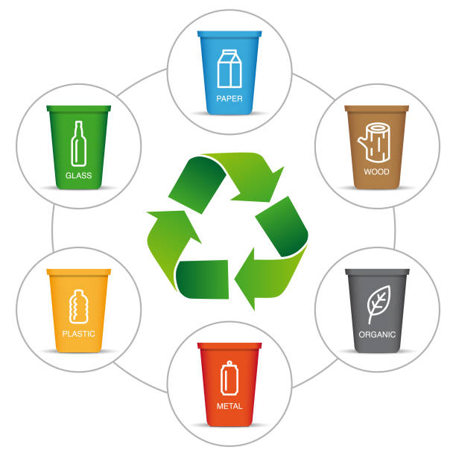
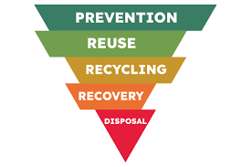
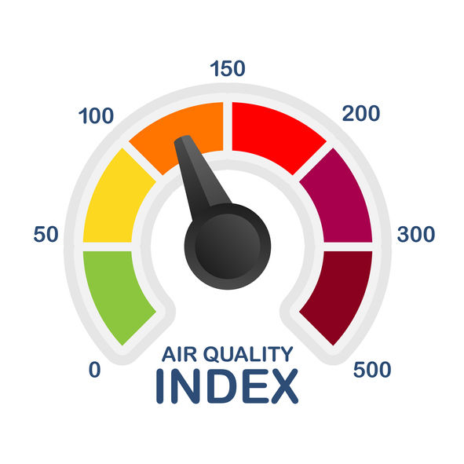
CERTH/CPERI contribution is focused on:
Waste Management, Carbon footprint and Air Quality
“NHSOS” Project
(promoting sustainability & circular economy in Chalki Island)
Waste Management
(studying the current conditions, investigating the environment to propose solutions)
Optimization of the Waste Management network
(promoting environmental sustainability and the circular economy)
Air Quality
(studying the variability of air pollution and the impact of meteorology and atmospheric circulation on pollution levels
Methodology to calculate the carbon footprint
(identifying the processes with the largest footprint, focusing on tourism infrastructure and public buildings)

Slide 6
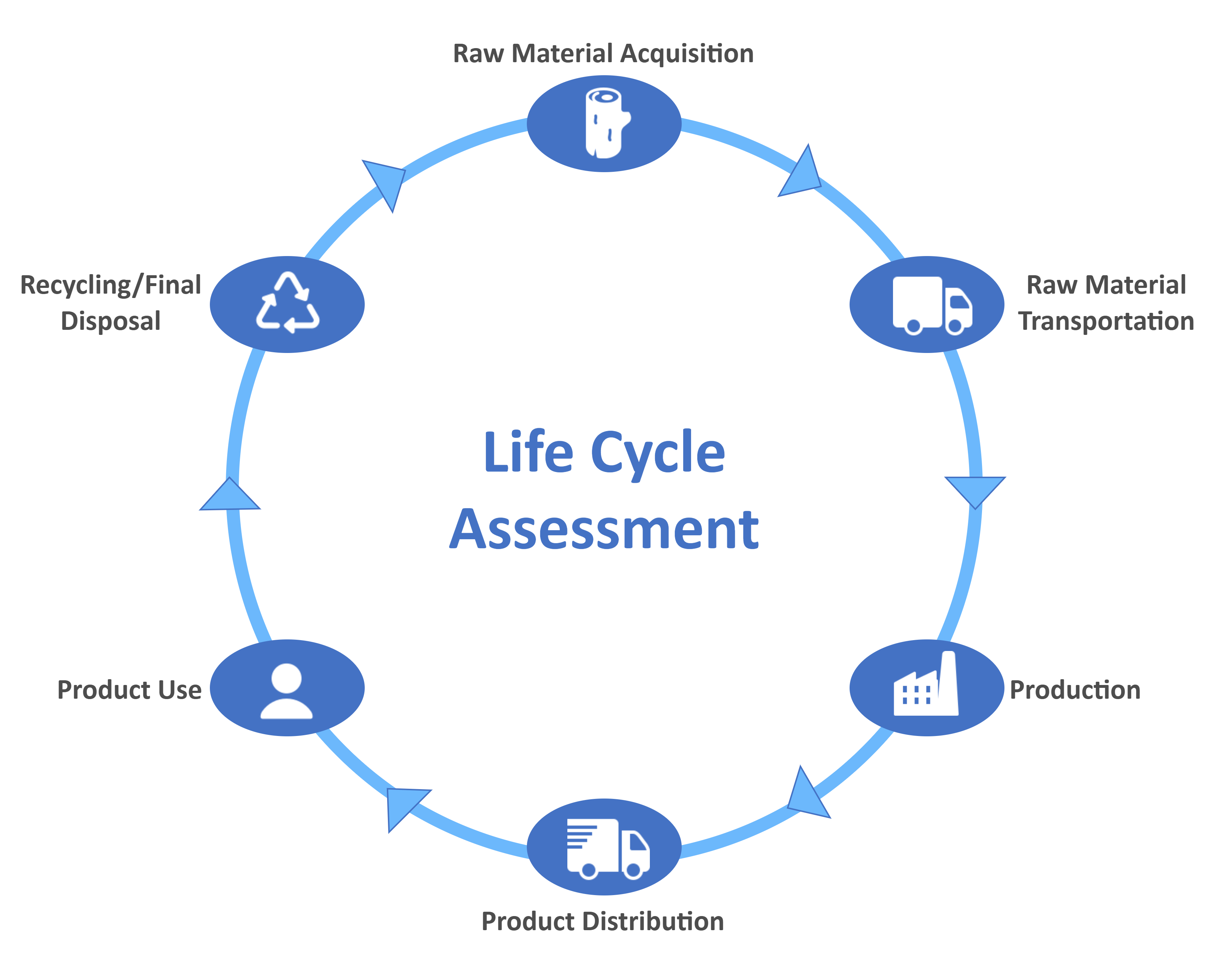
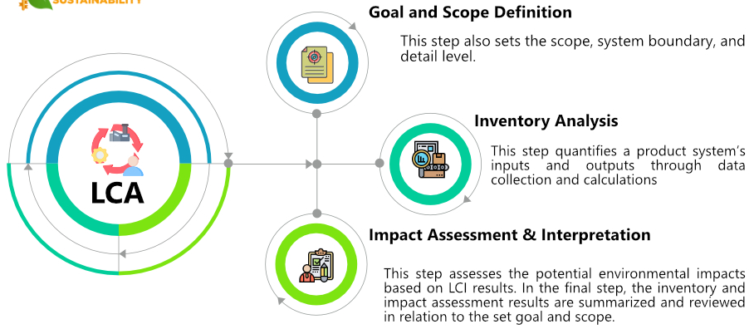
Life Cycle Assessment Methodology
According to the international standard ISO 14040, Life Cycle Assessment (LCA) is defined as the systematic method for evaluating the environmental aspects and potential impacts associated with a product or process throughout its entire life cycle, from raw material extraction to recycling and final disposal.
There are four stages in a LCA study:
Goal and Scope Definition
Inventory Analysis
Impact Assessment
Result Interpretation
Based on the interpretation stage, adjustments can be made to all preceding phases, ensuring robust results that align with the study’s intended objective.
During the LCA, all identified environmental impacts are quantified and standardized using impact category-specific equivalent units.
These impact results are further converted based on a selected Functional Unit (FU), in order to produce comprehensive results and facilitate the comparison with the international literature.
Some of the most commonly-assessed impact categories include:
Climate Change (CC), associated with the carbon footprint of the examined system (expressed in kg CO_{2-eq}).
Acidification Potential (AP), associated with all impacts that degrade soil quality (expressed in kg SO_{2-eq}).
Eutrophication Potential (EP), associated with nutrient pollution that is harmful to aquatic life (expressed in kg PO_{4-eq}).

Slide 7
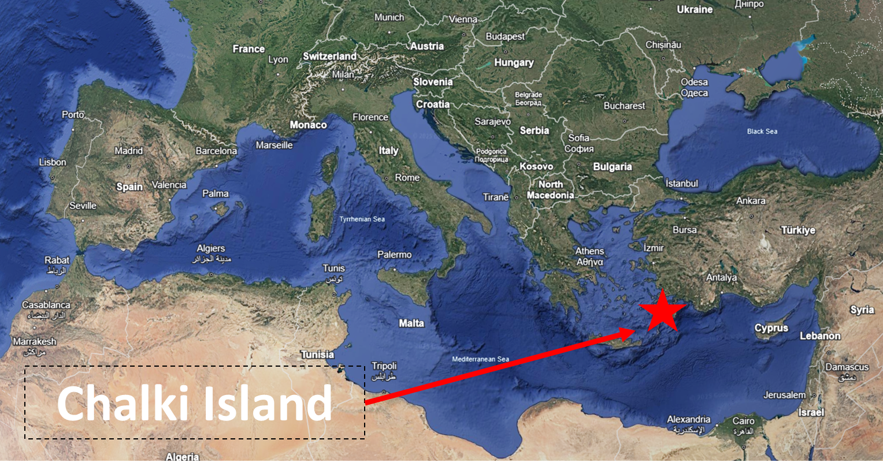
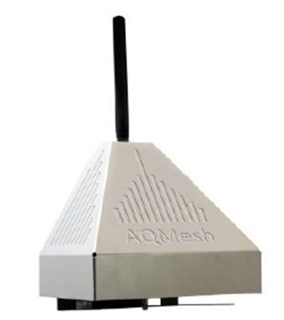
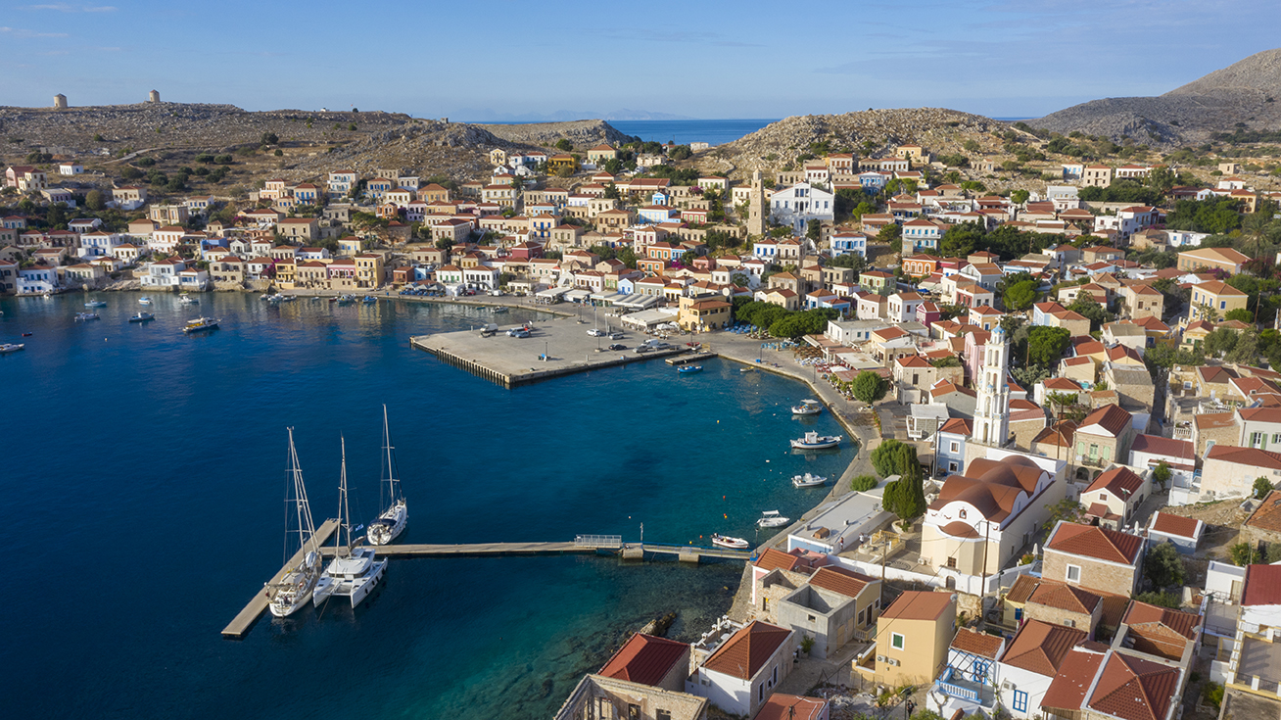
Goals
Air Quality in Chalki
Studying the Concentration & Variation of Pollutants
Mapping the Air Quality in vulnerable regional-based ecosystems over eastern Mediterranean
Promoting sustainability
a.)
b.)
DATA
Recordings from Air Quality Monitoring Systems (AQMS), Location: Town Hall & Port of Chalki city(calibrated Haz-Scanner™ Model HIM-600 & AQ-Mesh AQ monitoring system)
ERA5 Reanalysis data (a geographical window around Chalki Island)
HYSPLIT (back-trajectory Model)
Dust concentration (Barcelona Dust Regional Center visualization tool for dust forecasts).
Figure X. The location of (a) Chalki Island in the Mediterranean region (source: https://earth.google.com/web/ (b) the mobile air quality monitoring systems in the town of Chalki.
Findings
Generally, the air quality conditions are classified in “Good” and “Moderate” classes.
Traffic conditions affect the variation of pollutants concentrations
The meteorological conditions and atmospheric circulation features significantly affect the air quality
Findings emphasize the importance of air quality measurements in order to inform the authorities and protect the population.

Slide 8
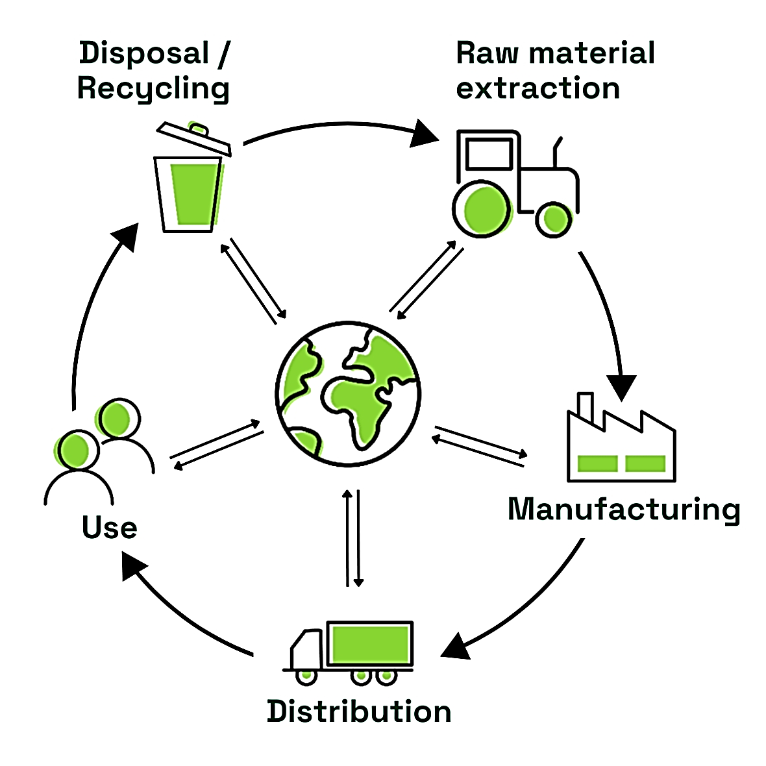
Examining the Carbon Emission Sources of Chalki
Life Cycle Assessment of Small Island Systems
The environmental evaluation of small islands presents distinct challenges compared to larger islands and conventional mainland systems. Limited resource availability, seasonal population surges, and geographic isolation often lead to increased carbon emissions, driven by the import of goods, tourism-related transportation, and inefficient waste management.
These factors additionally complicate accurate environmental assessments, as data on visitor fluctuations, associated waste generation, and dynamic transport schedules are often inconsistent or unavailable. Consequently, the LCAs of small islands require tailored approaches that effectively utilize all available data and distinguish the various potential emission sources.
The case of Chalki
During the qualitative assessment of Chalki’s carbon emission sources, several key contributors were identified:
Permanent residences (grid electricity usage for household appliances and conventional heating systems).
Accommodation facilities (elevated electricity consumption and frequent reliance on single-use products).
Food service establishments (inadequate management of the organic waste fraction).
Transportation means (fossil fuel powered vehicles).
Island Port (fossil fuel consumption).
Waste management network (high volume of transported mixed waste).
To reduce the carbon emissions, the suggested mitigation strategies included:
Integration of Renewable Energy Systems (RES) in the island’s electricity network and utilization of electric vehicles for tourism-related transportation.
Optimization οf the waste collection schedule and effective bin distribution.
Implementation of a 'Door-to-Door' waste collection system by the island's permanent residents, and installation of 'Green Points' (Recycling Centers) and Waste Transfer Stations (WTS) on the island.
Responsible use of electrical appliances by permanent residents, and electricity consumption limits for visitors enforced by hospitality businesses.

Slide 9
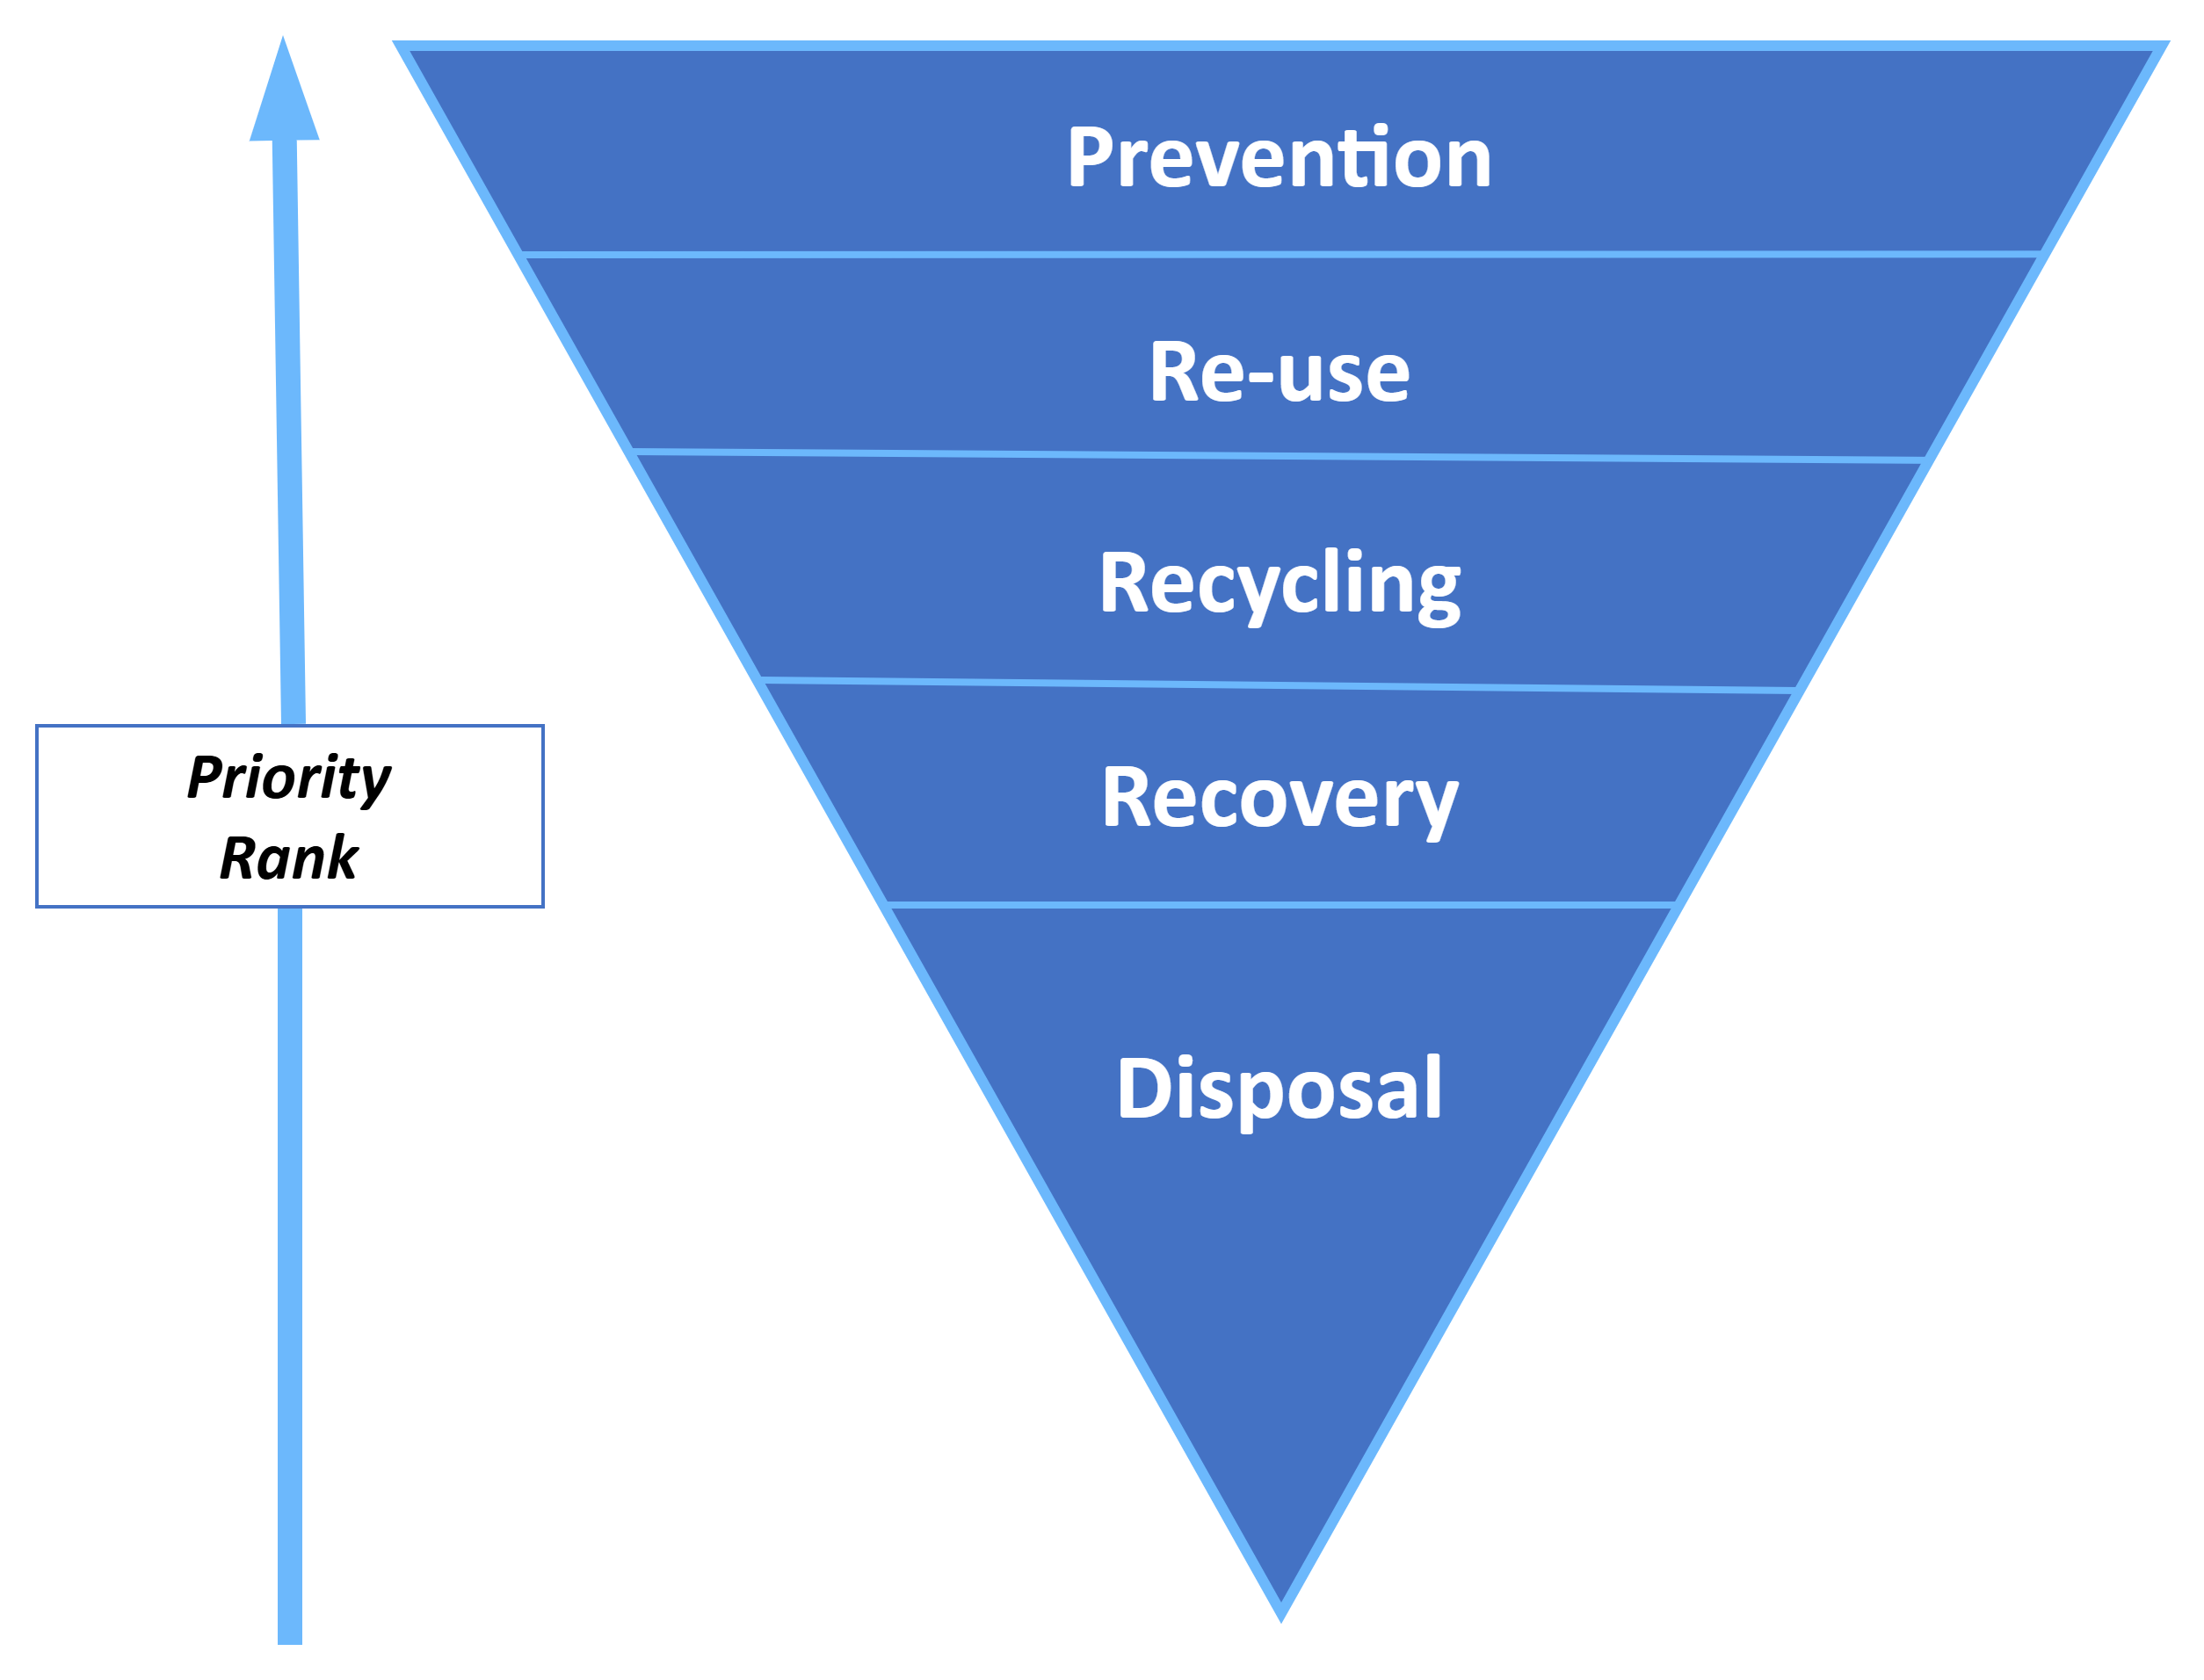
Optimization of Chalki’s Waste Management network
According to municipal data, the island of Chalki hosted 20,000 visitors in 2019, generating 303 tons of municipal solid waste (MSW) with 91% attributed to permanent residents and 9% to tourism.
By 2024, the island hosted approximately 125,000 visitors, whose activities generated 464 tons of MSW, marking a 35% increase in total waste output.
To sustainably manage this rise in produced waste, a series of targeted strategies was proposed, aligned with the principles of the waste management hierarchy.
Waste Management Strategies
Priority Level | Implementation Measures
Prevention | Develop school programs and workshops on sustainable waste management practices.
 | Upgrade of “Green Points” into educational hubs to promote source-sorting and recycling.
 | Mandate responsible management of single-use materials by hospitality businesses.
Reuse | Promote the use of reusable/biodegradable products in hospitality.
 | Implement deposit-return systems (DRS) for containers.
 | Support upcycle initiatives that convert metal/plastic/textile waste into daily-use items.
 | Establish local swap markets for used products.
Recycling | Implement a dynamic “Door-to-door” collection system based on the existing network’s capacity.
 | Integrate active source-separation in schools.
 | Install small "Green Points“ on a neighborhood scale before moving to larger investments.
 | Upgrade and optimize the public waste bin network.
Recovery | Install composting systems at “Green Points” for organic waste valorization and natural fertilizer production.
Disposal | Deploy pre-treatment systems to facilitate waste transportation.

Slide 10
THANK YOU
For more information pleas see the following links:
https://www.nhsos-project.gr/
https://www.certh.gr/
https://www.dimoshalkis.gr/

