Slide 1
Spring Phenology Models for Temperate Apple Cultivars:
A Citizen-Science based Approach
Thomas Ohnemus, Simon Paasch & Hannes Mollenhauer thomas.ohnemus@ufz.de |EGU25 – 28.04.2025

Slide 2
We want to answer two main questions
Can we produce precise generalized cultivar-specific spring phenology models using citizen science data?
Appropriate modelling framework?
Appropriate data quality?
Is this modelling approach valid to predict spring phenology in a warmer future?

Slide 3
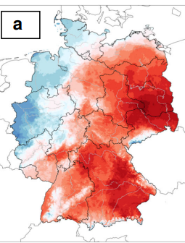
We use PhenoFlex to delineate cultivar-specific spring phenology models
Luedeling et al. 2021
Framework
Dynamic-style chill model (Fishman et al. 1987 a, b)
Growing Degree Hours style heat model (Anderson et al. 1986)
Gradual Transition
12 Parameters
Implementation
Weather
Phenology
Inputs
Open data
Hourly
1x1 km²
from 1995 until present
Open data
Citizen-science
Cultivar-specific
Phase-specific
Annually >1000 observations
chillR package
Luedeling et al. 2024
Fitting produces local optima
Krähenmann et al. 2018

Slide 4
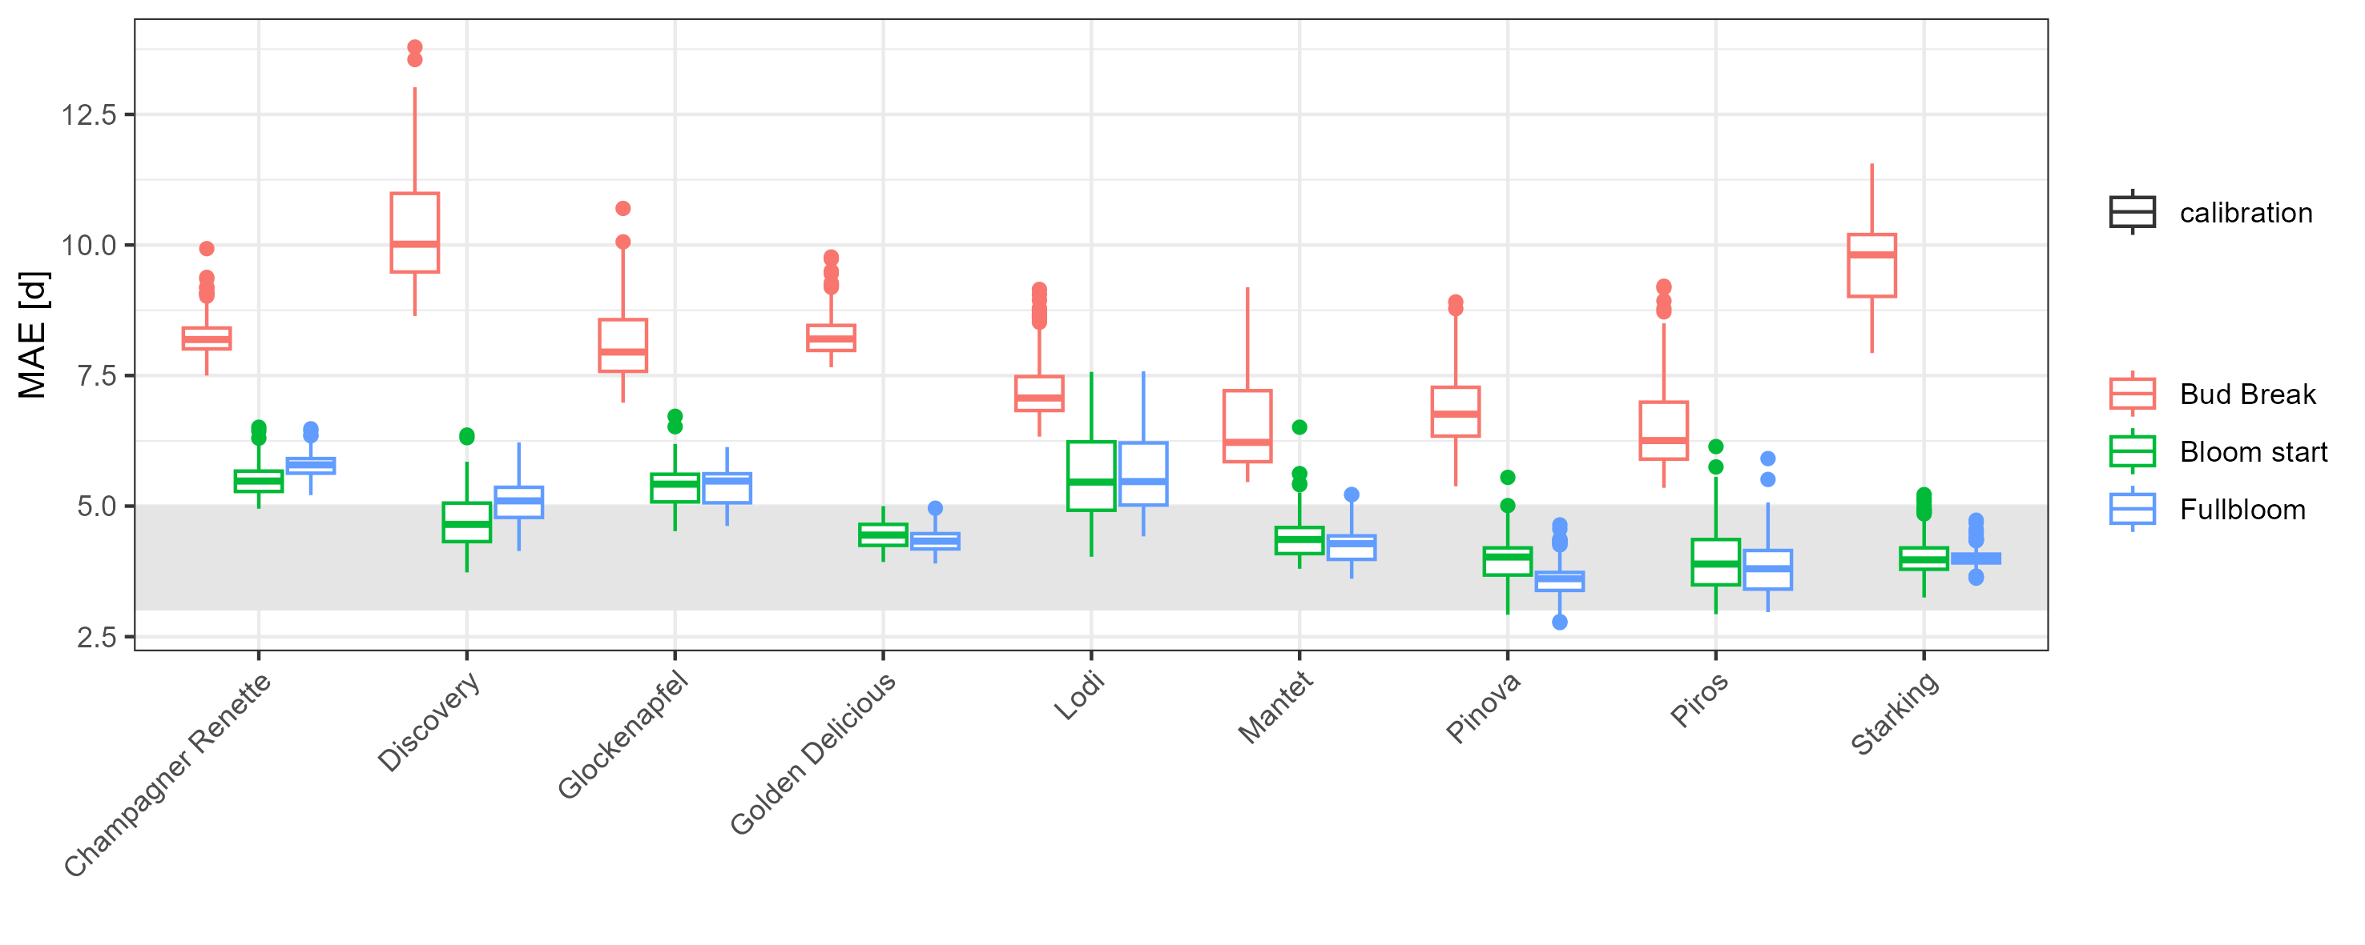
Bloom phases can be modelled with 3-5 days deviation, bud break clearly worse
Can we produce precise generalized cultivar-specific spring phenology models using citizen science data?

Slide 5
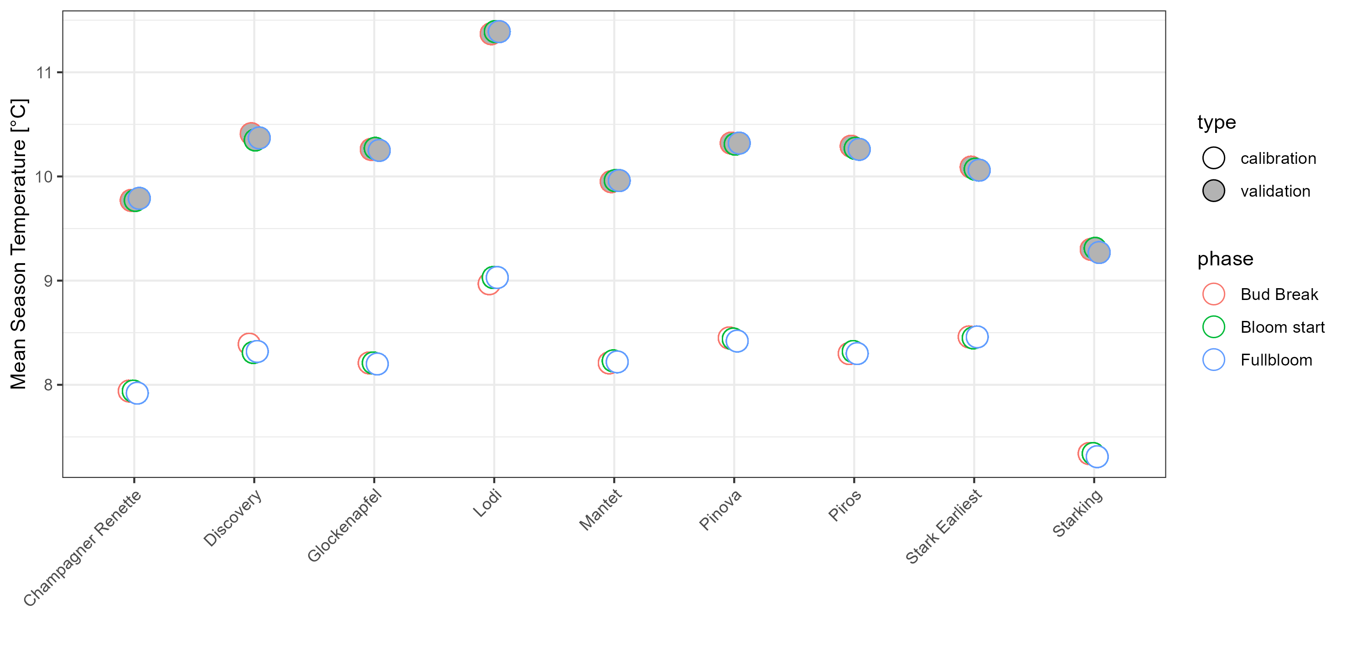
Is this modelling approach valid to predict spring phenology in a warmer future?
Validation Dataset 25 % warmest seasons used for parameter validation
1.8 – 2.4 °C
Calibration Dataset 75 % coolest seasons used for parameterization

Slide 6
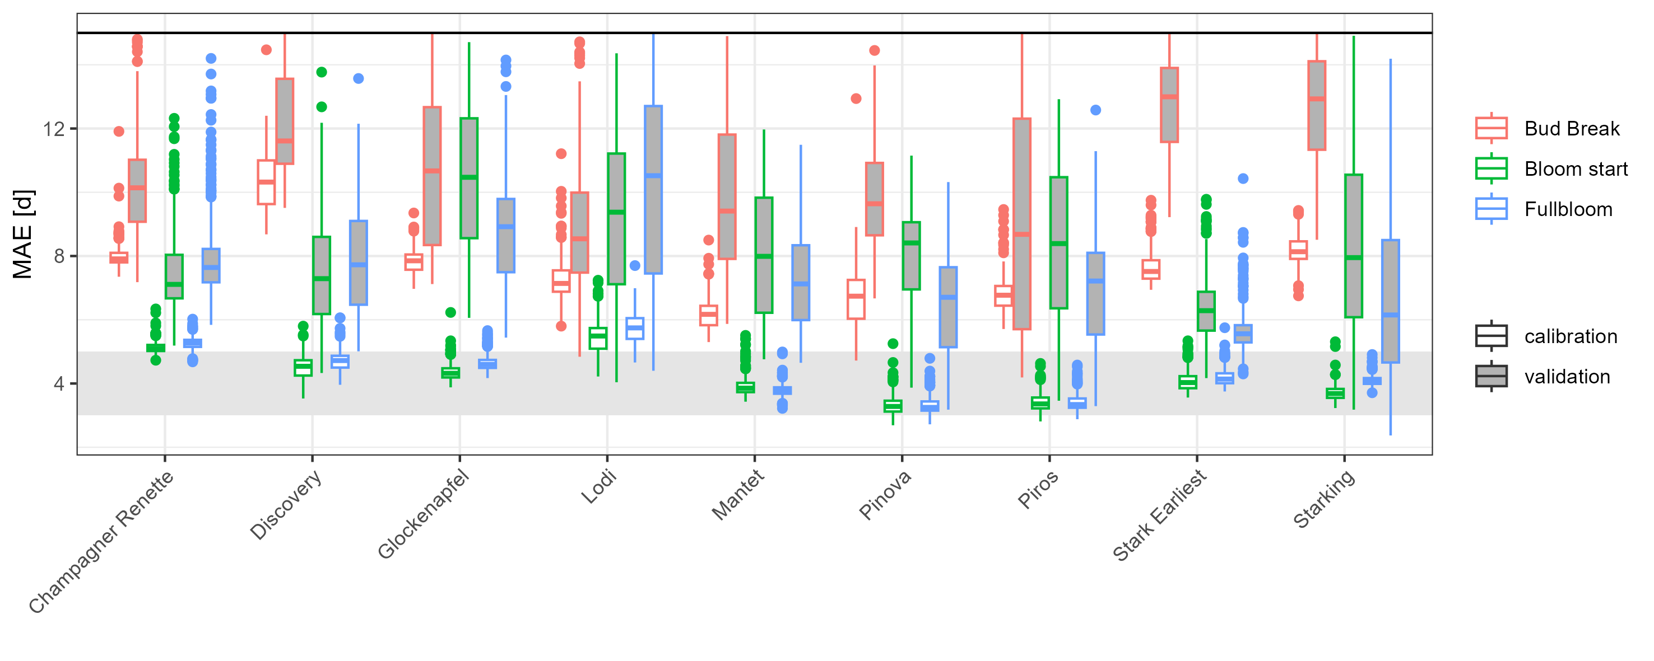
Is this modelling approach valid to predict spring phenology in a warmer future?
Yes, but parameter sets must be chosen carefully

Slide 7
Conclusions
PhenoFlex handy open source tool for quick process-based phenology modelling
Citizen-science data of bloom phases and 1x1 km² weather data suitable for generalized phenology models
Bud break modelling limited by data quality, since PhenoFlex can perform well for bud break (e.g. Kamimori & Hosomi 2025, Maguylo et al. 2012)
Prediction for warmer future possible, must be considered carefully
Outlook
Extend to > 20 cultivars
Use databases covering a wider range of climates
Different citizen-science sources could be combined (e.g. 26 apple cultivars in the UK, Tang et al. 2024)
Improved process understanding still required for improved process-based parameterization
Reach out: thomas.ohnemus@ufz.de

Slide 8
References
Anderson, J.L., Richardson, E.A., Kesner, C.D., 1986. Validation of Chill Unit and Flower Bud Phenology Models for ‘Montmorency’ sour Cherry. Acta Hortic. (184), 71–78.
Fishman, S., Erez, A., Couvillon, G.A., 1987a. The temperature dependence of dormancy breaking in plants: Computer simulation of processes studied under controlled temperatures. Journal of Theoretical Biology 126 (3), 309–321.
Fishman, S., Erez, A., Couvillon, G.A., 1987b. The temperature dependence of dormancy breaking in plants: Mathematical analysis of a two-step model involving a cooperative transition. Journal of Theoretical Biology 124 (4), 473–483.
Krähenmann, S., Walter, A., Brienen, S., Imbery, F., Matzarakis, A., 2018. High-resolution grids of hourly meteorological variables for Germany. Theor Appl Climatol 131 (3-4), 899–926.
Luedeling, E., Caspersen, L., Fernandez, E., 2024. chillR: Statistical Methods for Phenology Analysis in Temperate Fruit Trees. R package version 0.76.
Luedeling, E., Schiffers, K., Fohrmann, T., Urbach, C., 2021. PhenoFlex - an integrated model to predict spring phenology in temperate fruit trees. Agricultural and Forest Meteorology 307, 108491.
Maguylo, K., Cook, N.C., Theron, K.I. 2012. Environment and position of first bud to break on apple shoots affects lateral outgrowth. Trees 26, 663-675. doi: 10.1007/s00468-011-0634-y
Tang, H., Zhai, X., Xu, X., 2024. Evaluating the performance of models predicting the flowering times of twenty-six apple cultivars in England. European Journal of Agronomy 160, 127319.

Slide 9
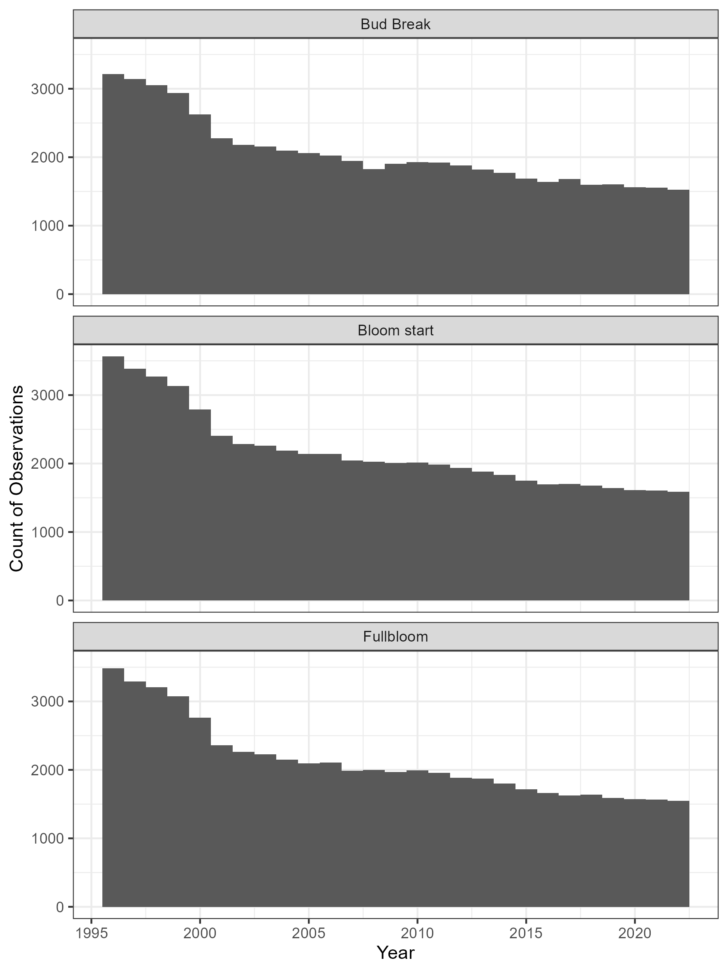
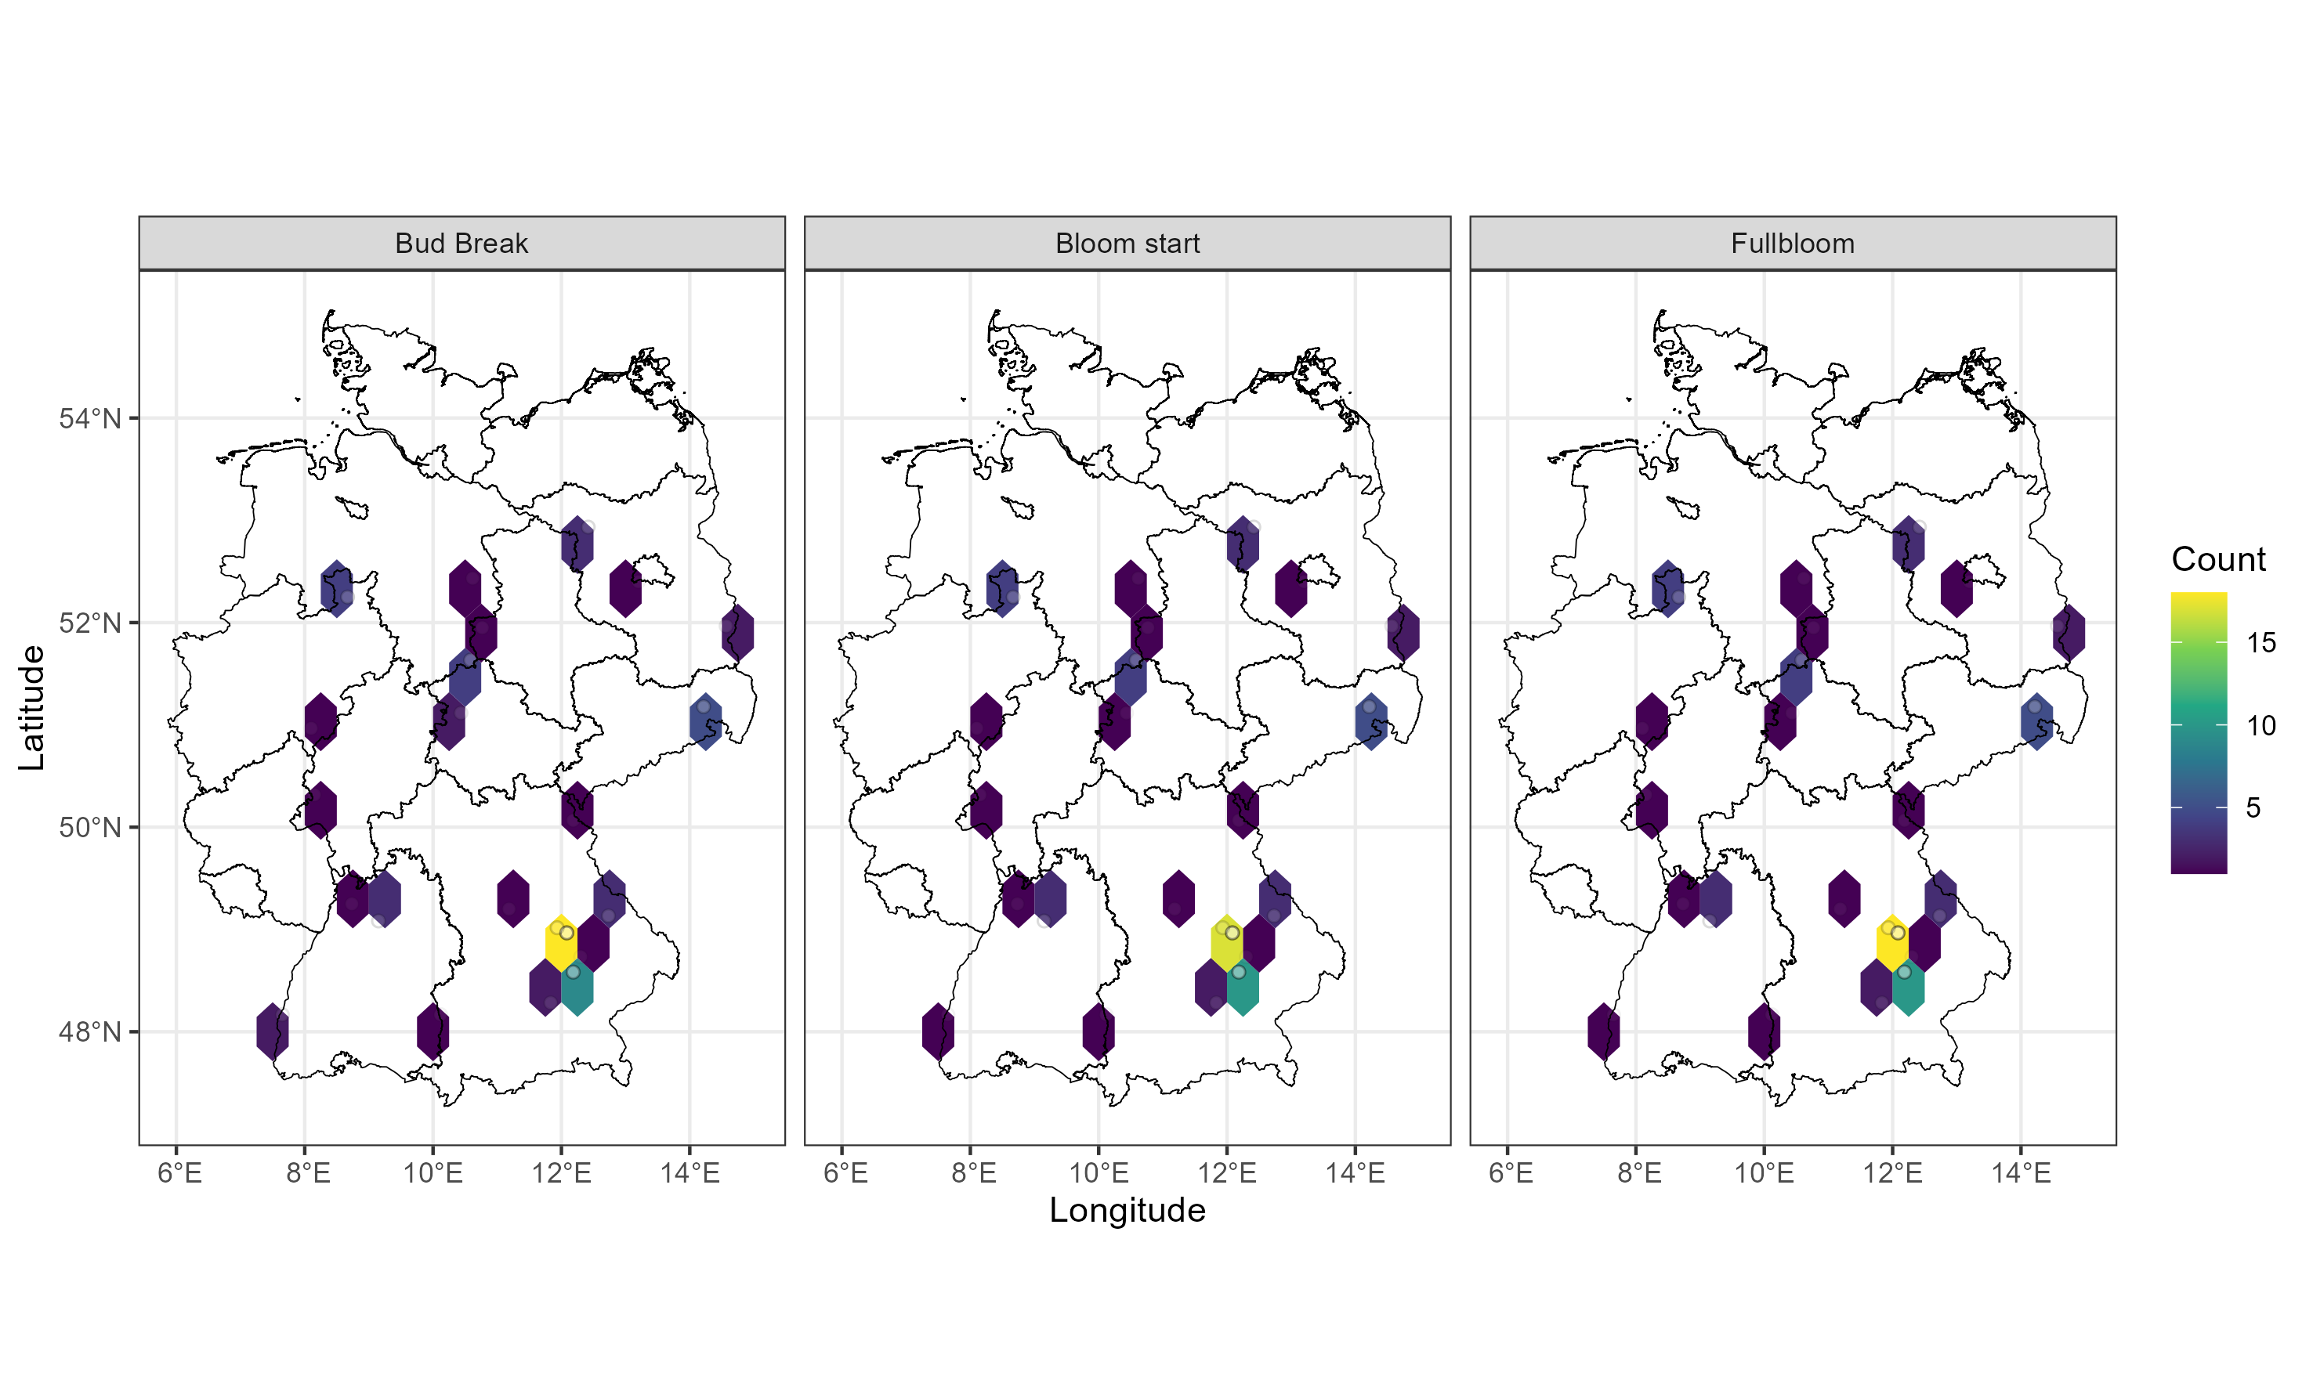
A DWD citizen-science phenology database provides a vast phenology dataset
Boskoop
Starking

Slide 10
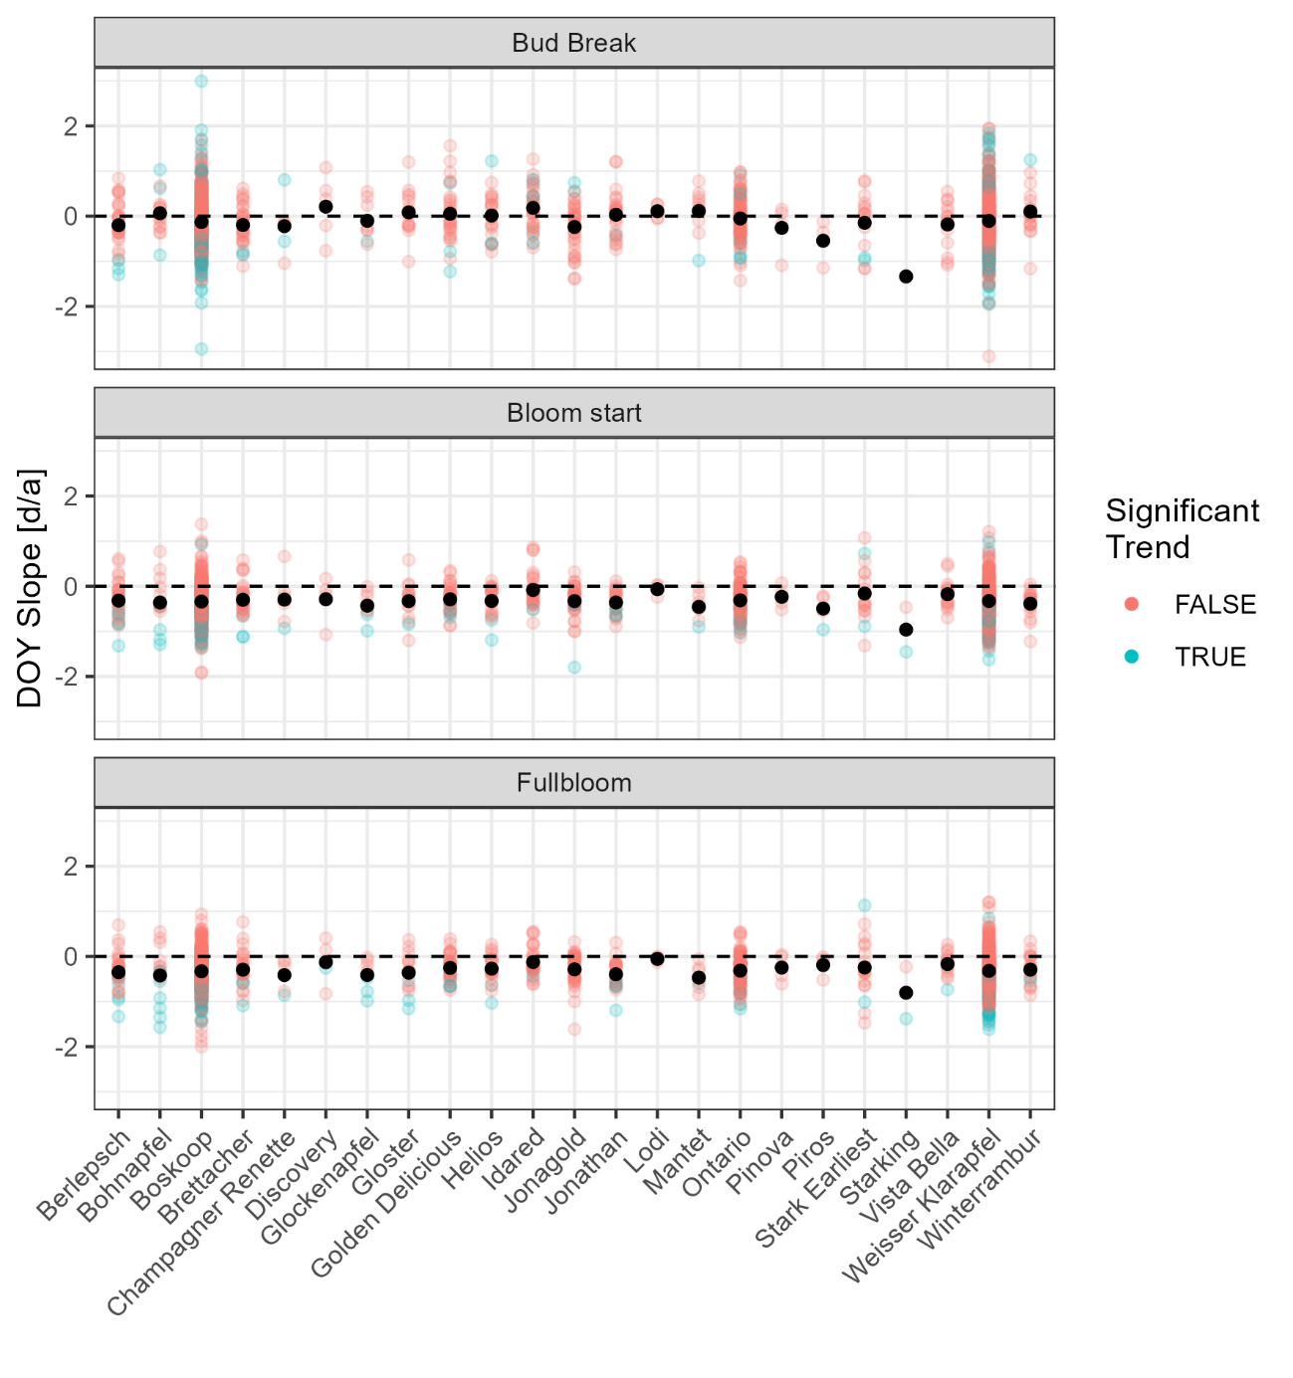
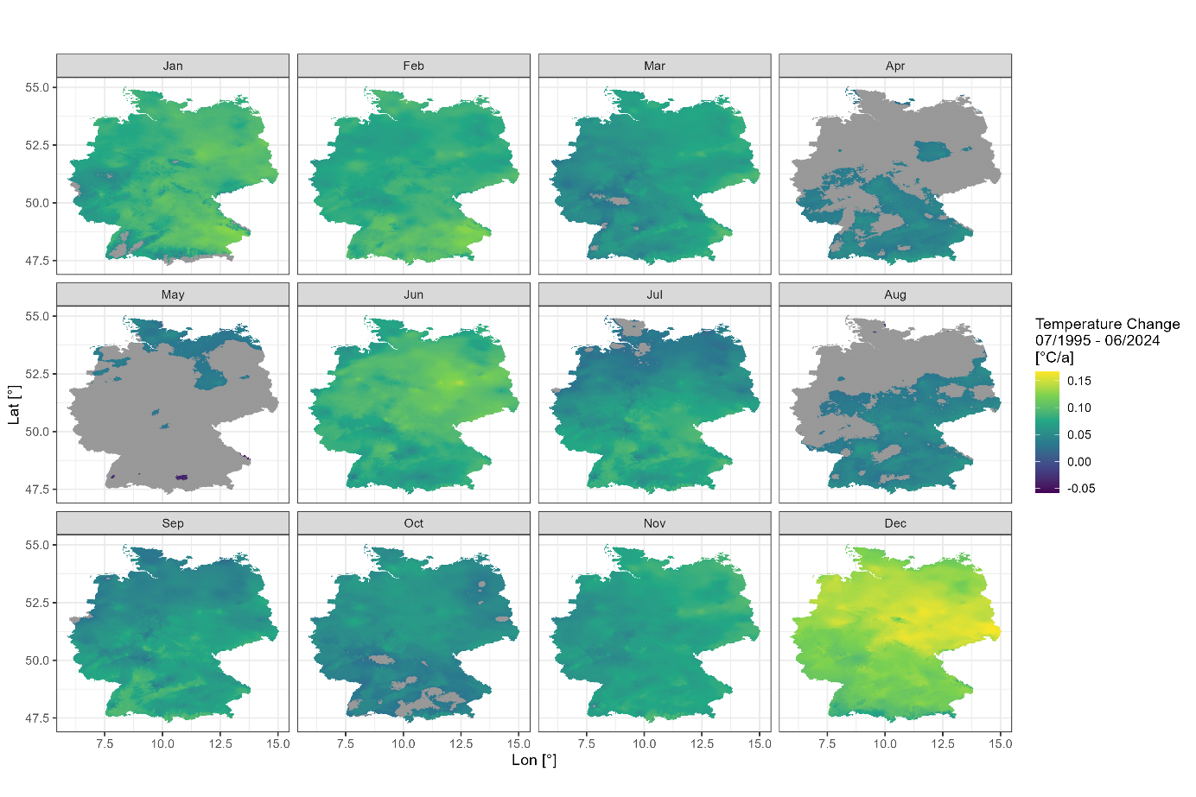
Changing spatio-temporal climatic patterns alter spring phenology occurrence

Slide 11
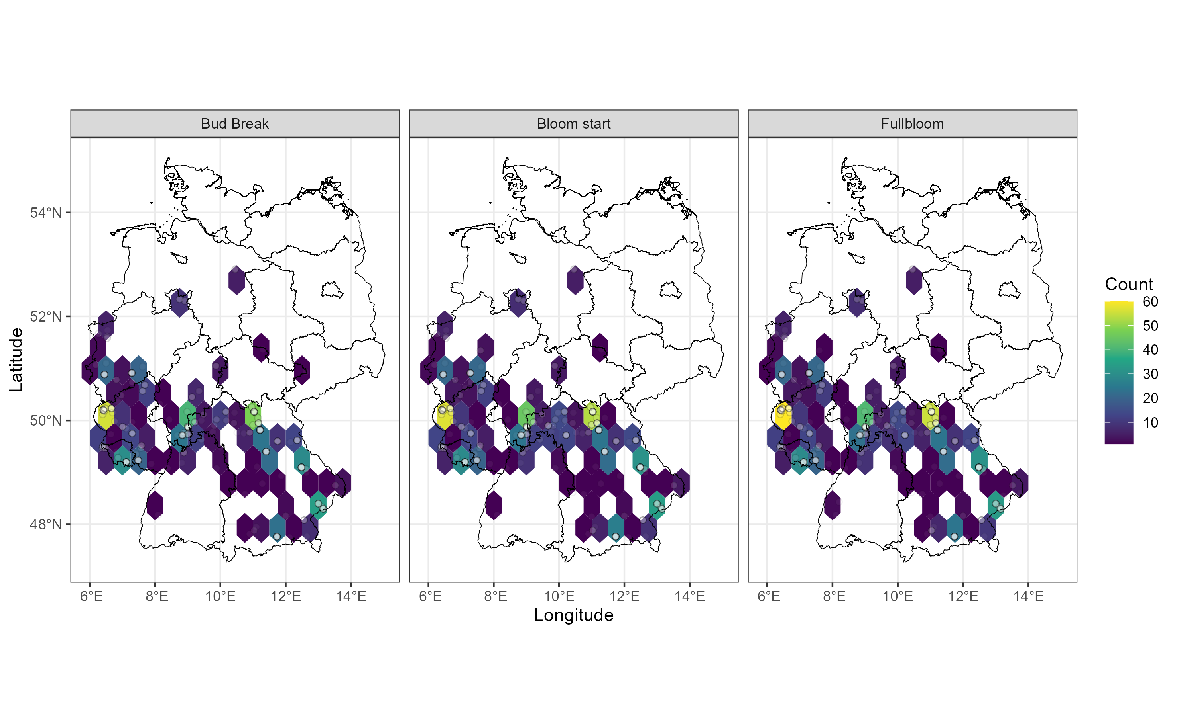
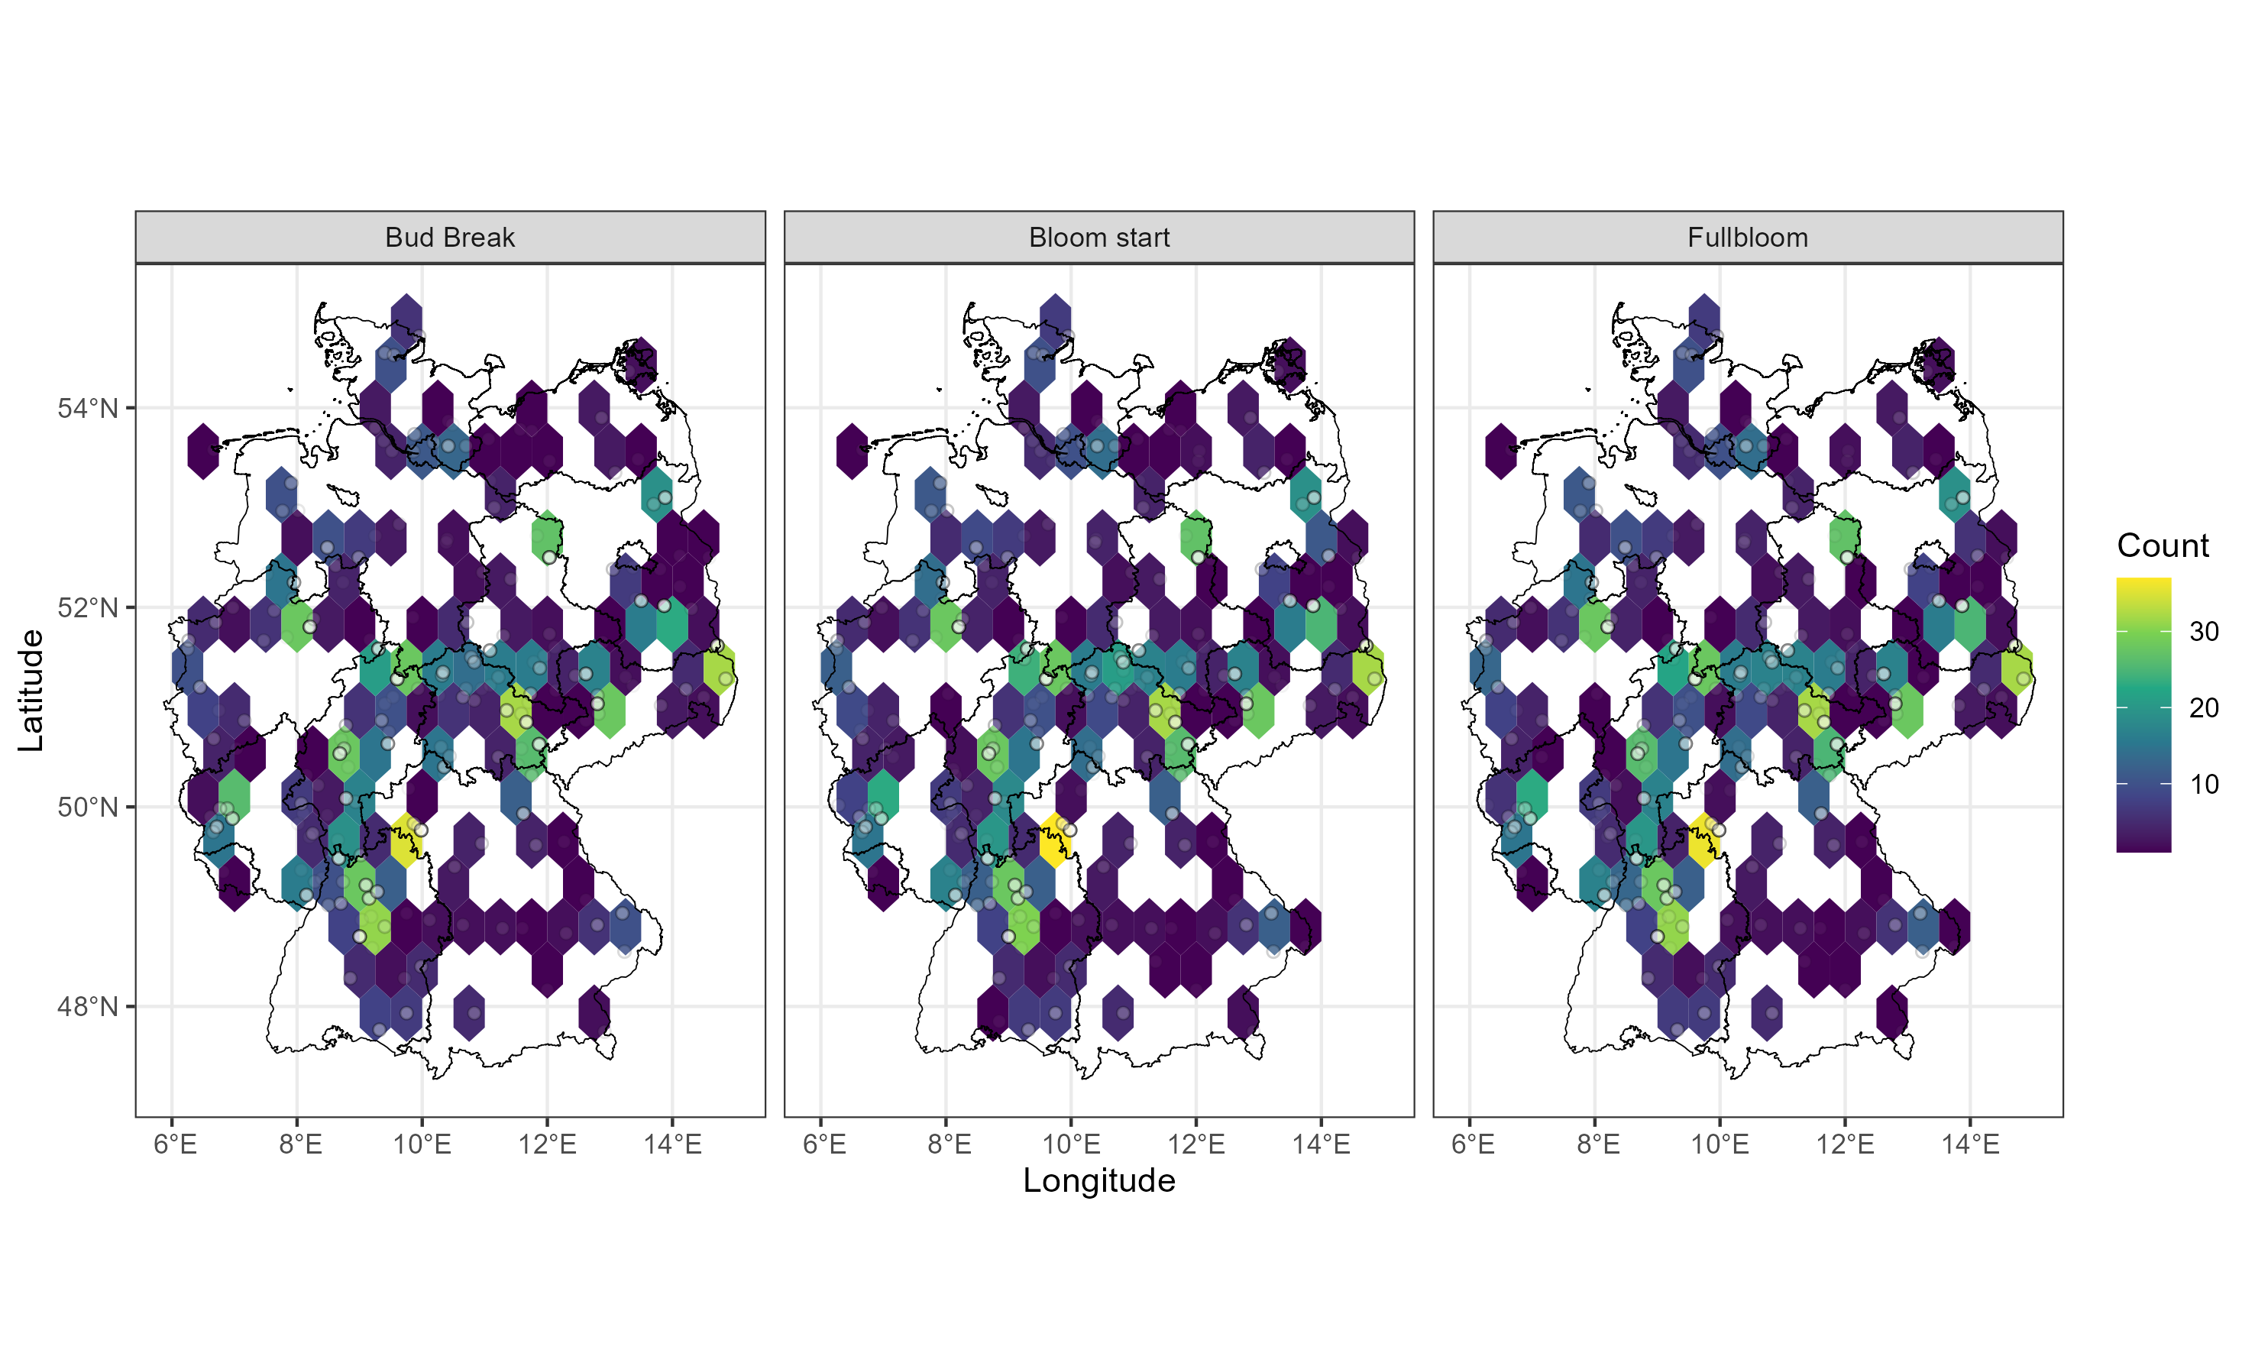
The spatial distribution differs strongly between cultivars
Boskoop
Starking
Winterrambur
Golden Delicious

Slide 12
Cultivar | Usage | Market Share 2023 | Observations
 |  |  | Bud Break | Bloom Start | Fullbloom
Berlepsch | Dessert, Cider |  | 923 | 962 | 945
Bohnapfel | Cider, Dessert |  | 455 | 471 | 460
Boskoop | Dessert, Cider | 2.5 % | 12,792 | 13,378 | 13,200
Brettacher | Cider |  | 622 | 660 | 648
Champagner Renette | Dessert, Cider |  | 155 | 153 | 153
Discovery | Dessert |  | 227 | 229 | 228
Glockenapfel | Dessert |  | 275 | 281 | 277
Gloster | Dessert |  | 451 | 486 | 486
Golden Delicious | Dessert | 1.3 % | 989 | 1,047 | 1,021
Helios | Dessert |  | 498 | 522 | 513
Idared | Dessert | 1.1 % | 925 | 955 | 945
Jonagold | Dessert | 4.9 % | 1,084 | 1,132 | 1,118
Jonathan | Dessert |  | 700 | 716 | 710
Lodi | Dessert |  | 127 | 130 | 130
Mantet | Dessert |  | 229 | 223 | 223
Ontario | Dessert, Cider |  | 2,419 | 2,518 | 2,486
Pinova | Dessert | 3 % | 129 | 132 | 132
Piros | Dessert, Cider |  | 163 | 169 | 169
Stark Earliest | Dessert |  | 387 | 392 | 386
Starking | Dessert |  | 67 | 65 | 66
Vista Bella | Dessert |  | 415 | 475 | 465
Weisser Klarapfel | Dessert |  | 17,800 | 18,507 | 18,211
Winterrambur | Dessert, Cider |  | 594 | 649 | 640
Other |  |  | 13,198 | 14,313 | 13,807
Total |  |  | 55,624 | 58,565 | 57,419

