Slide 1
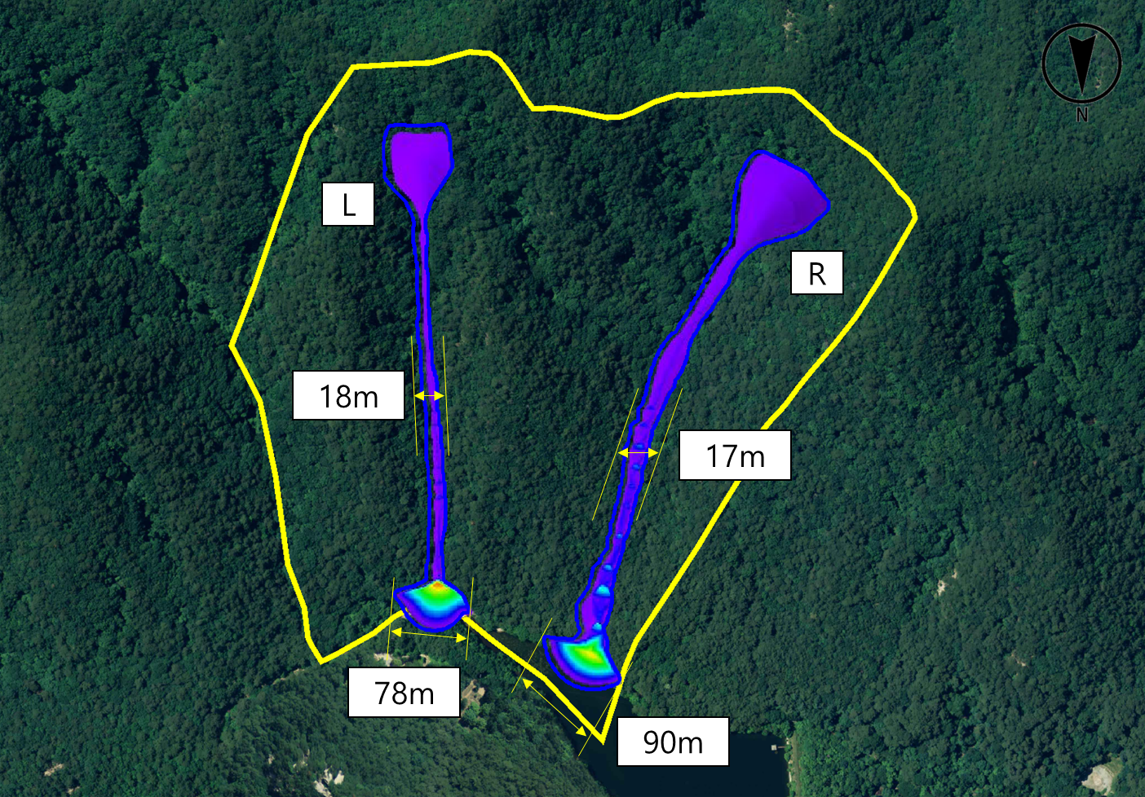
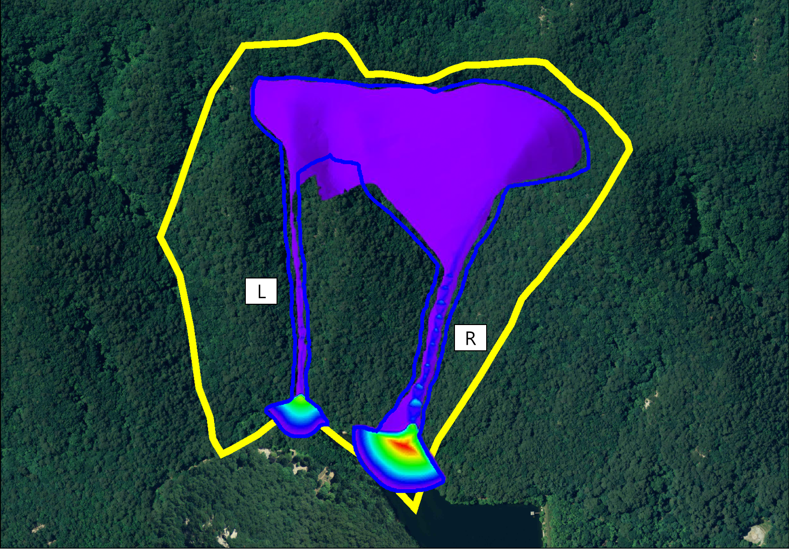
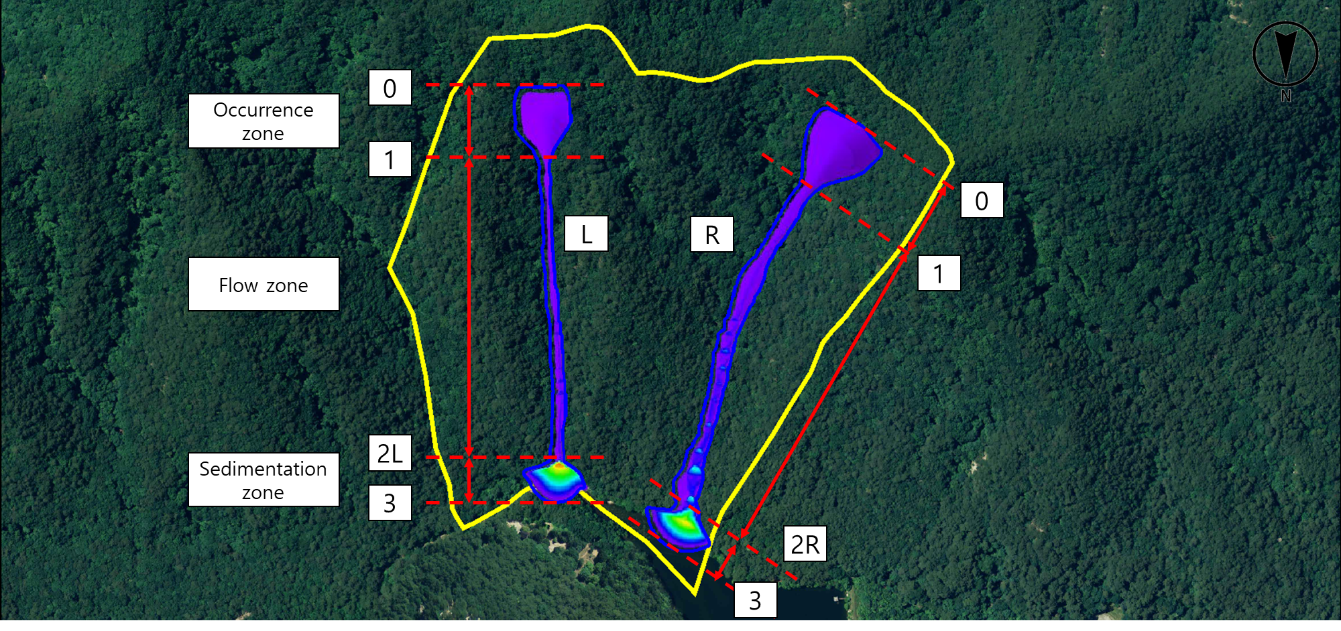
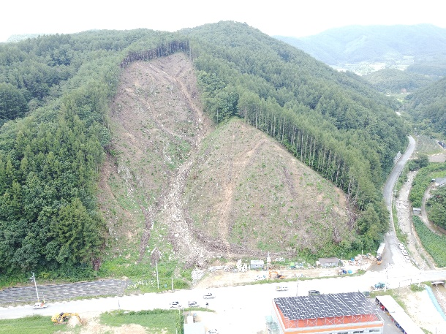
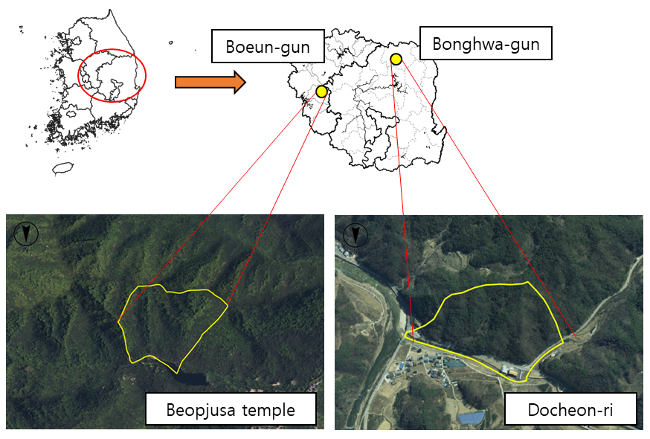
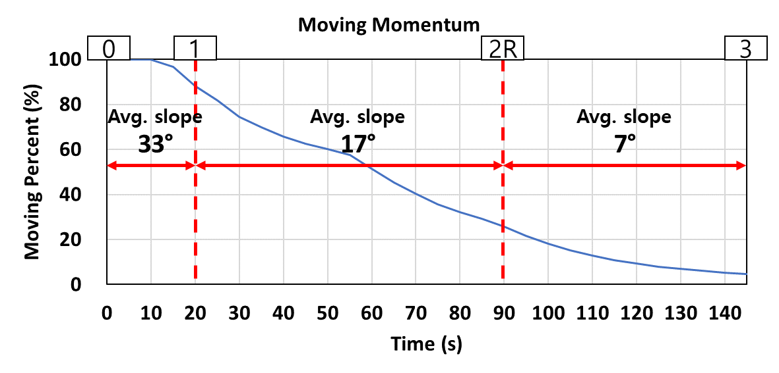
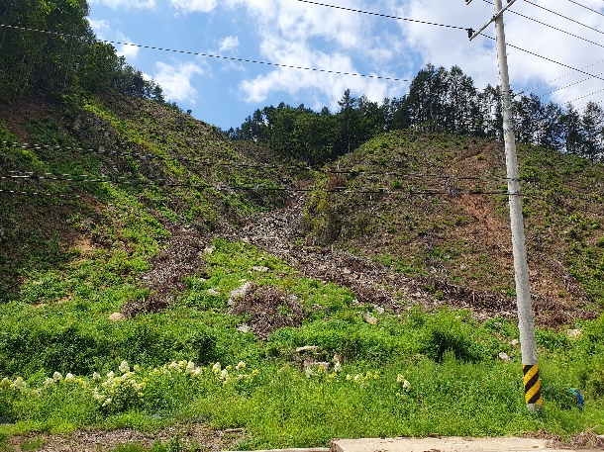
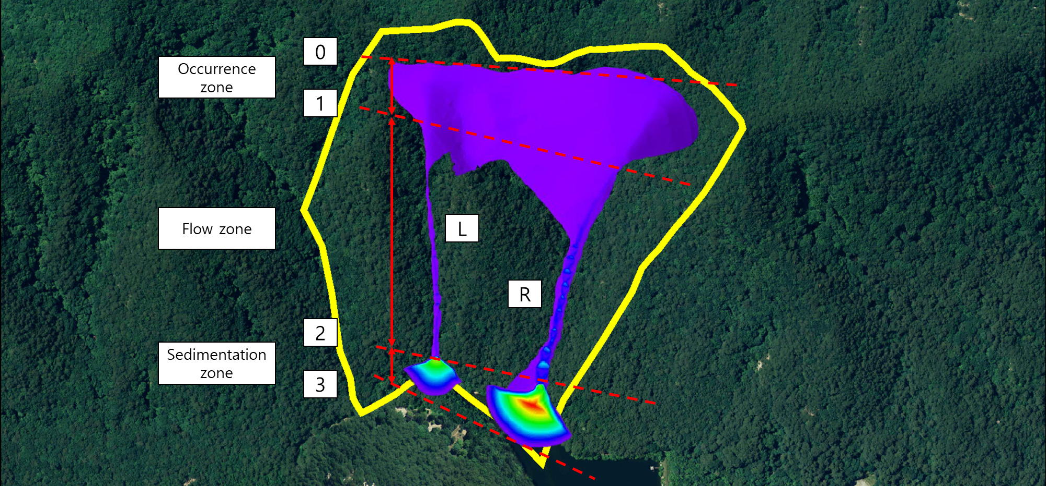
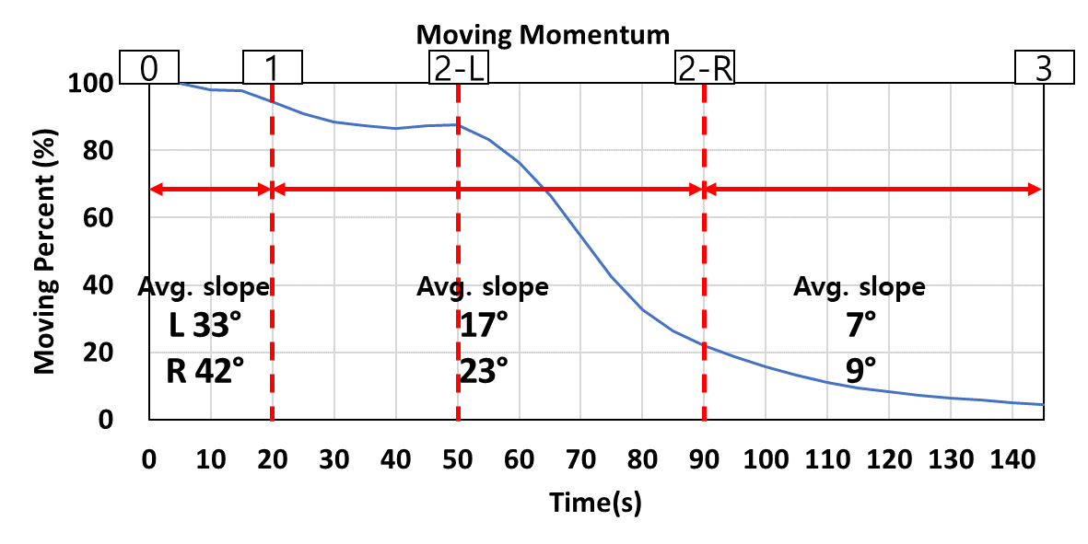
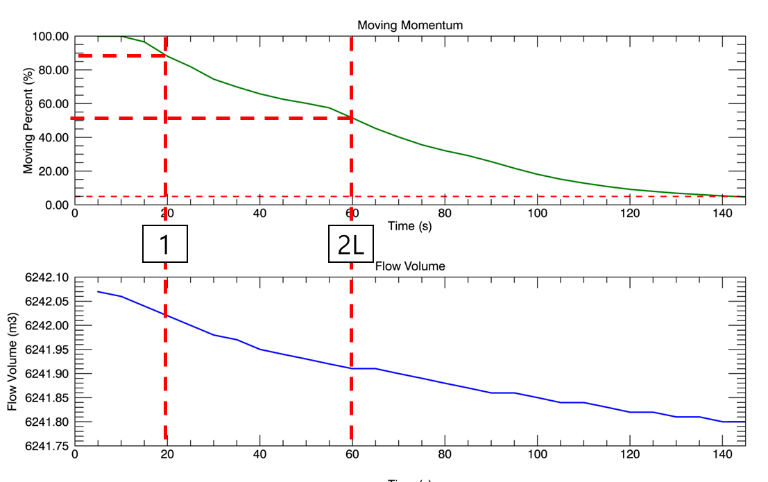
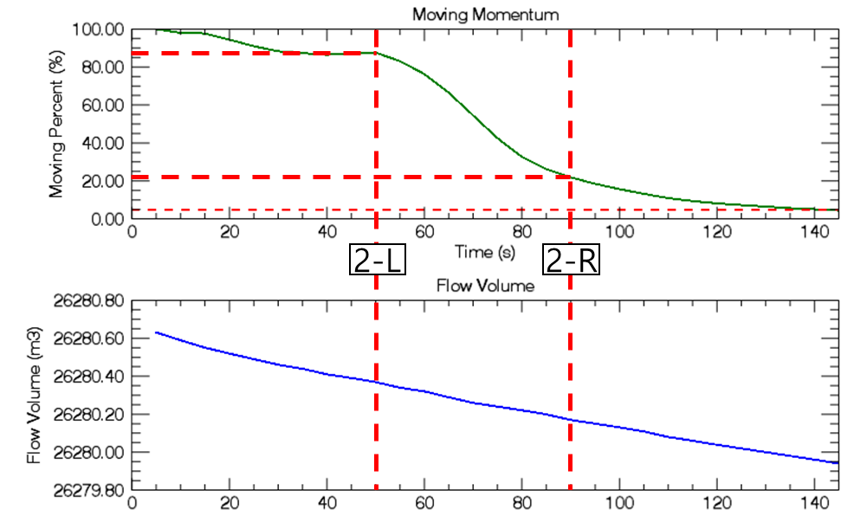
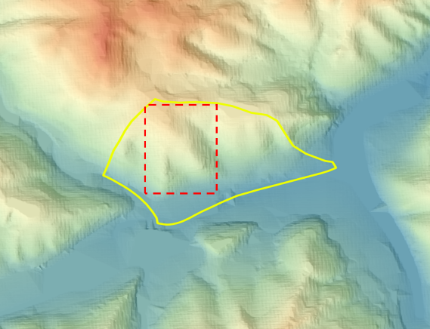
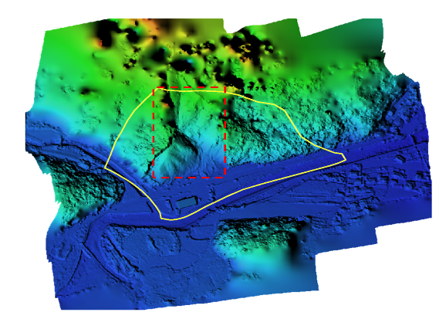
Analysis of debris flow mitigation at ungauged watershed
Hojin Lee¹ , Soungdoug Kim¹ , and Hyungjoon Chang²
1 School of Civil Engineering, Chungbuk National University, 1 Chungdae-ro, Cheongju, South Korea
2 Department of Research and Development, Hyeopseong Company, Cheongju, South Korea
Introduction
Result
This study focuses on analyzing debris flow risk zones by conducting field surveys and drone measurements in areas where debris flows have occurred, thereby generating high-precision terrain data.
To analyze debris flow movement in actual debris flow-prone watersheds, and the simulated debris flow distribution was compared with observed occurrences.
In watersheds lacking precise DEM data due to the absence of field surveys and measurements (referred to as " ungauged watersheds"), simulations of debris flow damage were performed to estimate the range and probability of debris flow occurrence in these regions.
Analysis of debris flow at ungauged watershed for scenario
(a)
(b)
(a)
Method
Study area
Fig. 5 Spread Range and Flow Depth by RAMMS Model at Beopjusa Watershed
((a) Case C, (b) Case D
(b)
(a)
(b)
(a)
(b)
(a)
(b)
(c)
Fig. 2. Docheon-ri Watershed
((a) Panoramic view of the watershed using drone imagery, (b) View of the watershed from the road)
Fig. 7 (a) Section split of Case D, (b) Ratio of mass movement elapsed time in the valley on the right side of Case D, (c) Ratio and volume of mass movement elapsed time in the valley on the right side of Case D (RAMMS result screen)
(c)
Fig. 1. The selected Study Areas
((a) Beopjusa Watershed (Ungauged Watershed) (b) Docheon-ri Watershed))
Viti Levu
Meteorological data
Fig. 3. Rainfall at Bonghwa-gun Observation Station (June–August 2023)
Fig. 6 (a) Section split of Case C, (b) Ratio of mass movement elapsed time in the valley on the right side of Case C, (c) Ratio and volume of mass movement elapsed time in the valley on the right side of Case C (RAMMS result screen)
Conclusion
For the ungauged watersheds, Case C and Case D simulated the debris flow
in the steep mountainous area of the Beopjusa watershed.
In Case D, where the debris flow was assumed to originate from the entire ridge of the valley,
the spread area was about 3.4 times larger than that in Case C, where debris flow was assumed to originate only near the valley's peak.
The time it took for the debris flow from the small mountain ridge to reach the downstream trail was 1.2 to 1.5 times faster in Case D than in Case C, with travel times of less than 2 minutes to cover a distance of approximately 550 m.
The sediment deposition width in the downstream area was 5.3 times wider on the left side and 4.6 times wider on the right side in Case C, and 4.5 times wider on the left side and 3.9 times wider on the right side in Case D.
The debris flows rapidly reach downstream areas in a short time and deposit over a wide area. In such cases, it is essential to establish a pre-evacuation system based on heavy rainfall forecasts before debris flows occur. I
n order to minimize damage from debris flows, it is recommended to set broader potential damage zones in the downstream deposition areas. This is exemplified in Case D, where significant debris flow occurred in two stages (primary and secondary). Additionally, when installing debris flow prevention facilities, it is necessary to account for the unique characteristics of debris flow, as seen in Case D, where the flow reaches the downstream in two stages.
Input and Topographic daa
(a)
(b)
Fig. 4. Example of Terrain Data Construction (Docheon-ri Watershed)
((a) DEM Constructed Using Topographic Map, DEM Constructed Using Drone Data)

