Slide 1
Investigating the Role of Anomalous Moisture Transport in Indian Subcontinent's Extreme Precipitation Events: A PIKART Perspective
Sree Anusha Ganpathiraju^{1,2}, Sara M. Vallejo-Bernal^{3,2}, Norbert Marwan^{2,4}, and Maheswaran Rathinasamy^{1,5}
¹Department of Climate Change, Indian Institute of Technology Hyderabad, Sangareddy, India
²Department of Complexity Science, Potsdam Institute for Climate Impact Research, Potsdam, Germany
³Institute of Earth System Science and Remote Sensing, Leipzig University, Leipzig, Germany
⁴Institute of Geosciences, University of Potsdam, Potsdam, Germany
⁵Department of Civil Engineering, Indian Institute of Technology Hyderabad, Sangareddy, India
https://www.linkedin.com/in/sree-anusha-ganapathiraju/

Slide 2
Supplementary Slides

Slide 3
Generalized Pareto Distribution: Theory

Slide 4
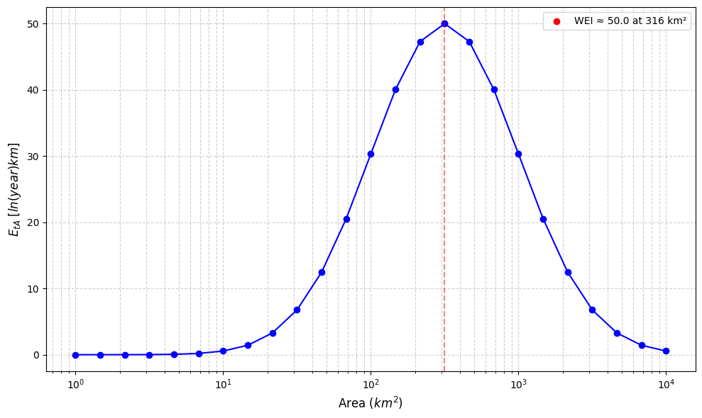
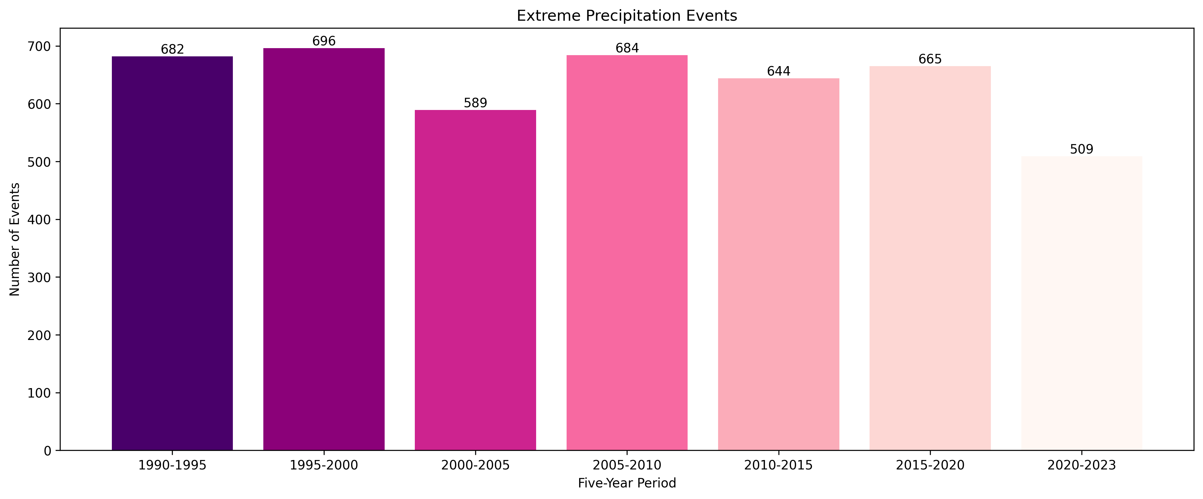
Data and Methods
Method 2: EPE Ranking: Weather Extremity Index (WEI)
The index measures rarity and spatial extent and assumes that the increased extremeness of an event is either due to increased intensity or spatial extent (Voit et al. 2023).
The measure of Extremeness $E_{tA}$ is given by:
where $p_{t,k}$is the return period of a grid $k$ and duration $t$(here, 1 day) and $A$ is the grid group area.
WEI is the inflection point with units [ln(year)km]
Voit, P., & Heistermann, M. (2022). A new index to quantify the extremeness of precipitation across scales. Natural Hazards and Earth System Sciences, 22(8), 2791–2805. https://doi.org/10.5194/nhess-22-2791-2022

Slide 5
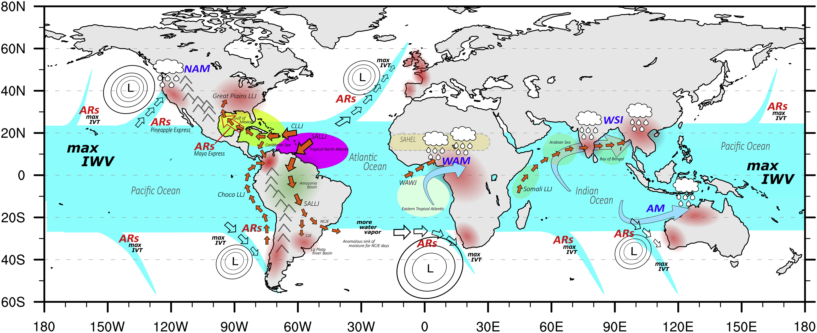
Physical Mechanisms
Do atmospheric rivers exist in the tropics? Any in the Indian subcontinent?
Gimeno-Sotelo, L., & Gimeno, L. (2023). Where does the link between atmospheric moisture transport and extreme precipitation matter? Weather and Climate Extremes, 39(100536), 100536, https://doi.org/10.1016/j.wace.2022.100536
Notes:
Different mechanisms are responsible for the moisture transport that produces EPEs. Among the various mechanisms, Atmospheric Rivers, Low-level Jets, Tropical Moisture Exports, and Tropical Cyclones are the prominent ones.
the monsoonal circulations
Jet streams
At local scale, land-atmospheric feedbacks are also critical in extreme precipitation

Slide 6
Detailed Message
The role of atmospheric rivers (ARs) in the tropics remains an open and important question, particularly regarding their contribution to extreme precipitation events (EPEs).
This study aims to comprehensively investigate the moisture transport pathways associated with EPEs in the region.
Our findings reveal that both local and synoptic-scale features are essential for understanding the thermodynamic and dynamic mechanisms governing the intensity and occurrence of EPEs.
Future work will involve in-depth case studies to verify instances of anomalous moisture transport over the Indian subcontinent, with a particular focus on how global-scale drivers (e.g., monsoon circulation, MJO, ENSO) interact with local and synoptic conditions to influence moisture delivery.
Broadly, such studies contribute to advancing our understanding of moisture transport mechanisms, with implications for improving predictability of extreme weather events, monsoon variability, and assessing their potential shifts under climate change.

