Slide 1
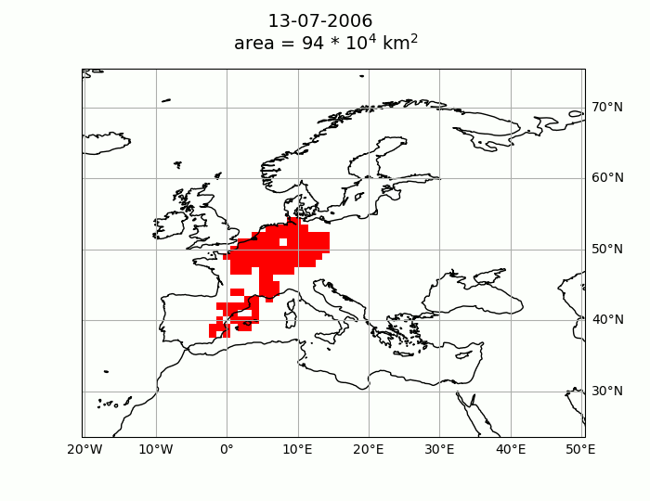
Methods: Pseudo-lagrangian algorithm
Central-Western Europe July 2006. Third greatest episode in CAMS reanalysis.

Slide 2
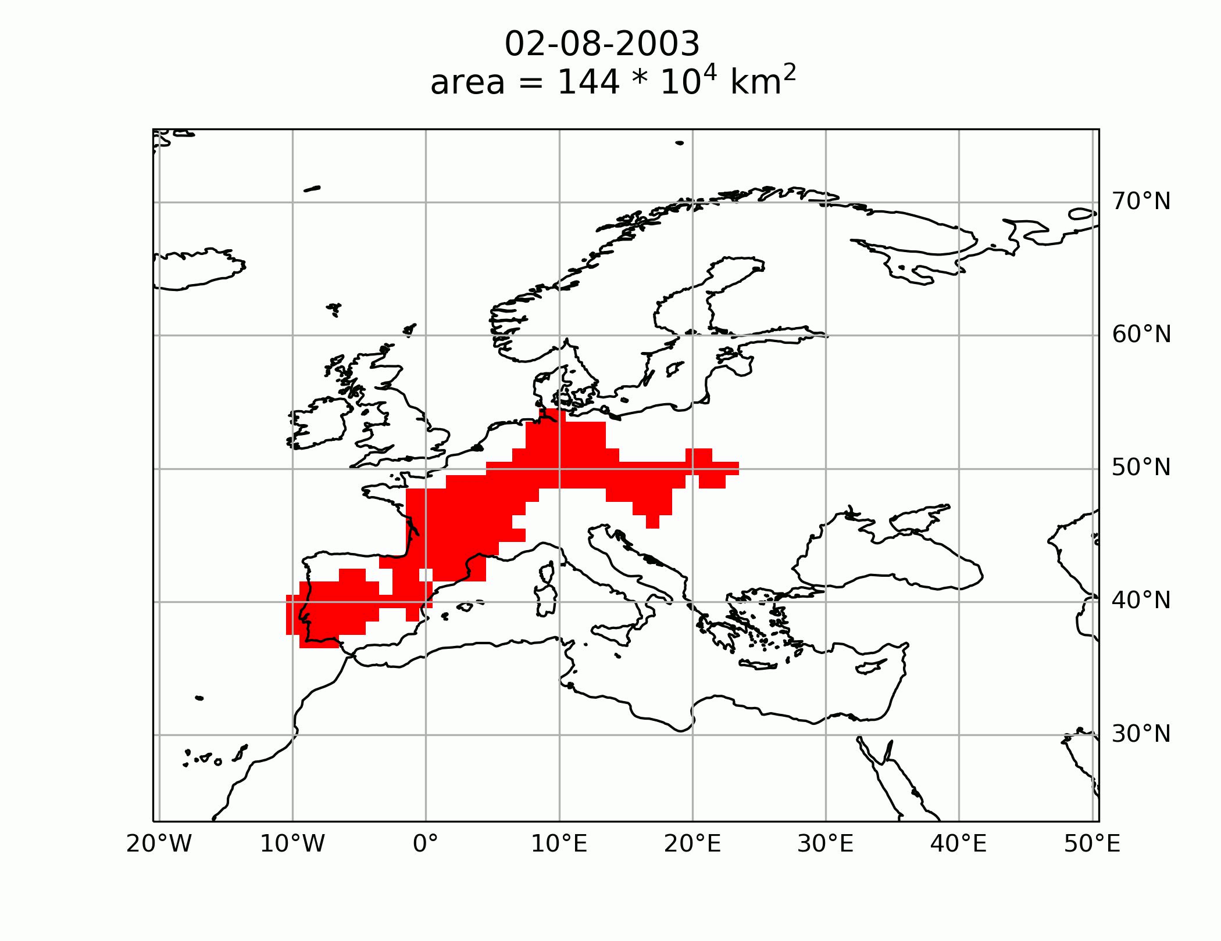
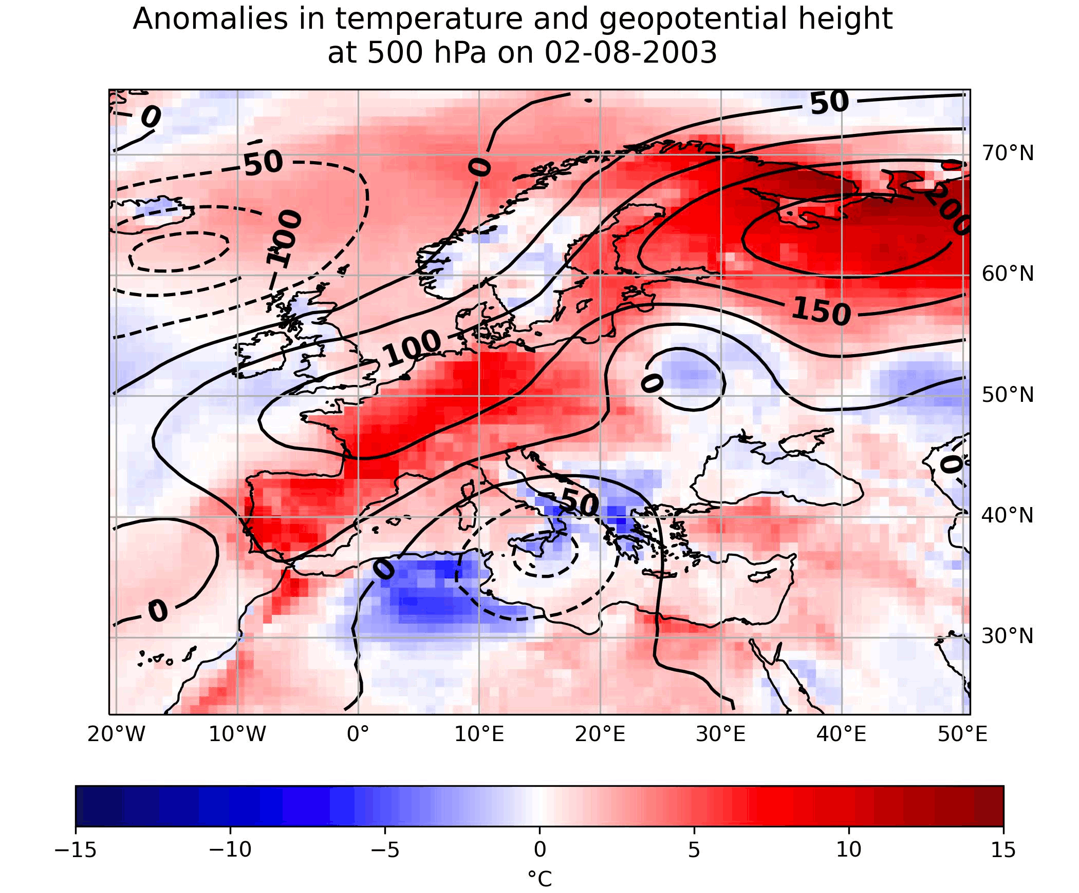
Results: Top 10 European episodes
Greatest episode:2–19 August 2003 West-Central Europe

