Slide 1
www.ufz.de
Crop adaptation and its impact on non-point source pollution under future climate challenges
Wenlu Ding
Supervisor: Prof. Dr. Michael Rode
Department of Aquatic Ecosystem Analysis and Management Helmholtz Centre for Environmental Research – UFZ Brückstraße 3a, 39114 Magdeburg, Germany
April 2025
Notes:
Titelfolie mit UFZ-Imagebild

Slide 2
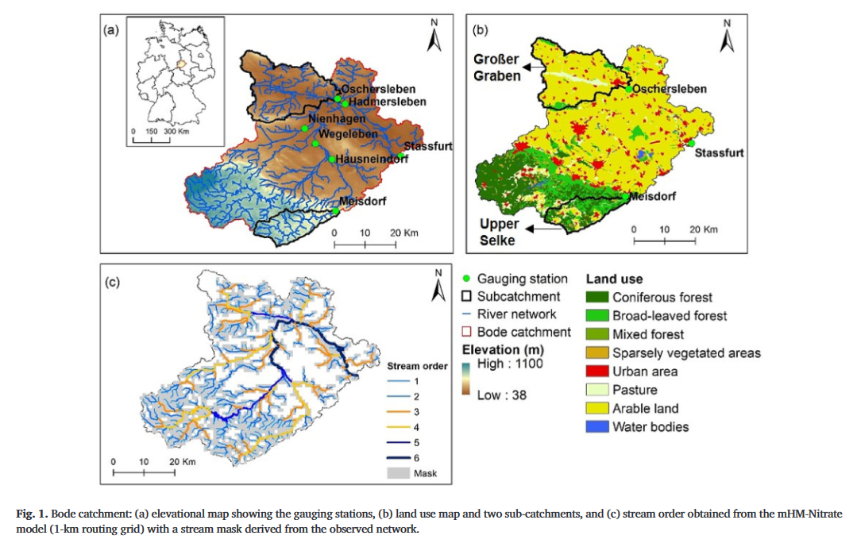
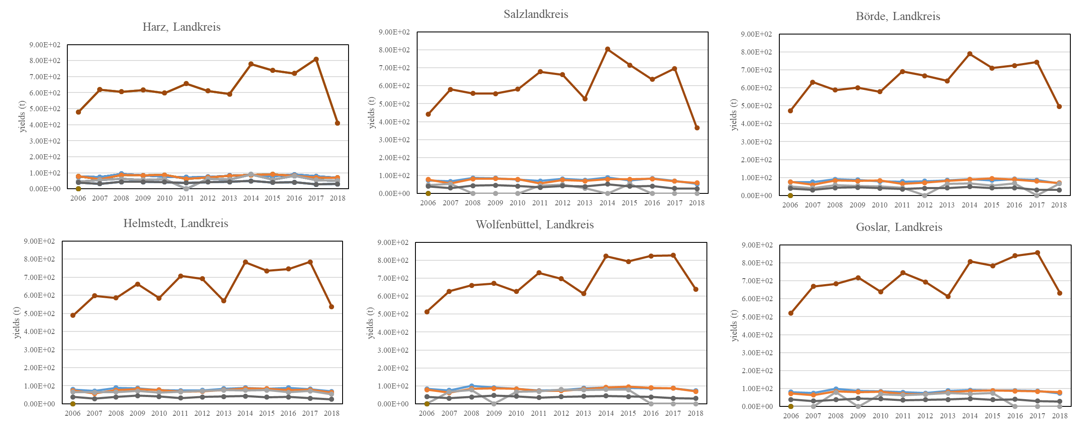
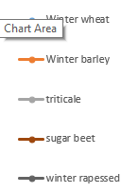
2 Methodology
2.1 Case study area and data collection
Location
The Bode catchment (3200 km², central Germany)
Gauge stations
Meisdorf, Hausneindorf, Wegeleben, Nienhagen, Hadmersleben and Stassfurt
Hydrometeorology & topography condition
Pre: 500-1500m
Dem: 70-1142m
Agricultural activities
winter wheat, winter barley, rapeseed and sugar beet
Crop yields per unit area (dt/ha)
Zhou, X. et al. Exploring the relations between sequential droughts and stream nitrogen dynamics in central Germany through catchment-scale mechanistic modelling. Journal of Hydrology 614, 128615 (2022).

Slide 3
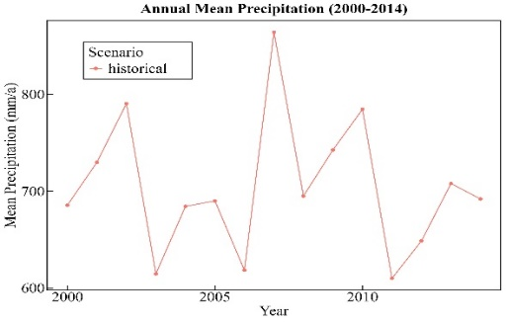
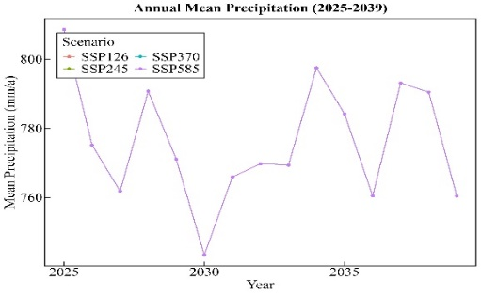
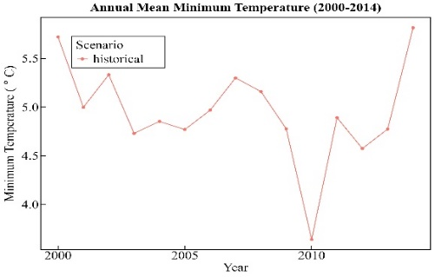
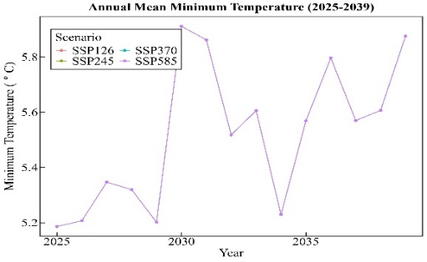
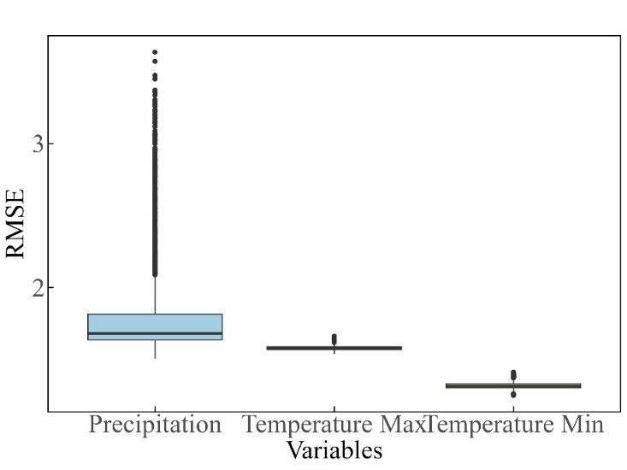
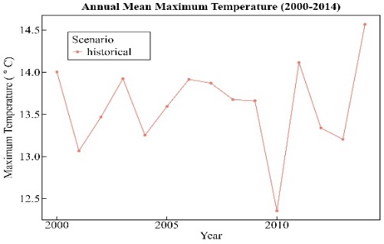
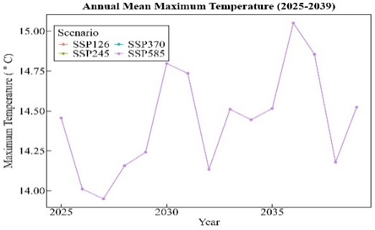
2 Methodology
2.3 Scenario design for future projections
Future meteorological variables under ssp126 scenario （using random forest）
NUM | Models | LAT | LON | Nominal Resolution
1 | ACCESS-ESM1-5 | 145 | 192 | 250
2 | EC-Earth3 | 256 | 512 | 100
3 | MIROC6 | 128 | 256 | 250
4 | MPI-ESM1-2-HR | 192 | 384 | 100

Slide 4
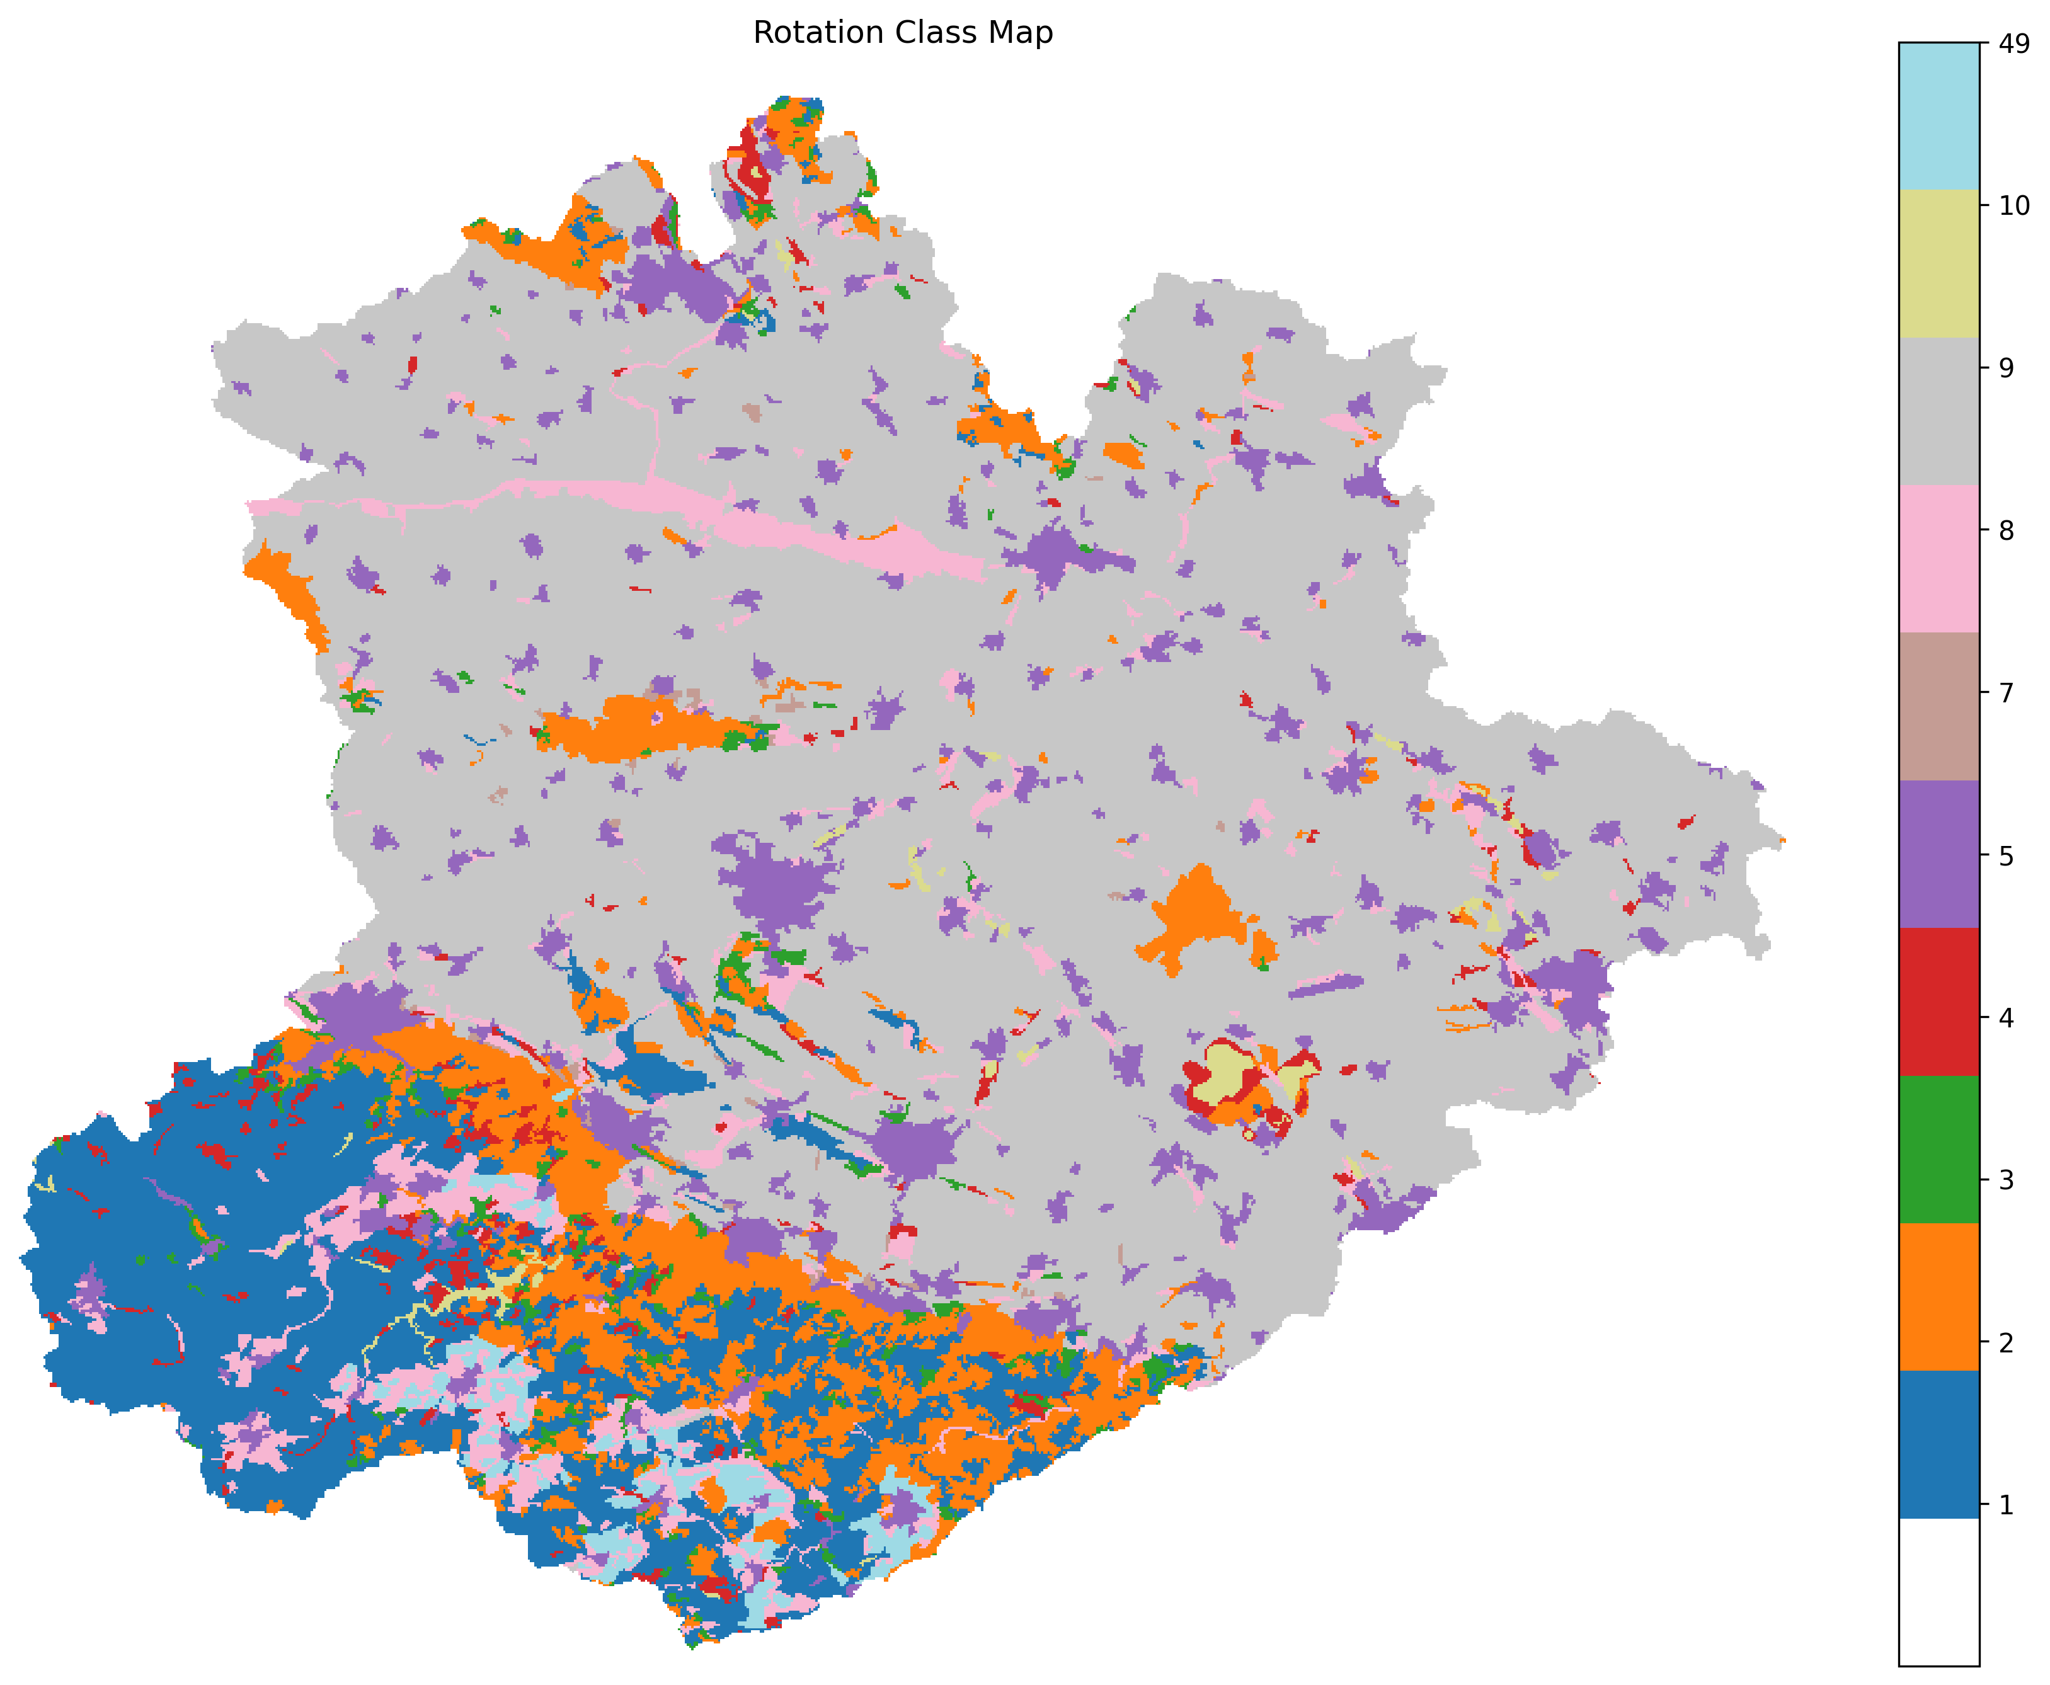
2 Methodology
2.4 Management practices/Crop rotations design
 | N demand | Cereals | Growth time | Minimum sequential break of a crop
Winter wheat | High | √ | 10.1-7.15 | 2-4
Winter barley | Medium | √ | 9.20-7.1 | 2-3
triticale | Medium | √ | 10.1-7.20 | 3-4
sugar beet | High |  | 4.1-10.30 | 3-5
winter rapessed | High |  | 8.20-6.20 | 4-6
settings
filter conditions:
# condition 1：minimum sequential break of a crop
# condition 2：no wheat after cereals
Historical rotation:
49：Winterwheat_up-winterbarley- Winterwheat-rapeseed- Winterwheat-triticale
9：winterwheat_la-winterbarley-winterwheat- rapeseed- winterwheat-winterwheat- rapeseed-winterwheat-sugarbeet
Reckling, M., Hecker, J.-M., Bergkvist, G., Watson, C. A., Zander, P., Schläfke, N., et al. (2016). A cropping system assessment framework—Evaluating effects of introducing legumes into crop rotations. European Journal of Agronomy, 76, 186–197. https://doi.org/10.1016/j.eja.2015.11.005
Faye, B., Webber, H., Gaiser, T., Müller, C., Zhang, Y., Stella, T., et al. (2023). Climate change impacts on European arable crop yields: Sensitivity to assumptions about rotations and residue management. European Journal of Agronomy, 142, 126670. https://doi.org/10.1016/j.eja.2022.126670
Zhou, X. et al. Exploring the relations between sequential droughts and stream nitrogen dynamics in central Germany through catchment-scale mechanistic modelling. Journal of Hydrology 614, 128615 (2022).

Slide 5
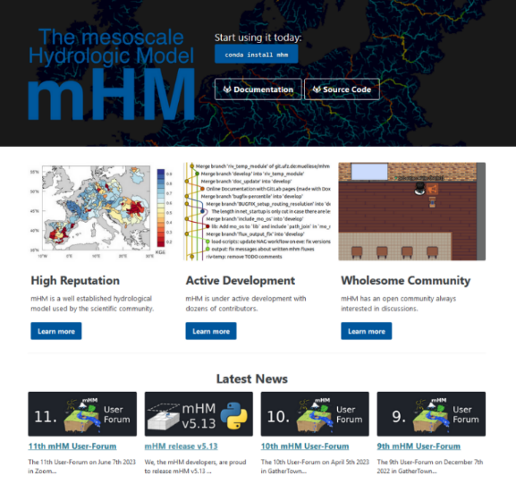
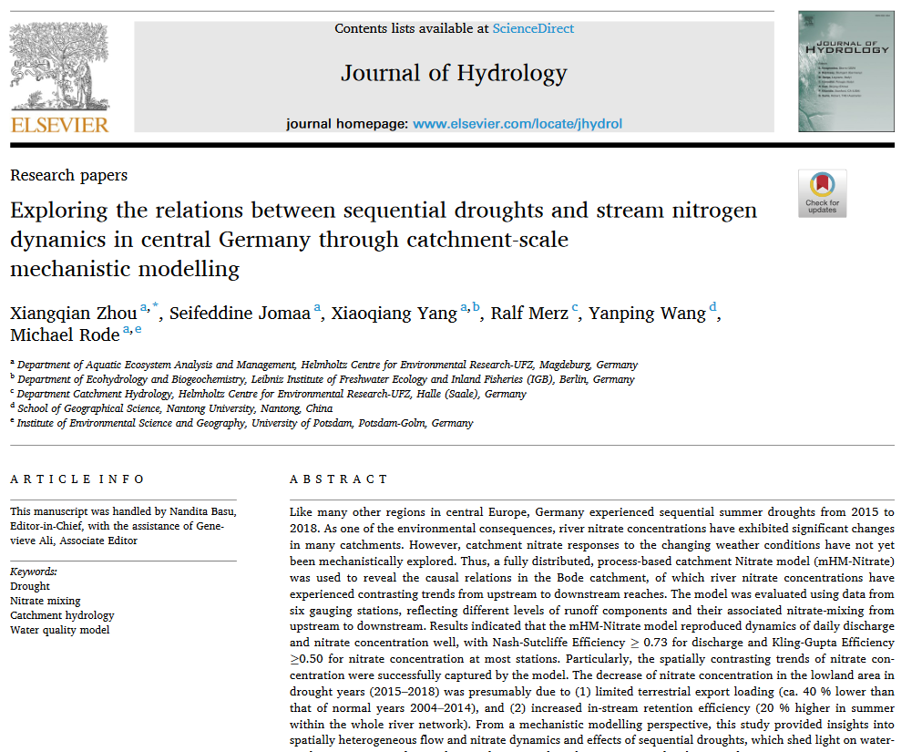
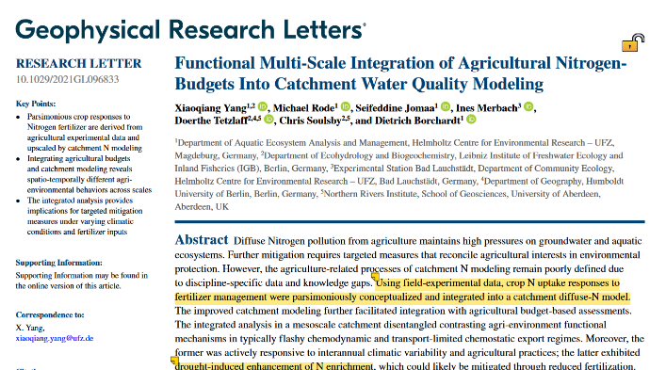
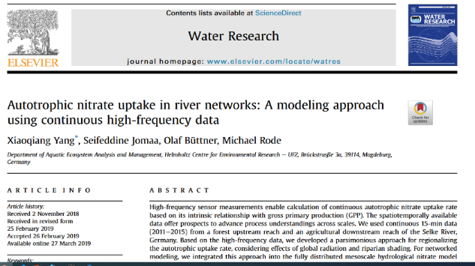
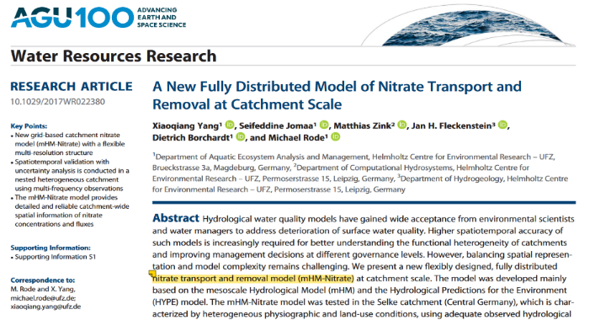
2 Methodology
2.5 Model----Hydrological water quality model
mHM-Nitrate model: a fully distributed nitrate transport and removal model
mHM v5.13 (https://mhm-ufz.org/docs/)
Yang, X., Jomaa, S., Zink, M., Fleckenstein, J. H., Borchardt, D., & Rode, M. (2018), A new fully distributed model of nitrate transport and removal at catchment scale, Water Resources Research, 54(8), 5856-5877. https://doi.org/10.1029/2017WR022380.
Yang, X., Jomaa, S., Büttner, O., & Rode, M. (2019), Autotrophic nitrate uptake in river networks: A modeling approach using continuous high-frequency data, Water Research, 157, 258-268. https://doi.org/10.1016/j.watres.2019.02.059.
Yang, X., Rode, M., Jomaa, S., Merbach, I., Tetzlaff, D., Soulsby, C., & Borchardt, D. (2022). Functional Multi‐Scale Integration of Agricultural Nitrogen‐Budgets Into Catchment Water Quality Modeling. Geophysical Research Letters, 49(4). https://doi.org/10.1029/2021GL096833

Slide 6
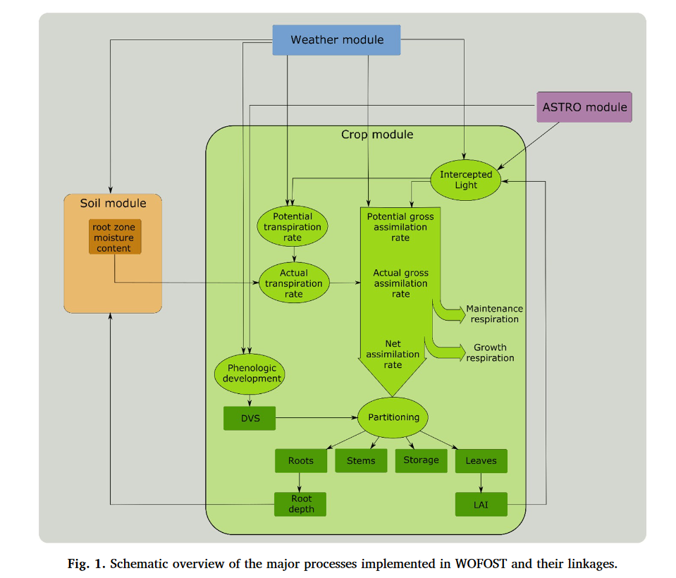
2 Methodology
2.5 Model----Crop model
(De Wit et al., 2019)
WOFOST（http://wageningenur.nl/wofost ）
semi-deterministic crop growth model that simulates crop growth and development under potential and water-limited conditions
Main process
phenological development, leaf development and light interception, CO2-assimilation, root growth, transpiration, respiration, partitioning of assimilates to the various organs, and dry matter formation
(https://pcse.readthedocs.io/en/stable/index.html)
WOFOST 7.1:
Basic crop growth model focused on potential yield, response to solar radiation, and water stress.
WOFOST 7.2:
Enhanced crop parameter structure and improved support for crop calendar management.
WOFOST 7.3:
Used mainly in EU25 CGMS simulations with more robust data structures and error handling improvements.
WOFOST 8.1:
Comprehensive model equations with CO₂ response, extended crop support, and higher simulation precision.
De Wit, A., Boogaard, H., Fumagalli, D., Janssen, S., Knapen, R., Van Kraalingen, D., et al. (2019). 25 years of the WOFOST cropping systems model. Agricultural Systems, 168, 154–167. https://doi.org/10.1016/j.agsy.2018.06.018

Slide 7
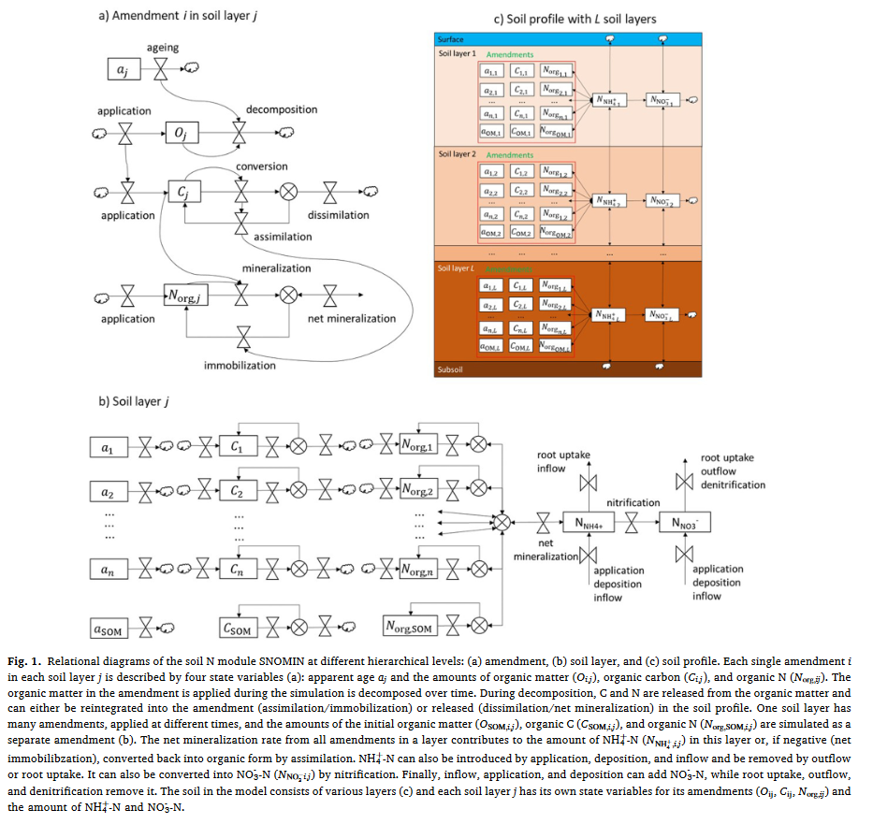
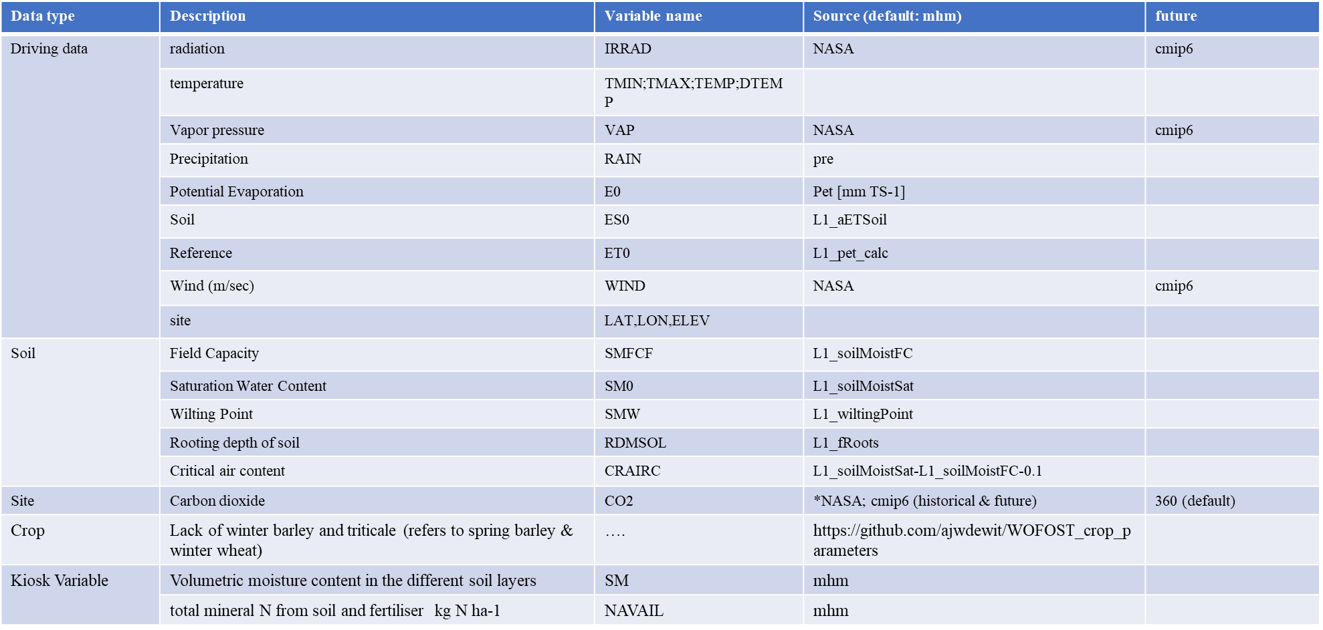
2 Methodology
2.5 Model----Crop model
 | water | nitrogen | carbon
Wofost81_PP
Wofost81_WLP_CWB | Classic water balance
Wofost81_WLP_MLWB | Multilayer water balance
Wofost81_NWLP_CWB_CNB |  | bucket | √
Wofost81_NWLP_MLWB_CNB |  | bucket | √
Wofost81_NWLP_MLWB_SNOMIN |  | N conversion | √
Required data of WOFOST81
Berghuijs, H. N. C., Silva, J. V., Reidsma, P., & De Wit, A. J. W. (2024). Expanding the WOFOST crop model to explore options for sustainable nitrogen management: A study for winter wheat in the Netherlands. European Journal of Agronomy, 154, 127099. https://doi.org/10.1016/j.eja.2024.127099

