Slide 1
Tracking the grounding line migration at Getz Ice Shelf using Sentinel-1 A/B observations
Sindhu Ramanath, Lukas Krieger, Dana Floricioiu

Slide 2
Grounding line
The grounding line marks the boundary where an outlet glacier no longer lies on bedrock but starts to float over open water (e.g. ocean)
Significance:
The GLL is the gate through which ice mass is transported to the ocean and it’s position is needed for mass balance estimation
Challenges:
GLL is not visible on the surface → difficult to detect!
The grounding line migrates on:
short time scales – ice flexure due to ocean tides
long time scales – changes in ice thickness
(Schoof, 2007)
Source: National Snow and Ice Data Center, NASA

Slide 3
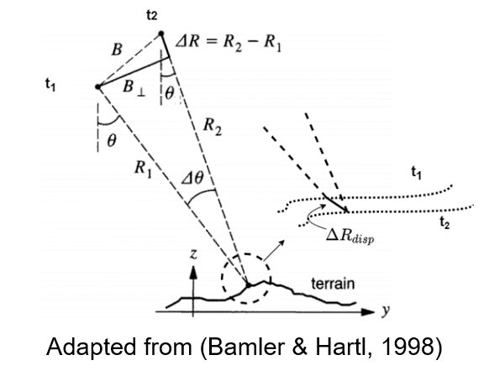
Differential SAR for grounding line detection
$$Δφ={Δφ}_{topo}+{Δφ}_{flat earth}+{Δφ}_{disp}+{Δφ}_{atmos}$$
$$Δφ_{disp}=\frac{4π}{λ}ΔR_{disp}$$
Assumption: steady ice motion

