Slide 1
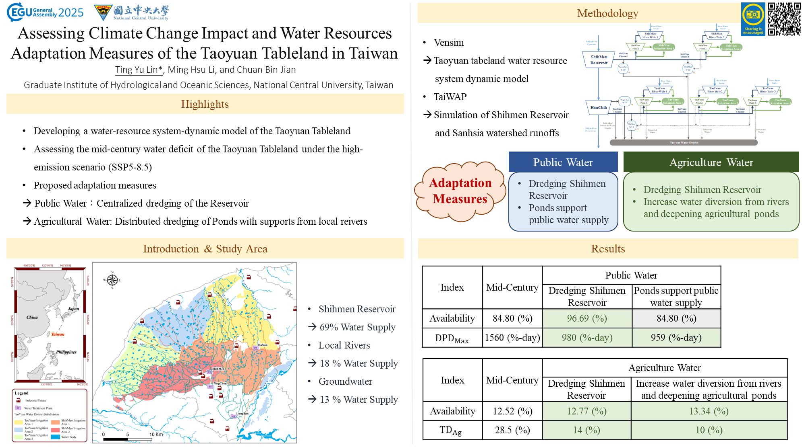

Slide 2




Assessing Climate Change Impact and Water Resources Adaptation Measures of the Taoyuan Tableland in Taiwan
Ting Yu Lin, Ming Hsu Li, and Chuan Bin Jian
Graduate Institute of Hydrological and Oceanic Sciences
National Central University, Taiwan

Slide 3
Highlights
01
Developing a water-resource system-dynamic model of the Taoyuan Tableland.
Assessing the mid-century water deficit of the Taoyuan Tableland under the high-emission scenario (SSP5-8.5).
02
Proposed adaptation measures
Public Water：Centralized dredging of the Reservoir
→ Agricultural Water: Distributed dredging of Ponds with supports from local reivers
03

Slide 4
Outline
1
Introduction
3
Results and Discussion
2
Methodology
4
Conclusions

Slide 5
01
Introduction

Slide 6
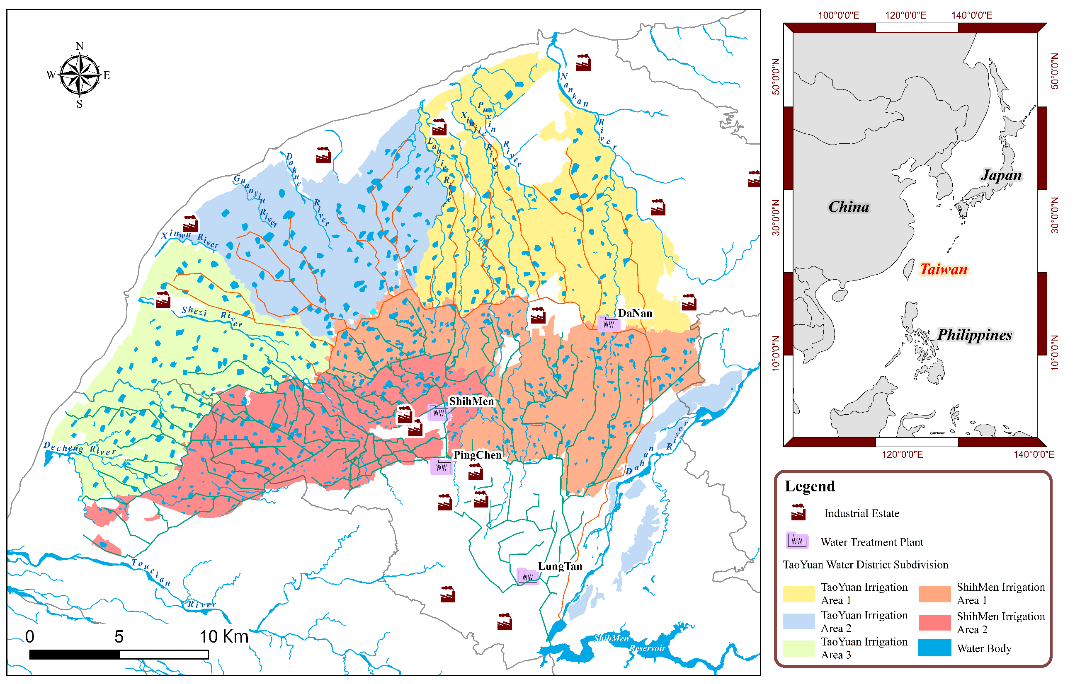

Introduction
1/3
Study Area
Shihmen reservoir
→ 69% Water Supply
River
→ 18 % Water Supply
Groundwater
→ 13 % Water Supply

Slide 7

Introduction
2/3
Historical Drought Events of the Taoyuan Tableland
1995-2004
2005-2014
2015-2024
Meteorological drought
1995
2002
2003
2004
Meteorological drought
2006
2010
2014
Meteorological drought
2017
2020
2021
Human Active (Fallowing)
2002
2003
2004
Human Active (Fallowing)
2006
2010
Human Active (Fallowing)
2015
2020
2021

Slide 8
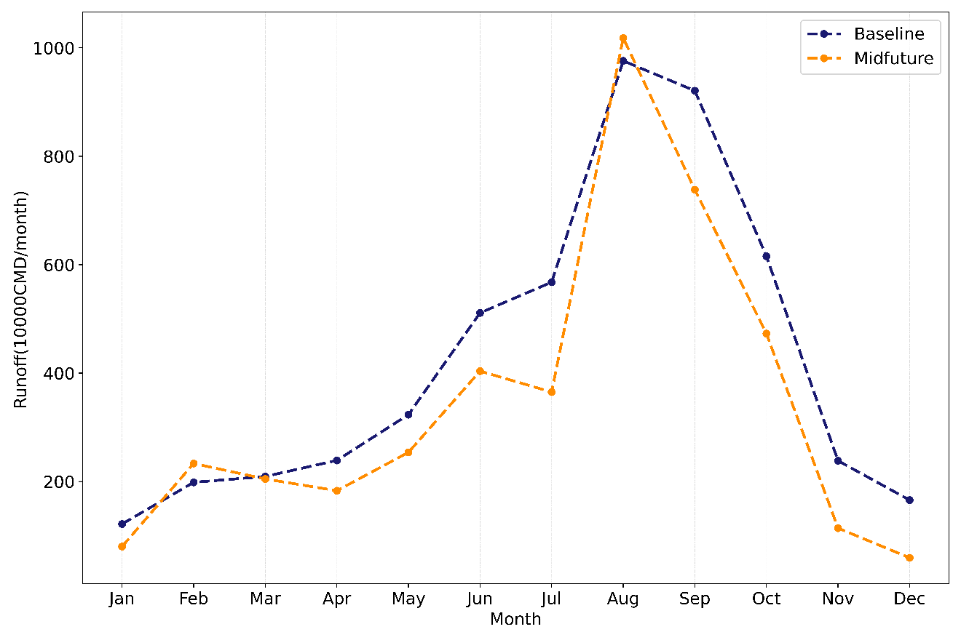
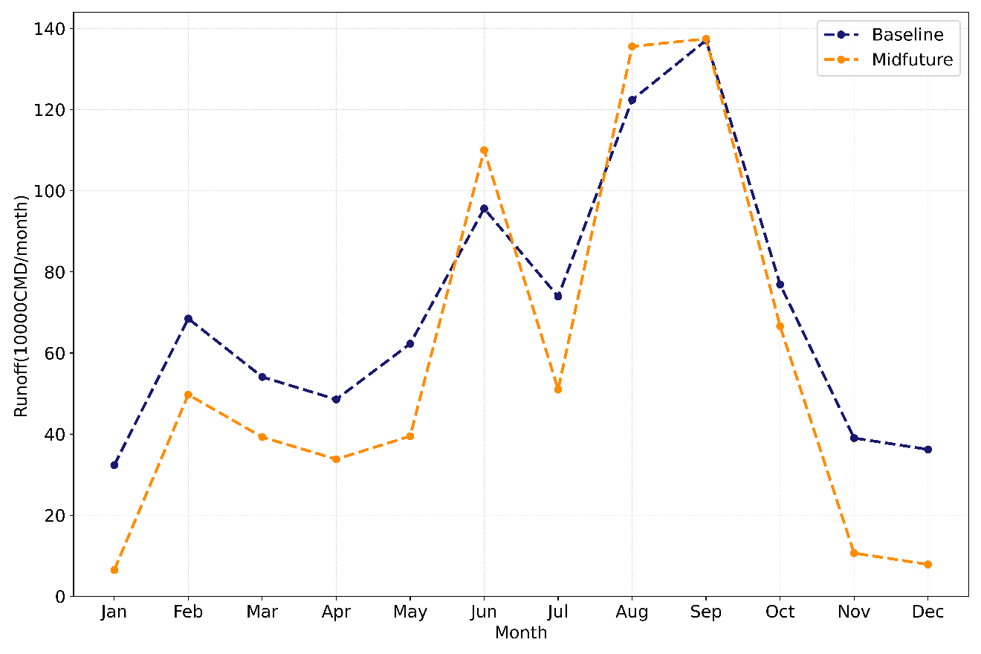
Introduction
3/3
Runoff Trends of the Baseline and under the SSP5-8.5 Scenario
Shihmen Reservoir watershed Runoff Trends:
Baseline (1995-2014) and Mid-Future (2041-2060)
Sanhsia River watershed Runoff Trends:
Baseline (1995-2014) and Mid-Future (2041-2060)

Slide 9
02
Methodology

Slide 10


Methodology
1/7
Research workflow
$$\text{Data} \text{collection}$$
$$\text{Model} \text{Development} \text{and} \text{Simulation}$$

Slide 11
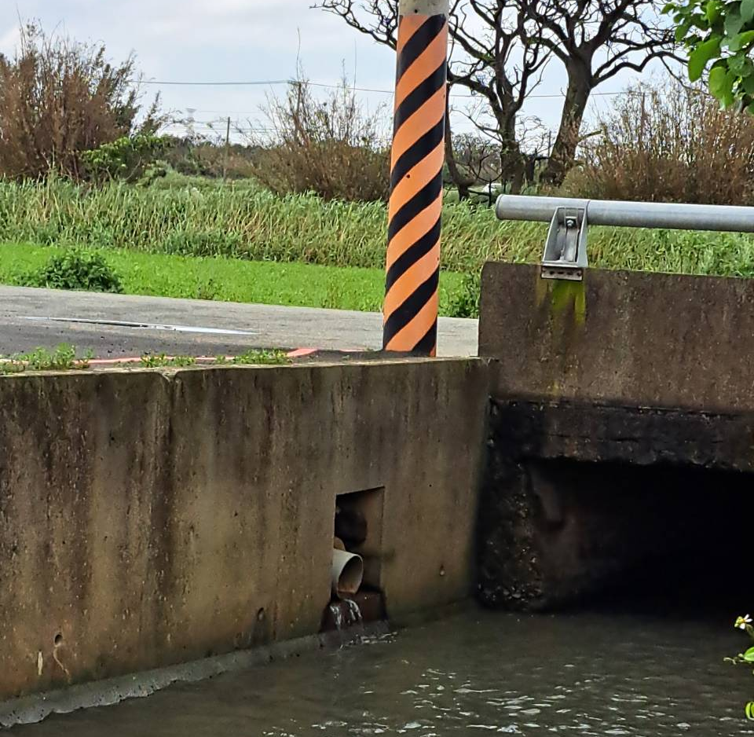
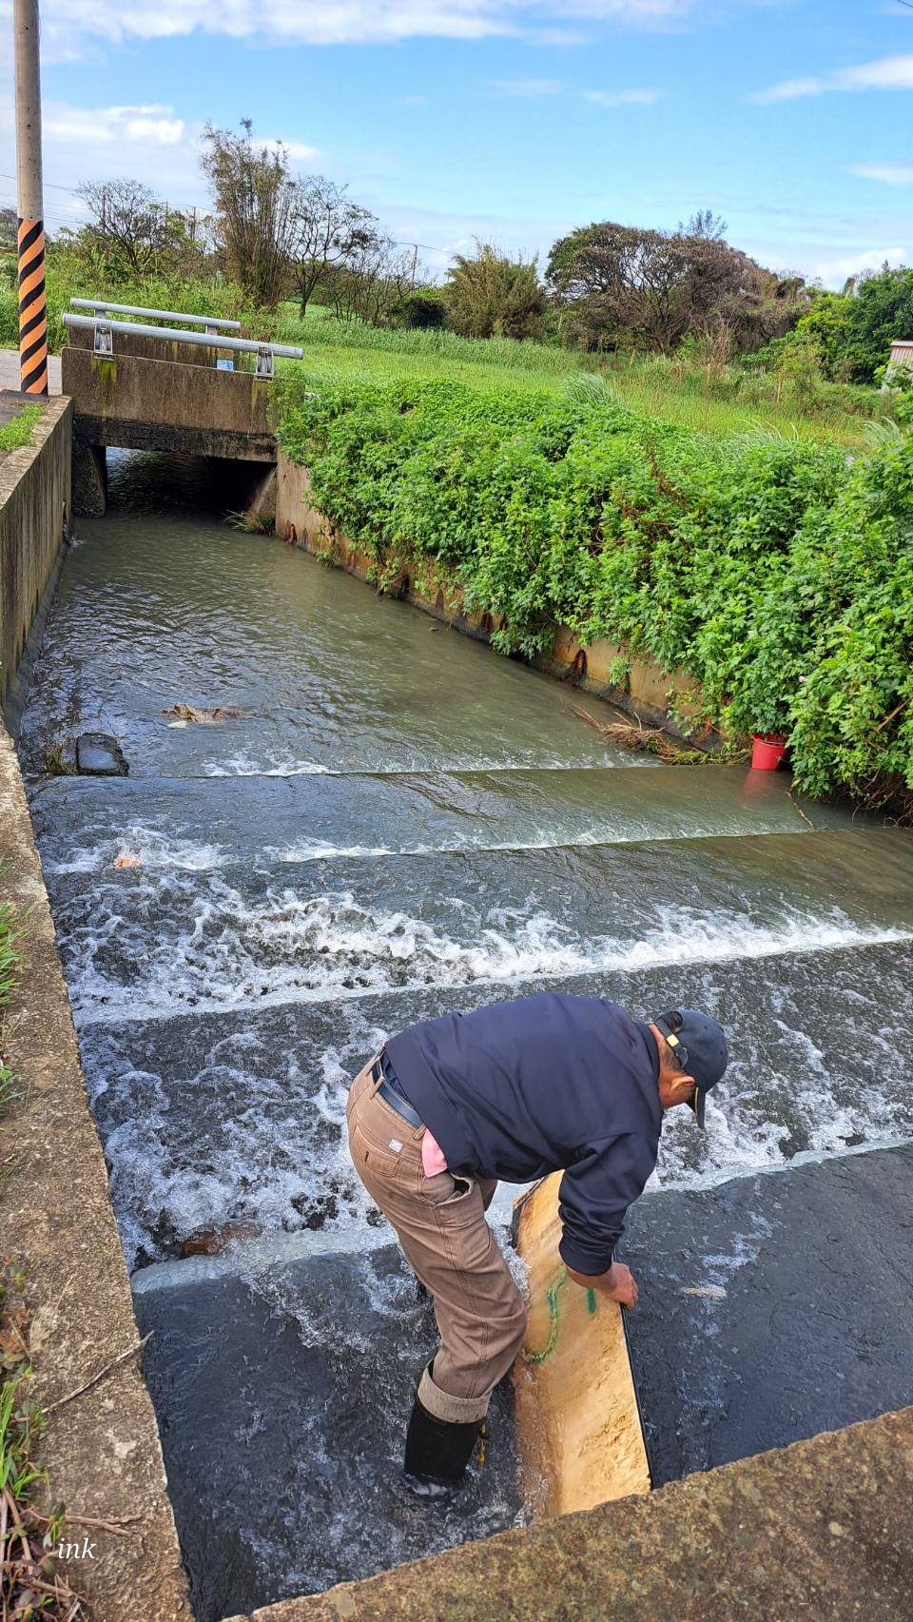
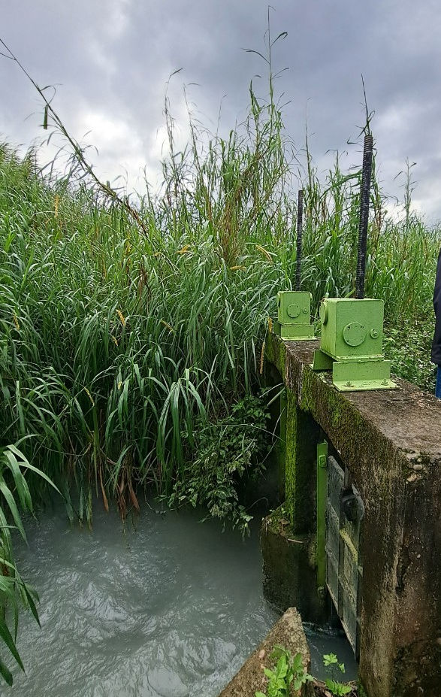
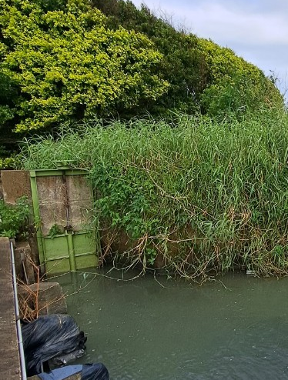
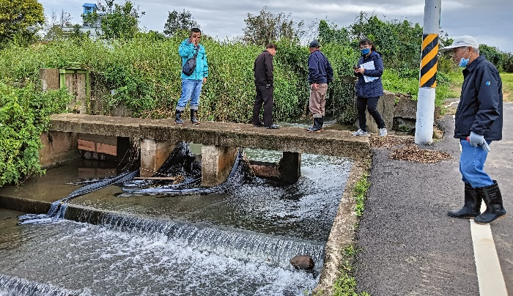
Methodology
2/7
Field Investigation
1. 17-Secondary Canal Intake Gate
2. Secondary Irrigation Channel
Xiao-Fanli River
3. Field Channel
2. River

Slide 12

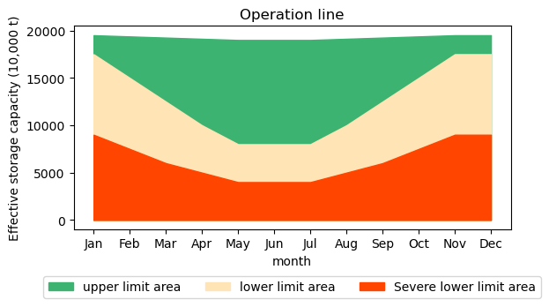




Research Methodology and Data Collection
Methodology
3/7
Model Parameter Settings
Reservoir operation assessment framework
Shihmen Reservoir Operation Rule Curves
Normal Water Demand
Agri→ Normal Water Demand * 0.75
Public→ Normal Water Demand *0.9
Agri → Normal Water Demand * 0.5
Public→ Normal Water Demand *0.8
System Balance Equation
Shihmen Reservoir :
Storage Capacity
Outflow
$V_{i+1}=$ $V_{i}+$ $I_{i} − O_{i} − Q_{i}$
Inflow
Overflow
Agricultural water use
Storage Capacity
Agriculture Ponds :
$${Sp}_{i+1}={Sp}_{i}+q_{i}^{l}+q_{i}^{w}−q_{i}^{p}−{Op}_{i}$$
Inflow
(Channel)
Inflow
(River)
Overflow
System Constraint Conditions
$$q_{i}≤q max$$
Channel:
Water Treatment Plant (WTP) :
$${WTP}_{i}≤WTP max$$

Slide 13
Research Methodology and Data Collection
Methodology
4/7
Building Water Resource System Dynamic Model (WRSDM)

Slide 14
Research Methodology and Data Collection
Methodology
5/7
Schematic Diagram of the Taoyuan Tableland Water Supply System

Slide 15
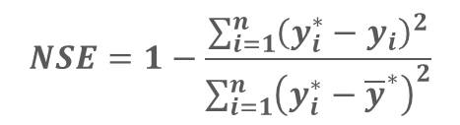
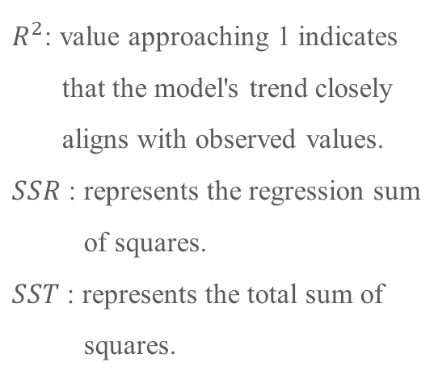
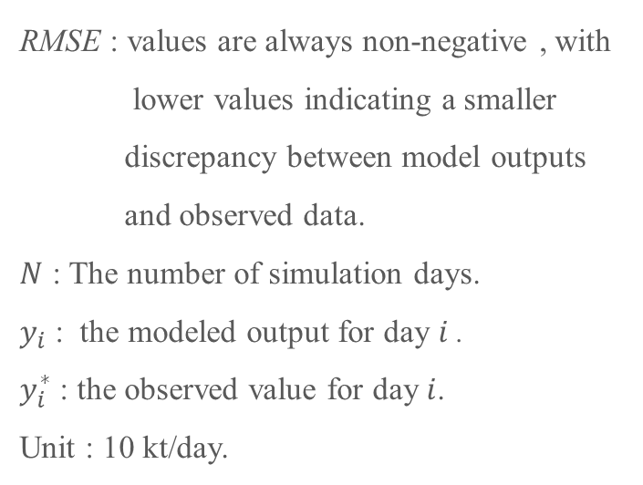

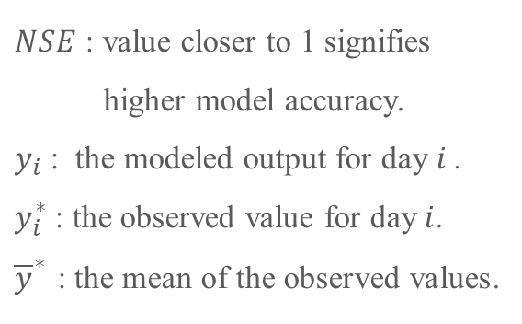
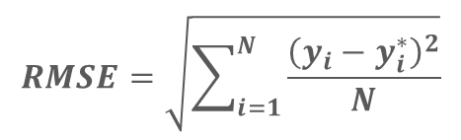
Methodology
6/7
Definition of Assessing Indicators
Validation Indicators
$$NSE=1−\frac{\sum_{i=1}^{n}{{\left(y_{i}^{∗}−y_{i}\right)}^{2}}}{\sum_{i=1}^{n}{{\left(y_{i}^{∗}−{\overline{y}}^{∗}\right)}^{2}}}$$
$$RMSE=\sqrt{\sum_{i=1}^{N}{\frac{{\left(y_{i}−y_{i}^{∗}\right)}^{2}}{N}}}$$
$$R^{2}=SSR/SST$$
$R^{2}$: value approaching 1 indicates
that the model's trend closely
aligns with observed values.
$SSR$ : represents the regression sum
of squares.
$SST$ : represents the total sum of
squares.
$NSE$ : value closer to 1 signifies
higher model accuracy.
$y_{i}$ : the modeled output for day $i$ .
$y_{i}^{∗}$ : the observed value for day $i$.
${\overline{y}}^{∗}$ : the mean of the observed values.
RMSE : values are always non-negative , with
lower values indicating a smaller
discrepancy between model outputs
and observed data.
$N$ : The number of simulation days.
$y_{i}$ : the modeled output for day $i$ .
$y_{i}^{∗}$ : the observed value for day $i$.
Unit : 10 kt/day.
A Higher value is preferable.
A Higher value is preferable.
A lower value is preferable.

Slide 16
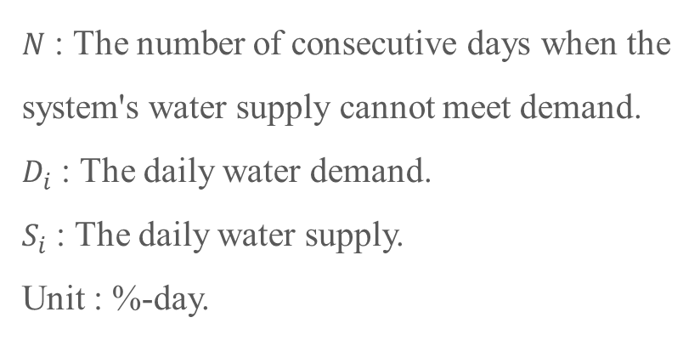
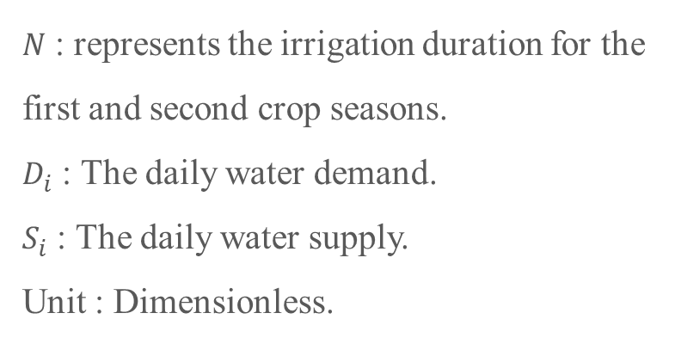
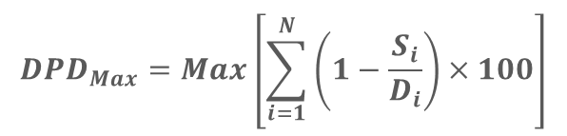
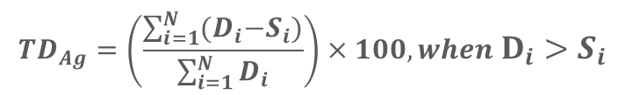
Methodology
7/7
Definition of Assessing Indicators
Deficit Indicator
$${DPD}_{Max}=Max\left[\sum_{i=1}^{N}{\left(1−\frac{S_{i}}{D_{i}}\right)×100}\right]$$
$${TD}_{Ag}=\left(\frac{\sum_{i=1}^{N}{{(D}_{i}−S_{i}})}{\sum_{i=1}^{N}{D_{i}}}\right)×100, when D_{i}>S_{i}$$
Public water
Agriculture water
Deficit Percent Day
Total Agricultural Water Deficit
$N$ : The number of consecutive days when the system's water supply cannot meet demand.
$D_{i}$ : The daily water demand.
$S_{i}$ : The daily water supply.
Unit : %-day.
$N$ : represents the irrigation duration for the first and second crop seasons.
$D_{i}$ : The daily water demand.
$S_{i}$ : The daily water supply.
Unit : Dimensionless.
A lower value is preferable.
A lower value is preferable.

Slide 17
03
Results and Discussion

Slide 18
Results and Discussion
Research workflow

Slide 19
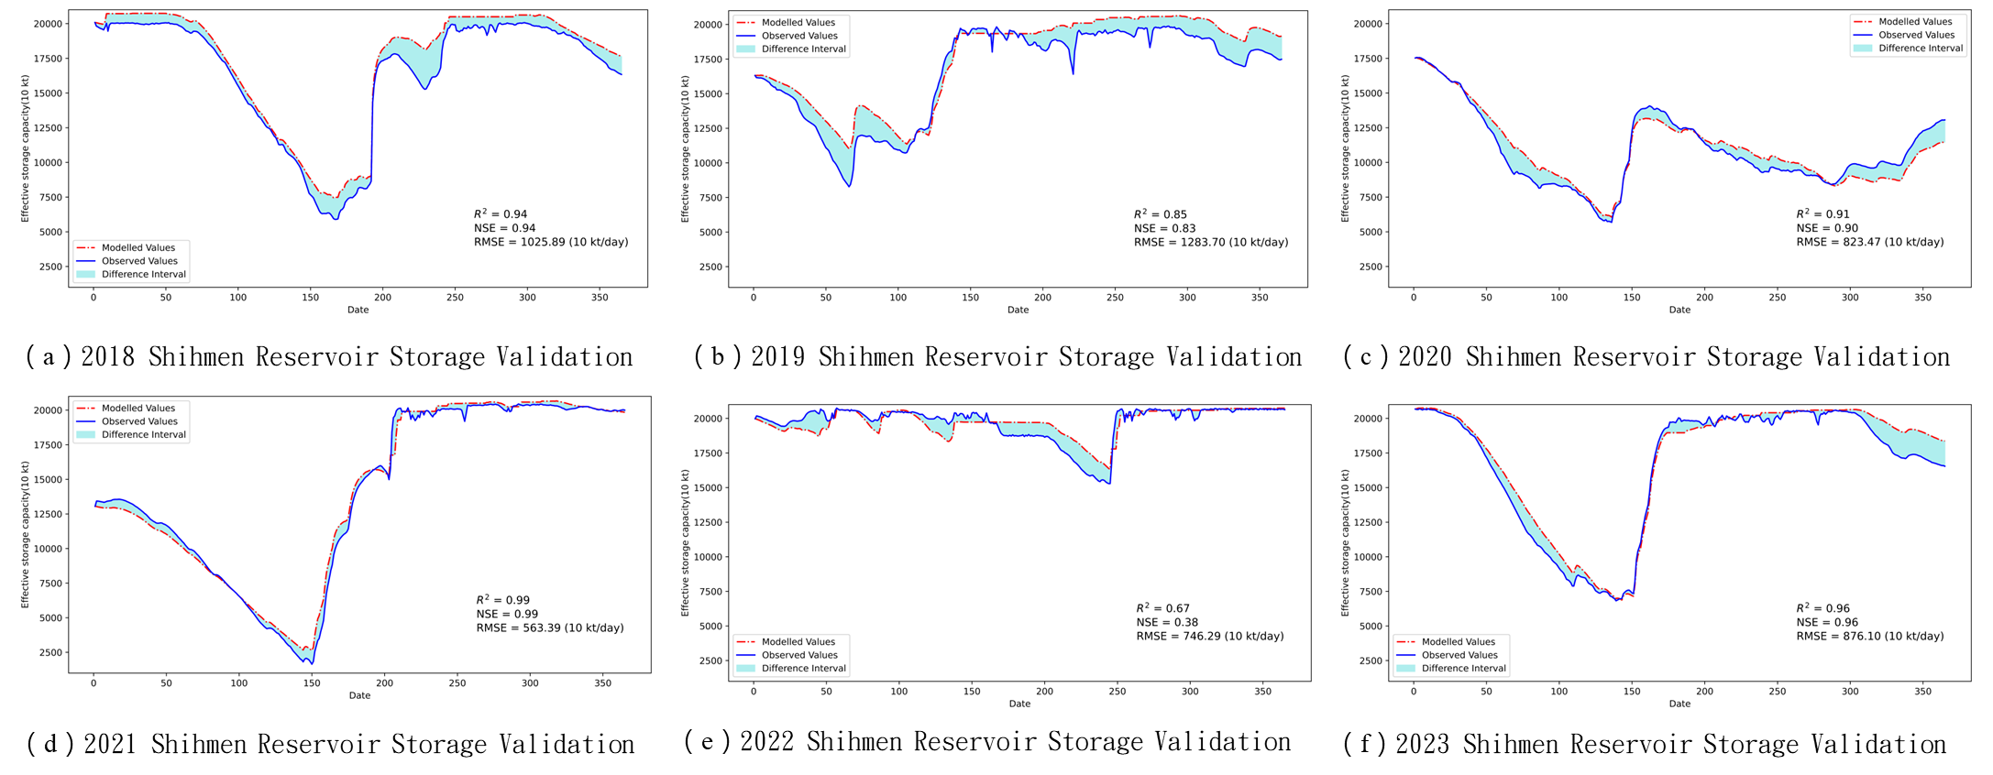
Results and Discussion
1/4
WRSDM’s Shihmen Reservoir Validation

Slide 20
Results and Discussion
Research workflow

Slide 21
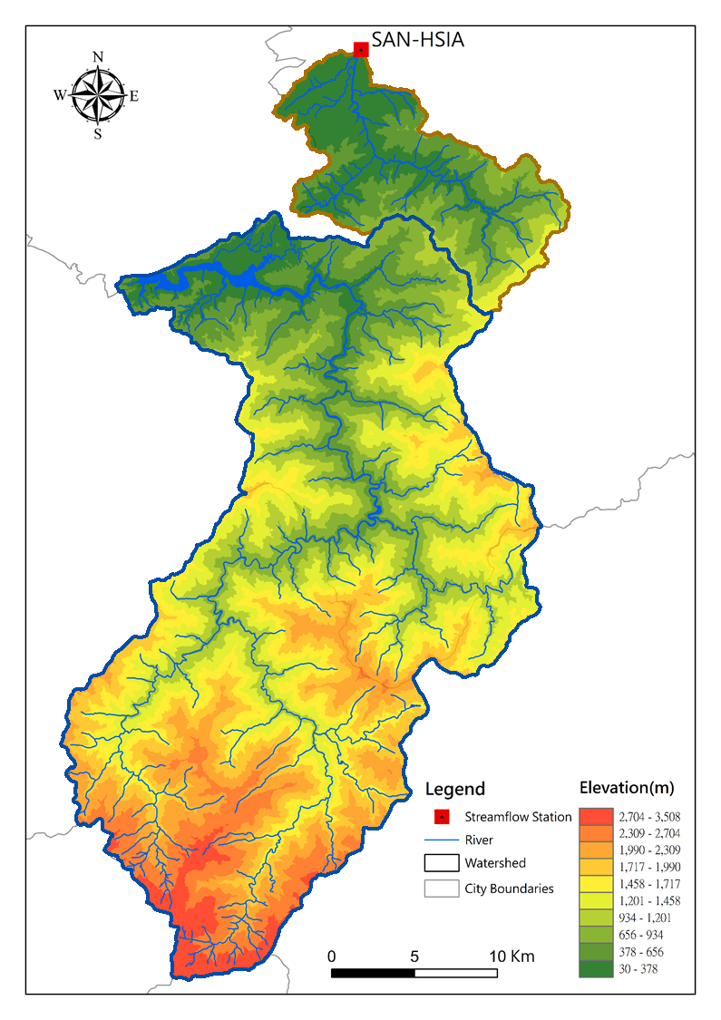
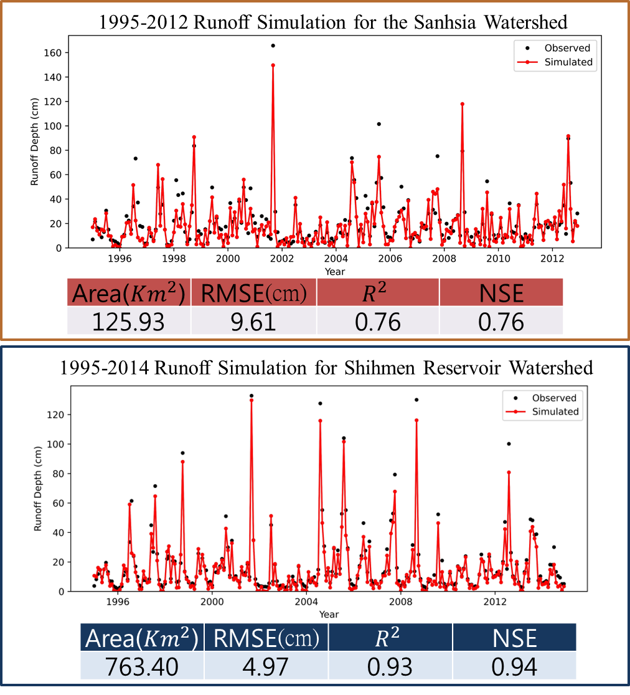
Results
2/4
Runoff
Simulation

Slide 22
Results and Discussion
Research workflow

Slide 23
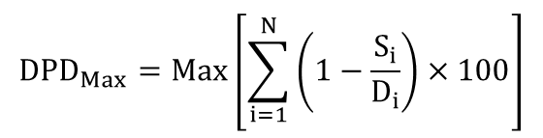
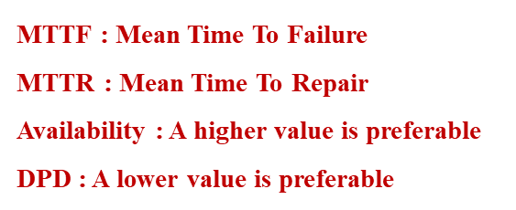
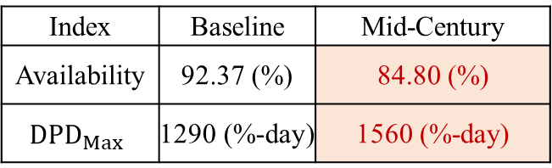
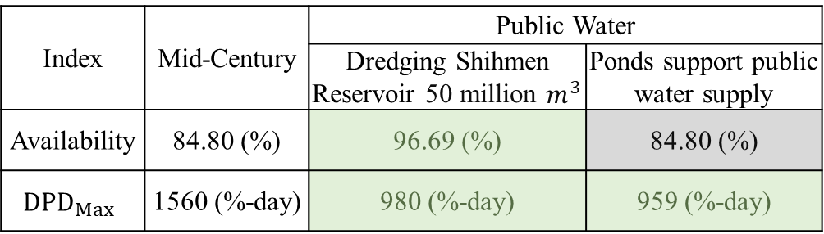

Results and Discussion
3/4
Adaptation Measures for Water Resources Management (Public Water)
Baseline & Mid-Century
$$Availability= \frac{MTTF}{\left(MTTF+MTTR\right)}$$
Index | Baseline | Mid-Century
Availability | 92.37 (%) | 84.80 (%)
$${DPD}_{Max}$$ | 1290 (%-day) | 1560 (%-day)
$${DPD}_{Max}=Max\left[\sum_{i=1}^{N}{\left(1−\frac{S_{i}}{D_{i}}\right)×100}\right]$$
Mid-Century & Adaptation Measures
Index | Mid-Century | Public Water
 |  | Dredging Shihmen Reservoir 50 million $m^{3}$ | Ponds support public water supply
Availability | 84.80 (%) | 96.69 (%) | 84.80 (%)
$${DPD}_{Max}$$ | 1560 (%-day) | 980 (%-day) | 959 (%-day)
MTTF : Mean Time To Failure
MTTR : Mean Time To Repair
Availability : A higher value is preferable
DPD : A lower value is preferable

Slide 24


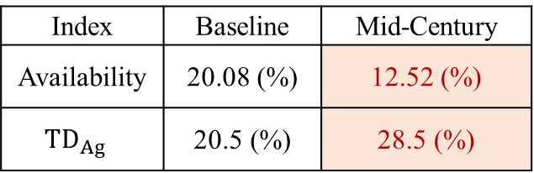
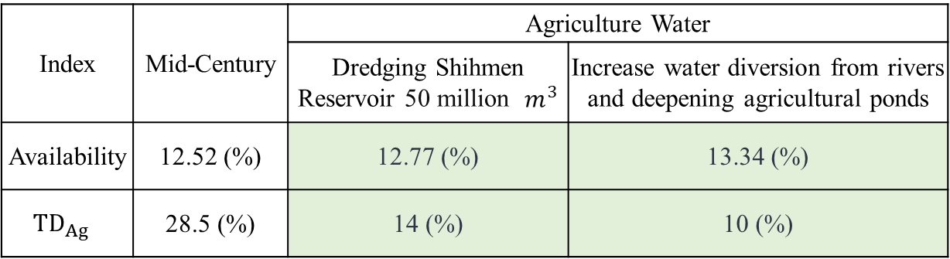


Results and Discussion
4/4
Adaptation Measures for Water Resources Management (Agriculture Water)
Baseline & Mid-Century
$$Availability= \frac{MTTF}{\left(MTTF+MTTR\right)}$$
Index | Baseline | Mid-Century
Availability | 20.08 (%) | 12.52 (%)
$${TD}_{Ag}$$ | 20.5 (%) | 28.5 (%)
${TD}_{Ag}=\left(\frac{\sum_{i=1}^{N}{{(D}_{i}−S_{i}})}{\sum_{i=1}^{N}{D_{i}}}\right)×100, when$ $D_{i}{>S}_{i}$
Mid-Century & Adaptation Measures
Index | Mid-Century | Agriculture Water
 |  | Dredging Shihmen Reservoir 50 million $m^{3}$ | Increase water diversion from rivers and deepening agricultural ponds
Availability | 12.52 (%) | 12.77 (%) | 13.34 (%)
$${TD}_{Ag}$$ | 28.5 (%) | 14 (%) | 10 (%)
MTTF : Mean Time To Failure
MTTR : Mean Time To Repair
Availability : A higher value is preferable
${TD}_{Ag}$: A lower value is preferable
≈ 34 million $m^{3}$

Slide 25
04
Conclusions and Future Work

Slide 26
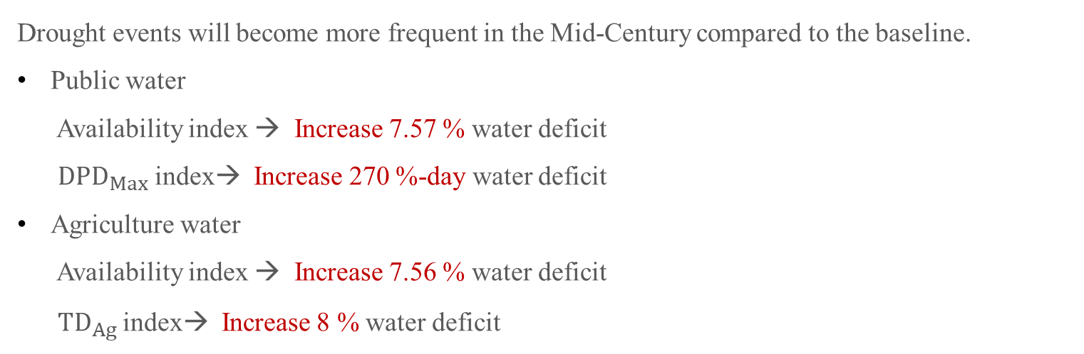
Conclusions
Baseline and Mid-Century
1/2
Drought events will become more frequent in the Mid-Century compared to the baseline.
Public water
Availability index → Increase 7.57 % water deficit
${DPD}_{Max}$ index→ Increase 270 %-day water deficit
Agriculture water
Availability index → Increase 7.56 % water deficit
${TD}_{Ag}$index→ Increase 8 % water deficit

Slide 27
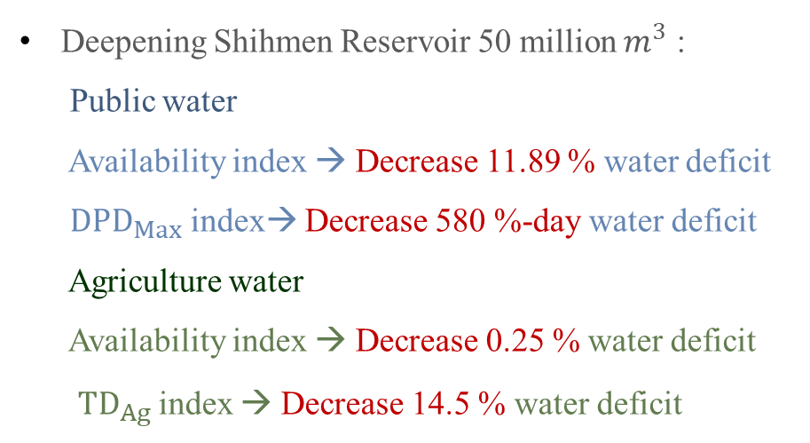
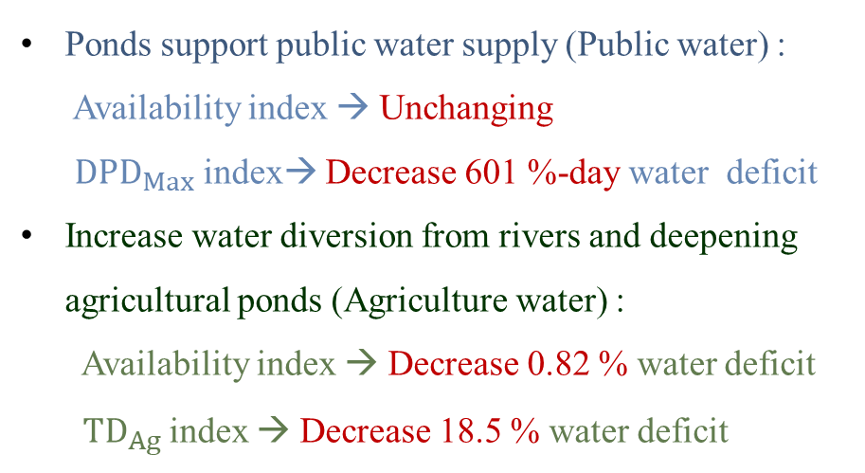
Conclusions
Adaptation Measures for Water Resources Management (Mid-Century)
2/2
Deepening Shihmen Reservoir 50 million $m^{3}$ :
Public water
Availability index → Decrease 11.89 % water deficit
${DPD}_{Max}$ index→ Decrease 580 %-day water deficit
Agriculture water
Availability index → Decrease 0.25 % water deficit
${TD}_{Ag}$index → Decrease 14.5 % water deficit
Ponds support public water supply (Public water) :
Availability index → Unchanging
${DPD}_{Max}$ index→ Decrease 601 %-day water deficit
Increase water diversion from rivers and deepening agricultural ponds (Agriculture water) :
Availability index → Decrease 0.82 % water deficit
${TD}_{Ag}$index → Decrease 18.5 % water deficit

Slide 28
References
Lee, M.-H. (2024). Sustainable Development of Key Areas in the Taoyuan Plateau and Coastal Zone: Cross-domain Research on Sustainable Development of the Taoyuan Plateau and Coastal Zone: Main Project (1/3) (Project No. NSTC 112-2621-M-008-003-). National Science and Technology Council Specialized Research Project Report.
Liu, T.M., C. P. Tung*, K. Y. Ke, L. H. Chuang and C. Y. Lin. 2009. Application and development of a decision-support system for assessing water shortage and allocation with climate change. Paddy and Water Environment, Vol.7, No. 4, pp301-311
Wilhite, D. A., & Glantz, M. H. (1985). Understanding: the drought phenomenon: the role of definitions. Water international, 10(3), 111-120.
Shahbazbegian, M., & Bagheri, A. (2010). Rethinking assessment of drought impacts: a systemic approach towards sustainability. Sustainability Science, 5, 223-236.
IPCC, 2023: Summary for Policymakers. In: Climate Change 2023: Synthesis Report. Contribution of Working Groups I, II and III to the Sixth Assessment Report of the Intergovernmental Panel on Climate Change [Core Writing Team, H. Lee and J. Romero (eds.)]. IPCC, Geneva, Switzerland, pp. 1-34
Lu, Y., Tian, F., Guo, L., Borzì, I., Patil, R., Wei, J., ... & Sivapalan, M. (2021). Socio-hydrologic modeling of the dynamics of cooperation in the transboundary Lancang–Mekong River. Hydrology and Earth System Sciences, 25(4), 1883-1903.
Ming-Hsu, L., Tseng, K. J., Tung, C. P., Dong-Sin, S., & Liu, T. M. (2017). Assessing water resources vulnerability and resilience of southern Taiwan to climate change. TAO: Terrestrial, Atmospheric and Oceanic Sciences, 28(1), 6.
Notes:
These are my references.

Slide 29
Thank you for your attention
Notes:
That concludes my presentation.

