Slide 1
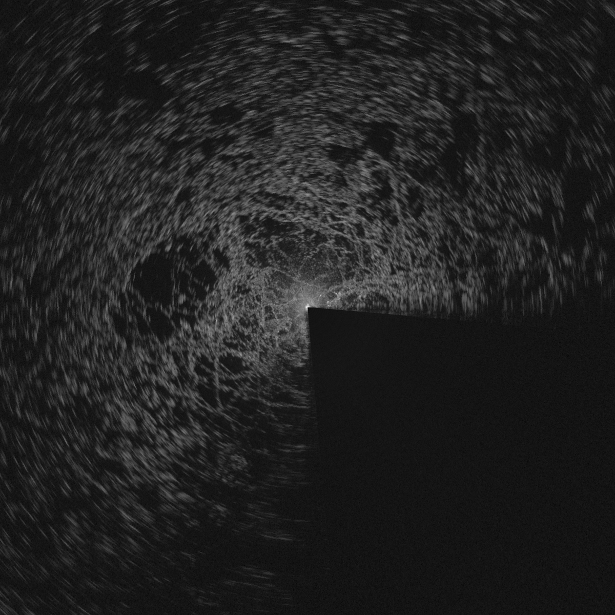
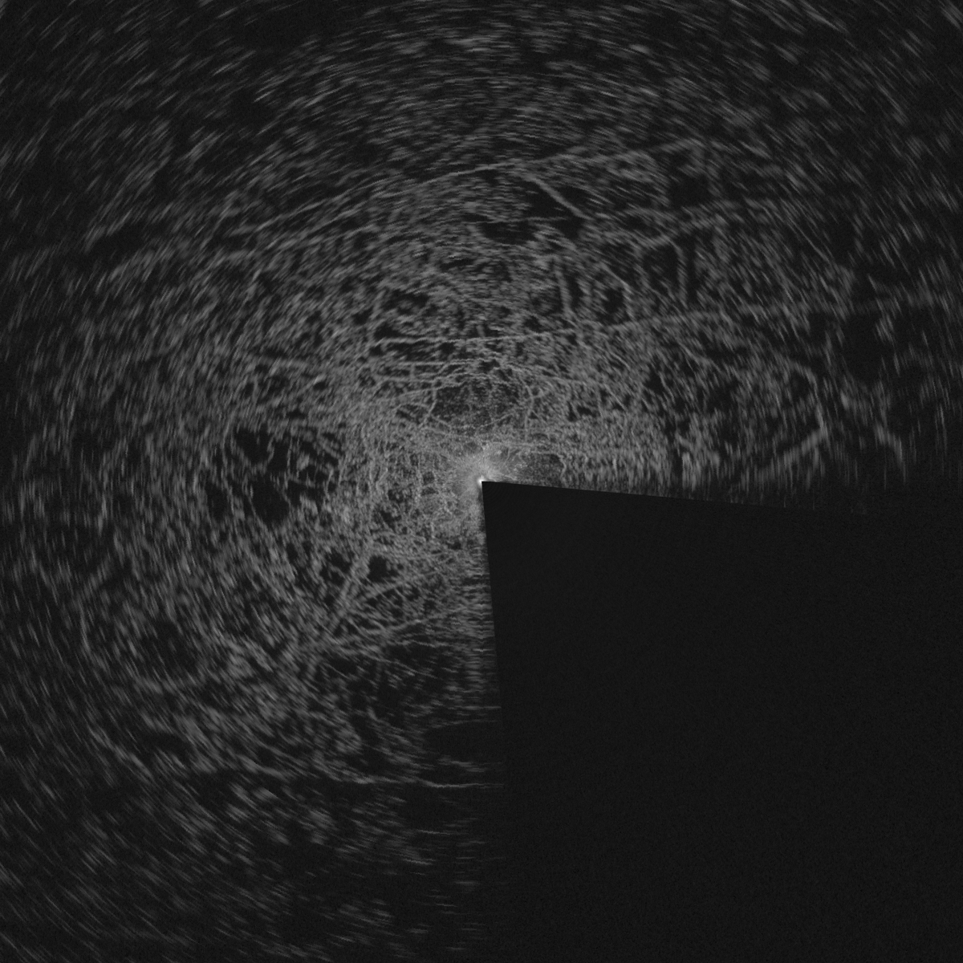
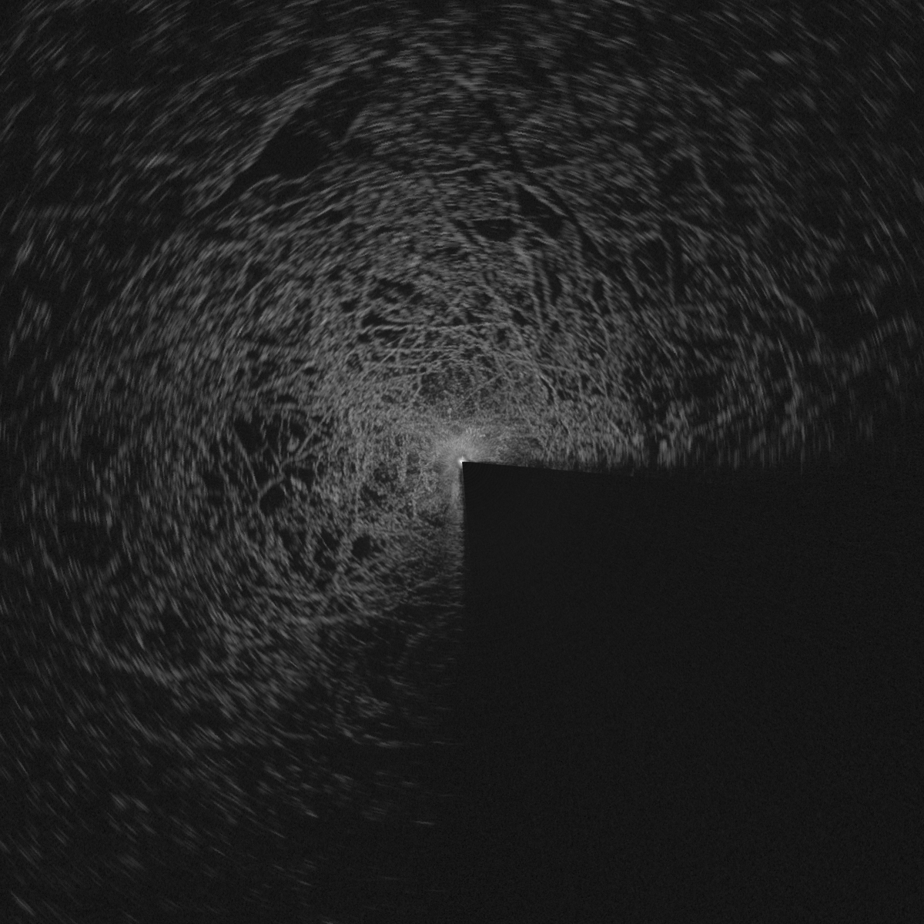
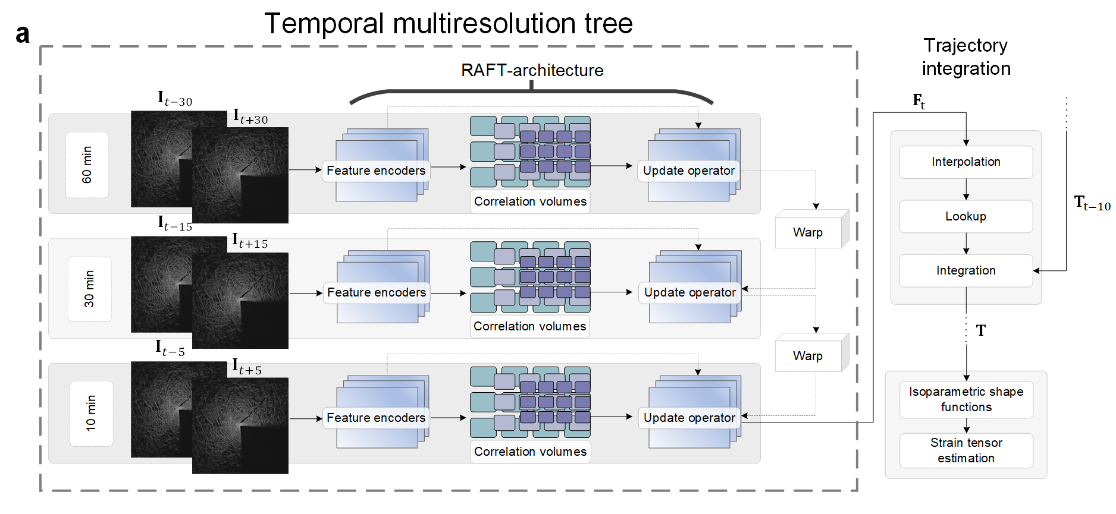
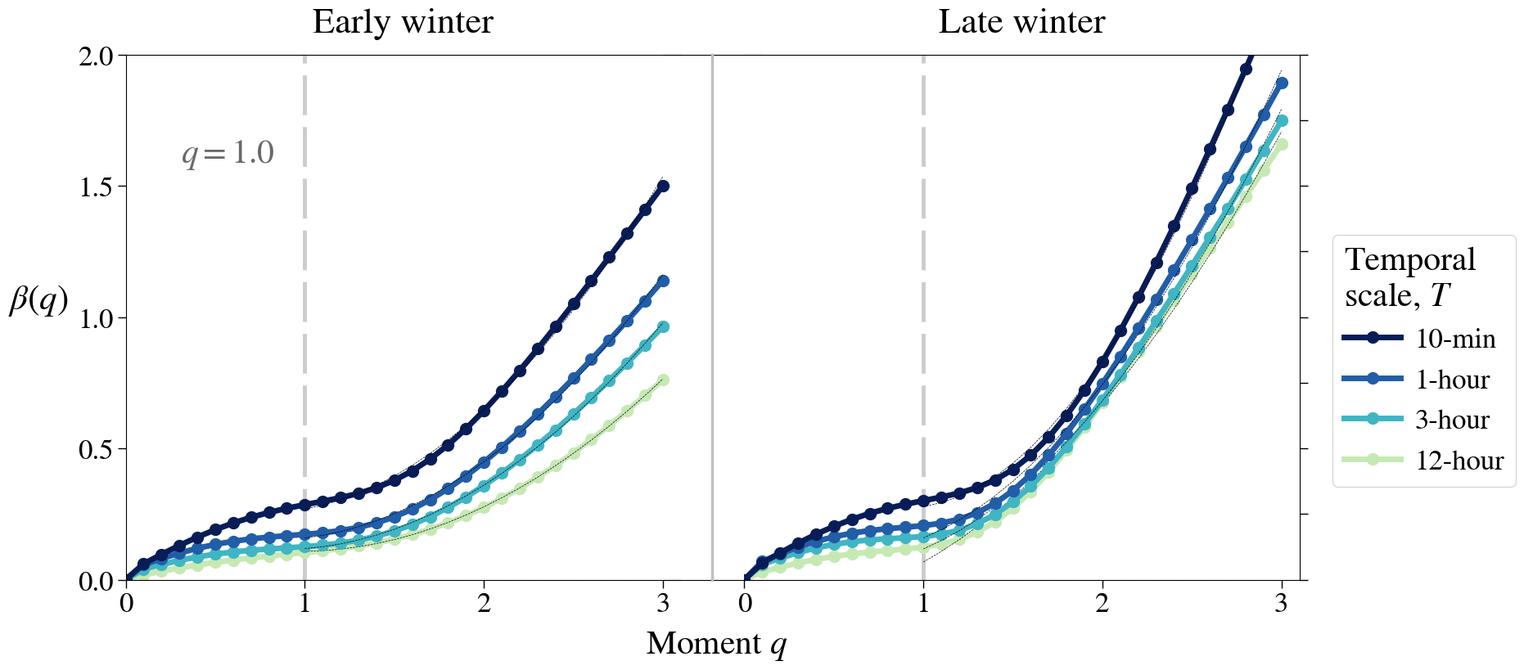
Exploring Nonlinear Dynamics of Sea Ice Deformation Through Deep Learning-Based Optical Flow
Matias Uusinoka¹, Arttu Polojärvi¹, Jari Haapala² , Jan Åström³
¹Department of Energy and Mechanical Engineering, Aalto University; ²Finnish Meteorological Institute; ³CSC – IT Center for Science
Matias Uusinoka¹, Arttu Polojärvi¹, Jari Haapala² , Jan Åström³
¹Department of Energy and Mechanical Engineering, Aalto University; ²Finnish Meteorological Institute; ³CSC – IT Center for Science
Motivation
1
Radar data ¹
Sea-ice drift is a textbook crackling system. Decades of buoy and SAR records reveal power-law strain-rate statistics and coupled space–time scaling (Weiss, 2013).
Key questions
How far down in scale do those scaling laws persist?
When do multifractal cascades break down during winter evolution?
Continuous ship radar data from MOSAiC between Oct 2019 – Sep 2020:
10 km × 10 km spatial domain with 10 m and 1-min resolutions.
~260 000 images, seasonal ice-state contrast from solid winter pack to summer floe field.
This data covers the mesoscale cascade while still capturing deformation features at the scale of tens of meters.
Deformation fields and time series ³
2
Deep learning-based deformation mapping ²
Spatial pattern:
Early winter: Deformation features distributed across the full $10 km×10 km$ domain.
Late winter: Deformation localized in only a few larger leads with intermittent shear pulses.
Temporal pattern:
A few major active deformation periods separated by weeks-long quiescence.
RAFT optical-flow architecture (Teed & Deng, 2020) extended with a temporal
resolution tree (Uusinoka, et al. 2025a):
Pixel-scale displacements with subpixel accuracy even in noisy sectors.
~750 000 displacements per frame integrated to Lagrangian trajectories.
Open-source code provided for reuse of the data pipeline.
Article
Scale invariance ⁴
3
Multifractal spectra ⁵
Lower bound for scale invariance observed at $∼{10}^{2} m$.
$β\left(q=1\right)∈[0.4 ,0.6]$ during winter but flattens during summer in the MIZ.
Intermittent events dominate winter but summer in MIZ shows viscous-like
flow with no clear scaling.
Continuum rheologies calibrated at kilometre-scale grids cannot capture physics below $L≫{10}^{2}m$ but DEM models or hybrid approaches are required (Uusinoka, et al. 2025b).
Early winter:
Rich hierarchy of deformation features and intensities. Quadratic spectrum with $q≥1.0$ for $β\left(q\right)$. Similar quadratic $α(q)$ but with weaker curvature.
Late winter:
Deformation field is dominated by few extreme features and events. β(q) becomes monofractal for larger moments and overshoots physical bound at q = 3.
Preprint
4
5
Take home message
Scale invariance in sea ice deformation holds down to ~10² m.
Degree of multifractality at mesoscale varies through winter.
1
2
References
Teed, Z., & Deng, J. (2020). Raft: Recurrent all-pairs field transforms for optical flow. Computer Vision–ECCV 2020.
Uusinoka, M., Haapala, J., & Polojärvi, A. (2025a). Deep learning‐based optical flow in fine‐scale deformation mapping of sea ice dynamics. Geophysical Research Letters.
Uusinoka, M., Haapala, J., Åström, J., Lensu, M., & Polojärvi, A. (2025b). Scale invariance in kilometer-scale sea ice deformation. EGUsphere. (Preprint)
Weiss, J. (2013). Drift, deformation, and fracture of sea ice: a perspective across scales. Springer.

