Slide 1
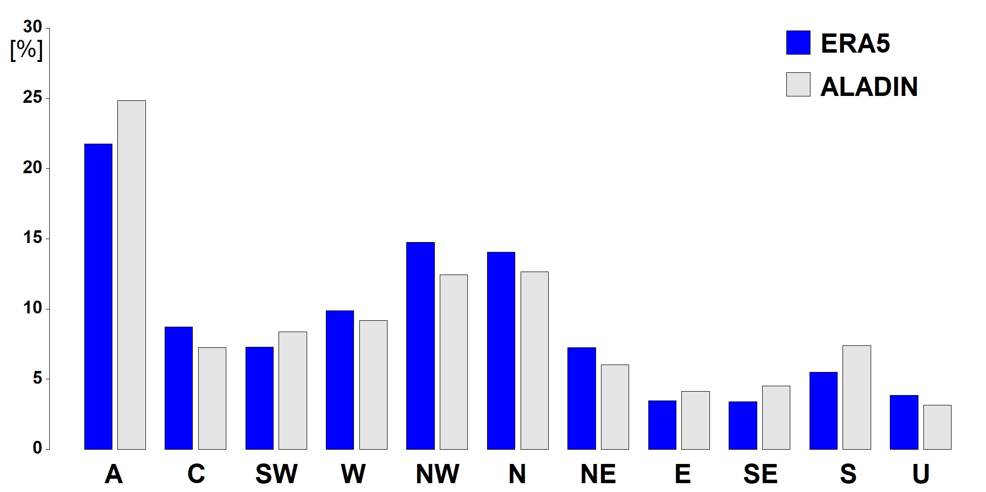
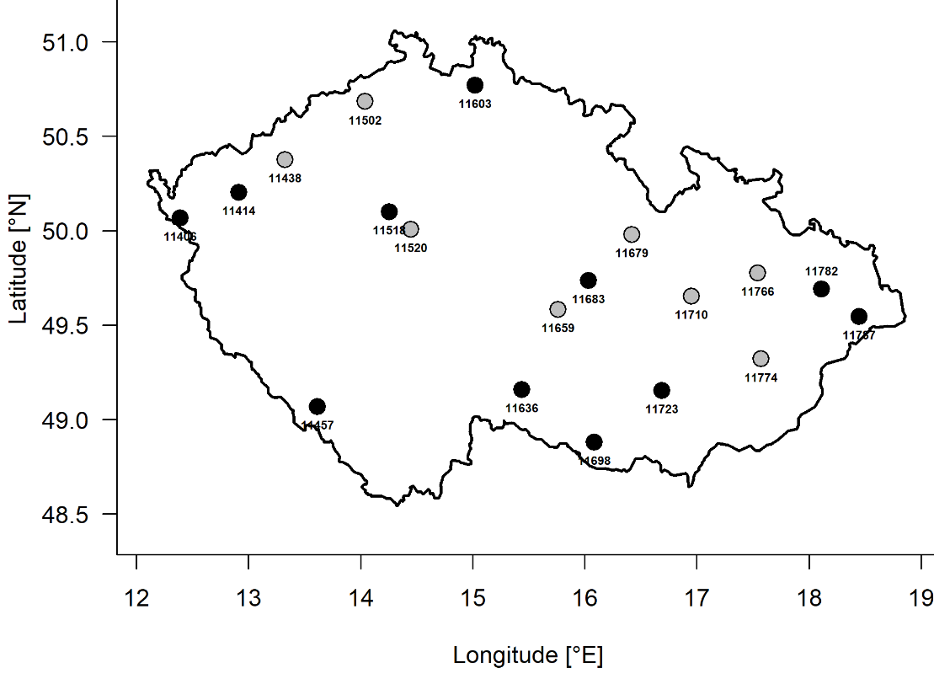
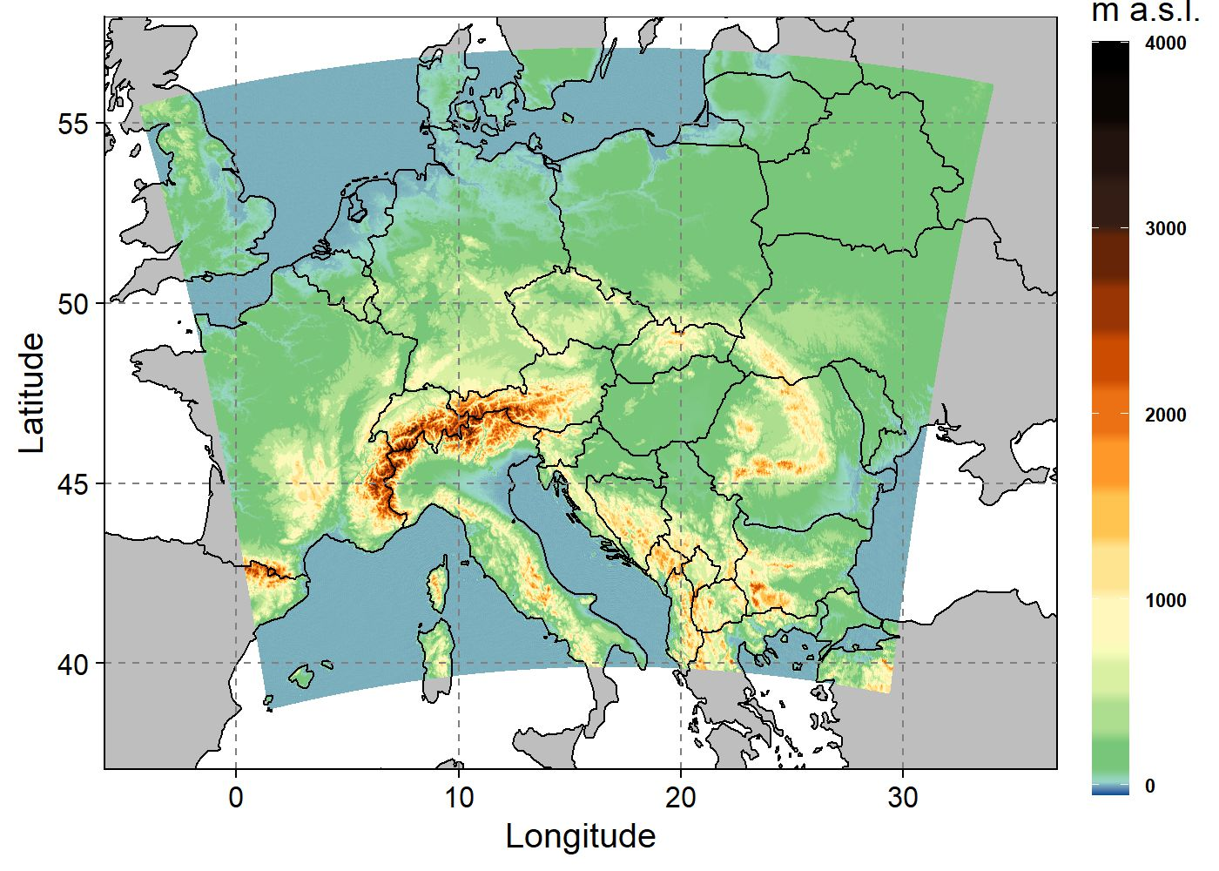
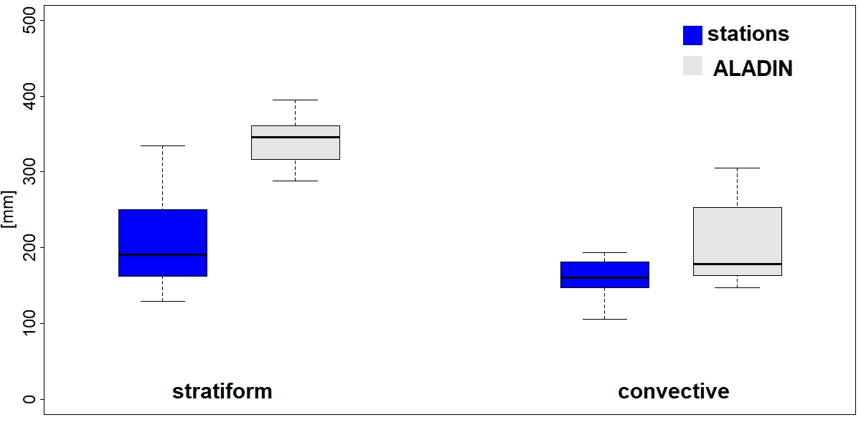
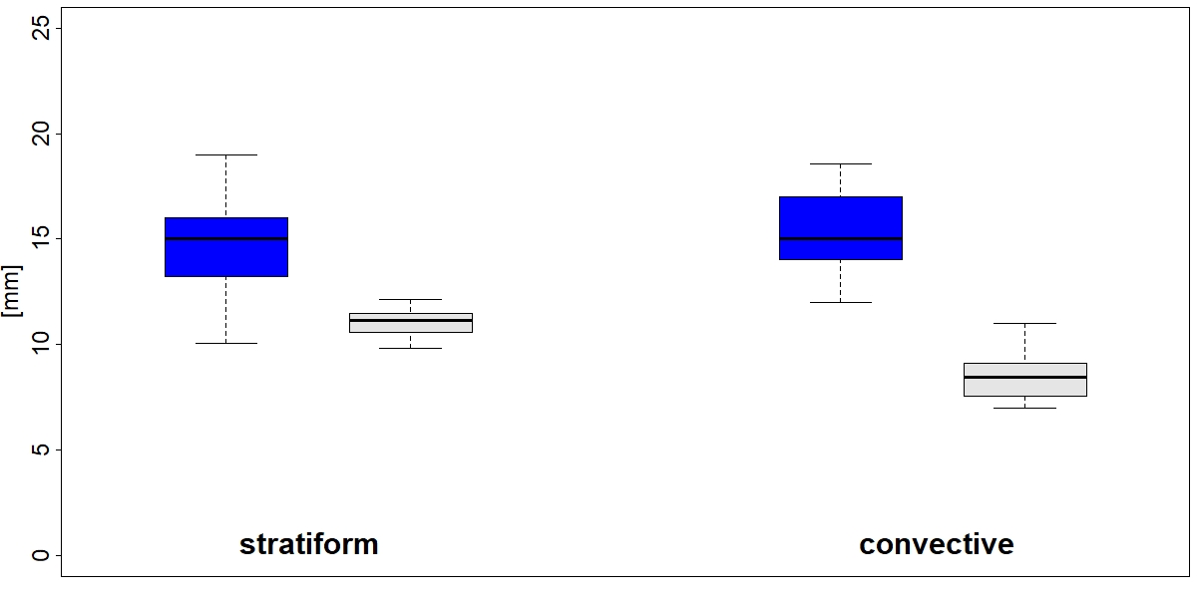
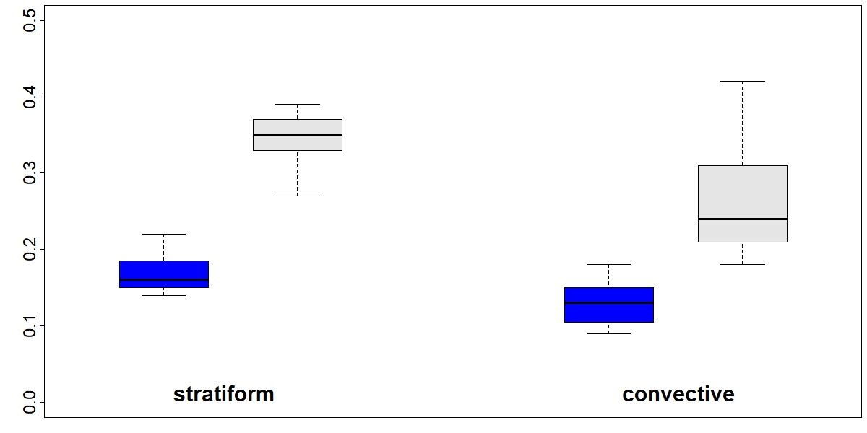
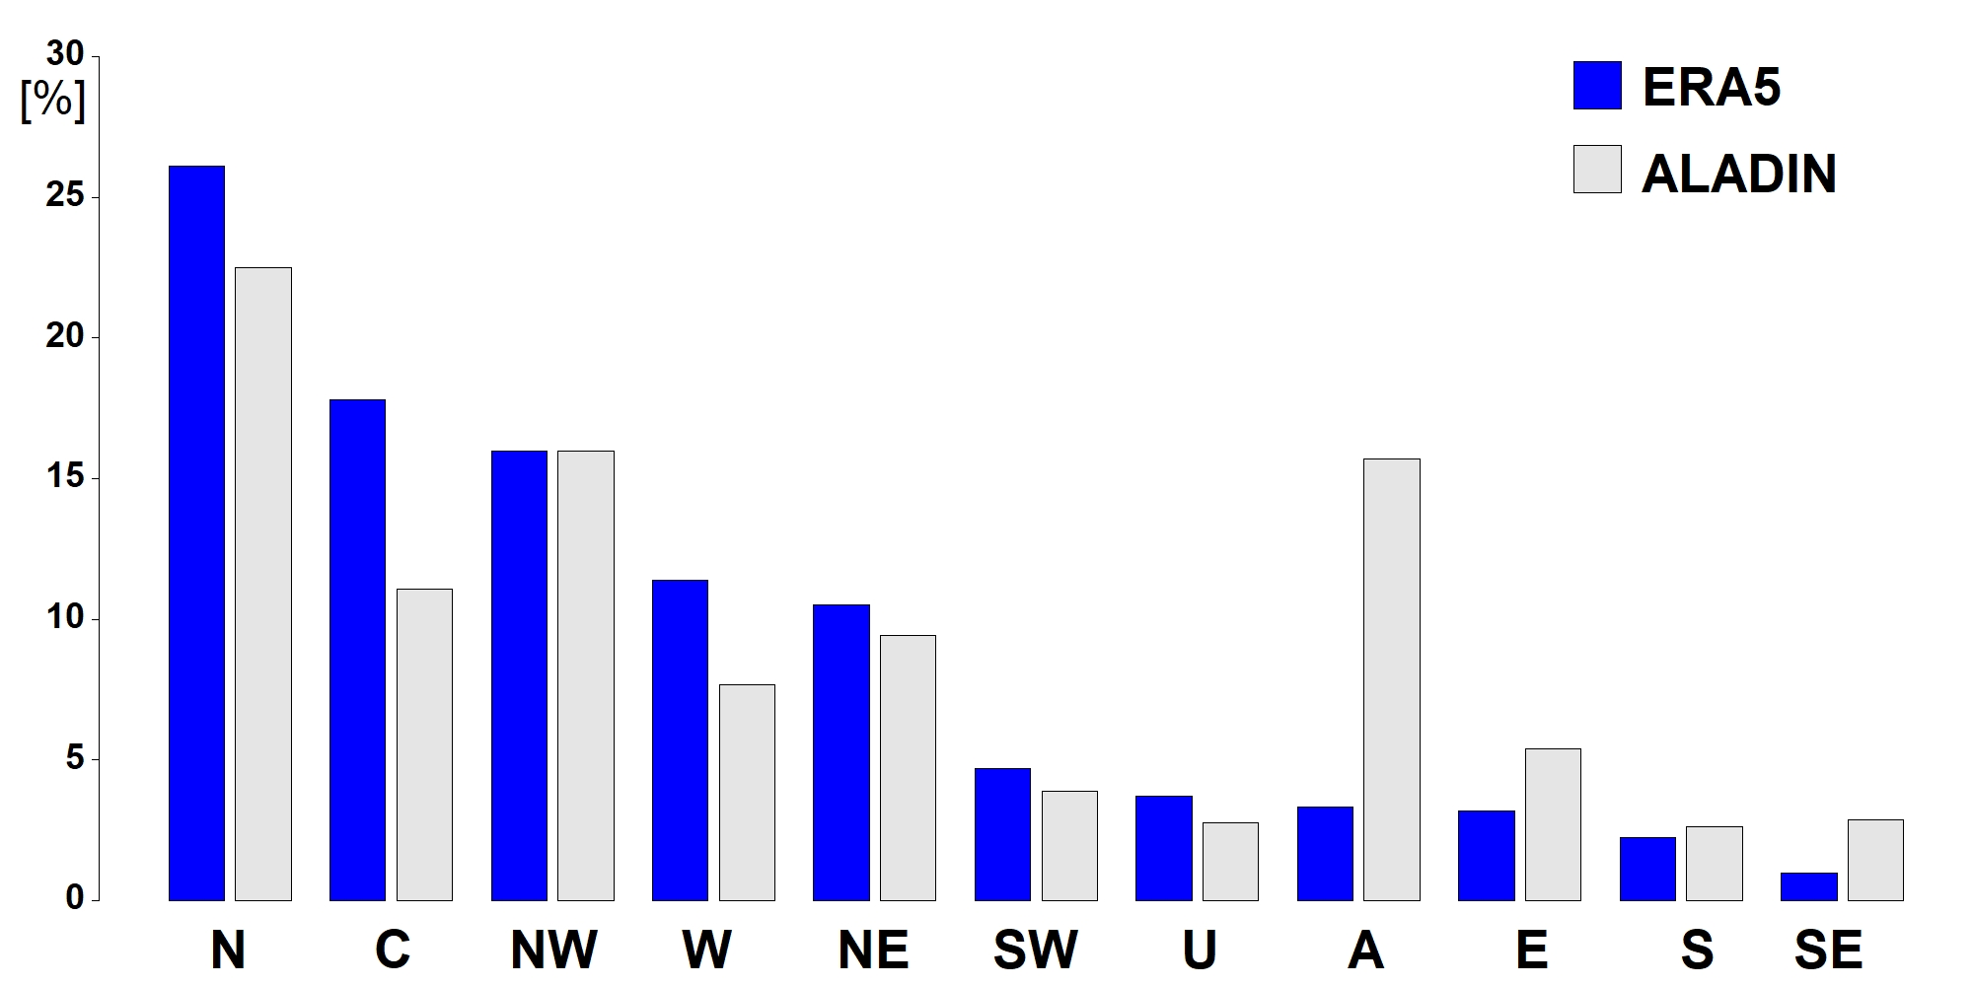
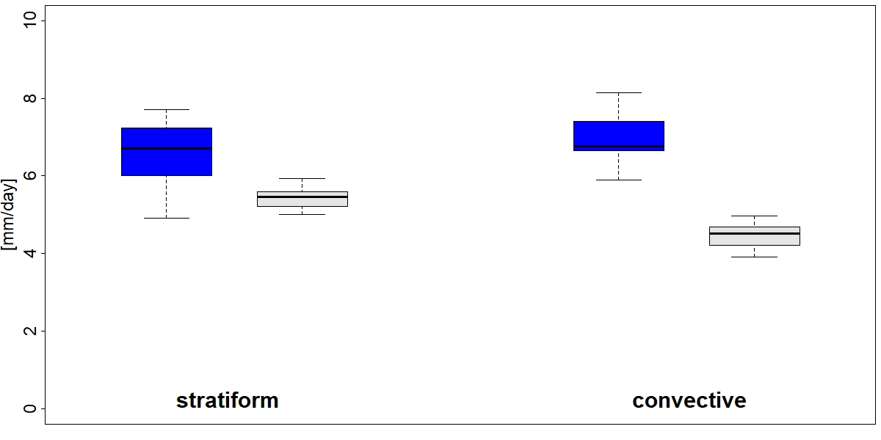
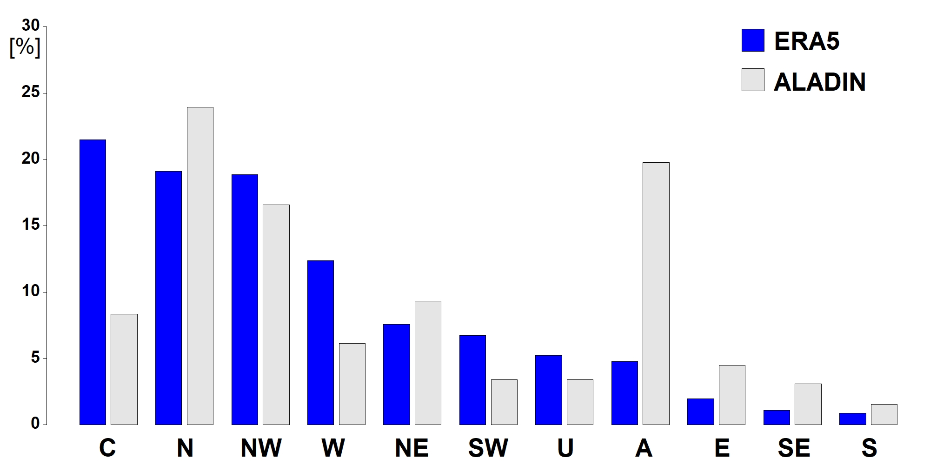
HEAVY CONVECTIVE AND STRATIFORM PRECIPITATION AND THEIR LINKS TO ATMOSPHERIC CIRCULATION
Romana Beranová (rber@ufa.cas.cz) and Zuzana Rulfová (rulfova@ufa.cas.cz)
Institute of Atmospheric Physics, Czech Academy of Sciences
Station data
Observations from 19 SYNOP stations across the Czech Republic
Operated by the Czech Hydrometeorological Institute (CHMI)
A classification algorithm was applied to subdivide 6-h precipitation amounts into convective and stratiform types
Based on hourly weather state data and cloud type information
ALADIN-climate/cz model
Based on the ALARO canonical model configuration
Horizontal grid size is 2.3 km and the model has 87 vertical levels
Convection permitting model
Fully-elastic non-hydrostatic dynamical core
Historical run
Period 1991-2010
Focusing on the warm half of the year (from April to September)
Precipitation Intensity: Defined as the total precipitation sum divided by the number of rainy days
Heavy precipitation
Defined as daily precipitation exceeding the 90th percentile of all rainy days
Rainy days: considered those with precipitation greater than 1 mm
Circulation types (CT)
SYNOP stations
Circulation types were classified using the Jenkinson and Collins (1977) method
Sea-level pressure (SLP) data were obtained from the ERA5 reanalysis dataset
A total of 11 circulation types were defined based on three indices: flow direction, flow strength, and vorticity
Model orography
Frequency of circulation types
The most frequently occurring circulation types are anticyclonic (A), northwesterly (NW), and northerly (N)
The ALADIN model successfully captures the overall frequency distribution of circulation types
Model slightly overestimates the occurrence of anticyclonic (A), southerly (S), southeasterly (SE), southwesterly (SW), and easterly (E) circulation types
Precipitation sum
90th percentile
Precipitation characteristics
Mean stratiform precipitation sum is 224 mm
Mean convective precipitation sum is 166 mm
The ALADIN model overestimates both stratiform and convective precipitation sums
Probability of stratiform precipitation is higher than probability of convective precipitation
Model substantially overestimates precipitation probabilities
Mean intensities of stratiform and convective precipitation are nearly identical
Model underestimates precipitation intensities, particularly for convective events
Heavy precipitation
Mean 90th percentile of stratiform precipitation (15.3 mm) is comparable to that of convective precipitation
The ALADIN model underestimates the 90th percentile values for both stratiform and convective precipitation
Days with heavy stratiform and convective precipitation are predominantly associated with northerly (N), cyclonic (C), and northwesterly (NW) circulation types
Model unrealistically links heavy precipitation events to anticyclonic (A) circulation types
Precipitation probability
CTs during heavy stratiform prec.
Precipitation intensity
CTs during heavy convective prec.

