Slide 1
Hydrological variability of large rivers in West Africa: gap filling with earth observations and daily rainfall-runoff modelling under climate change
Papa Malick NDIAYE, Andrew OGILVIE, Ansoumana BODIAN, Luc DESCROIX, Thomas LEGAY, Rémi GUILLET
HS2.1.6 – Vienna, Austria | 29 April 2025 | 10h:55 – 10h57

Slide 2
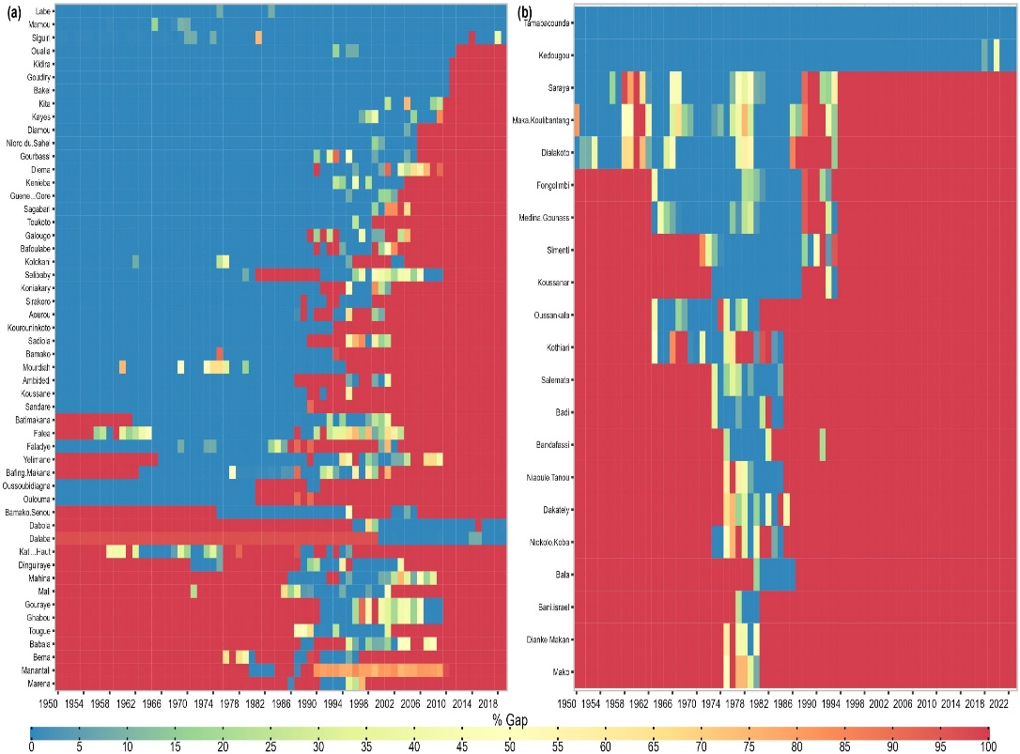
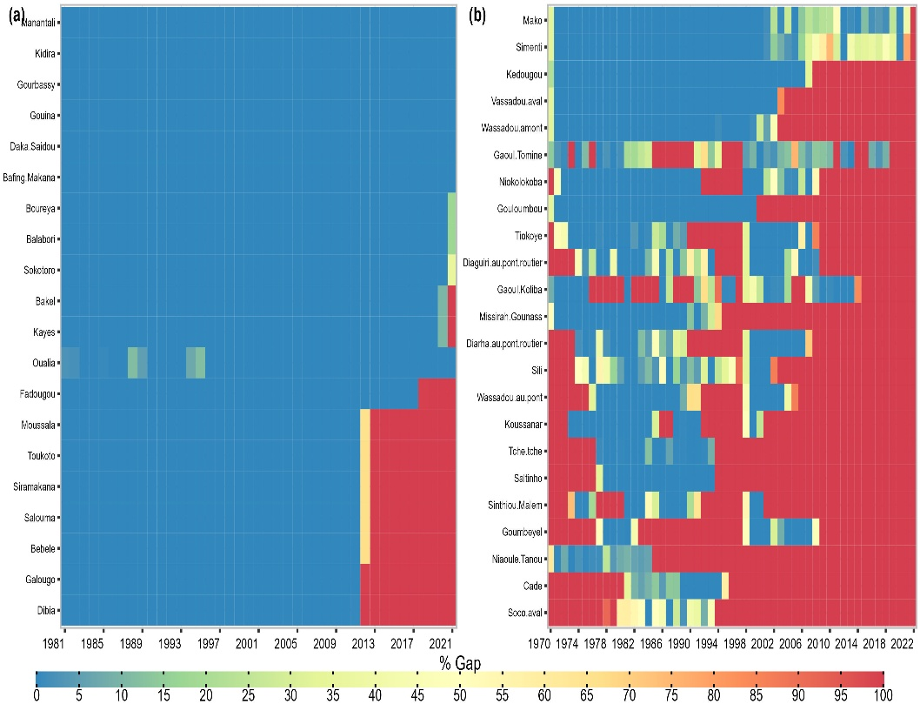
Observed Data
Available rainfall data : 54 stations in the basins managed by the OMVS and 21 stations in the OMVG basins, missing data rates range from 0% to 85% were identified.

Slide 3
CHIRPS, GLEAM and CMIP6 data
CHIRPS was developed by the Climate Hazards Group at the University of California and covers almost the entire globe from 50°N to 50°S. Its spatial resolution is 0.05° × 0.05°, and it integrates ground-based stations to create the precipitation grids.
Global Land Evaporation Amsterdam Model (GLEAM) version 4.1 database. GLEAM is based solely on climate forcings to generate evapotranspiration products. GLEAM is used here due to its temporal depth, which is identical to that of CHIRPS, and its suitability in multiple contexts.
Downscaled and Corrected data of 19 CMIP6 models with a 0.25° resolution

Slide 4
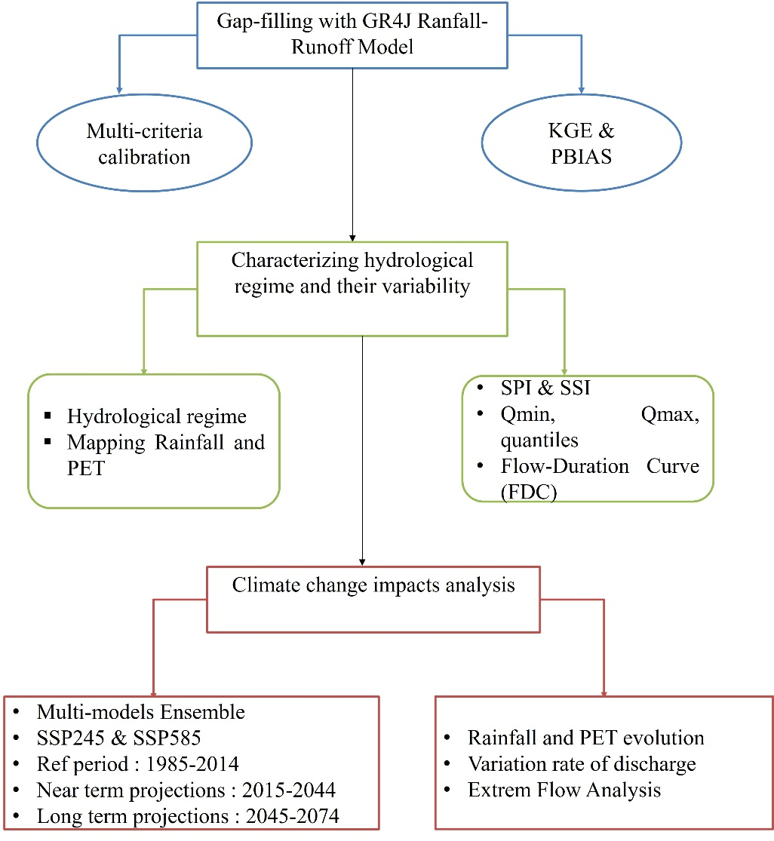
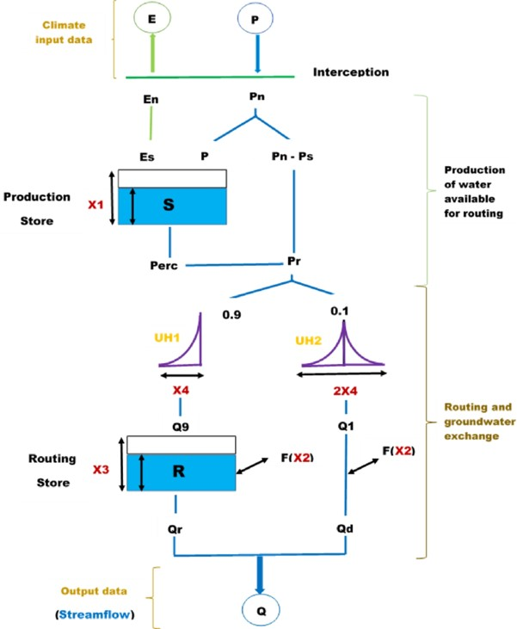
Methods

Slide 5
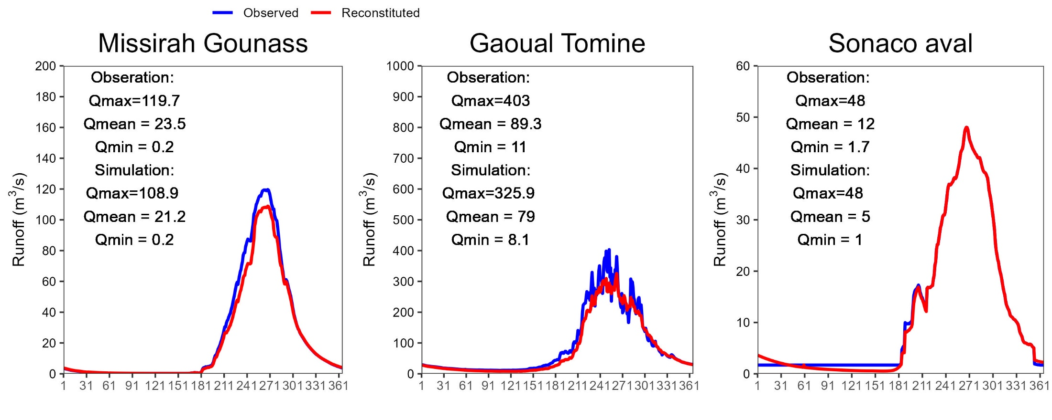
Discharge reconstitution
Example of reconstitution data in three stations. The GR4J model is performant to gap-fill discharge data in our area of study.

Slide 6
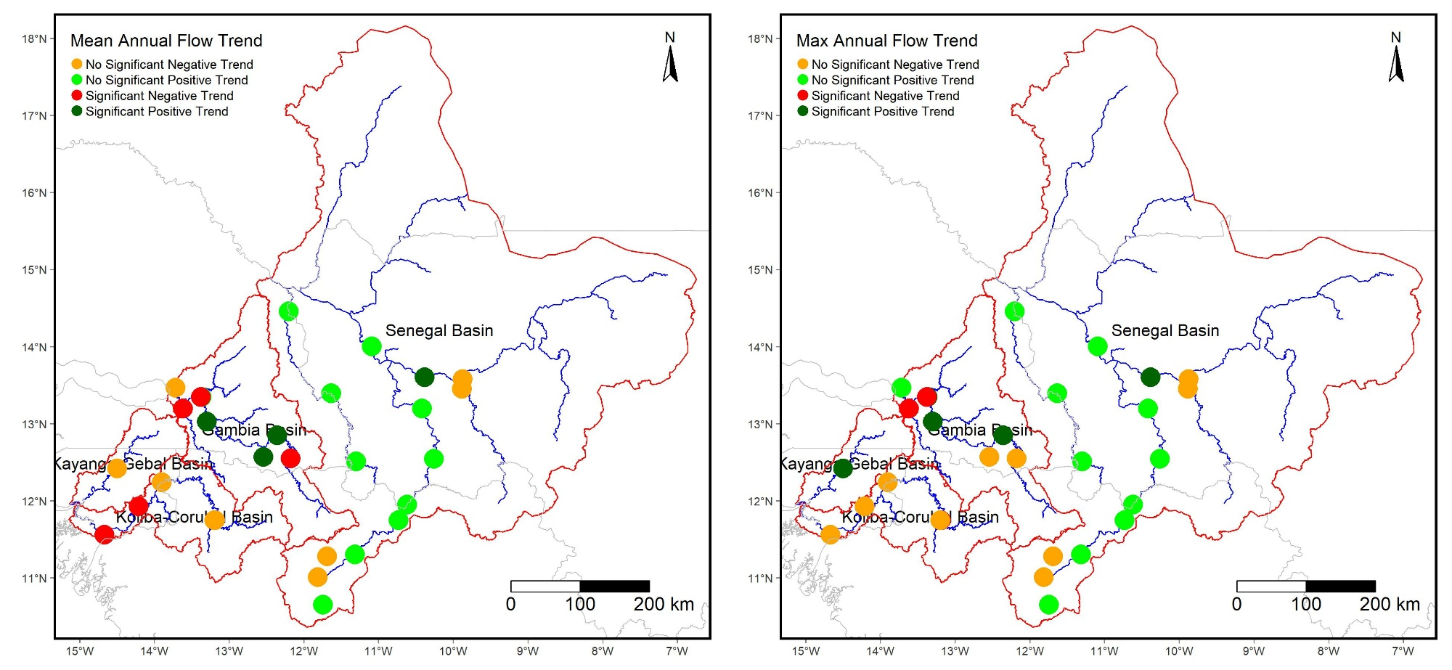
Trend of streamflow in recent decades
Global positive trend in Senegal and Gambia river basins and negative trend in other basins in the period 1981-2023.

Slide 7
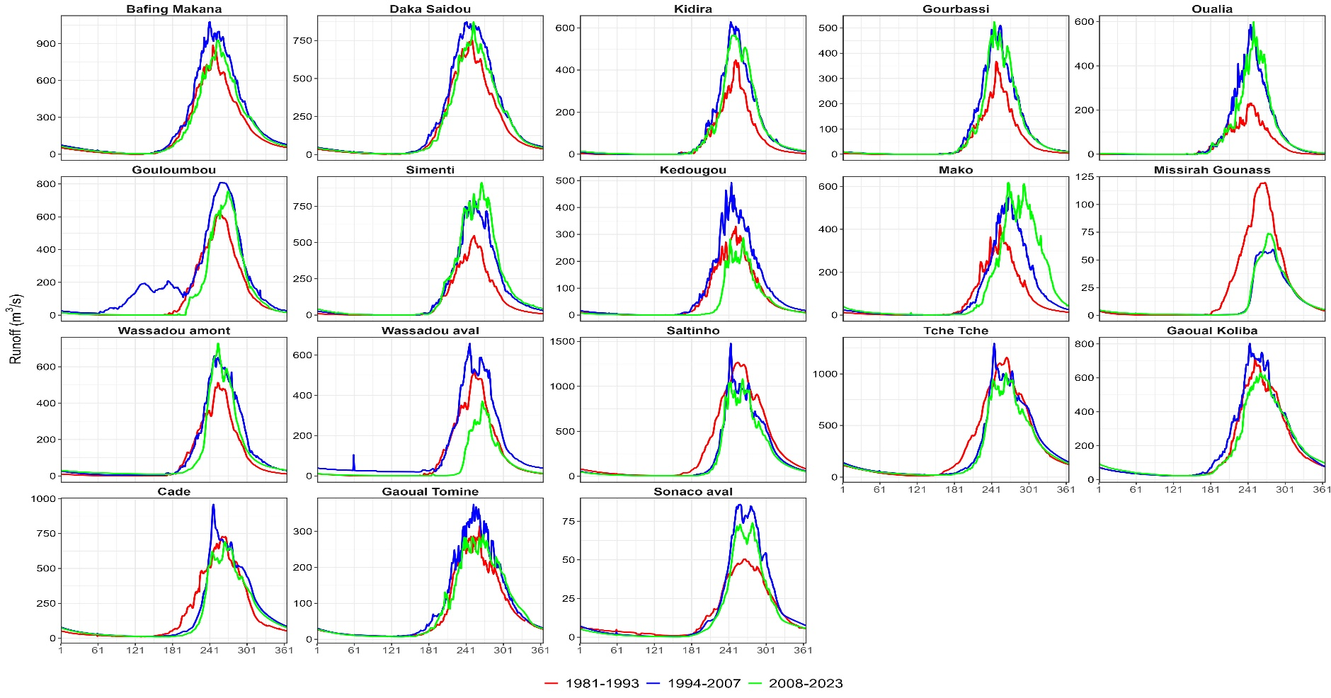
Recent hydrological variability
Monthly flow variability in the dry and wet periods

Slide 8
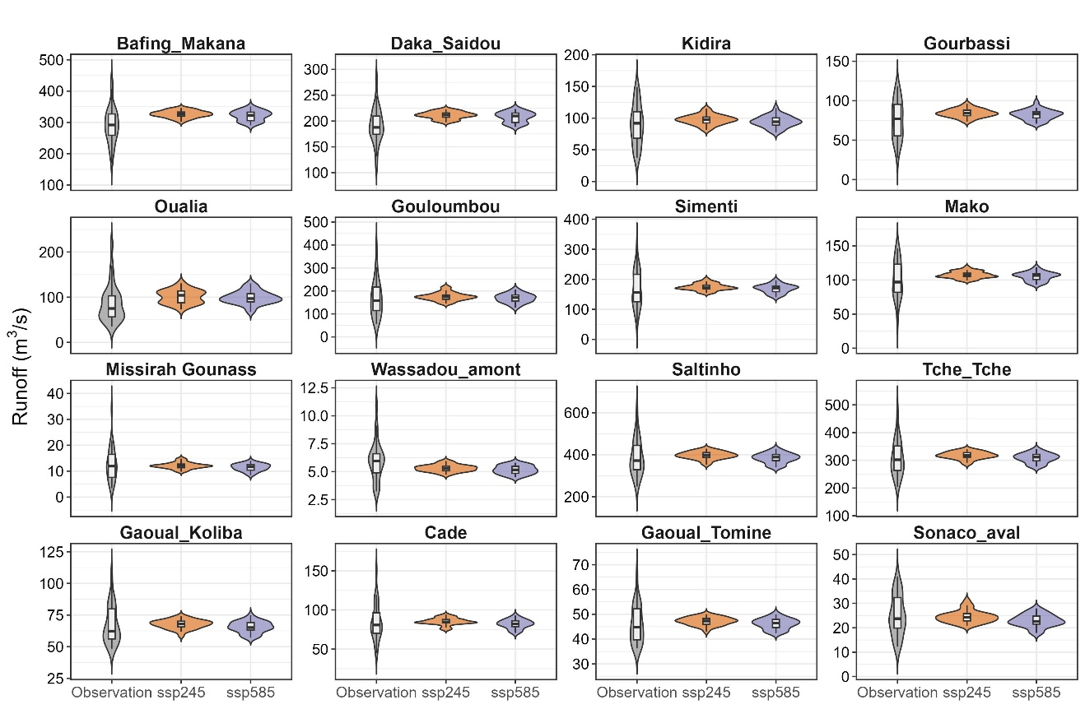
Future Hydrological Variability in 2015-2044
Stations | Rate (%) |  | Basins
 | SSP245 | SSP585
Bafing Makana | 12.3 | 10.5 | Senegal
Daka Saidou | 10.3 | 8.5
Kidira | 8.9 | 5.5
Gourbassi | 12.0 | 9.1
Oualia | 17.6 | 15.3
Gouloumbou | 5.0 | 0.8 | Gambia
Simenti | 3.9 | 0.5
Mako | 6.8 | 4.4
Missirah Gounass | -4.4 | -9.5
Wassadou amont | -11.2 | -13.6
Cade | 1.1 | -2.8 | Koliba-Corubal
Satlinho | 2.9 | -0.5
Tche Tche | 3.4 | 0.4
Gaoual Koliba | 0.8 | -2.5
Gaoual Tomine | 2.5 | 0.3
Sonaco aval | -2.8 | -9.2 | Kayanga-Geba
Regional increase in streamflow in near term projections (2015-2044).

Slide 9
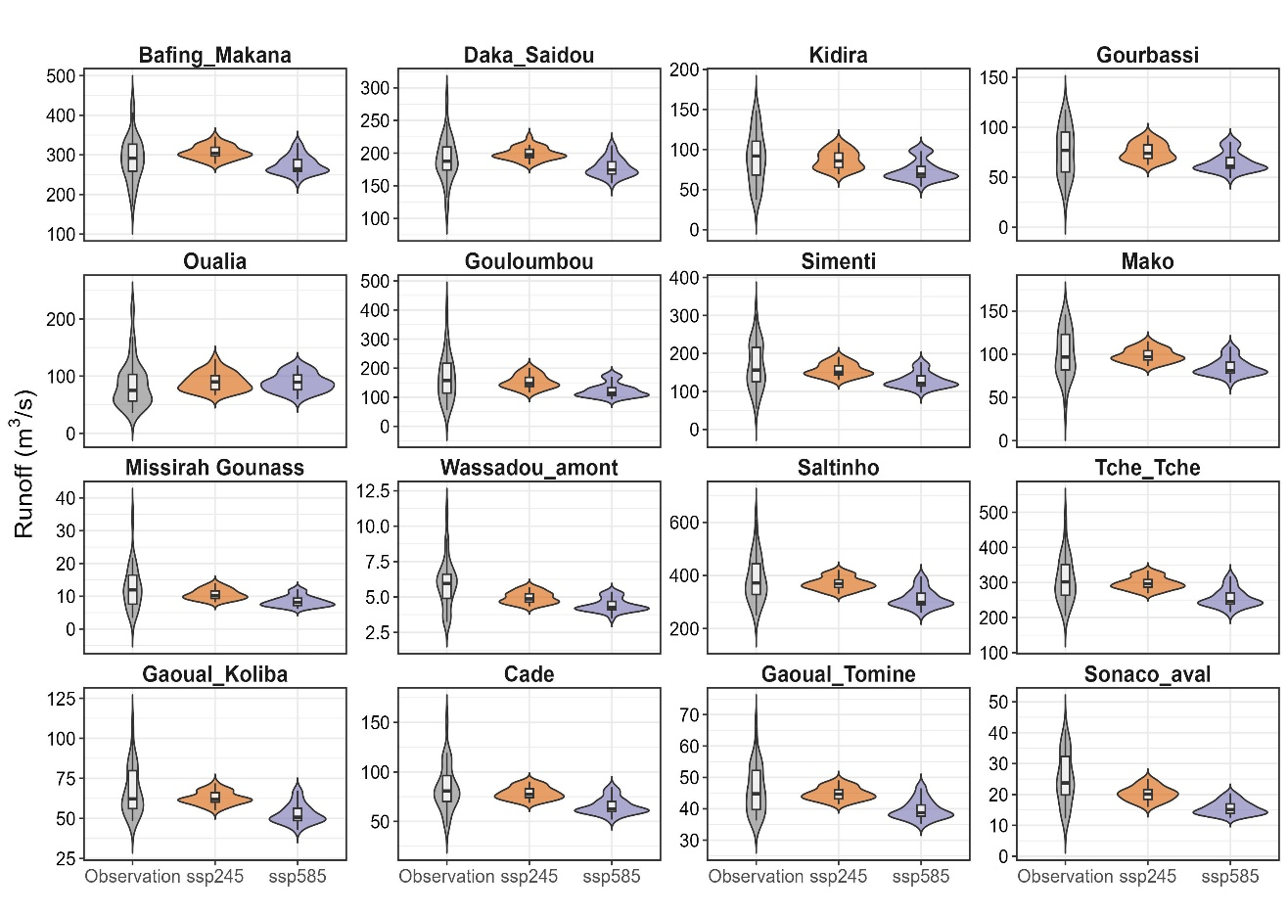
Future Hydrological Variability in 2045-2074
Stations | Rate (%) |  | Basins
 | SSP245 | SSP585
Bafing Makana | 5.4 | -5.6 | Senegal
Daka Saidou | -6.9 | -22.6
Kidira | 4.2 | -6.9
Gourbassi | -6.7 | -21.4
Oualia | -2.6 | -13.7
Gouloumbou | -8.1 | -25.7 | Gambia
Simenti | 0.6 | -13.3
Mako | -2.8 | -17.4
Missirah Gounass | -1.9 | -15.6
Wassadou amont | -16.3 | -33.4
Cade | 4.8 | 3.1 | Koliba-Corubal
Satlinho | -4.1 | -19.0
Tche Tche | -6.9 | -23.2
Gaoual Koliba | -19.7 | -38.4
Gaoual Tomine | -3.0 | -16.9
Sonaco aval | -17.2 | -26.1 | Kayanga-Geba
Regional decrease in streamflow in long term projections (2045-2074).

Slide 10
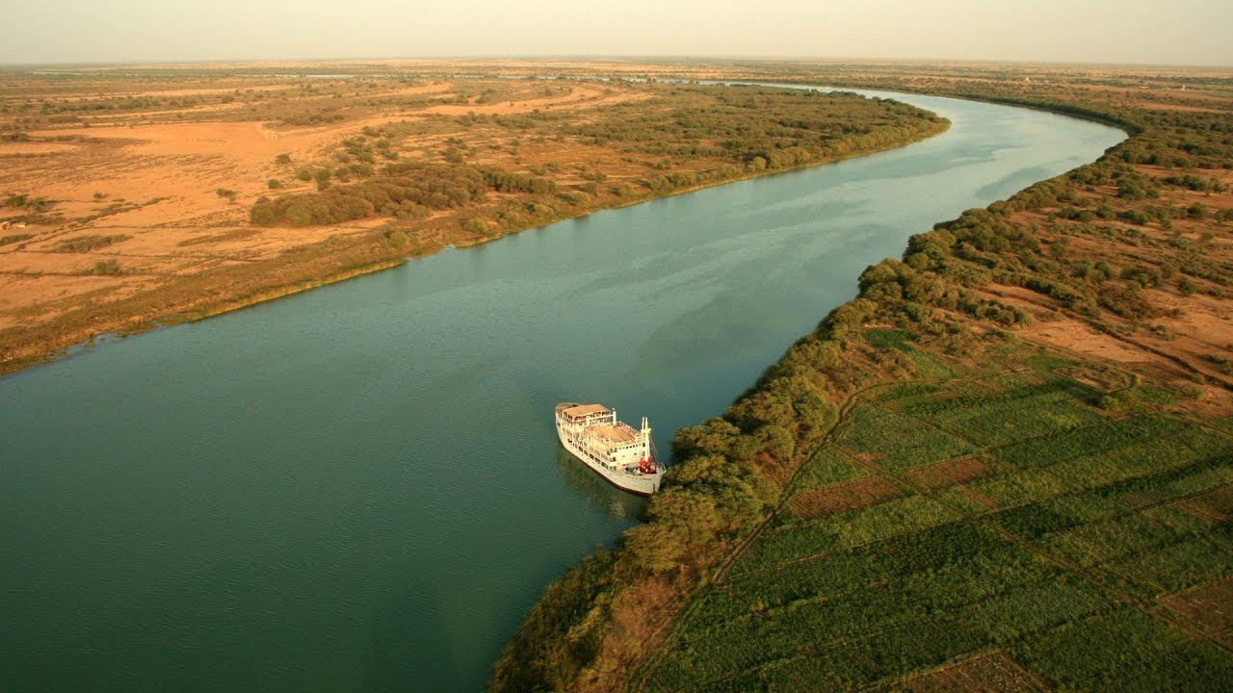
Thank you for your attention

